Slide 1

Argument Mining for Improving the Automated Scoring of Persuasive Essays
32nd AAAI, New Orleans, February 2 – 7, 2018
Huy Nguyen and Diane Litman
University of Pittsburgh

Slide 2
Introduction

Slide 3
Emerging needs in education
Argumentation and argumentative writing receive increasing attention
  Key focuses of Common Core Standard
  Standardized tests, academic content courses
Emerging attention to evaluating argument aspects of essays
  Thesis clarity, evidence use, critical question, argument strength
Existing automated scoring systems have not considered argumentation aspect
  A demand for “argumentation-aware” automated writing evaluation systems
[Persing & Ng, 2013]
[Rahimi & Litman, 2014]
[Song et al., 2014]
[Persing & Ng, 2015]
[Beigman Klebanov et al., 2016]

Slide 4

Persuasive essay writing rubrics
TOEFL iBT Independent Writing
    “… is well organized and well developed, using clearly appropriate explanations, exemplifications and/or details”
Kaggle ASAP: automated student assessment prize
    “Has fully elaborated reasons with specific details…”
…
Our study: Argument Mining (AM) for new capabilities that improve Automated Essay Scoring (AES)

Slide 5
What is argument mining?
“[…] the automatic discovery of an argumentative text portion, and the identification of the relevant components of the argument presented there.”
Argument component: argumentative discourse unit (ADU)
  E.g., text segment, sentence, clause
Argument mining (AM) pipeline with three steps:
  Separates argumentative from non-argumentative text units
  Labels argument components with their argumentative roles, e.g., premise, claim
  Recognizes if two argument components are argumentatively related (e.g., support) or not
[Peldszus & Stede, 2013]

Slide 6
Argument Mining for Automated Essay Scoring

Slide 7
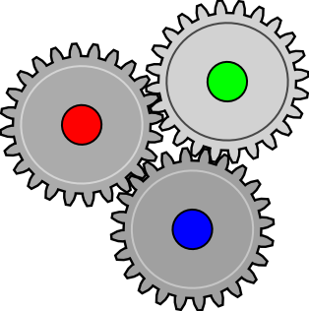
Argument mining pipeline
[Nguyen & Litman, 2014, 2015, 2016, 2018]
Trained/tested using an AM corpus of 402 essays
  End-to-end performance (suffered from error propagation)
    Argument component identification F1 = 0.87
    Argument component classification F1 = 0.42 (0.82 with true-label inputs)
    Support relation identification F1 = 0.38 (0.73 with true-label inputs)
[Stab & Gurevych, 2016]
Argument Component Identification
Argumentative vs. Not
AM challenges
Limited training data
End-to-end performance
Essay quality disparity training vs. test data
Argumentative Relation Classification
as Support or Not
ACC
Argument Component Classification
as Major Claim, Claim or Premise
“In conclusion, I would concede that city life has its own advantages. Nonetheless, peaceful atmosphere, friendliness of people, and green landscape strongly convince me that a small town is the best place for me to live in. I love the life in my town.”
Attack (Premise1, Claim)
Support (Premise2, Claim)
Premise1
Attack
Claim
Premise 1: city life has its own advantages
Premise 2: peaceful atmosphere, friendliness of people, and green landscape strongly convince me
Claim: a small town is the best place for me to live in
ACI
Support
ARC
Premise2

Slide 8


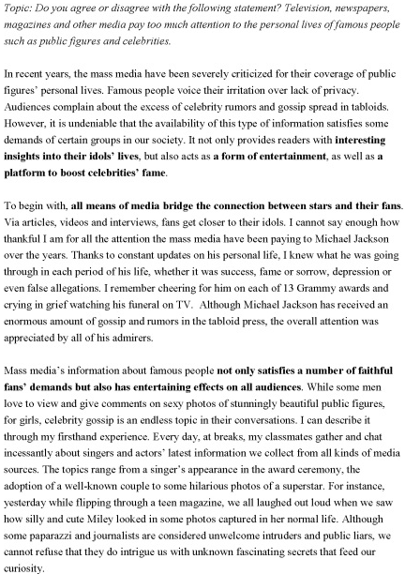
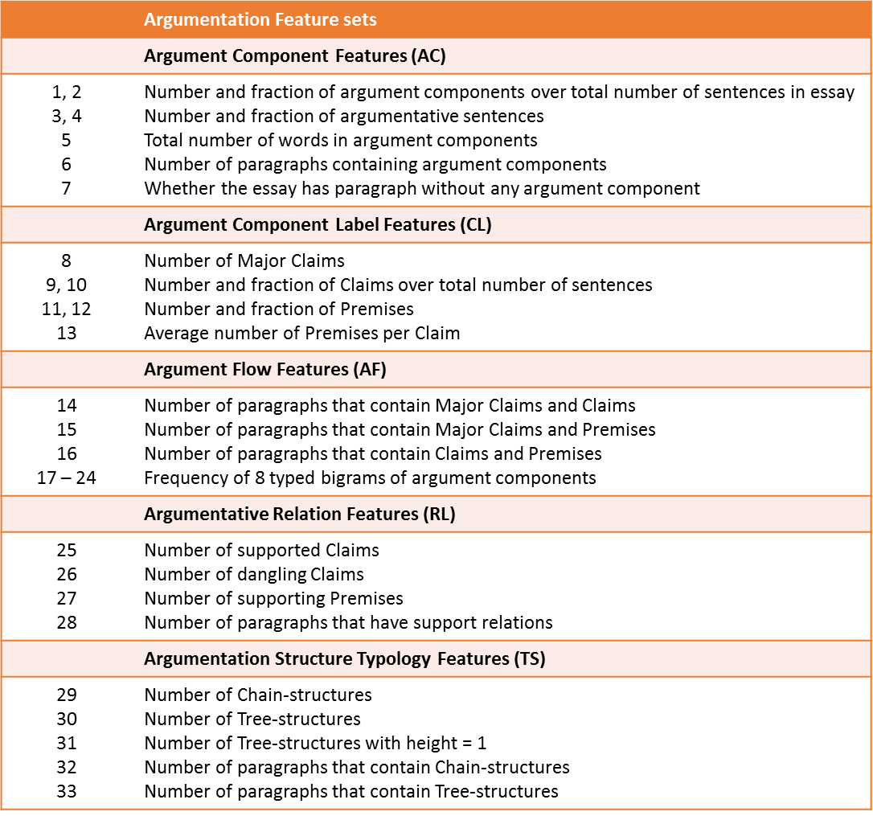

End-to-end argumentation feature extraction
Student writings
ACC
Argumentation features
ACI
AES
ARC
Other AES features

Slide 9
Contribution of our study
7 key attributes to evaluate argument mining for AES
Persing & Ng 2015
Wachsmuth et al. 2016
Ghosh et al. 2016
Klebanov et al. 2016
Our study
Holistic score
Advanced baseline
End-to-end AM
Relation features
Feature ablation
Multiple dataset
Cross-prompt




































Slide 10
AES Data and Prediction Features

Slide 11
AES data sets
Kaggle’s ASAP*
Essays by students in Grades 7 to 10
2 sets of persuasive essays:
  Prompt 1: computer usage
  Prompt 2: censorship in library
Data statistic
TOEFL11
Essays by non-native test takers
8 prompts, 8000+ opinionated essays
Categorical scores
[Blanchard et al., 2013]
No common essays with AM data
No AM annotation available
 | Prompt 1 | Prompt 2
#essays | 1783 | 1800
Word-count/essay | 350 | 350
Score range | 2 – 12 | 1 – 6
Score median | 8 | 3
 | Training | Test
#essays | 6074 | 2023
Low score | 655 | 222
Medium score | 3318 | 1101
High score | 2101 | 700
* Automated Student Assessment Prize
https://www.kaggle.com/c/asap-aes/data

Slide 12
Base AES models
EASE* system, ranked 3rd in ASAP
Length features
  word, character counts, average word length, number of questions…
Prompt features
  Number of essay words found in prompt, words that have synonyms in prompt…
BoW features
  Refined unigram, bigrams
POS features
  POS sequences found in English literature
Our implementation for TOEFL11 data
Length
  Character, word, sentence count
  Average word and sentence lengths
Content
  Spelling errors, stop-words, prompt words
  Punctuation counts, e.g., commas, question marks
  SAT word count
* https://github.com/edx/ease

Slide 13
Argumentation Feature Sets
 | Argumentation Feature sets
 | Argument Component Features (AC)
1, 2 3, 4 5 6 7 | Number and fraction of argument components over total number of sentences in essay Number and fraction of argumentative sentences Total number of words in argument components Number of paragraphs containing argument components Whether the essay has paragraph without any argument component
 | Argument Component Label Features (CL)
8 9, 10 11, 12 13 | Number of Major Claims Number and fraction of Claims over total number of sentences Number and fraction of Premises Average number of Premises per Claim
 | Argument Flow Features (AF)
14 15 16 17 – 24 | Number of paragraphs that contain Major Claims and Claims Number of paragraphs that contain Major Claims and Premises Number of paragraphs that contain Claims and Premises Frequency of 8 typed bigrams of argument components
 | Argumentative Relation Features (RL)
25 26 27 28 | Number of supported Claims Number of dangling Claims Number of supporting Premises Number of paragraphs that have support relations
 | Argumentation Structure Typology Features (TS)
29 30 31 32 33 | Number of Chain-structures Number of Tree-structures Number of Tree-structures with height = 1 Number of paragraphs that contain Chain-structures Number of paragraphs that contain Tree-structures
Argument component identification
33 features in 5 categories
  from prior studies *
  proposed in this study
Argument component classification
Support relation identification
[Persing & Ng, 2015]
[Wachsmuth et al., 2016]
[Ghosh et al., 2016]
[Beigman Klebanov et al., 2016]

Slide 14
Experiment Results

Slide 15

10-fold cross validation performance
Taghipour and Ng (2016) achieved the state-of-the-art with ASAP data (averaged over 8 prompts)
  We experiment with 2 prompts of persuasive essays
Limited amount of AES research on TOEFL11 data
Argumentation features help improve competitive base AES models
 | ASAP p.1 | ASAP p.2 | TOEFL11
(Taghipour and Ng, 2016) | 0.821 | 0.688 | -
Baseline | 0.831 | 0.680 | 0.599
ARG | 0.790 † | 0.620 † | 0.494 †
ALL (Baseline + ARG) | 0.830 | 0.689 * | 0.611 *
Symbols * and † indicate significantly higher and lower than baseline values (p < 0.05). Best values are in boldface.

Slide 16
Cross-prompt validation performance
ASAP data
  Dong and Zhang (2016) obtained the best over-all cross-prompt (averaged over 8 prompts)
  We use prompt 1 as training and prompt 2 as test data
TOEFL11
  8-fold cross prompt
Argumentation features help improve cross-prompt performance
 | ASAP | TOEFL11
(Dong and Zhang 2016) | 0.569 | -
Baseline | 0.585 | 0.591
ARG | 0.567 | 0.492 †
ALL (Baseline + ARG) | 0.622 | 0.600 *
Symbols * and † indicate significantly higher and lower than baseline values (p < 0.05). Best values are in boldface.

Slide 17
Summary
This study brings up a strong support of application of AM in AES
  End-to-end AM for improving holistic score prediction
  The largest argumentation feature set
  Competitive base AES models
  In- and cross-prompt evaluations
Automated writing assessment and auto-feedback
  Automated assessment of argumentative writing in peer-review/tutoring systems
  Feedback on argumentation structure, argument quality

Slide 18

Thank you!
AM
AES

Slide 19
Argument mining tasks
[Persing & Ng, 2016]
[Stab & Gurevych, 2016]
[Nguyen & Litman, 2018]
Argument component identification
  Separates argumentative from non-argumentative text units
Argument component classification
  Labels argument components with their argumentative roles, e.g., premise, claim
Argumentative relation classification
  Recognizes if two argument components are argumentatively related (e.g., support) or not
Claim(1)
⁽¹⁾[Taking care of thousands of citizens who suffer from disease or illiteracy is more urgent and pragmatic than building theaters or sports stadiums]_{Claim}. ⁽²⁾As a matter of fact, [an uneducated person may barely appreciate musicals]_{Premise}, whereas [a physical damaged person, resulting from the lack of medical treatment, may no longer participate in any sports games]_{Premise}. ⁽³⁾Therefore, [providing education and medical care is more essential and prioritized to the government]_{Claim}.
⁽¹⁾[Taking care of thousands of citizens who suffer from disease or illiteracy is more urgent and pragmatic than building theaters or sports stadiums]. ⁽²⁾As a matter of fact, [an uneducated person may barely appreciate musicals], whereas [a physical damaged person, resulting from the lack of medical treatment, may no longer participate in any sports games]. ⁽³⁾Therefore, [providing education and medical care is more essential and prioritized to the government].
Premise(2.1) supports Claim(1)
Premise(2.2) supports Claim(1)
Claim(3) supports Claim(1)
Claim(3)
Premise (2.1)
Premise (2.2)

Slide 20
Argument mining pipeline
Trained/tested using a persuasive essay corpus of 402 essays
  End-to-end performance (suffered from error propagation)
    Argument component identification F1 = 0.86
    Argument component classification F1 = 0.42
    Support relation identification F1 = 0.38
[Stab & Gurevych, 2016]
[Nguyen & Litman, 2014, 2015, 2016, 2018]
Argument Component Identification
Argumentative vs. Not
Argumentative Relation Classification
as Support or Not
ACC
Argument Component Classification
as Major Claim, Claim or Premise
“In conclusion, I would concede that city life has its own advantages. Nonetheless, peaceful atmosphere, friendliness of people, and green landscape strongly convince me that a small town is the best place for me to live in. I love the life in my town.”
Attack (Premise1, Claim)
Support (Premise2, Claim)
Premise1
Attack
Claim
Premise 1: city life has its own advantages
Premise 2: peaceful atmosphere, friendliness of people, and green landscape strongly convince me
Claim: a small town is the best place for me to live in
ACI
Support
ARC
Premise2
F-1 score: 0.87
F-1 score: 0.82
F-1 score: 0.73

Slide 21
Feature ablation
 | ASAP p.1 | ASAP p.2 | TOEFL11
(Taghipour and Ng, 2016) | 0.821 | 0.688 | -
Baseline | 0.831 | 0.680 | 0.599
ARG | 0.790 † | 0.620 † | 0.494 †
ALL (Baseline + ARG) | 0.830 | 0.689 * | 0.611 *
ALL – AC | 0.830 | 0.676 | 0.610 *
ALL – CL | 0.832 | 0.689 * | 0.608 *
ALL – AF | 0.830 | 0.688 * | 0.604
ALL – CL | 0.831 | 0.687 | 0.606 *
ALL – TS | 0.831 | 0.688 | 0.611 *
 | ASAP | TOEFL11
(Dong and Zhang 2016) | 0.569 | -
Baseline | 0.585 | 0.591
ARG | 0.567 | 0.492 †
ALL (Baseline + ARG) | 0.622 | 0.600 *
ALL – AC | 0.610 | 0.600 *
ALL – CL | 0.596 | 0.600 *
ALL – AF | 0.611 | 0.601 *
ALL – RL | 0.626 | 0.595 *
ALL – TS | 0.622 | 0.601 *

Slide 22
