Slide 1
CS 424P/ LINGUIST 287
Extracting Social Meaning and Sentiment
Dan Jurafsky
Lecture 6: Emotion and Mood

Slide 2
Scherer’s typology of affective states
Emotion: relatively brief eposide of synchronized response of all or most organismic subsystems in response to the evaluation of an external or internal event as being of major significance
  angry, sad, joyful, fearful, ashamed, proud, desparate
Mood: diffuse affect state, most pronounced as change in subjective feeling, of low intensity but relatively long duration, often without apparent cause
  cheerful, gloomy, irritable, listless, depressed, buoyant
Interpersonal stance: affective stance taken toward another person in a specific interaction, coloring the interpersonal exchange in that situation
  distant, cold, warm, supportive, contemptuous
Attitudes: relatively enduring, affectively colored beliefs, preferences predispositions towards objects or persons
  liking, loving, hating, valueing, desiring
Personality traits: emotionally laden, stable personality dispositions and behavior tendencies, typical for a person
  nervous, anxious, reckless, morose, hostile, envious, jealous

Slide 3
Scherer’s typology of affective states
Emotion: relatively brief eposide of synchronized response of all or most organismic subsystems in response to the evaluation of an external or internal event as being of major significance
  angry, sad, joyful, fearful, ashamed, proud, desparate
Mood: diffuse affect state, most pronounced as change in subjective feeling, of low intensity but relatively long duration, often without apparent cause
  cheerful, gloomy, irritable, listless, depressed, buoyant
Interpersonal stance: affective stance taken toward another person in a specific interaction, coloring the interpersonal exchange in that situation
  distant, cold, warm, supportive, contemptuous
Attitudes: relatively enduring, affectively colored beliefs, preferences predispositions towards objects or persons
  liking, loving, hating, valueing, desiring
Personality traits: emotionally laden, stable personality dispositions and behavior tendencies, typical for a person
  nervous, anxious, reckless, morose, hostile, envious, jealous

Slide 4
Outline
Theoretical background on emotion and smiles
Extracting emotion from speech and text: case studies
Extracting mood and medical state
  Depression
  Trauma
  (Alzheimers – if time)

Slide 5
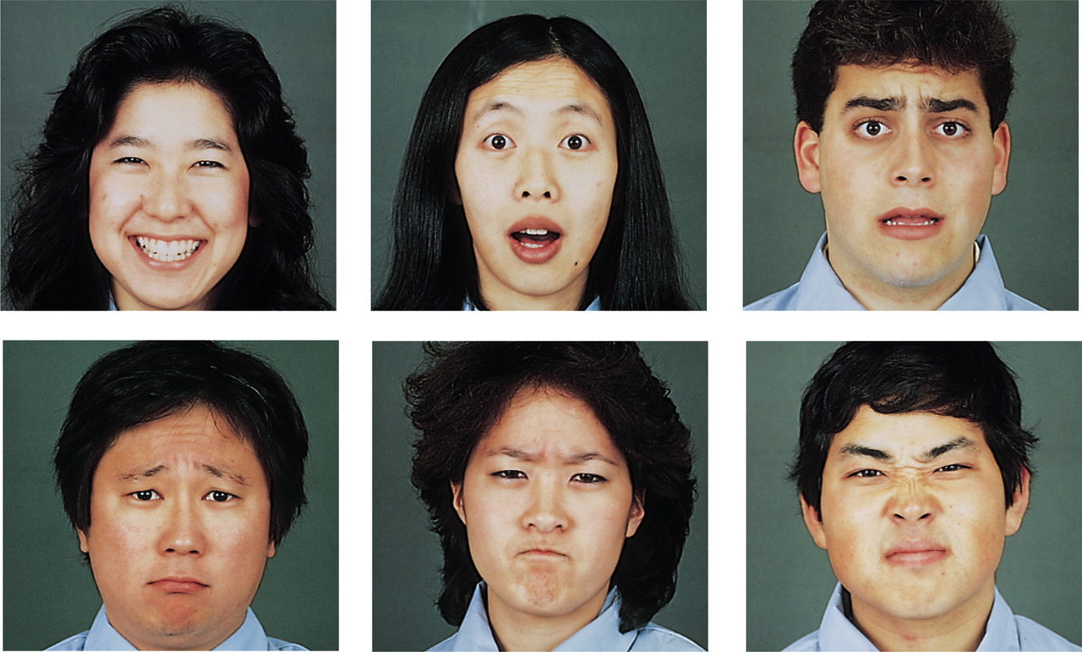
Ekman’s 6 basic emotions
    Surprise, happiness, anger, fear, disgust, sadness
Notes:
Ekman and his colleagues did 4 studies to add support for their hypothesis that certain basic emotions (fear, surprise, sadness, happiness, anger, disgust) are universally recognized across cultures. This supports the theory that emotions are evolutionarily adaptive and unlearned.
Study #1
Ekman, Friesen, and Tomkins: showed facial expressions of emotion to observers in 5 different countries (Argentina, US, Brazil, Chile, & Japan) and asked the observers to label each expression. Participants from all five countries showed widespread agreement on the emotion each of these pictures depicted.
Study #2
Ekman, Sorenson, and Friesen: conducted a similar study with preliterate tribes of New Guinea (subjects selected a story that best described the facial expression). The tribesmen correctly labeled the emotion even though they had no prior experience with print media.
Study #3
Ekman and colleagues: asked tribesman to show on their faces what they would look like if they experienced the different emotions. They took photos and showed them to Americans who had never seen a tribesman and had them label the emotion. The Americans correctly labeled the emotion of the tribesmen.
Study #4
Ekman and Friesen conducted a study in the US and Japan asking subjects to view highly stressful stimuli as their facial reactions were secretly videotaped. Both subjects did show exactly the same types of facial expressions at the same points in time, and these expressions corresponded to the same expressions that were considered universal in the judgment research.

Slide 6
Dimensional approach.
(Russell, 1980, 2003)
Arousal
High arousal, High arousal,
Displeasure (e.g., anger) High pleasure (e.g., excitement)
Valence
Low arousal, Low arousal,
Displeasure (e.g., sadness) High pleasure (e.g., relaxation)
Slide from Julia Braverman

Slide 7
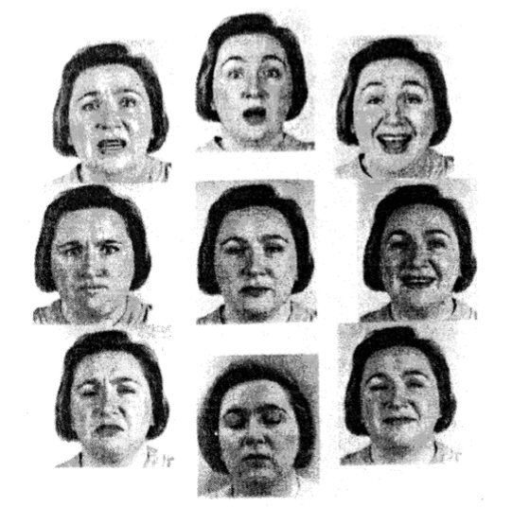
Image from Russell 1997
Image from
Russell, 1997
valence
-
+
-
arousal
Notes:
Engagement
Learning (memory, problem-solving, attention)
Motivation

Slide 8
Distinctive vs. Dimensional approach of emotion
Distinctive
Emotions are units.
Limited number of basic emotions.
Basic emotions are innate and universal
Methodology advantage
  Useful in analyzing traits of personality.
Dimensional
Emotions are dimensions.
Limited # of labels but unlimited number of emotions.
Emotions are culturally learned.
Methodological advantage:
  Easier to obtain reliable measures.
Slide from Julia Braverman

Slide 9
Duchenne versus non-Duchenne smiles
http://www.bbc.co.uk/science/humanbody/mind/surveys/smiles/
http://www.cs.cmu.edu/afs/cs/project/face/www/facs.htm

Slide 10
Duchenne smiles

Slide 11
How to detect Duchenne smiles
“As well as making the mouth muscles move, the muscles that raise the cheeks – the orbicularis oculi and the pars orbitalis – also contract, making the eyes crease up, and the eyebrows dip slightly.
Lines around the eyes do sometimes appear in intense fake smiles, and the cheeks may bunch up, making it look as if the eyes are contracting and the smile is genuine.
But there are a few key signs that distinguish these smiles from real ones. For example, when a smile is genuine, the eye cover fold - the fleshy part of the eye between the eyebrow and the eyelid - moves downwards and the end of the eyebrows dip slightly.”
BBC Science webpage referenced on previous slide

Slide 12

Emotional communication and the Brunswikian Lens
Example:
Loud voice
High pitched
Frown
Clenched fists
Shaking
Vocal cues
cues
Facial cues
Gestures
Other cues …
Expressed emotion
Emotional attribution
expressed anger ?
perception of
anger?
encoder
decoder
slide from Tanja Baenziger

Slide 13
Implications for HCI
If matching is low…
cues
Expressed emotion
Emotional attribution
relation of the cues to the expressed emotion
relation of the cues to the perceived emotion
Important for Extraction
matching
Important for Agent generation
Generation (Conversational agents): relation of cues to perceived emotion
Recognition (Extraction systems): relation of the cues to expressed emotion
slide from Tanja Baenziger

Slide 14
Extroversion in Brunswikian Lens
Similated jury discussions in German and English
  speakers had detailed personality tests
Extroversion personality type accurately identified from naïve listeners by voice alone
But not emotional stability
  listeners choose: resonant, warm, low-pitched voices
  but these don’t correlate with actual emotional stability
I

Slide 15
Acoustic implications of Duchenne smile
Amy Drahota, Alan Costall, Vasudevi Reddy. 2008.
The vocal communication of different kinds of smile. Speech Communication
“Asked subjects to repeat the same sentence in response to a set sequence of 17 questions, intended to provoke reactions such as amusement, mild embarrassment, or just a neutral response.”
Coded and examined Duchenne, non-Duchenne, and “suppressed” smiles”.
Listeners could tell the differences, but many mistakes
Standard prosodic and spectral (formant) measures showed no acoustic differences of any kind.
Correlations between listener judgements and acoustics:
  larger differences between f2 and f3-> not smiling
  smaller differences between f1 and f2 -> smiling

Slide 16
Evolution and Duchenne smiles
“honest signals” (Pentland 2008)
“behaviors that are sufficiently expensive to fake that they can form the basis for a reliable channel of communication”

Slide 17
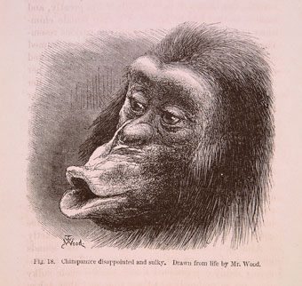
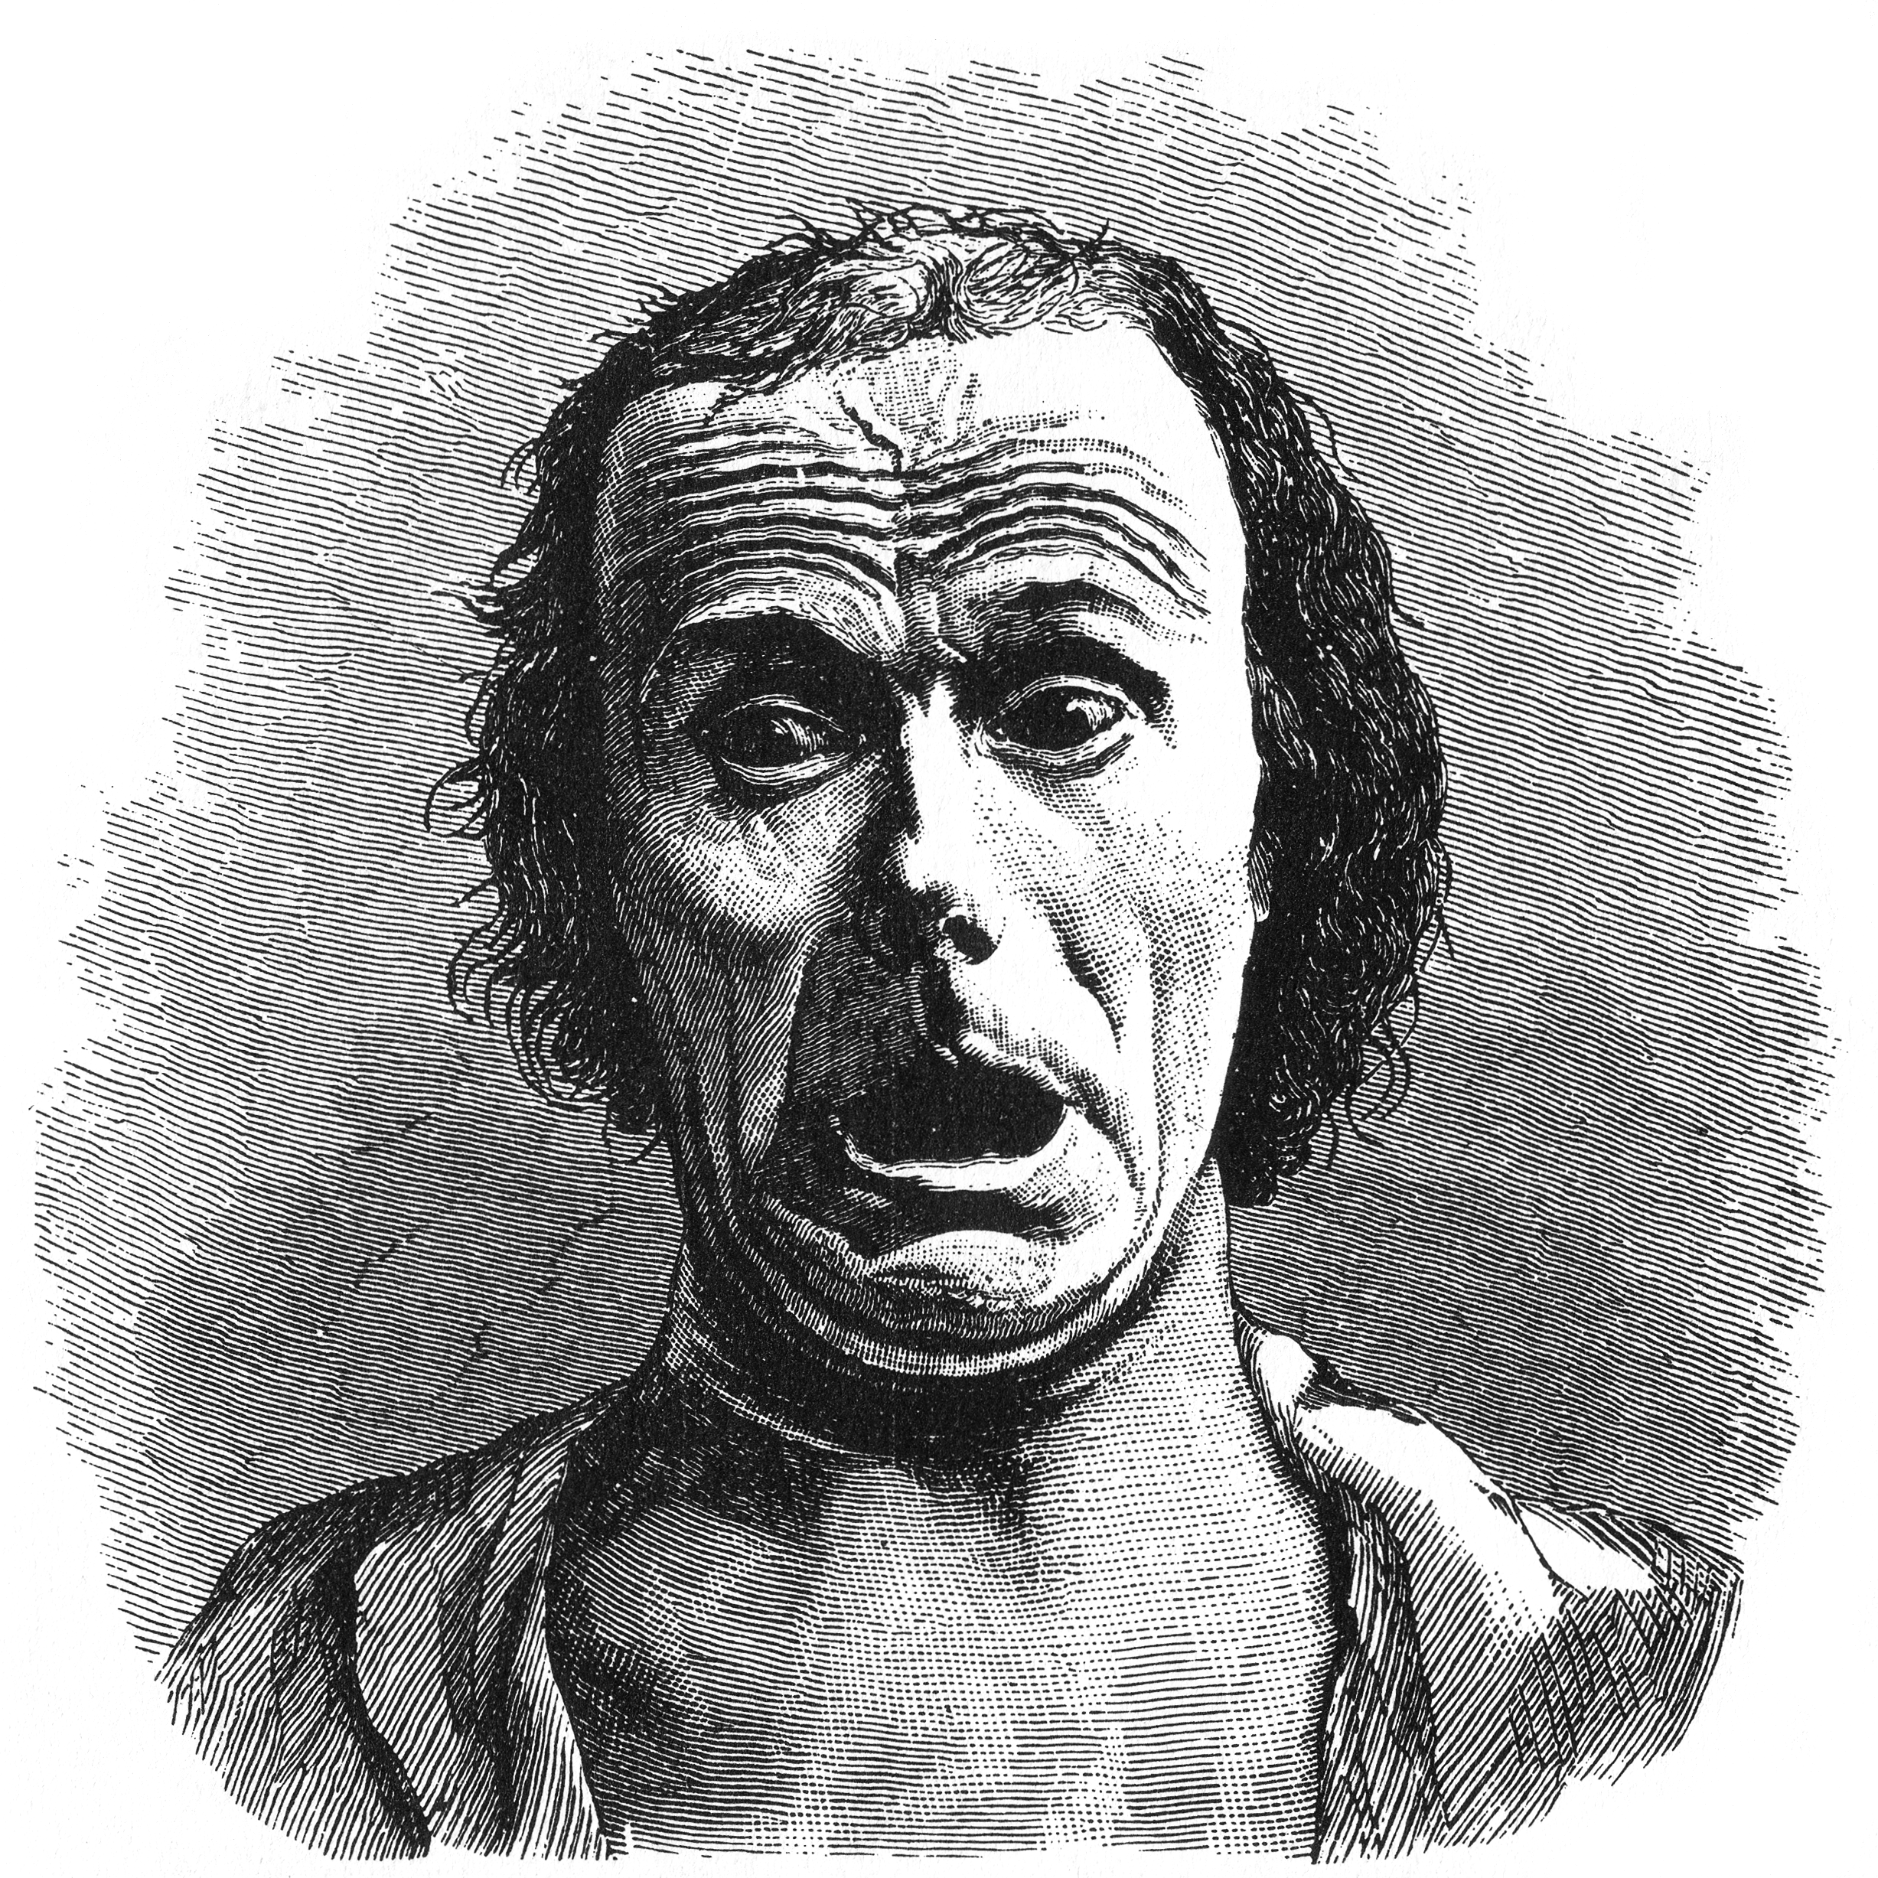
Four Theoretical Approaches to Emotion: 1. Darwinian (natural selection)
Darwin (1872) The Expression of Emotion in Man and Animals. Ekman, Izard, Plutchik
  Function: Emotions evolve to help humans survive
  Same in everyone and similar in related species
    Similar display for Big 6+ (happiness, sadness, fear, disgust, anger, surprise) → ‘basic’ emotions
    Similar understanding of emotion across cultures
    The particulars of fear may differ, but "the brain systems involved in mediating the function are the same in different species" (LeDoux, 1996)
extended from Julia Hirschberg’s slides discussing Cornelius 2000

Slide 18
Four Theoretical Approaches to Emotion: 2. Jamesian: Emotion is experience
William James 1884. What is an emotion?
  Perception of bodily changes → emotion
    “we feel sorry because we cry… afraid because we tremble"’
    “our feeling of the … changes as they occur IS the emotion"
  The body makes automatic responses to environment that help us survive
  Our experience of these reponses consitutes emotion.
  Thus each emotion accompanied by unique pattern of bodily responses
    Stepper and Strack 1993: emotions follow facial expressions or posture.
    Botox studies:
      Havas, D. A., Glenberg, A. M., Gutowski, K. A., Lucarelli, M. J., & Davidson, R. J. (2010). Cosmetic use of botulinum toxin-A affects processing of emotional language. Psychological Science, 21, 895-900.
      Hennenlotter, A., Dresel, C., Castrop, F., Ceballos Baumann, A. O., Wohlschlager, A. M., Haslinger, B. (2008). The link between facial feedback and neural activity within central circuitries of emotion - New insights from botulinum toxin-induced denervation of frown muscles. Cerebral Cortex, June 17.
extended from Julia Hirschberg’s slides discussing Cornelius 2000

Slide 19
Four Theoretical Approaches to Emotion:
3. Cognitive: Appraisal
An emotion is produced by appraising (extracting) particular elements of the situation. (Scherer)
  Fear: produced by the appraisal of an event or situation as obstructive to one’s central needs and goals, requiring urgent action, being difficult to control through human agency, and lack of sufficient power or coping potential to deal with the situation.
  Anger: difference: entails much higher evaluation of controllability and available coping potential
Smith and Ellsworth's (1985):
  Guilt: appraising a situation as unpleasant, as being one's own responsibility, but as requiring little effort.
Adapted from Cornelius 2000
Notes:
Spiesman et al 1964
All participants watch subincision (circmcisions) video, but with
different soundtracks:
– No sound
– Trauma narrative: emphasized pain
– Denial narrative: emphasized joyful ceremony
– Scientific narrative: detached tone
Measured heart rate and self-reported stress.
Who was most stressed?
Most stressed: Trauma narrative
Next most stressed: No sound
Least stressed: Denial narrative, Scientific narrative

Slide 20
Four Theoretical Approaches to Emotion:
4. Social Constructivism
Emotions are cultural products (Averill)
Explains gender and social group differences
anger is elicited by the appraisal that one has been wronged intentionally and unjustifiably by another person. Based on a moral judgment
  don’t get angry if you yank my arm accidentally
  or if you are a doctor and do it to reset a bone
  only if you do it on purpose
Adapted from Cornelius 2000

Slide 21
Link between valence/arousal and Cognitive-Appraisal model
Dutton and Aron (1974)
Male participants cross a bridge
  sturdy
  precarious
Other side of bridge female interviewed asked participants to take part in a survey
  willing participants were given interviewer’s phone number
Participants who crossed precarious bridge
  more likely to call and use sexual imagery in survey
Participants misattributed their arousal as sexual attraction

Slide 22
Why Emotion Detection from Speech or Text?
Detecting frustration of callers to a help line
Detecting stress in drivers or pilots
Detecting “interest”, “certainty”, “confusion” in on-line tutors
  Pacing/Positive feedback
Hot spots in meeting browsers
Synthesis/generation:
  On-line literacy tutors in the children’s storybook domain
  Computer games

Slide 23
Hard Questions in Emotion Recognition
How do we know what emotional speech is?
  Acted speech vs. natural (hand labeled) corpora
What can we classify?
    Distinguish among multiple ‘classic’ emotions
    Distinguish
      Valence: is it positive or negative?
      Activation: how strongly is it felt? (sad/despair)
What features best predict emotions?
What techniques best to use in classification?
Slide from Julia Hirschberg

Slide 24
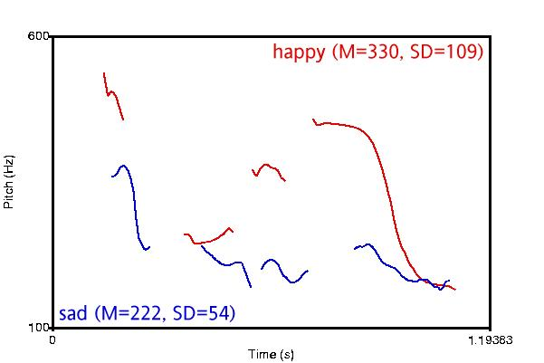

Major Problems for Classification:
Different Valence/Different Activation
slide from Julia Hirschberg
Notes:
It is useful to note where direct modeling features fall short: While mean f0 successfully differentiates between emotions with different valence, so long as they have different degrees of activation…

Slide 25
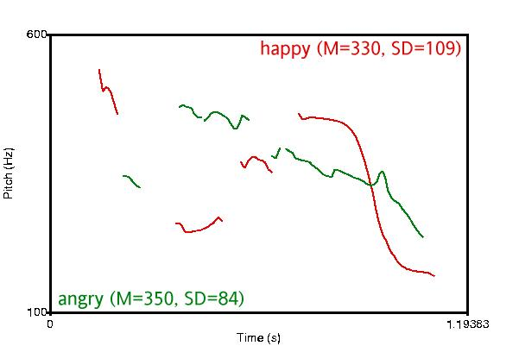
But….
Different Valence/ Same Activation
slide from Julia Hirschberg
Notes:
When different valence emotions such as happy and angry have the same activation, simple pitch features are less successful.

Slide 26
Accuracy of facial versus vocal cues to emotion (Scherer 2001)

Slide 27
Data and tasks for Emotion Detection
Scripted speech
  Acted emotions, often using 6 emotions
  Controls for words, focus on acoustic/prosodic differences
  Features:
    F0/pitch
    Energy
    speaking rate
Spontaneous speech
  More natural, harder to control
  Dialogue
  Kinds of emotion focused on:
    frustration,
    annoyance,
    certainty/uncertainty
    “activation/hot spots”

Slide 28
Four quick case studies
Acted speech:
    LDC’s EPSaT
Annoyance/Frustration in natural speech
    Ang et al on Annoyance and Frustration
Basic emotions crosslinguistically
    Braun and Katerbow, dubbed speach
Uncertainty in natural speech:
    Liscombe et al’s ITSPOKE

Slide 29
Example 1: Acted speech; emotional Prosody Speech and Transcripts Corpus (EPSaT)
Recordings from LDC
  http://www.ldc.upenn.edu/Catalog/LDC2002S28.html
8 actors read short dates and numbers in 15 emotional styles

Slide 30
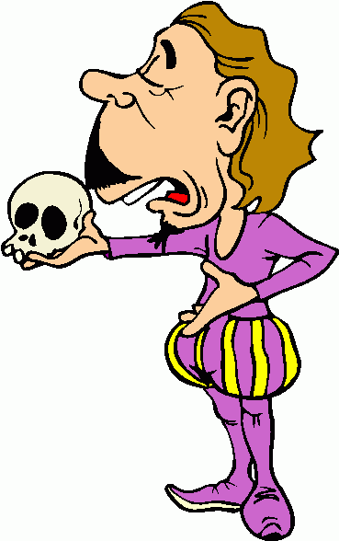
EPSaT Examples
happy
sad
angry
confident
frustrated
friendly
interested
anxious
bored
encouraging

Slide 31
Detecting EPSaT Emotions
Liscombe et al 2003
Ratings collected by Julia Hirschberg, Jennifer Venditti at Columbia University

Slide 32
Liscombe et al. Features
Automatic Acoustic-prosodic
  [Davitz, 1964] [Huttar, 1968]
  Global characterization
    pitch
    loudness
    speaking rate

Slide 33
Global Pitch Statistics

Slide 34
Global Pitch Statistics

Slide 35
Liscombe et al. Features
Automatic Acoustic-prosodic
  [Davitz, 1964] [Huttar, 1968]
ToBI Contours
  [Mozziconacci & Hermes, 1999]
Spectral Tilt
  [Banse & Scherer, 1996] [Ang et al., 2002]

Slide 36
Liscombe et al. Experiments
Binary Classification for Each Emotion
  Ripper, 90/10 split
Results
  62% average baseline
  75% average accuracy
Most useful features:

Slide 37
Example 2 - Ang 2002
Ang Shriberg Stolcke 2002 “Prosody-based automatic detection of annoyance and frustration in human-computer dialog”
Prosody-Based detection of annoyance/ frustration in human computer dialog
DARPA Communicator Project Travel Planning Data
  NIST June 2000 collection: 392 dialogs, 7515 utts
  CMU 1/2001-8/2001 data: 205 dialogs, 5619 utts
  CU 11/1999-6/2001 data: 240 dialogs, 8765 utts
Considers contributions of prosody, language model, and speaking style
Questions
  How frequent is annoyance and frustration in Communicator dialogs?
  How reliably can humans label it?
  How well can machines detect it?
  What prosodic or other features are useful?

Slide 38
Data Annotation
5 undergrads with different backgrounds
Each dialog labeled by 2+ people independently
  2nd “Consensus” pass for all disagreements, by two of the same labelers

Slide 39
Data Labeling
Emotion: neutral, annoyed, frustrated, tired/disappointed, amused/surprised, no-speech/NA
Speaking style: hyperarticulation, perceived pausing between words or syllables, raised voice
Repeats and corrections: repeat/rephrase, repeat/rephrase with correction, correction only
Miscellaneous useful events: self-talk, noise, non-native speaker, speaker switches, etc.

Slide 40

Emotion Samples
Neutral
  July 30
  Yes
Disappointed/tired
  No
Amused/surprised
  No
Annoyed
  Yes
  Late morning (HYP)
Frustrated
  Yes
  No
  No, I am … (HYP)
  There is no Manila...
3
1
2
8
6
4
5
9
7
10

Slide 41
Emotion Class Distribution
To get enough data, grouped annoyed and frustrated, versus else (with speech)

Slide 42
Prosodic Model
Classifier: CART-style decision trees
Downsampled to equal class priors
Automatically extracted prosodic features based on recognizer word alignments
Used 3/4 for train, 1/4th for test, no call overlap

Slide 43
Prosodic Features
Duration and speaking rate features
  duration of phones, vowels, syllables
  normalized by phone/vowel means in training data
  normalized by speaker (all utterances, first 5 only)
  speaking rate (vowels/time)
Pause features
  duration and count of utterance-internal pauses at various threshold durations
  ratio of speech frames to total utt-internal frames

Slide 44
Prosodic Features (cont.)
Pitch features
  F0-fitting approach developed at SRI (Sönmez)
  LTM model of F0 estimates speaker’s F0 range
  Many features to capture pitch range, contour shape & size, slopes, locations of interest
  Normalized using LTM parameters by speaker, using all utts in a call, or only first 5 utts
Fitting
LTM
F₀
Time
Log F₀

Slide 45
Features (cont.)
Spectral tilt features
  average of 1st cepstral coefficient
  average slope of linear fit to magnitude spectrum
  difference in log energies btw high and low bands
  extracted from longest normalized vowel region

Slide 46
Language Model Features
Train two 3-gram class-based LMs
  one on frustration, one on other.
Given a test utterance, chose class that has highest LM likelihood (assumes equal priors)
In prosodic decision tree, use sign of the likelihood difference as input feature

Slide 47
Results (cont.)
H-H labels agree 72%
H labels agree 84% with “consensus” (biased)
Tree model agrees 76% with consensus-- better than original labelers with each other
Language model features alone (64%) are not good predictors

Slide 48
Prosodic Predictors of Annoyed/Frustrated
Pitch:
  high maximum fitted F0 in longest normalized vowel
  high speaker-norm. (1st 5 utts) ratio of F0 rises/falls
  maximum F0 close to speaker’s estimated F0 “topline”
  minimum fitted F0 late in utterance (no “?” intonation)
Duration and speaking rate:
  long maximum phone-normalized phone duration
  long max phone- & speaker- norm.(1st 5 utts) vowel
  low syllable-rate (slower speech)

Slide 49
Ang et al ‘02 Conclusions
Emotion labeling is a complex task
Prosodic features:
  duration and stylized pitch
  Speaker normalizations help
Language model not a good feature

Slide 50
Example 3: Basic Emotions across languages
Braun and Katerbow
F0 and the basic emotions
Using “comparable corpora”
  English, German and Japanese
Dubbing of Ally McBeal into German and Japanese

Slide 51
Results: Male speaker
a

Slide 52
Results: Female speaker
a

Slide 53
Perception
A Japanese male joyful speaker:
Confusion matrix: % of misrecognitions
Japanese perceiver: American perceiver:

Slide 54
Example 4: Intelligent Tutoring Spoken Dialogue System
(ITSpoke)
Diane Litman, Katherine Forbes-Riley, Scott Silliman, Mihai Rotaru, University of Pittsburgh, Julia Hirschberg, Jennifer Venditti, Columbia University

Slide 55
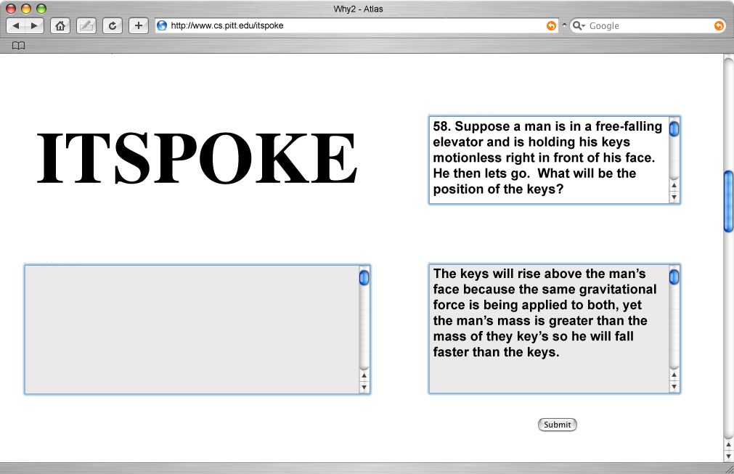
[pr01_sess00_prob58]

Slide 56
Task 1
Negative
  Confused, bored, frustrated, uncertain
Positive
  Confident, interested, encouraged
Neutral

Slide 57
Liscombe et al: Uncertainty in ITSpoke
um <sigh> I don’t even think I have an idea here ...... now .. mass isn’t weight ...... mass is ................ the .......... space that an object takes up ........ is that mass?
um <sigh> I don’t even think I have an idea here ...... now .. mass isn’t weight ...... mass is ................ the .......... space that an object takes up ........ is that mass?
um <sigh> I don’t even think I have an idea here ...... now .. mass isn’t weight ...... mass is ................ the .......... space that an object takes up ........ is that mass?
um <sigh> I don’t even think I have an idea here ...... now .. mass isn’t weight ...... mass is ................ the .......... space that an object takes up ........ is that mass?
um <sigh> I don’t even think I have an idea here ...... now .. mass isn’t weight ...... mass is ................ the .......... space that an object takes up ........ is that mass?
um <sigh> I don’t even think I have an idea here ...... now .. mass isn’t weight ...... mass is ................ the .......... space that an object takes up ........ is that mass?
[71-67-1:92-113]
Notes:
One ‘.’ corresponds to 0.25 seconds.

Slide 58
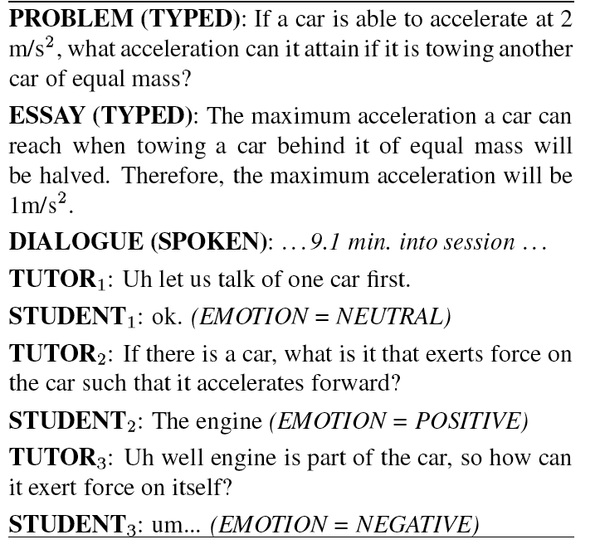

Slide 59
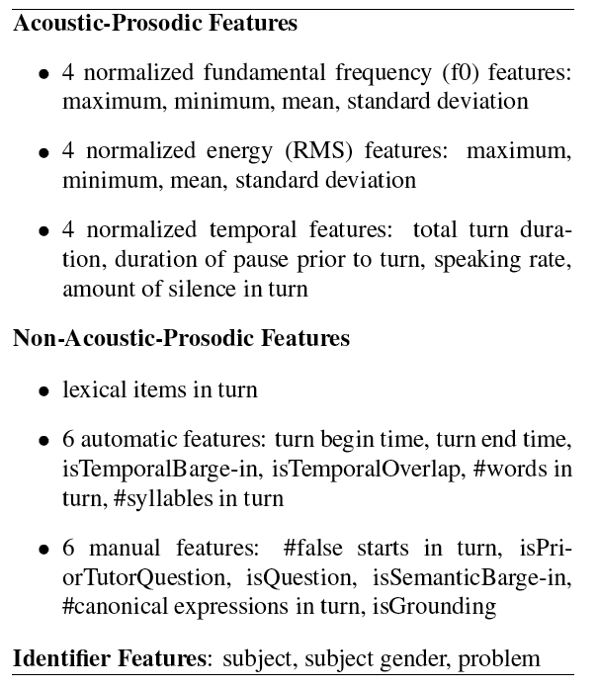

Slide 60
Liscombe et al: ITSpoke Experiment
Human-Human Corpus
AdaBoost(C4.5) 90/10 split in WEKA
Classes: Uncertain vs Certain vs Neutral
Results:
Features | Accuracy
Baseline | 66%
Acoustic-prosodic | 75%

Slide 61
Scherer summaries re: Prosodic features

Slide 62
Juslin and Laukka metastudy

Slide 65
Mood and Medical issues: 6 case studies
Depression
  Stirman and Pennebaker: Suicidal Poets
  Rude et al. Depression in College Freshman
  Ramirez-Esparza et al: Depression in English vs. Spanish
Trauma
  Cohn, Mehl, Pennebaker
Alzheimers
  Garrod et al. 2005
  Lancashire and Hirst 2009

Slide 66
3 studies on Depression

Slide 67
Stirman and Pennebaker
Suicidal poets
300 poems from early, middle, late periods of
  9 suicidal poets
  9 non-suicidal poets

Slide 68
Stirman and Pennebaker:
2 models
Durkheim disengagement model:
  suicidal individual has failed to integrate into society sufficiently, is detached from social life
  detach from the source of their pain, withdraw from social relationships, become more self-oriented
  prediction:
    more self-reference, less group references
Hopelessness model:
  Suicide takes place during extended periods of sadness and desperation, pervasive feelings of helplessness, thoughts of death
  prediction:
    more negative emotion, fewer positive, more refs to death

Slide 69
Methods
156 poems from 9 poets who
  committed suicide
  published, well-known
  in English
  have written within 1 year of commmiting suicide
Control poets matched for nationality, education, sex, era.

Slide 70
The poets

Slide 71
Stirman and Pennebaker:
Results

Slide 72
Significant factors
Disengagement theory
  I, me, mine
  we, our, ours
Hopelessness theory
  death, grave
Other
  sexual words (lust, breast)

Slide 73
Rude et al: Language use of depressed and depression-vulnerable college students
Beck (1967) cognitive theory of depression
  depression-prone individuals see the world and tehmselves in pervasively negative terms
Pyszynski and Greenberg (1987)
  think about themselves
  after the loss of a central source of self-worth, unable to exit a self-regulatory cycle concerned with efforts to regain what was lost.
  results in self-focus, self-blame
Durkheim social integration/disengagement
  perception of self as not integrated into society is key to suicidality and possibly depression

Slide 74
Methods
College freshmen
  31 currently-depressed (standard inventories)
  26 formerly-depressed
  67 never-depressed
Session 1: take depression inventory
Session 2: write essay
  please describe your deepest thoughts and feelings about being in college… write continuously off the top of your head. Don’t worry about grammar or spelling. Just write continuously.

Slide 75
Results
depressed used more “I,me” than never-depressed
  turned out to be only “I”
and used more negative emotional words
not enough “we” to check Durkheim model
formerly depressed participants used more “I” in the last third of the essay

Slide 76
Ramirez-Esparza et al: Depression in English and Spanish
Study 1: Use LIWC counts on posts from 320 English and Spanish forums
  80 posts each from depression forums in English and Spanish
  80 control posts each from breast cancer forums
Run the following LIWC categories
  I
  we
  negative emotion
  positive emotion

Slide 77
Results of Study 1

Slide 78
Study 2
From depression forums:
  404 English posts
  404 Spanish posts
Create a term by document matrix of content words
  200 most frequent content words
Do a factor analysis
  dimensionality reduction in term-document matrix
  Used 5 factors

Slide 79
English Factors
a

Slide 80
Spanish Factors
a

Slide 81
Trauma

Slide 82
Cohn, Mehl, Pennebaker: Linguistic Markers of Psychology Change Surrounding September 11, 2001
1084 LiveJournal users
all blog entries for 2 months before and after 9/11
Lumped prior two months into one “baseline” corpus.
Investigated changes after 9/11 compared to that baseline
Using LIWC categories

Slide 83
Factors
Emotional positivity
  difference between LIWC scores: posemotion (happy, good, nice) and negemotion (kill, ugly, guilty).
Psychological distancing
  factor-analytic:
    + articles,
    + words > 6 letters long
    - I/me/mine
    - would/should/could
    - present tense verbs
  low score = personal, experiential lg, focus on here and now
  high score: abstract, impersonal, rational tone

Slide 84
Livejournal.com:
I, me, my on or after Sep 11, 2001
Cohn, Mehl, Pennebaker. 2004. Linguistic markers of psychological change surrounding September 11, 2001. Psychological Science 15, 10: 687-693.
Graph from Pennebaker slides

Slide 85
September 11 LiveJournal.com study:
We, us, our
Cohn, Mehl, Pennebaker. 2004. Linguistic markers of psychological change surrounding September 11, 2001. Psychological Science 15, 10: 687-693.
Graph from Pennebaker slides

Slide 86
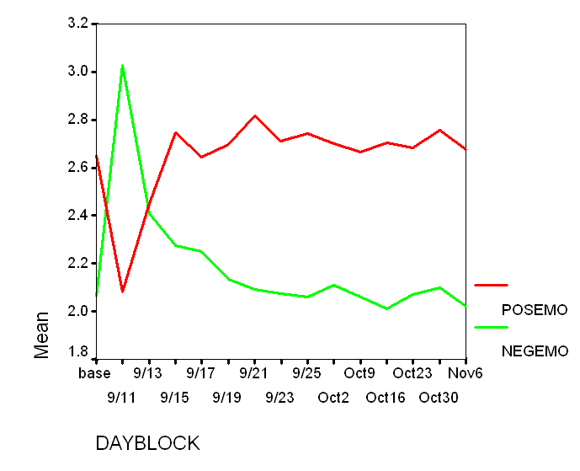
LiveJournal.com September 11, 2001 study:
Positive and negative emotion words
Cohn, Mehl, Pennebaker. 2004. Linguistic markers of psychological change surrounding September 11, 2001. Psychological Science 15, 10: 687-693.
Graph from Pennebaker slides

Slide 87
Implications from word counts
Cohn, Mehl, Pennebaker. 2004. Linguistic markers of psychological change surrounding September 11, 2001. Psychological Science 15, 10: 687-693.
after 9/11
  greater negative emotion
  more socially engaged, less distancting

Slide 88
Alzheimers
Garrod et al. 2005
Lancashire and Hirst 2009

Slide 89
The Nun Study
Linguistic Ability in Early Life and the Neuropathology of Alzheimer’s Disease and Cerebrovascular Disease: Findings from the Nun Study
D.A. SNOWDON, L.H. GREINER, AND W.R. MARKESBERY
The Nun Study: a longitudinal study of aging and Alzheimer’s disease
Cognitive and physical function assessed annually
All participants agreed to brain donation at death
At the first exam given between 1991 and 1993, the 678 participants were 75 to 102 years old.
This study:
  subset of 74 participants
  for whom we had handwritten autobiographies from early life,
  all of whom had died.

Slide 90
The data
In September 1930
leader of the School Sisters of Notre Dame religious congregation requested each sister write
“a short sketch of her own life. This account should not contain more than two to three hundred words and should be written on a single sheet of paper ... include the place of birth, parentage, interesting and edifying events of one's childhood, schools attended, influences that led to the convent, religious life, and its outstanding events.”
Handwritten diaries found in two participating convents, Baltimore and Milwaukee

Slide 91
The linguistic analysis
Grammatical complexity
  Developmental Level metric (Cheung/Kemper)
    sentences classified from 0 (simple one-clause sentences) to 7 (complex sentences with multiple embedding and subordination)
Idea density:
    average number of ideas expressed per 10 words. elementary propositions, typically verb, adjective, adverb, or prepositional phrase. Complex propositions that stated or inferred causal, temporal, or other relationships between ideas also were counted.
Prior studies suggest:
  idea density is associated with educational level, vocabulary, and general knowledge
  grammatical complexity is associated with working memory, performance on speeded tasks, and writing skill.

Slide 92
Idea density
“I was born in Eau Claire, Wis., on May 24, 1913 and was baptized in St. James Church.”
  (1) I was born,
  (2) born in Eau Claire, Wis.,
  (3) born on May 24, 1913,
  (4) I was baptized,
  (5) was baptized in church
  (6) was baptized in St. James Church,
  (7) I was born...and was baptized.
There are 18 words or utterances in that sentence.
The idea density for that sentence was 3.9 (7/18 * 10 = 3.9 ideas per 10 words).

Slide 93
Results
correlation between neuropatholocially defined Alzheimers desiease
had lower idea desnity socres than thnon-Alzheimers
Correlations between idea density scores and mean neurofibrillary tangle counts
  −0.59 for the frontal lobe,
  −0.48 for the temporal lobe,
  −0.49 for the parietal lobe

Slide 94
Explanations?
Early studies found same results with a college-education subset of the population who were teachers, suggesting education was not the key factor
They suggest:
  Low linguistic ability in early life may reflect suboptimal neurological and cognitive development which might increase susceptibility to the development of Alzheimer’s disease pathology in late life

Slide 95
Garrod et al. 2005
British writer Iris Murdoch
last novel published 1995,
Diagnosed with Alzheimers 1997
Compared three novels
  Under the Net (first)
  The Sea (in her prime)
  Jackson's Dilemma (final novel)
All her books written in longhand with little editing

Slide 96
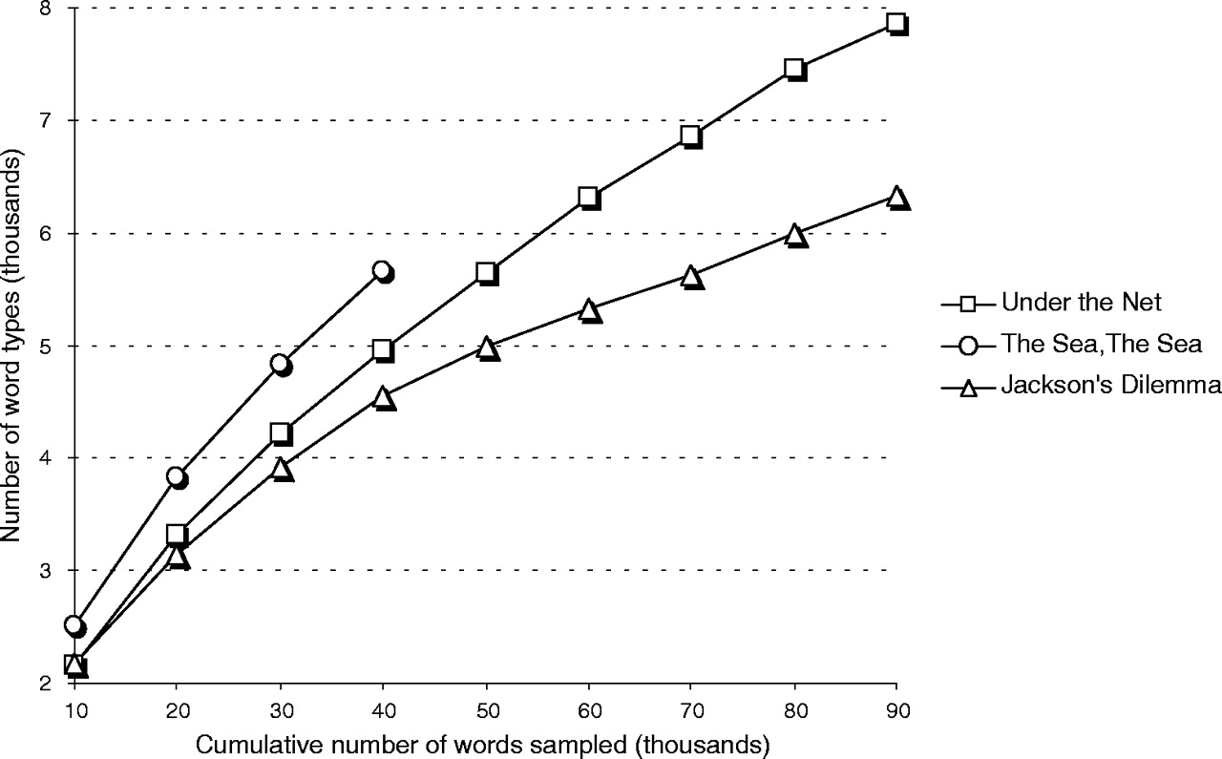
Type to token ratio in the 3 novels

Slide 97
Syntactic Complexity

Slide 98
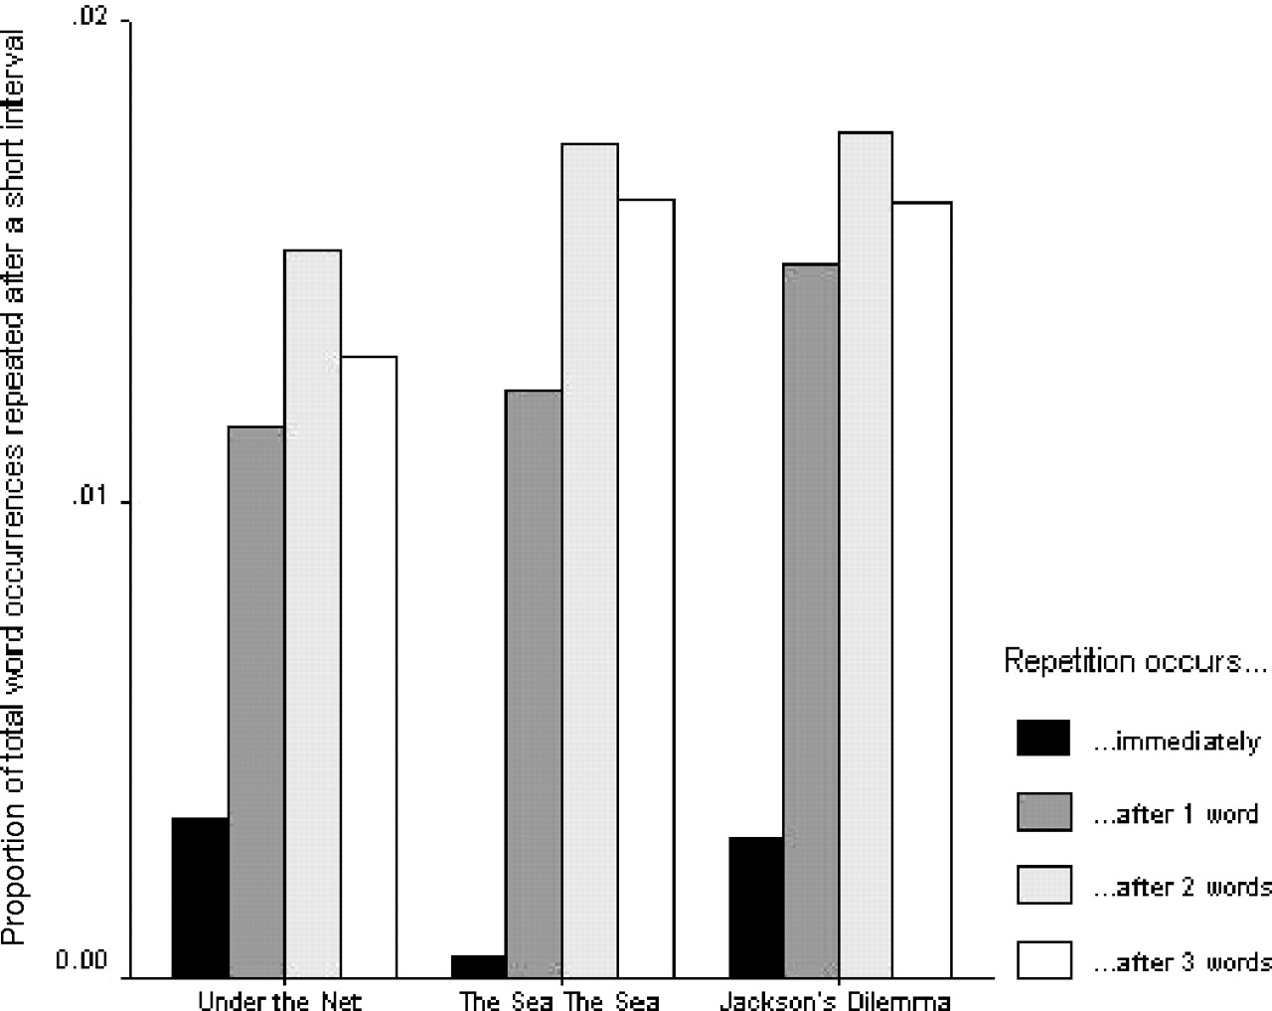

Mean proportions of usages of the 10 most frequently occurring words in each book that appear twice within a series of short intervals, ranging from consecutive positions in the text to a separation of three intervening words.
Garrard P et al. Brain 2005;128:250-260
Brain Vol. 128 No. 2 © Guarantors of Brain 2004; all rights reserved
Notes:
Mean proportions of usages of the 10 most frequently occurring words in each book that appear twice within a series of short intervals, ranging from consecutive positions in the text to a separation of three intervening words.

Slide 99
Parts of speech

Slide 100
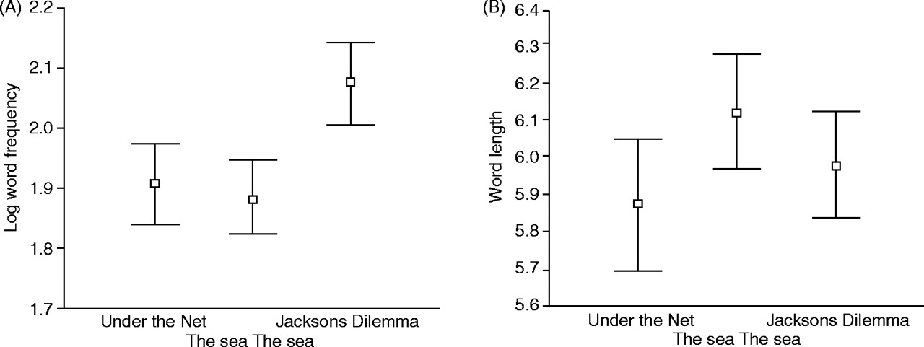
Comparative distributions of values of: (A) frequency and (B) word length in the three books.
Garrard P et al. Brain 2005;128:250-260
Brain Vol. 128 No. 2 © Guarantors of Brain 2004; all rights reserved
Notes:
Comparative distributions of values of: (A) frequency and (B) word length in the three books.

Slide 101
From Under the Net, 1954
"So you may imagine how unhappy it makes me to have to cool my heels at Newhaven, waiting for the trains to run again, and with the smell of France still fresh in my nostrils. On this occasion, too, the bottles of cognac, which I always smuggle, had been taken from me by the Customs, so that when closing time came I was utterly abandoned to the torments of a morbid self-scrutiny.”
From Jackson's Dilemma, 1995
"His beautiful mother had died of cancer when he was 10. He had seen her die. When he heard his father's sobs he knew. When he was 18, his younger brother was drowned. He had no other siblings. He loved his mother and his brother passionately. He had not got on with his father. His father, who was rich and played at being an architect, wanted Edward to be an architect too. Edward did not want to be an architect."

Slide 102
Lancashire and Hirst
Vocabulary Changes in Agatha Christie’s Mysteries as an Indication of Dementia: A Case Study
Ian Lancashire and Graeme Hirst 2009

Slide 104
Vocabulary Changes in Agatha Christie’s Mysteries as an Indication of Dementia: A Case Study
Ian Lancashire and Graeme Hirst 2009
Examined all of Agatha Christie’s novels
Features:
  Nicholas, M., Obler, L. K., Albert, M. L., Helm-Estabrooks, N. (1985). Empty speech in Alzheimer’s disease and fluent aphasia. Journal of Speech and Hearing Research, 28: 405–10.
  Number of unique word types
  Number of different repeated n-grams up to 5
  Number of occurences of “thing”, “anything”, and “something”

Slide 106
Results

