Slide 1
NLTK
Natural Language ToolKit
(www.nltk.org)

Slide 2
What is nltk?
A tool which allows you to do NLP such as parsing.
We’ll be using nltk to write custom CFGs for a set of given sentences and produce parse trees for those sentences to check the accuracy of the grammar.

Slide 3
Download and Install (On your local machine)
http://www.nltk.org/download
windows
Linux
Mac

Slide 4
NLTK is installed on the cs linux machines
rhenium{106} setenv PYTHONPATH /usr/local/lib64
rhenium{107} echo $PYTHONPATH
/usr/local/lib64
rhenium{108} python
Python 2.4.3 (#1, Sep 3 2009, 15:37:37)
[GCC 4.1.2 20080704 (Red Hat 4.1.2-46)] on linux2
Type "help", "copyright", "credits" or "license" for more information.
>>> import nltk
>>>
Slight variations depending on your shell

Slide 5
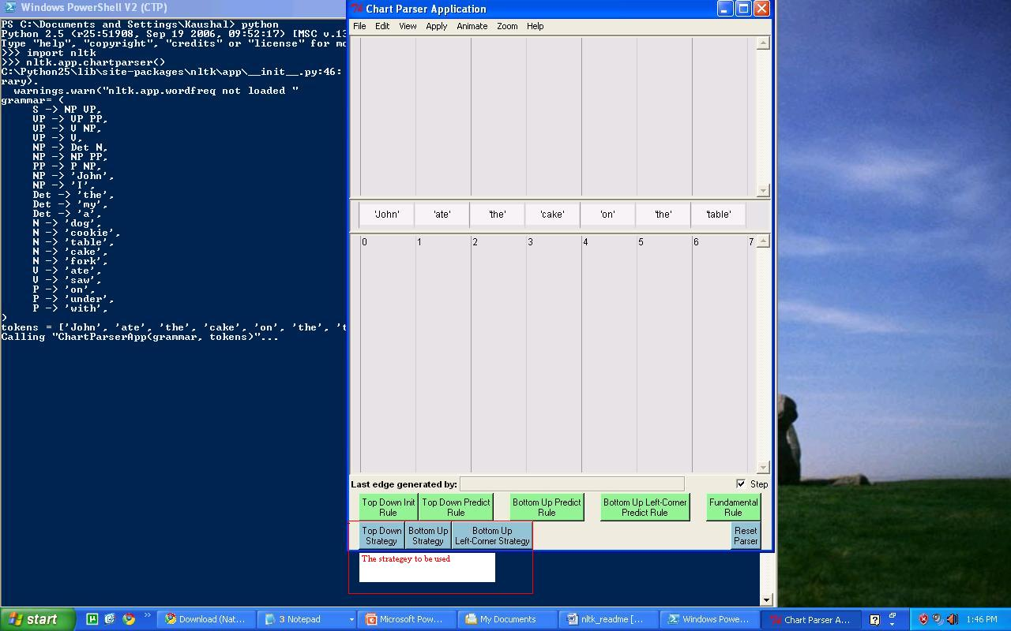
Bringing up the GUI for Chart Parser
nltk.app.chartparser()

Slide 6
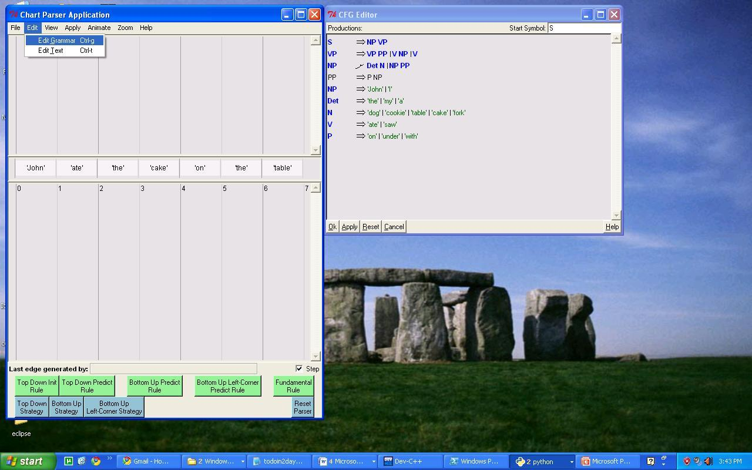
Loading the grammar

Slide 7
Stepping through the parse
To view the parse step by step, check the “Step” checkbox in the lower right corner.
To view the final parse without stepping through, uncheck “Step”

