Slide 1
Part-of-Speech Tagging
Chapter 8
(8.1-8.4.6)

Slide 2
Outline
Parts of speech (POS)
Tagsets
POS Tagging
  Rule-based tagging
  Probabilistic (HMM) tagging

Slide 3
Garden Path Sentences
The old dog the footsteps of the young

Slide 4
Parts of Speech
Traditional parts of speech
  Noun, verb, adjective, preposition, adverb, article, interjection, pronoun, conjunction, etc
  Called: parts-of-speech, lexical categories, word classes, morphological classes, lexical tags...
  Lots of debate within linguistics about the number, nature, and universality of these
    We’ll completely ignore this debate.

Slide 5
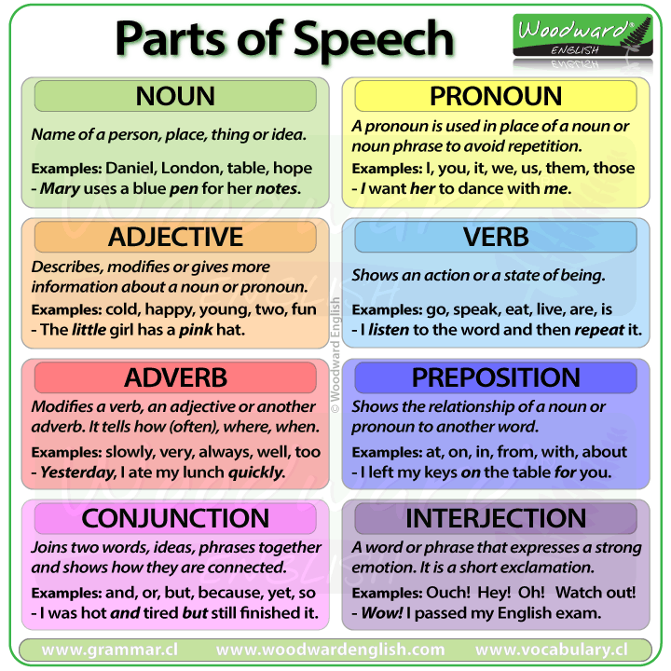
Parts of Speech
Traditional parts of speech
  ~ 8 of them

Slide 6
POS examples
N noun chair, bandwidth, pacing
V verb study, debate, munch
ADJ adjective purple, tall, ridiculous
ADV adverb unfortunately, slowly
P preposition of, by, to
PRO pronoun I, me, mine
DET determiner the, a, that, those

Slide 7
POS Tagging
The process of assigning a part-of-speech or lexical class marker to each word in a collection.
WORD tag
the
koala
put
the
keys
on
the
table

Slide 8
POS Tagging
The process of assigning a part-of-speech or lexical class marker to each word in a collection.
WORD tag
the DET
koala
put
the
keys
on
the
table

Slide 9
POS Tagging
The process of assigning a part-of-speech or lexical class marker to each word in a collection.
WORD tag
the DET
koala N
put
the
keys
on
the
table

Slide 10
POS Tagging
The process of assigning a part-of-speech or lexical class marker to each word in a collection.
WORD tag
the DET
koala N
put V
the
keys
on
the
table

Slide 11
POS Tagging
The process of assigning a part-of-speech or lexical class marker to each word in a collection.
WORD tag
the DET
koala N
put V
the DET
keys
on
the
table

Slide 12
POS Tagging
The process of assigning a part-of-speech or lexical class marker to each word in a collection.
WORD tag
the DET
koala N
put V
the DET
keys N
on
the
table

Slide 13
POS Tagging
The process of assigning a part-of-speech or lexical class marker to each word in a collection.
WORD tag
the DET
koala N
put V
the DET
keys N
on P
the
table

Slide 14
POS Tagging
The process of assigning a part-of-speech or lexical class marker to each word in a collection.
WORD tag
the DET
koala N
put V
the DET
keys N
on P
the DET
table

Slide 15
POS Tagging
The process of assigning a part-of-speech or lexical class marker to each word in a collection.
WORD tag
the DET
koala N
put V
the DET
keys N
on P
the DET
table N

Slide 16
Why is POS Tagging Useful?
First step of many practical tasks, e.g.
Speech synthesis (aka text to speech)
  How to pronounce “lead”?
  OBject obJECT
  CONtent conTENT
Parsing
  Need to know if a word is an N or V before you can parse
Information extraction
  Finding names, relations, etc.
Language modeling
  Backoff

Slide 17
Why is POS Tagging Difficult?
Words often have more than one POS: back
  The back door = adjective
  On my back =
  Win the voters back =
  Promised to back the bill =

Slide 18
Why is POS Tagging Difficult?
Words often have more than one POS: back
  The back door = adjective
  On my back = noun
  Win the voters back =
  Promised to back the bill =

Slide 19
Why is POS Tagging Difficult?
Words often have more than one POS: back
  The back door = adjective
  On my back = noun
  Win the voters back = adverb
  Promised to back the bill =

Slide 20
Why is POS Tagging Difficult?
Words often have more than one POS: back
  The back door = adjective
  On my back = noun
  Win the voters back = adverb
  Promised to back the bill = verb
The POS tagging problem is to determine the POS tag for a particular instance of a word.

Slide 21
POS Tagging
Input: Plays well with others
Ambiguity: NNS/VBZ UH/JJ/NN/RB IN NNS
Output: Plays/VBZ well/RB with/IN others/NNS
Penn Treebank POS tags

Slide 22
POS tagging performance
How many tags are correct? (Tag accuracy)
  About 97% currently
  But baseline is already 90%
    Baseline is performance of stupidest possible method
      Tag every word with its most frequent tag
      Tag unknown words as nouns
  Partly easy because
    Many words are unambiguous
    You get points for them (the, a, etc.) and for punctuation marks!

Slide 23
Deciding on the correct part of speech can be difficult even for people
Mrs/NNP Shaefer/NNP never/RB got/VBD around/RP to/TO joining/VBG
All/DT we/PRP gotta/VBN do/VB is/VBZ go/VB around/IN the/DT corner/NN
Chateau/NNP Petrus/NNP costs/VBZ around/RB 250/CD

Slide 24
How difficult is POS tagging?
About 11% of the word types in the Brown corpus are ambiguous with regard to part of speech
But they tend to be very common words. E.g., that
  I know that he is honest = IN
  Yes, that play was nice = DT
  You can’t go that far = RB
40% of the word tokens are ambiguous

Slide 25
Review
Backoff/Interpolation
Parts of Speech
  What?
Part of Speech Tagging
  What?
  Why?
  Easy or hard?
  Evaluation

Slide 26
Open vs. Closed Classes
Closed class: why?
  Determiners: a, an, the
  Prepositions: of, in, by, …
  Auxiliaries: may, can, will had, been, …
  Pronouns: I, you, she, mine, his, them, …
  Usually function words (short common words which play a role in grammar)
Open class: why?
  English has 4: Nouns, Verbs, Adjectives, Adverbs
  Many languages have these 4, but not all!

Slide 27
Open vs. Closed Classes
Closed class: a small fixed membership
  Determiners: a, an, the
  Prepositions: of, in, by, …
  Auxiliaries: may, can, will had, been, …
  Pronouns: I, you, she, mine, his, them, …
  Usually function words (short common words which play a role in grammar)
Open class: new ones can be created all the time
  English has 4: Nouns, Verbs, Adjectives, Adverbs
  Many languages have these 4, but not all!

Slide 28
Open Class Words
Nouns
  Proper nouns (Pittsburgh, Pat Gallagher)
    English capitalizes these.
  Common nouns (the rest).
  Count nouns and mass nouns
    Count: have plurals, get counted: goat/goats, one goat, two goats
    Mass: don’t get counted (snow, salt, communism) (*two snows)
Adverbs: tend to modify things
  Unfortunately, John walked home extremely slowly yesterday
  Directional/locative adverbs (here,home, downhill)
  Degree adverbs (extremely, very, somewhat)
  Manner adverbs (slowly, slinkily, delicately)
Verbs
  In English, have morphological affixes (eat/eats/eaten)

Slide 29
Closed Class Words
Examples:
  prepositions: on, under, over, …
  particles: up, down, on, off, …
  determiners: a, an, the, …
  pronouns: she, who, I, ..
  conjunctions: and, but, or, …
  auxiliary verbs: can, may should, …
  numerals: one, two, three, third, …

Slide 30
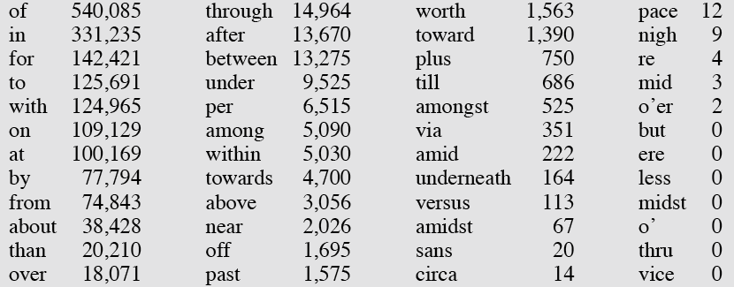
Prepositions from CELEX

Slide 31
POS Tagging
Choosing a Tagset
There are so many parts of speech, potential distinctions we can draw
To do POS tagging, we need to choose a standard set of tags to work with
Could pick very coarse tagsets
  N, V, Adj, Adv.
More commonly used set is finer grained, the “Penn TreeBank tagset”, 45 tags
Even more fine-grained tagsets exist

Slide 32
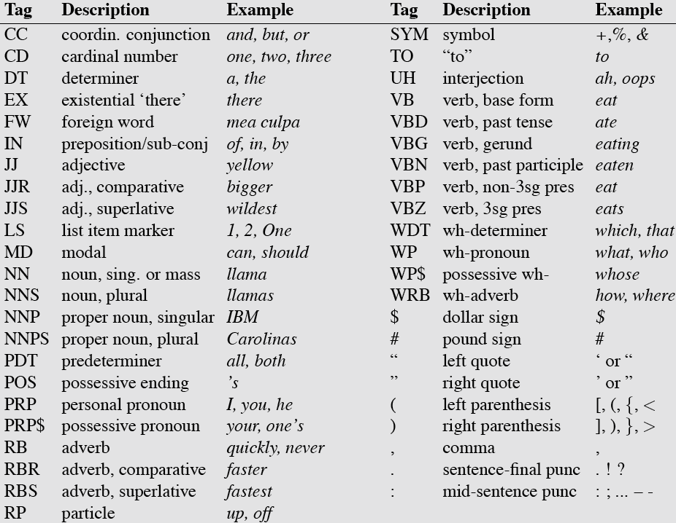
Penn TreeBank POS Tagset

Slide 33
Using the Penn Tagset
The/? grand/? jury/? commmented/? on/? a/? number/? of/? other/? topics/? ./?

Slide 34
Using the Penn Tagset
The/DT grand/JJ jury/NN commented/VBD on/IN a/DT number/NN of/IN other/JJ topics/NNS ./.

Slide 35
Recall POS Tagging Difficulty
Words often have more than one POS: back
  The back door = JJ
  On my back = NN
  Win the voters back = RB
  Promised to back the bill = VB
The POS tagging problem is to determine the POS tag for a particular instance of a word.
These examples from Dekang Lin

Slide 36
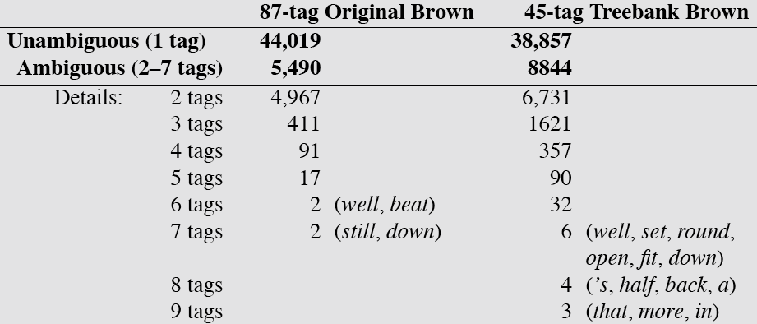
How Hard is POS Tagging? Measuring Ambiguity

Slide 37
Tagging Whole Sentences with POS is Hard too
Ambiguous POS contexts
  E.g., Time flies like an arrow.
Possible POS assignments
  Time/[V,N] flies/[V,N] like/[V,Prep] an/Det arrow/N
  Time/N flies/V like/Prep an/Det arrow/N
  Time/V flies/N like/Prep an/Det arrow/N
  Time/N flies/N like/V an/Det arrow/N
  …..
37
Notes:
37

Slide 38
How Do We Disambiguate POS?
Many words have only one POS tag (e.g. is, Mary, smallest)
Others have a single most likely tag (e.g. Dog is less used as a V)
Tags also tend to co-occur regularly with other tags (e.g. Det, N)
In addition to conditional probabilities of words P(w₁|w_{n-1}), we can look at POS likelihoods P(t₁|t_{n-1}) to disambiguate sentences and to assess sentence likelihoods
38
Notes:
38

Slide 39
More and Better Features ➔ Feature-based tagger
Can do surprisingly well just looking at a word by itself:
  Word the: the → DT
  Lowercased word Importantly: importantly → RB
  Prefixes unfathomable: un- → JJ
  Suffixes Importantly: -ly → RB
  Capitalization Meridian: CAP → NNP
  Word shapes 35-year: d-x → JJ
Notes:
Doing better

Slide 40
Overview: POS Tagging Accuracies
Most errors on unknown words
Rough accuracies:
  Most freq tag: ~90% / ~50%
  Trigram HMM: ~95% / ~55%
  Maxent P(t|w): 93.7% / 82.6%
  Upper bound: ~98% (human)

Slide 41
Rule-Based Tagging
Start with a dictionary
Assign all possible tags to words from the dictionary
Write rules by hand to selectively remove tags
Leaving the correct tag for each word.

Slide 42
Start With a Dictionary
she:
promised:
to
back:
the:
bill:

Slide 43
Start With a Dictionary
she: PRP
promised: VBN,VBD
to TO
back: VB, JJ, RB, NN
the: DT
bill: NN, VB

Slide 44
Assign Every Possible Tag
NN
RB
VBN JJ VB
PRP VBD TO VB DT NN
She promised to back the bill

Slide 45
Write Rules to Eliminate Tags
Eliminate VBN if VBD is an option when VBN|VBD follows “<start> PRP”
NN
RB
JJ VB
PRP VBD TO VB DT NN
She promised to back the bill
VBN
Notes:
Vbn eaten
Vbd ate

Slide 46
POS tag sequences
Some tag sequences are more likely occur than others
POS Ngram view
https://books.google.com/ngrams/graph?content=_ADJ_+_NOUN_%2C_ADV_+_NOUN_%2C+_ADV_+_VERB_
Existing methods often model POS tagging as a
sequence tagging problem

Slide 47
POS Tagging as Sequence Classification
We are given a sentence (an “observation” or “sequence of observations”)
  Secretariat is expected to race tomorrow
What is the best sequence of tags that corresponds to this sequence of observations?
Probabilistic view:
  Consider all possible sequences of tags
  Out of this universe of sequences, choose the tag sequence which is most probable given the observation sequence of n words w₁…w_{n}.

Slide 48
How do you predict the tags?
Two types of information are useful
  Relations between words and tags
  Relations between tags and tags
    DT NN, DT JJ NN…

Slide 49

Getting to HMMs
(Hidden Markov Models)
We want, out of all sequences of n tags t₁…t_{n} the single tag sequence such that P(t₁…t_{n}|w₁…w_{n}) is highest.
Hat ^ means “our estimate of the best one”
Argmax_{x} f(x) means “the x such that f(x) is maximized”

Slide 50
Getting to HMMs
This equation is guaranteed to give us the best tag sequence
But how to make it operational? How to compute this value?
Intuition of Bayesian classification:
  Use Bayes rule to transform this equation into a set of other probabilities that are easier to compute

Slide 51
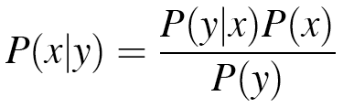
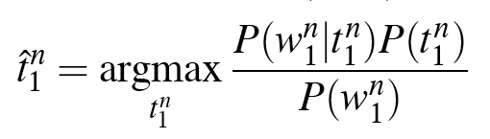
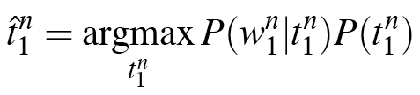
Using Bayes Rule

Slide 52
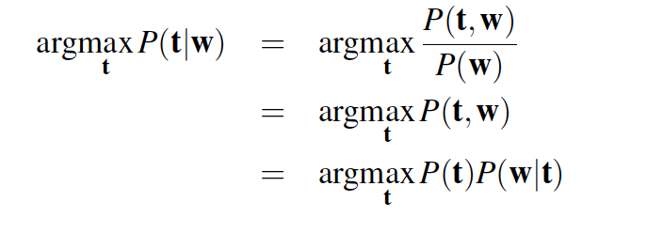
Statistical POS tagging
What is the most likely sequence of tags for the given sequence of words w
P( DT JJ NN | a smart dog) =

Slide 53
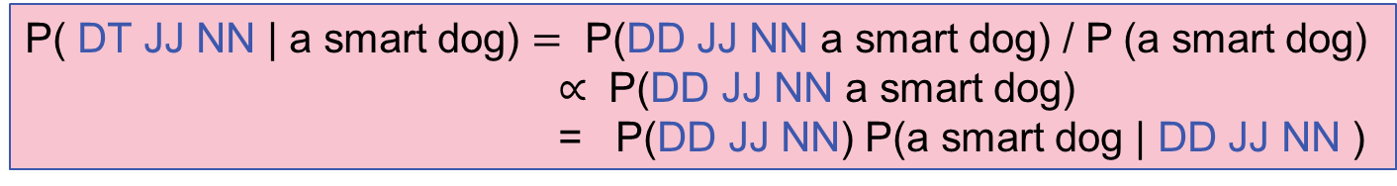
Statistical POS tagging
What is the most likely sequence of tags for the given sequence of words w

Slide 54
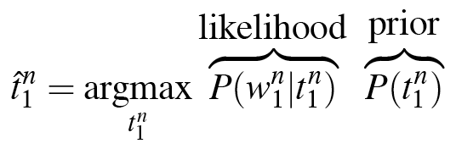
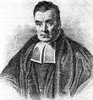
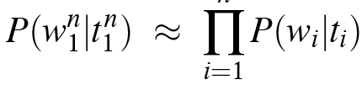
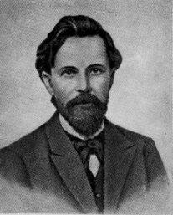
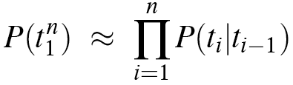
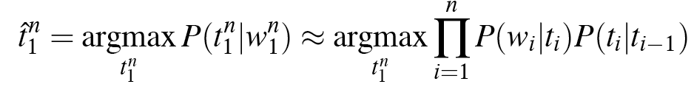
Likelihood and Prior

Slide 55
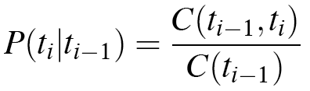
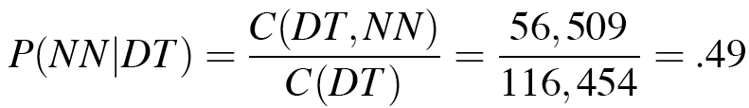
Two Kinds of Probabilities
Tag transition probabilities p(t_{i}|t_{i-1})
  Determiners likely to precede adjs and nouns
    That/DT flight/NN
    The/DT yellow/JJ hat/NN
    So we expect P(NN|DT) and P(JJ|DT) to be high
    But P(DT|JJ) to be:
  Compute P(NN|DT) by counting in a labeled corpus:

Slide 56
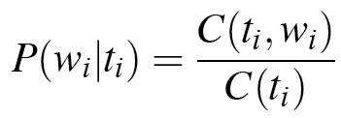
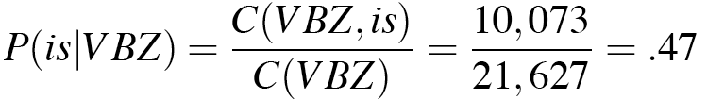
Two Kinds of Probabilities
Word likelihood (emission) probabilities p(w_{i}|t_{i})
  VBZ (3sg Pres verb) likely to be “is”
  Compute P(is|VBZ) by counting in a labeled corpus:

Slide 57
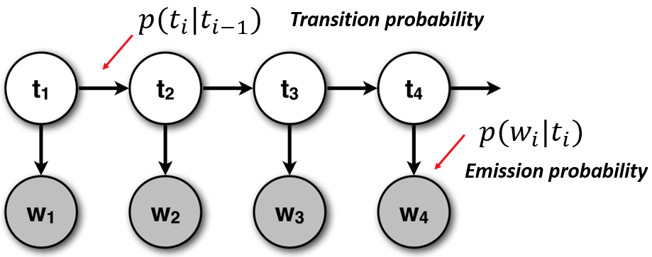
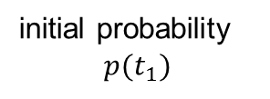
Put them together
Two independent assumptions
  Approximate P(t) by a bi(or N)-gram model
  Assume each word depends only on its POS tag

Slide 58
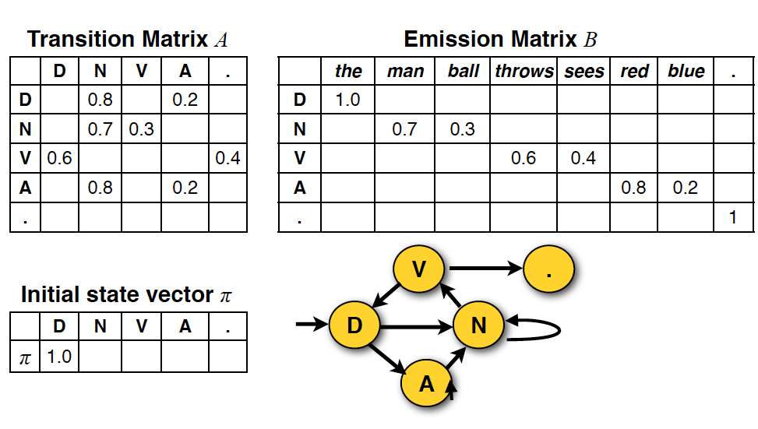
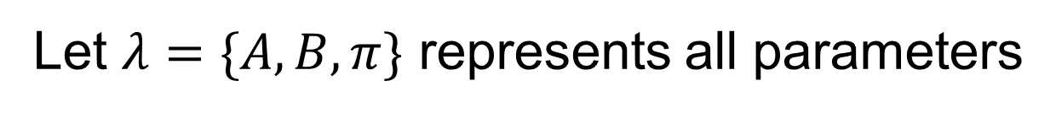
Table representation

Slide 59
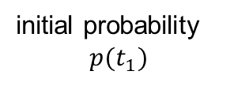
Prediction in generative model
Inference: What is the most likely sequence of tags for the given sequence of words w
What are the latent states that most likely generate the sequence of word w

Slide 60
Example: The Verb “race”
Secretariat/NNP is/VBZ expected/VBN to/TO race/VB tomorrow/NR
People/NNS continue/VB to/TO inquire/VB the/DT reason/NN for/IN the/DT race/NN for/IN outer/JJ space/NN
How do we pick the right tag?

Slide 61
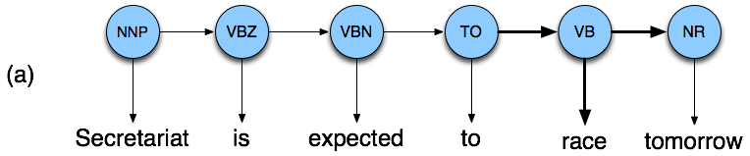

Disambiguating “race”

Slide 62
Example
P(NN|TO) = .00047
P(VB|TO) = .83
P(race|NN) = .00057
P(race|VB) = .00012
P(NR|VB) = .0027
P(NR|NN) = .0012
P(VB|TO)P(NR|VB)P(race|VB) = .00000027
P(NN|TO)P(NR|NN)P(race|NN)=.00000000032
So we (correctly) choose the verb reading

Slide 63
Hidden Markov Models
What we’ve described with these two kinds of probabilities is a Hidden Markov Model (HMM)

Slide 64
Definitions
A weighted finite-state automaton adds probabilities to the arcs
  The sum of the probabilities leaving any arc must sum to one
A Markov chain is a special case of a WFSA in which the input sequence uniquely determines which states the automaton will go through
Markov chains can’t represent inherently ambiguous problems
  Useful for assigning probabilities to unambiguous sequences
Notes:
here

Slide 65
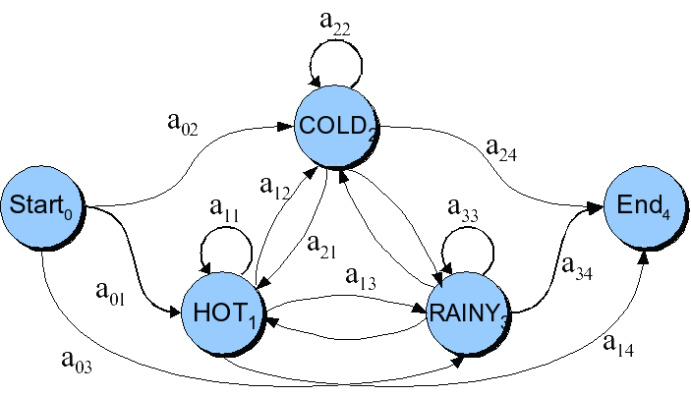
Markov Chain for Weather

Slide 66
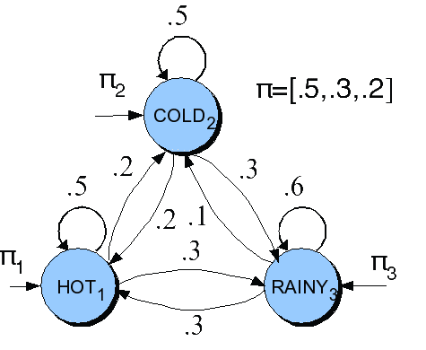
Weather continued
9/19/19
66
Notes:
66
.3 * .2 * .5 = .030

Slide 67
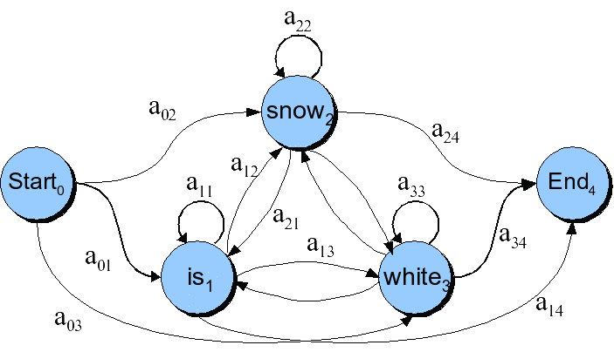
Markov Chain for Words

Slide 68
Markov Chain: “First-order observable Markov Model”
A set of states
  Q = q₁, q₂…q_{N;} the state at time t is q_{t}
Transition probabilities:
  a set of probabilities A = a₀₁a₀₂…a_{n1}…a_{nn}.
  Each a_{ij} represents the probability of transitioning from state i to state j
  The set of these is the transition probability matrix A
Current state only depends on previous state

Slide 69
Markov Chain for Weather
What is the probability of 4 consecutive rainy days?
Sequence is rainy-rainy-rainy-rainy
I.e., state sequence is 3-3-3-3
P(3,3,3,3) =

Slide 70
Markov Chain for Weather
What is the probability of 4 consecutive rainy days?
Sequence is rainy-rainy-rainy-rainy
I.e., state sequence is 3-3-3-3
P(3,3,3,3) =
  π₃a₃₃a₃₃a₃₃ = 0.2 x (0.6)³ = 0.0432

Slide 71
Review
Tagsets
  What?
  Example(s)
Baseline(s) for tagging evaluation
Two types of probabilities for POS tagging
  assumptions
Markov Chain vs Hidden Markov Model

Slide 72
HMM for Ice Cream
You are a climatologist in the year 2799
Studying global warming
You can’t find any records of the weather in Pittsburgh for summer of 2018
But you find a diary
Which lists how many ice-creams someone ate every date that summer
Our job: figure out how hot it was

Slide 73
Hidden Markov Model
For Markov chains, the output symbols are the same as the states.
  See hot weather: we’re in state hot
But in part-of-speech tagging (and other things)
  The output symbols are words
  But the hidden states are part-of-speech tags
So we need an extension!
A Hidden Markov Model is an extension of a Markov chain in which the input symbols are not the same as the states.
This means we don’t know which state we are in.

Slide 74
Hidden Markov Models
States Q = q₁, q₂…q_{N;}
Observations O= o₁, o₂…o_{N;}
  Each observation is a symbol from a vocabulary V = {v₁,v₂,…v_{V}}
Transition probabilities
  Transition probability matrix A = {a_{ij}}
Observation likelihoods
  Output probability matrix B={b_{i}(k)}
Special initial probability vector π

Slide 75
Task
Given
  Ice Cream Observation Sequence: 1,2,3,2,2,2,3…
Produce:
  Weather Sequence: H,C,H,H,H,C…

Slide 76
Weather/Ice Cream HMM
Hidden States:
Transition probabilities:
Observations:

Slide 77
Weather/Ice Cream HMM
Hidden States: {Hot,Cold}
Transition probabilities (A Matrix) between H and C
Observations: {1,2,3} # of ice creams eaten per day

Slide 78
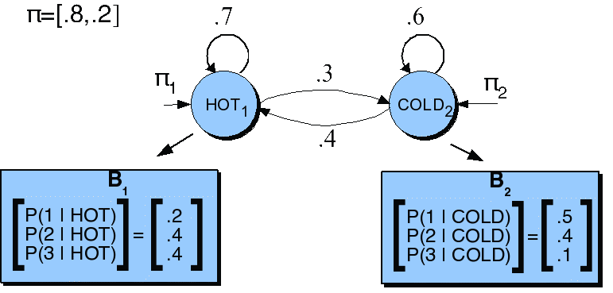
HMM for Ice Cream

Slide 79
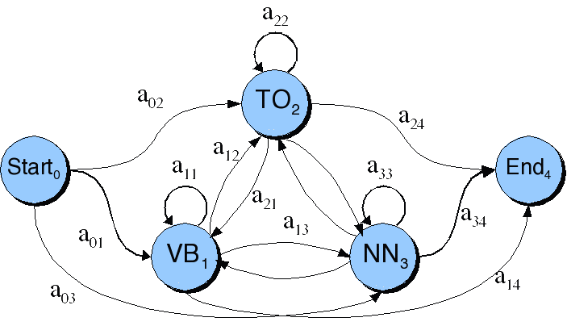
Back to POS Tagging: Transition Probabilities

Slide 80
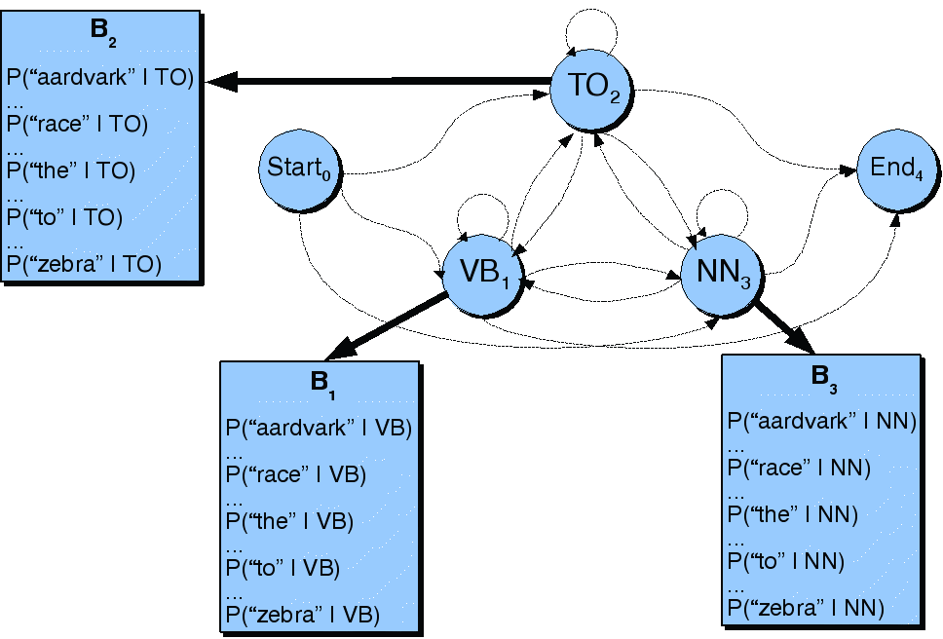
Observation Likelihoods

Slide 81
What can HMMs Do?
Likelihood: Given an HMM λ and an observation sequence O, determine the likelihood P(O, λ): language modeling
Decoding: Given an observation sequence O and an HMM λ, discover the best hidden state sequence Q: Given seq of ice creams, what was the most likely weather on those days? (tagging)
Learning: Given an observation sequence O and the set of states in the HMM, learn the HMM parameters
9/19/19
81
Notes:
81

Slide 82
Decoding
Ok, now we have a complete model that can give us what we need. Recall that we need to get
We could just enumerate all paths given the input and use the model to assign probabilities to each.
  Not a good idea.
  In practice: Viterbi Algorithm (dynamic programming)

Slide 83
Viterbi Algorithm
Intuition: since state transition out of a state only depend on the current state (and not previous states), we can record for each state the optimal path
We record
  Cheapest cost to state at step
  Backtrace for that state to best predecessor

Slide 84
Viterbi Summary
Create an array
  With columns corresponding to inputs
  Rows corresponding to possible states
Sweep through the array in one pass filling the columns left to right using our transition probs and observations probs
Dynamic programming key is that we need only store the MAX prob path to each cell (not all paths).
Notes:
here

Slide 85
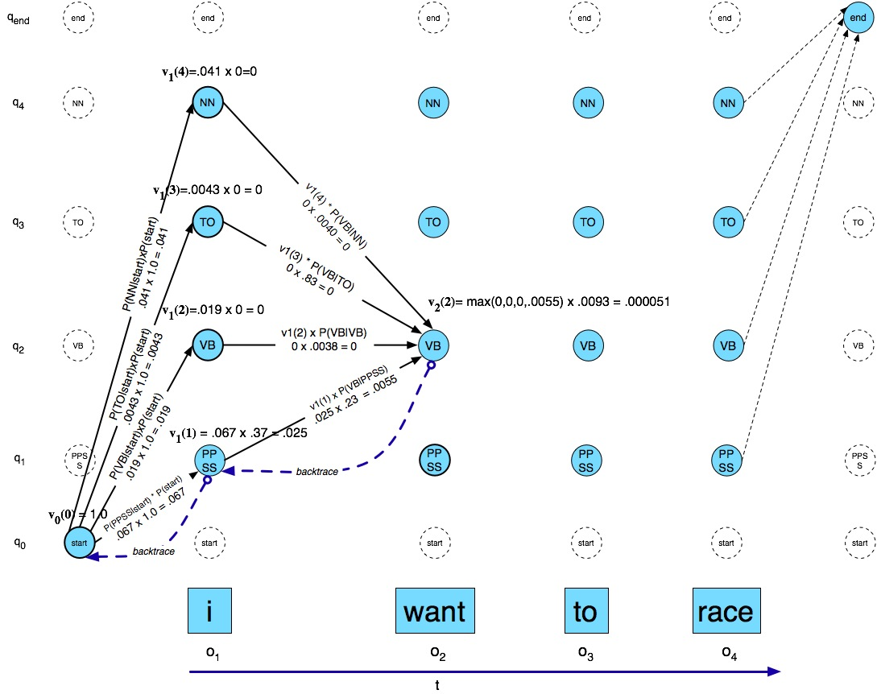
Viterbi Example

Slide 86
Another Viterbi Example
Analyzing “Fish sleep”
  Done in class

Slide 87
Evaluation
So once you have your POS tagger running how do you evaluate it?
  Overall error rate with respect to a gold-standard test set.
  Error rates on particular tags
  Error rates on particular words
  Tag confusions...
Need a baseline – just the most frequent tag is 90% accurate!

Slide 88
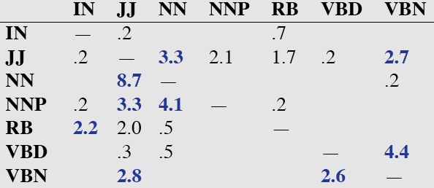
Error Analysis
Look at a confusion matrix
See what errors are causing problems
  Noun (NN) vs ProperNoun (NNP) vs Adj (JJ)
  Preterite (VBD) vs Participle (VBN) vs Adjective (JJ)

Slide 89
Evaluation
The result is compared with a manually coded “Gold Standard”
  Typically accuracy reaches 96-97%
  This may be compared with result for a baseline tagger (one that uses no context).
Important: 100% is impossible even for human annotators.

Slide 90
More Complex Issues
Tag indeterminacy: when ‘truth’ isn’t clear
  Caribbean cooking, child seat
Tagging multipart words
  wouldn’t --> would/MD n’t/RB
How to handle unknown words
  Assume all tags equally likely
  Assume same tag distribution as all other singletons in corpus
  Use morphology, word length,….

Slide 91
Other Tagging Tasks
Noun Phrase (NP) Chunking
[the student] said [the exam] is hard
Three tabs
  B = beginning of NP
  I = continuing in NP
  O = other word
Tagging result
  The/B student/I said/O the/B exam/I is/0 hard/0

Slide 92
Summary
Parts of speech
Tagsets
Part of speech tagging
Rule-Based, HMM Tagging
  Other methods later in course

