Slide 1
Chapter 6:
Vector Semantics, continued

Slide 2
Tf-idf and PPMI are sparse representations
tf-idf and PPMI vectors are
  long (length |V|= 20,000 to 50,000)
  sparse (most elements are zero)

Slide 3
Alternative: dense vectors
vectors which are
  short (length 50-1000)
  dense (most elements are non-zero)

Slide 4
Sparse versus dense vectors
Why dense vectors?
  Short vectors may be easier to use as features in machine learning (less weights to tune)
  Dense vectors may generalize better than storing explicit counts
  They may do better at capturing synonymy:
    car and automobile are synonyms; but are distinct dimensions
      a word with car as a neighbor and a word with automobile as a neighbor should be similar, but aren't
  In practice, they work better

Slide 5
Dense embeddings you can download!
Word2vec (Mikolov et al.)
https://code.google.com/archive/p/word2vec/
Fasttext http://www.fasttext.cc/
Glove (Pennington, Socher, Manning)
http://nlp.stanford.edu/projects/glove/

Slide 6
Word2vec
Popular embedding method
Very fast to train
Code available on the web
Idea: predict rather than count

Slide 7
Word2vec
  Instead of counting how often each word w occurs near "apricot"
  Train a classifier on a binary prediction task:
    Is w likely to show up near "apricot"?
  We don’t actually care about this task
    But we'll take the learned classifier weights as the word embeddings

Slide 8
Insight: Use running text as implicitly supervised training data!
A word s near apricot
  Acts as gold ‘correct answer’ to the question
  “Is word w likely to show up near apricot?”
No need for hand-labeled supervision
The idea comes from neural language modeling

Slide 9
Word2Vec: Skip-Gram Task
Word2vec provides a variety of options. Let's do
  "skip-gram with negative sampling" (SGNS)

Slide 10
Skip-gram algorithm
Treat the target word and a neighboring context word as positive examples.
Randomly sample other words in the lexicon to get negative samples
Use logistic regression to train a classifier to distinguish those two cases
Use the weights as the embeddings

Slide 11
Skip-Gram Training Data
Training sentence:
... lemon, a tablespoon of apricot jam a pinch ...
c1 c2 target c3 c4
Asssume context words are those in +/- 2 word window

Slide 12
Skip-Gram Goal
Given a tuple (t,c) = target, context
  (apricot, jam)
  (apricot, aardvark)
Return probability that c is a real context word:
P(+|t,c)
P(−|t,c) = 1−P(+|t,c)

Slide 13
How to compute p(+|t,c)?
Intuition:
  Words are likely to appear near similar words
  Model similarity with dot-product!
  Similarity(t,c) ∝ t ∙ c
Problem:
  Dot product is not a probability!
    (Neither is cosine)

Slide 14
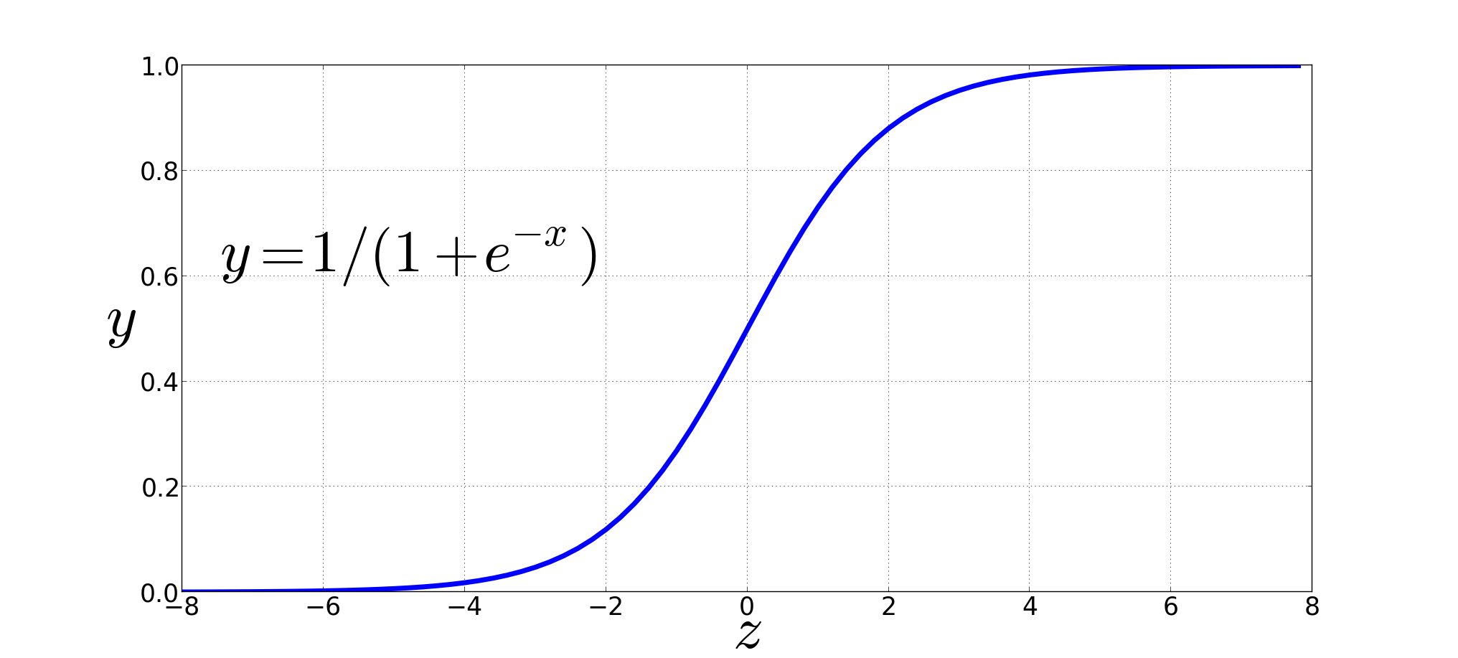
Turning dot product into a probability
The sigmoid lies between 0 and 1:

Slide 15
Turning dot product into a probability

Slide 16
For all the context words:
Assume all context words are independent

Slide 17
Skip-Gram Training Data
Training sentence:
... lemon, a tablespoon of apricot jam a pinch ...
c1 c2 t c3 c4
Training data: input/output pairs centering on apricot
Asssume a +/- 2 word window

Slide 18
Skip-Gram Training
Training sentence:
... lemon, a tablespoon of apricot jam a pinch ...
c1 c2 t c3 c4
For each positive example, we'll create k negative examples.
Using noise words
  Any random word that isn't t

Slide 19
Skip-Gram Training
Training sentence:
... lemon, a tablespoon of apricot jam a pinch ...
c1 c2 t c3 c4
k=2

Slide 20
Choosing noise words
Could pick w according to their unigram frequency P(w)
More common to chosen then according to p_{α}(w)
α= ¾ works well because it gives rare noise words slightly higher probability
To show this, imagine two events p(a)=.99 and p(b) = .01:

Slide 21
Setup
Let's represent words as vectors of some length (say 300), randomly initialized.
So we start with 300 * V random parameters
Over the entire training set, we’d like to adjust those word vectors such that we
  Maximize the similarity of the target word, context word pairs (t,c) drawn from the positive data
  Minimize the similarity of the (t,c) pairs drawn from the negative data.

Slide 22
Learning the classifier
Iterative process.
We’ll start with 0 or random weights
Then adjust the word weights to
  make the positive pairs more likely
  and the negative pairs less likely
over the entire training set:

Slide 23
Objective Criteria
We want to maximize…
Maximize the + label for the pairs from the positive training data, and the – label for the pairs sample from the negative data.

Slide 24
Focusing on one target word t:

Slide 26
Train using gradient descent
Actually learns two separate embedding matrices W and C
Can use W and throw away C, or merge them somehow

Slide 27
Summary: How to learn word2vec (skip-gram) embeddings
Start with V random 300-dimensional vectors as initial embeddings
Use logistic regression, the second most basic classifier used in machine learning after naïve bayes
  Take a corpus and take pairs of words that co-occur as positive examples
  Take pairs of words that don't co-occur as negative examples
  Train the classifier to distinguish these by slowly adjusting all the embeddings to improve the classifier performance
  Throw away the classifier code and keep the embeddings.

Slide 28
Other approaches
See end of chapter in text for pointers

Slide 29
Evaluating embeddings
Compare to human scores on word similarity-type tasks:
WordSim-353 (Finkelstein et al., 2002)
SimLex-999 (Hill et al., 2015)
Stanford Contextual Word Similarity (SCWS) dataset (Huang et al., 2012)
TOEFL dataset: Levied is closest in meaning to: imposed, believed, requested, correlated

Slide 30
Properties of embeddings
Similarity depends on window size C
C = ±2 The nearest words to Hogwarts:
  Sunnydale
  Evernight
C = ±5 The nearest words to Hogwarts:
  Dumbledore
  Malfoy
  halfblood

Slide 31
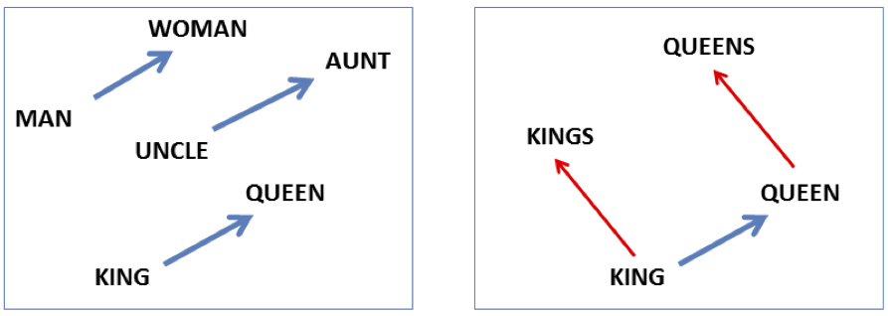

Analogy: Embeddings capture relational meaning!
vector(‘king’) - vector(‘man’) + vector(‘woman’) $≈$vector(‘queen’)
vector(‘Paris’) - vector(‘France’) + vector(‘Italy’) $≈$ vector(‘Rome’)

Slide 32
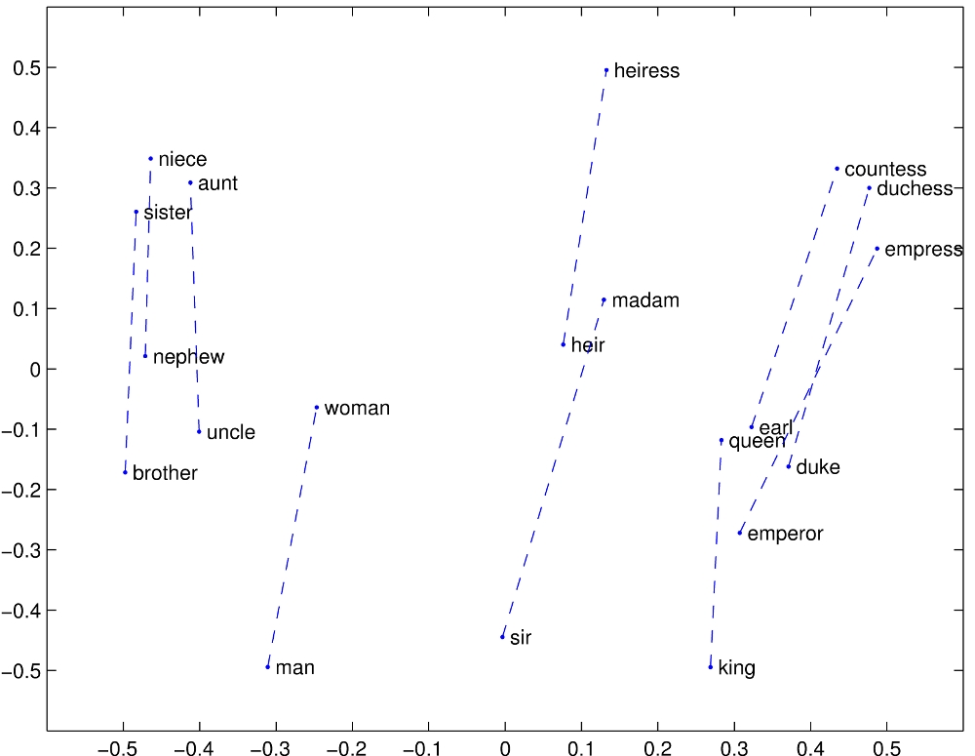

Slide 33
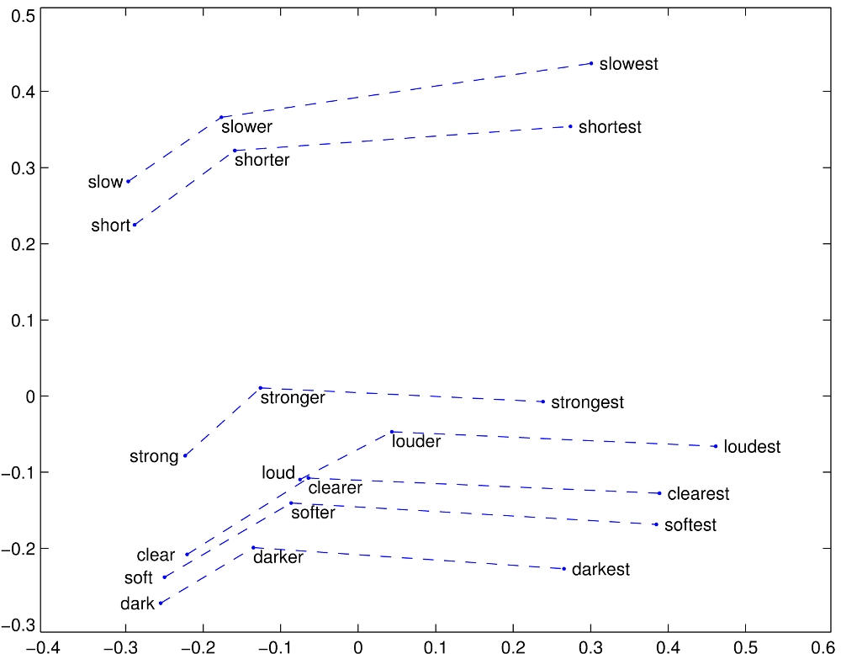

Slide 34
Embeddings can help study word history!
Train embeddings on old books to study changes in word meaning!!

Slide 35




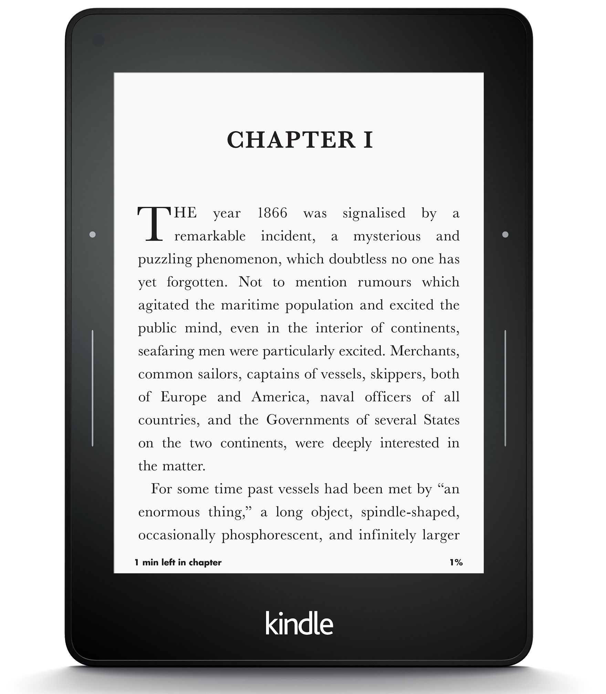
Word embeddings for studying language change!
Word vectors for 1920
Word vectors 1990
“dog” 1990 word vector
“dog” 1920 word vector
vs.
1900
1950
2000
￼
￼

Slide 36
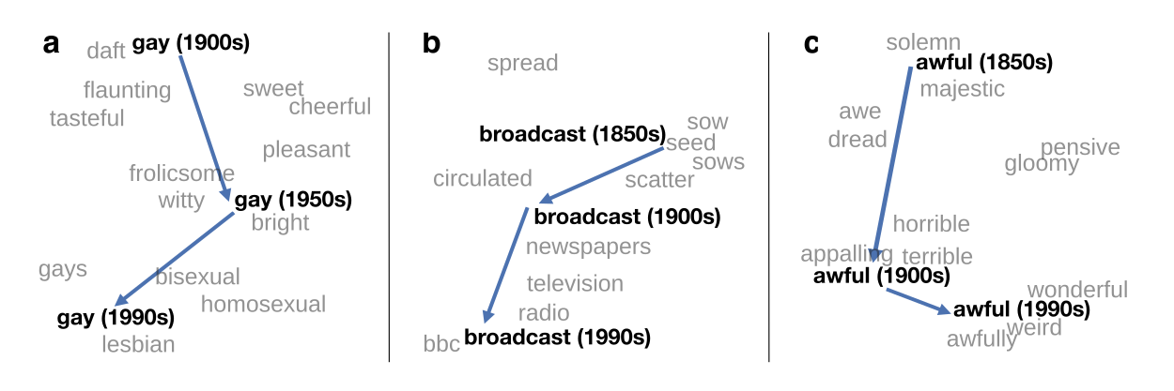
Visualizing changes
Project 300 dimensions down into 2
~30 million books, 1850-1990, Google Books data

Slide 37
Embeddings and bias

Slide 38
Embeddings reflect cultural bias
Bolukbasi, Tolga, Kai-Wei Chang, James Y. Zou, Venkatesh Saligrama, and Adam T. Kalai. "Man is to computer programmer as woman is to homemaker? debiasing word embeddings." In Advances in Neural Information Processing Systems, pp. 4349-4357. 2016.
Ask “Paris : France :: Tokyo : x”
  x = Japan
Ask “father : doctor :: mother : x”
  x = nurse
Ask “man : computer programmer :: woman : x”
  x = homemaker

Slide 39
Embeddings reflect cultural bias
Caliskan, Aylin, Joanna J. Bruson and Arvind Narayanan. 2017. Semantics derived automatically from language corpora contain human-like biases. Science 356:6334, 183-186.
Implicit Association test (Greenwald et al 1998): How associated are
  concepts (flowers, insects) & attributes (pleasantness, unpleasantness)?
  Studied by measuring timing latencies for categorization.
Psychological findings on US participants:
  African-American names are associated with unpleasant words (more than European-American names)
  Male names associated more with math, female names with arts
  Old people's names with unpleasant words, young people with pleasant words.
Caliskan et al. replication with embeddings:
  African-American names (Leroy, Shaniqua) had a higher GloVe cosine with unpleasant words (abuse, stink, ugly)
  European American names (Brad, Greg, Courtney) had a higher cosine with pleasant words (love, peace, miracle)
Embeddings reflect and replicate all sorts of pernicious biases.

Slide 40
Directions
Debiasing algorithms for embeddings
  Bolukbasi, Tolga, Chang, Kai-Wei, Zou, James Y., Saligrama, Venkatesh, and Kalai, Adam T. (2016). Man is to computer programmer as woman is to homemaker? debiasing word embeddings. In Advances in Neural Infor- mation Processing Systems, pp. 4349–4357.
Use embeddings as a historical tool to study bias

Slide 41
Embeddings as a window onto history
Garg, Nikhil, Schiebinger, Londa, Jurafsky, Dan, and Zou, James (2018). Word embeddings quantify 100 years of gender and ethnic stereotypes. Proceedings of the National Academy of Sciences, 115(16), E3635–E3644
The cosine similarity of embeddings for decade X for occupations (like teacher) to male vs female names
  Is correlated with the actual percentage of women teachers in decade X

Slide 42
History of biased framings of women
Garg, Nikhil, Schiebinger, Londa, Jurafsky, Dan, and Zou, James (2018). Word embeddings quantify 100 years of gender and ethnic stereotypes. Proceedings of the National Academy of Sciences, 115(16), E3635–E3644
Embeddings for competence adjectives are biased toward men
  Smart, wise, brilliant, intelligent, resourceful, thoughtful, logical, etc.
This bias is slowly decreasing

Slide 43
Embeddings reflect ethnic stereotypes over time
Garg, Nikhil, Schiebinger, Londa, Jurafsky, Dan, and Zou, James (2018). Word embeddings quantify 100 years of gender and ethnic stereotypes. Proceedings of the National Academy of Sciences, 115(16), E3635–E3644
Princeton trilogy experiments
Attitudes toward ethnic groups (1933, 1951, 1969) scores for adjectives
    industrious, superstitious, nationalistic, etc
Cosine of Chinese name embeddings with those adjective embeddings correlates with human ratings.

Slide 44
Change in linguistic framing 1910-1990
Garg, Nikhil, Schiebinger, Londa, Jurafsky, Dan, and Zou, James (2018). Word embeddings quantify 100 years of gender and ethnic stereotypes. Proceedings of the National Academy of Sciences, 115(16), E3635–E3644
Change in association of Chinese names with adjectives framed as "othering" (barbaric, monstrous, bizarre)

Slide 45
Changes in framing: adjectives associated with Chinese
Garg, Nikhil, Schiebinger, Londa, Jurafsky, Dan, and Zou, James (2018). Word embeddings quantify 100 years of gender and ethnic stereotypes. Proceedings of the National Academy of Sciences, 115(16), E3635–E3644

Slide 46
Changes in framing: adjectives associated with Chinese
Garg, Nikhil, Schiebinger, Londa, Jurafsky, Dan, and Zou, James (2018). Word embeddings quantify 100 years of gender and ethnic stereotypes. Proceedings of the National Academy of Sciences, 115(16), E3635–E3644

Slide 47
Conclusion
Concepts or word senses
  Have a complex many-to-many association with words (homonymy, multiple senses)
  Have relations with each other
    Synonymy, Antonymy, Superordinate
  But are hard to define formally (necessary & sufficient conditions)
Embeddings = vector models of meaning
  More fine-grained than just a string or index
  Especially good at modeling similarity/analogy
    Just download them and use cosines!!
  Can use sparse models (tf-idf) or dense models (word2vec, GLoVE)
  Useful in practice but know they encode cultural stereotypes

