Slide 1
Modeling Student Benefits from Illustrations and Graphs
Michael Lipschultz
Diane Litman
Computer Science Department
University of Pittsburgh

Slide 2
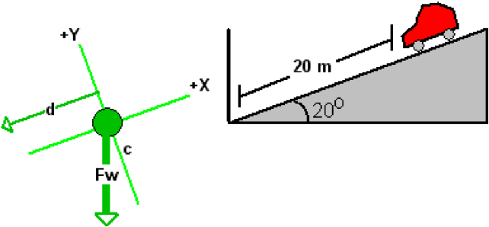
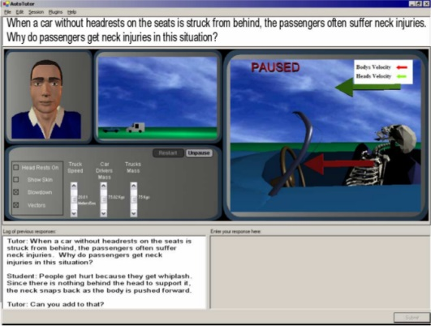
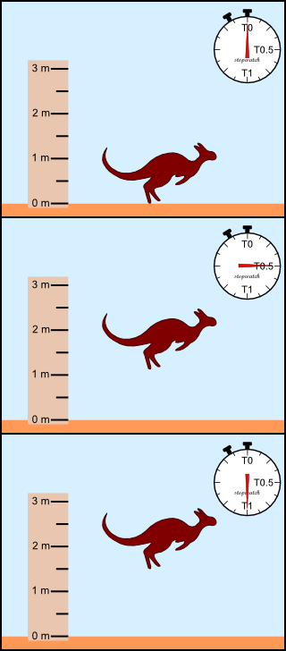
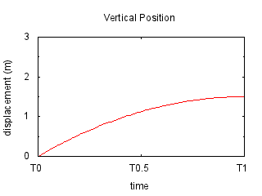
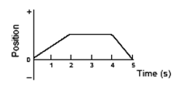
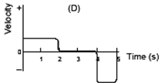
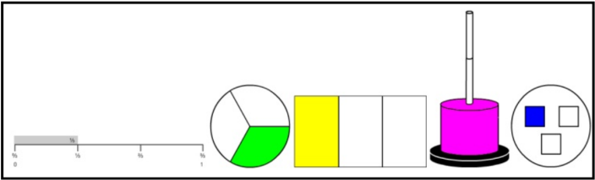
Visually Conveying Concepts in Intelligent Tutoring Systems
Some ITSes use visuals [Graesser et al, 05; VanLehn et al, 05; Rau et al, 09]
Benefits of
  Illustrations
  Graphs
Illustrations
Graphs
(VanLehn et al, 05)
(Graesser et al, 05)
(Rau et al, 09)
(Kozhevnikov et al, 07)

Slide 3
Visually Conveying Concepts in Intelligent Tutoring Systems
Visuals used to convey concepts[Graesser et al, 05; VanLehn et al, 05; Rau et al, 09]
Benefits of
  Illustrations
  Graphs
Illustrations
Graphs

Slide 4
Introduction
Visuals used to convey concepts [Graesser et al, 05; VanLehn et al, 05; Rau et al, 09]
Illustrations
Graphs
Frequent switching [Rau et al., 09; Rau et al., 12a,b]
Concreteness fading [Goldstone & Son, 05; McNeil & Fyfe, 12]
Better transfer [Leelawong & Biswas, 08; Van Heuvelen & Zou, 01]
Relatable [Kozhevnikov et al, 07; Goldstone et al, 12]

Slide 5
Illustrations vs. Graphs
Illustrations
Graphs
Frequent switching [Rau et al., 09; Rau et al., 12a,b]
Concreteness fading [Goldstone & Son, 05; McNeil & Fyfe, 12]
Better transfer [Leelawong & Biswas, 08; Van Heuvelen & Zou, 01]
Relatable [Kozhevnikov et al, 07; Goldstone et al, 12]

Slide 6
Adapt to Student
Best representation varies
  Gender [Meltzer, 05]
  Knowledge [Kozhevnikov et al, 07; Maries et al, 12]
  Skills [Dancy & Beichner, 06; Kozhevnikov et al, 07; Velez et al, 05; Conati & Maclaren, 08]
Adapt to student & context
  Successful in uncertainty & motivation -> persistence & better learning gains [Aist et al, 02; Forbes-Riley & Litman, 11]
In this work: develop modeling approach
  Model better than baseline
  Model with interesting properties

Slide 7
Outline
Introduction
Data
Modeling
  Augmented Stepwise Regression
Quantitative Results
Best Model
Conclusions and Future Work

Slide 8
Data
Prior study [Lipschultz & Litman, 13]
  Problem-solving [VanLehn et al, 05] + post-problem discussion [Katz et al, 11]
  Saw either illustrations only or graphs only
  Pretest & Post-test – to measure learning gains
  29 subjects: 2,042 data points (dialogue answers)
Features:
  Student information [Arroyo et al, 00; Chi et al, 11; Lipschultz & Litman, 11]
  Student skill [Chi et al, 11; Lipschultz & Litman, 11]
  Domain information [Baschera et al, 11; Lipschultz & Litman, 11; Ward & Litman, 06]
  Contextual information [Baker et al; Beck, 06; Drummond & Litman, 10; D'Mello & Graesser, 10]

Slide 9
Modeling
Don’t know best visual
  Know: visual seen & amount learned
Infer best visual from learning gains
Regression to predict learning
  Syntactic constraints for useful model
  Goal: good model that is useful

Slide 10
Modeling with Stepwise Regression
Algorithm
Stepwise Linear Regression
  Convert features to binary
Identify Problematic Rules
  Mutually Exclusive
  Non-Adaptive
Handle Problematic Rules
  Remove Lesser Rule in Pair
Relearn Model
  Regular Regression
Rank by absolute value of coefficient

Slide 11
Modeling with Stepwise Regression
1. Stepwise Linear Regression
Postscore = terms + prescore
terms: β_{i}*representation*(tutoring context)
β_{i}*representation*partition*rule
  β_{i}*Illustration*(PreScore=High)*(ResponseTime=Fast)
  For high pretesters, when ResponseTime=Fast, show illustrations
  Binary features
Learns coefficients (β_{i}’s)
Keeps only predictive terms

Slide 12
Modeling with Stepwise Regression
Example
Starting Set of Terms (72)
Terms from Step 1 (~10)
Illustration*(PreScore=High)*(WalkThruPct=Low)
Illustration*(PreScore=High)*(WalkThruPct=High)
Illustration*(PreScore=High)*(RQPctCorrect=Low)
Illustration*(PreScore=High)*(RQPctCorrect=High)
Illustration*(PreScore=High)*(PctSituationCorrect=Low)
Illustration*(PreScore=High)*(PctSituationCorrect=High)
Illustration*(PreScore=High)*(PctSessionCorrect=Low)
Illustration*(PreScore=High)*(PctSessionCorrect=High)
Illustration*(PreScore=High)*(PctThruSituation=Early)
Illustration*(PreScore=High)*(PctThruSituation=Late)
Illustration*(PreScore=High)*(PctThruSession=Early)
Illustration*(PreScore=High)*(PctThruSession=Late)
Illustration*(PreScore=High)*(KCUsage=State)
Illustration*(PreScore=High)*(KCUsage=Apply)
Illustration*(PreScore=High)*(ItemDiff=Easy)
Illustration*(PreScore=High)*(ItemDiff=Hard)
Illustration*(PreScore=High)*(ResponseTime=Fast)
Illustration*(PreScore=High)*(ResponseTime=Slow)
Graph*(PreScore=High)*(WalkThruPct=Low)
Graph*(PreScore=High)*(WalkThruPct=High)
Graph*(PreScore=High)*(RQPctCorrect=Low)
Graph*(PreScore=High)*(RQPctCorrect=High)
Graph*(PreScore=High)*(PctSituationCorrect=Low)
Graph*(PreScore=High)*(PctSituationCorrect=High)
Graph*(PreScore=High)*(PctSessionCorrect=Low)
Graph*(PreScore=High)*(PctSessionCorrect=High)
Graph*(PreScore=High)*(PctThruSituation=Early)
Graph*(PreScore=High)*(PctThruSituation=Late)
Graph*(PreScore=High)*(PctThruSession=Early)
Graph*(PreScore=High)*(PctThruSession=Late)
Graph*(PreScore=High)*(KCUsage=State)
Graph*(PreScore=High)*(KCUsage=Apply)
Graph*(PreScore=High)*(ItemDiff=Easy)
Graph*(PreScore=High)*(ItemDiff=Hard)
Graph*(PreScore=High)*(ResponseTime=Fast)
Graph*(PreScore=High)*(ResponseTime=Slow)
Illustration*(PreScore=Low)*(WalkThruPct=Low)
Illustration*(PreScore=Low)*(WalkThruPct=High)
Illustration*(PreScore=Low)*(RQPctCorrect=Low)
Illustration*(PreScore=Low)*(RQPctCorrect=High)
Illustration*(PreScore=Low)*(PctSituationCorrect=Low)
Illustration*(PreScore=Low)*(PctSituationCorrect=High)
Illustration*(PreScore=Low)*(PctSessionCorrect=Low)
Illustration*(PreScore=Low)*(PctSessionCorrect=High)
Illustration*(PreScore=Low)*(PctThruSituation=Early)
Illustration*(PreScore=Low)*(PctThruSituation=Late)
Illustration*(PreScore=Low)*(PctThruSession=Early)
Illustration*(PreScore=Low)*(PctThruSession=Late)
Illustration*(PreScore=Low)*(KCUsage=State)
Illustration*(PreScore=Low)*(KCUsage=Apply)
Illustration*(PreScore=Low)*(ItemDiff=Easy)
Illustration*(PreScore=Low)*(ItemDiff=Hard)
Illustration*(PreScore=Low)*(ResponseTime=Fast)
Illustration*(PreScore=Low)*(ResponseTime=Slow)
Graph*(PreScore=Low)*(WalkThruPct=Low)
Graph*(PreScore=Low)*(WalkThruPct=High)
Graph*(PreScore=Low)*(RQPctCorrect=Low)
Graph*(PreScore=Low)*(RQPctCorrect=High)
Graph*(PreScore=Low)*(PctSituationCorrect=Low)
Graph*(PreScore=Low)*(PctSituationCorrect=High)
Graph*(PreScore=Low)*(PctSessionCorrect=Low)
Graph*(PreScore=Low)*(PctSessionCorrect=High)
Graph*(PreScore=Low)*(PctThruSituation=Early)
Graph*(PreScore=Low)*(PctThruSituation=Late)
Graph*(PreScore=Low)*(PctThruSession=Early)
Graph*(PreScore=Low)*(PctThruSession=Late)
Graph*(PreScore=Low)*(KCUsage=State)
Graph*(PreScore=Low)*(KCUsage=Apply)
Graph*(PreScore=Low)*(ItemDiff=Easy)
Graph*(PreScore=Low)*(ItemDiff=Hard)
Graph*(PreScore=Low)*(ResponseTime=Fast)
Graph*(PreScore=Low)*(ResponseTime=Slow)
0.1423*Illustration*(PreScore=High)*(ResponseTime=Fast)
0.0342*Graph*(PreScore=High)*(ResponseTime=Fast)
-0.5820*Illustration*(PreScore=Low)*(PctThruTutoring=High)
0.2432*Graph*(PreScore=Low)*(PctThruTutoring=High)
0.3895*Illustration*(PreScore=High)*(PctSessionCorrect=High)
0.6921*Illustration*(PreScore=High)*(PctSessionCorrect=Low)
-0.3382*Illustration*(PreScore=High)*(KCUsage=Apply)
0.5243*Illustration*(PreScore=High)*(ItemDiff=Easy)
0.1322*Graph*(PreScore=Low)*(PctThruSituation=High)
-0.8225*Graph*(PreScore=Low)*(PctWalkThru=Low)

Slide 13
Modeling with Stepwise Regression
Example
Starting Set of Terms (72)
Terms from Step 1 (~10)
Illustration*(PreScore=High)*(WalkThruPct=Low)
Illustration*(PreScore=High)*(WalkThruPct=High)
Illustration*(PreScore=High)*(RQPctCorrect=Low)
Illustration*(PreScore=High)*(RQPctCorrect=High)
Illustration*(PreScore=High)*(PctSituationCorrect=Low)
Illustration*(PreScore=High)*(PctSituationCorrect=High)
Illustration*(PreScore=High)*(PctSessionCorrect=Low)
Illustration*(PreScore=High)*(PctSessionCorrect=High)
Illustration*(PreScore=High)*(PctThruSituation=Early)
Illustration*(PreScore=High)*(PctThruSituation=Late)
Illustration*(PreScore=High)*(PctThruSession=Early)
Illustration*(PreScore=High)*(PctThruSession=Late)
Illustration*(PreScore=High)*(KCUsage=State)
Illustration*(PreScore=High)*(KCUsage=Apply)
Illustration*(PreScore=High)*(ItemDiff=Easy)
Illustration*(PreScore=High)*(ItemDiff=Hard)
Illustration*(PreScore=High)*(ResponseTime=Fast)
Illustration*(PreScore=High)*(ResponseTime=Slow)
Graph*(PreScore=High)*(WalkThruPct=Low)
Graph*(PreScore=High)*(WalkThruPct=High)
Graph*(PreScore=High)*(RQPctCorrect=Low)
Graph*(PreScore=High)*(RQPctCorrect=High)
Graph*(PreScore=High)*(PctSituationCorrect=Low)
Graph*(PreScore=High)*(PctSituationCorrect=High)
Graph*(PreScore=High)*(PctSessionCorrect=Low)
Graph*(PreScore=High)*(PctSessionCorrect=High)
Graph*(PreScore=High)*(PctThruSituation=Early)
Graph*(PreScore=High)*(PctThruSituation=Late)
Graph*(PreScore=High)*(PctThruSession=Early)
Graph*(PreScore=High)*(PctThruSession=Late)
Graph*(PreScore=High)*(KCUsage=State)
Graph*(PreScore=High)*(KCUsage=Apply)
Graph*(PreScore=High)*(ItemDiff=Easy)
Graph*(PreScore=High)*(ItemDiff=Hard)
Graph*(PreScore=High)*(ResponseTime=Fast)
Graph*(PreScore=High)*(ResponseTime=Slow)
Illustration*(PreScore=Low)*(WalkThruPct=Low)
Illustration*(PreScore=Low)*(WalkThruPct=High)
Illustration*(PreScore=Low)*(RQPctCorrect=Low)
Illustration*(PreScore=Low)*(RQPctCorrect=High)
Illustration*(PreScore=Low)*(PctSituationCorrect=Low)
Illustration*(PreScore=Low)*(PctSituationCorrect=High)
Illustration*(PreScore=Low)*(PctSessionCorrect=Low)
Illustration*(PreScore=Low)*(PctSessionCorrect=High)
Illustration*(PreScore=Low)*(PctThruSituation=Early)
Illustration*(PreScore=Low)*(PctThruSituation=Late)
Illustration*(PreScore=Low)*(PctThruSession=Early)
Illustration*(PreScore=Low)*(PctThruSession=Late)
Illustration*(PreScore=Low)*(KCUsage=State)
Illustration*(PreScore=Low)*(KCUsage=Apply)
Illustration*(PreScore=Low)*(ItemDiff=Easy)
Illustration*(PreScore=Low)*(ItemDiff=Hard)
Illustration*(PreScore=Low)*(ResponseTime=Fast)
Illustration*(PreScore=Low)*(ResponseTime=Slow)
Graph*(PreScore=Low)*(WalkThruPct=Low)
Graph*(PreScore=Low)*(WalkThruPct=High)
Graph*(PreScore=Low)*(RQPctCorrect=Low)
Graph*(PreScore=Low)*(RQPctCorrect=High)
Graph*(PreScore=Low)*(PctSituationCorrect=Low)
Graph*(PreScore=Low)*(PctSituationCorrect=High)
Graph*(PreScore=Low)*(PctSessionCorrect=Low)
Graph*(PreScore=Low)*(PctSessionCorrect=High)
Graph*(PreScore=Low)*(PctThruSituation=Early)
Graph*(PreScore=Low)*(PctThruSituation=Late)
Graph*(PreScore=Low)*(PctThruSession=Early)
Graph*(PreScore=Low)*(PctThruSession=Late)
Graph*(PreScore=Low)*(KCUsage=State)
Graph*(PreScore=Low)*(KCUsage=Apply)
Graph*(PreScore=Low)*(ItemDiff=Easy)
Graph*(PreScore=Low)*(ItemDiff=Hard)
Graph*(PreScore=Low)*(ResponseTime=Fast)
Graph*(PreScore=Low)*(ResponseTime=Slow)
0.1230*Illustration*(PreScore=High)*(ResponseTime=Fast)
0.7890*Graph*(PreScore=High)*(ResponseTime=Fast)
-0.5820*Illustration*(PreScore=Low)*(PctThruTutoring=Later)
0.2432*Graph*(PreScore=Low)*(PctThruTutoring=Later)
0.4560*Graph*(PreScore=Low)*(ResponseTime=Fast)
0.1230*Graph*(PreScore=Low)*(ResponseTime=Slow)
-0.3382*Illustration*(PreScore=High)*(KCUsage=Apply)
0.5243*Illustration*(PreScore=High)*(ItemDiff=Easy)
0.1322*Graph*(PreScore=Low)*(PctThruSituation=High)
-0.8225*Graph*(PreScore=Low)*(PctWalkThru=Low)
But some of these rules don’t make sense…

Slide 14
Modeling with Stepwise Regression
Algorithm
Stepwise Linear Regression
  Convert features to binary
Identify Problematic Rules
  Mutually Exclusive
  Non-Adaptive
Handle Problematic Rules
  Remove Lesser Rule in Pair
Relearn Model
  Regular Regression
Rank by absolute value of coefficient

Slide 15
Modeling with Stepwise Regression
2. Identify Problematic Rules
Mutually Exclusive Rules
Non-Adaptive Rules
0.123*Illustration*(PreScore=High)*(ResponseTime=Fast)
0.789*Graph *(PreScore=High)*(ResponseTime=Fast)
Different Representation
Same context
0.456*Graph*(PreScore=Low)*(ResponseTime=Fast)
0.123*Graph*(PreScore=Low)*(ResponseTime=Slow)
Same Representation
Opposite Contexts

Slide 16
Modeling with Stepwise Regression
Algorithm
Stepwise Linear Regression
  Convert features to binary
Identify Problematic Rules
  Mutually Exclusive
  Non-Adaptive
Handle Problematic Rules
  Remove Lesser Rule in Pair
Relearn Model
  Regular Regression
Rank by absolute value of coefficient

Slide 17
Modeling with Stepwise Regression
3. Handling Problematic Rules
Mutually Exclusive Rules
Non-Adaptive Rules
0.123*Illustration*(PreScore=High)*(ResponseTime=Fast)
0.789*Graph *(PreScore=High)*(ResponseTime=Fast)
0.456*Graph*(PreScore=Low)*(ResponseTime=Fast)
0.123*Graph*(PreScore=Low)*(ResponseTime=Slow)

Slide 18
Modeling with Stepwise Regression
Algorithm
Stepwise Linear Regression
  Convert features to binary
Identify Problematic Rules
  Mutually Exclusive
  Non-Adaptive
Handle Problematic Rules
  Remove Lesser Rule in Pair
Relearn Model
  Regular Regression
Rank by absolute value of coefficient

Slide 19
Modeling the Best Representation:
Experiment
Model Types
  Baseline: just show one kind (illustration)
  1 Factor: 1 Tutoring Context factor in term
  2 Factors: Partition data along 1 variable
    High pretesters vs. Low pretesters
  3 Factors: Partition along 2 variables
10-fold cross validation
Partition variables:
Gender
SpatialReason
PreScore
PctThruProblem
PctThruSession

Slide 20
Modeling the Best Representation:
Results
Higher is Better
Significantly better than baseline
2 Factors
3 Factors (PreScore and …)

Slide 21
Modeling the Best Representation:
PreScore Model
If few correct answers during walk throughs or reflection dialogues, show graphs
If many correct answers during session, show illustrations
If later in tutoring, show illustrations
If few correct answers in problem, show graphs
High Pretesters
(n=11)
If many correct answers during session, show illustrations
If few correct answers in problem, show illustrations
If later in tutoring, show illustrations
Low Pretesters
(n=18)

Slide 22
Modeling the Best Representation:
Results
Significantly better than baseline
Higher is Better
Significantly better than baseline
2 Factors
3 Factors (PreScore and …)

Slide 23
Interpreting the Model
PreScore*Gender
Females
Males
(n=8)
If few correct answers in walk throughs or reflections, show graphs
If many correct answers in session or problem, show illustrations
If early in problem or session, show graphs
(n=3)
If few correct in reflections, show illustrations
If many correct in session, show illustrations
If few correct in walk throughs, show illustrations
High Pretesters
(n=9)
If many correct answers in session, show graphs
If early in session, show illustrations
If many correct answers in problem, show illustrations
If early in problem, show illustrations
If few correct answers in reflections, show illustrations
(n=9)
If few correct answers in walk throughs or reflections, show illustrations
If many correct answers in session, show illustrations
If early in session or problem, show graphs
If many correct answers in problem, show illustrations
Low Pretesters

Slide 24
Conclusion
Developed modeling technique
  Best visual unknown
  Handles “problematic” rules
5 models outperform baseline
  Possible to model benefit
Partitioning Useful: PreScore & Gender

Slide 25
Future Work
Empirical Evaluation of Model
  Is adapting visual representation helpful?
Develop method of selecting partition features
  Partial correlation with postscore (covars=existing partitions)?
Notes:
Does modeling algorithm transfer to other tasks?
Compare performance to Reinforcement Learning

Slide 26
Thank you
Thanks to IES for supporting this research.

