Slide 1
Question Answering
Speech and Language Processing
Chapter 23.2

Slide 2
Question-Answering Systems
Beyond retrieving relevant documents -- Do people want answers to particular questions?
One of the oldest problem in NLP
Three kinds of systems
  Finding answers in document collections (www, encylopeida, books, manuals, medical literature, scientific papers, etc.)
  Interfaces to relational databases
  Mixed initiative dialog systems
A scientific reason to do Q/A: the ability to answer questions about a story is the hallmark of understanding.

Slide 3
Question Answering: IBM’s Watson
Won Jeopardy on February 16, 2011!
WILLIAM WILKINSON’S
“AN ACCOUNT OF THE PRINCIPALITIES OF
WALLACHIA AND MOLDOVIA”
INSPIRED THIS AUTHOR’S
MOST FAMOUS NOVEL
Bram Stoker

Slide 4
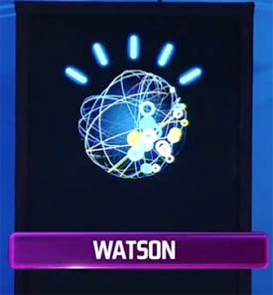
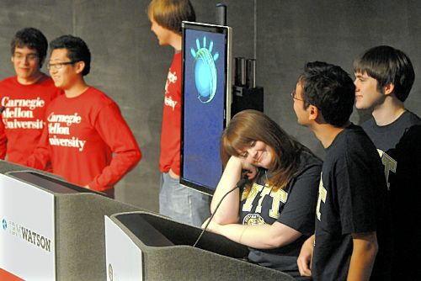

Slide 5
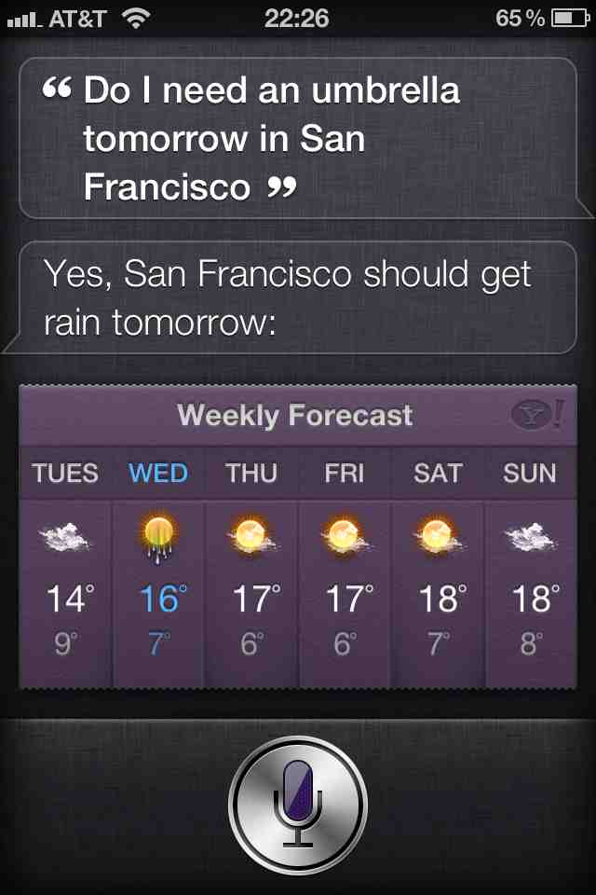
Apple’s Siri

Slide 6
Multiple Document Question Answering
A multiple document Q/A task involves questions posed against a collection of documents.
The answer may appear in the collection multiple times, or may not appear at all! For this task, it doesn’t matter where the answer is found.
Applications include WWW search engines, and searching text repositories such as news archives, medical literature, or scientific articles.

Slide 7
TREC-9 Q/A Task
Number of Documents: 979,000
Megabytes of Text: 3033
Document Sources: AP, WSJ, Financial Times, San Jose Mercury News,
LA Times, RBIS
Number of Questions: 682
Question Sources: Encarta log, Excite log
Sample questions:
How much folic acid should an expectant mother get daily?
Who invented the paper clip?
What university was Woodrow Wilson president of?
Where is Rider College located?
Name a film in which Jude law acted.
Where do lobsters like to live?

Slide 8
TREC and ACQUAINT
TREC-10: new questions from MSNSearch logs and AskJeeves, some of which have no answers, or require fusion across documents
List questions: Name 32 countires Pope John Paul II has visited.
“Dialogue” processing: Which museum in Florence was damaged by a major bomb explision in 1993? On what day did this happen?
ACQUAINT : Advanced Question and Answering for INTelligence (e.g., beyond factoids, the Multiple Perspective Q-A work at Pitt)
Current tracks at http://trec.nist.gov/tracks.html

Slide 9
Single Document Question Answering
A single document Q/A task involves questions associated with one particular document.
In most cases, the assumption is that the answer appears somewhere in the document and probably once.
Applications involve searching an individual resource, such as a book, encyclopedia, or manual.
Reading comprehension tests are also a form of single document question answering.

Slide 10
Reading Comprehension Tests
Mars Polar Lander- Where Are You?
(January 18, 2000) After more than a month of searching for a single sign from NASA’s Mars Polar Lander, mission controllers have lost hope of finding it. The Mars Polar Lander was on a mission to Mars to study its atmosphere and search for water, something that could help scientists determine whether life even existed on Mars. Polar Lander was to have touched down on December 3 for a 90-day mission. It was to land near Mars’ south pole. The lander was last heard from minutes before beginning its descent. The last effort to communicate with the three-legged lander ended with frustration at 8 a.m. Monday. “We didn’t see anything,” said Richard Cook, the spacecraft’s project manager at NASA’s Jest Propulsion laboratory. The failed mission to the Red Planet cost the American government more the $200 million dollars. Now, space agency scientists and engineers will try to find out what could have gone wrong. They do not want to make the same mistakes in the next mission.
  When did the mission controllers lost Hope of communication with the Lander? (Answer: 8AM, Monday Jan. 17)
  Who is the Polar Lander’s project manager? (Answer: Richard Cook)
  Where on Mars was the spacecraft supposed to touch down? (Answer: near Mars’ south pole)
  What was the mission of the Mars Polar Lander? (Answer: to study Mars’ atmosphere and search for water)

Slide 11
Question Types
  Simple (factoid) questions (most commercial systems)
    Who wrote the Declaration of Independence?
    What is the average age of the onset of autism?
    Where is Apple Computer based?
  Complex (narrative) questions
    What do scholars think about Jefferson’s position on dealing with pirates?
    What is a Hajj?
    In children with an acute febrile illness, what is the efficacy of single medication therapy with acetaminophen or ibuprofen in reducing fever?
  Complex (opinion) questions
    Was the Gore/Bush election fair?

Slide 12
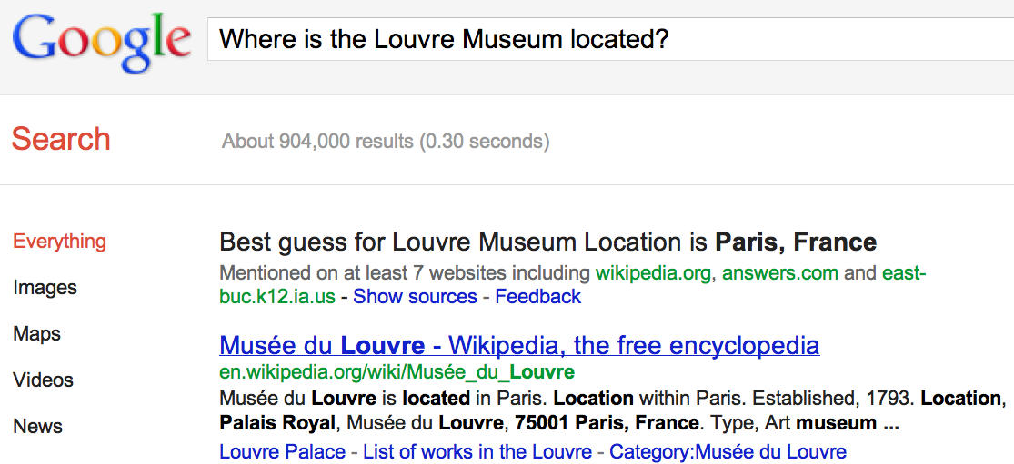
IR-based Question Answering
a

Slide 13
IR-Based (Corpus-based) Approaches
(As opposed to knowledge-based ones)
We assume an Information Retrieval (IR) system with an index into documents that plausibly contain the answer(s) to likely questions.
And that the IR system can find plausibly relevant documents in that collection given the words in a user’s question.

Slide 14
Knowledge-based approaches (Siri)
Build a semantic representation of the query
  Times, dates, locations, entities, numeric quantities
Map from this semantics to query structured data or resources
  Geospatial databases
  Ontologies (Wikipedia infoboxes, dbPedia, WordNet, Yago)
  Restaurant review sources and reservation services
  Scientific databases

Slide 15
Corpus-Based Approaches
Factoid questions
  From a smallish collection of relevant documents
  Extract the answer (or a snippet that contains the answer)
Complex questions
  From a smallish collection of relevant documents
  Summarize those documents to address the question
    Query-focused summarization

Slide 16
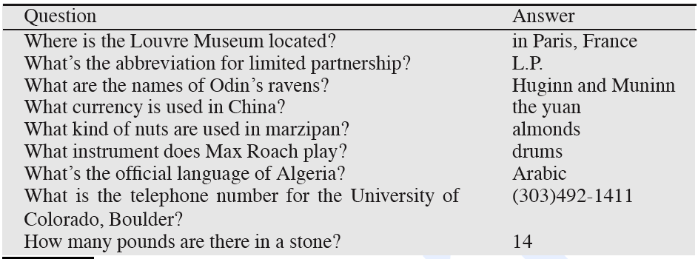
Factoid questions

Slide 17
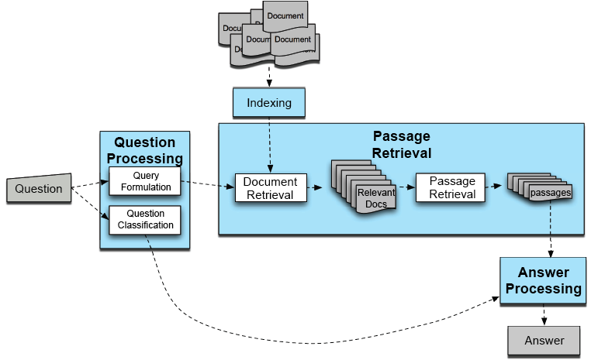
Factoid Q/A

Slide 18
Full-Blown System
QUESTION PROCESSING
  Parse and analyze the question / Determine the type of the answer
  Formulate queries suitable for use with an IR system (search engine)
PASSAGE RETRIEVAL
  Retrieve ranked results
  Break into suitable units
ANSWER PROCESSING
  Perform NLP on those
  Rank snippets based on NLP processing

Slide 19
Question Processing
Two tasks
  Answer Type Detection
    what kind of entity (person, place) is the answer?
  Query Formulation
    what is the query to the IR system
We extract both of these from the question
  keywords for query to the IR system
  an answer type

Slide 20
Factoid Q/A

Slide 21
Answer Type Detection
Who founded Virgin Airlines?
  PERSON.
What Canadian city has the largest population?
  CITY.

Slide 22
Answer Types Can Be Complicated
Who questions can have organizations or countries as answers
  Who sells the most hybrid cars?
  Who exports the most wheat?

Slide 23
Answer Types
Factoid questions…
  Who, where, when, how many…
    Who questions are going to be answered by…
    Where questions…
  Simplest: use Named Entities

Slide 24
Sample Text
Consider this sentence:
President George Bush announced a new bill that would send $1.2 million dollars to Miami Florida for a new hurricane tracking system.
After applying a Named Entity Tagger, the text might look like this:
<Person=“President George Bush”> announced a new bill that would send <MONEY=$1.2 million dollars”> to <LOCATION=“Miami Florida:”> for a new hurricane tracking system.

Slide 25
Rules for Name Entity Tagging
Many Named Entity Taggers use simple rules that are developed by hand. Most rules use the following types of clues:
Keywords: Ex. “Mr.”, “Corp.”, “city”
Common Lists: Ex. Cities, countries, months of the year, common first names, common last names
Special Symbols: Ex. Dollar signs, percent signs
Structured Phrases: Ex. Dates often appear as “MONTH, DAY #, YEAR”
Syntactic Patterns: (more rarely) Ex. “LOCATIONS_NP, LOCATION_NP” is usually a single location (e.g. Boston, Massachusetts).

Slide 26
Answer Type Taxonomy
(from Li & Roth)
Two-layered taxonomy
6 coarse classes
  ABBEVIATION, ENTITY, DESCRIPTION, HUMAN, LOCATION, NUMERIC_VALUE
50 fine classes
  HUMAN: group, individual, title, description
  ENTITY: animal, body, color, currency…
  LOCATION: city, country, mountain…

Slide 27
Answer Type Taxonomy (2/2)
distance
size
speed
…
money
weight
date
other
NUMERIC
…
abbreviation
country
LOCATION
ABBREVIATION
expression
city
DESCRIPTION
definition
group
…
HUMAN
individual
manner
…
ENTITY
description
reason
animal
…
vehicle
body
color

Slide 28
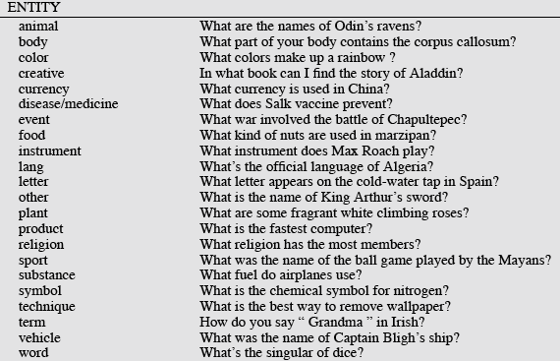
Answer Types

Slide 29
More Answer Types

Slide 30
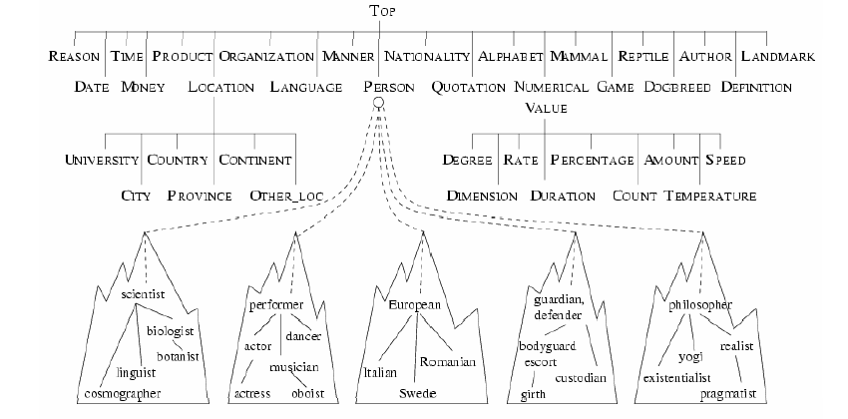
Another Taxonomy of Answer Types
Contains ~9000 concepts reflecting expected answer types
Merges NEs with the WordNet hierarchy

Slide 31
Answer Type Detection
Hand-written rules
Machine Learning
Hybrids:
Regular expression-based rules can get some cases:
  Who {is|was|are|were} PERSON
  PERSON (YEAR – YEAR)

Slide 32
Answer Type Detection
Regular expression-based rules can get some cases:
  Who {is|was|are|were} PERSON
  PERSON (YEAR – YEAR)
Make use of answer-type word:

Slide 33
Answer Types
Still, regular expressions can get some cases:
  Who {is|was|are|were} PERSON
  PERSON (YEAR – YEAR)
Other rules use the question headword:
  = headword of first noun phrase after wh-word:
  Which city in China has the largest number of foreign financial companies?
  What is the state flower of California?

Slide 34
Answer Type Detection
Most often, we treat the problem as machine learning classification
  Define a taxonomy of question types
  Annotate training data for each question type
  Train classifiers for each question class using a rich set of features.
    these features can include those hand-written rules!

Slide 35
Factoid Q/A

Slide 36
Query Terms Extraction
Grab terms from the query that will help us find answer passages
Question (from TREC QA track) | keywords
Q002: What was the monetary value of the Nobel Peace Prize in 1989? | monetary, value, Nobel, Peace, Prize, 1989
Q003: What does the Peugeot company manufacture? | Peugeot, company, manufacture
Q004: How much did Mercury spend on advertising in 1993? | Mercury, spend, advertising, 1993
Q005: What is the name of the managing director of Apricot Computer? | name, managing, director, Apricot, Computer

Slide 37
Document/Passage Retrieval
For some applications, the text collection that must be searched is very large. For example, the TREC Q/A collection is about 3 GB!
Applying NLP techniques to large text collections is too expensive to do in real-time. So, information retrieval (IR) engines identify the most relevant texts, using the question words as key words.
Document Retrieval Systems return the N documents that are most relevant to the question. Passage retrieval systems return the N passages that are most relevant to the question.
Only the most relevant documents/passages are given to the remaining modules of the Q/A system. If the IR engine doesn’t retrieve text(s) containing the answer, the Q/A system is out of luck!

Slide 38
Factoid Q/A

Slide 39
Passage Processing
Output of IR:
  Ranked Documents, according to similarity with keywords
Problems:
  Documents aren’t best unit for QA
  Ranking for IR may not be appropriate for QA
So passage retrieval:
  extracts and reranks shorter units from the returned set of documents

Slide 40
Passage Extraction Loop
Passage Extraction Component
  Extracts passages that contain all selected keywords
Passage quality and keyword adjustment
  If the number of passages is lower than a threshold ⇒ query is too strict ⇒ drop a keyword
  If the number of passages is higher than a threshold ⇒ query is too relaxed ⇒ add a keyword

Slide 41
Passage Processing
Step 1: Segmentation
  something like paragraphs
Step 2: Passage ranking
  Use answer type to help rerank passages

Slide 42
Passage Ranking
Number of Named Entities of the right type
Number of query words
Longest sequence of question words
Rank of the document from which the passage was extracted
N-Gram overlap

Slide 43
Named Entities
If we are looking for questions whose Answer Type is CITY
  We have to have a “CITY” named-entity detector
So if we have a rich set of answer types
  We also have to build answer-detectors for each of those types!

Slide 44
Factoid Q/A

Slide 45
Answer Identification
At this point, we’ve assigned a type to the question and we’ve tagged the
text with Named Entities. So we can now narrow down the candidate
pool to entities of the right type.
Problem: There are often many objects of the right type, even in a single
text.
The Answer Identification module is responsible for finding the best answer to the question.
For questions that have Named Entity types, this module must figure out which item of the right type is correct.
For questions that do not have Named Entity types, this module is essentially starting from scratch.

Slide 46
Answer Extraction
Pattern-extraction methods:
  Run the answer-type tagger on the passages:
  Return the string that is the right type:
Who is the prime minister of India” (PERSON)
  Manmohan Singh, Prime Minister of India, had told left leaders that the deal would not be renegotiated.
“How tall is Mt. Everest? (LENGTH)
  The official height of Mount Everest is 29035 feet

Slide 47
Answer Extraction
For answers that are not a particular named entity type:
  Use regular expression patterns
  These can be written by hand or learned automatically

Slide 48
Answer Extraction
Sometimes pattern-extraction methods are insufficient
  We can’t write rules
  There is more than one potential answer in the passage

Slide 49
Ranking Candidate Answers
Q066: Name the first private citizen to fly in space.
Answer type: Person
Text passage:
  “Among them was Christa McAuliffe, the first private citizen to fly in space. Karen Allen, best known for her starring role in “Raiders of the Lost Ark”, plays McAuliffe. Brian Kerwin is featured as shuttle pilot Mike Smith...”

Slide 50
Ranking Candidate Answers
Q066: Name the first private citizen to fly in space.
Answer type: Person
Text passage:
  “Among them was Christa McAuliffe, the first private citizen to fly in space. Karen Allen, best known for her starring role in “Raiders of the Lost Ark”, plays McAuliffe. Brian Kerwin is featured as shuttle pilot Mike Smith...”
Best candidate answer: Christa McAuliffe

Slide 51
Word Overlap
One common method of Answer Identification is to measure the amount of Word Overlap between the question and an answer candidate.
Basic Word Overlap: Each answer candidate is scored by counting how many question words are present in or near the candidate.
Stop Words: sometimes closed class words (often called Stop Words in IR) are not included in the word overlap measure.
Stemming: sometimes morphological analysis is used to compare only the root forms or words (e.g. “walk” and “walked” would match).
Weights: some words may be weighted more heavily than others (e.g., verbs might be given more weight than nouns).

Slide 52
Machine Learning
In other cases we use machine learning to combine many rich features about which phrase is the answer

Slide 53
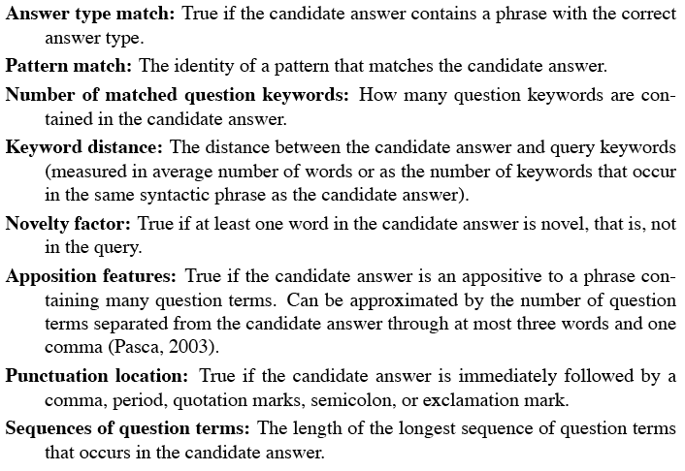
Features for Answer Ranking

Slide 54
Evaluation
NIST has been running Q/A evaluations as part of it’s TREC program. Both generic Q/A and application specific (bio- etc.).
Typical metric is Mean Reciprocal Rank.
  Assumes that systems return a ranked list of N possible answers.
  Your score is based on 1/Rank of the first right answer.

Slide 55
Mean Reciprocal Rank
What is the reciprocal rank for this question?
Q: What is the capital of Utah? A1: Ogden A2: Salt Lake City A3: Provo A4: St. George A5: Salt Lake

Slide 56
Mean Reciprocal Rank
What is the reciprocal rank for this question?
Q: What is the capital of Utah? A1: Ogden A2: Salt Lake City A3: Provo A4: St. George A5: Salt Lake
The score for the question Q would be ½.

Slide 57
Is the Web Different?
TREC and commercial applications:
  retrieval performed against small closed collection of texts.
The diversity/creativity in how people express themselves necessitates all that work to bring the question and the answer texts together.
But…

Slide 58
The Web is Different
On the Web popular factoids are likely to be expressed in many different ways.
At least a few of which will likely match the way the question was asked.
So why not just grep the Web using all or pieces of the original question.
Example: www.ask.com

Slide 59
Summary
factoid question answering
  answer type detection
  query formulation
  passage retrieval
  passage ranking
  answer extraction
web-based factoid question answering
And now to the present/future…

Slide 60
IBM Watson
A DeepQA computer system that can compete in real-time at the human champion level on the American TV quiz show Jeopardy
Grand Challenge Problem for AI/NLP

Slide 61
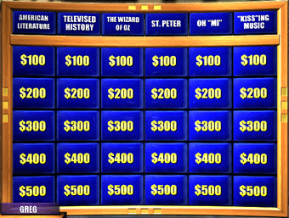
Jeopardy Requires a Broad Knowledge Base
Factual knowledge
  History, science, politics
Commonsense knowledge
  E.g., naïve physics and gender
Vagueness, obfuscation, uncertainty
  E.g., “KISS”ing music

Slide 62
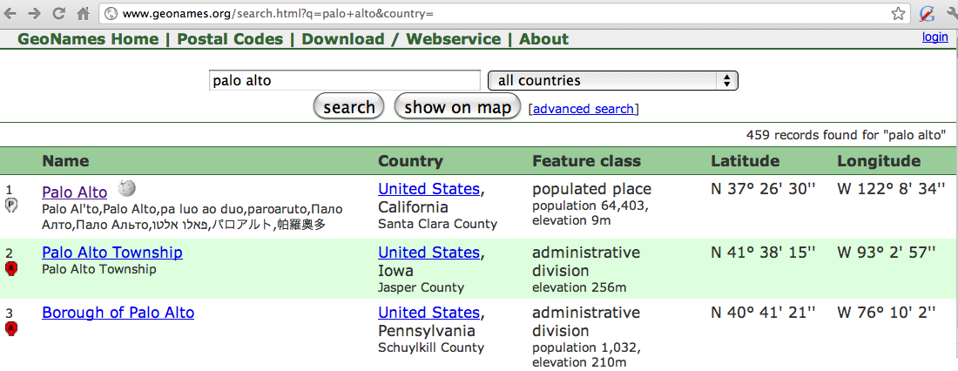
Geospatial knowledge
Beijing is a good answer for ”Asian city”
California is ”southwest of Montana”
geonames.org:

Slide 63
Using Knowledge in QA
IBM Watson
  ”In 1594 he took a job as a tax collector in Andalusia”
  Candidates:
    Thoreau is a bad answer (born in 1817)
    Cervantes is possible (was alive in 1594)

Slide 64

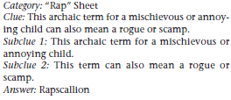

The Questions: Solution Methods
Factoid questions
Decomposition
Puzzles

Slide 65
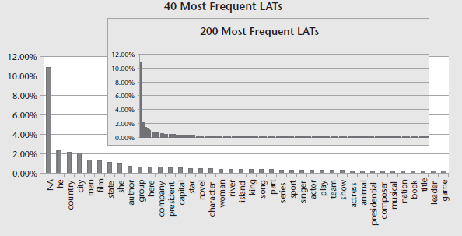
The Domain
Example: castling is a maneuver in chess

Slide 66
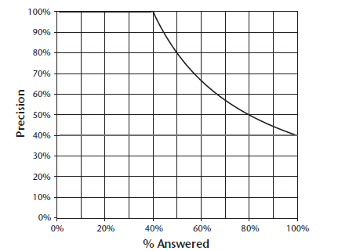
Precision vs. Percentage Attempted
Upper line: perfect confidence estimation
Notes:
There is a thick horizontal line at 40% corresponding to no confidence estimation.

Slide 67
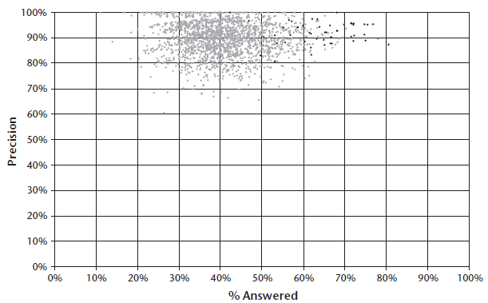
Champion Human Performance
Dark dots correspond to Ken Jenning’s games

Slide 68
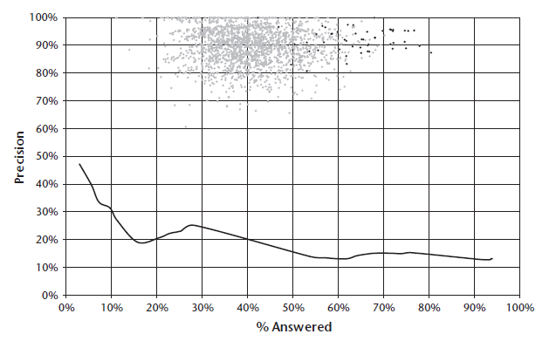
Baseline Performance
(IBM) PIQUANT system

Slide 69
The DeepQA Approach
Adapting PIQUANT did not work out
“The system we have built and are continuing to develop, called DeepQA, is a massively parallel probabilistic evidence-based architecture. For the Jeopardy Challenge, we use more than 100 different techniques for analyzing natural language, identifying sources, finding and generating hypotheses, finding and scoring evidence, and merging and ranking hypotheses. What is far more important than any particular technique we use is how we combine them in DeepQA such that overlapping approaches can bring their strengths to bear and contribute to improvements in accuracy, confidence, or speed.”

Slide 70
Overarching Principles
Massive parallelism
Many experts
  Facilitate the integration, application, and contextual evaluation of a wide range of loosely coupled probabilistic question and content analytics.
Pervasive confidence estimation
Integrate shallow and deep knowledge

Slide 71
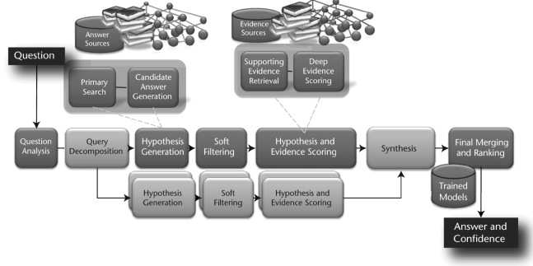
High-Level Architecture

Slide 72
Question Analysis
“The DeepQA approach encourages a mixture of experts at this stage, and in the Watson system we produce shallow parses, deep parses (McCord 1990), logical forms, semantic role labels, coreference, relations, named entities, and so on, as well as specific kinds of analysis for question answering.”

Slide 73
Hypothesis Generation
“The operative goal for primary search eventually stabilized at about 85 percent binary recall for the top 250 candidates; that is, the system generates the correct answer as a candidate answer for 85 percent of the questions somewhere within the top 250 ranked candidates.”
“If the correct answer(s) are not generated at this stage as a candidate, the system has no hope of answering the question. This step therefore significantly favors recall over precision, with the expectation that the rest of the processing pipeline will tease out the correct answer, even if the set of candidates is quite large.”

Slide 74
Hypothesis and Evidence Scoring
Q: He was presidentially pardoned on September 8, 1974.
A. Nixon
Evidence: “Ford pardoned Nixon on Sept. 8, 1974”
Notes:
Example is in the _AI Magazine_ paper.

Slide 75
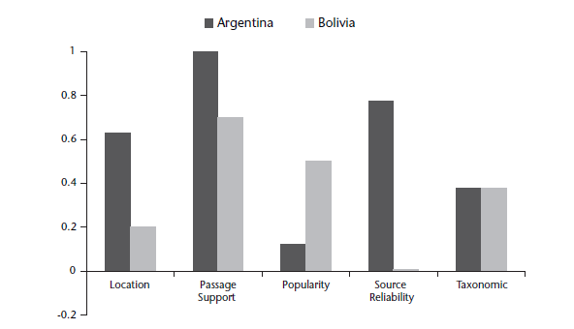
Search Engine Failure (want Argentina)

Slide 76
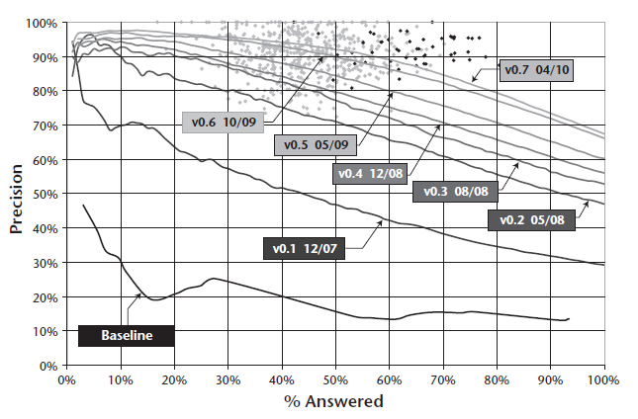
Progress

Slide 77
Results
Watson wins on Jeapordy!
Technical publications just coming out this year.

