Slide 1
Computational Discourse
Speech and Language Processing
Chapter 21

Slide 2
Terminology
Discourse: anything longer than a single utterance or sentence
  Monologue
  Dialogue:
    May be multi-party
    May be human-machine

Slide 3
Is this text coherent?
“Consider, for example, the difference between passages (18.71) and (18.72). Almost certainly not. The reason is that these utterances, when juxtaposed, will not exhibit coherence. Do you have a discourse? Assume that you have collected an arbitrary set of well-formed and independently interpretable utterances, for instance, by randomly selecting one sentence from each of the previous chapters of this book.”

Slide 4
Or, this?
“Assume that you have collected an arbitrary set of well-formed and independently interpretable utterances, for instance, by randomly selecting one sentence from each of the previous chapters of this book. Do you have a discourse? Almost certainly not. The reason is that these utterances, when juxtaposed, will not exhibit coherence. Consider, for example, the difference between passages (18.71) and (18.72).”

Slide 5
What makes a text coherent?
Discourse structure
  In a coherent text the parts of the discourse exhibit a sensible ordering and hierarchical relationship
Rhetorical structure
  The elements in a coherent text are related via meaningful relations (“coherence relations”)
Entity structure (“Focus”)
  A coherent text is about some entity or entities, and the entity/entities is/are referred to in a structured way throughout the text.

Slide 6
Outline
Discourse Structure
  TextTiling (unsupervised)
  Supervised approaches
Coherence
  Hobbs coherence relations
  Rhetorical Structure Theory
  Entity Structure
Pronouns and Reference Resolution

Slide 7
Conventions of Discourse Structure
Differ for different genres
  Academic articles:
    Abstract, Introduction, Methodology, Results, Conclusion
  Newspaper stories:
    Inverted Pyramid: Lead then expansion, least important last
  Textbook chapters
  News broadcasts
  Arguments
  NB: We can take advantage of this to ‘parse’ discourse structures

Slide 8
Discourse Segmentation
Simpler task: Separating document into linear sequence of subtopics
Applications
  Information retrieval
    Automatically segmenting a TV news broadcast or a long news story into sequence of stories
    Audio browsing (e.g. of voicemail)
  Text summarization
  Information extraction
    Extract information from a coherent segment or topic
  Question Answering

Slide 9
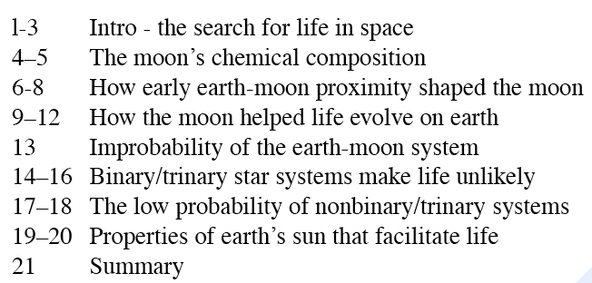
Unsupervised Segmentation
Hearst (1997): 21-paragraph science news article on “Stargazers”
Goal: produce the following subtopic segments:

Slide 10
Intuition: Cohesion
Halliday and Hasan (1976): “The use of certain linguistic devices to link or tie together textual units”
Lexical cohesion:
  Indicated by relations between words in the two units (identical word, synonym, hypernym)
    Before winter I built a chimney, and shingled the sides of my house.
    I thus have a tight shingled and plastered house.
    Peel, core and slice the pears and the apples. Add the fruit to the skillet.

Slide 11
Intuition: Cohesion
Non-lexical: anaphora
  The Woodhouses were first in consequence there. All looked up to them.
Cohesion chain:
  Peel, core and slice the pears and the apples. Add the fruit to the skillet. When they are soft…
Note: cohesion is not coherence

Slide 12
Cohesion-Based Segmentation
Sentences or paragraphs in a subtopic are cohesive with each other
But not with paragraphs in a neighboring subtopic
So, if we measured the cohesion between every neighboring sentences
  We might expect a ‘dip’ in cohesion at subtopic boundaries.

Slide 13
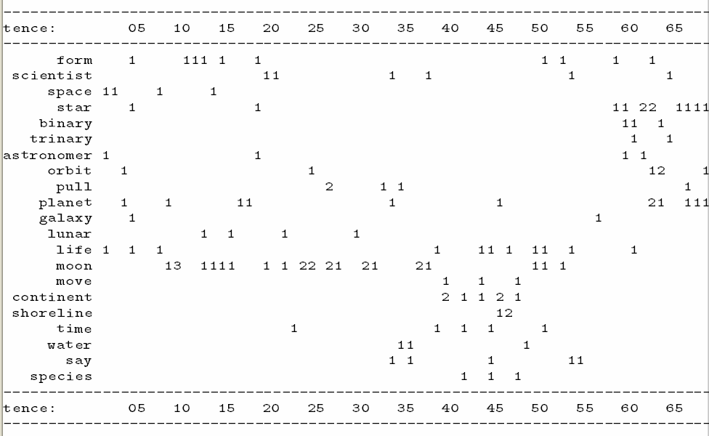

Slide 14
TextTiling (Hearst ’97)
Tokenization
  Each space-delimited word
  Converted to lower case
  Throw out stop list words
  Stem the rest
  Group into pseudo-sentences (windows) of length w=20
Lexical Score Determination: cohesion score
  Three part score including
    Average similarity (cosine measure) between gaps
    Introduction of new terms
    Lexical chains
Boundary Identification

Slide 15
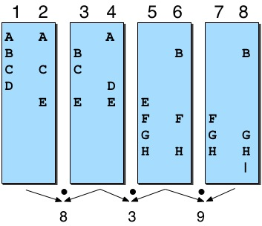
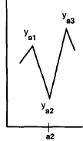
TextTiling Method

Slide 16
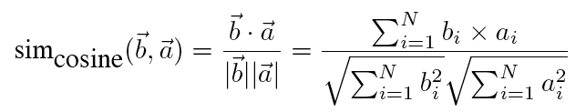
Cosine Similarity
Notes:
Normalized (by length) dot product of 2 lexical feature vectors

Slide 17
Vector Space Model
(recall distributional semantics, following IR)
In the vector space model for TextTiling, both segments are represented as vectors
Numbers are derived from the words that occur in the collection
  Could count bits to get similarity, frequency, weights etc.
But that favors long documents over shorter ones
  Cosine to normalize dot product by vector lengths

Slide 18
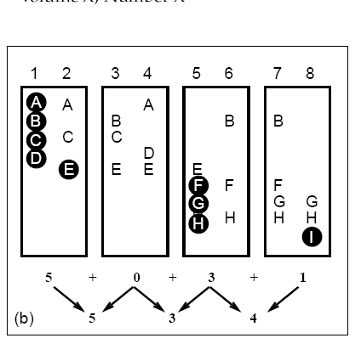
Lexical Score Part 2: Introduction of New Terms
Notes:
Cohesion score is negative of number of new terms that occur in left and right blocks.

Slide 19
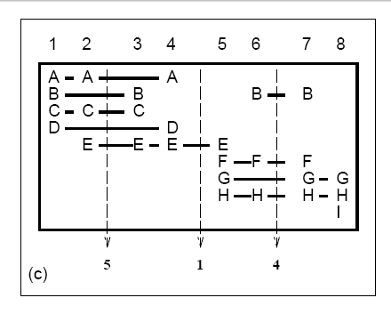
Lexical Score Part 3: Lexical Chains
Notes:
Cohesion: negative of number of lexical chains that span gap

Slide 20
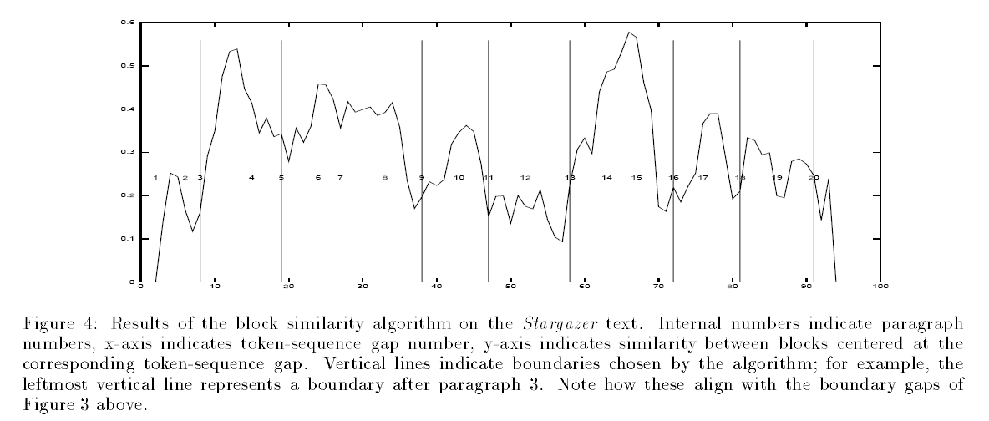

Slide 21
Supervised Discourse segmentation
Lexical features as before
Discourse markers or cue words
  Broadcast news
    Good evening, I’m <PERSON>
    …coming up….
  Science articles
    “First,….”
    “The next topic….”
  Subtasks
    disambiguating predefined connectives
    learning domain specific markers

Slide 22
Supervised discourse segmentation
Supervised machine learning
  Label segment boundaries in training and test set
    Easy to get automatically for very clear boundaries (paragraphs, news stories)
  Extract features in training
  Learn a (sequence) classifier
  In testing, apply features to predict boundaries

Slide 23
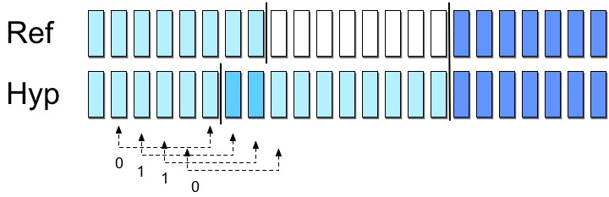
Supervised discourse segmentation
Evaluation: WindowDiff (Pevzner and Hearst 2000)
assign partial credit
Notes:
Mean number of boundary differences within windows (averaged over numbers of scans)

Slide 24
Some Local Work
Cue phrase disambiguation (Hirschberg & Litman, 1993; Litman, 1996)
Supervised linear discourse segmentation (Passonneau & Litman, 1997)
Representation and application of hierarchical discourse segmentation
  Mihai Rotaru, Computer Science, PhD 2008: Applications of Discourse Structure for Spoken Dialogue Systems (Litman)
Measuring and applying lexical cohesion (Ward & Litman, 2008)
Penn Discourse Treebank in argumentative essays and discussion forums
  (Chandrasekaran et al., 2017; Zhang et al., 2016)
Swapna Somasundaran, Computer Science, PhD 2010: Discourse-level relations for Opinion Analysis (Wiebe)

Slide 25
Part II of: What makes a text coherent?
Appropriate sequencing of subparts of the discourse -- discourse/topic structure
Appropriate use of coherence relations between subparts of the discourse -- rhetorical structure
Appropriate use of referring expressions
Notes:
25

Slide 26
Text Coherence, again
The reason is that these utterances, when juxtaposed, will not exhibit coherence. Almost certainly not. Do you have a discourse? Assume that you have collected an arbitrary set of well-formed and independently interpretable utterances, for instance, by randomly selecting one sentence from each of the previous chapters of this book.

Slide 27
Or….
Assume that you have collected an arbitrary set of well-formed and independently interpretable utterances, for instance, by randomly selecting one sentence from each of the previous chapters of this book. Do you have a discourse? Almost certainly not. The reason is that these utterances, when juxtaposed, will not exhibit coherence.

Slide 28
Coherence
John hid Bill’s car keys. He was drunk.
??John hid Bill’s car keys. He likes spinach.
Again, not the same as cohesion.

Slide 29
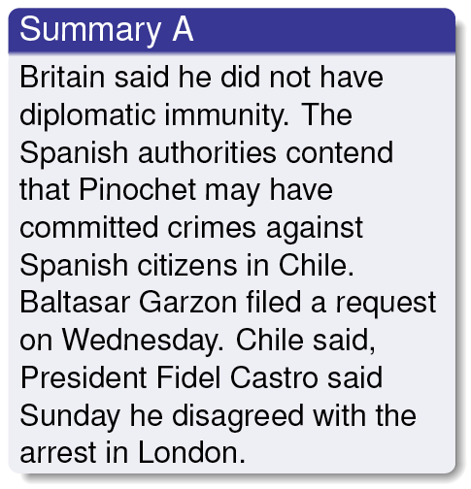
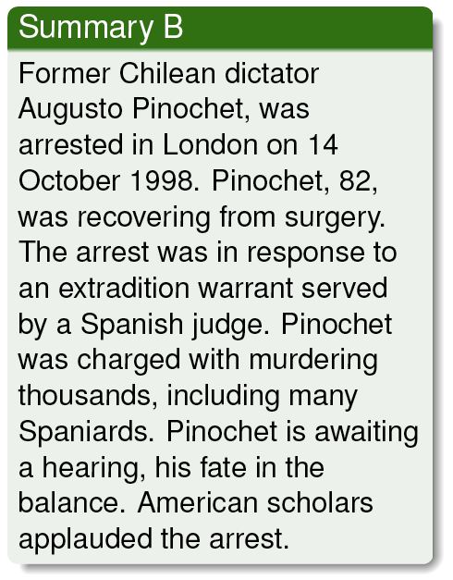
Why Coherence? Summarization
Slide from Mirella Lapata and Regina Barzilay

Slide 30
Applications of Coherence Metrics
Text Generation:
  concept-to-text generation
  summarization, text simplification
  question answering, machine translation
  essay grading
Text Understanding
  Improving coreference resolution
Potential uses
  automatic evaluation tool for text quality
  during system development (avoids repeated human evaluations)
Software
  Brown Coherence Toolkit
  Coh-Metrix: cohmetrix.memphis.edu/CohMetrixDemo/demo.htm

Slide 31
Hobbs ’79: Coherence Relations
Result
  Infer that the state or event asserted by S0 causes or could cause the state or event asserted by S1.
  The Tin Woodman was caught in the rain. His joints rusted.

Slide 32
Explanation
  Infer that the state or event asserted by S1 causes or could cause the state or event asserted by S0.
  John hid Bill’s car keys. He was drunk.

Slide 33
Parallel
  Infer p(a1, a2..) from the assertion of S0 and p(b1,b2…) from the assertion of S1, where ai and bi are similar, for all i.
  The Scarecrow wanted some brains. The Tin Woodman wanted a heart.

Slide 34
Elaboration
  Infer the same proposition P from the assertions of S0 and S1.
  Dorothy was from Kansas. She lived in the midst of the great Kansas prairies.

Slide 35
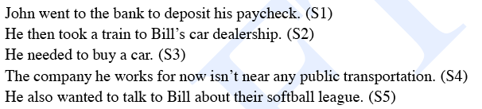
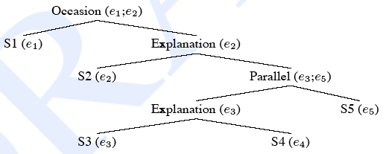
Coherence Relations
Notes:
35

Slide 36
Rhetorical Structure Theory
Another theory of discourse structure, based on identifying relations between segments of the text
  Nucleus/satellite notion encodes asymmetry
    Nucleus is thing that if you deleted it, text wouldn’t make sense.
  Some rhetorical relations:
    Elaboration: (set/member, class/instance, whole/part…)
    Contrast: multinuclear
    Condition: Sat presents precondition for N
    Purpose: Sat presents goal of the activity in N

Slide 37
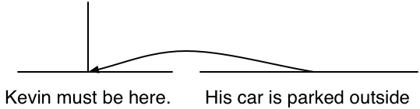
One Rhetorical Relation
Nucleus
Satellite
A sample definition
  Relation: Evidence
  Constraints on N: H might not believe N as much as S think s/he should
  Constraints on Sat: H already believes or will believe Sat
  Effect: H’s belief in N is increased
An example:
  Kevin must be here.
  His car is parked outside.

Slide 38
Some Problems with RST
How many Rhetorical Relations are there?
How can we use RST in dialogue as well as monologue?
Difficult to get annotators to agree on labeling the same texts
Trees versus directed graphs?
Notes:
38

Slide 39
Automatic Labeling / Discourse Parsing
Supervised machine learning
  Get a group of annotators to assign a set of relations to a text, and/or tree structure
  Extract a set of surface features from the text that might signal the presence of the coherence relations
  Train a supervised ML system based on the training set
  Some publicly available resources (RST treebank, Penn Discourse Treebank) exist
Semi and unsupervised approaches
Inferential / Abduction (my dissertation!)

Slide 40
Penn Discourse Treebank
The city’s Campaign Finance Board has refused to pay Mr. Dinkins $95,142 in matching funds because his campaign records are incomplete.
  Causal relation
So much of the stuff poured into Motorola’s offices that its mail rooms there simply stopped delivering it. Implicit = so. Now, thousands of mailers, catalogs and sales pitches go straight into the trash.
  - Consequence relation

Slide 41
Shallow Features
Explicit markers / cue phrases: because, however, therefore, then, etc.
Tendency of certain syntactic structures to signal certain relations:
  Infinitives are often used to signal purpose relations: Use rm to delete files.
Ordering
Tense/aspect
Intonation

Slide 42
Part III of: What makes a text coherent?
Entity-based Coherence
Appropriate sequencing of subparts of the discourse -- discourse/topic structure
Appropriate use of coherence relations between subparts of the discourse -- rhetorical structure
Appropriate use of referring expressions
Notes:
42

Slide 43
Pronouns and Reference Resolution
A Reference Joke
Gracie: Oh yeah ... and then Mr. and Mrs. Jones were having matrimonial trouble, and my brother was hired to watch Mrs. Jones.
George: Well, I imagine she was a very attractive woman.
Gracie: She was, and my brother watched her day and night for six months.
George: Well, what happened?
Gracie: She finally got a divorce.
George: Mrs. Jones?
Gracie: No, my brother's wife.

Slide 44
Reference Resolution: Vocabulary
Process of associating Bloomberg/he/his with particular person and big budget problem/it with a concept
  Guiliani left Bloomberg to be mayor of a city with a big budget problem. It’s unclear how he’ll be able to handle it during his term.
Referring exprs.: Guilani, Bloomberg, a big budget problem, he, it, his
Presentational it: non-referential
Referents: the person named Guiliani, the concept of a big budget problem

Slide 45
Co-referring referring expressions: Guiliani, he, his
Antecedent: Guiliani
Anaphors: he, his

Slide 46
Discourse Models
Needed to model reference because referring expressions (e.g. Guiliani, Bloomberg, he, it, budget problem) encode information about beliefs about the referent
When a referent is first mentioned in a discourse, a representation is evoked in the model
  Information predicated of it is stored also in the model
  On subsequent mention, it is accessed from the model

Slide 47
Types of Referring Expressions
Entities, concepts, places, propositions, events, ...
  According to John, Bob bought Sue an Integra, and Sue bought Fred a Legend.
  But that turned out to be a lie. (a speech act)
  But that was false. (proposition)
  That struck me as a funny way to describe the situation. (manner of description)
  That caused Sue to become rather poor. (event)
  That caused them both to become rather poor. (combination of multiple events)

Slide 48
Reference Phenomena:
5 Types of Referring Expressions
Indefinite NPs
  A homeless man hit up Bloomberg for a dollar.
  Some homeless guy hit up Bloomberg for a dollar.
  This homeless man hit up Bloomberg for a dollar.
Definite NPs
  The poor fellow only got a lecture.
Demonstratives
  This homeless man got a lecture but that one got carted off to jail.
Names
  Prof. Litman teaches on Tuesday.

Slide 49
Pronouns
A large tiger escaped from the Central Park zoo chasing a tiny sparrow. It was recaptured by a brave policeman.
  Referents of pronouns usually require some degree of salience in the discourse (as opposed to definite and indefinite NPs, e.g.)
  How do items become salient in discourse?

Slide 50
Salience vs. Recency
E: So you have the engine assembly finished. Now attach the rope. By the way, did you buy the gas can today?
A: Yes.
E: Did it cost much?
A: No.
E: OK, good. Have you got it attached yet?
Notes:
Here

Slide 51
Reference Phenomena: Information Status
Giveness hierarchy / accessibility scales …
But complications

Slide 52
Inferables
I almost bought an Acura Integra today, but a door had a dent and the engine seemed noisy.
Mix the flour, butter, and water. Knead the dough until smooth and shiny.

Slide 53
Discontinuous Sets
Entities evoked together but mentioned in different sentence or phrases
  John has a St. Bernard and Mary has a Yorkie. They arouse some comment when they walk them in the park.

Slide 54
Generics
I saw two Corgis and their seven puppies today. They are the funniest dogs

Slide 55
Constraints on Pronominal Reference
Number agreement
  John’s parents like opera. John hates it/John hates them.
Person agreement
  George and Edward brought bread. They shared it.

Slide 56
Gender agreement
  John has a Porsche. He/it/she is attractive.
Syntactic constraints
John bought himself a new Volvo. (himself = John)
  John bought him a new Volvo (him = not John).

Slide 57
Preferences in Pronoun Interpretation
Recency
  John bought a new boat. Bill bought a bigger one. Mary likes to sail it.
But…grammatical role raises its ugly head…
  John went to the Acura dealership with Bill. He bought an Integra.
  Bill went to the Acura dealership with John. He bought an Integra.
  ?John and Bill went to the Acura dealership. He bought an Integra.

Slide 58
And so does…repeated mention
  John needed a car to go to his new job. He decided that he wanted something sporty. Bill went to the dealership with him. He bought a Miata.
  Who bought the Miata?
  What about grammatical role preference?
Parallel constructions
  Saturday, Mary went with Sue to the farmer’s market.
  Sally went with her to the bookstore.
  Sunday, Mary went with Sue to the mall.
  Sally told her she should get over her shopping obsession.
Selectional restriction
  John left his plane in the hangar.
  He had flown it from Memphis this morning

Slide 59
Verb semantics/thematic roles
  John telephoned Bill. He’d lost the directions to his house.
  John criticized Bill. He’d lost the directions to his house.

Slide 60
Summary: What Affects Reference Resolution?
Lexical factors
  Reference type: Inferrability, discontinuous set, generics, one anaphora, pronouns,…
Discourse factors:
  Recency
  Focus/topic structure, digression
  Repeated mention
Syntactic factors:
  Agreement: gender, number, person, case
  Parallel construction
  Grammatical role
Semantic/lexical factors
  Selectional restrictions
  Verb semantics, thematic role

Slide 61
Reference Resolution Algorithms
Given these types of features, can we construct an algorithm that will apply them such that we can identify the correct referents of anaphors and other referring expressions?

Slide 62
Reference Resolution Task
Finding in a text all the referring expressions that have one and the same denotation
  Pronominal anaphora resolution
  Anaphora resolution between named entities
  Full noun phrase anaphora resolution

Slide 63
Issues
Which constraints/features can/should we make use of?
How should we order them? I.e. which override which?
What should be stored in our discourse model? I.e., what types of information do we need to keep track of?
How to evaluate?

Slide 64
Some Algorithms
Hobbs ‘78: syntax tree-based referential search
Centering: also entity-coherence
Supervised learning approaches

Slide 65
Hobbs: Syntax-Based Approach
Search for antecedent in parse tree of current sentence, then prior sentences in order of recency
  For current S, search for NP nodes to the left of a path p from the pronoun up to the first NP or S node (X) above it in L2R, breadth-first
    Propose as pronoun’s antecedent any NP you find as long as it has an NP or S node between itself and X
    If X is highest node in sentence, search prior sentences, L2R breadth-first, for candidate NPs
    O.w., continue searching current tree by going to next S or NP above X before going to prior sentences
Notes:
65

Slide 66
Centering Theory:
Grosz, Joshi and Weinstein, 1995
The way entities are introduced and discussed influences coherence
Entities in an utterance are ranked according to salience.
  Is an entity pronominalized or not?
  Is an entity in a prominent syntactic position?
Each utterance has one center (≈topic or focus).
  Coherent discourses have utterances with common centers.
Entity transitions capture degrees of coherence
  (e.g., in Centering theory CONTINUE > SHIFT).
Unlike Hobbs, has discourse model

Slide 67
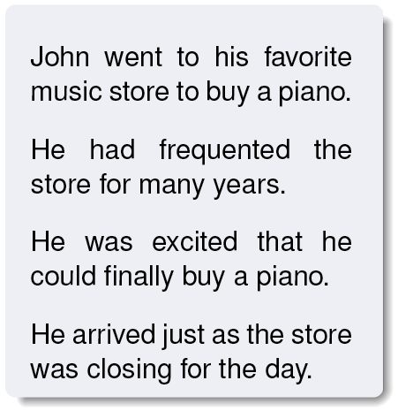
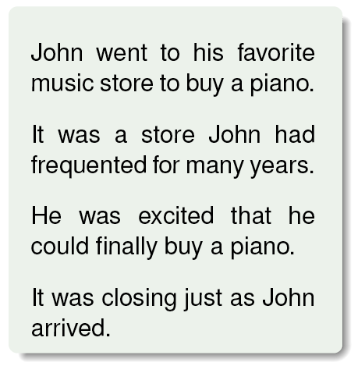
Claim: Entity coherence:
Discourses without a clear ‘central entity’ feel less coherent
Notes:
This example is a bit peculiar but is the standard one

Slide 68
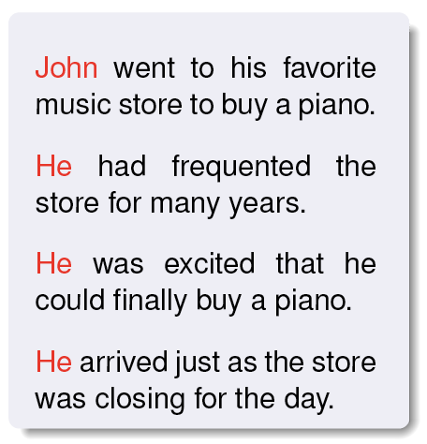
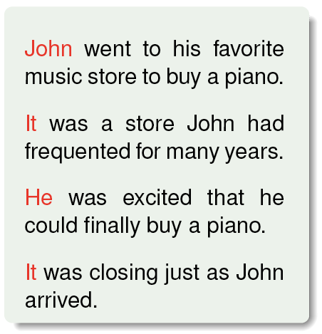
Claim: Entity coherence:
Discourses without a clear ‘central entity’ feel less coherent
Notes:
This example is a bit peculiar but is the standard one

Slide 69
Concepts and definitions, I
Every UTTERANCE U in a discourse (segment) DS updates the LOCAL FOCUS - a PARTIALLY RANKED set of discourse entities, or FORWARD-LOOKING CENTERS (CFs)
An utterance U in discourse segment DS updates the existing CF set by replacing it with the set of CFs REALIZED in U, CF(U,DS) (usually simplified to CF(U))
The most highly ranked CF realized in utterance U is CP(U)
(1) u1. Susan gave James a pet hamster.
CF(u1) = [Susan,James,pet hamster]. CP(u1) = Susan
(2) u2. She gave Peter a nice scarf.
CF(u2) = [Susan,Peter,nice scarf]. CP(u2) = Susan

Slide 70
Concepts and Definitions,II:
The CB
The BACKWARD-LOOKING CENTER of utterance U_{i},
CB(U_{i}),
is the highest-ranked element of CF(U_{I-1}) that is realized in U_{i}
Notes:
The hypotheses of entity coherence and uniqueness are formalized in terms of the CB, CT’s equivalent of ‘topic’

Slide 71
The CB: Examples
(1) u1. Susan gave James a pet hamster.
CF(u1) = [Susan,James,pet hamster]. CB = undefined CP=Susan
(2) u2. She gave Peter a nice scarf.
CF(u2) = [Susan,Peter,nice scarf]. CB=Susan. CP=Susan
NB: The CB is not always the most ranked entity of the PREVIOUS utterance
(2’) u2. He loves hamsters.
CF(u2) = [James,hamsters]. CB=James. CP=James
… or the most highly ranked entity of the CURRENT one
(2’’) u2. Peter gave her a nice scarf.
CF(u2) = [Peter,Susan, nice scarf]. CB=Susan. CP=Peter

Slide 72
Claims of the theory: Local salience and pronominalization
Grosz et al (1995): the CB is also the most salient entity. Texts in which other entities (but not the CB) are pronominalized are less felicitous
(1) a. Something must be wrong with John.
b. He has been acting quite odd.
c. He called up Mike yesterday.
d. John wanted to meet him quite urgently.
(2) a. Something must be wrong with John.
b. He has been acting quite odd.
c. He called up Mike yesterday.
d. He wanted to meet him quite urgently.

Slide 73
Rule 1
RULE 1: if any CF is pronominalized, the CB is.

Slide 74
Claims of the theory:
Preserving the ranking
Discourses without a clear ‘central entity’ feel less coherent
(1) a. John went to his favorite music store to buy a piano.
b. He had frequented the store for many years.
c. He was excited that he could finally buy a piano.
d. He arrived just as the store was closing for the day.
(2) a. John went to his favorite music store to buy a piano.
b. It was a store John had frequented for many years.
c. He was excited that he could finally buy a piano.
d. It was closing just as John arrived.

Slide 75
Transitions
Grosz et al.: utterances are easier to process
  if they preserve CB of previous utterance or
  if CB(U) is also CP(U).
CONTINUE: U_{i} is a continuation if CB(U_{i}) = CB(U_{i-1}), and CB(U_{i}) = CP(U_{i})
RETAIN: U_{i} is a retain if CB(U_{i}) = CB(U_{i-1}), but CB(U_{i}) is different from CP(U_{i})
SHIFT: U_{i} is a shift if CB(U_{i}) ≠ CB(U_{i-1}

Slide 76
Utterance classification
(0) u0. Susan is a generous person.
CF(u0) = [ ] CB = CP = .
(1) u1. She gave James a pet hamster.
CF(u1) = [ ]. CB = CP=
CONTINUE:
(2)

Slide 77
Utterance classification
(0) u0. Susan is a generous person.
CF(u0) = [Susan] CB = undefined CP = Susan.
(1) u1. She gave James a pet hamster.
CF(u1) = [ ]. CB = CP=
CONTINUE:
(2)

Slide 78
Utterance classification
(0) u0. Susan is a generous person.
CF(u0) = [Susan] CB = undefined CP = Susan.
(1) u1. She gave James a pet hamster.
CF(u1) = [Susan,James,pet hamster]. CB = Susan CP=Susan
CONTINUE:
(2) u2. She gave Peter a nice scarf.
CF(u2) = [Susan,Peter,nice scarf]. CB=Susan.
CP=Susan CONTINUE

Slide 79
Utterance classification, II
(0) u0. Susan is a generous person.
CF(u0) = [Susan] CB = undefined CP = Susan.
(1) u1. She gave James a pet hamster.
CF(u1) = [Susan,James,pet hamster]. CB = Susan
CP=Susan
SHIFT:
(2’) u2. He loves hamsters.
CF(u2) = [James]. CB=James. CP=James SHIFT

Slide 80
Utterance classification, III
(0) u0. Susan is a generous person.
CF(u0) = [Susan] CB = undefined CP = Susan.
(1) u1. She gave James a pet hamster.
CF(u1) = [Susan,James,pet hamster]. CB = Susan
CP=Susan
RETAIN:
(2’’) u2. Peter gave her a nice scarf.
CF(u2) = [Peter,Susan, nice scarf]. CB=Susan.
CP=Peter RETAIN

Slide 81
Rule 2
RULE 2: (Sequences of) continuations are preferred over (sequences of) retains, which are preferred over (sequences of) shifts.

Slide 82
Summary of the claims
CONSTRAINT 1: All utterances of a segment except for the first have exactly one CB
RULE 1: if any CF is pronominalized, the CB is.
RULE 2: (Sequences of) continuations are preferred over (sequences of) retains, which are preferred over (sequences of) shifts.

Slide 83
Application – anaphora resolution
Examples in prior slides assumed pronoun resolution, but can use the rules to disambiguate pronouns!
Centering also used for coherence (entity grids, next)

Slide 84
Original centering theory
Grosz et al do not provide algorithms for computing any of the notions used in the basic definitions:
  UTTERANCE (clause? finite clause? sentence?)
  PREVIOUS UTTERANCE
  REALIZATION
  RANKING
  What counts as a ‘PRONOUN’ for the purposes of Rule 1? (Only personal pronouns? Or demonstrative pronouns as well? What about second person pronouns?)
One of the reasons for the success of the theory is that it provides plenty of scope for theorizing …

Slide 85
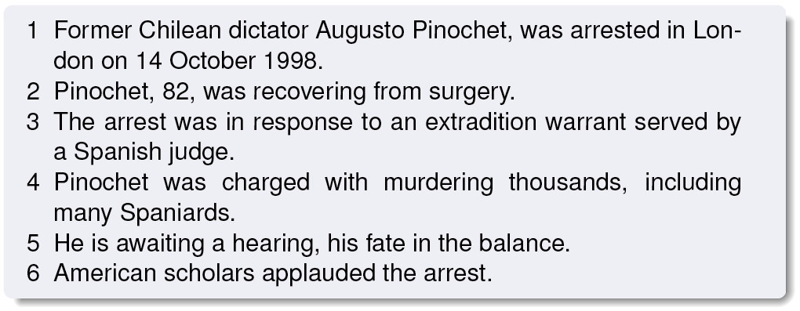
Barzilay and Lapata: The Entity Grid
(extensions/software, e.g. Brown Coherence Toolkit https://bitbucket.org/melsner/browncoherence )

Slide 86
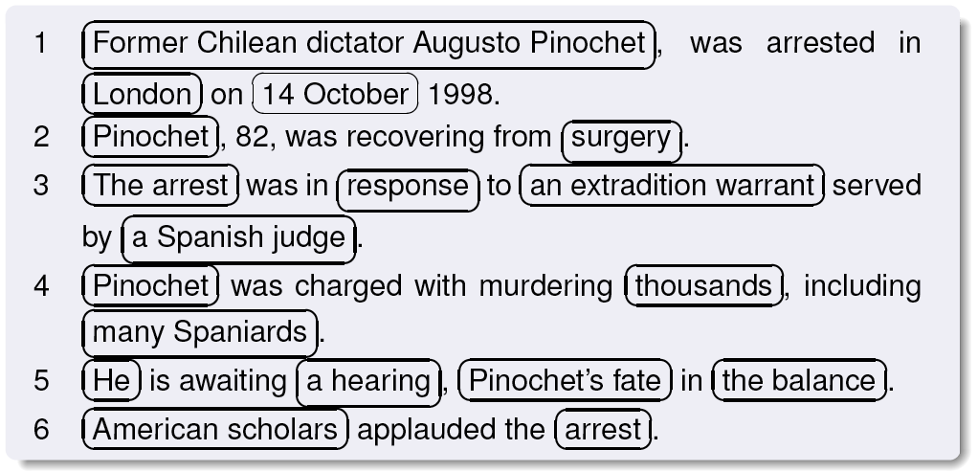
Barzilay and Lapata: The Entity Grid

Slide 87
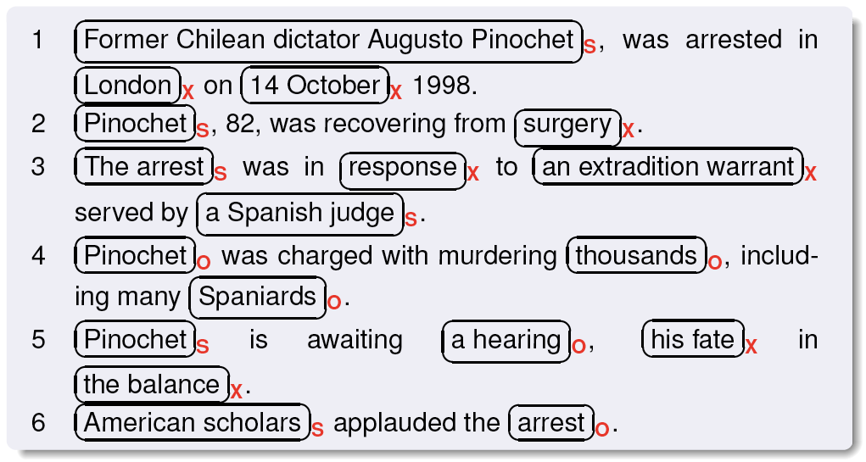
Barzilay and Lapata: The Entity Grid
Constituent parse, then identification of subjects (s), objects (o), and other grammatical roles (x)

Slide 88
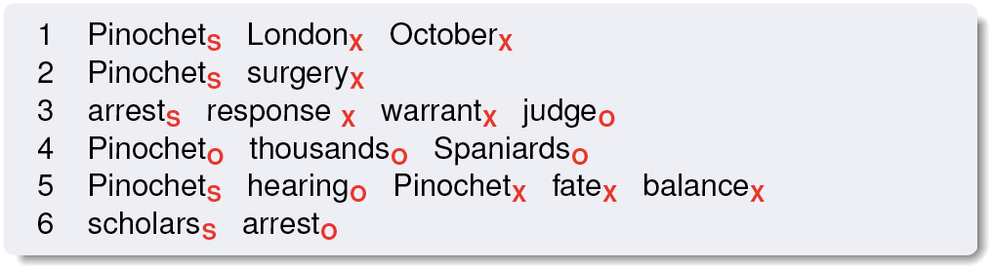
Barzilay and Lapata: The Entity Grid
NPs represented by their head N

Slide 89
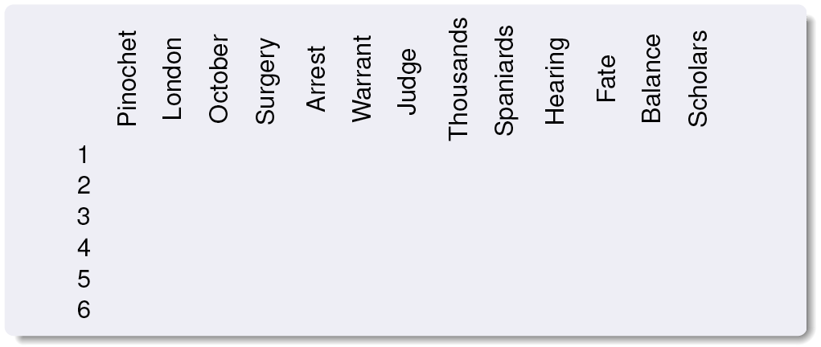
Barzilay and Lapata: The Entity Grid

Slide 90
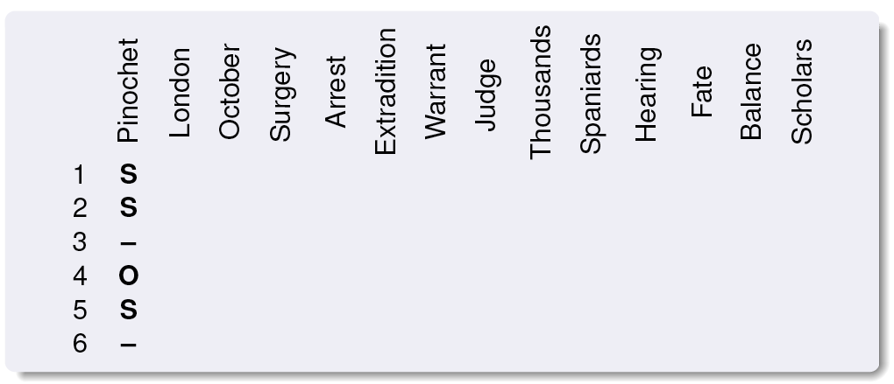
Barzilay and Lapata: The Entity Grid

Slide 91
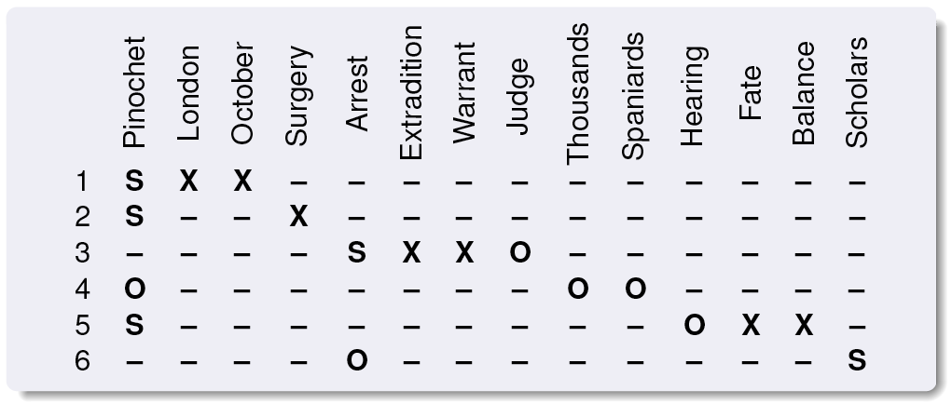
Barzilay and Lapata: The Entity Grid

Slide 92
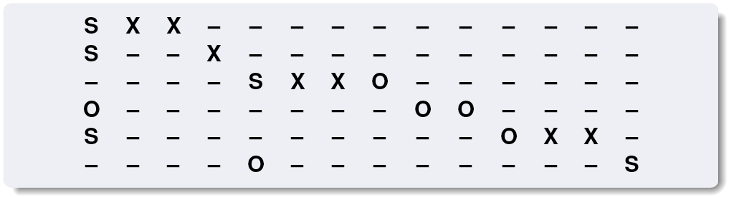
Barzilay and Lapata: The Entity Grid

Slide 93
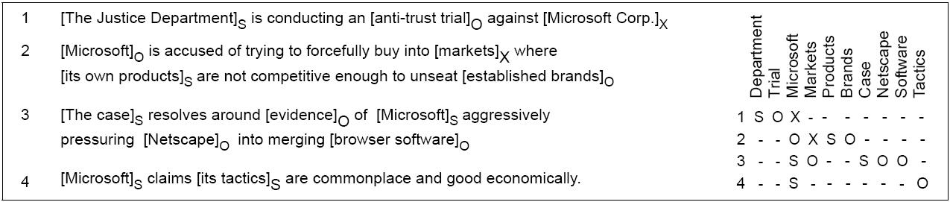
A (simplified) parsed text and extracted grid
A probabilistic model of particular entity transitions can then be trained
For example, the transitions {X, O, S, S} for the headword Microsoft exemplify that new entities are often introduced in non-subject position and only later appear in subject position

Slide 94
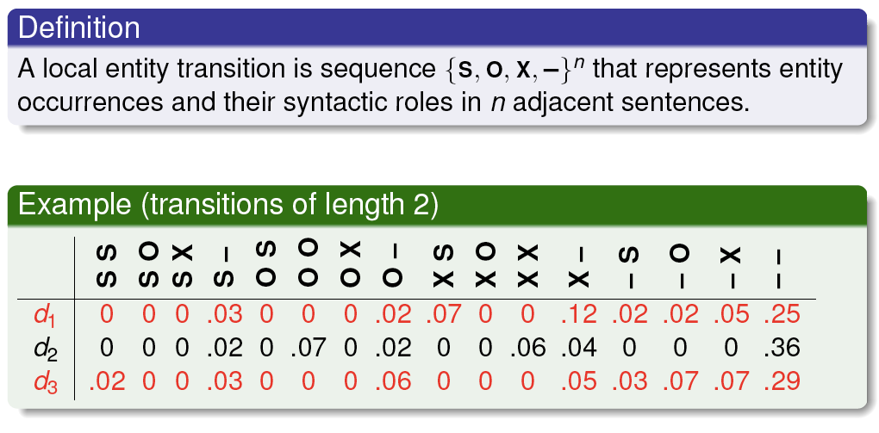
Barzilay and Lapata: The Entity Grid
Feature vector document representation (row per grid)

Slide 95
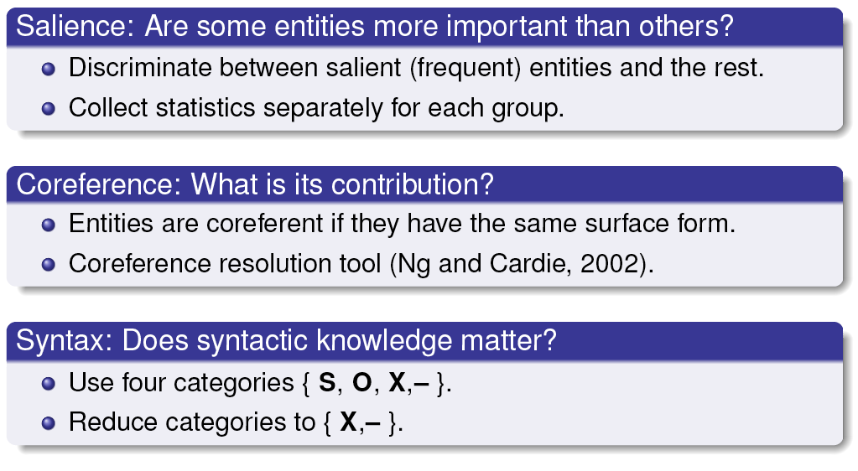
Barzilay and Lapata: The Entity Grid

Slide 96
Supervised Anaphora Resolution
Input: pronoun plus current and preceding sentences
Training: hand-labeled corpus of positive examples plus inferred negative examples
Features
    Strict number
    Compatible number
    Strict gender
    Compatible gender
    Sentence distance

Slide 97
    Hobbs distance (noun groups between pronoun and candidate antecedent
    Grammatical role
    Linguistic form (proper name, definite, indefinite, pronominal antecedent)
  From pronouns to general coreference
    Edit distance for full NPs

Slide 98
Summary: Reference Resolution
Many approaches to reference resolution
Use similar information/features but different methods
  Hobbs’ Syntax
  Centering coherence
  Supervised and shallow methods use simple techniques with reasonable success
  Also “deep” inferential approaches

