Slide 1
Computational Lexical Semantics
Speech and Language Processing
Chapter 20

Slide 2
Today
  Word Sense Disambiguation
    Supervised
    Semi- and unsupervised
  Word Similarity
    Thesaurus-based
    Distributional
  Hyponymy and Other Word Relations

Slide 3
Word Sense Disambiguation
Given
  A word in context,
  A fixed inventory of potential word senses
Decide which sense of the word this is
  English-to-Spanish MT
    Inventory is set of Spanish translations
  Speech Synthesis
    Inventory is homographs with different pronunciations like bass and bow

Slide 4
TheWordNet entry for the noun bat has the following distinct senses.
Cluster these senses by using the definitions of homonymy and polysemy.
bat#1: nocturnal mouselike mammal
bat#2: (baseball) a turn trying to get a hit
bat#3: a small racket. . . for playing squash
bat#4: the club used in playing cricket
bat#5: a club used for hitting a ball in various games

Slide 5
Two Variants of WSD
Lexical Sample task
  Small pre-selected set of target words
  And inventory of senses for each word
All-words task
  Every word in an entire text
  A lexicon with senses for each word
  ~Like part-of-speech tagging
    Except each lemma has its own tagset
    Less human agreement so upper bound is lower

Slide 6
Approaches
Knowledge-based (very early work)
Supervised
Unsupervised
  Dictionary-based techniques
  Selectional Association
Lightly supervised
  Bootstrapping
  Preferred Selectional Association

Slide 7
Supervised Machine Learning Approaches
Supervised machine learning approach
  Training corpus depends on task
  Train a classifier that can tag words in new text
  Just as we saw for part-of-speech tagging
What do we need?
  Tag set (“sense inventory”)
  Training corpus
  Set of features extracted from the training corpus
  A classifier

Slide 8
Bass in WordNet
The noun bass has 8 senses in WordNet
  bass - (the lowest part of the musical range)
  bass, bass part - (the lowest part in polyphonic music)
  bass, basso - (an adult male singer with the lowest voice)
  sea bass, bass - (flesh of lean-fleshed saltwater fish of the family Serranidae)
  freshwater bass, bass - (any of various North American lean-fleshed freshwater fishes especially of the genus Micropterus)
  bass, bass voice, basso - (the lowest adult male singing voice)
  bass - (the member with the lowest range of a family of musical instruments)
  bass -(nontechnical name for any of numerous edible marine and freshwater spiny-finned fishes)

Slide 9
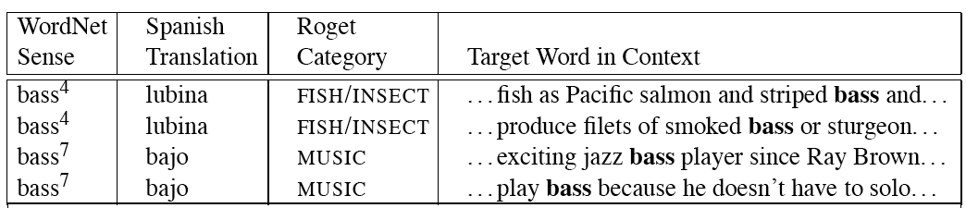
Sense Tags for Bass

Slide 10
What kind of Corpora?
Lexical sample task:
  Line-hard-serve corpus - 4000 examples of each
  Interest corpus - 2369 sense-tagged examples
All words:
  Semantic concordance: a corpus in which each open-class word is labeled with a sense from a specific dictionary/thesaurus.
    SemCor: 234,000 words from Brown Corpus, manually tagged with WordNet senses
    SENSEVAL-3 competition corpora - 2081 tagged word tokens
Notes:
Line of people, chalk line; hard as difficult or solid

Slide 11
What Kind of Features?
Weaver (1955) “If one examines the words in a book, one at a time as through an opaque mask with a hole in it one word wide, then it is obviously impossible to determine, one at a time, the meaning of the words. […] But if one lengthens the slit in the opaque mask, until one can see not only the central word in question but also say N words on either side, then if N is large enough one can unambiguously decide the meaning of the central word. […] The practical question is : `What minimum value of N will, at least in a tolerable fraction of cases, lead to the correct choice of meaning for the central word?’”

Slide 12
Frequency-based WSD
WordNet first sense heuristic, about 60-70% accuracy
To improve, need context
  Selectional restrictions
  “Topic”

Slide 13
dishes
  washing dishes.
  simple dishes including
  convenient dishes to
  of dishes and
bass
  free bass with
  pound bass of
  and bass player
  his bass while

Slide 14
“In our house, everybody has a career and none of them includes washing dishes,” he says.
In her tiny kitchen at home, Ms. Chen works efficiently, stir-frying several simple dishes, including braised pig’s ears and chcken livers with green peppers.
Post quick and convenient dishes to fix when you’re in a hurry.
Japanese cuisine offers a great variety of dishes and regional specialties

Slide 15
We need more good teachers – right now, there are only a half a dozen who can play the free bass with ease.
Though still a far cry from the lake’s record 52-pound bass of a decade ago, “you could fillet these fish again, and that made people very, very happy.” Mr. Paulson says.
An electric guitar and bass player stand off to one side, not really part of the scene, just as a sort of nod to gringo expectations again.
Lowe caught his bass while fishing with pro Bill Lee of Killeen, Texas, who is currently in 144th place with two bass weighing 2-09.

Slide 16
Feature Vectors
A simple representation for each observation (each instance of a target word)
  Vectors of sets of feature/value pairs
    I.e. files of comma-separated values
  These vectors should represent the window of words around the target
  How big should that window be?

Slide 17
What sort of Features?
Collocational features and bag-of-words features
  Collocational
    Features about words at specific positions near target word
      Often limited to just word identity and POS
  Bag-of-words
    Features about words that occur anywhere in the window (regardless of position)
      Typically limited to frequency counts
Notes:
Start here.

Slide 18
Example
Example text (WSJ)
  An electric guitar and bass player stand off to one side not really part of the scene, just as a sort of nod to gringo expectations perhaps
  Assume a window of +/- 2 from the target

Slide 19
Collocations
Position-specific information about the words in the window
guitar and bass player stand
  [guitar, NN, and, CC, player, NN, stand, VB]
  Word_{n-2,} POS_{n-2,} word_{n-1,} POS_{n-1,} Word_{n+1} POS_{n+1}…
  In other words, a vector consisting of
  [position n word, position n part-of-speech…]

Slide 20
Bag of Words
Information about what words occur within the window
First derive a set of terms to place in the vector
Then note how often each of those terms occurs in a given window

Slide 21
Co-Occurrence Example
Assume we’ve settled on a possible vocabulary of 12 words that includes guitar and player but not and and stand, and you see
“…guitar and bass player stand…”
  [0,0,0,1,0,0,0,0,0,1,0,0]
  Counts of words pre-identified as e.g.,
  [fish, fishing, viol, guitar, double, cello…]

Slide 22
Classifiers
Once we cast the WSD problem as a classification problem, many techniques possible
  Naïve Bayes
  Decision lists
  Decision trees
  Neural nets
  Support vector machines
  Nearest neighbor methods…

Slide 23
Classifiers
Choice of technique, in part, depends on the set of features that have been used
  Some techniques work better/worse with features with numerical values
  Some techniques work better/worse with features that have large numbers of possible values
    For example, the feature the word to the left has a fairly large number of possible values

Slide 24
Naïve Bayes
ŝ = p(s|V), or
Where s is one of the senses S possible for a word w and V the input vector of feature values for w
Assume features independent, so probability of V is the product of probabilities of each feature, given s, so
p(V) same for any ŝ
Then

Slide 25
How do we estimate p(s) and p(v_{j}|s)?

Slide 26
How do we estimate p(s) and p(v_{j}|s)?
  p(s_{i}) is max. likelihood estimate from a sense-tagged corpus (count(s_{i},w_{j})/count(w_{j})) – how likely is bank to mean ‘financial institution’ over all instances of bank?
  P(v_{j}|s) is max. likelihood of each feature given a candidate sense (count(v_{j},s)/count(s)) – how likely is the previous word to be ‘river’ when the sense of bank is ‘financial institution’
Calculate for each possible sense and take the highest scoring sense as the most likely choice

Slide 27
Naïve Bayes Evaluation
On a corpus of examples of uses of the word line, naïve Bayes achieved about 73% correct
Is this good?

Slide 28
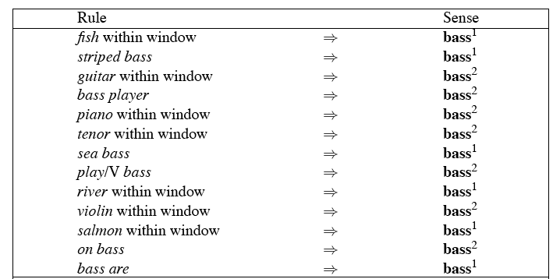
Decision Lists
Can be treated as a case statement….

Slide 29
Learning Decision Lists
Restrict lists to rules that test a single feature
Evaluate each possible test and rank them based on how well they work
Order the top-N tests as the decision list

Slide 30
Yarowsky’s Metric
On a binary (homonymy) distinction used the following metric to rank the tests
This gives about 95% on this test…

Slide 31
WSD Evaluations and Baselines
In vivo (intrinsic) versus in vitro (extrinsic) evaluation
In vitro evaluation most common now
  Exact match accuracy
    % of words tagged identically with manual sense tags
  Usually evaluate using held-out data from same labeled corpus
    Problems?
    Why do we do it anyhow?
Baselines: most frequent sense, Lesk algorithm

Slide 32
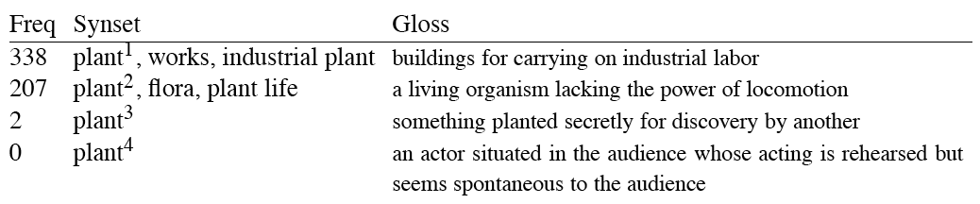
Most Frequent Sense
Wordnet senses are ordered in frequency order
So “most frequent sense” in WordNet = “take the first sense”
Sense frequencies come from SemCor

Slide 33
Ceiling
Human inter-annotator agreement
  Compare annotations of two humans
  On same data
  Given same tagging guidelines
Human agreements on all-words corpora with WordNet style senses
  75%-80%

Slide 34
Unsupervised Methods: Dictionary/Thesaurus Methods
The Lesk Algorithm
Selectional Restrictions

Slide 35
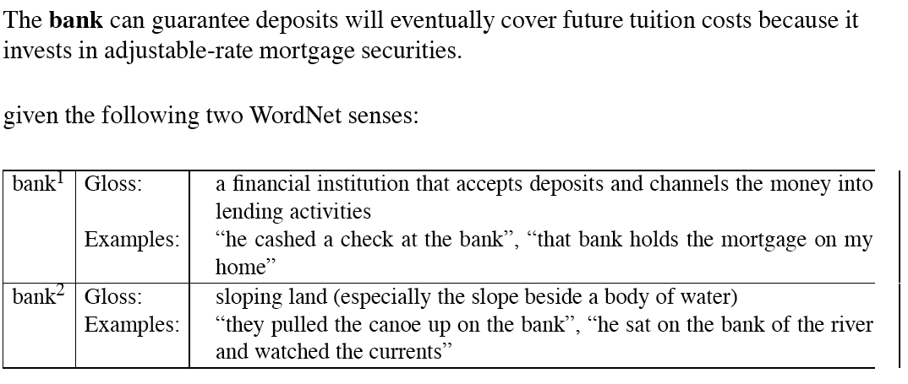
Simplified Lesk
Match dictionary entry of sense that best matches context

Slide 36
Simplified Lesk
Match dictionary entry of sense that best matches context: bank1 (deposits, mortgage)

Slide 37
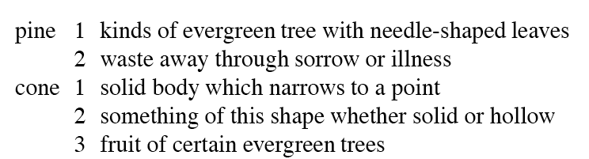
Original Lesk: pine cone
Compare entries for each context word for overlap

Slide 38
Original Lesk: pine cone
Compare entries for each context word for overlap
Cone3 selected: evergreen, tree

Slide 39
Corpus Lesk
Add corpus examples to glosses and examples
The best performing variant

Slide 40
“Time flies like an arrow” – what are the correct senses?
time#n#5 (the continuum of experience in which events pass from the future through the present to the past)
time#v#1 (measure the time or duration of an event or action or the person who performs an action in a certain period of time) “he clocked the runners”
flies#n#1 (two-winged insects characterized by active flight)
flies#v#8 (pass away rapidly) “Time flies like an arrow”; “Time fleeing beneath him”
like#v#4 (feel about or towards; consider, evaluate, or regard) “How did you like the President’s speech last night?”
like#a#1 (resembling or similar; having the same or some of the same characteristics; often used in combination) “suits of like design”; “a limited circle of likeminds”; “members of the cat family have like dispositions”; “as like as two peas in a pod”; “doglike devotion”; “a dreamlike quality”

Slide 41
Try the original algorithm on “Time flies like an arrow” using WordNet senses below. Assume that the words are to be disambiguated one at a time, from left to right,
and that the results from earlier decisions are used later in the process.
time#n#5 (the continuum of experience in which events pass from the future through the present to the past)
time#v#1 (measure the time or duration of an event or action or the person who performs an action in a certain period of time) “he clocked the runners”
flies#n#1 (two-winged insects characterized by active flight)
flies#v#8 (pass away rapidly) “Time flies like an arrow”; “Time fleeing beneath him”
like#v#4 (feel about or towards; consider, evaluate, or regard) “How did you like the President’s speech last night?”
like#a#1 (resembling or similar; having the same or some of the same characteristics; often used in combination) “suits of like design”; “a limited circle of likeminds”; “members of the cat family have like dispositions”; “as like as two peas in a pod”; “doglike devotion”; “a dreamlike quality”

Slide 42
“Time flies like an arrow”
time#n#5 (the continuum of experience in which events pass from the future through the present to the past)
time#v#1 (measure the time or duration of an event or action or the person who performs an action in a certain period of time) “he clocked the runners”
flies#n#1 (two-winged insects characterized by active flight)
flies#v#8 (pass away rapidly) “Time flies like an arrow”; “Time fleeing beneath him”
like#v#4 (feel about or towards; consider, evaluate, or regard) “How did you like the President’s speech last night?”
like#a#1 (resembling or similar; having the same or some of the same characteristics; often used in combination) “suits of like design”; “a limited circle of likeminds”; “members of the cat family have like dispositions”; “as like as two peas in a pod”; “doglike devotion”; “a dreamlike quality”
Time WSD : tie, backoff to most frequent, but can’t because POS differ

Slide 43
“Time flies like an arrow”
time#n#5 (the continuum of experience in which events pass from the future through the present to the past)
time#v#1 (measure the time or duration of an event or action or the person who performs an action in a certain period of time) “he clocked the runners”
flies#n#1 (two-winged insects characterized by active flight)
flies#v#8 (pass away rapidly) “Time flies like an arrow”; “Time fleeing beneath him”
like#v#4 (feel about or towards; consider, evaluate, or regard) “How did you like the President’s speech last night?”
like#a#1 (resembling or similar; having the same or some of the same characteristics; often used in combination) “suits of like design”; “a limited circle of likeminds”; “members of the cat family have like dispositions”; “as like as two peas in a pod”; “doglike devotion”; “a dreamlike quality”
Flies WSD: select verb

Slide 44
Disambiguation via Selectional Restrictions
“Verbs are known by the company they keep”
  Different verbs select for different thematic roles
    wash the dishes (takes washable-thing as patient)
    serve delicious dishes (takes food-type as patient)
Method: another semantic attachment in grammar
  Semantic attachment rules are applied as sentences are syntactically parsed, e.g.
    VP --> V NP
    V→ serve <theme> {theme:food-type}
  Selectional restriction violation: no parse
Notes:
Here

Slide 45
But this means we must:
  Write selectional restrictions for each sense of each predicate – or use FrameNet
    Serve alone has 15 verb senses
  Obtain hierarchical type information about each argument (using WordNet)
    How many hypernyms does dish have?
    How many words are hyponyms of dish?
But also:
  Sometimes selectional restrictions don’t restrict enough (Which dishes do you like?)
  Sometimes they restrict too much (Eat dirt, worm! I’ll eat my hat!)
Resnik 1988: 44% with traditional methods
Can we take a statistical approach?

Slide 46
Semi-Supervised Bootstrapping
What if you don’t have enough data to train a system…
Bootstrap
  Pick a word that you as an analyst think will co-occur with your target word in particular sense
  Grep through your corpus for your target word and the hypothesized word
  Assume that the target tag is the right one

Slide 47
Bootstrapping
For bass
  Assume play occurs with the music sense and fish occurs with the fish sense

Slide 48
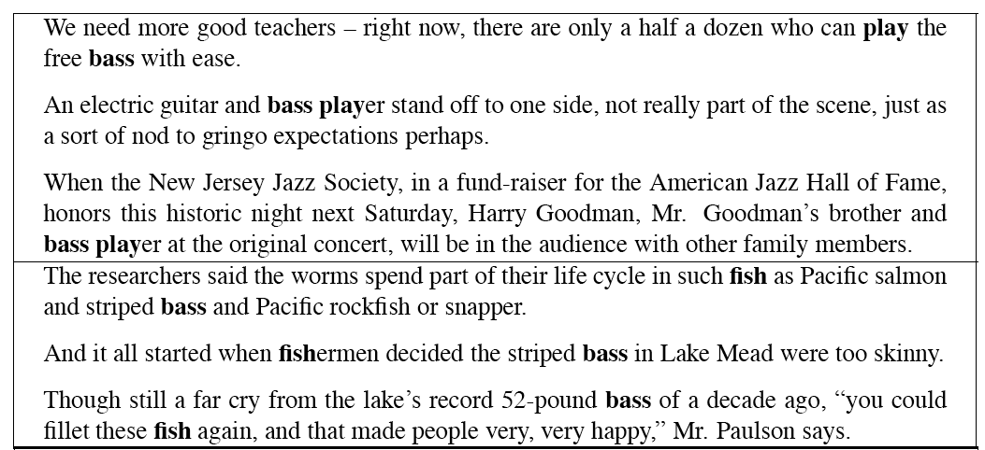
Sentences Extracts for bass and player

Slide 49
Where do the seeds come from?
Hand labeling
“One sense per discourse”:
  The sense of a word is highly consistent within a document - Yarowsky (1995)
  True for topic-dependent words
  Not so true for other POS like adjectives and verbs, e.g. make, take
  Krovetz (1998) “More than one sense per discourse” not true at all once you move to fine-grained senses
One sense per collocation:
  A word recurring in collocation with the same word will almost surely have the same sense

Slide 50
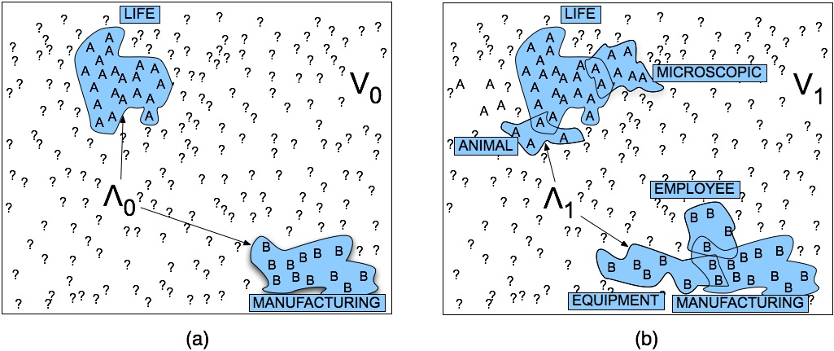
Stages in Yarowsky Bootstrapping Algorithm

Slide 51
Issues
Given these general ML approaches, how many classifiers do I need to perform WSD robustly
  One for each ambiguous word in the language
How do you decide what set of tags/labels/senses to use for a given word?
  Depends on the application

Slide 52
WordNet ‘bass’
Tagging with this set of senses is an impossibly hard task that’s probably overkill for any realistic application
bass, bass part - (the lowest part in polyphonic music)
bass, basso - (an adult male singer with the lowest voice)
sea bass, bass - (flesh of lean-fleshed saltwater fish of the family Serranidae)
freshwater bass, bass - (any of various North American lean-fleshed freshwater fishes especially of the genus Micropterus)
bass, bass voice, basso - (the lowest adult male singing voice)
bass - (the member with the lowest range of a family of musical instruments)
bass -(nontechnical name for any of numerous edible marine and
bass - (the lowest part of the musical range)
freshwater spiny-finned fishes)

Slide 53
History of Senseval
ACL-SIGLEX workshop (1997)
SENSEVAL-I (1998)
  Lexical Sample for English, French, and Italian
SENSEVAL-II (Toulouse, 2001)
  Lexical Sample and All Words
SENSEVAL-III (2004)
SENSEVAL-IV -> SEMEVAL (2007)
New: SEM, First Joint Conference on Lexical and Computational Semantics

Slide 54
2012
SEM: 1st Conf. on Lexical & Computational Semantics
SemEval: International Workshop on Semantic Evaluations
  1. English Lexical Simplification
  2. Measuring Degrees of Relational Similarity
  3. Spatial Role Labeling
  4. Evaluating Chinese Word Similarity
  5. Chinese Semantic Dependency Parsing
  6. Semantic Textual Similarity
  7. COPA: Choice Of Plausible Alternatives An evaluation of
  common-sense causal reasoning
  8. Cross-lingual Textual Entailment for Content Synchronization
2013: Our course project

Slide 55
WSD Performance
Varies widely depending on how difficult the disambiguation task is
Accuracies of over 90% are commonly reported on some of the classic, often fairly easy, WSD tasks (pike, star, interest)
Senseval brought careful evaluation of difficult WSD (many senses, different POS)
Senseval 1: more fine grained senses, wider range of types:
  Overall: about 75% accuracy
  Nouns: about 80% accuracy
  Verbs: about 70% accuracy

Slide 56
Word Similarity
Synonymy is a binary relation
  Two words are either synonymous or not
We want a looser metric
  Word similarity or
  Word distance
Two words are more similar
  If they share more features of meaning
Actually these are really relations between senses:
  Instead of saying “bank is like fund”
  We say
    Bank1 is similar to fund3
    Bank2 is similar to slope5
We’ll compute them over both words and senses

Slide 57
Why word similarity
Information retrieval
Question answering
Machine translation
Natural language generation
Language modeling
Automatic essay grading
Document clustering

Slide 58
Two classes of algorithms
Thesaurus-based algorithms
  Based on whether words are “nearby”, eg. in Wordnet
Distributional algorithms
  By comparing words based on their distributional context in corpora

Slide 59
Thesaurus-based word similarity
We could use anything in a thesaurus
In practice
  By “thesaurus-based” we often mean these 2 cues:
    the is-a/subsumption/hypernym hierarchy
    Sometimes using the glosses too
Word similarity versus word relatedness
  Similar words are near-synonyms
  Related could be related any way
    Car, gasoline: related, not similar
    Car, bicycle: similar

Slide 60
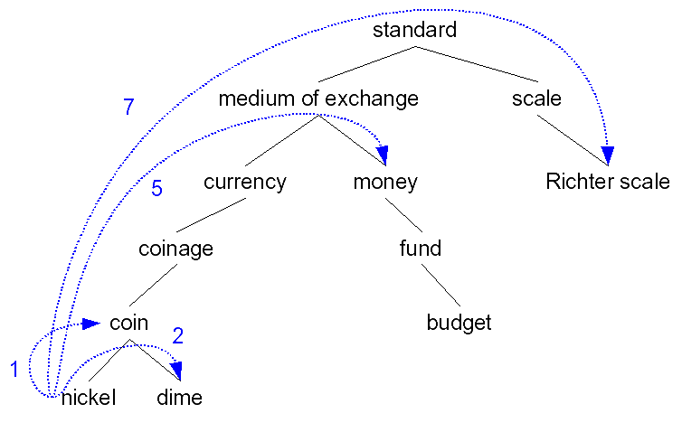
Path based similarity
Two words are similar if nearby in thesaurus hierarchy (i.e. short path between them)

Slide 61
Refinements to path-based similarity
pathlen(c1,c2) = number of edges in the shortest path in the thesaurus graph between the sense nodes c1 and c2
simpath(c1,c2) = -log pathlen(c1,c2)
wordsim(w1,w2) =
  maxc1∈senses(w1),c2∈senses(w2) sim(c1,c2)

Slide 62
Problem with basic path-based similarity
Assumes each link represents a uniform distance
Nickel to money seem closer than nickel to standard
Instead:
  Want a metric which lets us
  Represent the cost of each edge independently

Slide 63
Information content similarity metrics
Let’s define P(C) as:
  The probability that a randomly selected word in a corpus is an instance of concept c
  Formally: there is a distinct random variable, ranging over words, associated with each concept in the hierarchy
  P(root)=1
  The lower a node in the hierarchy, the lower its probability

Slide 64
Information content similarity
Train by counting in a corpus
  1 instance of “dime” could count toward frequency of coin, currency, standard, etc
More formally:

Slide 65
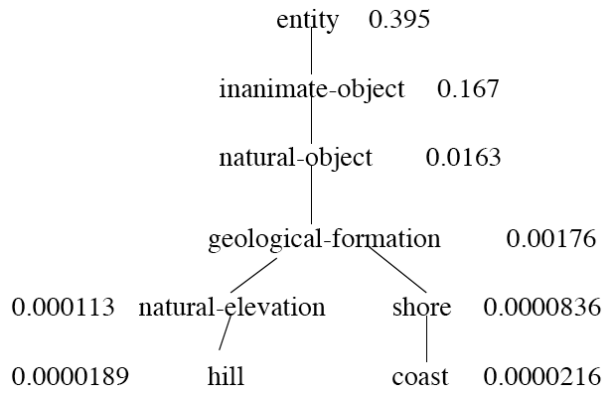
Information content similarity
WordNet hierarchy augmented with probabilities P(C)

Slide 66
Information content: definitions
Information content:
  IC(c)=-logP(c)
Lowest common subsumer
  LCS(c1,c2) = the lowest common subsumer
    I.e. the lowest node in the hierarchy
    That subsumes (is a hypernym of) both c1 and c2
We are now ready to see how to use information content IC as a similarity metric

Slide 67
Resnik method
The similarity between two words is related to their common information
The more two words have in common, the more similar they are
Resnik: measure the common information as:
  The info content of the lowest common subsumer of the two nodes
  sim_{resnik}(c1,c2) = -log P(LCS(c1,c2))

Slide 68
Dekang Lin method
Similarity between A and B needs to do more than measure common information
The more differences between A and B, the less similar they are:
  Commonality: the more info A and B have in common, the more similar they are
  Difference: the more differences between the info in A and B, the less similar
Commonality: IC(Common(A,B))
Difference: IC(description(A,B))-IC(common(A,B))

Slide 69
Dekang Lin method
Similarity theorem: The similarity between A and B is measured by the ratio between the amount of information needed to state the commonality of A and B and the information needed to fully describe what A and B are
sim_{Lin}(A,B)= log P(common(A,B))
_______________
log P(description(A,B))
Lin furthermore shows (modifying Resnik) that info in common is twice the info content of the LCS

Slide 70
Lin similarity function
SimLin(c1,c2) = 2 x log P (LCS(c1,c2))
________________
log P(c1) + log P(c2)
SimLin(hill,coast) = 2 x log P (geological-formation))
________________
log P(hill) + log P(coast)
= .59

Slide 71
The (extended) Lesk Algorithm
Two concepts are similar if their glosses contain similar words
  Drawing paper: paper that is specially prepared for use in drafting
  Decal: the art of transferring designs from specially prepared paper to a wood or glass or metal surface
For each n-word phrase that occurs in both glosses
  Add a score of n²
  Paper and specially prepared for 1 + 4 = 5…

Slide 72
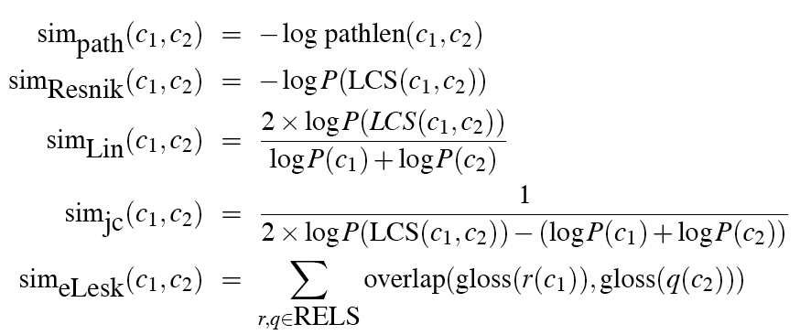
Summary: thesaurus-based similarity

Slide 73
Evaluating thesaurus-based similarity
Intrinsic Evaluation:
  Correlation coefficient between
    algorithm scores
    word similarity ratings from humans
Extrinsic (task-based, end-to-end) Evaluation:
  Embed in some end application
    Malapropism (spelling error) detection
    Essay grading
    Plagiarism Detection
    Language modeling in some application

Slide 74
Problems with thesaurus-based methods
We don’t have a thesaurus for every language
Even if we do, many words are missing
They rely on hyponym info:
  Strong for nouns, but lacking for adjectives and even verbs
Alternative
  Distributional methods for word similarity

Slide 75
Distributional methods for word similarity
Firth (1957): “You shall know a word by the company it keeps!”
Nida example noted by Lin:
  A bottle of tezgüino is on the table
  Everybody likes tezgüino
  Tezgüino makes you drunk
  We make tezgüino out of corn.
Intuition:
  just from these contexts a human could guess meaning of tezguino
  So we should look at the surrounding contexts, see what other words have similar context.

Slide 76
Context vector
Consider a target word w
Suppose we had one binary feature f_{i} for each of the N words in the lexicon v_{i}
Which means “word v_{i} occurs in the neighborhood of w”
w=(f1,f2,f3,…,fN)
If w=tezguino, v1 = bottle, v2 = drunk, v3 = matrix:
w = (1,1,0,…)

Slide 77
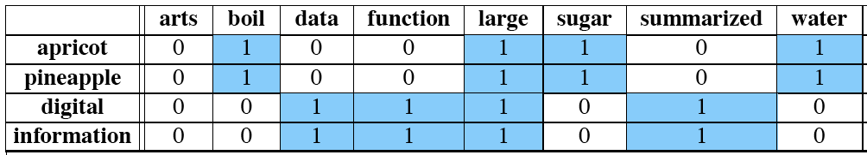
Intuition
Define two words by these sparse features vectors
Apply a vector distance metric
Say that two words are similar if two vectors are similar

Slide 78
Distributional similarity
So we just need to specify 3 things
  How the co-occurrence terms are defined
  How terms are weighted
    (frequency? Logs? Mutual information?)
  What vector distance metric should we use?
    Cosine? Euclidean distance?

Slide 79
Defining co-occurrence vectors
We could have windows of neighboring words
  Bag-of-words
  We generally remove stopwords
But the vectors are still very sparse
So instead of using ALL the words in the neighborhood
Let’s just use the words occurring in particular relations
Notes:
here

Slide 80
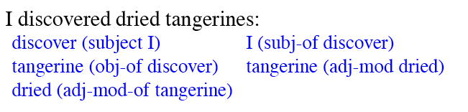
Defining co-occurrence vectors
Zellig Harris (1968)
  The meaning of entities, and the meaning of grammatical relations among them, is related to the restriction of combinations of these entitites relative to other entities
Idea: parse the sentence, extract syntactic dependencies:

Slide 81
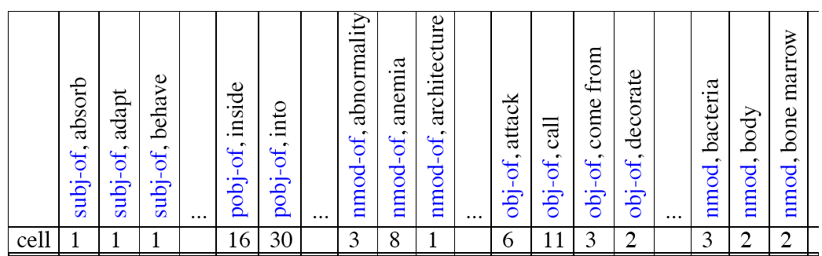
Co-occurrence vectors based on dependencies
For the word “cell”: vector of NxR features
  R is the number of dependency relations

Slide 82
2. Weighting the counts
(“Measures of association with context”)
We have been using the frequency of some feature as its weight or value
But we could use any function of this frequency
Let’s consider one feature
f=(r,w’) = (obj-of,attack)
P(f|w)=count(f,w)/count(w)
Assoc_{prob}(w,f)=p(f|w)

Slide 83
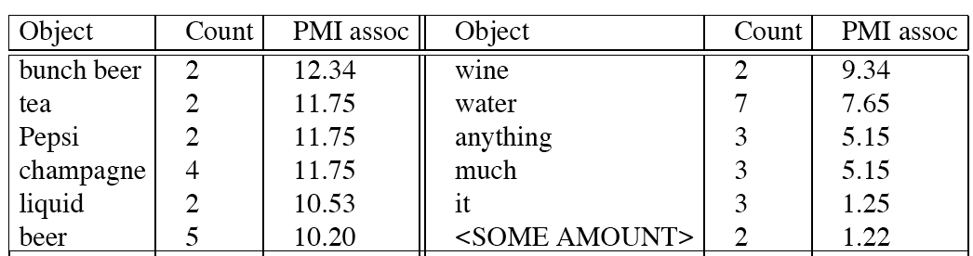
Intuition: why not frequency
“drink it” is more common than “drink wine”
But “wine” is a better “drinkable” thing than “it”
Idea:
  We need to control for chance (expected frequency)
  We do this by normalizing by the expected frequency we would get assuming independence

Slide 84


Weighting: Mutual Information
Mutual information: between 2 random variables X and Y
Pointwise mutual information: measure of how often two events x and y occur, compared with what we would expect if they were independent:

Slide 85

Weighting: Mutual Information
Pointwise mutual information: measure of how often two events x and y occur, compared with what we would expect if they were independent:
PMI between a target word w and a feature f :

Slide 86
Mutual information intuition
Objects of the verb drink

Slide 87

Lin is a variant on PMI
Pointwise mutual information: measure of how often two events x and y occur, compared with what we would expect if they were independent:
PMI between a target word w and a feature f :
Lin measure: breaks down expected value for P(f) differently:

Slide 88
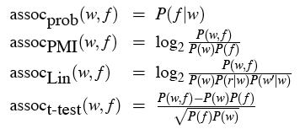
Summary: weightings
See Manning and Schuetze (1999) for more

Slide 89
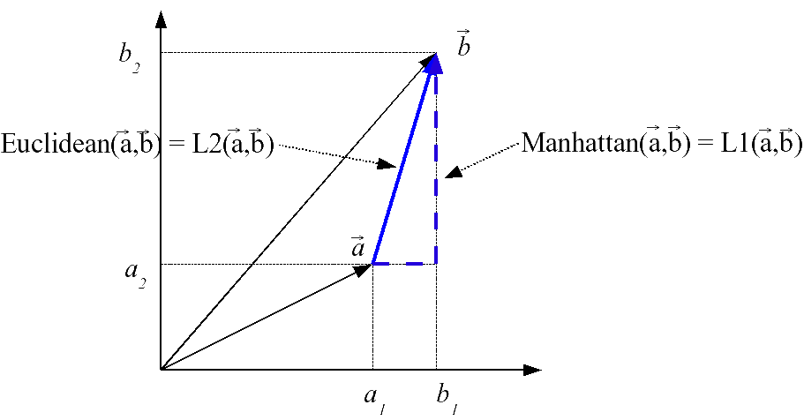
3. Defining similarity between vectors

Slide 90
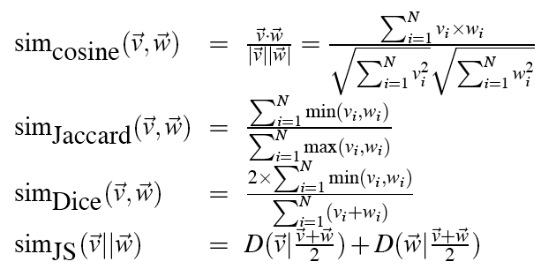
Summary of similarity measures

Slide 91
http://clg.wlv.ac.uk/demos/similarity/index.html

Slide 92
Evaluating similarity
Intrinsic Evaluation:
  Correlation coefficient between algorithm scores
    And word similarity ratings from humans
Extrinsic (task-based, end-to-end) Evaluation:
    Malapropism (spelling error) detection
    WSD
    Essay grading
    Taking TOEFL multiple-choice vocabulary tests
    Language modeling in some application

Slide 93
Hyponymy and Other Relations
Could we discover new relationhsips and add them to a taxonomy?
Why – unknown word problem (at one time Microsoft or IBM, but not Google)

Slide 94
Hearst Approach
Based on hand-built patterns
E.g. NP-0 such as NP-1 implies hyponym (NP-1, NP-0)
Corpus-based pattern extraction (Snow, Jurafsky, Ng 2005)

