Slide 1
Lexical Semantics
Speech and Language Processing
Chapter 19

Slide 2
Three Perspectives on Meaning
Lexical Semantics
  The meanings of individual words
Formal Semantics (or Compositional Semantics or Sentential Semantics)
  How those meanings combine to make meanings for individual sentences or utterances (see skipped chapters)
Discourse or Pragmatics
  How those meanings combine with each other and with other facts about various kinds of context to make meanings for a text or discourse
  Dialog or Conversation is often lumped together with Discourse

Slide 3
Sidebar: Compositional Semantic Analysis
Applies principle of compositionality
  Links semantic attachments to syntactic rules
    Incrementally ties semantics to parse processing
    Lambda calculus meaning representations
    Most complexity pushed into lexical items

Slide 4
Today
Introduction to Lexical Semantics
  Homonymy, Polysemy, Synonymy, and more
  Semantic Roles
  Online Resources

Slide 5
Lexical Semantics
Focus on word meanings:
  Relations of meaning among words
    Similarities & differences of meaning in sim context
  Internal meaning structure of words
    Basic internal units combine for meaning

Slide 6
Word Definitions
What’s a word?
  Definitions so far: Types, tokens, stems, roots, inflected forms, etc...
  Lexeme: An entry in a lexicon consisting of a pairing of a form with a single meaning representation
  Lexicon: A collection of lexemes

Slide 7
Possible Word Relations
Homonymy
Polysemy
Synonymy
Antonymy
Hypernomy
Hyponomy
Meronomy

Slide 8
Homonymy
Lexemes share a form
    Phonological, orthographic or both
  But have unrelated, distinct meanings
Clear examples
    Bat (wooden stick-like thing) vs. bat (flying scary mammal thing)
    Bank (financial institution) versus bank (riverside)
Can be homophones, homographs:
    Homophones:
      Write/right, piece/peace, to/too/two
    Homographs:
      Desert/desert
      Bass/bass

Slide 9
Issues for NLP Applications
Text-to-Speech
  Same orthographic form but different phonological form
    bass vs. bass
Information retrieval
  Different meanings same orthographic form
    QUERY: bat care
Machine Translation
Speech recognition

Slide 10
Polysemy
The bank is constructed from red brick
I withdrew the money from the bank
  Are these the same sense? Different?
Or consider the following WSJ example
  While some banks furnish sperm only to married women, others are less restrictive
  Which sense of bank is this?
    Is it distinct from the river bank sense?
    The savings bank sense?

Slide 11
Polysemy
A single lexeme with multiple related meanings (bank the building, bank the financial institution)
Most non-rare words have multiple meanings
  Number of meanings related to word frequency
  Verbs tend more to polysemy
  Distinguishing polysemy from homonymy isn’t always easy (or necessary)

Slide 12
Metaphor vs. Metonymy
Metaphor: two different meaning domains are related
  Citibank claimed it was misrepresented.
  Corporation as person
Metonymy: use of one aspect of a concept to refer to other aspects of entity or to entity itself
  The Citibank is on the corner of Main and State.
  Building stands for organization

Slide 13
How Do We Identify Words with Multiple Senses?
ATIS examples
  Which flights serve breakfast?
  Does America West serve Philadelphia?
The “zeugma” test: conjoin two potentially similar/dissimilar senses
  ?Does United serve breakfast and San Jose?
  Does United serve breakfast and lunch?

Slide 14
Synonymy
Word that have the same meaning in some or all contexts.
  filbert / hazelnut
  couch / sofa
  big / large
  automobile / car
  vomit / throw up
  Water / H₂0
Two lexemes are synonyms if they can be successfully substituted for each other in all situations
  If so they have the same propositional meaning

Slide 15
Few Examples of Perfect Synonymy
Even if many aspects of meaning are identical
  Still may not preserve the acceptability based on notions of politeness, slang, register, genre, etc.
E.g, water and H₂0, coffee and java

Slide 16
Terminology
Lemmas and wordforms
  A lexeme is an abstract pairing of meaning and form
  A lemma or citation form is the grammatical form that is used to represent a lexeme.
    Carpet is the lemma for carpets
  Specific surface forms carpets, sung are called wordforms
The lemma bank has two senses:
  Instead, a bank can hold the investments in a custodial account in the client’s name.
  But as agriculture burgeons on the east bank, the river will shrink even more.
A sense is a discrete representation of one aspect of the meaning of a word

Slide 17
Synonymy Relates Senses not Words
Consider big and large
Are they synonyms?
  How big is that plane?
  Would I be flying on a large or a small plane?
How about:
  Miss Nelson, for instance, became a kind of big sister to Benjamin.
  ?Miss Nelson, for instance, became a kind of large sister to Benjamin.
Why?
  big has a sense that means being older, or grown up
  large lacks this sense

Slide 18
Antonyms
Senses that are opposites with respect to one feature of their meaning
Otherwise, they are very similar
  dark / light
  short / long
  hot / cold
  up / down
  in / out
More formally: antonyms can
  Define a binary opposition or an attribute at opposite ends of a scale (long/short, fast/slow)
  Be reversives: rise/fall, up/down

Slide 19
Hyponyms
A sense is a hyponym of another if the first sense is more specific, denoting a subclass of the other
  car is a hyponym of vehicle
  dog is a hyponym of animal
  mango is a hyponym of fruit
Conversely
  vehicle is a hypernym/superordinate of car
  animal is a hypernym of dog
  fruit is a hypernym of mango
superordinate | vehicle | fruit | furniture | mammal
hyponym | car | mango | chair | dog

Slide 20
Hypernymy Defined
Extensional
  The class denoted by the superordinate
  Extensionally includes class denoted by the hyponym
Entailment
  A sense A is a hyponym of sense B if being an A entails being a B
Hyponymy is usually transitive
  (A hypo B and B hypo C entails A hypo C)

Slide 21
WordNet
Category | Unique Forms
Noun | 117,097
Verb | 11,488
Adjective | 22,141
Adverb | 4,601
A hierarchically organized lexical database
On-line thesaurus + aspects of a dictionary
    Versions for other languages are under development

Slide 22
Where to Find WordNet
http://wordnetweb.princeton.edu/perl/webwn

Slide 23
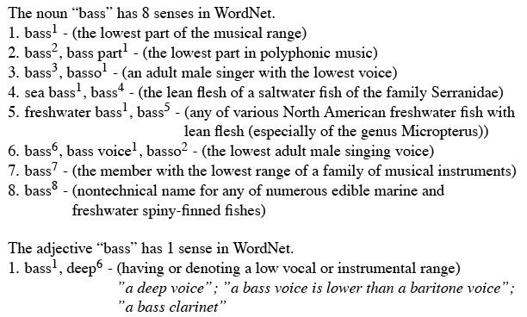
WordNet Entries

Slide 24
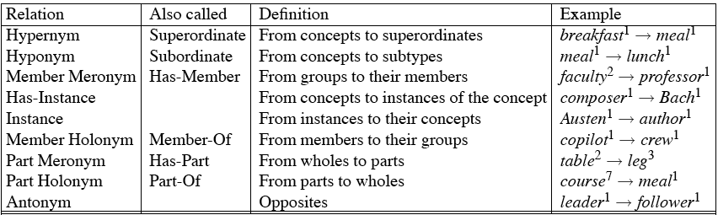
WordNet Noun Relations

Slide 25
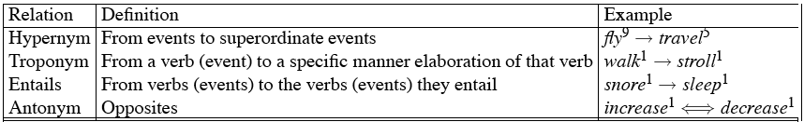
WordNet Verb Relations

Slide 26
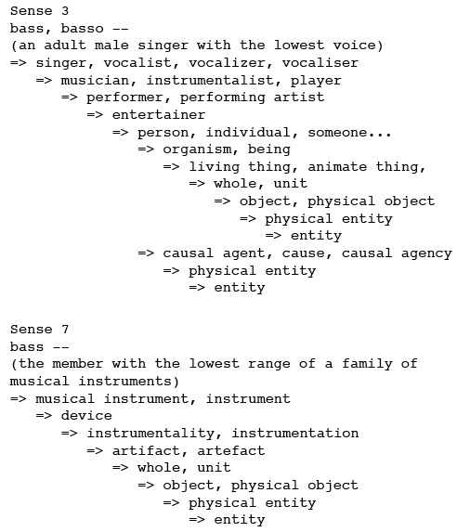
WordNet Hierarchies

Slide 27
How is ‘Sense’ Defined in WordNet?
The set of near-synonyms for a WordNet sense is called a synset (synonym set); their version of a sense or a concept
Example: chump as a noun to mean ‘a person who is gullible and easy to take advantage of’
Each of these senses share this same gloss
For WordNet, the meaning of this sense of chump is this list.

Slide 28
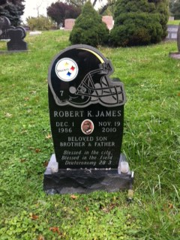

Slide 29
S: (n) field (a piece of land cleared of trees and usually enclosed)
S: (n) battlefield, battleground, field of battle, field of honor, field (a region where a battle is being (or has been) fought)
S: (n) field (somewhere (away from a studio or office or library or laboratory) where practical work is done or data is collected)
S: (n) discipline, subject, subject area, subject field, field, field of study, study, bailiwick (a branch of knowledge)
S: (n) field, field of force, force field (the space around a radiating body within which its electromagnetic oscillations can exert force on another similar body not in contact with it)
S: (n) field, field of operation, line of business (a particular kind of commercial enterprise)
S: (n) sphere, domain, area, orbit, field, arena (a particular environment or walk of life)
S: (n) playing field, athletic field, playing area, field (a piece of land prepared for playing a game)

Slide 30
From Chs 17/18: Predicate-Argument Structure
Verbs as predicates
Subcategorization (or, argument) frames specify number, position, and syntactic category of arguments
  NP likes NP
  NP likes Inf-VP
  NP likes NP Inf-VP
This chapter: semantic constraints on arguments
  Semantic roles
  Selectional restrictions

Slide 31
Semantic (Thematic) Roles
Subcat frames link arguments in surface structure with their semantic roles
  Agent: George hit Bill. Bill was hit by George.
  Patient: George hit Bill. Bill was hit by George.
The claim of a theory of semantic roles is that these arguments of predicates can be usefully classified into a small set of semantically contentful classes
  And that these classes are useful for explaining lots of things

Slide 32
Thematic Roles
Describe semantic roles of verbal arguments
  Capture commonality across verbs
  E.g. subject of break, open is AGENT
    AGENT: volitional cause
    THEME: things affected by action
  Enables generalization over surface order of arguments
    John_{AGENT} broke the window_{THEME}
    The rock_{INSTRUMENT} broke the window_{THEME}
    The window_{THEME} was broken by John_{AGENT}

Slide 33
Common semantic roles
Agent: initiator or doer in the event
Patient: affected entity in the event; undergoes the action
  Sue killed the rat.
Theme: object in the event undergoing a change of state or location, or of which location is predicated
  The ice melted
Experiencer: feels or perceive the event
  Bill likes pizza.
Stimulus: the thing that is felt or perceived

Slide 34
Common semantic roles
Goal:
  Bill ran to Copley Square.
Recipient (may or may not be distinguished from Goal):
  Bill gave the book to Mary.
Benefactive (may be grouped with Recipient):
  Bill cooked dinner for Mary.
Source:
  Bill took a pencil from the pile.
Instrument:
  Bill ate the burrito with a plastic spork.
Location:
  Bill sits under the tree on Wednesdays

Slide 35
Linking of thematic roles to syntactic positions
John opened the door
AGENT THEME
The door was opened by John
THEME AGENT
The door opened
THEME
John opened the door with the key
AGENT THEME INSTRUMENT

Slide 36
Deeper Semantics
From the WSJ…
  He melted her reserve with a husky-voiced paean to her eyes.
  If we label the constituents He and her reserve as the Melter and Melted, then those labels lose any meaning they might have had.
  If we make them Agent and Theme then we can do more inference.

Slide 37
Thematic Role Issues
Hard to produce
  Standard set of roles
    Fragmentation: Often need to make more specific
      E,g, INSTRUMENTS can be subject or not
  Standard definition of roles
    Most AGENTs: animate, volitional, sentient, causal
    But not all….
Strategies:
  Generalized semantic roles: PROTO-AGENT/PROTO-PATIENT
    Defined heuristically (rather than necessary and sufficient): PropBank
  Define roles specific to frames evoked by verbs/nouns: FrameNet

Slide 38
PropBank http://verbs.colorado.edu/propbank/
Corpus annotated with verbs/semantic roles (propositions and their arguments)
  Penn and Chinese Treebank
  Roles specific to verb sense
    Numbered: Arg0, Arg1, Arg2,…
      Arg0: PROTO-AGENT; Arg1: PROTO-PATIENT, etc
  E.g. agree.01
    Arg0: Agreer
    Arg1: Proposition
    Arg2: Other entity agreeing
    Ex1: [_{Arg0}The group] agreed [_{Arg1}it wouldn’t make an offer]

Slide 39
FrameNet https://framenet.icsi.berkeley.edu/fndrupal/
A lexical database of English that is both human- and machine-readable, based on annotating examples of how words are used in actual texts.
  A dictionary of more than 10,000 word senses, most of them with annotated examples that show the meaning and usage
  More than 170,000 manually annotated sentences provide a unique training dataset for semantic role labeling, used in information extraction, machine translation, etc.

Slide 40
FrameNet
Semantic roles specific to Frame
  Frame: script-like structure, roles (frame elements)
  E.g. change_position_on_scale: increase, rise
    Attribute, Initial_value, Final_value
  Core, non-core roles
  Relationships b/t frames, frame elements
    Add causative: cause_change_position_on_scale

Slide 41
FrameNet
FrameNet defines the frames and annotates sentences to show how the frame elements (FEs) fit syntactically around the word that evokes the frame
Revenge frame:
  [_{Avenger} I] 'll GET EVEN [_{Offender} with you] [_{Injury} for this]!
  [ _{Punishment} This attack was conducted] [_{Support} in] RETALIATION [ _{Injury} for the U.S. bombing raid on Tripoli...
In the simplest case the word is a verb, but the second example is the noun retaliation

Slide 42
Selectional Restrictions
Selectional Restrictions: constraints on the types of arguments verbs take
  George assassinated the senator.
  *The spider assassinated the fly.
  assassinate: intentional (political?) killing
The astronaut married the star.

Slide 43
Selectional Restrictions
Semantic type constraint on arguments
  I want to eat someplace close to Pitt
  E.g. THEME of eating should be edible
    Associated with senses
Vary in specificity:
  Imagine: AGENT: human/sentient; THEME: any
Representation:
  Associate with WordNet synset (and hyponyms)

Slide 44
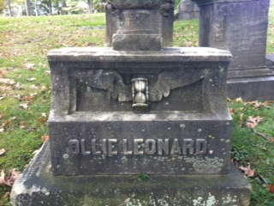
Time flies.
(thanks to Dr. Wiebe for Allegheny Cemetery photos)

Slide 45
S: (v) fly, wing (travel through the air; be airborne) "Man cannot fly"
S: (v) fly (move quickly or suddenly) "He flew about the place"
S: (v) fly, aviate, pilot (operate an airplane) "The pilot flew to Cuba"
S: (v) fly (transport by aeroplane) "We fly flowers from the Caribbean to North America"
S: (v) fly (cause to fly or float) "fly a kite"
S: (v) fly (be dispersed or disseminated) "Rumors and accusations are flying"
S: (v) fly (change quickly from one emotional state to another) "fly into a rage"
S: (v) fly, fell, vanish (pass away rapidly) "Time flies like an arrow"; "Time fleeing beneath him"

Slide 46
Summary
Lexical Semantics
  Homonymy, Polysemy, Synonymy, etc.
  Thematic roles and selectional restrictions
Computational resource for lexical semantics
  WordNet, PropBank, FrameNet

