Slide 1
Chapter 20:
NER and Entity Linking

Slide 2
Organizing knowledge
It’s a version of Chicago – the standard classic Macintosh menu font, with that distinctive thick diagonal in the ”N”.
Chicago was used by default for Mac menus through MacOS 7.6, and OS 8 was released mid-1997..
Chicago VIII was one of the early 70s-era Chicago albums to catch my
ear, along with Chicago II.
Slides are adapted from Kai-Wei Chang and Dan Roth

Slide 3
Cross-document co-reference resolution
It’s a version of Chicago – the standard classic Macintosh menu font, with that distinctive thick diagonal in the ”N”.
Chicago was used by default for Mac menus through MacOS 7.6, and OS 8 was released mid-1997..
Chicago VIII was one of the early 70s-era Chicago albums to catch my
ear, along with Chicago II.

Slide 4



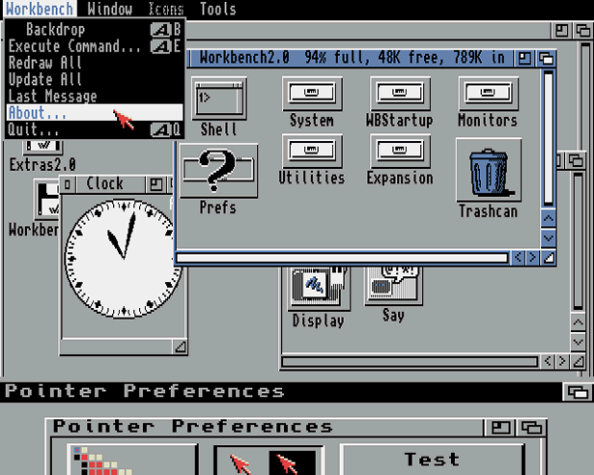

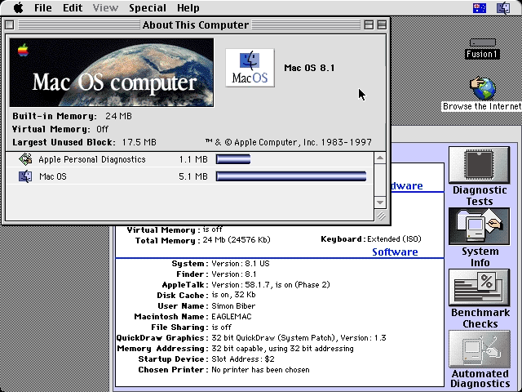
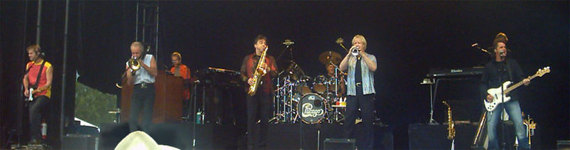
Reference resolution: (disambiguation to Wikipedia)
It’s a version of Chicago – the standard classic Macintosh menu font, with that distinctive thick diagonal in the ”N”.
Chicago was used by default for Mac menus through MacOS 7.6, and OS 8 was released mid-1997..
Chicago VIII was one of the early 70s-era Chicago albums to catch my
ear, along with Chicago II.

Slide 5
The “Reference” Collection has Structure
It’s a version of Chicago – the standard classic Macintosh menu font, with that distinctive thick diagonal in the ”N”.
Chicago was used by default for Mac menus through MacOS 7.6, and OS 8 was released mid-1997..
Chicago VIII was one of the early 70s-era Chicago albums to catch my
ear, along with Chicago II.
Is_a
Is_a
Used_In
Released
Succeeded

Slide 6

Wikipedia as a knowledge resource ….
Is_a
Is_a
Used_In
Released
Succeeded

Slide 7






Wikification: The Reference Problem
Blumenthal (D) is a candidate for the U.S. Senate seat now held by Christopher Dodd (D), and he has held a commanding lead in the race since he entered it. But the Times report has the potential to fundamentally reshape the contest in the Nutmeg State.
Blumenthal (D) is a candidate for the U.S. Senate seat now held by Christopher Dodd (D), and he has held a commanding lead in the race since he entered it. But the Times report has the potential to fundamentally reshape the contest in the Nutmeg State.
Notes:
Let’s start with what is wikification
Read wiki titles slower

Slide 8
Challenging
Dealing with Ambiguity of Natural Language
  Mentions of entities and concepts could have multiple meanings
Dealing with Variability of Natural Language
  A given concept could be expressed in many ways
Wikification addresses these two issues in a specific way:
The Reference Problem
  What is meant by this concept? (WSD + Grounding)
  More than just co-reference (within and across documents)
Notes:
. We expect this idea to inspire a completely new philosophy for fact
extraction which will be essential for the creation of a high-quality StructNet.
Incorporate arbitrary global features and soft constraints;
Features are automatically learned selectively
Save some human knowledge engineering efforts
Capture inter-dependency knowledge on the entire structure
Efficient linear-time beam search by joint learning and decoding
No need to model joint/conditional distribution with a large number of variables
Extract all facts jointly in a unified framework
Local predictions can be mutually improved
Avoid error compounding problem

Slide 10
Wikification: Subtasks
Wikification and Entity Linking requires addressing several sub-tasks:
  Identifying Target Mentions
    Mentions in the input text that should be Wikified
  Identifying Candidate Titles
    Candidate Wikipedia titles that could correspond to each mention
  Candidate Title Ranking
    Rank the candidate titles for a given mention
  NIL Detection and Clustering
    Identify mentions that do not correspond to a Wikipedia title
    Entity Linking: cluster NIL mentions that represent the same entity.
Notes:
. We expect this idea to inspire a completely new philosophy for fact
extraction which will be essential for the creation of a high-quality StructNet.
Incorporate arbitrary global features and soft constraints;
Features are automatically learned selectively
Save some human knowledge engineering efforts
Capture inter-dependency knowledge on the entire structure
Efficient linear-time beam search by joint learning and decoding
No need to model joint/conditional distribution with a large number of variables
Extract all facts jointly in a unified framework
Local predictions can be mutually improved
Avoid error compounding problem

Slide 11
High-level Algorithmic Approach.
Input: A text document d; Output: a set of pairs (m_{i} ,t_{i})
  m_{i} are mentions in d; t_{j}(m_{i} ) are corresponding Wikipedia titles, or NIL.
(1) Identify mentions m_{i} in d
(2) Local Inference
  For each m_{i} in d:
    Identify a set of relevant titles T(m_{i} )
    Rank titles t_{i} ∈ T(m_{i} )
    [E.g., consider local statistics of edges [(m_{i} ,t_{i}) , (m_{i} ,*), and (*, t_{i} )] occurrences in the Wikipedia graph]
(3) Global Inference
  For each document d:
    Consider all m_{i} ∈ d; and all t_{i} ∈ T(m_{i} )
    Re-rank titles t_{i} ∈ T(m_{i} )
    [E.g., if m, m’ are related by virtue of being in d, their corresponding titles t, t’ may also be related]
Notes:
Don’t focus on “our contribution” only – focus on describing an algorithmic approach (which is impressive and good)

Slide 12
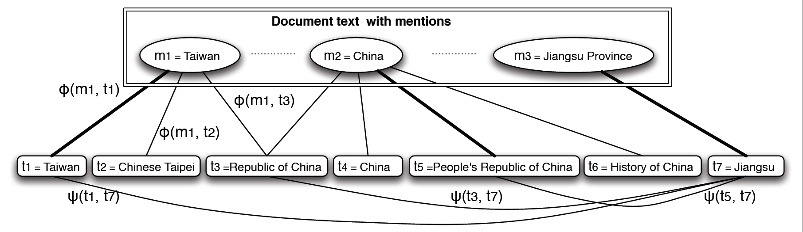
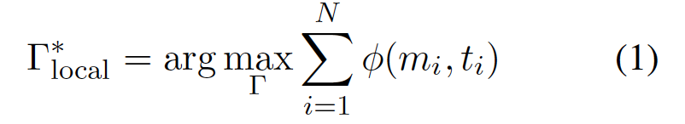
Local approach
A text Document
Identified mentions
Wikipedia Articles
Γ is a solution to the problem
  A set of pairs (m,t)
m: a mention in the document
t: the matched Wikipedia Title
Local score of matching
the mention to the title
(decomposed by m_{i})
Notes:
Changed—change in related slides.

Slide 13
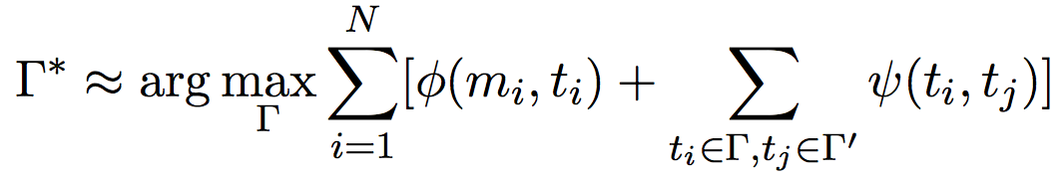
Global Approach: Using Additional Structure
Text Document(s)—News, Blogs,…
Wikipedia Articles
Adding a “global” term to evaluate how good the structure of the solution is.
Use the local solutions Γ’ (each mention considered independently.
Evaluate the structure based on pair-wise coherence scores Ψ(t_{i},t_{j})
Choose those that satisfy document coherence conditions.
Notes:
Add a cartoon of edge cover to justify that the overall problem is hard.

