Slide 1
Identify L1 of Non-English Writer
Zhaomin Xiao

Slide 2
Task and Dataset
Task: Identify L1 of non-English author.
Dataset:
  TOEFL11 Corpus
  ASK Corpus (composed of the writings of learners of Norwegian)
  Jinan Chinese Learner Corpus (a large-scale corpus of L2 Chinese consisting of university student essays)
  ……

Slide 3
Features
Syntactic Features
Stylistic Features
Lexical Features

Slide 4
Feature
Syntactic features:
  POS n-gram (unigram/bigram/trigram)
  Ratio of passive verbs to verbs

Slide 5
Feature
Stylistic features:
  Document Length (minimum requirement 300)
    HIN: 385 tokens
    ARA: 310 tokens
  Average Word Length
  Punctuation Marks
    raw counts, probability distribution

Slide 6
Feature
Lexical features:
  Spelling Error (raw counts, probability distribution)
  Word n-gram (unigram/bigram/trigram)
  Stop Words
  Lemma n-gram (overlap with word n-gram)

Slide 7
Discussion
Feature Extraction
  POS-based TF-IDF
  Word-based TF-IDF
  Document Length, # of punctuation marks, # of stop words
  Feature Selection
    Use Logistic Regression (L1 penalty) as estimator
  Parameter Tuning
    Use Logistic Regression (L2 penalty) for classification
    Use GridSearch with 5-fold cross-validation to search for the best parameter

Slide 8
Discussion
Word-based TF-IDF
35%
Word-based TF-IDF + POS-based TF-IDF
67%
Word-based TF-IDF + POS-based TF-IDF + other features
69%

Slide 9
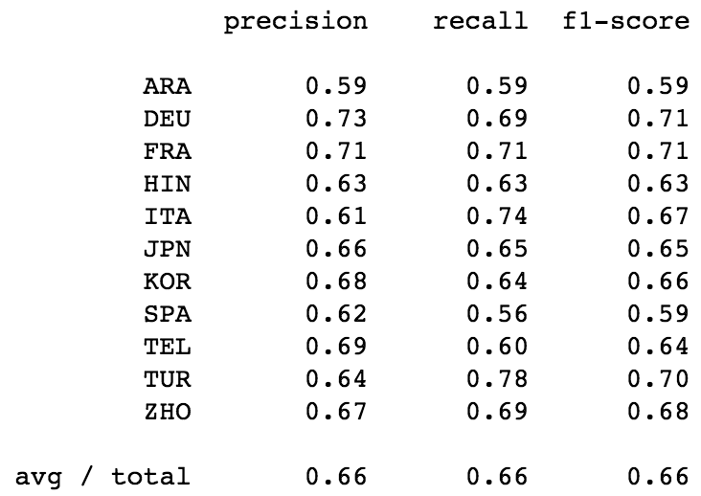
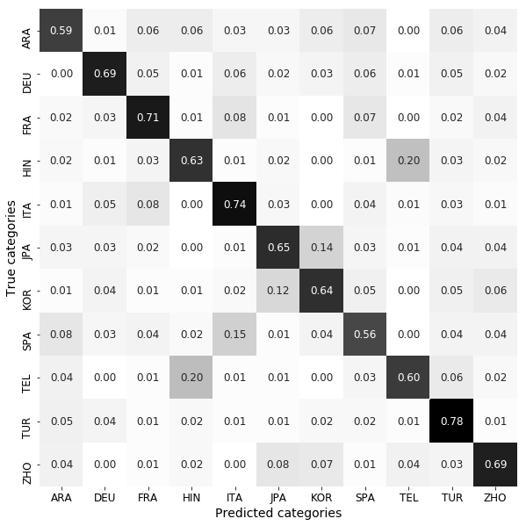
Discussion
Recall of each class

Slide 10
Future Work
Feature Extraction
  TF-IDF-based improvement
  Find more linguistic features
  Classification Methods
    Classic machine learning methods
    Deep learning techniques (RNN+LSTM)

Slide 11
Thank you

