Slide 1
Natural Language Identification using TOEFL11
Katherine Debick, Ruben Horn, and Simran Gidwani

Slide 2
Visualization: Data used
Text TRAIN -> responses -> original -> 278.txt
IThe importance and popularity of travelling is still raising, Everybody is interested in getting to know other countries and continents but the ways how to do it, are very differently. [...]
UPenn POS tags
NNP NN CC NN IN NN VBZ RB VBG NN VBZ JJ IN VBG , TO VB JJ NNS CC NNS CC DT NNS WRB TO VB PRP , VBP RB RB . [...]

Slide 3
Technologies used
Language: Python
Libraries: NLTK, SKLearn

Slide 4
Initial Approach: Use SVM Classifier with POS N-Gram Feature Vectors
Rationale: Morphological differences in first-learned languages likely reveal themselves through POS-orderings in second-language responses
How feature vectors are built:
  1.) Calculate and allocate positions for every possible POS N-gram combination given a tagset
  2.) When a POS N-gram occurs in the set of POS N-grams for a given response, record the result in the given position of the feature vector

Slide 5
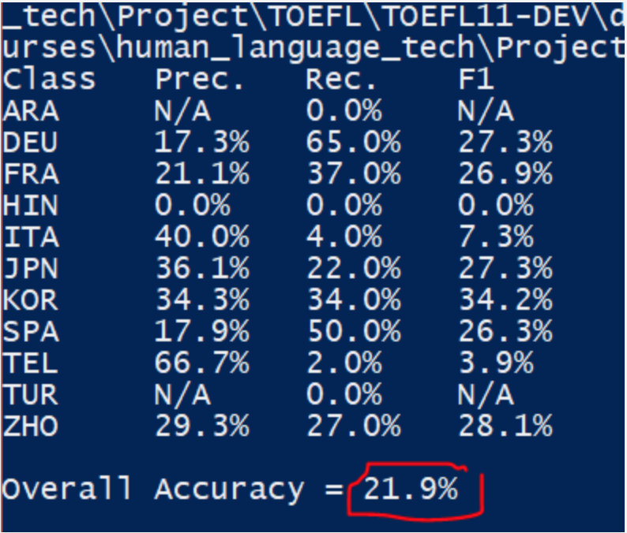
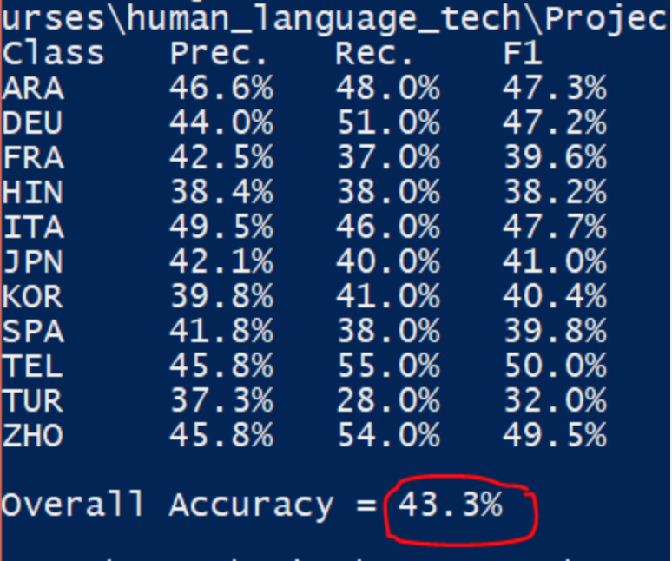
Feature Vector Population
Methods
Word level N-gram model
  Frequency
    If N-gram is in response, record frequency
  Binary
    0: If N-gram is in response
    1: If N-gram is not in response

Slide 6
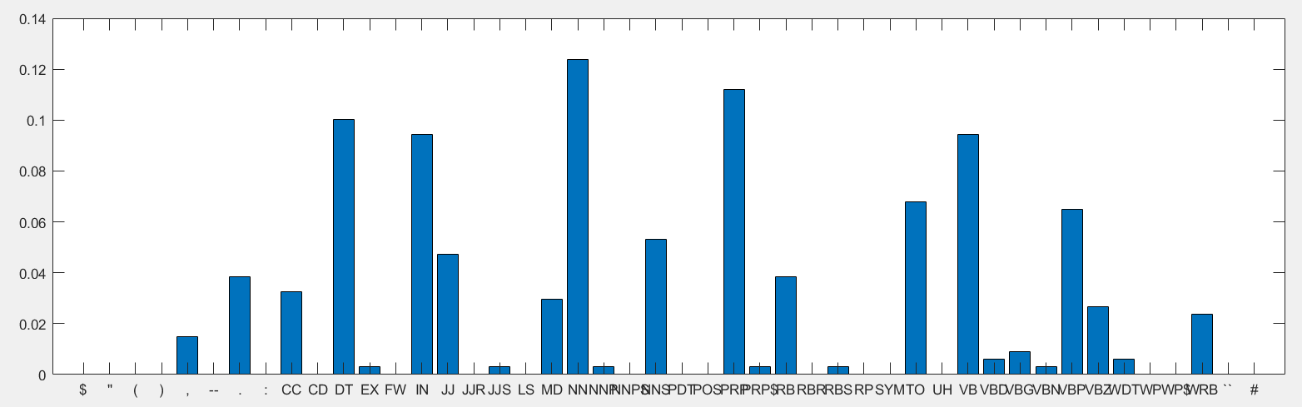
Visualization: UPenn POS Unigram Freq

Slide 7
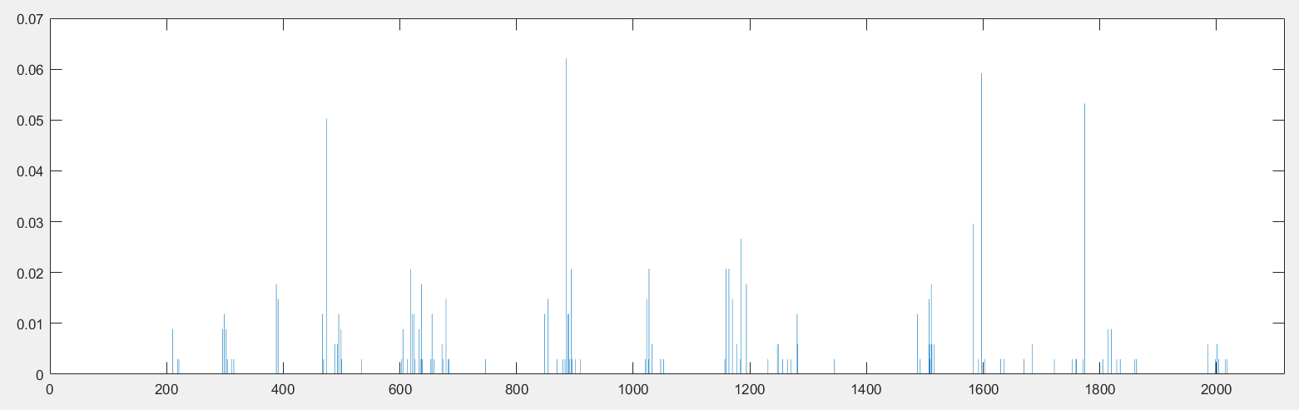
Visualization: UPenn POS Bigram Freq

Slide 8
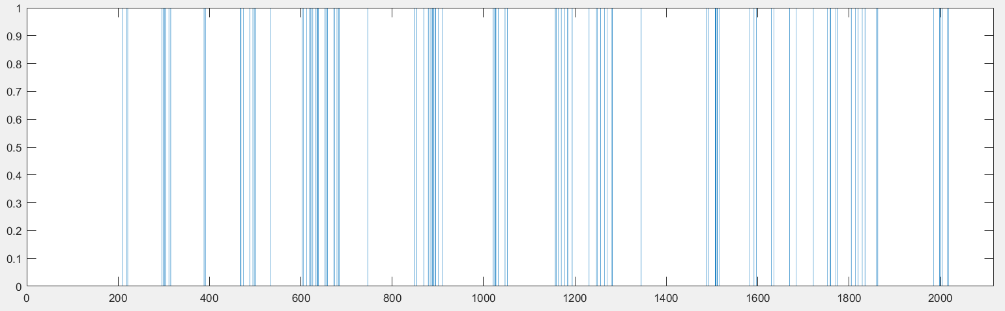
Visualization: UPenn POS Bigram Occur

Slide 9
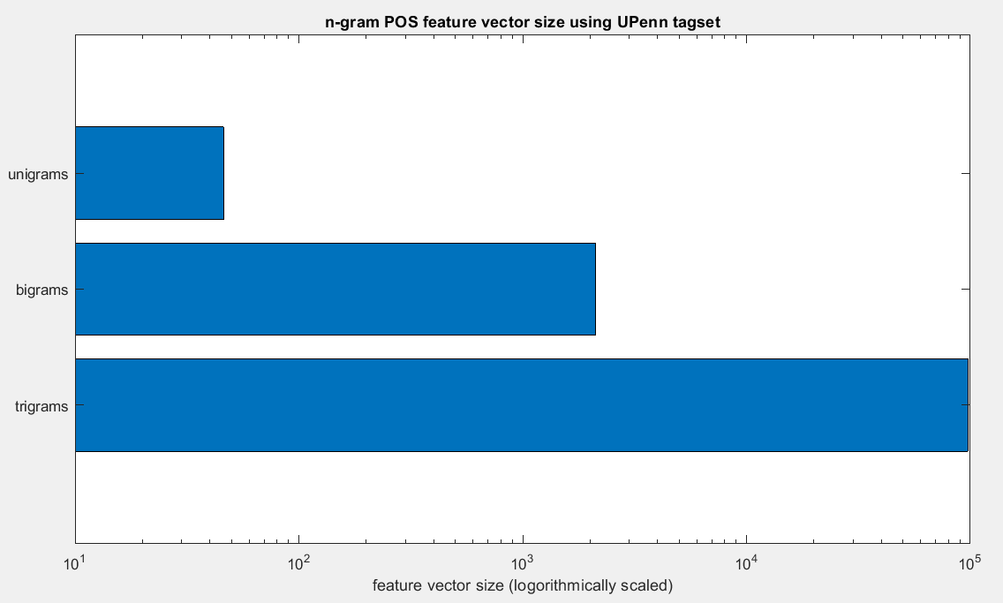
Unigrams, Bigrams, or Trigrams?
Problem: Higher order n-grams offer more context but run the risk of feature vector bloating
Visualization: Feature Vector Size (variable: n-gram size)

Slide 10
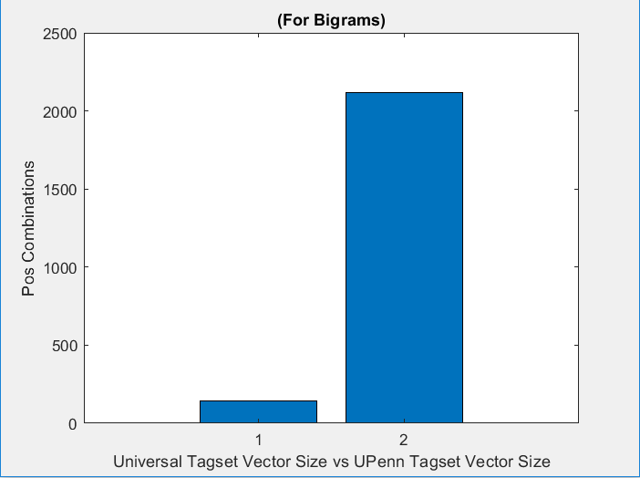
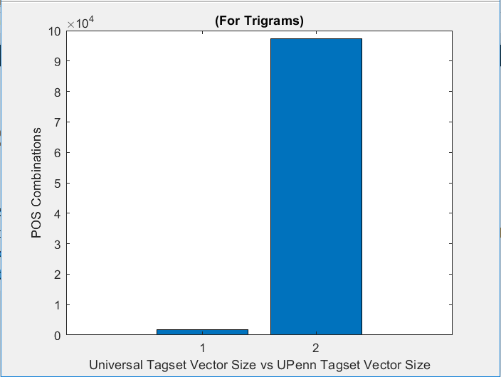
Universal Tagset vs UPenn Tagset
Tagset size presents a dilemma that is similar to the dilemma of N-gram size:
  Increasing number of tags increases the set of data that’s labeled but we also run into the problem of feature vector bloating
Visualization: Feature Vector Size (variable: tagset size)
We can live with this
This takes forever

Slide 11
Can we cut out noise to avoid bloat?
There is a lot of potential empty space in any given vector
Idea: Eliminate vector space for certain N-grams based on frequency across all responses
Possible approaches:
  Construct feature vectors based on 1000 most-frequently observed POS N-grams across all responses then populate them using binary approach per response
  Construct feature vectors which include all POS N-grams except the most-frequently observed POS N-grams across all responses (Don’t look at the N-grams that always occur in responses)
  Construct feature vectors which include all POS N-grams except the POS N-grams that never occur in any responses
Result? -> Accuracy reduction
Conclusion: The massive amounts of empty space in our vectors may be a distinguishing factor

Slide 12
Classifier Overview
We also tried other types of classifiers:
  SVM: 43%
    Linear SVM: 40%
  Naive Bayes: 21%
  Neural Net: 25%
  K-nearest Neighbor: 25%
Support Vector Machine had the highest accuracy so we decided to stick with that

Slide 13
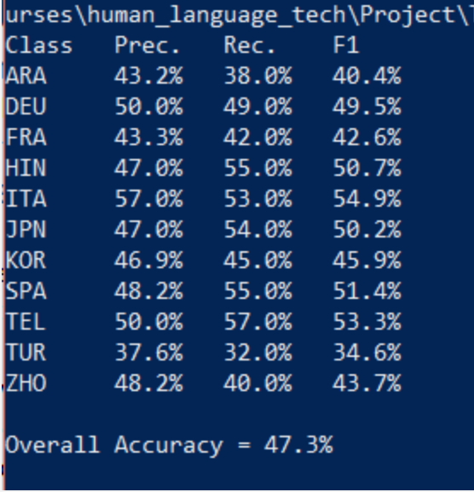
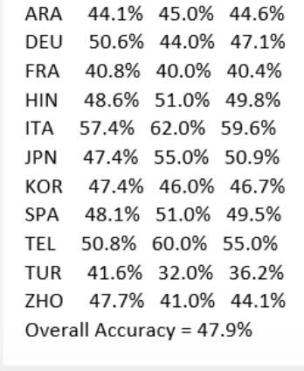
Successful Approach Overview
Switching from frequency based word n-grams to binary based
  Increased from 21.9% to 43.3%
Including part of speech tagging using UPenn tagset:
  Increased from 43.4% to 47.3%
Using the English proficiency levels as weights
  Low:3, Medium:2, High:1
  Increased accuracy from 47.3% to 47.6%
Concatenating Bigram and Unigram feature vectors
  Increased accuracy from 47.6% to 47.9%

Slide 14
Another Failed Approach
Splitting the essay into shorter paragraphs to get more labeled data. From there we would use the most frequent predictions from each and then combine them to represent the entire essay
  Did not improve our accuracy

Slide 15
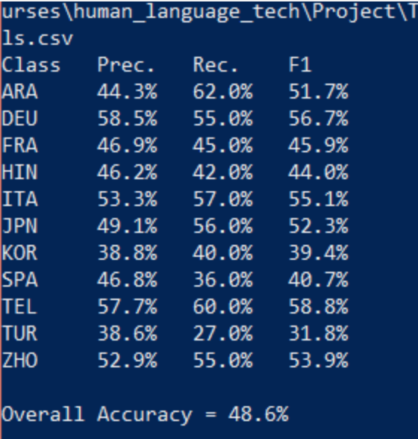
Test Set - Final Evaluation Score
Training our model on the test data resulted in a 48.6% overall accuracy.

Slide 16
Regrets, Ifs and Should-Haves
Continuous testing to speed up development
Closer analysis of data - visualizations made for this presentation may have helped in choosing better approaches
More research into other machine learning libraries
Try combining sampling of essays (or splitting them up into chunks), larger n-grams and POS tagsets, and feature vector bloat reduction methods - might be more of hack though

