Slide 1
Language Modeling with N-grams
Chapter 3
(3.1-3.4)

Slide 2
Rule-based vs. Probabilistic
“But it must be recognized that the notion of “probability of a sentence” is an entirely useless one, under any known interpretation of this term.” Noam Chomsky (1969)
“Anytime a linguist leaves the group the recognition rate goes up.” Fred Jelinek (1988, alleged)

Slide 3
Intuition
Predict the next word...
  ... I noticed three guys standing on the ???
There are many sources of knowledge that can be used to inform this task, including arbitrary world knowledge.
But it turns out that you can do pretty well by simply looking at the preceding words and keeping track of some fairly simple counts.

Slide 4
Word Prediction
We can formalize this task using what are called N-gram models.
N-grams are token sequences of length N.
This example contains what 2-grams (aka bigrams)?
  I notice three guys standing on the
Given knowledge of counts of N-grams such as these, we can guess likely next words in a sequence.

Slide 5
N-Gram Models
More formally, we can use knowledge of the counts of N-grams to assess the conditional probability of candidate words as the next word in a sequence.
Or, we can use them to assess the probability of an entire sequence of words.
  Pretty much the same thing as we’ll see...

Slide 6
Probability
Quick Review

Slide 7
Different Kinds of Statistics
descriptive: mean Pitt SAT (or median)
confirmatory: statistically significant?
predictive: wanna bet?
  N-grams

Slide 8
Notation
0.9
“Paul
Revere”
probability
model
p(Paul Revere wins | weather’s clear) = 0.9

Slide 9
p is a function on sets of “outcomes”
p(win | clear) ≡ p(win, clear) / p(clear)
weather’s
clear
Paul Revere
wins
All Outcomes (races)

Slide 10
p is a function on sets of “outcomes”
p(win | clear) ≡ p(win, clear) / p(clear)
syntactic sugar
logical conjunction
of predicates
predicate selecting
races where
weather’s clear
p measures total
probability of a set of outcomes
weather’s
clear
Paul Revere
wins
All Outcomes (races)

Slide 11
Required Properties of p (axioms)
most of the
p(∅) = 0 p(all outcomes) = 1
p(X) ≤ p(Y) for any X ⊆ Y
p(X) + p(Y) = p(X ∪ Y) provided X ∩ Y=∅
  e.g., p(win & clear) + p(win & ¬clear) = p(win)

Slide 12
Commas denote conjunction
p(Paul Revere wins | weather’s clear, ground is dry, jockey getting over sprain, Epitaph also in race, Epitaph was recently bought by Gonzalez, race is on May 17, … )

Slide 13
Simplifying Right Side: Backing Off
p(Paul Revere wins | weather’s clear, ground is dry, jockey getting over sprain, Epitaph also in race, Epitaph was recently bought by Gonzalez, race is on May 17, … )
  not exactly what we want but at least we can get a reasonable estimate of it!
  try to keep the conditions that we suspect will have the most influence on whether Paul Revere wins

Slide 14
Language Modeling
Introduction to N-grams

Slide 15
Probabilistic Language Models
Goal: assign a probability to a sentence
      Machine Translation:
        P(high winds tonite) > P(large winds tonite)
      Spell Correction
        The office is about fifteen minuets from my house
          P(about fifteen minutes from) > P(about fifteen minuets from)
      Speech Recognition
        P(I saw a van) >> P(eyes awe of an)
      + many more applications
Why?

Slide 16
Probabilistic Language Modeling
Compute the probability of a sentence or word sequence
  P(W) = P(w₁,w₂,w₃,w₄,w₅…w_{n})
Related task: probability of an upcoming word
  P(w_{n}|w₁,w₂…w_{n-1})
A model that computes either is a language model
    What kind of probabilities are these?

Slide 17
How to compute P(W)
How to compute this joint probability:
  P(its, water, is, so, transparent, that)
Intuition: let’s rely on the Chain Rule of Probability

Slide 18
Reminder: The Chain Rule
Recall the definition of conditional probabilities
  p(B|A) = P(A,B)/P(A) Rewriting: P(A,B) = P(A)P(B|A)
  Independent p(B|A) = P(B)
More variables:
  P(A,B,C,D) = P(A)P(B|A)P(C|A,B)P(D|A,B,C)
The Chain Rule in General
P(x₁,x₂,x₃,…,x_{n}) = P(x₁)P(x₂|x₁)P(x₃|x₁,x₂)…P(x_{n}|x₁,…,x_{n-1})

Slide 19
The Chain Rule applied to compute joint probability of words in sentence
P(“its water is so transparent”) =
P(its) × P(water|its) × P(is|its water)
× P(so|its water is) × P(transparent|its water is so)

Slide 20
How to estimate these probabilities
Could we just count and divide?
No! Too many possible sentences!
We’ll never see enough data for estimating these

Slide 21
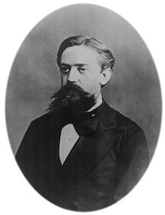
Markov Assumption
Simplifying assumption:
Or maybe
Andrei Markov

Slide 22
Markov Assumption
In other words, we approximate each component in the product

Slide 23
Bigram model (k=1, e.g., context of one so model two words)

Slide 24
Simplest case: Unigram model
Some automatically generated sentences from a unigram model
fifth, an, of, futures, the, an, incorporated, a, a, the, inflation, most, dollars, quarter, in, is, mass
thrift, did, eighty, said, hard, 'm, july, bullish
that, or, limited, the

Slide 25
Bigram model
Condition on the previous word:
texaco, rose, one, in, this, issue, is, pursuing, growth, in, a, boiler, house, said, mr., gurria, mexico, 's, motion, control, proposal, without, permission, from, five, hundred, fifty, five, yen
outside, new, car, parking, lot, of, the, agreement, reached
this, would, be, a, record, november

Slide 26
N-gram models
We can extend to trigrams, 4-grams, 5-grams
In general this is an insufficient model of language
  because language has long-distance dependencies:
  “The computer(s) which I had just put into the machine room on the fifth floor is (are) crashing.”
But we can often get away with N-gram models

Slide 27
Language Modeling
Estimating N-gram Probabilities

Slide 28
Estimating bigram probabilities
The Maximum Likelihood Estimate

Slide 29

An example
<s> I am Sam </s>
<s> Sam I am </s>
<s> I do not like green eggs and ham </s>

Slide 30
Example from Julia Hockenmaier

Slide 31
Conditional on the previous word

Slide 32
Conditional on the previous word

Slide 33
More examples:
Berkeley Restaurant Project sentences
can you tell me about any good cantonese restaurants close by
mid priced thai food is what i’m looking for
tell me about chez panisse
can you give me a listing of the kinds of food that are available
i’m looking for a good place to eat breakfast
when is caffe venezia open during the day

Slide 34
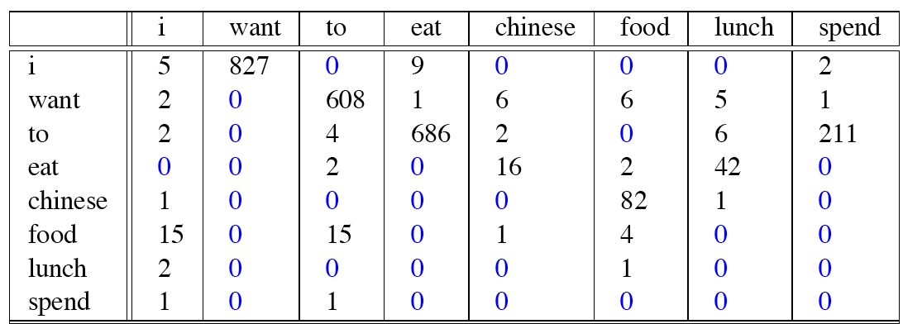
Raw bigram counts
Out of 9222 sentences

Slide 35
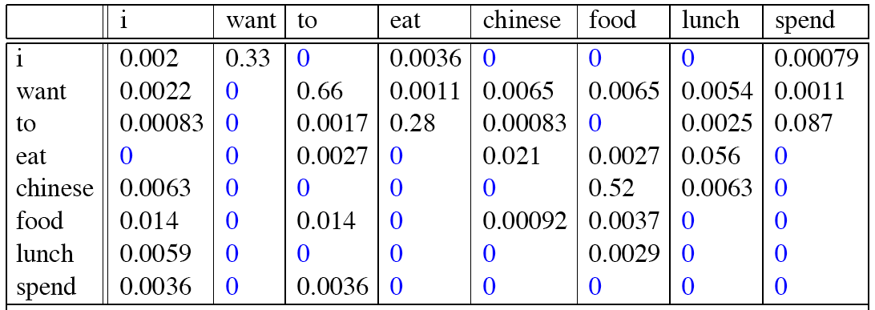
Raw bigram probabilities
Normalize by unigrams:
Result:

Slide 36
Bigram estimates of sentence probabilities
P(<s> I want english food </s>) =
P(I|<s>)
× P(want|I)
× P(english|want)
× P(food|english)
× P(</s>|food)
= .000031

Slide 37
What kinds of knowledge?
P(english|want) = .0011
P(chinese|want) = .0065
P(to|want) = .66
P(eat | to) = .28
P(food | to) = 0
P(want | spend) = 0
P (i | <s>) = .25

Slide 38
Practical Issues
We do everything in log space
  Avoid underflow
  (also adding is faster than multiplying)

Slide 39
Language Modeling Toolkits
SRILM
  http://www.speech.sri.com/projects/srilm/
KenLM
  https://kheafield.com/code/kenlm/

Slide 40
Google N-Gram Release, August 2006
…

Slide 41
Google N-Gram Release
serve as the incoming 92
serve as the incubator 99
serve as the independent 794
serve as the index 223
serve as the indication 72
serve as the indicator 120
serve as the indicators 45
serve as the indispensable 111
serve as the indispensible 40
serve as the individual 234
http://googleresearch.blogspot.com/2006/08/all-our-n-gram-are-belong-to-you.html

Slide 42
Google Books N-gram Viewer
https://books.google.com/ngrams
Notes:
http://ngrams.googlelabs.com/

Slide 43
Google Caveat
We will talk more about test sets and training sets... Test sets should be similar to the training set (drawn from the same distribution) for the probabilities to be meaningful.
So... The Google corpus is fine if your application deals with arbitrary English text on the Web.
If not then a smaller domain specific corpus is likely to yield better results.

Slide 44
Language Modeling
Evaluation and Perplexity

Slide 45
Evaluation: How good is our model?
Does our language model prefer good sentences to bad ones?
  Assign higher probability to “real” or “frequently observed” sentences
    Than “ungrammatical” or “rarely observed” sentences?
    Recall word salad example
We train parameters of our model on a training set.
We test the model’s performance on data we haven’t seen.
  A test set is an unseen dataset that is different from our training set, totally unused.
  An evaluation metric tells us how well our model does on the test set.

Slide 46
Training on the test set
We can’t allow test sentences into the training set
We will assign it an artificially high probability when we set it in the test set
“Training on the test set”
Bad science!
And violates the honor code
More later!

Slide 47
Extrinsic evaluation of N-gram models
Best evaluation for comparing models A and B
  Put each model in a task
    spelling corrector, speech recognizer, MT system
  Run the task, get an accuracy for A and for B
    How many misspelled words corrected properly
    How many words translated correctly
  Compare accuracy for A and B

Slide 48
Difficulty of extrinsic (in-vivo) evaluation of N-gram models
Extrinsic evaluation
  Time-consuming; can take days or weeks
So
  Sometimes use intrinsic evaluation: perplexity
  Bad approximation
    unless the test data looks just like the training data
    So generally only useful in pilot experiments
  But is helpful to think about.

Slide 49
Intuition of Perplexity
mushrooms 0.1
pepperoni 0.1
anchovies 0.01
….
fried rice 0.0001
….
and 1e-100
The Shannon Game:
  How well can we predict the next word?
  Unigrams are terrible at this game. (Why?)
A better model of a text
  is one which assigns a higher probability to the word that actually occurs
I always order pizza with cheese and ____
The 33rd President of the US was ____
I saw a ____

Slide 50
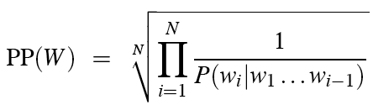
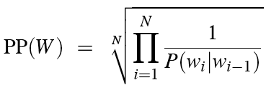
Perplexity
The best language model is one that best predicts an unseen test set
  Gives the highest P(sentence)
Perplexity is the inverse probability of the test set, normalized by the number of words:
Chain rule:
For bigrams:
Minimizing perplexity is the same as maximizing probability

Slide 51
Lower perplexity = better model
Training 38 million words, test 1.5 million words, WSJ
N-gram Order | Unigram | Bigram | Trigram
Perplexity | 962 | 170 | 109

Slide 52
Language Modeling
Generalization and zeros

Slide 53
The Shannon Visualization Method
Choose a random bigram
(<s>, w) according to its probability
Now choose a random bigram (w, x) according to its probability
And so on until we choose </s>
Then string the words together
<s> I
I want
want to
to eat
eat Chinese
Chinese food
food </s>
I want to eat Chinese food

Slide 54
Approximating Shakespeare

Slide 55
Shakespeare as corpus
N=884,647 tokens, V=29,066
Shakespeare produced 300,000 bigram types out of V²= 844 million possible bigrams.
  So 99.96% of the possible bigrams were never seen (have zero entries in the table)
Quadrigrams worse: What's coming out looks like Shakespeare because it is Shakespeare

Slide 56
The Wall Street Journal is not Shakespeare

Slide 57
Can you guess the author of these random 3-gram sentences?
They also point to ninety nine point six billion dollars from two hundred four oh six three percent of the rates of interest stores as Mexico and gram Brazil on market conditions
This shall forbid it should be branded, if renown made it empty.

Slide 58
The perils of overfitting
N-grams only work well for word prediction if the test corpus looks like the training corpus
  In real life, it often doesn’t
  We need to train robust models that generalize!
  One kind of generalization: Zeros!
    Things that don’t ever occur in the training set
      But occur in the test set

Slide 59
Zeros
Training set:
  … denied the allegations
  … denied the reports
  … denied the claims
  … denied the request
  P(“offer” | denied the) = 0
Test set
  … denied the offer
  … denied the loan

Slide 60
Zero probability bigrams
Bigrams with zero probability
  mean that we will assign 0 probability to the test set!
And hence we cannot compute perplexity (can’t divide by 0)!

Slide 61
Language Modeling
Smoothing: Add-one (Laplace) smoothing

Slide 62
The intuition of smoothing (from Dan Klein)
When we have sparse statistics:
Steal probability mass to generalize better
P(w | denied the)
3 allegations
2 reports
1 claims
1 request
7 total
allegations
attack
man
reports
outcome
…
claims
request
P(w | denied the)
2.5 allegations
1.5 reports
0.5 claims
0.5 request
2 other
7 total
allegations
allegations
attack
man
outcome
reports
…
claims
request

Slide 63
Add-one estimation
Also called Laplace smoothing
Pretend we saw each word one more time than we did
Just add one to all the counts!
MLE estimate:
Add-1 estimate:

Slide 64
Maximum Likelihood Estimates
The maximum likelihood estimate
  of some parameter of a model M from a training set T
  maximizes the likelihood of the training set T given the model M
Suppose the word “bagel” occurs 400 times in a corpus of a million words
What is the probability that a random word from some other text will be “bagel”?
MLE estimate is 400/1,000,000 = .0004
This may be a bad estimate for some other corpus
  But it is the estimate that makes it most likely that “bagel” will occur 400 times in a million word corpus.

Slide 65
Add-One Smoothing
xya | 100 | 100/300 | 101 | 101/326
xyb | 0 | 0/300 | 1 | 1/326
xyc | 0 | 0/300 | 1 | 1/326
xyd | 200 | 200/300 | 201 | 201/326
xye | 0 | 0/300 | 1 | 1/326
…
xyz | 0 | 0/300 | 1 | 1/326
Total xy | 300 | 300/300 | 326 | 326/326

Slide 66
Problem with Add-One Smoothing
We’ve been considering just 26 letter types …
xya | 1 | 1/3 | 2 | 2/29
xyb | 0 | 0/3 | 1 | 1/29
xyc | 0 | 0/3 | 1 | 1/29
xyd | 2 | 2/3 | 3 | 3/29
xye | 0 | 0/3 | 1 | 1/29
…
xyz | 0 | 0/3 | 1 | 1/29
Total xy | 3 | 3/3 | 29 | 29/29

Slide 67
Problem with Add-One Smoothing
Suppose we’re considering 20000 word types
see the abacus | 1 | 1/3 | 2 | 2/20003
see the abbot | 0 | 0/3 | 1 | 1/20003
see the abduct | 0 | 0/3 | 1 | 1/20003
see the above | 2 | 2/3 | 3 | 3/20003
see the Abram | 0 | 0/3 | 1 | 1/20003
…
see the zygote | 0 | 0/3 | 1 | 1/20003
Total | 3 | 3/3 | 20003 | 20003/20003

Slide 68
Problem with Add-One Smoothing
Suppose we’re considering 20000 word types
see the abacus | 1 | 1/3 | 2 | 2/20003
see the abbot | 0 | 0/3 | 1 | 1/20003
see the abduct | 0 | 0/3 | 1 | 1/20003
see the above | 2 | 2/3 | 3 | 3/20003
see the Abram | 0 | 0/3 | 1 | 1/20003
…
see the zygote | 0 | 0/3 | 1 | 1/20003
Total | 3 | 3/3 | 20003 | 20003/20003
“Novel event” = event never happened in training data.
Here: 19998 novel events, with total estimated probability 19998/20003.
Add-one smoothing thinks we are extremely likely to see novel events, rather than words we’ve seen.
600.465 - Intro to NLP - J. Eisner
68

Slide 69
Add-Lambda Smoothing
A large dictionary makes novel events too probable.
To fix: Instead of adding 1 to all counts, add λ = 0.01?
  This gives much less probability to novel events.
But how to pick best value for λ?
  That is, how much should we smooth?

Slide 70
Add-0.001 Smoothing
Doesn’t smooth much
xya | 1 | 1/3 | 1.001 | 0.331
xyb | 0 | 0/3 | 0.001 | 0.0003
xyc | 0 | 0/3 | 0.001 | 0.0003
xyd | 2 | 2/3 | 2.001 | 0.661
xye | 0 | 0/3 | 0.001 | 0.0003
…
xyz | 0 | 0/3 | 0.001 | 0.0003
Total xy | 3 | 3/3 | 3.026 | 1

Slide 71
Add-1000 Smoothing
Smooths too much
xya | 1 | 1/3 | 1001 | 1/26
xyb | 0 | 0/3 | 1000 | 1/26
xyc | 0 | 0/3 | 1000 | 1/26
xyd | 2 | 2/3 | 1002 | 1/26
xye | 0 | 0/3 | 1000 | 1/26
…
xyz | 0 | 0/3 | 1000 | 1/26
Total xy | 3 | 3/3 | 26003 | 1

Slide 72
Add-Lambda Smoothing
A large dictionary makes novel events too probable.
To fix: Instead of adding 1 to all counts, add λ = 0.01?
  This gives much less probability to novel events.
But how to pick best value for λ?
  That is, how much should we smooth?
  E.g., how much probability to “set aside” for novel events?
    Depends on how likely novel events really are!
    Which may depend on the type of text, size of training corpus, …
  Can we figure it out from the data? (advanced topics)

Slide 73
Setting Smoothing Parameters
How to pick best value for λ? (in add- λ smoothing)
Try many λ values & report the one that gets best results?
How to measure whether a particular λ gets good results?
Is it fair to measure that on test data (for setting λ)?
  Moral: Selective reporting on test data can make a method look artificially good. So it is unethical.
  Rule: Test data cannot influence system development. No peeking! Use it only to evaluate the final system(s). Report all results on it.
Training
Test

Slide 74
Setting Smoothing Parameters
How to pick best value for λ? (in add- λ smoothing)
Try many λ values & report the one that gets best results?
How to measure whether a particular λ gets good results?
Is it fair to measure that on test data (for setting λ)?
  Moral: Selective reporting on test data can make a method look artificially good. So it is unethical.
  Rule: Test data cannot influence system development. No peeking! Use it only to evaluate the final system(s). Report all results on it.
Training
Test

Slide 75
Setting Smoothing Parameters
How to pick best value for λ?
Try many λ values & report the one that gets best results?
Training
Test
Dev.
Training
… and report results of that final model on test data.
Pick λ that
gets best
results on this 20% …
… when we collect counts from this 80% and smooth them using add-λ smoothing.
Now use that λ to get smoothed counts from all 100% …
600.465 - Intro to NLP - J. Eisner

Slide 76
Large or small Dev set?
Here we held out 20% of our training set (yellow) for development.
Would like to use > 20% yellow:
  20% not enough to reliably assess λ
Would like to use > 80% blue:
  Best λ for smoothing 80% ≠ best λ for smoothing 100%

Slide 77
Cross-Validation
Try 5 training/dev splits as below
  Pick λ that gets best average performance
  ☺ Tests on all 100% as yellow, so we can more reliably assess λ
  ☹ Still picks a λ that’s good at smoothing the 80% size, not 100%.
  But now we can grow that 80% without trouble
Dev.
Test
Dev.
Dev.
Dev.
Dev.
600.465 - Intro to NLP - J. Eisner
77

Slide 78
N-fold Cross-Validation (“Leave One Out”)
Test
…
Test each sentence with smoothed model from other N-1 sentences
☺ Still tests on all 100% as yellow, so we can reliably assess λ
☺ Trains on nearly 100% blue data ((N-1)/N) to measure whether λ is good for smoothing that
600.465 - Intro to NLP - J. Eisner
78

Slide 79
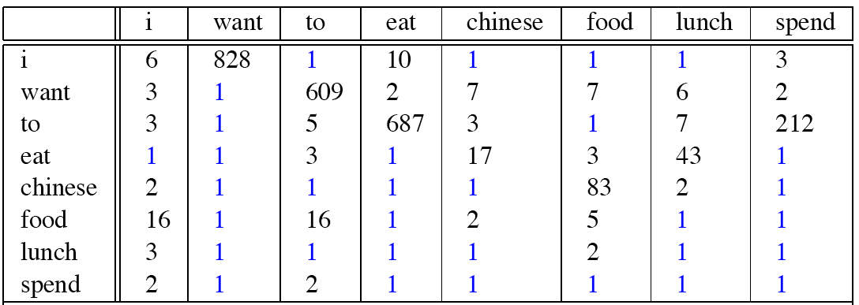
Berkeley Restaurant Corpus: Laplace smoothed bigram counts

Slide 80

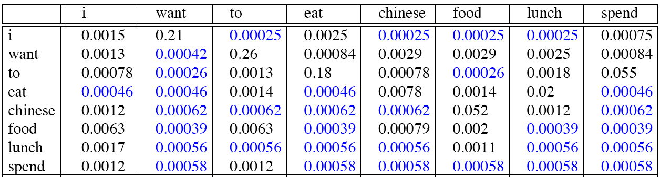
Laplace-smoothed bigrams

Slide 81
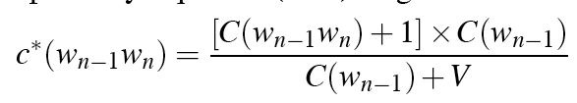
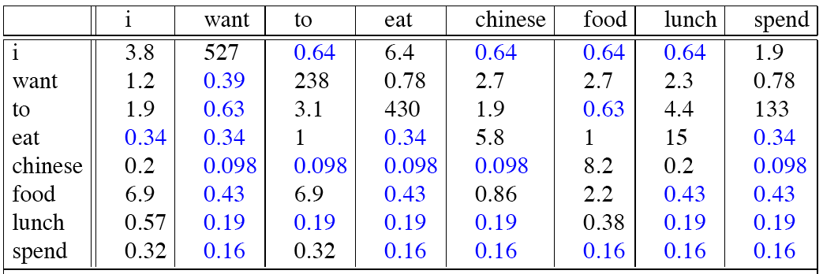
Reconstituted counts

Slide 82
Compare with raw bigram counts
Notes:
C(want to) went from 608 to 238, P(to|want) from .66 to .26!
Discount d= c*/c
d for “chinese food” =.10!!! A 10x reduction

Slide 83
Add-1 estimation is a blunt instrument
So add-1 isn’t used for N-grams:
  We’ll see better methods
But add-1 is used to smooth other NLP models
  In domains where the number of zeros isn’t so huge.

Slide 84
Unigram Smoothing Example
Tiny Corpus, V=4; N=20
Word | True Ct | Unigram Prob | New Ct | Adjusted Prob
eat | 10 | .5 | ? | ?
British | 4 | .2 | 5 | .21
food | 6 | .3 | 7 | .29
happily | 0 | .0 | ? | ?
 | 20 | 1.0 | ~20 | 1.0
Notes:
Cut 11, .46 and 1, .04

Slide 85
Language Modeling
Interpolation, Backoff, and Web-Scale LMs

Slide 86
Backoff and Interpolation
Sometimes it helps to use less context
  Condition on less context for contexts you haven’t learned much about
Backoff:
  use trigram if you have good evidence,
  otherwise bigram, otherwise unigram
Interpolation:
  mix unigram, bigram, trigram
Interpolation works better

Slide 87
Backoff and interpolation
p(zombie | see the) vs. p(baby | see the)
  What if count(see the ngram) = count(see the baby) = 0?
  baby beats ngram as a unigram
  the baby beats the ngram as a bigram
  ∴ see the baby beats see the ngram ?
  (even if both have the same count, such as 0)
600.465 - Intro to NLP - J. Eisner
87

Slide 88
Class-Based Backoff
Back off to the class rather than the word
  Particularly useful for proper nouns (e.g., names)
  Use count for the number of names in place of the particular name
  E.g. < N | friendly > instead of < dog | friendly>
Notes:
88

Slide 89
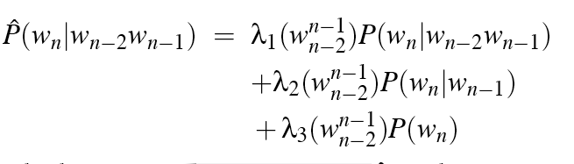
Linear Interpolation
Simple interpolation
Lambdas conditional on context:

Slide 90
How to set the lambdas?
Use a held-out corpus
Choose λs to maximize the probability of held-out data:
  Fix the N-gram probabilities (on the training data)
  Then search for λs that give largest probability to held-out set:
Training Data
Held-Out Data
Test
Data

Slide 91
Unknown words: Open versus closed vocabulary tasks
If we know all the words in advanced
  Vocabulary V is fixed
  Closed vocabulary task
Often we don’t know this
  Out Of Vocabulary = OOV words
  Open vocabulary task
Instead: create an unknown word token <UNK>
  Training of <UNK> probabilities
    Create a fixed lexicon L of size V
    At text normalization phase, any training word not in L changed to <UNK>
    Now we train its probabilities like a normal word
  At decoding time
    If text input: Use UNK probabilities for any word not in training

Slide 92
Huge web-scale n-grams
How to deal with, e.g., Google N-gram corpus
Pruning
  E.g., only store N-grams with count > threshold.
    Remove singletons of higher-order n-grams
Efficient data structures, etc.

Slide 93
N-gram Smoothing Summary
Add-1 smoothing:
  OK for some tasks, but not for language modeling
See text for
  The most commonly used method:
    Extended Interpolated Kneser-Ney
  For very large N-grams like the Web:
    Stupid backoff

Slide 94
Other Applications
N-grams are not only for words
  Characters
  Sentences

Slide 95
More examples
Yoav’s blog post: http://nbviewer.jupyter.org/gist/yoavg/d76121dfde2618422139
10-gram character-level LM:
First Citizen: Nay, then, that was hers, It speaks against your other service: But since the youth of the circumstance be spoken: Your uncle and one Baptista's daughter.
SEBASTIAN: Do I stand till the break off.
BIRON:
Hide thy head.

Slide 96
Example: Language ID
“Horses and Lukasiewicz are on the curriculum.”
  Is this English or Polish or ??
Let’s use n-gram models …
Space of outcomes will be character sequences (x₁, x₂, x₃, …)

Slide 97
Language ID: Problem Formulation
Let p(X) = probability of text X in English
Let q(X) = probability of text X in Polish
Which probability is higher?
  (we’d also like bias toward English since it’s more likely a priori – ignore that for now)
“Horses and Lukasiewicz are on the curriculum.”
p(x₁=h, x₂=o, x₃=r, x₄=s, x₅=e, x₆=s, …)

Slide 98
Apply the Chain Rule
p(x₁=h, x₂=o, x₃=r, x₄=s, x₅=e, x₆=s, …)
= p(x₁=h)
* p(x₂=o | x₁=h)
* p(x₃=r | x₁=h, x₂=o)
* p(x₄=s | x₁=h, x₂=o, x₃=r)
* p(x₅=e | x₁=h, x₂=o, x₃=r, x₄=s)
* p(x₆=s | x₁=h, x₂=o, x₃=r, x₄=s, x₅=e)
* …
4470/ 52108
395/ 4470
5/ 395
3/ 5
3/ 3
0/ 3
counts from Brown corpus
= 0

Slide 99
Use Bigrams
p(x₁=h, x₂=o, x₃=r, x₄=s, x₅=e, x₆=s, …)
≈ p(x₁=h)
* p(x₂=o | x₁=h)
* p(x₃=r | x₁=h, x₂=o)
* p(x₄=s | x₂=o, x₃=r)
* p(x₅=e | x₃=r, x₄=s)
* p(x₆=s | x₄=s, x₅=e)
* … = 7.3e-10 * …
4470/ 52108
395/ 4470
5/ 395
12/ 919
12/ 126
3/ 485
counts from Brown corpus

Slide 100
English vs. Polish?
N-gram Model
English
compute
p(X)
Polish
compute
q(X)
compare
Compare!

Slide 101
Chapter Summary
N-gram probabilities can be used to estimate the likelihood
  Of a word occurring in a context (N-1)
  Of a sentence occurring at all
Perplexity can be used to evaluate the goodness of fit of a LM
Smoothing techniques and backoff models deal with problems of unseen words in corpus
  Improvement via algorithm versus big data

