Slide 1
Regular Expressions, Text Normalization, Edit Distance
Chapter 2

Slide 2
Basic Text Processing
Regular Expressions

Slide 3
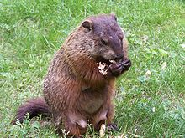
Regular expressions
A formal language for specifying text strings
How can we search for any of these?
  woodchuck
  woodchucks
  Woodchuck
  Woodchucks
  Ill vs. illness
  color vs. colour

Slide 4
Example
Does $> grep “elect” news.txt return every line in a file called news.txt that contains the word “elect”
  elect
    Misses capitalized examples
  [eE]lect
    Incorrectly returns select or electives
  [^a-zA-Z][eE]lect[^a-zA-Z]

Slide 5
Errors
The process we just went through was based on fixing two kinds of errors
  Matching strings that we should not have matched (there, then, other)
    False positives (Type I)
  Not matching things that we should have matched (The)
    False negatives (Type II)

Slide 6
Errors cont.
In NLP we are always dealing with these kinds of errors.
Reducing the error rate for an application often involves two antagonistic efforts:
  Increasing accuracy or precision (minimizing false positives)
  Increasing coverage or recall (minimizing false negatives).

Slide 7
Summary
Regular expressions play a surprisingly large role
  Sophisticated sequences of regular expressions are often the first model for any text processing text
  I am assuming you know, or will learn, in a language of your choice
For many hard tasks, we use machine learning classifiers
  But regular expressions are used as features in the classifiers
  Can be very useful in capturing generalizations

Slide 8
In Class Exercise
Cars that drive themselves — even parking at their
destination — could be ready for sale within a decade,
General Motors Corp. executives say. 'This is not science
fiction,' Larry Burns, GM's vice president for research
and development, said in a recent interview. GM plans
to use an inexpensive computer chip and an antenna to
link vehicles equipped with driverless technologies. The
first use likely would be on highways; people would have
the option to choose a driverless mode while they still
would control the vehicle on local streets, Burns said.
 | ^[^A-Z]
No upper case letters in the line (2, 6, 8, 9)

Slide 9
nitrogen{130} egrep "^[^A-Z]" cars.txt
destination - could be ready for sale within a decade,
fiction,' Larry Burns, GM's vice president for research
and development, said in a recent interview. GM plans
to use an inexpensive computer chip and an antenna to
link vehicles equipped with driverless technologies. The
first use likely would be on highways; people would have
the option to choose a driverless mode while they still
would control the vehicle on local streets, Burns said.

Slide 10
nitrogen{174} egrep '^[^A-Z]+$' cars.txt
destination - could be ready for sale within a decade,
to use an inexpensive computer chip and an antenna to
first use likely would be on highways; people would have
the option to choose a driverless mode while they still

Slide 11
Basic Text Processing
Word tokenization

Slide 12
Text Normalization
Every NLP task needs to do text normalization:
  Segmenting/tokenizing words in running text
  Normalizing word formats
  Segmenting sentences in running text

Slide 13
How many words?
I do uh main- mainly business data processing
  Fragments, filled pauses
Terminology
  Lemma: same stem, part of speech, rough word sense
    cat and cats = same lemma
  Wordform: the full inflected surface form
    cat and cats = different wordforms

Slide 14
How many words?
they lay back on the San Francisco grass and looked at the stars and their
Type: an element of the vocabulary.
Token: an instance of that type in running text.
How many?
  15 tokens (or 14)
  13 types (or 12) (or 11?)

Slide 15
How many words?
N = number of tokens
V = vocabulary = set of types
  |V| is the size of the vocabulary
 | Tokens = N | Types = |V|
Switchboard phone conversations | 2.4 million | 20 thousand
Shakespeare | 884,000 | 31 thousand
Google N-grams | 1 trillion | 13 million

Slide 16
Issues in Tokenization
Finland’s capital →
what’re, I’m, isn’t →
state-of-the-art →
San Francisco →

Slide 17
Issues in Tokenization
Finland’s capital → Finland Finlands Finland’s ?
what’re, I’m, isn’t → What are, I am, is not
state-of-the-art → state of the art ?
San Francisco → one token or two?

Slide 18
Tokenization: language issues
Chinese and Japanese no spaces between words:
  莎拉波娃现在居住在美国东南部的佛罗里达。
  莎拉波娃 现在 居住 在 美国 东南部 的 佛罗里达
  Sharapova now lives in US southeastern Florida

Slide 19
Basic Text Processing
Word Normalization and Stemming

Slide 20
Normalization
Need to “normalize” terms
  Information Retrieval: indexed text & query terms must have same form.
    We want to match U.S.A. and USA
We implicitly define equivalence classes of terms
  e.g., deleting periods in a term
Alternative: asymmetric expansion:
  Enter: windows Search: Windows, windows, window
Potentially more powerful, but less efficient

Slide 21
Case folding
Applications like IR: reduce all letters to lower case
  Since users tend to use lower case
  Possible exception: upper case in mid-sentence?
    e.g., General Motors
    Fed vs. fed
    SAIL vs. sail
For sentiment analysis, MT, Information extraction
  Case is helpful (US versus us is important)

Slide 22
Lemmatization
Reduce inflections or variant forms to base form
  am, are, is → be
  car, cars, car's, cars' → car
the boy's cars are different colors → the boy car be different color
Lemmatization: have to find correct dictionary headword form

Slide 23
Morphology
Morphemes:
  The small meaningful units that make up words
  Stems: The core meaning-bearing units
  Affixes: Bits and pieces that adhere to stems
    Often with grammatical functions

Slide 24
Stemming
Reduce terms to their stems in information retrieval
Stemming is crude chopping of affixes
  language dependent
  e.g., automate(s), automatic, automation all reduced to automat.
for example compressed
and compression are both
accepted as equivalent to
compress.
for exampl compress and
compress ar both accept
as equival to compress

Slide 25
Porter’s algorithm
The most common English stemmer
Step 1a
  sses → ss caresses → caress
  ies → i ponies → poni
  ss → ss caress → caress
  s → ø cats → cat
Step 1b
  (*v*)ing → ø walking → walk
  sing → sing
  (*v*)ed → ø plastered → plaster
  …
Step 2
  ational→ ate relational→ relate
  izer→ ize digitizer → digitize
  ator→ ate operator → operate
  …
Step 3
  al → ø revival → reviv
  able → ø adjustable → adjust
  ate → ø activate → activ
  …

Slide 26
Viewing morphology in a corpus
Why only strip –ing if there is a vowel?
  (*v*)ing → ø walking → walk
  sing → sing

Slide 27
Viewing morphology in a corpus
Why only strip –ing if there is a vowel?
  (*v*)ing → ø walking → walk
  sing → sing
tr -sc 'A-Za-z' '\n' < shakes.txt | grep ’ing$' | sort | uniq -c | sort –nr
tr -sc 'A-Za-z' '\n' < shakes.txt | grep '[aeiou].*ing$' | sort | uniq -c | sort –nr
1312 King
548 being
541 nothing
388 king
375 bring
358 thing
307 ring
152 something
145 coming
130 morning
548 being
541 nothing
152 something
145 coming
130 morning
122 having
120 living
117 loving
116 Being
102 going

Slide 28
Sentence Segmentation
!, ? are relatively unambiguous
Period “.” is quite ambiguous
  Sentence boundary
  Abbreviations like Inc. or Dr.
  Numbers like .02% or 4.3
Build a binary classifier
  Looks at a “.”
  Decides EndOfSentence/NotEndOfSentence
  Classifiers: hand-written rules, regular expressions, or machine-learning

Slide 29
Minimum Edit Distance
Definition and Computation

Slide 30
How similar are two strings?
Spell correction
  The user typed “graffe”
  Which is closest?
    graf
    graft
    grail
    giraffe
Computational Biology
  Align two sequences of nucleotides
  Resulting alignment:
AGGCTATCACCTGACCTCCAGGCCGATGCCC
TAGCTATCACGACCGCGGTCGATTTGCCCGAC
-AGGCTATCACCTGACCTCCAGGCCGA--TGCCC---
TAG-CTATCAC--GACCGC--GGTCGATTTGCCCGAC
Also for Machine Translation, Information Extraction, Speech Recognition

Slide 31
Edit Distance
The minimum edit distance between two strings
Is the minimum number of editing operations
  Insertion
  Deletion
  Substitution
Needed to transform one into the other

Slide 32

Minimum Edit Distance
Two strings and their alignment:

Slide 33
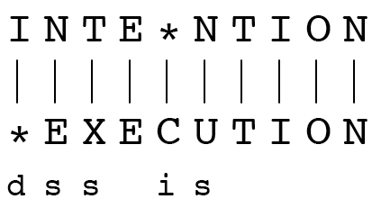
Minimum Edit Distance
If each operation has cost of 1
  Distance between these is 5
If substitutions cost 2 (Levenshtein)
  Distance between them is 8

Slide 34
Other uses of Edit Distance in NLP
Evaluating Machine Translation and speech recognition
R Spokesman confirms senior government adviser was shot
H Spokesman said the senior adviser was shot dead
S I D I
Named Entity Extraction and Entity Coreference
  IBM Inc. announced today
  IBM profits
  Stanford President John Hennessy announced yesterday
  for Stanford University President John Hennessy

Slide 35
ArgRewrite (Profs. Litman & Hwa; subjects needed!)
What’s different about this alignment from prior examples?
Draft 1
The next level is the level for angry people.
Saddam Hussein can be put in this circle.
He is a ruthless dictator and killed many people.
He deserves to be in the level of Hell.
Draft 2
The next level is the level for angry people.
Osama Bin Laden can be put in this circle.
He is a terrorist and killed innocent people.
He deserves to be in the level of Hell.
2-2, Modify, Thesis
3-Null, Delete, Reasoning
Null-3, Add, Reasoning

Slide 36
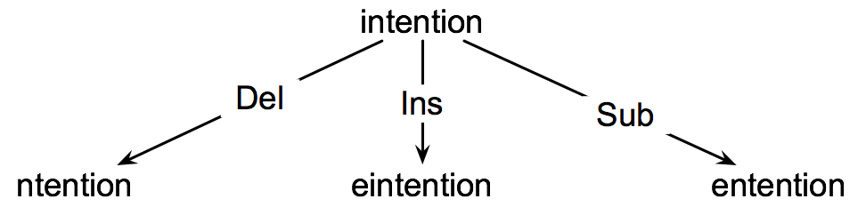
How to find the Min Edit Distance?
Searching (like in CS1571) for a path (sequence of edits) from the start string to the final string:
  Initial state: the word we’re transforming
  Operators: insert, delete, substitute
  Goal state: the word we’re trying to get to
  Path cost: what we want to minimize: the number of edits

Slide 37
Minimum Edit as Search
But the space of all edit sequences is huge!
  We can’t afford to navigate naïvely
  Lots of distinct paths wind up at the same state.
    We don’t have to keep track of all of them
    Just the shortest path to each of those revisted states.

Slide 38
Defining Min Edit Distance
For two strings
  X of length n
  Y of length m
We define D(i,j)
  the edit distance between X[1..i] and Y[1..j]
    i.e., the first i characters of X and the first j characters of Y
  The edit distance between X and Y is thus D(n,m)

Slide 39
Dynamic Programming for
Minimum Edit Distance
Dynamic programming: A tabular computation of D(n,m)
Solving problems by combining solutions to subproblems.
Bottom-up
  We compute D(i,j) for small i,j
  And compute larger D(i,j) based on previously computed smaller values
  i.e., compute D(i,j) for all i (0 < i < n) and j (0 < j < m)

Slide 40
Defining Min Edit Distance (Levenshtein)
Initialization
  D(i,0) = i
  D(0,j) = j
Recurrence Relation:
  For each i = 1…M
  For each j = 1…N
  D(i-1,j) + 1
  D(i,j)= min D(i,j-1) + 1
  D(i-1,j-1) + 2; if X(i) ≠ Y(j)
  0; if X(i) = Y(j)
Termination:
  D(N,M) is distance

Slide 41
The Edit Distance Table
N | 9
O | 8
I | 7
T | 6
N | 5
E | 4
T | 3
N | 2
I | 1
# | 0 | 1 | 2 | 3 | 4 | 5 | 6 | 7 | 8 | 9
 | # | E | X | E | C | U | T | I | O | N

Slide 42
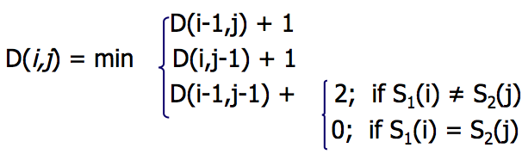
The Edit Distance Table
N | 9
O | 8
I | 7
T | 6
N | 5
E | 4
T | 3
N | 2
I | 1
# | 0 | 1 | 2 | 3 | 4 | 5 | 6 | 7 | 8 | 9
 | # | E | X | E | C | U | T | I | O | N

Slide 43
Edit Distance
N | 9
O | 8
I | 7
T | 6
N | 5
E | 4
T | 3
N | 2
I | 1
# | 0 | 1 | 2 | 3 | 4 | 5 | 6 | 7 | 8 | 9
 | # | E | X | E | C | U | T | I | O | N

Slide 44
The Edit Distance Table
N | 9 | 8 | 9 | 10 | 11 | 12 | 11 | 10 | 9 | 8
O | 8 | 7 | 8 | 9 | 10 | 11 | 10 | 9 | 8 | 9
I | 7 | 6 | 7 | 8 | 9 | 10 | 9 | 8 | 9 | 10
T | 6 | 5 | 6 | 7 | 8 | 9 | 8 | 9 | 10 | 11
N | 5 | 4 | 5 | 6 | 7 | 8 | 9 | 10 | 11 | 10
E | 4 | 3 | 4 | 5 | 6 | 7 | 8 | 9 | 10 | 9
T | 3 | 4 | 5 | 6 | 7 | 8 | 7 | 8 | 9 | 8
N | 2 | 3 | 4 | 5 | 6 | 7 | 8 | 7 | 8 | 7
I | 1 | 2 | 3 | 4 | 5 | 6 | 7 | 6 | 7 | 8
# | 0 | 1 | 2 | 3 | 4 | 5 | 6 | 7 | 8 | 9
 | # | E | X | E | C | U | T | I | O | N

Slide 45
Computing alignments
Edit distance isn’t sufficient
  We often need to align each character of the two strings to each other
We do this by keeping a “backtrace”
Every time we enter a cell, remember where we came from
When we reach the end,
  Trace back the path from the upper right corner to read off the alignment

Slide 46
In Class Exercise
Using 1-insertion, 1-deletion, 2-substitution costs, compute the minimum distance between drive (left column) and brief (bottom row)

Slide 47
Weighted Edit Distance
Why would we add weights to the computation?
  Spell Correction: some letters are more likely to be mistyped than others
  Biology: certain kinds of deletions or insertions are more likely than others
Also other variants on basic algorithm (e.g., global context)

Slide 48
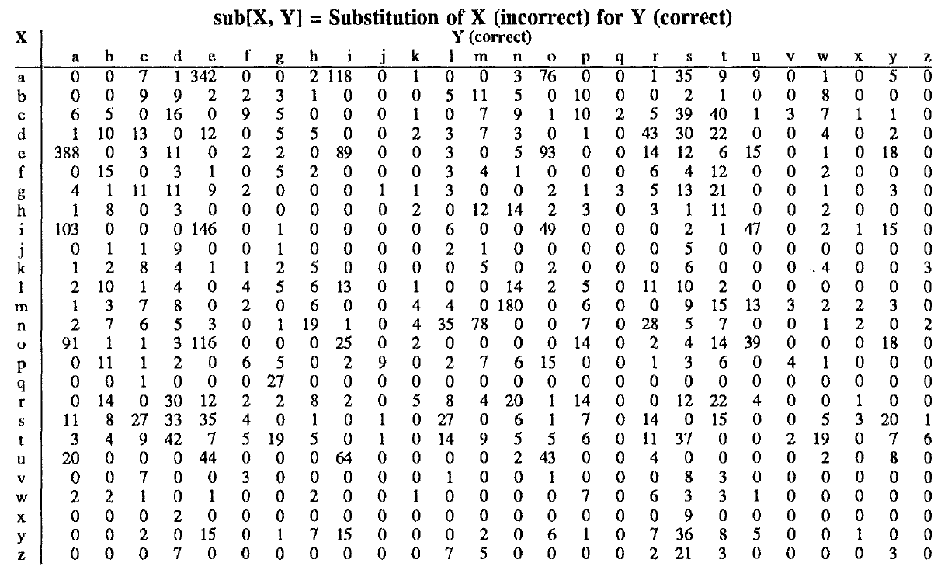
Confusion matrix for spelling errors

Slide 49
