Slide 1
Vector Semantics
Dense Vectors
(based on Jurafsky, TensorFlow)

Slide 2
Three Perspectives on Meaning
Lexical Semantics
  The meanings of individual words
Formal Semantics (or Compositional Semantics or Sentential Semantics)
  How those meanings combine to make meanings for individual sentences or utterances (see skipped chapters)
Discourse or Pragmatics
  How those meanings combine with each other and with other facts about various kinds of context to make meanings for a text or discourse
  Dialog or Conversation is often lumped together with Discourse

Slide 3
Lexical Semantics
Focus on word meanings:
  Relations of meaning among words
  Internal meaning structure of words (current chapters)

Slide 4
The old days: words were represented as discrete, atomic symbols
  Prof. Litman = prof1
  Prof. Hwa = prof2
  Teach(prof1,NLP17)
  Teach(prof2,NLP16)
  ids are arbitrary, atomic, led to data sparsity…
Last class: sparse vectors
  still had data sparsity problems
Today’s class: dense vectors
  Count then reduce
  Parameters of prediction model

Slide 5
Review: Context vector
Consider a target word w
One binary feature f_{i} for each of the N words in the lexicon v_{i}
Which means “word v_{i} occurs in the neighborhood of w”
w=(f₁,f₂,f₃,…,f_{N})

Slide 6
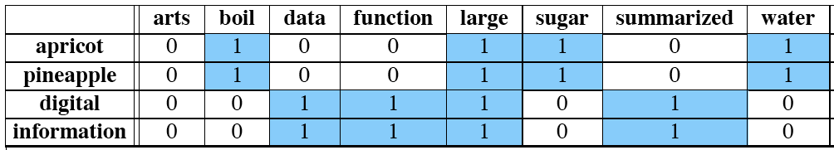
Intuition
Define two words by these sparse features vectors
Apply a vector distance metric
Say that two words are similar if two vectors are similar

Slide 7
Distributional similarity
So just need to specify 3 things
  How the co-occurrence terms are defined
  How terms are weighted
    (Frequency? Logs? Mutual information?)
  What vector distance metric to use?
    Cosine? Euclidean distance?

Slide 8
Defining co-occurrence vectors
Could have windows of neighboring words
  Bag-of-words
  Generally remove stopwords
But the vectors are still very sparse
So instead of using ALL the words in the neighborhood could use the words occurring in particular relations
Notes:
here

Slide 9
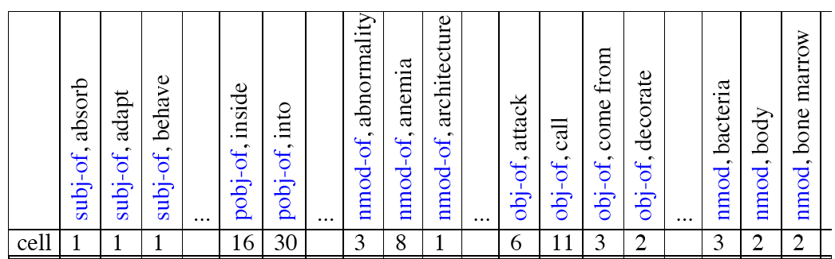
Co-occurrence vectors based on dependencies
For the word “cell”: vector of NxR features
  R is the number of dependency relations

Slide 10
2. Weighting the counts
(“Measures of association with context”)
Use the frequency of some feature as its weight or value
But could use any function of this frequency

Slide 11
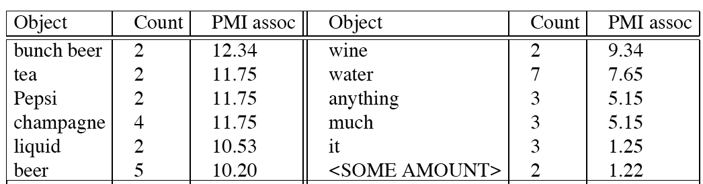
Intuition: why not frequency
“drink it” is more common than “drink wine”
But “wine” is a better “drinkable” thing than “it”
Idea:
  We need to control for chance (expected frequency)
  We do this by normalizing by the expected frequency we would get assuming independence

Slide 12
Sparse versus dense vectors
PPMI vectors are
  long (length |V|= 20,000 to 50,000)
  sparse (most elements are zero)
Alternative: learn vectors which are
  short (length 200-1000)
  dense (most elements are non-zero)

Slide 13
Sparse versus dense vectors
Why dense vectors?
  Short vectors may be easier to use as features in machine learning (less weights to tune)
  Dense vectors may generalize better than storing explicit counts
  They may do better at capturing synonymy:
    car and automobile are synonyms; but are represented as distinct dimensions; this fails to capture similarity between a word with car as a neighbor and a word with automobile as a neighbor

Slide 14
Three methods for getting short dense vectors
Singular Value Decomposition (SVD)
  A special case of this is called LSA – Latent Semantic Analysis
“Neural Language Model”-inspired predictive models
  skip-grams and CBOW
Brown clustering

Slide 15
Vector Semantics
Dense Vectors via SVD

Slide 16
Intuition
Approximate an N-dimensional dataset using fewer dimensions
By first rotating the axes into a new space
In which the highest order dimension captures the most variance in the original dataset
And the next dimension captures the next most variance, etc.
Many such (related) methods:
  PCA – principle components analysis
  Factor Analysis
  SVD

Slide 17
Dimensionality reduction

Slide 18
Singular Value Decomposition
Any rectangular w x c matrix X equals the product of 3 matrices:
W: rows corresponding to original but m columns represents a dimension in a new latent space, such that
  M column vectors are orthogonal to each other
  Columns are ordered by the amount of variance in the dataset each new dimension accounts for
S: diagonal m x m matrix of singular values expressing the importance of each dimension.
C: columns corresponding to original but m rows corresponding to singular values

Slide 19
SVD applied to term-document matrix:
Latent Semantic Analysis
Deerwester et al (1988)
If instead of keeping all m dimensions, we just keep the top k singular values. Let’s say 300.
But instead of multiplying, we’ll just make use of W.
Each row of W:
  A k-dimensional vector
  Representing word W

Slide 20
LSA more details
300 dimensions are commonly used
The cells are commonly weighted by a product of two weights
  Local weight: Log term frequency
  Global weight: either idf or an entropy measure

Slide 21
Let’s return to PPMI word-word matrices
Can we apply to SVD to them?

Slide 22
SVD applied to term-term matrix
(simplifying by assuming the matrix has rank |V|)

Slide 23
Truncated SVD on term-term matrix

Slide 24
Truncated SVD produces embeddings
Each row of W matrix is a k-dimensional representation of each word w
K might range from 50 to 1000
Generally we keep the top k dimensions, but some experiments suggest that getting rid of the top 1 dimension or even the top 50 dimensions is helpful (Lapesa and Evert 2014).

Slide 25
Embeddings versus sparse vectors
Dense SVD embeddings sometimes work better than sparse PPMI matrices at tasks like word similarity
  Denoising: low-order dimensions may represent unimportant information
  Truncation may help the models generalize better to unseen data.
  Having a smaller number of dimensions may make it easier for classifiers to properly weight the dimensions for the task.
  Dense models may do better at capturing higher order co-occurrence.

Slide 26
Vector Semantics
Embeddings inspired by neural language models: skip-grams and CBOW

Slide 27
Prediction-based models:
An alternative way to get dense vectors
Skip-gram (Mikolov et al. 2013a) CBOW (Mikolov et al. 2013b)
Learn embeddings as part of the process of word prediction.
Train a neural network to predict neighboring words
    Inspired by neural net language models.
    In so doing, learn dense embeddings for the words in the training corpus.
Advantages:
  Fast, easy to train (much faster than SVD)
  Available online in the word2vec package
  Including sets of pretrained embeddings!

Slide 28
CBOW
  Predict “mat” from “the cat sits on the”
  Better for smaller corpora
Skip-gram
  Prediction goes the other way around

Slide 29
Neural Probabilistic Language Models
Maximize the probability of the word w_{t} (for “target”) given the previous words h (for “history”) in terms of a softmax function
  P(w_{t} |h) = softmax(score(w_{t} ,h))
Score: computes word/history compatibility (typically dot-product)
Softmax: squashes a vector of real values to a vector of real values in the range (0,1) that add up to 1

Slide 30
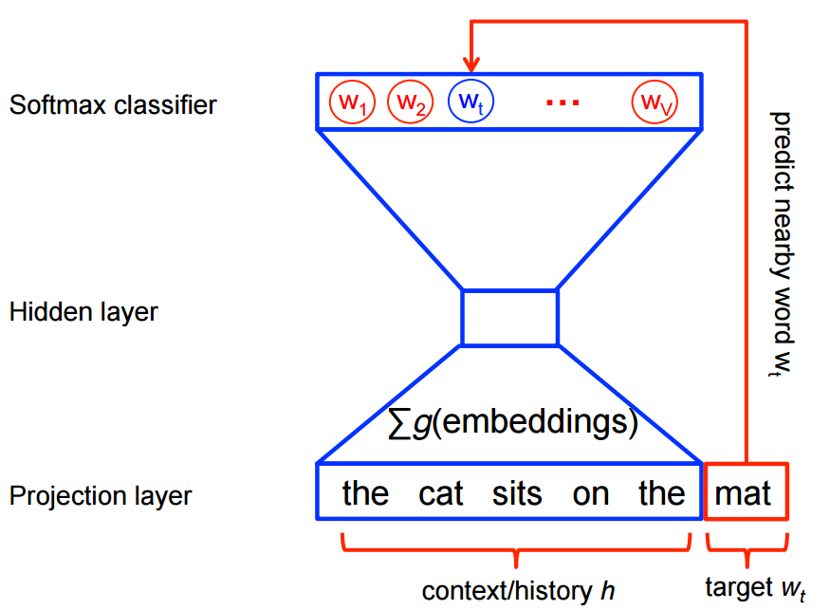
Add 2 pics from TensorFlow
Very expensive, because need to compute and normalize each probability using the score for all other words in the current context , at every training step.

Slide 31
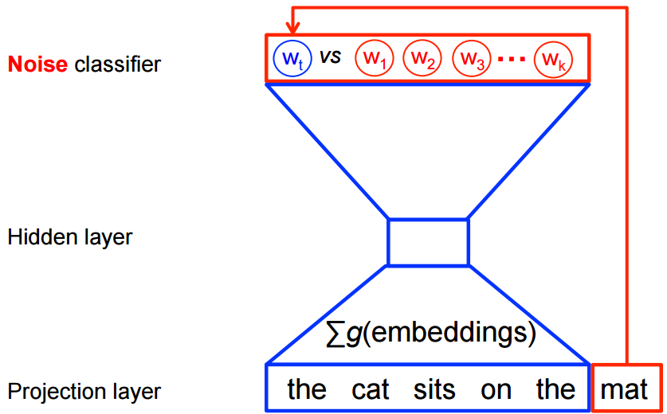
The CBOW and skip-gram models are instead trained using a binary classification objective (logistic regression) to discriminate the real target words from imaginary (noise) words , in the same context

Slide 32
The Skip-gram Model: An Example
Dataset: the quick brown fox jumped over the lazy dog
Dataset of (context, target) pairs with window size of 1
  ([the, brown], quick), ([quick, fox], brown), ([brown, jumped], fox), …
Since skip-gram tries to predict each context word from its target word, dataset becomes (input, output) pairs
  (quick, the), (quick, brown), (brown, quick), (brown, fox), ….
Training step to predict the from quick, need noisy examples (e.g., sheep) to optimize model discriminating real from noise words

Slide 33
Skip-grams
Predict each neighboring word
  in a context window of 2C words
  from the current word.
So for C=2, we are given word w_{t} and predicting these 4 words:

Slide 34
Skip-grams learn 2 embeddings for each w
Input embedding v, in the matrix W
Column i of the matrix W is the 1×d embedding v_{i} for word i in the vocabulary.
Output embedding v′, in matrix W’
Row i of the matrix W′ is a d × 1 vector embedding v′_{i} for word i in the vocabulary.

Slide 35
Setup
Walking through corpus pointing at word w(t), whose index in the vocabulary is j, so we’ll call it w_{j} (1 < j < |V |).
Let’s predict w(t+1) , whose index in the vocabulary is k (1 < k < |V |). Hence our task is to compute P(w_{k}|w_{j}).
  The heart is computing the dot product between the context vector for w_{k} and the target vector for w_{j}

Slide 36
Intuition: similarity as dot-product between a target vector and context vector

Slide 37
Similarity is computed from dot product
Remember: two vectors are similar if they have a high dot product
  Cosine is just a normalized dot product
We’ll need to normalize to get a probability
  softmax

Slide 38
Embeddings from W and W’
Since we have two embeddings, v_{j} and c_{j} for each word w_{j}
We can either:
  Just use v_{j}
  Sum them
  Concatenate them to make a double-length embedding

Slide 39
Learning
Start with some initial embeddings (e.g., random)
iteratively make the embeddings for a word
  more like the embeddings of its neighbors
  less like the embeddings of other words.

Slide 40
Problem with the softamx
Have to compute over every word in vocab
Instead: just sample a few of those negative words

Slide 41
Goal in learning
Make the word like the context words
We want this to be high:
And not like k randomly selected “noise words”
We want this to be low:

Slide 42
Properties of embeddings
Nearest words to some embeddings (Mikolov et al. 2013)

Slide 43
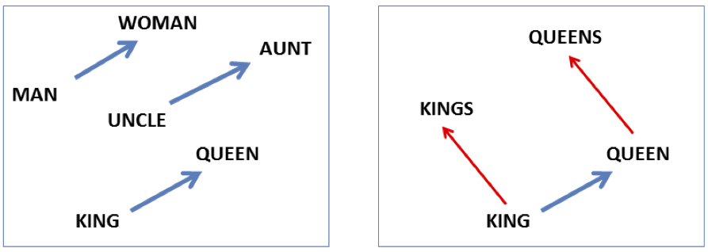

Embeddings capture relational meaning!
vector(‘king’) - vector(‘man’) + vector(‘woman’) $≈$vector(‘queen’)
vector(‘Paris’) - vector(‘France’) + vector(‘Italy’) $≈$ vector(‘Rome’)

Slide 44
Vector Semantics
Brown clustering

Slide 45
Brown clustering
A clustering algorithm that clusters words based on which words precede or follow them
These word clusters can be turned into a kind of vector

Slide 46
Brown clustering algorithm
Each word is initially assigned to its own cluster.
We now consider consider merging each pair of clusters. Highest quality merge is chosen.
  Quality = merges two words that have similar probabilities of preceding and following words
  (More technically quality = smallest decrease in the likelihood of the corpus according to a class-based language model)
Clustering proceeds until all words are in one big cluster.

Slide 47
Brown Clusters as vectors
By tracing the order in which clusters are merged, the model builds a binary tree from bottom to top.
Each word represented by binary string = path from root to leaf
Each intermediate node is a cluster
Chairman is 0010, “months” = 01, and verbs = 1

Slide 48
Brown cluster examples

Slide 49
Class-based language model
Suppose each word was in some class c_{i:}

Slide 50
Summary
Singular Value Decomposition (SVD)
  Create lower dimensional embeddings from
    a full term-term matrix
    a term-document matrix (e.g., Latent Semantic Analysis)
Algorithms inspired by neural language models (word prediction)
  Skip-gram, CBOW
  Find embeddings that have high dot-product with neighboring words and low dot-product with noise words
Brown Clustering
  Word grouping based on relationship with neighboring words, then create vectors

