Slide 1
Project update, V2
First zero because Python code is trying to compile and run Java code, and that part failed. Still have operating system related issues
Last zero because output format is incorrect. Output contains only the label column, which is the right format scorer.py requires (there should be three columns, head, body, and label).
GO TO YUHUAN’S OFFICE HOURS!!!!!!!!!!!!!!!!!!!!!!!!!!!!!!!!!!!!!!!
Team | Score
- | 0
- | 0.069
- | 0.732
- | 0.738
- | 0.809
- | 0

Slide 2
Question Answering

Slide 3
Question-Answering Systems
Beyond retrieving relevant documents -- Do people want answers to particular questions?
One of the oldest problem in NLP
Different kinds of systems
  Finding answers in document collections (www, encylopeida, books, manuals, medical literature, scientific papers, etc.)
  Interfaces to relational databases
  Mixed initiative dialog systems
A scientific reason to do Q/A: the ability to answer questions about a story is the hallmark of understanding.

Slide 4
Question Answering: IBM’s Watson
Won Jeopardy on February 16, 2011!
WILLIAM WILKINSON’S
“AN ACCOUNT OF THE PRINCIPALITIES OF
WALLACHIA AND MOLDOVIA”
INSPIRED THIS AUTHOR’S
MOST FAMOUS NOVEL
Bram Stoker

Slide 5
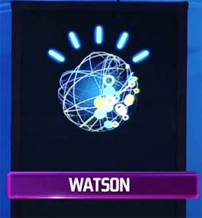
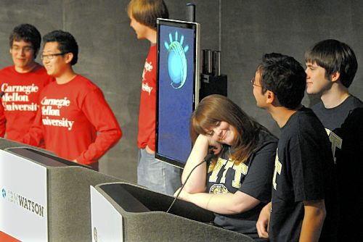

Slide 6
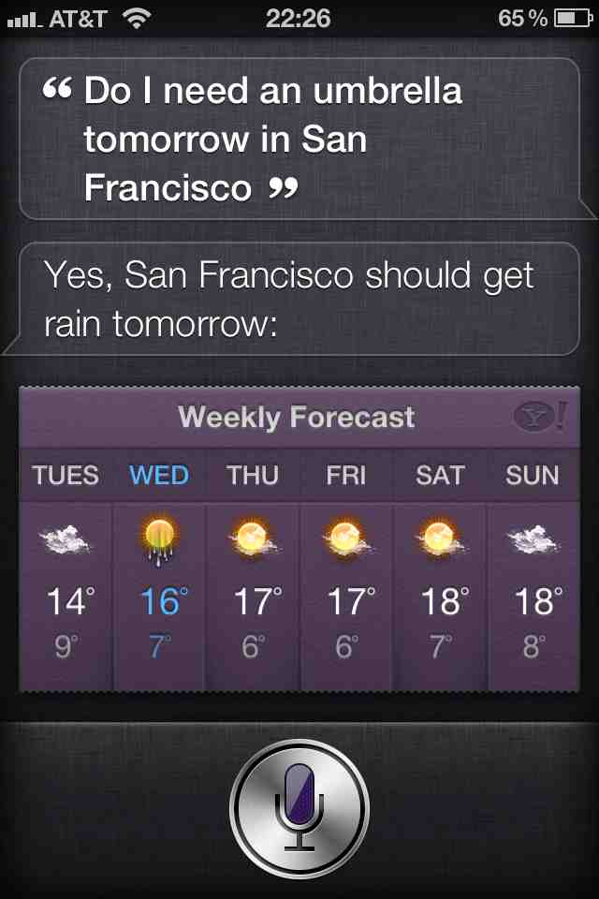
Apple’s Siri

Slide 7
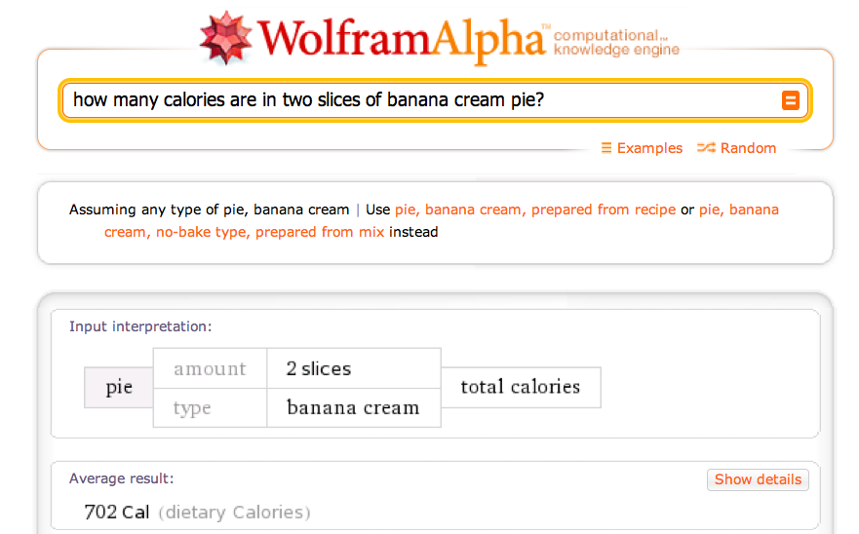

Slide 8
Multiple Document Question Answering
A multiple document Q/A task involves questions posed against a collection of documents.
The answer may appear in the collection multiple times, or may not appear at all! For this task, it doesn’t matter where the answer is found.
Applications include WWW search engines, and searching text repositories such as news archives, medical literature, or scientific articles.

Slide 9
TREC-9 Q/A Task
Number of Documents: 979,000
Megabytes of Text: 3033
Document Sources: AP, WSJ, Financial Times, San Jose Mercury News,
LA Times, RBIS
Number of Questions: 682
Question Sources: Encarta log, Excite log
Sample questions:
How much folic acid should an expectant mother get daily?
Who invented the paper clip?
What university was Woodrow Wilson president of?
Where is Rider College located?
Name a film in which Jude law acted.
Where do lobsters like to live?

Slide 10
TREC (Text REtrieval Conference) and ACQUAINT
TREC-10: new questions from MSNSearch logs and AskJeeves, some of which have no answers, or require fusion across documents
List questions: Name 32 countires Pope John Paul II has visited.
“Dialogue” processing: Which museum in Florence was damaged by a major bomb explision in 1993? On what day did this happen?
ACQUAINT : Advanced Question and Answering for INTelligence (e.g., beyond factoids, the Multiple Perspective Q-A work at Pitt)
Current tracks at http://trec.nist.gov/tracks.html

Slide 11
Single Document Question Answering
A single document Q/A task involves questions associated with one particular document.
In most cases, the assumption is that the answer appears somewhere in the document and probably once.
Applications involve searching an individual resource, such as a book, encyclopedia, or manual.
Reading comprehension tests are also a form of single document question answering.

Slide 12
Reading Comprehension Tests
Mars Polar Lander- Where Are You?
(January 18, 2000) After more than a month of searching for a single sign from NASA’s Mars Polar Lander, mission controllers have lost hope of finding it. The Mars Polar Lander was on a mission to Mars to study its atmosphere and search for water, something that could help scientists determine whether life even existed on Mars. Polar Lander was to have touched down on December 3 for a 90-day mission. It was to land near Mars’ south pole. The lander was last heard from minutes before beginning its descent. The last effort to communicate with the three-legged lander ended with frustration at 8 a.m. Monday. “We didn’t see anything,” said Richard Cook, the spacecraft’s project manager at NASA’s Jest Propulsion laboratory. The failed mission to the Red Planet cost the American government more the $200 million dollars. Now, space agency scientists and engineers will try to find out what could have gone wrong. They do not want to make the same mistakes in the next mission.
  When did the mission controllers lost Hope of communication with the Lander? (Answer: 8AM, Monday Jan. 17)
  Who is the Polar Lander’s project manager? (Answer: Richard Cook)
  Where on Mars was the spacecraft supposed to touch down? (Answer: near Mars’ south pole)
  What was the mission of the Mars Polar Lander? (Answer: to study Mars’ atmosphere and search for water)

Slide 13
Question Types
  Simple (factoid) questions (most commercial systems)
    Who wrote the Declaration of Independence?
    What is the average age of the onset of autism?
    Where is Apple Computer based?
  Complex (narrative) questions
    What do scholars think about Jefferson’s position on dealing with pirates?
    What is a Hajj?
    In children with an acute febrile illness, what is the efficacy of single medication therapy with acetaminophen or ibuprofen in reducing fever?
  Complex (opinion) questions
    Was the Gore/Bush election fair?

Slide 14
Commercial systems: mainly factoid questions
Where is the Louvre Museum located? | In Paris, France
What’s the abbreviation for limited partnership? | L.P.
What are the names of Odin’s ravens? | Huginn and Muninn
What currency is used in China? | The yuan
What kind of nuts are used in marzipan? | almonds
What instrument does Max Roach play? | drums
What is the telephone number for Stanford University? | 650-723-2300

Slide 15
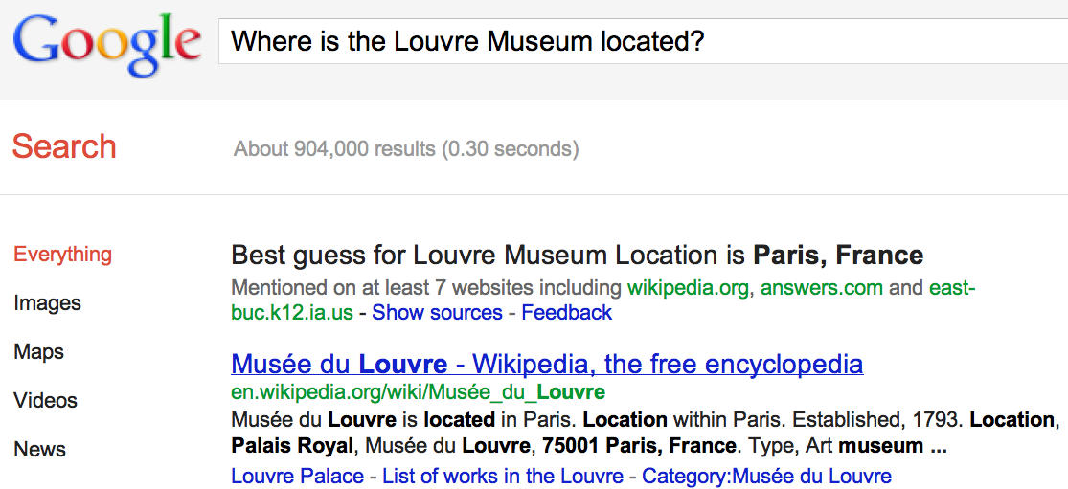
IR-based Question Answering
(e.g., TREC, Google)
a

Slide 16
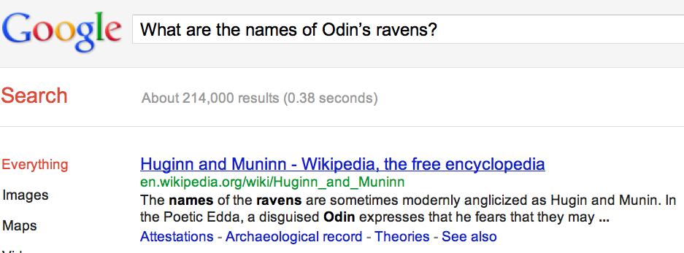
Many questions can already be answered by web search

Slide 17
IR-Based (Corpus-based) Approaches
(As opposed to knowledge-based ones)
We assume an Information Retrieval (IR) system with an index into documents that plausibly contain the answer(s) to likely questions.
And that the IR system can find plausibly relevant documents in that collection given the words in a user’s question.

Slide 18
Knowledge-based Approaches (e.g., Siri)
Build a semantic representation of the query
  Times, dates, locations, entities, numeric quantities
Map from this semantics to query structured data or resources
  Geospatial databases
  Ontologies (Wikipedia infoboxes, dbPedia, WordNet)
  Restaurant review sources and reservation services
  Scientific databases

Slide 19
Hybrid approaches (IBM Watson)
Build a shallow semantic representation of the query
Generate answer candidates using IR methods
  Augmented with ontologies and semi-structured data
Score each candidate using richer knowledge sources
  Geospatial databases
  Temporal reasoning
  Taxonomical classification

Slide 20
Corpus-Based Approaches
Factoid questions
  From a smallish collection of relevant documents
  Extract the answer (or a snippet that contains the answer)
Complex questions
  From a smallish collection of relevant documents
  Summarize those documents to address the question
    Query-focused summarization

Slide 21
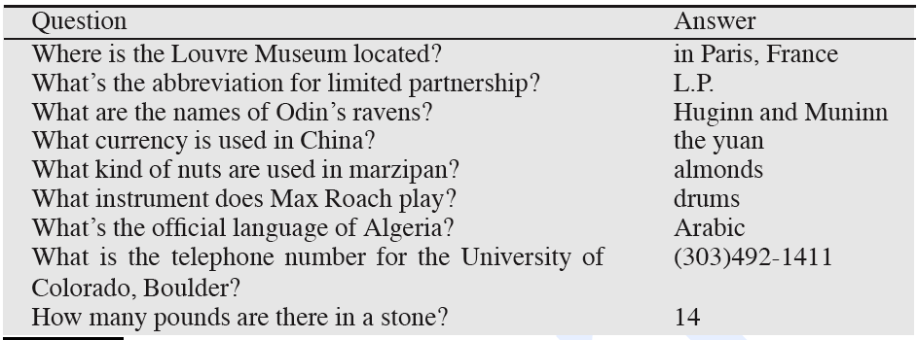
Factoid questions

Slide 22
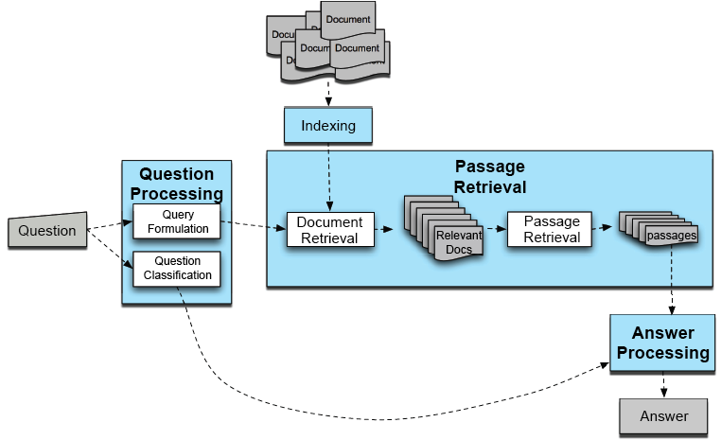
IR-based Factoid Q/A

Slide 23
Full-Blown System
QUESTION PROCESSING
  Parse and analyze question / Determine type of the answer
    i.e., detect question type, answer type, focus, relations
  Formulate queries suitable for use with IR/search engine
PASSAGE RETRIEVAL
  Retrieve ranked results
  Break into suitable passages and rerank
ANSWER PROCESSING
  Perform NLP on those to extract candidate answers
  Rank candidates based on NLP processing
    Using evidence from text and external sources

Slide 24
Question Processing
Two tasks
  Answer Type Detection
    what kind of entity (person, place) is the answer?
  Query Formulation
    what is the query to the IR system
We extract both of these from the question
  keywords for query to the IR system
  an answer type

Slide 25
Things to extract from the question
Answer Type Detection
  Decide the named entity type (person, place) of the answer
Query Formulation
  Choose query keywords for the IR system
Question Type classification
  Is this a definition question, a math question, a list question?
Focus Detection
  Find the question words that are replaced by the answer
Relation Extraction
  Find relations between entities in the question

Slide 26
  Question Processing
  They’re the two states you could be reentering if you’re crossing Florida’s northern border
Answer Type:
Query:
Focus:
Relations:

Slide 27
  Question Processing
  They’re the two states you could be reentering if you’re crossing Florida’s northern border
Answer Type: US state
Query: two states, border, Florida, north
Focus: the two states
Relations: borders(Florida, ?x, north)

Slide 28
Factoid Q/A

Slide 29
Answer Type Detection: Named Entities
Who founded Virgin Airlines?
  PERSON.
What Canadian city has the largest population?
  CITY.

Slide 30
Answer Types Can Be Complicated
Who questions can have organizations or countries as answers
  Who sells the most hybrid cars?
  Who exports the most wheat?

Slide 31
Answer Types
Factoid questions…
  Who, where, when, how many…
    Who questions are going to be answered by…
    Where questions…
  Simplest: use Named Entities

Slide 32
Sample Text
Consider this sentence:
President George Bush announced a new bill that would send $1.2 million dollars to Miami Florida for a new hurricane tracking system.
After applying a Named Entity Tagger, the text might look like this:
<Person=“President George Bush”> announced a new bill that would send <MONEY=$1.2 million dollars”> to <LOCATION=“Miami Florida:”> for a new hurricane tracking system.

Slide 33
Rules for Name Entity Tagging
Many Named Entity Taggers use simple rules that are developed by hand. Most rules use the following types of clues:
Keywords: Ex. “Mr.”, “Corp.”, “city”
Common Lists: Ex. Cities, countries, months of the year, common first names, common last names
Special Symbols: Ex. Dollar signs, percent signs
Structured Phrases: Ex. Dates often appear as “MONTH, DAY #, YEAR”
Syntactic Patterns: (more rarely) Ex. “LOCATIONS_NP, LOCATION_NP” is usually a single location (e.g. Boston, Massachusetts).

Slide 34
Named Entities
If we are looking for questions whose Answer Type is CITY
  We have to have a “CITY” named-entity detector
So if we have a rich set of answer types
  We also have to build answer-detectors for each of those types!

Slide 35
Answer Type Taxonomy
(from Li & Roth, 2002)
Two-layered taxonomy
6 coarse classes
  ABBEVIATION, ENTITY, DESCRIPTION, HUMAN, LOCATION, NUMERIC_VALUE
50 fine classes
  HUMAN: group, individual, title, description
  ENTITY: animal, body, color, currency…
  LOCATION: city, country, mountain…

Slide 36
Answer Type Taxonomy (2/2)
distance
size
speed
…
money
weight
date
other
NUMERIC
…
abbreviation
country
LOCATION
ABBREVIATION
expression
city
DESCRIPTION
definition
group
…
HUMAN
individual
manner
…
ENTITY
description
reason
animal
…
vehicle
body
color

Slide 37
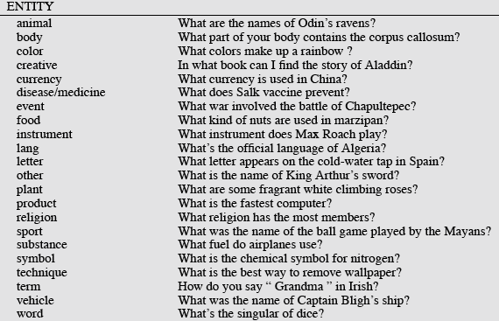
Answer Types

Slide 38
More Answer Types

Slide 39
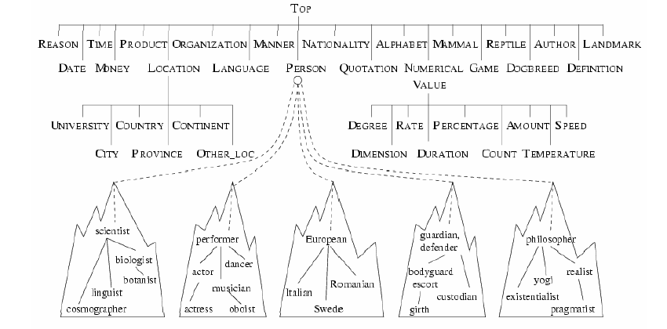
Another Taxonomy of Answer Types
Contains ~9000 concepts reflecting expected answer types
Merges NEs with the WordNet hierarchy

Slide 40
Answer types in Jeopardy
Ferrucci et al. 2010. Building Watson: An Overview of the DeepQA Project. AI Magazine. Fall 2010. 59-79.
2500 answer types in 20,000 Jeopardy question sample
The most frequent 200 answer types cover < 50% of data
The 40 most frequent Jeopardy answer types
he, country, city, man, film, state, she, author, group, here, company, president, capital, star, novel, character, woman, river, island, king, song, part, series, sport, singer, actor, play, team, show, actress, animal, presidential, composer, musical, nation, book, title, leader, game

Slide 41
Answer Type Detection
Hand-written rules
Machine Learning
Hybrids

Slide 42
Answer Type Detection
Regular expression-based rules can get some cases:
  Who {is|was|are|were} PERSON
  PERSON (YEAR – YEAR)
Make use of answer-type word

Slide 43
Answer Type Detection
Other rules use the question headword:
  = headword of first noun phrase after wh-word:
  Which city in China has the largest number of foreign financial companies?
  What is the state flower of California?

Slide 44
Answer Type Detection
Most often, we treat the problem as machine learning classification
  Define a taxonomy of question types
  Annotate training data for each question type
  Train classifiers for each question class using a rich set of features.
    these features can include those hand-written rules!

Slide 45
Features for Answer Type Detection
Question words and phrases
Part-of-speech tags
Parse features (headwords)
Named Entities
Semantically related words

Slide 46
Factoid Q/A

Slide 47
Query Terms Extraction
Grab terms from the query that will help us find answer passages
Question (from TREC QA track) | keywords
Q002: What was the monetary value of the Nobel Peace Prize in 1989? | monetary, value, Nobel, Peace, Prize, 1989
Q003: What does the Peugeot company manufacture? | Peugeot, company, manufacture
Q004: How much did Mercury spend on advertising in 1993? | Mercury, spend, advertising, 1993
Q005: What is the name of the managing director of Apricot Computer? | name, managing, director, Apricot, Computer

Slide 48
Keyword Selection Algorithm
Dan Moldovan, Sanda Harabagiu, Marius Paca, Rada Mihalcea, Richard Goodrum, Roxana Girju and Vasile Rus. 1999. Proceedings of TREC-8.
1. Select all non-stop words in quotations
2. Select all NNP words in recognized named entities
3. Select all complex nominals with their adjectival modifiers
4. Select all other complex nominals
5. Select all nouns with their adjectival modifiers
6. Select all other nouns
7. Select all verbs
8. Select all adverbs
9. Select the QFW word (skipped in all previous steps)
10. Select all other words

Slide 49
Choosing keywords from the query
Slide from Mihai Surdeanu
Who coined the term “cyberspace” in his novel “Neuromancer”?
1
1
4
4
7
cyberspace/1 Neuromancer/1 term/4 novel/4 coined/7

Slide 50
Factoid Q/A

Slide 51
Document/Passage Retrieval
For some applications, the text collection that must be searched is very large. For example, the TREC Q/A collection is about 3 GB!
Applying NLP techniques to large text collections is too expensive to do in real-time. So, information retrieval (IR) engines identify the most relevant texts, using the question words as key words.
Document Retrieval Systems return the N documents that are most relevant to the question. Passage retrieval systems return the N passages that are most relevant to the question.
Only the most relevant documents/passages are given to the remaining modules of the Q/A system. If the IR engine doesn’t retrieve text(s) containing the answer, the Q/A system is out of luck!

Slide 52
Passage Processing
Output of IR:
  Ranked Documents, according to similarity with keywords
Problems:
  Documents aren’t best unit for QA
  Ranking for IR may not be appropriate for QA
So passage retrieval:
  extracts and reranks shorter units from the returned set of documents

Slide 53
Passage Retrieval
Step 1: IR engine retrieves documents using query terms
Step 2: Segment the documents into shorter units
  something like paragraphs
Step 3: Passage ranking
  Use answer type to help rerank passages

Slide 54
Passage Extraction Loop
Passage Extraction Component
  Extracts passages that contain all selected keywords
Passage quality and keyword adjustment
  If the number of passages is lower than a threshold ⇒ query is too strict ⇒ drop a keyword
  If the number of passages is higher than a threshold ⇒ query is too relaxed ⇒ add a keyword

Slide 55
Features for Passage Ranking
Either in rule-based classifiers or with supervised machine learning
Number of Named Entities of the right type in passage
Number of query words in passage
Number of question N-grams also in passage
Proximity of query keywords to each other in passage
Longest sequence of question words
Rank of the document containing passage

Slide 56
Factoid Q/A

Slide 57
Answer Identification/Extraction
At this point, we’ve assigned a type to the question and we’ve tagged the
text with Named Entities. So we can now narrow down the candidate
pool to entities of the right type.
Problem: There are often many objects of the right type, even in a single
text.
The Answer Identification module is responsible for finding the best answer to the question.
For questions that have Named Entity types, this module must figure out which item of the right type is correct.
For questions that do not have Named Entity types, this module is essentially starting from scratch.

Slide 58
Answer Extraction
Pattern-extraction methods:
  Run an answer-type named-entity tagger on the passages
    Each answer type requires a named-entity tagger that detects it
    If answer type is CITY, tagger has to tag CITY
      Can be full NER, simple regular expressions, or hybrid
  Return the string that is the right type:
Who is the prime minister of India” (PERSON)
  Manmohan Singh, Prime Minister of India, had told left leaders that the deal would not be renegotiated.
“How tall is Mt. Everest? (LENGTH)
  The official height of Mount Everest is 29035 feet

Slide 59
Answer Extraction
Pattern-extraction methods:
  Run an answer-type named-entity tagger on the passages
    Each answer type requires a named-entity tagger that detects it
    If answer type is CITY, tagger has to tag CITY
      Can be full NER, simple regular expressions, or hybrid
  Return the string that is the right type:
Who is the prime minister of India” (PERSON)
  Manmohan Singh, Prime Minister of India, had told left leaders that the deal would not be renegotiated.
“How tall is Mt. Everest? (LENGTH)
  The official height of Mount Everest is 29035 feet

Slide 60
Answer Extraction
For answers that are not a particular named entity type:
  Use regular expression patterns
  These can be written by hand or learned automatically

Slide 61
Answer Extraction
Sometimes pattern-extraction methods are insufficient
  We can’t write rules
  There is more than one potential answer in the passage

Slide 62
Ranking (multiple) Candidate Answers
Q066: Name the first private citizen to fly in space.
Answer type: Person
Text passage:
  “Among them was Christa McAuliffe, the first private citizen to fly in space. Karen Allen, best known for her starring role in “Raiders of the Lost Ark”, plays McAuliffe. Brian Kerwin is featured as shuttle pilot Mike Smith...”

Slide 63
Ranking Candidate Answers
Q066: Name the first private citizen to fly in space.
Answer type: Person
Text passage:
  “Among them was Christa McAuliffe, the first private citizen to fly in space. Karen Allen, best known for her starring role in “Raiders of the Lost Ark”, plays McAuliffe. Brian Kerwin is featured as shuttle pilot Mike Smith...”
Best candidate answer: Christa McAuliffe

Slide 64
Word Overlap
One common method of Answer Identification is to measure the amount of Word Overlap between the question and an answer candidate.
Basic Word Overlap: Each answer candidate is scored by counting how many question words are present in or near the candidate.
Stop Words: sometimes closed class words (often called Stop Words in IR) are not included in the word overlap measure.
Stemming: sometimes morphological analysis is used to compare only the root forms or words (e.g. “walk” and “walked” would match).
Weights: some words may be weighted more heavily than others (e.g., verbs might be given more weight than nouns).

Slide 65
Machine Learning
In other cases we use machine learning to combine many rich features about which phrase is the answer

Slide 66
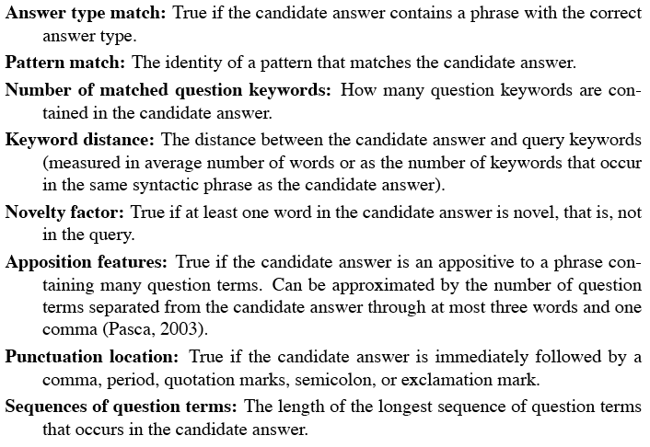
Features for Answer Ranking

Slide 67
Apposition
Apposition
from English Grammar Today
When we use two noun phrases (np) next to each other in a clause,
and they refer to the same person or thing, we call this apposition:
[NP 1]The living room, [NP 2]the biggest room in the house,
looks out on to a beautiful garden.
(The living room and the biggest room in the house are the same room.)
[NP 1]Timothy, [NP 2]their youngest child, is very musical.
(Timothy and their youngest child are the same person.)

Slide 68
Candidate Answer scoring in Watson
Each candidate answer gets scores from >50 components
  (from unstructured text, semi-structured text, triple stores)
  logical form (parse) match between question and candidate
  passage source reliability
  geospatial location
    California is ”southwest of Montana”
  temporal relationships
  taxonomic classification

Slide 69
Evaluation
NIST (National Institute of Standards and Technology) has been running Q/A evaluations as part of it’s TREC program. Both generic Q/A and application specific (bio- etc.).
  (Also does DUC)
Accuracy (does answer match gold answer?)
Typical metric is Mean Reciprocal Rank.
  Assumes that systems return a ranked list of M possible answers.
  Your score is based on 1/Rank of the first right answer
    If first answer is correct: 1
    else if second answer is correct: ½
    else if third answer is correct: ⅓, etc.
    Score is 0 if none of the M answers are correct
  Take the mean over all queries

Slide 70
Mean Reciprocal Rank
What is the reciprocal rank for this question?
Q: What is the capital of Utah? A1: Ogden A2: Salt Lake City A3: Provo A4: St. George A5: Salt Lake

Slide 71
Mean Reciprocal Rank
What is the reciprocal rank for this question?
Q: What is the capital of Utah? A1: Ogden A2: Salt Lake City A3: Provo A4: St. George A5: Salt Lake
The score for the question Q would be ½.

Slide 72
Is the Web Different?
TREC and commercial applications:
  retrieval performed against small closed collection of texts.
The diversity/creativity in how people express themselves necessitates all that work to bring the question and the answer texts together.
But…

Slide 73
The Web is Different
On the Web popular factoids are likely to be expressed in many different ways.
At least a few of which will likely match the way the question was asked.
So why not just grep the Web using all or pieces of the original question.

Slide 74
Interim Summary
factoid question answering
  answer type detection
  query formulation
  passage retrieval
  passage ranking
  answer extraction
web-based factoid question answering

Slide 75
Question Answering
Using Knowledge in QA

Slide 76
Relation Extraction
Answers: Databases of Relations
  born-in(“Emma Goldman”, “June 27 1869”)
  author-of(“Cao Xue Qin”, “Dream of the Red Chamber”)
  Draw from Wikipedia infoboxes, DBpedia, FreeBase, etc.
Questions: Extracting Relations in Questions
  Whose granddaughter starred in E.T.?
(acted-in ?x “E.T.”)
  (granddaughter-of ?x ?y)

Slide 77
Temporal Reasoning
Relation databases
  (and obituaries, biographical dictionaries, etc.)
IBM Watson
  ”In 1594 he took a job as a tax collector in Andalusia”
  Candidates:
    Thoreau is a bad answer (born in 1817)
    Cervantes is possible (was alive in 1594)

Slide 78
Context and Conversation in Virtual Assistants like Siri
Coreference helps resolve ambiguities
  U: “Book a table at Il Fornaio at 7:00 with my mom”
  U: “Also send her an email reminder”
Clarification questions:
  U: “Chicago pizza”
  S: “Did you mean pizza restaurants in Chicago or Chicago-style pizza?”

Slide 79
IBM Watson
A DeepQA computer system that can compete in real-time at the human champion level on the American TV quiz show Jeopardy
Grand Challenge Problem for AI/NLP

Slide 80
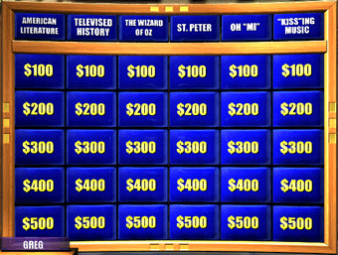
Jeopardy Requires a Broad Knowledge Base
Factual knowledge
  History, science, politics
Commonsense knowledge
  E.g., naïve physics and gender
Vagueness, obfuscation, uncertainty
  E.g., “KISS”ing music

Slide 81
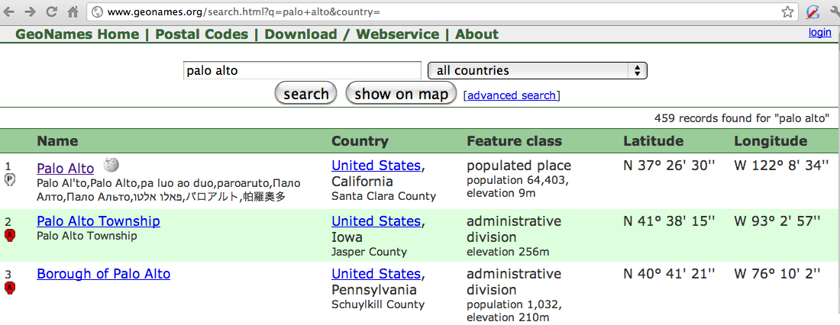
Geospatial knowledge (and earlier temporal knowlege example)
Beijing is a good answer for ”Asian city”
California is ”southwest of Montana”
geonames.org:

Slide 82

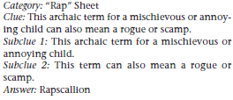

The Questions: Solution Methods
Factoid questions
Decomposition
Puzzles

Slide 83
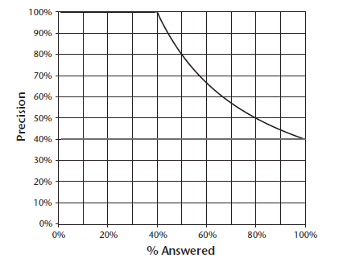
Precision vs. Percentage Attempted
Upper line: perfect confidence estimation
Notes:
There is a thick horizontal line at 40% corresponding to no confidence estimation.

Slide 84
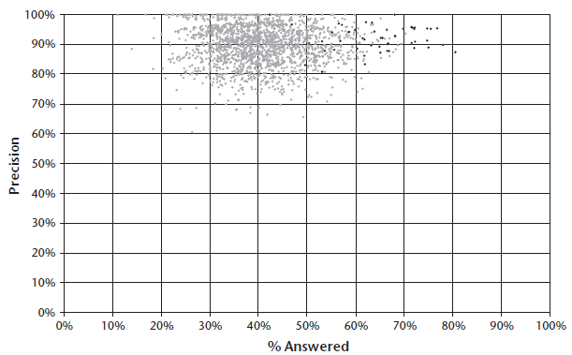
Champion Human Performance
Dark dots correspond to Ken Jenning’s games

Slide 85
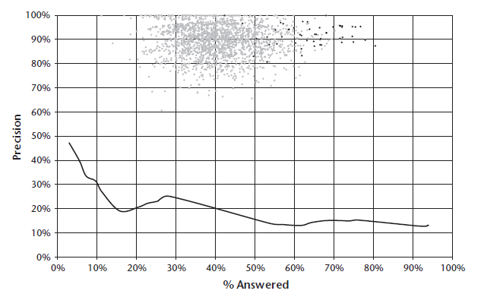
Baseline Performance
(IBM) PIQUANT system

Slide 86
The DeepQA Approach
Adapting PIQUANT did not work out
“The system we have built and are continuing to develop, called DeepQA, is a massively parallel probabilistic evidence-based architecture. For the Jeopardy Challenge, we use more than 100 different techniques for analyzing natural language, identifying sources, finding and generating hypotheses, finding and scoring evidence, and merging and ranking hypotheses. What is far more important than any particular technique we use is how we combine them in DeepQA such that overlapping approaches can bring their strengths to bear and contribute to improvements in accuracy, confidence, or speed.”

Slide 87
Overarching Principles
Massive parallelism
Many experts
  Facilitate the integration, application, and contextual evaluation of a wide range of loosely coupled probabilistic question and content analytics.
Pervasive confidence estimation
Integrate shallow and deep knowledge

Slide 88
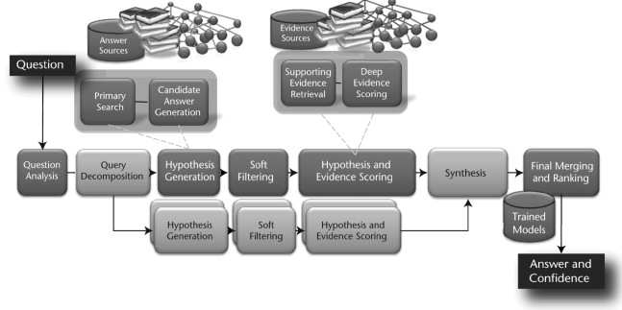
High-Level Architecture

Slide 89
Question Analysis
“The DeepQA approach encourages a mixture of experts at this stage, and in the Watson system we produce shallow parses, deep parses (McCord 1990), logical forms, semantic role labels, coreference, relations, named entities, and so on, as well as specific kinds of analysis for question answering.”

Slide 90
Hypothesis Generation
“The operative goal for primary search eventually stabilized at about 85 percent binary recall for the top 250 candidates; that is, the system generates the correct answer as a candidate answer for 85 percent of the questions somewhere within the top 250 ranked candidates.”
“If the correct answer(s) are not generated at this stage as a candidate, the system has no hope of answering the question. This step therefore significantly favors recall over precision, with the expectation that the rest of the processing pipeline will tease out the correct answer, even if the set of candidates is quite large.”

Slide 91
Hypothesis and Evidence Scoring
Q: He was presidentially pardoned on September 8, 1974.
A. Nixon
Evidence: “Ford pardoned Nixon on Sept. 8, 1974”
Notes:
Example is in the _AI Magazine_ paper.

Slide 92
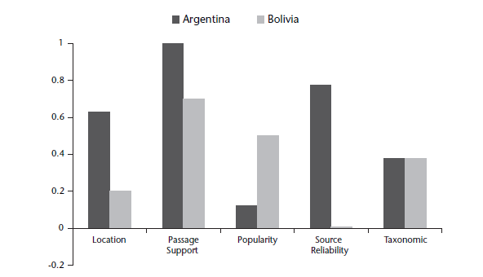
Search Engine Failure (want Argentina)

Slide 93
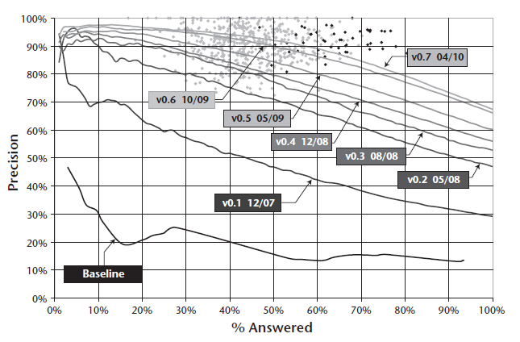
Progress

Slide 94
Results
Watson wins on Jeapordy!

