Slide 1
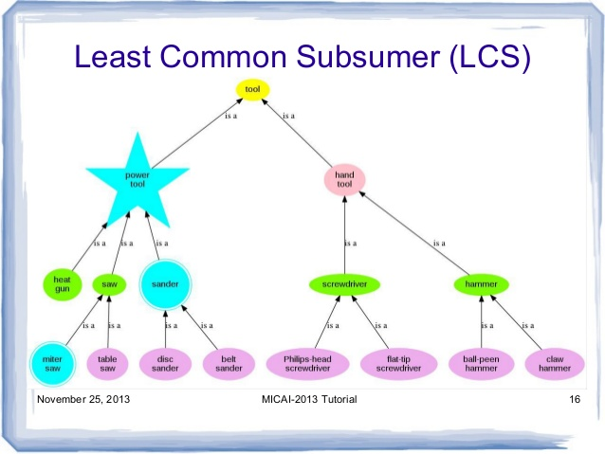

Slide 2
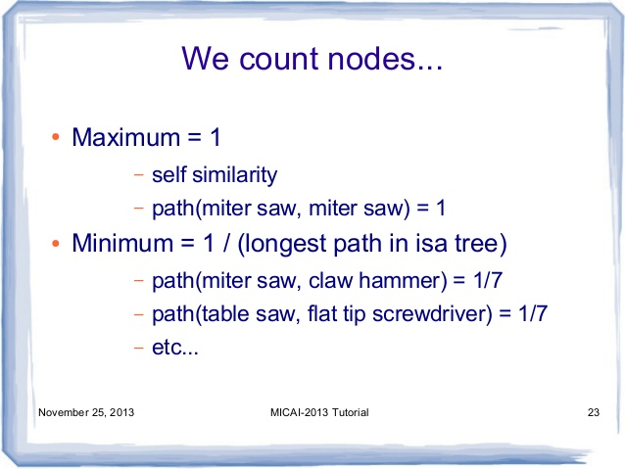

Slide 3
Path(mitre saw, sander) = .25
Path(hammer, power tool) = .25
Problem: deeper paths travel less semantic distance
Path+depth measures (not covered in text)

Slide 4
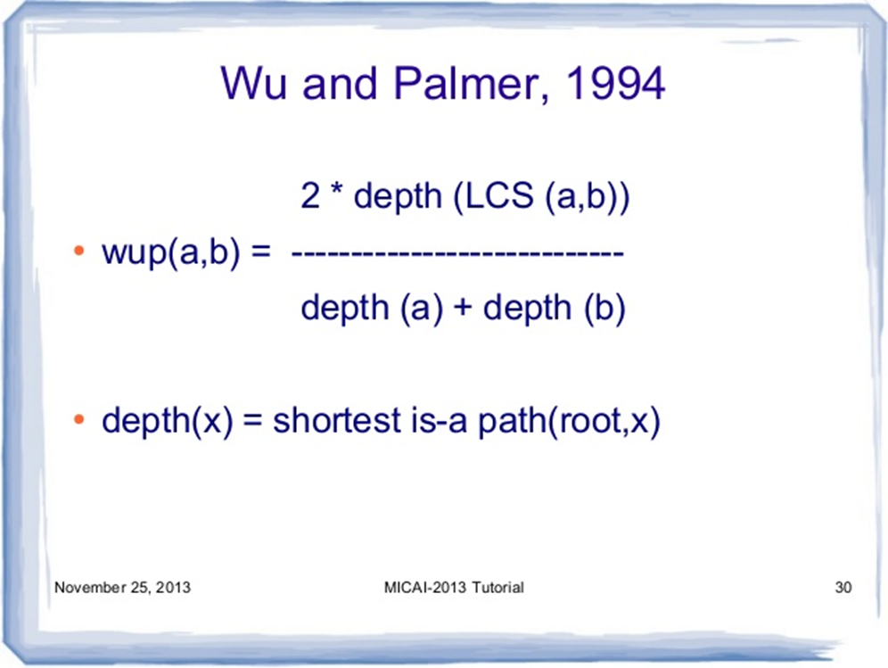

Slide 5
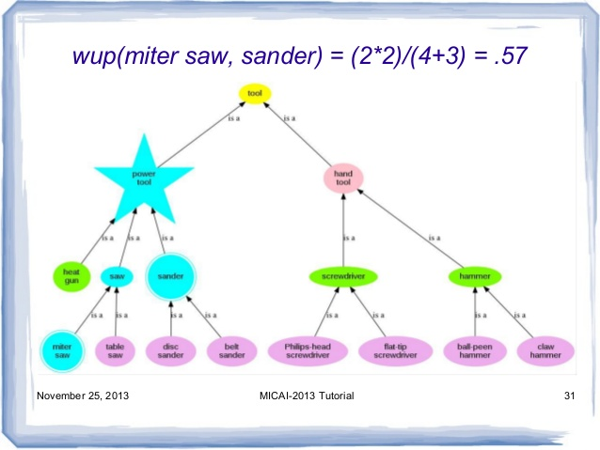

Slide 6
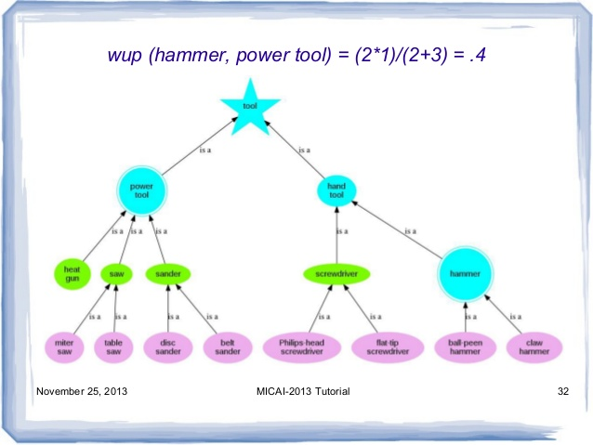

Slide 7
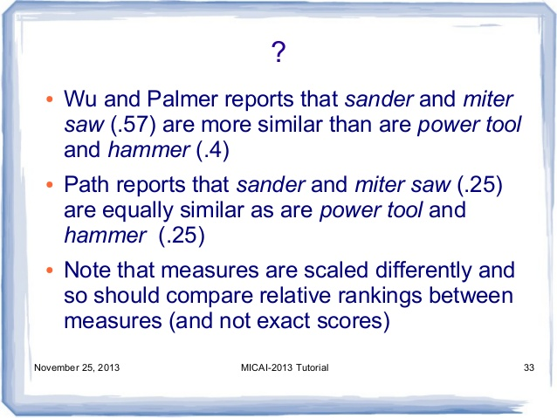

Slide 8
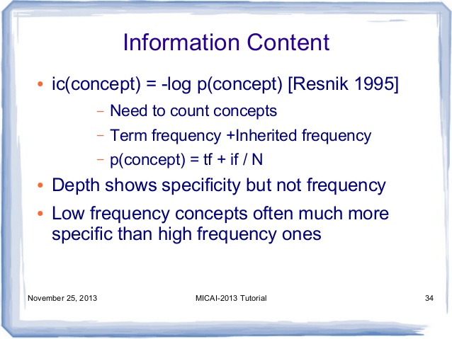

Slide 9
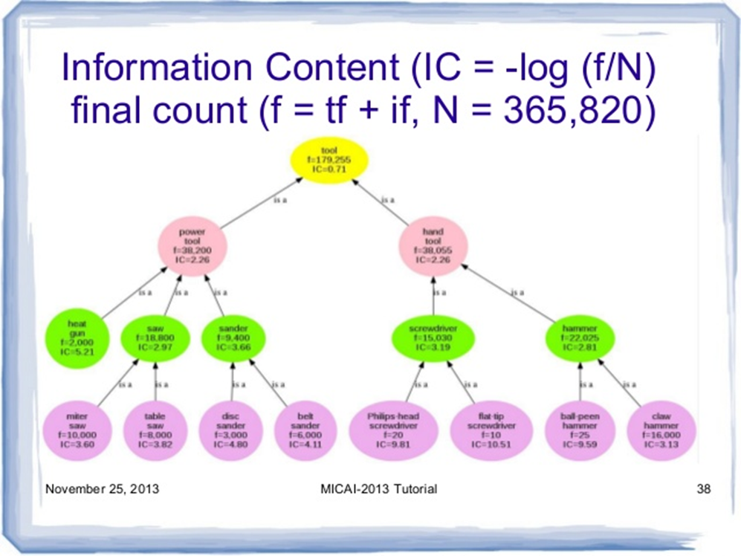

Slide 10
Lin (miter saw, sander) =
2*2.26 / (3.60 + 3.68) = 0.62
Lin (hammer, power tool) =
2 * 0.71 / (2.26 + 2.81) = 0.28

Slide 11
