Slide 1
Language Modeling
Introduction to N-grams
(Based on the slides of Jurafsky & Martin)

Slide 2
Word Prediction
Guess the next word...
  ... I notice three guys standing on the ???
There are many sources of knowledge that can be used to inform this task, including arbitrary world knowledge.
But it turns out that you can do pretty well by simply looking at the preceding words and keeping track of some fairly simple counts.

Slide 3
Word Prediction
We can formalize this task using what are called N-gram models.
N-grams are token sequences of length N.
This example contains what 2-grams (aka bigrams)?
  I notice three guys standing on the
Given knowledge of counts of N-grams such as these, we can guess likely next words in a sequence.

Slide 4
N-Gram Models
More formally, we can use knowledge of the counts of N-grams to assess the conditional probability of candidate words as the next word in a sequence.
Or, we can use them to assess the probability of an entire sequence of words.
  Pretty much the same thing as we’ll see...

Slide 5
Probabilistic Language Models
Today’s goal: assign a probability to a sentence
      Machine Translation:
        P(high winds tonite) > P(large winds tonite)
      Spell Correction
        The office is about fifteen minuets from my house
          P(about fifteen minutes from) > P(about fifteen minuets from)
      Speech Recognition
        P(I saw a van) >> P(eyes awe of an)
      + Summarization, question-answering, etc., etc.!!
Why?

Slide 6
Probabilistic Language Modeling
Goal: compute the probability of a sentence or sequence of words:
  P(W) = P(w₁,w₂,w₃,w₄,w₅…w_{n})
Related task: probability of an upcoming word:
  P(w₅|w₁,w₂,w₃,w₄)
A model that computes either of these:
  P(W) or P(w_{n}|w₁,w₂…w_{n-1}) is called a language model.
Better: the grammar But language model or LM is standard

Slide 7
How to compute P(W)
How to compute this joint probability:
  P(its, water, is, so, transparent, that)
Intuition: let’s rely on the Chain Rule of Probability

Slide 8
Reminder: The Chain Rule
Recall the definition of conditional probabilities
  p(B|A) = P(A,B)/P(A) Rewriting: P(A,B) = P(A)P(B|A)
More variables:
  P(A,B,C,D) = P(A)P(B|A)P(C|A,B)P(D|A,B,C)
The Chain Rule in General
P(x₁,x₂,x₃,…,x_{n}) = P(x₁)P(x₂|x₁)P(x₃|x₁,x₂)…P(x_{n}|x₁,…,x_{n-1})

Slide 9
The Chain Rule applied to compute joint probability of words in sentence
P(“its water is so transparent”) =
P(its) × P(water|its) × P(is|its water)
× P(so|its water is) × P(transparent|its water is so)

Slide 10
How to estimate these probabilities
Could we just count and divide?
No! Too many possible sentences!
We’ll never see enough data for estimating these

Slide 11
A Digression Regarding Counting
Simple counting lies at the core of any probabilistic approach. So let’s first take a look at what we’re counting.
  He stepped out into the hall, was delighted to encounter a water cooler.
    13 tokens, 15 if we include “,” and “.” as separate tokens.
    Assuming we include the comma and period, what bigrams are there?

Slide 12
Counting
Not always that simple
  I do uh main- mainly business data processing
Spoken language poses various challenges.
  Should we count “uh” and other fillers as tokens?
  What about the repetition of “mainly”? Should such do-overs count twice or just once?
  The answers depend on the application.
    If we’re focusing on something like ASR to support indexing for search, then “uh” isn’t helpful (it’s not likely to occur as a query).
    But filled pauses are very useful in dialog management, so we might want them there.

Slide 13
Counting: Types and Tokens
How about
  They picnicked by the pool, then lay back on the grass and looked at the stars.
    18 tokens (again counting punctuation)
But we might also note that “the” is used 3 times, so there are only 16 unique types (as opposed to tokens).
In going forward, we’ll have occasion to focus on counting both types and tokens of both words and N-grams.

Slide 14
Counting: Wordforms
Should “cats” and “cat” count as the same when we’re counting?
How about “geese” and “goose”?
Some terminology:
  Lemma: a set of lexical forms having the same stem, major part of speech, and rough word sense
  Wordform: fully inflected surface form
Again, we’ll have occasion to count both lemmas and wordforms

Slide 15
Counting: Corpora (end of digression)
So what happens when we look at large bodies of text instead of single utterances?
Brown et al (1992) large corpus of English text
  583 million wordform tokens
  293,181 wordform types
Google
  Crawl of 1,024,908,267,229 English tokens
  13,588,391 wordform types
    That seems like a lot of types... After all, even large dictionaries of English have only around 500k types. Why so many here?
Numbers
Misspellings
Names
Acronyms
etc

Slide 16
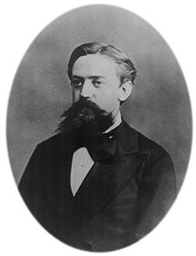
Markov Assumption
Simplifying assumption:
Or maybe
Andrei Markov

Slide 17
Markov Assumption
In other words, we approximate each component in the product

Slide 18
Simplest case: Unigram model
Some automatically generated sentences from a unigram model
fifth, an, of, futures, the, an, incorporated, a, a, the, inflation, most, dollars, quarter, in, is, mass
thrift, did, eighty, said, hard, 'm, july, bullish
that, or, limited, the

Slide 19
Bigram model
Condition on the previous word:
texaco, rose, one, in, this, issue, is, pursuing, growth, in, a, boiler, house, said, mr., gurria, mexico, 's, motion, control, proposal, without, permission, from, five, hundred, fifty, five, yen
outside, new, car, parking, lot, of, the, agreement, reached
this, would, be, a, record, november

Slide 20
N-gram models
We can extend to trigrams, 4-grams, 5-grams
In general this is an insufficient model of language
  because language has long-distance dependencies:
  “The computer which I had just put into the machine room on the fifth floor crashed.”
But we can often get away with N-gram models

Slide 21
Language Modeling
Introduction to N-grams

Slide 22
Language Modeling
Estimating N-gram Probabilities

Slide 23
Estimating bigram probabilities
The Maximum Likelihood Estimate

Slide 24
An example
<s> I am Sam </s>
<s> Sam I am </s>
<s> I do not like green eggs and ham </s>
P (I | <s>) = 2/3
P (</s> | Sam)
P (Sam | <s>)
P (Sam | am)
P (am | I)
P (do | I)

Slide 25

An example
<s> I am Sam </s>
<s> Sam I am </s>
<s> I do not like green eggs and ham </s>

Slide 26
More examples:
Berkeley Restaurant Project sentences
can you tell me about any good cantonese restaurants close by
mid priced thai food is what i’m looking for
tell me about chez panisse
can you give me a listing of the kinds of food that are available
i’m looking for a good place to eat breakfast
when is caffe venezia open during the day

Slide 27
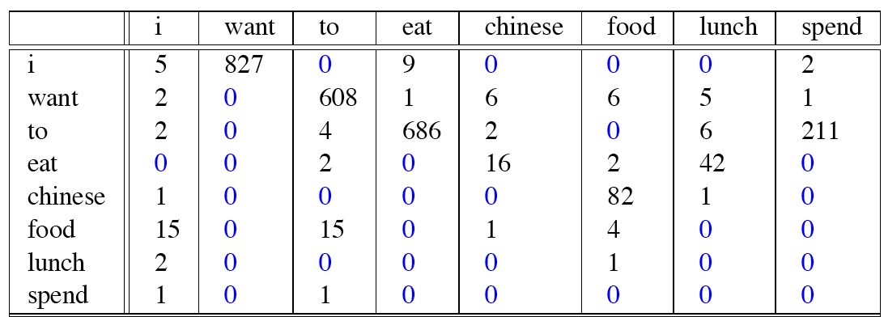
Raw bigram counts
Out of 9222 sentences

Slide 28
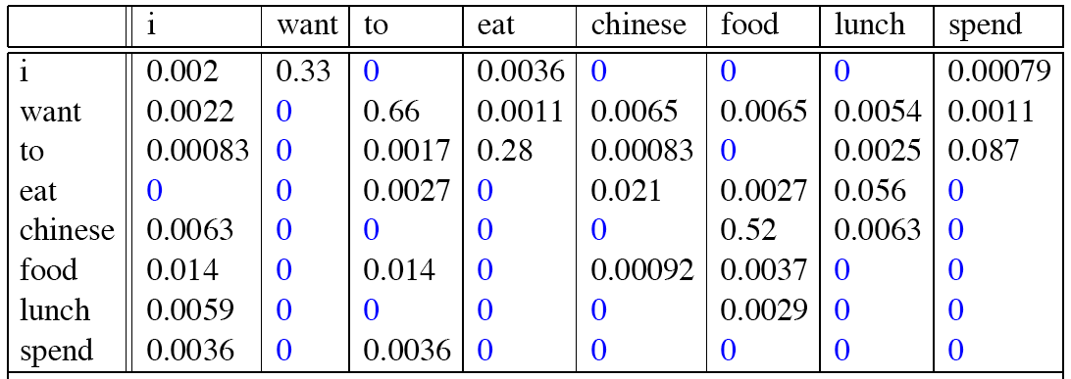
Raw bigram probabilities
Normalize by unigrams:
Result:
Notes:
i i 5/2533=.002
I want 827/2533=.33
686/2417=

Slide 29
Bigram estimates of sentence probabilities
P(<s> I want english food </s>) =
P(I|<s>)
× P(want|I)
× P(english|want)
× P(food|english)
× P(</s>|food)
= .000031

Slide 30
What kinds of knowledge?
P(english|want) = .0011
P(chinese|want) = .0065
P(to|want) = .66
P(eat | to) = .28
P(food | to) = 0
P(want | spend) = 0
P (i | <s>) = .25

Slide 31
Practical Issues
We do everything in log space
  Avoid underflow
  (also adding is faster than multiplying)

Slide 32
Language Modeling Toolkits
SRILM
  http://www.speech.sri.com/projects/srilm/
KenLM: Faster and Smaller Language Model Queries
  https://github.com/kpu/kenlm
  http://kheafield.com/code/kenlm/

Slide 33
Google N-Gram Release, August 2006
…

Slide 34
Google N-Gram Release
serve as the incoming 92
serve as the incubator 99
serve as the independent 794
serve as the index 223
serve as the indication 72
serve as the indicator 120
serve as the indicators 45
serve as the indispensable 111
serve as the indispensible 40
serve as the individual 234
http://googleresearch.blogspot.com/2006/08/all-our-n-gram-are-belong-to-you.html

Slide 35
Google Books N-gram Viewer
https://books.google.com/ngrams
Notes:
http://ngrams.googlelabs.com/

Slide 36
Google Caveat
We will talk more about test sets and training sets... Test sets should be similar to the training set (drawn from the same distribution) for the probabilities to be meaningful.
So... The Google corpus is fine if your application deals with arbitrary English text on the Web.
If not then a smaller domain specific corpus is likely to yield better results.

Slide 37
Language Modeling
Estimating N-gram Probabilities

Slide 38
Language Modeling
Evaluation and Perplexity

Slide 39
Evaluation: How good is our model?
Does our language model prefer good sentences to bad ones?
  Assign higher probability to “real” or “frequently observed” sentences
    Than “ungrammatical” or “rarely observed” sentences?
We train parameters of our model on a training set.
We test the model’s performance on data we haven’t seen.
  A test set is an unseen dataset that is different from our training set, totally unused.
  An evaluation metric tells us how well our model does on the test set.

Slide 40
Training on the test set
We can’t allow test sentences into the training set
We will assign it an artificially high probability when we set it in the test set
“Training on the test set”
Bad science!
And violates the honor code

Slide 41
Extrinsic evaluation of N-gram models
Best evaluation for comparing models A and B
  Put each model in a task
    spelling corrector, speech recognizer, MT system
  Run the task, get an accuracy for A and for B
    How many misspelled words corrected properly
    How many words translated correctly
  Compare accuracy for A and B

Slide 42
Difficulty of extrinsic (in-vivo) evaluation of N-gram models
Extrinsic evaluation
  Time-consuming; can take days or weeks
So
  Sometimes use intrinsic evaluation: perplexity
  Bad approximation
    unless the test data looks just like the training data
    So generally only useful in pilot experiments
  But is helpful to think about.

Slide 43
Intuition of Perplexity
mushrooms 0.1
pepperoni 0.1
anchovies 0.01
….
fried rice 0.0001
….
and 1e-100
The Shannon Game:
  How well can we predict the next word?
  Unigrams are terrible at this game. (Why?)
A better model of a text
  is one which assigns a higher probability to the word that actually occurs
I always order pizza with cheese and ____
The 33rd President of the US was ____
I saw a ____

Slide 44
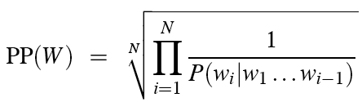
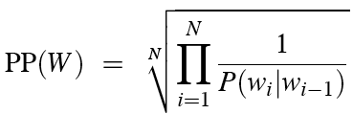
Perplexity
The best language model is one that best predicts an unseen test set
  Gives the highest P(sentence)
Perplexity is the inverse probability of the test set, normalized by the number of words:
Chain rule:
For bigrams:
Minimizing perplexity is the same as maximizing probability

Slide 45
Lower perplexity = better model
Training 38 million words, test 1.5 million words, WSJ
N-gram Order | Unigram | Bigram | Trigram
Perplexity | 962 | 170 | 109

Slide 46
Language Modeling
Evaluation and Perplexity

Slide 47
Language Modeling
Generalization and zeros

Slide 48
The Shannon Visualization Method
Choose a random bigram
(<s>, w) according to its probability
Now choose a random bigram (w, x) according to its probability
And so on until we choose </s>
Then string the words together
<s> I
I want
want to
to eat
eat Chinese
Chinese food
food </s>
I want to eat Chinese food

Slide 49
Approximating Shakespeare

Slide 50
Shakespeare as corpus
N=884,647 tokens, V=29,066
Shakespeare produced 300,000 bigram types out of V²= 844 million possible bigrams.
  So 99.96% of the possible bigrams were never seen (have zero entries in the table)
Quadrigrams worse: What's coming out looks like Shakespeare because it is Shakespeare

Slide 51
The wall street journal is not shakespeare (no offense)

Slide 52
Can you guess the author of these random 3-gram sentences?
They also point to ninety nine point six billion dollars from two hundred four oh six three percent of the rates of interest stores as Mexico and gram Brazil on market conditions
This shall forbid it should be branded, if renown made it empty.
“You are uniformly charming!” cried he, with a smile of associating and now and then I bowed and they perceived a chaise and four to wish for.

Slide 53
The perils of overfitting
N-grams only work well for word prediction if the test corpus looks like the training corpus
  In real life, it often doesn’t
  We need to train robust models that generalize!
  One kind of generalization: Zeros!
    Things that don’t ever occur in the training set
      But occur in the test set

Slide 54
Zeros
Training set:
  … denied the allegations
  … denied the reports
  … denied the claims
  … denied the request
  P(“offer” | denied the) = 0
Test set
  … denied the offer
  … denied the loan

Slide 55
Zero probability bigrams
Bigrams with zero probability
  mean that we will assign 0 probability to the test set!
And hence we cannot compute perplexity (can’t divide by 0)!

Slide 56
Language Modeling
Generalization and zeros

Slide 57
Language Modeling
Smoothing: Add-one (Laplace) smoothing

Slide 58
The intuition of smoothing (from Dan Klein)
When we have sparse statistics:
Steal probability mass to generalize better
P(w | denied the)
3 allegations
2 reports
1 claims
1 request
7 total
allegations
attack
man
reports
outcome
…
claims
request
P(w | denied the)
2.5 allegations
1.5 reports
0.5 claims
0.5 request
2 other
7 total
allegations
allegations
attack
man
outcome
reports
…
claims
request

Slide 59
Add-one estimation
Also called Laplace smoothing
Pretend we saw each word one more time than we did
Just add one to all the counts!
MLE estimate:
Add-1 estimate:
Notes:
Easier in unigrams
C / N
C + 1 / (N+V)

Slide 60
Maximum Likelihood Estimates
The maximum likelihood estimate
  of some parameter of a model M from a training set T
  maximizes the likelihood of the training set T given the model M
Suppose the word “bagel” occurs 400 times in a corpus of a million words
What is the probability that a random word from some other text will be “bagel”?
MLE estimate is 400/1,000,000 = .0004
This may be a bad estimate for some other corpus
  But it is the estimate that makes it most likely that “bagel” will occur 400 times in a million word corpus.

Slide 61
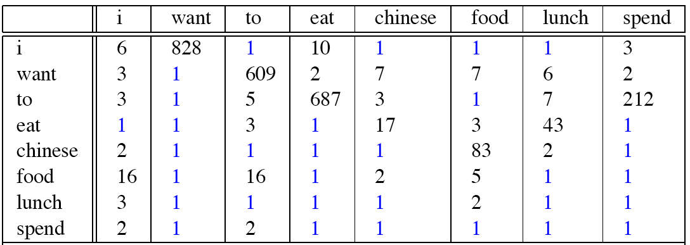
Berkeley Restaurant Corpus: Laplace smoothed bigram counts

Slide 62

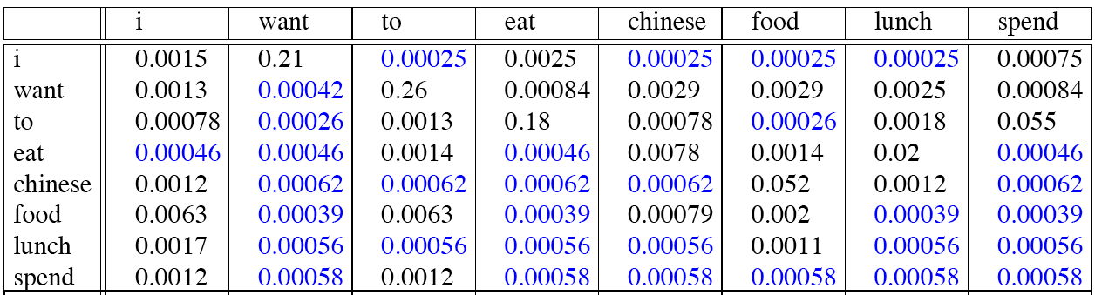
Laplace-smoothed bigrams
Notes:
I I = 6 / (2533+1446) = .0015

Slide 63
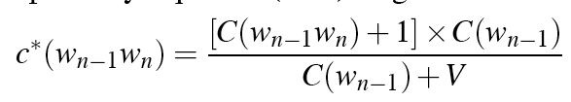
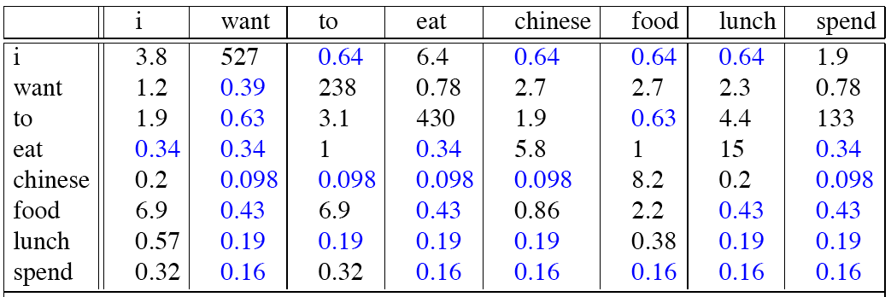
Reconstituted counts
Notes:
.0015*2533=3.8

Slide 64
Compare with raw bigram counts
Notes:
C(want to) went from 608 to 238, P(to|want) from .66 to .26!
Discount d= c*/c
d for “chinese food” =.10!!! A 10x reduction

Slide 65
Add-1 estimation is a blunt instrument
So add-1 isn’t used for N-grams:
  We’ll see better methods
But add-1 is used to smooth other NLP models
  For text classification
  In domains where the number of zeros isn’t so huge.

Slide 66
Unigram Smoothing Example
Tiny Corpus, V=4; N=20
Word | True Ct | Unigram Prob | New Ct | Adjusted Prob
eat | 10 | .5 | ? | ?
British | 4 | .2 | 5 | .21
food | 6 | .3 | 7 | .29
happily | 0 | .0 | ? | ?
 | 20 | 1.0 | ~20 | 1.0
Notes:
Cut 11, .46 and 1, .04

Slide 67
Language Modeling
Smoothing: Add-one (Laplace) smoothing

Slide 68
Language Modeling
Interpolation, Backoff, and Web-Scale LMs

Slide 69
Backoff and Interpolation
Sometimes it helps to use less context
  Condition on less context for contexts you haven’t learned much about
Backoff:
  use trigram if you have good evidence,
  otherwise bigram, otherwise unigram
Interpolation:
  mix unigram, bigram, trigram
Interpolation works better

Slide 70
Class-Based Backoff
Back off to the class rather than the word
  Particularly useful for proper nouns (e.g., names)
  Use count for the number of names in place of the particular name
  E.g. < N | friendly > instead of < dog | friendly>
Notes:
70

Slide 71
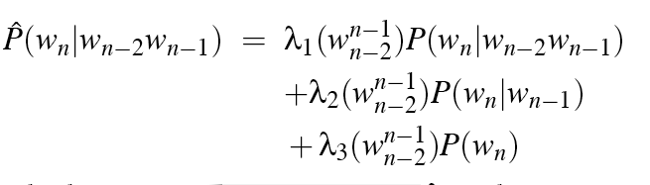
Linear Interpolation
Simple interpolation
Lambdas conditional on context:

Slide 72
How to set the lambdas?
Use a held-out corpus
Choose λs to maximize the probability of held-out data:
  Fix the N-gram probabilities (on the training data)
  Then search for λs that give largest probability to held-out set:
Training Data
Held-Out Data
Test
Data

Slide 73
Unknown words: Open versus closed vocabulary tasks
If we know all the words in advanced
  Vocabulary V is fixed
  Closed vocabulary task
Often we don’t know this
  Out Of Vocabulary = OOV words
  Open vocabulary task
Instead: create an unknown word token <UNK>
  Training of <UNK> probabilities
    Create a fixed lexicon L of size V
    At text normalization phase, any training word not in L changed to <UNK>
    Now we train its probabilities like a normal word
  At decoding time
    If text input: Use UNK probabilities for any word not in training

Slide 74
Huge web-scale n-grams
How to deal with, e.g., Google N-gram corpus
Pruning
  E.g., only store N-grams with count > threshold.
    Remove singletons of higher-order n-grams
Efficiency, e.g.,
  efficient data structures
  quantize probabilities (4-8 bits instead of 8-byte float)

Slide 75
Smoothing for Web-scale N-grams
“Stupid backoff” (Brants et al. 2007)
No discounting, just use relative frequencies

Slide 76
N-gram Smoothing Summary
Add-1 smoothing:
  Add 1 to every word count (Note: this is type)
  Increment normalization by Vocab size: N (tokens) + V (types)
  OK for text categorization, not for language modeling
The most commonly used method:
  Extended Interpolated Kneser-Ney (see J&M text)
For very large N-grams like the Web:
  Stupid backoff

Slide 77
Advanced Language Modeling
Discriminative models:
  choose n-gram weights to improve a task, not to fit the training set
Parsing-based models
Caching Models
  Recently used words are more likely to appear

Slide 78
Language Modeling
Interpolation, Backoff, and Web-Scale LMs

Slide 79
Summary
N-gram probabilities can be used to estimate the likelihood
  Of a word occurring in a context (N-1)
  Of a sentence occurring at all
Perplexity can be used to evaluate the goodness of fit of a LM
Smoothing techniques and backoff models deal with problems of unseen words in corpus
  Improvement via algorithm versus big data

Slide 80
Language Modeling
Advanced (Optional)
Kneser-Ney Smoothing

Slide 81
Absolute discounting: just subtract a little from each count
Suppose we wanted to subtract a little from a count of 4 to save probability mass for the zeros
How much to subtract ?
Church and Gale (1991)’s clever idea
Divide up 22 million words of AP Newswire
  Training and held-out set
  for each bigram in the training set
  see the actual count in the held-out set!
It sure looks like c* = (c - .75)
Bigram count in training | Bigram count in heldout set
0 | .0000270
1 | 0.448
2 | 1.25
3 | 2.24
4 | 3.23
5 | 4.21
6 | 5.23
7 | 6.21
8 | 7.21
9 | 8.26

Slide 82
Absolute Discounting Interpolation
Save ourselves some time and just subtract 0.75 (or some d)!
  (Maybe keeping a couple extra values of d for counts 1 and 2)
But should we really just use the regular unigram P(w)?
discounted bigram
Interpolation weight
unigram

Slide 83
Kneser-Ney Smoothing I
Better estimate for probabilities of lower-order unigrams!
  Shannon game: I can’t see without my reading___________?
  “Francisco” is more common than “glasses”
  … but “Francisco” always follows “San”
The unigram is useful exactly when we haven’t seen this bigram!
Instead of P(w): “How likely is w”
P_{continuation}(w): “How likely is w to appear as a novel continuation?
  For each word, count the number of bigram types it completes
  Every bigram type was a novel continuation the first time it was seen
Francisco
glasses

Slide 84
Kneser-Ney Smoothing II
How many times does w appear as a novel continuation:
Normalized by the total number of word bigram types

Slide 85
Kneser-Ney Smoothing III
Alternative metaphor: The number of # of word types seen to precede w
normalized by the # of words preceding all words:
A frequent word (Francisco) occurring in only one context (San) will have a low continuation probability

Slide 86
Kneser-Ney Smoothing IV
λ is a normalizing constant; the probability mass we’ve discounted
The number of word types that can follow w_{i-1}
= # of word types we discounted
= # of times we applied normalized discount
the normalized discount

Slide 87
Kneser-Ney Smoothing: Recursive formulation
Continuation count = Number of unique single word contexts for •

Slide 88
Language Modeling
Advanced:
Kneser-Ney Smoothing

