Slide 1
Ethics, Social Good, and NLP
(slides sampled from CMU/LTI Computational Ethics for NLP course)

Slide 2
Human Subjects
We are trying to model a human function
Labels are certainly noisy
How to use humans to find better labels/know if they are right
Let’s put it on Amazon Mechanical Turk (Crowdsourcing) and get the answer

Slide 3
History of using Human Subjects
WWII Nazi and Japanese prisoners in concentration camps
  Medical science did learn things
  But even at the time this was not considered acceptable
Tuskegee Syphilis Experiments (US Public Health System, 1932-1972)
  Understand how untreated syphilis develops
  African-American sharecroppers given free healthcare, meals…
  Not provided with penicillin when it would have helped
Milgram Obedience Experiment (Yale, 1962)
  Experimenters asked subjects/teachers to give electric shocks after wrong answers
Others…

Slide 4
Ethics in Human Subject Use
These experiments led to the National Research Act 1974
  Requiring “Informed Consent” from participants
  Requiring external review of experiments
For all federal funded experiments
  Covers my dialogue work at Pitt, but not when I was at AT&T!

Slide 5
IRB (Ethical Review Board)
Institutional Review Board
  Internal to institution
  Independent of researcher
Reviews all human experimentation
  Assesses instructions
  Compensation
  Contribution of research
  Value to the participant
  Protection of privacy

Slide 6
IRB (Ethical Review Board)
Different standards for different institutions
  Medical School vs SCI
Board consists of (primarily) non-expert peers
At educational institutions also
  Help educate new researchers (e.g., before Pitt FER starts)
  Make suggestions to find solutions to ethics problems
    How to get informed consent on an Android App
    “click here to accept terms and conditions”

Slide 7
Ethical Questions
Can you lie to a human subject?
Can you harm a human subject?
Can you mislead a human subject?
  Wizard of Oz experiments?

Slide 8
Using Human Subjects
But it’s not all these extremes
Your human subjects are biased
Your selection of them is biased
Your tests are biased too

Slide 9
Human Subject Selection Example
For speech synthesis evaluation
  Listen to these and say which you prefer
Who do you get to listen
  Experts are biased, non-experts are biased
Hardware makes a difference
  Expensive headphones give different result
Experiment itself makes a difference
  Listening in quiet office vs on the bus
Hearing ability makes a difference
  Young vs old

Slide 10
Human Subject Selection
All subject pools will have bias
  So identify the biases (as best you can)
  Does the bias affect your result (maybe not)
Can you recruit others to reduce bias
  Can you do this post experiment
Most Psych experiments use undergrads
  Undergrads do experiments for course credit
  SCI researchers typically recruit via $
  Real vs. experimental users yield different results

Slide 11
Human Subject Selection
Most IRB have special requirements for involving
  Minors, pregnant women, disabled
So most experiments exclude these
Protected or hard to access groups are underrepresented

Slide 12
Human Subjects – Summary Part 1
Unchecked human experiment
Led to IRB reviews of human experimentation
All human experimentation includes bias
  Admit it, and try to ameliorate it
  Experimentation vs Actual is different

Slide 13


BIASED
AI
Online data is riddled with SOCIAL STEREOTYPES

Slide 14
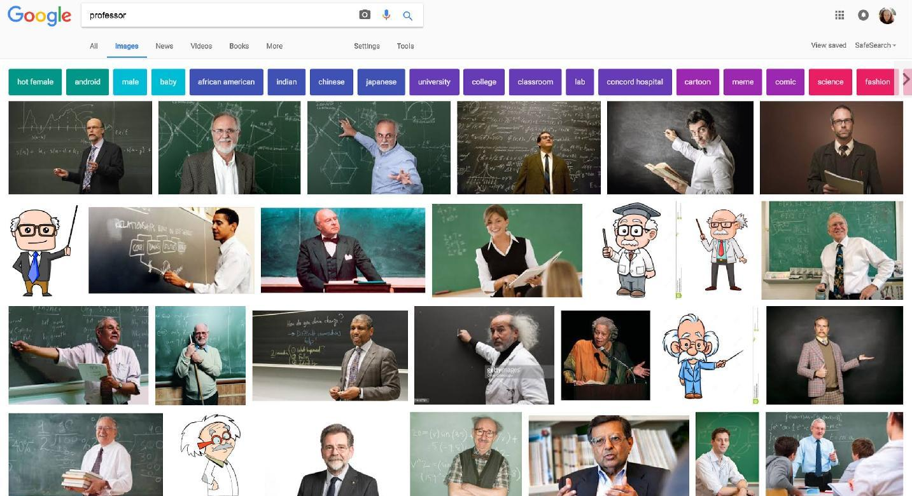
Gender/Race/Age Stereotypes
June 2017: image search query “Professor”

Slide 15
BIASED
AI
Consequence: models are biased

Slide 16
Sources of Human Biases in Machine Learning
Sample selection bias
  unbalanced training data
  data and annotations may reflect human cognitive biases and cultural stereotypes
Optimizing towards a biased objective
  Labels are biased proxies to the real objective
    e.g., “who is more likely to be convicted” vs “who is more likely to commit a crime”
Inductive bias
  the set of “assumptions” used by the learner, e.g. features in discriminative models are biased
Notes:
https://socialmediacollective.org/reading-lists/critical-algorithm-studies/

Slide 17
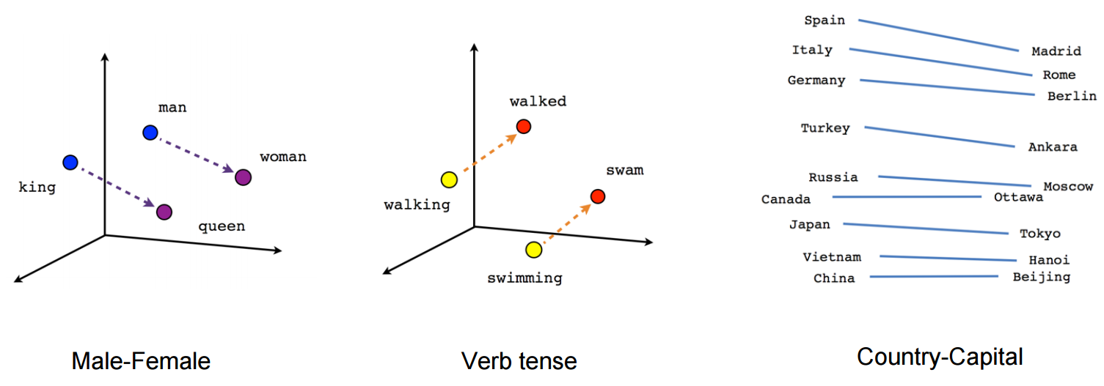
Word Analogy Tasks
Mikolov et al. ‘13
man is to king as woman is to x
Notes:
https://www.aclweb.org/anthology/N13-1090
Image from https://towardsdatascience.com/deep-learning-4-embedding-layers-f9a02d55ac12

Slide 18
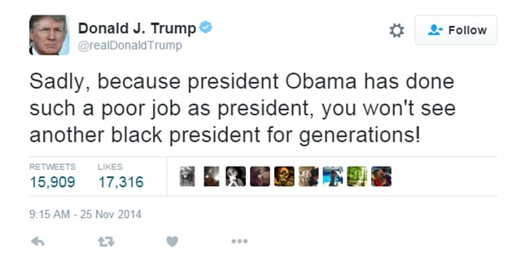
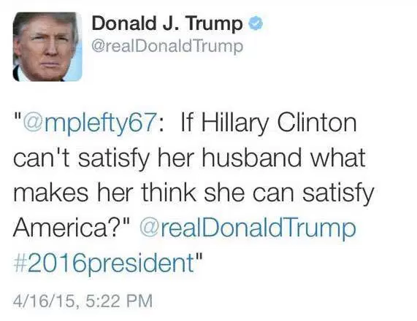
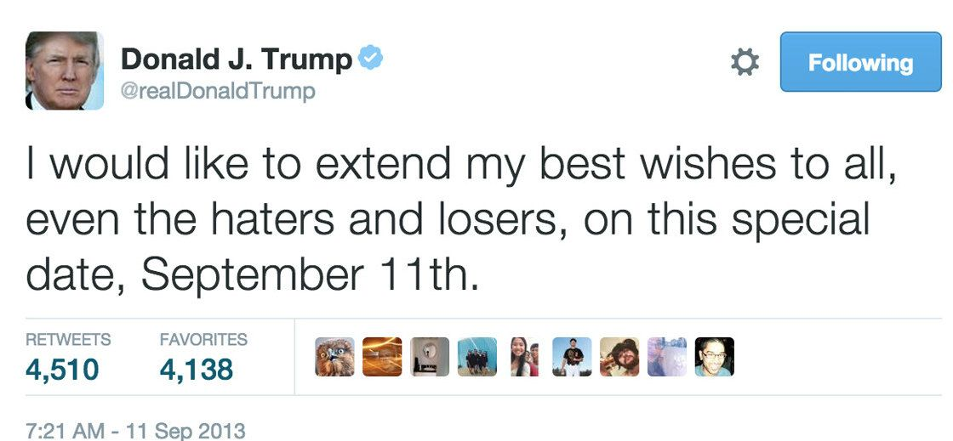
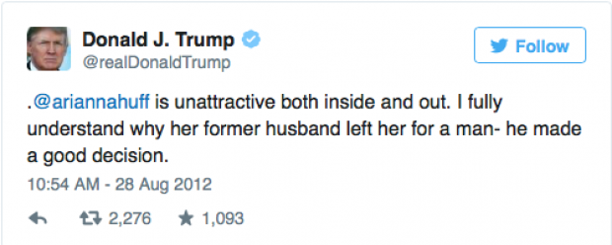
Training Data for Word Embeddings
Notes:
Examples by Aylin Caliskan. Watch her talk! https://www.youtube.com/watch?v=n7WKo_duKTM

Slide 19
Bolukbasi T., Chang K.-W., Zou J., Saligrama V., Kalai A. (2016) Man is to Computer Programmer as Woman is to Homemaker? Debiasing Word Embeddings. NIPS
Notes:
https://pdfs.semanticscholar.org/2744/59c52103f9b7880d0697aa28755ac3366987.pdf
https://youtu.be/zMrwR98IanU

Slide 20
Main Ideas
Demonstrate gender bias in embeddings trained even from Google news
Show that gender defined words are linearly separable from others that (should be?) gender neutral
Use the above finding as the basis of a word embedding debiasing algorithm
Evaluate

Slide 21
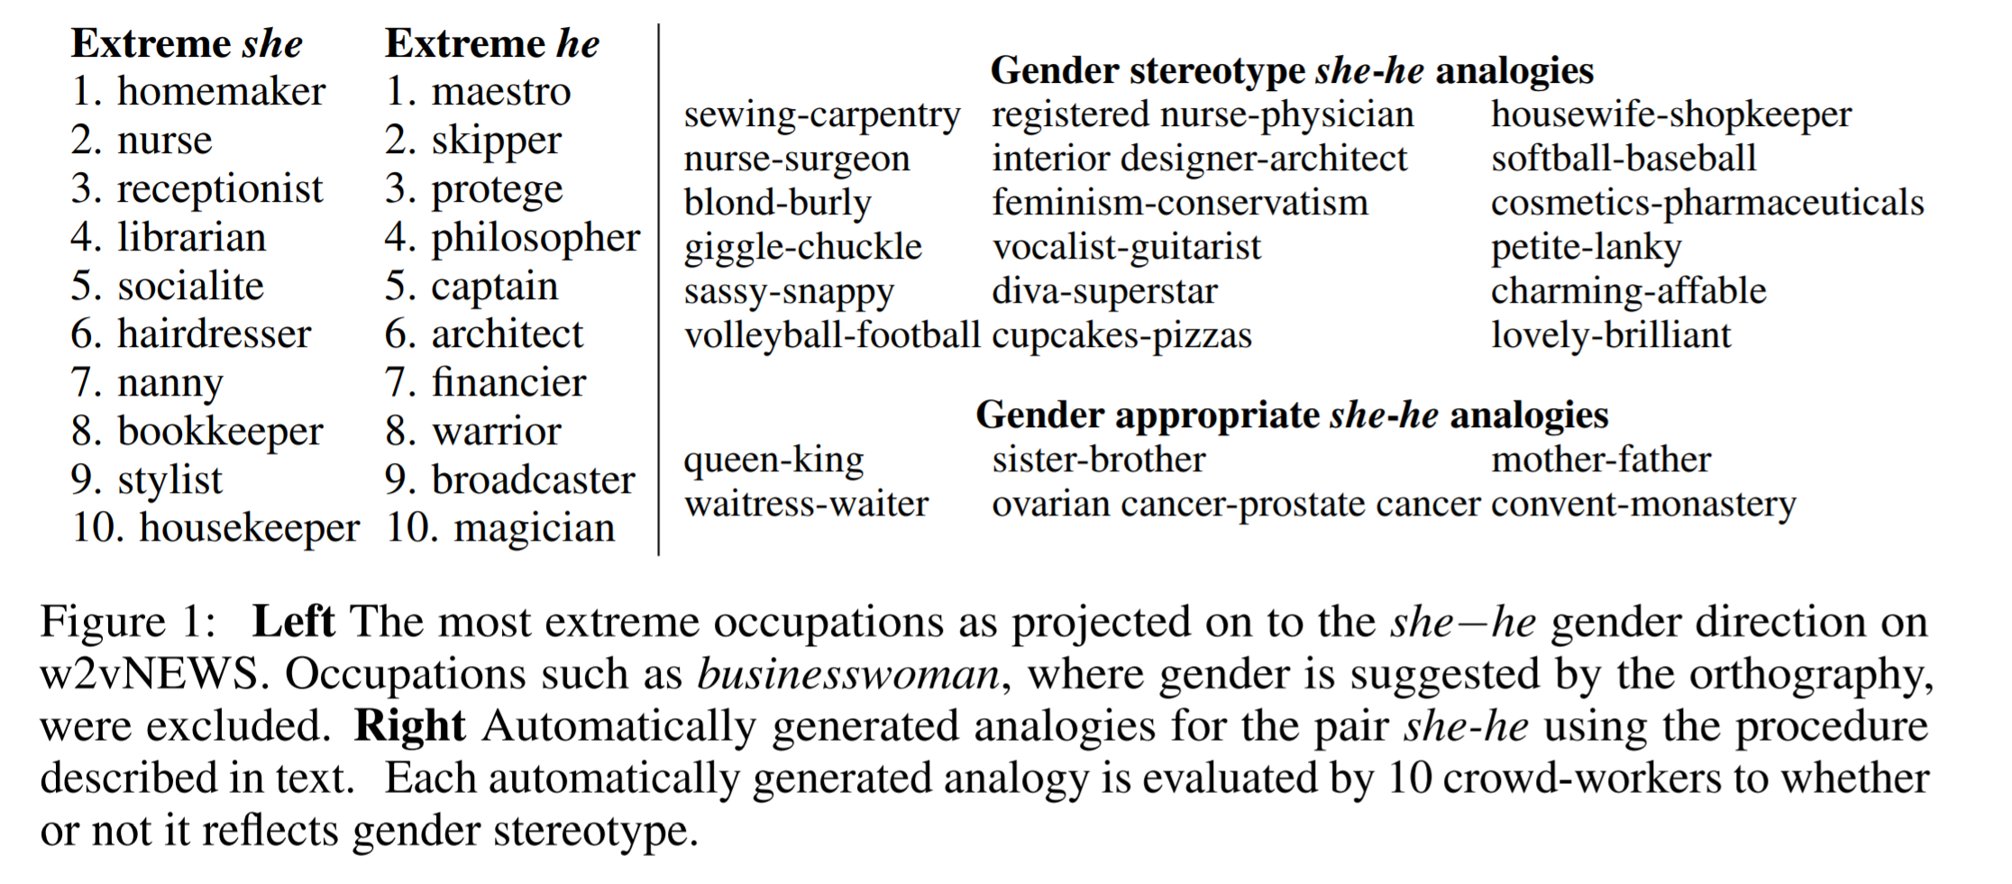

Slide 22
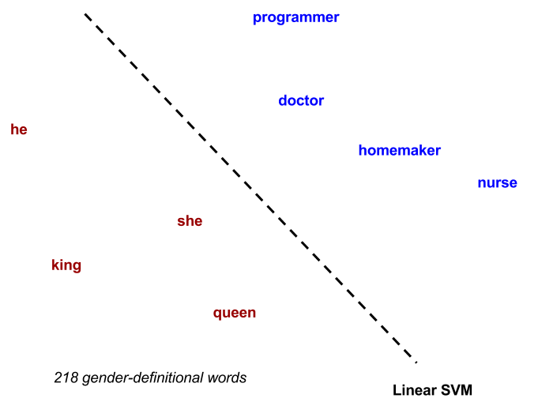
Gender-definitional vs. Gender-neutral Words

Slide 23
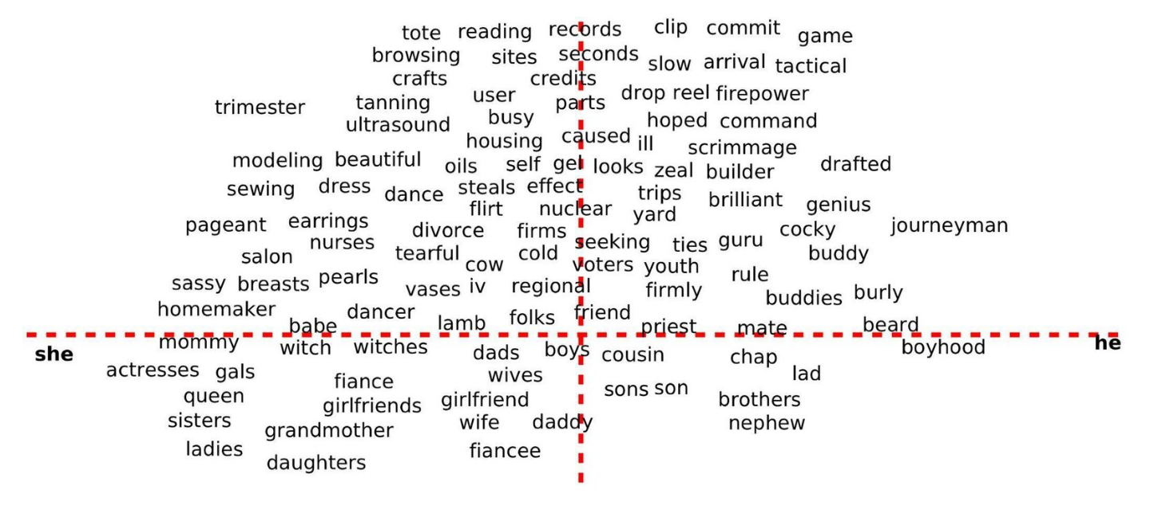
BIASED
FEMALE
MALE
GENDERED

Slide 24
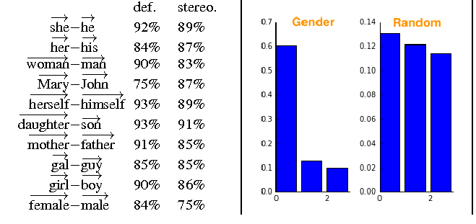
Gender Subspace
The top PC captures the gender subspace

Slide 25
Debiasing
Identify gender-definitional and gender-neutral words
Project away the gender subspace from the gender-neutral words
Normalize vectors
Notes:
Add next year: https://arxiv.org/abs/1711.08412

