Slide 1
Binary Bag-of-Words Feed-Forward Neural Network with Fused Prompt Information for L1 Prediction
Harrison Green
Zhen Yu Ding

Slide 2
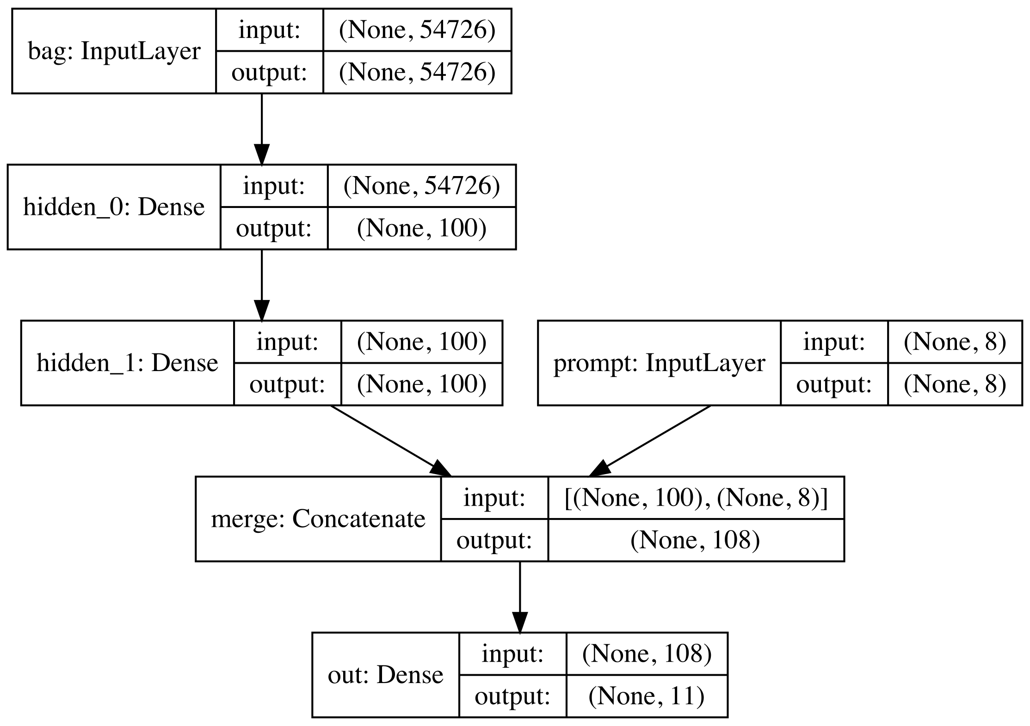
Model

Slide 3
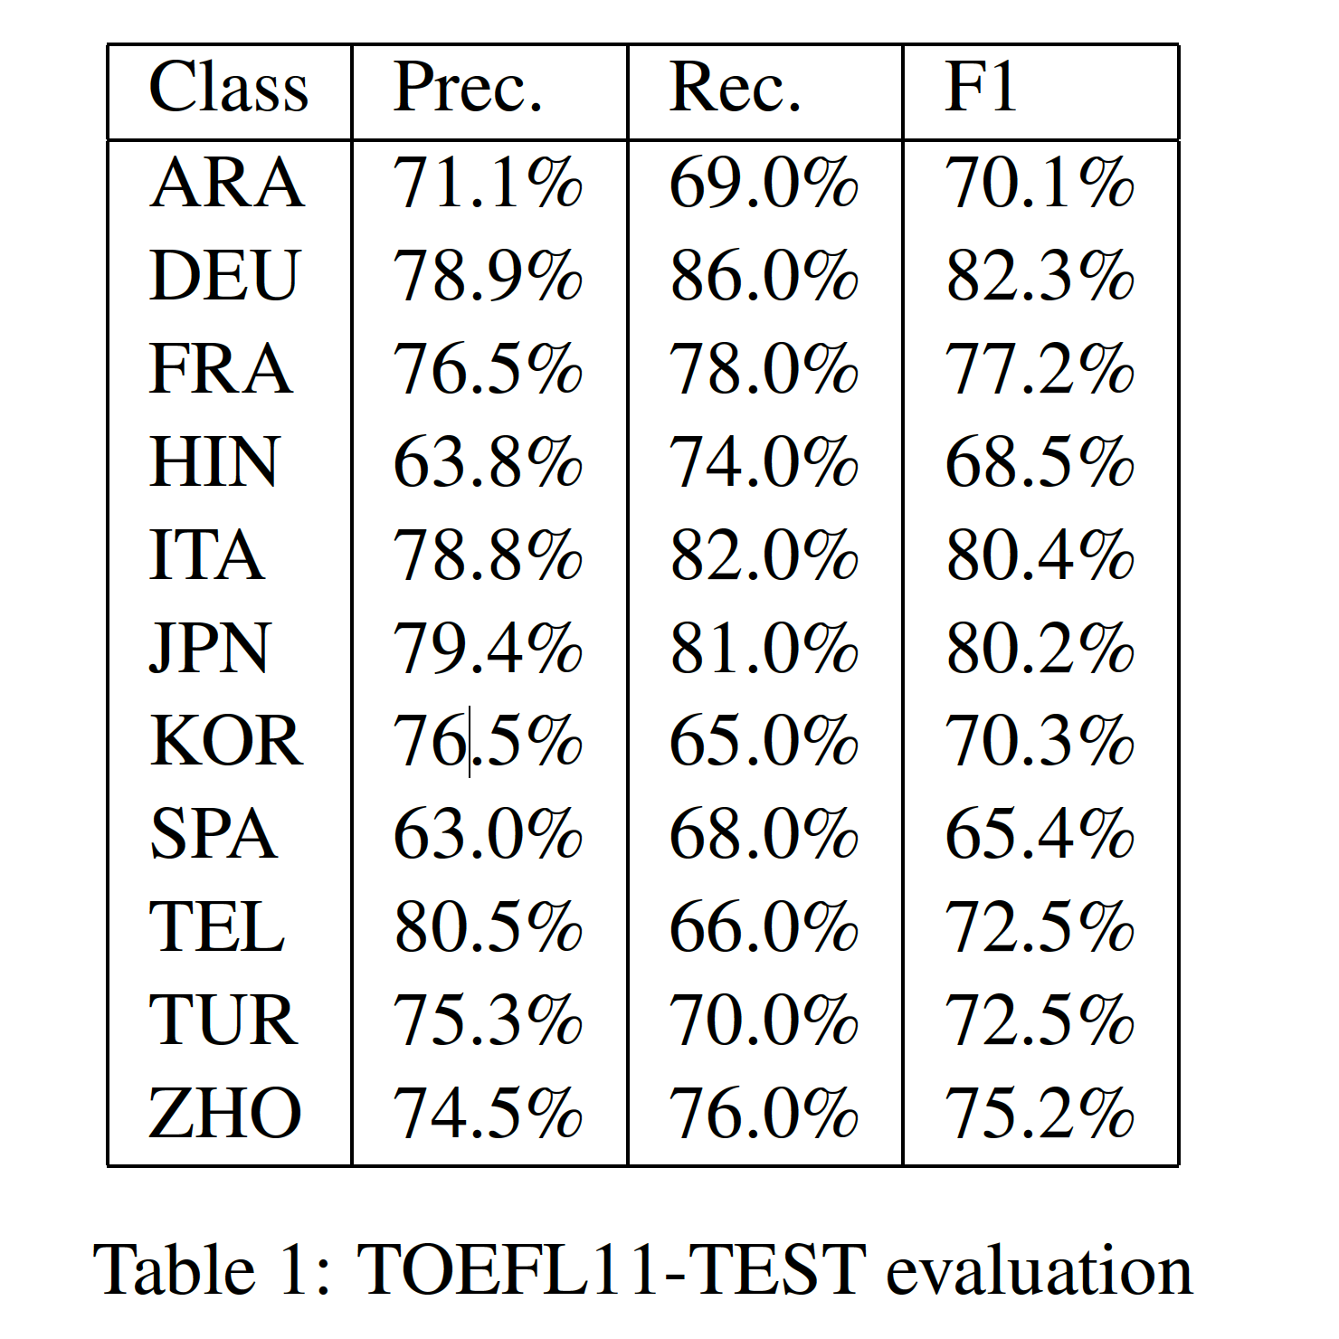
Overall accuracy: 74.1%

Slide 4
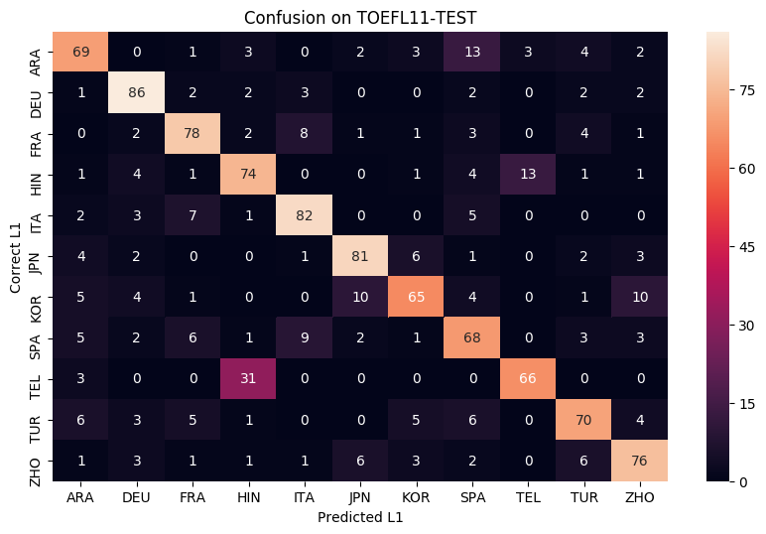

Slide 5
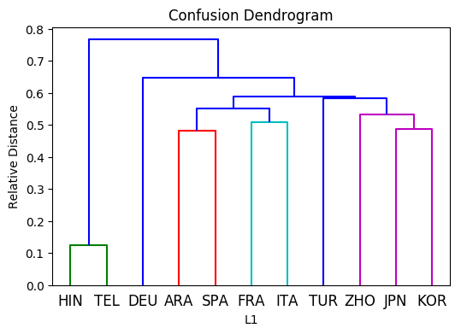

Slide 6
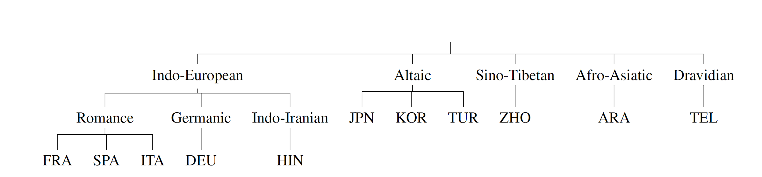

Slide 7
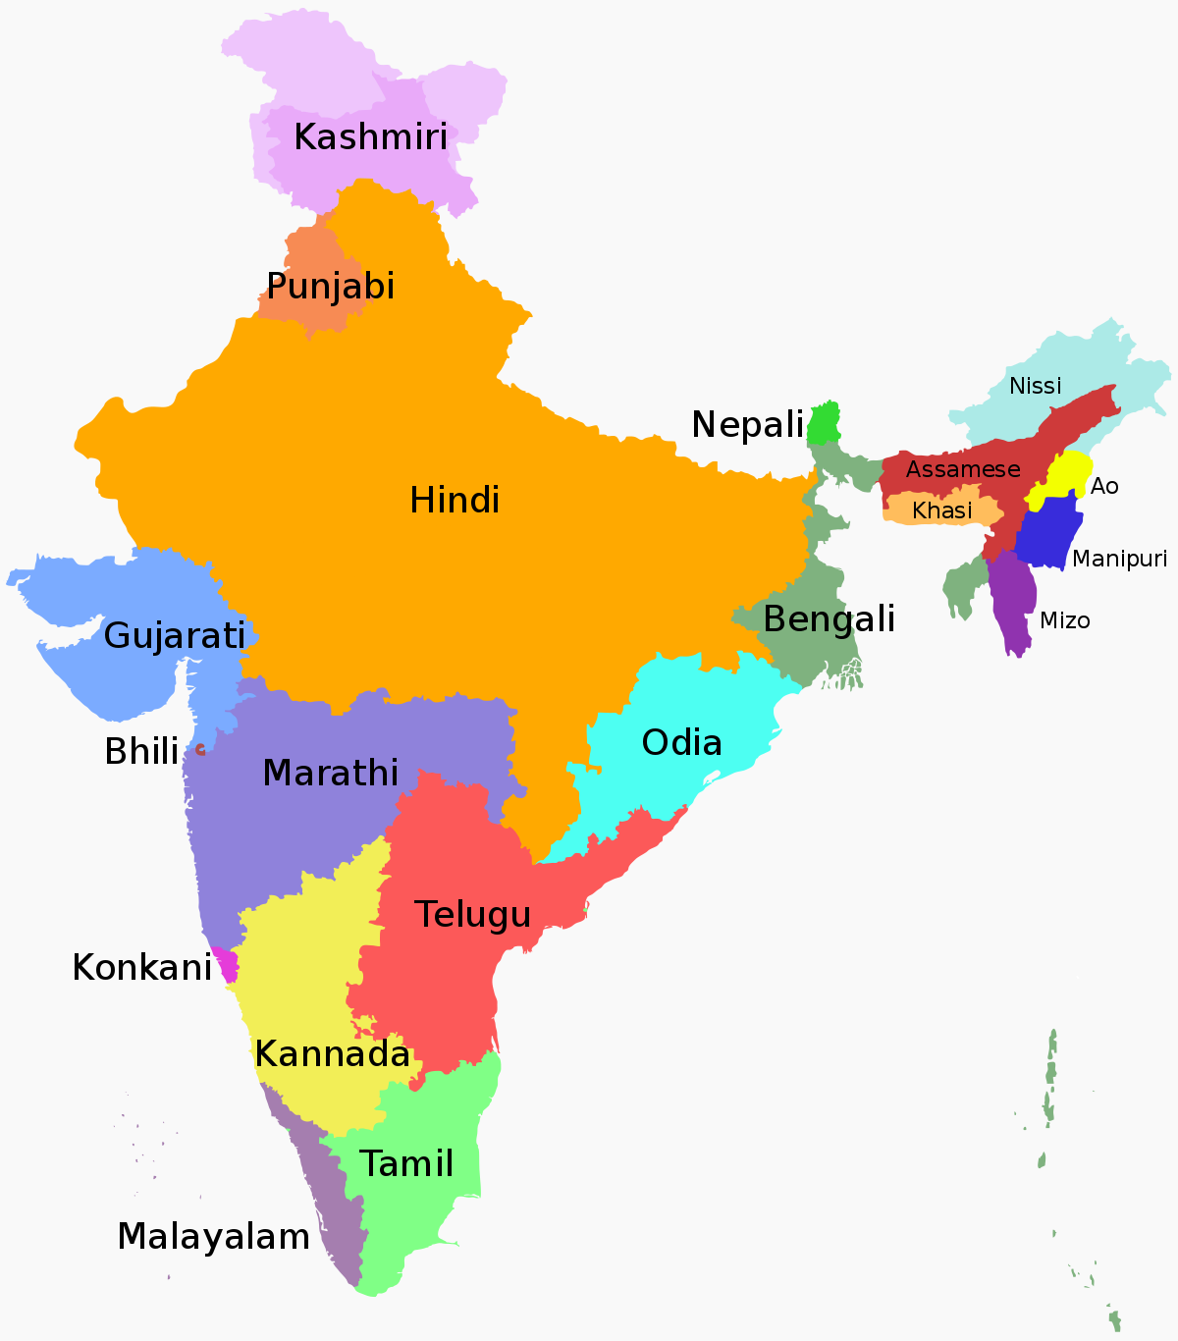

Slide 8
Possible Explanations for Confusion
Use of cognates from L1 languages.
Regional & cultural influence on response content.

