Slide 1
Chapter 22
Natural Language Processing

Slide 2
What is Natural Language Processing (NLP)?
NLP is a field of CS, AI, and computational linguistics concerned with the interactions between computers and human languages
  understanding + generating language

Slide 3
Why should agents do NLP?
Knowledge acquisition from spoken and written language artifacts (e.g. online)
  Much (most?) data available today is text
    emails, blogs, news, search results, reviews, social media, medical reports, course content, etc.
Communicate with humans
  Recall Turing test
  NLP for communication methods in Chapter 23

Slide 4
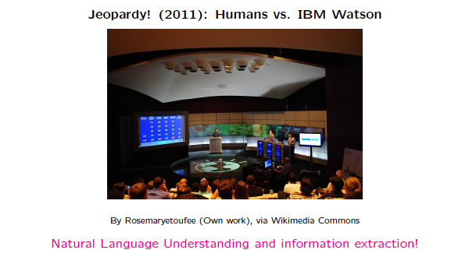
NLP Applications

Slide 5
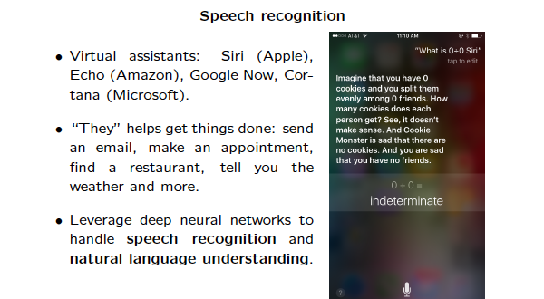
NLP Applications

Slide 6
NLP Applications
Machine Translation
  Historical motivation: Russian -> English
  First systems used one-to-one correspondence and failed
    “Out of sight, out of mind” -> “Invisible, imbecile”
  Now statistical, google translate, amazon (Local!)
    https://aws.amazon.com/translate/

Slide 7
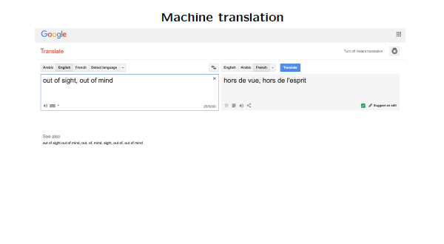

Slide 8
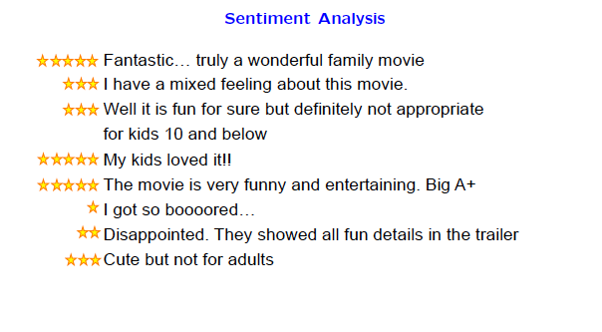
NLP Applications

Slide 9
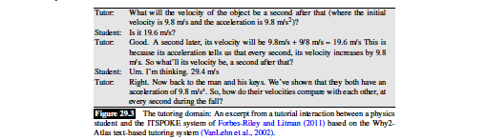
NLP Applications – Dialogue Systems

Slide 10
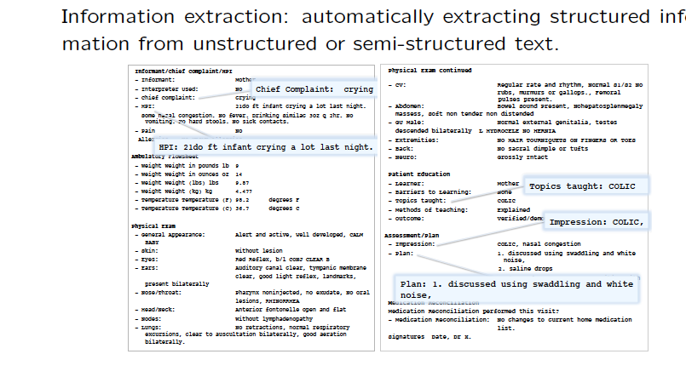
NLP Applications

Slide 11
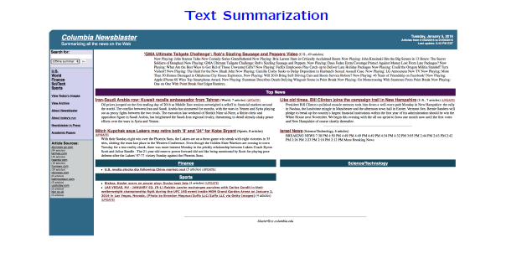
NLP Applications

Slide 12
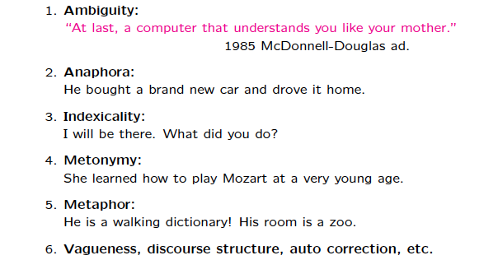
Why is NLP hard?

Slide 13
Ambiguity
“At last, a computer that understands you like your mother.”
  The computer understands you as well as your mother understands you.
  The computer understands that you like your mother.
  The computer understands you as well as it understands your mother.

Slide 14
Outline
Language Models
  Predict the probability distribution of language expressions
Information-Seeking Tasks
  Text Classification

Slide 15
Language Models
Formal languages (e.g. Python, Logic)
  Grammar (syntax)
  Semantics
Natural languages (e.g. English)
  Grammaticality is less clear
    * To be not invited is sad
  Ambiguity at many levels (syntax, semantics, …)
    I saw the man with the telescope
    He saw her duck
  Suggests modeling via probability distributions
    What is the probability that a random sentence would be a string of words?
    What is the probability distribution over possible meanings for a sentence?

Slide 16
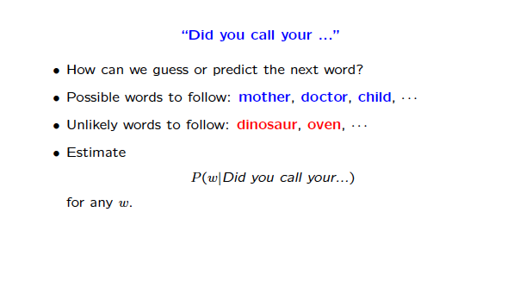
Language Models

Slide 17
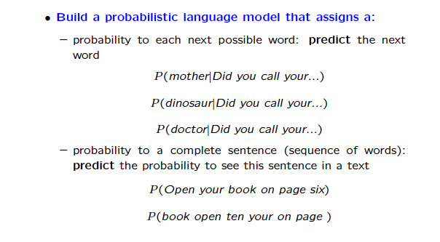
Language Models

Slide 18
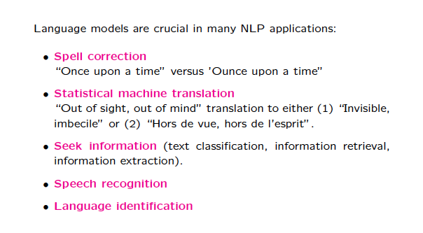
Language Models

Slide 19
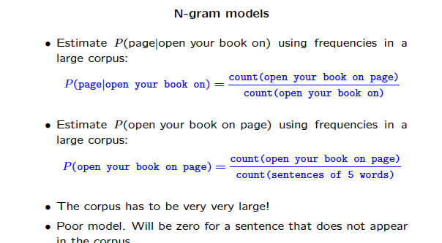
Language Models

Slide 20
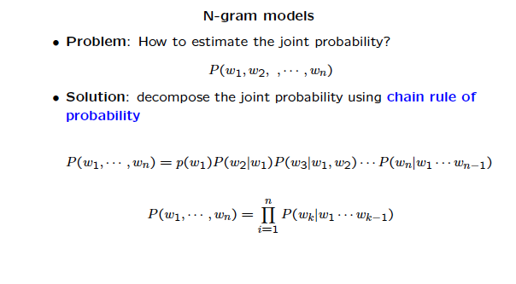
Language Models

Slide 21
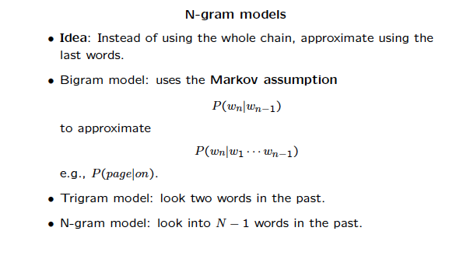
Language Models

Slide 22
N-Gram Models
N-Gram
  a sequence (of some unit – characters, words, etc.) of length n
  Unigram, Bigram and Trigrams for n= 1, 2, and 3
N-Gram Model
  probability distribution of n-unit sequences
  Markov chain of order n -1
    the probability of a unit depends only on some of the immediately preceding units

Slide 23
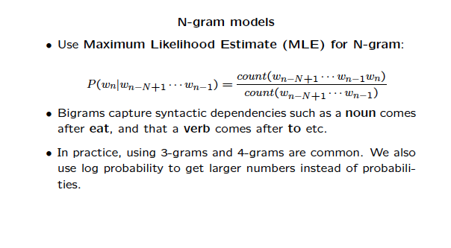
Language Models

Slide 24
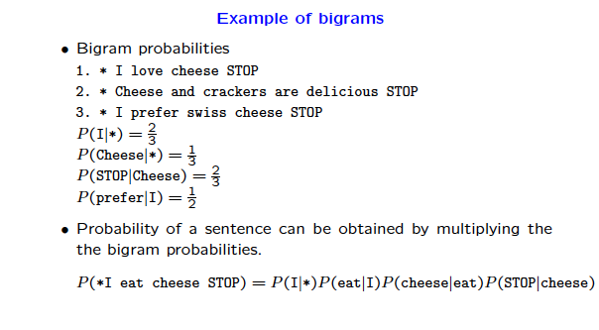
Language Models

Slide 25
N-gram character models
P(c_{1:n}) is the probability of a sequence of N characters c₁ through c_{N}
  Typically corpus-based (uses a body of text)
  P(“the”) = .03
  P(“zgq”) = .000000000002
Application: language identification
  Corpus: P(Text|Language) (trigrams)
  Language Identification – use Bayes Rule!
Application: named–entity recognition
  “ex “ -> drug name
  Can handle unseen words!

Slide 26
N-gram word models
Much larger “vocabulary” of units
Since units are open, out of vocabulary becomes a problem
“Word” needs to be defined precisely
Common in speech recognition

Slide 27
Smoothing
What do we do about zero (or low) counts in a training corpus?
  Sequences with count zero are assigned a small non-zero probabililty (support generalization)
  Need to adjust other counts downward, so probability still sums to 1
Add one smoothing
Backoff (e.g. if no trigram, use bigram)
Many others in NLP course
Just like ML, is it better to improve smoothing methods, or to get more data???

Slide 28
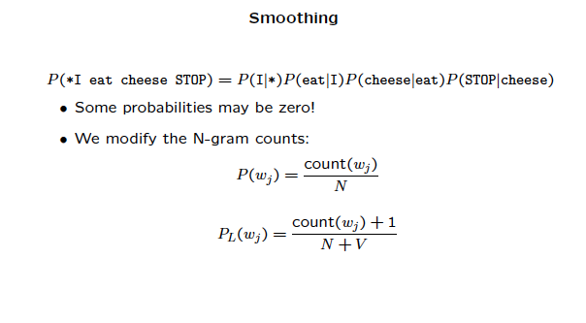
Language Models

Slide 29
Evaluation
Just like ML, cross-validation with train/validate/test data
Just like ML, many metrics
  extrinsic – e.g. language identification
  intrinsic - perplexity

Slide 30
Text Classification
Our spam filter from probability chapters (now think language modeling), was also recast as supervised learning
  Input: text
  Output: one of a set of predefined classes
  Features: NLP-based (e.g. word and character n-grams)
    Bag of words: unigrams

