Slide 1
Introduction
to Computers and Python
CS 0008

Slide 2
Why Program
Computers are tools
Multi-purpose
Computers are customizable tools
Customize through programming
Computers are good at...
tedious, repetitive tasks
math
handling a lot of data
following instructions exactly as you give them

Slide 3
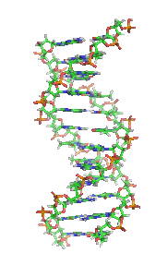
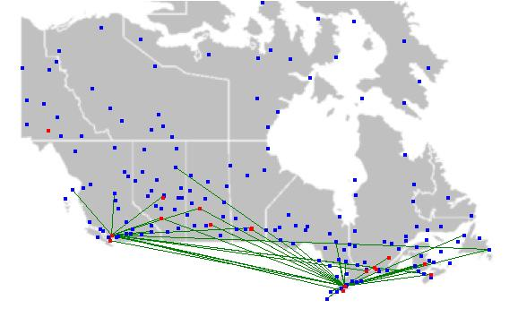
Some problems computers can handle
Remove red-eye from a picture
Find the complement of a DNA strand
Display maps with airplane flight paths
Multiply matrices
Assess the reading level of a text book

Slide 4
Programming Languages
Ada
Assembly
BASH
BASIC
C
C++
C#
D
COBOL
FORTRAN
Go
Haskell
Java
JavaScript
LISP
Mathematica
MATLAB
ML
Objective C
Pascal
Perl
PHP
Prolog
Python
R
Ruby
Visual Basic
and many others

Slide 5
So why Python?
Popular language
Often ranked among top 10 programming languages
Used at many companies
One of four official Google languages (the others are Java, C++, and Go)
Free, well-documented, and well-supported
Clean syntax

Slide 6
Learning to Program
Programming ideas are the same from one language to another
Once you learn one language, it is straightforward to learn others
Python programs are shorter and simpler than other languages
You can concentrate on the ideas, and learn programming concepts quicker.

Slide 7
Python vs. Java
Java:
public class HelloWorld
{
public static void main (String[] args)
{
System.out.println("Hello, world!");
}
}
Python:
print("Hello, world!")

Slide 8
Running Python Programs
Scripting, interpreted language
Write code in interpreter for immediate feedback
Although, can write code in text files for easy reuse
Two versions of Python currently in use:
Python 2
Python 3
We will use Python 3
A lot of information online about Python refers to Python 2, but there are incompatibilities between the languages

Slide 9
The Big Picture
How will our programs run?
Software
Our program
Python 3 interpreter
Operating System
Hardware
The code that we wrote
Converts our program into something that can be executed.
It also fills in some blanks for us
Provides access to the hardware and other resources.
Actually executes our code
It is many of those resources
Stores software and data

Slide 10
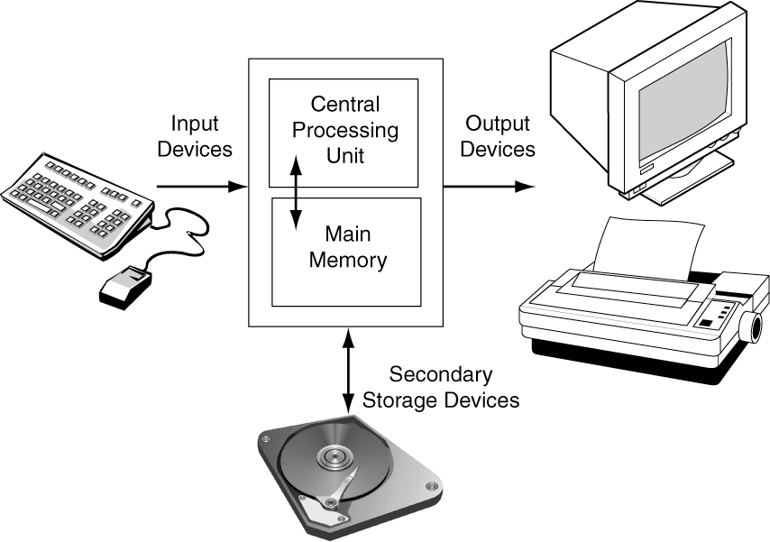
The Big Picture

