Slide 1
CS 2770: Computer Vision
Classification
(Convolutional Neural Networks, Support Vector Machines)
Prof. Adriana Kovashka
University of Pittsburgh
February 18, 2021

Slide 2
Plan for this lecture
What is classification?
Support vector machines
  Separable case / non-separable case
  Linear / non-linear (kernels)
  The importance of generalization
Convolutional neural networks

Slide 3
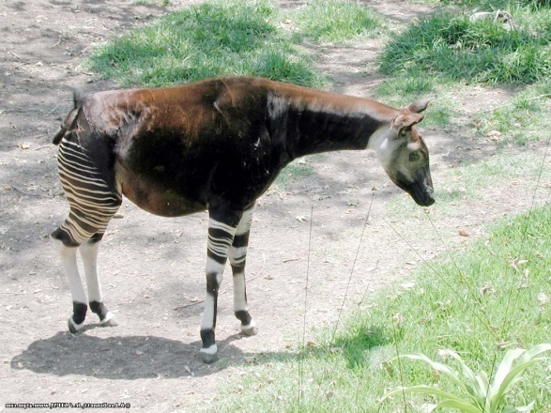
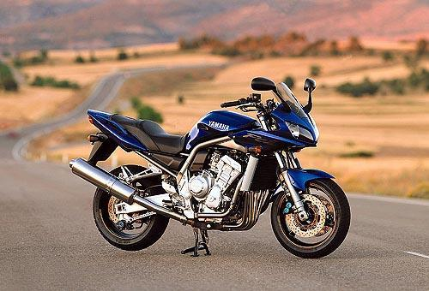
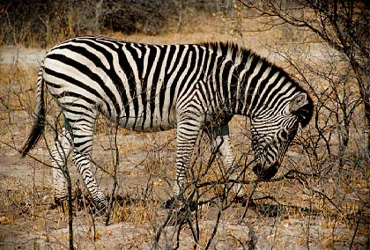
Classification
Given a feature representation for images, how do we learn a model for distinguishing features from different classes?
Decision
boundary
Zebra
Non-zebra
Slide credit: L. Lazebnik

Slide 4
Classification
Assign input vector to one of two or more classes
Input space divided into decision regions separated by decision boundaries
Slide credit: L. Lazebnik

Slide 5
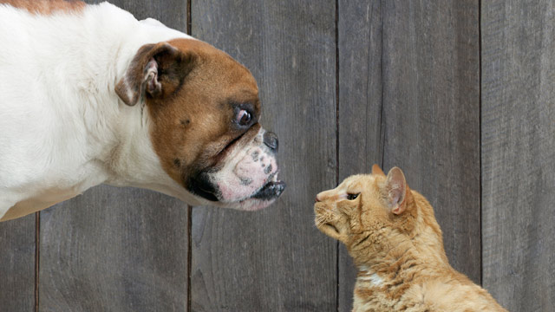
Examples of image classification
Two-class (binary): Cat vs Dog
Adapted from D. Hoiem

Slide 6
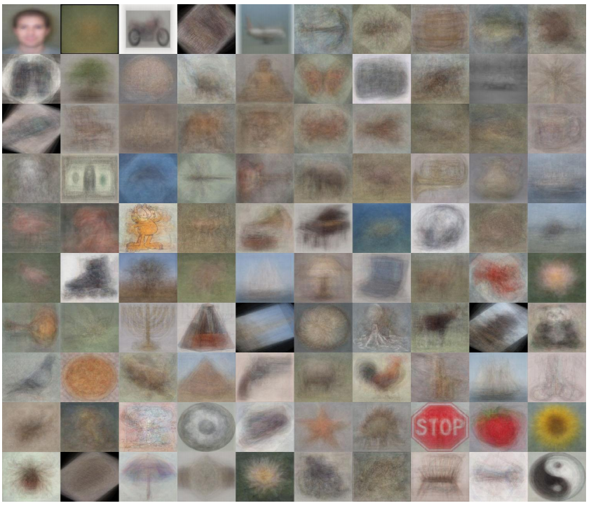
Examples of image classification
Multi-class (often): Object recognition
Caltech 101 Average Object Images
Adapted from D. Hoiem

Slide 7
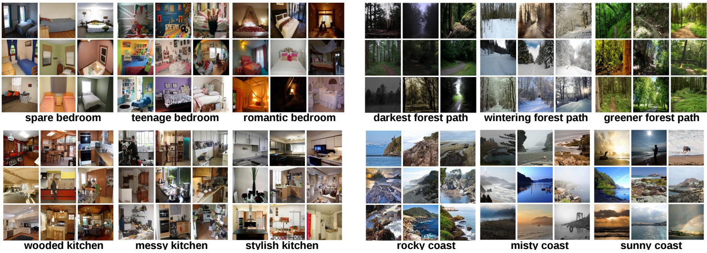
Examples of image classification
Place recognition
Places Database [Zhou et al. NIPS 2014]
Slide credit: D. Hoiem

Slide 8
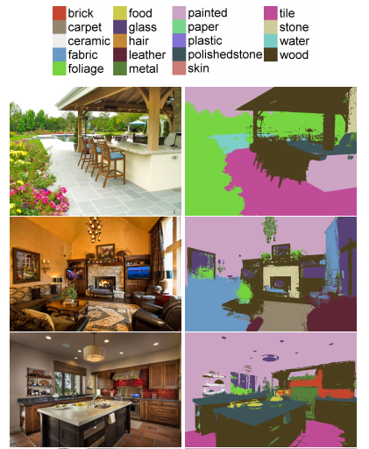
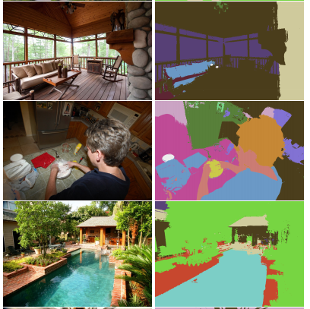
Examples of image classification
Material recognition
[Bell et al. CVPR 2015]
Slide credit: D. Hoiem

Slide 9
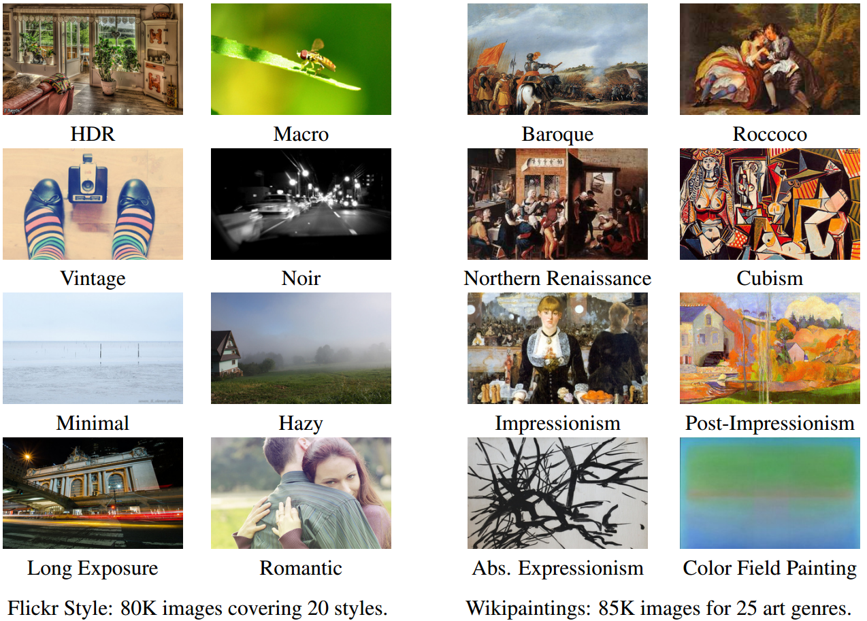
Examples of image classification
Image style recognition
[Karayev et al. BMVC 2014]
Slide credit: D. Hoiem

Slide 10
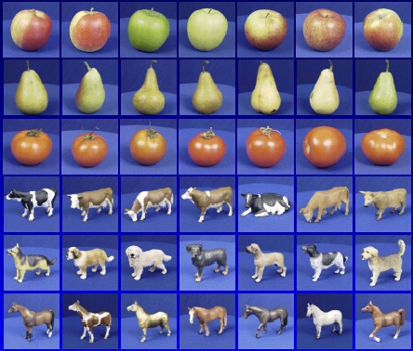
Recognition: A machine learning approach

Slide 11



The machine learning framework
Apply a prediction function to a feature representation of the image to get the desired output:
f( ) = “apple”
f( ) = “tomato”
f( ) = “cow”
Slide credit: L. Lazebnik

Slide 12
The machine learning framework
y* = f(x)
Training: given a training set of labeled examples {(x₁,y₁), …, (x_{N},y_{N})}, estimate the prediction function f by minimizing the prediction error on the training set, e.g. |f(x_{i}) – y_{i}|
  Evaluate multiple hypotheses f₁, f₂, f_{H} … and pick the best one as f
Testing: apply f to a never before seen test example x and output the predicted value y* = f(x)
output (may differ from ground-truth label y)
prediction function
image / image feature
Slide credit: L. Lazebnik

Slide 13

The old-school way
Training
Training Labels
Training Images
Image Features
Training
Learned model
Testing
Image Features
Learned model
Prediction
Test Image
Slide credit: D. Hoiem and L. Lazebnik

Slide 14
The simplest classifier
Test example
Training examples from class 2
Training examples from class 1
f(x) = label of the training example nearest to x
All we need is a distance function for our inputs
No training required!
Slide credit: L. Lazebnik

Slide 15
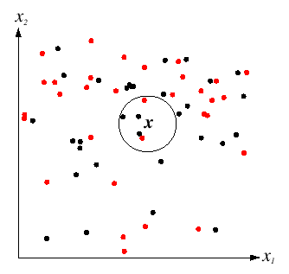
K-Nearest Neighbors classification
For a new point, find the k closest points from training data
Labels of the k points “vote” to classify
k = 5
Black = negative
Red = positive
If query lands here, the 5 NN consist of 3 negatives and 2 positives, so we classify it as negative.
Slide credit: D. Lowe

Slide 16
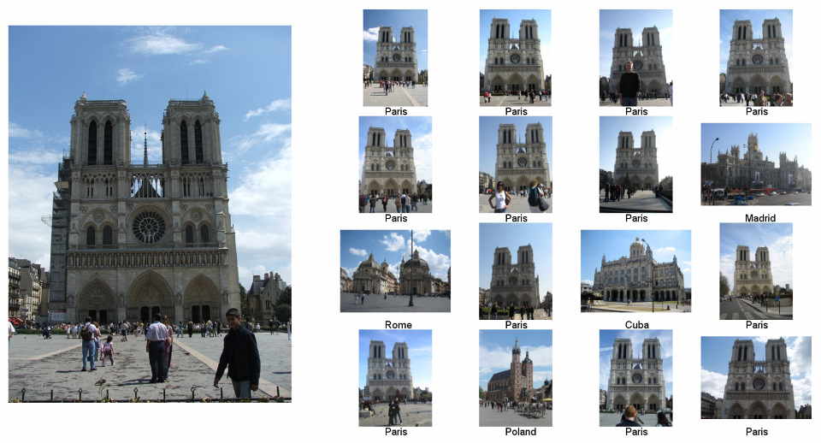
im2gps: Estimating Geographic Information from a Single Image
James Hays and Alexei Efros, CVPR 2008
Where was this image taken?
Nearest Neighbors according to bag of SIFT + color histogram + a few others
Slide credit: James Hays

Slide 17
Linear classifier
Find a linear function to separate the classes
f(x) = sgn(w₁x₁ + w₂x₂ + … + w_{D}x_{D}) = sgn(w ⋅ x)
Slide credit: L. Lazebnik

Slide 18
Linear classifier
Decision = sign(w^{T}x) = sign(w1*x1 + w2*x2)
x2
w
x1
(0, 0)
(1, 0)
What should the weights be?

Slide 19
Lines in R²
Let
distance from point to line
Kristen Grauman

Slide 20
Linear classifiers
Find linear function to separate positive and negative examples
B
C
A
D
Not seen until test time,
of class blue
Which line
is best?
C. Burges, A Tutorial on Support Vector Machines for Pattern Recognition, Data Mining and Knowledge Discovery, 1998

Slide 21
Support vector machines
Discriminative classifier based on optimal separating line (for 2d case)
Maximize the margin between the positive and negative training examples
C. Burges, A Tutorial on Support Vector Machines for Pattern Recognition, Data Mining and Knowledge Discovery, 1998

Slide 22
Support vector machines
Want line that maximizes the margin.
wx+b=1
wx+b=0
wx+b=-1
For support, vectors,
Support vectors
Margin
C. Burges, A Tutorial on Support Vector Machines for Pattern Recognition, Data Mining and Knowledge Discovery, 1998

Slide 23
Support vector machines
Want line that maximizes the margin.
wx+b=1
wx+b=0
wx+b=-1
For support, vectors,
Distance between point and line:
For support vectors:
Support vectors
Margin
C. Burges, A Tutorial on Support Vector Machines for Pattern Recognition, Data Mining and Knowledge Discovery, 1998

Slide 24
Support vector machines
Want line that maximizes the margin.
wx+b=1
wx+b=0
wx+b=-1
For support, vectors,
Distance between point and line:
Therefore, the margin is 2 / ||w||
Support vectors
Margin
C. Burges, A Tutorial on Support Vector Machines for Pattern Recognition, Data Mining and Knowledge Discovery, 1998

Slide 25
Finding the maximum margin line
Maximize margin 2/||w||
Correctly classify all training data points:
Quadratic optimization problem:
Minimize
Subject to y_{i}(w·x_{i}+b) ≥ 1
One constraint for each training point.
Note sign trick.
C. Burges, A Tutorial on Support Vector Machines for Pattern Recognition, Data Mining and Knowledge Discovery, 1998

Slide 26
Finding the maximum margin line
Solution:
Learned
weight
Support
vector
C. Burges, A Tutorial on Support Vector Machines for Pattern Recognition, Data Mining and Knowledge Discovery, 1998

Slide 27
Finding the maximum margin line
Solution:
b = y_{i} – w·x_{i} (for any support vector)
Classification function:
Notice that it relies on an inner product between the test point x and the support vectors x_{i}
(Solving the optimization problem also involves computing the inner products x_{i} · x_{j} between all pairs of training points)
If f(x) < 0, classify as negative, otherwise classify as positive.
C. Burges, A Tutorial on Support Vector Machines for Pattern Recognition, Data Mining and Knowledge Discovery, 1998

Slide 28
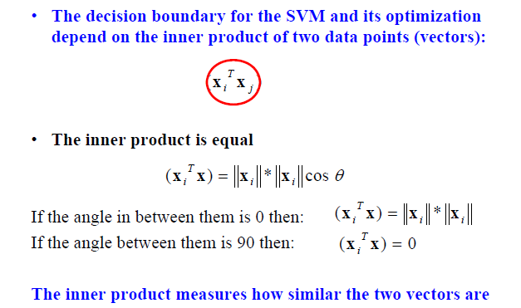
Inner product
Adapted from Milos Hauskrecht

Slide 29
Nonlinear SVMs
Datasets that are linearly separable work out great:
But what if the dataset is just too hard?
We can map it to a higher-dimensional space:
0
x
0
x
x²
0
x
Andrew Moore

Slide 30
Nonlinear SVMs
General idea: the original input space can always be mapped to some higher-dimensional feature space where the training set is separable:
Φ: x → φ(x)
Andrew Moore

Slide 31
Nonlinear kernel: Example
Consider the mapping
x²
Svetlana Lazebnik

Slide 32
The “Kernel Trick”
The linear classifier relies on dot product between vectors K(x_{i} , x_{j}) = x_{i} · x_{j}
If every data point is mapped into high-dimensional space via some transformation Φ: x_{i} → φ(x_{i} ), the dot product becomes: K(x_{i} , x_{j}) = φ(x_{i} ) · φ(x_{j})
A kernel function is similarity function that corresponds to an inner product in some expanded feature space
The kernel trick: instead of explicitly computing the lifting transformation φ(x), define a kernel function K such that: K(x_{i} , x_{j}) = φ(x_{i} ) · φ(x_{j})
Andrew Moore

Slide 33
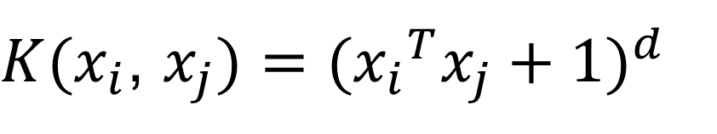
Examples of kernel functions
Linear:
Polynomials of degree up to d:
Gaussian RBF:
Histogram intersection:
$K(x_{i}$, $x_{j})={({x_{i}}^{T}x_{j}+1)}^{d}$
Andrew Moore / Carlos Guestrin

Slide 34
Hard-margin SVMs
The w that minimizes…
Maximize margin

Slide 35
Soft-margin SVMs
# data samples
Misclassification
cost
Slack variable
The w that minimizes…
Maximize margin
Minimize misclassification
Figure from Chris Bishop

Slide 36
What about multi-class SVMs?
Unfortunately, there is no “definitive” multi-class SVM formulation
In practice, we have to obtain a multi-class SVM by combining multiple two-class SVMs
One vs. others
  Training: learn an SVM for each class vs. the others
  Testing: apply each SVM to the test example, and assign it to the class of the SVM that returns the highest decision value
One vs. one
  Training: learn an SVM for each pair of classes
  Testing: each learned SVM “votes” for a class to assign to the test example
Svetlana Lazebnik

Slide 37
Multi-class problems
One-vs-all (a.k.a. one-vs-others)
  Train K classifiers
  In each, pos = data from class i, neg = data from classes other than i
  The class with the most confident prediction wins
  Example:
    You have 4 classes, train 4 classifiers
    1 vs others: score 3.5
    2 vs others: score 6.2
    3 vs others: score 1.4
    4 vs other: score 5.5
    Final prediction: class 2

Slide 38
Multi-class problems
One-vs-one (a.k.a. all-vs-all)
  Train K(K-1)/2 binary classifiers (all pairs of classes)
  They all vote for the label
  Example:
    You have 4 classes, then train 6 classifiers
    1 vs 2, 1 vs 3, 1 vs 4, 2 vs 3, 2 vs 4, 3 vs 4
    Votes: 1, 1, 4, 2, 4, 4
    Final prediction is class 4

Slide 39
Some SVM packages
LIBSVM http://www.csie.ntu.edu.tw/~cjlin/libsvm/
LIBLINEAR https://www.csie.ntu.edu.tw/~cjlin/liblinear/
SVM Light http://svmlight.joachims.org/

Slide 40
Linear classifiers vs nearest neighbors
Linear pros:
  Low-dimensional parametric representation
  Very fast at test time
Linear cons:
  Can be tricky to select best kernel function for a problem
  Learning can take a very long time for large-scale problem
NN pros:
  Works for any number of classes
  Decision boundaries not necessarily linear
  Nonparametric method
  Simple to implement
NN cons:
  Slow at test time (large search problem to find neighbors)
  Storage of data
  Especially need good distance function (but true for all classifiers)
Adapted from L. Lazebnik

Slide 41
Training vs Testing
What do we want?
  High accuracy on training data?
  No, high accuracy on unseen/new/test data!
  Why is this tricky?
Training data
  Features (x) and labels (y) used to learn mapping f
Test data
  Features (x) used to make a prediction
  Labels (y) only used to see how well we’ve learned f!!!
Validation data
  Held-out set of the training data
  Can use both features (x) and labels (y) to tune parameters of the model we’re learning

Slide 42

Generalization
Training set (labels known)
Test set (labels unknown)
How well does a learned model generalize from the data it was trained on to a new test set?
Slide credit: L. Lazebnik

Slide 43
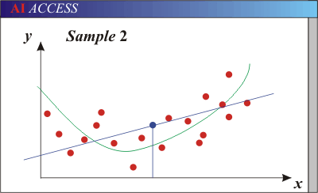
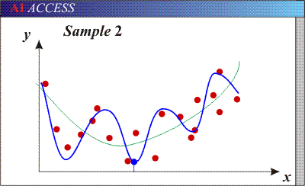
Generalization
Underfitting: Models with too few parameters are inaccurate because of a large bias (not enough flexibility).
Overfitting: Models with too many parameters are inaccurate because of a large variance (too much sensitivity to the sample).
Purple dots = possible test points
Red dots = training data (all that we see before we ship off our model!)
Green curve = true underlying model Blue curve = our predicted model/fit
Adapted from D. Hoiem

Slide 44
Generalization
Components of generalization error
  Noise in our observations: unavoidable
  Bias: how much the average model over all training sets differs from the true model
    Inaccurate assumptions/simplifications made by the model
  Variance: how much models estimated from different training sets differ from each other
Underfitting: model is too “simple” to represent all the relevant class characteristics
  High bias and low variance
  High training error and high test error
Overfitting: model is too “complex” and fits irrelevant characteristics (noise) in the data
  Low bias and high variance
  Low training error and high test error
Slide credit: L. Lazebnik

Slide 45
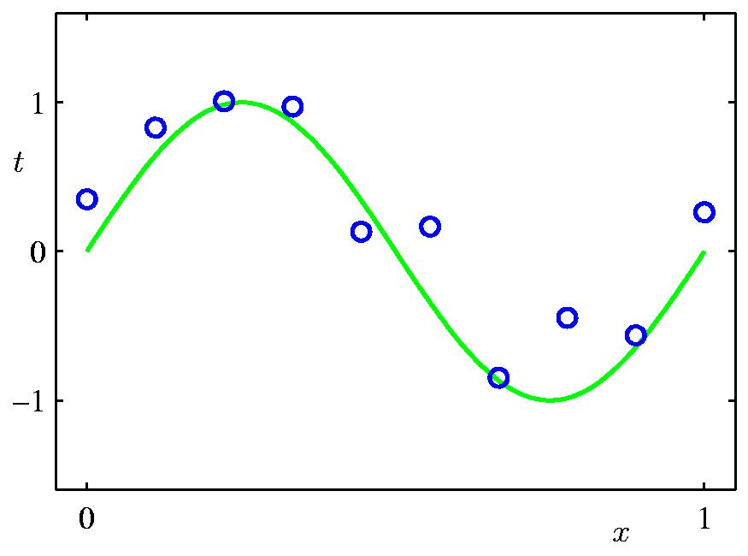
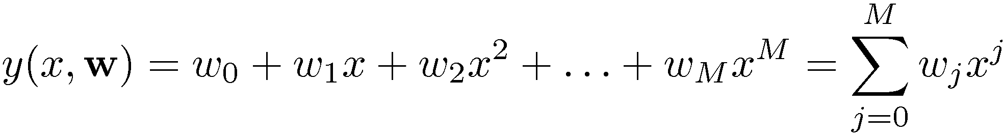
Polynomial Curve Fitting
Slide credit: Chris Bishop

Slide 46
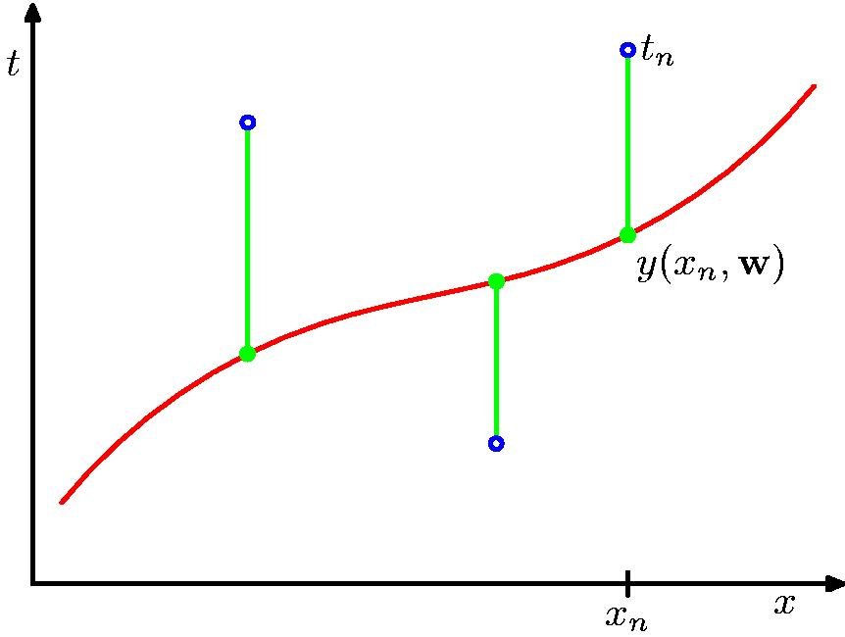
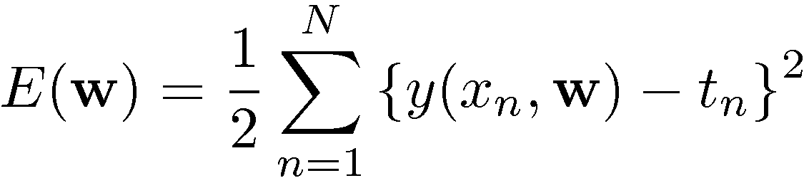
Sum-of-Squares Error Function
Slide credit: Chris Bishop

Slide 47
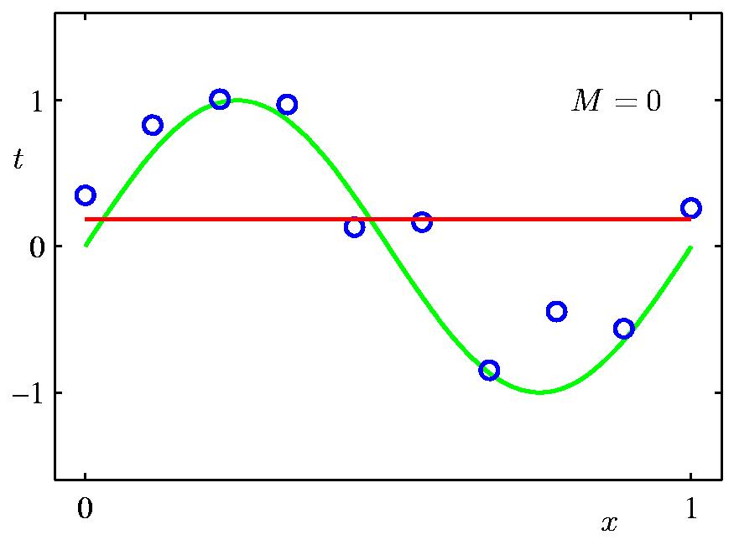
0th Order Polynomial
Slide credit: Chris Bishop

Slide 48
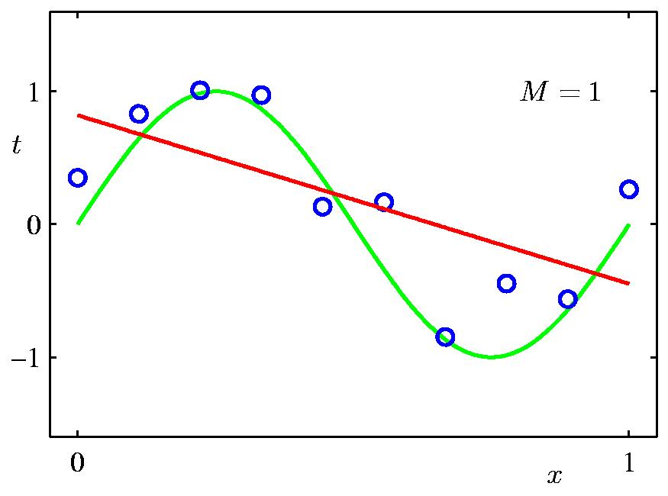
1st Order Polynomial
Slide credit: Chris Bishop

Slide 49
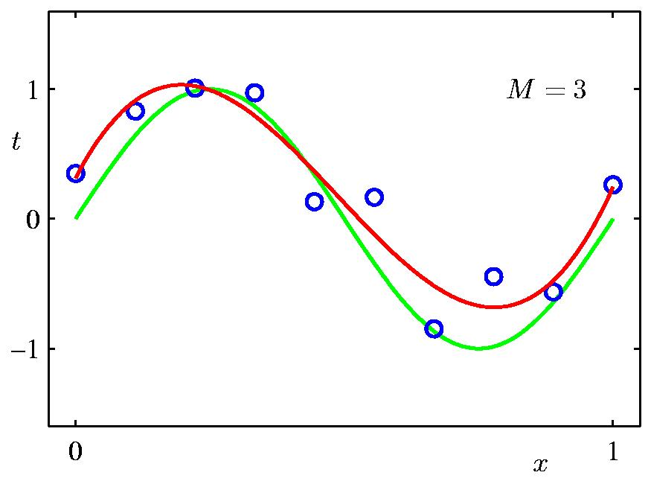
3rd Order Polynomial
Slide credit: Chris Bishop

Slide 50
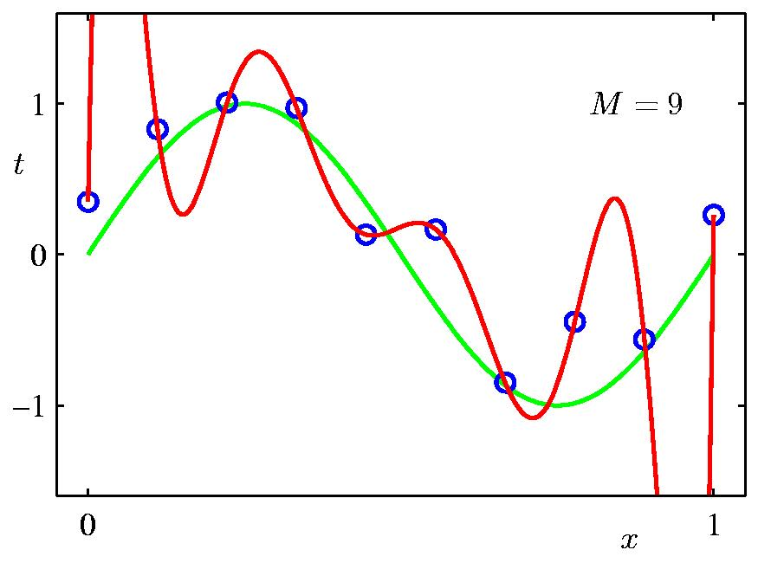
9th Order Polynomial
Slide credit: Chris Bishop

Slide 51
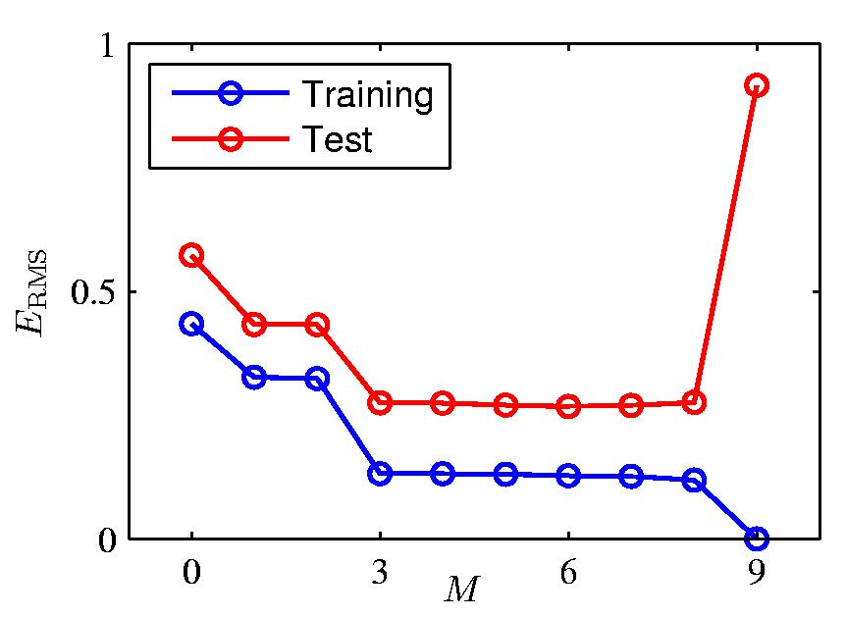
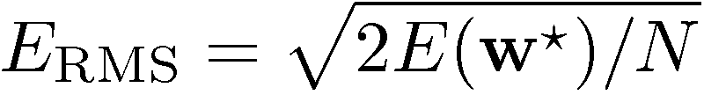
Over-fitting
Root-Mean-Square (RMS) Error:
Slide credit: Chris Bishop

Slide 52

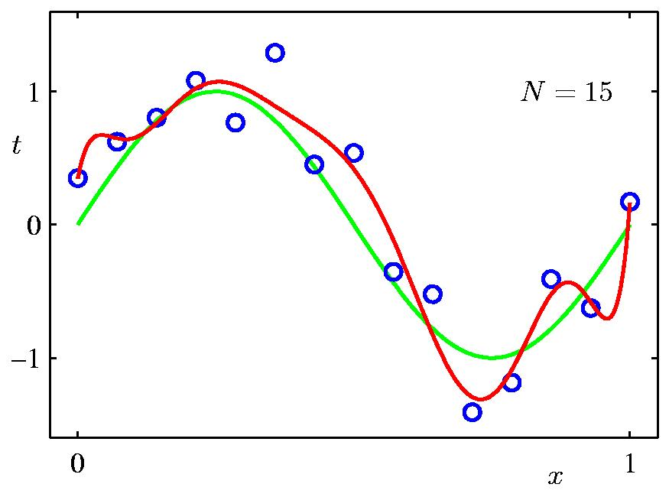
Data Set Size:
9th Order Polynomial
Slide credit: Chris Bishop

Slide 53

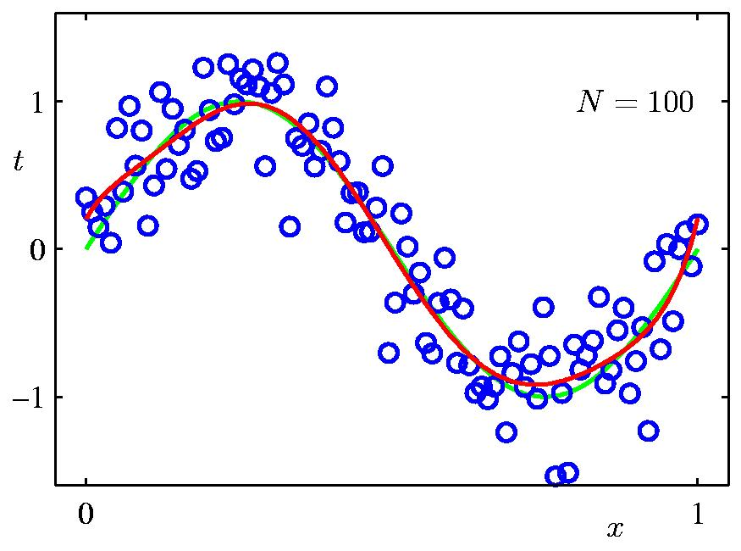
Data Set Size:
9th Order Polynomial
Slide credit: Chris Bishop

Slide 54
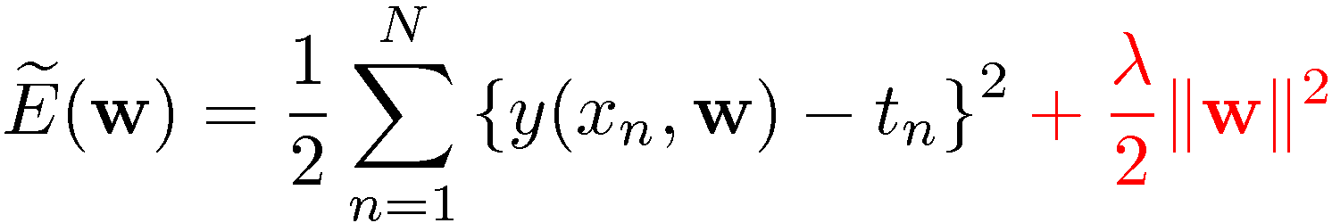
Regularization
Penalize large coefficient values
(Remember: We want to minimize this expression.)
Adapted from Chris Bishop

Slide 55

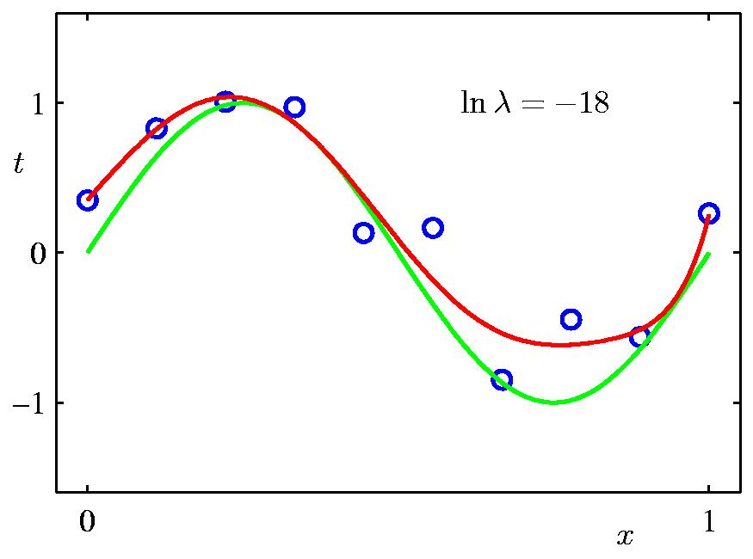
Regularization:
Slide credit: Chris Bishop

Slide 56

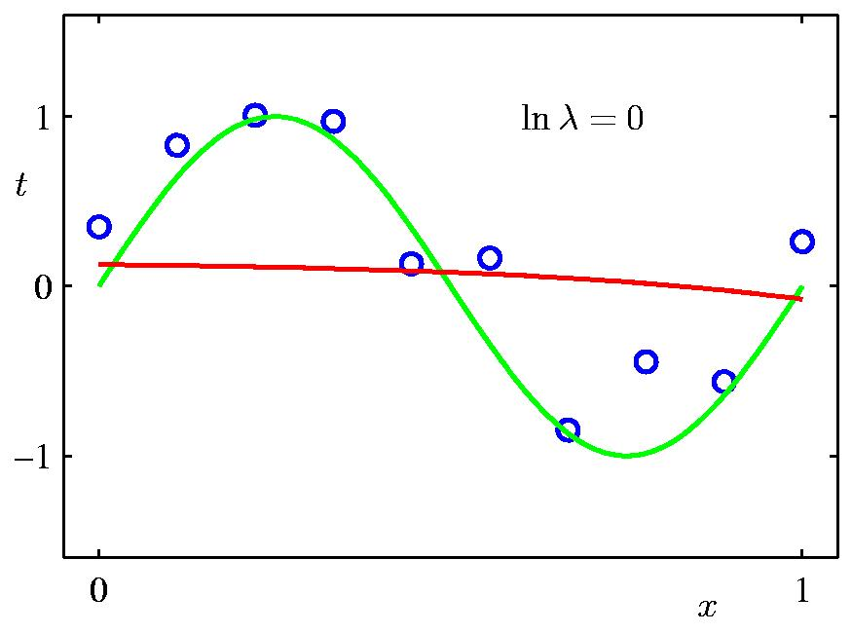
Regularization:
Slide credit: Chris Bishop

Slide 57
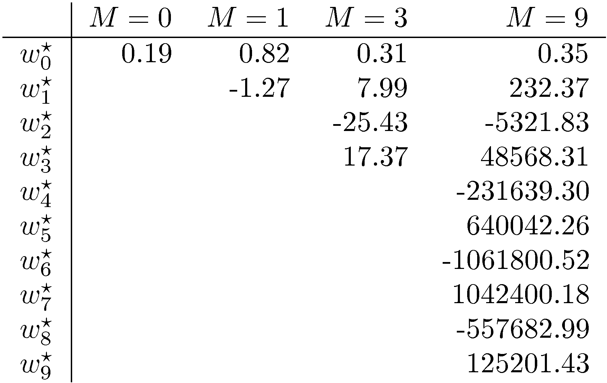
Polynomial Coefficients
Slide credit: Chris Bishop

Slide 58
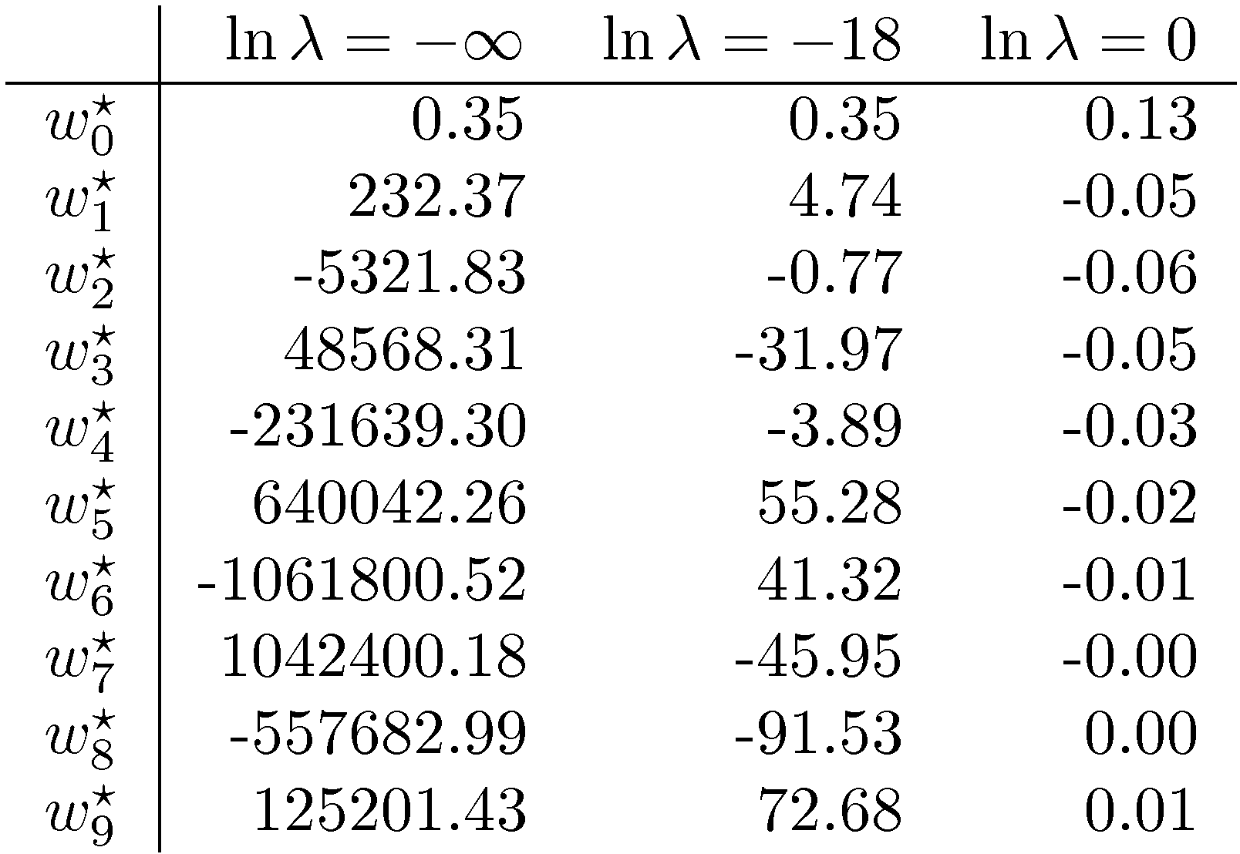
Polynomial Coefficients
No regularization Huge regularization
Adapted from Chris Bishop

Slide 59


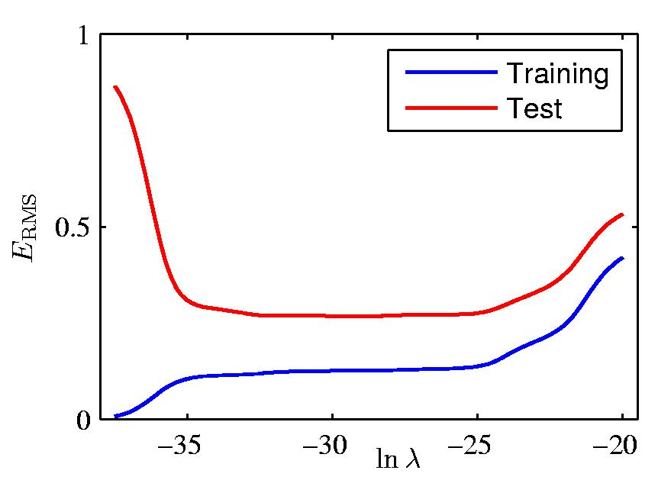
Regularization: vs.
Slide credit: Chris Bishop

Slide 60
Training vs test error
Underfitting
Overfitting
Error
Test error
Training error
High Bias
Low Variance
Complexity
Low Bias
High Variance
Slide credit: D. Hoiem

Slide 61
The effect of training set size
Few training examples
Test Error
Many training examples
High Bias
Low Variance
Complexity
Low Bias
High Variance
Slide credit: D. Hoiem
Notes:
Note: these figures don’t work in pdf

Slide 62
Choosing the trade-off between bias and variance
Need validation set (separate from the test set)
Apply this model to test set
Validation error
Error
Training error
High Bias
Low Variance
Complexity
Low Bias
High Variance
Slide credit: D. Hoiem

Slide 63
Summary of generalization
Better to have smart features and simple classifiers than simple features and smart classifiers
Use increasingly powerful classifiers with more training data
As an additional technique for reducing variance, try regularizing the parameters
Slide credit: D. Hoiem
Notes:
You can only get generalization through assumptions.

Slide 64
Plan for the rest of the lecture
Neural network basics
  Definition
  Loss functions
  Optimization w/ gradient descent and backpropagation
Convolutional neural networks (CNNs)
  Special operations
  Common architectures
Practical matters
  Getting started: Preprocessing, initialization, optimization, normalization
  Improving performance: regularization, augmentation, transfer
  Hardware and software
Understanding CNNs
  Visualization
  Breaking CNNs

Slide 65
Neural network basics

Slide 66
ImageNet Challenge 2012
~14 million labeled images, 20k classes
Images gathered from Internet
Human labels via Amazon Turk
Challenge: 1.2 million training images, 1000 classes
[Deng et al. CVPR 2009]
A. Krizhevsky, I. Sutskever, and G. Hinton, ImageNet Classification with Deep Convolutional Neural Networks, NIPS 2012
Lana Lazebnik

Slide 67

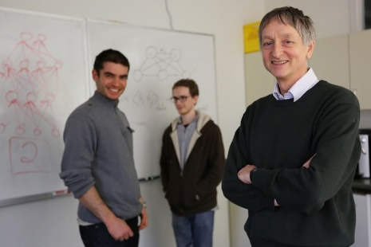
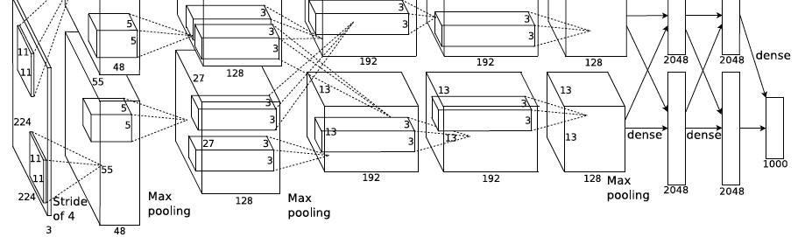
ImageNet Challenge 2012
AlexNet: Similar framework to LeCun’98 but:
  Bigger model (7 hidden layers, 650,000 units, 60,000,000 params)
  More data (10⁶ vs. 10³ images)
  GPU implementation (50x speedup over CPU)
    Trained on two GPUs for a week
  Better regularization for training (DropOut)
A. Krizhevsky, I. Sutskever, and G. Hinton, ImageNet Classification with Deep Convolutional Neural Networks, NIPS 2012
Adapted from Lana Lazebnik
Notes:
Two-GPU architecture

Slide 68
ImageNet Challenge 2012
Krizhevsky et al. -- 16.4% error (top-5)
Next best (non-convnet) – 26.2% error
Lana Lazebnik

Slide 69
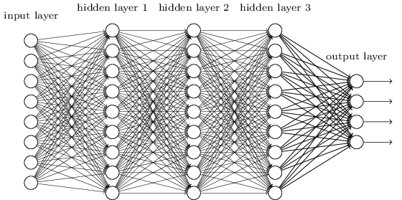
What are CNNs?
Convolutional neural networks are a type of neural network with layers that perform special operations
Used in vision but also in NLP, biomedical etc.
Often they are deep
Figure from http://neuralnetworksanddeeplearning.com/chap5.html

Slide 70
Traditional Recognition Approach
Hand-designed
feature extraction (e.g. SIFT, HOG)
Trainable
classifier
Image/ Video
Pixels
Object
Class
  Features are key to recent progress in recognition, but research shows they’re flawed…
Where next?
Adapted from Lana Lazebnik

Slide 71
What about learning the features?
  Learn a feature hierarchy all the way from pixels to classifier
  Each layer extracts features from the output of previous layer
  Train all layers jointly
Image/ Video
Pixels
Layer 1
Layer 2
Layer 3
Object
Class
Lana Lazebnik

Slide 72
“Shallow” vs. “deep” architectures
Traditional recognition: “Shallow” architecture
Image/ Video
Pixels
Hand-designed
feature extraction
Trainable
classifier
Object
Class
Deep learning: “Deep” architecture
Image/ Video
Pixels
Layer 1
Layer N
Simple classifier
…
Object Class
Lana Lazebnik

Slide 73
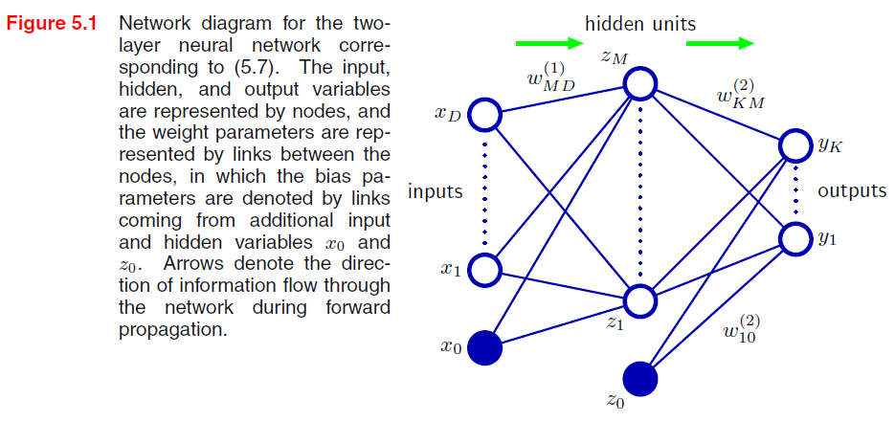


Neural network definition
Activations:
Nonlinear activation function h (e.g. sigmoid, RELU):
Recall SVM:
w^{T}x + b
Figure from Christopher Bishop

Slide 74

Neural network definition
Layer 2
Layer 3 (final)
Outputs
Finally:
(multiclass)
(binary)
(binary)

Slide 75
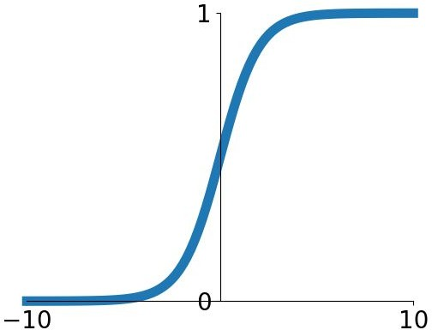
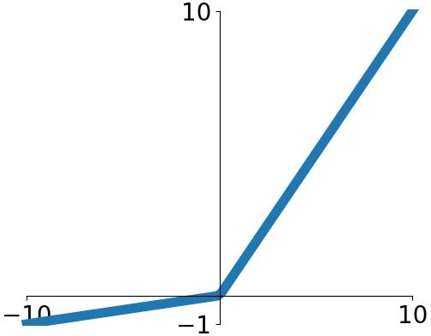


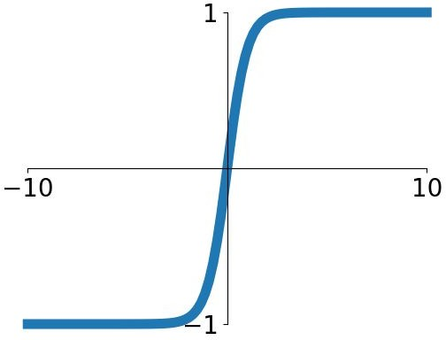


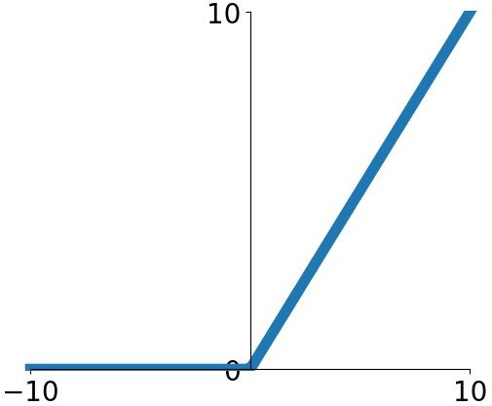
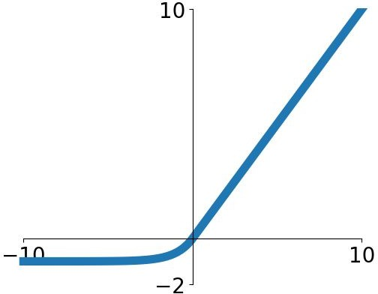

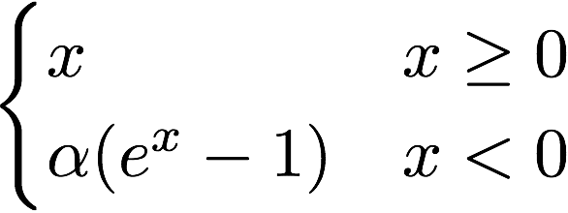
Activation functions
Sigmoid
tanh
Leaky ReLU
Maxout
ReLU
ELU
Fei-Fei Li & Justin Johnson & Serena Yeung Lecture 6 - April 19, 2018
Fei-Fei Li, Andrej Karpathy, Justin Johnson, Serena Yeung

Slide 76
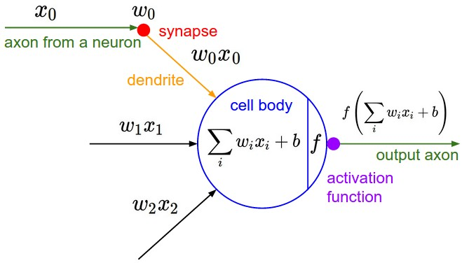
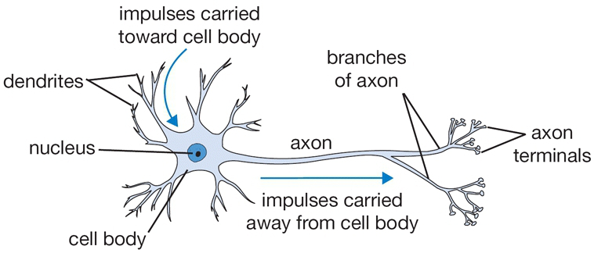
Inspiration: Neuron cells
Neurons
  accept information from multiple inputs,
  transmit information to other neurons.
Multiply inputs by weights along edges
Apply some function to the set of inputs at each node
If output of function over threshold, neuron “fires”
Text: HKUST, figures: Andrej Karpathy
Notes:
From Wikipedia: At the majority of synapses, signals are sent from the axon of one neuron to a dendrite of another... All neurons are electrically excitable, maintaining voltage gradients across their membranes… If the voltage changes by a large enough amount, an all-or-none electrochemical pulse called an action potential is generated, which travels rapidly along the cell's axon, and activates synaptic connections with other cells when it arrives.

Slide 77
Deep neural networks
Lots of hidden layers
Depth = power (usually)
Weights to learn!
Weights to learn!
Weights to learn!
Weights to learn!
Figure from http://neuralnetworksanddeeplearning.com/chap5.html

Slide 78
How do we train them?
The goal is to iteratively find such a set of weights that allow the activations/outputs to match the desired output
We want to minimize a loss function
The loss function is a function of the weights in the network
For now let’s simplify and assume there’s a single layer of weights in the network

Slide 79
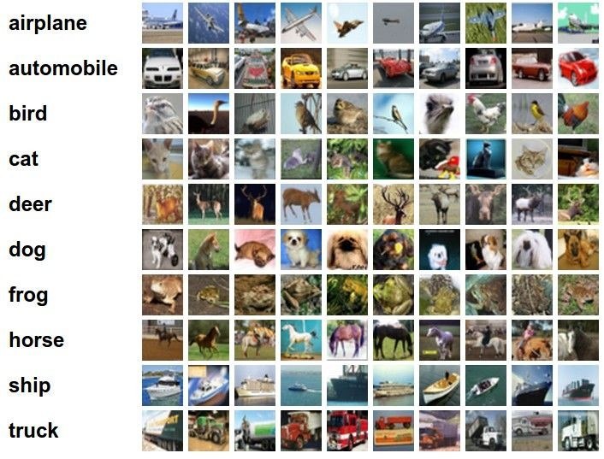
Classification goal
Example dataset: CIFAR-10 10 labels
50,000 training images each image is 32x32x3
10,000 test images.
Andrej Karpathy

Slide 80


Classification scores
image
parameters
f(x,W)
10 numbers, indicating class scores
[32x32x3]
array of numbers 0...1 (3072 numbers total)
Andrej Karpathy

Slide 81
Linear classifier
3072x1
(+b)
10x1
10x1
10x3072
10 numbers, indicating class scores
[32x32x3]
array of numbers 0...1
parameters, or “weights”
Andrej Karpathy

Slide 82
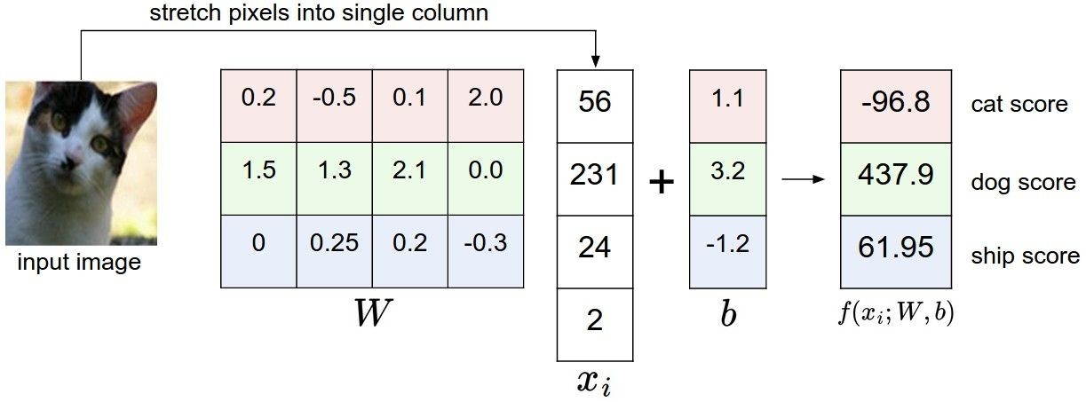
Linear classifier
Example with an image with 4 pixels, and 3 classes (cat/dog/ship)
Andrej Karpathy

Slide 83

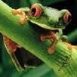
Linear classifier
Going forward: Loss function/Optimization
TODO:
1. Define a loss function that quantifies our unhappiness with the scores across the training data.
cat car frog
3.2
5.1
-1.7
1.3
4.9
2.0
2.2
2.5
-3.1
2. Come up with a way of efficiently finding the parameters that minimize the loss function. (optimization)
Andrej Karpathy

Slide 84
Linear classifier
Suppose: 3 training examples, 3 classes. With some W the scores
are:
cat car frog
3.2
5.1
-1.7
1.3
4.9
2.0
2.2
2.5
-3.1
Adapted from Andrej Karpathy

Slide 85









Linear classifier: Hinge loss
Suppose: 3 training examples, 3 classes. With some W the scores
Hinge loss:
Given an example
are:
where where
is the image and
is the (integer) label,
and using the shorthand for the scores vector:
cat car frog
the loss has the form:
3.2
5.1
-1.7
1.3
4.9
2.0
2.2
2.5
-3.1
Want: s_{yi} >= s_{j} + 1
i.e. s_{j} – s_{yi} + 1 <= 0
If true, loss is 0
If false, loss is magnitude of violation
Adapted from Andrej Karpathy

Slide 86
Linear classifier: Hinge loss
Suppose: 3 training examples, 3 classes. With some W the scores
Hinge loss:
Given an example
are:
where where
is the image and
is the (integer) label,
and using the shorthand for the scores vector:
the loss has the form:
cat car frog | 3.2 5.1 -1.7 | 1.3 2.2 4.9 2.5 2.0 -3.1
Losses: | 2.9
= max(0, 5.1 - 3.2 + 1)
+max(0, -1.7 - 3.2 + 1)
= max(0, 2.9) + max(0, -3.9)
= 2.9 + 0
= 2.9
Adapted from Andrej Karpathy

Slide 87
Linear classifier: Hinge loss
Suppose: 3 training examples, 3 classes. With some W the scores
Hinge loss:
Given an example
are:
where where
is the image and
is the (integer) label,
and using the shorthand for the scores vector:
the loss has the form:
cat 3.2 car 5.1 frog -1.7 | 1.3 4.9 2.0 | 2.2 2.5 -3.1
Losses: 2.9 | 0
= max(0, 1.3 - 4.9 + 1)
+max(0, 2.0 - 4.9 + 1)
= max(0, -2.6) + max(0, -1.9)
= 0 + 0
= 0
Adapted from Andrej Karpathy

Slide 88
Linear classifier: Hinge loss
Suppose: 3 training examples, 3 classes. With some W the scores
Hinge loss:
Given an example
are:
where where
is the image and
is the (integer) label,
and using the shorthand for the scores vector:
the loss has the form:
cat car frog | 3.2 5.1 -1.7 | 1.3 4.9 2.0 | 2.2 2.5 -3.1
Losses: | 2.9 | 0 | 12.9
= max(0, 2.2 - (-3.1) + 1)
+max(0, 2.5 - (-3.1) + 1)
= max(0, 5.3 + 1)
+ max(0, 5.6 + 1)
= 6.3 + 6.6
= 12.9
Adapted from Andrej Karpathy

Slide 89

Linear classifier: Hinge loss
Suppose: 3 training examples, 3 classes. With some W the scores
Hinge loss:
Given an example
are:
where where
is the image and
is the (integer) label,
and using the shorthand for the scores vector:
cat car frog
the loss has the form:
3.2
5.1
-1.7
1.3
4.9
2.0
2.2
2.5
-3.1
and the full training loss is the mean over all examples in the training data:
L = (2.9 + 0 + 12.9)/3
Losses:
2.9
0
12.9
= 15.8 / 3 = 5.3
Lecture 3 - 12
Adapted from Andrej Karpathy

Slide 90
Linear classifier: Hinge loss
Adapted from Andrej Karpathy

Slide 91


Linear classifier: Hinge loss
λ = regularization strength (hyperparameter)
Weight Regularization
In common use: L2 regularization L1 regularization
Dropout (will see later)
Adapted from Andrej Karpathy

Slide 92



Another loss: Softmax (cross-entropy)
scores = unnormalized log probabilities of the classes.
where
cat car frog
Want to maximize the log likelihood, or (for a loss function) to minimize the negative log likelihood of the correct class:
3.2
5.1
-1.7
Andrej Karpathy

Slide 93

Another loss: Cross-entropy
Probabilities must be >= 0
Probabilities must sum to 1
cat car frog
3.2 5.1 -1.7 | exp
0.13
0.87
0.00
24.5
164.0
0.18
L_i = -log(0.13)
= 0.89
normalize
unnormalized log probabilities
probabilities
unnormalized probabilities
Aside:
- This is multinomial logistic regression
- Choose weights to maximize the likelihood of the observed x/y data (Maximum Likelihood Estimation)
Adapted from Fei-Fei, Johnson, Yeung

Slide 94


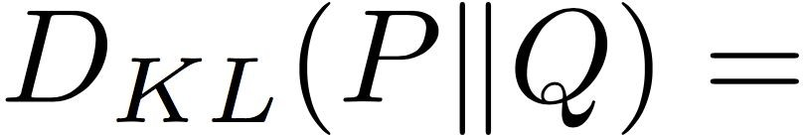

Another loss: Cross-entropy
Probabilities must be >= 0
Probabilities must sum to 1
cat car frog
3.2
5.1
-1.7
24.5
164.0
0.18
0.13
0.87
0.00
compare
 | 1.00
 | 0.00
 | 0.00
exp
normalize
Kullback–Leibler divergence
unnormalized
log-probabilities / logits
unnormalized
probabilities
probabilities
correct
probs
Adapted from Fei-Fei, Johnson, Yeung

Slide 95


Other losses
Triplet loss (Schroff, FaceNet, CVPR 2015)
Anything you want!
a denotes anchor
p denotes positive
n denotes negative

Slide 96


How to minimize the loss function?
Andrej Karpathy

Slide 97

How to minimize the loss function?
In 1-dimension, the derivative of a function:
In multiple dimensions, the gradient is the vector of (partial derivatives).
Andrej Karpathy

Slide 98
current W:
gradient dW:
[0.34,
-1.11,
0.78,
0.12,
0.55,
2.81,
-3.1,
-1.5,
0.33,…]
loss 1.25347
[-2.5,
0.6,
0,
0.2,
0.7,
-0.5,
1.1,
1.3,
-2.1,…]
dW = ...
(some function data and W)
Andrej Karpathy

Slide 99


Loss gradients
Denoted as (diff notations):
i.e. how does the loss change as a function of the weights
We want to change the weights in such a way that makes the loss decrease as fast as possible

Slide 100

Gradient descent
We’ll update weights
Move in direction opposite to gradient:
L
Time
Learning rate
W_2
original W
W_1
negative gradient direction
Figure from Andrej Karpathy

Slide 101
Gradient descent
Iteratively subtract the gradient with respect to the model parameters (w)
I.e. we’re moving in a direction opposite to the gradient of the loss
I.e. we’re moving towards smaller loss

Slide 102
Mini-batch gradient descent
In classic gradient descent, we compute the gradient from the loss for all training examples
Could also only use some of the data for each gradient update
We cycle through all the training examples multiple times
Each time we’ve cycled through all of them once is called an ‘epoch’
Allows faster training (e.g. on GPUs), parallelization

Slide 103


Learning rate selection
The effects of step size (or “learning rate”)
Andrej Karpathy

Slide 104
Gradient descent in multi-layer nets
We’ll update weights
Move in direction opposite to gradient:
How to update the weights at all layers?
Answer: backpropagation of error from higher layers to lower layers

Slide 105
Backpropagation: Graphic example
First calculate error of output units and use this to change the top layer of weights.
output
k
j
i
Update weights into j
w⁽²⁾
hidden
w⁽¹⁾
input
Adapted from Ray Mooney, equations from Chris Bishop

Slide 106
Backpropagation: Graphic example
Next calculate error for hidden units based on errors on the output units it feeds into.
output
k
j
i
hidden
input
Adapted from Ray Mooney, equations from Chris Bishop

Slide 107
Backpropagation: Graphic example
Finally update bottom layer of weights based on errors calculated for hidden units.
output
k
j
i
Update weights into i
hidden
input
Adapted from Ray Mooney, equations from Chris Bishop

Slide 108
Computing gradient for each weight
We need to move weights in direction opposite to gradient of loss wrt that weight:
w_{kj} = w_{kj} – η dE/dw_{kj} (output layer)
w_{ji} = w_{ji} – η dE/dw_{ji} (hidden layer)
Loss depends on weights in an indirect way, so we’ll use the chain rule and compute:
dE/dw_{kj} = dE/dy_{k} dy_{k}/da_{k} da_{k}/dw_{kj}
dE/dw_{ji} = dE/dz_{j} dz_{j}/da_{j} da_{j}/dw_{ji}

Slide 109
Gradient for output layer weights
Loss depends on weights in an indirect way, so we’ll use the chain rule and compute:
dE/dw_{kj} = dE/dy_{k} dy_{k}/da_{k} da_{k}/dw_{kj}
How to compute each of these?
dE/dy_{k} : need to know form of error function
  Example: if E = (y_{k} – y_{k}’)², where y_{k}’ is the ground-truth label, then dE/dy_{k} = 2(y_{k} – y_{k}’)
dy_{k}/da_{k} : need to know output layer activation
  If h(a_{k})=σ(a_{k}), then d h(a_{k})/d a_{k} = σ(a_{k})(1-σ(a_{k}))
da_{k}/dw_{kj} : z_{j} since a_{k} is a linear combination
  a_{k} = w_{k:}^{T} z = Σ_{j} w_{kj} z_{j}

Slide 110
Gradient for hidden layer weights
We’ll use the chain rule again and compute:
dE/dw_{ji} = dE/dz_{j} dz_{j}/da_{j} da_{j}/dw_{ji}
Unlike the previous case (weights for output layer), the error (dE/dz_{j}) is hard to compute (indirect, need chain rule again)
We’ll simplify the computation by doing it step by step via backpropagation of error
You could directly compute this term– you will get the same result as with backprop (do as an exercise!)

Slide 111
Gradients – slightly different notation
The following is a framework, slightly imprecise
Let us denote the inputs at a layer by in, the linear combination of inputs computed at that layer as raw, the activation as act
We define a new quantity that will roughly correspond to accumulated error, err
Then we can write the updates as
w = w – η * err * in
We can compute error as:
err = d E / d act * d act / d raw

Slide 112
Gradients – slightly different approach
We’ll write the weight updates as follows
  w_{kj} = w_{kj} - η δ_{k} z_{j} for output units
  w_{ji} = w_{ji} - η δ_{j} x_{i} for hidden units
What are δ_{k}, δ_{j}?
  They store error, gradient wrt raw activations (i.e. dE/da)
  They’re of the form dE/dz_{j} dz_{j}/da_{j}
  The latter is easy to compute – just use derivative of activation function
  The former is easy for output – e.g. (y_{k} – y_{k}’)
  It is harder to compute for hidden layers
  dE/dz_{j} = ∑_{k} w_{kj} δ_{k} (see Bishop book Eq. 5.56)
Figure from Chris Bishop

Slide 113
Example algorithm for sigmoid, L2 error
Initialize all weights to small random values
Until convergence (e.g. all training examples’ error small, or error stops decreasing) repeat:
  For each (x, y’=class(x)) in training set:
    Calculate network outputs: y_{k}
    Compute errors (gradients wrt activations) for each unit:
      δ_{k} = y_{k} (1-y_{k}) (y_{k} – y_{k}’) for output units
      δ_{j} = z_{j} (1-z_{j}) ∑_{k} w_{kj} δ_{k} for hidden units
    Update weights:
      w_{kj} = w_{kj} - η δ_{k} z_{j} for output units
      w_{ji} = w_{ji} - η δ_{j} x_{i} for hidden units
Recall: w_{ji} = w_{ji} – η dE/dz_{j} dz_{j}/da_{j} da_{j}/dw_{ji}
Adapted from R. Hwa, R. Mooney

Slide 114


activations
f
Fei-Fei Li & Andrej Karpathy & Justin Johnson Lecture 4 - 13 Jan 2016
Lecture 4 - 22
Andrej Karpathy

Slide 115


activations
“local gradient”
f
gradients
Fei-Fei Li & Andrej Karpathy & Justin Johnson Lecture 4 - 13 Jan 2016
Lecture 4 - 23
Andrej Karpathy

Slide 116

activations
“local gradient”
f
gradients
Fei-Fei Li & Andrej Karpathy & Justin Johnson Lecture 4 - 13 Jan 2016
Lecture 4 - 24
Andrej Karpathy

Slide 117

activations
“local gradient”
f
gradients
Fei-Fei Li & Andrej Karpathy & Justin Johnson Lecture 4 - 13 Jan 2016
Lecture 4 - 25
Andrej Karpathy

Slide 118

activations
“local gradient”
f
gradients
Fei-Fei Li & Andrej Karpathy & Justin Johnson Lecture 4 - 13 Jan 2016
Lecture 4 - 26
Andrej Karpathy

Slide 119
Over-training prevention
Running too many epochs can result in over-fitting.
Keep a hold-out validation set and test accuracy on it after every epoch. Stop training when additional epochs actually increase validation error.
error
on test data
on training data
0
# training epochs
Adapted from Ray Mooney

Slide 120
Comments on training algorithm
Not guaranteed to converge to zero training error, may converge to local optima or oscillate indefinitely.
However, in practice, does converge to low error for many large networks on real data.
Local minima – not a huge problem in practice for deep networks (but saddle points are).
Thousands of epochs (epoch = network sees all training data once) may be required, hours or days to train.
May be hard to set learning rate and to select number of hidden units and layers.
When in doubt, use validation set to decide on design/hyperparameters.
Neural networks had fallen out of fashion in 90s, early 2000s; now significantly improved performance (deep networks trained with dropout and lots of data).
Adapted from Ray Mooney, Carlos Guestrin, Dhruv Batra

Slide 121
Plan for the rest of the lecture
Neural network basics
  Definition
  Loss functions
  Optimization w/ gradient descent and backpropagation
Convolutional neural networks (CNNs)
  Special operations
  Common architectures
Practical matters
  Getting started: Preprocessing, initialization, optimization, normalization
  Improving performance: regularization, augmentation, transfer
  Hardware and software
Understanding CNNs
  Visualization
  Breaking CNNs

Slide 122
Convolutional neural networks

Slide 123


Convolutional Neural Networks (CNN)
Neural network with specialized connectivity structure
Stack multiple stages of feature extractors
Higher stages compute more global, more invariant, more abstract features
Classification layer at the end
Y. LeCun, L. Bottou, Y. Bengio, and P. Haffner, Gradient-based learning applied to document recognition, Proceedings of the IEEE 86(11): 2278–2324, 1998.
Adapted from Rob Fergus

Slide 124
Convolutional Neural Networks (CNN)
Feed-forward feature extraction:
  Convolve input with learned filters
  Apply non-linearity
  Spatial pooling (downsample)
Recent architectures have additional operations (to be discussed)
Trained with some loss, backprop
Output (class probs)
…
Spatial pooling
Non-linearity
Convolution (Learned)
Input Image
Adapted from Lana Lazebnik

Slide 125





1. Convolution
Apply learned filter weights
One feature map per filter
Stride can be greater than 1 (faster, less memory)
...
Input
Feature Map
Adapted from Rob Fergus

Slide 126



2. Non-Linearity
Per-element (independent)
Some options:
  Tanh
  Sigmoid: 1/(1+exp(-x))
  Rectified linear unit (ReLU)
    Avoids saturation issues
Adapted from Rob Fergus

Slide 127


3. Spatial Pooling
Sum or max over non-overlapping / overlapping regions
Rob Fergus, figure from Andrej Karpathy

Slide 128



3. Spatial Pooling
Sum or max over non-overlapping / overlapping regions
Role of pooling:
  Invariance to small transformations
  Larger receptive fields (neurons see more of input)
  Max
  Sum
Adapted from Rob Fergus

Slide 129
Convolutions: More detail
32x32x3 image
32
height
32
depth
width
3
Andrej Karpathy

Slide 130
Convolutions: More detail
32x32x3 image
5x5x3 filter
32
Convolve the filter with the image
i.e. “slide over the image spatially, computing dot products”
32
3
Andrej Karpathy

Slide 131


Convolution Layer
Convolutions: More detail
32x32x3 image 5x5x3 filter
32
1 number:
the result of taking a dot product between the filter and a small 5x5x3 chunk of the image
(i.e. 5*5*3 = 75-dimensional dot product + bias)
32
3
Andrej Karpathy

Slide 132
Convolution Layer
Convolutions: More detail
activation map
32x32x3 image
5x5x3 filter
32
28
convolve (slide) over all spatial locations
32
28
3
1
Andrej Karpathy

Slide 133
consider a second, green filter
Convolutions: More detail
Convolution Layer
32x32x3 image 5x5x3 filter
activation maps
32
28
convolve (slide) over all spatial locations
32
28
3
1
Andrej Karpathy

Slide 134
For example, if we had 6 5x5 filters, we’ll get 6 separate activation maps:
Convolutions: More detail
activation maps
32
28
Convolution Layer
32
28
3
6
We stack these up to get a “new image” of size 28x28x6!
Andrej Karpathy

Slide 135
Preview: ConvNet is a sequence of Convolution Layers, interspersed with activation functions
Convolutions: More detail
32
28
CONV, ReLU
e.g. 6 5x5x3 filters
32
28
3
6
Andrej Karpathy

Slide 136
Preview: ConvNet is a sequence of Convolutional Layers, interspersed with activation functions
Convolutions: More detail
32
28
24
….
CONV, ReLU
e.g. 6 5x5x3 filters
CONV, ReLU
e.g. 10 5x5x6 filters
CONV, ReLU
32
28
24
3
6
10
Andrej Karpathy

Slide 137

Preview
Convolutions: More detail
[From recent Yann LeCun slides]
Andrej Karpathy

Slide 138


one filter =>
one activation map
Convolutions: More detail
example 5x5 filters
(32 total)
We call the layer convolutional because it is related to convolution of two signals:
Element-wise multiplication and sum of a filter and the signal (image)
Adapted from Andrej Karpathy, Kristen Grauman

Slide 139
A closer look at spatial dimensions:
Convolutions: More detail
activation map
32x32x3 image
5x5x3 filter
32
28
convolve (slide) over all spatial locations
32
28
3
1
Andrej Karpathy

Slide 140
A closer look at spatial dimensions:
Convolutions: More detail
7
7x7 input (spatially) assume 3x3 filter
7
Andrej Karpathy

Slide 141
A closer look at spatial dimensions:
Convolutions: More detail
7
7x7 input (spatially) assume 3x3 filter
7
Andrej Karpathy

Slide 142
A closer look at spatial dimensions:
Convolutions: More detail
7
7x7 input (spatially) assume 3x3 filter
7
Andrej Karpathy

Slide 143
A closer look at spatial dimensions:
Convolutions: More detail
7
7x7 input (spatially) assume 3x3 filter
7
Andrej Karpathy

Slide 144
A closer look at spatial dimensions:
Convolutions: More detail
7
7x7 input (spatially) assume 3x3 filter
=> 5x5 output
7
Andrej Karpathy

Slide 145
A closer look at spatial dimensions:
Convolutions: More detail
7
7x7 input (spatially) assume 3x3 filter applied with stride 2
7
Andrej Karpathy

Slide 146
A closer look at spatial dimensions:
Convolutions: More detail
7
7x7 input (spatially) assume 3x3 filter applied with stride 2
7
Andrej Karpathy

Slide 147
A closer look at spatial dimensions:
Convolutions: More detail
7
7x7 input (spatially) assume 3x3 filter applied with stride 2
=> 3x3 output!
7
Andrej Karpathy

Slide 148
A closer look at spatial dimensions:
Convolutions: More detail
7
7x7 input (spatially) assume 3x3 filter applied with stride 3?
7
Andrej Karpathy

Slide 149
A closer look at spatial dimensions:
Convolutions: More detail
7
7x7 input (spatially) assume 3x3 filter applied with stride 3?
7
doesn’t fit!
cannot apply 3x3 filter on 7x7 input with stride 3.
Andrej Karpathy

Slide 150
Convolutions: More detail
N
Output size:
(N - F) / stride + 1
 |  |  | F
 | F
e.g. N = 7, F = 3:
stride 1 => (7 - 3)/1 + 1 = 5
stride 2 => (7 - 3)/2 + 1 = 3
stride 3 => (7 - 3)/3 + 1 = 2.33 :\
N
Andrej Karpathy

Slide 151
In practice: Common to zero pad the border
Convolutions: More detail
0 | 0 | 0 | 0 | 0 | 0
0
0
0
0
e.g. input 7x7
3x3 filter, applied with stride 1
pad with 1 pixel border => what is the output?
(recall:)
(N - F) / stride + 1
Andrej Karpathy

Slide 152
In practice: Common to zero pad the border
Convolutions: More detail
0 | 0 | 0 | 0 | 0 | 0
0
0
0
0
e.g. input 7x7
3x3 filter, applied with stride 1
pad with 1 pixel border => what is the output?
7x7 output!
Andrej Karpathy

Slide 153
In practice: Common to zero pad the border
Convolutions: More detail
0 | 0 | 0 | 0 | 0 | 0
0
0
0
0
e.g. input 7x7
3x3 filter, applied with stride 1
pad with 1 pixel border => what is the output?
7x7 output!
in general, common to see CONV layers with stride 1, filters of size FxF, and zero-padding with (F-1)/2. (will preserve size spatially)
e.g. F = 3 => zero pad with 1 F = 5 => zero pad with 2 F = 7 => zero pad with 3
(N + 2*padding - F) / stride + 1
Andrej Karpathy

Slide 154
Convolutions: More detail
Examples time:
Input volume: 32x32x3
10 5x5x3 filters with stride 1, pad 2
Output volume size: ?
Andrej Karpathy

Slide 155
Convolutions: More detail
Examples time:
Input volume: 32x32x3
10 5x5x3 filters with stride 1, pad 2
Output volume size:
(32+2*2-5)/1+1 = 32 spatially, so
32x32x10
Andrej Karpathy

Slide 156
Convolutions: More detail
Examples time:
Input volume: 32x32x3
10 5x5x3 filters with stride 1, pad 2
Number of parameters in this layer?
Andrej Karpathy

Slide 157
Examples time:
Convolutions: More detail
Input volume: 32x32x3
10 5x5x3 filters with stride 1, pad 2
Number of parameters in this layer? each filter has 5*5*3 + 1 = 76 params
=> 76*10 = 760
(+1 for bias)
Andrej Karpathy

Slide 158

Putting it all together
Andrej Karpathy

Slide 159

Case Study: AlexNet
[Krizhevsky et al. 2012]
Architecture:
CONV1 MAX POOL1 NORM1 CONV2 MAX POOL2 NORM2 CONV3 CONV4 CONV5
Max POOL3 FC6
FC7 FC8
Lecture 9 -
159
Fei-Fei Li & Justin Johnson & Serena Yeung Lecture 9 - May 1, 2018
Fei-Fei Li, Andrej Karpathy, Justin Johnson, Serena Yeung

Slide 160
Case Study: AlexNet
[Krizhevsky et al. 2012]
Input: 227x227x3 images
First layer (CONV1): 96 11x11 filters applied at stride 4
=>
Output volume [55x55x96]
Parameters: (11*11*3)*96 = 35K
Fei-Fei Li & Justin Johnson & Serena Yeung Lecture 9 - May 1, 2018
Fei-Fei Li, Andrej Karpathy, Justin Johnson, Serena Yeung

Slide 161
Case Study: AlexNet
[Krizhevsky et al. 2012]
Input: 227x227x3 images After CONV1: 55x55x96
Second layer (POOL1): 3x3 filters applied at stride 2 Output volume: 27x27x96
Q: what is the number of parameters in this layer?
Fei-Fei Li & Justin Johnson & Serena Yeung Lecture 9 - May 1, 2018
Fei-Fei Li, Andrej Karpathy, Justin Johnson, Serena Yeung

Slide 162
Case Study: AlexNet
[Krizhevsky et al. 2012]
Full (simplified) AlexNet architecture: [227x227x3] INPUT
[55x55x96] CONV1: 96 11x11 filters at stride 4, pad 0 [27x27x96] MAX POOL1: 3x3 filters at stride 2 [27x27x96] NORM1: Normalization layer
[27x27x256] CONV2: 256 5x5 filters at stride 1, pad 2 [13x13x256] MAX POOL2: 3x3 filters at stride 2 [13x13x256] NORM2: Normalization layer [13x13x384] CONV3: 384 3x3 filters at stride 1, pad 1 [13x13x384] CONV4: 384 3x3 filters at stride 1, pad 1 [13x13x256] CONV5: 256 3x3 filters at stride 1, pad 1 [6x6x256] MAX POOL3: 3x3 filters at stride 2
Details/Retrospectives:
first use of ReLU
used Norm layers (not common anymore)
heavy data augmentation
dropout 0.5
batch size 128
SGD Momentum 0.9
Learning rate 1e-2, reduced by 10 manually when val accuracy plateaus
L2 weight decay 5e-4
[4096] FC6: 4096 neurons
[4096] FC7: 4096 neurons
[1000] FC8: 1000 neurons (class scores)
Fei-Fei Li & Justin Johnson & Serena Yeung Lecture 9 - May 1, 2018
Fei-Fei Li, Andrej Karpathy, Justin Johnson, Serena Yeung

Slide 163




ImageNet Large Scale Visual Recognition Challenge (ILSVRC) winners
Deeper Networks
152 layers
152 layers
152 layers
19 layers
22 layers
shallow
8 layers
8 layers
Fei-Fei Li & Justin Johnson & Serena Yeung Lecture 9 - May 1, 2018
Fei-Fei Li, Andrej Karpathy, Justin Johnson, Serena Yeung

Slide 164
Case Study: VGGNet
[Simonyan and Zisserman, 2014]
Small filters, Deeper networks
8 layers (AlexNet)
-> 16 - 19 layers (VGG16Net)
Only 3x3 CONV stride 1, pad 1 and 2x2 MAX POOL stride 2
11.7% top 5 error in ILSVRC’13 (ZFNet)
-> 7.3% top 5 error in ILSVRC’14
AlexNet
VGG16
VGG19
Fei-Fei Li & Justin Johnson & Serena Yeung Lecture 9 - May 1, 2018
Fei-Fei Li, Andrej Karpathy, Justin Johnson, Serena Yeung

Slide 165
Case Study: VGGNet
[Simonyan and Zisserman, 2014]
Q: Why use smaller filters? (3x3 conv)
Stack of three 3x3 conv (stride 1) layers has same effective receptive field as one 7x7 conv layer
But deeper, more non-linearities
And fewer parameters: 3 * (3²C²) vs. 7²C² for C channels per layer
AlexNet
VGG16
VGG19
Fei-Fei Li & Justin Johnson & Serena Yeung Lecture 9 - May 1, 2018
Fei-Fei Li, Andrej Karpathy, Justin Johnson, Serena Yeung

Slide 166
Case Study: VGGNet
INPUT: [224x224x3] memory: 224*224*3=150K params: 0
CONV3-64: [224x224x64] memory: 224*224*64=3.2M params: (3*3*3)*64 = 1,728 CONV3-64: [224x224x64] memory: 224*224*64=3.2M params: (3*3*64)*64 = 36,864
POOL2: [112x112x64] memory: 112*112*64=800K params: 0
CONV3-128: [112x112x128] memory: 112*112*128=1.6M params: (3*3*64)*128 = 73,728 CONV3-128: [112x112x128] memory: 112*112*128=1.6M params: (3*3*128)*128 = 147,456
POOL2: [56x56x128] memory: 56*56*128=400K params: 0
CONV3-256: [56x56x256] memory: 56*56*256=800K params: (3*3*128)*256 = 294,912 CONV3-256: [56x56x256] memory: 56*56*256=800K params: (3*3*256)*256 = 589,824 CONV3-256: [56x56x256] memory: 56*56*256=800K params: (3*3*256)*256 = 589,824
POOL2: [28x28x256] memory: 28*28*256=200K params: 0
CONV3-512: [28x28x512] memory: 28*28*512=400K params: (3*3*256)*512 = 1,179,648 CONV3-512: [28x28x512] memory: 28*28*512=400K params: (3*3*512)*512 = 2,359,296 CONV3-512: [28x28x512] memory: 28*28*512=400K params: (3*3*512)*512 = 2,359,296
POOL2: [14x14x512] memory: 14*14*512=100K params: 0
CONV3-512: [14x14x512] memory: 14*14*512=100K params: (3*3*512)*512 = 2,359,296 CONV3-512: [14x14x512] memory: 14*14*512=100K params: (3*3*512)*512 = 2,359,296 CONV3-512: [14x14x512] memory: 14*14*512=100K params: (3*3*512)*512 = 2,359,296
POOL2: [7x7x512] memory: 7*7*512=25K params: 0
FC: [1x1x4096] memory: 4096 params: 7*7*512*4096 = 102,760,448 FC: [1x1x4096] memory: 4096 params: 4096*4096 = 16,777,216
FC: [1x1x1000] memory: 1000 params: 4096*1000 = 4,096,000
TOTAL memory: 24M * 4 bytes ~= 96MB / image (for a forward pass) TOTAL params: 138M parameters
VGG16
Fei-Fei Li & Justin Johnson & Serena Yeung Lecture 9 - May 1, 2018
Fei-Fei Li, Andrej Karpathy, Justin Johnson, Serena Yeung

Slide 167
ImageNet Large Scale Visual Recognition Challenge (ILSVRC) winners
Deeper Networks
152 layers
152 layers
152 layers
19 layers
22 layers
shallow
8 layers
8 layers
Fei-Fei Li & Justin Johnson & Serena Yeung Lecture 9 - May 1, 2018
Fei-Fei Li, Andrej Karpathy, Justin Johnson, Serena Yeung

Slide 168


Case Study: GoogLeNet
[Szegedy et al., 2014]
Deeper networks, with computational efficiency
22 layers
Efficient “Inception” module
No FC layers
Only 5 million parameters!
12x less than AlexNet
ILSVRC’14 classification winner (6.7% top 5 error)
Inception module
Fei-Fei Li & Justin Johnson & Serena Yeung Lecture 9 - May 1, 2018
Fei-Fei Li, Andrej Karpathy, Justin Johnson, Serena Yeung

Slide 169
Case Study: GoogLeNet
[Szegedy et al., 2014]
“Inception module”: design a good local network topology (network within a network) and then stack these modules on top of each other
Inception module
Fei-Fei Li & Justin Johnson & Serena Yeung Lecture 9 - May 1, 2018
Fei-Fei Li, Andrej Karpathy, Justin Johnson, Serena Yeung

Slide 170

Case Study: GoogLeNet
[Szegedy et al., 2014]
Apply parallel filter operations on the input from previous layer:
Multiple receptive field sizes for convolution (1x1, 3x3, 5x5)
Pooling operation (3x3)
Concatenate all filter outputs together depth-wise
Naive Inception module
Fei-Fei Li & Justin Johnson & Serena Yeung Lecture 9 - May 1, 2018
Fei-Fei Li, Andrej Karpathy, Justin Johnson, Serena Yeung

Slide 171

Case Study: GoogLeNet
Q: What is the problem with this? [Hint: Computational complexity]
[Szegedy et al., 2014]
Example:
Q3:What is output size after filter concatenation?
Conv Ops:
[1x1 conv, 128] 28x28x128x1x1x256 [3x3 conv, 192] 28x28x192x3x3x256 [5x5 conv, 96] 28x28x96x5x5x256 Total: 854M ops
28x28x(128+192+96+256) = 529k
28x28x128
28x28x192
28x28x96
28x28x256
Very expensive compute
Module input: 28x28x256
Pooling layer also preserves feature depth, which means total depth after concatenation can only grow at every layer!
Naive Inception module
Fei-Fei Li & Justin Johnson & Serena Yeung Lecture 9 - May 1, 2018
Fei-Fei Li, Andrej Karpathy, Justin Johnson, Serena Yeung

Slide 172
Case Study: GoogLeNet
Q: What is the problem with this? [Hint: Computational complexity]
[Szegedy et al., 2014]
Example:
Q3:What is output size after filter concatenation?
28x28x(128+192+96+256) = 529k
Solution: “bottleneck” layers that use 1x1 convolutions to reduce feature depth
28x28x128
28x28x192
28x28x96
28x28x256
Module input: 28x28x256
Naive Inception module
Fei-Fei Li & Justin Johnson & Serena Yeung Lecture 9 - May 1, 2018
Fei-Fei Li, Andrej Karpathy, Justin Johnson, Serena Yeung

Slide 173
1x1 convolutions
1x1 CONV
with 32 filters
56
56
(each filter has size 1x1x64, and performs a 64-dimensional dot product)
56
56
64
32
Fei-Fei Li & Justin Johnson & Serena Yeung Lecture 9 - May 1, 2018
Fei-Fei Li, Andrej Karpathy, Justin Johnson, Serena Yeung

Slide 174
1x1 convolutions
1x1 CONV
with 32 filters
56
56
preserves spatial dimensions, reduces depth!
56
Projects depth to lower dimension (combination of feature maps)
56
64
32
Fei-Fei Li & Justin Johnson & Serena Yeung Lecture 9 - May 1, 2018
Fei-Fei Li, Andrej Karpathy, Justin Johnson, Serena Yeung

Slide 175


Case Study: GoogLeNet
[Szegedy et al., 2014]
Naive Inception module
Inception module with dimension reduction
Fei-Fei Li & Justin Johnson & Serena Yeung Lecture 9 - May 1, 2018
Fei-Fei Li, Andrej Karpathy, Justin Johnson, Serena Yeung

Slide 176

Case Study: GoogLeNet
[Szegedy et al., 2014]
1x1 conv “bottleneck” layers
Naive Inception module
Inception module with dimension reduction
Total: 854M ops
Total: 358M ops
Fei-Fei Li & Justin Johnson & Serena Yeung Lecture 9 - May 1, 2018
Fei-Fei Li, Andrej Karpathy, Justin Johnson, Serena Yeung

Slide 177

Case Study: GoogLeNet
[Szegedy et al., 2014]
Full GoogLeNet architecture
Fei-Fei Li & Justin Johnson & Serena Yeung Lecture 9 - May 1, 2018
Fei-Fei Li, Andrej Karpathy, Justin Johnson, Serena Yeung

Slide 178
ImageNet Large Scale Visual Recognition Challenge (ILSVRC) winners
“Revolution of Depth”
152 layers 152 layers
152 layers
19 layers
22 layers
shallow
8 layers
8 layers
Fei-Fei Li & Justin Johnson & Serena Yeung Lecture 9 - May 1, 2018
Fei-Fei Li, Andrej Karpathy, Justin Johnson, Serena Yeung

Slide 179
Case Study: ResNet
[He et al., 2016]
Very deep networks using residual connections
relu
F(x) + x
..
.
152-layer model for ImageNet
ILSVRC’15 classification winner (3.57% top 5 error)
Swept all classification and detection competitions in ILSVRC’15 and COCO’15!
X
identity
F(x)
relu
X
Residual block
Fei-Fei Li & Justin Johnson & Serena Yeung Lecture 9 - May 1, 2018
Fei-Fei Li, Andrej Karpathy, Justin Johnson, Serena Yeung

Slide 180


Case Study: ResNet
[He et al., 2016]
What happens when we continue stacking deeper layers on a “plain” convolutional neural network?
Q: What’s strange about these training and test curves? [Hint: look at the order of the curves]
Fei-Fei Li & Justin Johnson & Serena Yeung Lecture 9 - May 1, 2018
Fei-Fei Li, Andrej Karpathy, Justin Johnson, Serena Yeung

Slide 181
Case Study: ResNet
[He et al., 2016]
What happens when we continue stacking deeper layers on a “plain” convolutional neural network?
56-layer model performs worse on both training and test error
-> The deeper model performs worse, but it’s not caused by overfitting!
Fei-Fei Li & Justin Johnson & Serena Yeung Lecture 9 - May 1, 2018
Fei-Fei Li, Andrej Karpathy, Justin Johnson, Serena Yeung

Slide 182
Case Study: ResNet
[He et al., 2016]
Hypothesis: the problem is an optimization problem, deeper models are harder to optimize
The deeper model should be able to perform at least as well as the shallower model.
A solution by construction is copying the learned layers from the shallower model and setting additional layers to identity mapping.
Fei-Fei Li & Justin Johnson & Serena Yeung Lecture 9 - May 1, 2018
Fei-Fei Li, Andrej Karpathy, Justin Johnson, Serena Yeung

Slide 183
Case Study: ResNet
[He et al., 2016]
Solution: Use network layers to fit a residual mapping instead of directly trying to fit a desired underlying mapping
H(x) = F(x) + x
relu
H(x)
F(x) + x
Use layers to fit residual F(x) = H(x) - x
instead of H(x) directly
F(x)
relu
X
identity
relu
X
“Plain” layers
X
Residual block
Fei-Fei Li & Justin Johnson & Serena Yeung Lecture 9 - May 1, 2018
Fei-Fei Li, Andrej Karpathy, Justin Johnson, Serena Yeung

Slide 184

Case Study: ResNet
[He et al., 2016]
Full ResNet architecture:
Stack residual blocks
Every residual block has two 3x3 conv layers
relu
F(x) + x
..
.
F(x)
relu
X
identity
X
Residual block
Fei-Fei Li & Justin Johnson & Serena Yeung Lecture 9 - May 1, 2018
Fei-Fei Li, Andrej Karpathy, Justin Johnson, Serena Yeung

Slide 185

Comparing complexity...
An Analysis of Deep Neural Network Models for Practical Applications, 2017.
Figures copyright Alfredo Canziani, Adam Paszke, Eugenio Culurciello, 2017..
Fei-Fei Li & Justin Johnson & Serena Yeung Lecture 9 - May 1, 2018
Fei-Fei Li, Andrej Karpathy, Justin Johnson, Serena Yeung

Slide 186


Improving ResNets...
Wide Residual Networks
[Zagoruyko et al. 2016]
Argues that residuals are the important factor, not depth
User wider residual blocks (F x k filters instead of F filters in each layer)
50-layer wide ResNet outperforms 152-layer original ResNet
Increasing width instead of depth more computationally efficient (parallelizable)
Basic residual block
Wide residual block
Fei-Fei Li, Andrej Karpathy, Justin Johnson, Serena Yeung

Slide 187


Improving ResNets...
Aggregated Residual Transformations for Deep
Neural Networks (ResNeXt)
[Xie et al. 2016]
Also from creators of ResNet
Increases width of residual block through multiple parallel pathways (“cardinality”)
Parallel pathways similar in spirit to Inception module
Fei-Fei Li, Andrej Karpathy, Justin Johnson, Serena Yeung

Slide 188
Improving ResNets...
Deep Networks with Stochastic Depth
[Huang et al. 2016]
Motivation: reduce vanishing gradients and training time through short networks during training
Randomly drop a subset of layers during each training pass
Bypass with identity function
Use full deep network at test time
Fei-Fei Li, Andrej Karpathy, Justin Johnson, Serena Yeung

Slide 189
ImageNet Large Scale Visual Recognition Challenge (ILSVRC) winners
Adaptive feature map reweighting
152 layers
152 layers 152 layers
19 layers
22 layers
shallow
8 layers
8 layers
Lecture 9 - 98
Fei-Fei Li & Justin Johnson & Serena Yeung Lecture 9 - May 1, 2018
Fei-Fei Li, Andrej Karpathy, Justin Johnson, Serena Yeung

Slide 190


Improving ResNets...
Squeeze-and-Excitation Networks (SENet)
[Hu et al. 2017]
Add a “feature recalibration” module that learns to adaptively reweight feature maps
Global information (global avg. pooling layer) + 2 FC layers used to determine feature map weights
ILSVRC’17 classification winner (using ResNeXt-152 as a base architecture)
Lecture 9 - 99
Fei-Fei Li, Andrej Karpathy, Justin Johnson, Serena Yeung

Slide 191

Beyond ResNets...
Densely Connected Convolutional Networks
[Huang et al. 2017]
Dense blocks where each layer is connected to every other layer in feedforward fashion
Alleviates vanishing gradient, strengthens feature propagation, encourages feature reuse
Lecture 9 -
Fei-Fei Li & Justin Johnson & Serena Yeung Lecture 9 - May 1, 2018
Fei-Fei Li, Andrej Karpathy, Justin Johnson, Serena Yeung

Slide 192

Efficient networks...
SqueezeNet: AlexNet-level Accuracy With 50x Fewer Parameters and <0.5Mb Model Size
[Iandola et al. 2017]
Fire modules consisting of a ‘squeeze’ layer with 1x1 filters feeding an ‘expand’ layer with 1x1 and 3x3 filters
AlexNet level accuracy on ImageNet with 50x fewer parameters
Can compress to 510x smaller than AlexNet (0.5Mb)
Figure copyright Iandola, Han, Moskewicz, Ashraf, Dally, Keutzer, 2017.
Lecture 9 -
Fei-Fei Li & Justin Johnson & Serena Yeung Lecture 9 - May 1, 2018
Fei-Fei Li, Andrej Karpathy, Justin Johnson, Serena Yeung

Slide 193


Meta-learning: Learning to learn network architectures...
Neural Architecture Search with Reinforcement Learning (NAS)
[Zoph et al. 2016]
“Controller” network that learns to design a good network architecture (output a string corresponding to network design)
Iterate:
  Sample an architecture from search space
  Train the architecture to get a “reward” R corresponding to accuracy
  Compute gradient of sample probability, and scale by R to perform controller parameter update (i.e. increase likelihood of good architecture being sampled, decrease likelihood of bad architecture)
Lecture 9 - ¹⁰
3
Fei-Fei Li, Andrej Karpathy, Justin Johnson, Serena Yeung

Slide 194
Summary: CNN Architectures
Case Studies
AlexNet
VGG
GoogLeNet
ResNet
Also....
Wide ResNet
ResNeXT
DenseNet
Squeeze-and-Excitation Network
Lecture 9 - ¹⁰
5
Fei-Fei Li, Andrej Karpathy, Justin Johnson, Serena Yeung

Slide 195
Summary: CNN Architectures
VGG, GoogLeNet, ResNet all in wide use, available in model zoos
ResNet current best default, also consider SENet when available
Trend towards extremely deep networks
Significant research centers around design of layer / skip connections and improving gradient flow
Efforts to investigate necessity of depth vs. width and residual connections
Even more recent trend towards meta-learning
Lecture 9 -
106
Fei-Fei Li, Andrej Karpathy, Justin Johnson, Serena Yeung

Slide 196
Practical matters

Slide 197
Plan for the rest of the lecture
Neural network basics
  Definition
  Loss functions
  Optimization w/ gradient descent and backpropagation
Convolutional neural networks (CNNs)
  Special operations
  Common architectures
Practical matters
  Getting started: Preprocessing, initialization, optimization, normalization
  Improving performance: regularization, augmentation, transfer
  Hardware and software
Understanding CNNs
  Visualization
  Breaking CNNs

Slide 198



Preprocessing the Data
(Assume X [NxD] is data matrix, each example in a row)
Fei-Fei Li & Justin Johnson & Serena Yeung Lecture 6 - April 19, 2018
Fei-Fei Li, Andrej Karpathy, Justin Johnson, Serena Yeung

Slide 199

Preprocessing the Data
In practice, you may also see PCA and Whitening of the data
(data has diagonal covariance matrix)
(covariance matrix is the identity matrix)
Lecture 6 - 39
Fei-Fei Li & Justin Johnson & Serena Yeung Lecture 6 - April 19, 2018
Fei-Fei Li, Andrej Karpathy, Justin Johnson, Serena Yeung

Slide 200

Weight Initialization
Q: what happens when W=constant init is used?
Fei-Fei Li, Andrej Karpathy, Justin Johnson, Serena Yeung

Slide 201
Weight Initialization
- Another idea: Small random numbers
(gaussian with zero mean and 1e-2 standard deviation)
Works ~okay for small networks, but problems with deeper networks.
Fei-Fei Li & Justin Johnson & Serena Yeung Lecture 6 - April 19, 2018
Fei-Fei Li, Andrej Karpathy, Justin Johnson, Serena Yeung

Slide 202

“Xavier initialization” [Glorot et al., 2010]
Reasonable initialization. (Mathematical derivation assumes linear activations)
Fei-Fei Li & Justin Johnson & Serena Yeung Lecture 6 - April 19, 2018
Fei-Fei Li, Andrej Karpathy, Justin Johnson, Serena Yeung

Slide 203

Batch Normalization
[Ioffe and Szegedy, 2015]
“you want zero-mean unit-variance activations? just make them so.”
consider a batch of activations at some layer. To make each dimension zero-mean unit-variance, apply:
Fei-Fei Li & Justin Johnson & Serena Yeung Lecture 6 - April 19, 2018
Fei-Fei Li, Andrej Karpathy, Justin Johnson, Serena Yeung

Slide 204


Batch Normalization
[Ioffe and Szegedy, 2015]
“you want zero-mean unit-variance activations? just make them so.”
1. compute the empirical mean and variance independently for each dimension.
N
2. Normalize
D
Fei-Fei Li & Justin Johnson & Serena Yeung Lecture 6 - April 19, 2018
Fei-Fei Li, Andrej Karpathy, Justin Johnson, Serena Yeung

Slide 205



Batch Normalization
[Ioffe and Szegedy, 2015]
Normalize:
Note, the network can learn:
to recover the identity mapping.
And then allow the network to squash the range if it wants to:
Fei-Fei Li & Justin Johnson & Serena Yeung Lecture 6 - April 19, 2018
Fei-Fei Li, Andrej Karpathy, Justin Johnson, Serena Yeung

Slide 206

Batch Normalization
[Ioffe and Szegedy, 2015]
Improves gradient flow through the network
Allows higher learning rates
Reduces the strong dependence on initialization
Acts as a form of regularization
Fei-Fei Li & Justin Johnson & Serena Yeung Lecture 6 - April 19, 2018
Fei-Fei Li, Andrej Karpathy, Justin Johnson, Serena Yeung

Slide 207
Batch Normalization
[Ioffe and Szegedy, 2015]
Note: at test time BatchNorm layer functions differently:
The mean/std are not computed based on the batch. Instead, a single fixed empirical mean of activations during training is used.
(e.g. can be estimated during training with running averages)
Fei-Fei Li & Justin Johnson & Serena Yeung Lecture 6 - April 19, 2018
Fei-Fei Li, Andrej Karpathy, Justin Johnson, Serena Yeung

Slide 208
Babysitting the Learning Process
Preprocess data
Choose architecture
Initialize and check initial loss with no regularization
Increase regularization, loss should increase
Then train – try small portion of data, check you can overfit
Add regularization, and find learning rate that can make the loss go down
Check learning rates in range [1e-3 … 1e-5]
Coarse-to-fine search for hyperparameters (e.g. learning rate, regularization)
Fei-Fei Li, Andrej Karpathy, Justin Johnson, Serena Yeung

Slide 209

Monitor and visualize accuracy
big gap = overfitting
=> increase regularization strength?
no gap
=> increase model capacity?
Fei-Fei Li & Justin Johnson & Serena Yeung Lecture 6 - April 19, 2018
Fei-Fei Li, Andrej Karpathy, Justin Johnson, Serena Yeung

Slide 210



Optimization
W_2
W_1
Fei-Fei Li & Justin Johnson & Serena Yeung Lecture 7 - April 24, 2018
Fei-Fei Li, Andrej Karpathy, Justin Johnson, Serena Yeung

Slide 211

Optimization:
Problems with SGD
What if loss changes quickly in one direction and slowly in another? What does gradient descent do?
Loss function has high condition number: ratio of largest to smallest
singular value of the Hessian matrix is large
Fei-Fei Li & Justin Johnson & Serena Yeung Lecture 7 - April 24, 2018
Fei-Fei Li, Andrej Karpathy, Justin Johnson, Serena Yeung

Slide 212

Optimization:
Problems with SGD
What if loss changes quickly in one direction and slowly in another? What does gradient descent do?
Very slow progress along shallow dimension, jitter along steep direction
Loss function has high condition number: ratio of largest to smallest
singular value of the Hessian matrix is large
Fei-Fei Li & Justin Johnson & Serena Yeung Lecture 7 - April 24, 2018
Fei-Fei Li, Andrej Karpathy, Justin Johnson, Serena Yeung

Slide 213


Optimization:
Problems with SGD
What if the loss function has a local minima or saddle point?
Zero gradient, gradient descent gets stuck
Fei-Fei Li & Justin Johnson & Serena Yeung Lecture 7 - April 24, 2018
Fei-Fei Li, Andrej Karpathy, Justin Johnson, Serena Yeung

Slide 214




Optimization:
Problems with SGD
Our gradients come from minibatches so they can be noisy!
Fei-Fei Li & Justin Johnson & Serena Yeung Lecture 7 - April 24, 2018
Fei-Fei Li, Andrej Karpathy, Justin Johnson, Serena Yeung

Slide 215




SGD + Momentum
SGD
SGD+Momentum
Build up “velocity” as a running mean of gradients
Rho gives “friction”; typically rho=0.9 or 0.99
Sutskever et al, “On the importance of initialization and momentum in deep learning”, ICML 2013
Fei-Fei Li & Justin Johnson & Serena Yeung Lecture 7 - April 24, 2018
Fei-Fei Li, Andrej Karpathy, Justin Johnson, Serena Yeung

Slide 216

AdaGrad
Added element-wise scaling of the gradient based on the historical sum of squares in each dimension
“Per-parameter learning rates” or “adaptive learning rates”
Duchi et al, “Adaptive subgradient methods for online learning and stochastic optimization”, JMLR 2011
Fei-Fei Li & Justin Johnson & Serena Yeung Lecture 7 - April 24, 2018
Fei-Fei Li, Andrej Karpathy, Justin Johnson, Serena Yeung

Slide 217

AdaGrad
Q: What happens with AdaGrad?
Progress along “steep” directions is damped; progress along “flat” directions is accelerated
Fei-Fei Li & Justin Johnson & Serena Yeung Lecture 7 - April 24, 2018
Fei-Fei Li, Andrej Karpathy, Justin Johnson, Serena Yeung

Slide 218
AdaGrad
Q2: What happens to the step size over long time?
Fei-Fei Li & Justin Johnson & Serena Yeung Lecture 7 - April 24, 2018
Fei-Fei Li, Andrej Karpathy, Justin Johnson, Serena Yeung

Slide 219


RMSProp
AdaGrad
RMSProp
Tieleman and Hinton, 2012
Fei-Fei Li, Andrej Karpathy, Justin Johnson, Serena Yeung

Slide 220

Adam
Momentum
Bias correction
AdaGrad / RMSProp
Bias correction for the fact that first and second moment estimates start at zero
Adam with beta1 = 0.9,
beta2 = 0.999, and learning_rate = 1e-3 or 5e-4 is a great starting point for many models!
Kingma and Ba, “Adam: A method for stochastic optimization”, ICLR 2015
Fei-Fei Li & Justin Johnson & Serena Yeung Lecture 7 - April 24, 2018
Fei-Fei Li, Andrej Karpathy, Justin Johnson, Serena Yeung

Slide 221



SGD, SGD+Momentum, Adagrad, RMSProp, Adam all have
learning rate as a hyperparameter.
=> Learning rate decay over time!
step decay:
e.g. decay learning rate by half every few epochs.
exponential decay:
1/t decay:
Fei-Fei Li & Justin Johnson & Serena Yeung Lecture 7 - April 24, 2018
Fei-Fei Li, Andrej Karpathy, Justin Johnson, Serena Yeung

Slide 222
SGD, SGD+Momentum, Adagrad, RMSProp, Adam all have
learning rate as a hyperparameter.
Loss
Learning rate decay!
Epoch
Fei-Fei Li & Justin Johnson & Serena Yeung Lecture 7 - April 24, 2018
Fei-Fei Li, Andrej Karpathy, Justin Johnson, Serena Yeung

Slide 223
Plan for the rest of the lecture
Neural network basics
  Definition
  Loss functions
  Optimization w/ gradient descent and backpropagation
Convolutional neural networks (CNNs)
  Special operations
  Common architectures
Practical matters
  Getting started: Preprocessing, initialization, optimization, normalization
  Improving performance: regularization, augmentation, transfer
  Hardware and software
Understanding CNNs
  Visualization
  Breaking CNNs

Slide 224

Data Augmentation
“cat”
Load image and label
Compute loss
CNN
Fei-Fei Li & Justin Johnson & Serena Yeung Lecture 7 - April 24, 2018
Fei-Fei Li, Andrej Karpathy, Justin Johnson, Serena Yeung

Slide 225

Data Augmentation
“cat”
Load image and label
Compute loss
CNN
Transform image
Fei-Fei Li & Justin Johnson & Serena Yeung Lecture 7 - April 24, 2018
Fei-Fei Li, Andrej Karpathy, Justin Johnson, Serena Yeung

Slide 226

Data Augmentation
Horizontal Flips
Fei-Fei Li & Justin Johnson & Serena Yeung Lecture 7 - April 24, 2018
Fei-Fei Li, Andrej Karpathy, Justin Johnson, Serena Yeung

Slide 227
Data Augmentation
Random crops and scales
Training: sample random crops / scales
ResNet:
Pick random L in range [256, 480]
Resize training image, short side = L
Sample random 224 x 224 patch
Fei-Fei Li & Justin Johnson & Serena Yeung Lecture 7 - April 24, 2018
Fei-Fei Li, Andrej Karpathy, Justin Johnson, Serena Yeung

Slide 228
Data Augmentation
Random crops and scales
Training: sample random crops / scales
ResNet:
Pick random L in range [256, 480]
Resize training image, short side = L
Sample random 224 x 224 patch
Testing: average a fixed set of crops
ResNet:
1. Resize image at 5 scales: {224, 256, 384, 480, 640}
2. For each size, use 10 224 x 224 crops: 4 corners + center, + flips
Fei-Fei Li & Justin Johnson & Serena Yeung Lecture 7 - April 24, 2018
Fei-Fei Li, Andrej Karpathy, Justin Johnson, Serena Yeung

Slide 229

Data Augmentation
Get creative for your problem!
Random mix/combinations of :
translation
rotation
stretching
shearing,
lens distortions
…
Fei-Fei Li & Justin Johnson & Serena Yeung Lecture 7 - April 24, 2018
Fei-Fei Li, Andrej Karpathy, Justin Johnson, Serena Yeung; Image: https://github.com/aleju/imgaug

Slide 230


Regularization: Dropout
Randomly turn off some neurons
Allows individual neurons to independently be responsible for performance
Dropout: A simple way to prevent neural networks from overfitting [Srivastava JMLR 2014]
Adapted from Jia-bin Huang

Slide 231
Transfer Learning
“You need a lot of a data if you want to train/use CNNs”
BUSTED
Andrej Karpathy

Slide 232
Transfer Learning with CNNs
The more weights you need to learn, the more data you need
That’s why with a deeper network, you need more data for training than for a shallower network
One possible solution:
Set these to the already learned
weights from another network
Learn these on your own task

Slide 233

Transfer Learning with CNNs
Source: classification on ImageNet Target: classification on Places
1. Train on ImageNet
2. Small dataset:
3. Medium dataset:
finetuning
more data = retrain more of the network (or all of it)
Freeze these
Freeze these
Train this
Train this
Lecture 11 - 29
Another option: use network as feature extractor,
train SVM on extracted features for target task
Adapted from Andrej Karpathy

Slide 234
Training: Best practices
Center (subtract mean from) your data
To initialize weights, use “Xavier initialization”
Use RELU or leaky RELU or ELU, don’t use sigmoid
Use mini-batch
Use data augmentation
Use regularization
Use batch normalization
Use cross-validation for your parameters
Learning rate: too high? Too low?

Slide 235
Plan for the rest of the lecture
Neural network basics
  Definition
  Loss functions
  Optimization w/ gradient descent and backpropagation
Convolutional neural networks (CNNs)
  Special operations
  Common architectures
Practical matters
  Getting started: Preprocessing, initialization, optimization, normalization
  Improving performance: regularization, augmentation, transfer
  Hardware and software
Understanding CNNs
  Visualization
  Breaking CNNs

Slide 236
Hardware and software

Slide 237


Spot the CPU! (central processing unit)
Fei-Fei Li & Justin Johnson & Serena Yeung
Fei-Fei Li, Andrej Karpathy, Justin Johnson, Serena Yeung

Slide 238

Spot the GPUs! (graphics processing unit)
Fei-Fei Li & Justin Johnson & Serena Yeung
Fei-Fei Li, Andrej Karpathy, Justin Johnson, Serena Yeung

Slide 239
CPU vs GPU
 | Cores | Clock Speed | Memory | Price | Speed
CPU (Intel Core i7-7700k) | 4 (8 threads with hyperthreading) | 4.2 GHz | System RAM | $339 | ~540 GFLOPs FP32
GPU (NVIDIA GTX 1080 Ti) | 3584 | 1.6 GHz | 11 GB GDDR5 X | $699 | ~11.4 TFLOPs FP32
CPU: Fewer cores, but each core is much faster and much more capable; great at sequential tasks
GPU: More cores, but each core is much slower and “dumber”; great for parallel tasks
Fei-Fei Li & Justin Johnson & Serena Yeung
Fei-Fei Li, Andrej Karpathy, Justin Johnson, Serena Yeung

Slide 240




CPU vs GPU in practice
(CPU performance not
well-optimized, a little unfair)
66x
67x 71x 64x
76x
Data from https://github.com/jcjohnson/cnn-benchmarks
Fei-Fei Li & Justin Johnson & Serena Yeung
Fei-Fei Li & Justin Johnson & Serena Yeung Lecture 8 - April 26, 2018
Fei-Fei Li, Andrej Karpathy, Justin Johnson, Serena Yeung

Slide 241


CPU / GPU Communication
Model is here
Data is here
If you aren’t careful, training can bottleneck on reading data and transferring to GPU!
Solutions:
Read all data into RAM
Use SSD instead of HDD
Use multiple CPU threads to prefetch data
Fei-Fei Li & Justin Johnson & Serena Yeung
Fei-Fei Li & Justin Johnson & Serena Yeung Lecture 8 - April 26, 2018
Fei-Fei Li, Andrej Karpathy, Justin Johnson, Serena Yeung

Slide 242
Software: A zoo of frameworks!
PaddlePaddle
(Baidu)
Chainer
Caffe
(UC Berkeley)
Caffe2
(Facebook)
MXNet
(Amazon)
CNTK
(Microsoft)
Torch
(NYU / Facebook)
PyTorch
(Facebook)
Deeplearning4j
Theano
(U Montreal)
TensorFlow
(Google)
And others...
Fei-Fei Li & Justin Johnson & Serena Yeung
Fei-Fei Li & Justin Johnson & Serena Yeung Lecture 8 - April 26, 2018
Fei-Fei Li, Andrej Karpathy, Justin Johnson, Serena Yeung

Slide 243
Plan for the rest of the lecture
Neural network basics
  Definition
  Loss functions
  Optimization w/ gradient descent and backpropagation
Convolutional neural networks (CNNs)
  Special operations
  Common architectures
Practical matters
  Getting started: Preprocessing, initialization, optimization, normalization
  Improving performance: regularization, augmentation, transfer
  Hardware and software
Understanding CNNs
  Visualization
  Breaking CNNs

Slide 244
Understanding CNNs

Slide 245

Layer 1
Visualizing and Understanding Convolutional Networks [Zeiler and Fergus, ECCV 2014]

Slide 246

Layer 2
Activations projected down to pixel level via decovolution
Patches from validation images that give maximal activation of a given feature map
Visualizing and Understanding Convolutional Networks [Zeiler and Fergus, ECCV 2014]

Slide 247

Layer 3
Visualizing and Understanding Convolutional Networks [Zeiler and Fergus, ECCV 2014]

Slide 248

Layer 4 and 5
Visualizing and Understanding Convolutional Networks [Zeiler and Fergus, ECCV 2014]

Slide 249


Occlusion experiments
(as a function of the position of the square of zeros in the original image)
[Zeiler & Fergus 2014]
Andrej Karpathy

Slide 250
Occlusion experiments
(as a function of the position of the square of zeros in the original image)
[Zeiler & Fergus 2014]
Andrej Karpathy

Slide 251

What image maximizes a class score?
Repeat:
Forward an image
Set activations in layer of interest to all zero, except for a 1.0 for a neuron of interest
Backprop to image
Do an “image update”
Andrej Karpathy

Slide 252

What image maximizes a class score?
[Understanding Neural Networks Through Deep Visualization, Yosinski et al. , 2015]
http://yosinski.com/deepvis
Andrej Karpathy

Slide 253

What image maximizes a class score?
Andrej Karpathy

Slide 254

Breaking CNNs
Intriguing properties of neural networks [Szegedy ICLR 2014]
Andrej Karpathy

Slide 255

Breaking CNNs
Deep Neural Networks are Easily Fooled: High Confidence Predictions for Unrecognizable Images [Nguyen et al. CVPR 2015]
Jia-bin Huang

Slide 256
Summary of CNNs
We use DNNs/CNNs due to performance
Convolutional neural network (CNN)
  Convolution, nonlinearity, max pooling
  AlexNet,VGG, GoogleNet, ResNet, …
Training deep neural nets
  We need an objective function that measures and guides us towards good performance
  Backpropagate error towards all layers and change weights
  Take steps to minimize the loss function: SGD, AdaGrad, RMSProp, Adam
Practices for preventing overfitting
  Dropout; data augmentation; transfer learning

