Slide 1
CS 2770: Computer Vision
Grouping & Transformations
Prof. Adriana Kovashka
University of Pittsburgh
February 9, 2021

Slide 2
Plan for this lecture
Group pixels into:
  Edges: Extract gradients and threshold
  Lines: Find which edge points are collinear or belong to another shape
  Segments: Find which pixels form a consistent region, e.g. via clustering
Transform pixels:
  Find relationships between multiple views of the same world point
  Both parts rely on finding geometric relationships between pixels

Slide 3
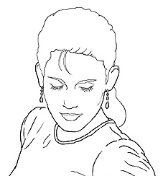
Edge detection
Goal: map image from 2d array of pixels to a set of curves or line segments or contours.
Why?
Main idea: look for differences in intensity, i.e. find strong gradients, then post-process
Figure from J. Shotton et al., PAMI 2007
Adapted from K. Grauman

Slide 4
Designing an edge detector
Criteria for a good edge detector
  Good categorization (edge vs not edge)
    find all real edges, ignoring noise or other artifacts
  Good localization
    detect edges as close as possible to the true edges
    return one point only for each true edge point (true edges = the edges humans drew on an image)
Cues of edge detection
  Bottom-up: Differences in color, intensity, or texture across the boundary
  Top-down: Continuity and closure, high-level knowledge
Adapted from L. Fei-Fei

Slide 5
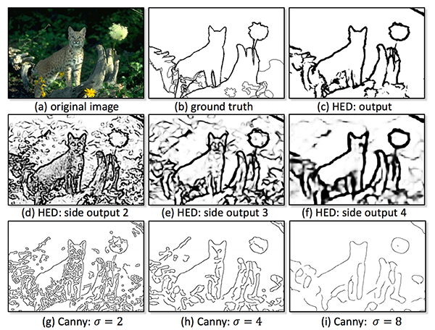
Examples of edge detection results
Xie and Tu, Holistically-Nested Edge Detection, ICCV 2015

Slide 6
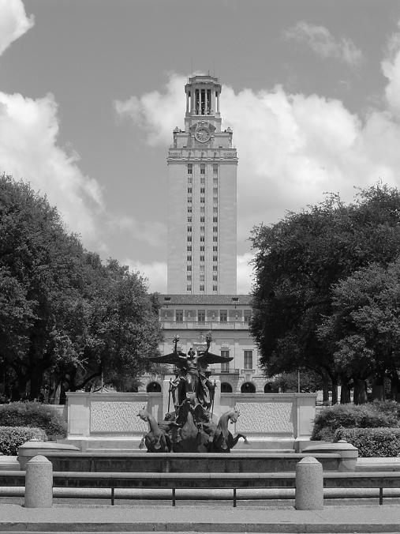
What causes an edge?
Depth discontinuity: object boundary
Reflectance change: appearance information, texture
Cast shadows
Adapted from K. Grauman

Slide 7

Characterizing edges
An edge is a place of rapid change in the image intensity function
intensity function
(along horizontal scanline)
image
first derivative
edges correspond to
extrema of derivative
Source: L. Lazebnik

Slide 8

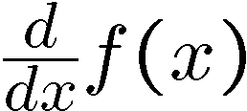
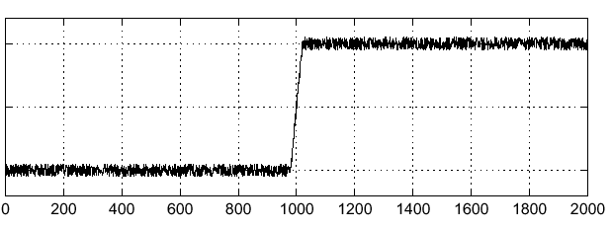
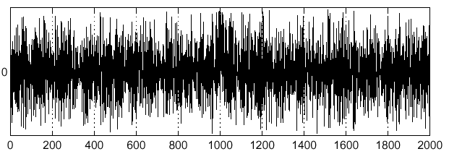
Now with a little noise…
Consider a single row or column of the image
  Plotting intensity as a function of position gives a signal
Where is the edge?
Source: S. Seitz
Notes:
How to fix?

Slide 9

Without noise
Consider a single row or column of the image
  Plotting intensity as a function of position gives a signal
Intensity = 7
1
Pixel location = 1 … 14
Diff = 1
0
-1
Pixel location = 1 … 14
Where is the edge?
https://en.wikipedia.org/wiki/Derivative
Notes:
How to fix?

Slide 10
With noise
Consider a single row or column of the image
  Plotting intensity as a function of position gives a signal
Intensity = 7
1
Pixel location = 1 … 14
Diff = 1
0
-1
Pixel location = 1 … 14
Where is the edge?
https://en.wikipedia.org/wiki/Derivative
Notes:
How to fix?

Slide 11
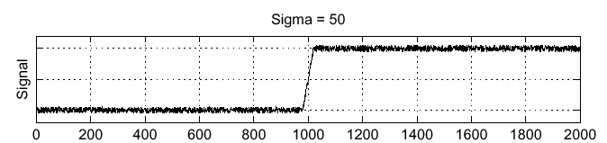
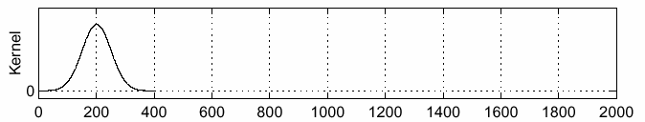
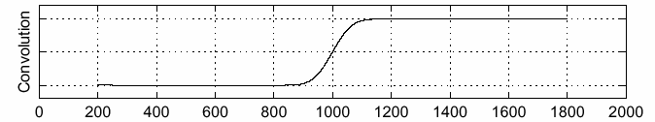
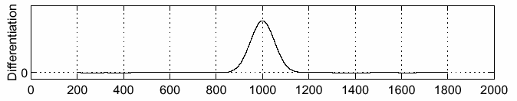
Solution: smooth first
f
g
f * g
To find edges, look for peaks in
Source: S. Seitz

Slide 12
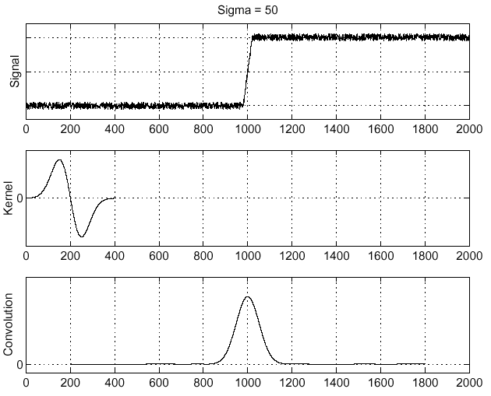
Derivative theorem of convolution
Differentiation is convolution, and convolution is associative:
This saves us one operation:
f
Image
with edge
Derivative
of Gaussian
Edge = max
of derivative
Source: S. Seitz

Slide 13
Canny edge detector
Filter image with derivative of Gaussian
Find magnitude and orientation of gradient
Threshold: Determine which local maxima from filter output are actually edges
Non-maximum suppression:
  Thin wide “ridges” down to single pixel width
Linking and thresholding (hysteresis):
  Define two thresholds: low and high
  Use the high threshold to start edge curves and the low threshold to continue them
Adapted from K. Grauman, D. Lowe, L. Fei-Fei

Slide 14

Example
input image (“Lena”)

Slide 15
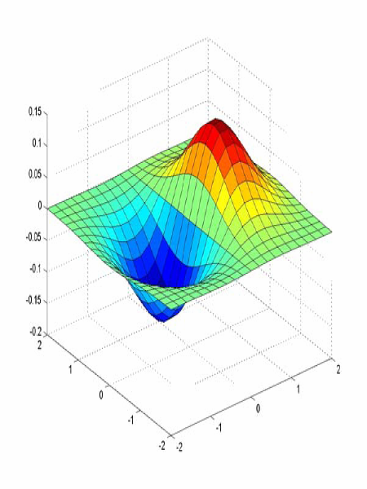
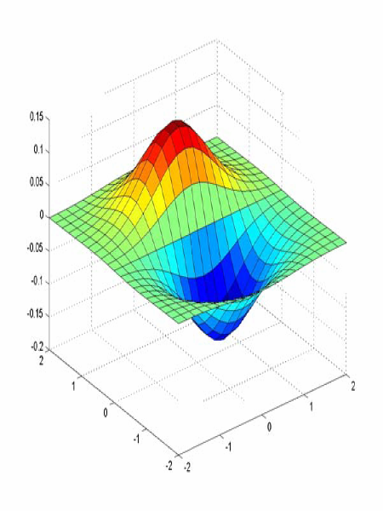
Derivative of Gaussian filter
x-direction
y-direction
Source: L. Lazebnik

Slide 16
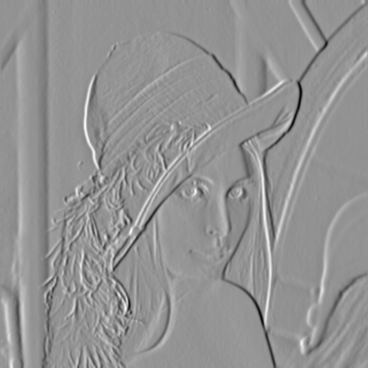
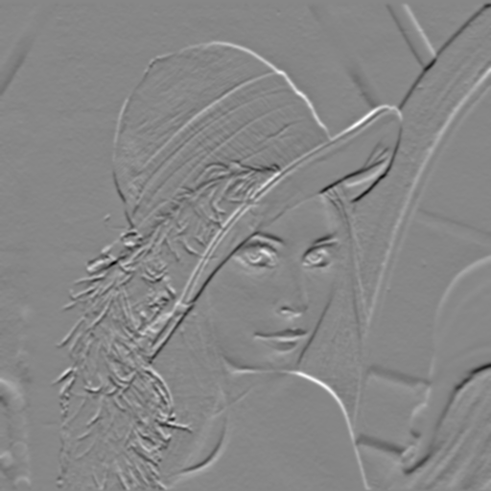
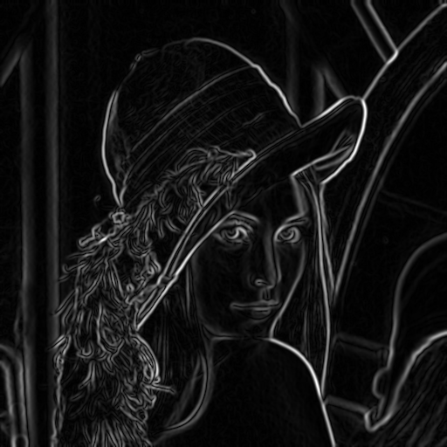
Compute Gradients
X-Derivative of Gaussian
Y-Derivative of Gaussian
Gradient Magnitude
Source: D. Hoiem

Slide 17
Thresholding
Choose a threshold value t
Set any pixels less than t to 0 (off)
Set any pixels greater than or equal to t to 1 (on)
Source: K. Grauman

Slide 18
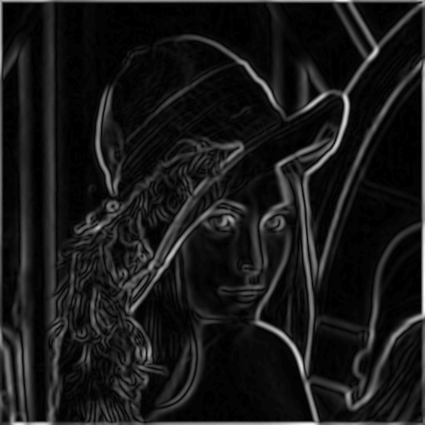
The Canny edge detector
norm of the gradient (magnitude)
Source: K. Grauman

Slide 19
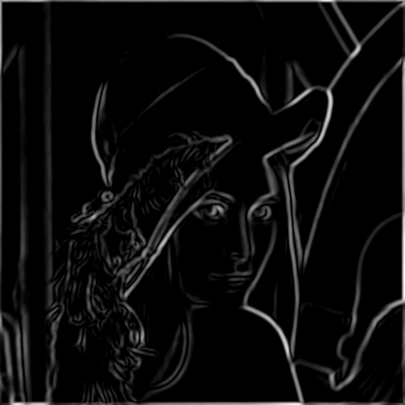
The Canny edge detector
thresholding
Source: K. Grauman

Slide 20
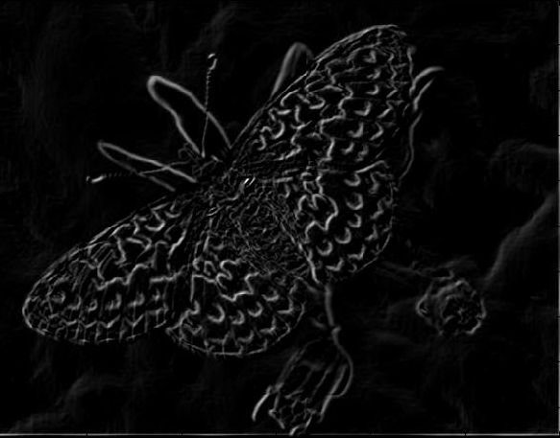
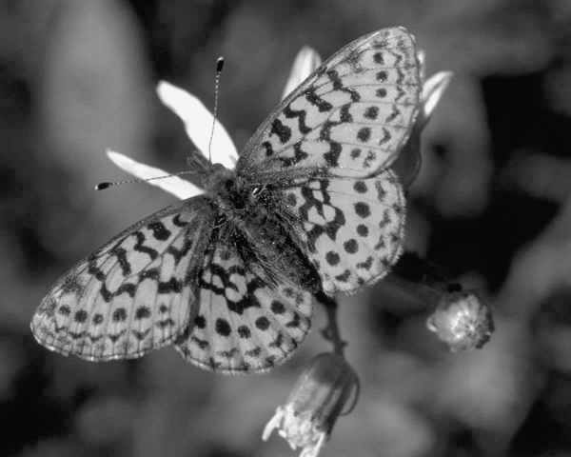
Another example: Gradient magnitudes
Source: K. Grauman

Slide 21
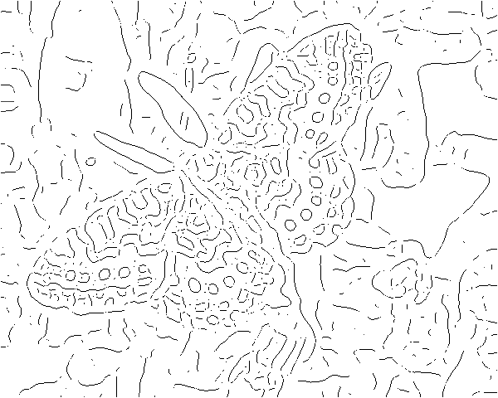
Thresholding gradient with a lower threshold
Source: K. Grauman

Slide 22
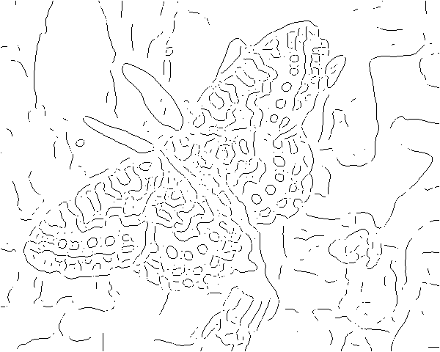
Thresholding gradient with a higher threshold
Source: K. Grauman

Slide 23

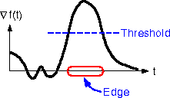
The Canny edge detector
How to turn these thick regions of the gradient into curves?
thresholding
Source: K. Grauman

Slide 24

Non-maximum suppression
I(1, 3) = 50
I(1, 4) = 60
I(2, 3) = 50
I(3, 2) = 70
I(3, 3) = 50
  Check if pixel is local maximum along gradient direction
  Compare to pixels immediately neighboring on both sides
    i.e. compare q to p and r
  Requires checking interpolated “pixels” p and r (at non-integer locations, so no intensity information) – bilinear interpolation
Adapted from K. Grauman

Slide 25

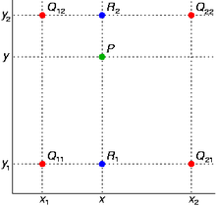
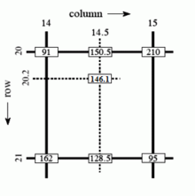
Bilinear interpolation
(0, 1)
(x, y₂)
(1, 1)
(x, y)
(0, 0)
(x, y₁)
(1, 0)
http://en.wikipedia.org/wiki/Bilinear_interpolation
Notes:
Definition:
% adopt new coordinate system with origin at (0, 0) (bottom left at x1, y1)
p1 = (1-x) f(0, 0) + x f(1, 0) % p1 := (x, y1)
p2 = (1-x) f(0, 1) + x f(1, 1) % p2 := (x, y2)
f(x, y) = (1-y) p1 + y p2
Example:
p1 = 0.5 * 162 + 0.5 * 95 = 128.5
p2 = 0.5 * 91 + 0.5 * 210 = 150.5
f(x, y) = 0.2 * 128.5 + 0.8 * 150.5 = 146.1

Slide 26
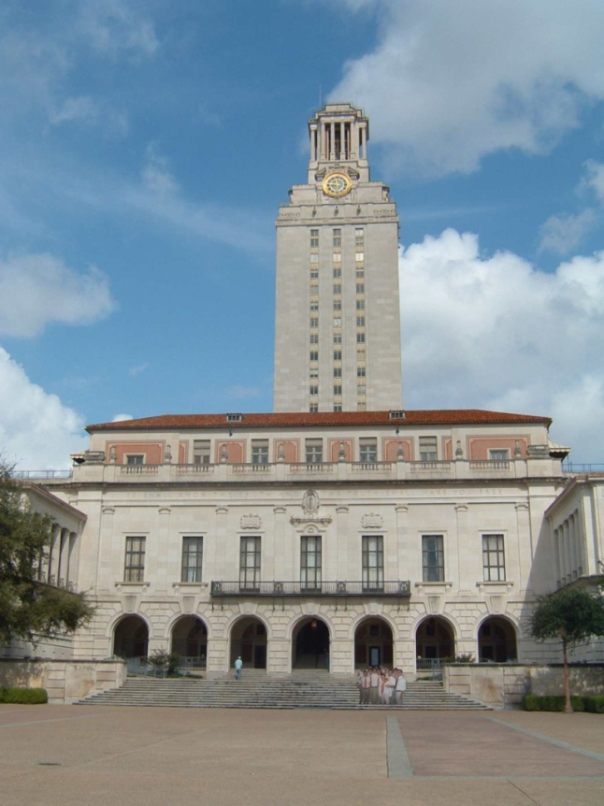
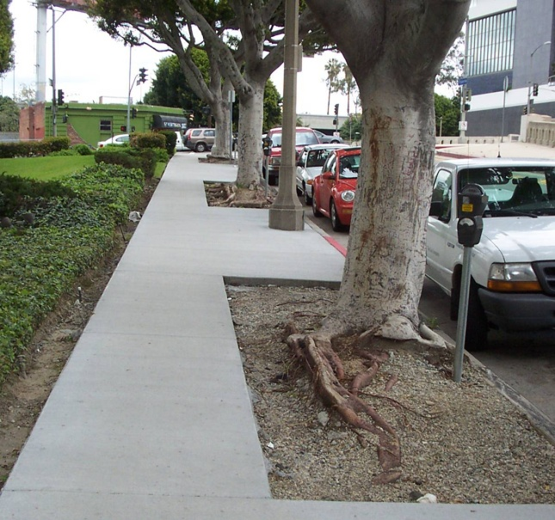
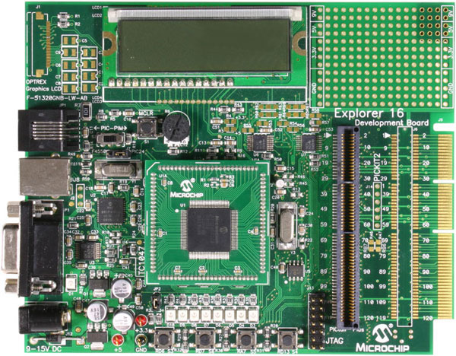
Related: Line detection (fitting)
Why fit lines?
Many objects characterized by presence of straight lines
Why aren’t we done just by running edge detection?
Kristen Grauman

Slide 27
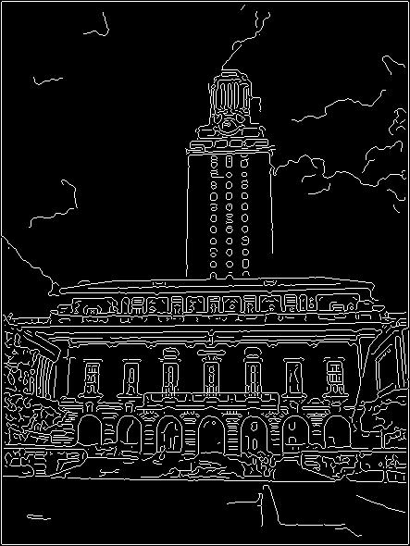
Difficulty of line fitting
Noise in measured edge points, orientations:
  e.g. edges not collinear where they should be
  how to detect true underlying parameters?
Extra edge points (clutter):
  which points go with which line, if any?
Only some parts of each line detected, and some parts are missing:
  how to find a line that bridges missing evidence?
Adapted from Kristen Grauman

Slide 28
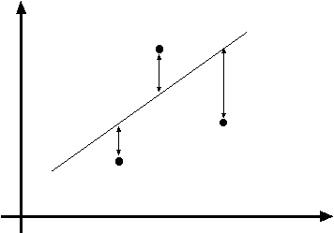
Least squares line fitting
Data: (x₁, y₁), …, (x_{n}, y_{n})
Line equation: y_{i} = m x_{i} + b
Find (m, b) to minimize
y=mx+b
(x_{i}, y_{i})
where line you found tells you point is along y axis
where point really is along y axis
You want to find a single line that “explains” all of the points in your data,
but data may be noisy!
Adapted from Svetlana Lazebnik

Slide 29
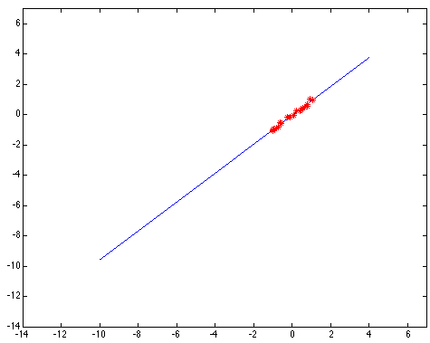
Outliers affect least squares fit
Kristen Grauman
Notes:
29

Slide 30
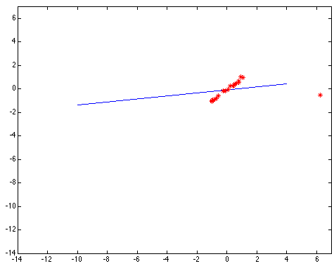
Outliers affect least squares fit
Kristen Grauman
Notes:
30

Slide 31
Dealing with outliers: Voting
Voting is a general technique where we let the features vote for all models that are compatible with it.
  Cycle through features, cast votes for model parameters.
  Look for model parameters that receive a lot of votes.
Noise & clutter features?
  They will cast votes too, but typically their votes should be inconsistent with the majority of “good” features.
Two common techniques
  Hough transform
  RANSAC
Adapted from Kristen Grauman

Slide 32

Finding lines in an image: Hough space
y
b
b₀
x
m₀
m
image space
Hough (parameter) space
Connection between image (x,y) and Hough (m,b) spaces
  A line in the image corresponds to a point in Hough space
Steve Seitz

Slide 33

Finding lines in an image: Hough space
y
b
y₀
x₀
x
m
image space
Hough (parameter) space
Connection between image (x,y) and Hough (m,b) spaces
  A line in the image corresponds to a point in Hough space
  What does a point (x₀, y₀) in the image space map to?
    Answer: the solutions of b = -x₀m + y₀
    This is a line in Hough space
    Given a pair of points (x,y), find all (m,b) such that y = mx + b
Adapted from Steve Seitz

Slide 34
Finding lines in an image: Hough space
y
b
(x₁, y₁)
y₀
(x₀, y₀)
b = –x₁m + y₁
x₀
x
m
image space
Hough (parameter) space
What are the line parameters for the line that contains both (x₀, y₀) and (x₁, y₁)?
  It is the intersection of the lines b = –x₀m + y₀ and
  b = –x₁m + y₁
Steve Seitz

Slide 35
Finding lines in an image: Hough space
y
b
m = 17.5
x
0 5 10 15 20
m
image space
Hough (parameter) space
How can we use this to find the most likely parameters (m,b) for the most prominent line in the image space?
Let each edge point in image space vote for a set of possible parameters in Hough space
Accumulate votes in discrete set of bins; parameters with the most votes indicate line in image space.
Steve Seitz

Slide 36
Finding lines in an image: Hough space
y
m
x
b
y
m
3
5
3
3
2
2
3
7
11
10
4
3
2
3
1
4
5
2
2
1
0
1
3
3
x
b
Adapted from Silvio Savarese

Slide 37
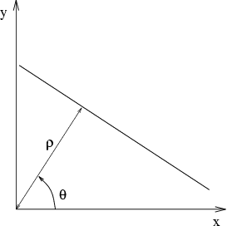
Parameter space representation
Problems with the (m,b) space:
  Unbounded parameter domains
  Vertical lines require infinite m
Alternative: polar representation
Each point (x,y) will add a sinusoid in the (θ,ρ) parameter space
Svetlana Lazebnik

Slide 38
Parameter space representation
Problems with the (m,b) space:
  Unbounded parameter domains
  Vertical lines require infinite m
Alternative: polar representation
y
x
Hough space
Each point (x,y) will add a sinusoid in the (θ,ρ) parameter space
Svetlana Lazebnik

Slide 39
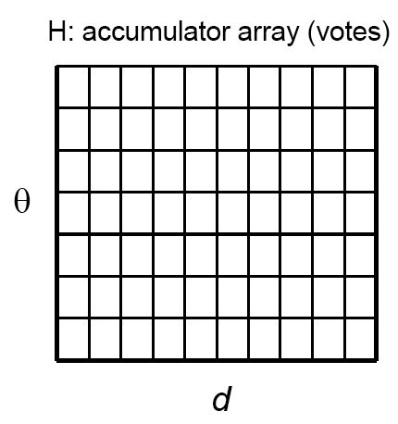
Algorithm outline: Hough transform
Initialize accumulator H
to all zeros
For each edge point (x,y)
in the image
For θ = 0 to 180
ρ = x cos θ + y sin θ
H(θ, ρ) = H(θ, ρ) + 1
end
end
Find the value(s) of (θ*, ρ*) where H(θ, ρ) is a local maximum
  The detected line in the image is given by
  ρ* = x cos θ* + y sin θ*
ρ
θ
Svetlana Lazebnik

Slide 40
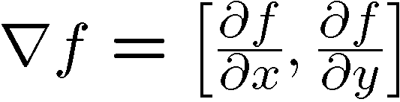

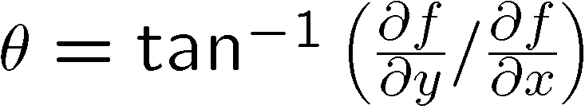
Incorporating image gradients
Recall: when we detect an
edge point, we also know its
gradient direction
But this means that the line
is uniquely determined!
Modified Hough transform:
For each edge point (x,y) in the image
θ = gradient orientation at (x,y)
ρ = x cos θ + y sin θ
H(θ, ρ) = H(θ, ρ) + 1
end
Svetlana Lazebnik

Slide 41
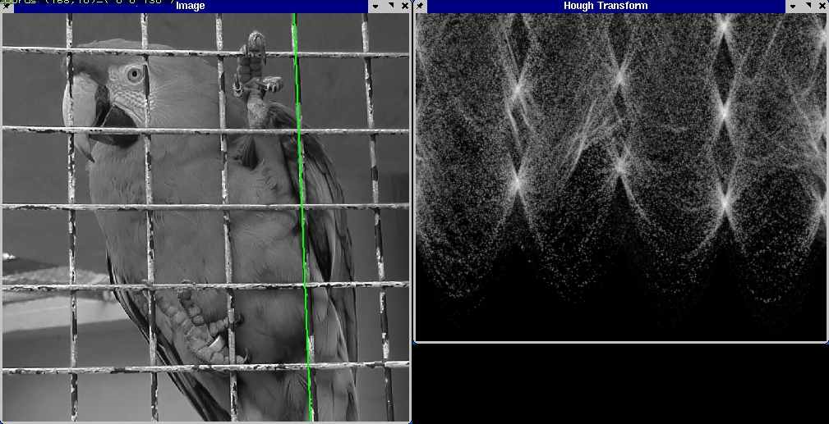
Hough transform example
Derek Hoiem

Slide 42
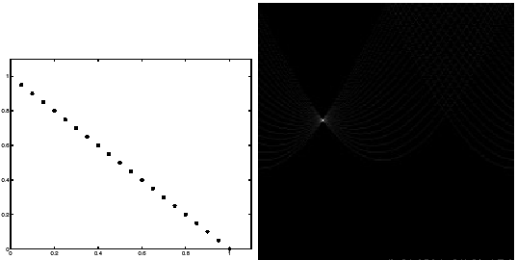
Impact of noise on Hough
y
d
x
θ
Image space
edge coordinates
Votes
Kristen Grauman

Slide 43
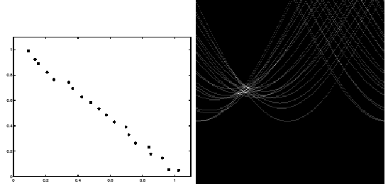
Impact of noise on Hough
y
d
x
θ
Image space
edge coordinates
Votes
What difficulty does this present for an implementation?
Kristen Grauman

Slide 44
Voting: practical tips
Minimize irrelevant tokens first (reduce noise)
Choose a good grid / discretization
  Too coarse: large votes obtained when too many different lines correspond to a single bucket
  Too fine: miss lines because points that are not exactly collinear cast votes for different buckets
Vote for neighbors (smoothing in accumulator array)
Use direction of edge to reduce parameters by 1
To read back which points voted for “winning” peaks, keep tags on the votes
Too fine
?
Too coarse
Kristen Grauman

Slide 45
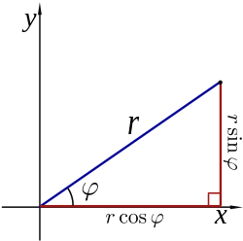
Hough transform for circles
A circle with radius r and center (a, b) can be described as:
x = a + r cos(θ)
y = b + r sin(θ)
(x, y)
(a, b)

Slide 46
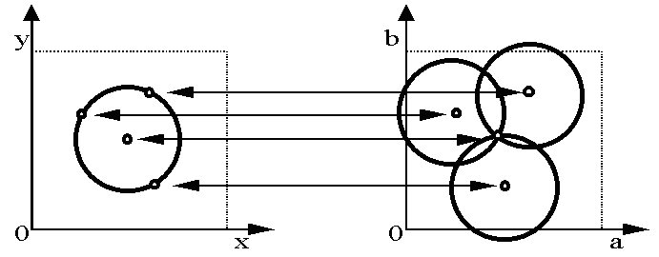
Hough transform for circles
Circle: center (a, b) and radius r
For a fixed radius r, unknown gradient direction
Image space
Hough space
Kristen Grauman

Slide 47
Hough transform for circles
Circle: center (a, b) and radius r
For a fixed radius r, unknown gradient direction
Intersection: most votes for center occur here.
Image space
Hough space
Kristen Grauman

Slide 48
Hough transform for circles
x = a + r cos(θ)
y = b + r sin(θ)
For every edge pixel (x,y) :
For each possible radius value r:
For each possible gradient direction θ:
// or use estimated gradient at (x,y)
a = x – r cos(θ) // column
b = y – r sin(θ) // row
H[a,b,r] += 1
end
end
end
x
θ
Modified from Kristen Grauman

Slide 49
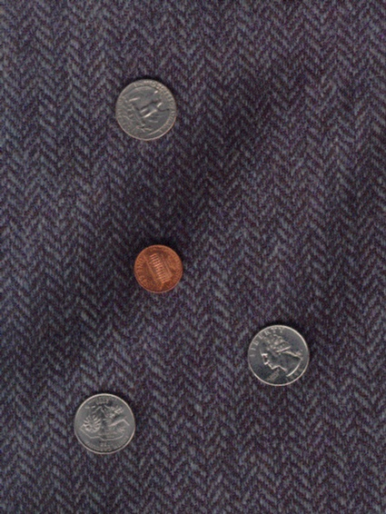
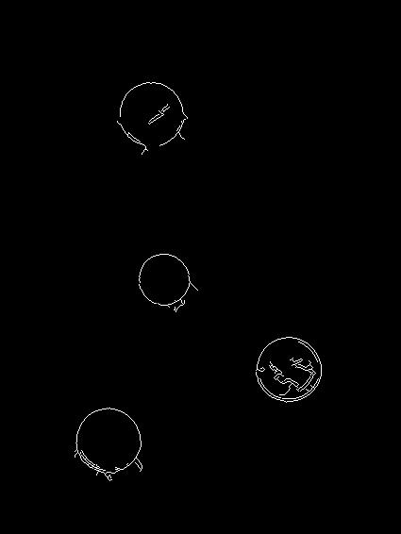
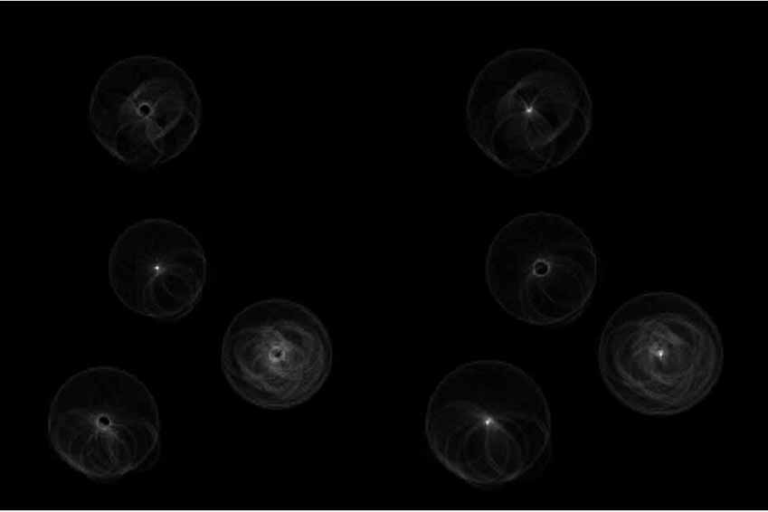
Example: detecting circles with Hough
Original
Edges
Votes: Penny
Note: a different Hough transform (with separate accumulators) was used for each circle radius (quarters vs. penny).
Kristen Grauman, images from Vivek Kwatra

Slide 50
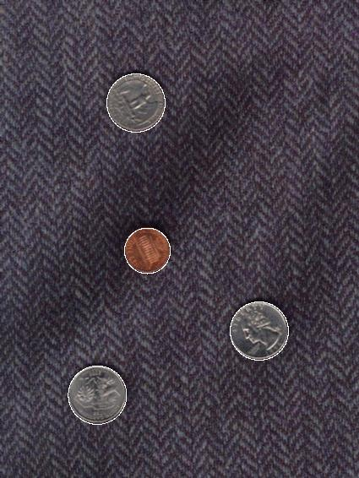
Example: detecting circles with Hough
Original
Combined detections
Edges
Votes: Quarter
Note: a different Hough transform (with separate accumulators) was used for each circle radius (quarters vs. penny).
Kristen Grauman, images from Vivek Kwatra

Slide 51
Hough transform: pros and cons
Pros
All points are processed independently, so can cope with occlusion, gaps
Some robustness to noise: noise points unlikely to contribute consistently to any single bin
Can detect multiple instances of a model in a single pass
Cons
Complexity of search time for maxima increases exponentially with the number of model parameters
  If 3 parameters and 10 choices for each, search is O(10³)
Quantization: can be tricky to pick a good grid size
Adapted from Kristen Grauman

Slide 52
Generalized Hough transform
We want to find a template defined by its reference point (center) and several distinct types of landmark points in stable spatial configuration
Template
Triangle, circle, diamond:
some type of visual token,
e.g. feature or edge point
c
Adapted from Svetlana Lazebnik

Slide 53
Generalized Hough transform
Intuition:
Displacement vectors
x
x
x
Ref. point
x
x
Model image
Novel image
Vote space
Now suppose those colors encode gradient directions…
Adapted from Kristen Grauman

Slide 54
Generalized Hough transform
Define a model shape by its boundary points and a reference point.
Offline procedure:
x
a
At each boundary point, compute displacement vector: r = a – p_{i}.
Store these vectors in a table indexed by gradient orientation θ.
θ
θ
p₁
p₂
Model shape
θ
…
θ
…
…
Kristen Grauman
[Dana H. Ballard, Generalizing the Hough Transform to Detect Arbitrary Shapes, 1980]

Slide 55
Generalized Hough transform
Detection procedure:
x
For each edge point:
Use its gradient orientation θ to index into stored table
Use retrieved r vectors to vote for reference point
x
θ
x
x
x
θ
θ
p₁
θ
θ
Novel image
θ
…
Assuming translation is the only transformation here, i.e., orientation and scale are fixed.
θ
…
…
Kristen Grauman

Slide 56
Generalized Hough transform
Template representation
  For each type of landmark point, store all possible displacement vectors towards the center
Model
Template
Svetlana Lazebnik

Slide 57
Generalized Hough transform
Detecting the template
  For each feature in a new image, look up that feature type in the model and vote for the possible center locations associated with that type in the model
Model
Test image
Svetlana Lazebnik
Notes:
Note that some of the features present in the template may actually be absent in the test image. The positions of the features can move around; new “noise” or “clutter” features can be added.
The small circles represent votes for possible center location.

Slide 58

Application: Hough for object detection
Index displacements by “visual codeword”
“visual codeword” with
displacement vectors
training image
B. Leibe, A. Leonardis, and B. Schiele, Combined Object Categorization and Segmentation with an Implicit Shape Model, ECCV Workshop on Statistical Learning in Computer Vision 2004
Svetlana Lazebnik

Slide 59
RANSAC
RANdom Sample Consensus
Approach: we want to avoid the impact of outliers, so let’s look for “inliers”, and use those only.
Intuition: if an outlier is chosen to compute the current fit, then the resulting line won’t have much support from rest of the points.
Kristen Grauman

Slide 60
RANSAC: General form
RANSAC loop:
Randomly select a seed group of s points on which to base model estimate (e.g. s=2 for a line)
Fit model to these s points
Find inliers to this model (i.e., points whose distance from the line is less than t)
Repeat N times
Keep the model with the largest number of inliers
Adapted from Kristen Grauman and Svetlana Lazebnik

Slide 61
RANSAC
_{(RANdom SAmple Consensus) :}
Fischler & Bolles in ‘81.
Line fitting example
Algorithm:
Sample (randomly) the number of points required to fit the model
Solve for model parameters using samples
Score by the fraction of inliers within a preset threshold of the model
Repeat 1-3 until the best model is found with high confidence
Silvio Savarese

Slide 62
RANSAC
_{(RANdom SAmple Consensus) :}
Fischler & Bolles in ‘81.
Line fitting example
Algorithm:
Sample (randomly) the number of points required to fit the model (#=2)
Solve for model parameters using samples
Score by the fraction of inliers within a preset threshold of the model
Repeat 1-3 until the best model is found with high confidence
Silvio Savarese

Slide 63
RANSAC
_{(RANdom SAmple Consensus) :}
Fischler & Bolles in ‘81.
Line fitting example
Algorithm:
Sample (randomly) the number of points required to fit the model (#=2)
Solve for model parameters using samples
Score by the fraction of inliers within a preset threshold of the model
Repeat 1-3 until the best model is found with high confidence
Silvio Savarese

Slide 64
RANSAC
_{(RANdom SAmple Consensus) :}
Fischler & Bolles in ‘81.
Line fitting example
Algorithm:
Sample (randomly) the number of points required to fit the model (#=2)
Solve for model parameters using samples
Score by the fraction of inliers within a preset threshold of the model
Repeat 1-3 until the best model is found with high confidence
Silvio Savarese

Slide 65
RANSAC
_{(RANdom SAmple Consensus) :}
Fischler & Bolles in ‘81.
Line fitting example
Algorithm:
Sample (randomly) the number of points required to fit the model (#=2)
Solve for model parameters using samples
Score by the fraction of inliers within a preset threshold of the model
Repeat 1-3 until the best model is found with high confidence
Silvio Savarese

Slide 66
How to choose parameters?
Number of samples N
  Choose N so that, with probability p, at least one random sample is free from outliers (e.g. p=0.99) (outlier ratio: e )
Number of sampled points s
  Minimum number needed to fit the model
Distance threshold δ
  Choose δ so that a good point with noise is likely (e.g., prob=0.95) within threshold
  E.g. for zero-mean Gaussian noise with std. dev. σ: δ ² = 3.84σ²
 | proportion of outliers e
s | 5% | 10% | 20% | 25% | 30% | 40% | 50%
2 | 2 | 3 | 5 | 6 | 7 | 11 | 17
3 | 3 | 4 | 7 | 9 | 11 | 19 | 35
4 | 3 | 5 | 9 | 13 | 17 | 34 | 72
5 | 4 | 6 | 12 | 17 | 26 | 57 | 146
6 | 4 | 7 | 16 | 24 | 37 | 97 | 293
7 | 4 | 8 | 20 | 33 | 54 | 163 | 588
8 | 5 | 9 | 26 | 44 | 78 | 272 | 1177
Explanation in Szeliski 6.1.4
Marc Pollefeys and Derek Hoiem

Slide 67
RANSAC pros and cons
Pros
  Applicable to many different problems, e.g. image stitching, relating two views
  Often works well in practice
Cons
  Lots of parameters to tune (see previous slide)
  Doesn’t work well for low inlier ratios (too many iterations, or can fail completely)
Adapted from Svetlana Lazebnik

Slide 68
Plan for this lecture
Group pixels into:
  Edges: Extract gradients and threshold
  Lines: Find which edge points are collinear or belong to another shape
  Segments: Find which pixels form a consistent region, e.g. via clustering
Transform pixels:
  Find relationships between multiple views of the same world point
  Both parts rely on finding geometric relationships between pixels

Slide 69
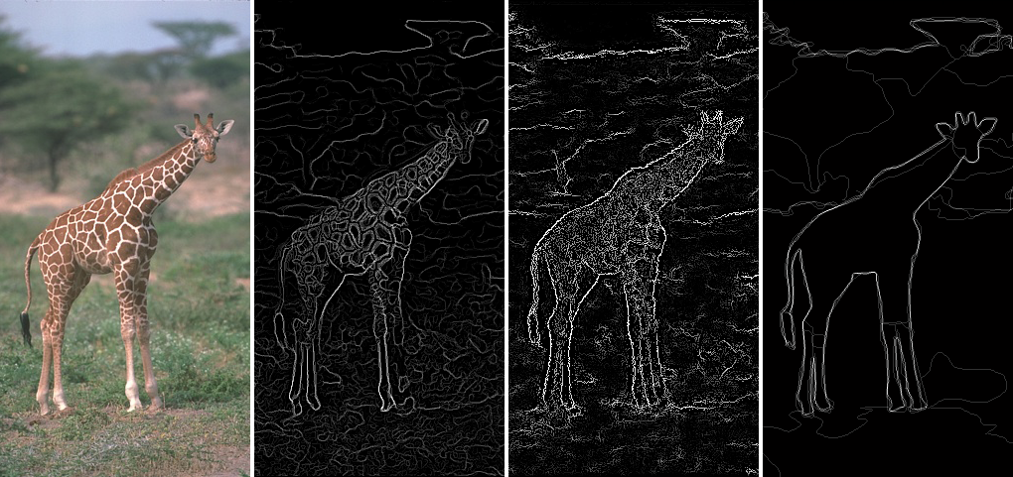
Edges vs Segments
Edges: More low-level; don’t need to be closed
Segments: Ideally one segment for each semantic group/object; should include closed contours
Figure adapted from J. Hays

Slide 70
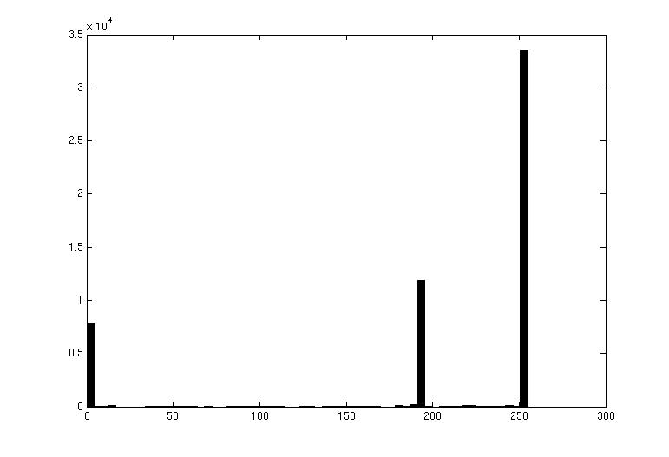

Image segmentation: toy example
white pixels
pixel count
3
black pixels
gray pixels
1
2
input image
intensity
These intensities define the three groups.
We could label every pixel in the image according to which of these primary intensities it is.
  i.e., segment the image based on the intensity feature.
What if the image isn’t quite so simple?
Source: K. Grauman

Slide 71
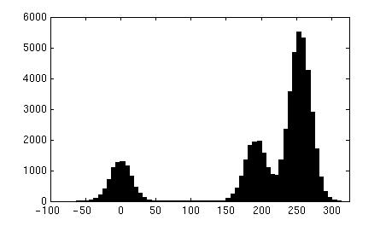
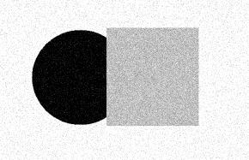
pixel count
input image
intensity
Now how to determine the three main intensities that define our groups?
We need to cluster.
Source: K. Grauman

Slide 72
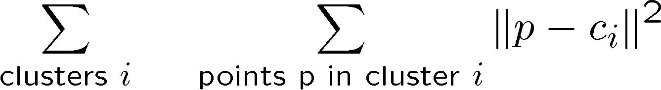
0
190
255
intensity
3
1
2
Goal: choose three “centers” as the representative intensities, and label every pixel according to which of these centers it is nearest to.
Best cluster centers are those that minimize sum of squared differences (SSD) between all points and their nearest cluster center ci:
Source: K. Grauman

Slide 73
Clustering
With this objective, it is a “chicken and egg” problem:
  If we knew the cluster centers, we could allocate points to groups by assigning each to its closest center.
  If we knew the group memberships, we could get the centers by computing the mean per group.
Source: K. Grauman

Slide 74

K-means clustering
Basic idea: randomly initialize the k cluster centers, and iterate between the two steps we just saw.
  Randomly initialize the cluster centers, c₁, ..., c_{K}
  Given cluster centers, determine points in each cluster
    For each point p, find the closest c_{i}. Put p into cluster i
  Given points in each cluster, solve for c_{i}
    Set c_{i} to be the mean of points in cluster i
  If c_{i} have changed, repeat Step 2
Properties
  Will always converge to some solution
  Can be a “local minimum” of objective:
Slide: Steve Seitz, image: Wikipedia

Slide 75

Source: A. Moore

Slide 76

Source: A. Moore

Slide 77

Source: A. Moore

Slide 78

Source: A. Moore

Slide 79

Source: A. Moore

Slide 80

K-means converges to a local minimum
How can I try to fix this problem?
Adapted from James Hays

Slide 81


K-means: pros and cons
Pros
Simple, fast to compute
Converges to local minimum of within-cluster squared error
Cons/issues
Setting k?
  One way: silhouette coefficient
Sensitive to initial centers
  Use heuristics or output of another method
  Try different initializations
Sensitive to outliers
Detects spherical clusters
ALTERNATIVES?
Adapted from K. Grauman
Notes:
81

Slide 82

Mean shift algorithm
The mean shift algorithm seeks modes or local maxima of density in the feature space
Feature space
(L*u*v* color values)
image
Source: K. Grauman

Slide 83

Kernel density estimation
Kernel
Estimated density
Data (1-D)
Source: D. Hoiem

Slide 84
Mean shift
Search
window
Center of
mass
Mean Shift
vector
Slide by Y. Ukrainitz & B. Sarel

Slide 85
Mean shift
Search
window
Center of
mass
Mean Shift
vector
Slide by Y. Ukrainitz & B. Sarel

Slide 86
Mean shift
Search
window
Center of
mass
Mean Shift
vector
Slide by Y. Ukrainitz & B. Sarel

Slide 87
Mean shift
Search
window
Center of
mass
Mean Shift
vector
Slide by Y. Ukrainitz & B. Sarel

Slide 88
Mean shift
Search
window
Center of
mass
Mean Shift
vector
Slide by Y. Ukrainitz & B. Sarel

Slide 89
Mean shift
Search
window
Center of
mass
Mean Shift
vector
Slide by Y. Ukrainitz & B. Sarel

Slide 90
Mean shift
Search
window
Center of
mass
Slide by Y. Ukrainitz & B. Sarel

Slide 91


Computing the mean shift
Simple Mean Shift procedure:
Compute mean shift vector
Translate the Kernel window by m(x)
Adapted from Y. Ukrainitz & B. Sarel

Slide 92
Points in same cluster converge
Source: D. Hoiem

Slide 93

Mean shift clustering
Cluster: all data points in the attraction basin of a mode
Attraction basin: the region for which all trajectories lead to the same mode
Slide by Y. Ukrainitz & B. Sarel

Slide 94

Mean shift clustering/segmentation
Compute features for each point (color, texture, etc)
Initialize windows at individual feature points
Perform mean shift for each window until convergence
Merge windows that end up near the same “peak” or mode
Source: D. Hoiem

Slide 95




Mean shift segmentation results
http://www.caip.rutgers.edu/~comanici/MSPAMI/msPamiResults.html

Slide 96

Segmentation as clustering
Depending on what we choose as the feature space, we can group pixels in different ways.
Grouping pixels based on intensity similarity
Feature space: intensity value (1-d)
Source: K. Grauman
Notes:
96

Slide 97


K=2
K=3
Adapted from K. Grauman

Slide 98
Segmentation as clustering
Depending on what we choose as the feature space, we can group pixels in different ways.
Grouping pixels based on intensity similarity
Clusters based on intensity similarity don’t have to be spatially coherent.
Source: K. Grauman
Notes:
98

Slide 99
Segmentation as clustering
Depending on what we choose as the feature space, we can group pixels in different ways.
Grouping pixels based
on intensity+position similarity
Intensity
Y
X
Both regions are black, but if we also include position (x,y), then we could group the two into distinct segments; way to encode both similarity & proximity.
Source: K. Grauman
Notes:
99

Slide 100


Segmentation as clustering
Depending on what we choose as the feature space, we can group pixels in different ways.
Grouping pixels based on texture similarity
F₁
F₂
Filter bank of 24 filters
…
F₂₄
Feature space: filter bank responses (e.g., 24-d)
Source: K. Grauman
Notes:
100

Slide 101
Summary
Edges: threshold gradient magnitude
Lines: edge points vote for parameters of line, circle, etc. (works for general objects)
Segments: use clustering (e.g. K-means) to group pixels by intensity, texture, etc.

Slide 102
Plan for this lecture
Group pixels into:
  Edges: Extract gradients and threshold
  Lines: Find which edge points are collinear or belong to another shape
  Segments: Find which pixels form a consistent region, e.g. via clustering
Transform pixels:
  Find relationships between multiple views of the same world point
  Both parts rely on finding geometric relationships between pixels

Slide 103

Why multiple views?
Structure and depth are inherently ambiguous from single views.
Multiple views help us perceive 3d shape and depth.
Kristen Grauman, images from Svetlana Lazebnik

Slide 104
Alignment problem
We previously discussed how to match features across images, of the same or different objects
Now let’s focus on the case of “two images of the same object”(e.g. x_{i} and x_{i}’)
What transformation relates x_{i} and x_{i}’?
In alignment, we will fit the parameters of some transformation according to a set of matching feature pairs (“correspondences”).
x_{i}
x_{i}
'
T
Adapted from Kristen Grauman and Derek Hoiem

Slide 105

Motivation: Image mosaics
Kristen Grauman
Image from http://graphics.cs.cmu.edu/courses/15-463/2010_fall/

Slide 106
First, what are the correspondences?
Min dist = match
?
Compare content in local patches, find best matches.
  Scan x_{i}’ with template formed from a point in x_{i}, and compute e.g. Euclidean distance between SIFT features of the patches
Adapted from Kristen Grauman

Slide 107




Second, what are the transformations?
Examples of transformations:
translate
rotate
change aspect ratio
squish/shear
change perspective
Adapted from Alyosha Efros

Slide 108
Parametric (global) warping
T
p = (x,y)
p’ = (x’,y’)
Transformation T is a coordinate-changing machine:
p’ = T(p)
What does it mean that T is global?
  It is the same for any point p
  It can be described by just a few numbers (parameters)
Let’s represent T as a matrix:
p’ = Mp
Alyosha Efros

Slide 109
Scaling
Scaling a coordinate means multiplying each of its components by a scalar
Uniform scaling means this scalar is the same for all components:
× 2
(4, 2)
(2, 1)
Adapted from Alyosha Efros

Slide 110
Scaling
Non-uniform scaling: different scalars per component
X × 2,
Y × 0.5
(2, 1)
(4, 0.5)
Adapted from Alyosha Efros

Slide 111
Scaling
Scaling operation:
Or, in matrix form:
scaling matrix S
Adapted from Alyosha Efros

Slide 112
2D Linear transformations
Only linear 2D transformations can be represented with a 2x2 matrix.
Linear transformations are combinations of …
  Scale,
  Rotation,
  Shear, and
  Mirror
Alyosha Efros

Slide 113

What transforms can we write w/ 2x2 matrix?
2D Scaling?
2D Rotate around (0,0)? (see next slide)
2D Shear?
Modified from Alyosha Efros
Fig. from https://www.siggraph.org/education/materials/HyperGraph/modeling/mod_tran/2dshear.htm

Slide 114
2D Rotation: Example
Θ = 90 → M = [0 -1; 1 0], i.e. x' = -y, y' = x
(2, 5)
(4, 2)
(5, -2)
X’ = -Y,
Y’ = X
(2, -4)

Slide 115

2D Rotation: How to write
Polar coordinates…
x = r cos (φ)
y = r sin (φ)
x’ = r cos (φ + θ)
y’ = r sin (φ + θ)
Trig Identity…
x’ = r cos(φ) cos(θ) – r sin(φ) sin(θ)
y’ = r sin(φ) cos(θ) + r cos(φ) sin(θ)
Substitute…
x’ = x cos(θ) - y sin(θ)
y’ = x sin(θ) + y cos(θ)
(x’, y’)
(x, y)
θ
φ
Adapted from Derek Hoiem, reference: https://www2.clarku.edu/faculty/djoyce/trig/identities.html

Slide 116
What transforms can we write w/ 2x2 matrix?
2D Mirror about Y axis?
2D Mirror over (0,0)?
2D Translation?
CAN’T DO!
Alyosha Efros

Slide 117


Homogeneous coordinates
To convert to homogeneous coordinates:
homogeneous image
coordinates
Converting from homogeneous coordinates
Kristen Grauman

Slide 118
Translation
Homogeneous Coordinates
t_{x} = 2
t_{y} = 1
(4, 2)
(2, 1)
Adapted from Alyosha Efros

Slide 119
2D affine transformations
Affine transformations are combinations of …
  Linear transformations, and
  Translations
Maps lines to lines, parallel lines remain parallel
Adapted from Alyosha Efros

Slide 120




Detour: Keypoint matching for search
In database
1. Find a set of
distinctive key-
points
Query
A₁
B₃
2. Define a region
around each
keypoint (window)
A₂
A₃
B₁
B₂
3. Compute a local
descriptor from the
region
4. Match descriptors

Slide 121

Detour: solving for translation with outliers
A₁
A₂
A₃
B₁
B₂
B₃
Given matched points in {A} and {B}, estimate the translation of the object
Derek Hoiem

Slide 122
Detour: solving for translation with outliers
B₄
A₁
B₆
B₅
A₂
A₃
(t_{x}, t_{y})
B₁
A₄
B₂
B₃
A₅
A₆
Problem: outliers, multiple objects
Hough transform solution
Initialize a grid of parameter values
Each matched pair casts a vote for consistent values
Find the parameters with the most votes
Adapted from Derek Hoiem

Slide 123
Projective transformations
Projective transformations:
  Affine transformations, and
  Projective warps
Parallel lines do not necessarily remain parallel
Kristen Grauman

Slide 124



Image mosaics: Goals
. . .
image from S. Seitz
Obtain a wider angle view by combining multiple images.
Kristen Grauman

Slide 125


Image mosaics: Camera setup
Two images with camera rotation but no translation
(0, 0)
(0, 0)
(50, 70)
(50, 20)
Camera Center
Adapted from Derek Hoiem

Slide 126
Image mosaics: Many 2D views, one 3D object
mosaic plane
The mosaic has a natural interpretation in 3D
  The images are reprojected onto a common plane
  The mosaic is formed on this plane
  Mosaic is a synthetic wide-angle camera
Steve Seitz

Slide 127
How to stitch together panorama (mosaic)?
Basic Procedure
  Take a sequence of images from the same position
    Rotate the camera about its optical center
  Compute the homography (transformation) between first and second image
  Combine images (draw first image onto second’s canvas)
  Blend the two together to create a mosaic (post-process)
  (If there are more images, repeat)
Adapted from Steve Seitz

Slide 128
Computing the homography
…
…
To compute the homography given pairs of corresponding points in the images, we need to set up an equation where the parameters of H are the unknowns…
Kristen Grauman

Slide 129
Computing the homography
Assume we have four matched points: How do we compute homography H?
p’=Hp
Can set scale factor h₉ = 1.
So, there are 8 unknowns.
Need at least 8 eqs, but the more the better…
A
…
…
Adapted from Derek Hoiem, Kristen Grauman
Derivation: http://www.cse.psu.edu/~rtc12/CSE486/lecture16.pdf (pp. 25-36)

Slide 130
How to stitch together panorama (mosaic)?
Basic Procedure
  Take a sequence of images from the same position
    Rotate the camera about its optical center
  Compute the homography (transformation) between first and second image
  Combine images (draw first image onto second’s canvas)
  Blend the two together to create a mosaic (post-process)
  (If there are more images, repeat)
Adapted from Steve Seitz

Slide 131
Combining images
Image 1
Image 2 canvas
To apply a given homography H
  Compute p’ = Hp (regular matrix multiply)
  Convert p’ from homogeneous to image coordinates
p’
H
p
Modified from Kristen Grauman

Slide 132
Combining images
Image 1
Image 2 canvas
H(x,y)
y
y’
x
x’
f(x,y)
g(x’,y’)
Forward warping:
Send each pixel f(x,y) to its corresponding location
(x’,y’) = H(x,y) in the right image
Modified from Alyosha Efros

Slide 133
Combining images
H(x,y)
y
y’
x
x’
f(x,y)
g(x’,y’)
Forward warping:
Send each pixel f(x,y) to its corresponding location
(x’,y’) = H(x,y) in the right image
Q: what if pixel lands “between” two pixels?
A: round values of (x’,y’) or distribute color among neighbors
Adapted from Alyosha Efros

Slide 134
Combining images
Image 1
Image 2 canvas
H⁻¹(x,y)
y
y’
x
x
x’
f(x,y)
g(x’,y’)
Inverse warping:
Get each pixel g(x’,y’) from its corresponding location
(x,y) = H⁻¹(x’,y’) in the left image
Modified from Alyosha Efros

Slide 135
Combining images
H⁻¹(x,y)
y
y’
x
x
x’
f(x,y)
g(x’,y’)
Inverse warping:
Get each pixel g(x’,y’) from its corresponding location
(x,y) = H⁻¹(x’,y’) in the left image
Q: what if pixel comes from “between” two pixels?
A: interpolate color value from neighbors
Alyosha Efros

Slide 136
Next: Stereo vision
Homography: Same camera center, but camera rotates
Stereo vision: Camera center is not the same (we have multiple cameras)
Epipolar geometry
  Relates cameras from two positions/cameras
Stereo depth estimation
  Recover depth from disparities between two images
Adapted from Derek Hoiem

Slide 137




Stereo photography and stereo viewers
Take two pictures of the same subject from two slightly different viewpoints and display so that each eye sees only one of the images.
Invented by Sir Charles Wheatstone, 1838
Image from fisher-price.com
Kristen Grauman

Slide 138


Depth from stereo for computers
Two cameras, simultaneous views
Single moving camera and static scene
Kristen Grauman

Slide 139
Depth from stereo
Goal: recover depth by finding image coordinate x’ that corresponds to x, then measuring discrepancy between x and x’
X
X
x
z
x
x’
x'
f
f
C
Baseline
B
C’
Derek Hoiem

Slide 140

Geometry for a simple stereo system
Assume parallel optical axes, known camera parameters (i.e., calibrated cameras). What is expression for Z?
Similar triangles (p_{l}, P, p_{r}) and (O_{l}, P, O_{r}):
depth
Depth is inversely proportional to disparity.
disparity
Adapted from Kristen Grauman
Notes:
140

Slide 141



Depth from disparity
We have two images from different cameras.
First, find corresponding points in two images
  How to do this efficiently?
Second, estimate relative depth from correspondences
image I(x,y)
Disparity map D(x,y)
image I´(x´,y´)
Kristen Grauman

Slide 142

Stereo correspondence constraints
Given p in left image, where can corresponding point p’ be?
Kristen Grauman

Slide 143

Epipolar constraint
world point
first image plane
second image plane
Geometry of two views constrains where the corresponding pixel for some image point in the first view must occur in the second view.
It must be on the line where (1) the plane connecting the world point and optical centers, and (2) the image plane, intersect.
Potential matches for p have to lie on the corresponding line l’.
Potential matches for p’ have to lie on the corresponding line l.
Adapted from Kristen Grauman, Derek Hoiem
Notes:
143

Slide 144

Epipolar geometry: notation
P
p
p’
Baseline – line connecting the two camera centers
Epipoles
= intersections of baseline with image planes
= projections of the other camera center
Epipolar Plane – plane containing baseline
Epipolar Lines - intersections of epipolar plane with image
planes (always come in corresponding pairs)
Adapted from Derek Hoiem

Slide 145

Epipolar constraint
The epipolar constraint is useful because
it reduces the correspondence problem
to a 1D search along an epipolar line.
See hidden slides for details.
Kristen Grauman, image from Andrew Zisserman

Slide 146

Stereo geometry, with calibrated cameras
If the stereo rig is calibrated, we know how to rotate and translate camera reference frame 1 to get to camera reference frame 2
  Rotation: 3x3 matrix R; translation: 3x1 vector T.
(See hidden slides for how we get to the next slide.)
Adapted from Kristen Grauman
Notes:
146

Slide 147

An aside: cross product
Vector cross product takes two vectors and returns a third vector that’s perpendicular to both inputs.
So here, c is perpendicular to both a and b, which means the dot product = 0.
Can be expressed as a matrix multiplication.
Kristen Grauman
Notes:
147

Slide 148
From geometry to algebra
Normal to the plane
Cross-product of
vector with itself is 0.
T x X’ normal to plane in which X’ lies, i.e. dot product is 0.
Kristen Grauman
Notes:
148

Slide 149

Essential matrix
  Rigs related by:
  Rotation: 3x3 matrix R
  Translation: 3x1 vector T.
Let
E is called the essential matrix, and it relates corresponding image points between both cameras, given the rotation and translation.
Before we said: If we observe a point in one image, its position in other image is constrained to lie on line defined by above. It turns out that:
E^{T}x is the epipolar line l’ through x’ in the second image, corresponding to x.
Ex’ is the epipolar line l through x in the first image, corresponding to x’.
Adapted from Kristen Grauman, Derek Hoiem
Notes:
Note: these points are in camera coordinate systems.
149

Slide 150


Essential matrix example: parallel cameras
0 0 0
0 0 d
0 –d 0
For the parallel cameras, image of any point must lie on same horizontal line in each image plane.
Kristen Grauman
Notes:
150

Slide 151
image I(x,y)
Disparity map D(x,y)
image I´(x´,y´)
(x´,y´)=(x+D(x,y),y)
Adapted from Kristen Grauman

Slide 152

Basic stereo matching algorithm
For each pixel in the first image
  Find corresponding epipolar scanline in the right image
  Search along epipolar line and pick the best match x’ (e.g. smallest Euclidean distance between SIFT in patch)
  Compute disparity x-x’ and set depth(x) = f*T/(x-x’)
Adapted from Derek Hoiem

Slide 153


Results with window search
Data
Left image
Right image
Window-based matching
Ground truth
Predicted depth
Ground truth
Derek Hoiem

Slide 154
Projective structure from motion
Given: m images of n fixed 3D points
x_{ij} = P_{i} X_{j} , i = 1,… , m, j = 1, … , n
Problem: estimate m projection matrices P_{i} and n 3D points X_{j} from the mn corresponding 2D points x_{ij}
X_{j}
x_{1j}
x_{3j}
x_{2j}
P₁
P₃
P₂
Svetlana Lazebnik

Slide 155

Photo tourism
Noah Snavely, Steven M. Seitz, Richard Szeliski, "Photo tourism: Exploring photo collections in 3D," SIGGRAPH 2006
http://phototour.cs.washington.edu/

Slide 156

3D from multiple images
Sameer Agarwala, Noah Snavely, Ian Simon, Steven M. Seitz, Richard Szeliski, "Building Rome in a Day," ICCV 2009

Slide 157
Summary of multiple views
  Write 2d transformations as matrix-vector multiplication
  Fitting transformations: Solve for unknown parameters given corresponding points from two views – linear, affine, projective (homography)
  Mosaics: Uses homography and image warping to merge views taken from same center of projection
Stereo depth estimation: Find corresponding points along epipolar scanline, then measure disparity (as inverse to depth)
Epipolar geometry: Matching point in second image is on a line passing through its epipole; makes search for correspondences quicker
Adapted from Kristen Grauman and Derek Hoiem

