Slide 1
CS 2750: Machine Learning
Other Topics
Prof. Adriana Kovashka
University of Pittsburgh
April 13, 2017

Slide 2
Plan for last lecture
Overview of other topics and applications
  Reinforcement learning
  Active learning
  Domain adaptation
  Unsupervised feature learning using context
  Ranking

Slide 3
Reinforcement learning

Slide 4
Reinforcement learning
So far we’ve considered offline learning where we learn a model first and make predictions
Reinforcement learning is a type of online learning
Lies in between supervised and unsupervised

Slide 5
Reinforcement learning
You have an agent acting in an environment, exploring possible behaviors with the intent of maximizing some reward
For example, the agent wants to learn how to play some game so that it wins frequently

Slide 6
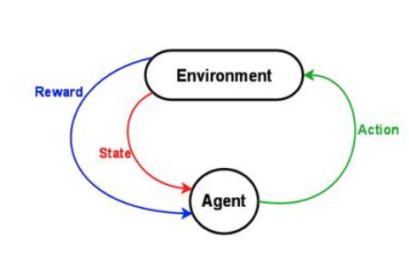

Reinforcement learning
States
Actions
Rewards
https://www.nervanasys.com/demystifying-deep-reinforcement-learning/

Slide 7
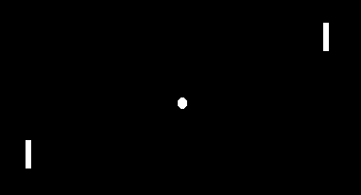
Reinforcement learning
States – e.g. image of board
Actions – up/down
Rewards – if won, +1, if lost, -1
http://karpathy.github.io/2016/05/31/rl/

Slide 8
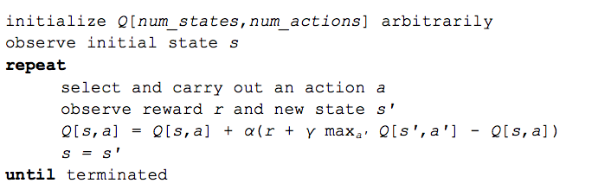
Q-Learning
https://www.nervanasys.com/demystifying-deep-reinforcement-learning/

Slide 9
Policy gradients
Wait before updating model parameters until end of game when we know if we won or lost, use outcome as gradient to backprop
Credit assignment: Which actions should I reward in case I won?
  Reward is given for a certain action taken in a certain state
  If I won, reward all actions that led to this
  Penalize all actions that led to a loss
http://karpathy.github.io/2016/05/31/rl/

Slide 10
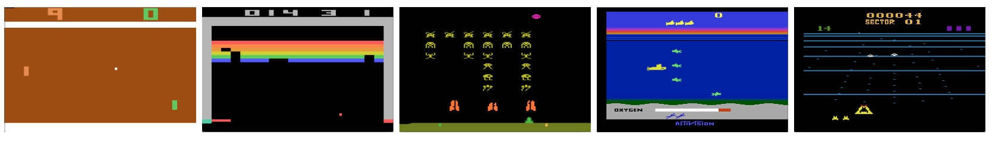
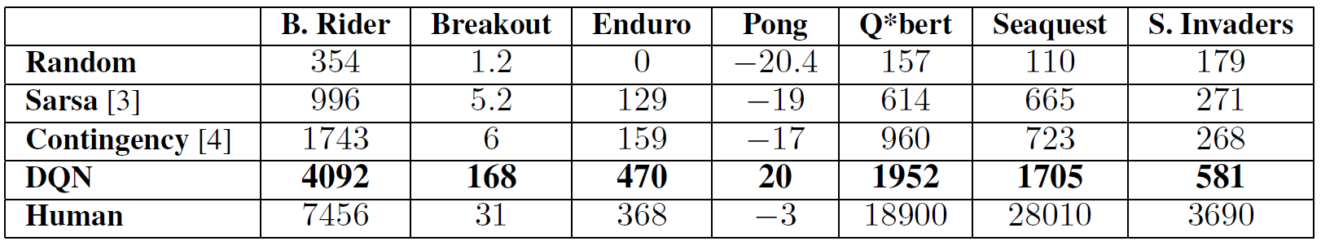
Learning to play Atari games w/ RL
Games
Total reward collected
Mnih et al., “Playing Atari with Deep Reinforcement Learning”, 2013

Slide 11
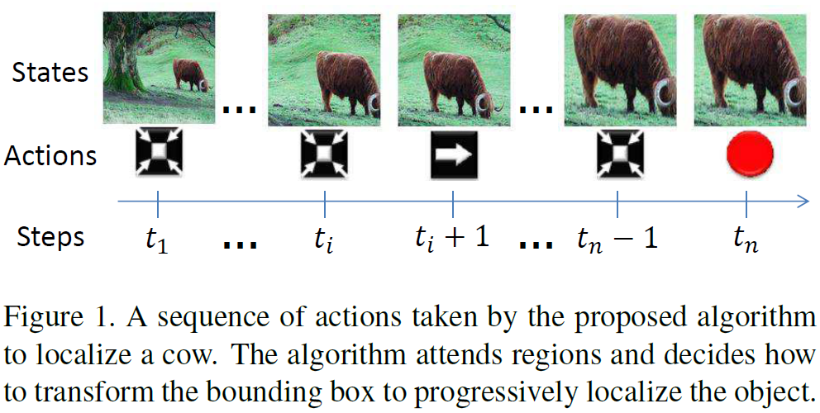
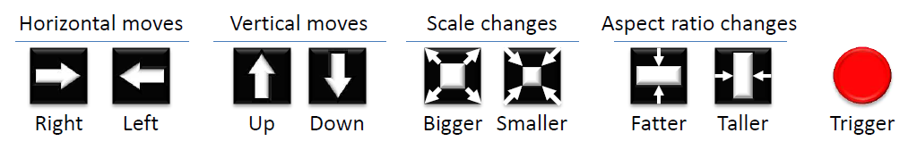
Learning to localize objects w/ RL
Caicedo and Lazebnik, “Active Object Localization with Deep Reinforcement Learning”, ICCV 2015

Slide 12
Active learning

Slide 13
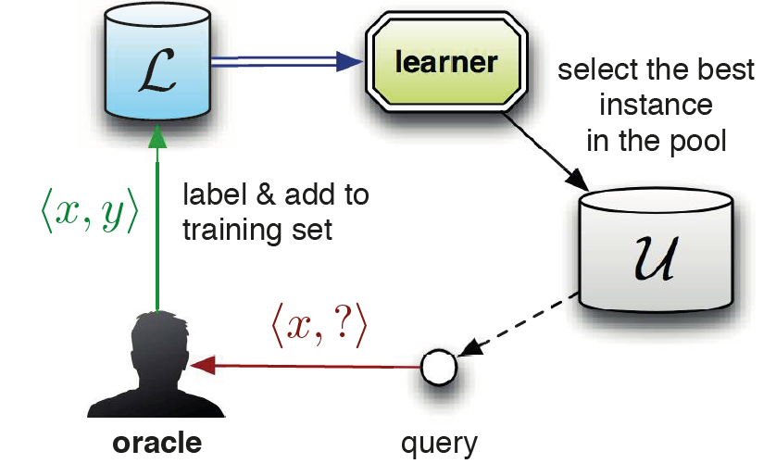
Pool-based sampling
Settles, “Active Learning” (Synthesis Lectures on AI and ML), 2012

Slide 14
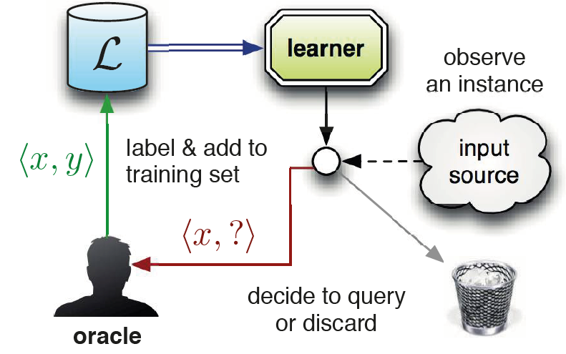
Selective sampling (stream-based)
Settles, “Active Learning” (Synthesis Lectures on AI and ML), 2012

Slide 15
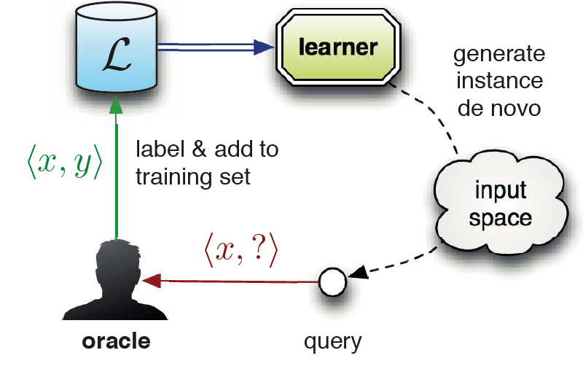
Query synthesis
Settles, “Active Learning” (Synthesis Lectures on AI and ML), 2012

Slide 16
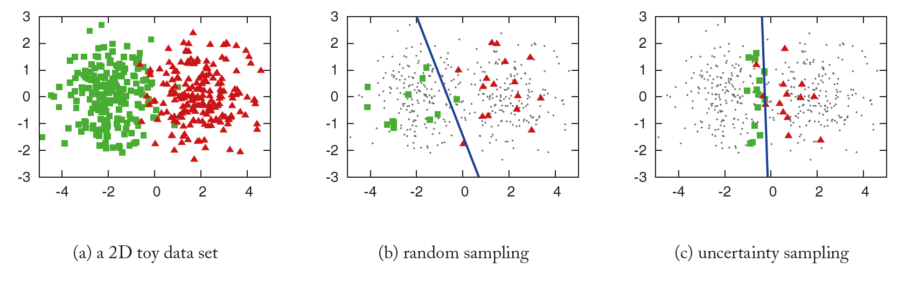
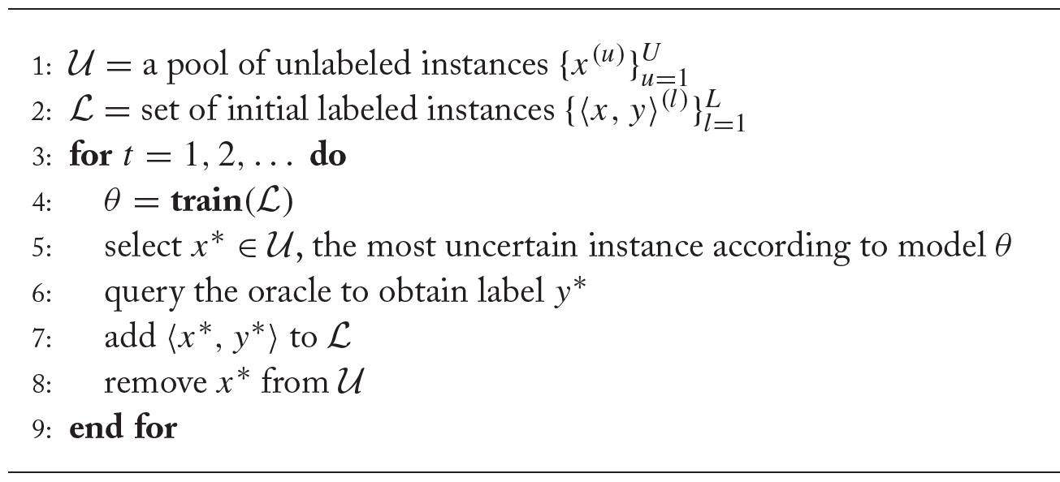
Uncertainty sampling
Settles, “Active Learning” (Synthesis Lectures on AI and ML), 2012

Slide 17
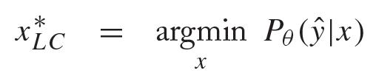

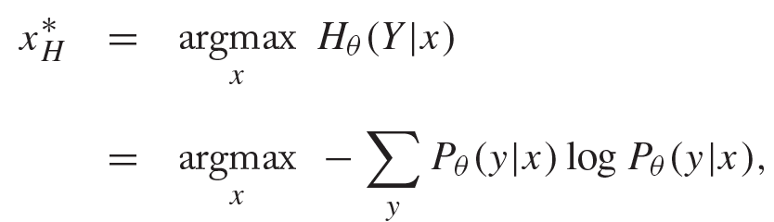
Measures of uncertainty
highest-probability label
Least confident
Smallest margin
Highest entropy
2nd-highest-probability label
Settles, “Active Learning” (Synthesis Lectures on AI and ML), 2012

Slide 18
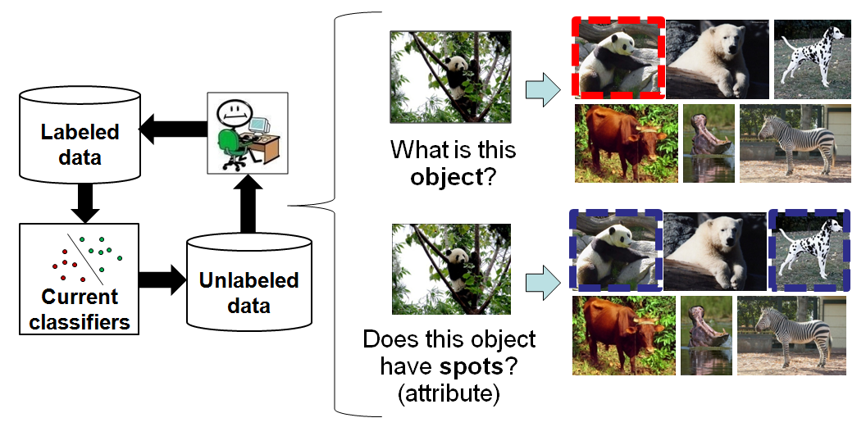
Actively choosing sample and annotation type
Kovashka et al., “Actively Selecting Annotations Among Objects and Attributes“, ICCV 2011

Slide 19
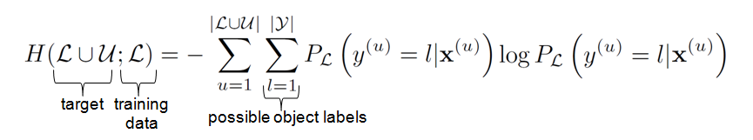
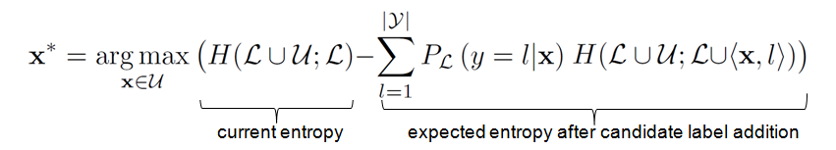
Expected entropy reduction on all data
Our entropy-based selection function seeks to maximize the expected object label entropy reduction. We measure object class entropy on the labeled and unlabeled image sets:
We seek maximal expected entropy reduction, which is equivalent to minimum entropy after the label addition:
By predicting entropy change over all data, selection accounts for the impact of all desired interactions between labels and data.
Kovashka et al., “Actively Selecting Annotations Among Objects and Attributes“, ICCV 2011

Slide 20
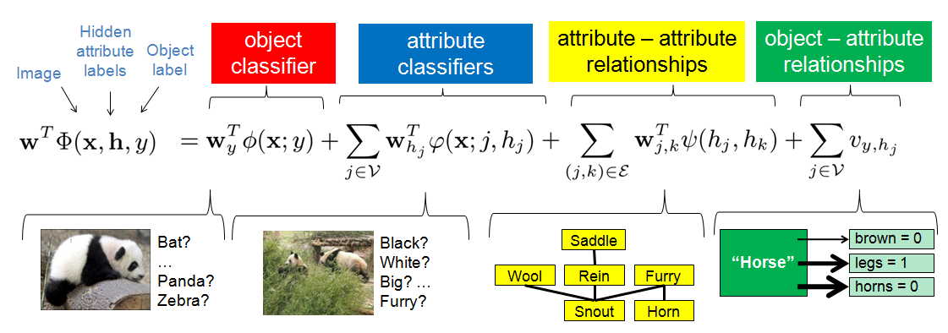
Object label depends on attribute labels
Kovashka et al., “Actively Selecting Annotations Among Objects and Attributes“, ICCV 2011

Slide 21
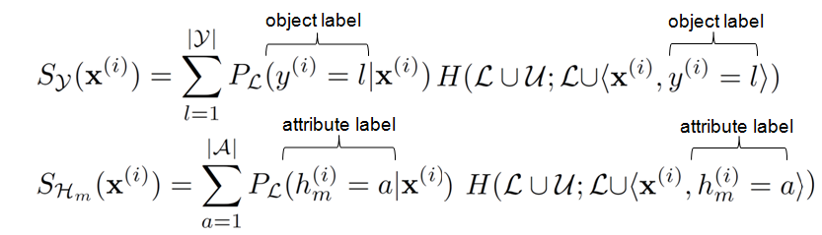
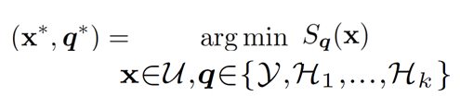
Choose object or attribute label
The expected entropy scores for object label and attribute label additions can be expressed as follows. Note that these two formulations are comparable since they both measure entropy of the object class.
Then the best (image, label) choice can be made as: where x ranges over unlabeled images and q ranges over possible label types.
Kovashka et al., “Actively Selecting Annotations Among Objects and Attributes“, ICCV 2011

Slide 22
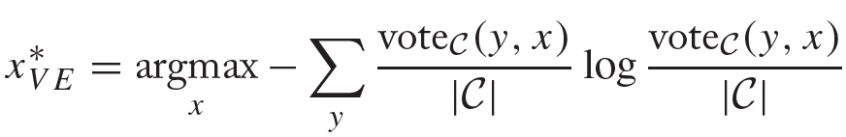
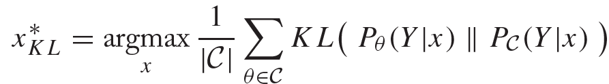
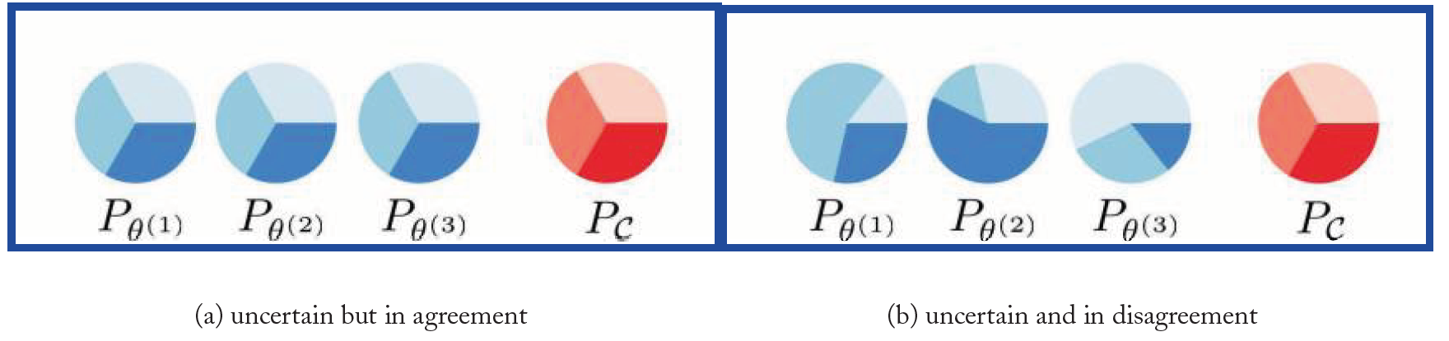
Query by committee
Settles, “Active Learning” (Synthesis Lectures on AI and ML), 2012

Slide 23
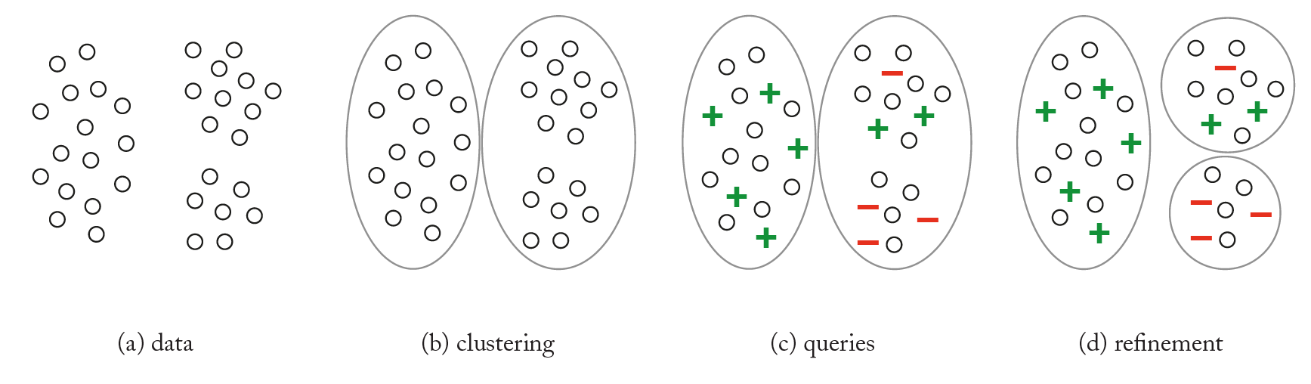
Cluster-based
Settles, “Active Learning” (Synthesis Lectures on AI and ML), 2012

Slide 24
Domain adaptation

Slide 25
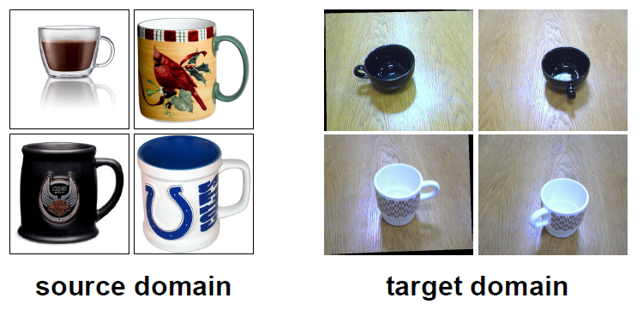
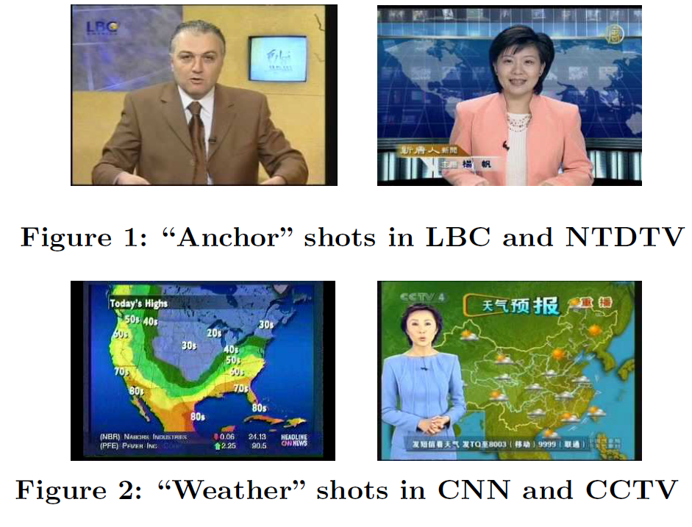
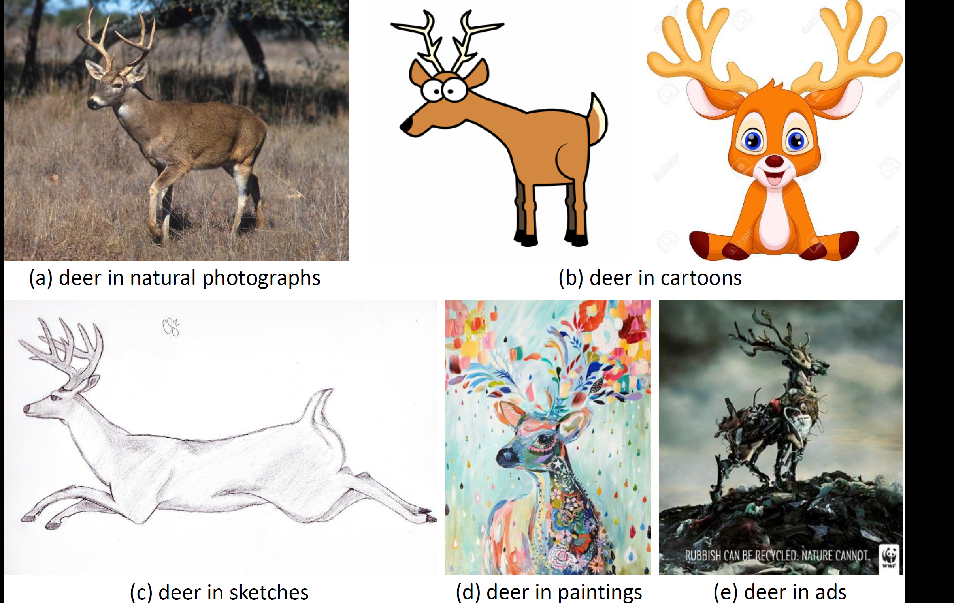
The same class looks different in different domains

Slide 26
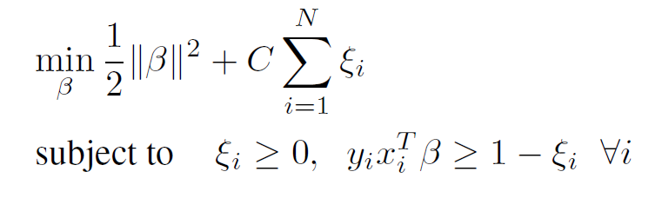
Adaptive SVM
Target domain:
Auxiliary (source) domain:
Standard SVM:
Yang et al., “Adapting SVM Classifiers to Data with Shifted Distributions”, ICDM Workshops 2007

Slide 27
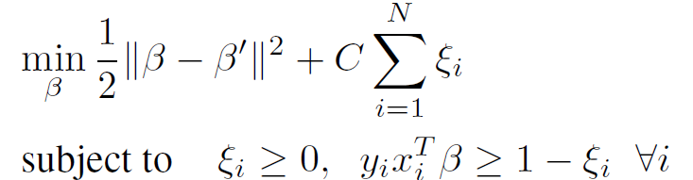
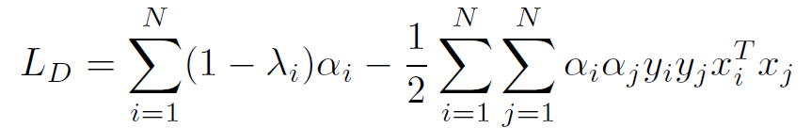
Adaptive SVM
learned on auxiliary domain with standard SVM
Adaptive SVM objective:
Adaptive SVM dual problem:
Adaptive SVM prediction:
prediction from auxiliary
Yang et al., “Adapting SVM Classifiers to Data with Shifted Distributions”, ICDM Workshops 2007

Slide 28
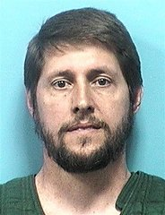
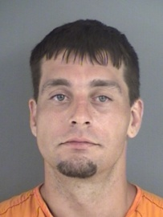
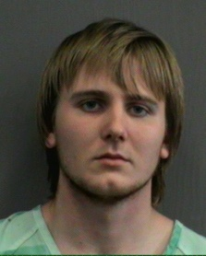

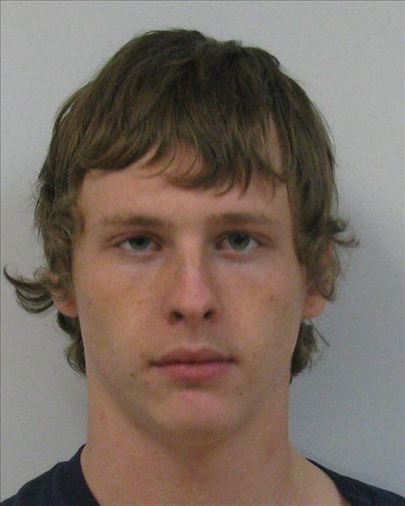
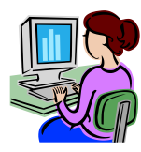
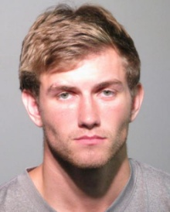

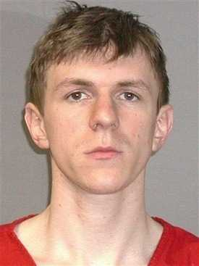

Personalized image search
“Like this… but with curlier hair”
Allow user to “whittle away” irrelevant images via comparative feedback on attributes of results
But different users might perceive attributes differently
Kovashka et al., “WhittleSearch: Image Search with Relative Attribute Feedback”, CVPR 2012

Slide 29
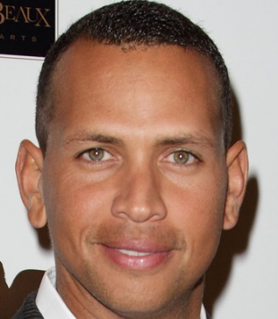
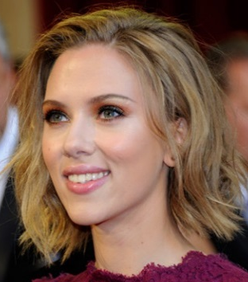
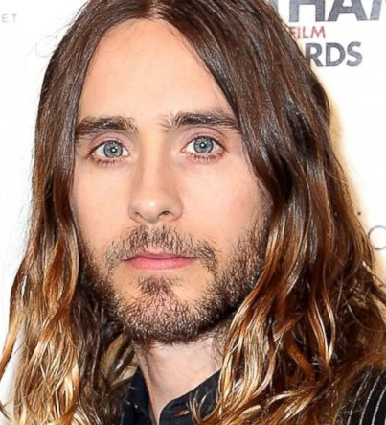
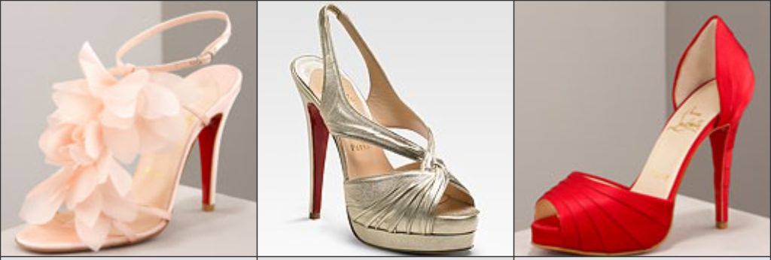
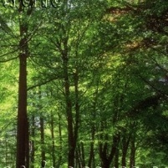
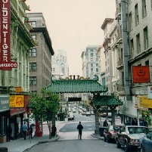

Semantic visual attributes
High-level descriptive properties shared by objects
Human-understandable and machine-detectable
Middle ground between user and system
smiling
large-lips
high heel
metallic
long-hair
ornaments
red
perspective
open
natural

Slide 30
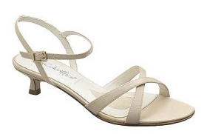
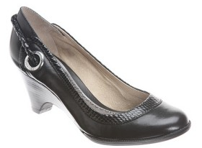
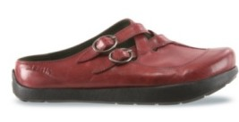
Users perceive attributes differently
Formal?
User labels:
50% “yes”
50% “no”
More ornamented?
User labels:
50% “first”
20% “second”
30% “equally”
or
Binary attribute
Relative attribute
There may be valid perceptual differences within an attribute, yet existing methods assume monolithic attribute sufficient
Kovashka and Grauman, “Attribute Adaptation for Personalized Image Search”, ICCV 2013

Slide 31


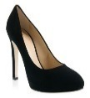
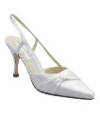
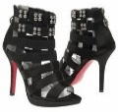
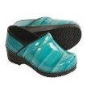


Learning user-specific attributes
Crowd
Vote on labels
“formal”
Standard
approach:
Adapt
“not formal”
User
“formal”
“formal”
Our idea:
“not
formal”
“not formal”
Treat as a domain adaptation problem
Adapt generic attribute model with minimal user-specific labeled examples
Kovashka and Grauman, “Attribute Adaptation for Personalized Image Search”, ICCV 2013

Slide 32


Learning adapted attributes
Adapting binary attribute classifiers:
Given user-labeled data
and generic model ,
learn adapted model ,
Yang et al., “Adapting SVM Classifiers to Data with Shifted Distributions”, ICDM Workshops 2007

Slide 33
Learning adapted attributes
“formal”
“formal”
Adapted boundary
Generic boundary
“not formal”
“not formal”

Slide 34

Adapted attribute accuracy
Result over all 3 datasets, 32 attributes, and 75 users
Generic learns a model from the crowd (no personalization)
Our method most accurately captures perceived attributes
Kovashka and Grauman, “Attribute Adaptation for Personalized Image Search”, ICCV 2013

Slide 35

Domain adaptation w/ metric learning
Colors = domains, shapes = classes
Saenko et al., “Adapting visual category models to new domains”, ECCV 2010

Slide 36

Domain adaptation with metric learning
Want to learn to relate two domains, x is from one domain, y is from the other
Constraints in learned space:
Use nearest neighbor classifier in learned space
Saenko et al., “Adapting visual category models to new domains”, ECCV 2010

Slide 37


Invariant representations w/ deep nets
q_{d} is the probability that a sample belongs to the d-th domain
Tzeng et al., “Simultaneous Deep Transfer Across Domains and Tasks”, ICCV 2015

Slide 38

Invariant representations w/ deep nets
Bousmalis et al., “Domain Separation Networks”, NIPS 2016

Slide 39
Unsupervised feature learning using context

Slide 40


Skip-gram model (word embeddings)
WE(king) – WE(man) + WE(woman) = WE(queen)
Mikolov et al., “Distributed Representations of Words and Phrases…”, NIPS 2013

Slide 41


Mikolov et al., “Distributed Representations of Words and Phrases…”, NIPS 2013

Slide 42

Context prediction for images
1
2
3
4
5
A
B
6
7
8
Doersch et al., “Unsupervised Visual Representation Learning by Context Prediction”, ICCV 2015

Slide 43

Relative position task
8 possible locations
Classifier
CNN
CNN
Randomly Sample Patch
Sample Second Patch
Doersch et al., “Unsupervised Visual Representation Learning by Context Prediction”, ICCV 2015
Notes:
- Let’s ask a machine learner to solve this. Given an unlabeled image, we sample one patch uniformly at random, and then a second patch from one of these 8 possible locations relative to the first.
- We then pass both patches to a deep network which is trained to predict which of the 8 classes was sampled.
- Note the structure of this network: we have a relatively complex embedding that happens in parallel for both patches, followed by a relatively simple classifier that receives input from both patches. We expect that this will encourage the network to extract semantics, because that’s what makes life easier for the simple classifier.
- This embedding function can be transferred to other problems

Slide 44





Patch Embedding
Classifier
Input
Nearest Neighbors
CNN
CNN
CNN
Note: connects across instances!
Doersch et al., “Unsupervised Visual Representation Learning by Context Prediction”, ICCV 2015
Notes:
- Create an embedding where semantically similar patches are close together
- indeed, for this patch, the most similar other patches are other cats
- Note what this means: we’ve connected across instances of cats despite using an objective function that operates within a single image
- We never told the algorithm that these were the same in any way

Slide 45
Ranking

Slide 46






















Relative attributes
We need to compare images by attribute “strength”
bright
smiling
natural
Parikh and Grauman, “Relative attributes”, ICCV 2011
Notes:
… we need to be able to compare images and rank them along a certain attribute spectrum, using their attribute strengths. Since it is infeasible to collect annotations on an entire large image database, we need to be able estimate the strength of a given attribute in a given image automatically.

Slide 47




















Learning relative attributes
We want to learn a spectrum (ranking model) for an attribute, e.g. “brightness”.
Supervision consists of:
Ordered pairs
Similar pairs
Parikh and Grauman, “Relative attributes”, ICCV 2011

Slide 48


Learning relative attributes
Learn a ranking function
Image features
Learned parameters
that best satisfies the constraints:
Parikh and Grauman, “Relative attributes”, ICCV 2011

Slide 49


Learning relative attributes
Max-margin learning to rank formulation
Rank margin
w_{m}
Image Relative attribute score
Joachims, “Optimizing search engines using clickthrough data”, KDD 2002

