Slide 1
CS 2750: Machine Learning
Hidden Markov Models
Prof. Adriana Kovashka
University of Pittsburgh
April 6, 11, 2017

Slide 2
Beyond Classification Learning
Standard classification problem assumes individual cases are disconnected and independent (i.i.d.: independently and identically distributed).
Many problems do not satisfy this assumption and involve making many connected decisions which are mutually dependent.
Adapted from Ray Mooney

Slide 3
Markov Chains
A finite state machine with probabilistic state transitions.
Makes Markov assumption that next state only depends on the current state and independent of previous history.
Ray Mooney

Slide 4


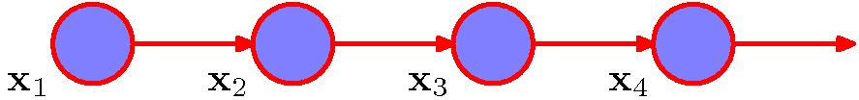
Markov Chains
General joint probability distribution:
First-order Markov chain:
Figures from Chris Bishop

Slide 5

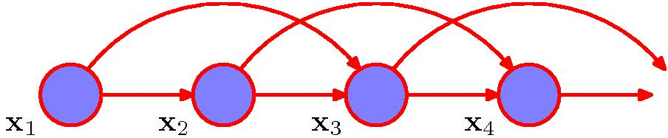
Markov Chains
Second-order Markov chain:
Figures from Chris Bishop

Slide 6
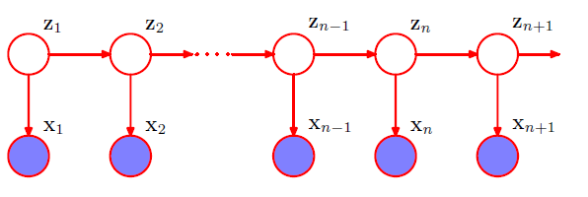
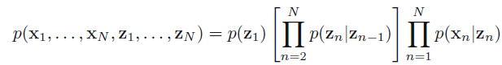
Hidden Markov Models
Latent variables (z) satisfy Markov property
Observed variables/predictions (x) do not
Figures from Chris Bishop

Slide 7
Hidden Markov Models
Probabilistic generative model for sequences.
Assume an underlying set of hidden (unobserved) states in which the model can be (e.g. parts of speech).
Assume probabilistic transitions between states over time (e.g. transition from POS to another POS as sequence is generated).
Assume a probabilistic generation of tokens from states (e.g. words generated for each POS).
Ray Mooney

Slide 8
Example: Part Of Speech Tagging
Annotate each word in a sentence with a part-of-speech marker.
John saw the saw and decided to take it to the table.
NNP VBD DT NN CC VBD TO VB PRP IN DT NN
Adapted from Ray Mooney

Slide 9
English Parts of Speech
Noun (person, place or thing)
  Singular (NN): dog, fork
  Plural (NNS): dogs, forks
  Proper (NNP, NNPS): John, Springfields
  Personal pronoun (PRP): I, you, he, she, it
  Wh-pronoun (WP): who, what
Verb (actions and processes)
  Base, infinitive (VB): eat
  Past tense (VBD): ate
  Gerund (VBG): eating
  Past participle (VBN): eaten
  Non 3rd person singular present tense (VBP): eat
  3rd person singular present tense: (VBZ): eats
  Modal (MD): should, can
  To (TO): to (to eat)
Ray Mooney

Slide 10
English Parts of Speech (cont.)
Adjective (modify nouns)
  Basic (JJ): red, tall
  Comparative (JJR): redder, taller
  Superlative (JJS): reddest, tallest
Adverb (modify verbs)
  Basic (RB): quickly
  Comparative (RBR): quicker
  Superlative (RBS): quickest
Preposition (IN): on, in, by, to, with
Determiner:
  Basic (DT) a, an, the
  WH-determiner (WDT): which, that
Coordinating Conjunction (CC): and, but, or,
Particle (RP): off (took off), up (put up)
Ray Mooney

Slide 11
Ambiguity in POS Tagging
“Like” can be a verb or a preposition
  I like/VBP candy.
  Time flies like/IN an arrow.
“Around” can be a preposition, particle, or adverb
  I bought it at the shop around/IN the corner.
  I never got around/RP to getting a car.
  A new Prius costs around/RB $25K.
Context from other words can help
Adapted from Ray Mooney

Slide 12
Sample Markov Model for POS
0.05
0.1
Det
Noun
0.95
0.5
0.85
stop
0.05
Verb
0.25
0.1
PropNoun
0.8
0.4
0.5
0.1
0.25
0.1
start
Ray Mooney

Slide 13
Sample Markov Model for POS
0.05
0.1
Det
Noun
0.95
0.5
0.85
stop
0.05
Verb
0.25
0.1
PropNoun
0.8
0.4
0.5
0.1
0.25
0.1
start
P(PropNoun Verb Det Noun) = 0.4*0.8*0.25*0.95*0.1=0.0076
Ray Mooney

Slide 14
Sample HMM for POS
0.05
the
cat
0.1
a
the
dog
a
the
car
bed
the
a
apple
that
pen
0.95
0.5
Det
Noun
0.85
bit
saw
stop
0.05
ate
played
Tom
0.25
hit
gave
0.1
John
Verb
Mary
Alice
0.8
0.4
Jerry
0.5
PropNoun
0.1
0.25
0.1
start
Ray Mooney

Slide 15
Sample HMM Generation
0.05
the
cat
0.1
a
the
dog
a
the
car
bed
the
a
apple
that
pen
0.95
0.5
Det
Noun
0.85
bit
saw
stop
0.05
ate
played
Tom
0.25
hit
gave
0.1
John
Verb
Mary
Alice
0.8
0.4
Jerry
0.5
PropNoun
0.1
0.25
0.1
start
Ray Mooney

Slide 16
Sample HMM Generation
0.05
the
cat
0.1
a
the
dog
a
the
car
bed
the
a
apple
that
pen
0.95
0.5
Det
Noun
0.85
bit
saw
stop
0.05
ate
played
Tom
0.25
hit
gave
0.1
John
Verb
Mary
Alice
0.8
0.4
Jerry
0.5
PropNoun
0.1
0.1
start
Ray Mooney

Slide 17
Sample HMM Generation
0.05
the
cat
0.1
a
the
dog
a
the
car
bed
the
a
apple
that
pen
0.95
0.5
Det
Noun
0.85
bit
saw
stop
0.05
ate
played
Tom
0.25
hit
gave
0.1
John
Verb
Mary
Alice
0.8
0.4
Jerry
0.5
PropNoun
0.1
0.25
0.1
start
John
Ray Mooney

Slide 18
Sample HMM Generation
0.05
the
cat
0.1
a
the
dog
a
the
car
bed
the
a
apple
that
pen
0.95
0.5
Det
Noun
0.85
bit
saw
stop
0.05
ate
played
Tom
0.25
hit
gave
0.1
John
Verb
Mary
Alice
0.8
0.4
Jerry
0.5
PropNoun
0.1
0.25
0.1
start
John
Ray Mooney

Slide 19
Sample HMM Generation
0.05
the
cat
0.1
a
the
dog
a
the
car
bed
the
a
apple
that
pen
0.95
0.5
Det
Noun
0.85
bit
saw
stop
0.05
ate
played
Tom
0.25
hit
gave
0.1
John
Verb
Mary
Alice
0.8
0.4
Jerry
0.5
PropNoun
0.1
0.25
0.1
start
John bit
Ray Mooney

Slide 20
Sample HMM Generation
0.05
the
cat
0.1
a
the
dog
a
the
car
bed
the
a
apple
that
pen
0.95
0.5
Det
Noun
0.85
bit
saw
stop
0.05
ate
played
Tom
0.25
hit
gave
0.1
John
Verb
Mary
Alice
0.8
0.4
Jerry
0.5
PropNoun
0.1
0.25
0.1
start
John bit
Ray Mooney

Slide 21
Sample HMM Generation
0.05
the
cat
0.1
a
the
dog
a
the
car
bed
the
a
apple
that
pen
0.95
0.5
Det
Noun
0.85
bit
saw
stop
0.05
ate
played
Tom
0.25
hit
gave
0.1
John
Verb
Mary
Alice
0.8
0.4
Jerry
0.5
PropNoun
0.1
0.25
0.1
start
John bit the
Ray Mooney

Slide 22
Sample HMM Generation
0.05
the
cat
0.1
a
the
dog
a
the
car
bed
the
a
apple
that
pen
0.95
0.5
Det
Noun
0.85
bit
saw
stop
0.05
ate
played
Tom
0.25
hit
gave
0.1
John
Verb
Mary
Alice
0.8
0.4
Jerry
0.5
PropNoun
0.1
0.25
0.1
start
John bit the
Ray Mooney

Slide 23
Sample HMM Generation
0.05
the
cat
0.1
a
the
dog
a
the
car
bed
the
a
apple
that
pen
0.95
0.5
Det
Noun
0.85
bit
saw
stop
0.05
ate
played
Tom
0.25
hit
gave
0.1
John
Verb
Mary
Alice
0.8
0.4
Jerry
0.5
PropNoun
0.1
0.25
0.1
start
John bit the apple
Ray Mooney

Slide 24
Sample HMM Generation
0.05
the
cat
0.1
a
the
dog
a
the
car
bed
the
a
apple
that
pen
0.95
0.5
Det
Noun
0.85
bit
saw
stop
0.05
ate
played
Tom
0.25
hit
gave
0.1
John
Verb
Mary
Alice
0.8
0.4
Jerry
0.5
PropNoun
0.1
0.25
0.1
start
John bit the apple
Ray Mooney

Slide 25
Formal Definition of an HMM
A set of N +2 states S={s₀,s₁,s₂, … s_{N,} s_{F}}
  Distinguished start state: s₀
  Distinguished final state: s_{F}
A set of M possible observations V={v₁,v₂…v_{M}}
A state transition probability distribution A={a_{ij}}
Observation probability distribution for each state j B={b_{j}(k)}
Total parameter set λ={A,B}
Ray Mooney

Slide 26
Three Useful HMM Tasks
Observation Likelihood: To classify and order sequences.
Most likely state sequence (Decoding): To tag each token in a sequence with a label.
Maximum likelihood training (Learning): To train models to fit empirical training data.
Ray Mooney

Slide 27
HMM: Observation Likelihood
Given a sequence of observations, O, and a model with a set of parameters, λ, what is the probability that this observation was generated by this model: P(O| λ) ?
Allows HMM to be used as a language model: A formal probabilistic model of a language that assigns a probability to each string saying how likely that string was to have been generated by the language.
Example uses:
  Sequence Classification
  Most Likely Sequence
Adapted from Ray Mooney

Slide 28
Sequence Classification
Assume an HMM is available for each category (i.e. language or word).
What is the most likely category for a given observation sequence, i.e. which category’s HMM is most likely to have generated it?
Used in speech recognition to find most likely word model to have generated a given sound or phoneme sequence.
O
ah s t e n
?
?
Austin
P(O | Austin) > P(O | Boston) ?
Boston
Ray Mooney

Slide 29
Most Likely Sequence
Of two or more possible sequences, which one was most likely generated by a given model?
Used to score alternative word sequence interpretations in speech recognition.
O₁
?
dice precedent core
?
vice president Gore
O₂
Ordinary English
P(O₂ | OrdEnglish) > P(O₁ | OrdEnglish) ?
Ray Mooney

Slide 30
HMM: Observation Likelihood
Naïve Solution
Consider all possible state sequences, Q, of length T that the model could have traversed in generating the given observation sequence.
Compute
  the probability of a given state sequence from A, and
  multiply it by the probabilities (from B) of generating each of the given observations in each of the corresponding states in this sequence,
  to get P(O,Q| λ) = P(O| Q, λ) P(Q| λ) .
Sum this over all possible state sequences to get P(O| λ).
Computationally complex: O(TN^{T}).
Adapted from Ray Mooney

Slide 31
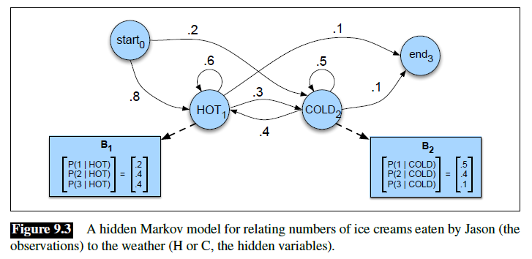
Example
States = weather (hot/cold), observations = number of ice-creams eaten
What is the probability of observing {3, 1, 3}?

Slide 32
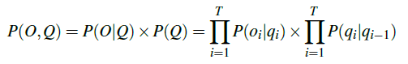

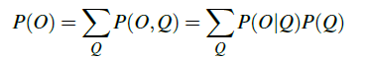
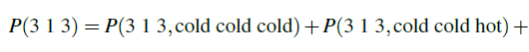
Example
What is the probability of observing {3, 1, 3} and the state sequence being {hot, hot, cold}?
What is the probability of observing {3, 1, 3}?
…

Slide 33
HMM: Observation Likelihood
Efficient Solution
Due to the Markov assumption, the probability of being in any state at any given time t only relies on the probability of being in each of the possible states at time t−1.
Forward Algorithm: Uses dynamic programming to exploit this fact to efficiently compute observation likelihood in O(TN²) time.
  Compute a forward trellis that compactly and implicitly encodes information about all possible state paths.
Ray Mooney

Slide 34
Forward Probabilities
Let α_{t}(j) be the probability of being in state j after seeing the first t observations (by summing over all initial paths leading to j).
Ray Mooney

Slide 35
Forward Step
Consider all possible ways of getting to s_{j} at time t by coming from all possible states s_{i} and determine probability of each.
Sum these to get the total probability of being in state s_{j} at time t while accounting for the first t −1 observations.
Then multiply by the probability of actually observing o_{t} in s_{j.}
s₁
a_{1j}
s₂
a_{2j}
•
•
•
a_{2j}
s_{j}
a_{Nj}
s_{N}
α_{t-1}(i)
α_{t}(i)
Ray Mooney

Slide 36
Forward Trellis
s₁
• • •
s₂
• • •
•
•
•
•
•
•
•
•
•
•
•
•
•
•
•
s₀
• • •
s_{F}
s_{N}
• • •
t₁
t₂
t₃
t_{T-1}
t_{T}
Continue forward in time until reaching final time point, and sum probability of ending in final state.
Ray Mooney

Slide 37
Computing the Forward Probabilities
Initialization
Recursion
Termination
Ray Mooney

Slide 38
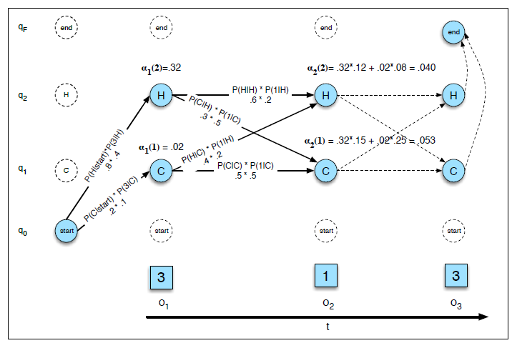
Example

Slide 39
Forward Computational Complexity
Requires only O(TN²) time to compute the probability of an observed sequence given a model.
Exploits the fact that all state sequences must merge into one of the N possible states at any point in time and the Markov assumption that only the last state effects the next one.
Ray Mooney

Slide 40
Three Useful HMM Tasks
Observation Likelihood: To classify and order sequences.
Most likely state sequence (Decoding): To tag each token in a sequence with a label.
Maximum likelihood training (Learning): To train models to fit empirical training data.
Ray Mooney

Slide 41
Most Likely State Sequence (Decoding)
Given an observation sequence, O, and a model, λ, what is the most likely state sequence,Q=q₁,q₂,…q_{T}, that generated this sequence from this model?
Used for sequence labeling, assuming each state corresponds to a tag, it determines the globally best assignment of tags to all tokens in a sequence using a principled approach grounded in probability theory.
John gave the dog an apple.
Ray Mooney

Slide 42
Most Likely State Sequence
Given an observation sequence, O, and a model, λ, what is the most likely state sequence,Q=q₁,q₂,…q_{T}, that generated this sequence from this model?
Used for sequence labeling, assuming each state corresponds to a tag, it determines the globally best assignment of tags to all tokens in a sequence using a principled approach grounded in probability theory.
John gave the dog an apple.
Det Noun PropNoun Verb
Ray Mooney

Slide 43
Most Likely State Sequence
Given an observation sequence, O, and a model, λ, what is the most likely state sequence,Q=q₁,q₂,…q_{T}, that generated this sequence from this model?
Used for sequence labeling, assuming each state corresponds to a tag, it determines the globally best assignment of tags to all tokens in a sequence using a principled approach grounded in probability theory.
John gave the dog an apple.
Det Noun PropNoun Verb
Ray Mooney

Slide 44
Most Likely State Sequence
Given an observation sequence, O, and a model, λ, what is the most likely state sequence,Q=q₁,q₂,…q_{T}, that generated this sequence from this model?
Used for sequence labeling, assuming each state corresponds to a tag, it determines the globally best assignment of tags to all tokens in a sequence using a principled approach grounded in probability theory.
John gave the dog an apple.
Det Noun PropNoun Verb
Ray Mooney

Slide 45
Most Likely State Sequence
Given an observation sequence, O, and a model, λ, what is the most likely state sequence,Q=q₁,q₂,…q_{T}, that generated this sequence from this model?
Used for sequence labeling, assuming each state corresponds to a tag, it determines the globally best assignment of tags to all tokens in a sequence using a principled approach grounded in probability theory.
John gave the dog an apple.
Det Noun PropNoun Verb
Ray Mooney

Slide 46
Most Likely State Sequence
Given an observation sequence, O, and a model, λ, what is the most likely state sequence,Q=q₁,q₂,…q_{T}, that generated this sequence from this model?
Used for sequence labeling, assuming each state corresponds to a tag, it determines the globally best assignment of tags to all tokens in a sequence using a principled approach grounded in probability theory.
John gave the dog an apple.
Det Noun PropNoun Verb
Ray Mooney

Slide 47
Most Likely State Sequence
Given an observation sequence, O, and a model, λ, what is the most likely state sequence,Q=q₁,q₂,…q_{T}, that generated this sequence from this model?
Used for sequence labeling, assuming each state corresponds to a tag, it determines the globally best assignment of tags to all tokens in a sequence using a principled approach grounded in probability theory.
John gave the dog an apple.
Det Noun PropNoun Verb
Ray Mooney

Slide 48
HMM: Most Likely State Sequence
Efficient Solution
Obviously, could use naïve algorithm based on examining every possible state sequence of length T.
Dynamic Programming can also be used to exploit the Markov assumption and efficiently determine the most likely state sequence for a given observation and model.
Standard procedure is called the Viterbi algorithm (Viterbi, 1967) and also has O(TN²) time complexity.
Ray Mooney

Slide 49
Viterbi Scores
Recursively compute the probability of the most likely subsequence of states that accounts for the first t observations and ends in state s_{j}.
Also record “backpointers” that subsequently allow backtracing the most probable state sequence.
  bt_{t}(j) stores the state at time t-1 that maximizes the probability that system was in state s_{j} at time t (given the observed sequence).
Ray Mooney

Slide 50
Computing the Viterbi Scores
Initialization
Recursion
Termination
Analogous to Forward algorithm except take max instead of sum
Ray Mooney

Slide 51
Computing the Viterbi Backpointers
Initialization
Recursion
Termination
Final state in the most probable state sequence. Follow
backpointers to initial state to construct full sequence.
Ray Mooney

Slide 52
Viterbi Backpointers
s₁
• • •
s₂
• • •
•
•
•
•
•
•
•
•
•
•
•
•
•
•
•
s₀
• • •
s_{F}
s_{N}
• • •
t₁
t₂
t₃
t_{T-1}
t_{T}
Ray Mooney

Slide 53
Viterbi Backtrace
s₁
• • •
s₂
• • •
•
•
•
•
•
•
•
•
•
•
•
•
•
•
•
s₀
• • •
s_{F}
s_{N}
• • •
t₁
t₂
t₃
t_{T-1}
t_{T}
Most likely Sequence: s₀ s_{N} s₁ s₂ …s₂ s_{F}
Ray Mooney

Slide 54
Three Useful HMM Tasks
Observation Likelihood: To classify and order sequences.
Most likely state sequence (Decoding): To tag each token in a sequence with a label.
Maximum likelihood training (Learning): To train models to fit empirical training data.
Ray Mooney

Slide 55
HMM Learning
Supervised Learning: All training sequences are completely labeled (tagged).
Unsupervised Learning: All training sequences are unlabelled (but generally know the number of tags, i.e. states).
Adapted from Ray Mooney

Slide 56
Supervised HMM Training
If training sequences are labeled (tagged) with the underlying state sequences that generated them, then the parameters, λ={A,B} can all be estimated directly.
Training Sequences
John ate the apple
A dog bit Mary
Mary hit the dog
John gave Mary the cat.
Supervised
HMM
Training
.
.
.
Det Noun PropNoun Verb
Ray Mooney

Slide 57
Supervised Parameter Estimation
Estimate state transition probabilities based on tag bigram and unigram statistics in the labeled data.
Estimate the observation probabilities based on tag/word co-occurrence statistics in the labeled data.
Use appropriate smoothing if training data is sparse.
Ray Mooney

Slide 58
Unsupervised
Maximum Likelihood Training
Training Sequences
ah s t e n
a s t i n
oh s t u n
eh z t en
HMM
Training
.
.
.
Austin
Ray Mooney

Slide 59
Maximum Likelihood Training
Given an observation sequence, O, what set of parameters, λ, for a given model maximizes the probability that this data was generated from this model (P(O| λ))?
Used to train an HMM model and properly induce its parameters from a set of training data.
Only need to have an unannotated observation sequence (or set of sequences) generated from the model. Does not need to know the correct state sequence(s) for the observation sequence(s). In this sense, it is unsupervised.
Ray Mooney

Slide 60
HMM: Maximum Likelihood Training
Efficient Solution
There is no known efficient algorithm for finding the parameters, λ, that truly maximizes P(O| λ).
However, using iterative re-estimation, the Baum-Welch algorithm (a.k.a. forward-backward) , a version of a standard statistical procedure called Expectation Maximization (EM), is able to locally maximize P(O| λ).
In practice, EM is able to find a good set of parameters that provide a good fit to the training data in many cases.
Ray Mooney

Slide 61
Sketch of Baum-Welch (EM) Algorithm for Training HMMs
Assume an HMM with N states.
Randomly set its parameters λ=(A,B)
(making sure they represent legal distributions)
Until converge (i.e. λ no longer changes) do:
E Step: Use the forward/backward procedure to
determine the probability of various possible
state sequences for generating the training data
M Step: Use these probability estimates to
re-estimate values for all of the parameters λ
Ray Mooney

Slide 62
Backward Probabilities
Let β_{t}(i) be the probability of observing the final set of observations from time t+1 to T given that one is in state i at time t.
62
Ray Mooney
Notes:
62

Slide 63
Computing the Backward Probabilities
63
Ray Mooney
Initialization
Recursion
Termination
Notes:
63

Slide 64
Estimating Probability of State Transitions
s₁
a_{1i}
a_{j1}
s₁
s₂
a_{2i}
a_{j2}
s₂
•
•
•
a_{3i}
a_{j3}
•
•
•
s_{i}
s_{j}
a_{Ni}
a_{jN}
s_{N}
s_{N}
t-1
t
t+1
t+2
Ray Mooney
Let ξ_{t}(i,j) be the probability of being in state i at time t and state j at time t + 1

Slide 65
Re-estimating A
Ray Mooney

Slide 66
Estimating Observation Probabilities
Let γ_{t}(i) be the probability of being in state i at time t given the observations and the model.
Ray Mooney

Slide 67
Re-estimating B
Ray Mooney

Slide 68
Pseudocode for Baum-Welch (EM) Algorithm for Training HMMs
Assume an HMM with N states.
Randomly set its parameters λ=(A,B)
(making sure they represent legal distributions)
Until converge (i.e. λ no longer changes) do:
E Step:
Compute values for γ_{t}(j) and ξ_{t}(i,j) using current
values for parameters A and B.
M Step:
Re-estimate parameters:
68
Ray Mooney
Notes:
68

Slide 69
EM Properties
Ray Mooney
Each iteration changes the parameters in a way that is guaranteed to increase the likelihood of the data: P(O|λ).
Anytime algorithm: Can stop at any time prior to convergence to get approximate solution.
Converges to a local maximum.

