Slide 1
CS 2750: Machine Learning
Markov Random Fields
Inference in Graphical Models
Prof. Adriana Kovashka
University of Pittsburgh
April 4, 2017

Slide 2
Bayes Nets vs. Markov Nets
Bayes nets represent a subclass of joint distributions that capture non-cyclic causal dependencies between variables.
A Markov net can represent any joint distribution.
Ray Mooney

Slide 3
Markov Random Fields
Undirected graph over a set of random variables, where an edge represents a dependency.
The Markov blanket of a node, X, in a Markov Net is the set of its neighbors in the graph (nodes that have an edge connecting to X).
Every node in a Markov Net is conditionally independent of every other node given its Markov blanket.
Ray Mooney

Slide 4

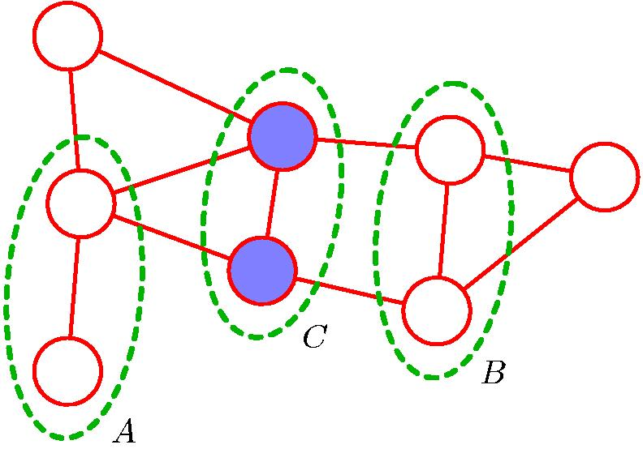
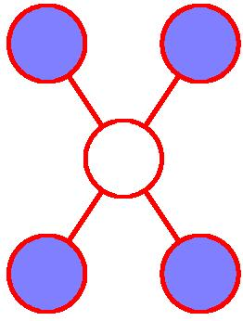
Markov Random Fields
Markov Blanket
A node is conditionally independent of all other nodes conditioned only on the neighboring nodes.
Chris Bishop

Slide 5
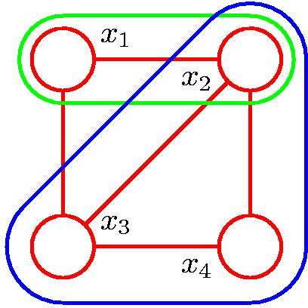
Cliques and Maximal Cliques
Clique
Maximal Clique
Chris Bishop

Slide 6
Joint Distribution for a Markov Net
The distribution of a Markov net is most compactly described in terms of a set of potential functions, ψ_{c}, for each clique, C, in the graph.
For each joint assignment of values to the variables in clique C, ψ_{c} assigns a non-negative real value that represents the compatibility of these values.
Ray Mooney

Slide 7
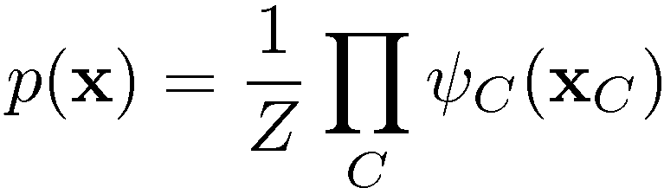

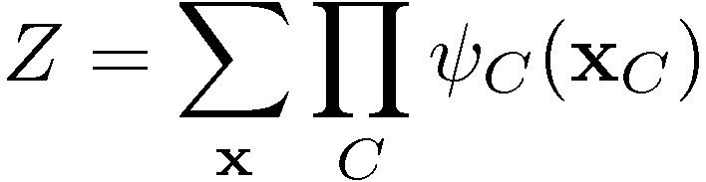

Joint Distribution for a Markov Net
where is the potential over clique C and
is the normalization coefficient; note: M K-state variables → K^{M} terms in Z.
Energies and the Boltzmann distribution
Chris Bishop

Slide 8
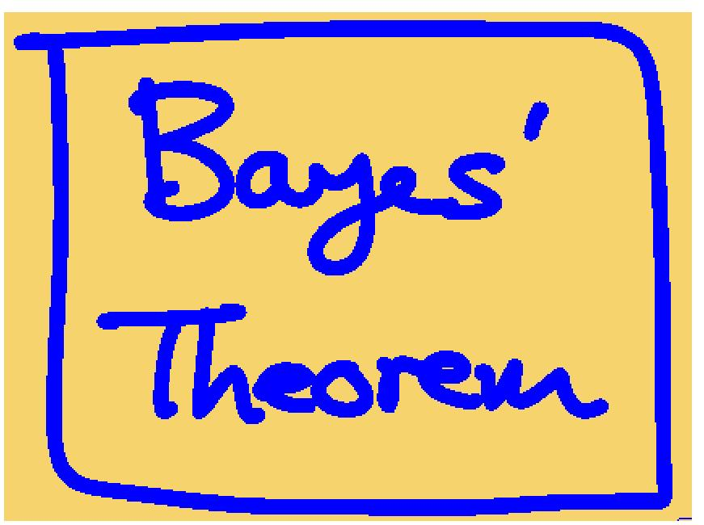
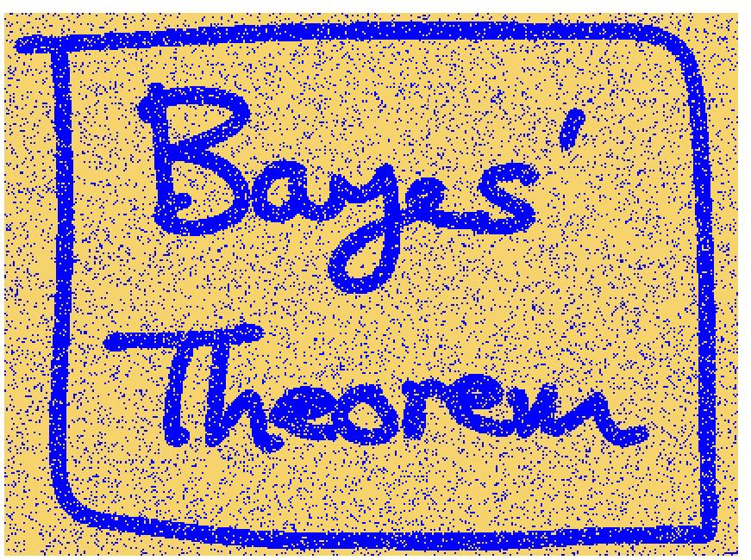
Illustration: Image De-Noising
Original Image
Noisy Image
Chris Bishop

Slide 9
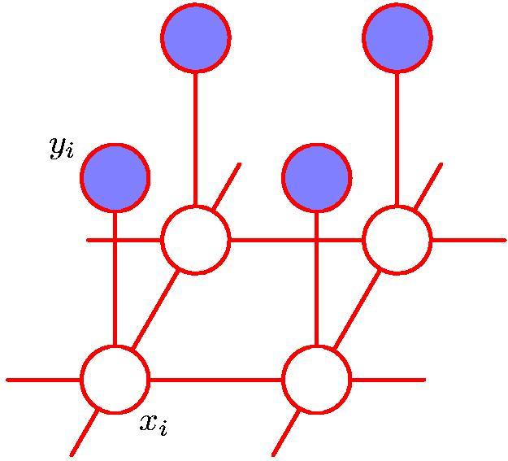
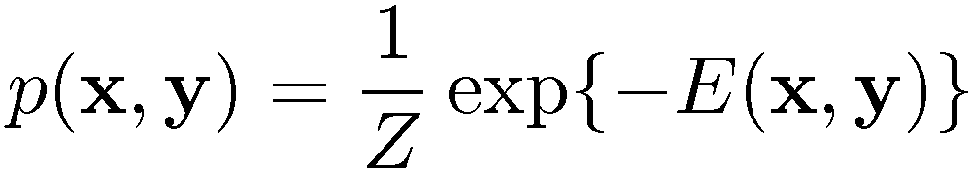
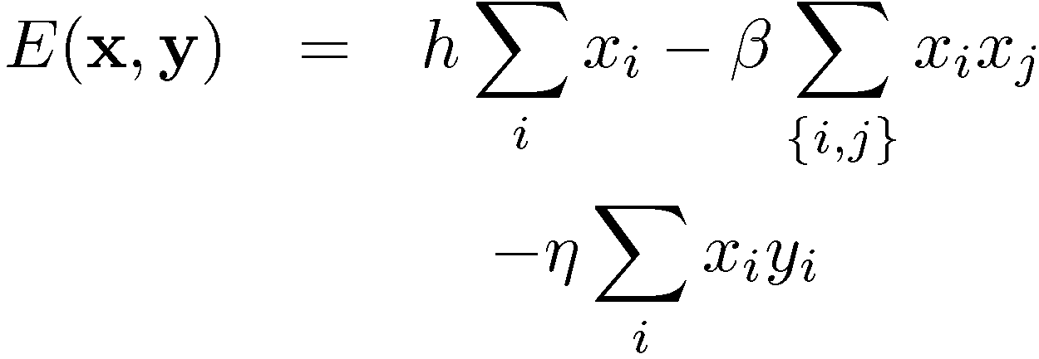
Illustration: Image De-Noising
y_{i} in {+1, -1}: labels in noisy image (which we have),
x_{i} in {+1, -1}: labels in noise-free image
(which we want to recover),
i is the index over pixels
x_{j}
Prior
Pixels are like their neighbors
Pixels of noisy and noise-free images are related
Adapted from Chris Bishop

Slide 10
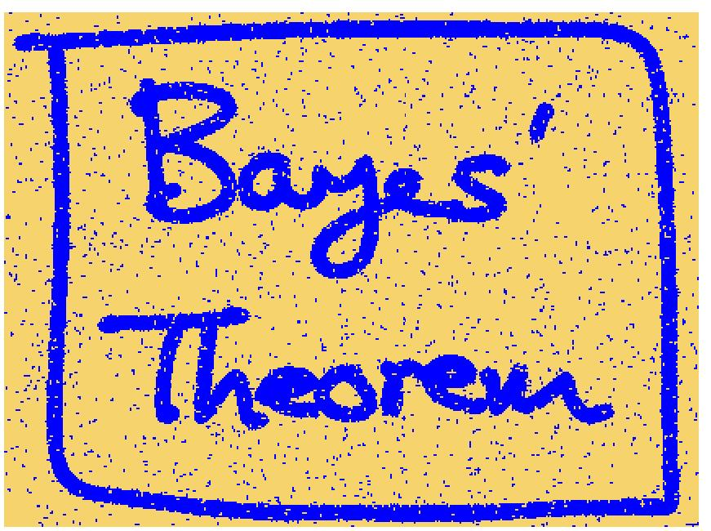
Illustration: Image De-Noising
Noisy Image
Restored Image (ICM)
Chris Bishop

Slide 11
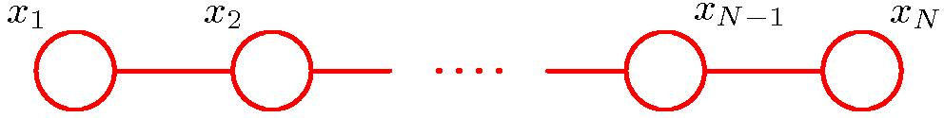
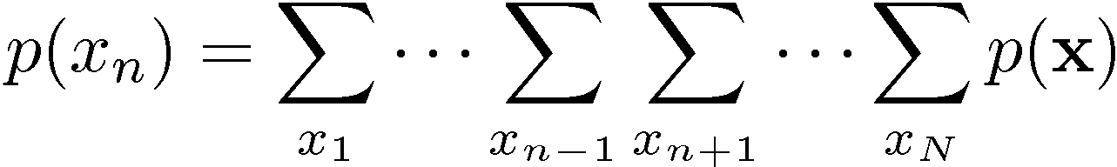
Inference on a Chain
O(K^{N}) operations (K states, N variables)
Adapted from Chris Bishop

Slide 12
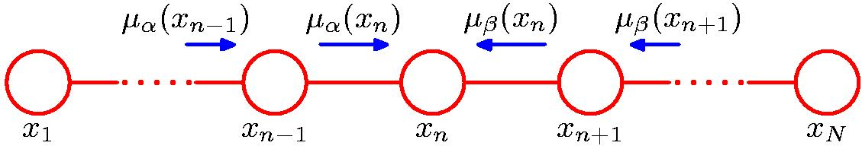
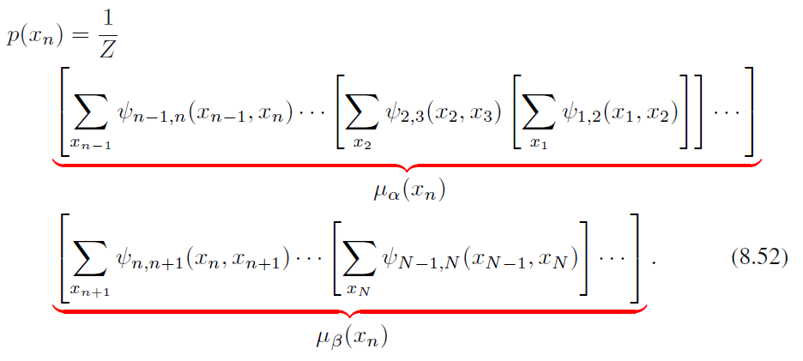
Inference on a Chain
O(NK²) operations (K states, N variables)
Chris Bishop

Slide 13
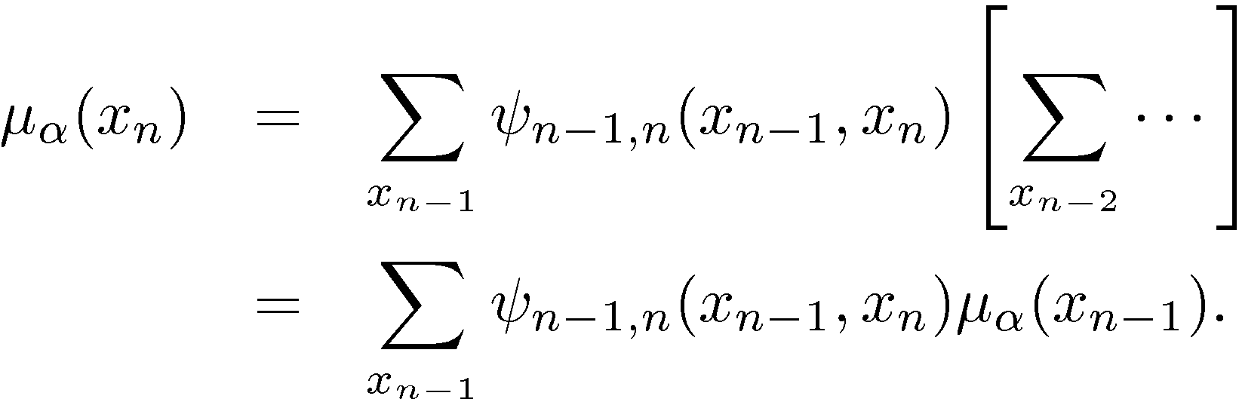
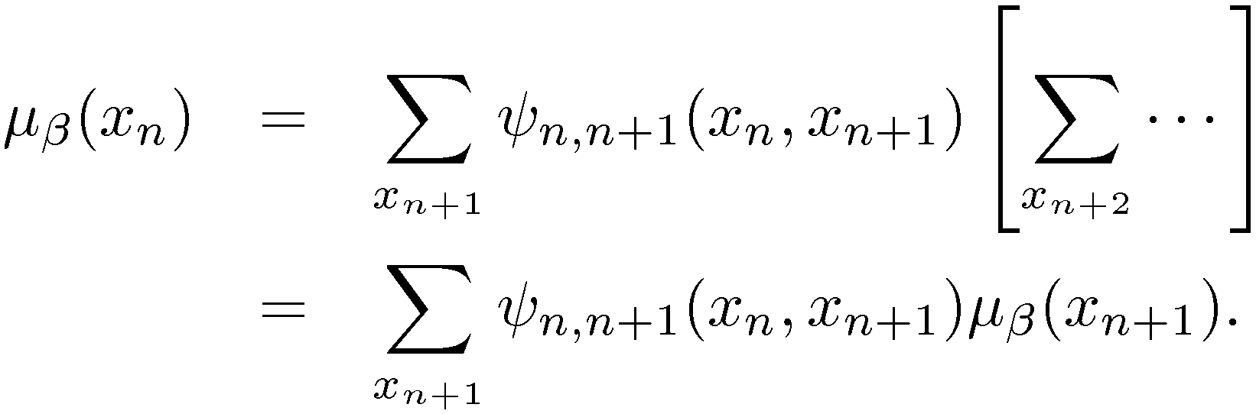
Inference on a Chain
Chris Bishop

Slide 14


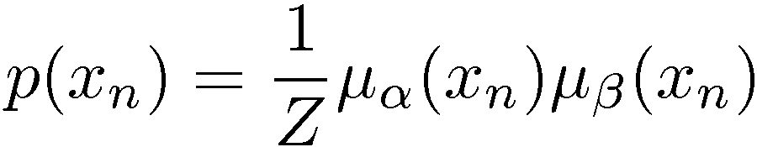
Inference on a Chain
To compute local marginals:
  Compute and store all forward messages, .
  Compute and store all backward messages, .
  Compute Z at any node x_{m}
  Compute
  for all variables required.
Chris Bishop

Slide 15
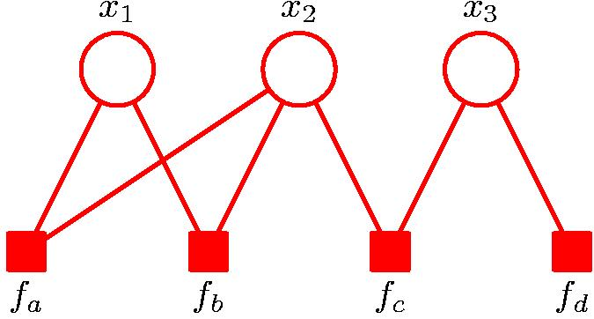
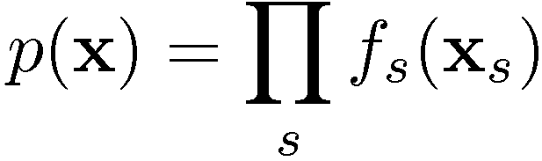
Factor Graphs
Chris Bishop

Slide 16
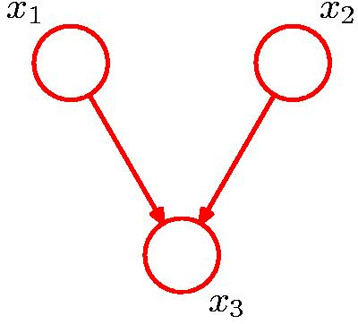
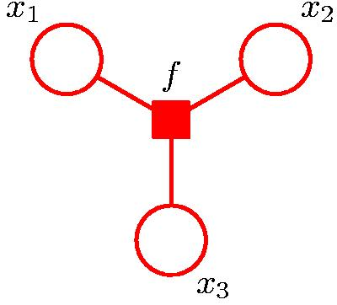
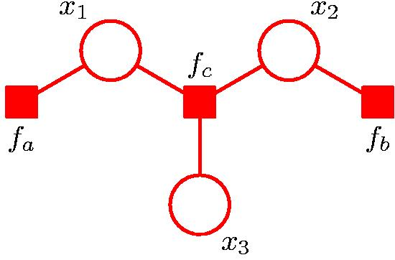
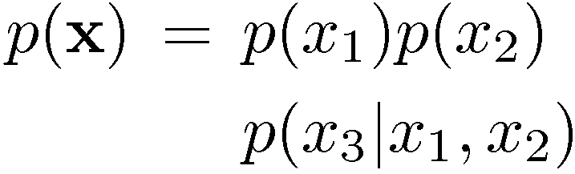
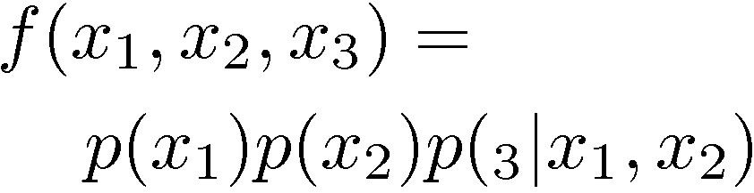
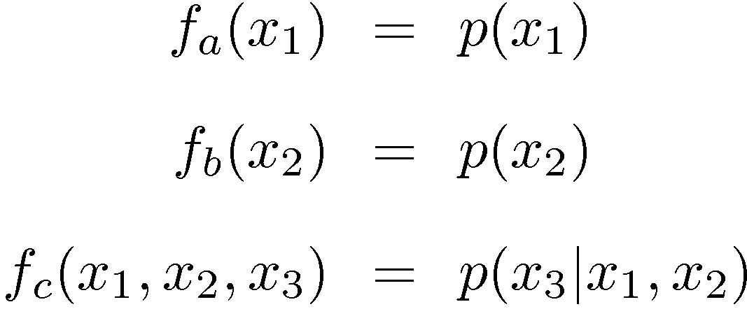
Factor Graphs from Directed Graphs
Chris Bishop

Slide 17
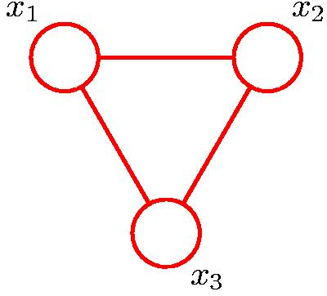
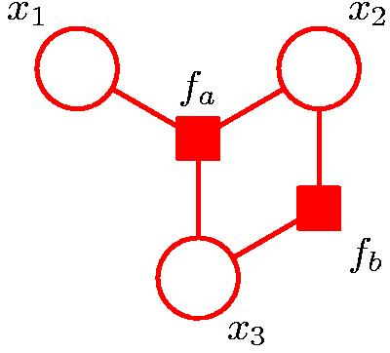

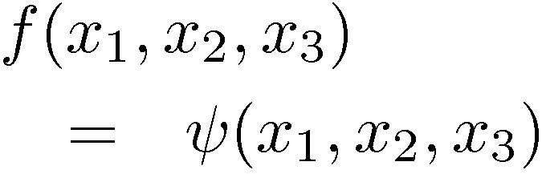
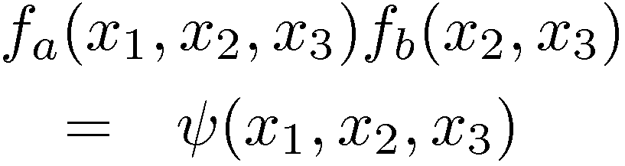
Factor Graphs from Undirected Graphs
Chris Bishop

Slide 18

The Sum-Product Algorithm
Objective:
  to obtain an efficient, exact inference algorithm for finding marginals;
  in situations where several marginals are required, to allow computations to be shared efficiently.
Key idea: Distributive Law
Chris Bishop

Slide 19
The Sum-Product Algorithm
To compute local marginals:
  Pick an arbitrary node as root
  Compute and propagate messages from the leaf nodes to the root, storing received messages at every node.
  Compute and propagate messages from the root to the leaf nodes, storing received messages at every node.
  Compute the product of received messages at each node for which the marginal is required, and normalize if necessary.
Chris Bishop

Slide 20
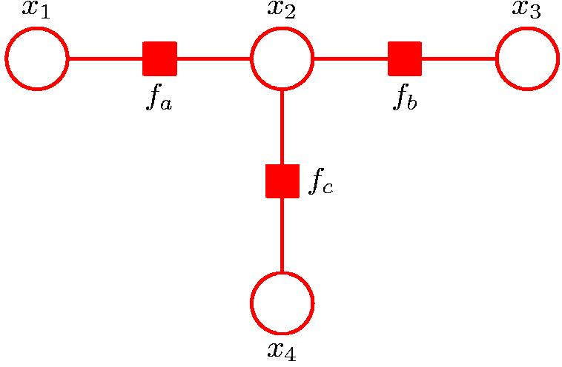
Sum-Product: Example
Chris Bishop

Slide 21
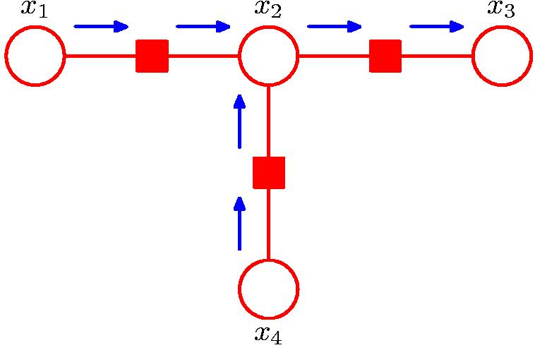
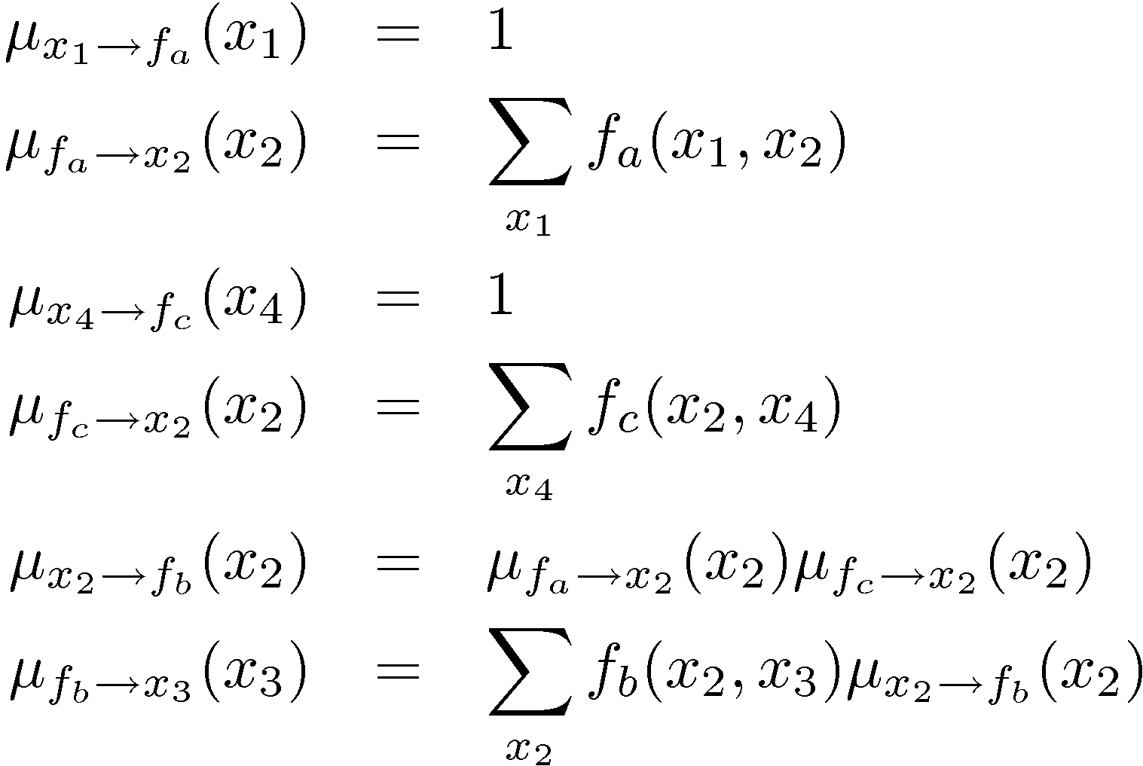
Sum-Product: Example
f_{a}
f_{b}
f_{c}
Chris Bishop

Slide 22
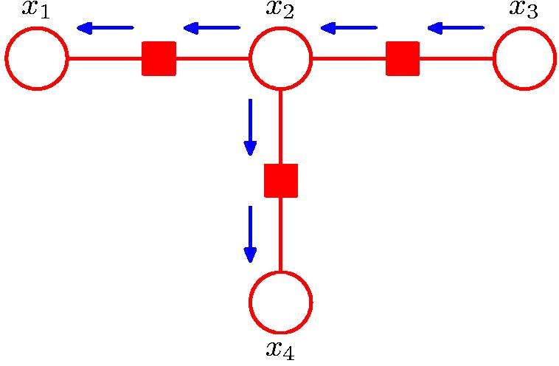
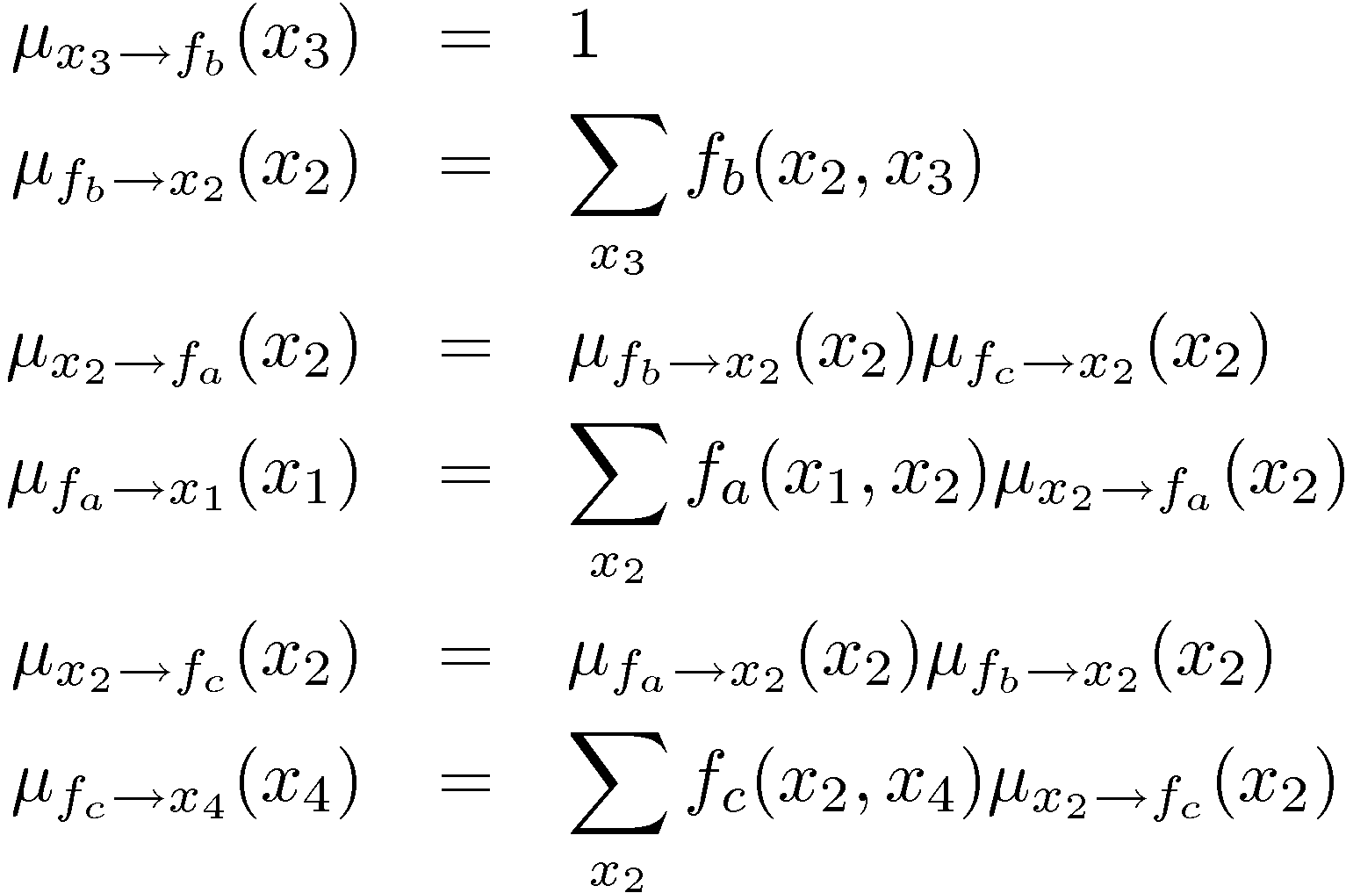
Sum-Product: Example
f_{a}
f_{b}
f_{c}
Chris Bishop

Slide 23
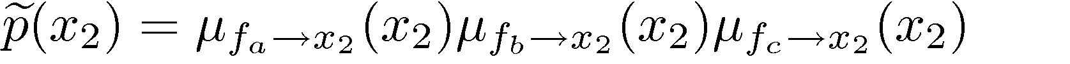
Sum-Product: Example
Chris Bishop

Slide 24
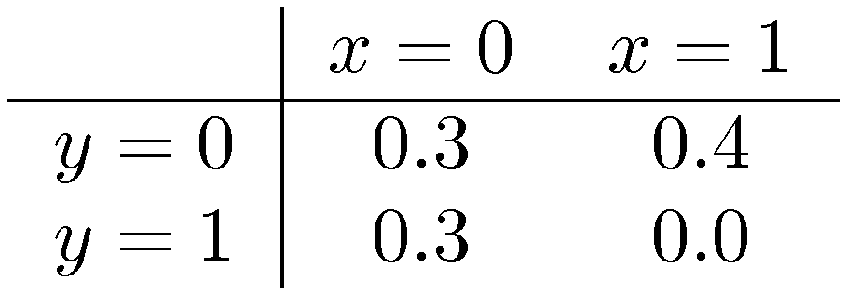
The Max-Sum Algorithm
Objective: an efficient algorithm for finding
  the value x^{max} that maximises p(x);
  the value of p(x^{max}).
In general, maximum marginals ≠ joint maximum.
Chris Bishop

