Slide 1
CS 2750: Machine Learning
Directed Graphical Models
Prof. Adriana Kovashka
University of Pittsburgh
March 28, 2017

Slide 2
Graphical Models
If no assumption of independence is made, must estimate an exponential number of parameters
  No realistic amount of training data is sufficient
If we assume all variables independent, efficient training and inference possible, but assumption too strong
Graphical models use graphs over random variables to specify variable dependencies and allow for less restrictive independence assumptions while limiting the number of parameters that must be estimated
  Bayesian networks: Directed acyclic graphs indicate causal structure
  Markov networks: Undirected graphs capture general dependencies
Adapted from Ray Mooney

Slide 3
Bayesian Networks
Directed Acyclic Graph (DAG)
Nodes are random variables
Edges indicate causal influences
Burglary
Earthquake
Alarm
JohnCalls
MaryCalls
Ray Mooney

Slide 4
Conditional Probability Tables
Each node has a conditional probability table (CPT) that gives the probability of each of its values given every possible combination of values for its parents (conditioning case)
  Roots (sources) of the DAG that have no parents are given prior probabilities
P(B)
.001
Burglary
Earthquake
P(E)
.002
B | E | P(A)
T | T | .95
T | F | .94
F | T | .29
F | F | .001
Alarm
A | P(J)
T | .90
F | .05
A | P(M)
T | .70
F | .01
JohnCalls
MaryCalls
Ray Mooney

Slide 5
CPT Comments
Probability of false not given since rows must add to 1
Example requires 10 parameters rather than 2⁵–1=31 for specifying the full joint distribution
Number of parameters in the CPT for a node is exponential in the number of parents
Ray Mooney

Slide 6
Bayes Net Inference
Given known values for some evidence variables, determine the posterior probability of some query variables
Example: Given that John calls, what is the probability that there is a Burglary?
???
Burglary
Earthquake
John calls 90% of the time there
is an Alarm and the Alarm detects
94% of Burglaries so people
generally think it should be fairly high.
However, this ignores the prior
probability of John calling.
Alarm
JohnCalls
MaryCalls
Ray Mooney

Slide 7
Bayes Net Inference
Example: Given that John calls, what is the probability that there is a Burglary?
???
P(B)
.001
John also calls 5% of the time when there
is no Alarm. So over 1,000 days we
expect 1 Burglary and John will probably call. However, he will also call with a false report 50 times on average. So the call is about 50 times more likely a false report: P(Burglary | JohnCalls) ≈ 0.02
Burglary
Earthquake
Alarm
JohnCalls
MaryCalls
A | P(J)
T | .90
F | .05
Ray Mooney

Slide 8
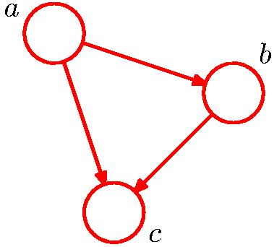
Bayesian Networks
No independence encoded
Chris Bishop

Slide 9
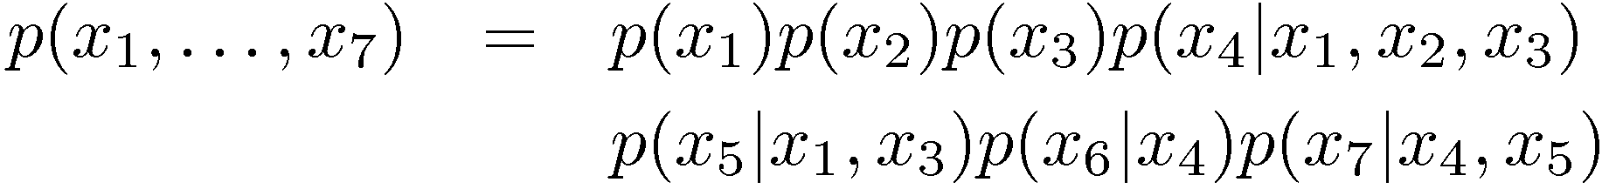
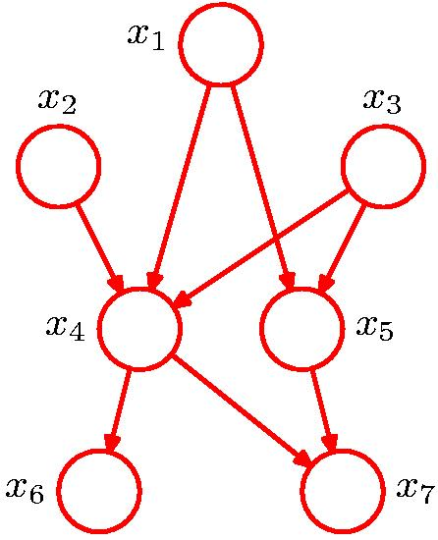
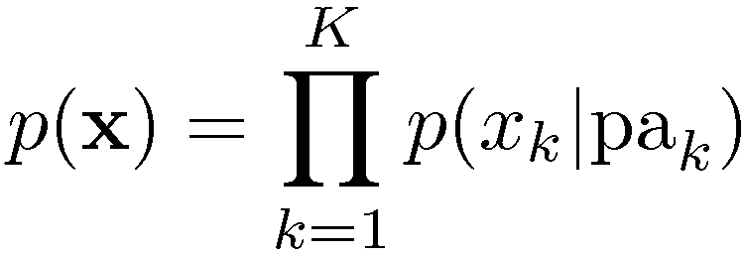
Bayesian Networks
More interesting: Some independences encoded
General Factorization
Chris Bishop

Slide 10

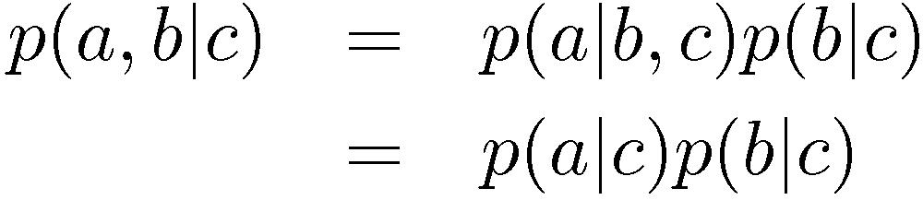

Conditional Independence
a is independent of b given c
Equivalently
Notation
Chris Bishop

Slide 11
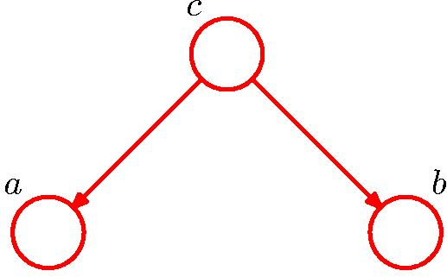
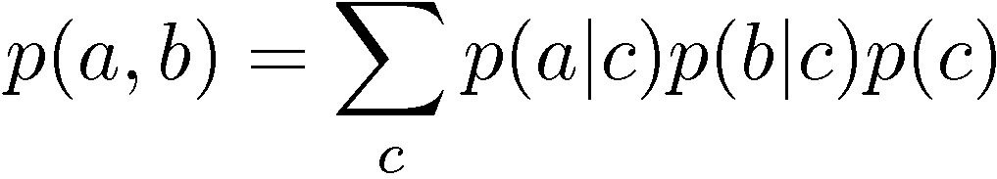

Conditional Independence: Example 1
Node c is “tail to tail” for path from a to b:
No independence of a and b follows from this path
Chris Bishop

Slide 12
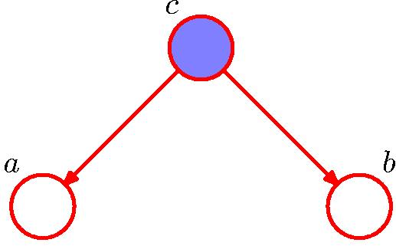
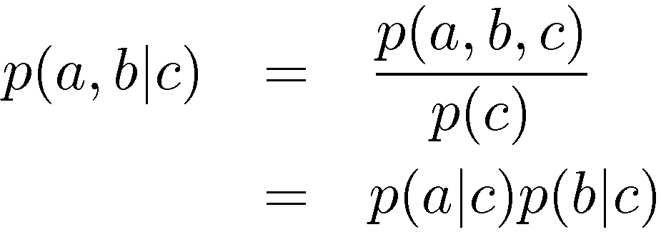
Conditional Independence: Example 1
Node c is “tail to tail” for path from a to b:
Observing c blocks the path thus making a and b conditionally independent
Chris Bishop

Slide 13
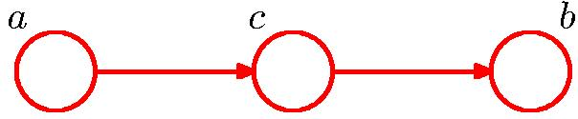
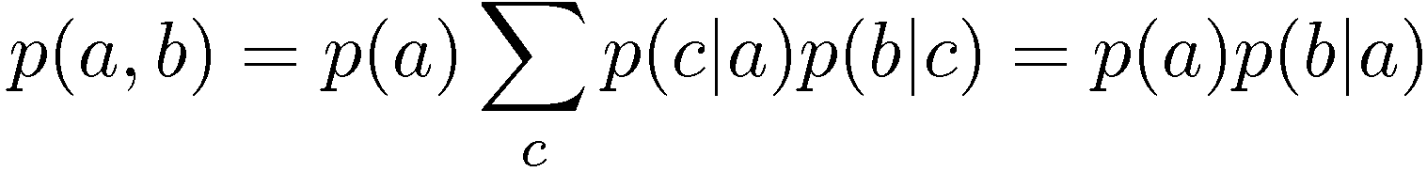
Conditional Independence: Example 2
Σ_{c} p(c|a) p(b|c) =
Σ_{c} p(c|a) p(b|c, a) = // next slide
Σ_{c} p(b, c|a) =
p(b|a)
Node c is “head to tail” for path from a to b:
No independence of a and b follows from this path
Chris Bishop

Slide 14
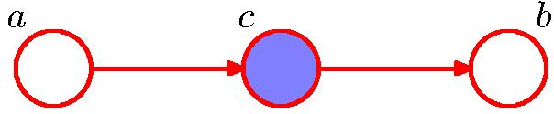
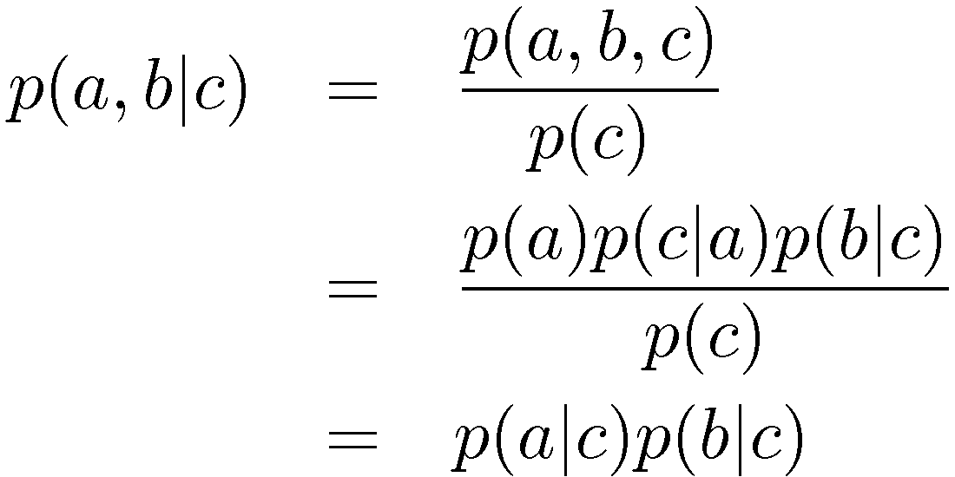
Conditional Independence: Example 2
Node c is “head to tail” for path from a to b:
Observing c blocks the path thus making a and b conditionally independent
Chris Bishop

Slide 15
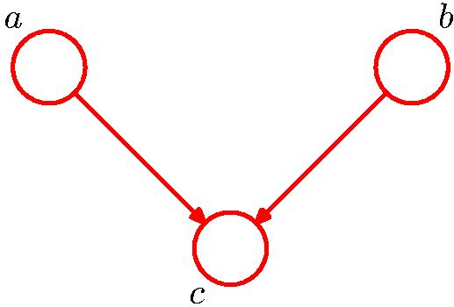


Conditional Independence: Example 3
Note: this is the opposite of Example 1, with c unobserved.
Node c is “head to head” for path from a to b:
Unobserved c blocks the path thus making a and b independent
Chris Bishop

Slide 16
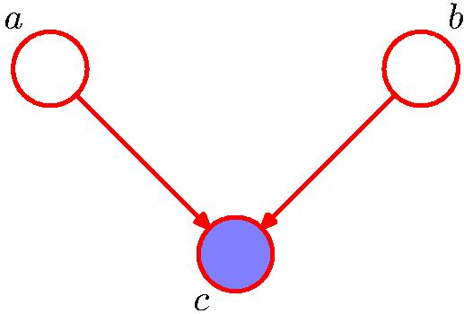
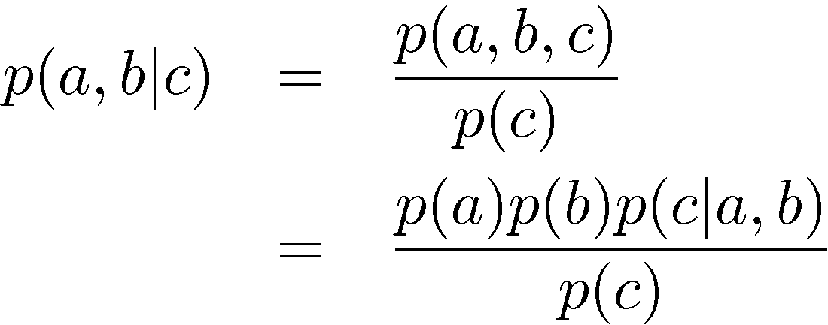

Conditional Independence: Example 3
Note: this is the opposite of Example 1, with c observed.
Node c is “head to head” for path from a to b:
Observing c unblocks the path thus making a and b conditionally dependent
Chris Bishop

Slide 17
Bayesian Networks
More interesting: Some independences encoded
General Factorization
Chris Bishop

Slide 18
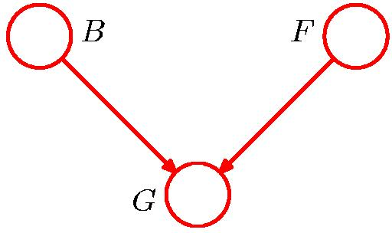
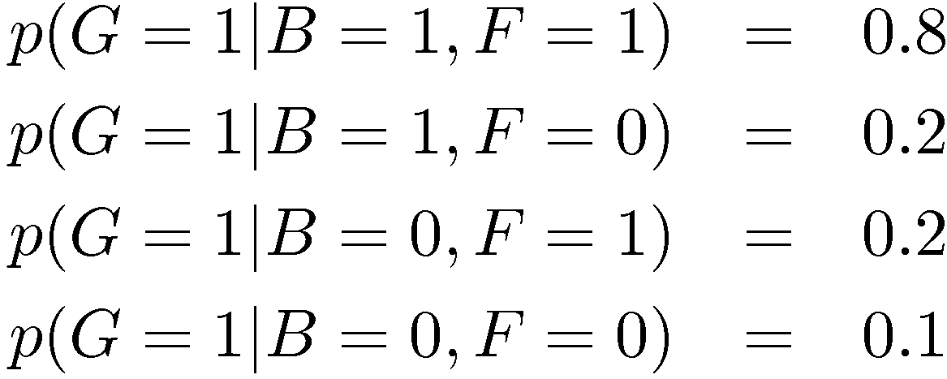
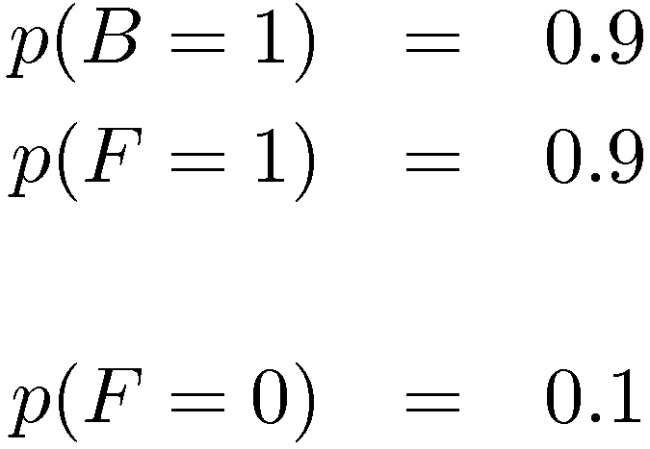
“Am I out of fuel?”
B = Battery (0=flat, 1=fully charged)
F = Fuel Tank (0=empty, 1=full)
G = Fuel Gauge Reading
(0=empty, 1=full)
and hence
Chris Bishop

Slide 19
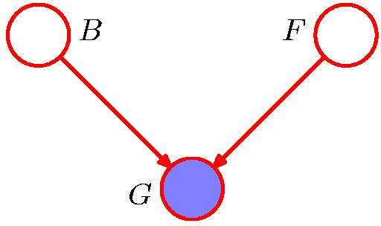
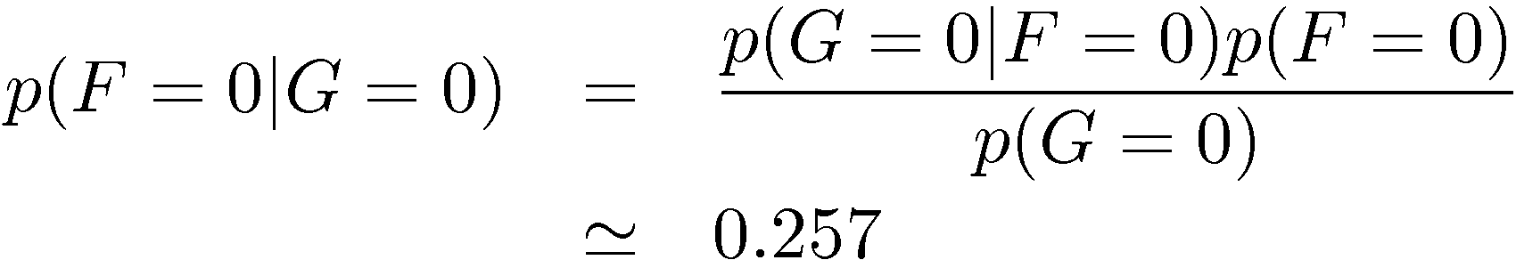
“Am I out of fuel?”
Probability of an empty tank increased by observing G = 0.
Chris Bishop

Slide 20
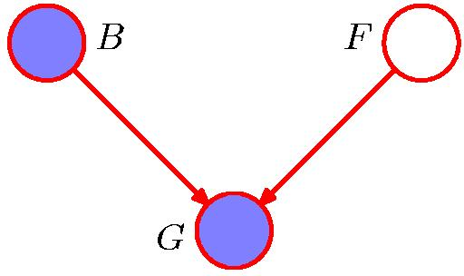
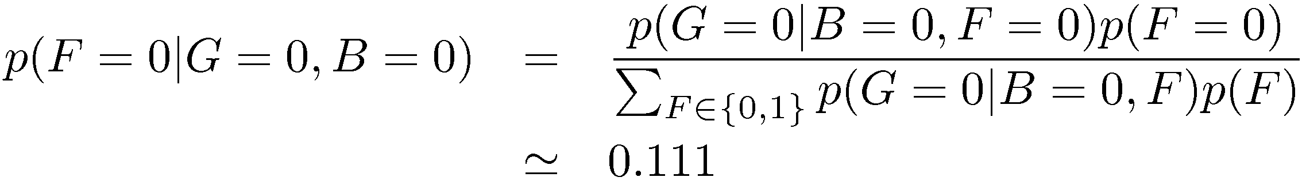
“Am I out of fuel?”
Probability of an empty tank reduced by observing B = 0.
This referred to as “explaining away”.
Chris Bishop

Slide 21

D-separation
A, B, and C are non-intersecting subsets of nodes in a directed graph.
A path from A to B is blocked if it contains a node such that either
  the arrows on the path meet either head-to-tail or tail-to-tail at the node, and the node is in the set C, or
  the arrows meet head-to-head at the node, and neither the node, nor any of its descendants, are in the set C.
If all paths from A to B are blocked, A is said to be d-separated from B by C.
If A is d-separated from B by C, the joint distribution over all variables in the graph satisfies .
Chris Bishop

Slide 22
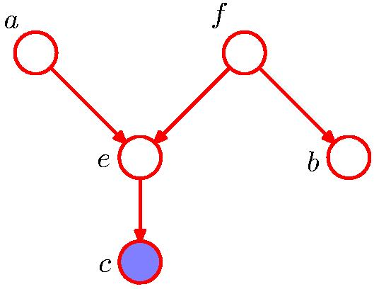
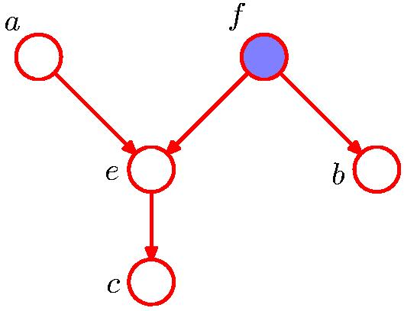

D-separation: Example
Chris Bishop

Slide 23
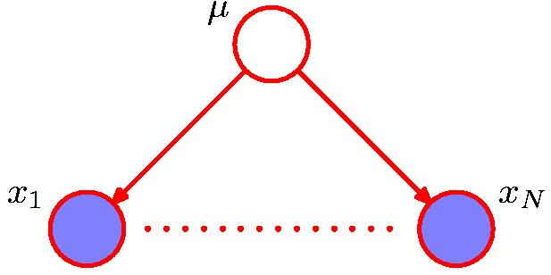
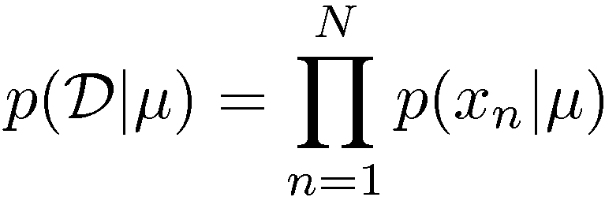
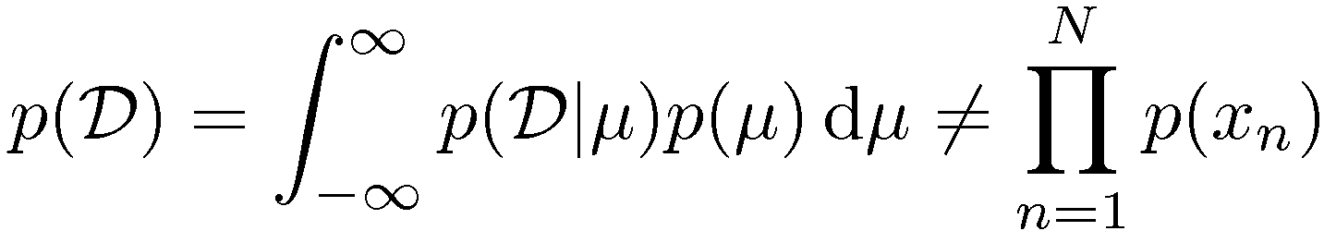
D-separation: I.I.D. Data
The x_{i}’s conditionally independent.
Are the x_{i}’s marginally independent?
Chris Bishop

Slide 24
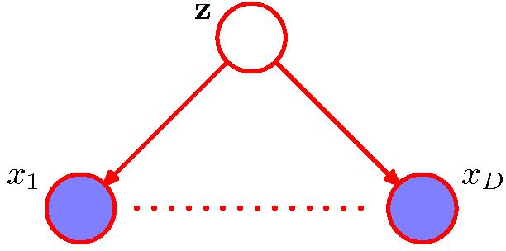
Naïve Bayes
Conditioned on the class z,
the distributions of the input variables x₁, …, x_{D} are independent.
Are the x₁, …, x_{D} marginally independent?
Chris Bishop

Slide 25
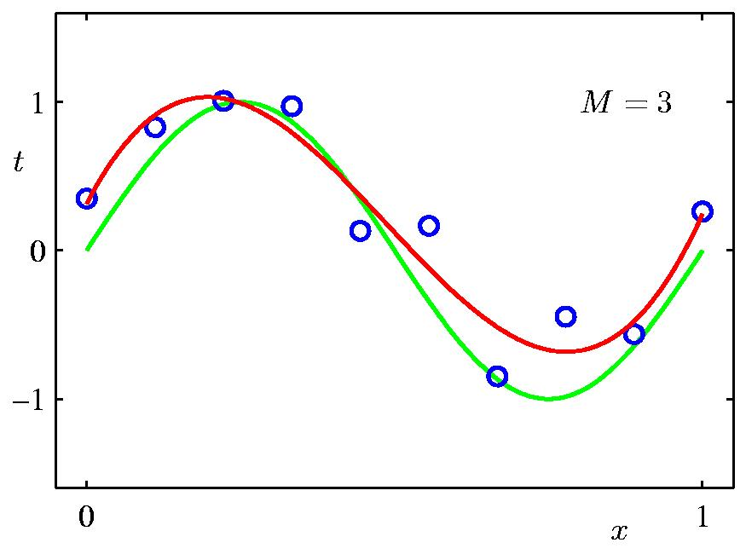
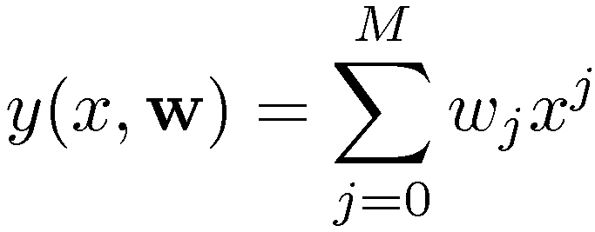
Bayesian Curve Fitting
Polynomial
Chris Bishop

Slide 26
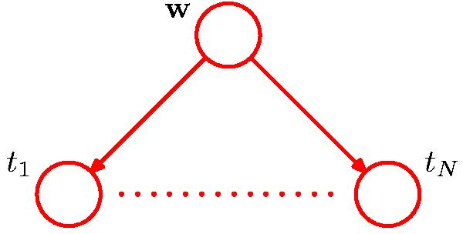
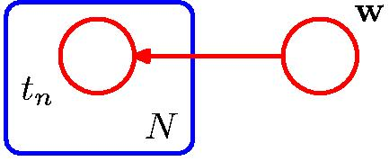
Bayesian Curve Fitting
Plate
Chris Bishop

Slide 27
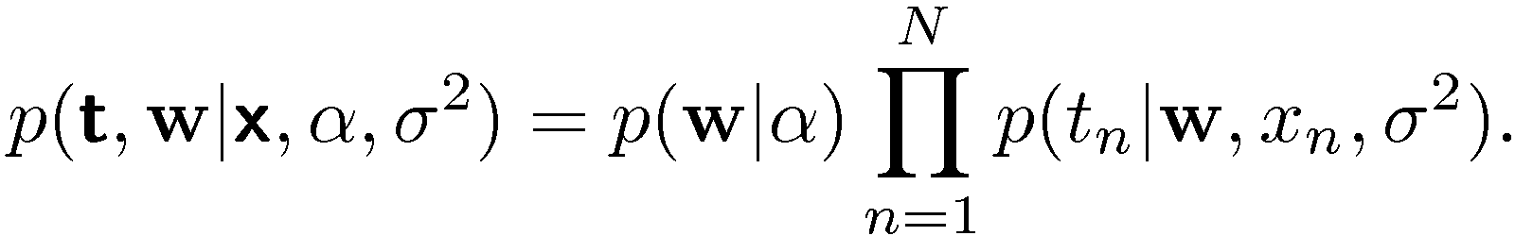
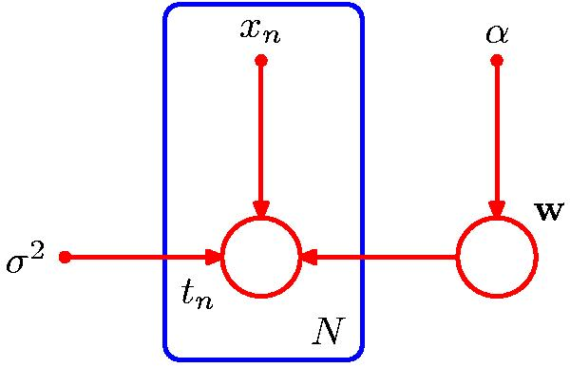
Bayesian Curve Fitting
Input variables and explicit hyperparameters
Chris Bishop

Slide 28
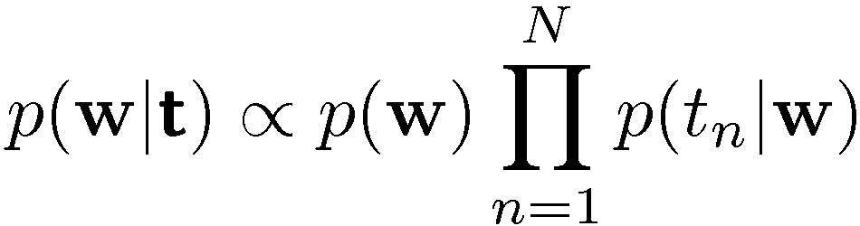
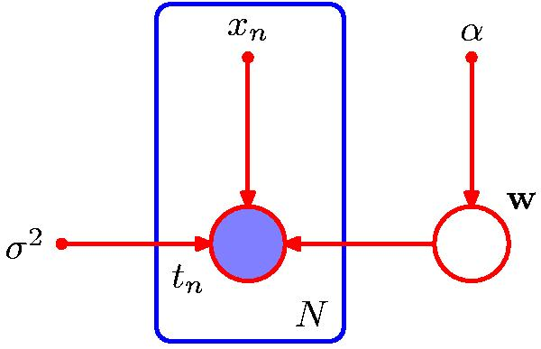
Bayesian Curve Fitting —Learning
Condition on data
Chris Bishop

Slide 29
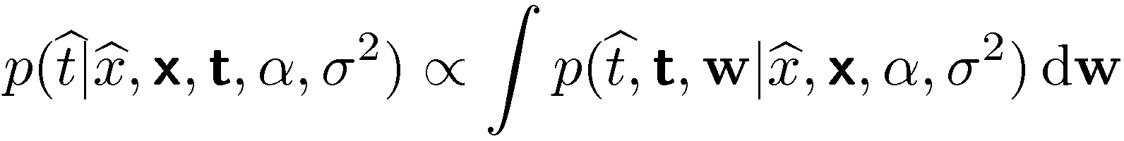
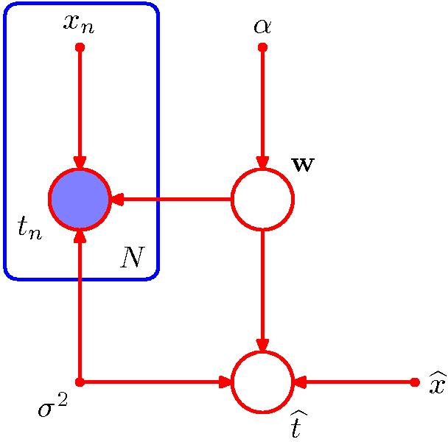
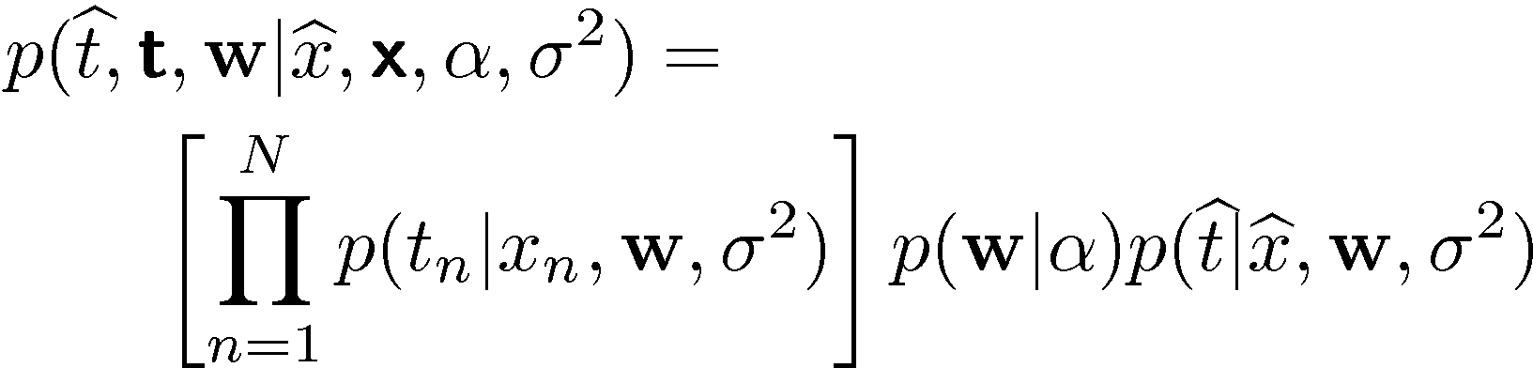
Bayesian Curve Fitting —Prediction
Predictive distribution:
where
Chris Bishop

Slide 30
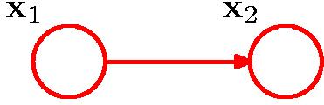
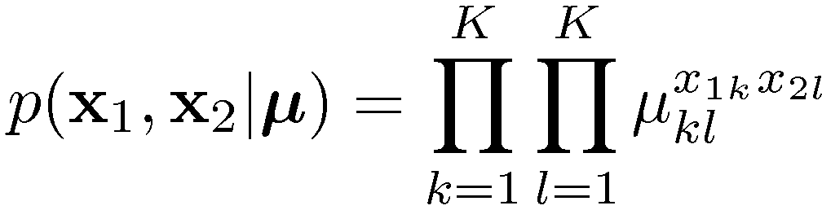


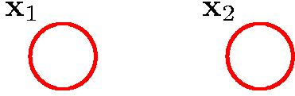
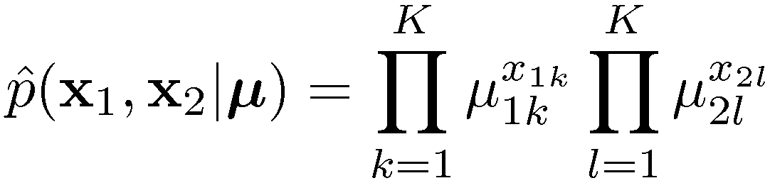
Discrete Variables
General joint distribution: K ² { 1 parameters
Independent joint distribution: 2(K { 1) parameters
Chris Bishop

Slide 31
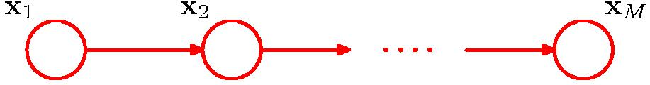
Discrete Variables
General joint distribution over M variables:
K^{M} { 1 parameters
M -node Markov chain: K { 1 + (M { 1) K(K { 1) parameters
Chris Bishop

Slide 32
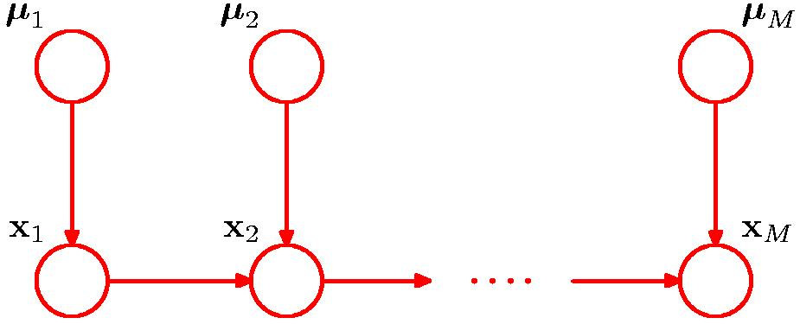
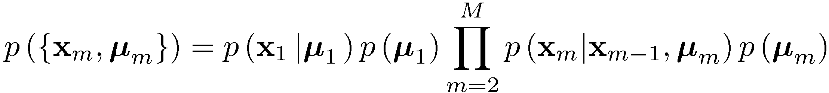

Discrete Variables: Bayesian Parameters
Chris Bishop

Slide 33
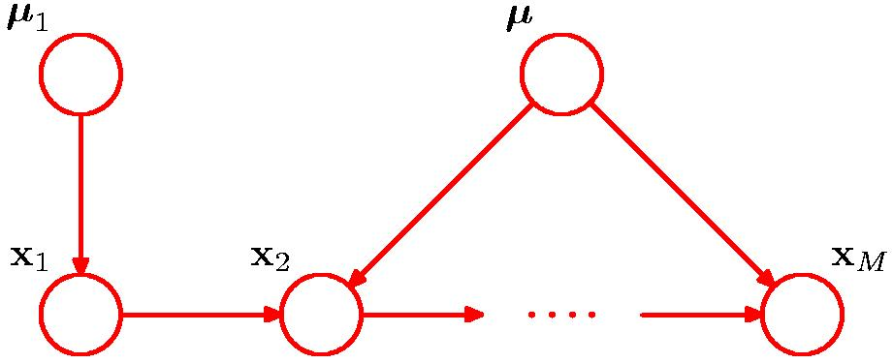
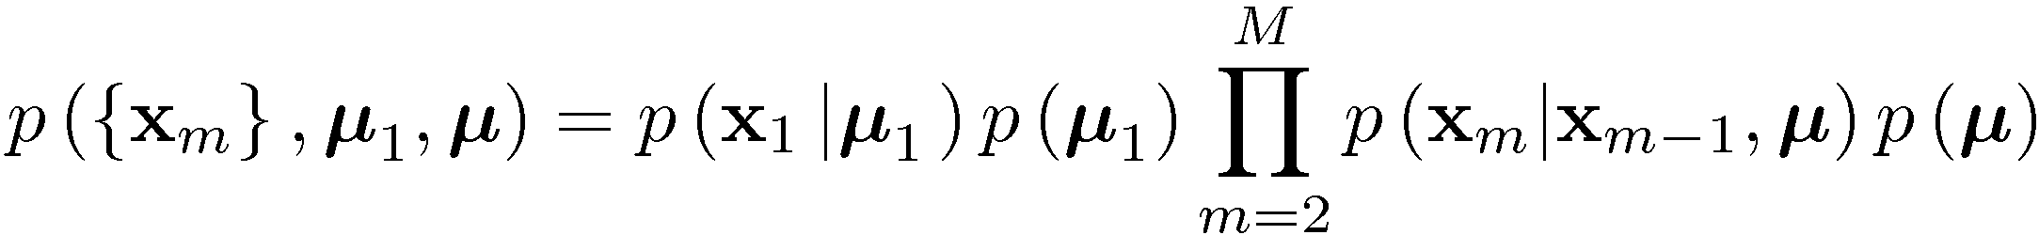
Discrete Variables: Bayesian Parameters
Shared prior
Chris Bishop

Slide 34
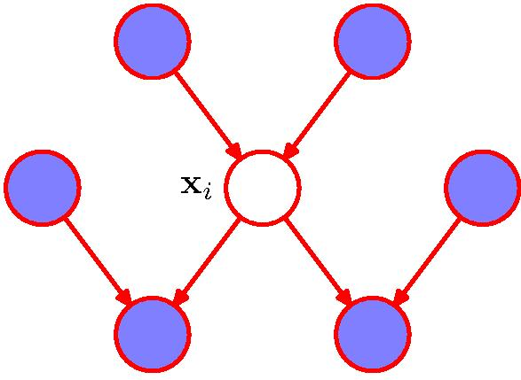

The Markov Blanket
Factors independent of x_{i} cancel between numerator and denominator.
The parents, children and co-parents of x_{i} form its Markov blanket, the minimal set of nodes that isolate x_{i} from the rest of the graph.
Chris Bishop

