Slide 1
CS 2750: Machine Learning
Probability Review
Density Estimation
Prof. Adriana Kovashka
University of Pittsburgh
March 23, 2017

Slide 2
Plan for this lecture
Probability basics (review)
Some terms from probabilistic learning
Some common probability distributions

Slide 3
Machine Learning: Procedural View
Training Stage:
  Raw Data → x (Extract features)
  Training Data { (x,y) } → f (Learn model)
Testing Stage
  Raw Data → x (Extract features)
  Test Data x → f(x) (Apply learned model, Evaluate error)
Adapted from Dhruv Batra

Slide 4
Statistical Estimation View
Probabilities to rescue:
  x and y are random variables
  D = (x₁,y₁), (x₂,y₂), …, (x_{N},y_{N}) ~ P(X,Y)
IID: Independent Identically Distributed
  Both training & testing data sampled IID from P(X,Y)
  Learn on training set
  Have some hope of generalizing to test set
Dhruv Batra

Slide 5
Probability
A is non-deterministic event
  Can think of A as a Boolean-valued variable
Examples
  A = your next patient has cancer
  A = Andy Murray wins US Open 2017
Dhruv Batra

Slide 6
Interpreting Probabilities
What does P(A) mean?
Frequentist View
  limit N→∞ #(A is true)/N
  frequency of a repeating non-deterministic event
Bayesian View
  P(A) is your “belief” about A
Adapted from Dhruv Batra

Slide 7
Axioms of Probability
0<= P(A) <= 1
P(false) = 0
P(true) = 1
P(A v B) = P(A) + P(B) – P(A ^ B)
Dhruv Batra, Andrew Moore

Slide 8
Axioms of Probability
0<= P(A) <= 1
P(false) = 0
P(true) = 1
P(A v B) = P(A) + P(B) – P(A ^ B)
’
Dhruv Batra, Andrew Moore

Slide 9
Axioms of Probability
0<= P(A) <= 1
P(false) = 0
P(true) = 1
P(A v B) = P(A) + P(B) – P(A ^ B)
’
Dhruv Batra, Andrew Moore

Slide 10
Axioms of Probability
0<= P(A) <= 1
P(false) = 0
P(true) = 1
P(A v B) = P(A) + P(B) – P(A ^ B)
Dhruv Batra, Andrew Moore

Slide 11
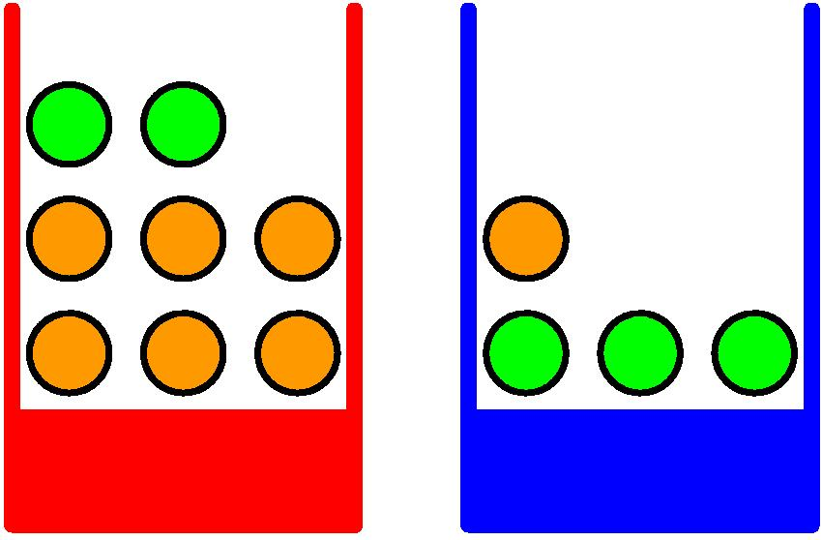
Probabilities: Example Use
Apples and Oranges
Chris Bishop

Slide 12
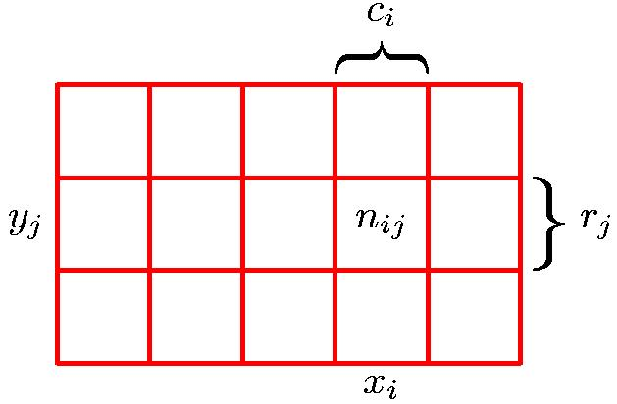
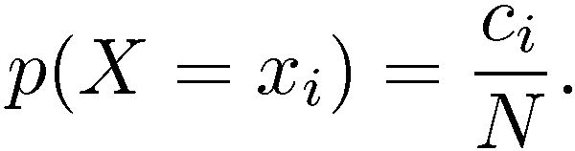
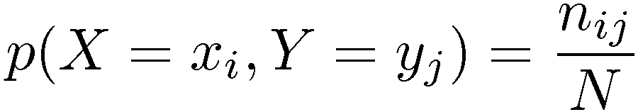
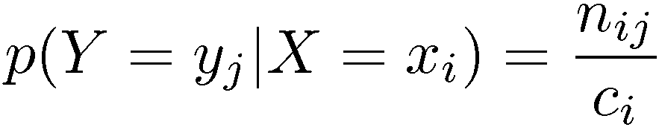
Marginal, Joint, Conditional
Marginal Probability
Conditional Probability
Joint Probability
Chris Bishop

Slide 13
Joint Probability
P(X₁,…,X_{n}) gives the probability of every combination of values (an n-dimensional array with v^{n} values if all variables are discrete with v values, all v^{n} values must sum to 1):
The probability of all possible conjunctions (assignments of values to some subset of variables) can be calculated by summing the appropriate subset of values from the joint distribution.
Therefore, all conditional probabilities can also be calculated.
positive
negative
 | circle | square
red | 0.20 | 0.02
blue | 0.02 | 0.01
 | circle | square
red | 0.05 | 0.30
blue | 0.20 | 0.20
Adapted from Ray Mooney

Slide 14
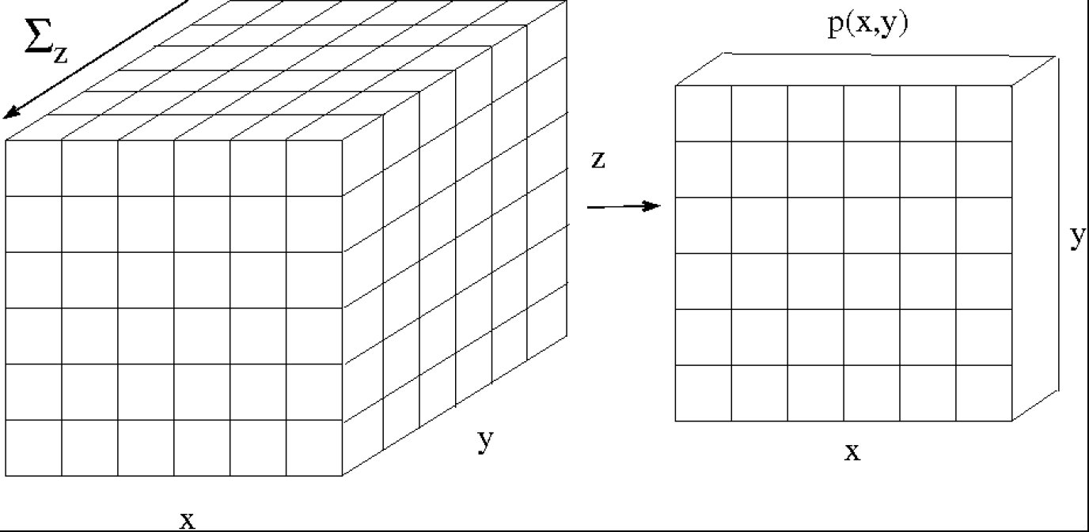
Marginal Probability
y
z
Dhruv Batra, Erik Suddherth

Slide 15
Conditional Probability
P(Y=y | X=x): What do you believe about Y=y, if I tell you X=x?
P(Andy Murray wins US Open 2017)?
What if I tell you:
  He is currently ranked #1
  He has won the US Open once
Dhruv Batra

Slide 16
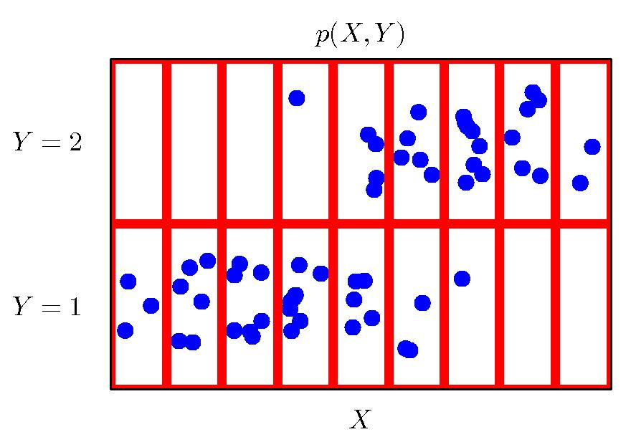
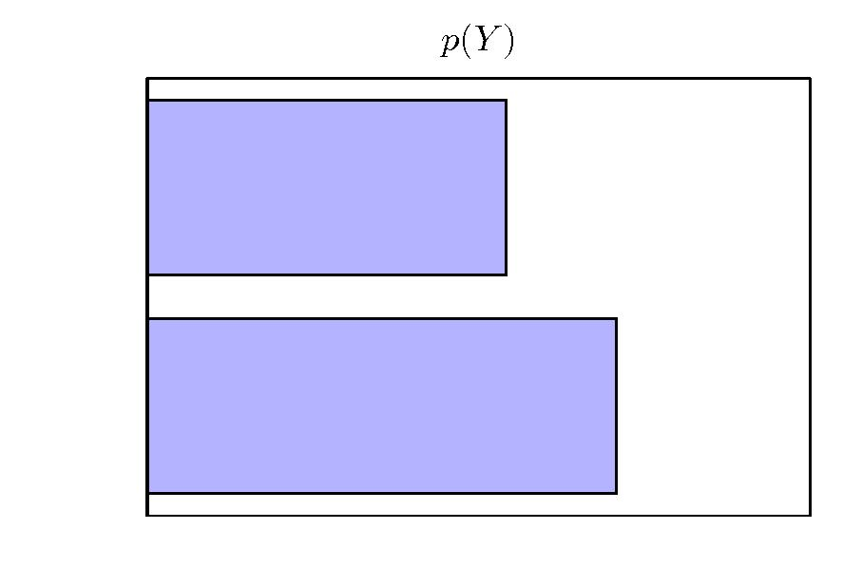
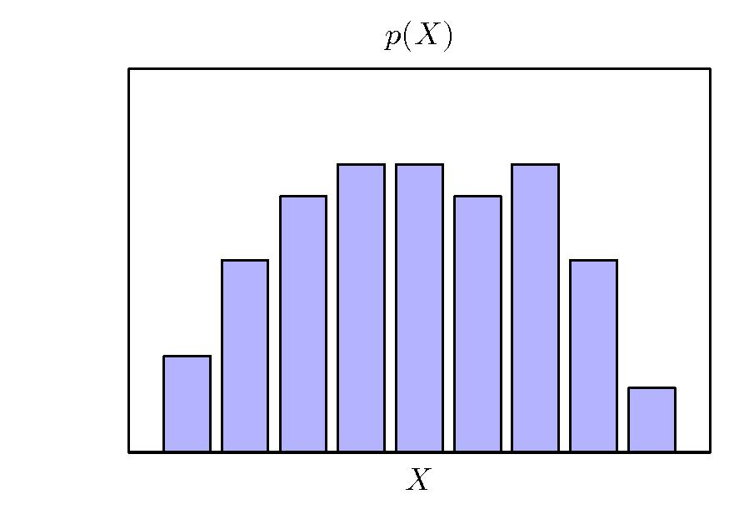
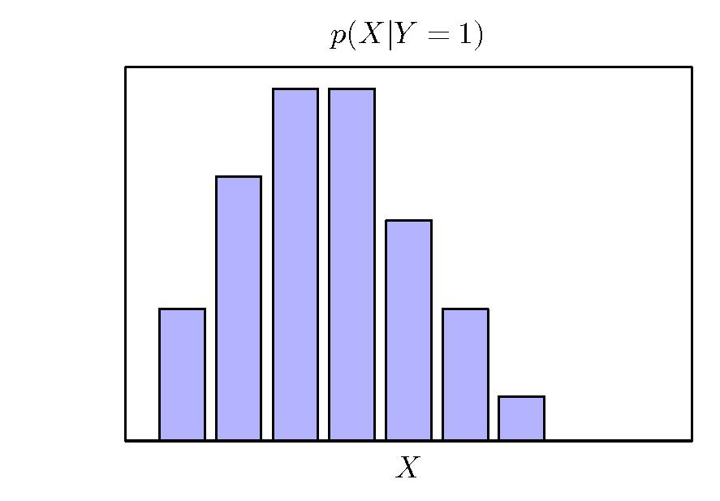
Conditional Probability
Chris Bishop

Slide 17
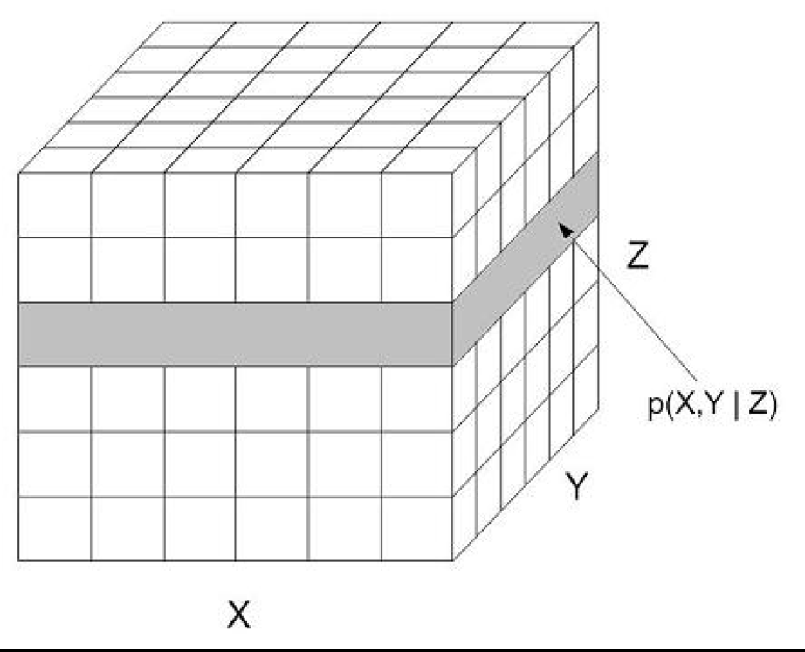
Conditional Probability
Dhruv Batra, Erik Suddherth

Slide 18
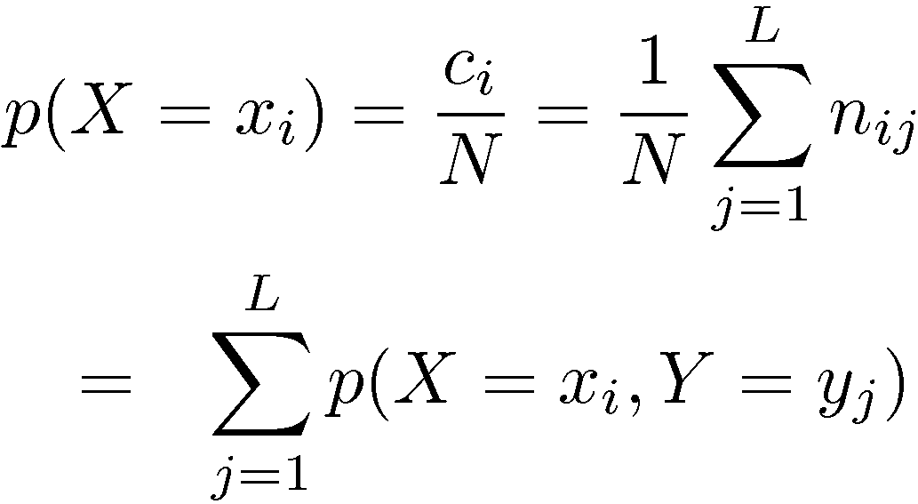
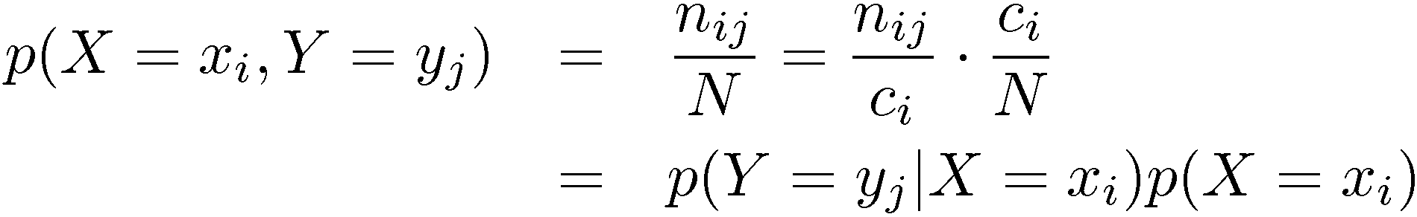
Sum and Product Rules
Sum Rule
Product Rule
Chris Bishop

Slide 19

Chain Rule
Generalizes the product rule:
Example:
Equations from Wikipedia

Slide 20
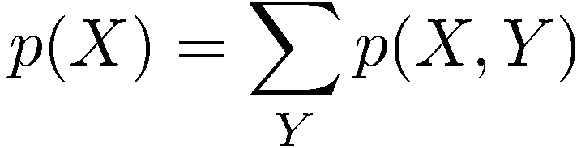

The Rules of Probability
Sum Rule
Product Rule
Chris Bishop

Slide 21
Independence
A and B are independent iff:
Therefore, if A and B are independent:
These two constraints are logically equivalent
Ray Mooney

Slide 22
Independence
Marginal: P satisfies (X ⊥ Y) if and only if
  P(X=x,Y=y) = P(X=x) P(Y=y), ∀x∈Val(X), y∈Val(Y)
Conditional: P satisfies (X ⊥ Y | Z) if and only if
  P(X,Y|Z) = P(X|Z) P(Y|Z), ∀x∈Val(X), y∈Val(Y), z∈Val(Z)
Dhruv Batra

Slide 23
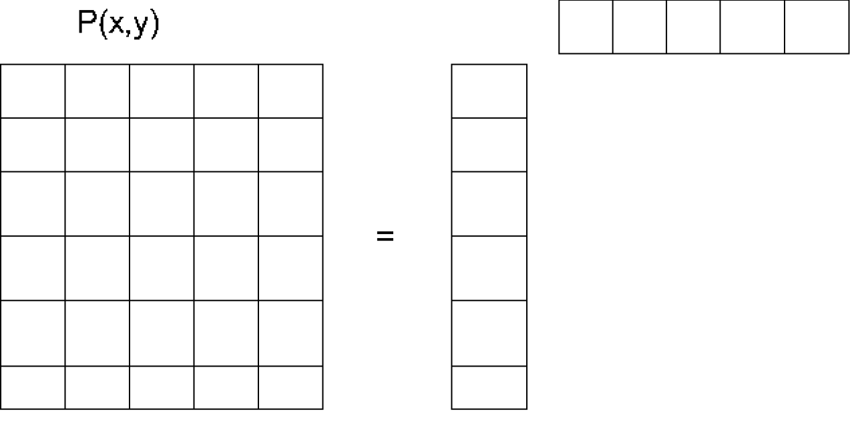
Independence
Dhruv Batra, Erik Suddherth

Slide 24
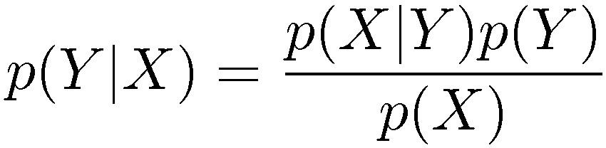
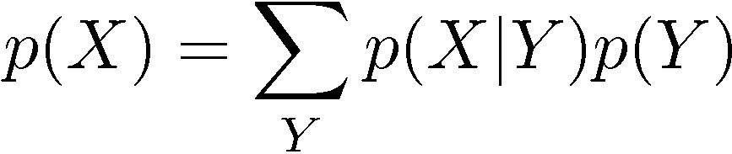
Bayes’ Theorem
posterior ∝ likelihood × prior
Chris Bishop

Slide 25
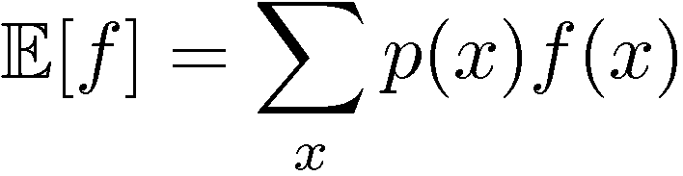
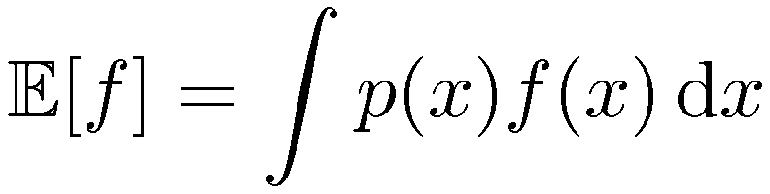
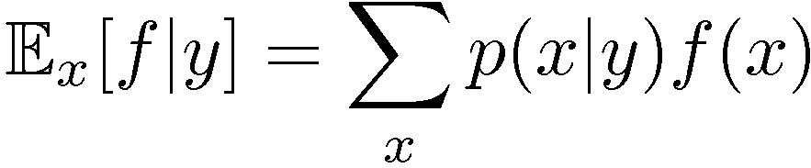
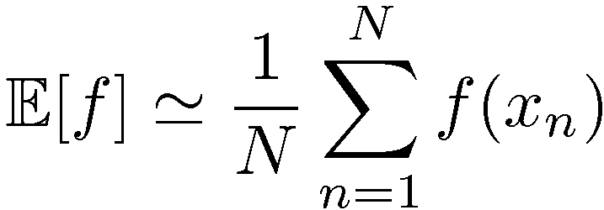
Expectations
Conditional Expectation
(discrete)
Approximate Expectation
(discrete and continuous)
Chris Bishop

Slide 26
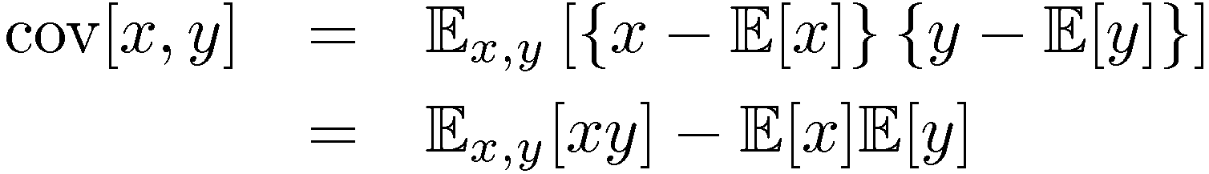
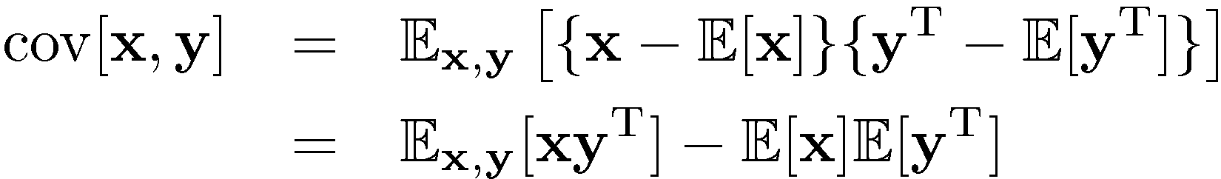
Variances and Covariances
Chris Bishop

Slide 27
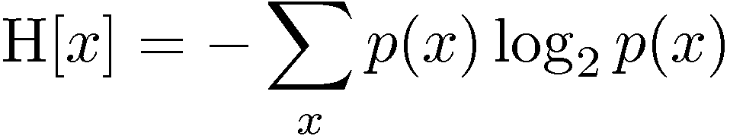
Entropy
Important quantity in
  coding theory
  statistical physics
  machine learning
Chris Bishop

Slide 28
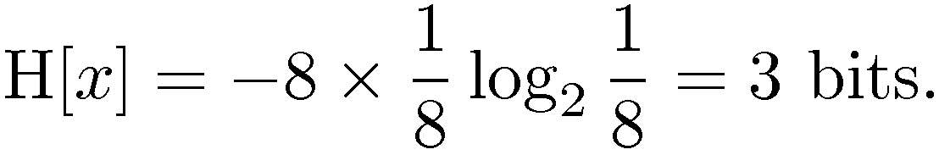
Entropy
Coding theory: x discrete with 8 possible states; how many bits to transmit the state of x?
All states equally likely
Chris Bishop

Slide 29
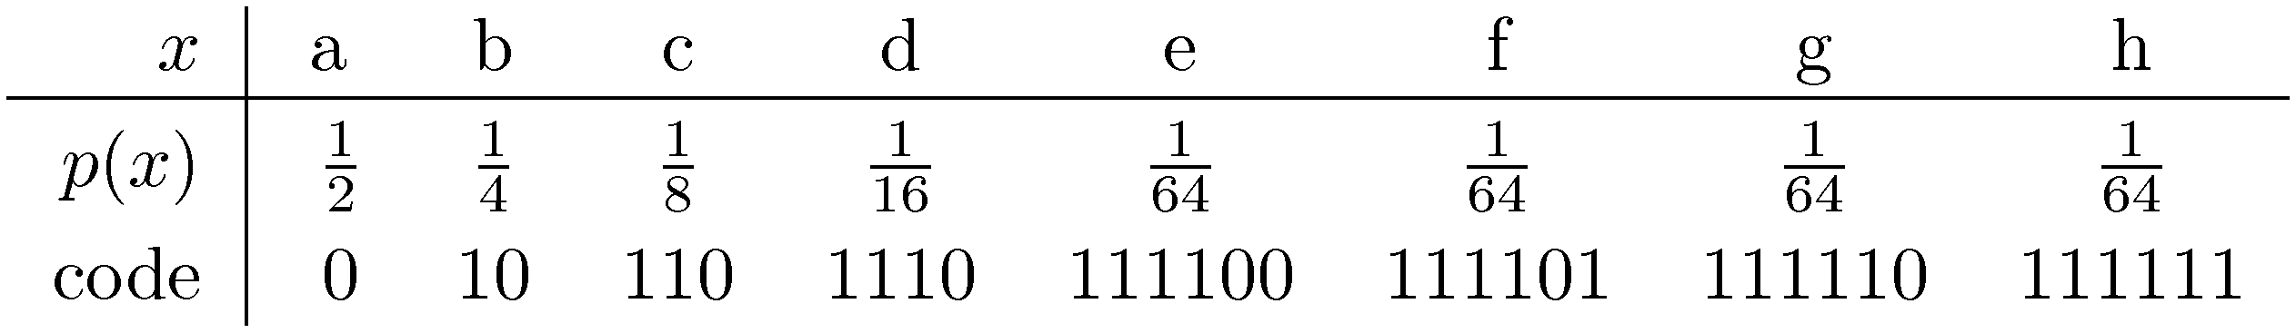
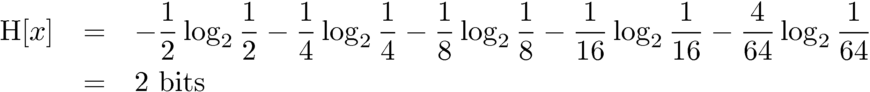
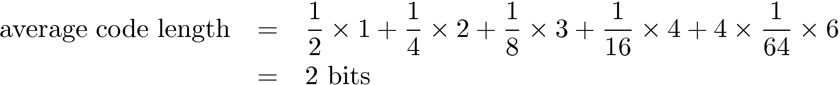
Entropy
Chris Bishop

Slide 30
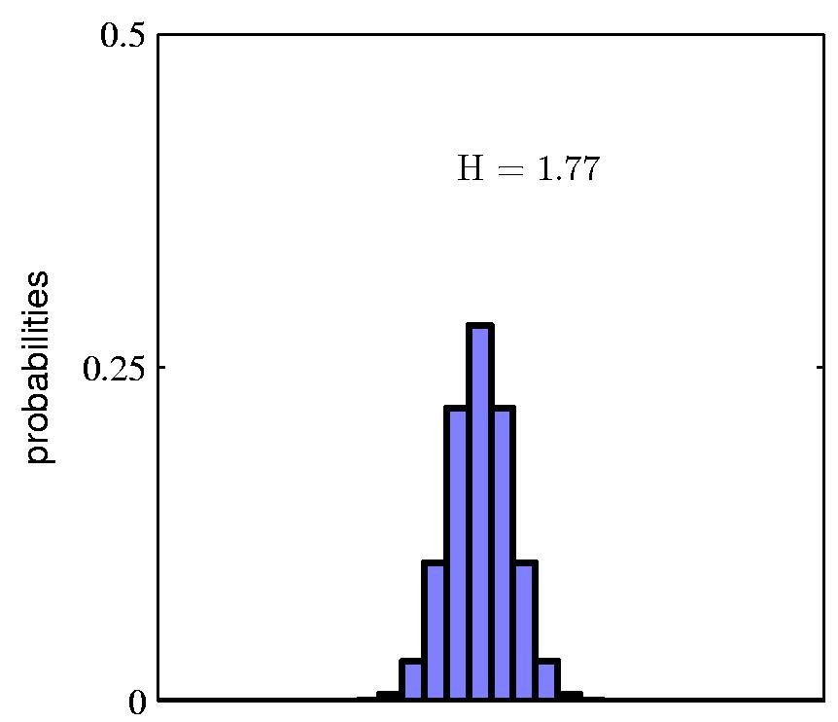
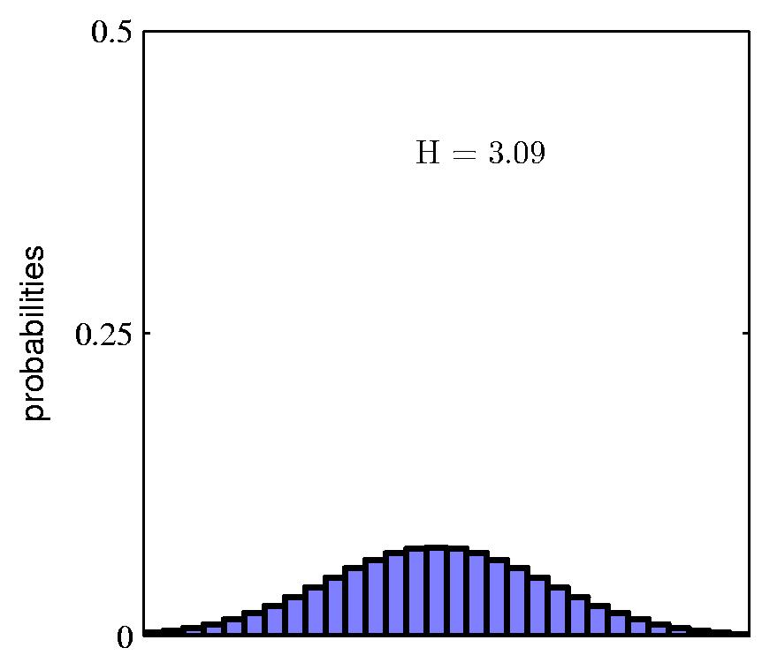
Entropy
Chris Bishop

Slide 31
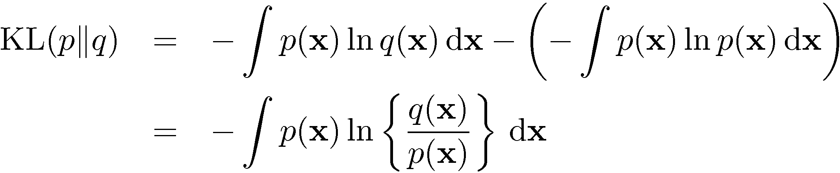
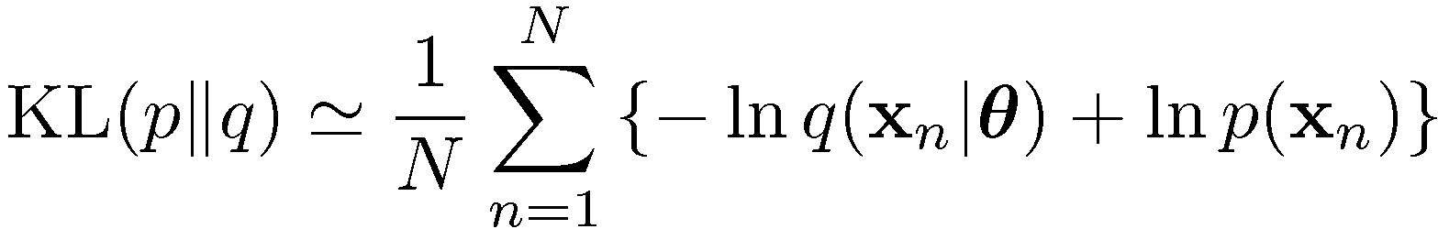


The Kullback-Leibler Divergence
Chris Bishop

Slide 32
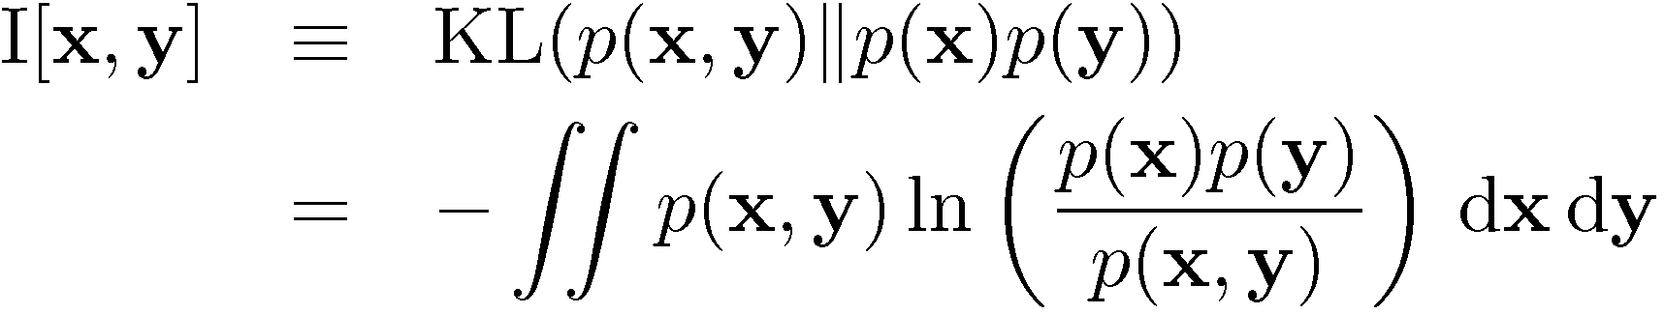
Mutual Information
Chris Bishop

Slide 33
Likelihood / Prior / Posterior
A hypothesis is denoted as h; it is one member of the hypothesis space H
A set of training examples is denoted as D, a collection of (x, y) pairs for training
Pr(h) – the prior probability of the hypothesis – without observing any training data, what is the probability that h is the target function we want?
Rebecca Hwa

Slide 34
Likelihood / Prior / Posterior
Pr(D) – the prior probability of the observed data – chance of getting the particular set of training examples D
Pr(h|D) – the posterior probability of h – what is the probability that h is the target given that we have observed D?
Pr(D|h) – the probability of getting D if h were true (a.k.a. likelihood of the data)
Pr(h|D) = Pr(D|h)Pr(h)/Pr(D)
Rebecca Hwa

Slide 35
MAP vs MLE Estimation
Maximum-a-posteriori (MAP) estimation:
  h_{MAP} = argmax_{h} Pr(h|D)
  = argmax_{h} Pr(D|h)Pr(h)/Pr(D)
  = argmax_{h} Pr(D|h)Pr(h)
Maximum likelihood estimation (MLE):
  h_{ML} = argmax Pr(D|h)
Rebecca Hwa

Slide 36
Plan for this lecture
Probability basics (review)
Some terms from probabilistic learning
Some common probability distributions

Slide 37
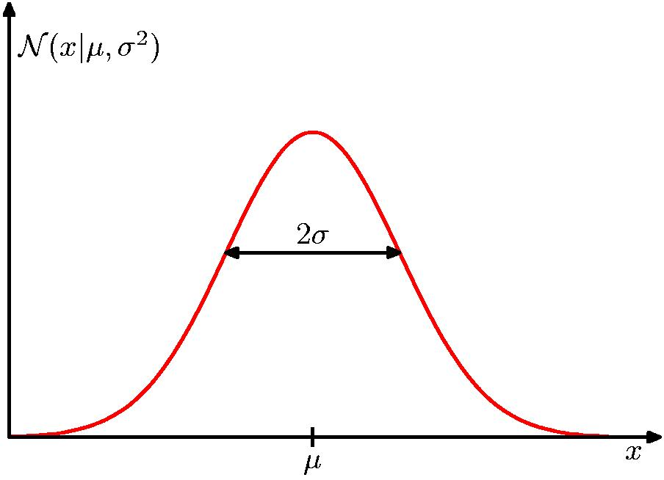
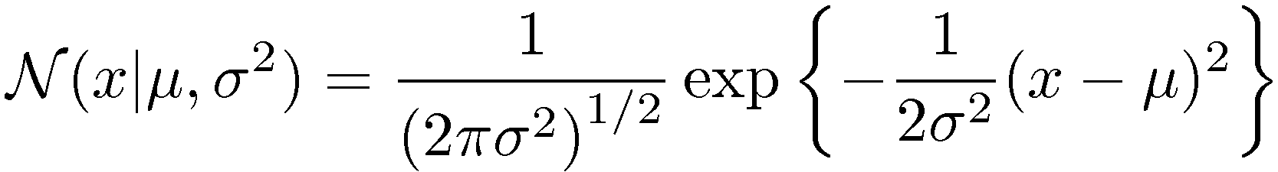
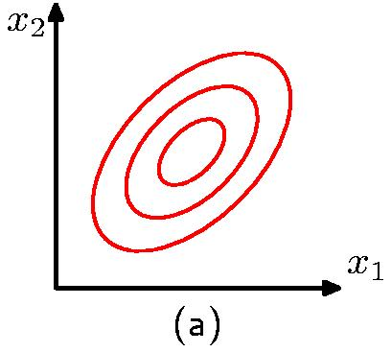
The Gaussian Distribution
Chris Bishop

Slide 38
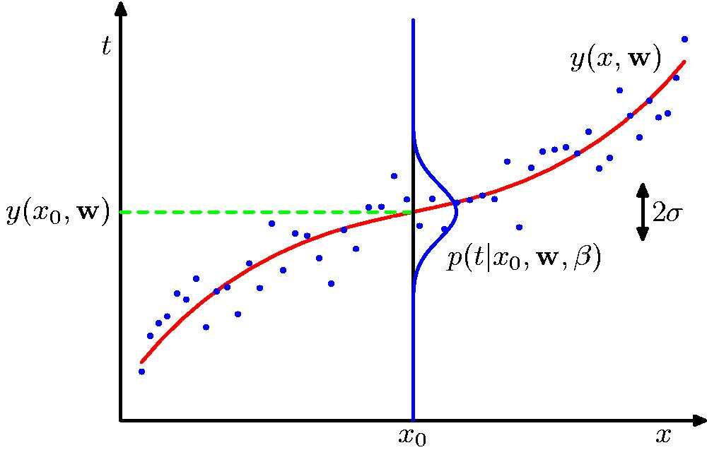
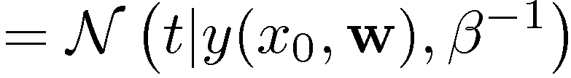
Curve Fitting Re-visited
Chris Bishop

Slide 39
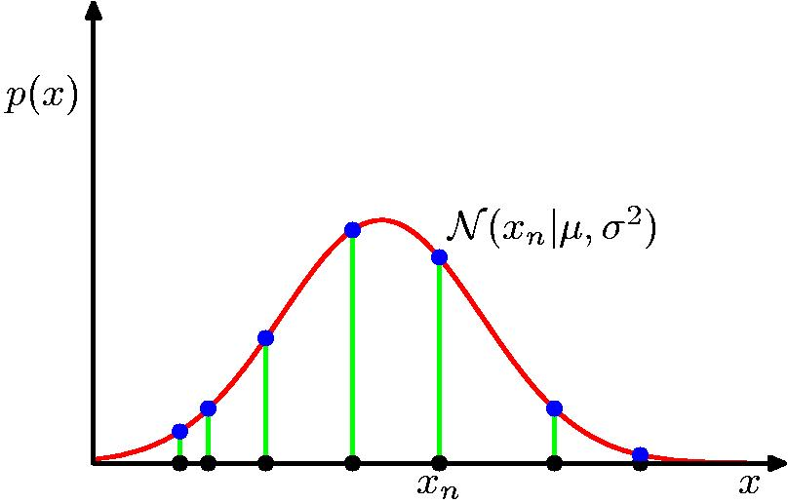
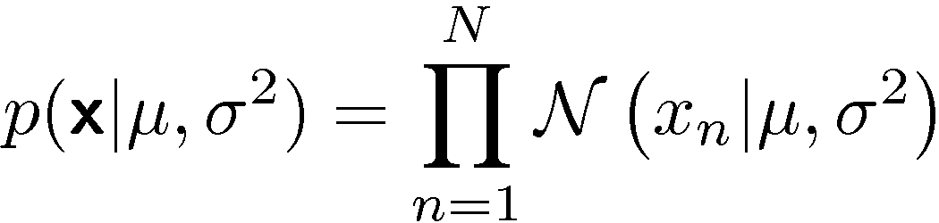
Gaussian Parameter Estimation
Likelihood function
Chris Bishop

Slide 40
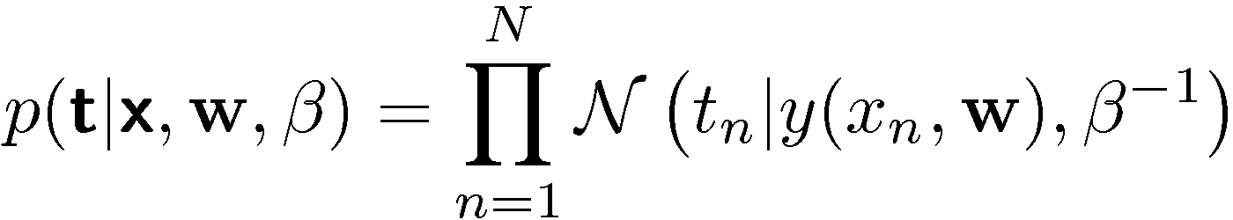
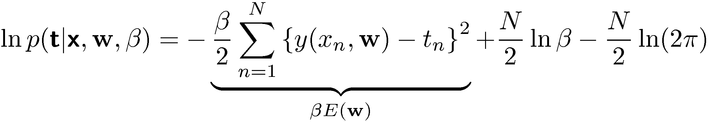


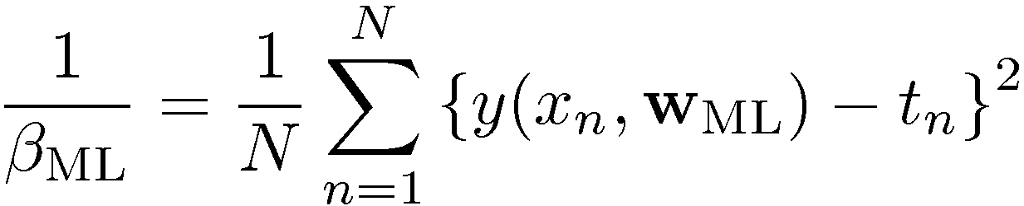
Maximum Likelihood
Determine by minimizing sum-of-squares error, .
Chris Bishop

Slide 41
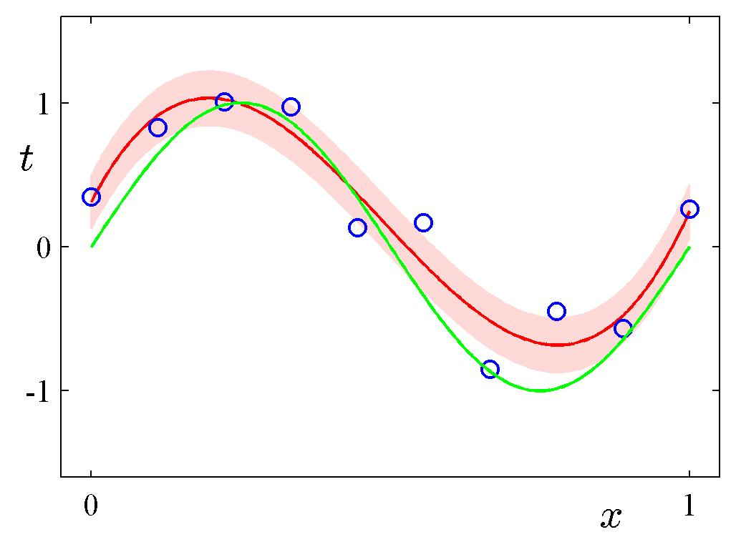
Predictive Distribution
Chris Bishop

Slide 42
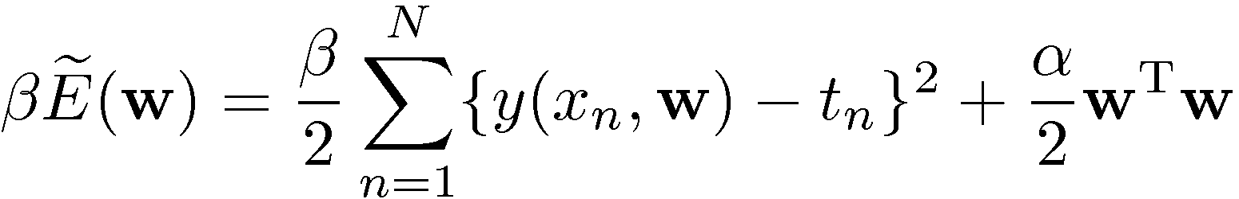

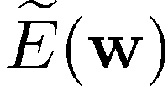
MAP: A Step towards Bayes
posterior ∝ likelihood × prior
Determine by minimizing regularized sum-of-squares error, .
Adapted from Chris Bishop

Slide 43
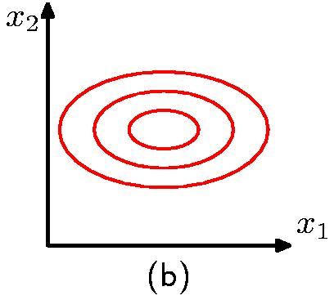
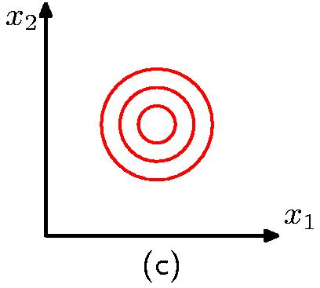
The Gaussian Distribution
Diagonal covariance matrix
Covariance matrix
proportional to the
identity matrix
Chris Bishop

Slide 44
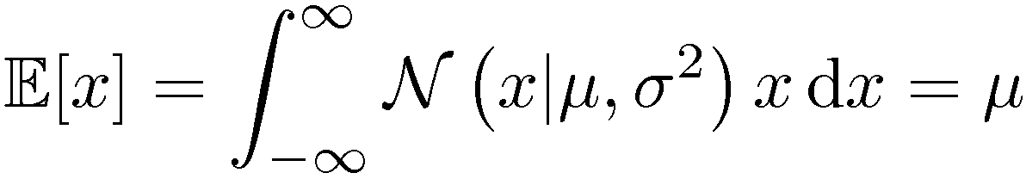
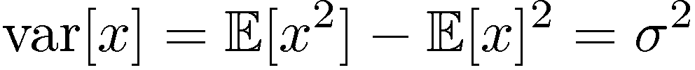
Gaussian Mean and Variance
Chris Bishop

Slide 45


Maximum Likelihood for the Gaussian
Given i.i.d. data , the log likeli-hood function is given by
Sufficient statistics
Chris Bishop

Slide 46



Maximum Likelihood for the Gaussian
Set the derivative of the log likelihood function to zero,
and solve to obtain
Similarly
Chris Bishop

Slide 47



Maximum Likelihood – 1D Case
Chris Bishop

Slide 48


Mixtures of Gaussians
Old Faithful data set
Single Gaussian
Mixture of two Gaussians
Chris Bishop

Slide 49



Mixtures of Gaussians
Combine simple models
into a complex model:
Component
Mixing coefficient
K=3
Chris Bishop

Slide 50




Mixtures of Gaussians
Chris Bishop

Slide 51


Binary Variables
Coin flipping: heads=1, tails=0
Bernoulli Distribution
Chris Bishop

Slide 52




Binary Variables
N coin flips:
Binomial Distribution
Chris Bishop

Slide 53


Binomial Distribution
Chris Bishop

Slide 54



Parameter Estimation
ML for Bernoulli
Given:
Chris Bishop

Slide 55

Parameter Estimation
Example:
Prediction: all future tosses will land heads up
Overfitting to D
Chris Bishop

Slide 56



Beta Distribution
Distribution over .
Chris Bishop

Slide 57

Bayesian Bernoulli
The Beta distribution provides the conjugate prior for the Bernoulli distribution.
Chris Bishop

Slide 58
Bayesian Bernoulli
The hyperparameters a_{N} and b_{N} are the effective number of observations of x=1 and x=0 (need not be integers)
The posterior distribution in turn can act as a prior as more data is observed

Slide 59

Bayesian Bernoulli
Interpretation?
The fraction of (real and fictitious/prior observations) corresponding to x=1
For infinitely large datasets, reduces to Maxmimum Likelihood Estimation
l = N - m

Slide 60



Prior ∙ Likelihood = Posterior
Chris Bishop

Slide 61





Multinomial Variables
1-of-K coding scheme:
Chris Bishop

Slide 62





ML Parameter Estimation
Given:
Ensure , use a Lagrange multiplier, λ.
Chris Bishop

Slide 63

The Multinomial Distribution
Chris Bishop

Slide 64


The Dirichlet Distribution
Conjugate prior for the multinomial distribution.
Chris Bishop

