Slide 1
CS 2750: Machine Learning
Convolutional Neural Networks
Prof. Adriana Kovashka
University of Pittsburgh
March 2, 2017

Slide 2
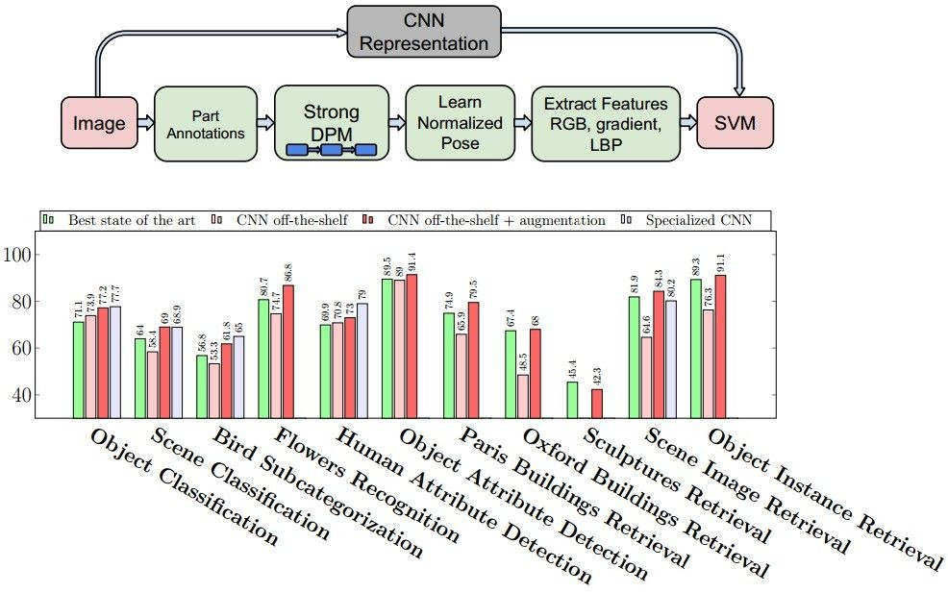
Why convolutional neural networks?
Obtained state of the art performance on many problems…
Most papers in CVPR 2016 use deep learning
Razavian et al., CVPR 2014 Workshops

Slide 3
ImageNet Challenge 2012
~14 million labeled images, 20k classes
Images gathered from Internet
Human labels via Amazon Turk
Challenge: 1.2 million training images, 1000 classes
[Deng et al. CVPR 2009]
A. Krizhevsky, I. Sutskever, and G. Hinton, ImageNet Classification with Deep Convolutional Neural Networks, NIPS 2012
Lana Lazebnik

Slide 4
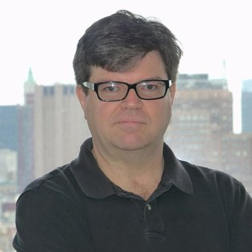
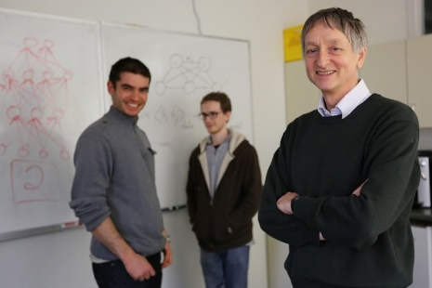
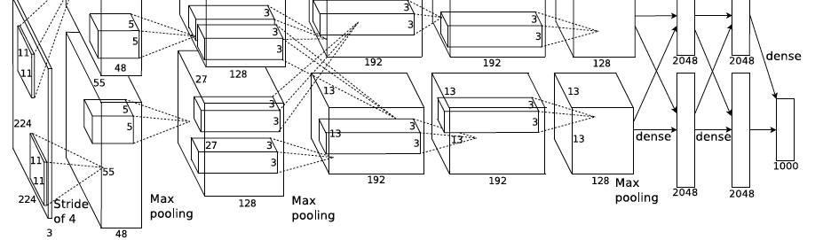
ImageNet Challenge 2012
AlexNet: Similar framework to LeCun’98 but:
  Bigger model (7 hidden layers, 650,000 units, 60,000,000 params)
  More data (10⁶ vs. 10³ images)
  GPU implementation (50x speedup over CPU)
    Trained on two GPUs for a week
  Better regularization for training (DropOut)
A. Krizhevsky, I. Sutskever, and G. Hinton, ImageNet Classification with Deep Convolutional Neural Networks, NIPS 2012
Adapted from Lana Lazebnik
Notes:
Two-GPU architecture

Slide 5
ImageNet Challenge 2012
Krizhevsky et al. -- 16.4% error (top-5)
Next best (non-convnet) – 26.2% error
Lana Lazebnik

Slide 6
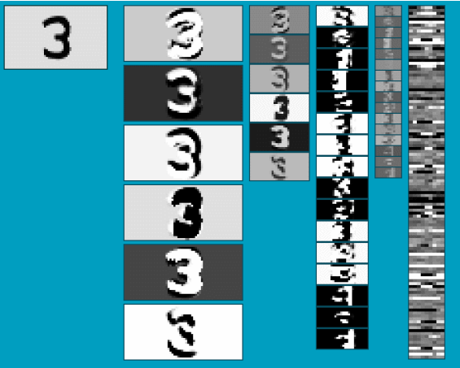
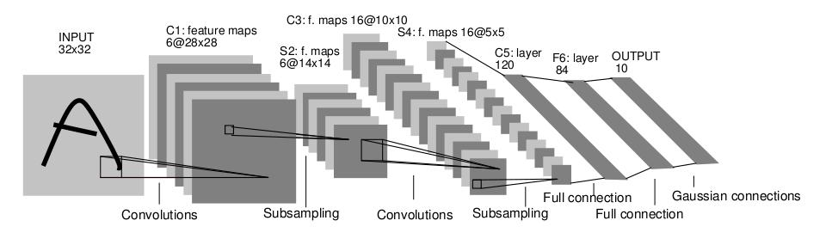
Convolutional Neural Networks (CNN)
Neural network with specialized connectivity structure
Stack multiple stages of feature extractors
Higher stages compute more global, more invariant, more abstract features
Classification layer at the end
Used in vision, but to a lesser extent also in NLP, biomedical, etc.
Y. LeCun, L. Bottou, Y. Bengio, and P. Haffner, Gradient-based learning applied to document recognition, Proceedings of the IEEE 86(11): 2278–2324, 1998.
Adapted from Rob Fergus

Slide 7
Traditional recognition approach
Hand-designed
feature extraction (e.g. SIFT, HOG)
Trainable
classifier
Image/ Video
Pixels
Object
Class
  Features are key to recent progress in recognition, but research shows they’re flawed…
Where next? Better classifiers? Or keep building more features?
Adapted from Lana Lazebnik

Slide 8
What about learning the features?
  Learn a feature hierarchy all the way from pixels to classifier
  Each layer extracts features from the output of previous layer
  Train all layers jointly
Image/ Video
Pixels
Layer 1
Layer 2
Layer 3
Simple
Classifier
Lana Lazebnik
Notes:
Make clear that classic methods, e.g. convnets are purely supervised.

Slide 9
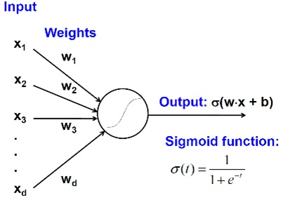
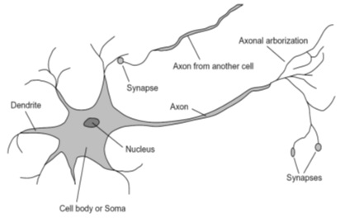
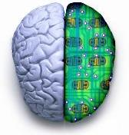
Biological analog
A biological neuron
An artificial neuron
Jia-bin Huang

Slide 10
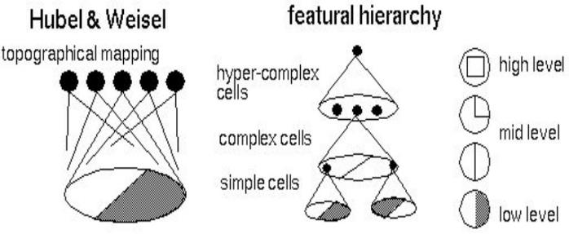
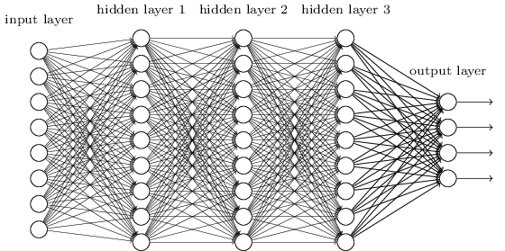
Biological analog
Hubel and Weisel’s architecture
Multi-layer neural network
Adapted from Jia-bin Huang

Slide 11
Convolutional Neural Networks (CNN)
Feed-forward feature extraction:
  Convolve input with learned filters
  Apply non-linearity
  Spatial pooling (downsample)
Supervised training of convolutional
filters by back-propagating
classification error
Output (class probs)
…
Spatial pooling
Non-linearity
Convolution (Learned)
Input Image
Adapted from Lana Lazebnik

Slide 12
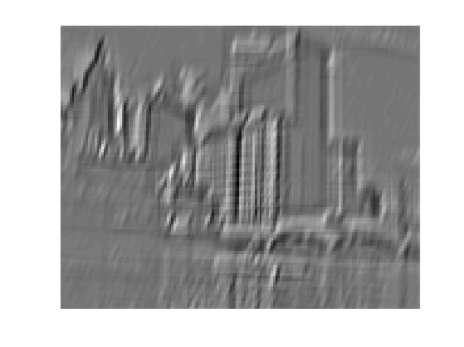
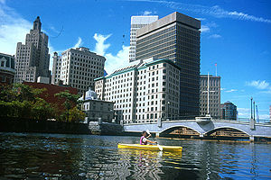
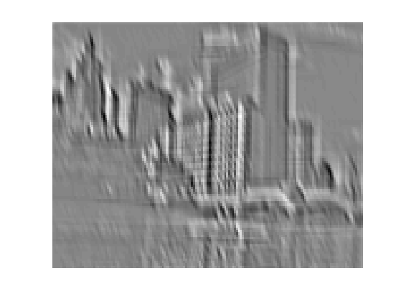
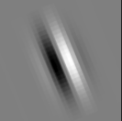
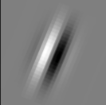
1. Convolution
Apply learned filter weights
One feature map per filter
Stride can be greater than 1 (faster, less memory)
...
Input
Feature Map
Adapted from Rob Fergus

Slide 13
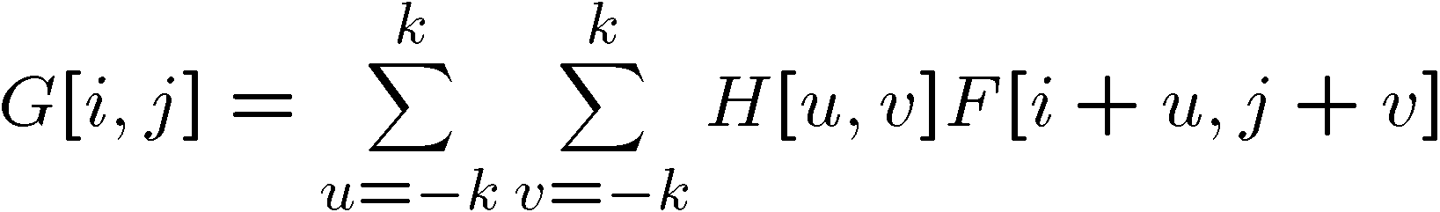

1. Convolution
F
(i, j)
output
filter
input (image)
5 | 2 | 5 | 4 | 4
5 | 200 | 3 | 200 | 4
1 | 5 | 5 | 4 | 4
5 | 5 | 1 | 1 | 2
200 | 1 | 3 | 5 | 200
1 | 200 | 200 | 200 | 1
u = -1,
v = -1
H
.06 | .12 | .06
.12 | .25 | .12
.06 | .12 | .06
(0, 0)

Slide 14
1. Convolution
F
(i, j)
output
filter
input (image)
5 | 2 | 5 | 4 | 4
5 | 200 | 3 | 200 | 4
1 | 5 | 5 | 4 | 4
5 | 5 | 1 | 1 | 2
200 | 1 | 3 | 5 | 200
1 | 200 | 200 | 200 | 1
u = -1,
v = -1
v = 0
H
.06 | .12 | .06
.12 | .25 | .12
.06 | .12 | .06
(0, 0)

Slide 15
1. Convolution
F
(i, j)
output
filter
input (image)
5 | 2 | 5 | 4 | 4
5 | 200 | 3 | 200 | 4
1 | 5 | 5 | 4 | 4
5 | 5 | 1 | 1 | 2
200 | 1 | 3 | 5 | 200
1 | 200 | 200 | 200 | 1
u = -1,
v = -1
v = 0
v = +1
H
.06 | .12 | .06
.12 | .25 | .12
.06 | .12 | .06
(0, 0)

Slide 16
1. Convolution
F
(i, j)
output
filter
input (image)
5 | 2 | 5 | 4 | 4
5 | 200 | 3 | 200 | 4
1 | 5 | 5 | 4 | 4
5 | 5 | 1 | 1 | 2
200 | 1 | 3 | 5 | 200
1 | 200 | 200 | 200 | 1
u = -1,
v = -1
v = 0
v = +1
u = 0,
v = -1
H
.06 | .12 | .06
.12 | .25 | .12
.06 | .12 | .06
(0, 0)

Slide 17
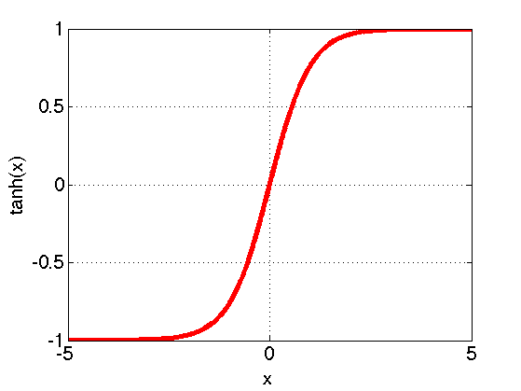
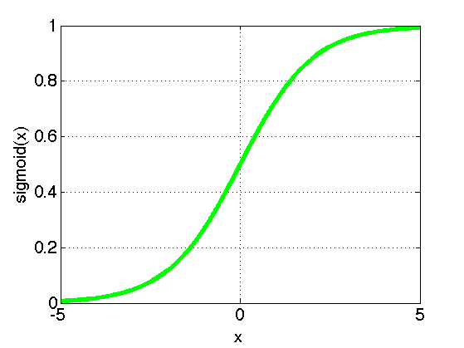
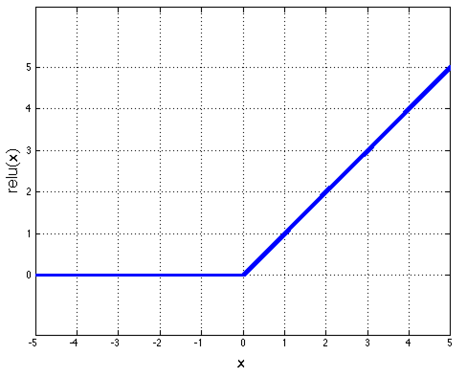
2. Non-Linearity
Per-element (independent)
Options:
  Tanh
  Sigmoid: 1/(1+exp(-x))
  Rectified linear unit (ReLU)
    Avoids saturation issues
Adapted from Rob Fergus

Slide 18
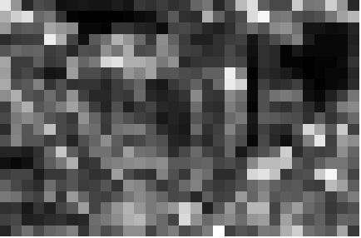
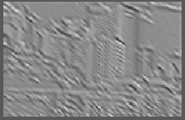
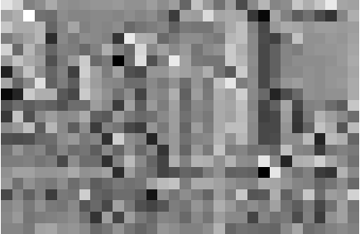
3. Spatial Pooling
Sum or max over non-overlapping / overlapping regions
Role of pooling:
  Invariance to small transformations
  Larger receptive fields (neurons see more of input)
  Max
  Sum
Adapted from Rob Fergus

Slide 19
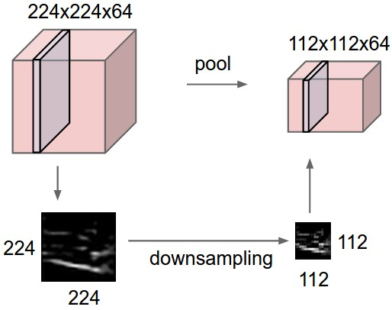
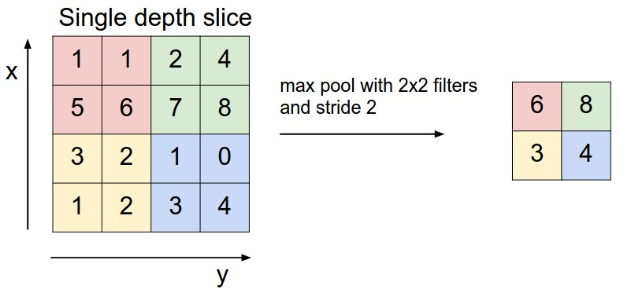
3. Spatial Pooling
Sum or max over non-overlapping / overlapping regions
Role of pooling:
  Invariance to small transformations
  Larger receptive fields (neurons see more of input)
Rob Fergus, figure from Andrej Karpathy

Slide 20
Convolutions: More detail
32x32x3 image
32
height
32
depth
width
3
Andrej Karpathy

Slide 21
Convolutions: More detail
32x32x3 image
5x5x3 filter
32
Convolve the filter with the image
i.e. “slide over the image spatially, computing dot products”
32
3
Andrej Karpathy

Slide 22


Convolution Layer
Convolutions: More detail
32x32x3 image 5x5x3 filter
32
1 number:
the result of taking a dot product between the filter and a small 5x5x3 chunk of the image
(i.e. 5*5*3 = 75-dimensional dot product + bias)
32
3
Andrej Karpathy

Slide 23
Convolution Layer
Convolutions: More detail
activation map
32x32x3 image
5x5x3 filter
32
28
convolve (slide) over all spatial locations
32
28
3
1
Andrej Karpathy

Slide 24
consider a second, green filter
Convolutions: More detail
Convolution Layer
32x32x3 image 5x5x3 filter
activation maps
32
28
convolve (slide) over all spatial locations
32
28
3
1
Andrej Karpathy

Slide 25
For example, if we had 6 5x5 filters, we’ll get 6 separate activation maps:
Convolutions: More detail
activation maps
32
28
Convolution Layer
32
28
3
6
We stack these up to get a “new image” of size 28x28x6!
Andrej Karpathy

Slide 26
Convolutions: More detail
Preview: ConvNet is a sequence of Convolutional Layers, interspersed with activation functions
32
28
CONV, ReLU
e.g. 6 5x5x3 filters
32
28
3
6
Andrej Karpathy

Slide 27
Preview: ConvNet is a sequence of Convolutional Layers, interspersed with activation functions
Convolutions: More detail
32
28
24
….
CONV, ReLU
e.g. 6 5x5x3 filters
CONV, ReLU
e.g. 10 5x5x6 filters
CONV, ReLU
32
28
24
3
6
10
Andrej Karpathy

Slide 28
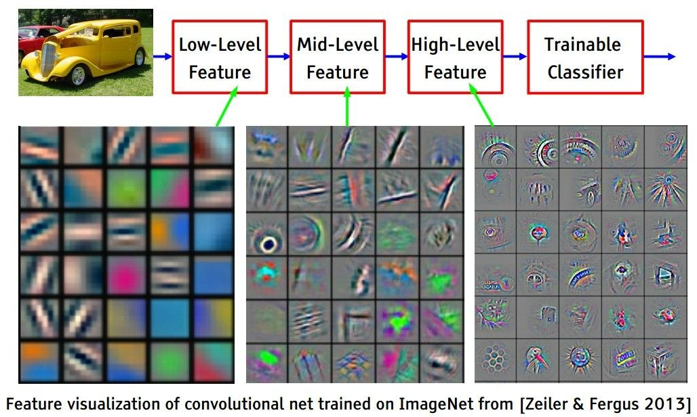
Convolutions: More detail
[From recent Yann LeCun slides]
Andrej Karpathy

Slide 29
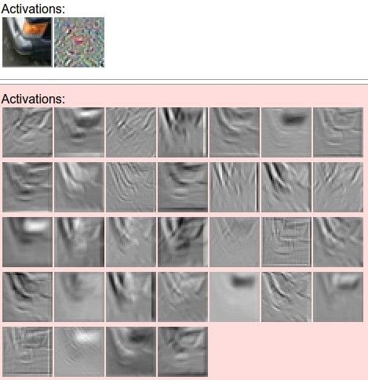
one filter =>
one activation map
Convolutions: More detail
example 5x5 filters
(32 total)
We call the layer convolutional because it is related to convolution of two signals:
elementwise multiplication and sum of a filter and the signal (image)
Adapted from Andrej Karpathy, Kristen Grauman

Slide 30
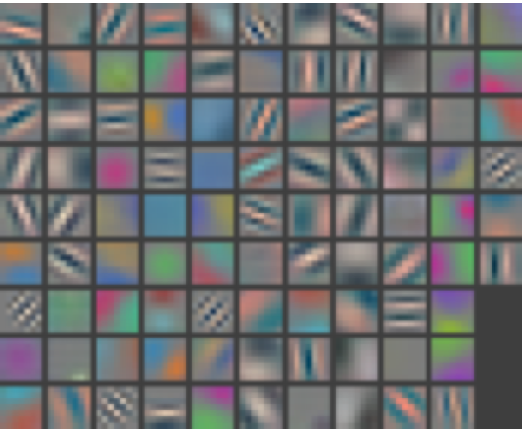
Layer 1
Visualizing and Understanding Convolutional Networks [Zeiler and Fergus, ECCV 2014]

Slide 31
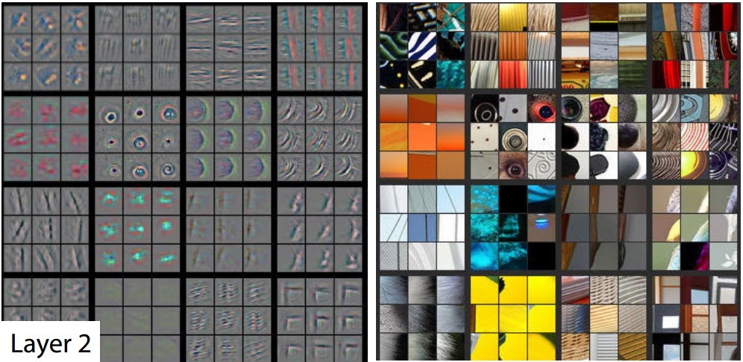
Layer 2
Activations projected down to pixel level via decovolution
Patches from validation images that give maximal activation of a given feature map
Visualizing and Understanding Convolutional Networks [Zeiler and Fergus, ECCV 2014]

Slide 32
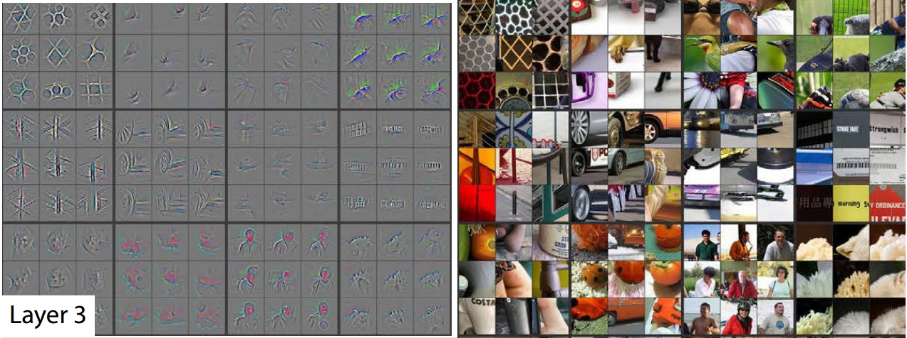
Layer 3
Visualizing and Understanding Convolutional Networks [Zeiler and Fergus, ECCV 2014]

Slide 33
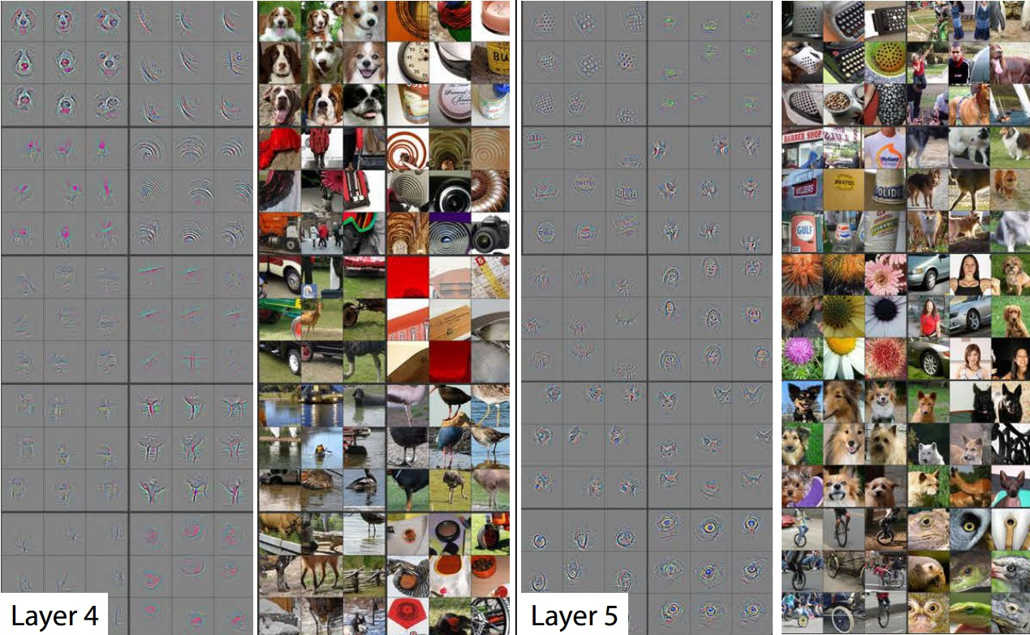
Layers 4 and 5
Visualizing and Understanding Convolutional Networks [Zeiler and Fergus, ECCV 2014]

Slide 34
A closer look at spatial dimensions:
Convolutions: More detail
activation map
32x32x3 image
5x5x3 filter
32
28
convolve (slide) over all spatial locations
32
28
3
1
Andrej Karpathy

Slide 35
A closer look at spatial dimensions:
Convolutions: More detail
7
7x7 input (spatially) assume 3x3 filter
7
Andrej Karpathy

Slide 36
A closer look at spatial dimensions:
Convolutions: More detail
7
7x7 input (spatially) assume 3x3 filter
7
Andrej Karpathy

Slide 37
A closer look at spatial dimensions:
Convolutions: More detail
7
7x7 input (spatially) assume 3x3 filter
7
Andrej Karpathy

Slide 38
A closer look at spatial dimensions:
Convolutions: More detail
7
7x7 input (spatially) assume 3x3 filter
7
Andrej Karpathy

Slide 39
A closer look at spatial dimensions:
Convolutions: More detail
7
7x7 input (spatially) assume 3x3 filter
=> 5x5 output
7
Andrej Karpathy

Slide 40
A closer look at spatial dimensions:
Convolutions: More detail
7
7x7 input (spatially) assume 3x3 filter applied with stride 2
7
Andrej Karpathy

Slide 41
A closer look at spatial dimensions:
Convolutions: More detail
7
7x7 input (spatially) assume 3x3 filter applied with stride 2
7
Andrej Karpathy

Slide 42
A closer look at spatial dimensions:
Convolutions: More detail
7
7x7 input (spatially) assume 3x3 filter applied with stride 2
=> 3x3 output!
7
Andrej Karpathy

Slide 43
A closer look at spatial dimensions:
Convolutions: More detail
7
7x7 input (spatially) assume 3x3 filter applied with stride 3?
7
Andrej Karpathy

Slide 44
A closer look at spatial dimensions:
Convolutions: More detail
7
7x7 input (spatially) assume 3x3 filter applied with stride 3?
7
doesn’t fit!
cannot apply 3x3 filter on 7x7 input with stride 3.
Andrej Karpathy

Slide 45
Convolutions: More detail
N
Output size:
(N - F) / stride + 1
 |  |  | F
 | F
e.g. N = 7, F = 3:
stride 1 => (7 - 3)/1 + 1 = 5
stride 2 => (7 - 3)/2 + 1 = 3
stride 3 => (7 - 3)/3 + 1 = 2.33 :\
N
Andrej Karpathy

Slide 46
In practice: Common to zero pad the border
Convolutions: More detail
0 | 0 | 0 | 0 | 0 | 0
0
0
0
0
e.g. input 7x7
3x3 filter, applied with stride 1
pad with 1 pixel border => what is the output?
(recall:)
(N - F) / stride + 1
Andrej Karpathy

Slide 47
In practice: Common to zero pad the border
Convolutions: More detail
0 | 0 | 0 | 0 | 0 | 0
0
0
0
0
e.g. input 7x7
3x3 filter, applied with stride 1
pad with 1 pixel border => what is the output?
7x7 output!
Andrej Karpathy

Slide 48
In practice: Common to zero pad the border
Convolutions: More detail
0 | 0 | 0 | 0 | 0 | 0
0
0
0
0
e.g. input 7x7
3x3 filter, applied with stride 1
pad with 1 pixel border => what is the output?
7x7 output!
in general, common to see CONV layers with stride 1, filters of size FxF, and zero-padding with (F-1)/2. (will preserve size spatially)
e.g. F = 3 => zero pad with 1 F = 5 => zero pad with 2 F = 7 => zero pad with 3
(N + 2*padding - F) / stride + 1
Andrej Karpathy

Slide 49
Convolutions: More detail
Examples time:
Input volume: 32x32x3
10 5x5x3 filters with stride 1, pad 2
Output volume size: ?
Andrej Karpathy

Slide 50
Convolutions: More detail
Examples time:
Input volume: 32x32x3
10 5x5x3 filters with stride 1, pad 2
Output volume size:
(32+2*2-5)/1+1 = 32 spatially, so
32x32x10
Andrej Karpathy

Slide 51
Convolutions: More detail
Examples time:
Input volume: 32x32x3
10 5x5x3 filters with stride 1, pad 2
Number of parameters in this layer?
Andrej Karpathy

Slide 52
Examples time:
Convolutions: More detail
Input volume: 32x32x3
10 5x5x3 filters with stride 1, pad 2
Number of parameters in this layer? each filter has 5*5*3 + 1 = 76 params
=> 76*10 = 760
(+1 for bias)
Andrej Karpathy

Slide 53
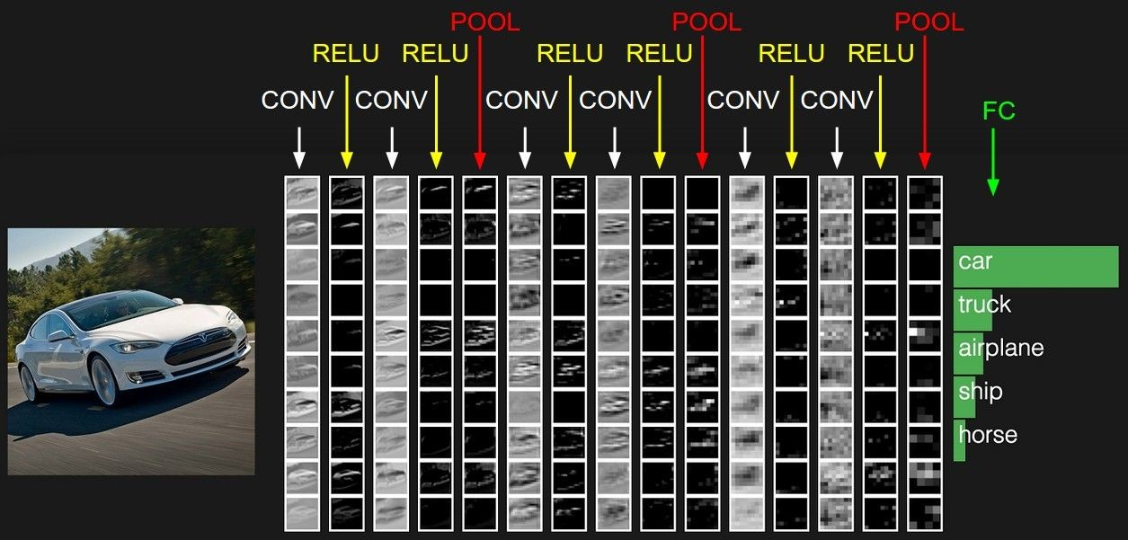
Convolutions: More detail
Andrej Karpathy

Slide 54
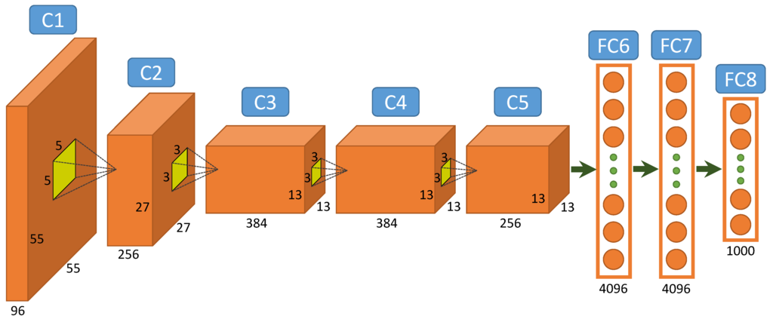
A Common Architecture: AlexNet
Figure from http://www.mdpi.com/2072-4292/7/11/14680/htm

Slide 55
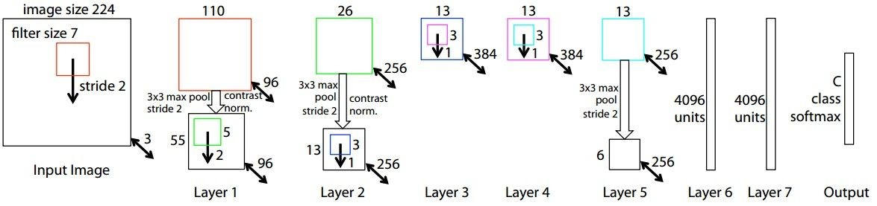
Case Study: ZFNet
[Zeiler and Fergus, 2013]
AlexNet but:
CONV1: change from (11x11 stride 4) to (7x7 stride 2) CONV3,4,5: instead of 384, 384, 256 filters use 512, 1024, 512
ImageNet top 5 error: 15.4% -> 14.8%
Andrej Karpathy

Slide 56
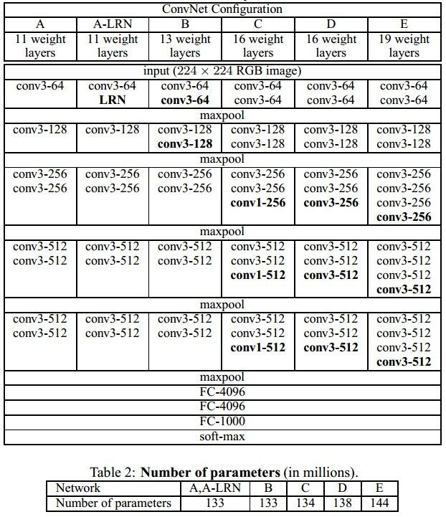
Case Study: VGGNet
[Simonyan and Zisserman, 2014]
Only 3x3 CONV stride 1, pad 1 and 2x2 MAX POOL stride 2
best model
11.2% top 5 error in ILSVRC 2013
->
7.3% top 5 error
Andrej Karpathy

Slide 57
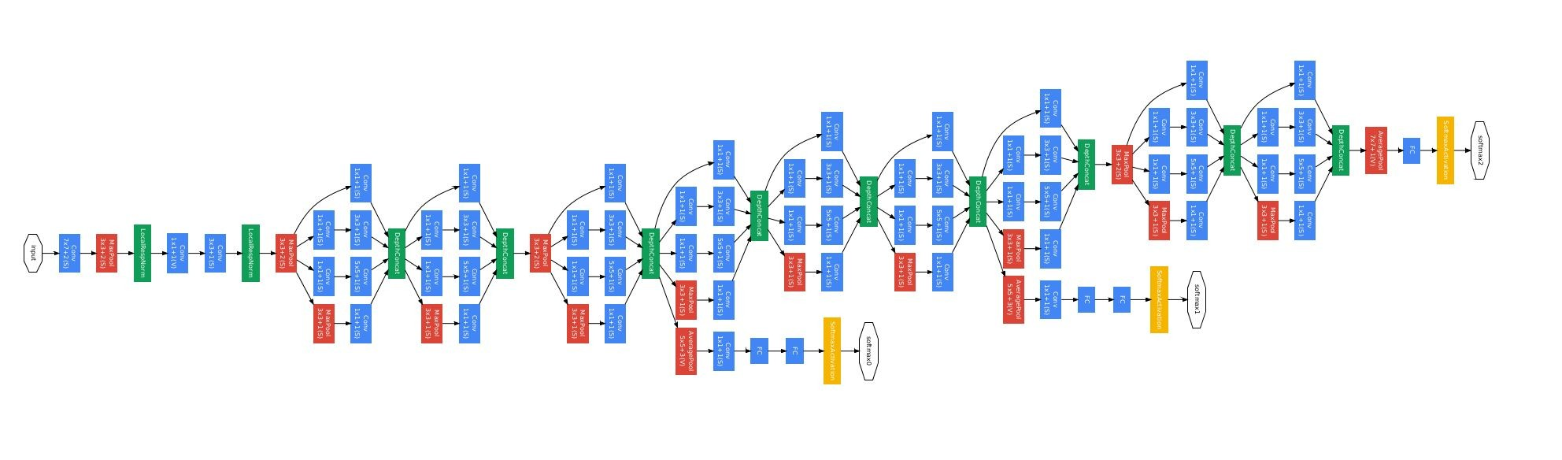
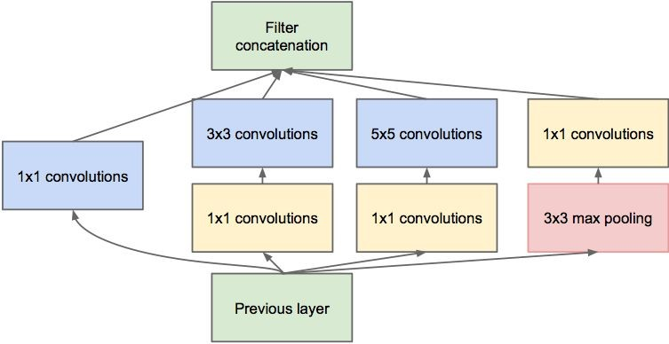
Case Study: GoogLeNet
[Szegedy et al., 2014]
Inception module
ILSVRC 2014 winner (6.7% top 5 error)
Andrej Karpathy

Slide 58
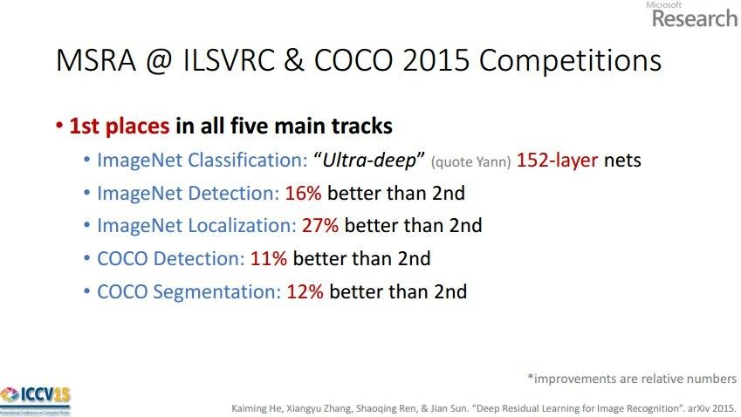
Case Study: ResNet
[He et al., 2015]
ILSVRC 2015 winner (3.6% top 5 error)
Slide from Kaiming He’s recent presentation https://www.youtube.com/watch?v=1PGLj-uKT1w
Andrej Karpathy

Slide 59
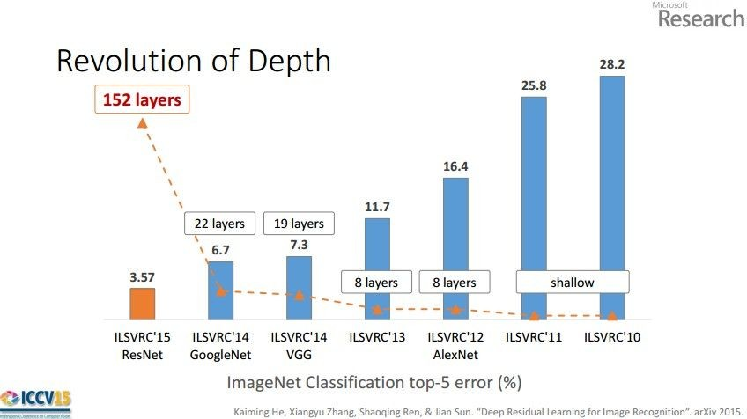
Case Study: ResNet
(slide from Kaiming He’s recent presentation)
Andrej Karpathy

Slide 60
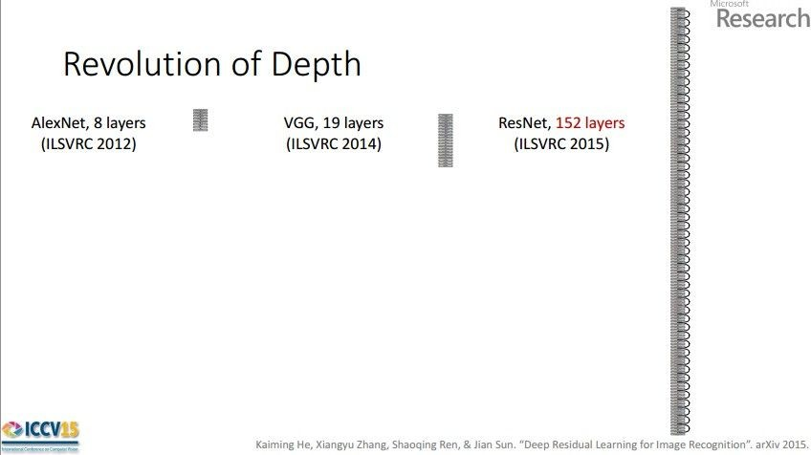
Case Study: ResNet
[He et al., 2015]
ILSVRC 2015 winner (3.6% top 5 error)
2-3 weeks of training on 8 GPU machine
at runtime: faster than a VGGNet! (even though it has 8x more layers)
(slide from Kaiming He’s recent presentation)
Andrej Karpathy

Slide 61
Visualizing CNNs

Slide 62
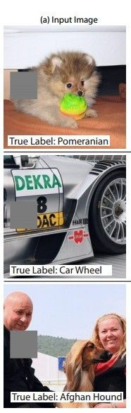
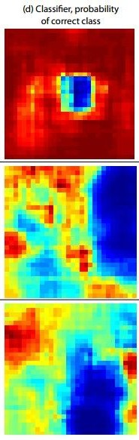
Occlusion experiments
(as a function of the position of the square of zeros in the original image)
[Zeiler & Fergus 2014]
Andrej Karpathy

Slide 63
Occlusion experiments
(as a function of the position of the square of zeros in the original image)
[Zeiler & Fergus 2014]
Andrej Karpathy

Slide 64
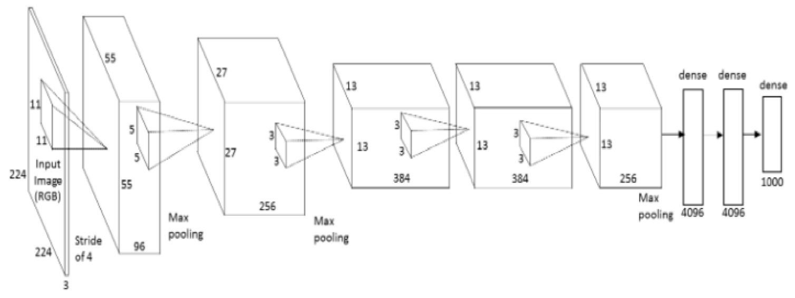
What image maximizes a class score?
Repeat:
Forward an image
Set activations in layer of interest to all zero, except for a 1.0 for a neuron of interest
Backprop to image
Do an “image update”
Andrej Karpathy

Slide 65
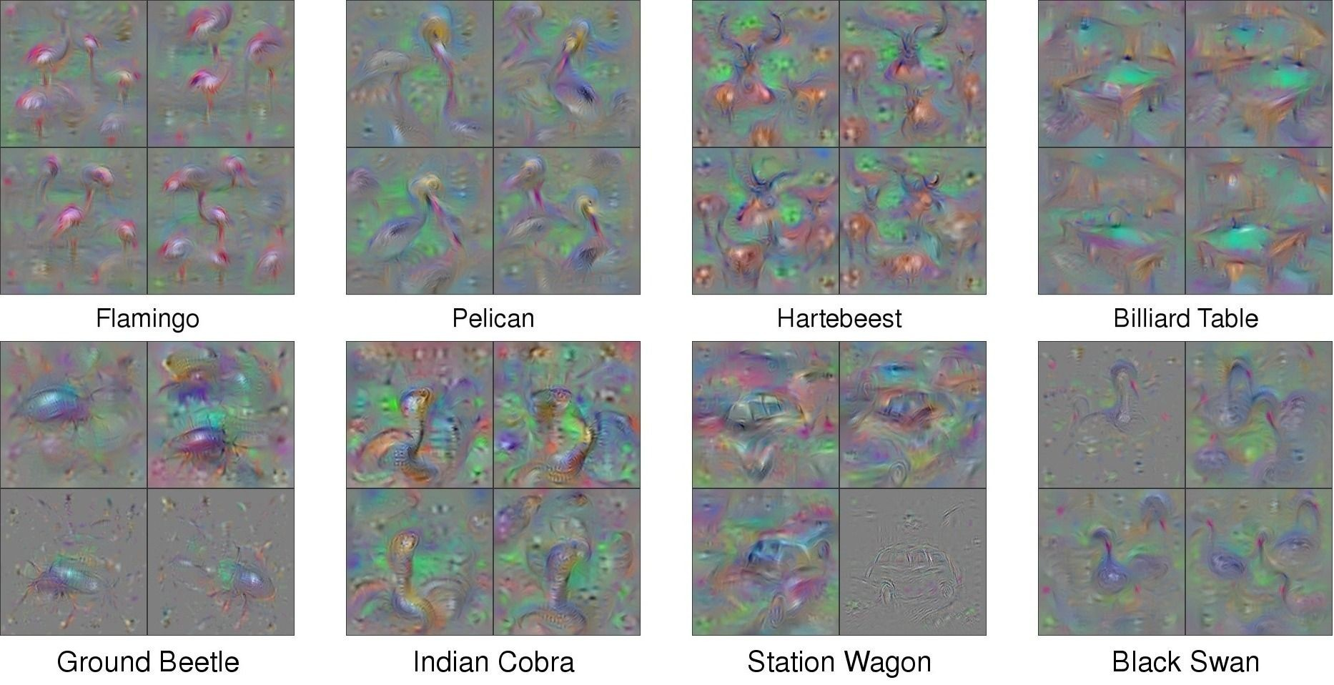
What image maximizes a class score?
[Understanding Neural Networks Through Deep Visualization, Yosinski et al. , 2015]
http://yosinski.com/deepvis
Andrej Karpathy

Slide 66
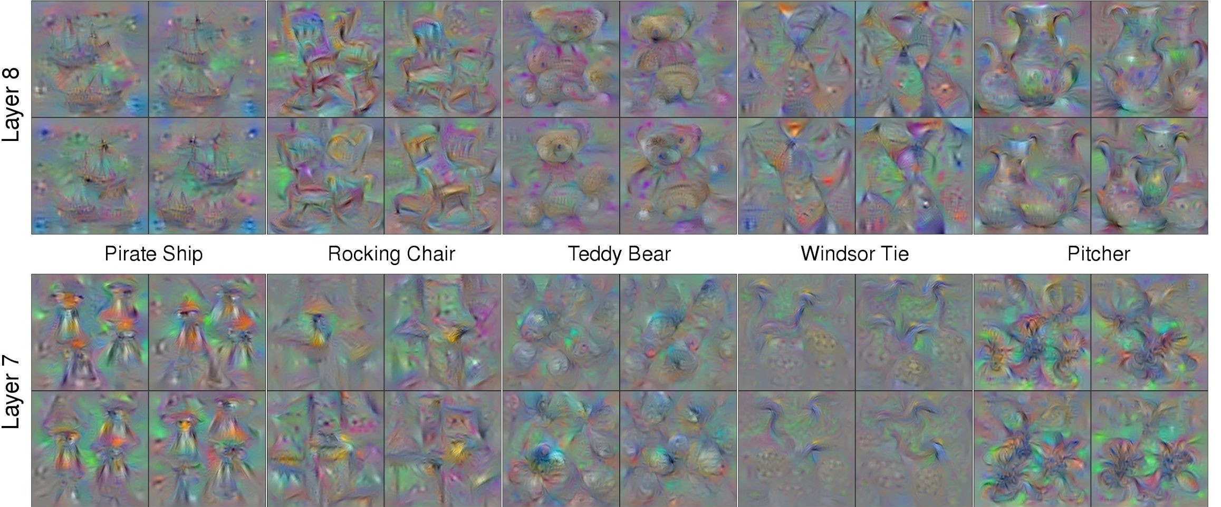
What image maximizes a class score?
Andrej Karpathy

Slide 67
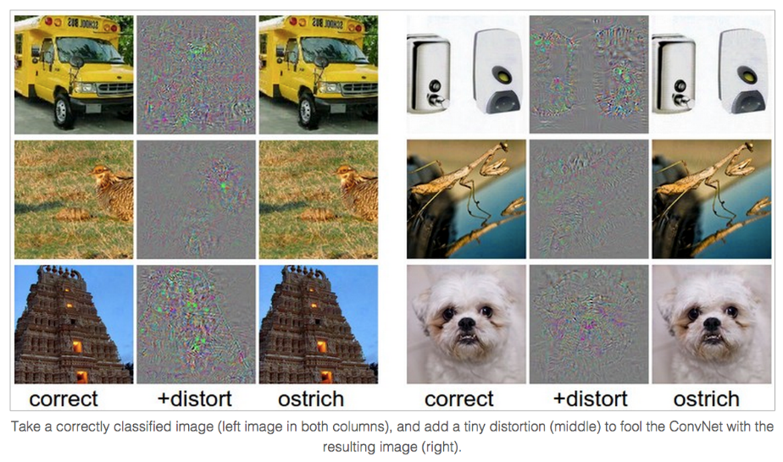
Breaking CNNs
Intriguing properties of neural networks [Szegedy ICLR 2014]
Andrej Karpathy

Slide 68
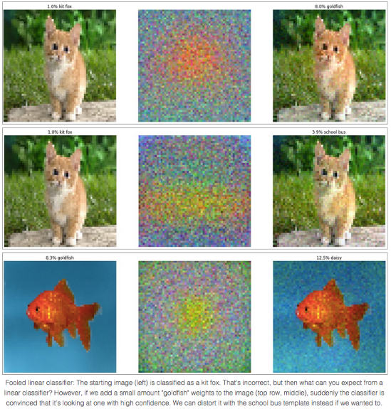
Fooling a linear classifier
To fool a linear classifier, add a small multiple of the weight vector to the training example:
x ← x + α w
http://karpathy.github.io/2015/03/30/breaking-convnets/
Jia-bin Huang

Slide 69
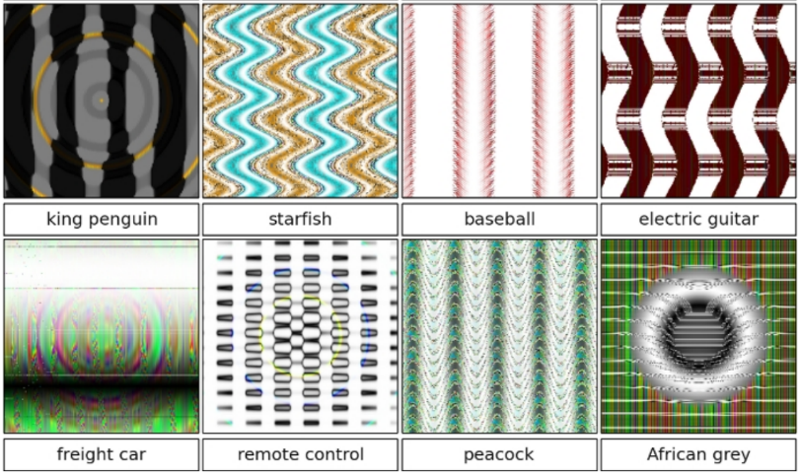
Breaking CNNs
Deep Neural Networks are Easily Fooled: High Confidence Predictions for Unrecognizable Images [Nguyen et al. CVPR 2015]
Jia-bin Huang

Slide 70
Reconstructing images
Question: Given a CNN code, is it possible to reconstruct the original image?
Andrej Karpathy

Slide 71


Reconstructing images
Find an image such that:
Its code is similar to a given code
It “looks natural” (image prior regularization)
Andrej Karpathy

Slide 72
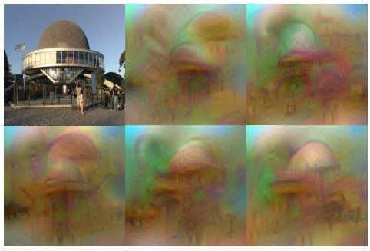
Reconstructing images
original image
Reconstructions from the 1000 log probabilities for ImageNet (ILSVRC)
classes
Understanding Deep Image Representations by Inverting Them [Mahendran and Vedaldi, 2014]
Andrej Karpathy

Slide 73
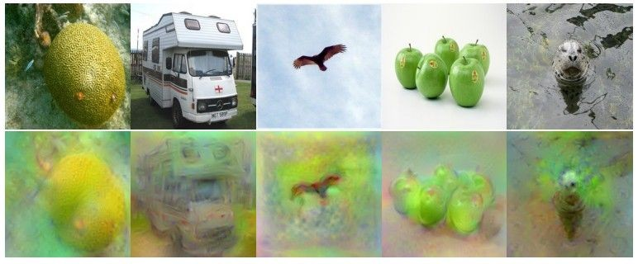
Reconstructing images
Reconstructions from the representation after last last pooling layer (immediately before the first Fully Connected layer)
Andrej Karpathy

Slide 74




DeepDream
DeepDream https://github.com/google/deepdream
Andrej Karpathy

Slide 75



DeepDream
DeepDream modifies the image in a way that “boosts” all activations, at any layer
this creates a feedback loop: e.g. any slightly detected dog face will be made more and more dog like over time
Andrej Karpathy

Slide 76
DeepDream
Deep Dream Grocery Trip https://www.youtube.com/watch?v=DgPaCWJL7XI
Deep Dreaming Fear & Loathing in Las Vegas: the Great San Francisco Acid Wave https://www.youtube.com/watch?v=oyxSerkkP4o
Andrej Karpathy

Slide 77
Synthesis / style transfer

Slide 78



Neural Style
[ A Neural Algorithm of Artistic Style by Leon A. Gatys, Alexander S. Ecker, and Matthias Bethge, 2015]
good implementation by Justin Johnson in Torch:
h ttps://github.com/jcjohnson/neural-style
Andrej Karpathy

Slide 79








Neural Style
make your own easily on deepart.io
Andrej Karpathy

Slide 80

Neural Style
Step 1: Extract content targets (ConvNet activations of all layers for the given content image)
content activations
e.g.
at CONV5_1 layer we would have a [14x14x512] array of target activations
Andrej Karpathy

Slide 81
Neural Style
Step 2: Extract style targets (Gram matrices of ConvNet activations of all layers for the given style image)
style gram matrices
e.g.
at CONV1 layer (with [224x224x64] activations) would give a [64x64] Gram matrix of all pairwise activation covariances (summed across spatial locations)
Andrej Karpathy

Slide 82

Neural Style
Step 3: Optimize over image to have:
The content of the content image (activations match content)
The style of the style image (Gram matrices of activations match style)
match content
match style
Adapted from Andrej Karpathy

