Slide 1
CS 2750: Machine Learning
Linear Models for Classification
Prof. Adriana Kovashka
University of Pittsburgh
February 7, 2017

Slide 2
Plan for next two lectures
Regression for classification
Fisher’s linear discriminant
Perceptron
Logistic regression
Multi-way classification
Generative vs discriminative models

Slide 3
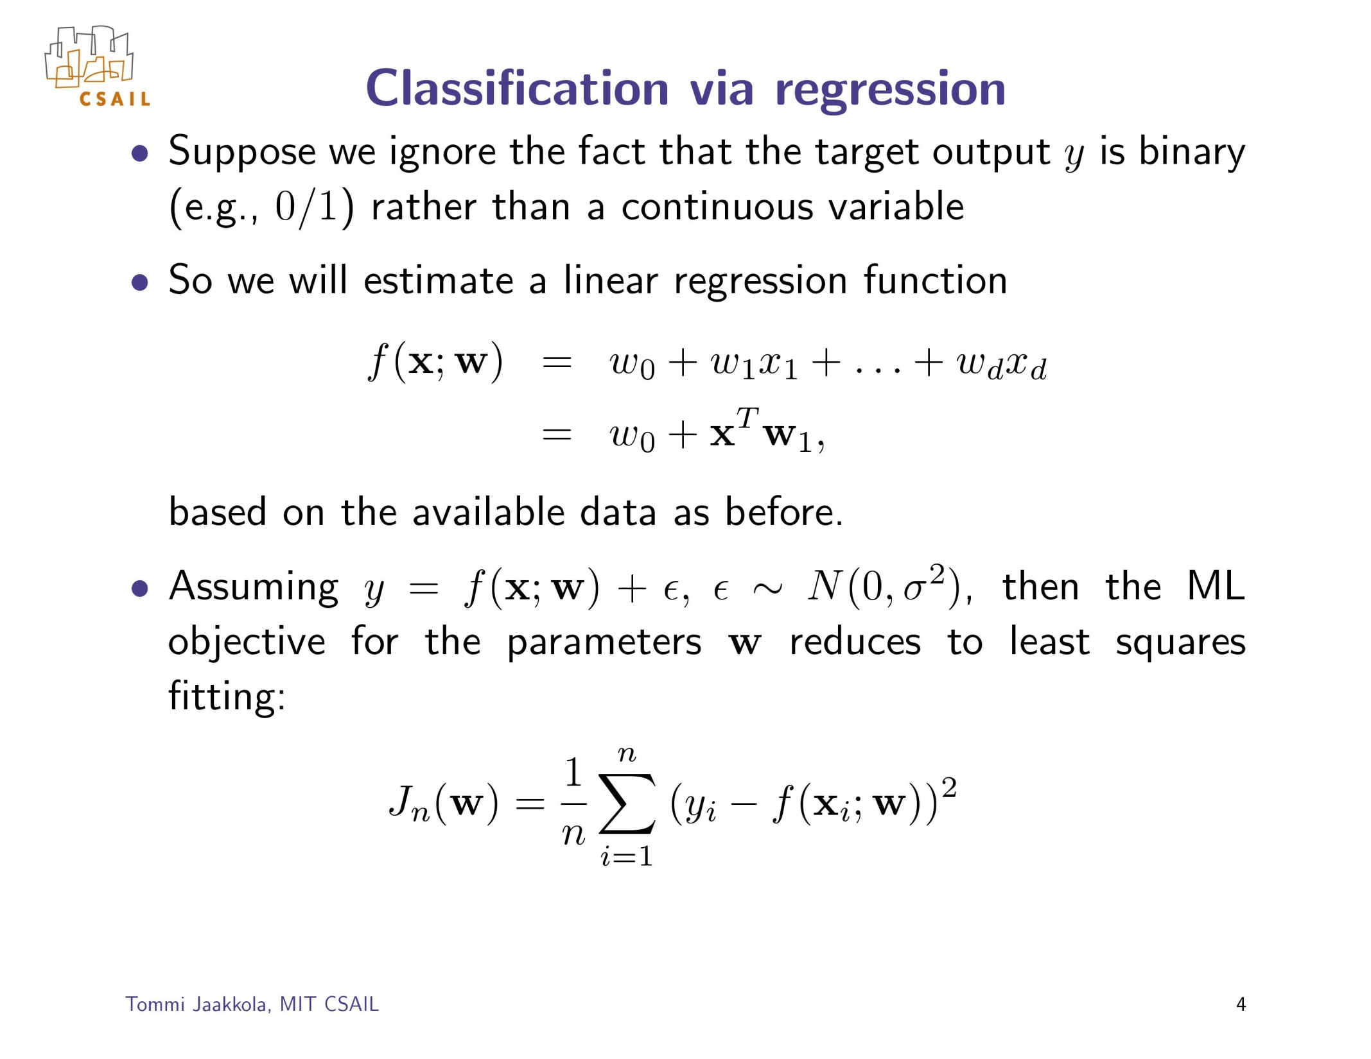
Objective we want to minimize:

Slide 4
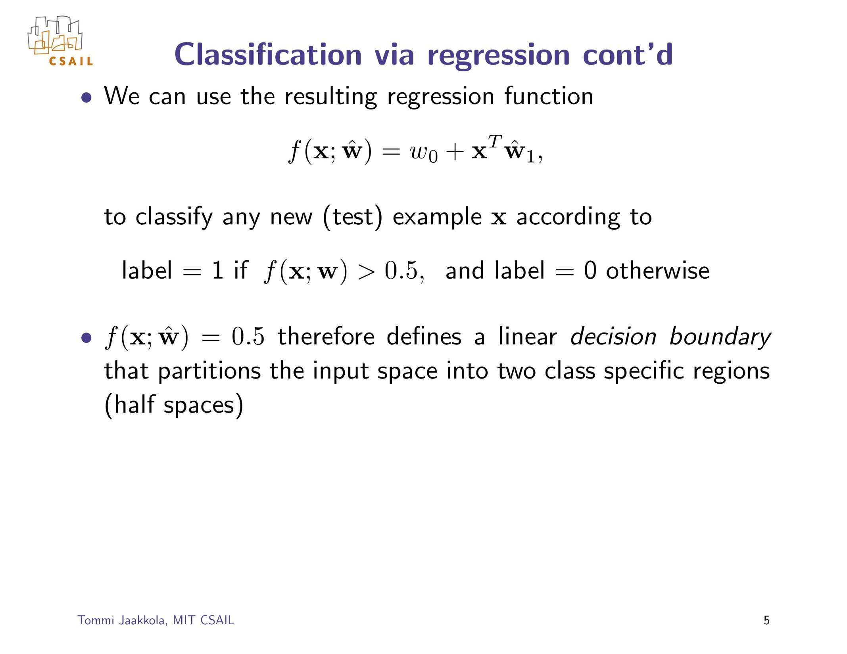

Slide 5
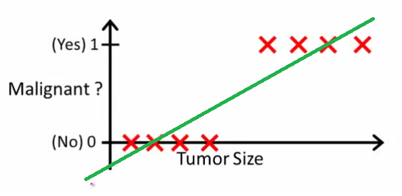
f(x, w) = 0.5
Figures adapted from from Andrew Ng

Slide 6
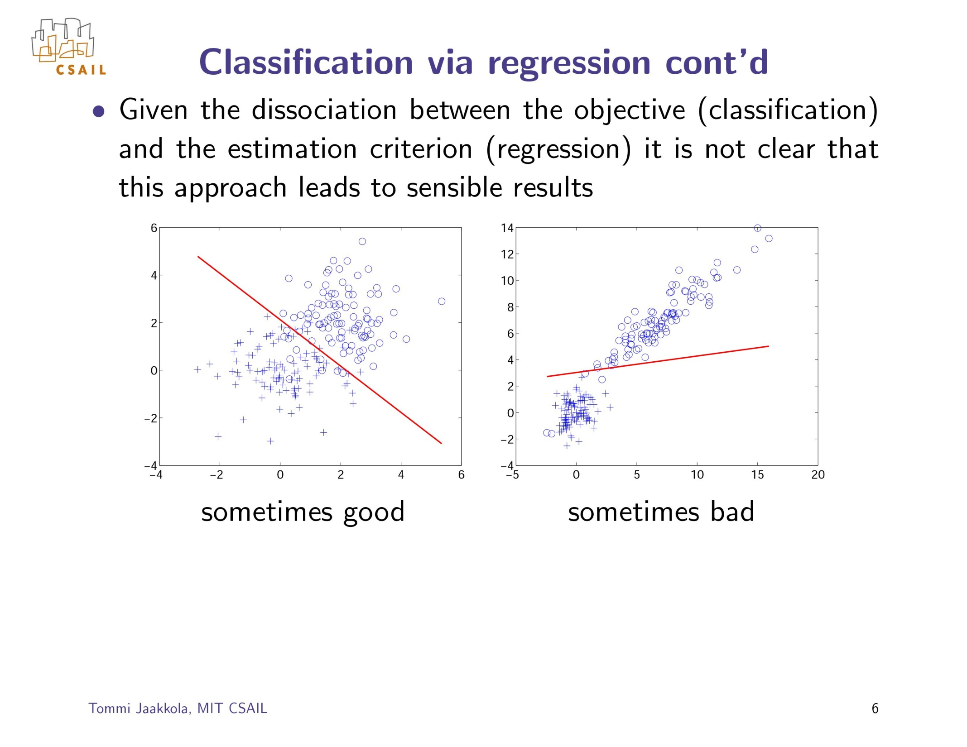

Slide 7
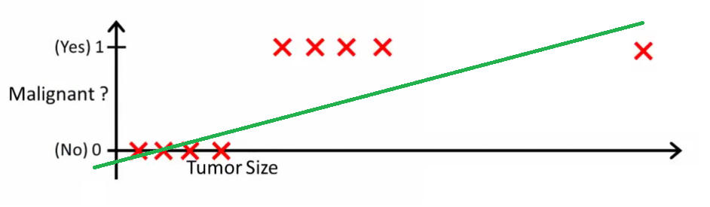
f(x, w) = 0.5
f(x, w) = 0.5
Figures adapted from from Andrew Ng

Slide 8
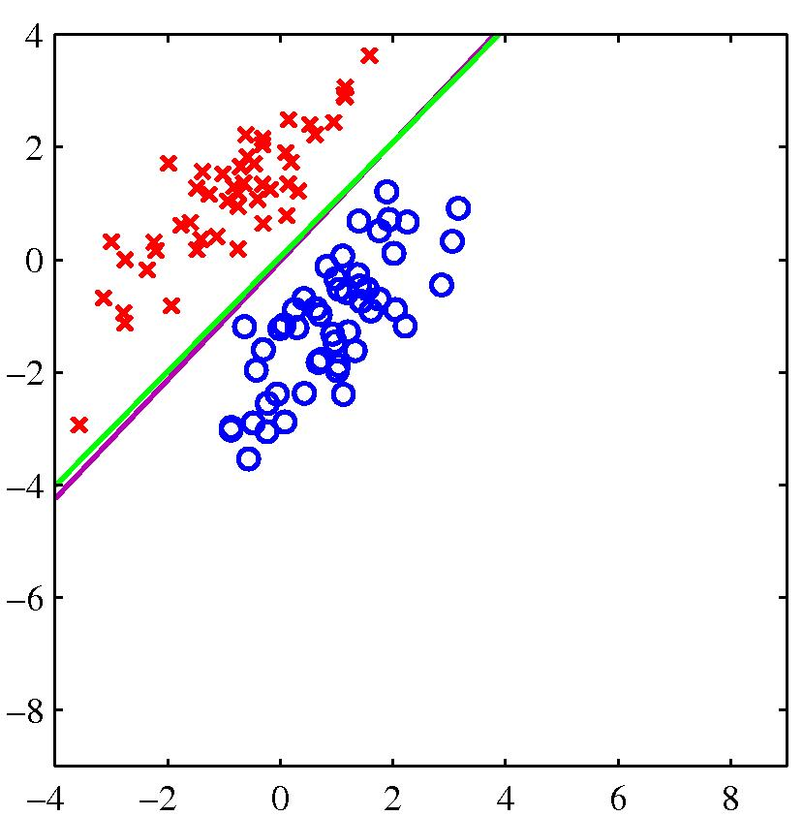
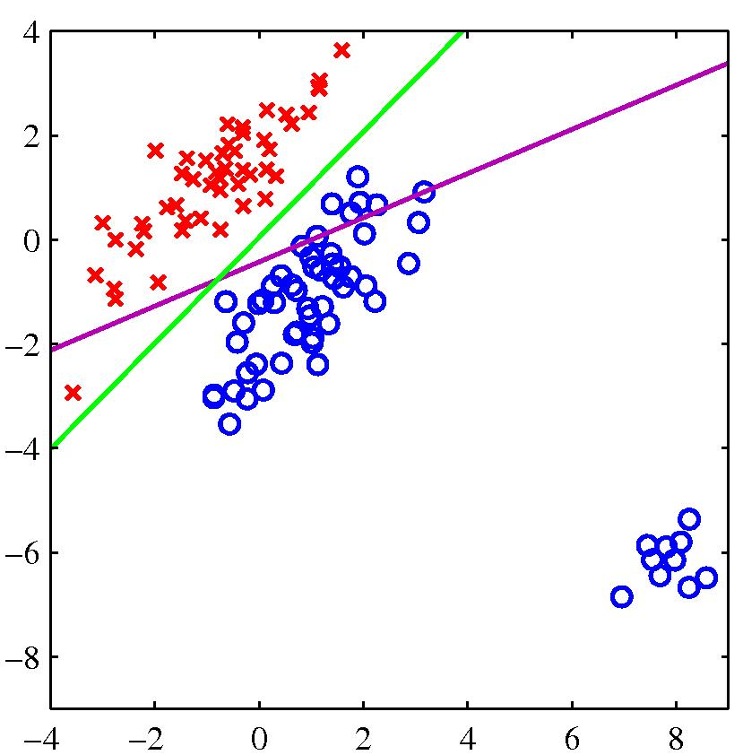
The effect of outliers: Another example
Magenta = least squares, green = logistic regression
Figures from Bishop

Slide 9
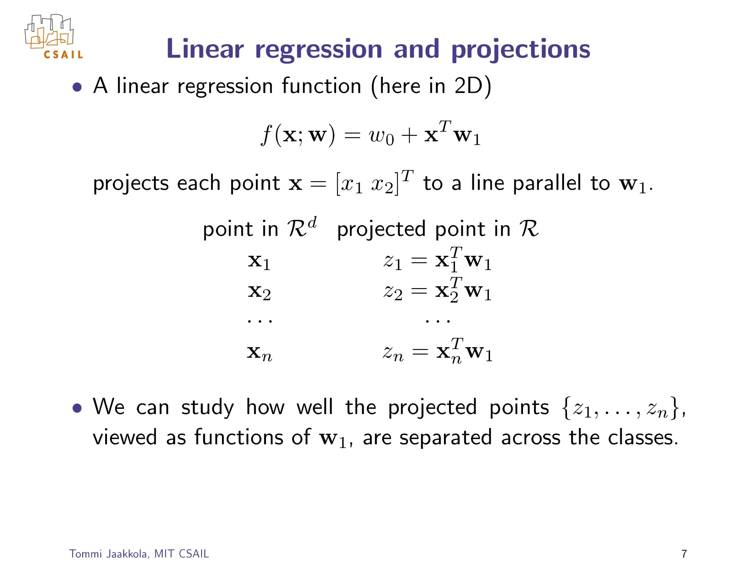
y
y
y

Slide 10
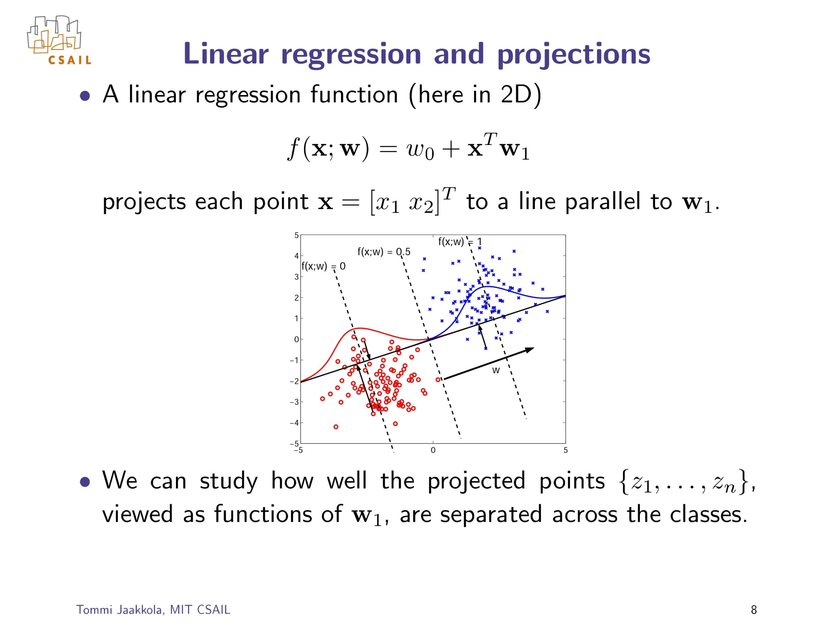
y
y

Slide 11
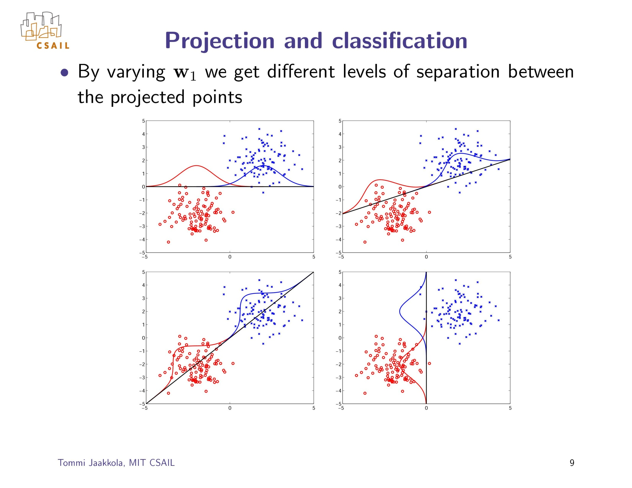

Slide 12
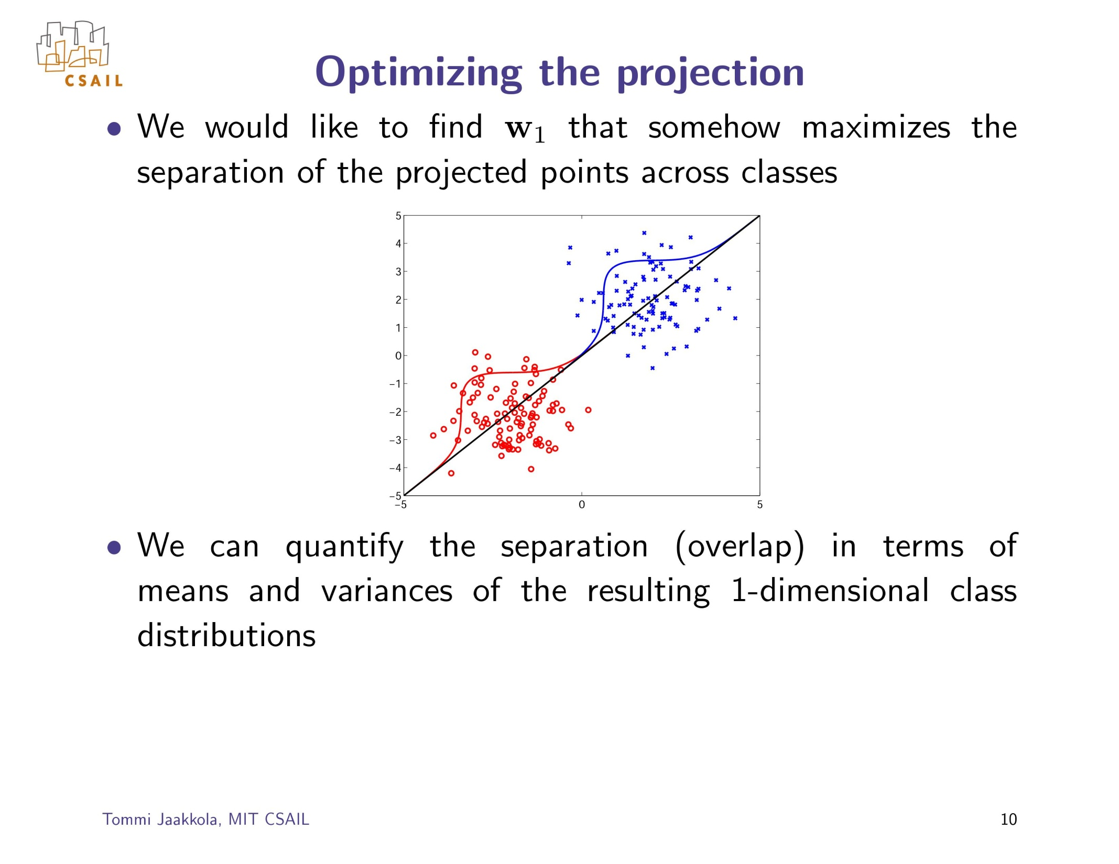

Slide 13
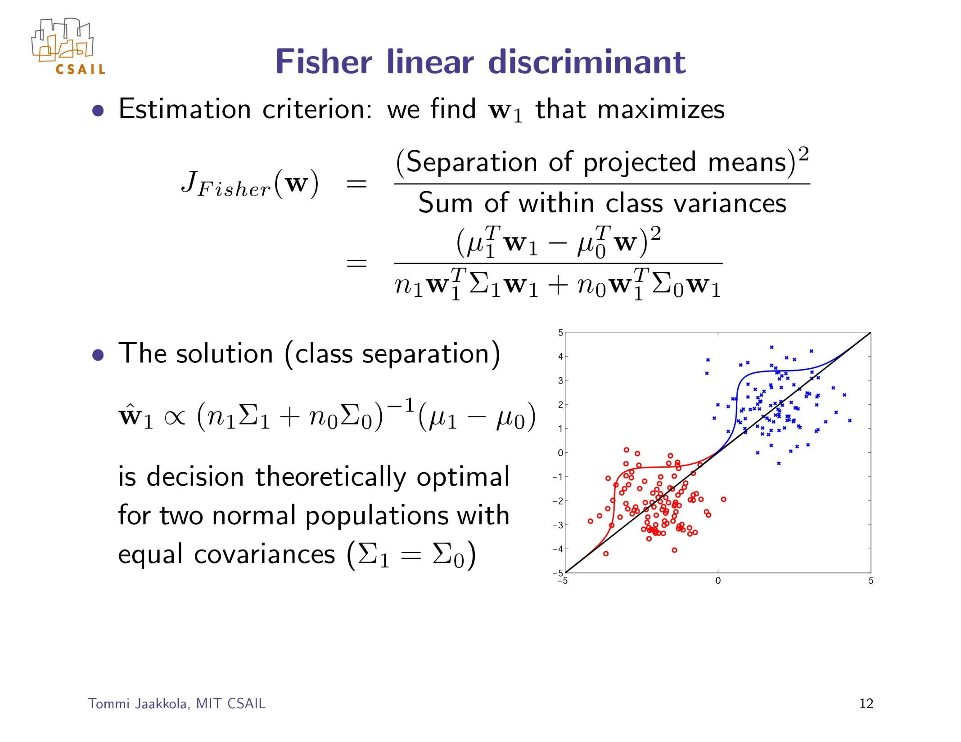

Slide 14
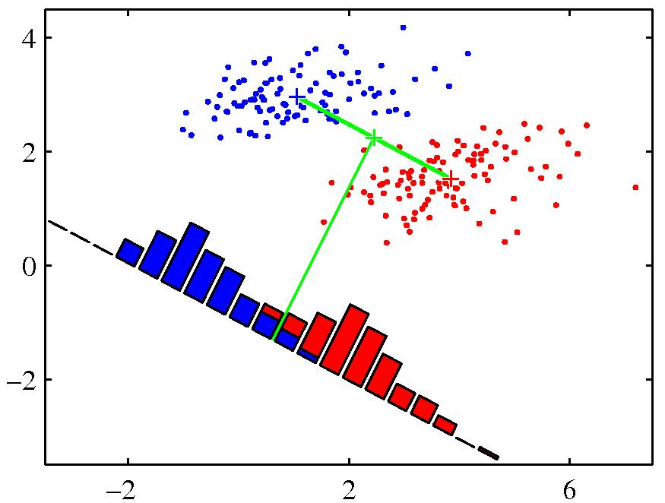
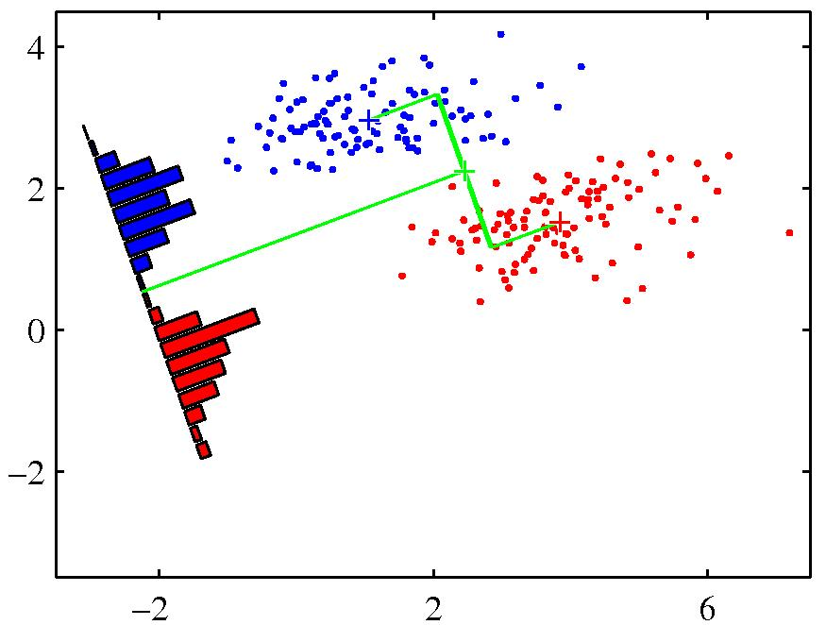
Fisher’s linear discriminant
Figures from Bishop

Slide 15
Plan for Today
Regression for classification
Fisher’s linear discriminant
Perceptron
Logistic regression
Multi-way classification
Generative vs discriminative models

Slide 16

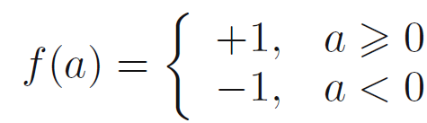
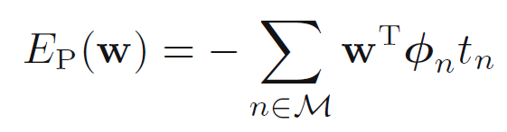
The perceptron algorithm
Rosenblatt (1962)
Prediction rule:
where
Want: (t_{n} = +1 or -1)
Loss:
(just using the Misclassified examples)

Slide 17
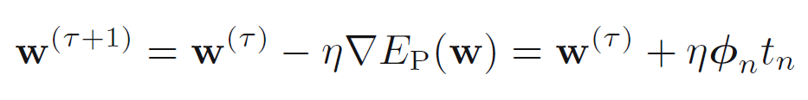
The perceptron algorithm
Loss:
Learning algorithm update rule:
Interpretation:
  If sample is being misclassified, make the weight vector more like it

Slide 18
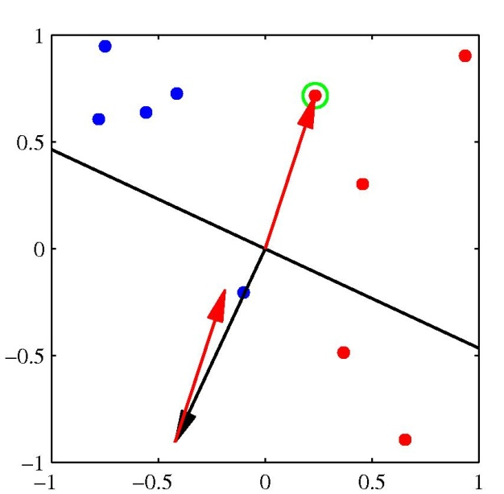
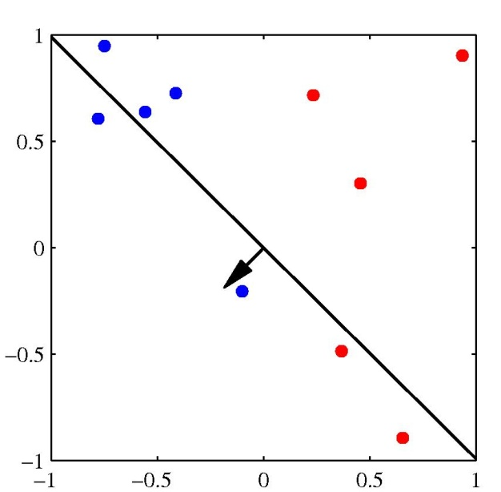
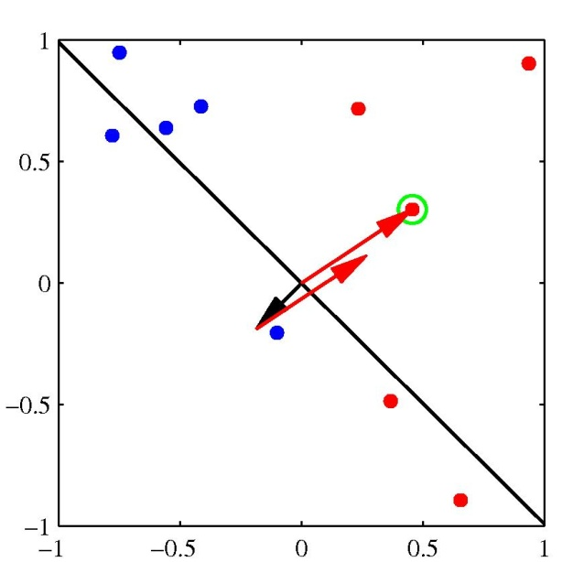
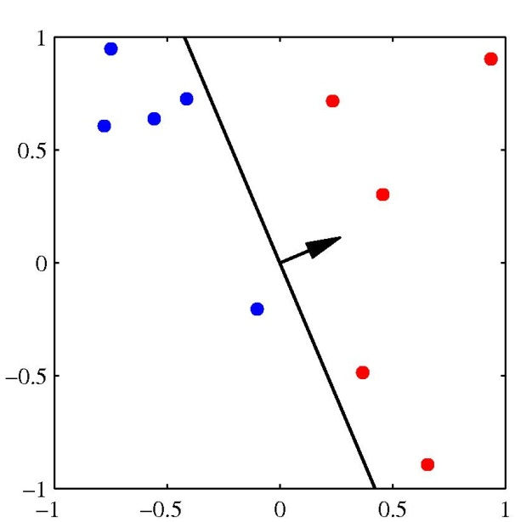
The perceptron algorithm
Figures from Bishop

Slide 19
Plan for Today
Regression for classification
Fisher’s linear discriminant
Perceptron
Logistic regression
Multi-way classification
Generative vs discriminative models

Slide 20
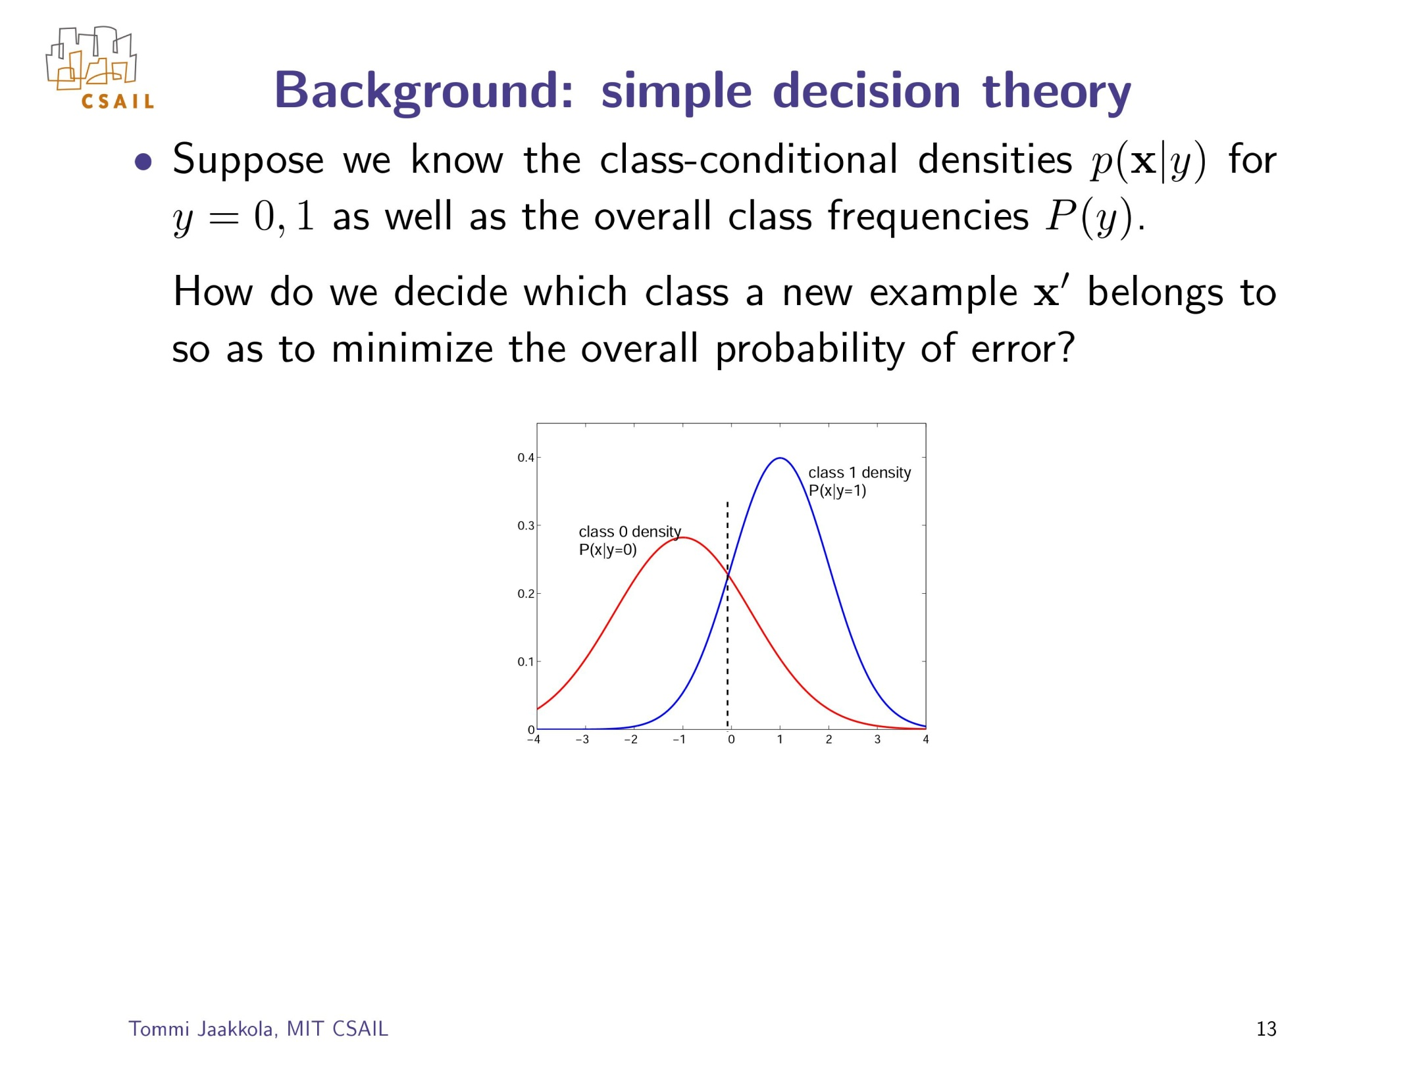

Slide 21
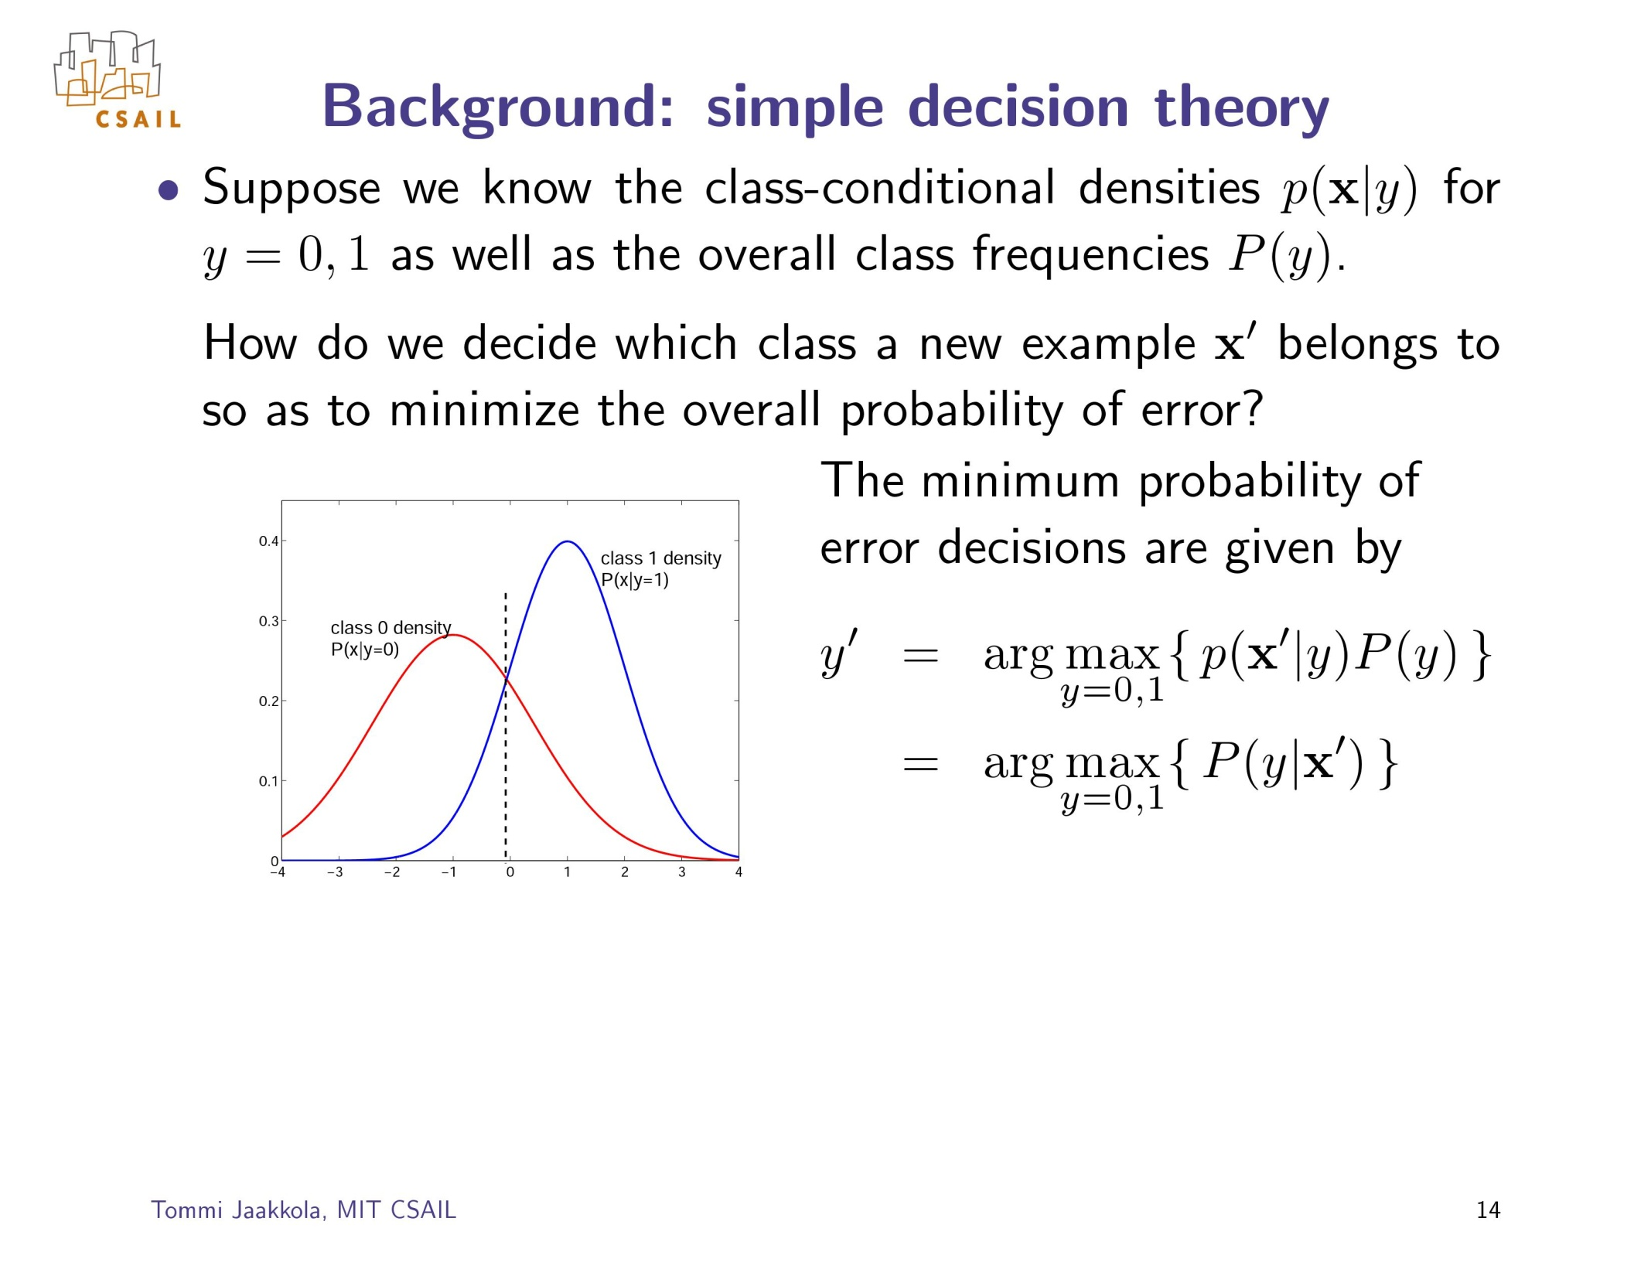

Slide 22
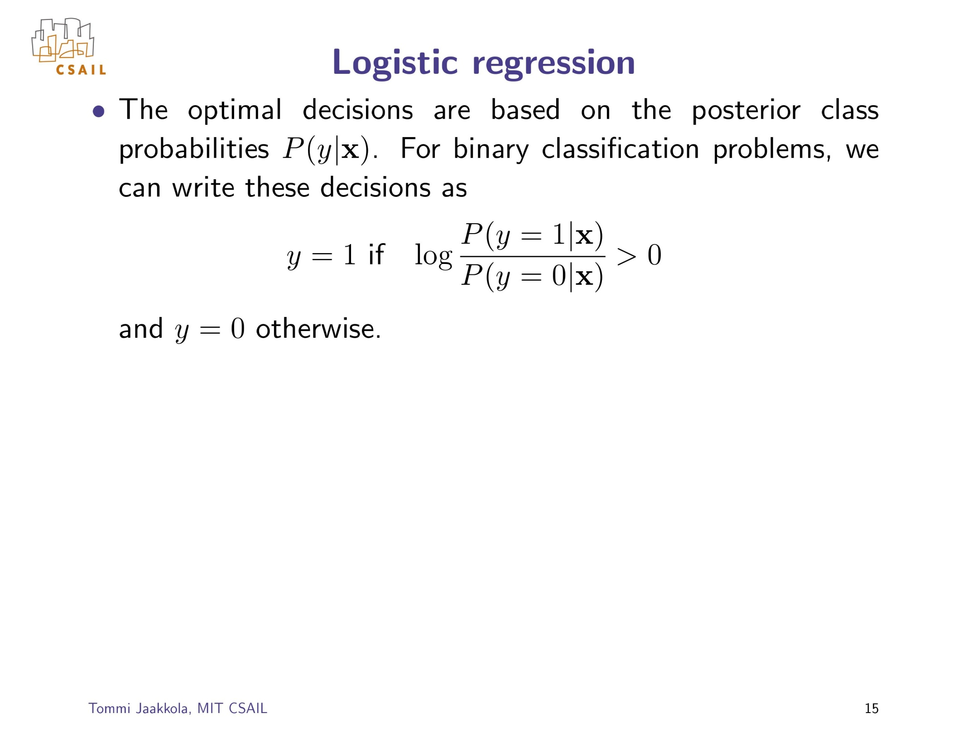

Slide 23
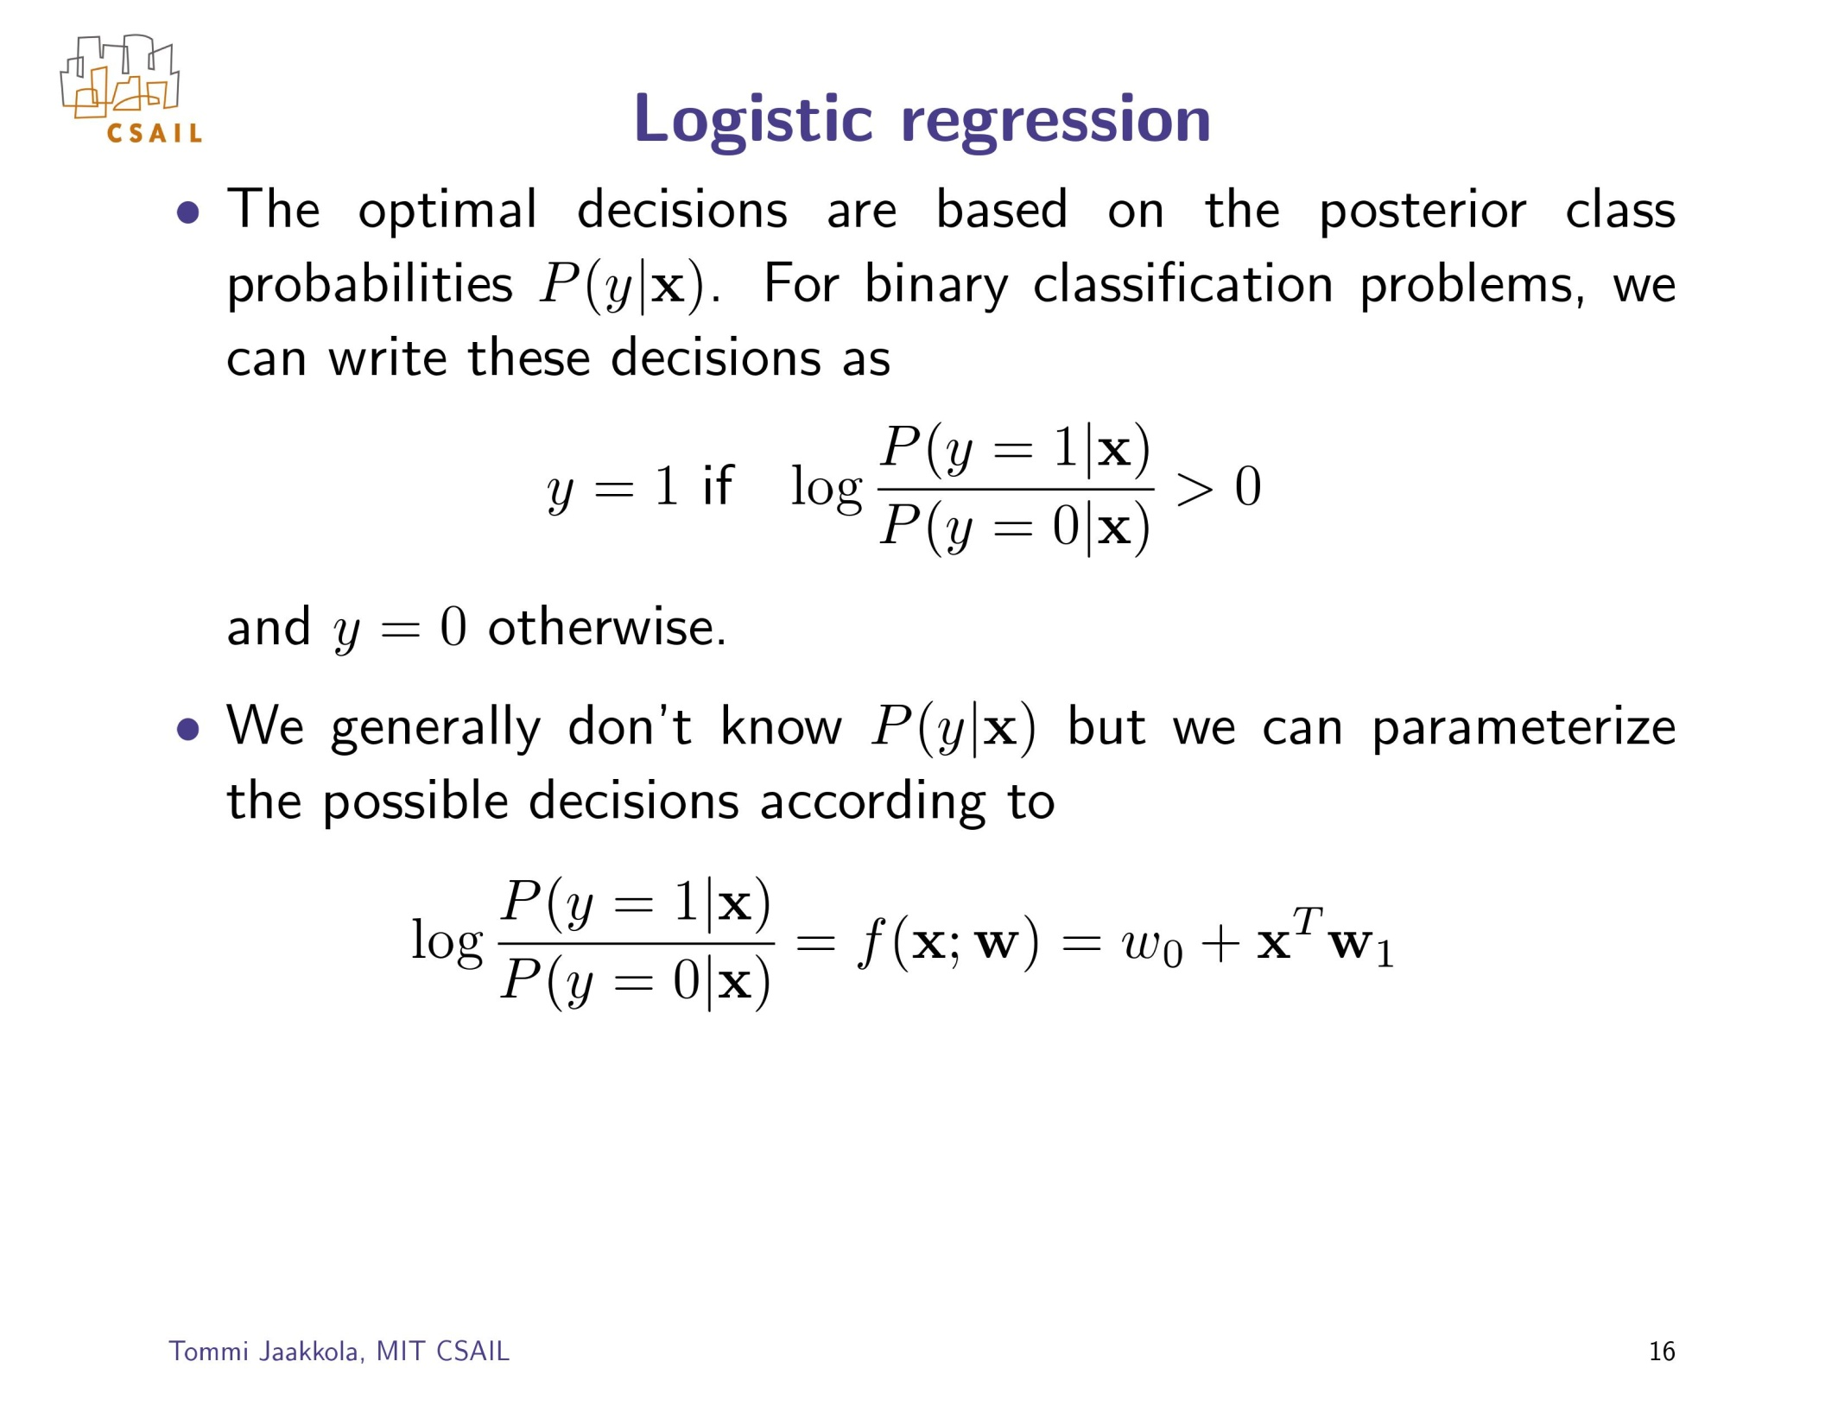

Slide 24
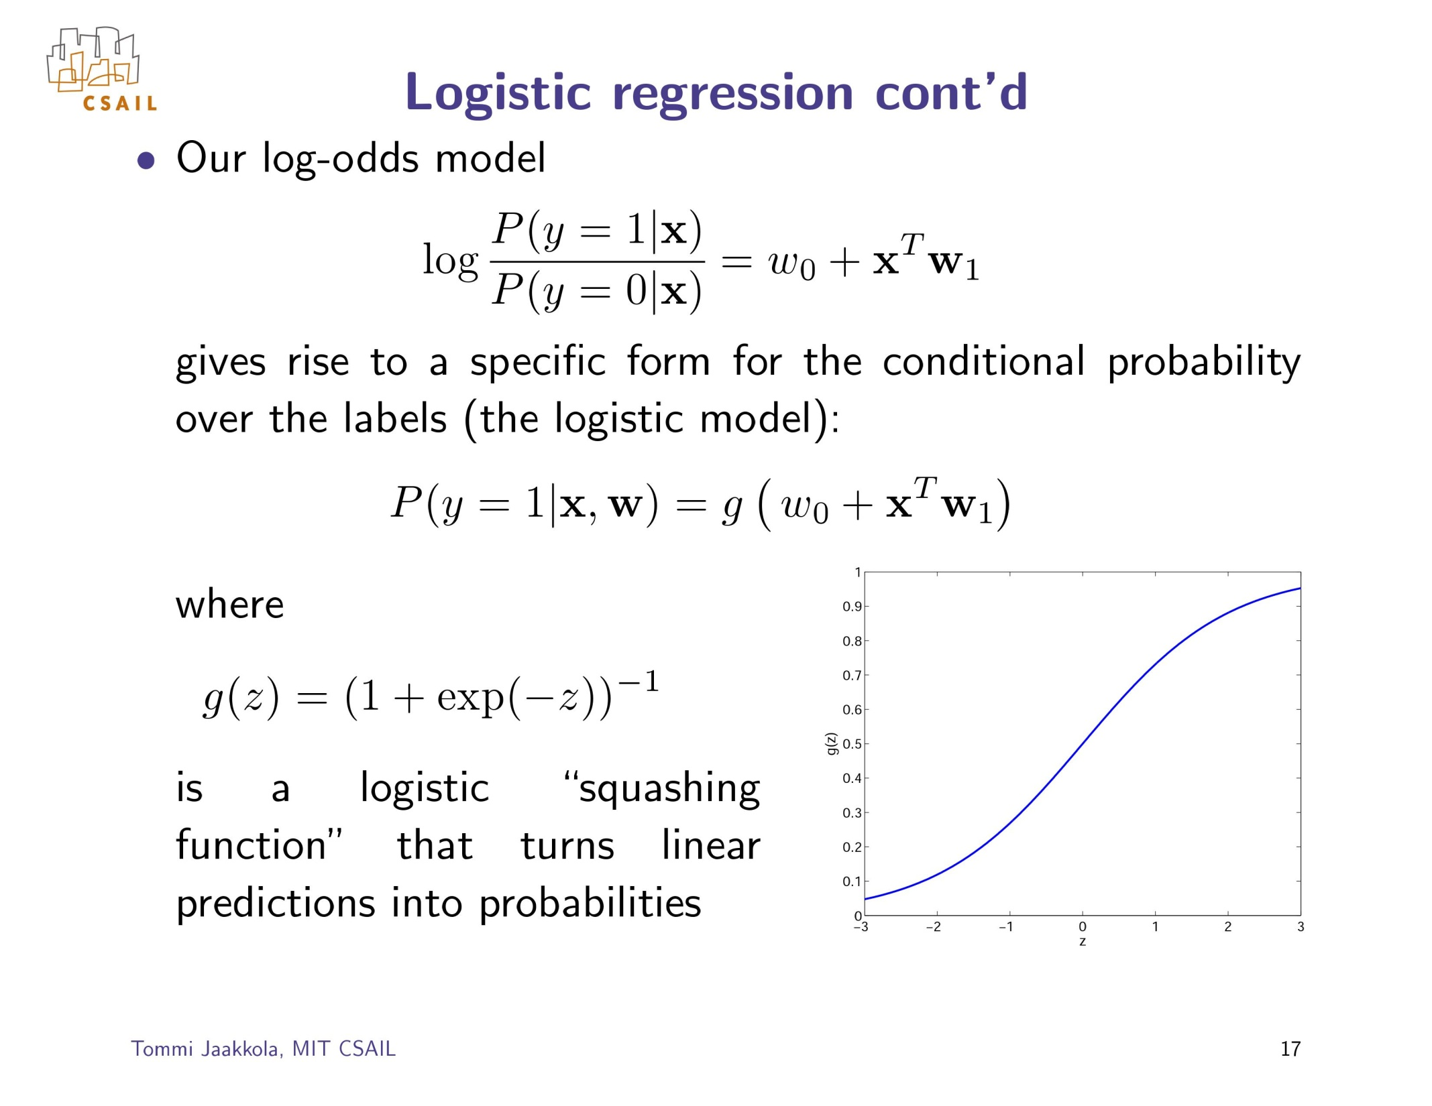
σ
σ

Slide 25
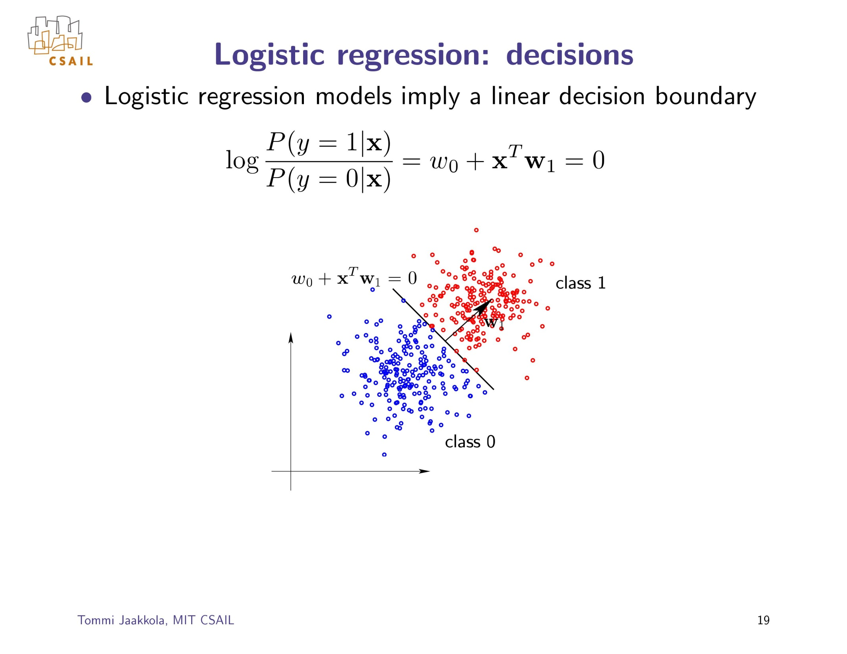

Slide 26
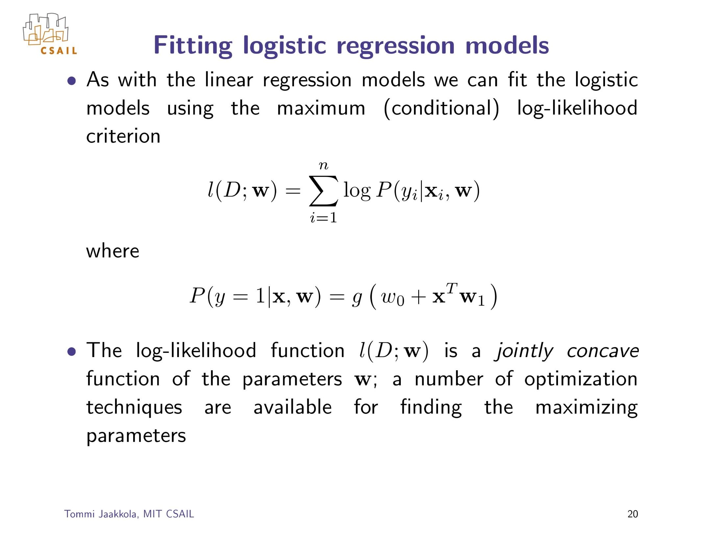
σ

Slide 27
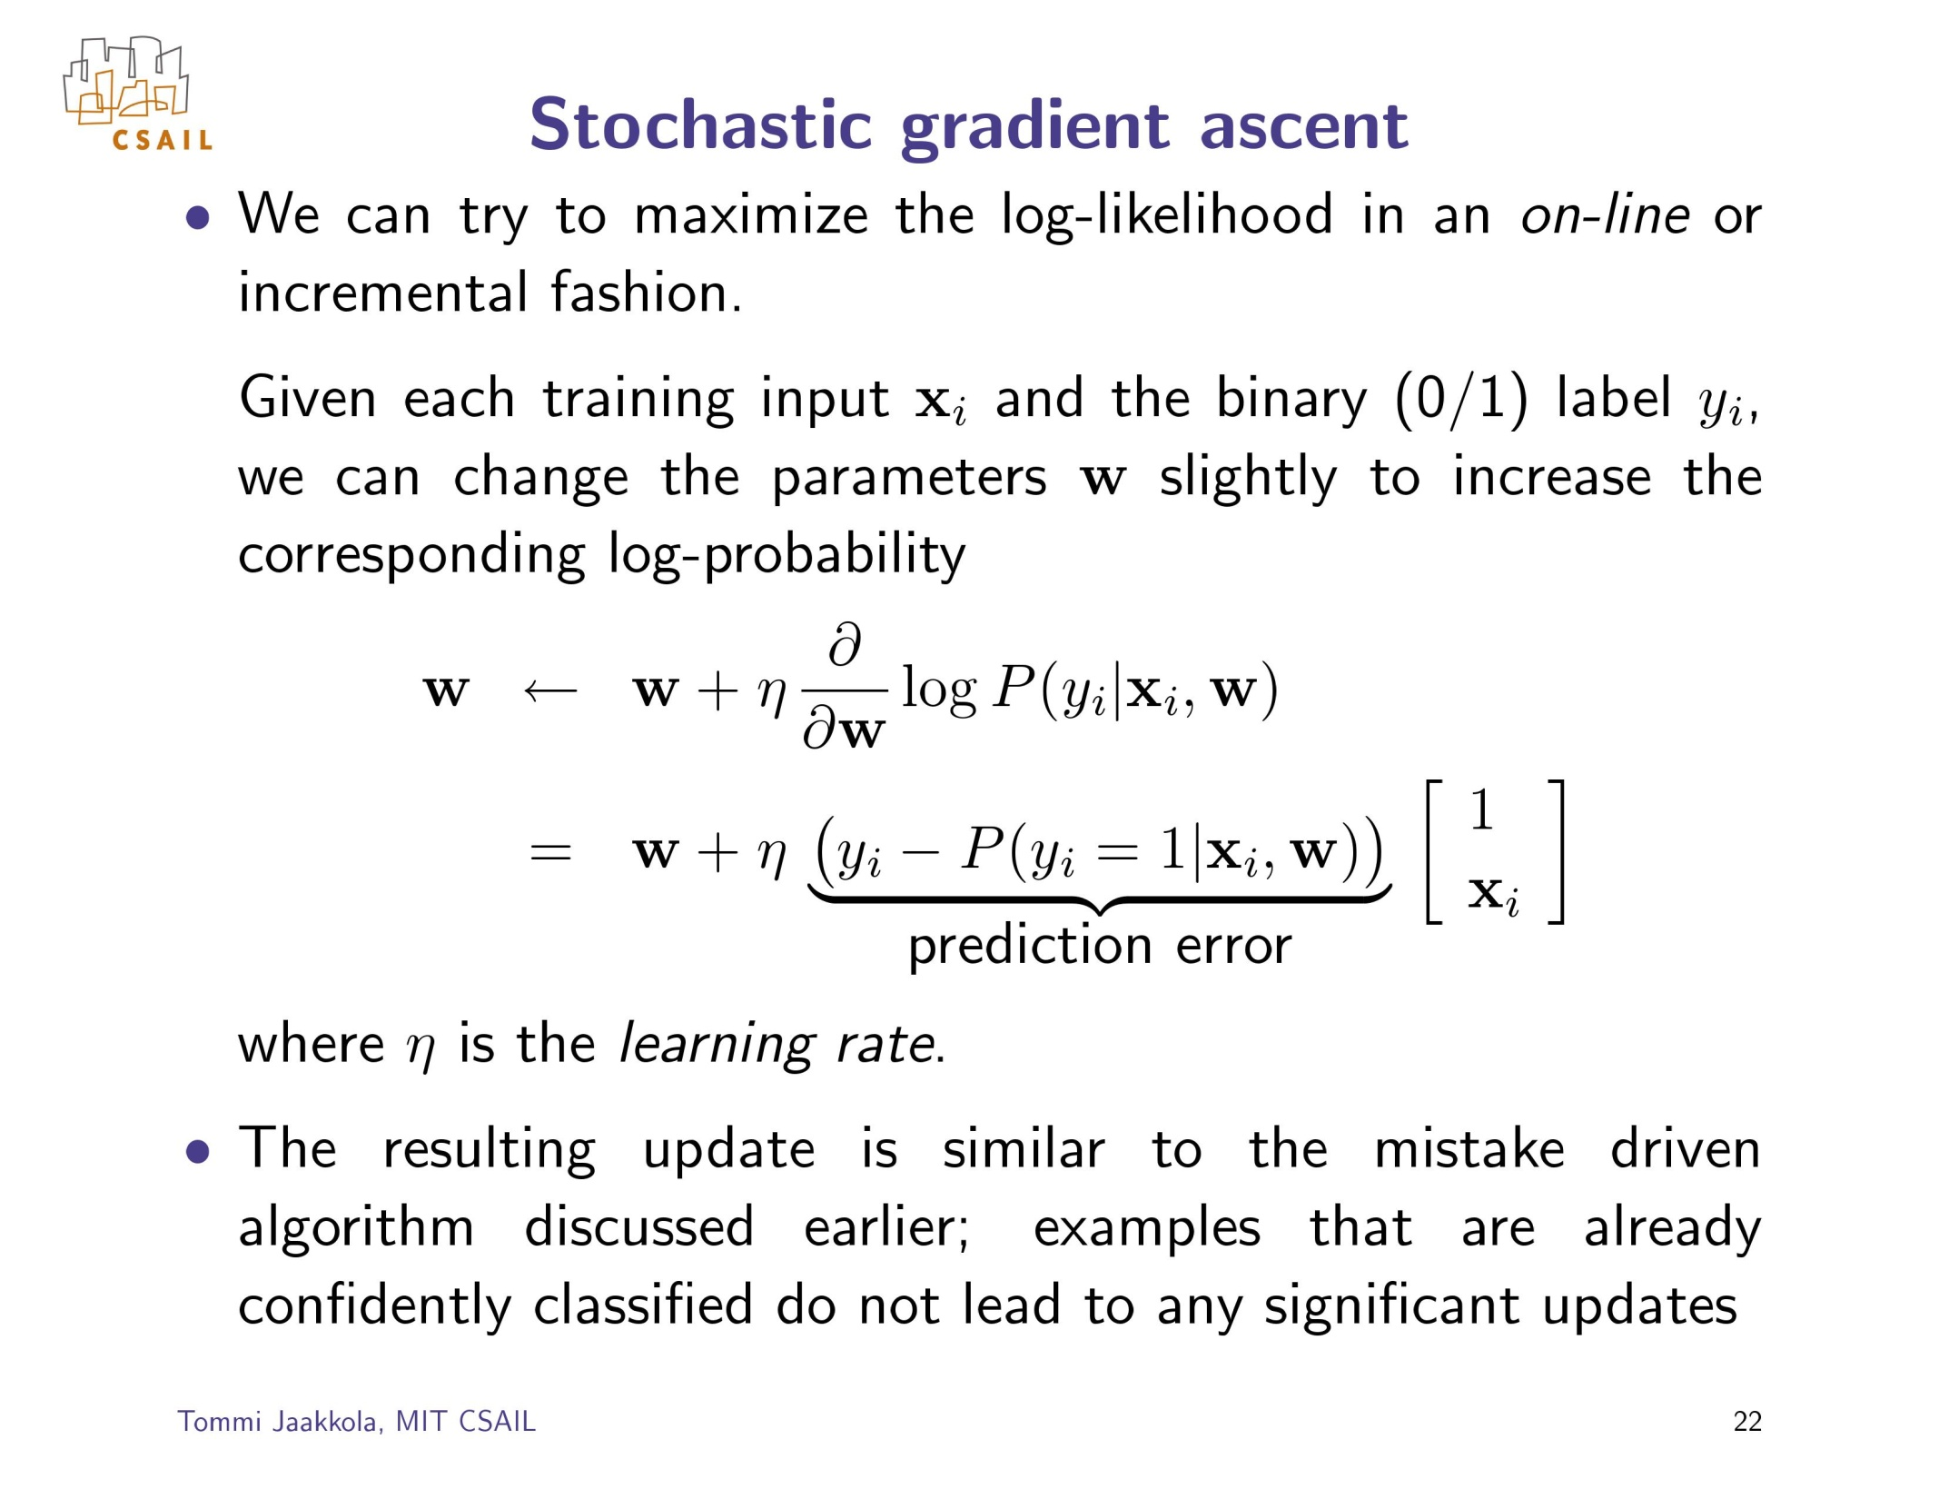

Slide 28
Plan for Today
Regression for classification
Fisher’s linear discriminant
Perceptron
Logistic regression
Multi-way classification
Generative vs discriminative models

Slide 29
Multi-class problems
Instead of just two classes, we now have C classes
  E.g. predict which movie genre a viewer likes best
  Possible answers: action, drama, indie, thriller, etc.
Two approaches:
  One-vs-all
  One-vs-one

Slide 30
Multi-class problems
One-vs-all (a.k.a. one-vs-others)
  Train C classifiers
  In each, pos = data from class i, neg = data from classes other than i
  The class with the most confident prediction wins
  Example:
    You have 4 classes, train 4 classifiers
    1 vs others: score 3.5
    2 vs others: score 6.2
    3 vs others: score 1.4
    4 vs other: score 5.5
    Final prediction: class 2
  Issues?

Slide 31
Multi-class problems
One-vs-one (a.k.a. all-vs-all)
  Train C(C-1)/2 binary classifiers (all pairs of classes)
  They all vote for the label
  Example:
    You have 4 classes, then train 6 classifiers
    1 vs 2, 1 vs 3, 1 vs 4, 2 vs 3, 2 vs 4, 3 vs 4
    Votes: 1, 1, 4, 2, 4, 4
    Final prediction is class 4

Slide 32
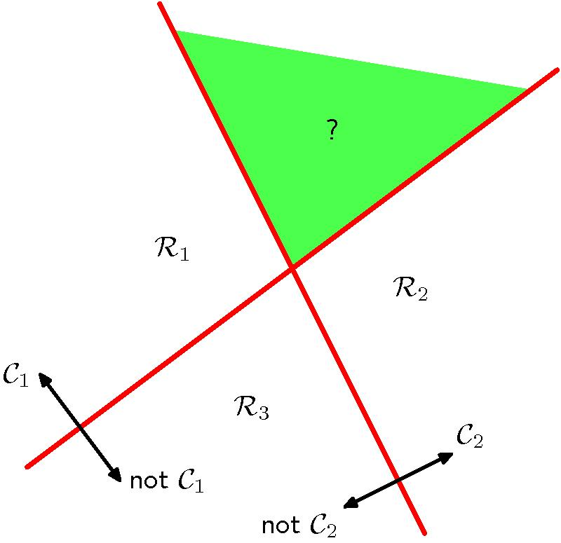
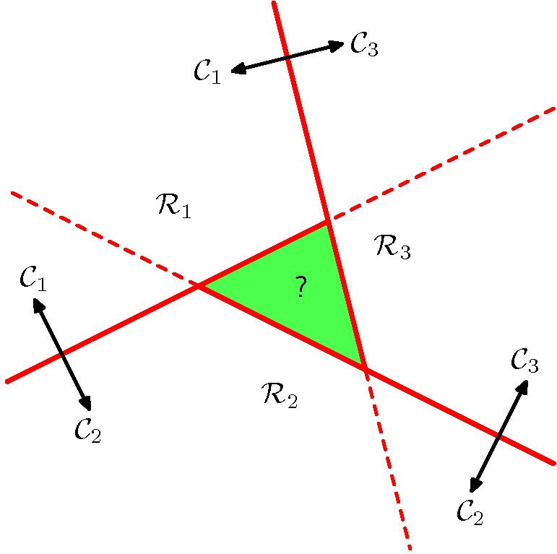
Multi-class problems
What are some problems with this approach to doing multi-class?
  There are “natively multi-class” methods
Figures from Bishop

Slide 33
Multi-class problems
Single K-class classifier:
f_{k}(x) = w_{k}^{T} x + w_{k0}
Prediction:
  Assign x to class C_{k} if f_{k}(x) > f_{j}(x) for all j ≠ k
Benefit:
  Decision regions would not overlap

Slide 34
Plan for Today
Regression for classification
Fisher’s linear discriminant
Perceptron
Logistic regression
Multi-way classification
Generative vs discriminative models

Slide 35
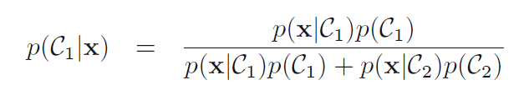


Generative models
Binary case:

Slide 36
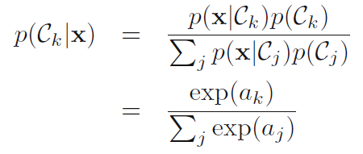

Generative models
Multi-class case:

Slide 37
Generative models
Why are these called generative?
Model probability of the data features x
  Can use them to generate new samples x
  Can model which data points are outliers
Don’t always need to model the probability of the features
  In SVMs (coming next) we don’t

Slide 38
Tradeoffs in discussed methods
Regression for classification
  Generally not a good idea
Fisher’s linear discriminant
  Finds a discriminative projection of the data
  Can be coupled with a threshold to allow classification
Perceptron
  Decision boundary corresponds to w^{T} x = 0
  Simple update rule
  Won’t converge for non-linearly-separable data
Logistic regression (a classification method)
  Same decision boundary as perceptron
  Models the probability of a label given the data

