Slide 1
CS 2750: Machine Learning
Classification:
Nearest Neighbors
Prof. Adriana Kovashka
University of Pittsburgh
February 2, 2017

Slide 2
Announcement
Just for today, my office hours will be slightly shifted, 4:30-6pm

Slide 3
Plan for today
Basic formulation of the simplest classifier: K-Nearest Neighbors
  Example use
Generalizing the distance metric and weighting neighbors differently
Problems:
  The curse of dimensionality
  Picking K
  Approximation strategies

Slide 4
Key Idea
A type of supervised learning: We want to learn to predict, for a new data point x, its label y (e.g. spam / not spam)
Don’t learn an explicit function F: X → Y
Keep all training data {X, Y}
For a test example x, find the training example x_{i} closest to it (e.g. using Euclidean distance)
Then copy the target label y_{i} as the label for x

Slide 5
Related Methods
Instance-based methods
Exemplar methods
Memory-based methods
Non-parametric methods

Slide 6
Instance/Memory-based Learning
Four things make a memory based learner:
A distance metric
How many nearby neighbors to look at?
A weighting function (optional)
How to fit with the local points?
Slide credit: Carlos Guestrin

Slide 7
1-Nearest Neighbor Classifier
Four things make a memory based learner:
A distance metric
  Euclidean (and others)
How many nearby neighbors to look at?
  1
A weighting function (optional)
  Not used
How to fit with the local points?
  Just predict the same output as the nearest neighbor
Slide credit: Carlos Guestrin

Slide 8
1-Nearest Neighbor Classifier
Test example
Training examples from class 2
Training examples from class 1
f(x) = label of the training example nearest to x
Adapted from Lana Lazebnik

Slide 9
K-Nearest Neighbor Classifier
Four things make a memory based learner:
A distance metric
  Euclidean (and others)
How many nearby neighbors to look at?
  K
A weighting function (optional)
  Not used
How to fit with the local points?
  Just predict the average output among the nearest neighbors
Slide credit: Carlos Guestrin

Slide 10
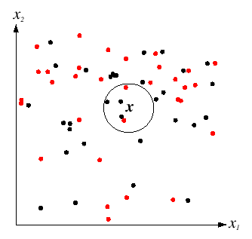
K-Nearest Neighbor Classifier
For a new point, find the k closest points from training data (e.g. k=5)
Labels of the k points “vote” to classify
Black = negative
Red = positive
If query lands here, the 5 NN consist of 3 negatives and 2 positives, so we classify it as negative.
Slide credit: David Lowe

Slide 11
1-nearest neighbor
x
x
x
o
x
x
x
+
o
o
x
x
o
o
+
o
o
x2
x1
Slide credit: Derek Hoiem

Slide 12
3-nearest neighbor
x
x
x
o
x
x
x
+
o
o
x
x
o
o
+
o
o
x2
x1
Slide credit: Derek Hoiem

Slide 13
5-nearest neighbor
x
x
x
o
x
x
x
+
o
o
x
x
o
o
+
o
o
x2
x1
What are the tradeoffs of having a too large k? Too small k?
Slide credit: Derek Hoiem

Slide 14

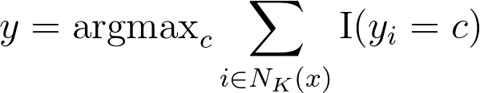
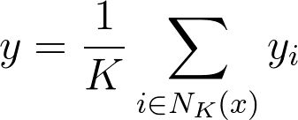
Formal Definition
Let x be our test data point, and N_{K}(x) be the indices of the k nearest neighbors of x
Classification:
Regression:

Slide 15
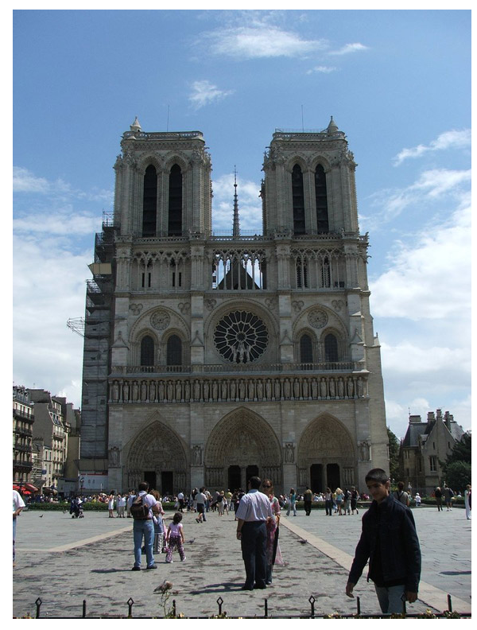
Example: Predict where this picture was taken
Hays and Efros, IM2GPS: Estimating Geographic Information from a Single Image, CVPR 2008

Slide 16
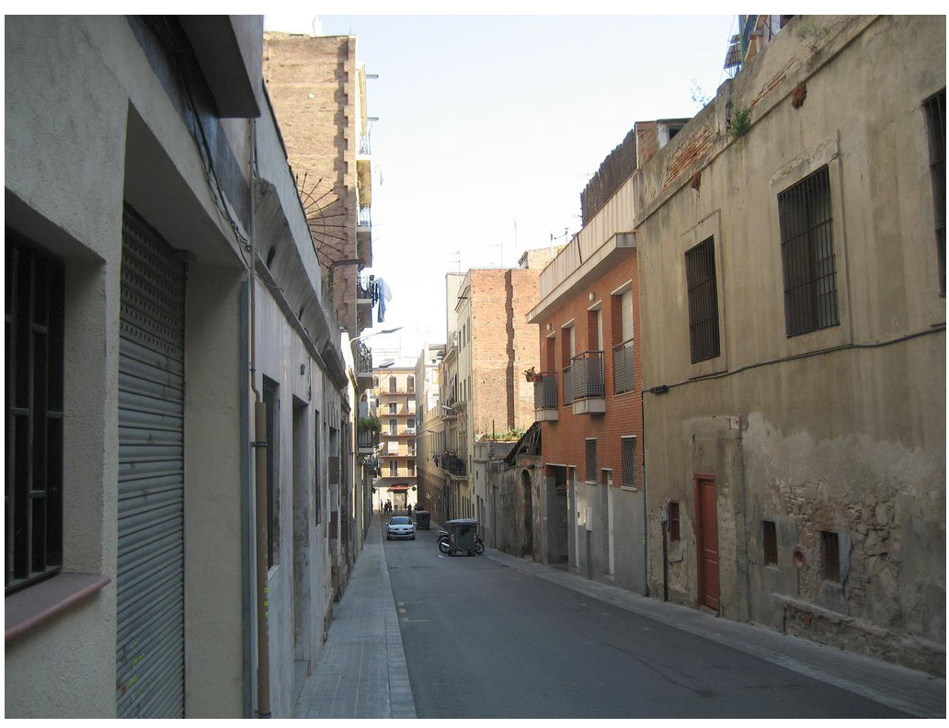
Example: Predict where this picture was taken
Hays and Efros, IM2GPS: Estimating Geographic Information from a Single Image, CVPR 2008

Slide 17
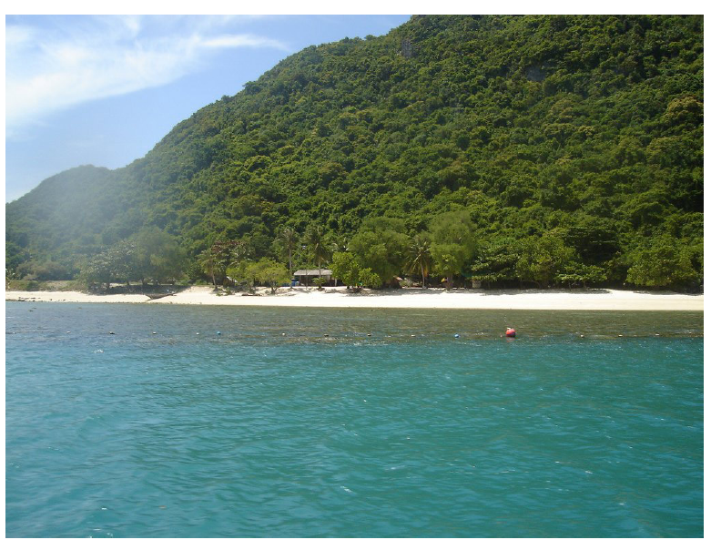
Example: Predict where this picture was taken
Hays and Efros, IM2GPS: Estimating Geographic Information from a Single Image, CVPR 2008

Slide 18
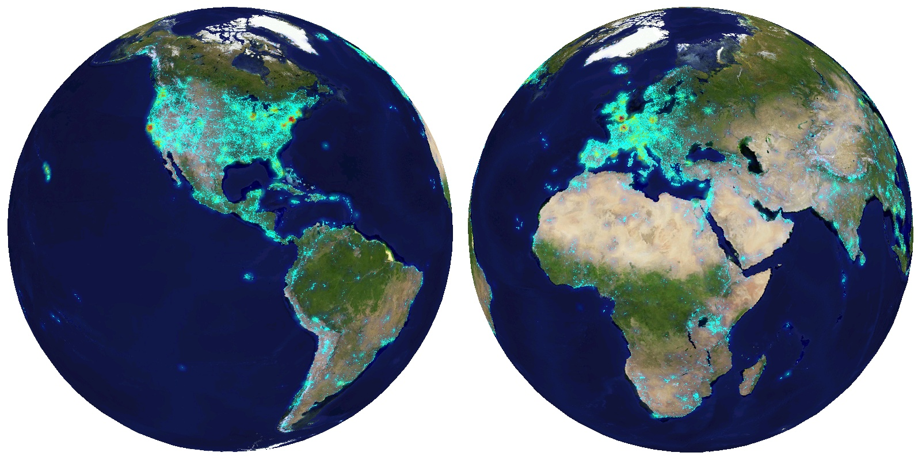
6+ million geotagged photos by 109,788 photographers
Hays and Efros, IM2GPS: Estimating Geographic Information from a Single Image, CVPR 2008

Slide 19
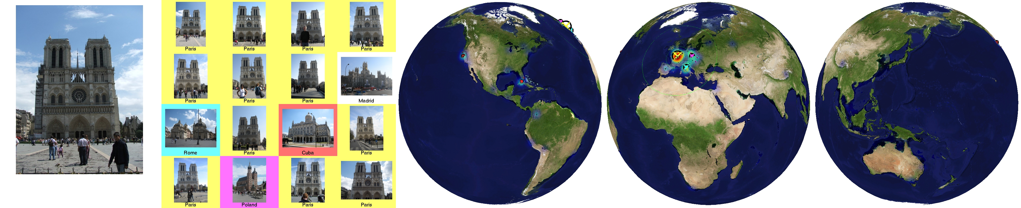
Scene Matches
Hays and Efros, IM2GPS: Estimating Geographic Information from a Single Image, CVPR 2008

Slide 20

Hays and Efros, IM2GPS: Estimating Geographic Information from a Single Image, CVPR 2008

Slide 21
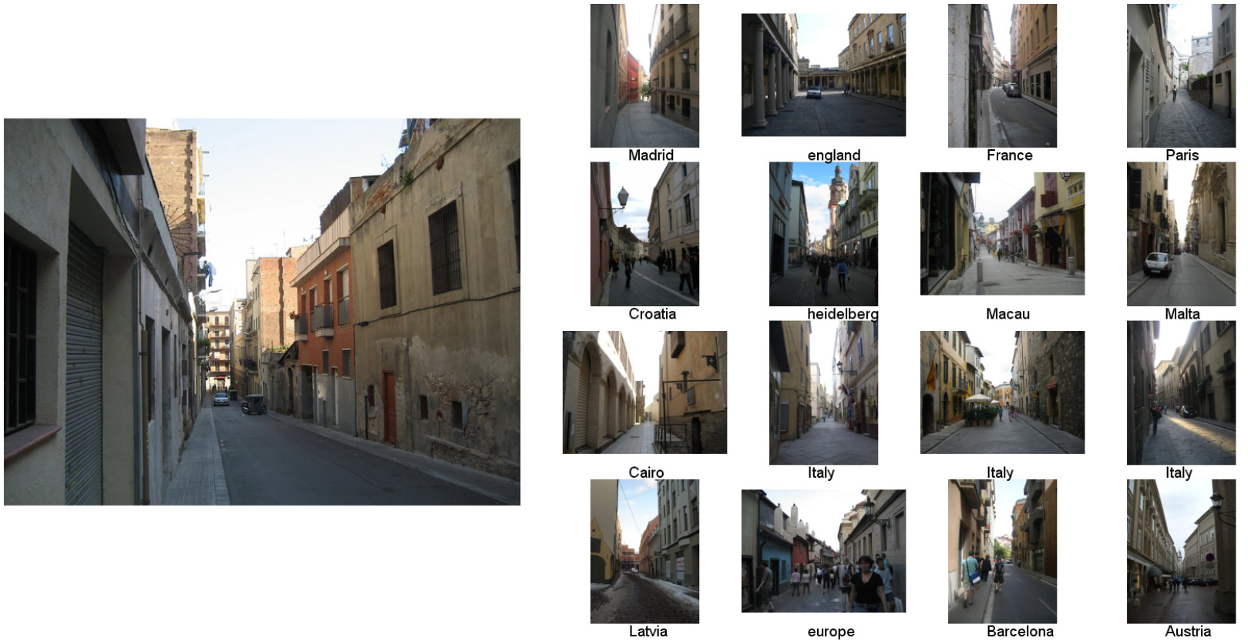
Scene Matches
Hays and Efros, IM2GPS: Estimating Geographic Information from a Single Image, CVPR 2008

Slide 22
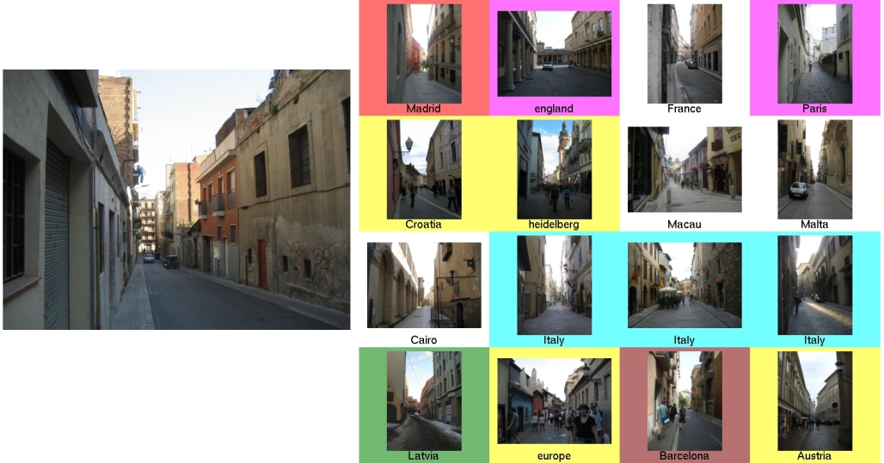

Hays and Efros, IM2GPS: Estimating Geographic Information from a Single Image, CVPR 2008

Slide 23
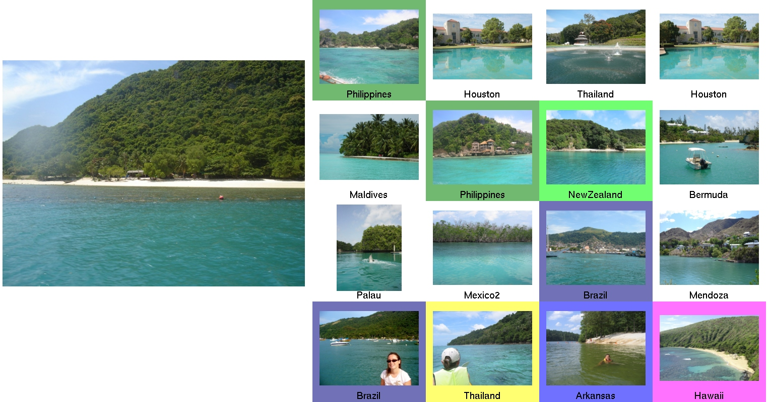
Scene Matches
Hays and Efros, IM2GPS: Estimating Geographic Information from a Single Image, CVPR 2008

Slide 24


Hays and Efros, IM2GPS: Estimating Geographic Information from a Single Image, CVPR 2008

Slide 25
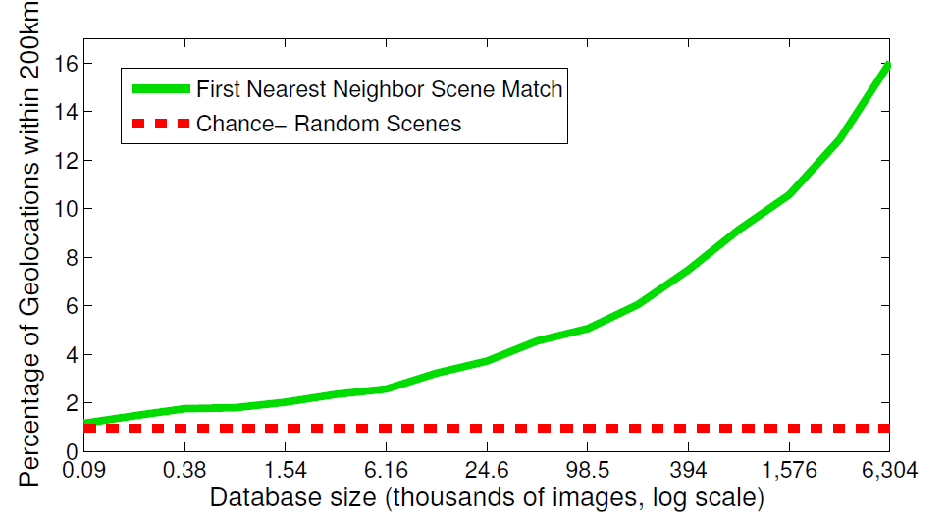
The Importance of Data
Hays and Efros, IM2GPS: Estimating Geographic Information from a Single Image, CVPR 2008

Slide 26
k-Nearest Neighbor
Four things make a memory based learner:
A distance metric
  Euclidean (and others)
How many nearby neighbors to look at?
  k
A weighting function (optional)
  Not used
How to fit with the local points?
  Just predict the average output among the nearest neighbors
Slide credit: Carlos Guestrin

Slide 27
Distances
Suppose I want to charge my overall distance more for differences in x₂ direction as opposed to x₁ direction
Setup A: equal weighing on all directions
Setup B: more weight on x₂ direction
Will my neighborhoods be longer in the x₁ or x₂ direction?

Slide 28
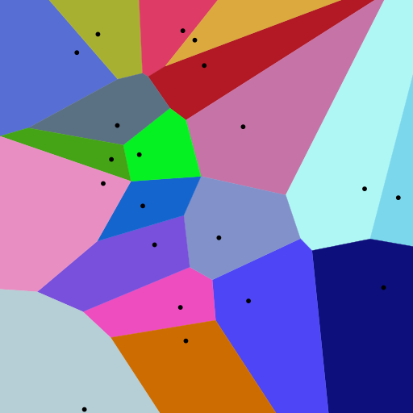
Voronoi partitioning
Nearest neighbor regions
All points in a region are closer to the seed in that region than to any other seed (black dots = seeds)
Figure from Wikipedia

Slide 29
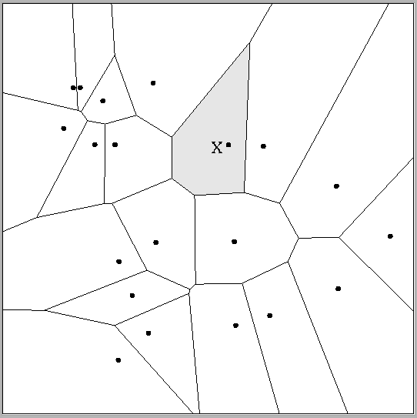
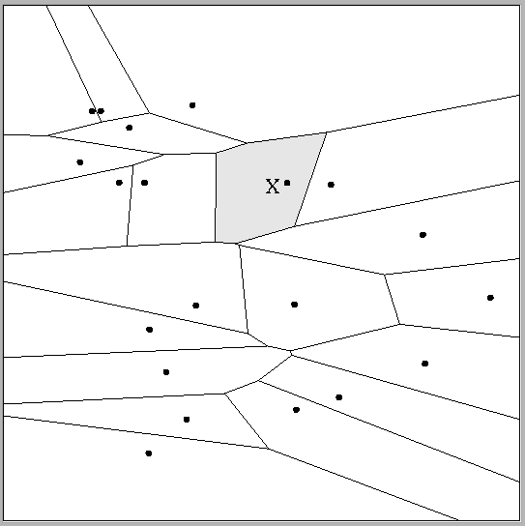
Multivariate distance metrics
Suppose the input vectors x₁, x₂, …x_{N} are two dimensional:
x₁ = ( x₁¹ , x₁² ) , x₂ = ( x₂¹ , x₂² ) , … , x_{N} = ( x_{N}¹ , x_{N}² ).
 | Dist(x_{i},x_{j}) =(x_{i}¹ – x_{j}¹)²+(3x_{i}² – 3x_{j}²)²
Dist(x_{i},x_{j}) = (x_{i}¹ – x_{j}¹)² + (x_{i}² – x_{j}²)²
The relative scalings in the distance metric affect region shapes
Adapted from Carlos Guestrin

Slide 30
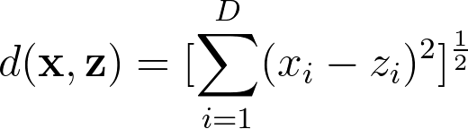
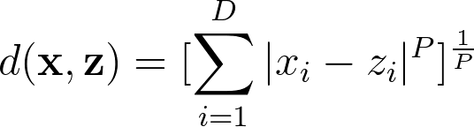
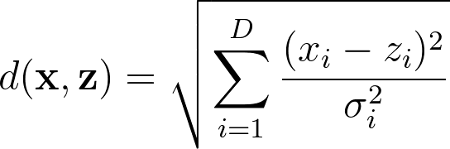
Distance metrics
Euclidean:
Minkowski:
Mahalanobis:
(where A is a positive semidefinite matrix,
i.e. symmetric matrix with all non-negative eigenvalues)

Slide 31
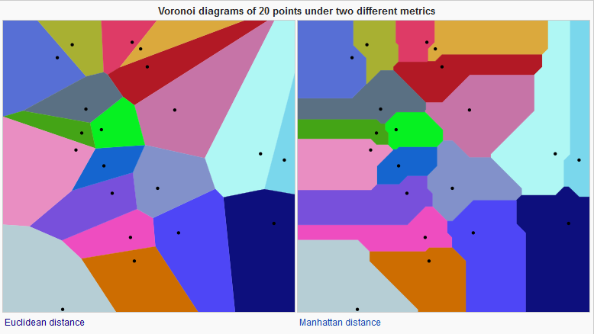
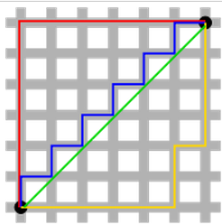
Distance metrics
Euclidean
Manhattan
Figures from Wikipedia

Slide 32

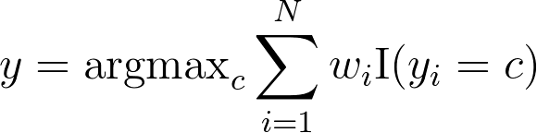
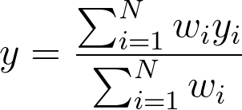
Another generalization: Weighted K-NNs
Neighbors weighted differently:
  Use all samples, i.e. K = N
  Weight on i-th sample:
  σ = the bandwidht parameter, expresses how quickly our weight function “drops off” as points get further and further from the query x
Classification:
Regression:

Slide 33
Another generalization: Weighted K-NNs
Extremes
  Bandwidth = infinity: prediction is dataset average
  Bandwidth = zero: prediction becomes 1-NN

Slide 34
Kernel Regression/Classification
Four things make a memory based learner:
A distance metric
  Euclidean (and others)
How many nearby neighbors to look at?
  All of them
A weighting function (optional)
  w_{i} = exp(-d(x_{i}, query)² / σ²)
  Nearby points to the query are weighted strongly, far points weakly. The σ parameter is the kernel width / bandwidth.
How to fit with the local points?
  Predict the weighted average of the outputs
Adapted from Carlos Guestrin

Slide 35
Problems with Instance-Based Learning
Too many features?
  Doesn’t work well if large number of irrelevant features, distances overwhelmed by noisy features
  Distances become meaningless in high dimensions (the curse of dimensionality)
What is the impact of the value of K?
Expensive
  No learning: most real work done during testing
  For every test sample, must search through all dataset – very slow!
  Must use tricks like approximate nearest neighbor search
  Need to store all training data
Adapted from Dhruv Batra

Slide 36
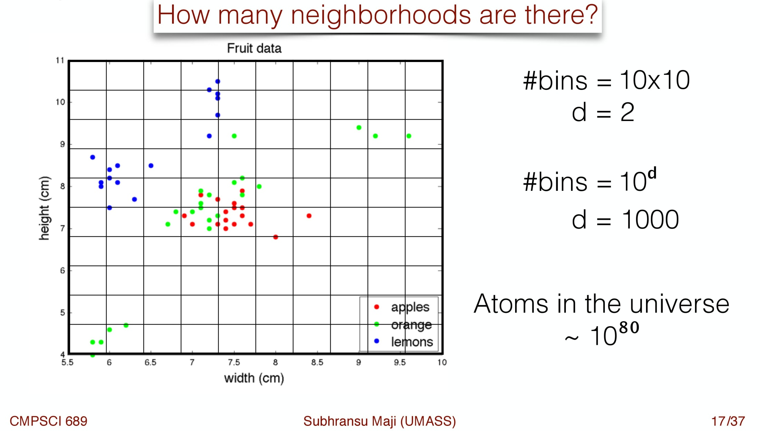
Curse of Dimensionality (1)

Slide 37
Curse of Dimensionality (2)
Consider: Sphere of radius 1 in d-dims
Consider: An outer ε-shell in this sphere
What is ?
Slide credit: Dhruv Batra

Slide 38
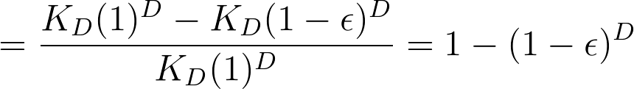
Curse of Dimensionality (2)
The volume of a “sphere” with radius r in D dimensions is K_{D}r^{D} (Bishop Sec. 1.4)
What is ?
As D tends to infinity, this ratio tends to 1
I.e. most of the volume of the sphere is in that thin outer shell, which is counter-intuitive

Slide 39
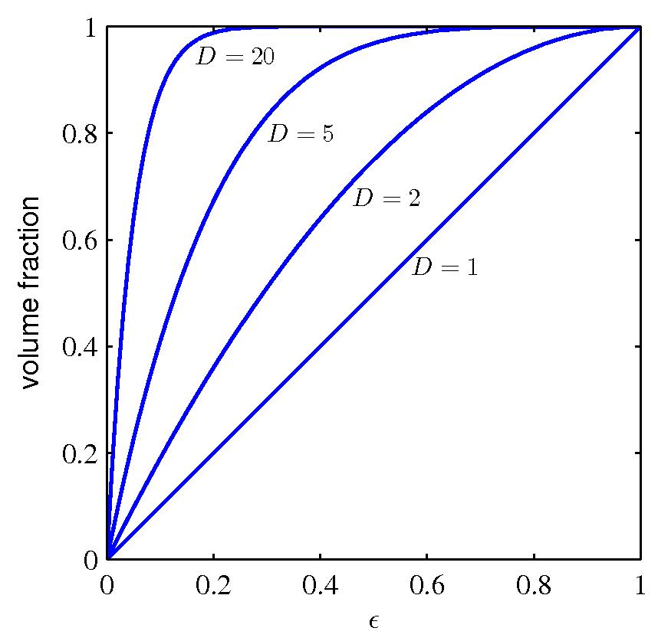
Curse of Dimensionality (2)
Figure 1.22 from Bishop

Slide 40
Curse of Dimensionality (2)
Problem: In very high dimensions, all points are equally close
This problem applies to all types of classifiers, not just K-NN

Slide 41
Problems with Instance-Based Learning
Too many features?
  Doesn’t work well if large number of irrelevant features, distances overwhelmed by noisy features
  Distances become meaningless in high dimensions (the curse of dimensionality)
What is the impact of the value of K?
Expensive
  No learning: most real work done during testing
  For every test sample, must search through all dataset – very slow!
  Must use tricks like approximate nearest neighbor search
  Need to store all training data
Adapted from Dhruv Batra

Slide 42
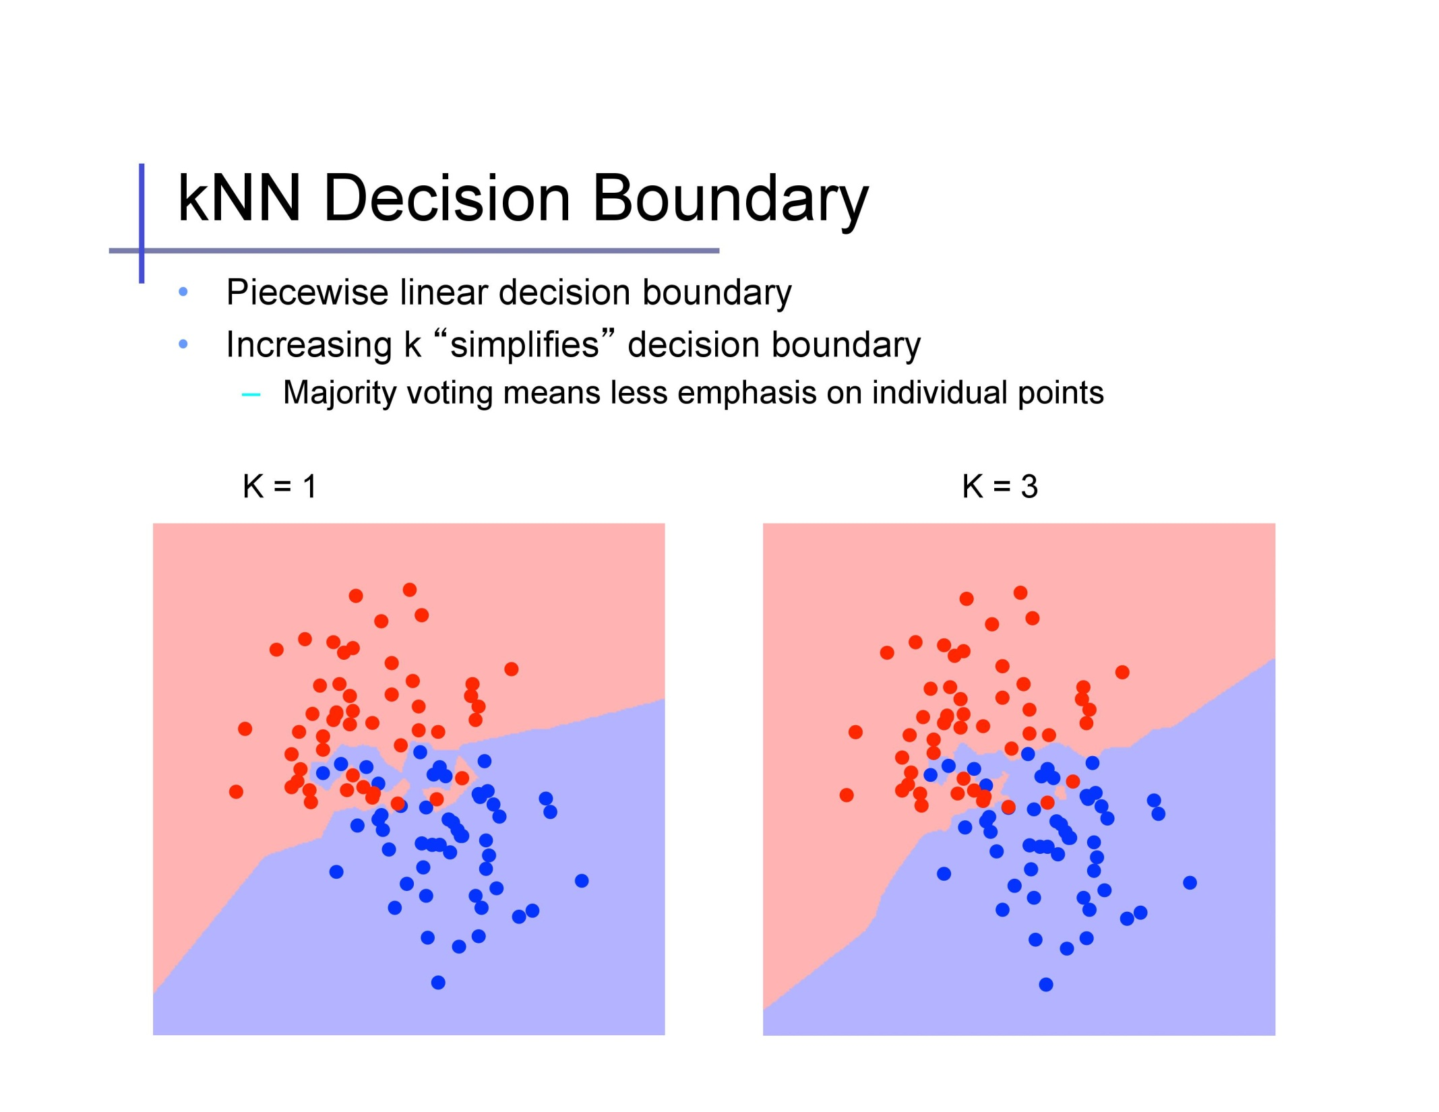
simplifies /
complicates
Slide credit: Alexander Ihler

Slide 43
Slide credit: Alexander Ihler

Slide 44
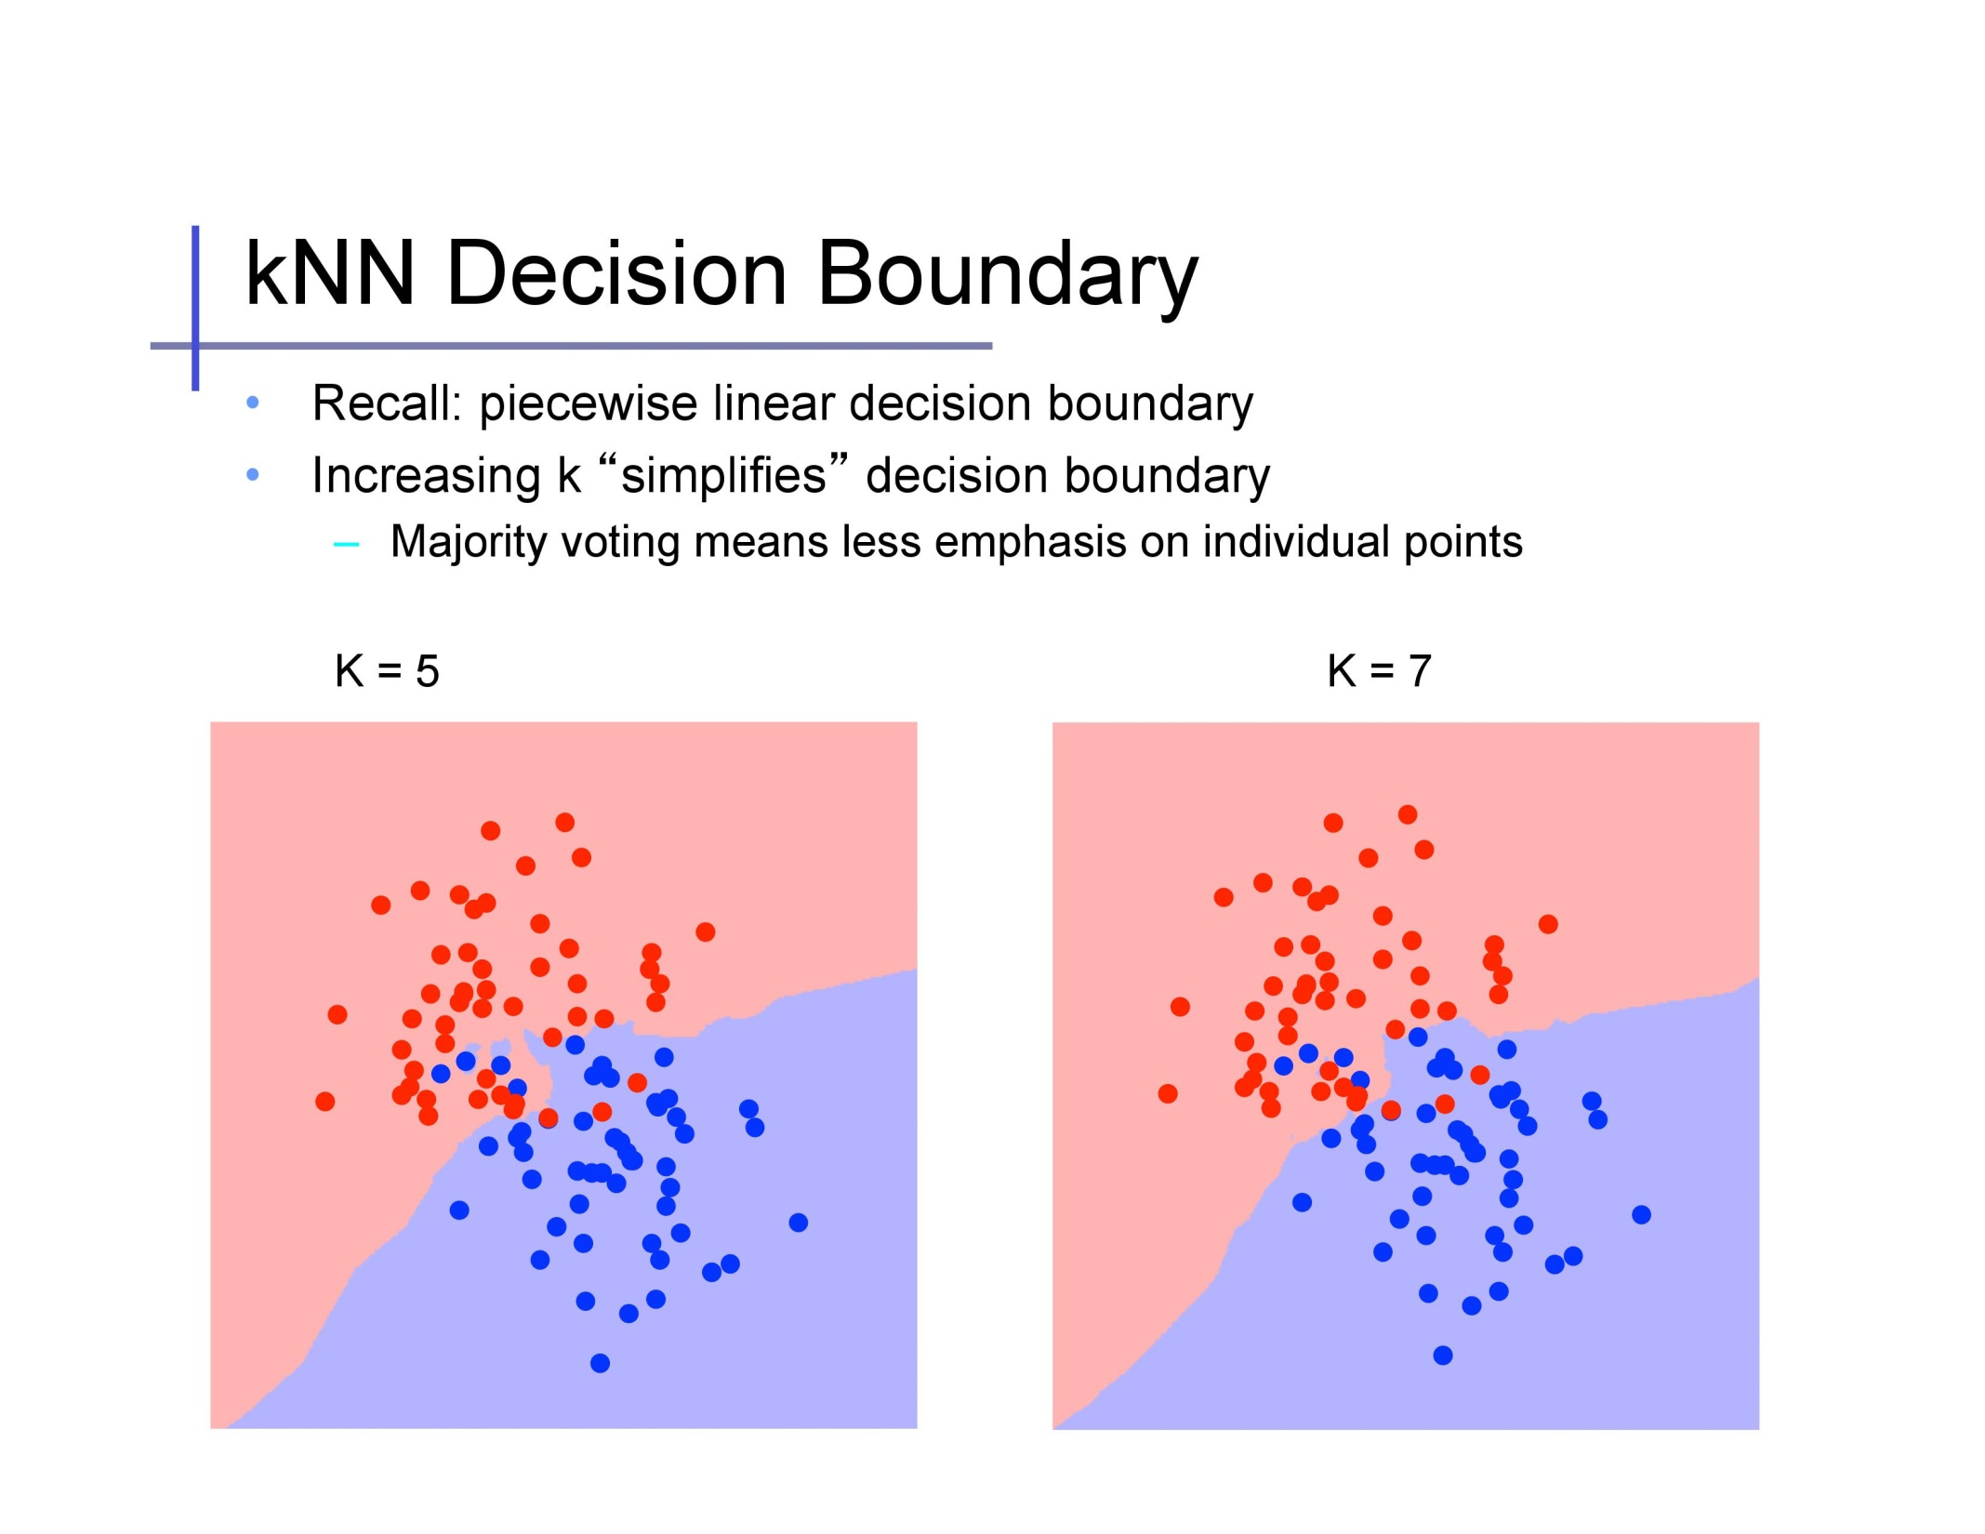
Slide credit: Alexander Ihler

Slide 45
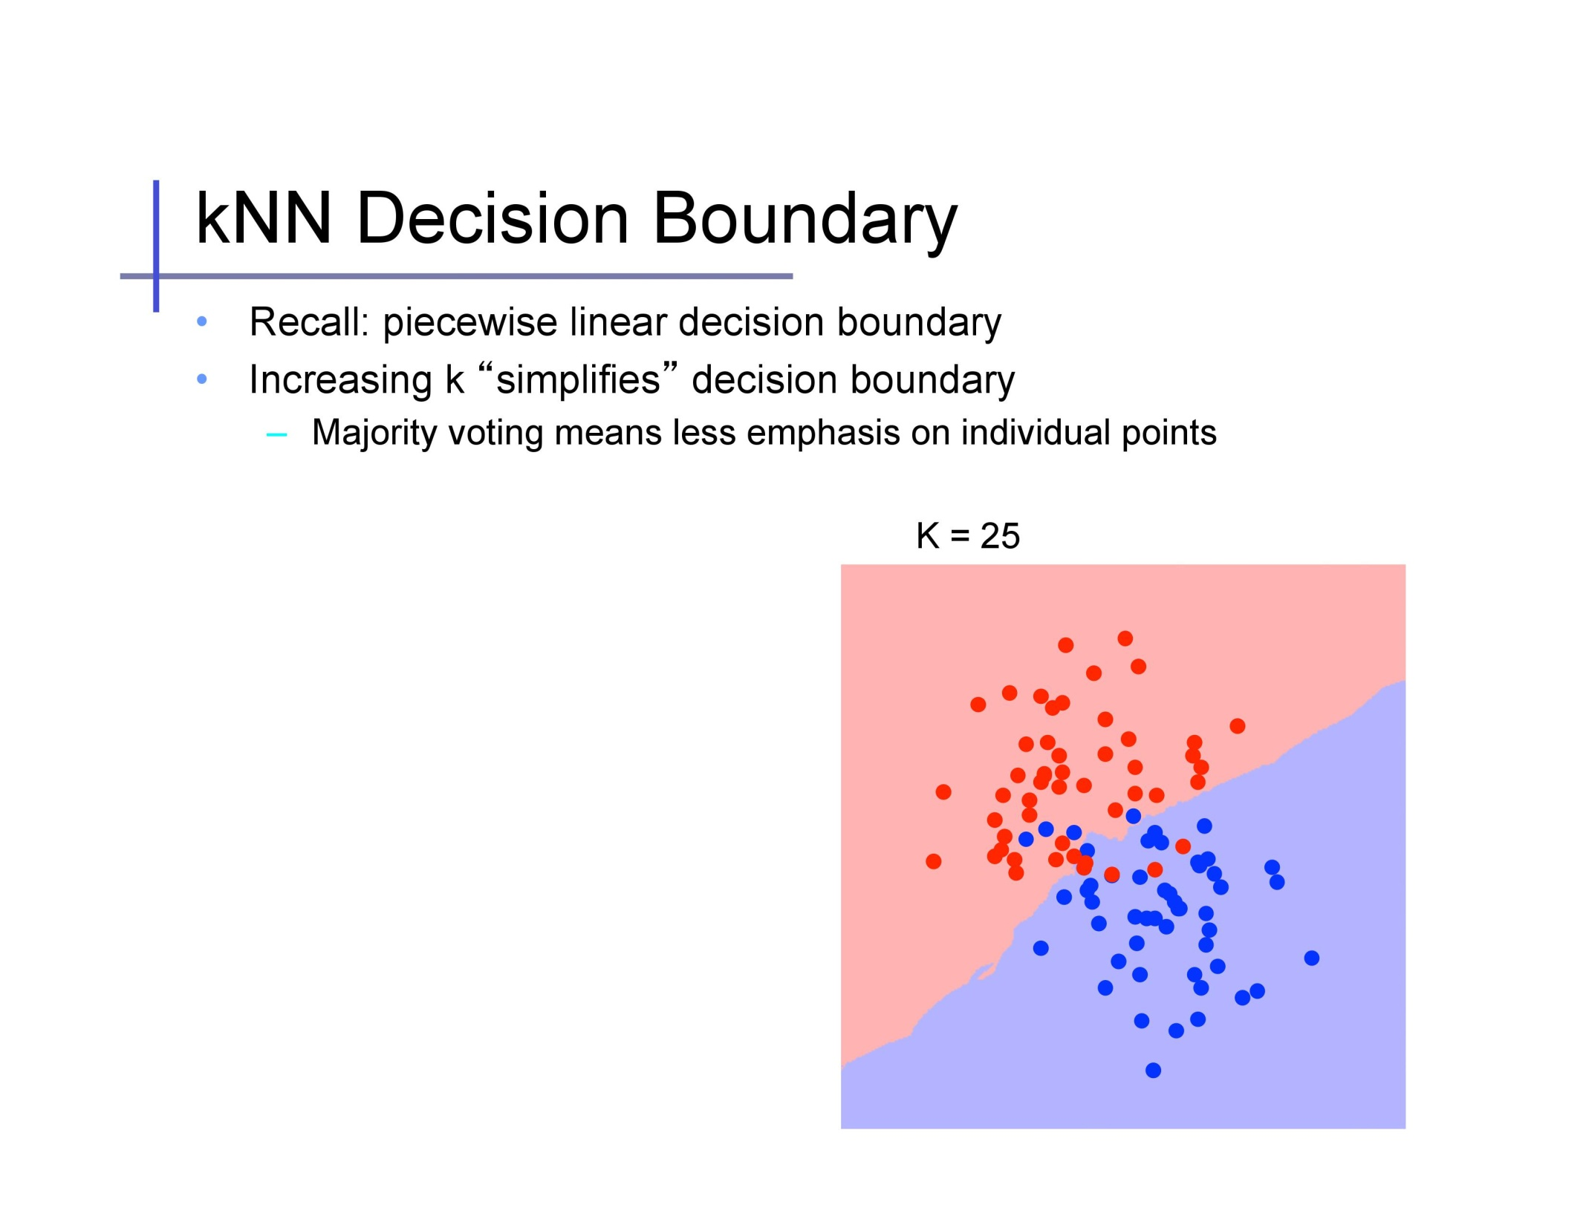
Slide credit: Alexander Ihler

Slide 46
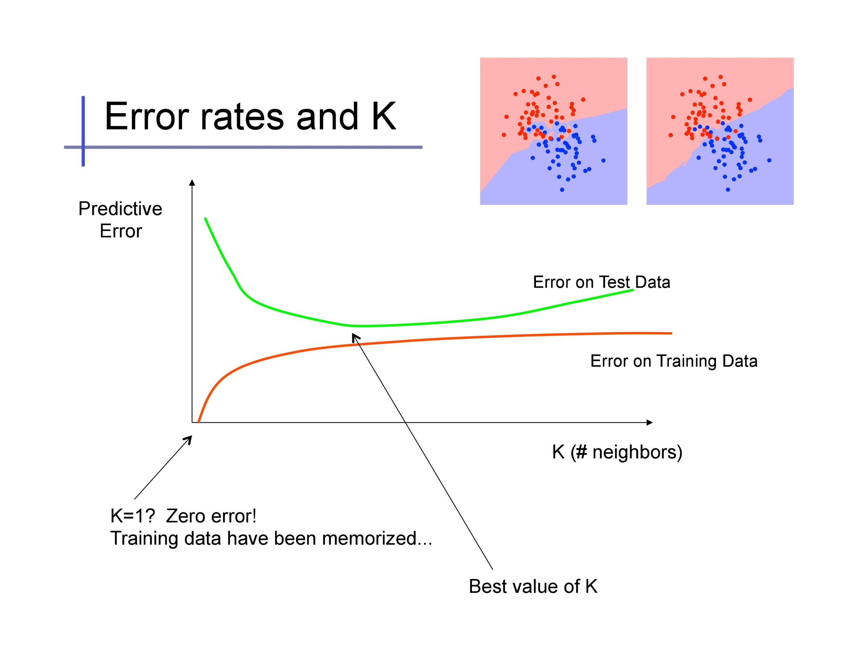
Use a validation set to pick K
Too complex
Slide credit: Alexander Ihler

Slide 47
Problems with Instance-Based Learning
Too many features?
  Doesn’t work well if large number of irrelevant features, distances overwhelmed by noisy features
  Distances become meaningless in high dimensions (the curse of dimensionality)
What is the impact of the value of K?
Expensive
  No learning: most real work done during testing
  For every test sample, must search through all dataset – very slow!
  Must use tricks like approximate nearest neighbor search
  Need to store all training data
Adapted from Dhruv Batra

Slide 48
An approximate distance method
Build a balanced tree of data points (kd-tree), splitting along different dimensions
Go down tree (starting from root) to find in which bin a query point lives, declare that leaf “current best” neighbor
Go up the tree, checking for and exploring branches as needed when a closer neighbor could exist in that branch
Check for possibility of better neighbor by intersecting regions with hypersphere defined by radius of current best; eliminate parts of the search space if they cannot contain a better current best
Only search for neighbors up until some budget exhausted

Slide 49
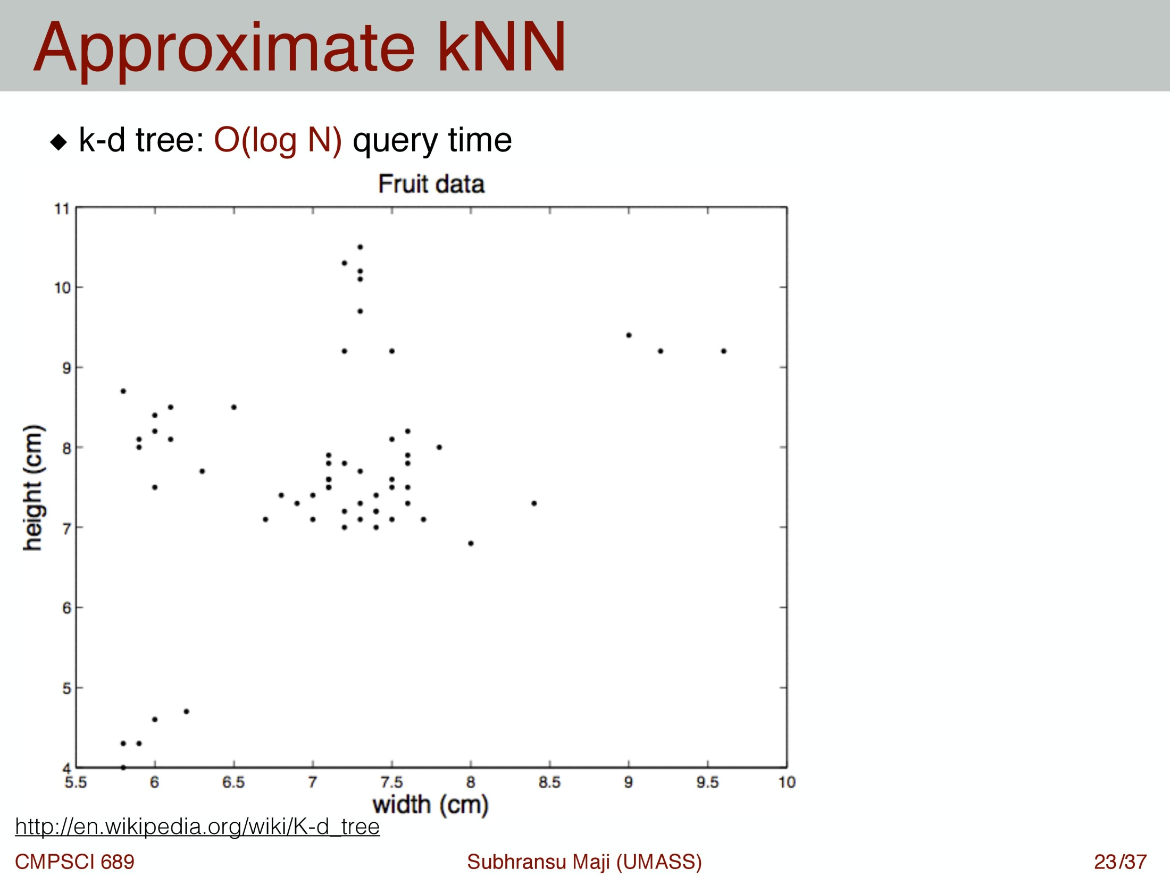

Slide 50
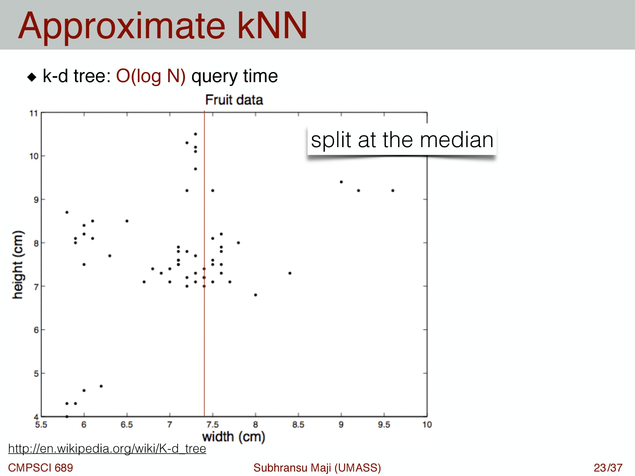

Slide 51
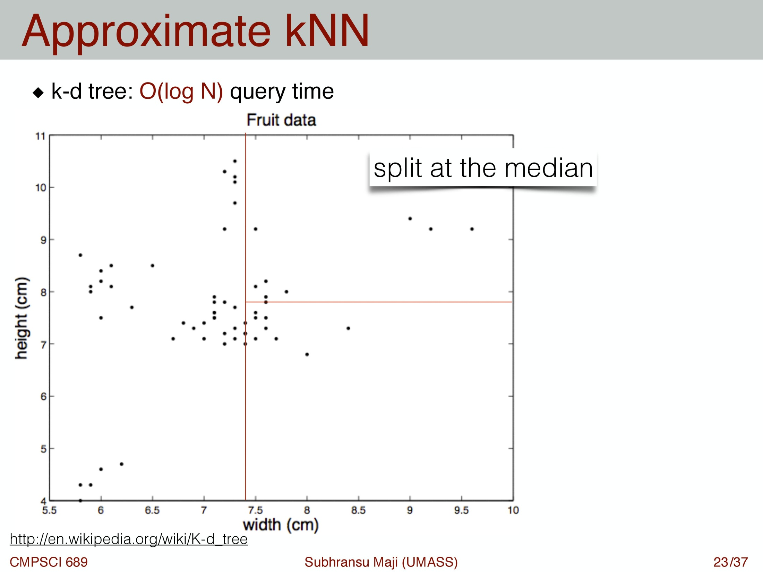

Slide 52


Slide 53


Slide 54
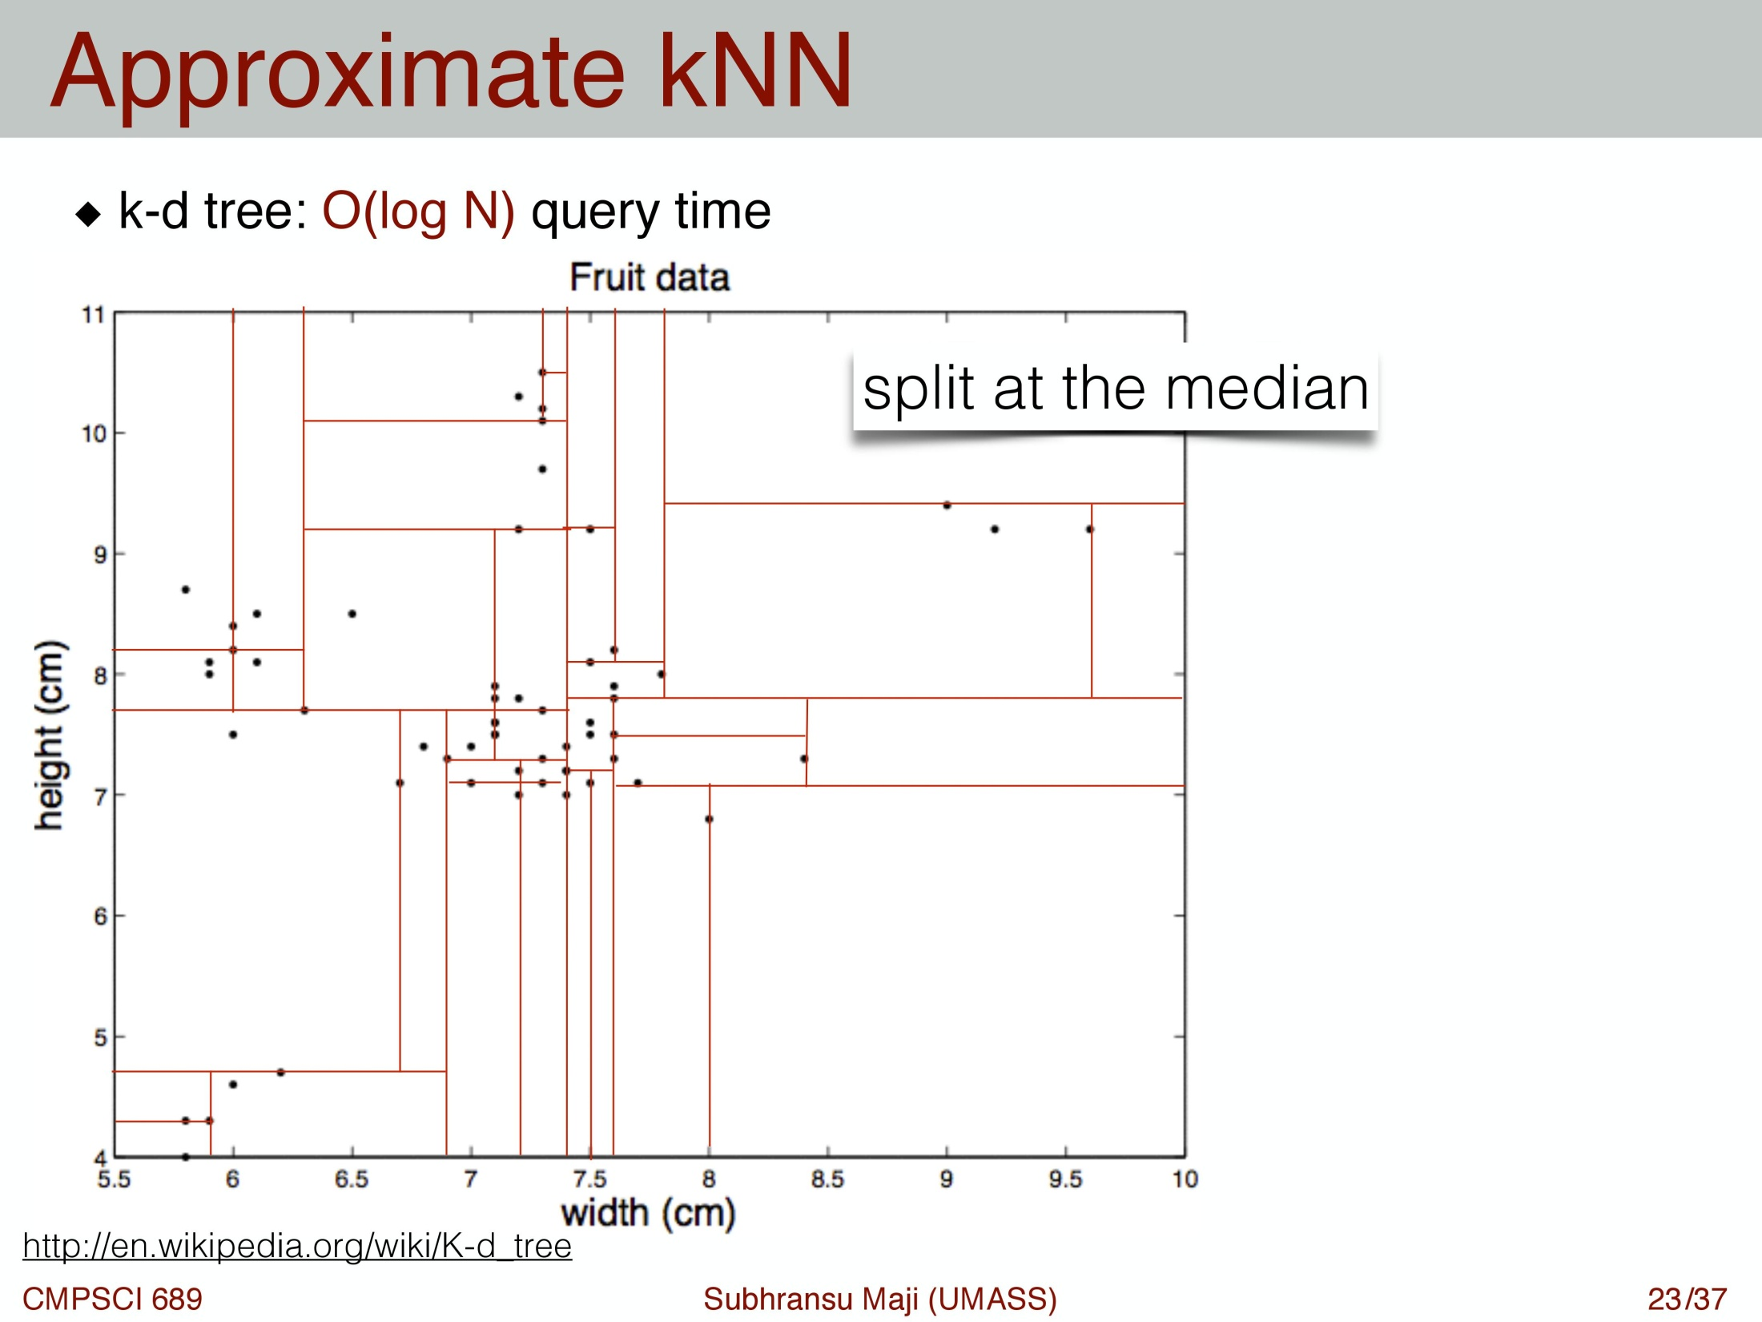

Slide 55
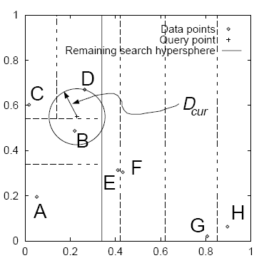
Figure from Szeliski

Slide 56
Summary
K-Nearest Neighbor is the most basic and simplest to implement classifier
Cheap at training time, expensive at test time
Unlike other methods we’ll see later, naturally works for any number of classes
Pick K through a validation set, use approximate methods for finding neighbors
Success of classification depends on the amount of data and the meaningfulness of the distance function

