Slide 1
CS 2750: Machine Learning
Linear Regression
Prof. Adriana Kovashka
University of Pittsburgh
January 31, 2017

Slide 2
Announcement
Your TA will be back this Wednesday
Office hours:
  Tuesday and Thursday 4-5pm
  Friday 12-2pm
Office hours start this Thursday

Slide 3
Plan for Today
Linear regression definition
Solution via least squares
Solution via gradient descent
Regularized least squares
Dealing with outliers

Slide 4
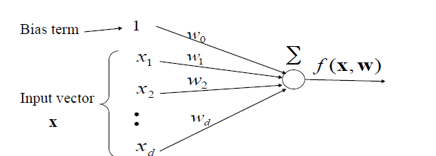
Linear Models
Sometimes want to add a bias term
Can add 1 as x₀ such that x = (1, x₁, …, x_{d})
Figure from Milos Hauskrecht

Slide 5
Regression
f(x, w): x → y
At training time: Use given {(x₁,y₁), …, (x_{N},y_{N})}, to estimate mapping function f
  Objective: minimize (y_{i} – f(w, x_{i}))², for all i = 1, …, N
  x_{i} are the input features (d-dimensional)
  y_{i} is the target continuous output label (given by human/oracle)
At test time: Use f to make prediction for some new x_{test}

Slide 6
Regression vs Classification
Problem is called classification if… y is discrete
  Does your patient have cancer?
  Should your bank give this person a credit card?
  Is it going to rain tomorrow?
  What animal is in this image?
Problem is called regression if … y is continuous
  What price should you ask for this house?
  What is the temperature going to be tomorrow?
  What score should your system give to this person’s figure-skating performance?

Slide 7
= b + mx

Slide 8
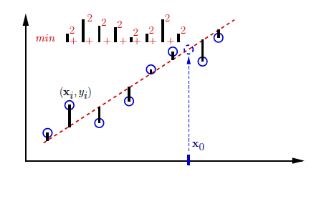
1-d example
Fit line to points
Use parameters of line to predict the y-coordinate of a new data point x_{new}
new
Figure from Greg Shakhnarovich

Slide 9
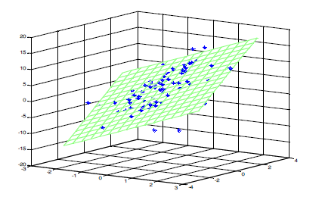
2-d example
Find parameters of plane
Figure from Milos Hauskrecht

Slide 10
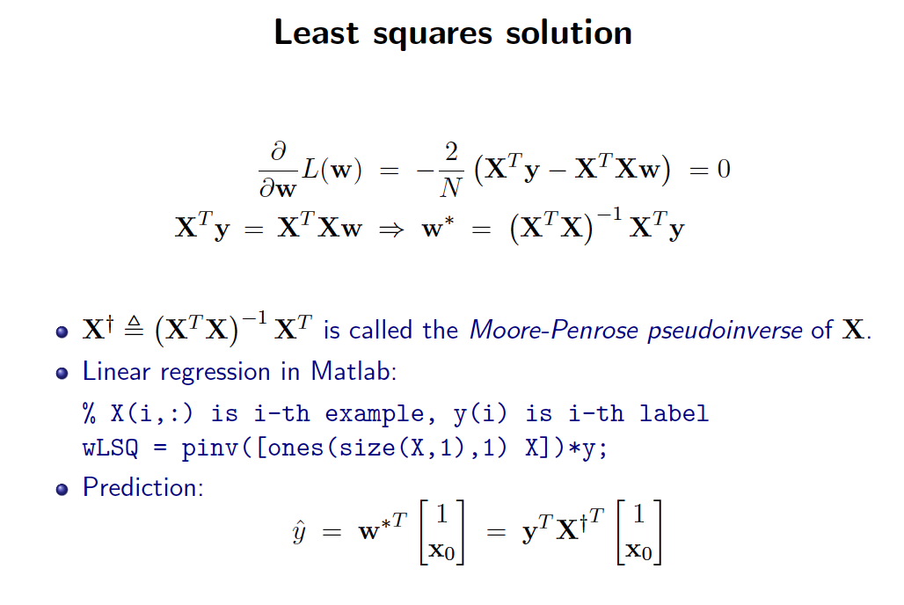
(Derivation on board)
test
test
Slide credit: Greg Shakhnarovich

Slide 11
Challenges
Computing the pseudoinverse might be slow for large matrices
  Cubic in number of features D (due to SVD)
  Linear in number of samples N
We might want to adjust solution as new examples come in, without recomputing the pseudoinverse for each new sample that comes in
Another solution: Gradient descent
  Cost: linear in both D and N
  If D > 10,000, use gradient descent

Slide 12
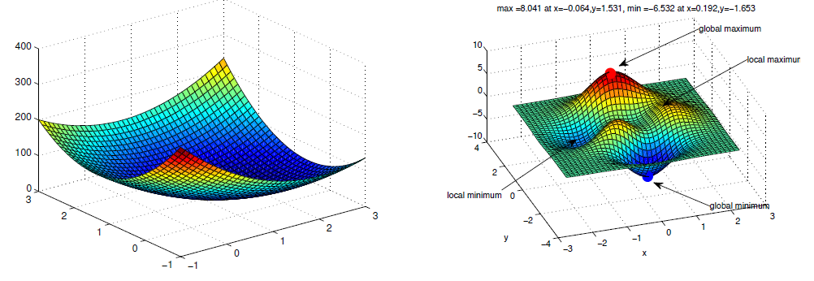
Solution optimality
Global vs local minima
Fortunately, least squares is convex
Adapted from Erik Sudderth

Slide 13
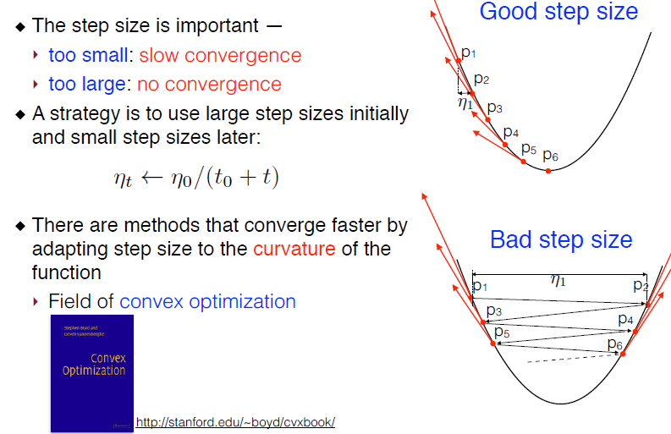
Solution optimality
Slide credit: Subhransu Maji

Slide 14
Plan for Today
Linear regression definition
Solution via least squares
Solution via gradient descent
Regularized least squares
Dealing with outliers

Slide 15
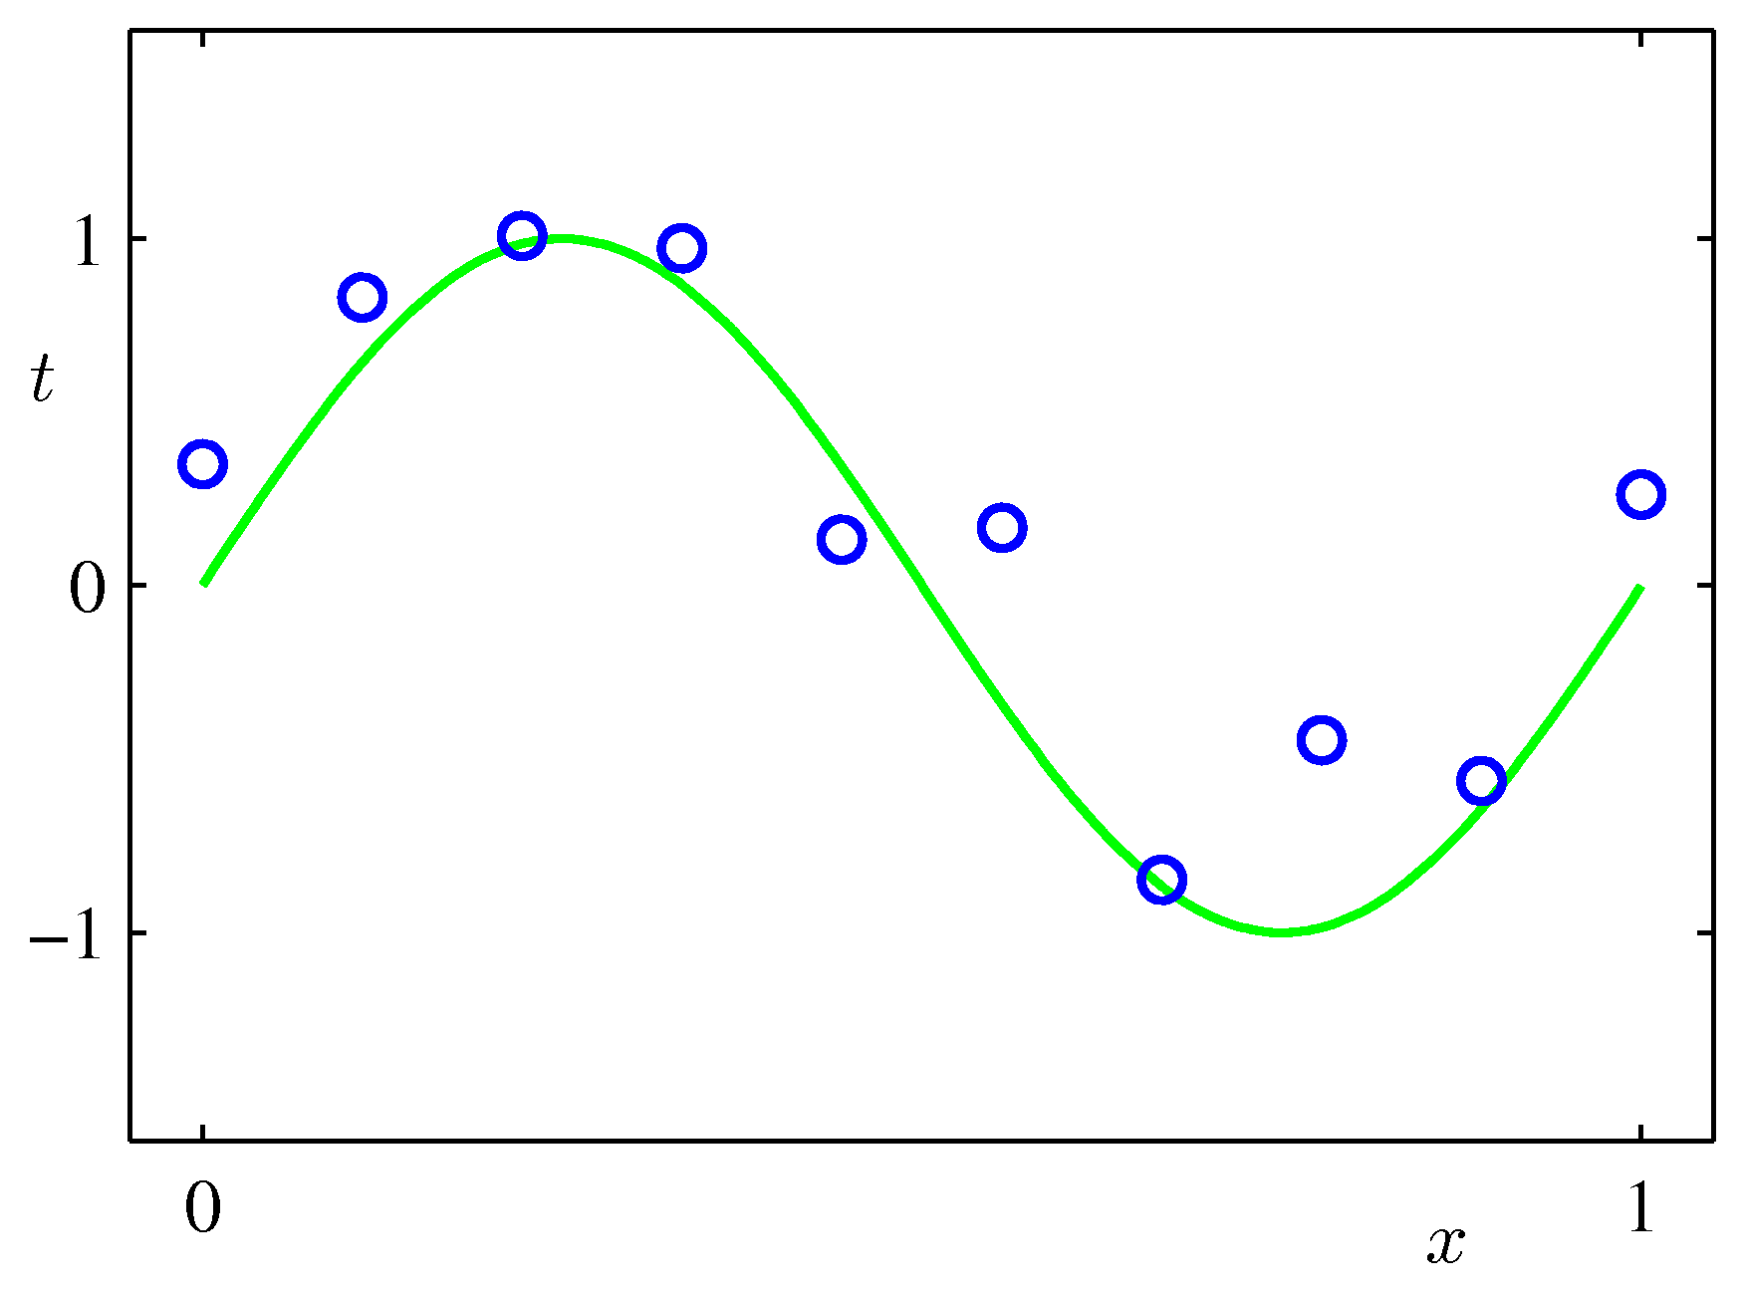
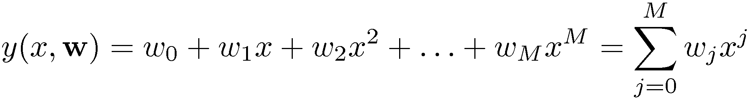
Linear Basis Function Models (1)
Example: Polynomial Curve Fitting
Slide credit: Christopher Bishop

Slide 16
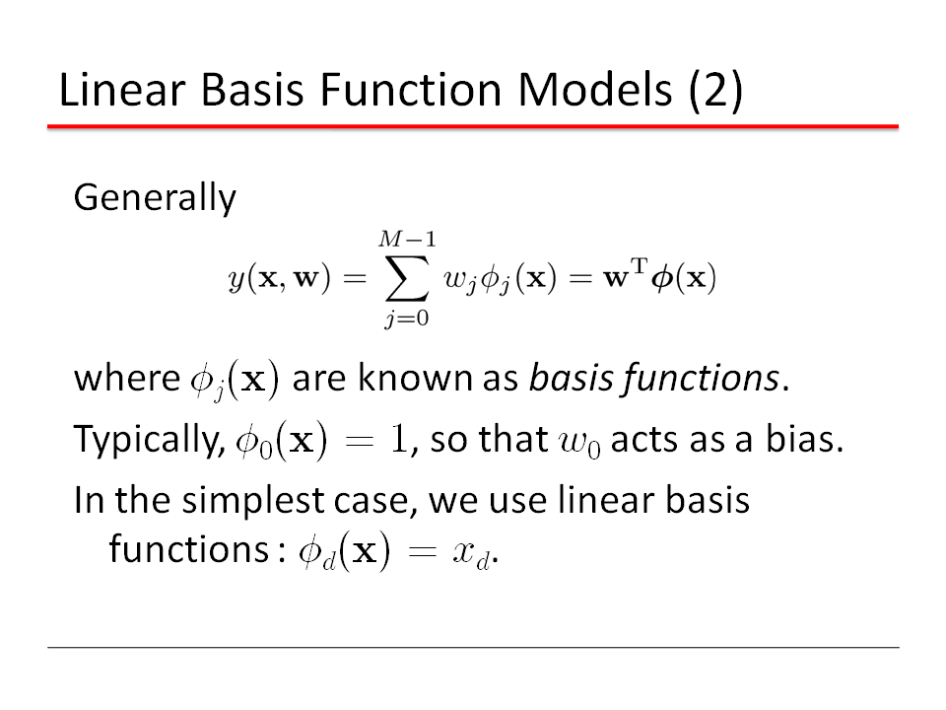
Slide credit: Christopher Bishop

Slide 17

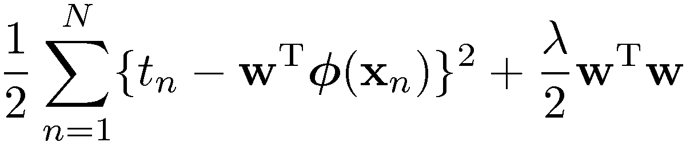
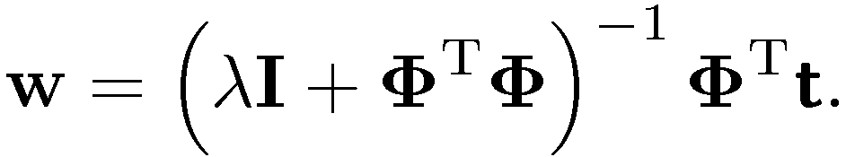
Regularized Least Squares (1)
Consider the error function:
With the sum-of-squares error function and a quadratic regularizer, we get
which is minimized by
Data term + Regularization term
λ is called the regularization coefficient.
Slide credit: Christopher Bishop

Slide 18
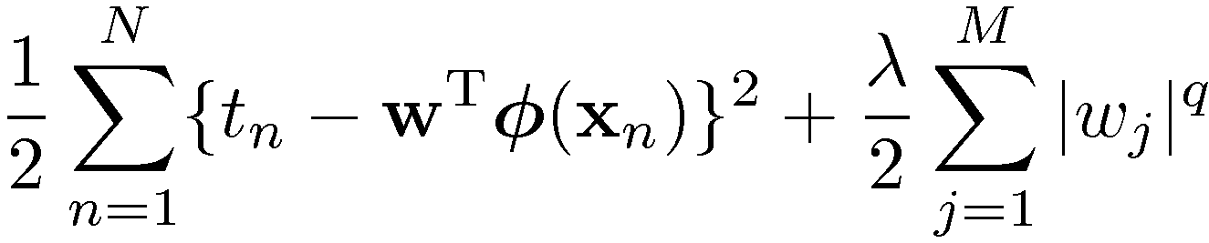
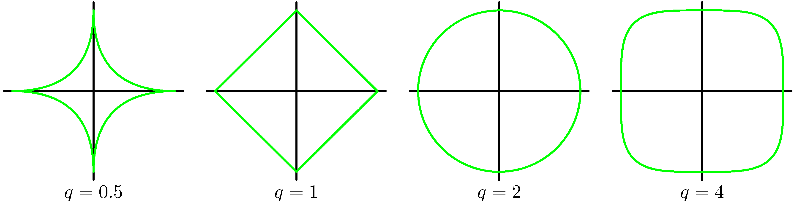
Regularized Least Squares (2)
With a more general regularizer, we have
Isosurfaces: ||w||_{q} = constant, e.g. 1
w₁
w₀
Lasso
Quadratic
Adapted from Christopher Bishop

Slide 19
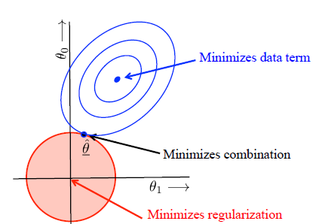
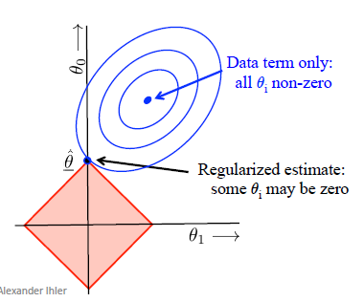
Regularized Least Squares (3)
Lasso (L1) tends to generate sparser solutions than a quadratic regularizer.
Adapted from Christopher Bishop, figures from Alexander Ihler

Slide 20
Plan for Today
Linear regression definition
Solution via least squares
Solution via gradient descent
Regularized least squares
Dealing with outliers

Slide 21
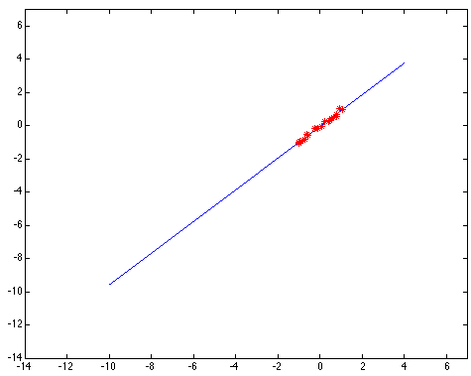
Outliers affect least squares fit
Kristen Grauman
Notes:
21

Slide 22
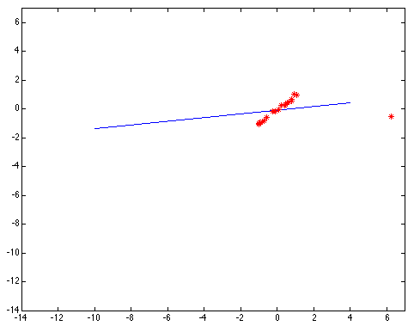
Outliers affect least squares fit
Kristen Grauman
Notes:
22

Slide 23
Hypothesize and test
Try all possible parameter combinations
  Repeatedly sample enough points to solve for parameters
  Each point votes for all consistent parameters
  E.g. each point votes for all possible lines on which it might lie
Score the given parameters: Number of consistent points
Choose the optimal parameters using the scores
Noise & clutter features?
  They will cast votes too, but typically their votes should be inconsistent with the majority of “good” features
Two methods: Hough transform and RANSAC
Adapted from Derek Hoiem and Kristen Grauman

Slide 24

Hough transform for finding lines
y
b
b₀
x
m₀
m
image space
Hough (parameter) space
Connection between image (x,y) and Hough (m,b) spaces
  A line in the image corresponds to a point in Hough space
Steve Seitz

Slide 25

Hough transform for finding lines
y
b
y₀
x₀
x
m
image space
Hough (parameter) space
Connection between image (x,y) and Hough (m,b) spaces
  A line in the image corresponds to a point in Hough space
  What does a point (x₀, y₀) in the image space map to?
    Answer: the solutions of b = -x₀m + y₀
    This is a line in Hough space
Steve Seitz

Slide 26
Hough transform for finding lines
y
b
x
m
image space
Hough (parameter) space
How can we use this to find the most likely parameters (m,b) for the most prominent line in the image space?
Let each edge point in image space vote for a set of possible parameters in Hough space
Accumulate votes in discrete set of bins; parameters with the most votes indicate line in image space
Steve Seitz

Slide 27
RANdom Sample Consensus (RANSAC)
RANSAC loop:
Randomly select a seed group of s points on which to base model estimate
Fit model to these s points
Find inliers to this model (i.e., points whose distance from the line is less than t)
If there are d or more inliers, re-compute estimate of model on all of the inliers
Repeat N times
Keep the model with the largest number of inliers
Modified from Kristen Grauman and Svetlana Lazebnik

Slide 28
RANSAC
_{(RANdom SAmple Consensus) :}
Fischler & Bolles in ‘81.
Algorithm:
Sample (randomly) the number of points required to fit the model
Solve for model parameters using samples
Score by the fraction of inliers within a preset threshold of the model
Repeat 1-3 until the best model is found with high confidence
Silvio Savarese
Notes:
Let me give you an intuition of what is going on. Suppose we have the standard line fitting problem in presence of outliers.
We can formulate this problem as follows: want to find the best partition of points in inlier set and outlier set such that…
The objective consists of adjusting the parameters of a model function so as to best fit a data set.
"best" is defined by a function f that needs to be minimized.
Such that the best parameter of fitting the line give rise to a residual error lower that delta
as when the sum, S, of squared residuals

Slide 29
RANSAC
Line fitting example
Algorithm:
Sample (randomly) the number of points required to fit the model (#=2)
Solve for model parameters using samples
Score by the fraction of inliers within a preset threshold of the model
Repeat 1-3 until the best model is found with high confidence
Silvio Savarese
Notes:
Let me give you an intuition of what is going on. Suppose we have the standard line fitting problem in presence of outliers.
We can formulate this problem as follows: want to find the best partition of points in inlier set and outlier set such that…
The objective consists of adjusting the parameters of a model function so as to best fit a data set.
"best" is defined by a function f that needs to be minimized.
Such that the best parameter of fitting the line give rise to a residual error lower that delta
as when the sum, S, of squared residuals

Slide 30
RANSAC
Line fitting example
Algorithm:
Sample (randomly) the number of points required to fit the model (#=2)
Solve for model parameters using samples
Score by the fraction of inliers within a preset threshold of the model
Repeat 1-3 until the best model is found with high confidence
Silvio Savarese
Notes:
Let me give you an intuition of what is going on. Suppose we have the standard line fitting problem in presence of outliers.
We can formulate this problem as follows: want to find the best partition of points in inlier set and outlier set such that…
The objective consists of adjusting the parameters of a model function so as to best fit a data set.
"best" is defined by a function f that needs to be minimized.
Such that the best parameter of fitting the line give rise to a residual error lower that delta
as when the sum, S, of squared residuals

Slide 31
RANSAC
Line fitting example
Algorithm:
Sample (randomly) the number of points required to fit the model (#=2)
Solve for model parameters using samples
Score by the fraction of inliers within a preset threshold of the model
Repeat 1-3 until the best model is found with high confidence
Silvio Savarese
Notes:
Let me give you an intuition of what is going on. Suppose we have the standard line fitting problem in presence of outliers.
We can formulate this problem as follows: want to find the best partition of points in inlier set and outlier set such that…
The objective consists of adjusting the parameters of a model function so as to best fit a data set.
"best" is defined by a function f that needs to be minimized.
Such that the best parameter of fitting the line give rise to a residual error lower that delta
as when the sum, S, of squared residuals

Slide 32
RANSAC
Algorithm:
Sample (randomly) the number of points required to fit the model (#=2)
Solve for model parameters using samples
Score by the fraction of inliers within a preset threshold of the model
Repeat 1-3 until the best model is found with high confidence
Silvio Savarese
Notes:
Let me give you an intuition of what is going on. Suppose we have the standard line fitting problem in presence of outliers.
We can formulate this problem as follows: want to find the best partition of points in inlier set and outlier set such that…
The objective consists of adjusting the parameters of a model function so as to best fit a data set.
"best" is defined by a function f that needs to be minimized.
Such that the best parameter of fitting the line give rise to a residual error lower that delta
as when the sum, S, of squared residuals

