Slide 1
CS 2750: Machine Learning
Ensembles; bagging and boosting; decision trees
Prof. Adriana Kovashka
University of Pittsburgh
April 11, 2016

Slide 2
Plan for Today
Ensemble methods
  Bagging
  Boosting
Boosting application: Face detection
Decision trees

Slide 3
Learning Ensembles
Learn multiple alternative definitions of a concept using different training data or different learning algorithms
Train several classifiers: SVM, KNN, logistic regression, decision tree, neural network etc.
Call these classifiers f₁(x), f₂(x), …, f_{M}(x)
Take majority of predictions: y = majority( f₁(x), f₂(x), …, f_{M}(x) )
For regression use mean or median of the predictions
Averaging is a form of regularization: each model can individually overfit but the average is able to overcome the overfitting
Slide credit: Ray Mooney / Subhransu Maji

Slide 4
Learning Ensembles
Learn multiple alternative definitions of a concept using different training data or different learning algorithms
Combine decisions of multiple definitions
Training Data
⋅ ⋅ ⋅ ⋅ ⋅ ⋅ ⋅ ⋅
Data1
Data2
Data m
Learner1
Learner2
⋅ ⋅ ⋅ ⋅ ⋅ ⋅ ⋅ ⋅
Learner m
⋅ ⋅ ⋅ ⋅ ⋅ ⋅ ⋅ ⋅
Model1
Model2
Model m
Model Combiner
Final Model
Slide credit: Ray Mooney

Slide 5
Value of Ensembles
When combing multiple independent and diverse decisions each of which is at least more accurate than random guessing, random errors cancel each other out, correct decisions are reinforced.
Human ensembles are demonstrably better
  How many jelly beans in the jar?: Individual estimates vs. group average.
  Who Wants to be a Millionaire: Expert friend vs. audience vote.
Slide credit: Ray Mooney

Slide 6
Homogenous Ensembles
Use a single, arbitrary learning algorithm but manipulate training data to make it learn multiple models.
  Data1 ≠ Data2 ≠ … ≠ Data m
  Learner1 = Learner2 = … = Learner m
Different methods for changing training data:
  Bagging: Resample training data
  Boosting: Reweight training data
Slide credit: Ray Mooney

Slide 7
Bagging
Create ensembles by repeatedly randomly resampling the training data (Brieman, 1996).
Given a training set of size n, create m samples of size n by drawing n examples from the original data, with replacement.
Combine the m resulting models using simple majority vote.
Decreases error by decreasing the variance in the results due to unstable learners, algorithms (like decision trees) whose output can change dramatically when the training data is slightly changed.
However, often the errors of the different models are correlated, which defies the purpose of bagging.
Slide credit: Ray Mooney

Slide 8
Boosting
Originally developed by computational learning theorists to guarantee performance improvements on fitting training data for a weak learner that only needs to generate a hypothesis with a training accuracy greater than 0.5 (Schapire, 1990).
Revised to be a practical algorithm, AdaBoost, for building ensembles that empirically improves generalization performance (Freund & Shapire, 1996).
Examples are given weights. At each iteration, a new hypothesis is learned and the examples are reweighted to focus the system on examples that the most recently learned classifier got wrong.
Slide credit: Ray Mooney

Slide 9
Boosting: Basic Algorithm
General Loop:
Set all examples to have equal uniform weights.
For m from 1 to M do:
  Find the weak learner h_{m} that achieves lowest weighted training error
Increase the weights of examples that h_{m} classifies incorrectly
During testing: Each of the M classifiers gets a weighted vote proportional to its accuracy on the training data; final classifier is a linear combination of all weak learners.
Base (weak) learner must focus on correctly classifying the most highly weighted examples while strongly avoiding over-fitting.
Weak learners must perform better than chance.
Slide credit: Ray Mooney, Lana Lazebnik, Kristen Grauman

Slide 10
Boosting Illustration
Weak
Classifier 1
Paul Viola

Slide 11
Boosting Illustration
Weights
Increased
Paul Viola

Slide 12
Boosting Illustration
Weak
Classifier 2
Paul Viola

Slide 13
Boosting Illustration
Weights
Increased
Paul Viola

Slide 14
Boosting Illustration
Weak
Classifier 3
Paul Viola

Slide 15
Boosting Illustration
Final classifier is
a combination of weak classifiers
Paul Viola

Slide 16
AdaBoost Pseudocode
TrainAdaBoost(D, BaseLearn)
For each example d_{i} in D let its weight w_{i}=1/|D|
Let H be an empty set of hypotheses
For t from 1 to T do:
Learn a hypothesis, h_{t}, from the weighted examples: h_{t}=BaseLearn(D)
Add h_{t} to H
Calculate the error, ε_{t}, of the hypothesis h_{t} as the total sum weight of the
examples that it classifies incorrectly.
If ε_{t} > 0.5 then exit loop, else continue.
Let β_{t} = ε_{t} / (1 – ε_{t} )
Multiply the weights of the examples that h_{t} classifies correctly by β_{t}
Rescale the weights of all of the examples so the total sum weight remains 1.
Return H
TestAdaBoost(ex, H)
Let each hypothesis, h_{t}, in H vote for ex’s classification with weight log(1/ β_{t} )
Return the class with the highest weighted vote total.
Slide credit: Ray Mooney

Slide 17
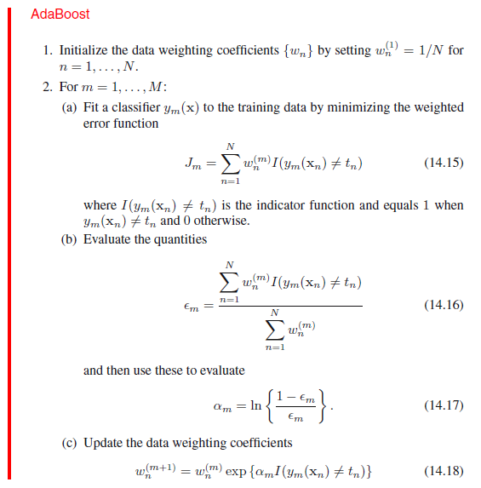
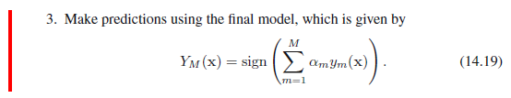
Start with uniform weights on training examples.
For M rounds
Evaluate weighted error for each weak learner, pick best learner.
Re-weight the examples:
Incorrectly classified
get more weight,
correctly classified
get less weight.
(d) Normalize the weights so they sum to 1
Final classifier is combination of weak ones, weighted according to error they had.
Figure from C. Bishop, notes from K. Grauman

Slide 18
Learning with Weighted Examples
Generic approach is to replicate examples in the training set proportional to their weights (e.g. 10 replicas of an example with a weight of 0.01 and 100 for one with weight 0.1).
Most algorithms can be enhanced to efficiently incorporate weights directly in the learning algorithm so that the effect is the same.
For decision trees, for calculating information gain, when counting example i, simply increment the corresponding count by w_{i} rather than by 1.
Slide credit: Ray Mooney

Slide 19
Experimental Results on Ensembles
(Freund & Schapire, 1996; Quinlan, 1996)
Ensembles have been used to improve generalization accuracy on a wide variety of problems.
On average, Boosting provides a larger increase in accuracy than Bagging.
Boosting on rare occasions can degrade accuracy.
Bagging more consistently provides a modest improvement.
Boosting is particularly subject to over-fitting when there is significant noise in the training data.
Slide credit: Ray Mooney

Slide 20
Issues in Ensembles
Parallelism in Ensembles: Bagging is easily parallelized, Boosting is not.
Variants of Boosting to handle noisy data.
How “weak” should a base-learner for Boosting be?
What is the theoretical explanation of Boosting’s ability to improve generalization?
Exactly how does the diversity of ensembles affect their generalization performance?
Combining Boosting and Bagging?
Slide credit: Ray Mooney

Slide 21
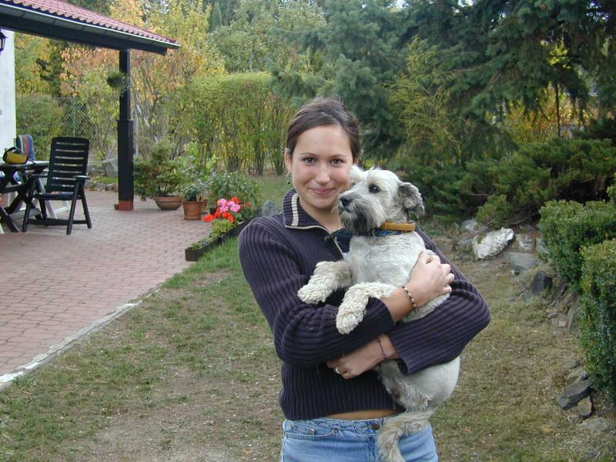

Boosting application: Face detection
Detection
Lana Lazebnik

Slide 22
Challenges of face detection
Sliding window detector must evaluate tens of thousands of location/scale combinations
Faces are rare: 0–10 per image
A megapixel image has ~10⁶ pixels and a comparable number of candidate face locations
For computational efficiency, we should try to spend as little time as possible on the non-face windows
Lana Lazebnik

Slide 23
Viola-Jones face detector
Main idea:
  Represent local texture with efficiently computable “rectangular” features within window of interest
  Select discriminative features to be weak classifiers
  Use boosted combination of them as final classifier
  Form a cascade of such classifiers, rejecting clear negatives quickly (not discussed, see hidden slides)
Kristen Grauman

Slide 24
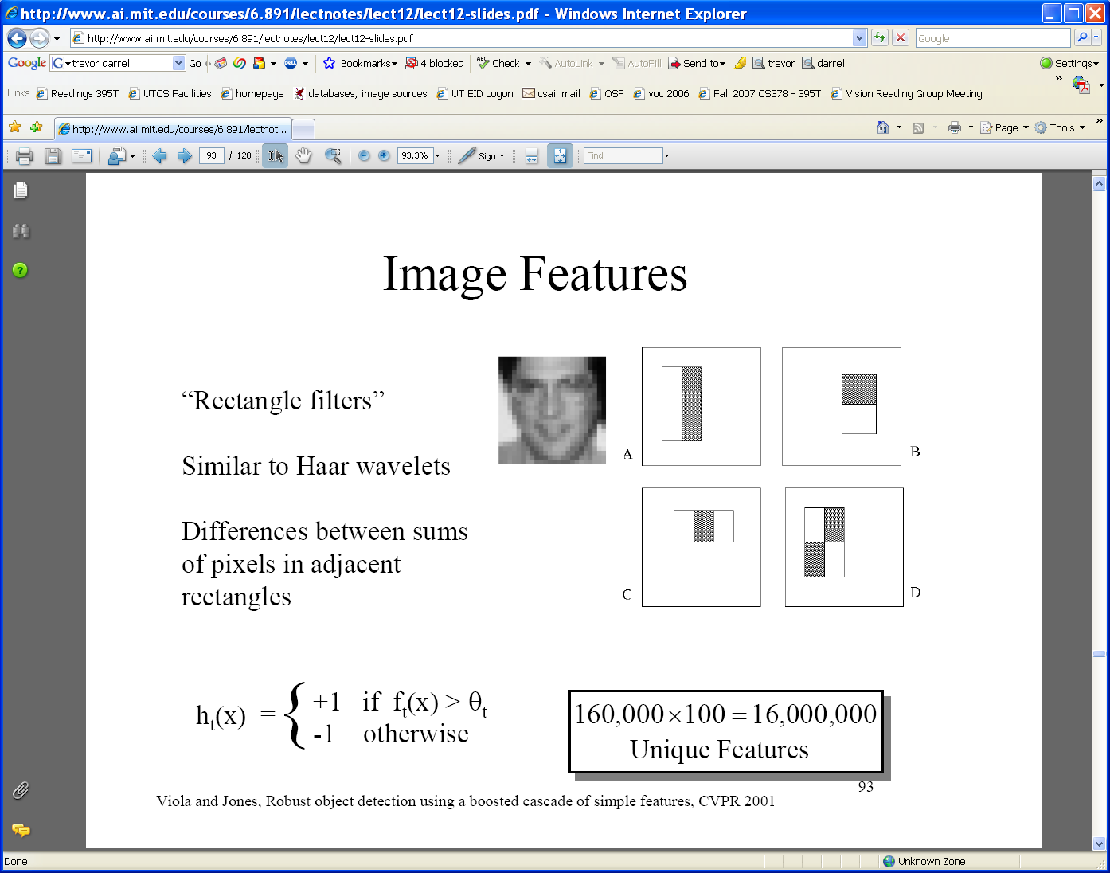
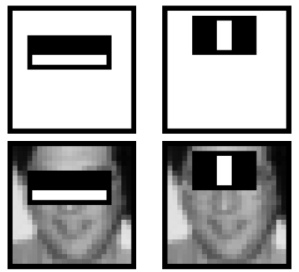
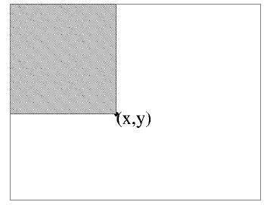
Viola-Jones detector: features
“Rectangular” filters
  Feature output is difference between adjacent regions
Value = ∑ (pixels in white area) – ∑ (pixels in black area)
Value at (x,y) is sum of pixels above and to the left of (x,y)
  Efficiently computable with integral image: any sum can be computed in constant time
Integral image
Adapted from Kristen Grauman and Lana Lazebnik

Slide 25
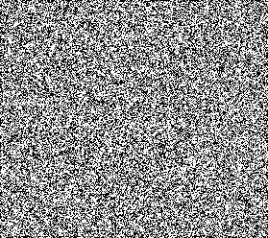

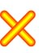

Example
Lana Lazebnik

Slide 26
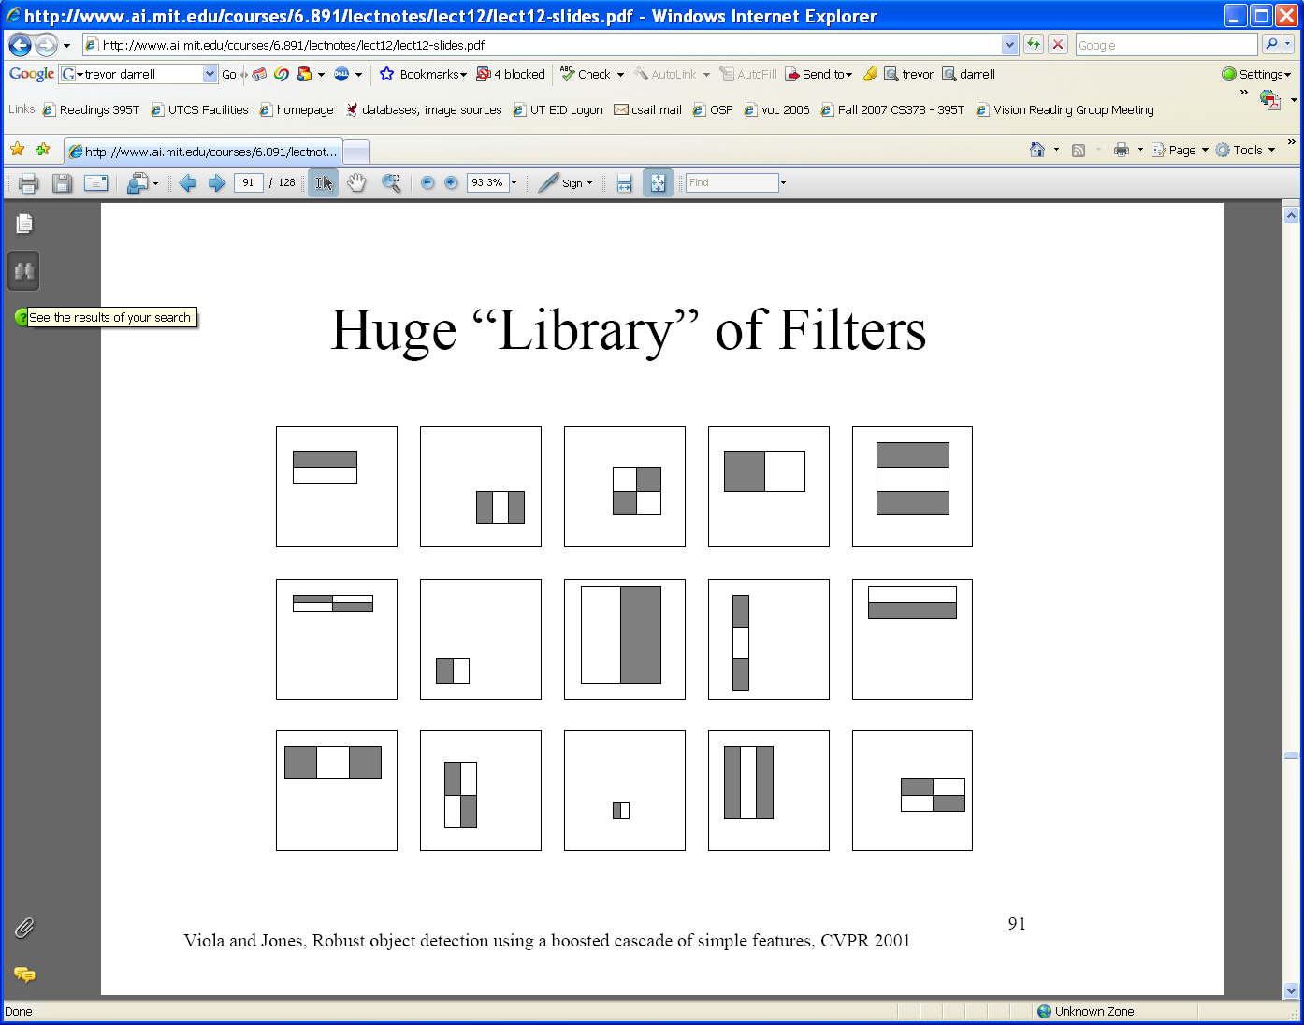
Viola-Jones detector: features
  Considering all possible filter parameters: position, scale, and type:
180,000+ possible features associated with each 24 x 24 window
Which subset of these features should we use to determine if a window has a face?
Use AdaBoost both to select the informative features and to form the classifier
Kristen Grauman

Slide 27
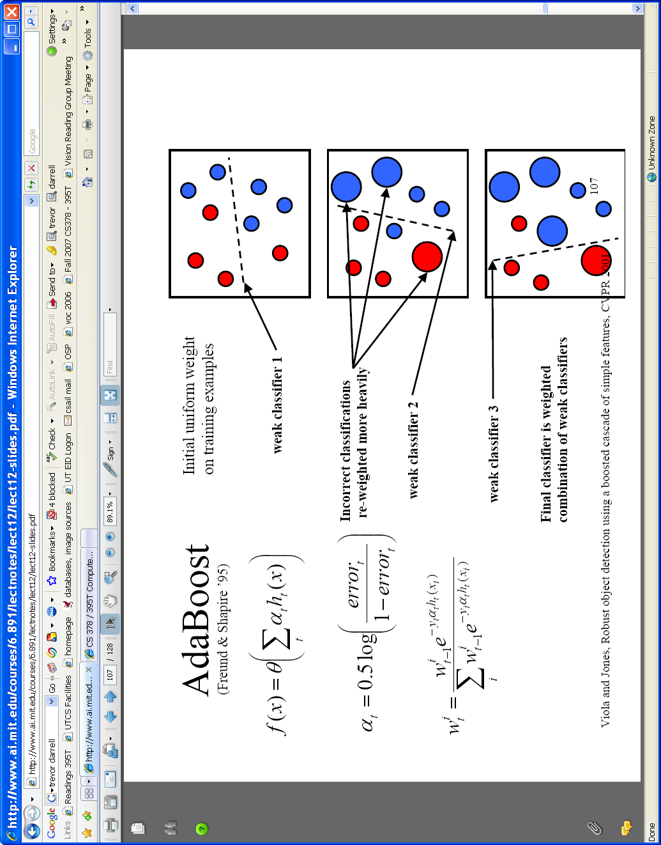
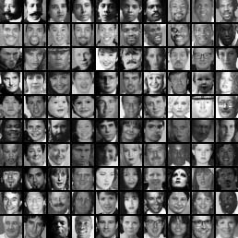
Viola-Jones detector: AdaBoost
Want to select the single rectangle feature and threshold that best separates positive (faces) and negative (non-faces) training examples, in terms of weighted error.
Resulting weak classifier:
For next round, reweight the examples according to errors, choose another filter/threshold combo.
…
Outputs of a possible rectangle feature on faces and non-faces.
Kristen Grauman

Slide 28
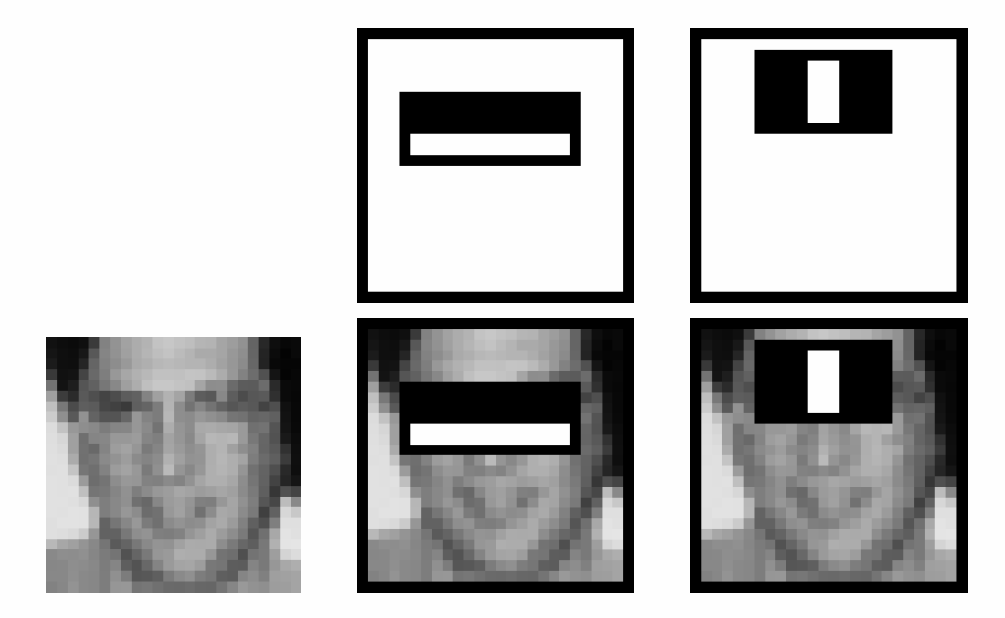
Boosting for face detection
First two features selected by boosting:
This feature combination can yield 100% detection rate and 50% false positive rate
Lana Lazebnik

Slide 29
Are we done?
Even if the filters are fast to compute, each new image has a lot of possible windows to search.
How to make the detection more efficient?
Kristen Grauman

Slide 30
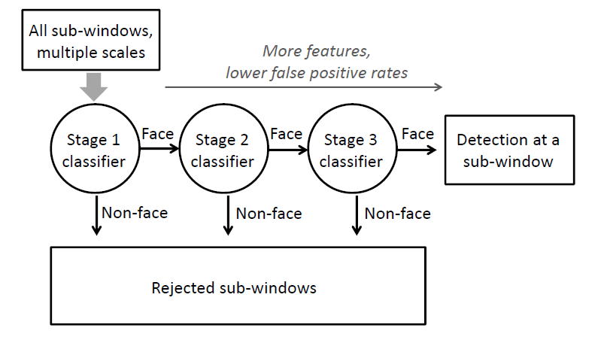
Cascading classifiers for detection
Form a cascade with low false negative rates early on
Apply less accurate but faster classifiers first to immediately discard windows that clearly appear to be negative
Kristen Grauman

Slide 31
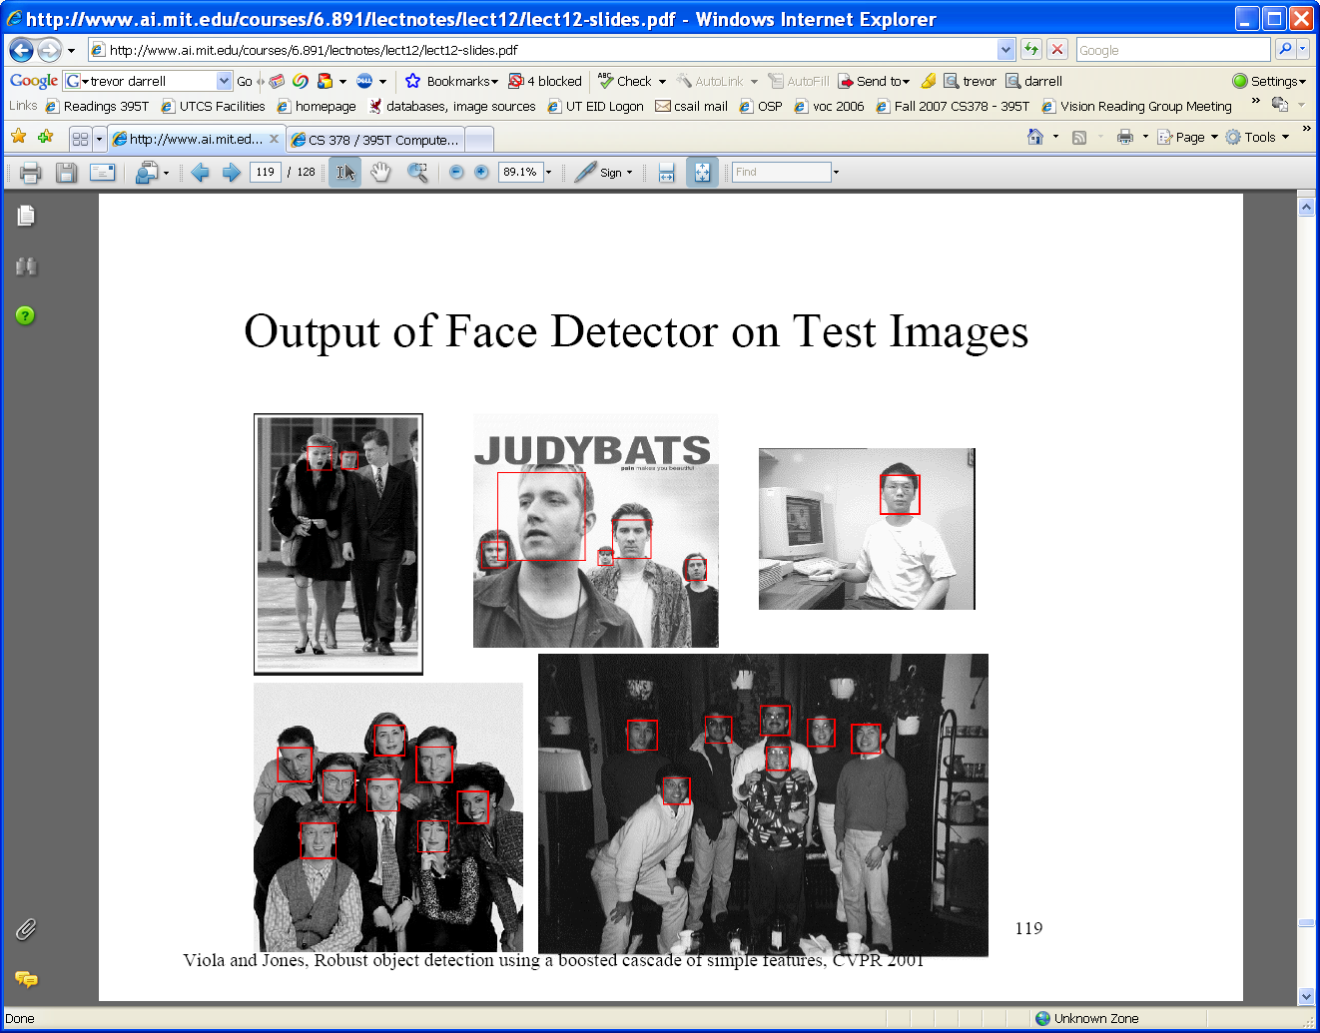





Viola-Jones detector: summary
Train cascade of classifiers with AdaBoost
Apply to each subwindow
New image
Faces
Selected features, thresholds, and weights
Non-faces
Train with 5K positives, 350M negatives
Real-time detector using 38 layer cascade (0.067s)
6061 features in all layers
Adapted from Kristen Grauman

Slide 32
Viola-Jones detector: summary
A seminal approach to real-time object detection
Training is slow, but detection is very fast
Key ideas
  Integral images for fast feature evaluation
  Boosting for feature selection
  Attentional cascade of classifiers for fast rejection of non-face windows
P. Viola and M. Jones. Rapid object detection using a boosted cascade of simple features. CVPR 2001.
P. Viola and M. Jones. Robust real-time face detection. IJCV 57(2), 2004.
Kristen Grauman

Slide 33
Viola-Jones face detector: Results
Kristen Grauman
Notes:
33

Slide 34
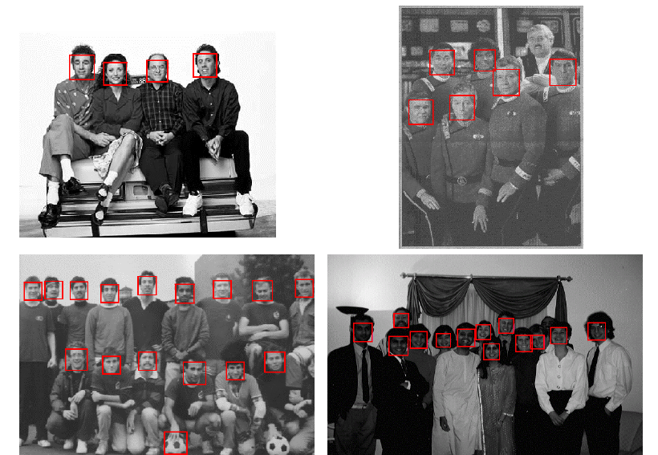
Viola-Jones face detector: Results
Kristen Grauman
Notes:
34

Slide 35

Decision Stumps
Like the thresholded features=classifiers in face detection
A single-level decision tree (discussed next)
For HW4, use a total of 10-30 of these, and don’t worry about them having better-than-chance performance
Figure from Wikipedia

Slide 36
Plan for Today
Ensemble methods
  Bagging
  Boosting
Boosting application: Face detection
Decision trees

Slide 37
Decision Trees
Tree-based classifiers for instances represented as feature-vectors. Nodes test features, there is one branch for each value of the feature, and leaves specify the category.
Can represent arbitrary conjunction and disjunction. Can represent any classification function over discrete feature vectors.
Can be rewritten as a set of rules:
  red ∧ circle → pos
  red ∧ circle → A
  blue → B
  red ∧ square → B
  green → C
  red ∧ triangle → C
color
color
red
green
red
blue
green
blue
shape
shape
C
neg
pos
B
circle
square
triangle
circle
square
triangle
pos
neg
neg
A
B
C
Slide credit: Ray Mooney

Slide 38
What about continuous features?
Continuous (real-valued) features can be handled by allowing nodes to split a real valued feature into two ranges based on a threshold (e.g. length < 3 and length ≥3)
Classification trees have discrete class labels at the leaves.
Adapted from Ray Mooney

Slide 39
Top-Down Decision Tree Induction
Recursively build a tree top-down by divide and conquer.
<big, red, circle>: + <small, red, circle>: +
<small, red, square>: − <big, blue, circle>: −
color
red
blue
green
<big, red, circle>: +
<small, red, circle>: +
<small, red, square>: −
Slide credit: Ray Mooney

Slide 40
Top-Down Decision Tree Induction
Recursively build a tree top-down by divide and conquer.
<big, red, circle>: + <small, red, circle>: +
<small, red, square>: − <big, blue, circle>: −
color
red
blue
green
<big, red, circle>: +
<small, red, circle>: +
<small, red, square>: −
shape
neg
neg
circle
<big, blue, circle>: −
square
triangle
pos
neg
pos
<big, red, circle>: +
<small, red, circle>: +
<small, red, square>: −
Slide credit: Ray Mooney

Slide 41
Decision Tree Induction Pseudocode
DTree(examples, features) returns a tree
If all examples are in one category, return a leaf node with that category label.
Else if the set of features is empty, return a leaf node with the category label that
is the most common in examples.
Else pick a feature F and create a node R for it
For each possible value v_{i} of F:
Let examples_{i} be the subset of examples that have value v_{i} for F
Add an out-going edge E to node R labeled with the value v_{i.}
If examples_{i} is empty
then attach a leaf node to edge E labeled with the category that
is the most common in examples.
else call DTree(examples_{i} , features – {F}) and attach the resulting
tree as the subtree under edge E.
Return the subtree rooted at R.
Slide credit: Ray Mooney

Slide 42
Picking a Good Split Feature
Goal is to have the resulting tree be as small as possible, per Occam’s razor.
Finding a minimal decision tree (nodes, leaves, or depth) is an NP-hard optimization problem.
Top-down divide-and-conquer method does a greedy search for a simple tree but does not guarantee to find the smallest; that’s ok.
Want to pick a feature that creates subsets of examples that are relatively “pure” in a single class so they are “closer” to being leaf nodes.
There are a variety of heuristics for picking a good test, a popular one is based on information gain that originated with the ID3 system of Quinlan (1979).
Adapted from Ray Mooney

Slide 43
Entropy
Entropy (disorder, impurity) of a set of examples, S, relative to a binary classification is:
where p₁ is the fraction of positive examples in S and p₀ is the fraction of negatives.
If all examples are in one category, entropy is zero (we define 0⋅log(0)=0)
If examples are equally mixed (p₁=p₀=0.5), entropy is a maximum of 1.
For multi-class problems with c categories, entropy generalizes to:
Adapted from Ray Mooney

Slide 44
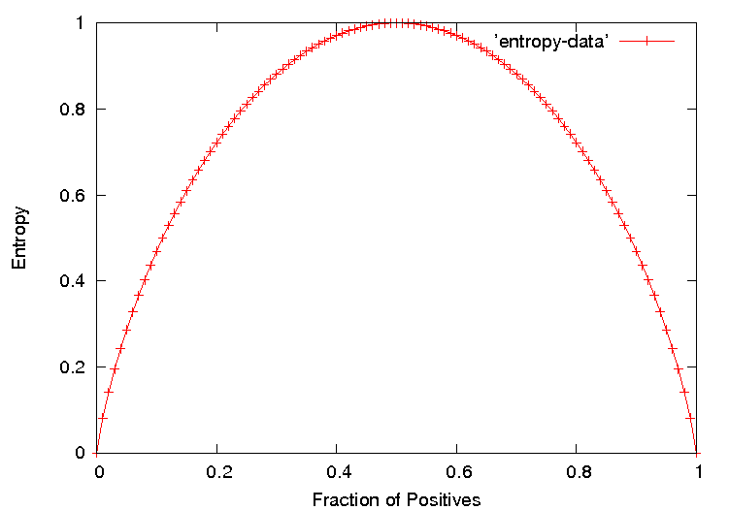
Entropy Plot for Binary Classification
Slide credit: Ray Mooney

Slide 45
Information Gain
The information gain of a feature F is the expected reduction in entropy resulting from splitting on this feature.
where S_{v} is the subset of S having value v for feature F.
Entropy of each resulting subset weighted by its relative size.
Example:
  <big, red, circle>: + <small, red, circle>: +
  <small, red, square>: − <big, blue, circle>: −
2+, 2 −: E=1
size
2+, 2 − : E=1
color
2+, 2 − : E=1
shape
big small
1+,1− 1+,1−
E=1 E=1
red blue
2+,1− 0+,1−
E=0.918 E=0
circle square
2+,1− 0+,1−
E=0.918 E=0
Gain=1−(0.5⋅1 + 0.5⋅1) = 0
Gain=1−(0.75⋅0.918 +
0.25⋅0) = 0.311
Gain=1−(0.75⋅0.918 +
0.25⋅0) = 0.311
Slide credit: Ray Mooney

Slide 46
Another Example Decision Tree Classifier
Example problem: decide whether to wait for a table at a restaurant, based on the following attributes:
  Alternate: is there an alternative restaurant nearby?
  Bar: is there a comfortable bar area to wait in?
  Fri/Sat: is today Friday or Saturday?
  Hungry: are we hungry?
  Patrons: number of people in the restaurant (None, Some, Full)
  Price: price range ($, $$, $$$)
  Raining: is it raining outside?
  Reservation: have we made a reservation?
  Type: kind of restaurant (French, Italian, Thai, Burger)
  WaitEstimate: estimated waiting time (0-10, 10-30, 30-60, >60)
Lana Lazebnik

Slide 47
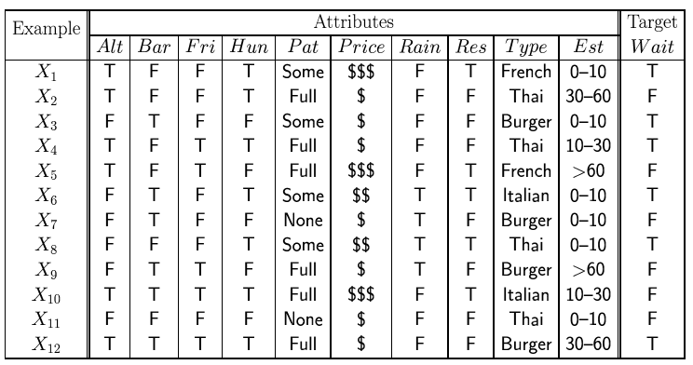
Another Example Decision Tree Classifier
Lana Lazebnik

Slide 48
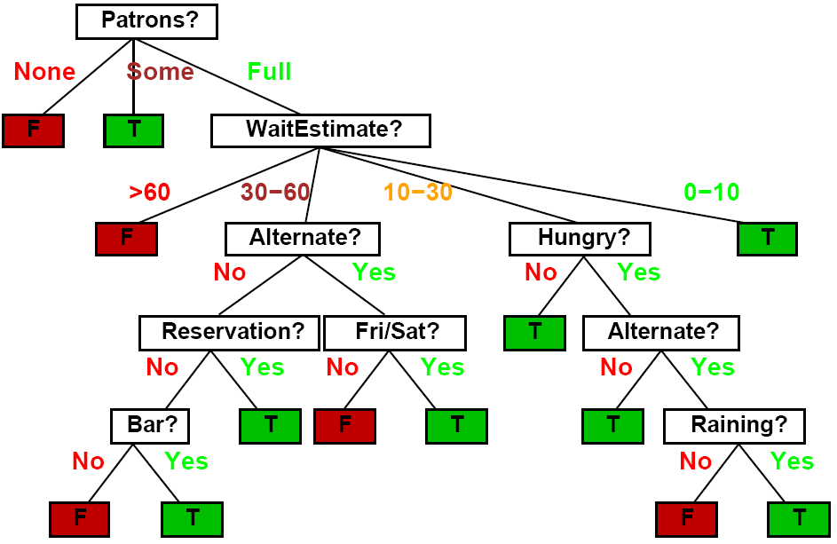
Another Example Decision Tree Classifier
Lana Lazebnik

Slide 49
Another Example Decision Tree Classifier
Lana Lazebnik

Slide 50
Another Example Decision Tree Classifier
Lana Lazebnik

Slide 51
Another Example Decision Tree Classifier
Lana Lazebnik

Slide 52
Overfitting
Learning a tree that classifies the training data perfectly may not lead to the tree with the best generalization to unseen data.
  There may be noise in the training data that the tree is erroneously fitting.
  The algorithm may be making poor decisions towards the leaves of the tree that are based on very little data and may not reflect reliable trends.
on training data
on test data
accuracy
hypothesis complexity
Slide credit: Ray Mooney

Slide 53
Overfitting Noise in Decision Trees
Category or feature noise can easily cause overfitting.
  Add noisy instance <medium, blue, circle>: pos (but really neg)
color
red
green
blue
shape
neg
neg
circle
square
triangle
pos
neg
pos
Slide credit: Ray Mooney

Slide 54
Overfitting Noise in Decision Trees
Category or feature noise can easily cause overfitting.
  Add noisy instance <medium, blue, circle>: pos (but really neg)
color
red
green
blue
<big, blue, circle>: −
<medium, blue, circle>: +
shape
neg
circle
square
triangle
small
med
big
pos
neg
pos
neg
pos
neg
Noise can also cause different instances of the same feature vector to have different classes. Impossible to fit this data and must label leaf with the majority class.
  <big, red, circle>: neg (but really pos)
Conflicting examples can also arise if the features are incomplete and inadequate to determine the class or if the target concept is non-deterministic.
Slide credit: Ray Mooney

Slide 55
Overfitting Prevention (Pruning) Methods
Two basic approaches for decision trees
  Prepruning: Stop growing tree as some point during top-down construction when there is no longer sufficient data to make reliable decisions.
  Postpruning: Grow the full tree, then remove subtrees that do not have sufficient evidence.
Label leaf resulting from pruning with the majority class of the remaining data, or a class probability distribution.
Method for determining which subtrees to prune:
  Cross-validation: Reserve some training data as a hold-out set (validation set) to evaluate utility of subtrees.
  Statistical test: Use a statistical test on the training data to determine if any observed regularity can be dismisses as likely due to random chance.
  Minimum description length (MDL): Determine if the additional complexity of the hypothesis is less complex than just explicitly remembering any exceptions resulting from pruning.
Slide credit: Ray Mooney

Slide 56
Reduced Error Pruning
A post-pruning, cross-validation approach.
Partition training data in “grow” and “validation” sets.
Build a complete tree from the “grow” data.
Until accuracy on validation set decreases do:
For each non-leaf node, n, in the tree do:
Temporarily prune the subtree below n and replace it with a
leaf labeled with the current majority class at that node.
Measure and record the accuracy of the pruned tree on the validation set.
Permanently prune the node that results in the greatest increase in accuracy on
the validation set.
Slide credit: Ray Mooney

