Slide 1
CS 2750: Machine Learning
Expectation Maximization
Prof. Adriana Kovashka
University of Pittsburgh
March 28, 2016

Slide 2
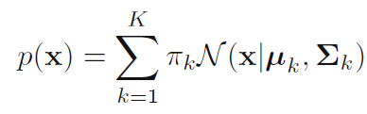
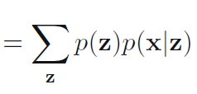

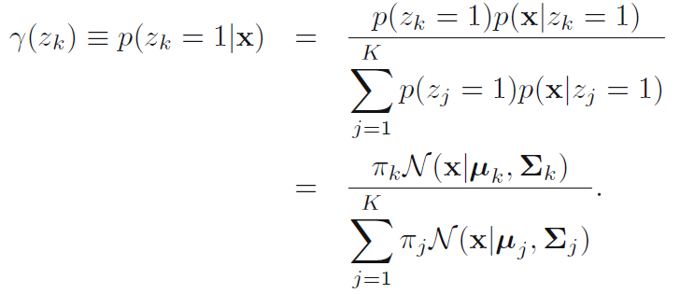
Mixtures of Gaussians
Form:
Let z (latent variable) be 1-of-K representation, then
Responsibility of component k for explaining x:

Slide 3
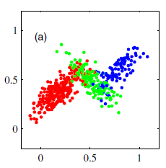
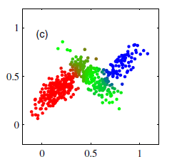
Generating samples
Sample value z* from p(z) then sample a value for x from p(x|z*)
Color generated samples using z* (left)
Color samples using responsibilities (right)

Slide 4
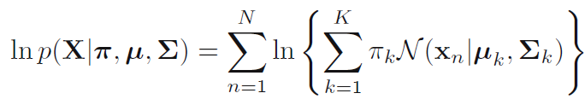
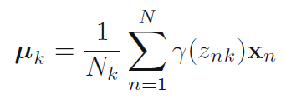
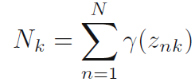
Finding parameters of mixture
Want to maximize:
Set derivative with respect to means to 0, get

Slide 5
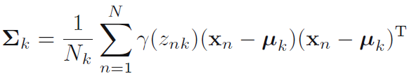

Finding parameters of mixture
Set derivative wrt covariance to 0:
Set derivative wrt mixing coefficients to 0:

Slide 6
Reminder
Responsibilities:
So parameters of Gaussian depend on responsibilities and vice versa…
Remember K-means?

Slide 7
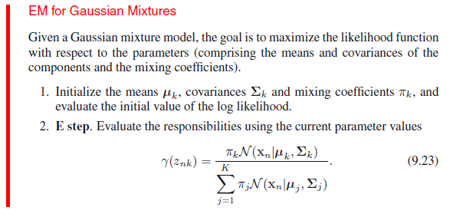
Iterative algorithm
From Bishop

Slide 8
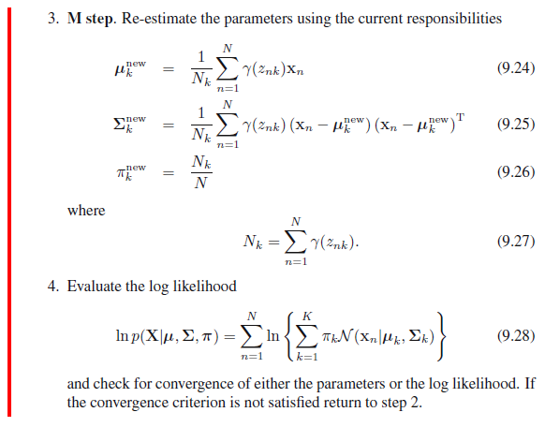
From Bishop

Slide 9
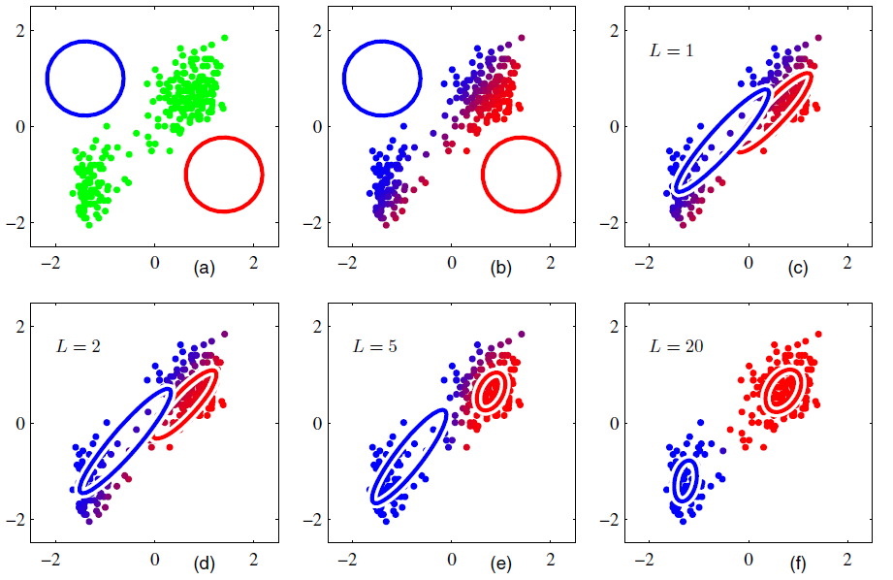

Slide 10
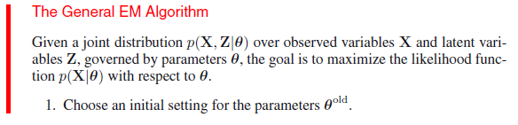
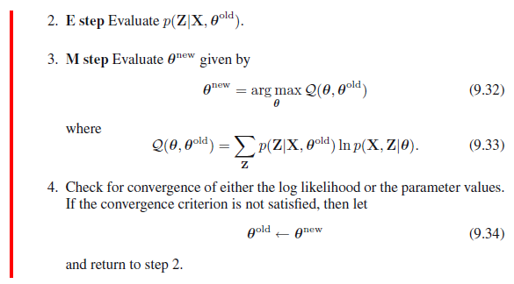
General algorithm
From Bishop

