Slide 1
CS 2750: Machine Learning
Density Estimation
Prof. Adriana Kovashka
University of Pittsburgh
March 14, 2016

Slide 2
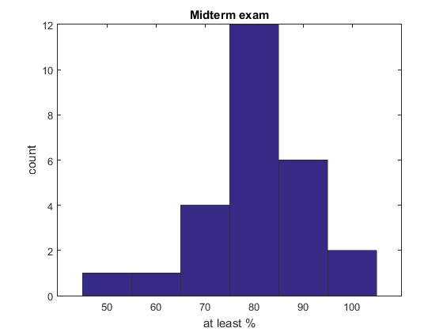
Midterm exam

Slide 3
Midterm exam
T/F Question # | # Correct (Total 26)
1 | 22
2 | 26
3 | 17
4 | 21
5 | 21
6 | 23
7 | 25
8 | 24
9 | 25
10 | 25
11 | 26
12 | 15
13 | 22
14 | 26
15 | 16
16 | 26
17 | 25
18 | 14
19 | 26
20 | 15
21 | 21
22 | 26

Slide 4



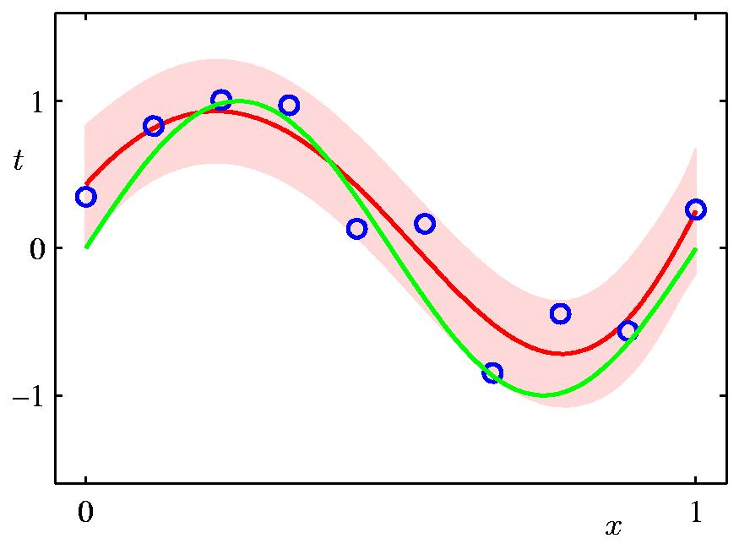
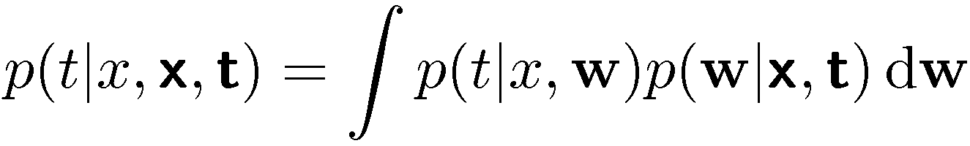
Parametric Distributions
Basic building blocks:
Need to determine given
Curve Fitting
Slide from Bishop

Slide 5

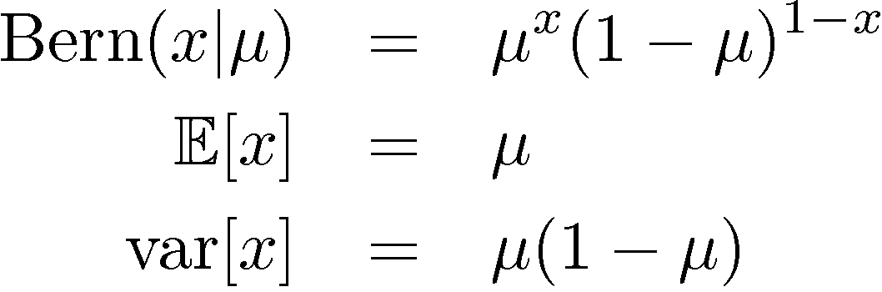
Binary Variables (1)
Coin flipping: heads=1, tails=0
Bernoulli Distribution
Slide from Bishop

Slide 6

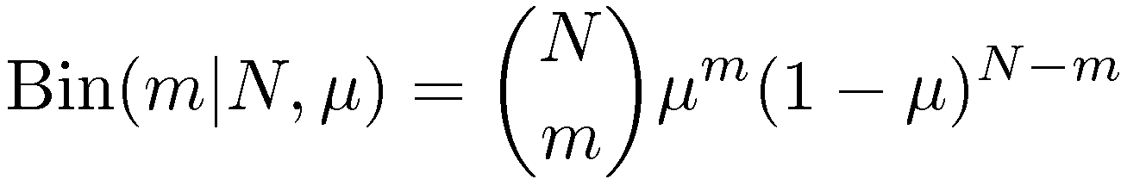
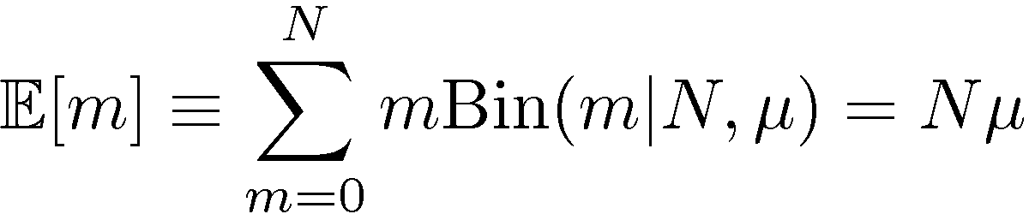
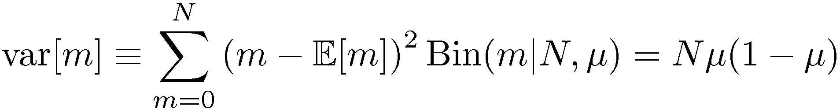
Binary Variables (2)
N coin flips:
Binomial Distribution
Slide from Bishop

Slide 7
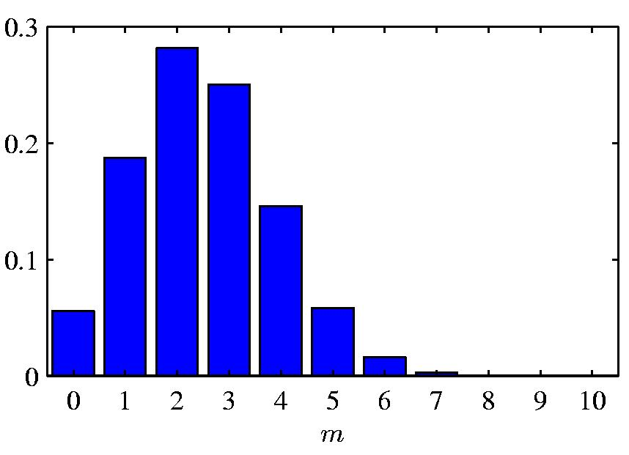

Binomial Distribution
Slide from Bishop

Slide 8
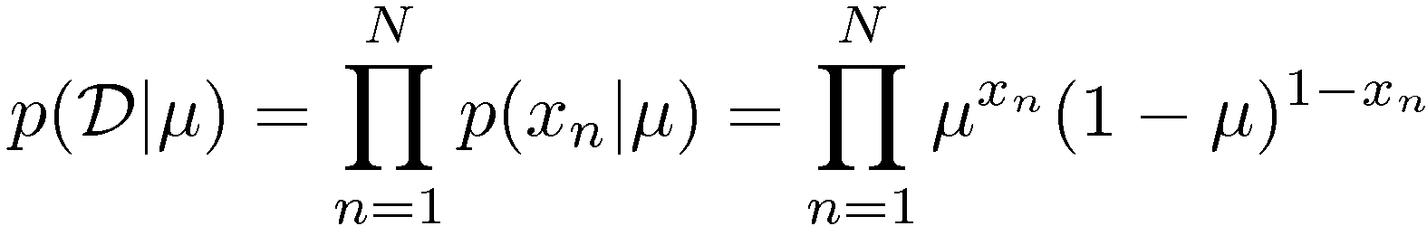
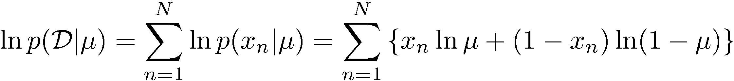
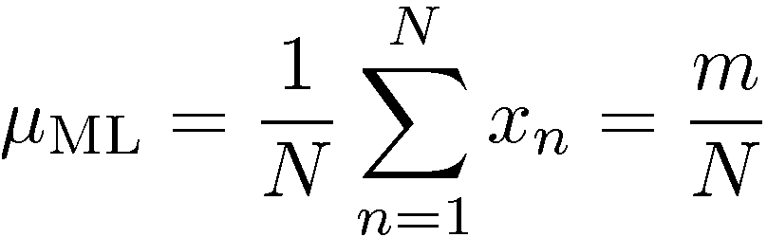
Parameter Estimation (1)
ML for Bernoulli
Given:
Slide from Bishop

Slide 9
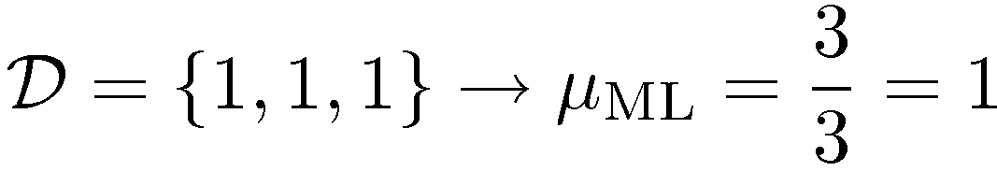
Parameter Estimation (2)
Example:
Prediction: all future tosses will land heads up
Overfitting to D
Slide from Bishop

Slide 10

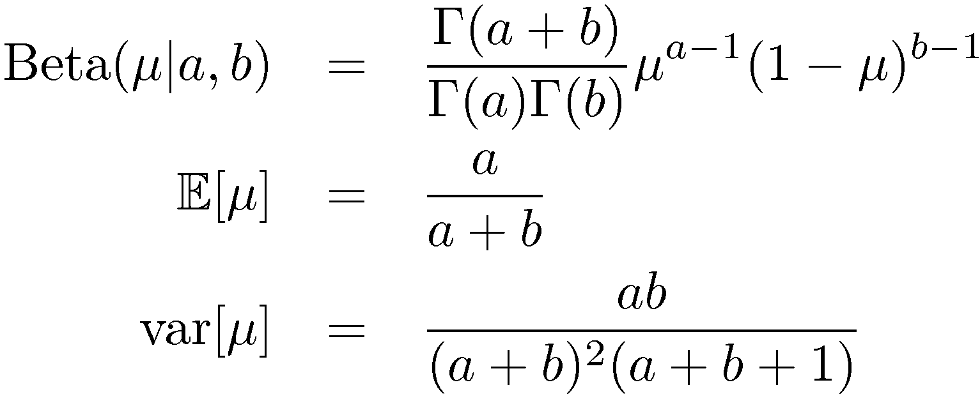

Beta Distribution
Distribution over .
Slide from Bishop

Slide 11
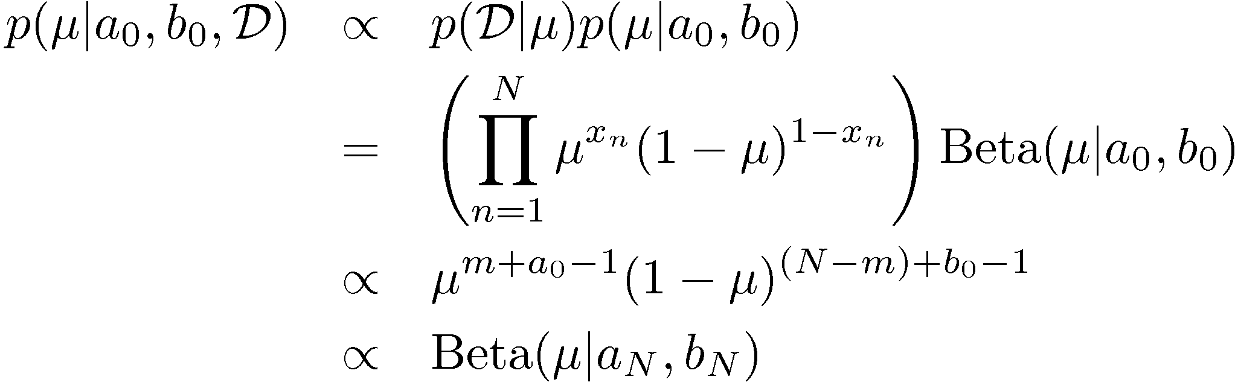
Bayesian Bernoulli
The Beta distribution provides the conjugate prior for the Bernoulli distribution.
Slide from Bishop

Slide 12
Bayesian Bernoulli
The hyperparameters a_{N} and b_{N} are the effective number of observations of x=1 and x=0 (need not be integers)
The posterior distribution in turn can act as a prior as more data is observed

Slide 13

Bayesian Bernoulli
Interpretation?
The fraction of (real and fictitious/prior observations) corresponding to x=1
l = N - m

Slide 14
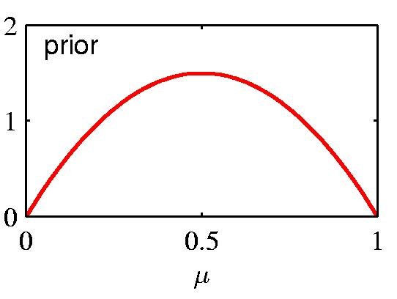
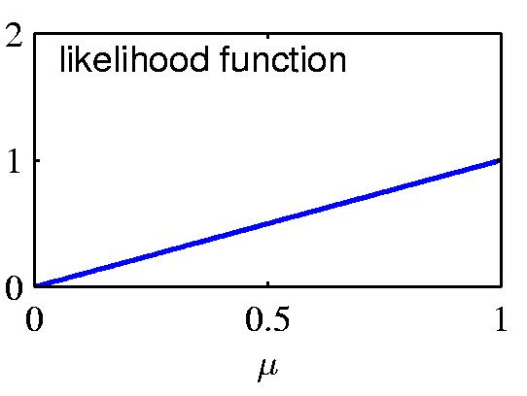
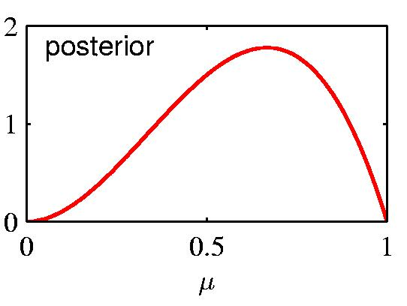
Prior ∙ Likelihood = Posterior
Slide from Bishop

Slide 15
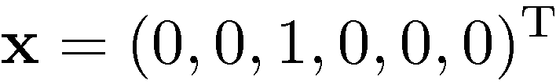
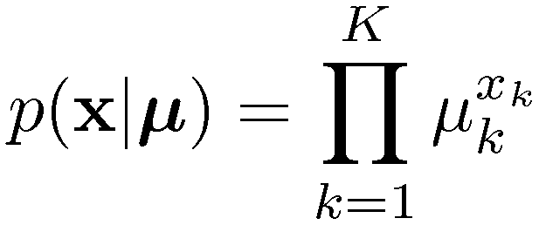
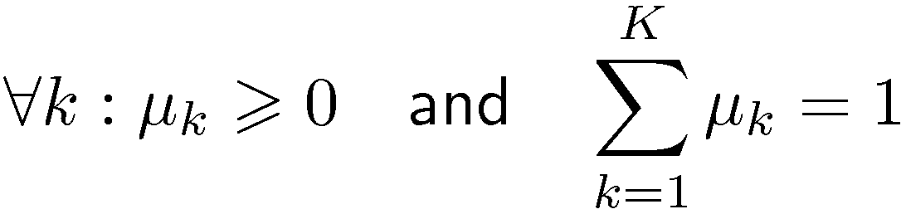
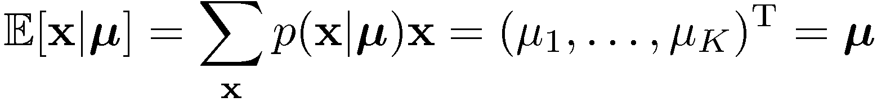
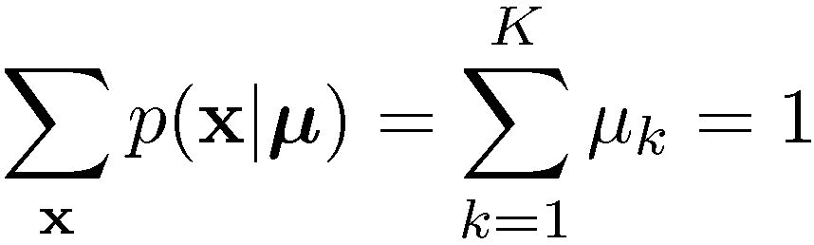
Multinomial Variables
1-of-K coding scheme:
Slide from Bishop

Slide 16

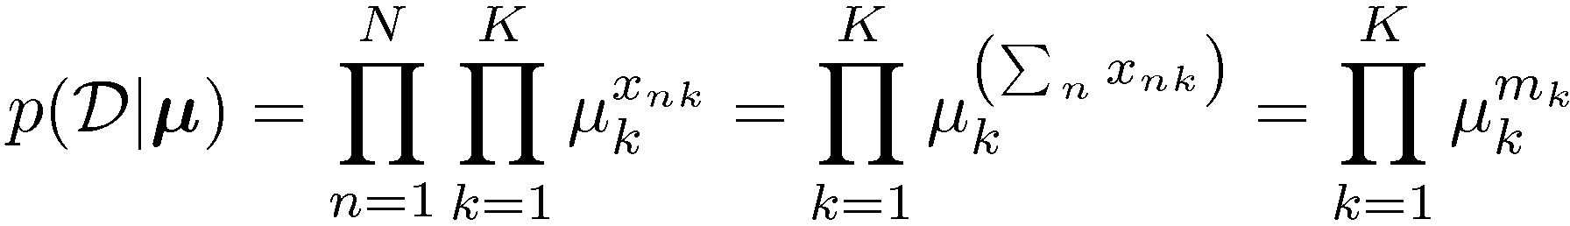

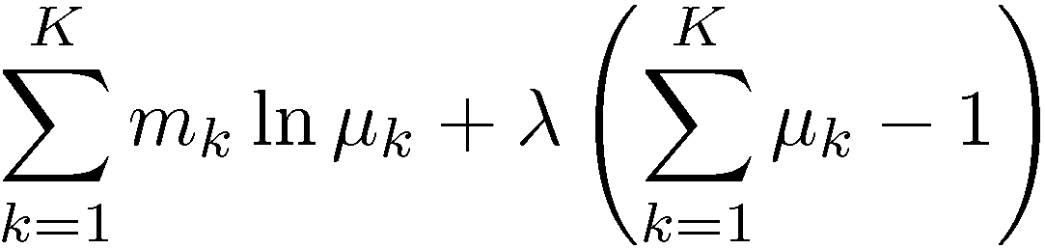
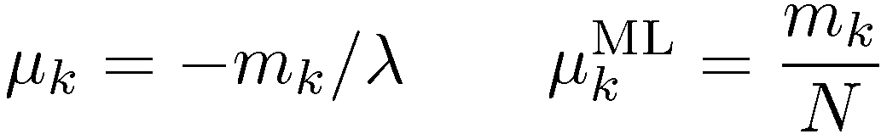
ML Parameter estimation
Given:
Ensure , use a Lagrange multiplier, λ.
Slide from Bishop

Slide 17
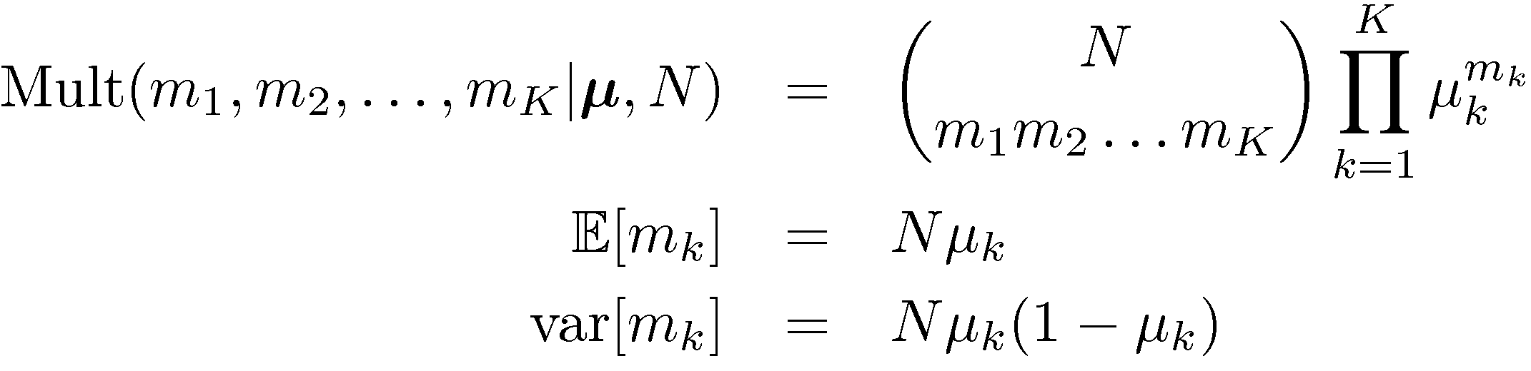
The Multinomial Distribution
Slide from Bishop

Slide 18
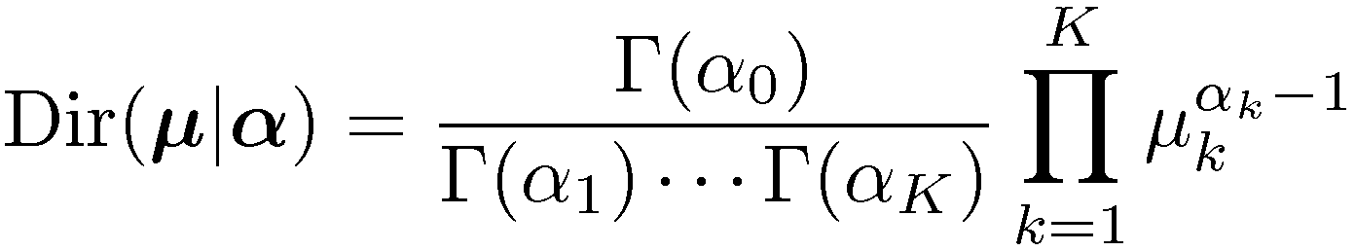
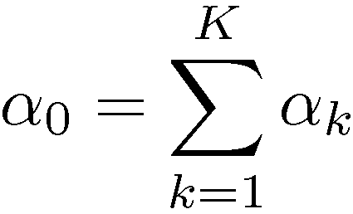
The Dirichlet Distribution
Conjugate prior for the multinomial distribution.
Slide from Bishop

Slide 19
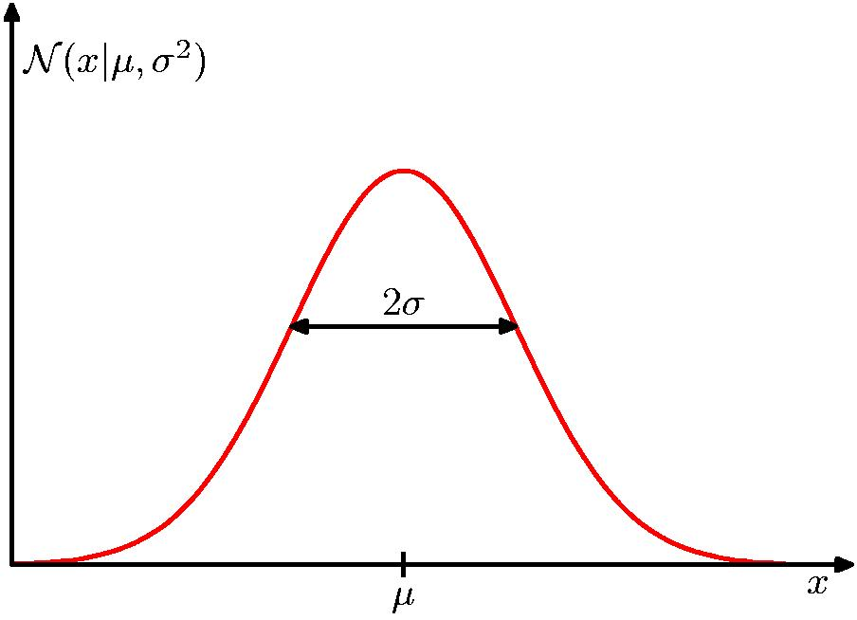
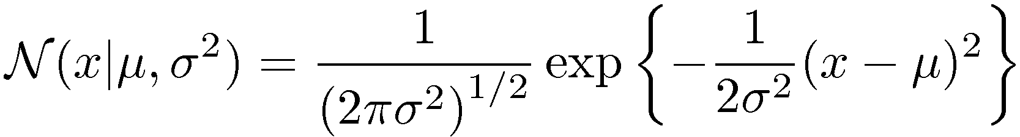
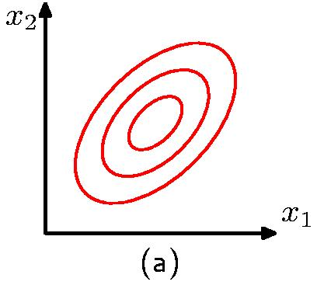
The Gaussian Distribution
Slide from Bishop

Slide 20
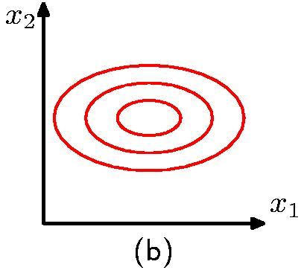
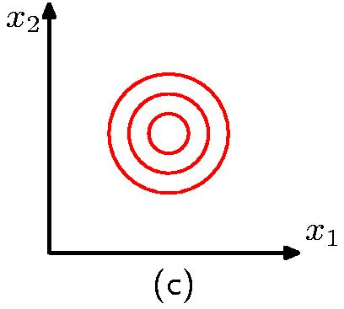
The Gaussian Distribution
Diagonal covariance matrix
Covariance matrix
proportional to the
identity matrix
Slide from Bishop

Slide 21
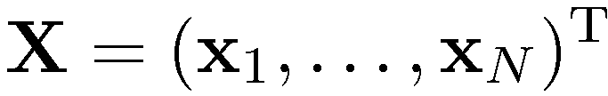
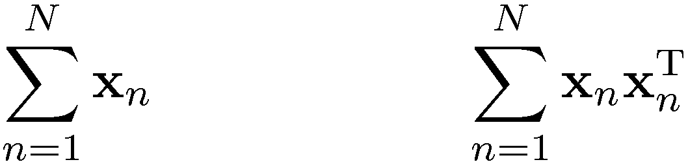
Maximum Likelihood for the Gaussian (1)
Given i.i.d. data , the log likeli-hood function is given by
Sufficient statistics
Slide from Bishop

Slide 22
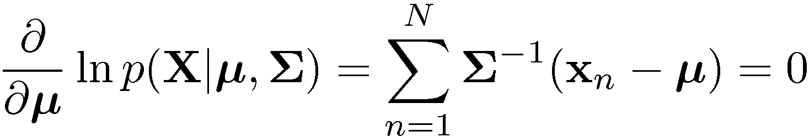
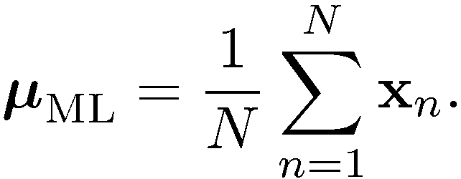
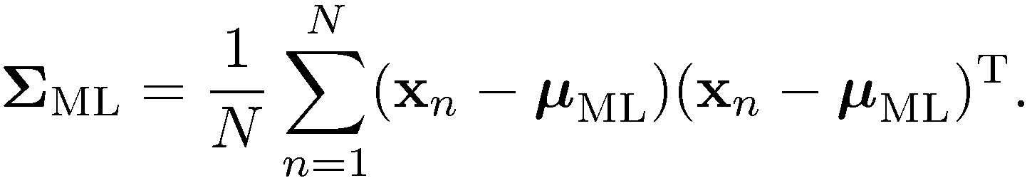
Maximum Likelihood for the Gaussian (2)
Set the derivative of the log likelihood function to zero,
and solve to obtain
Similarly
Slide from Bishop

Slide 23
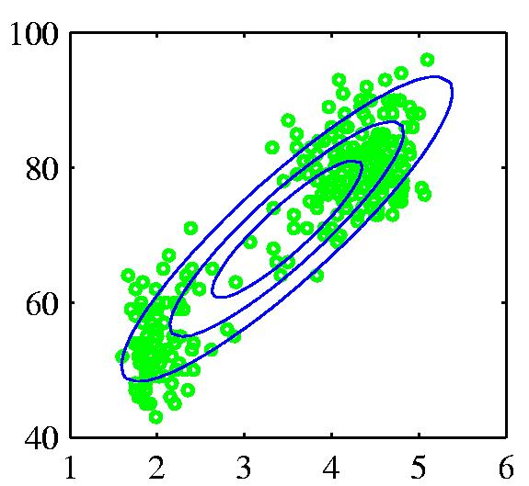
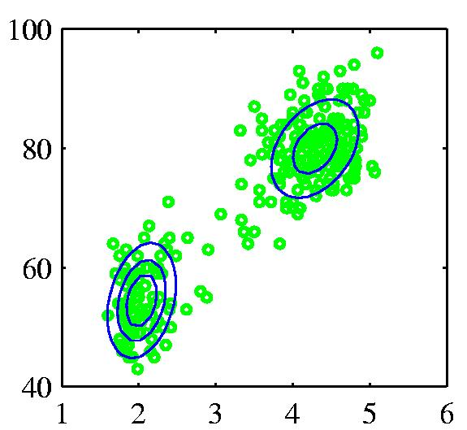
Mixtures of Gaussians (1)
Old Faithful data set
Single Gaussian
Mixture of two Gaussians
Slide from Bishop

Slide 24
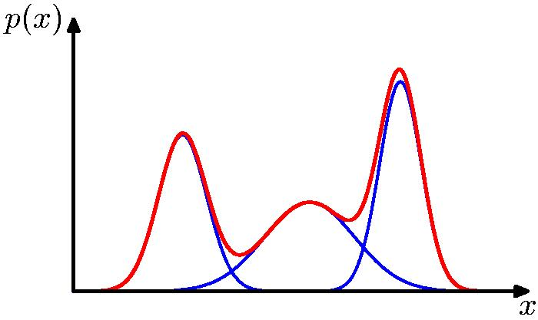
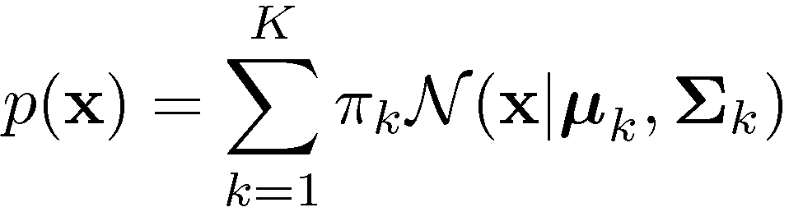
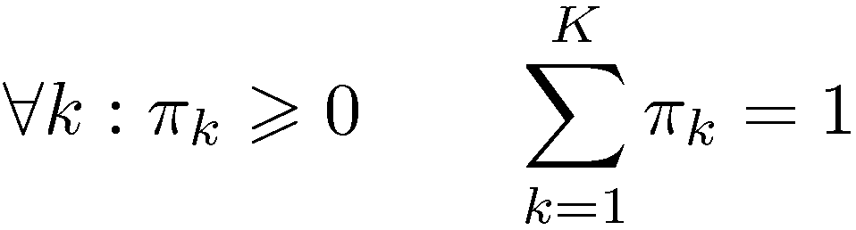
Mixtures of Gaussians (2)
Combine simple models
into a complex model:
Component
Mixing coefficient
K=3
Slide from Bishop

Slide 25
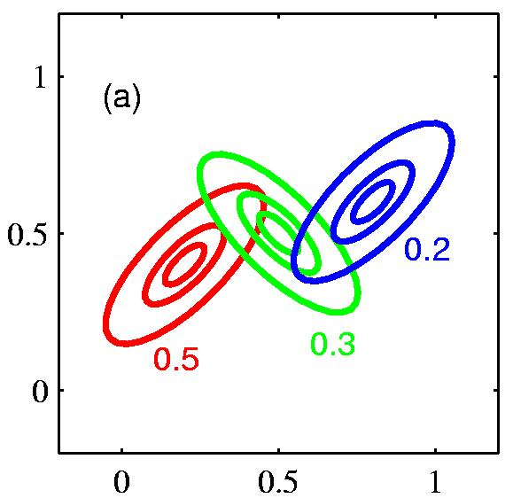
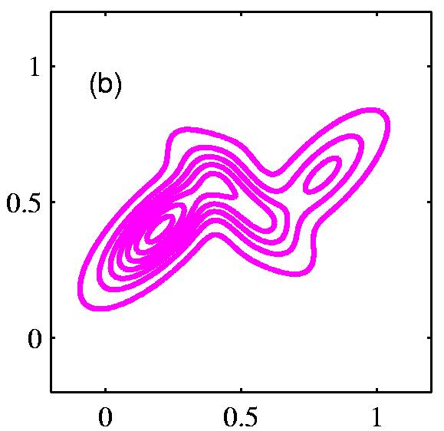
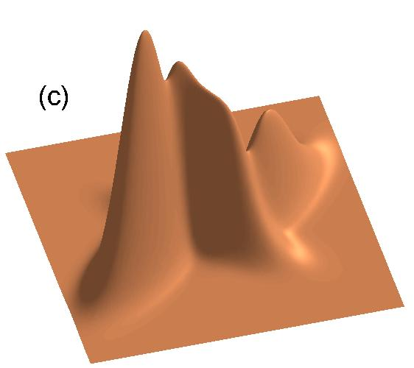
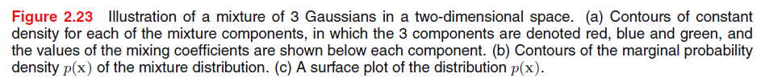
Mixtures of Gaussians (3)
Slide from Bishop

