Slide 1
CS 2750: Machine Learning
Clustering
Prof. Adriana Kovashka
University of Pittsburgh
January 25, 2016

Slide 2
What is clustering?
Grouping items that “belong together” (i.e. have similar features)
Unsupervised: we only use the features X, not the labels Y
This is useful because we may not have any labels but we can still detect patterns
If goal is classification, we can later ask a human to label each group (cluster)
BOARD

Slide 3
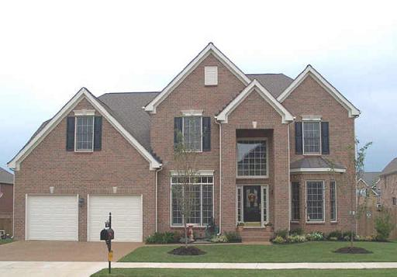
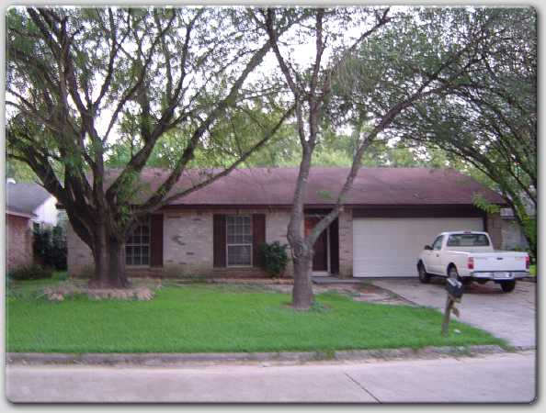
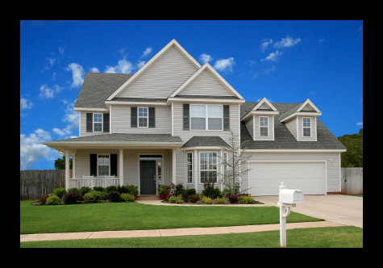

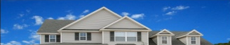


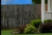






Unsupervised visual discovery
?
?
?
sky
sky
sky
house
house
truck
fence
house
drive-way
drive-way
?
grass
grass
?
drive-way
grass
?
We don’t know what the objects in red boxes are, but we know they tend to occur in similar context
If features = the context, objects in red will cluster together
Then ask human for a label on one example from the cluster, and keep learning new object categories iteratively
Lee and Grauman, “Object-Graphs for Context-Aware Category Discovery”, CVPR 2010

Slide 4
Why do we cluster?
Summarizing data
  Look at large amounts of data
  Represent a large continuous vector with the cluster number
Counting
  Computing feature histograms
Prediction
  Images in the same cluster may have the same labels
Segmentation
  Separate the image into different regions
Slide credit: J. Hays, D. Hoiem

Slide 5
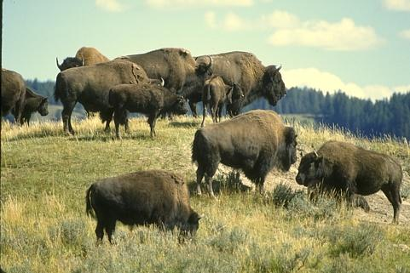
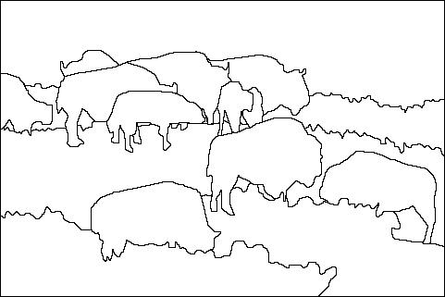
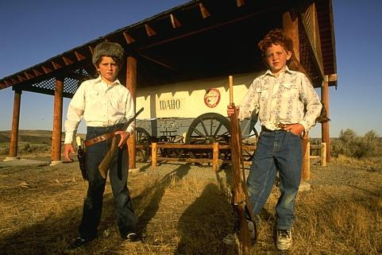
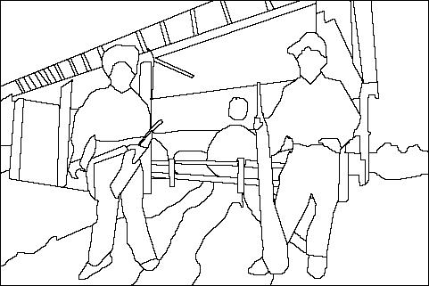
Image segmentation via clustering
Separate image into coherent “objects”
image
human segmentation
Source: L. Lazebnik

Slide 6
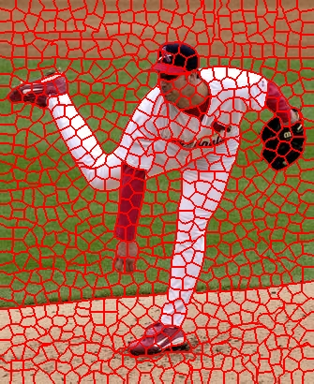
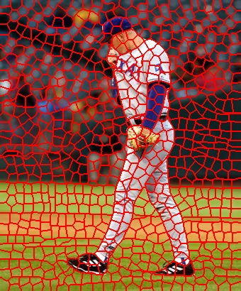
Image segmentation via clustering
Separate image into coherent “objects”
Group together similar-looking pixels for efficiency of further processing
“superpixels”
X. Ren and J. Malik. Learning a classification model for segmentation. ICCV 2003.
Source: L. Lazebnik

Slide 7
Today
Clustering: motivation and applications
Algorithms
  K-means (iterate between finding centers and assigning points)
  Mean-shift (find modes in the data)
  Hierarchical clustering (start with all points in separate clusters and merge)
  Normalized cuts (split nodes in a graph based on similarity)
Notes:
7

Slide 8
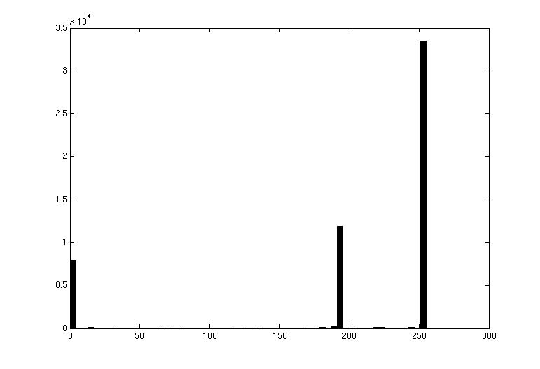
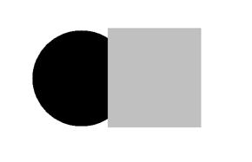
Image segmentation: toy example
white pixels
pixel count
3
black pixels
gray pixels
1
2
input image
intensity
These intensities define the three groups.
We could label every pixel in the image according to which of these primary intensities it is.
  i.e., segment the image based on the intensity feature.
What if the image isn’t quite so simple?
Source: K. Grauman

Slide 9
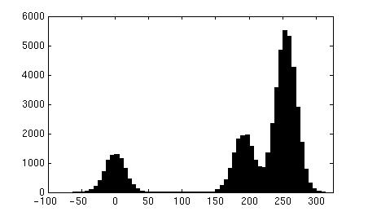

Now how to determine the three main intensities that define our groups?
We need to cluster.
pixel count
input image
intensity
pixel count
input image
intensity
Source: K. Grauman

Slide 10
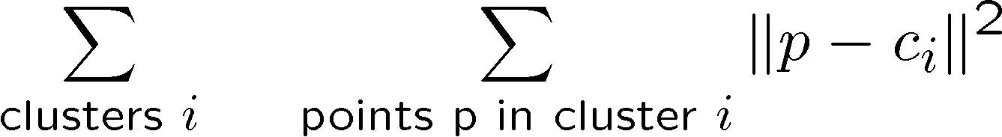
0
190
255
intensity
3
1
2
Goal: choose three “centers” as the representative intensities, and label every pixel according to which of these centers it is nearest to.
Best cluster centers are those that minimize SSD between all points and their nearest cluster center c_{i}:
Source: K. Grauman

Slide 11
Clustering
With this objective, it is a “chicken and egg” problem:
  If we knew the cluster centers, we could allocate points to groups by assigning each to its closest center.
  If we knew the group memberships, we could get the centers by computing the mean per group.
Source: K. Grauman

Slide 12
K-means clustering
Basic idea: randomly initialize the k cluster centers, and iterate between the two steps we just saw.
  Randomly initialize the cluster centers, c₁, ..., c_{K}
  Given cluster centers, determine points in each cluster
    For each point p, find the closest c_{i}. Put p into cluster i
  Given points in each cluster, solve for c_{i}
    Set c_{i} to be the mean of points in cluster i
  If c_{i} have changed, repeat Step 2
Properties
  Will always converge to some solution
  Can be a “local minimum”
    does not always find the global minimum of objective function:
Source: Steve Seitz

Slide 13
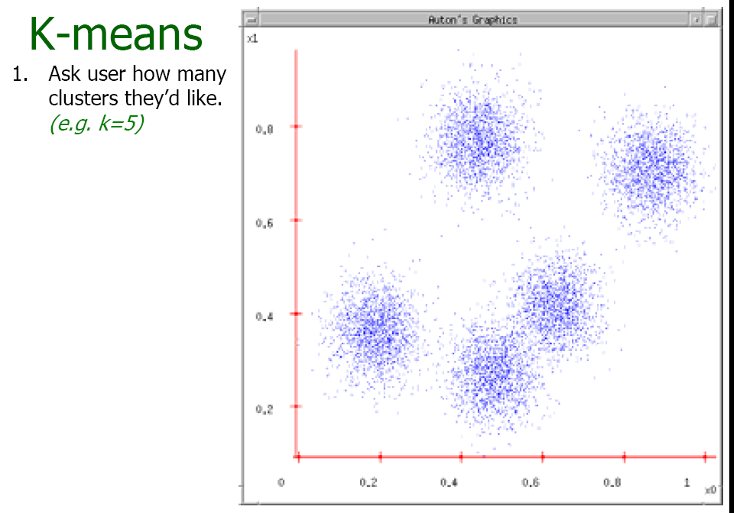
Source: A. Moore

Slide 14
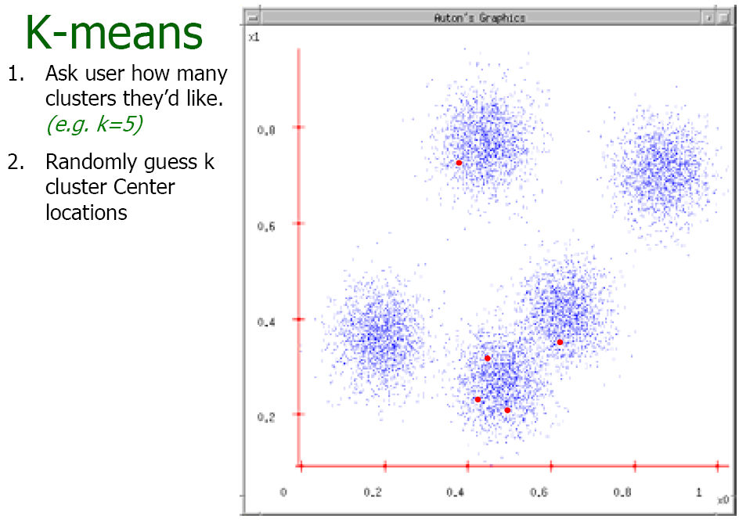
Source: A. Moore

Slide 15
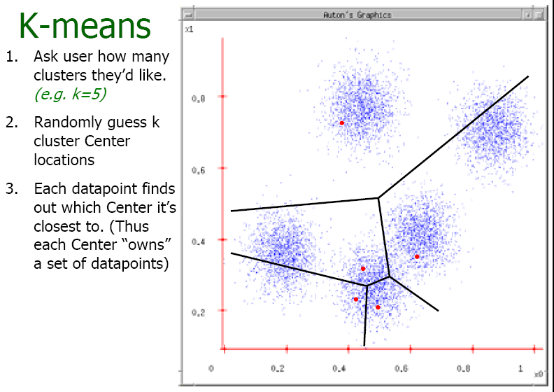
Source: A. Moore

Slide 16
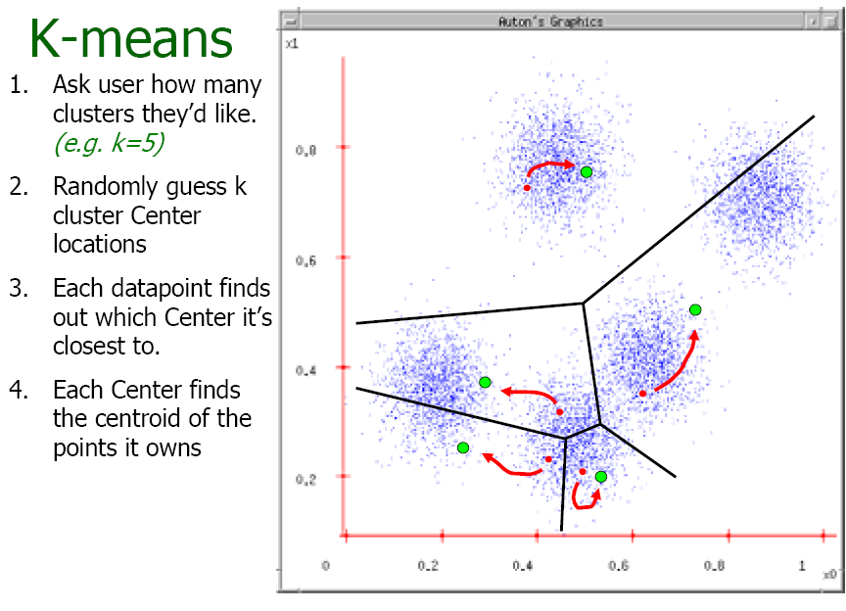
Source: A. Moore

Slide 17
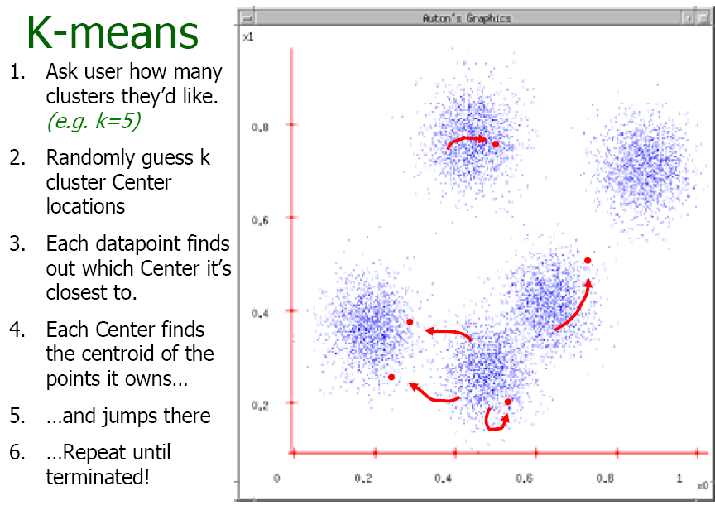
Source: A. Moore

Slide 18
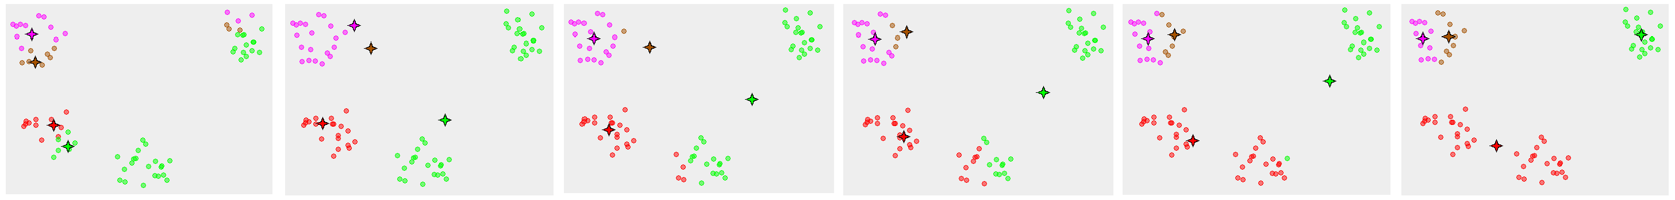
K-means converges to a local minimum
Figure from Wikipedia

Slide 19
K-means clustering
Java demo
http://home.dei.polimi.it/matteucc/Clustering/tutorial_html/AppletKM.html
Matlab demo
http://www.cs.pitt.edu/~kovashka/cs1699/kmeans_demo.m

Slide 20
Time Complexity
Let n = number of instances, m = dimensionality of the vectors, k = number of clusters
Assume computing distance between two instances is O(m)
Reassigning clusters:
  O(kn) distance computations, or O(knm)
Computing centroids:
  Each instance vector gets added once to a centroid: O(nm)
Assume these two steps are each done once for a fixed number of iterations I: O(Iknm)
  Linear in all relevant factors
Adapted from Ray Mooney

Slide 21
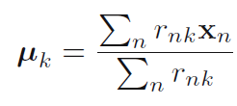
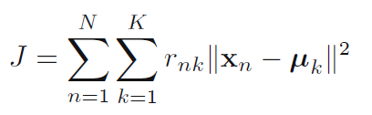
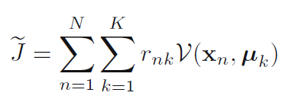
K-means Variations
K-means:
K-medoids:

Slide 22
Distance Metrics
Euclidian distance (L₂ norm):
L₁ norm:
Cosine Similarity (transform to a distance by subtracting from 1):
Slide credit: Ray Mooney

Slide 23
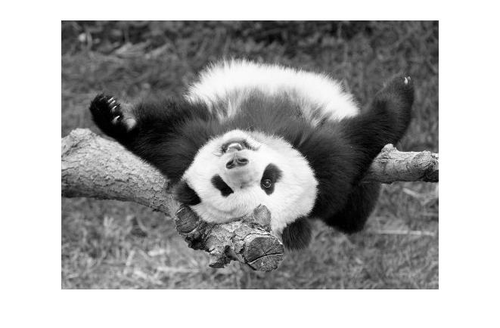
Segmentation as clustering
Depending on what we choose as the feature space, we can group pixels in different ways.
Grouping pixels based on intensity similarity
Feature space: intensity value (1-d)
Source: K. Grauman
Notes:
23

Slide 24
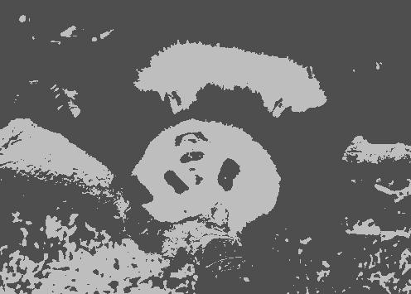
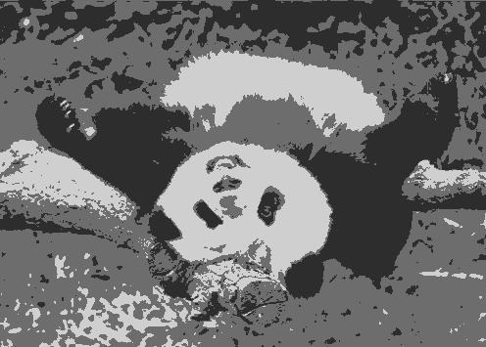
K=2
K=3
quantization of the feature space; segmentation label map
Source: K. Grauman

Slide 25
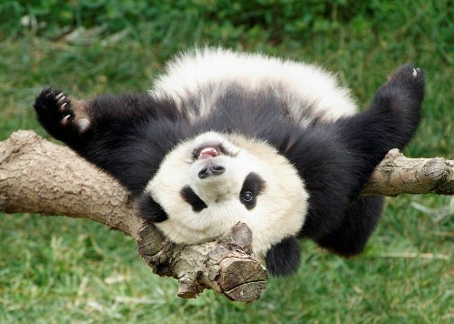
Segmentation as clustering
Depending on what we choose as the feature space, we can group pixels in different ways.
R=255
G=200
B=250
Grouping pixels based on color similarity
B
R=245
G=220
B=248
G
R=15
G=189
B=2
R=3
G=12
B=2
R
Feature space: color value (3-d)
Source: K. Grauman
Notes:
25

Slide 26
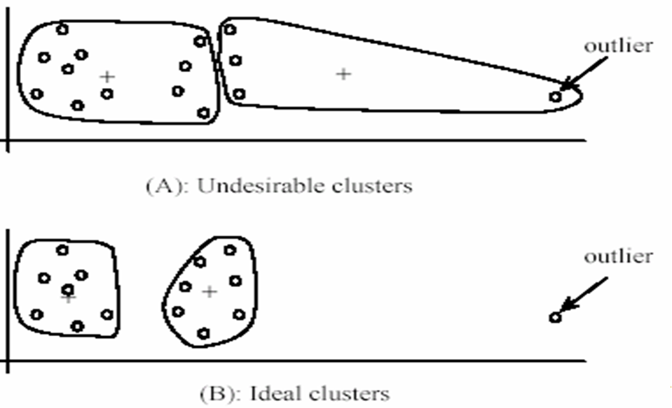
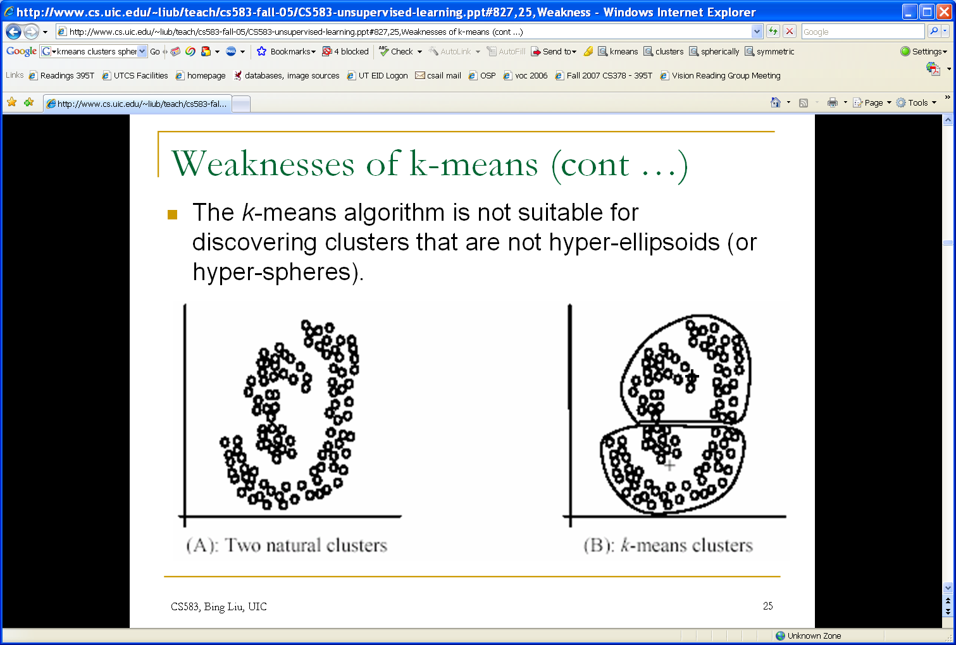
K-means: pros and cons
Pros
Simple, fast to compute
Converges to local minimum of within-cluster squared error
Cons/issues
Setting k?
  One way: silhouette coefficient
Sensitive to initial centers
  Use heuristics or output of another method
Sensitive to outliers
Detects spherical clusters
Adapted from K. Grauman
Notes:
26

Slide 27
Today
Clustering: motivation and applications
Algorithms
  K-means (iterate between finding centers and assigning points)
  Mean-shift (find modes in the data)
  Hierarchical clustering (start with all points in separate clusters and merge)
  Normalized cuts (split nodes in a graph based on similarity)
Notes:
27

Slide 28
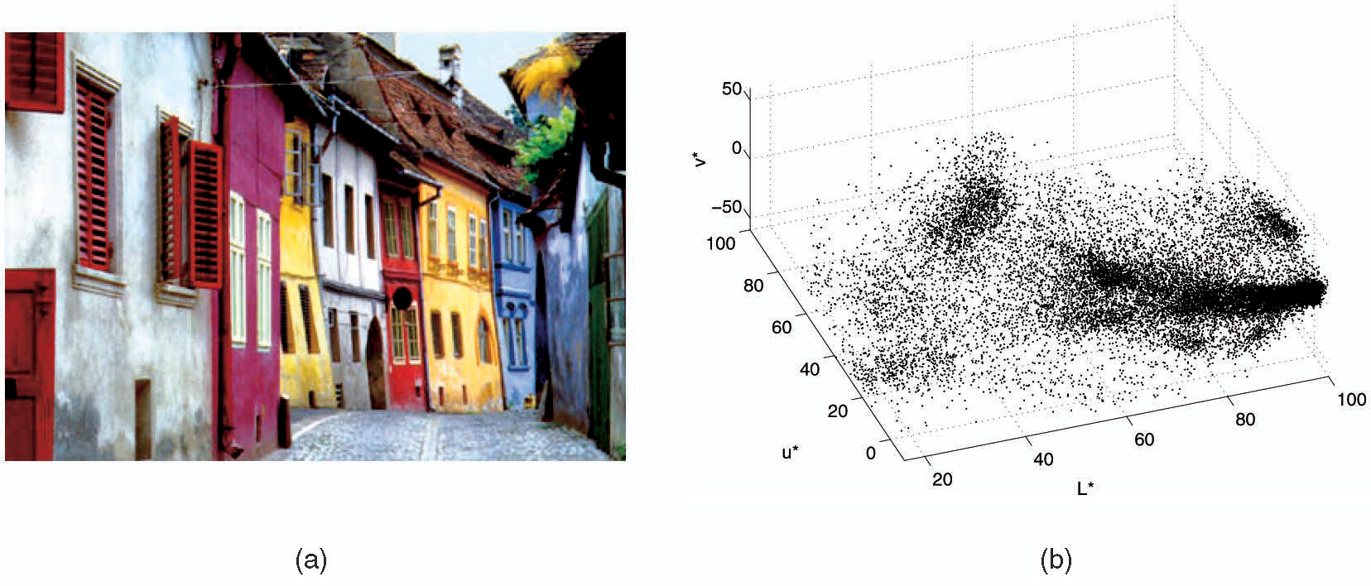
Mean shift algorithm
The mean shift algorithm seeks modes or local maxima of density in the feature space
Feature space
(L*u*v* color values)
image
Source: K. Grauman

Slide 29
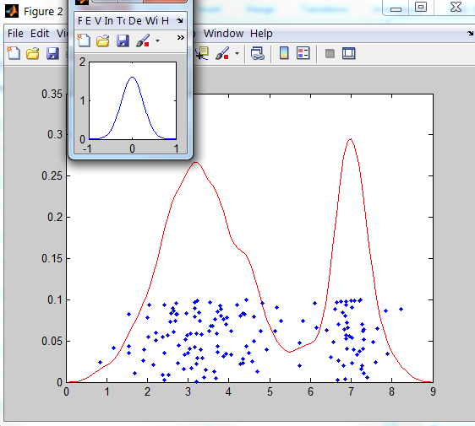
Kernel density estimation
Kernel
Estimated density
Data (1-D)
Source: D. Hoiem

Slide 30
Mean shift
Search
window
Center of
mass
Mean Shift
vector
Slide by Y. Ukrainitz & B. Sarel

Slide 31
Mean shift
Search
window
Center of
mass
Mean Shift
vector
Slide by Y. Ukrainitz & B. Sarel

Slide 32
Mean shift
Search
window
Center of
mass
Mean Shift
vector
Slide by Y. Ukrainitz & B. Sarel

Slide 33
Mean shift
Search
window
Center of
mass
Mean Shift
vector
Slide by Y. Ukrainitz & B. Sarel

Slide 34
Mean shift
Search
window
Center of
mass
Mean Shift
vector
Slide by Y. Ukrainitz & B. Sarel

Slide 35
Mean shift
Search
window
Center of
mass
Mean Shift
vector
Slide by Y. Ukrainitz & B. Sarel

Slide 36
Mean shift
Search
window
Center of
mass
Slide by Y. Ukrainitz & B. Sarel

Slide 37
Points in same cluster converge
Source: D. Hoiem

Slide 38
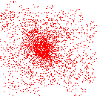
Mean shift clustering
Cluster: all data points in the attraction basin of a mode
Attraction basin: the region for which all trajectories lead to the same mode
Slide by Y. Ukrainitz & B. Sarel

Slide 39
Computing the Mean Shift
Simple Mean Shift procedure:
Compute mean shift vector
Translate the Kernel window by m(x)
Slide by Y. Ukrainitz & B. Sarel

Slide 40
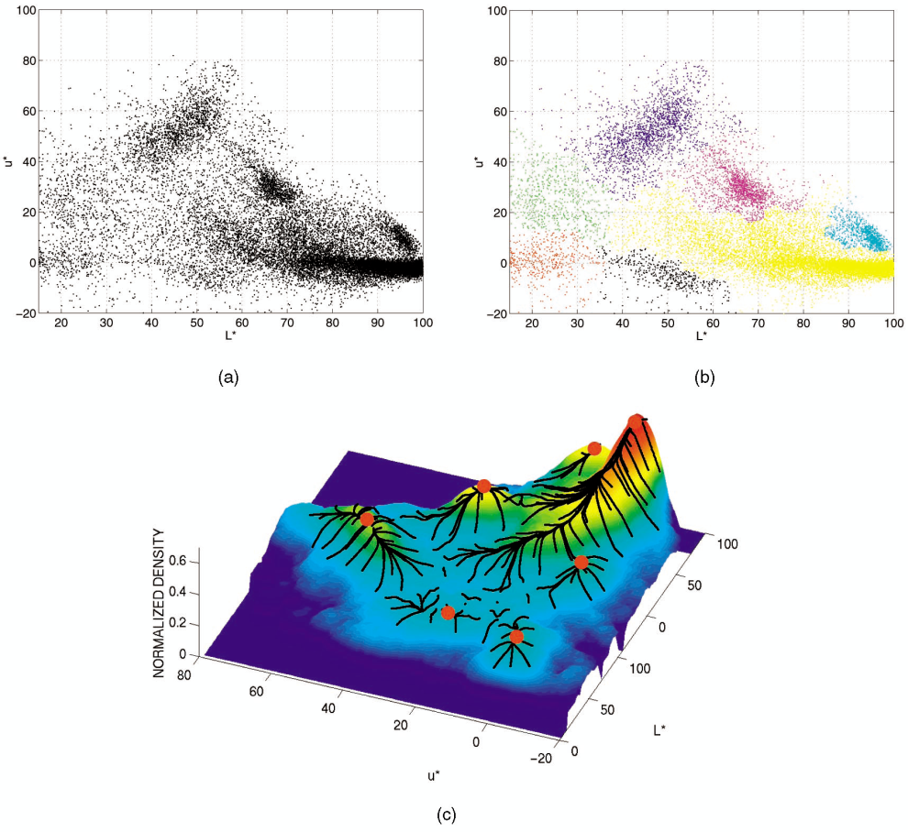
Mean shift clustering/segmentation
Compute features for each point (color, texture, etc)
Initialize windows at individual feature points
Perform mean shift for each window until convergence
Merge windows that end up near the same “peak” or mode
Source: D. Hoiem

Slide 41
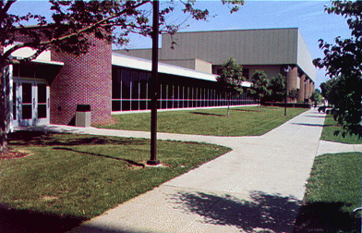
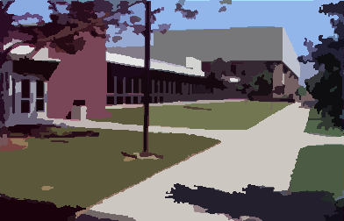
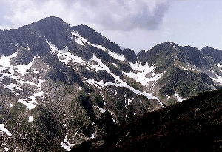
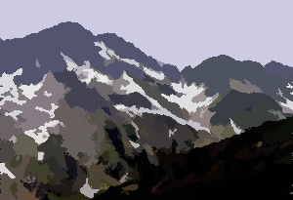
Mean shift segmentation results
http://www.caip.rutgers.edu/~comanici/MSPAMI/msPamiResults.html

Slide 42
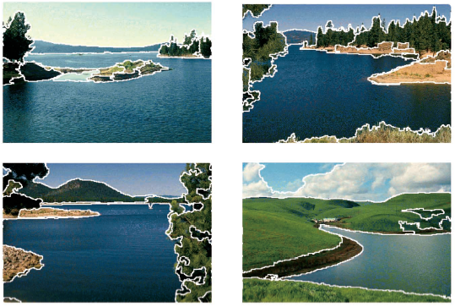
Mean shift segmentation results

Slide 43
Mean shift
Pros:
  Does not assume shape on clusters
  Robust to outliers
Cons/issues:
  Need to choose window size
  Does not scale well with dimension of feature space
  Expensive: O(I n²)

Slide 44
Mean-shift reading
Nicely written mean-shift explanation (with math)
http://saravananthirumuruganathan.wordpress.com/2010/04/01/introduction-to-mean-shift-algorithm/
  Includes .m code for mean-shift clustering
Mean-shift paper by Comaniciu and Meer
http://www.caip.rutgers.edu/~comanici/Papers/MsRobustApproach.pdf
Adaptive mean shift in higher dimensions
http://mis.hevra.haifa.ac.il/~ishimshoni/papers/chap9.pdf
Source: K. Grauman

Slide 45
Today
Clustering: motivation and applications
Algorithms
  K-means (iterate between finding centers and assigning points)
  Mean-shift (find modes in the data)
  Hierarchical clustering (start with all points in separate clusters and merge)
  Normalized cuts (split nodes in a graph based on similarity)
Notes:
45

Slide 46
Hierarchical Agglomerative Clustering (HAC)
Assumes a similarity function for determining the similarity of two instances.
Starts with all instances in a separate cluster and then repeatedly joins the two clusters that are most similar until there is only one cluster.
The history of merging forms a binary tree or hierarchy.
Slide credit: Ray Mooney

Slide 47
HAC Algorithm
Start with all instances in their own cluster.
Until there is only one cluster:
Among the current clusters, determine the two
clusters, c_{i} and c_{j}, that are most similar.
Replace c_{i} and c_{j} with a single cluster c_{i} ∪ c_{j}
Slide credit: Ray Mooney

Slide 48
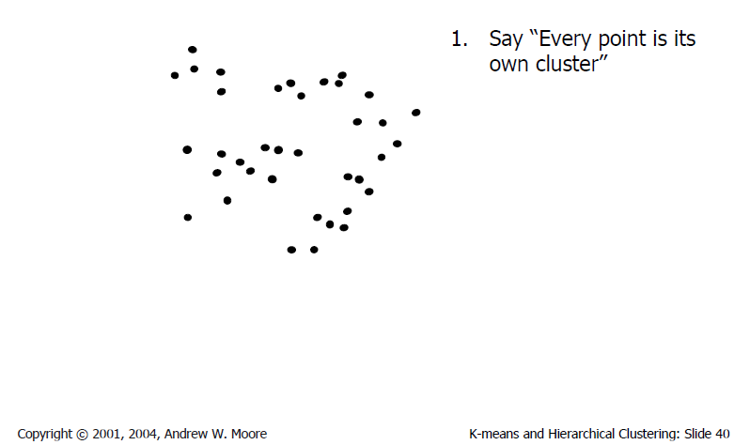
Agglomerative clustering

Slide 49
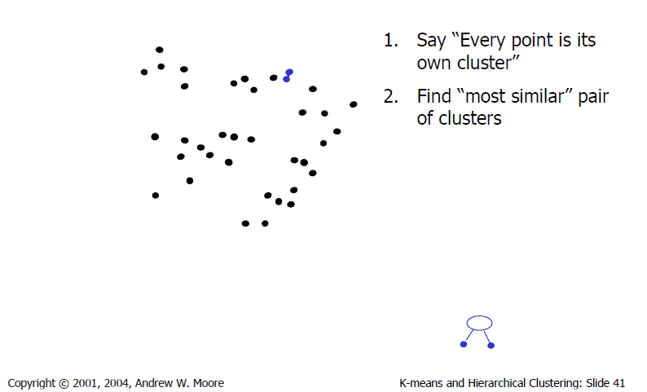
Agglomerative clustering

Slide 50
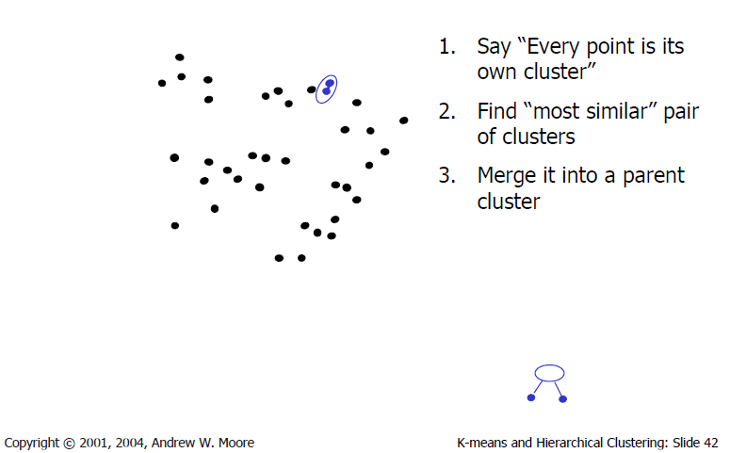
Agglomerative clustering

Slide 51
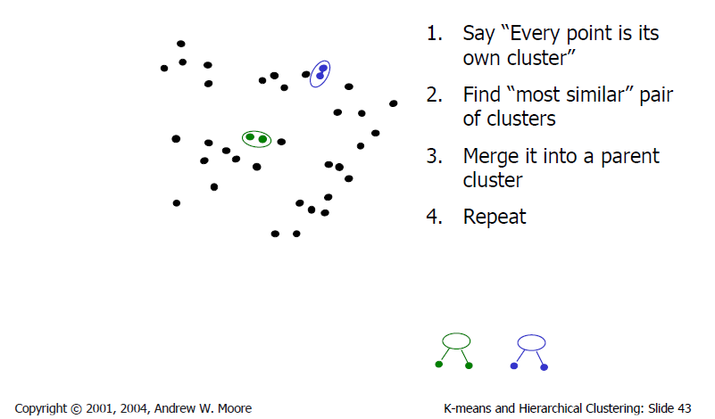
Agglomerative clustering

Slide 52
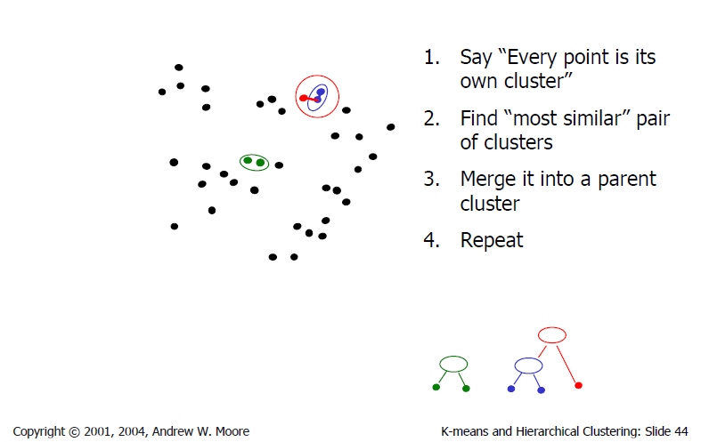
Agglomerative clustering

Slide 53
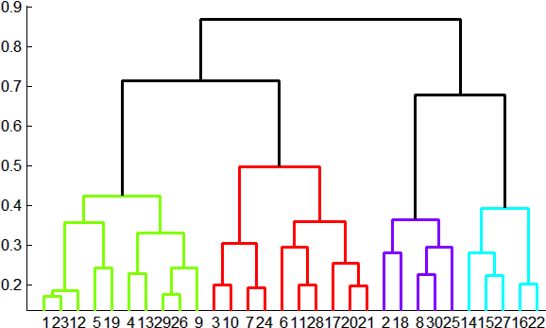
Agglomerative clustering
How many clusters?
Clustering creates a dendrogram (a tree)
To get final clusters, pick a threshold
  max number of clusters or
  max distance within clusters (y axis)
distance
Adapted from J. Hays

Slide 54
Cluster Similarity
How to compute similarity of two clusters each possibly containing multiple instances?
  Single Link: Similarity of two most similar members.
  Complete Link: Similarity of two least similar members.
  Group Average: Average similarity between members.
Adapted from Ray Mooney

Slide 55
Today
Clustering: motivation and applications
Algorithms
  K-means (iterate between finding centers and assigning points)
  Mean-shift (find modes in the data)
  Hierarchical clustering (start with all points in separate clusters and merge)
  Normalized cuts (split nodes in a graph based on similarity)
Notes:
55

Slide 56
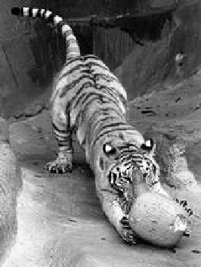
Images as graphs
q
w_{pq}
w
p
Fully-connected graph
  node (vertex) for every pixel
  link between every pair of pixels, p,q
  affinity weight w_{pq} for each link (edge)
    w_{pq} measures similarity
      similarity is inversely proportional to difference (in color and position…)
Source: Steve Seitz

Slide 57
Segmentation by Graph Cuts
q
w_{pq}
w
p
A
B
C
Break Graph into Segments
  Want to delete links that cross between segments
  Easiest to break links that have low similarity (low weight)
    similar pixels should be in the same segments
    dissimilar pixels should be in different segments
Source: Steve Seitz

Slide 58
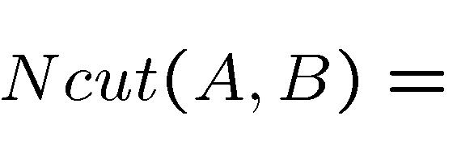
Cuts in a graph: Normalized cut
B
A
  Normalize for size of segments:
  assoc(A,V) = sum of weights of all edges that touch A
  Ncut value small when we get two clusters with many edges with high weights, and few edges of low weight between them
      J. Shi and J. Malik, Normalized Cuts and Image Segmentation, CVPR, 1997
Adapted from S.Seitz

Slide 59
Normalized cut: Algorithm
Let W be the affinity matrix of the graph (n x n for n pixels)
Let D be the diagonal matrix with entries D(i, i) = Σ_{j} W(i, j)
Solve generalized eigenvalue problem (D − W)y = λDy
for the eigenvector with the second smallest eigenvalue
  The ith entry of y can be viewed as a “soft” indicator
  of the component membership of the ith pixel
  Use 0 or median value of the entries of y to split
  the graph into two components
  To find more than two components:
    Recursively bipartition the graph
    Run k-means clustering on values of
    several eigenvectors
Adapted from K. Grauman / L. Lazebnik

Slide 60
Normalized cuts: pros and cons
Pros:
Generic framework, flexible to choice of function that computes weights (“affinities”) between nodes
Does not require model of the data distribution
Cons:
Time complexity can be high
  Dense, highly connected graphs → many affinity computations
  Solving eigenvalue problem
Preference for balanced partitions
Adapted from K. Grauman

Slide 61



Concluding thoughts
Lots of ways to do clustering
How to evaluate performance?
  Purity
  Might depend on application
where is the set of clusters
and is the set of classes
http://nlp.stanford.edu/IR-book/html/htmledition/evaluation-of-clustering-1.html

