Slide 1
CS 2750: Machine Learning
Bias-Variance Trade-off (cont’d) + Image Representations
Prof. Adriana Kovashka
University of Pittsburgh
January 20, 2016

Slide 2
Announcement
Homework 1 now due Feb. 1

Slide 3
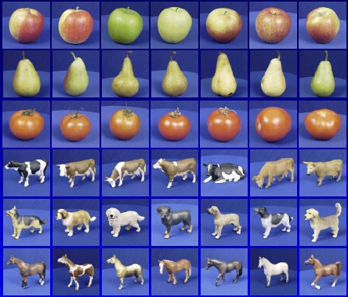

Generalization
Training set (labels known)
Test set (labels unknown)
How well does a learned model generalize from the data it was trained on to a new test set?
Slide credit: L. Lazebnik

Slide 4
Generalization
Components of expected loss
  Noise in our observations: unavoidable
  Bias: how much the average model over all training sets differs from the true model
    Error due to inaccurate assumptions/simplifications made by the model
  Variance: how much models estimated from different training sets differ from each other
Underfitting: model is too “simple” to represent all the relevant class characteristics
  High bias and low variance
  High training error and high test error
Overfitting: model is too “complex” and fits irrelevant characteristics (noise) in the data
  Low bias and high variance
  Low training error and high test error
Adapted from L. Lazebnik

Slide 5
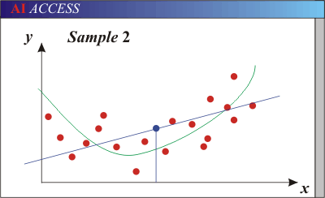
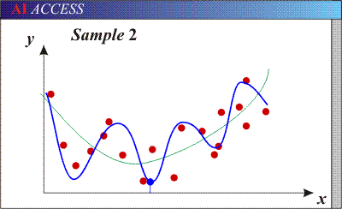
Bias-Variance Trade-off
Think about “squinting”…
Models with too few parameters are inaccurate because of a large bias (not enough flexibility).
Models with too many parameters are inaccurate because of a large variance (too much sensitivity to the sample).
Purple dots = possible test points
Red dots = training data (all that we see before we ship off our model!)
Green curve = true underlying model Blue curve = our predicted model/fit
Adapted from D. Hoiem

Slide 6
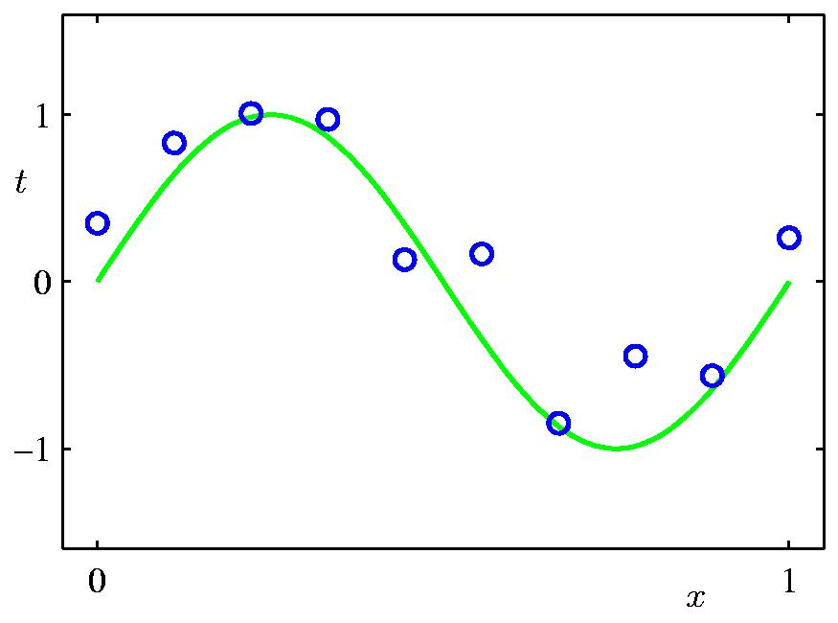
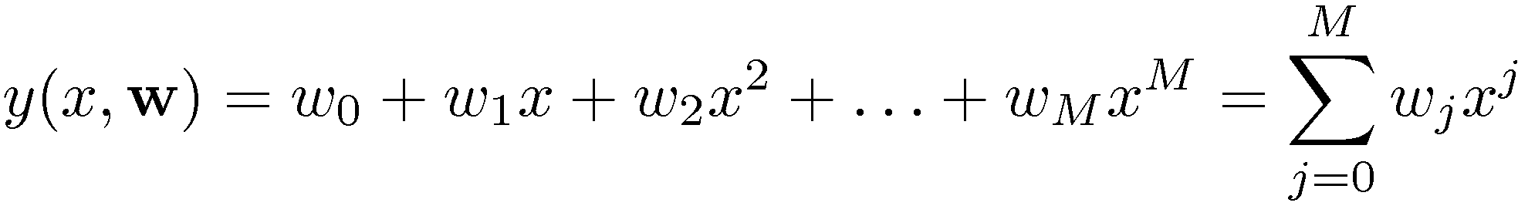
Polynomial Curve Fitting
Slide credit: Chris Bishop

Slide 7
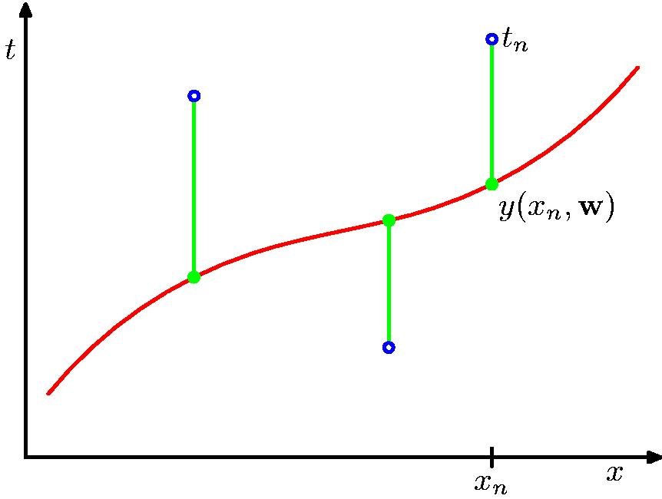
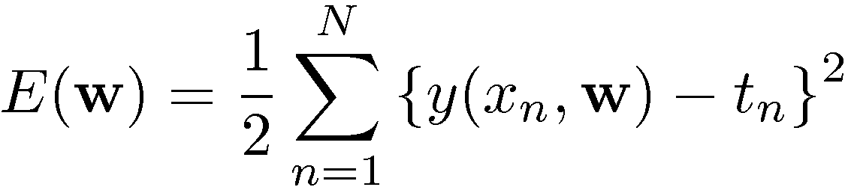
Sum-of-Squares Error Function
Slide credit: Chris Bishop

Slide 8
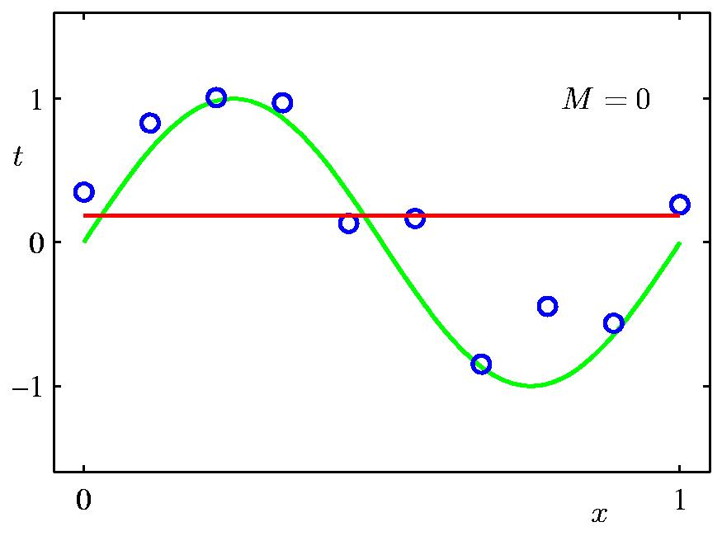
0th Order Polynomial
Slide credit: Chris Bishop

Slide 9
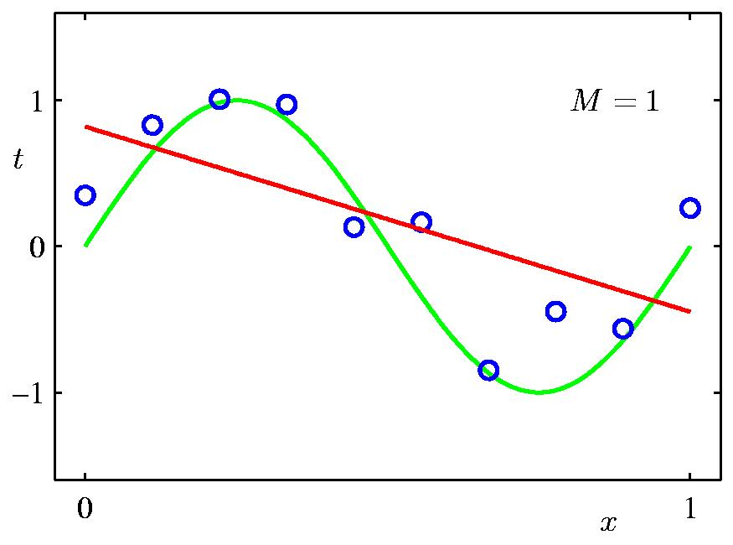
1st Order Polynomial
Slide credit: Chris Bishop

Slide 10
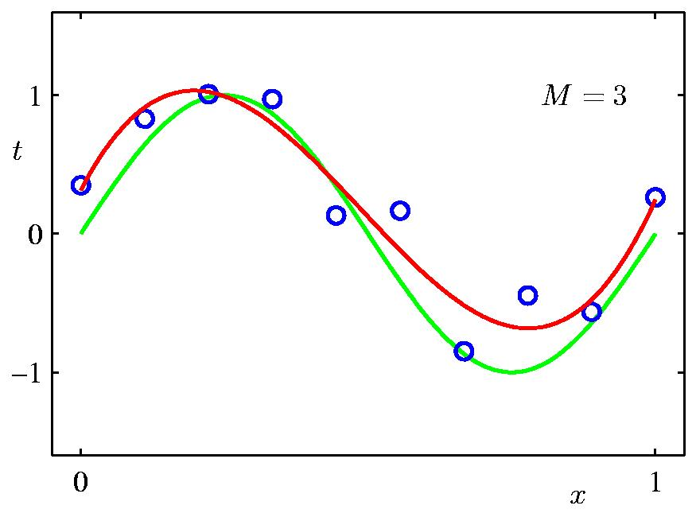
3rd Order Polynomial
Slide credit: Chris Bishop

Slide 11
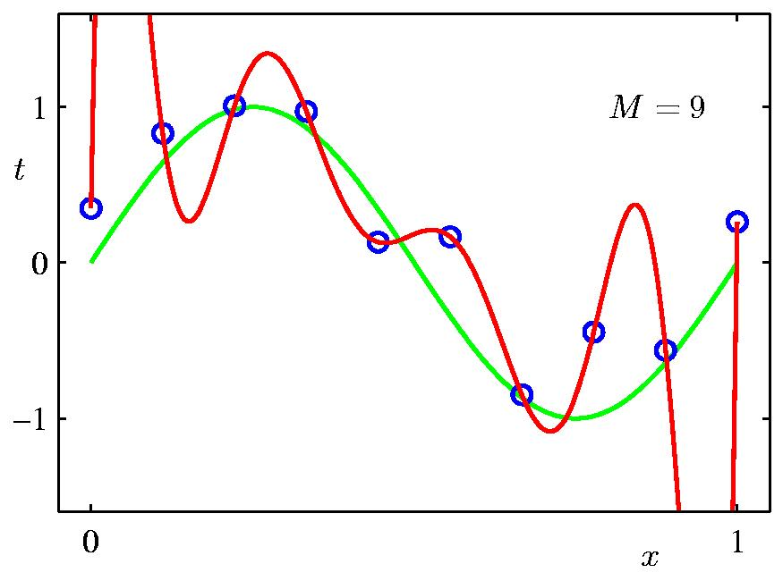
9th Order Polynomial
Slide credit: Chris Bishop

Slide 12
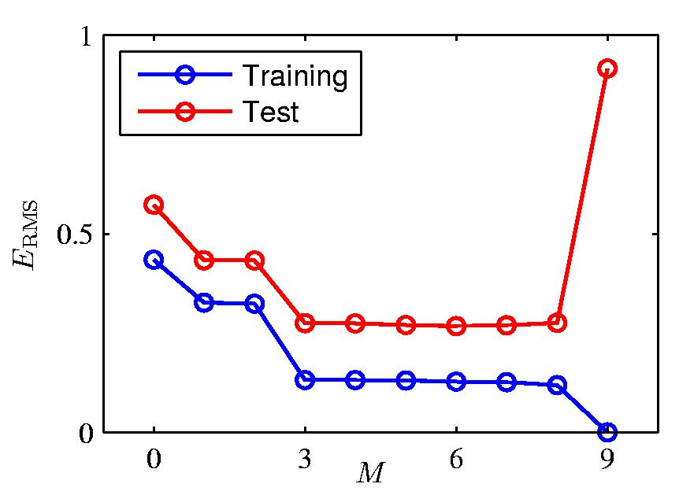
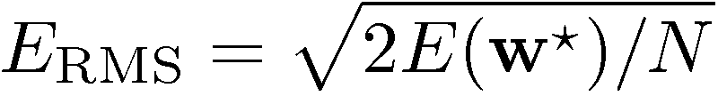
Over-fitting
Root-Mean-Square (RMS) Error:
Slide credit: Chris Bishop

Slide 13

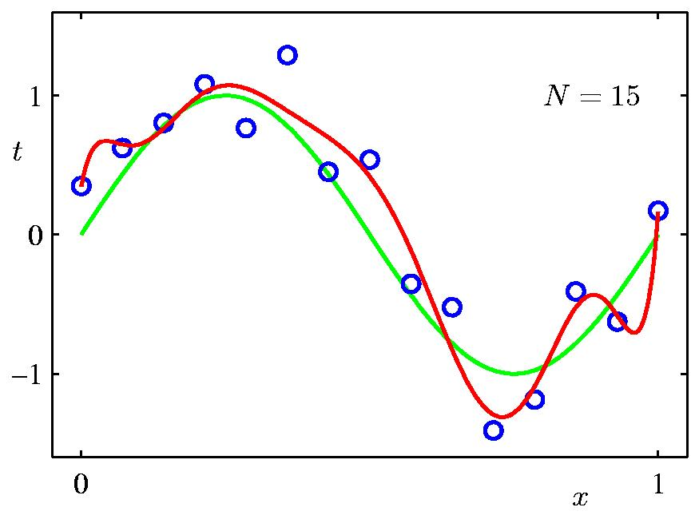
Data Set Size:
9th Order Polynomial
Slide credit: Chris Bishop

Slide 14

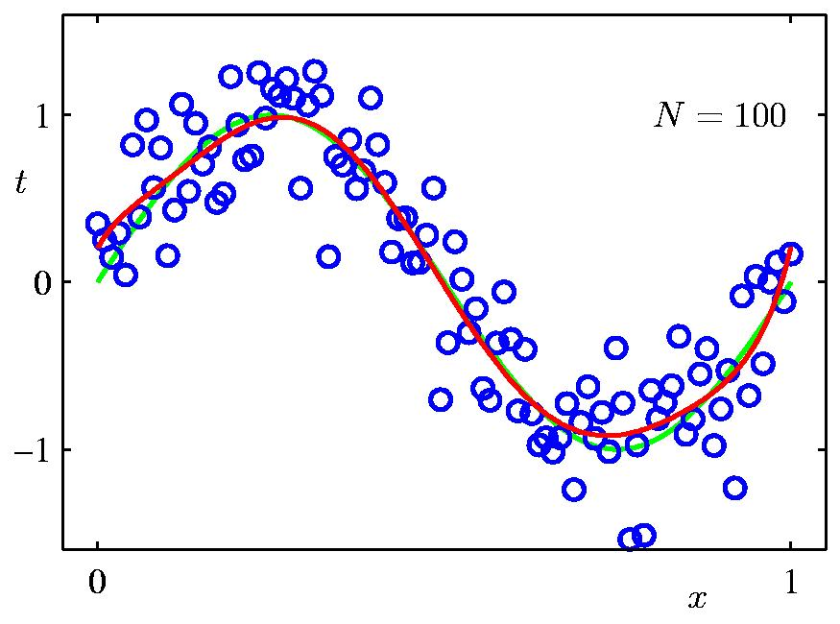
Data Set Size:
9th Order Polynomial
Slide credit: Chris Bishop

Slide 15
How to reduce over-fitting?
Get more training data
Slide credit: D. Hoiem

Slide 16
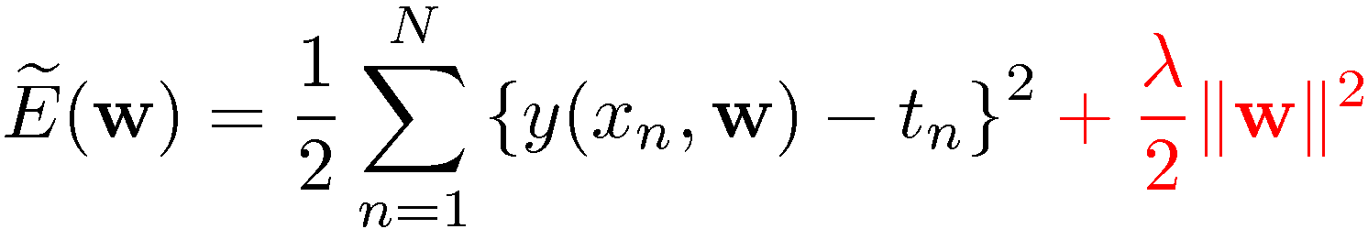
Regularization
Penalize large coefficient values
(Remember: We want to minimize this expression.)
Adapted from Chris Bishop

Slide 17

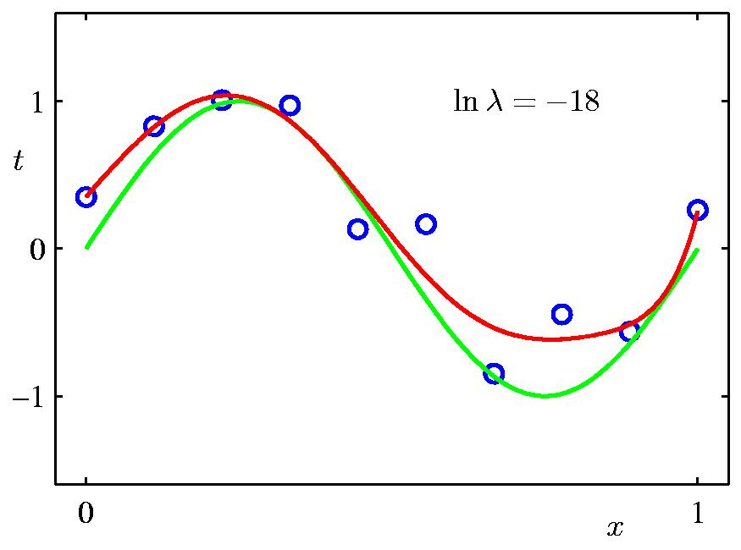
Regularization:
Slide credit: Chris Bishop

Slide 18

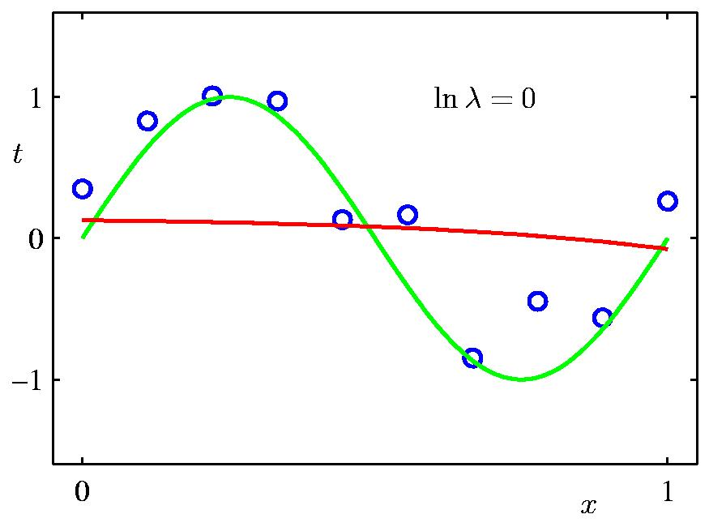
Regularization:
Slide credit: Chris Bishop

Slide 19
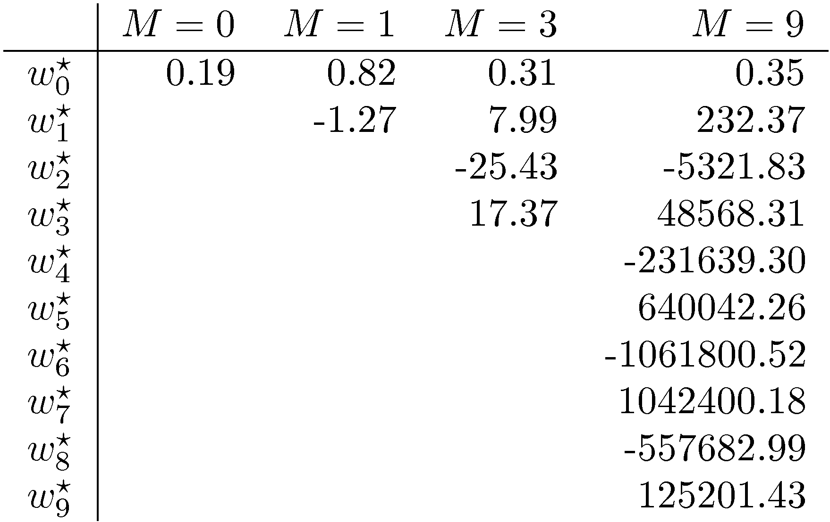
Polynomial Coefficients
Slide credit: Chris Bishop

Slide 20
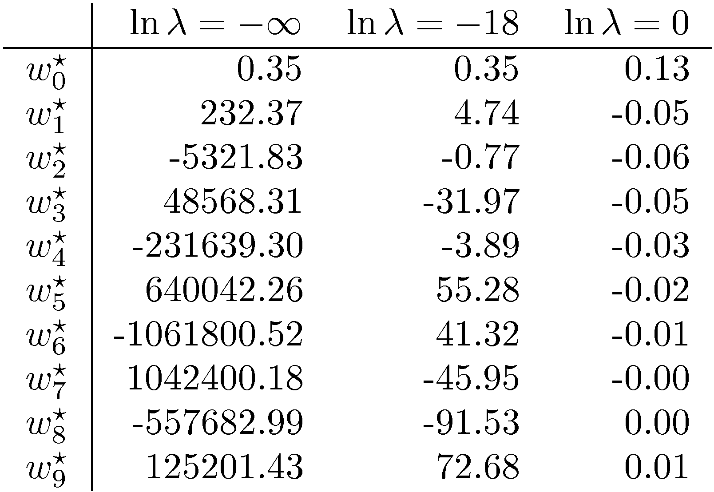
Polynomial Coefficients
No regularization Huge regularization
Adapted from Chris Bishop

Slide 21


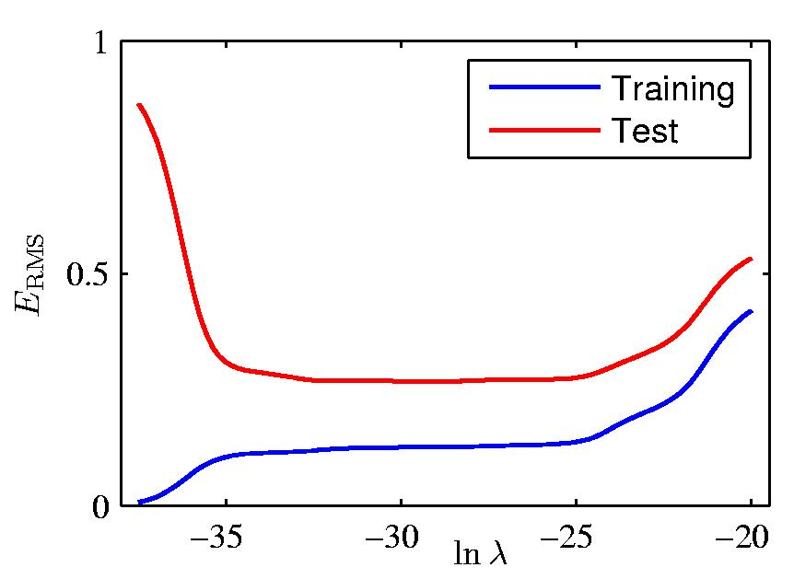
Regularization: vs.
Slide credit: Chris Bishop

Slide 22
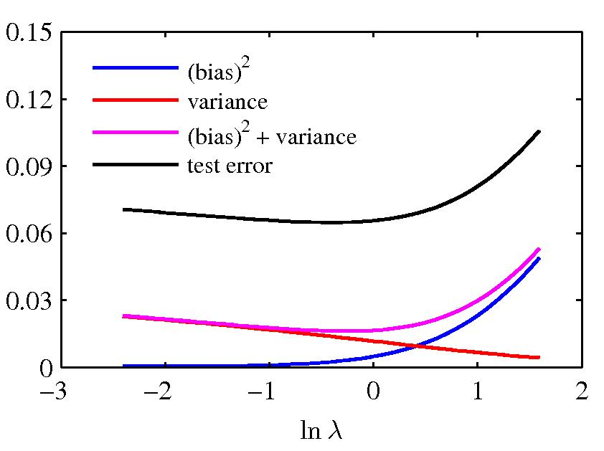
Bias-variance
Figure from Chris Bishop

Slide 23
How to reduce over-fitting?
Get more training data
Regularize the parameters
Slide credit: D. Hoiem

Slide 24
Bias-variance tradeoff
Underfitting
Overfitting
Error
Test error
Training error
High Bias
Low Variance
Complexity
Low Bias
High Variance
Slide credit: D. Hoiem

Slide 25
Bias-variance tradeoff
Few training examples
Test Error
Many training examples
High Bias
Low Variance
Complexity
Low Bias
High Variance
Slide credit: D. Hoiem

Slide 26
Effect of training size
Fixed prediction model
Error
Testing
Generalization Error
Training
Number of Training Examples
Adapted from D. Hoiem

Slide 27
How to reduce over-fitting?
Get more training data
Regularize the parameters
Use fewer features
Choose a simpler classifier
Use validation set to find when overfitting occurs
Underfitting
Overfitting
Test error
Adapted from D. Hoiem
Notes:
The simpler classifier or regularization could increase bias and lead to more error.

Slide 28
Remember…
Three kinds of error
  Inherent: unavoidable
  Bias: due to over-simplifications
  Variance: due to inability to perfectly estimate parameters from limited data
Try simple classifiers first
Use increasingly powerful classifiers with more training data (bias-variance trade-off)
Adapted from D. Hoiem

Slide 29
Image Representations
Keypoint-based image description
  Extraction / detection of keypoints
  Description (via gradient histograms)
Texture-based
  Filter bank representations
  Filtering

Slide 30
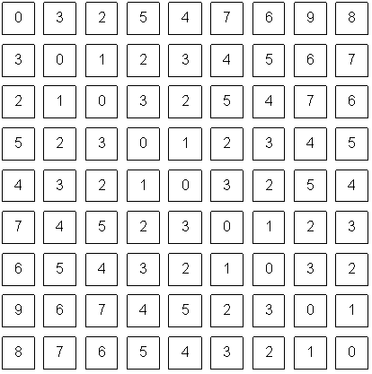
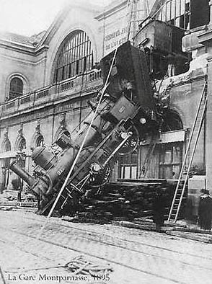

An image is a set of pixels…
What we see
What a computer sees
Adapted from S. Narasimhan
Source: S. Narasimhan

Slide 31
Problems with pixel representation
Not invariant to small changes
  Translation
  Illumination
  etc.
Some parts of an image are more important than others

Slide 32
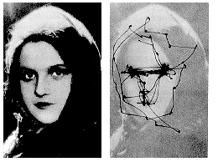
Human eye movements
Yarbus eye tracking
D. Hoiem
Notes:
Your eyes don’t see everything at once, but they jump around. You see only about 2 degrees with high resolution

Slide 33
Choosing distinctive interest points
If you wanted to meet a friend would you say
  “Let’s meet on campus.”
  “Let’s meet on Green street.”
  “Let’s meet at Green and Wright.”
  Corner detection
Or if you were in a secluded area:
  “Let’s meet in the Plains of Akbar.”
  “Let’s meet on the side of Mt. Doom.”
  “Let’s meet on top of Mt. Doom.”
  Blob (valley/peak) detection
D. Hoiem

Slide 34
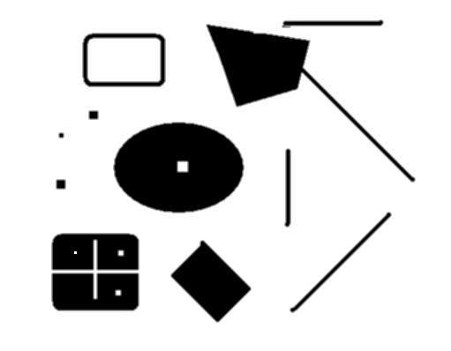
Interest points
original
Suppose you have to click on some point, go away and come back after I deform the image, and click on the same points again.
  Which points would you choose?
deformed
D. Hoiem

Slide 35

Corners as distinctive interest points
We should easily recognize the point by looking through a small window
Shifting a window in any direction should give a large change in intensity
“flat” region:
no change in all directions
“edge”:
no change along the edge direction
“corner”:
significant change in all directions
A. Efros, D. Frolova, D. Simakov

Slide 36
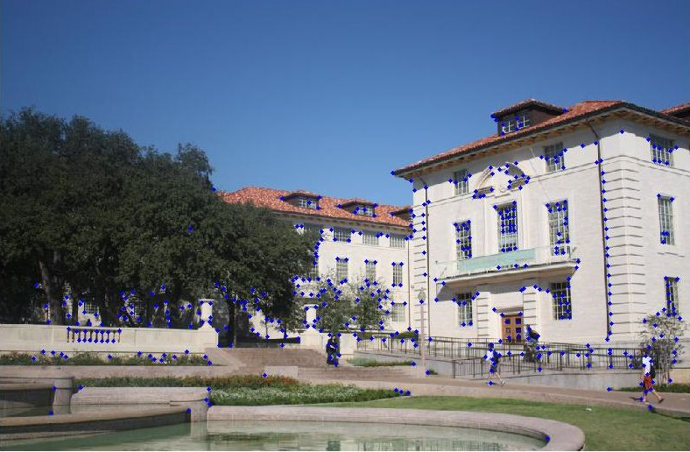
Example of Harris application
K. Grauman
Notes:
24 min

Slide 37
Local features: desired properties
Repeatability
  The same feature can be found in several images despite geometric and photometric transformations
Distinctiveness
  Each feature has a distinctive description
Compactness and efficiency
  Many fewer features than image pixels
Locality
  A feature occupies a relatively small area of the image; robust to clutter and occlusion
Adapted from K. Grauman

Slide 38




Overview of Keypoint Description
1. Find a set of
distinctive key-
points
A₁
B₃
2. Define a region
around each
keypoint
A₂
A₃
B₁
B₂
3. Compute a local
descriptor from the
normalized region

Slide 39
Gradients

Slide 40
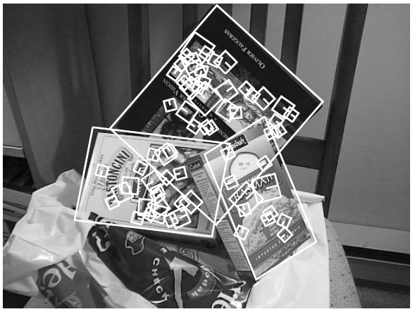
SIFT Descriptor
Histogram of oriented gradients
Captures important texture information
Robust to small translations / affine deformations
[Lowe, ICCV 1999]
K. Grauman, B. Leibe

Slide 41
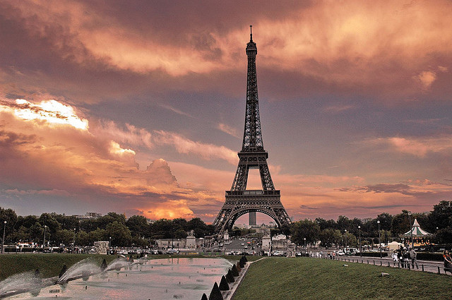
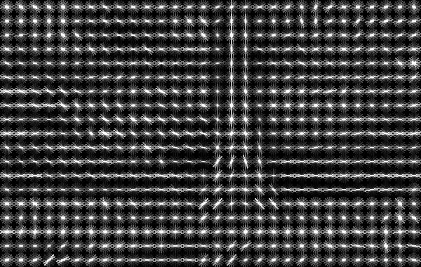
HOG Descriptor
Computes histograms of gradients per region of the image and concatenates them
N. Dalal and B. Triggs, Histograms of Oriented Gradients for Human Detection, CVPR 2005
Image credit: N. Snavely

Slide 42
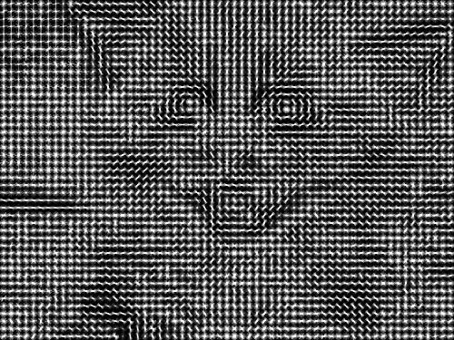

What is this?
http://web.mit.edu/vondrick/ihog/

Slide 43
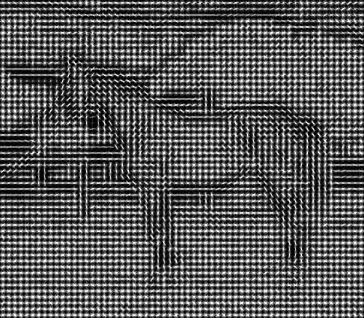
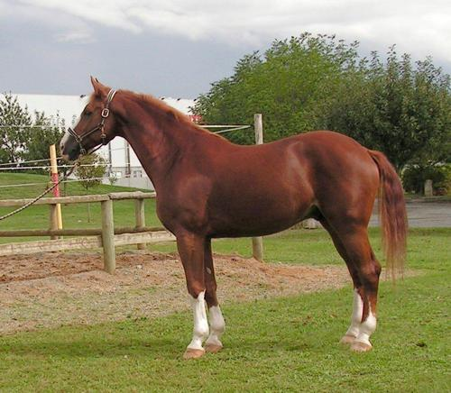
What is this?
http://web.mit.edu/vondrick/ihog/

Slide 44
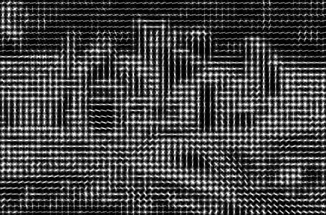
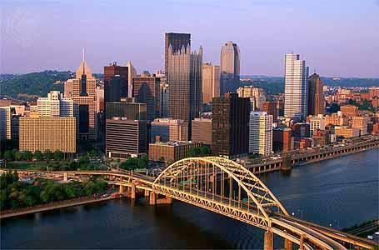
What is this?
http://web.mit.edu/vondrick/ihog/

Slide 45
Image Representations
Keypoint-based image description
  Extraction / detection of keypoints
  Description (via gradient histograms)
Texture-based
  Filter bank representations
  Filtering [read the extra slides if interested]

Slide 46
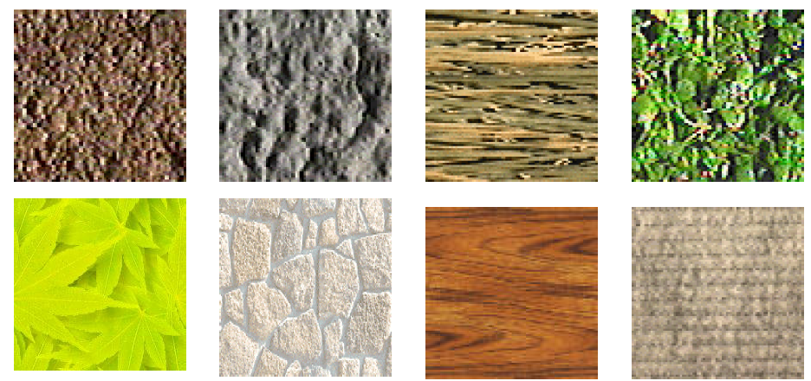
Texture
Marks and patterns, e.g. ones caused by grooves
Can include regular or more random patterns

Slide 47
Texture representation
Textures are made up of repeated local patterns, so:
  Find the patterns
    Use “filters” that look like patterns (spots, bars, raw patches…)
    Consider magnitude of response
  Describe their statistics within each image
    E.g. histogram of pattern occurrences
    Results in a d-dimensional feature vector, where d is the number of patterns/filters
Adapted from Kristen Grauman

Slide 48
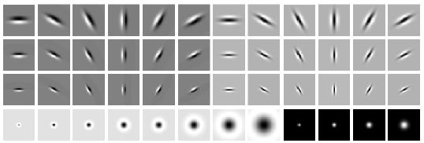
Filter banks
orientations
scales
“Edges”
“Bars”
“Spots”
What filters to put in the bank?
  Typically we want a combination of scales and orientations, different types of patterns.
Matlab code available for these examples: http://www.robots.ox.ac.uk/~vgg/research/texclass/filters.html

Slide 49
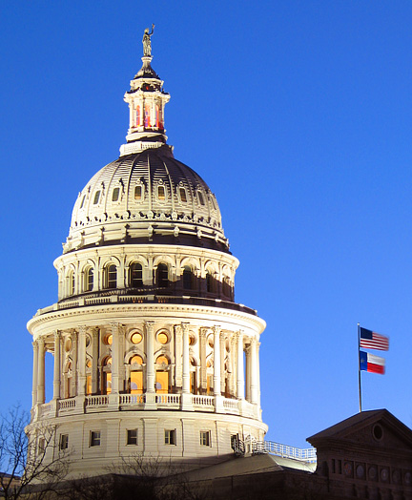
Image from http://www.texasexplorer.com/austincap2.jpg
Kristen Grauman

Slide 50
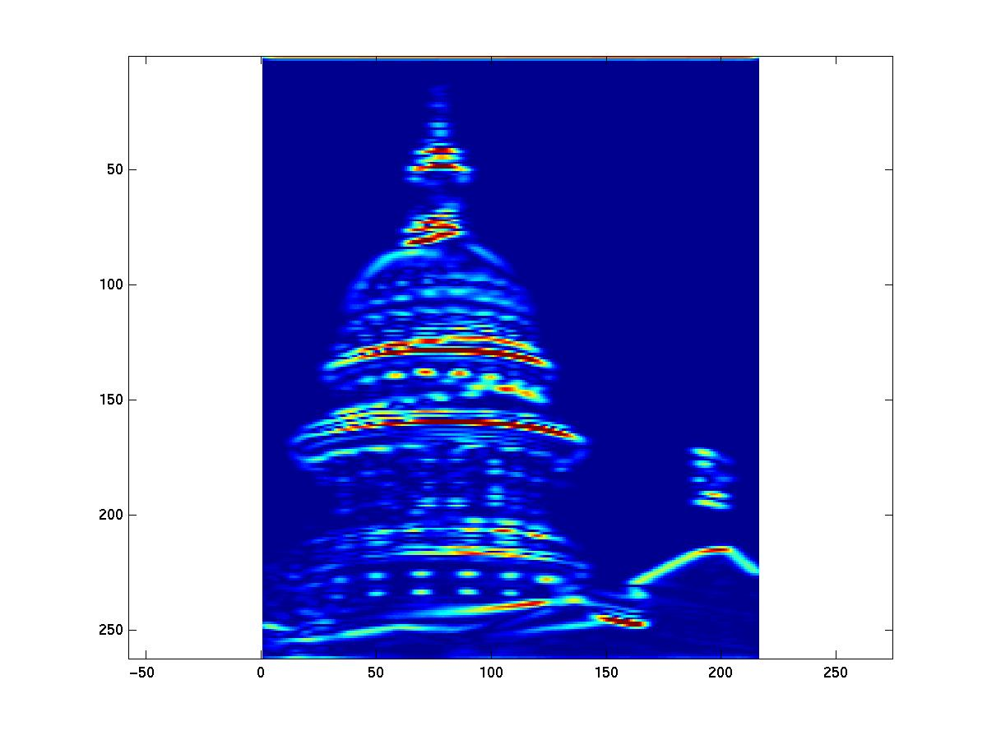
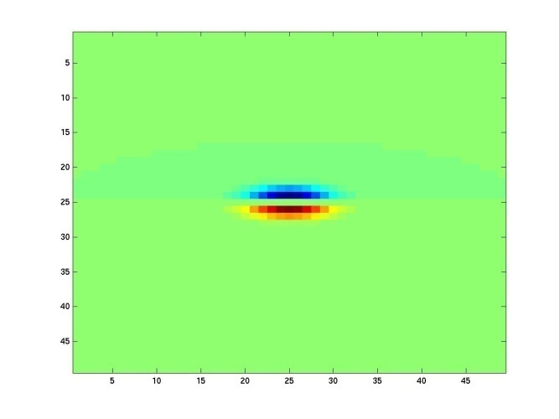
Showing magnitude of responses
Kristen Grauman

Slide 51
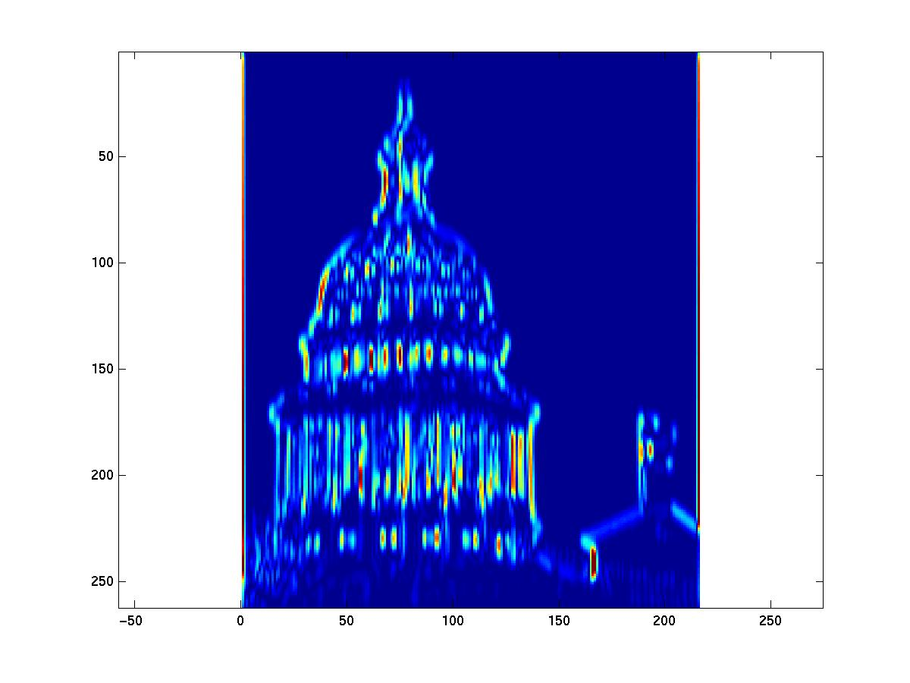
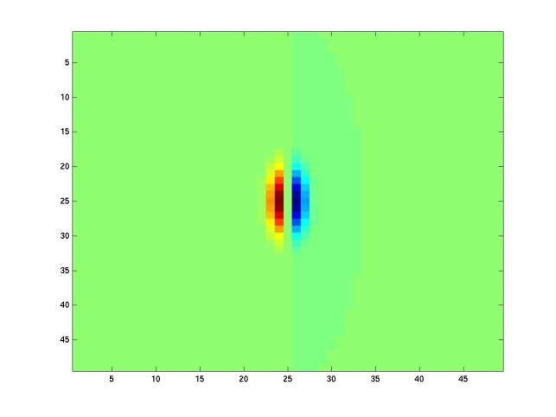
Kristen Grauman
Notes:
4

Slide 52
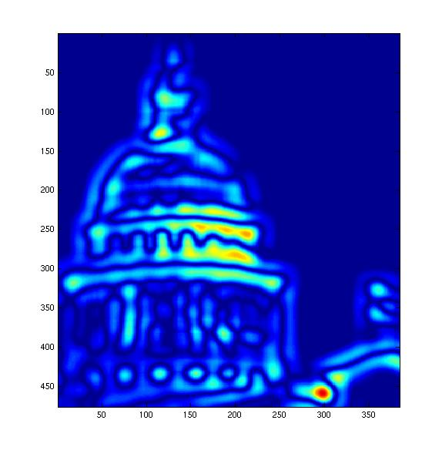
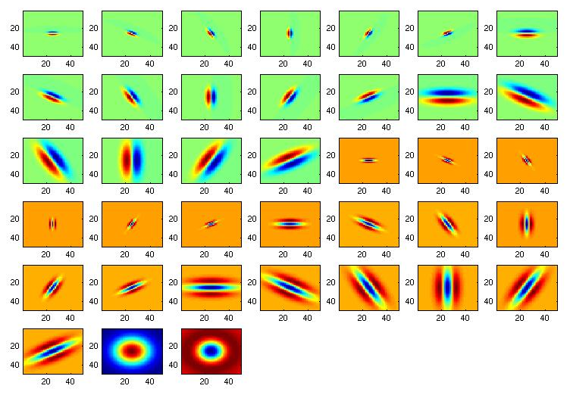
[r1, r2, …, r38]
Patch description: A feature vector formed from the list of responses at each pixel.
Adapted from Kristen Grauman

Slide 53
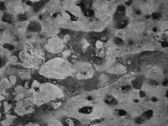
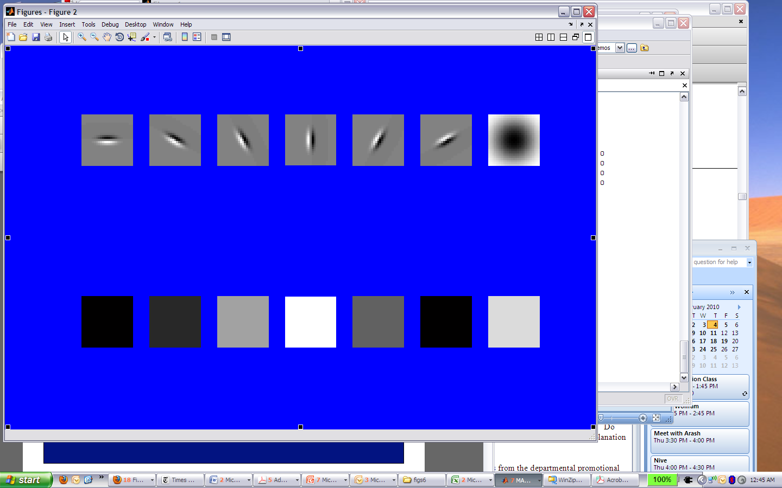
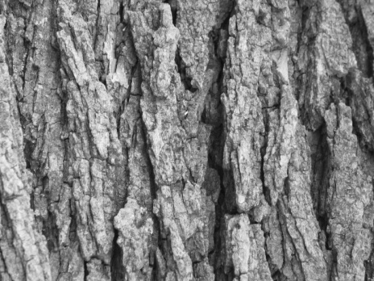
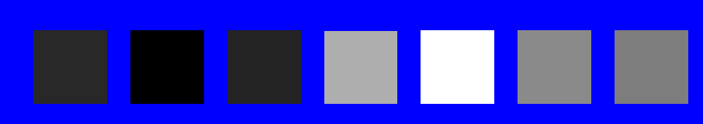
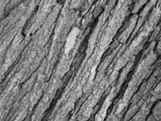
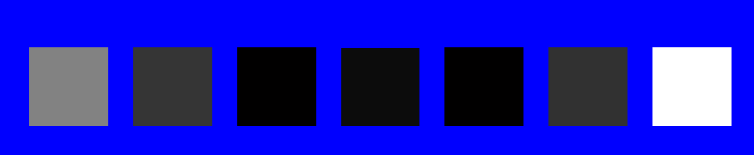
You try: Can you match the texture to the response?
Filters
A
B
1
2
C
3
Mean responses
Answer: 1 → B, 2 → C, 3 → A
Derek Hoiem

Slide 54
How do we compute these reponses?
The remaining slides are optional
(i.e. view them if you’re interested)

Slide 55
Next time
Unsupervised learning: clustering

Slide 56
Image filtering
Compute a function of the local neighborhood at each pixel in the image
  Function specified by a “filter” or mask saying how to combine values from neighbors.
Uses of filtering:
  De-noise an image
    Expect pixels to be like their neighbors
    Expect noise processes to be independent from pixel to pixel
  Extract information (texture, edges, etc)
Adapted from Derek Hoiem

Slide 57


Moving Average In 2D
0 | 0 | 0 | 0 | 0 | 0 | 0 | 0 | 0 | 0
0 | 0 | 0 | 0 | 0 | 0 | 0 | 0 | 0 | 0
0 | 0 | 0 | 90 | 90 | 90 | 90 | 90 | 0 | 0
0 | 0 | 0 | 90 | 90 | 90 | 90 | 90 | 0 | 0
0 | 0 | 0 | 90 | 90 | 90 | 90 | 90 | 0 | 0
0 | 0 | 0 | 90 | 0 | 90 | 90 | 90 | 0 | 0
0 | 0 | 0 | 90 | 90 | 90 | 90 | 90 | 0 | 0
0 | 0 | 0 | 0 | 0 | 0 | 0 | 0 | 0 | 0
0 | 0 | 90 | 0 | 0 | 0 | 0 | 0 | 0 | 0
0 | 0 | 0 | 0 | 0 | 0 | 0 | 0 | 0 | 0
 | 0
0 | 0 | 0 | 0 | 0 | 0 | 0 | 0 | 0 | 0
0 | 0 | 0 | 0 | 0 | 0 | 0 | 0 | 0 | 0
0 | 0 | 0 | 90 | 90 | 90 | 90 | 90 | 0 | 0
0 | 0 | 0 | 90 | 90 | 90 | 90 | 90 | 0 | 0
0 | 0 | 0 | 90 | 90 | 90 | 90 | 90 | 0 | 0
0 | 0 | 0 | 90 | 0 | 90 | 90 | 90 | 0 | 0
0 | 0 | 0 | 90 | 90 | 90 | 90 | 90 | 0 | 0
0 | 0 | 0 | 0 | 0 | 0 | 0 | 0 | 0 | 0
0 | 0 | 90 | 0 | 0 | 0 | 0 | 0 | 0 | 0
0 | 0 | 0 | 0 | 0 | 0 | 0 | 0 | 0 | 0
Source: S. Seitz

Slide 58
Moving Average In 2D
0 | 0 | 0 | 0 | 0 | 0 | 0 | 0 | 0 | 0
0 | 0 | 0 | 0 | 0 | 0 | 0 | 0 | 0 | 0
0 | 0 | 0 | 90 | 90 | 90 | 90 | 90 | 0 | 0
0 | 0 | 0 | 90 | 90 | 90 | 90 | 90 | 0 | 0
0 | 0 | 0 | 90 | 90 | 90 | 90 | 90 | 0 | 0
0 | 0 | 0 | 90 | 0 | 90 | 90 | 90 | 0 | 0
0 | 0 | 0 | 90 | 90 | 90 | 90 | 90 | 0 | 0
0 | 0 | 0 | 0 | 0 | 0 | 0 | 0 | 0 | 0
0 | 0 | 90 | 0 | 0 | 0 | 0 | 0 | 0 | 0
0 | 0 | 0 | 0 | 0 | 0 | 0 | 0 | 0 | 0
 | 0 | 10
0 | 0 | 0 | 0 | 0 | 0 | 0 | 0 | 0 | 0
0 | 0 | 0 | 0 | 0 | 0 | 0 | 0 | 0 | 0
0 | 0 | 0 | 90 | 90 | 90 | 90 | 90 | 0 | 0
0 | 0 | 0 | 90 | 90 | 90 | 90 | 90 | 0 | 0
0 | 0 | 0 | 90 | 90 | 90 | 90 | 90 | 0 | 0
0 | 0 | 0 | 90 | 0 | 90 | 90 | 90 | 0 | 0
0 | 0 | 0 | 90 | 90 | 90 | 90 | 90 | 0 | 0
0 | 0 | 0 | 0 | 0 | 0 | 0 | 0 | 0 | 0
0 | 0 | 90 | 0 | 0 | 0 | 0 | 0 | 0 | 0
0 | 0 | 0 | 0 | 0 | 0 | 0 | 0 | 0 | 0
Source: S. Seitz

Slide 59
Moving Average In 2D
0 | 0 | 0 | 0 | 0 | 0 | 0 | 0 | 0 | 0
0 | 0 | 0 | 0 | 0 | 0 | 0 | 0 | 0 | 0
0 | 0 | 0 | 90 | 90 | 90 | 90 | 90 | 0 | 0
0 | 0 | 0 | 90 | 90 | 90 | 90 | 90 | 0 | 0
0 | 0 | 0 | 90 | 90 | 90 | 90 | 90 | 0 | 0
0 | 0 | 0 | 90 | 0 | 90 | 90 | 90 | 0 | 0
0 | 0 | 0 | 90 | 90 | 90 | 90 | 90 | 0 | 0
0 | 0 | 0 | 0 | 0 | 0 | 0 | 0 | 0 | 0
0 | 0 | 90 | 0 | 0 | 0 | 0 | 0 | 0 | 0
0 | 0 | 0 | 0 | 0 | 0 | 0 | 0 | 0 | 0
 | 0 | 10 | 20
0 | 0 | 0 | 0 | 0 | 0 | 0 | 0 | 0 | 0
0 | 0 | 0 | 0 | 0 | 0 | 0 | 0 | 0 | 0
0 | 0 | 0 | 90 | 90 | 90 | 90 | 90 | 0 | 0
0 | 0 | 0 | 90 | 90 | 90 | 90 | 90 | 0 | 0
0 | 0 | 0 | 90 | 90 | 90 | 90 | 90 | 0 | 0
0 | 0 | 0 | 90 | 0 | 90 | 90 | 90 | 0 | 0
0 | 0 | 0 | 90 | 90 | 90 | 90 | 90 | 0 | 0
0 | 0 | 0 | 0 | 0 | 0 | 0 | 0 | 0 | 0
0 | 0 | 90 | 0 | 0 | 0 | 0 | 0 | 0 | 0
0 | 0 | 0 | 0 | 0 | 0 | 0 | 0 | 0 | 0
Source: S. Seitz

Slide 60
Moving Average In 2D
0 | 0 | 0 | 0 | 0 | 0 | 0 | 0 | 0 | 0
0 | 0 | 0 | 0 | 0 | 0 | 0 | 0 | 0 | 0
0 | 0 | 0 | 90 | 90 | 90 | 90 | 90 | 0 | 0
0 | 0 | 0 | 90 | 90 | 90 | 90 | 90 | 0 | 0
0 | 0 | 0 | 90 | 90 | 90 | 90 | 90 | 0 | 0
0 | 0 | 0 | 90 | 0 | 90 | 90 | 90 | 0 | 0
0 | 0 | 0 | 90 | 90 | 90 | 90 | 90 | 0 | 0
0 | 0 | 0 | 0 | 0 | 0 | 0 | 0 | 0 | 0
0 | 0 | 90 | 0 | 0 | 0 | 0 | 0 | 0 | 0
0 | 0 | 0 | 0 | 0 | 0 | 0 | 0 | 0 | 0
 | 0 | 10 | 20 | 30
0 | 0 | 0 | 0 | 0 | 0 | 0 | 0 | 0 | 0
0 | 0 | 0 | 0 | 0 | 0 | 0 | 0 | 0 | 0
0 | 0 | 0 | 90 | 90 | 90 | 90 | 90 | 0 | 0
0 | 0 | 0 | 90 | 90 | 90 | 90 | 90 | 0 | 0
0 | 0 | 0 | 90 | 90 | 90 | 90 | 90 | 0 | 0
0 | 0 | 0 | 90 | 0 | 90 | 90 | 90 | 0 | 0
0 | 0 | 0 | 90 | 90 | 90 | 90 | 90 | 0 | 0
0 | 0 | 0 | 0 | 0 | 0 | 0 | 0 | 0 | 0
0 | 0 | 90 | 0 | 0 | 0 | 0 | 0 | 0 | 0
0 | 0 | 0 | 0 | 0 | 0 | 0 | 0 | 0 | 0
Source: S. Seitz

Slide 61
Moving Average In 2D
0 | 0 | 0 | 0 | 0 | 0 | 0 | 0 | 0 | 0
0 | 0 | 0 | 0 | 0 | 0 | 0 | 0 | 0 | 0
0 | 0 | 0 | 90 | 90 | 90 | 90 | 90 | 0 | 0
0 | 0 | 0 | 90 | 90 | 90 | 90 | 90 | 0 | 0
0 | 0 | 0 | 90 | 90 | 90 | 90 | 90 | 0 | 0
0 | 0 | 0 | 90 | 0 | 90 | 90 | 90 | 0 | 0
0 | 0 | 0 | 90 | 90 | 90 | 90 | 90 | 0 | 0
0 | 0 | 0 | 0 | 0 | 0 | 0 | 0 | 0 | 0
0 | 0 | 90 | 0 | 0 | 0 | 0 | 0 | 0 | 0
0 | 0 | 0 | 0 | 0 | 0 | 0 | 0 | 0 | 0
 | 0 | 10 | 20 | 30 | 30
Source: S. Seitz

Slide 62
Moving Average In 2D
0 | 0 | 0 | 0 | 0 | 0 | 0 | 0 | 0 | 0
0 | 0 | 0 | 0 | 0 | 0 | 0 | 0 | 0 | 0
0 | 0 | 0 | 90 | 90 | 90 | 90 | 90 | 0 | 0
0 | 0 | 0 | 90 | 90 | 90 | 90 | 90 | 0 | 0
0 | 0 | 0 | 90 | 90 | 90 | 90 | 90 | 0 | 0
0 | 0 | 0 | 90 | 0 | 90 | 90 | 90 | 0 | 0
0 | 0 | 0 | 90 | 90 | 90 | 90 | 90 | 0 | 0
0 | 0 | 0 | 0 | 0 | 0 | 0 | 0 | 0 | 0
0 | 0 | 90 | 0 | 0 | 0 | 0 | 0 | 0 | 0
0 | 0 | 0 | 0 | 0 | 0 | 0 | 0 | 0 | 0
 | 0 | 10 | 20 | 30 | 30 | 30 | 20 | 10
 | 0 | 20 | 40 | 60 | 60 | 60 | 40 | 20
 | 0 | 30 | 60 | 90 | 90 | 90 | 60 | 30
 | 0 | 30 | 50 | 80 | 80 | 90 | 60 | 30
 | 0 | 30 | 50 | 80 | 80 | 90 | 60 | 30
 | 0 | 20 | 30 | 50 | 50 | 60 | 40 | 20
 | 10 | 20 | 30 | 30 | 30 | 30 | 20 | 10
 | 10 | 10 | 10 | 0 | 0 | 0 | 0 | 0
Source: S. Seitz
Notes:
ones, divide by 9

Slide 63


Correlation filtering
Say the averaging window size is 2k+1 x 2k+1:
Attribute uniform weight to each pixel
Loop over all pixels in neighborhood around image pixel F[i,j]
Now generalize to allow different weights depending on neighboring pixel’s relative position:
Non-uniform weights
Filtering an image = replace each pixel with linear combination of neighbors.

Slide 64

Correlation filtering
F = image
5 | 2 | 5 | 4 | 4
5 | 200 | 3 | 200 | 4
1 | 5 | 5 | 4 | 4
5 | 5 | 1 | 1 | 2
200 | 1 | 3 | 5 | 200
1 | 200 | 200 | 200 | 1
(i, j)
u = -1,
v = -1 → 200x0.6 +
H = filter
.06 | .12 | .06
.12 | .25 | .12
.06 | .12 | .06
(0, 0)

Slide 65
Correlation filtering
F = image
5 | 2 | 5 | 4 | 4
5 | 200 | 3 | 200 | 4
1 | 5 | 5 | 4 | 4
5 | 5 | 1 | 1 | 2
200 | 1 | 3 | 5 | 200
1 | 200 | 200 | 200 | 1
(i, j)
u = -1,
v = -1 → 200x0.6 +
v = 0 → 3x.12 +
H = filter
.06 | .12 | .06
.12 | .25 | .12
.06 | .12 | .06
(0, 0)

Slide 66
Correlation filtering
F = image
5 | 2 | 5 | 4 | 4
5 | 200 | 3 | 200 | 4
1 | 5 | 5 | 4 | 4
5 | 5 | 1 | 1 | 2
200 | 1 | 3 | 5 | 200
1 | 200 | 200 | 200 | 1
(i, j)
u = -1,
v = -1
v = -1 → 200x0.6 +
v = 0
v = 0 → 3x.12 +
v = +1 → 200x0.6 +
H = filter
.06 | .12 | .06
.12 | .25 | .12
.06 | .12 | .06
(0, 0)

Slide 67
Correlation filtering
F = image
5 | 2 | 5 | 4 | 4
5 | 200 | 3 | 200 | 4
1 | 5 | 5 | 4 | 4
5 | 5 | 1 | 1 | 2
200 | 1 | 3 | 5 | 200
1 | 200 | 200 | 200 | 1
(i, j)
u = -1,
v = -1
v = -1 → 200x0.6 +
v = 0
v = 0 → 3x.12 +
v = +1
v = +1 → 200x0.6 +
u = 0,
v = -1 → 5x.12 …
H = filter
.06 | .12 | .06
.12 | .25 | .12
.06 | .12 | .06
(0, 0)

Slide 68

Practice with linear filters
0
0
0
?
0
1
0
0
0
0
Original
Source: D. Lowe

Slide 69
Practice with linear filters
0
0
0
0
1
0
0
0
0
Original
Filtered
(no change)
Source: D. Lowe

Slide 70
Practice with linear filters
0
0
0
?
0
0
1
0
0
0
Original
Source: D. Lowe

Slide 71
Practice with linear filters
0
0
0
0
0
1
0
0
0
Original
Shifted left
by 1 pixel with correlation
Source: D. Lowe

Slide 72

Practice with linear filters
1
1
1
?
1
1
1
1
1
1
Original
Source: D. Lowe

Slide 73

Practice with linear filters
1
1
1
1
1
1
1
1
1
Original
Blur
Source: D. Lowe

Slide 74
Practice with linear filters
0
0
0
-
1
1
1
?
0
2
0
1
1
1
0
0
0
1
1
1
Original
Source: D. Lowe

Slide 75

Practice with linear filters
0
0
0
-
1
1
1
0
2
0
1
1
1
0
0
0
1
1
1
Original
Sharpening filter:
  accentuates differences with local average
Source: D. Lowe

Slide 76

Filtering examples: sharpening

Slide 77




Gaussian filter
What if we want nearest neighboring pixels to have the most influence on the output?
This kernel is an approximation of a 2d Gaussian function:
0 | 0 | 0 | 0 | 0 | 0 | 0 | 0 | 0 | 0
0 | 0 | 0 | 0 | 0 | 0 | 0 | 0 | 0 | 0
0 | 0 | 0 | 90 | 90 | 90 | 90 | 90 | 0 | 0
0 | 0 | 0 | 90 | 90 | 90 | 90 | 90 | 0 | 0
0 | 0 | 0 | 90 | 90 | 90 | 90 | 90 | 0 | 0
0 | 0 | 0 | 90 | 0 | 90 | 90 | 90 | 0 | 0
0 | 0 | 0 | 90 | 90 | 90 | 90 | 90 | 0 | 0
0 | 0 | 0 | 0 | 0 | 0 | 0 | 0 | 0 | 0
0 | 0 | 90 | 0 | 0 | 0 | 0 | 0 | 0 | 0
0 | 0 | 0 | 0 | 0 | 0 | 0 | 0 | 0 | 0
1 | 2 | 1
2 | 4 | 2
1 | 2 | 1
Source: S. Seitz

