Slide 1
CS 2750: Machine Learning
The Bias-Variance Tradeoff
Prof. Adriana Kovashka
University of Pittsburgh
January 13, 2016

Slide 2
Plan for Today
More Matlab
Measuring performance
The bias-variance trade-off

Slide 3
Matlab Tutorial
http://cs.brown.edu/courses/cs143/2011/docs/matlab-tutorial/
https://people.cs.pitt.edu/~milos/courses/cs2750/Tutorial/
http://www.math.udel.edu/~braun/M349/Matlab_probs2.pdf

Slide 4
Matlab Exercise
http://www.facstaff.bucknell.edu/maneval/help211/basicexercises.html
  Do Problems 1-8, 12
  Most also have solutions
  Ask the TA if you have any problems

Slide 5
Homework 1
http://people.cs.pitt.edu/~kovashka/cs2750/hw1.htm
If I hear about issues, I will mark clarifications and adjustments in the assignment in red, so check periodically

Slide 6
ML in a Nutshell
y = f(x)
Training: given a training set of labeled examples {(x₁,y₁), …, (x_{N},y_{N})}, estimate the prediction function f by minimizing the prediction error on the training set
Testing: apply f to a never before seen test example x and output the predicted value y = f(x)
output
prediction function
features
Slide credit: L. Lazebnik

Slide 7



ML in a Nutshell
Apply a prediction function to a feature representation (in this example, of an image) to get the desired output:
f( ) = “apple”
f( ) = “tomato”
f( ) = “cow”
Slide credit: L. Lazebnik

Slide 8
Data Representation
Let’s brainstorm what our “X” should be for various “Y” prediction tasks…

Slide 9
Measuring Performance
If y is discrete:
  Accuracy: # correctly classified / # all test examples
  Loss: Weighted misclassification via a confusion matrix
    In case of only two classes: True Positive, False Positive, True Negative, False Negative
    Might want to “fine” our system differently for FP and FN
    Can extend to k classes
Notes:
Diagnosis example

Slide 10
Measuring Performance
If y is discrete:
  Precision/recall
    Precision = # predicted true pos / # predicted pos
    Recall = # predicted true pos / # true pos
  F-measure
    = 2PR / (P + R)

Slide 11
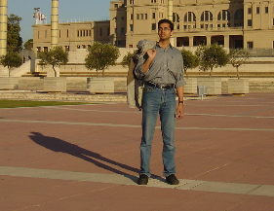

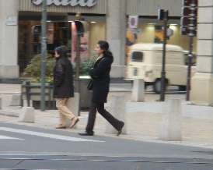




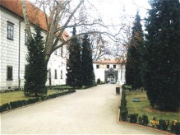


Precision / Recall / F-measure
True positives
(images that contain people)
True negatives
(images that do not contain people)
Predicted positives
(images predicted to contain people)
Predicted negatives
(images predicted not to contain people)
Precision = 2 / 5 = 0.4
Recall = 2 / 4 = 0.5
F-measure = 2*0.4*0.5 / 0.4+0.5 = 0.44
Accuracy: 5 / 10 = 0.5

Slide 12
Measuring Performance
If y is continuous:
  Euclidean distance between true y and predicted y’

Slide 13
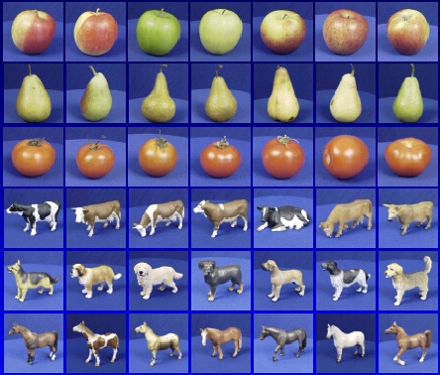

Generalization
Training set (labels known)
Test set (labels unknown)
How well does a learned model generalize from the data it was trained on to a new test set?
Slide credit: L. Lazebnik

Slide 14
Generalization
Components of expected loss
  Noise in our observations: unavoidable
  Bias: how much the average model over all training sets differs from the true model
    Error due to inaccurate assumptions/simplifications made by the model
  Variance: how much models estimated from different training sets differ from each other
Underfitting: model is too “simple” to represent all the relevant class characteristics
  High bias and low variance
  High training error and high test error
Overfitting: model is too “complex” and fits irrelevant characteristics (noise) in the data
  Low bias and high variance
  Low training error and high test error
Adapted from L. Lazebnik

Slide 15
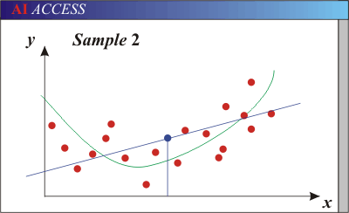
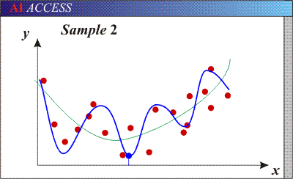
Bias-Variance Trade-off
Models with too few parameters are inaccurate because of a large bias (not enough flexibility).
Models with too many parameters are inaccurate because of a large variance (too much sensitivity to the sample).
Slide credit: D. Hoiem

Slide 16
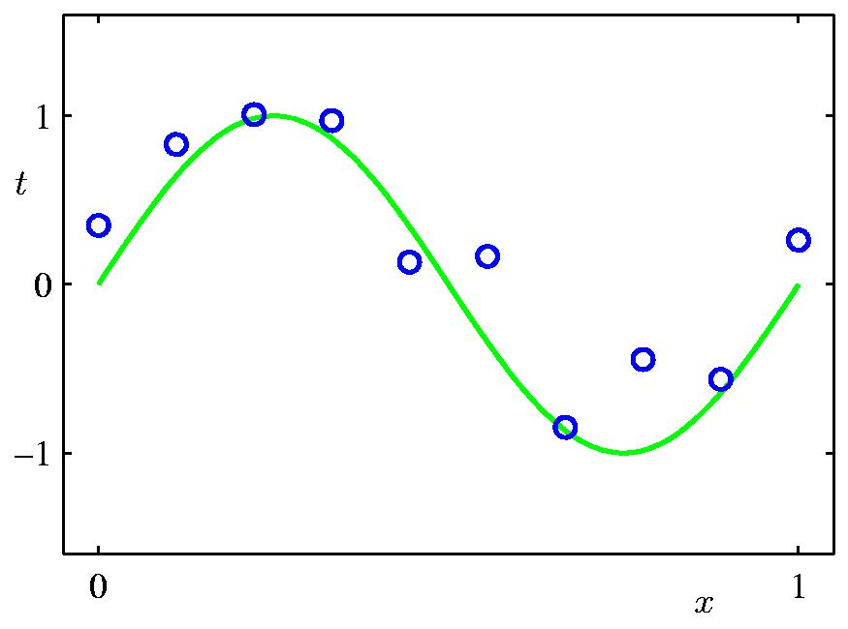
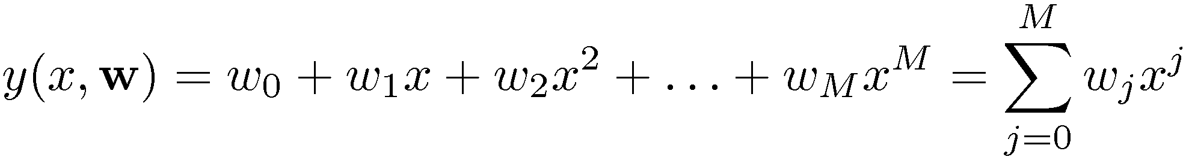
Polynomial Curve Fitting
Slide credit: Chris Bishop

Slide 17
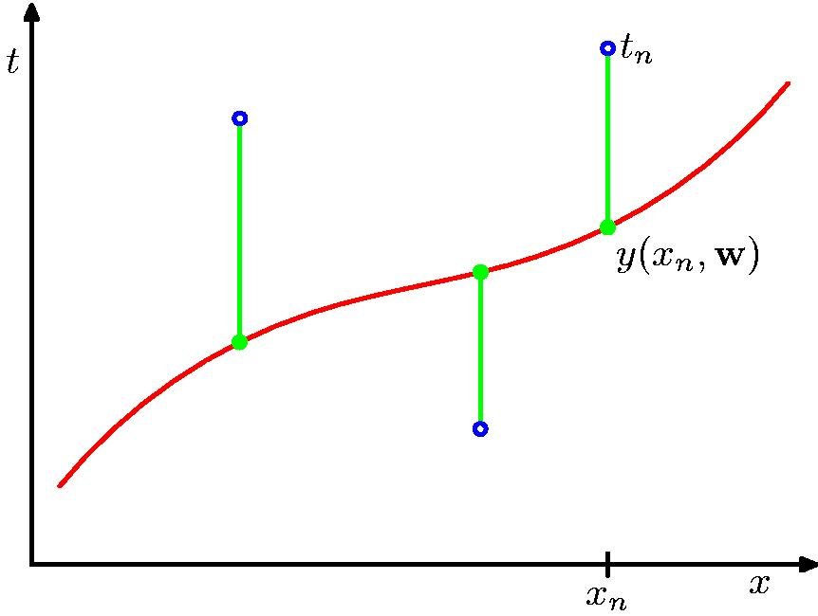
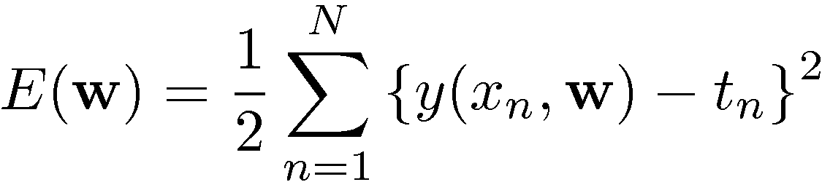
Sum-of-Squares Error Function
Slide credit: Chris Bishop

Slide 18
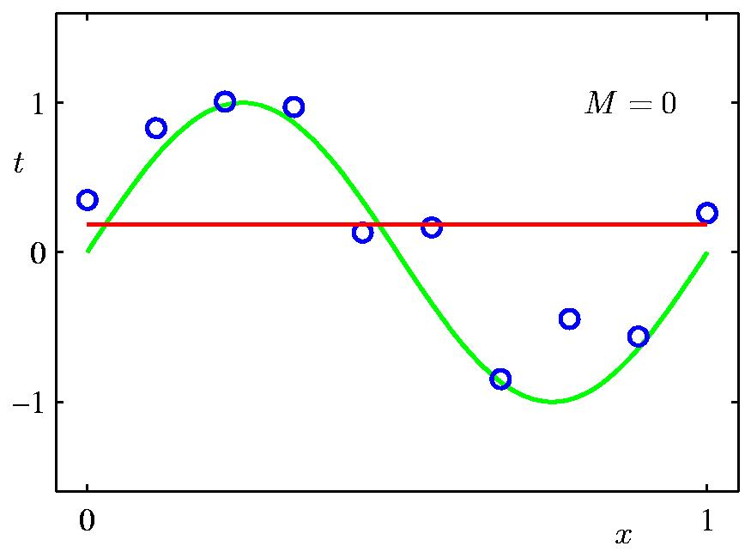
0th Order Polynomial
Slide credit: Chris Bishop

Slide 19
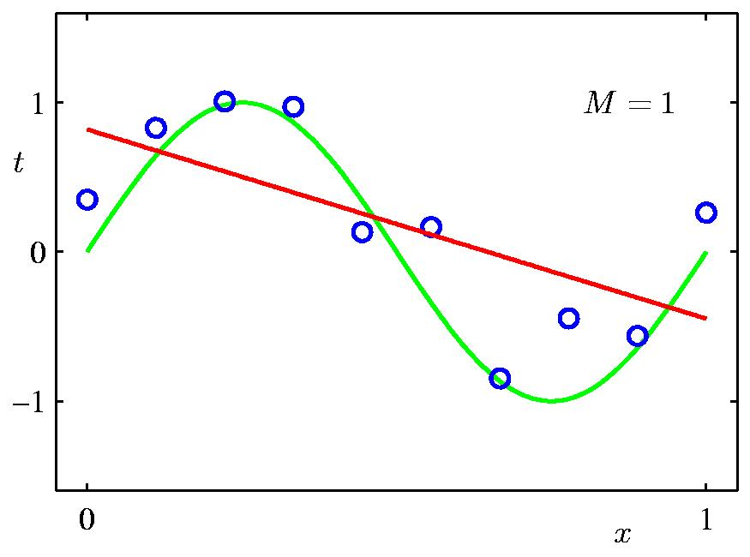
1st Order Polynomial
Slide credit: Chris Bishop

Slide 20
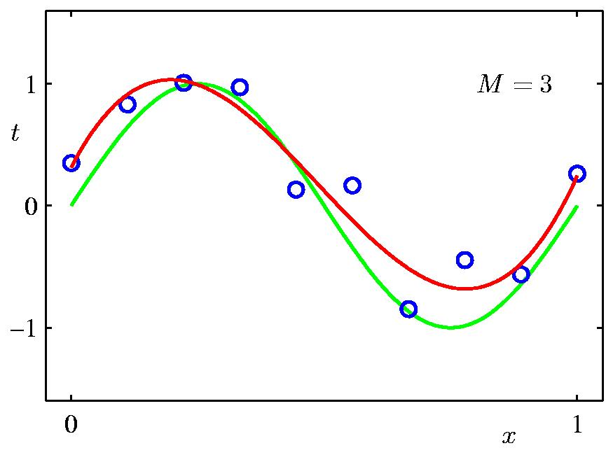
3rd Order Polynomial
Slide credit: Chris Bishop

Slide 21
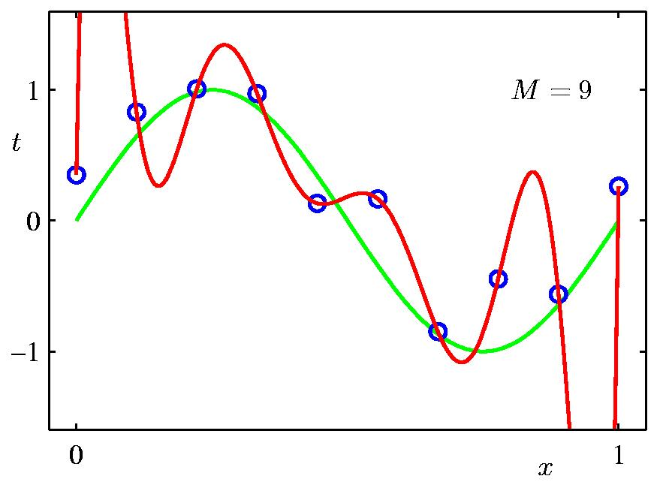
9th Order Polynomial
Slide credit: Chris Bishop

Slide 22
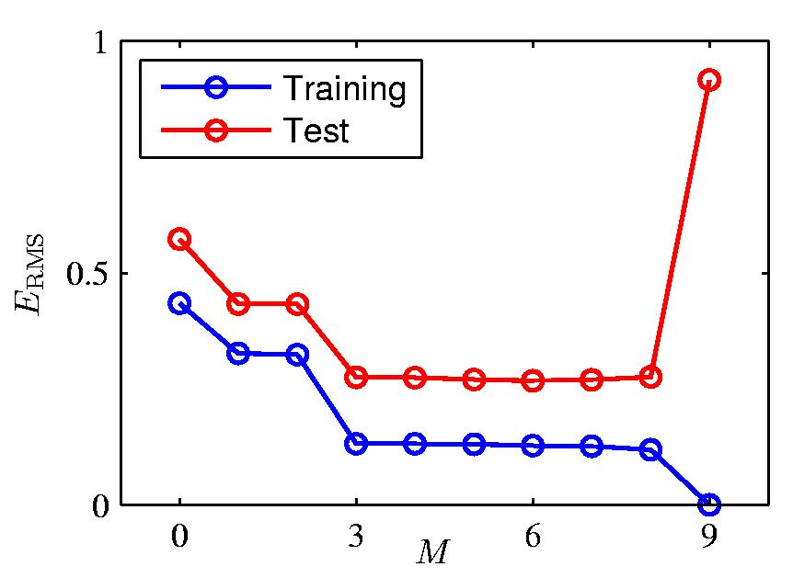
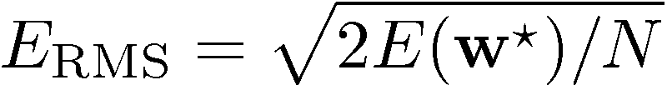
Over-fitting
Root-Mean-Square (RMS) Error:
Slide credit: Chris Bishop

Slide 23

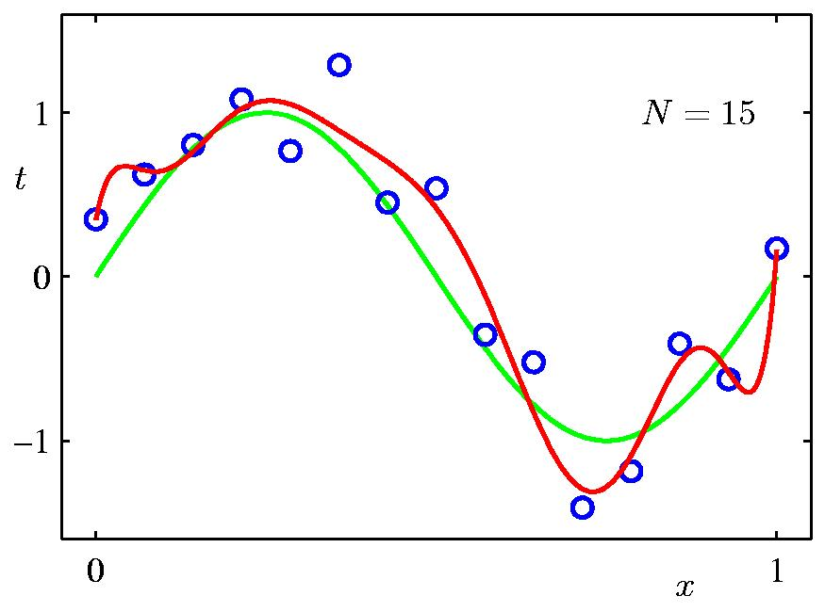
Data Set Size:
9th Order Polynomial
Slide credit: Chris Bishop

Slide 24

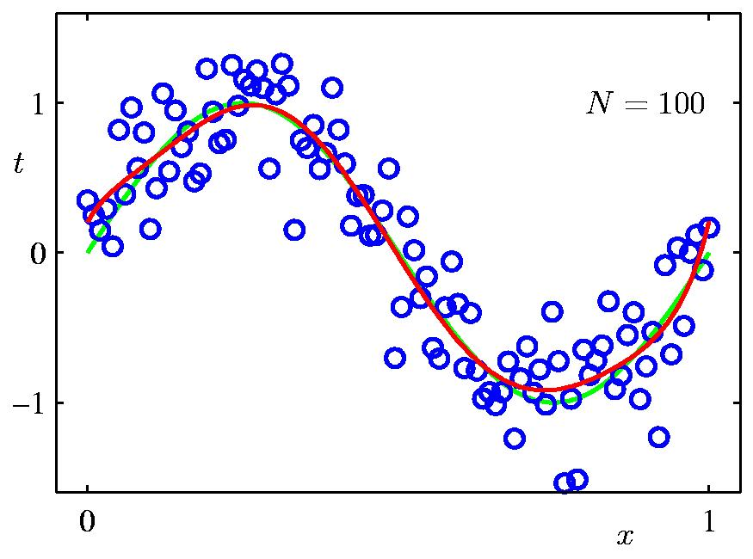
Data Set Size:
9th Order Polynomial
Slide credit: Chris Bishop

Slide 25
Question
Who can give me an example of overfitting…
involving the Steelers and what will happen on Sunday?

Slide 26
How to reduce over-fitting?
Get more training data
Slide credit: D. Hoiem

Slide 27
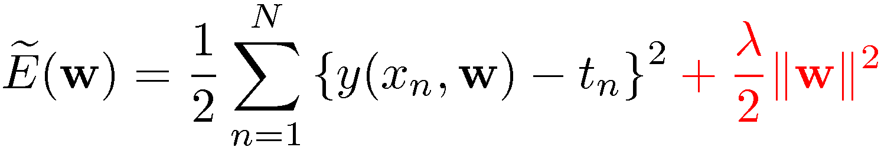
Regularization
Penalize large coefficient values
(Remember: We want to minimize this expression.)
Adapted from Chris Bishop

Slide 28
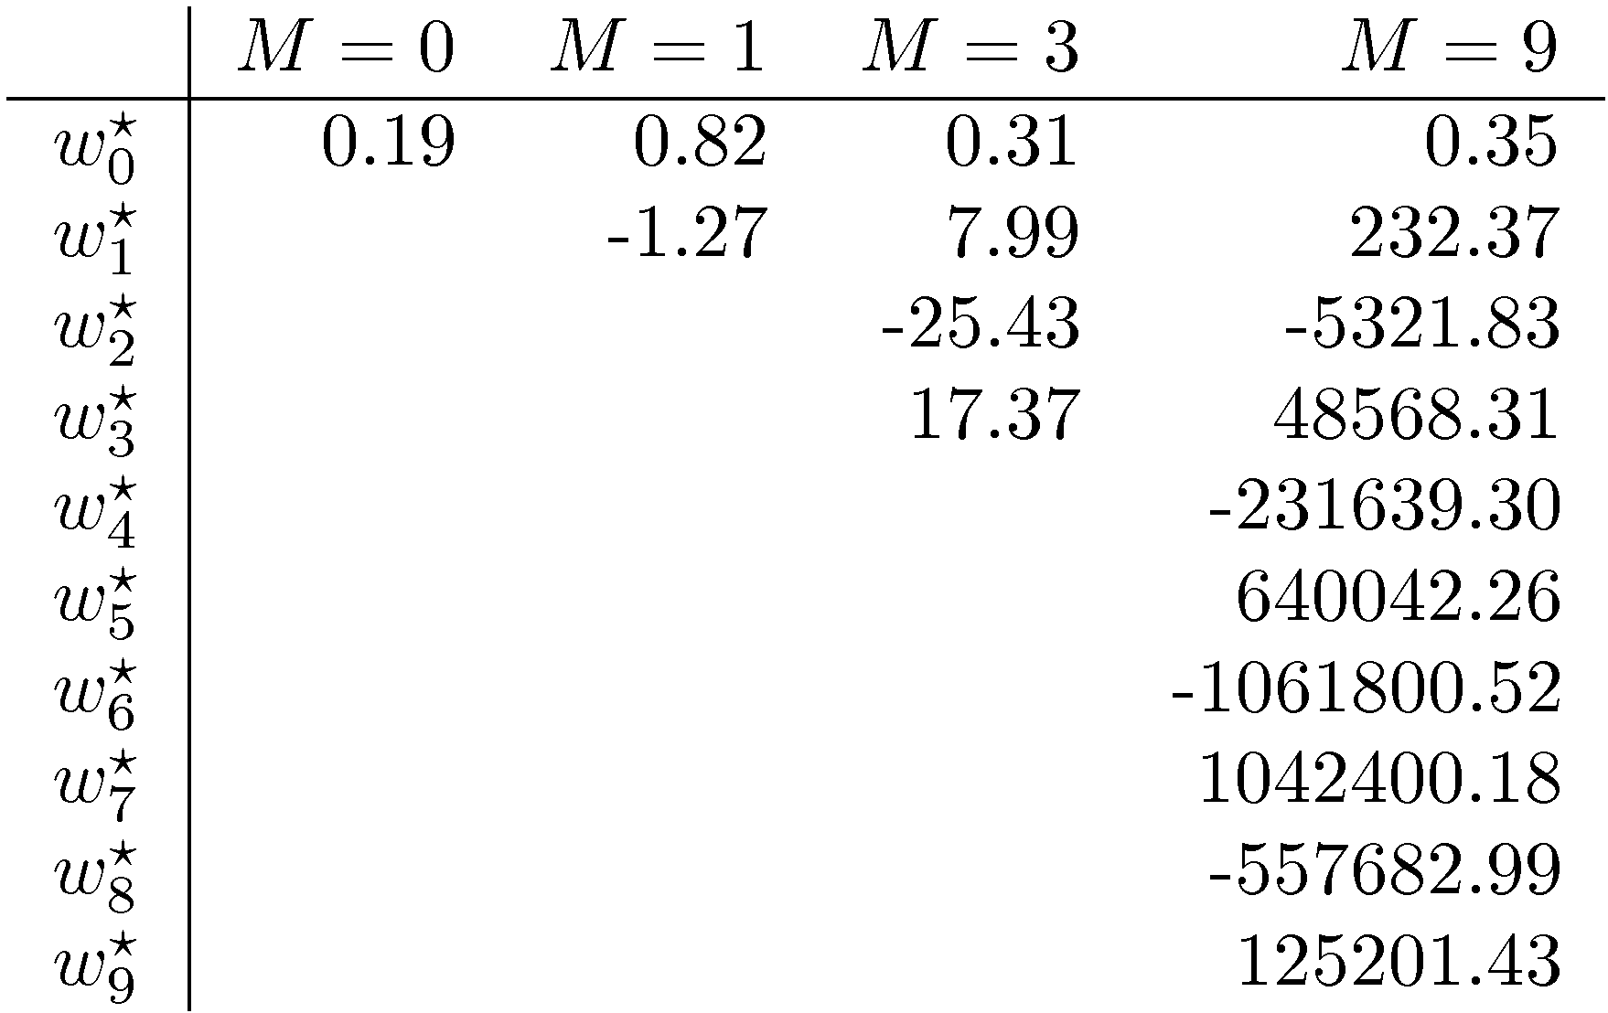
Polynomial Coefficients
Slide credit: Chris Bishop

Slide 29

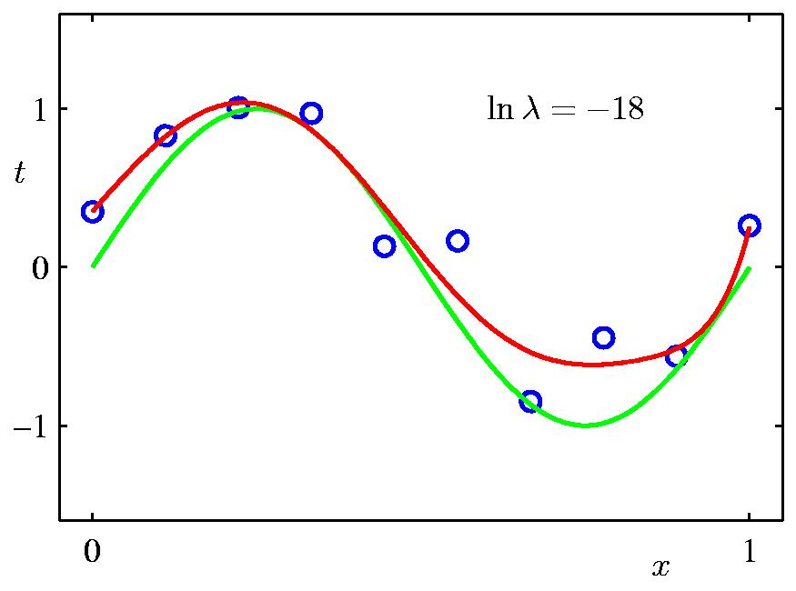
Regularization:
Slide credit: Chris Bishop

Slide 30

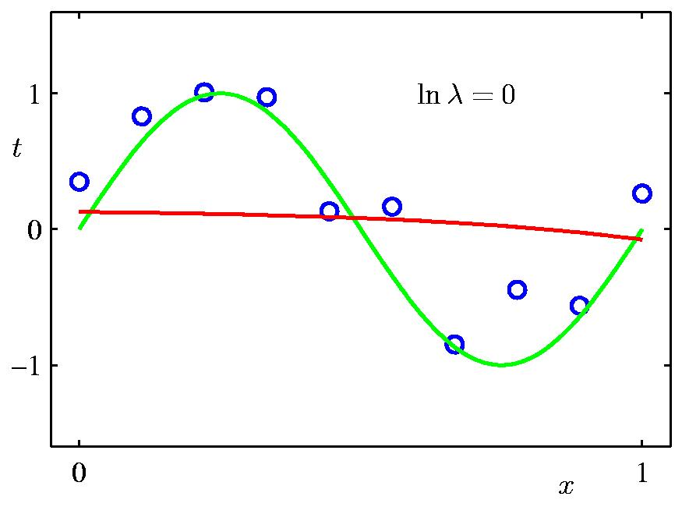
Regularization:
Slide credit: Chris Bishop

Slide 31


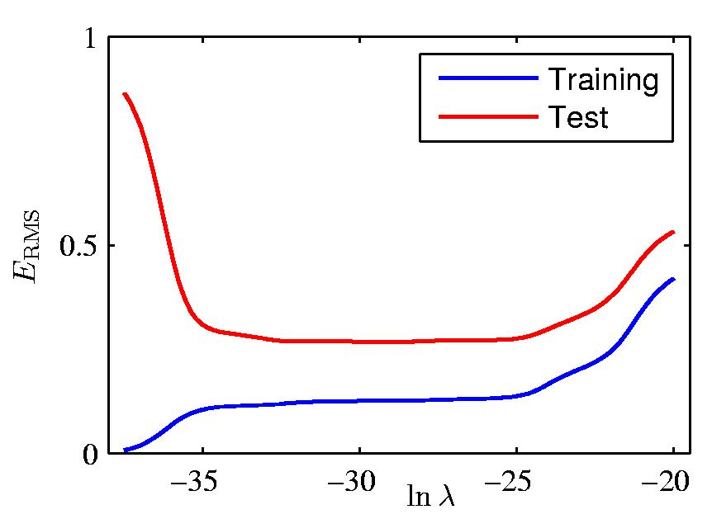
Regularization: vs.
Slide credit: Chris Bishop

Slide 32
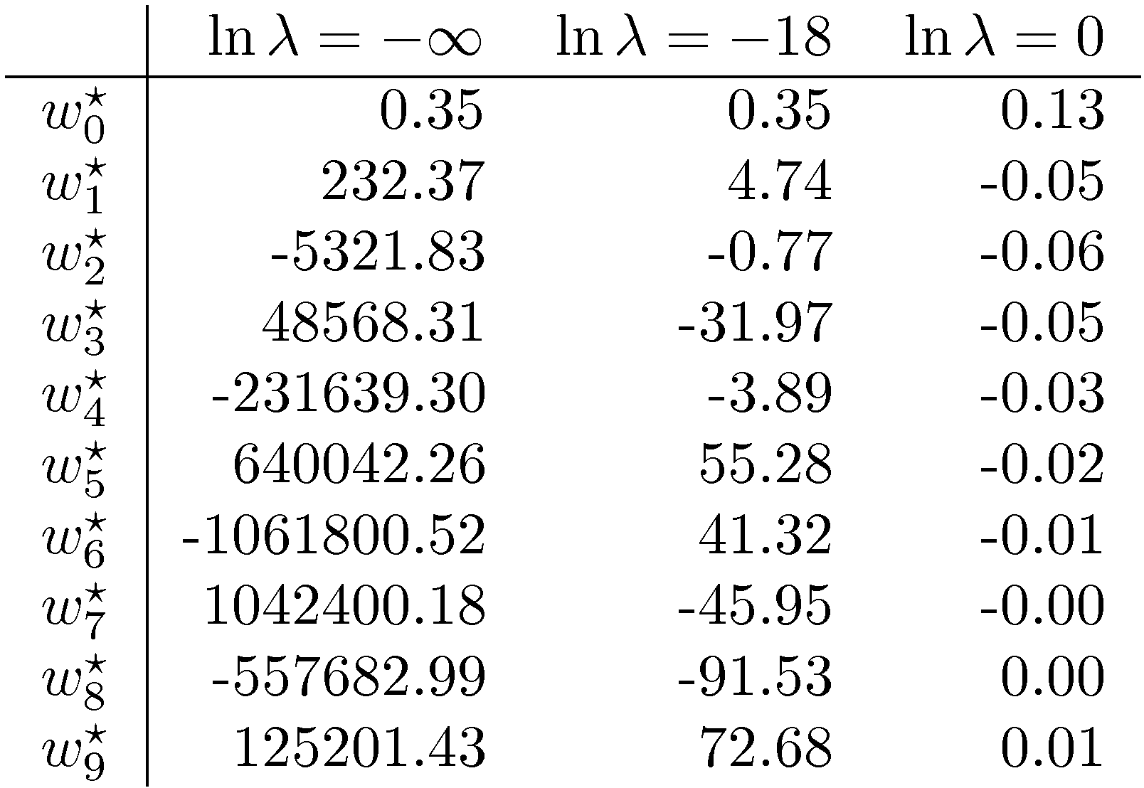
Polynomial Coefficients
No regularization Huge regularization
Adapted from Chris Bishop

Slide 33
How to reduce over-fitting?
Get more training data
Regularize the parameters
Slide credit: D. Hoiem

Slide 34
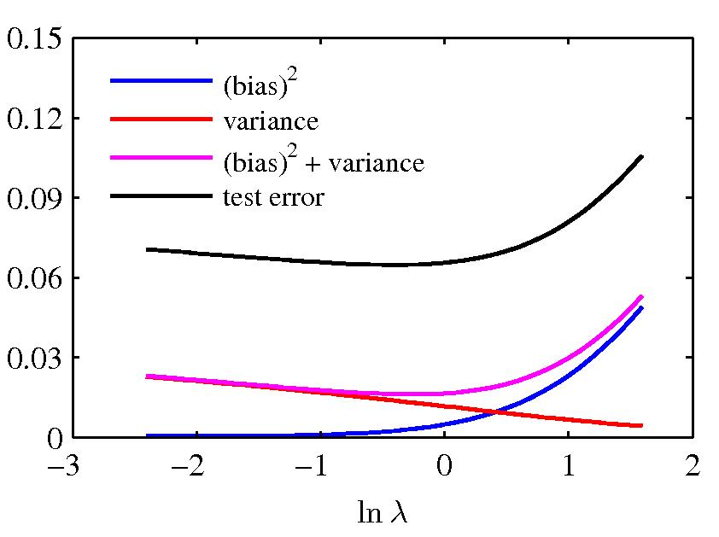
Bias-variance
Figure from Chris Bishop

Slide 35
Bias-variance tradeoff
Underfitting
Overfitting
Error
Test error
Training error
High Bias
Low Variance
Complexity
Low Bias
High Variance
Slide credit: D. Hoiem

Slide 36
Bias-variance tradeoff
Few training examples
Test Error
Many training examples
High Bias
Low Variance
Complexity
Low Bias
High Variance
Slide credit: D. Hoiem

Slide 37
Choosing the trade-off
Need validation set (separate from test set)
Test error
Error
Training error
High Bias
Low Variance
Complexity
Low Bias
High Variance
Slide credit: D. Hoiem

Slide 38
Effect of Training Size
Fixed prediction model
Error
Testing
Generalization Error
Training
Number of Training Examples
Adapted from D. Hoiem

Slide 39
How to reduce over-fitting?
Get more training data
Regularize the parameters
Use fewer features
Choose a simpler classifier
Slide credit: D. Hoiem
Notes:
The simpler classifier or regularization could increase bias and lead to more error.

Slide 40
Remember…
Three kinds of error
  Inherent: unavoidable
  Bias: due to over-simplifications
  Variance: due to inability to perfectly estimate parameters from limited data
Try simple classifiers first
Use increasingly powerful classifiers with more training data (bias-variance trade-off)
Adapted from D. Hoiem

