Slide 1
CS 2750: Machine Learning
Machine Learning Basics +
Matlab Tutorial
Prof. Adriana Kovashka
University of Pittsburgh
January 11, 2016

Slide 2
Course Info
Website: http://people.cs.pitt.edu/~kovashka/cs2750
Instructor: Adriana Kovashka (kovashka@cs.pitt.edu)
  → Use "CS2750" at the beginning of your Subject
Office: Sennott Square 5325
Office hours: Mon/Wed, 12:15pm-1:15pm
Textbook: Christopher M. Bishop. Pattern Recognition and Machine Learning. Springer, 2006
  → And other readings
Notes:
Plan + website (4 min)
Introductions of students (10 min)
Intro to visual recognition (12 min)
Topics (12 min)
Structure of course (14 min)
Prereqs test (15 min)
Questions + extra (8 min)

Slide 3
TA
Changsheng Liu
Office: Sennott Square 6805
Office hours:
  Wednesday, 5-6pm, and
  Thursday, 12:30-2:30pm

Slide 4
Should I take this class?
It will be a lot of work!
  But you will learn a lot
Some parts will be hard and require that you pay close attention!
  But I will have periodic ungraded pop quizzes to see how you’re doing
  I will also pick on students randomly to answer questions
  Use instructor’s and TA’s office hours!!!

Slide 5
Should I take this class?
Homework 1 should be fairly representative of the other homeworks
  I think it will take you 20-25 hours
Projects will take at least three times the work
  So overall you will spend 10+ hours working on this class per week
Drop deadline is January 19

Slide 6
Plan for Today
Machine learning notation, tasks, and challenges
HW1 overview
Matlab tutorial

Slide 7
ML in a Nutshell
y = f(x)
Training: given a training set of labeled examples {(x₁,y₁), …, (x_{N},y_{N})}, estimate the prediction function f by minimizing the prediction error on the training set
Testing: apply f to a never before seen test example x and output the predicted value y = f(x)
output
prediction function
image feature
Slide credit: L. Lazebnik

Slide 8



ML in a Nutshell
Apply a prediction function to a feature representation of the image to get the desired output:
f( ) = “apple”
f( ) = “tomato”
f( ) = “cow”
Slide credit: L. Lazebnik

Slide 9
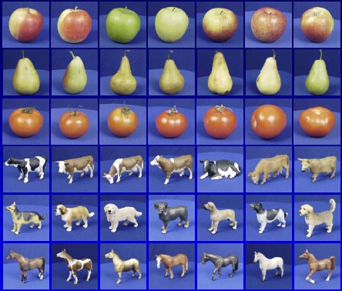

ML in a Nutshell
Training
Training Labels
Training Images
Features
Training
Learned model
Testing
Features
Learned model
Prediction
Test Image
Slide credit: D. Hoiem and L. Lazebnik

Slide 10
Training vs Testing vs Validation
What do we want?
  High accuracy on training data?
  No, high accuracy on unseen/new/test data!
  Why is this tricky?
Training data
  Features (x) and labels (y) used to learn mapping f
Test data
  Features used to make a prediction
  Labels only used to see how well we’ve learned f!!!
Validation data
  Held-out set of the training data
  Can use both features and labels to see how well we are doing

Slide 11
Statistical Estimation View
Probabilities to rescue:
  x and y are random variables
  D = (x₁,y₁), (x₂,y₂), …, (x_{N},y_{N}) ~ P(X,Y)
IID: Independent and Identically Distributed
  Both training & testing data sampled IID from P(X,Y)
  Learn on training set
  Have some hope of generalizing to test set
Slide credit: Dhruv Batra

Slide 12
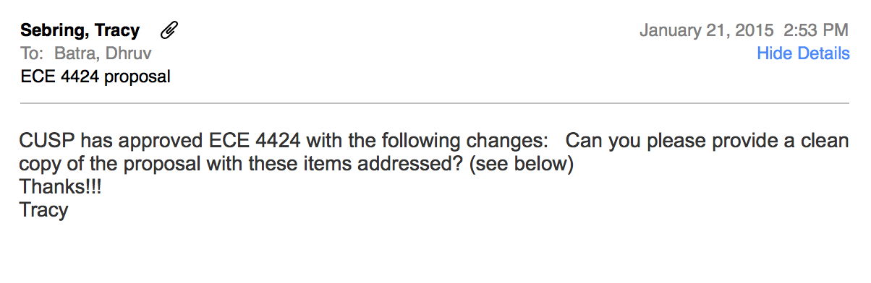
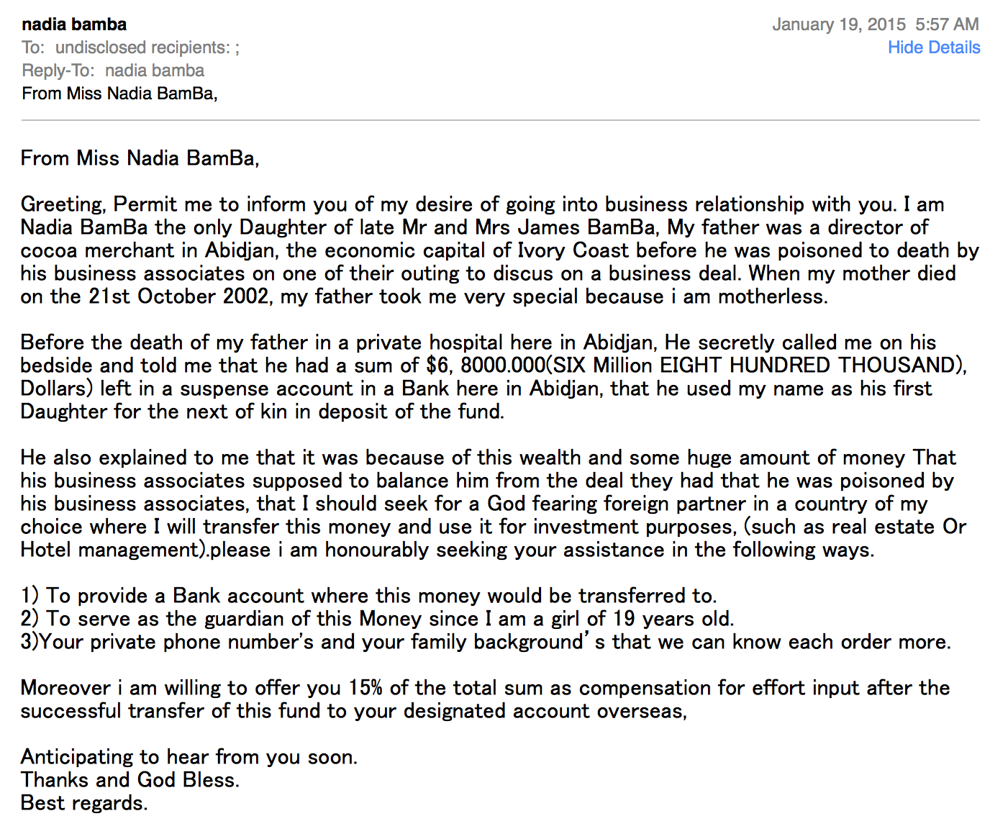
Example of Solving a ML Problem
vs
Slide credit: Dhruv Batra

Slide 13
Intuition
Spam Emails
  a lot of words like
    “money”
    “free”
    “bank account”
Regular Emails
  word usage pattern is more spread out
Slide credit: Dhruv Batra, Fei Sha

Slide 14
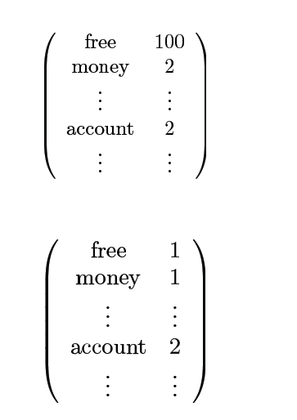
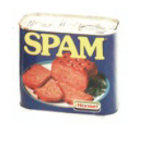
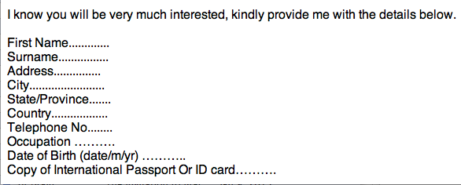
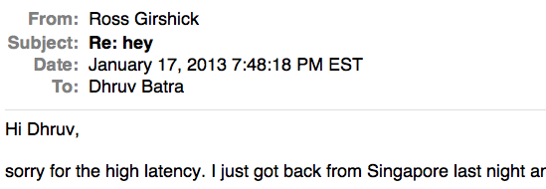
Simple strategy: Let’s count!
This is X
This is Y
Slide credit: Dhruv Batra, Fei Sha

Slide 15
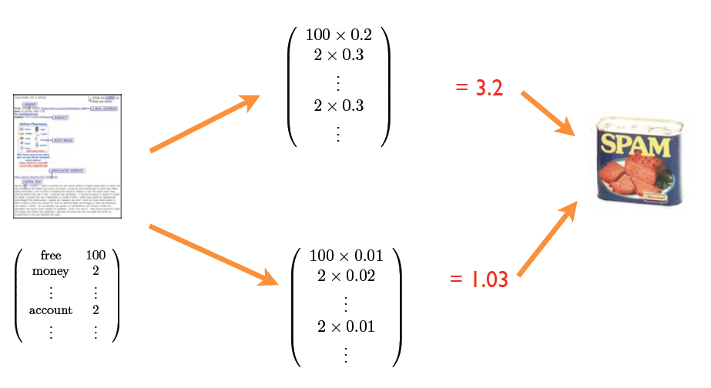
… and weigh these counts (final step)
Why these words?
Where do the weights come from?
Adapted from Dhruv Batra, Fei Sha

Slide 16
Klingon vs Mlingon Classification
Training Data
  Klingon: klix, kour, koop
  Mlingon: moo, maa, mou
Testing Data: kap
Which language?
Why?
Slide credit: Dhruv Batra

Slide 17
Why not just hand-code these weights?
We’re letting the data do the work rather than develop hand-code classification rules
  The machine is learning to program itself
But there are challenges…

Slide 18
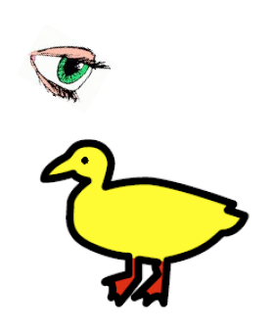
“I saw her duck”
Slide credit: Dhruv Batra, figure credit: Liang Huang

Slide 19
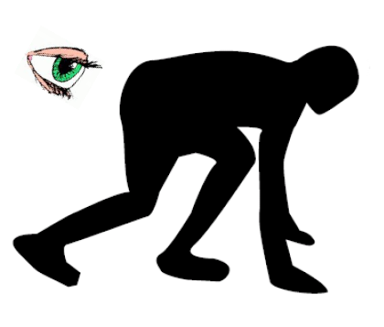
“I saw her duck”
Slide credit: Dhruv Batra, figure credit: Liang Huang

Slide 20
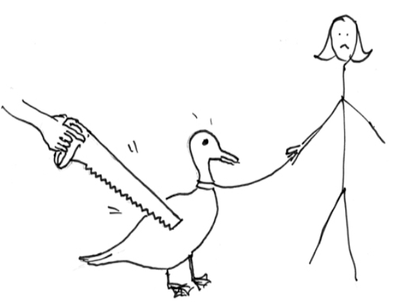
“I saw her duck”
Slide credit: Dhruv Batra, figure credit: Liang Huang

Slide 21
“I saw her duck with a telescope…”
Slide credit: Dhruv Batra, figure credit: Liang Huang

Slide 22

What humans see
Slide credit: Larry Zitnick

Slide 23
What computers see
243 | 239 | 240 | 225 | 206 | 185 | 188 | 218 | 211 | 206 | 216 | 225
242 | 239 | 218 | 110 | 67 | 31 | 34 | 152 | 213 | 206 | 208 | 221
243 | 242 | 123 | 58 | 94 | 82 | 132 | 77 | 108 | 208 | 208 | 215
235 | 217 | 115 | 212 | 243 | 236 | 247 | 139 | 91 | 209 | 208 | 211
233 | 208 | 131 | 222 | 219 | 226 | 196 | 114 | 74 | 208 | 213 | 214
232 | 217 | 131 | 116 | 77 | 150 | 69 | 56 | 52 | 201 | 228 | 223
232 | 232 | 182 | 186 | 184 | 179 | 159 | 123 | 93 | 232 | 235 | 235
232 | 236 | 201 | 154 | 216 | 133 | 129 | 81 | 175 | 252 | 241 | 240
235 | 238 | 230 | 128 | 172 | 138 | 65 | 63 | 234 | 249 | 241 | 245
237 | 236 | 247 | 143 | 59 | 78 | 10 | 94 | 255 | 248 | 247 | 251
234 | 237 | 245 | 193 | 55 | 33 | 115 | 144 | 213 | 255 | 253 | 251
248 | 245 | 161 | 128 | 149 | 109 | 138 | 65 | 47 | 156 | 239 | 255
190 | 107 | 39 | 102 | 94 | 73 | 114 | 58 | 17 | 7 | 51 | 137
23 | 32 | 33 | 148 | 168 | 203 | 179 | 43 | 27 | 17 | 12 | 8
17 | 26 | 12 | 160 | 255 | 255 | 109 | 22 | 26 | 19 | 35 | 24
Slide credit: Larry Zitnick

Slide 24
Challenges
Some challenges: ambiguity and context
Machines take data representations too literally
Humans are much better than machines at generalization, which is needed since test data will rarely look exactly like the training data

Slide 25
Challenges
Why might it be hard to:
  Predict if a viewer will like a movie?
  Recognize cars in images?
  Translate between languages?

Slide 26
The Time is Ripe to Study ML
Many basic effective and efficient algorithms available.
Large amounts of on-line data available.
Large amounts of computational resources available.
Slide credit: Ray Mooney

Slide 27
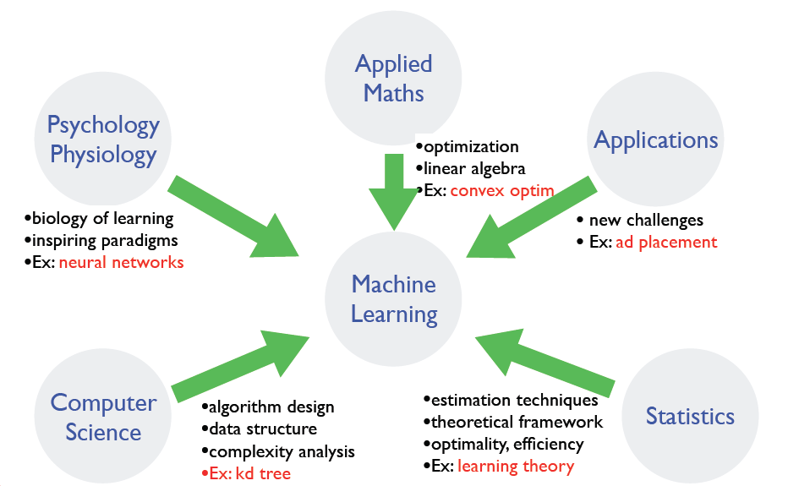
Where does ML fit in?
Slide credit: Dhruv Batra, Fei Sha

Slide 28
Defining the Learning Task
Improve on task, T, with respect to
performance metric, P, based on experience, E.
T: Playing checkers
P: Percentage of games won against an arbitrary opponent
E: Playing practice games against itself
T: Recognizing hand-written words
P: Percentage of words correctly classified
E: Database of human-labeled images of handwritten words
T: Driving on four-lane highways using vision sensors
P: Average distance traveled before a human-judged error
E: A sequence of images and steering commands recorded while
observing a human driver.
T: Categorize email messages as spam or legitimate
P: Percentage of email messages correctly classified
E: Database of emails, some with human-given labels
Slide credit: Ray Mooney

Slide 29
ML in a Nutshell
Every machine learning algorithm has:
  Representation / model class
  Evaluation / objective function
  Optimization
You also need:
  A way to represent your data
Adapted from Pedro Domingos

Slide 30
Representation / model class
Decision trees
Sets of rules / Logic programs
Instances
Graphical models (Bayes/Markov nets)
Neural networks
Support vector machines
Model ensembles
Etc.
Slide credit: Pedro Domingos

Slide 31
Evaluation / objective function
Accuracy
Precision and recall
Squared error
Likelihood
Posterior probability
Cost / Utility
Margin
Entropy
K-L divergence
Etc.
Slide credit: Pedro Domingos

Slide 32

Optimization
Discrete / combinatorial optimization
  E.g. graph algorithms
Continuous optimization
  E.g. linear programming
Adapted from Dhruv Batra, image from Wikipedia

Slide 33
Data Representation
Let’s brainstorm what our “X” should be for various “Y” prediction tasks…

Slide 34
Types of Learning
Supervised learning
  Training data includes desired outputs
Unsupervised learning
  Training data does not include desired outputs
Weakly or Semi-supervised learning
  Training data includes a few desired outputs
Reinforcement learning
  Rewards from sequence of actions
Slide credit: Dhruv Batra

Slide 35
Tasks
Supervised Learning
x
Classification
y
Discrete
x
Regression
y
Continuous
Unsupervised Learning
x
Clustering
y
Discrete ID
x
Dimensionality
Reduction
y
Continuous
Slide credit: Dhruv Batra

Slide 36
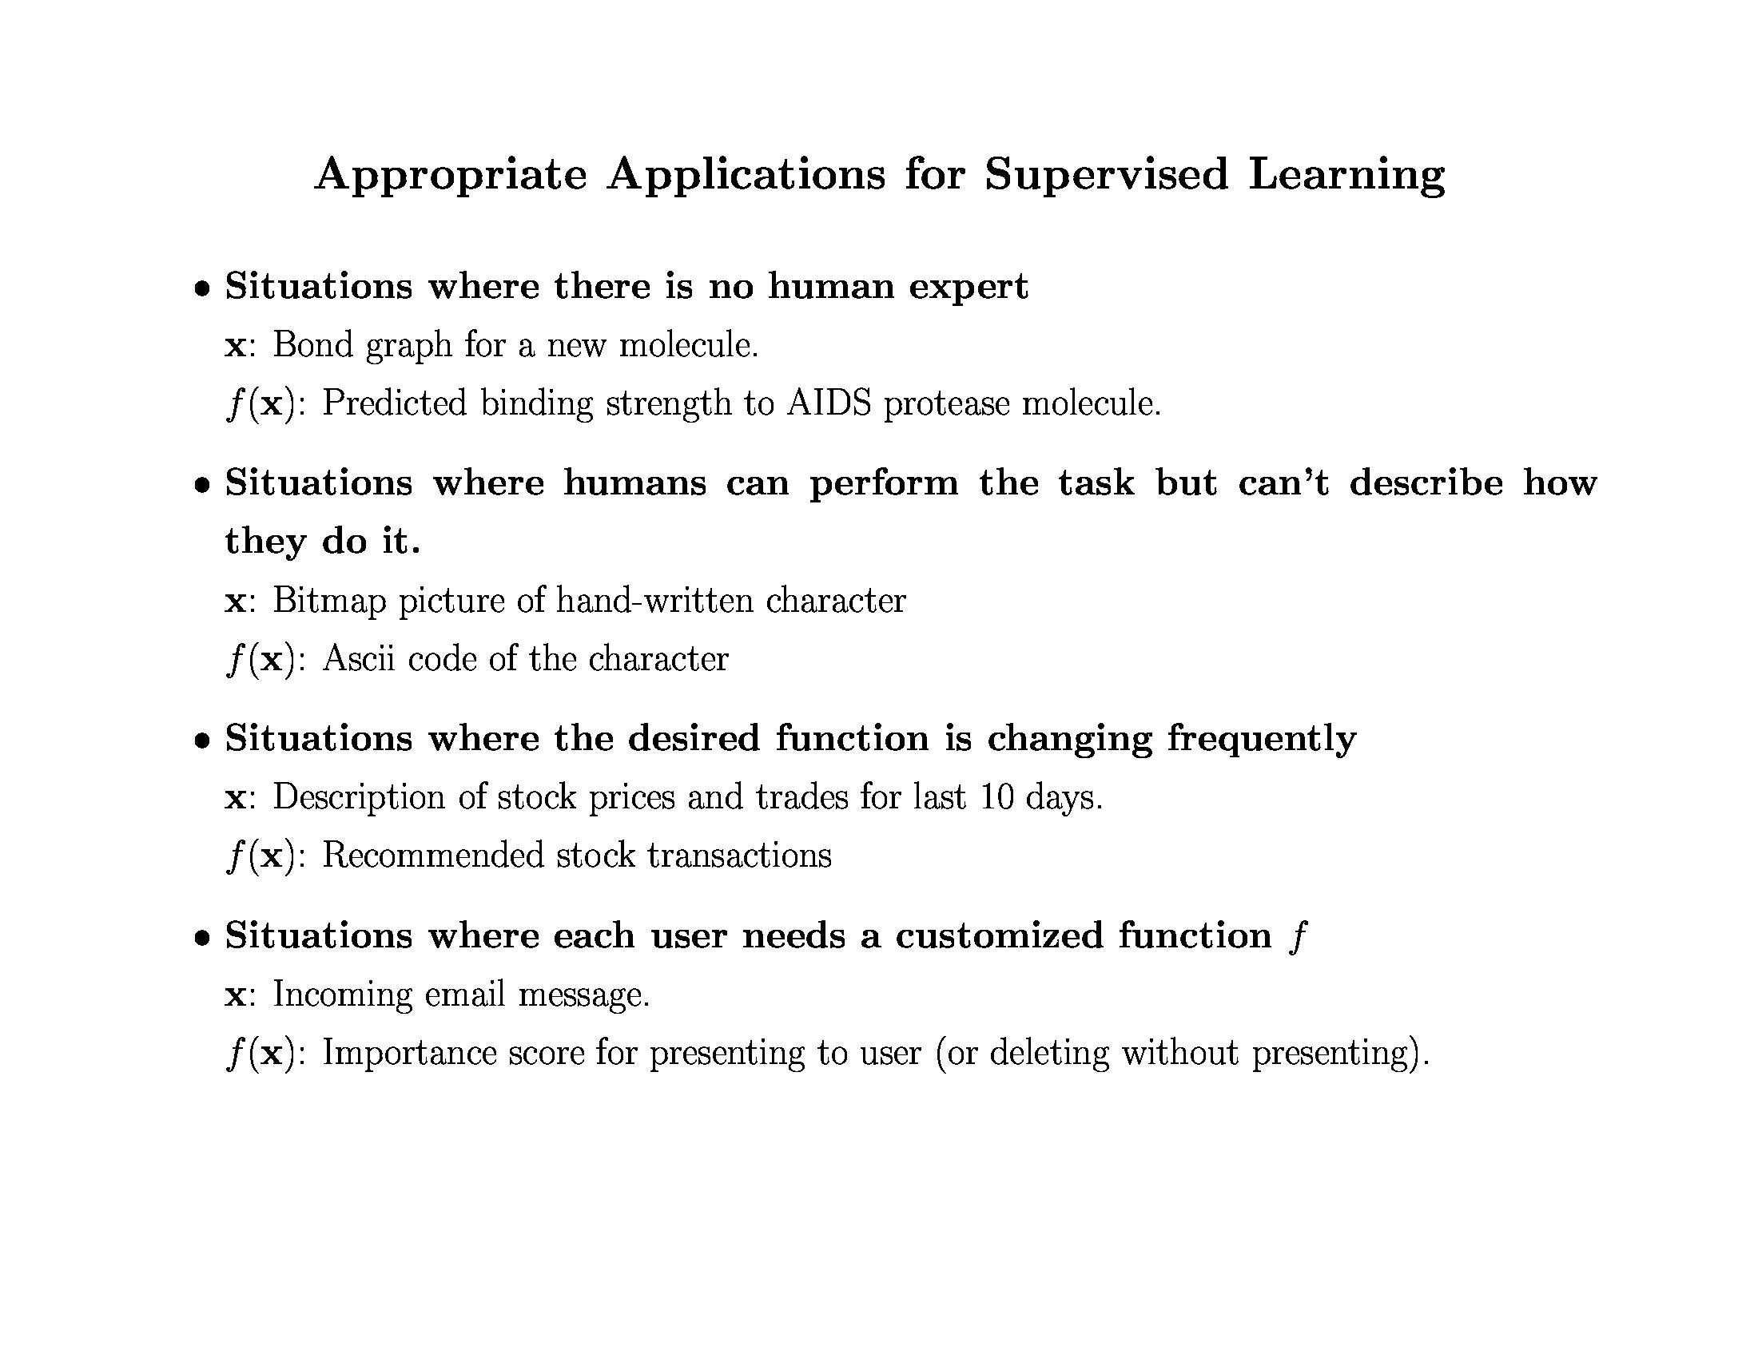
Slide credit: Pedro Domingos, Tom Mitchell, Tom Dietterich

Slide 37
Measuring Performance
If y is discrete:
  Accuracy: # correctly classified / # all test examples
  Weighted misclassification via a confusion matrix
    In case of only two classes: True Positive, False Positive, True Negative, False Negative
Notes:
Diagnosis example

Slide 38
Measuring Performance
If y is discrete:
  Precision/recall
    Precision = # predicted true pos / # predicted pos
    Recall = # predicted true pos / # true pos
  F-measure
    = 2PR / (P + R)
Want evaluation metric to be in some range, e.g. [0 1]
  0 = worst possible classifier, 1 = best possible classifier

Slide 39
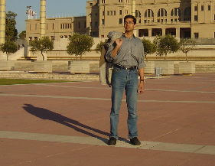
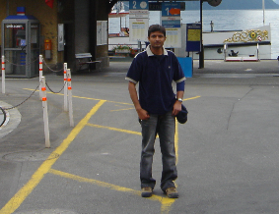
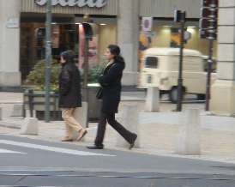
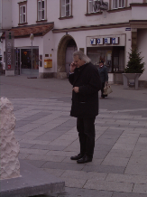
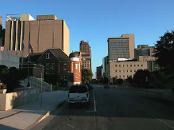
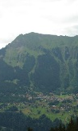
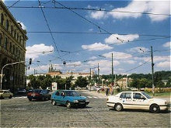
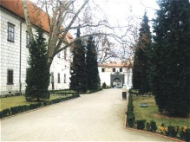
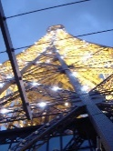
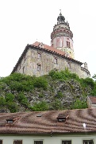
Precision / Recall / F-measure
True positives
(images that contain people)
True negatives
(images that do not contain people)
Predicted positives
(images predicted to contain people)
Predicted negatives
(images predicted not to contain people)
Precision = 2 / 5 = 0.4
Recall = 2 / 4 = 0.5
F-measure = 2*0.4*0.5 / 0.4+0.5 = 0.44
Accuracy: 5 / 10 = 0.5

Slide 40
Measuring Performance
If y is continuous:
  L₂ error between true and predicted y

Slide 41
Homework 1
http://people.cs.pitt.edu/~kovashka/cs2750/hw1.htm

Slide 42
Matlab Tutorial
http://cs.brown.edu/courses/cs143/2011/docs/matlab-tutorial/
https://people.cs.pitt.edu/~milos/courses/cs2750/Tutorial/
http://www.math.udel.edu/~braun/M349/Matlab_probs2.pdf

Slide 43
Homework
Get started on Homework 1
Do the assigned readings!
  Bishop Ch. 1, Sec. 3.2
  Szeliski Sec. 4.1, Grauman/Leibe Ch. 1-3
Review both linked Matlab tutorials

Slide 44
Matlab Exercise
http://www.facstaff.bucknell.edu/maneval/help211/basicexercises.html
  Do Problems 1-8, 12
  Most also have solutions
  Ask the TA if you have any problems

Slide 45
Next time
The bias-variance trade-off
Data representations in computer vision

