Slide 1
CS 2750: Machine Learning
Introduction
Prof. Adriana Kovashka
University of Pittsburgh
January 6, 2016

Slide 2
Course Info
Website: http://people.cs.pitt.edu/~kovashka/cs2750
Instructor: Adriana Kovashka (kovashka@cs.pitt.edu)
  → Use "CS2750" at the beginning of your Subject
Office: Sennott Square 5325
Office hours: Mon/Wed, 12:15pm-1:15pm
Textbook: Christopher M. Bishop. Pattern Recognition and Machine Learning. Springer, 2006
  → And other readings
Notes:
Plan + website (4 min)
Introductions of students (10 min)
Intro to visual recognition (12 min)
Topics (12 min)
Structure of course (14 min)
Prereqs test (15 min)
Questions + extra (8 min)

Slide 3
TA
Changsheng Liu
Office: Sennott Square 6805
Office hours: TBD
  Wednesday 1PM to 3PM
  Wednesday 4PM to 6PM
  Any time Thursday
  Do the Doodle by the end of Friday: http://doodle.com/poll/7qinfkgu2xwqrxna

Slide 4
Schedule
http://people.cs.pitt.edu/~kovashka/cs2750

Slide 5
Grading
Homework (40%)
Project (20%)
  Status presentation and report (5%)
  Final presentation and report (15%)
Midterm exam (15%)
Final exam (20%)
Participation (5%)

Slide 6
Homework
Four homework assignments
Will use Matlab (tutorial next class)
Bias towards computer vision applications
Submission through CourseWeb → CS2750 → Assignments → Homework 1, etc.
Attach a zip file with your written responses and code, named YourFirstName_YourLastName.zip
Homework is due at 11:59pm on the due
Grades will appear on CourseWeb

Slide 7
Homework Late Policy
You get 3 "free" late days, i.e., you can submit homework a total of 3 days late.
For example, you can submit one problem set 12 hours late, and another 60 hours late.
Once you've used up your free late days, you will incur a penalty of 25% from the total project credit possible for each late day.
A late day is anything from 1 minute to 24 hours.

Slide 8
Project
Encouraged to work in groups of two
Proposal due Feb. 29
Status report and in-class status presentations March 28
Final report and presentations in last week of class
Aim for workshop-level work
See course website for resources and more info

Slide 9
Exams
One mid-term and one final exam
The final exam will be cumulative but will focus on the latter half of the course

Slide 10
Readings
Posted on course website (tentatively)
Subject to change until 6pm on the day of the previous class

Slide 11
Participation
5% of grade will be based on participation
No attendance will be taken, but if you don’t attend, you can’t participate
How to participate:
  Answer questions asked by instructor and others
  Ask meaningful questions
  Bring in relevant articles about recent developments in machine learning
  Contribute on Piazza
Feedback is welcome!

Slide 12
Collaboration Policy
You will work individually. The work you turn in must be your own work.
You can discuss the problem sets with your classmates, but do not look at their code.
You cannot use posted solutions, search for code on the internet or use or look at Matlab implementations of something you are asked to write.
When in doubt, ask the instructor or TA!
Plagiarism will cause you to fail the class and receive disciplinary penalty.

Slide 13
Disabilities
If you have a disability for which you are or may be requesting an accommodation, you are encouraged to contact both your instructor and Disability Resources and Services (DRS), 140 William Pitt Union, (412) 648-7890, drsrecep@pitt.edu, (412) 228-5347 for P3 ASL users, as early as possible in the term. DRS will verify your disability and determine reasonable accommodations for this course.

Slide 14
Medical Conditions
If you have a medical condition which will prevent you from doing a certain assignment or coming to class, you must inform the instructor of this before the deadline.
You must then submit documentation of your condition within a week of the assignment deadline.

Slide 15
Prerequisites
Linear algebra
Probability
Calculus
Programming and complexity analysis

Slide 16
Should I take this class?
It will be a lot of work!
  But you will learn a lot
Some parts will be hard and require that you pay close attention!
  But I will have periodic ungraded pop quizzes to see how you’re doing
  I will also pick on students randomly to answer questions
  Use instructor’s and TA’s office hours!!!

Slide 17
Questions?

Slide 18
Plan for Today
Course structure and policies
Introductions
What is machine learning?
  Example problems
  Framework
  Challenges

Slide 19
Introductions
What is your name?
What is your department and year in the program?
What are your research interests?
What one thing outside of school are you passionate about?
What do you hope to get out of this class?

Slide 20
What is machine learning?
Finding patterns and relationships in data
We can apply these patterns to make useful predictions
E.g. we can predict how much a user will like a movie, even though that user never rated that movie

Slide 21
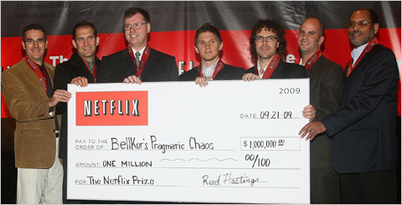
Example machine learning tasks
Netflix challenge
  Given lots of data about how users rated movies (training data)
  But we don’t know how user i will rate movie j and want to predict that (test data)

Slide 22
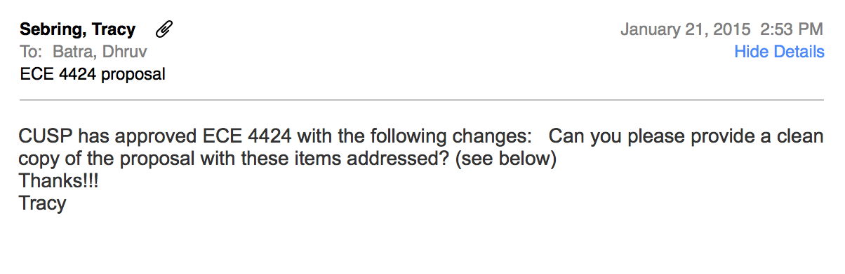
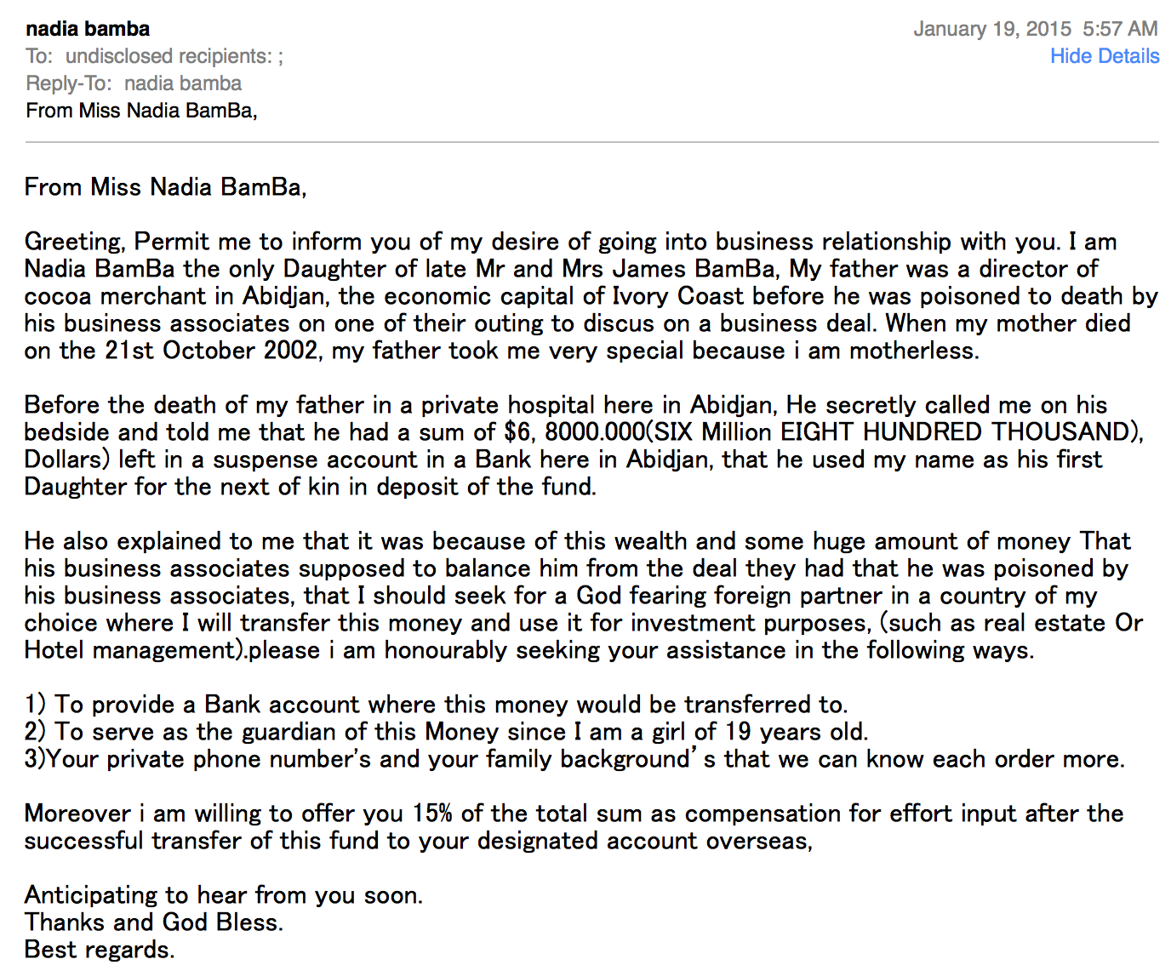
Example machine learning tasks
Spam or not?
vs
Slide credit: Dhruv Batra

Slide 23
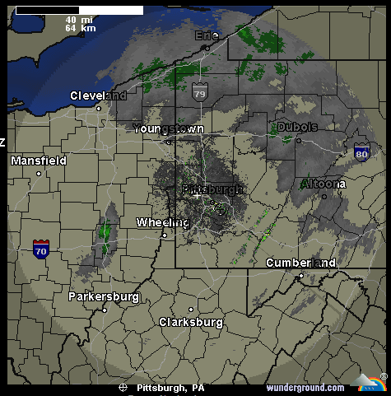
Example machine learning tasks
Weather prediction
Temperature
Slide credit: Carlos Guestrin

Slide 24
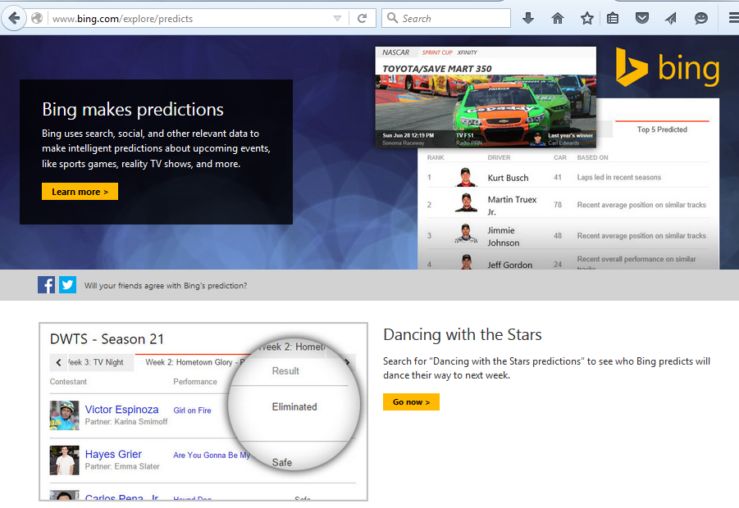
Example machine learning tasks
Who will win <contest of your choice>?

Slide 25
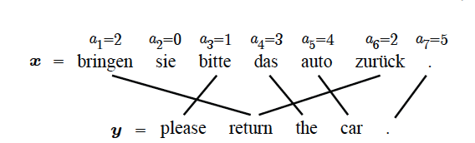
Example machine learning tasks
Machine translation
Slide credit: Dhruv Batra, figure credit: Kevin Gimpel

Slide 26
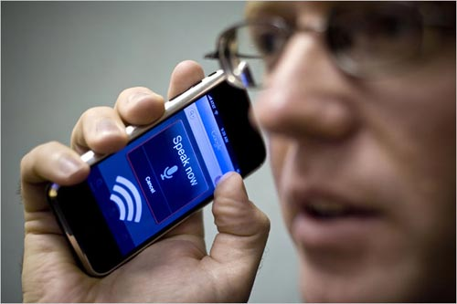
Example machine learning tasks
Speech recognition
Slide credit: Carlos Guestrin

Slide 27
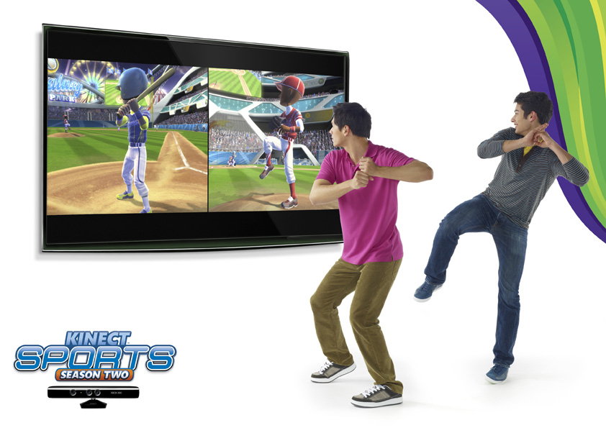
Example machine learning tasks
Pose estimation
Slide credit: Noah Snavely

Slide 28

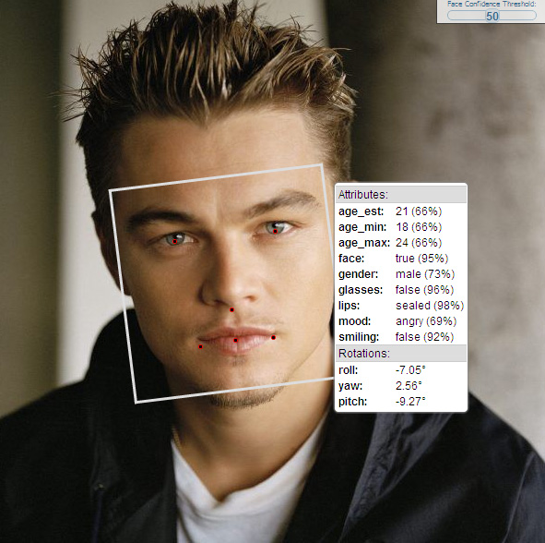
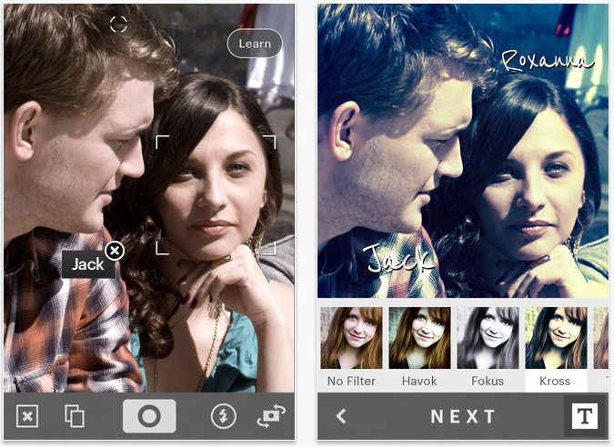
Example machine learning tasks
Face recognition
Slide credit: Noah Snavely

Slide 29
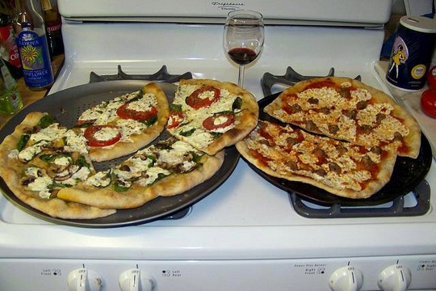
Example machine learning tasks
Image categorization
Pizza
Wine
Stove
Slide credit: Dhruv Batra

Slide 30
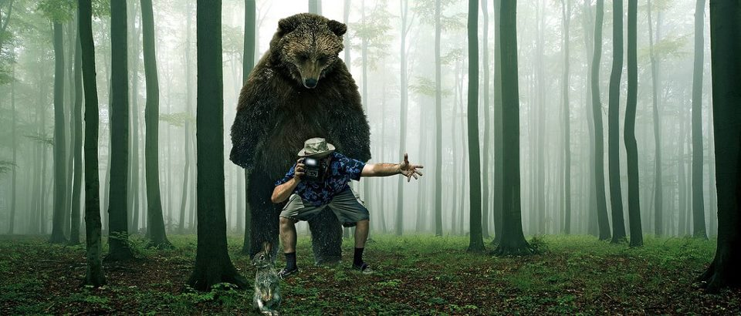
Example machine learning tasks
Is it dangerous?
Is it alive?
How fast does it run?
Is it soft?
Does it have a tail?
Can I poke with it?
Slide credit: Derek Hoiem

Slide 31
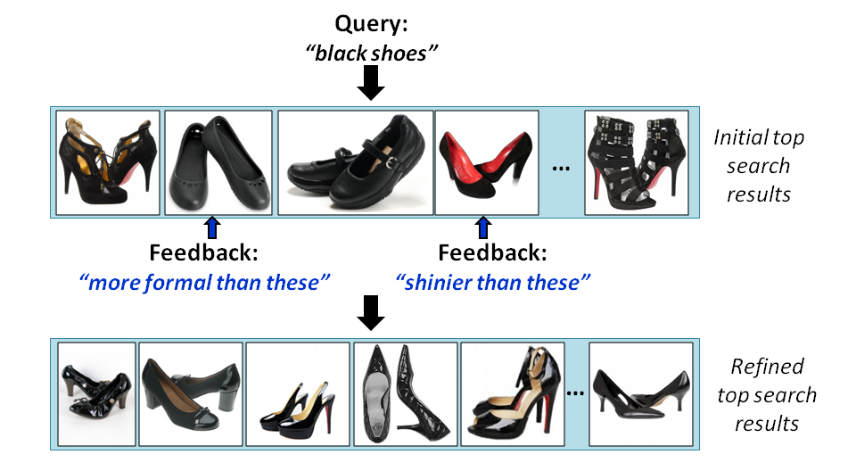
Example machine learning tasks
Attribute-based image retrieval
Kovashka et al., “WhittleSearch: Image Search with Relative Attribute Feedback”, CVPR 2012

Slide 32
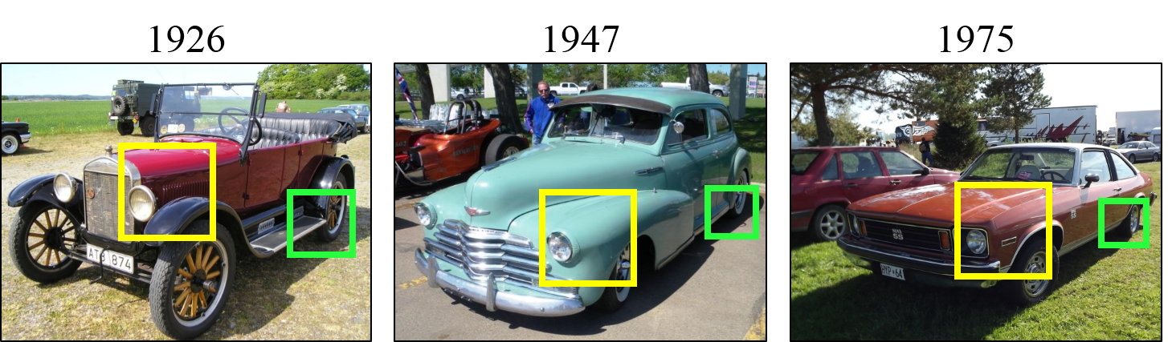
Example machine learning tasks
Dating car photographs
Lee et al., “Style-aware Mid-level Representation for Discovering Visual Connections in Space and Time”, ICCV 2013

Slide 33
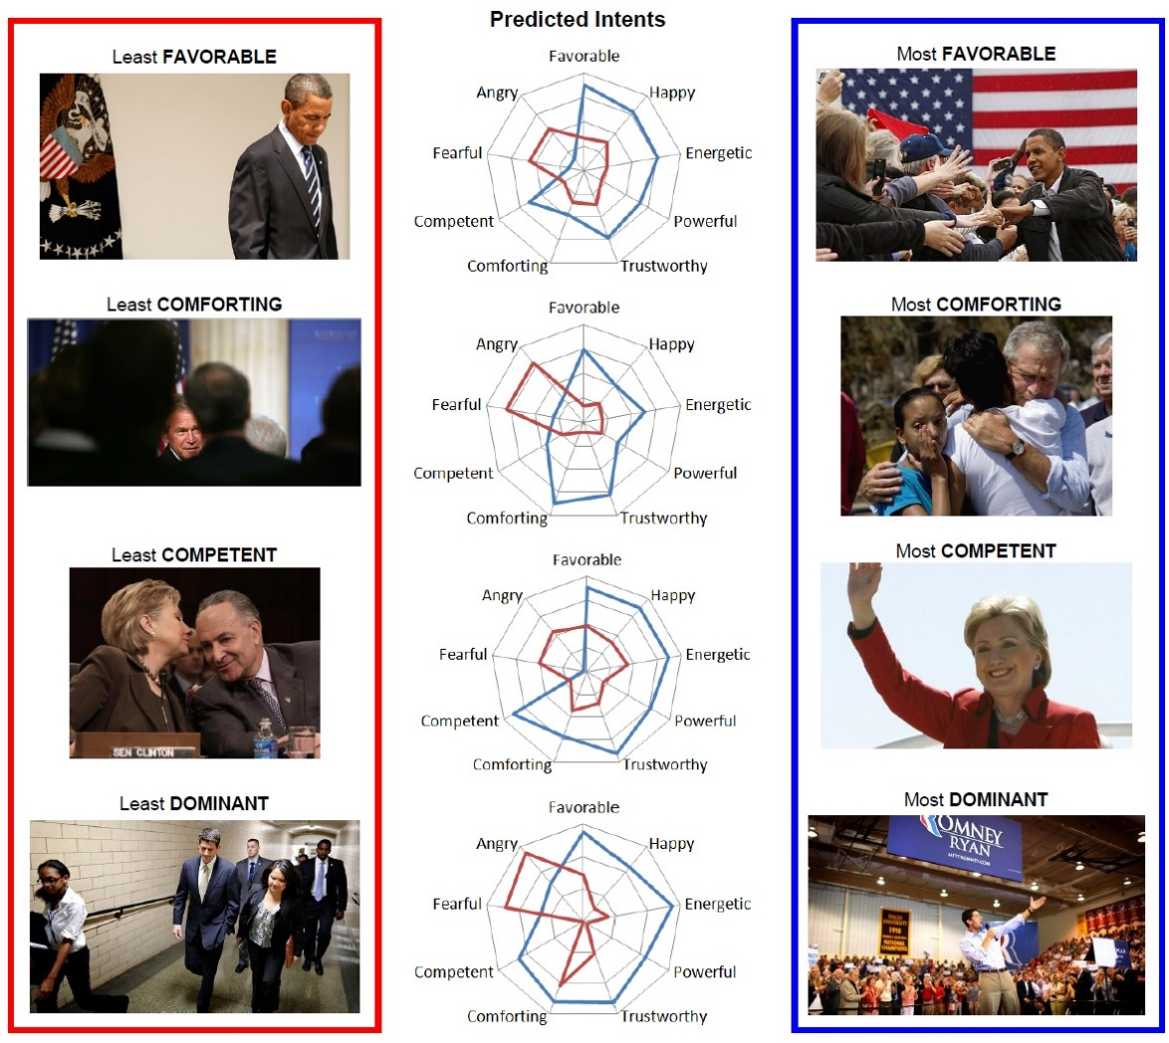
Example machine learning tasks
Inferring visual persuasion
Joo et al., “Visual Persuasion: Inferring Communicative Intents of Images”, CVPR 2014

Slide 34
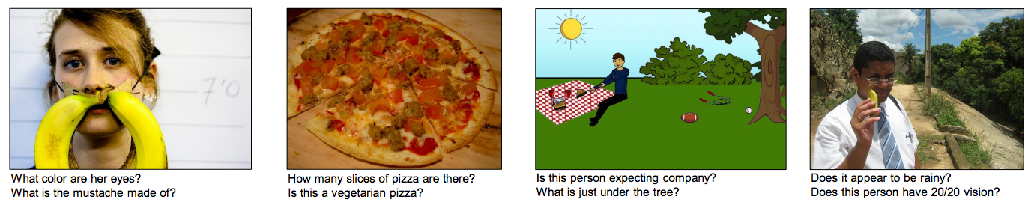
Example machine learning tasks
Answering questions about images
Antol et al., “VQA: Visual Question Answering”, ICCV 2015

Slide 35
Example machine learning tasks
What else?

Slide 36
Plan for Today
Course structure and policies
Introductions
What is machine learning?
  Example problems
  Framework
  Challenges

Slide 37
ML in a Nutshell
Tens of thousands of machine learning algorithms
Decades of ML research oversimplified:
  Learn a mapping from input to output f: X → Y
  X: emails, Y: {spam, notspam}
Slide credit: Pedro Domingos

Slide 38
ML in a Nutshell
Input: x (images, text, emails…)
Output: y (spam or non-spam…)
(Unknown) Target Function
  f: X → Y (the “true” mapping / reality)
Data
  (x₁,y₁), (x₂,y₂), …, (x_{N},y_{N})
Model
  g: X → Y
  y = g(x) = sign(w^{T}x)
Slide credit: Dhruv Batra

Slide 39
ML in a Nutshell
Every machine learning algorithm has:
  Representation
  Evaluation / objective function
  Optimization
You also need:
  A way to represent your data
Adapted from Pedro Domingos

Slide 40
Representation
Decision trees
Sets of rules / Logic programs
Instances
Graphical models (Bayes/Markov nets)
Neural networks
Support vector machines
Model ensembles
Etc.
Slide credit: Pedro Domingos

Slide 41
Evaluation / objective function
Accuracy
Precision and recall
Squared error
Likelihood
Posterior probability
Cost / Utility
Margin
Entropy
K-L divergence
Etc.
Slide credit: Pedro Domingos

Slide 42

Optimization
Discrete / combinatorial optimization
  E.g. graph algorithms
Continuous optimization
  E.g. linear programming
Adapted from Dhruv Batra, image from Wikipedia

Slide 43
Types of Learning
Supervised learning
  Training data includes desired outputs
Unsupervised learning
  Training data does not include desired outputs
Weakly or Semi-supervised learning
  Training data includes a few desired outputs
Reinforcement learning
  Rewards from sequence of actions
Slide credit: Dhruv Batra

Slide 44
Tasks
Supervised Learning
x
Classification
y
Discrete
x
Regression
y
Continuous
Unsupervised Learning
x
Clustering
y
Discrete ID
x
Dimensionality
Reduction
y
Continuous
Slide credit: Dhruv Batra

Slide 45
Your Homework
Fill out Doodle
Read entire course website
Read Chapter 1 and Section 3.2 of Bishop
Homework 1 released, due 1/27
  Read it and let me know if any questions
  Will overview next time

Slide 46
Next Time
Matlab tutorial
Homework 1 overview
Machine learning basics and challenges (in more detail)
The bias-variance trade-off

