Slide 1
CS 2750: Machine Learning
Review
Changsheng Liu
University of Pittsburgh
April 4, 2016

Slide 2
Plan for today
Review some questions from HW 3
Density Estimation
Mixture of Gaussian
Naïve Bayesian

Slide 3
HW 3
Please see whiteboard

Slide 4
Density Estimation
Maximum Likelihood
Maximum a posteriori estimation

Slide 5
Density Estimation
A set of random variables X ={X₁,X₂,…X_{d}}
A model of distribution over variables in X with Parameters Θ : P(X|Θ)
Data D={D₁,D₂,…D_{n}}
Objective: Find parameter Θ that P(X|Θ) fits data D the best

Slide 6
Density Estimation
Maximum likelihood
  Maximize P(D| Θ ,ξ)
Maximum a posteriori probability(MAP)
  A model of distribution over variables in X with Parameters Θ : P(Θ|D, ξ)

Slide 7
A coin example
A biased coin, with the probability of a head θ
Data
HHTTHHTHTHTTTHTHHHHTHHHHT
  Heads 15
  Tails:10
What is a good estimate of θ?
Slide from Milos

Slide 8


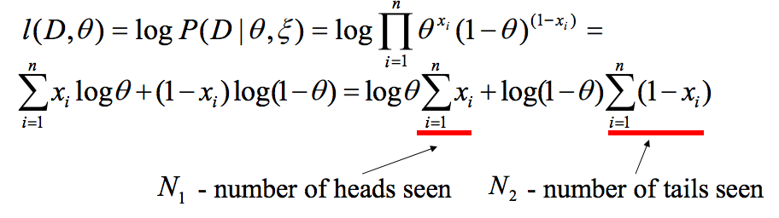
Maximum likelihood
Use the frequency of occurrences
15/25
This is the maximum likelihood estimate
The likelihood of the data
Maximum likelihood
Slide from Milos

Slide 9

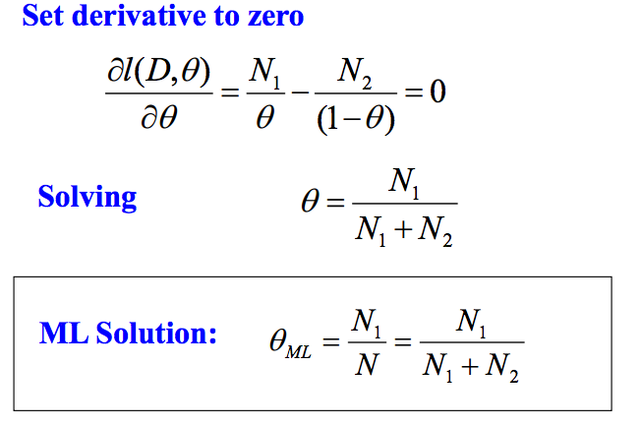
Maximum likelihood
Slide from Milos

Slide 10
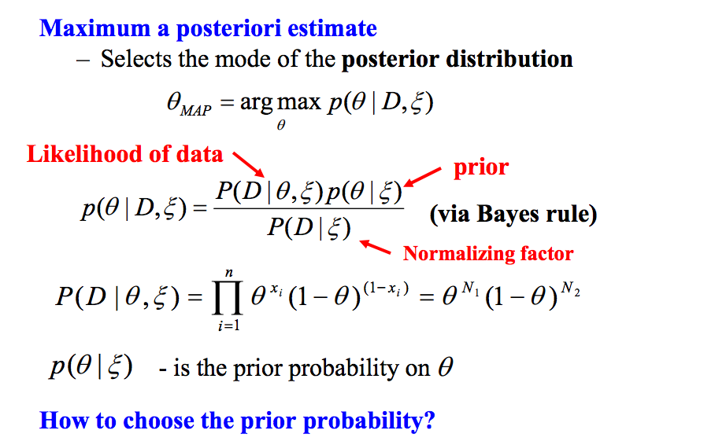
Maximum a posteriori estimate
Slide from Milos

Slide 11
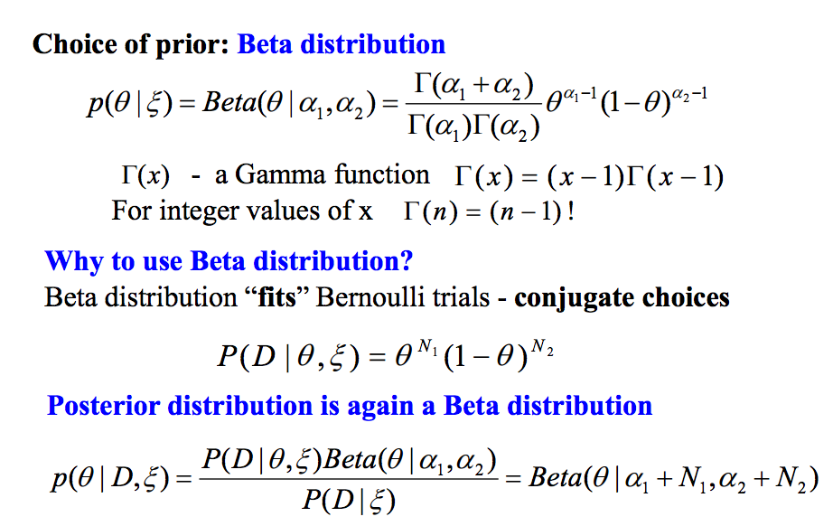
Maximum a posteriori estimate
Choose from the same family for convienence
Slide from Milos

Slide 12
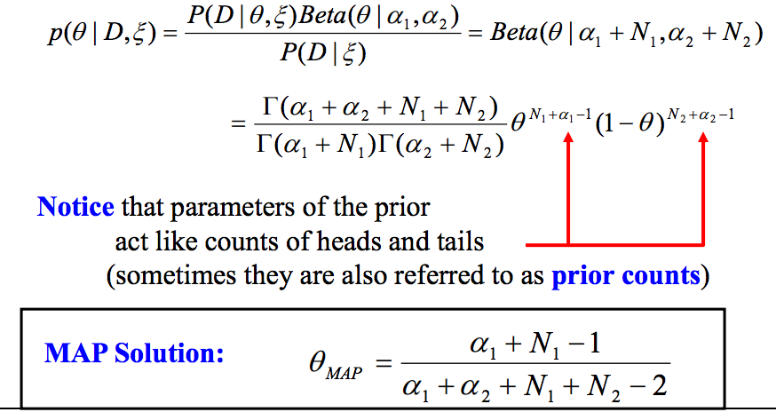
Maximum a posteriori estimate
Slide from Bishop

Slide 13
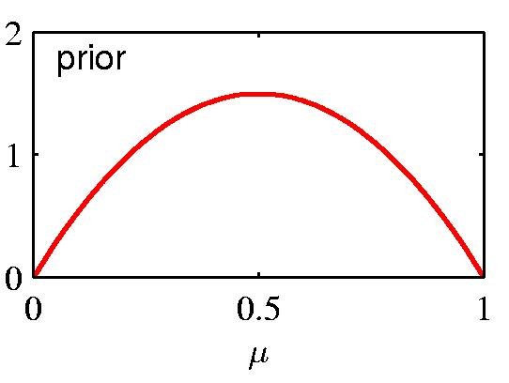
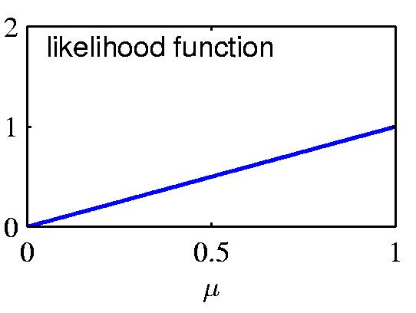
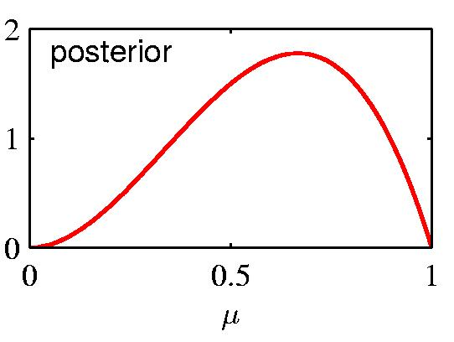
Prior ∙ Likelihood = Posterior
Slide from Bishop

Slide 14
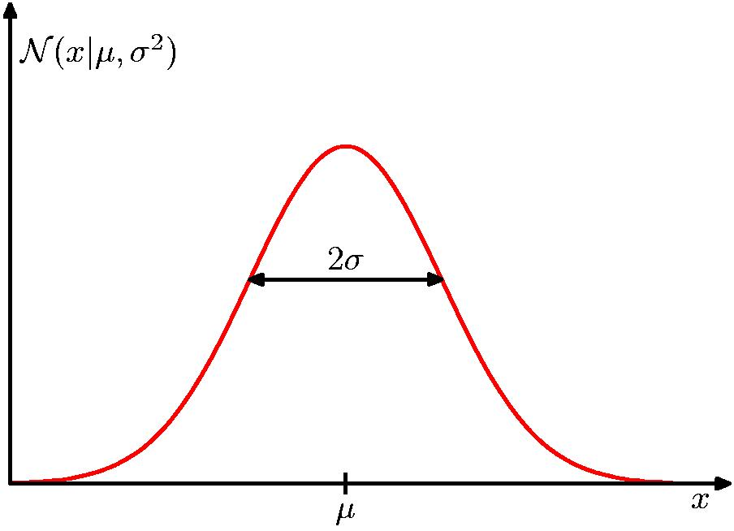
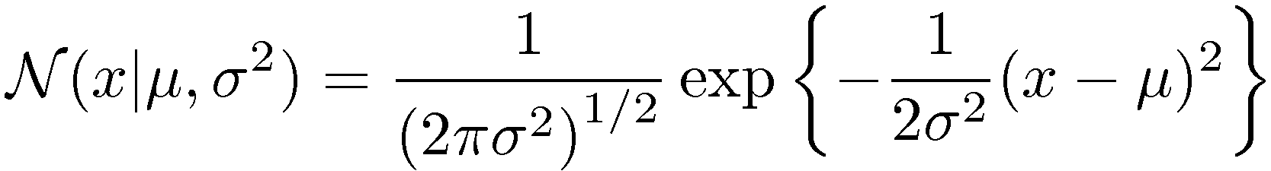
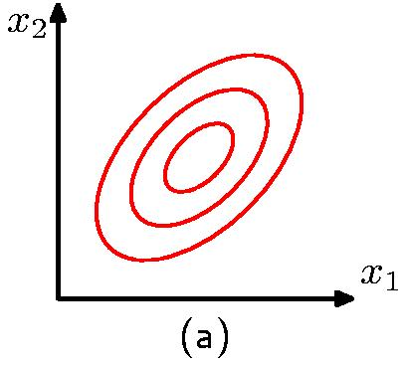
The Gaussian Distribution
Slide from Bishop

Slide 15
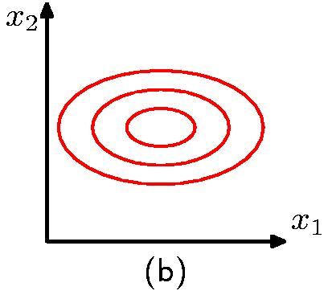
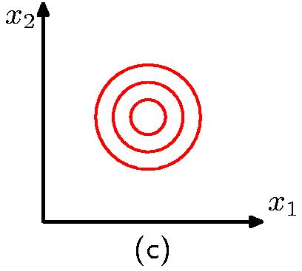
The Gaussian Distribution
Diagonal covariance matrix
Covariance matrix
proportional to the
identity matrix
Slide from Bishop

Slide 16
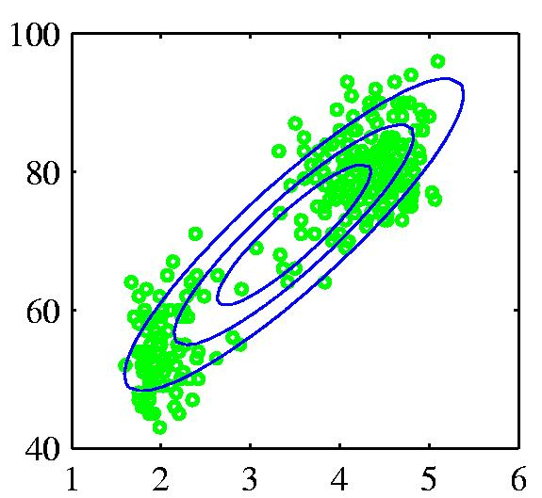
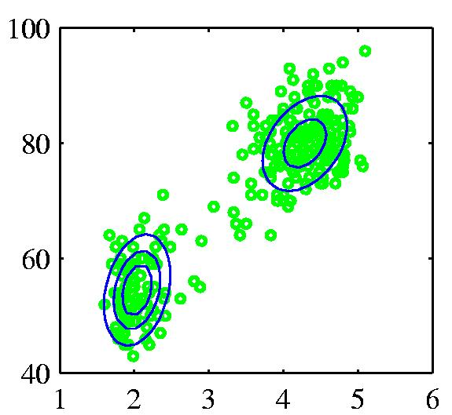
Mixtures of Gaussians (1)
Old Faithful data set
Single Gaussian
Mixture of two Gaussians
Slide from Bishop

Slide 17
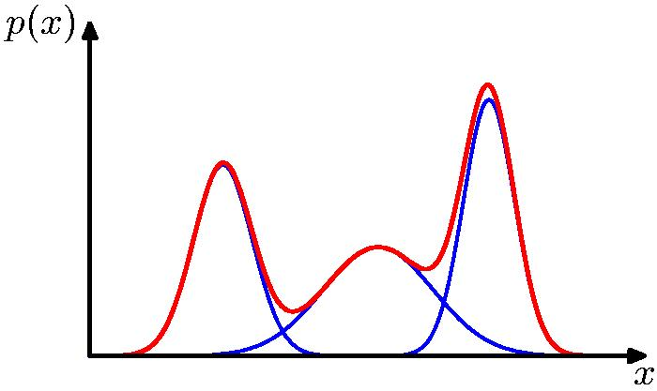
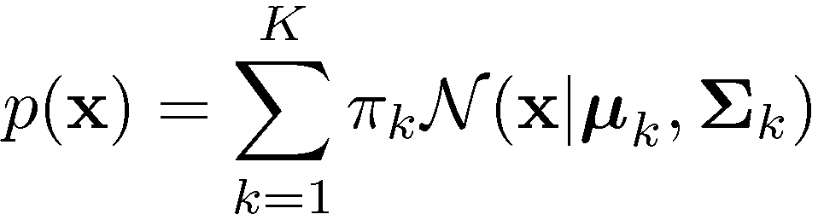
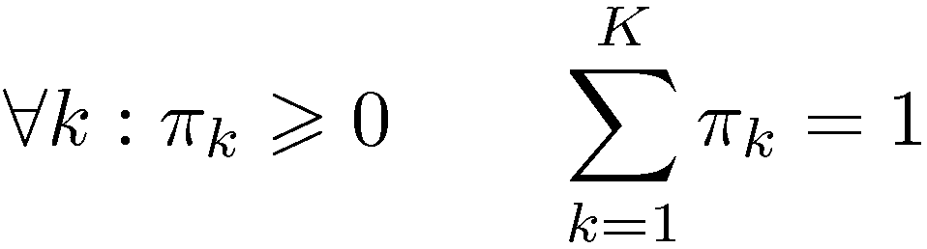
Mixtures of Gaussians (2)
Combine simple models
into a complex model:
Component
Mixing coefficient
K=3
Slide from Bishop

Slide 18
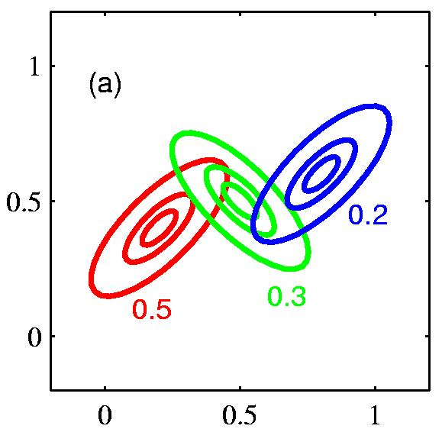
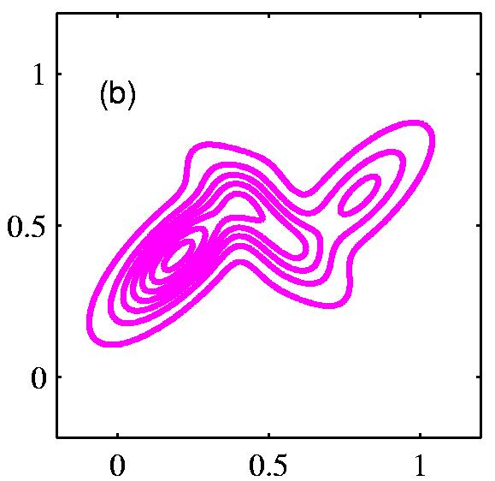
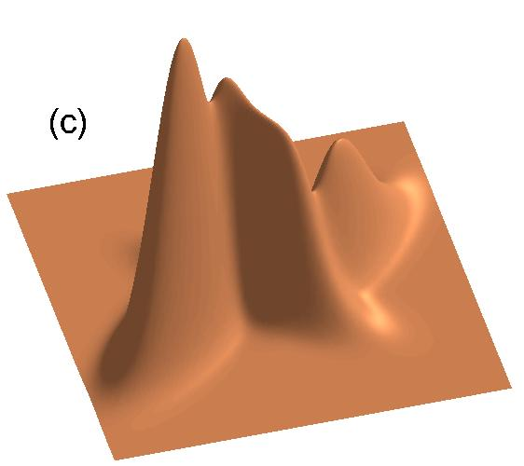
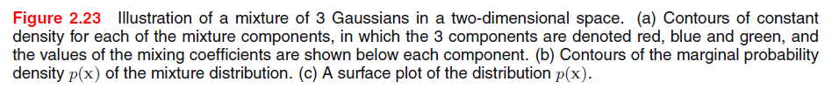
Mixtures of Gaussians (3)
Slide from Bishop

Slide 19
Bayesian Networks
Directed Acyclic Graph (DAG)
  Nodes are random variables
  Edges indicate causal influences
Burglary
Earthquake
Alarm
JohnCalls
MaryCalls
Slide credit: Ray Mooney

Slide 20
Conditional Probability Tables
Each node has a conditional probability table (CPT) that gives the probability of each of its values given every possible combination of values for its parents (conditioning case).
  Roots (sources) of the DAG that have no parents are given prior probabilities.
P(B)
.001
Burglary
Earthquake
P(E)
.002
B | E | P(A)
T | T | .95
T | F | .94
F | T | .29
F | F | .001
Alarm
A | P(J)
T | .90
F | .05
A | P(M)
T | .70
F | .01
JohnCalls
MaryCalls
Slide credit: Ray Mooney

Slide 21

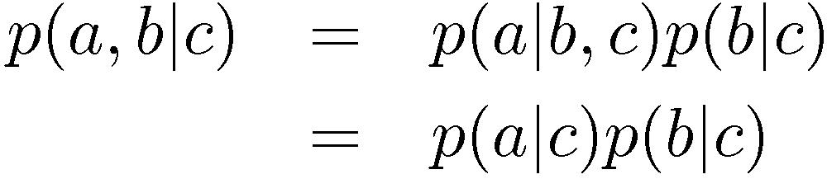

Conditional Independence
a is independent of b given c
Equivalently
Notation
Slide from Bishop

Slide 22
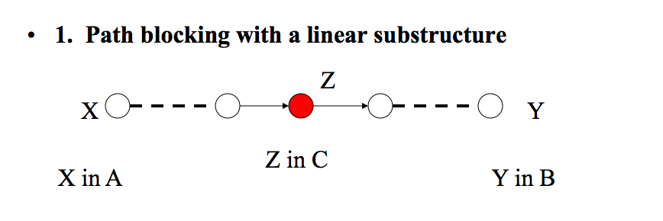
Conditionally independent via D-separation
D-separation in the graph
Let X,Y and Z be three sets of nodes
If X and Y are d-separated by Z then X and Y are conditionally independent give Z
D-separation
A is d-separated from B give C if every undirected path between them is blocked with C
Slide from Milos

Slide 23
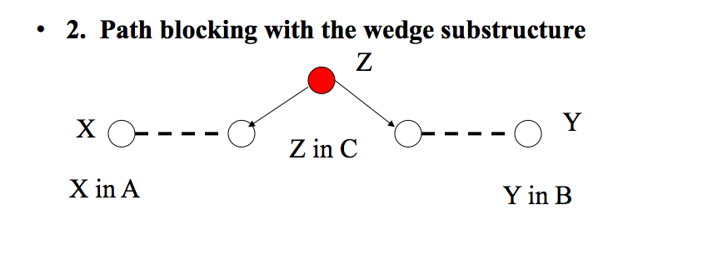
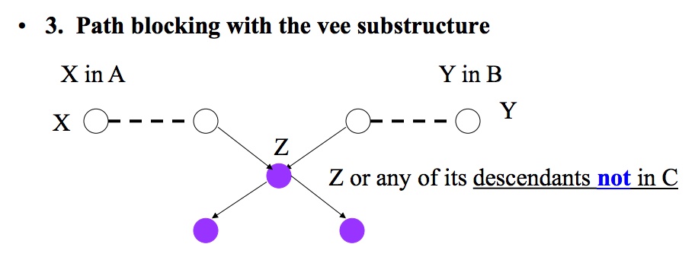
D-separation
Slide from Milos

Slide 24
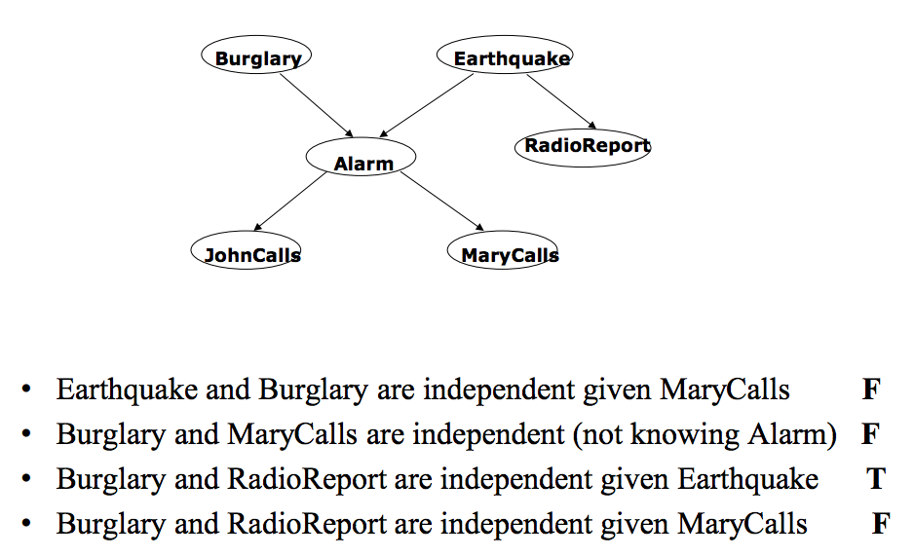
Exercise
Slide from Milos

Slide 25
Naïve Bayes as a Bayes Net
Naïve Bayes is a simple Bayes Net
Y
…
X₁
X₂
X_{n}
Priors P(Y) and conditionals P(X_{i}|Y) for Naïve Bayes provide CPTs for the network.
Slide credit: Ray Mooney

