Slide 1
CS 2001: Research Topics
Publishing: writing, reviewing, rebuttals, presenting
Prof. Adriana Kovashka
University of Pittsburgh
September 22, 2026

Slide 2
Plan for this lecture
Structure of a paper
Writing
  Writing timeline
  Writing style: Consistency, aesthetics, emphasis
  Submission logistics (paper limit, metadata)
  Writing rebuttals
Presenting
  Planning how you present depending on audience
  Oral delivery tips
Reviewing papers

Slide 3
Structure of a Paper

Slide 4
Structure of an 8-page, 2-col Paper
Abstract
Introduction
Related Work
Approach/Method
Validation/Results/Experiments
Conclusion
Acknowledgements
References

Slide 5
Abstract (1 paragraph)
Purpose
Why is this paper interesting?
Why should I spend my time reading this?
What do you claim to do?
Summarize problem being tackled, key innovations, main results
One strategy: write it after rest of paper written
  Caveat: some conferences might want an abstract earlier than the submission deadline
Some text from Adam Lee’s slides

Slide 6
Introduction (1-1.5 page)
Purpose: motivate work, inform reader what is to come
First paragraph: describe problem and state current gap in science, including current methods’ deficiencies
  Also briefly describe motivation: why addressing this particular gap is important, has applications
Second paragraph: state the very high-level idea of your solution to address this gap
Third paragraph: briefly introduce your method
Fourth paragraph: briefly summarize experiments
Fifth paragraph: summarize contributions
Concept figure (Fig. 1): illustrate key idea of the work
Important: sets initial expectations
Some text from Adam Lee’s slides

Slide 7
Related Work (0.5-1 page)
Note: This may also come before Conclusions—tradeoffs?
Purpose: inform reader you are aware of prior results, and demonstrate the novelty of the work
Summarize 15-50 most relevant papers
Organize by rough topic or approach (use paragraph headings but no separate subsections, for space)
Within each paragraph, can describe papers at a course level, e.g. “Some works approach the task by… [ref1, ref2, ref3].”
End each paragraph or group of papers with how proposed method is different
Some text from Adam Lee’s slides

Slide 8
Approach (2.5-3.5 pages)
Purpose: describe novel approach, contribution
Have an introductory paragraph describing an overview of the approach
Make it clear which part of the approach is standard/from prior work, and which part is new/novel/innovative
Common to have 2-5 subsections
Should be detailed enough for others to replicate the work—in ML, common to include a separate “implementation details” section (could also go in appendix/supplementary)
Some text from Adam Lee’s slides

Slide 9
Experiments (2.5-3.5 pages)
Purpose: prove stated contributions are meaningful
Forms: performance measurements, simulation results, analysis of user study data, formal proofs…
Include experimental setup (e.g. data and metrics used, methods tested with names, perhaps in special font setting)
Include one or more results subsections (the outcomes from running the experiments); may want to title each paragraph with the high-level takeaway
Show results in tables and/or figures, and describe/analyze these tables/figures in the text
Explicitly make all the conclusions you want the reviewers to draw from them
May or may not show statistical significance but be prepared to answer questions about it
Some text from Adam Lee’s slides

Slide 10
Conclusion (1 paragraph)
Summarize contributions and findings of the paper, briefly
Acknowledge limitations and briefly suggest future work– no more than 1-2 sentences (may vary by research community)
Some conferences require a standalone Limitations section

Slide 11
Discussion (takes different forms)
May be part of experiments, potentially conclusion
Purpose: papers do not often “close” a topic—this is where you reflect on what has been done, and what is still open
May include: interpretation of results or evaluation, discussion of open problems, description of limitations, etc.
Text from Adam Lee’s slides

Slide 12
Acknowledgements (1 paragraph)
Omit for review due to anonymity
Ask your advisor which funding sources to acknowledge, any particular phrasing to use
Can also thank the anonymous reviewers and area chairs

Slide 13
References
Standard formats for this
Can get bibtex citations for a paper from Google Scholar or DBLP, but may have to fix
If a paper appeared in a conference/journal, don’t cite the arxiv version
Use consistent formatting, e.g. the same conference should use the exact same string including abbreviation for the conference name

Slide 14
Writing a Paper

Slide 15
Getting started
Download conference/journal template
Set up Overleaf.com project directory
Write extended outline
  What will each paragraph say? – summarize with one bullet
  (Show to advisor, iterate based on feedback)
Then fill in details
  Show to advisor, iterate based on feedback

Slide 16
Timeline
You don’t have to wait for all results to be finished before you start writing
  Write parts of intro, including motivation and claims, as early as you have a clear idea—helps you identify the work you still need to prove claims
  Write related work—you might find more relevant baselines, methods to compare to
  Write parts of approach—good way to make sure approach is sound, and your advisor is on the same page
  Write plan for experiments–to help identify what experiments still need to be conducted
Iterating on writing with advisor can take 2-4 weeks for a first-time submission, so leave plenty of time!

Slide 17
Reference management software
Mendeley
EndNote
Zotero
PaperPile
ReadCube Papers

Slide 18
Writing Style
Your advisor may be used to writing papers in a particular way
A certain style may be common in your research community (and not others)
Talk to you advisor about their writing style
Talk to them about their pet peeves
  Pet peeve: “minor annoyance that an individual finds particularly irritating” (Wikipedia)
  These might be about consistency, aesthetics, etc.

Slide 19
Consistency
Strive to describe and run things in a way that is consistent across methods etc.
  Don’t run one method with one set of settings and another with other settings, unless you have a reason
Strive to describe and format text consistently
  Don’t use Capitalization in one section Title but not Another
  Don’t use bold for emphasis in one section and underline for another
  Use the same string for the same conference, not “CVPR” and “32nd CVPR” and “cvpr”

Slide 20
Aesthetics
Make sure tables and figures are legible
  Font large enough
  Colors in lines in figures different enough
Make sure it’s easy to navigate through paper
  Provide section headers, paragraph headers, where appropriate

Slide 21
Emphasis
Writing is a craft—think of yourself as a woodcarver—every detail matters
Avoid sentences (in intro) that are not crucial for the point you’re trying to make—you’re just losing the reader’s attention and an opportunity to emphasize your contribution
Be careful about how you say what you—what is the accent?

Slide 22
Inclusivity
Use neutral pronouns – “they” rather than “he”/”she”
Avoid potentially hurtful terms, e.g. “master and slave”
Consider including examples that a broader audience will find intuitive: do not assume understanding of any particular culture
Use colors everyone will read easily; avoid red/green and blue/purple

Slide 23
Making Paper Fit the Page Limit
Your draft is 10 pages but limit is 8 pages—no problem!
Remove papers from related work that aren’t all that related, or trim your descriptions of them
Read through whole paper, and rephrase sentences as needed to make your narrative more concise, punchier
Revise paragraphs ending in a few words (trailing lines)
Remove unnecessary words and characters
  Examples: “first X and second X” -> “first and second X”, “that”
  Change tense to lose characters, replace subsection headers with paragraph headers, etc. — it’s easy, but it takes practice!
Last resort: use negative vspace, \vspace{-2mm}
  May be disallowed by conference
You will take many passes through your paper, and each time, you’ll find ways you can say it more concisely

Slide 24
Note on Equations
Explain all variables
Explain purpose, idea in English
Refer to equations by name rather than just ID later in the text
https://www.microsoft.com/en-us/research/wp-content/uploads/2016/07/How-to-write-a-great-research-paper.pdf

Slide 25
More from readings: Jones
Don’t wait: write
  Idea -> write -> research
Identify your (one, sharp) key idea
  “infect mind of reader with your idea, like a virus”
  “can you hear the ping?”
Tell a story
Nail your contributions to the mast
  Contributions should be listed, and should be refutable
Related work later
Put readers first
  Present the intuition, examples, then details
Listen to your readers
Use simple, direct language

Slide 26
Common Mistakes in Writing
Starting introduction with platitudes (“deep learning has greatly improved the state of the art…”)
Too long related work, plus not saying what’s different about proposed work
Method mixes standard techniques with novel contribution
Not clear what motivation, key contribution are
Results—unclear where gains in performance come from
Results—focusing just on the negative outcomes—results won’t be perfect, but the question is whether there is evidence that your proposed idea has benefits

Slide 27
Should you get writing help from AI?
Check conference rules
Even if allowed, I strongly recommend doing the writing yourself
Gives you a chance to read and reflect on what you are stating, may offer an opportunity to reframe the work better

Slide 28
Other Paper Submission Logistics
Paper ID (may need to register paper before submission deadline)
Title
Author list and order
Subject areas

Slide 29
Writing Rebuttals: Audience
“We write rebuttals for two different audiences
The reviewers, who have read your paper (to varying degrees), but may have forgotten some of the details or didn’t understand them in the first place.
The AC, who is likely even less familiar with your work, and a good guiding principle is to assume that all they will read is the set of reviews and the rebuttal.”
Source: Devi Parikh et al., https://deviparikh.medium.com/how-we-write-rebuttals-dc84742fece1

Slide 30
Writing Rebuttals: Goals
“1. For the reviewers: clarify doubts, answer questions, correct misunderstandings, push back on mischaracterizations, and make a good-faith effort to incorporate feedback and improve your work.
2. For the AC: convince them that you have made a good-faith effort, present a representative summary of the reviews, help them understand if the reviewer concerns were addressed, call out bad-faith reviewing, and ultimately, help them make a decision.
[…] Would a neutral third-party be able to tell if the reviewer concerns were addressed purely based on your rebuttal (without reading the paper or the reviews again)?”
Source: Devi Parikh et al., https://deviparikh.medium.com/how-we-write-rebuttals-dc84742fece1

Slide 31
Writing Rebuttals: Example Process
Itemize reviewer comments
Brain dump possible responses
Write a draft rebuttal
Review and revise
Source: Devi Parikh et al., https://deviparikh.medium.com/how-we-write-rebuttals-dc84742fece1

Slide 32
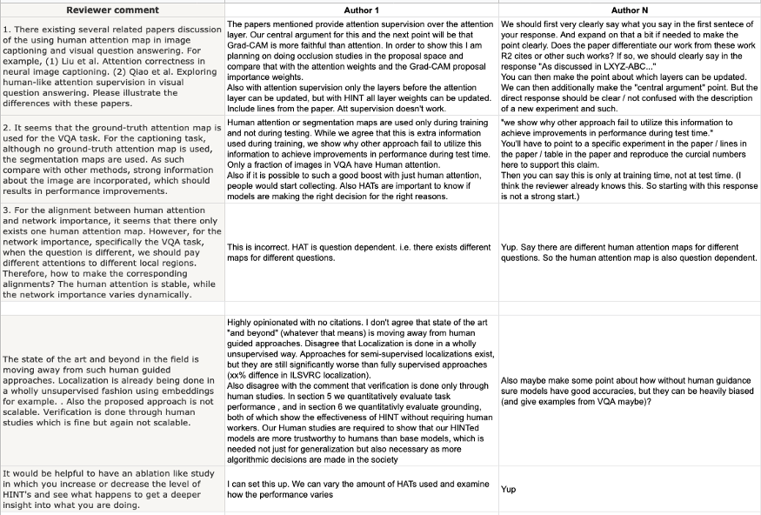
Writing Rebuttals: Example Process
Source: Devi Parikh et al., https://deviparikh.medium.com/how-we-write-rebuttals-dc84742fece1

Slide 33
Writing Rebuttals: Tips
Start positive. Provide a summary of the reviews, highlighting positive things that reviewers said about your work. Rebuttals focus mostly on responding to perceived negatives, don’t let RACs forget about the strengths along the way.
Order matters. Start with the biggest concerns that you have good answers for and work your way to less clear-cut responses and minor points.
Let reviewers speak for themselves, then respond directly. Quote the core of the reviewer’s question or concern concisely and completely. Then before saying anything else, respond to it directly. And then give details, describe context, or explain your position.
Be conversational. Notice the conversational nature of the example responses above. It makes it easier for RACs to follow, and the responses are less likely to be perceived as being combative.
Source: Devi Parikh et al., https://deviparikh.medium.com/how-we-write-rebuttals-dc84742fece1

Slide 34
Writing Rebuttals: Tips
Respond to the intent of the questions. Don’t feel trapped to only discuss the quoted concern — also address the intent of the comment. For example, “Why didn’t you evaluate on GLORP3?” may generally be calling your experiments into question. Answer, but then point out that you’ve already evaluated on X,Y, and Z which should be sufficient! Note that it is useful for other RACs to be reminded of your extensive experimental evaluation. A first glance at a reviewer comment suggesting otherwise could leave a false impression.
Don’t be afraid of emphasis. “Row 2 in Table 4 shows exactly that.” “We do NOT need a human-in-the-loop at test time.” Notice that many of the responses above are not just direct, but also have emphasis (in tone if not formatting of text).
Feel free to set the stage. If it seems like all reviewers missed a central point, a concise, crisp recap of the main point could help.
Keep things self-contained. Assume RACs don’t remember much about your paper and that they likely won’t read it again in detail. Re-introduce any acronyms, remind them of relevant details of an experimental setup. Notice that all the responses above likely make sense to you even though you may be unfamiliar with the papers (and in some cases the names and details are made up).
Source: Devi Parikh et al., https://deviparikh.medium.com/how-we-write-rebuttals-dc84742fece1

Slide 35
Writing Rebuttals: Tips
But get credit for details you already included. That said, if something a reviewer asked for was already in the paper, say so. Give them line/Table/Figure numbers, and then restate it in the rebuttal. The references back to the main paper are to establish credibility with all RACs that the paper was not lacking important details. (They are not necessarily to have RACs go back and look at the paper.)
Consolidate common concerns. Save space by responding to multiple reviewers at once if they share related concerns.
Color-code reviewers. Notice above the trick to color-code reviewers. Make it as easy as possible for reviewers to spot responses that are relevant to them — even when things are merged or not in reviewer order.
Stats speak louder than words. Rather than argue with RACs, give them data/stats to back your claim up. These can be statistics/analysis of your data or results. Or the results of additional experiments you run to respond to their concern (if allowed by the venue). Every time you find yourself having a different opinion than the reviewer, ask if you can establish that with data. You can always provide the intuitive arguments after you’ve settled the issue with data.
Source: Devi Parikh et al., https://deviparikh.medium.com/how-we-write-rebuttals-dc84742fece1

Slide 36
Writing Rebuttals: Tips
Don’t promise, do. Instead of saying “We will discuss Singh et al. in the paper.”, provide a discussion in the rebuttal. Instead of saying “We will explain what D_{RT} stands for in the paper”, explain what it stands for in the rebuttal. And then also add that you will add it to the paper. It makes it significantly easier for RACs to trust that you will make the promised changes.
Be receptive and reasonable. Most RACs will appreciate it. Plus, it is just the better thing to do — these are your colleagues! :)
Be transparent. Reviewers hinted at an additional experiment but the venue doesn’t allow it? Say so. They asked about intuitions about a trend but you don’t have any? Say that you’ve thought about it but don’t have any good ideas, and will continue to investigate it. Don’t have enough GPUs to run the experiment they asked for? Say so.
Shine a spotlight on reviewers acting in bad-faith. In some circumstances, a reviewer may not be adhering to reviewing best practices or may not have taken the reviewing role seriously. It can be important to make sure the other RACs realize this and appropriately discount their review. Pointing out unreasonable or unsubstantiated comments and referencing other reviewers that disagree can help. This can also include confidential comments to the AC (where applicable).
Source: Devi Parikh et al., https://deviparikh.medium.com/how-we-write-rebuttals-dc84742fece1

Slide 37
Writing Rebuttals: Tips
Acknowledge reviewer efforts. On the other hand, if a reviewer goes above and beyond to be constructive, thank them for it. Typo list? Thank you. Pointers to relevant work? Thank you. Detailed musings about future work? Thank you. Add at least a short blurb acknowledging these things!
Don’t forget the humans on the other end. Keep in mind that this is not just a scientific but a sociopolitical interaction with other humans :) So decide whether you’d like to be argumentative and risk your reviewer taking a strong stand against the paper, or if you’d like to work towards a common ground. Finding points where you do agree with the reviewer and acknowledging them can help with the latter.
Source: Devi Parikh et al., https://deviparikh.medium.com/how-we-write-rebuttals-dc84742fece1

Slide 38
Presenting

Slide 39
Some Guidelines
Consider the audience & event
Structure based on audience and time
How you say it matters
Don’t bury the lead
Be concise
Give credit
Q&A: the unknown unknowns
Delivery tips
Clear slides
Slide credit: Kristen Grauman, Adam Lee

Slide 40
Consider Audience and Event
Your group meeting?
CVPR?
Job talk to entire CS department?
Interdisciplinary?
K-12?
Formal? Casual?
Degree of detail
Degree of jargon
Depth vs. breadth
Latest vs. arc of progress
Slide credit: Kristen Grauman

Slide 41


Structure based on Audience and Time
Your audience: Generally smart individuals
Computer Scientists? Yes
In your area? Maybe
Knowledgeable about your problem? Probably not
Time is usually limited
Conference talk: 20 minutes or so
Job talk: < 1 hour
This is not a lot of time…
Bottom line: Your talk should be an advertisement for your paper(s)
Slide credit: Adam Lee

Slide 42





Structure based on Audience and Time
This is a hard
problem…
… with interesting
applications…
… that builds on
prior work…
… in a verifiable
way
Two sub-parts:
You do something that has not
been done
You use neat technological advancements to do this
Hint: Try to give audience one good take-home point
Slide credit: Adam Lee

Slide 43



How You Say It Matters
Body language says a lot
Make eye contact with your audience
Corollary: Face your audience
Some movement is good
Don’t speak too fast (or too slow!)
Make useful slides
  Provide a topic outline to structure your talk
  One primary idea per slide
  Use slide titles to convey take-away message
  Do not read your slides!
  A picture is worth a thousand words…
Slide credit: Adam Lee

Slide 44
Don’t Bury the Lead
Problem
Our idea
Don’t leave contribution implicit
Reiterate and rephrase message throughout
Verbally: give salient markers; “Important”…”stress that”...
“Punchlines” for results
Slide credit: Kristen Grauman

Slide 45
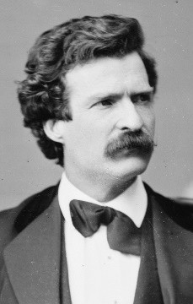
Be Concise
“I didn't have time to write a short letter, so I wrote a long one instead.”
— Mark Twain
Prep the “concept bullets”
Breathe, and use fewer words
Short text phrases (not sentences)
Not every detail needs to surface
https://en.wikipedia.org/wiki/Mark_Twain
Slide credit: Kristen Grauman

Slide 46
Give Credit
Paint the big picture of literature for context
(Clusters of) related work & key contrasts
Give credit for borrowed slides, per slide
[Slide credit: Jane Smith]
Slide credit: Kristen Grauman

Slide 47

Q&A: The Unknown Unknowns
Guess likely questions & prepare
Don’t skip to backup slides unless necessary
Sometimes it’s better to defer a question
Answer, then stop
Share feedback with co-authors afterwards
https://duffylondon.com/product/tables/abyss-horizon/
Slide credit: Kristen Grauman

Slide 48

Delivery Tips
Practice and get feedback; iterate
The first slide - what will you say?
Be loud enough
Use pauses
Flow: think through transition in and out of each slide
Qualitative examples: say something about one or two
Manage time: stopwatch, prevent derail
If you’re skipping something, then skip it
Think about where you want to stand / test the room
Check the laptop, AV
Nerves: “If you’re nervous, it means you care” ~Trevor Darrell
https://www.ted.com/playlists/497/practice_makes_perfect
Slide credit: Kristen Grauman

Slide 49

Carefully Done Slides…
… reduce cognitive load:
Animation – to focus attention
Font size – 28+ for main text
Simplest visual possible to make the point
Consistency: font size, capitalization, alignment…
Avoid jitter of text placement in consecutive slides
One liners where possible
Use color to link pieces of equations
Delete “Hi my name is …” from notes of first slide!
Avoid content-free “Thank you!” slide
Slide credit: Kristen Grauman

Slide 50
More Tips and Tricks
Practice makes better
Alone: Work on your “script,” smooth out transitions
Research group: Get used to other people being around
Broader population: Assess comprehensibility to outsiders
e.g., other grad student friends, department
seminars, etc…
Do you really want that laser pointer?
“Flash” is good, but too much flash is distracting
Good: Animations to progressively build large diagrams or equations
Bad: Animating every slide transition and every line of text…
Get out of your head and into your talk ☺
Slide credit: Adam Lee

Slide 51
Example: A Mediocre Talk

Slide 52
Towards Quantitative Analysis of Proofs of Authorization: Applications, Framework, and Techniques
Adam J. Lee (University of Pittsburgh) Ting Yu (North Carolina State University)
Slide credit: Adam Lee

Slide 53
Proofs of Authorization
Trust management systems are used for access control in open systems
Logical proofs are constructed at runtime to determine whether a given principal is allowed to access some specific resource
Rather than simply interpreting a proof as a binary decision, we aim to analyze these proofs in a more quantitative manner
Slide credit: Adam Lee

Slide 54
Framework
Conceptually, a trust management system contains
A set P of principals
A set S of resources
A set C of credentials that make policy statements
  Abstraction: s <- q, signed by p
    P says that anyone that satisfies q can access s
    P must control s
An inference scheme F : P x S x 2^{C} -> {true, false}
Slide credit: Adam Lee

Slide 55
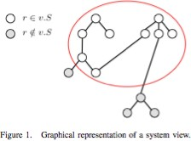
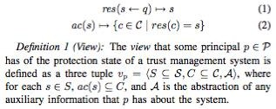
Views
We assume principals have some view of the system.
This allows us to define proof scoring functions, score: P x S x V -> T
Slide credit: Adam Lee

Slide 56
Properties of Scoring Functions
Required Properties
Deterministic
Simple ordering
  F(A,s,C)=T ⋀ F(B,x,C)=F → score(A,s,v) > score(B,s,v)
Authorization relevant
Optional Properties
Interpretable
Bounded
Monotonic
Slide credit: Adam Lee

Slide 57
Overview of RT₀
Basics
Public keys identify users
Roles group users
Four types of rules
Simple member: A.R <- B
Simple containment: A.R <- B.R’
Linking containment: A.R <- A.R1.R2
Intersection containment: A.R <- B₁.R₁ ∩ … ∩ B_{n}.R_{n}
Policies built up using combinations of these rules
Slide credit: Adam Lee

Slide 58
Scoring Functions: Take 1
Assumptions
  Simplified model
  User designing function only knows about A.R
    Knows all rules defining A.R
    Understands semantics of every role “used” in these
rules
  Each credential associated with a vector w_{i}
    All entries > 0
    ||w_{i}||₁ = 1
Slide credit: Adam Lee

Slide 59
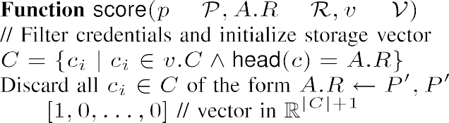
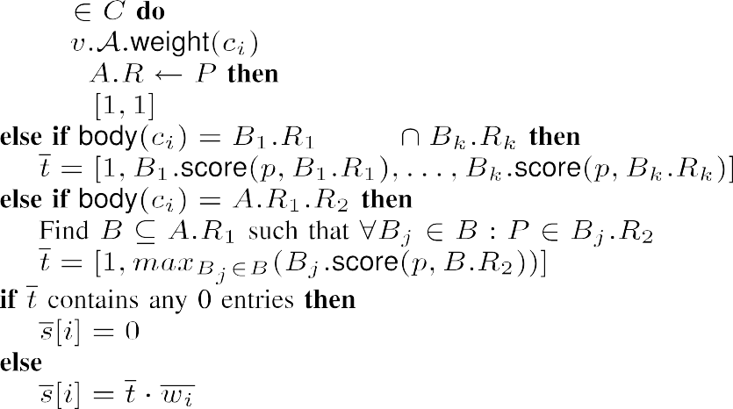


Scoring Functions: Take 1
Slide credit: Adam Lee

Slide 60
















Scoring Functions: Take 1
Proof sketch:
Deterministic: Obvious
Simple ordering: Members scored with a positive value, non- members not scored (Line 16)
Authorization relevant: Only credentials defining A.R used when
computing a score (Line 3)
Bounded: ||w_{i}||₁ = 1 for all credentials c_{i}, so bounded above by
  All entries in each w_{i} > 0, so bounded below by 0.
Monotonic: No negative entries in any w_{i}, so score can never
decrease by getting more information
Slide credit: Adam Lee

Slide 61
Scoring Functions: Take 2
Assumptions
  More general system model
  User knows nothing about policies
    Structural information is discovered at runtime
    Like RT, SecPAL, Gray, etc.
Basic idea: Compute score based on number of ways that a policy can be satisfied
Slide credit: Adam Lee

Slide 62





























Scoring Functions: Take 2
Weighting functions ω : 2^{C} x 2^{2C} -> [0,1] weight the contribution of each proof
Slide credit: Adam Lee

Slide 63
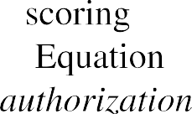



Scoring Functions: Take 2
Proof sketch
  Deterministic: ω is deterministic, so score is too
  Simple ordering: Same as function #1
  Authorization relevant: trivial by def’n of proofs of
authorization
  Bounded: Based on geometric series in score converging to 1 when summed infinitely
Slide credit: Adam Lee

Slide 64
Scoring Functions: Take 2
Proof Sketch (cont)
Monotonic. To prove the monotonicity of Equation 6, we proceed by induction. We ﬁrst assume that principal p has previously discovered the (ordered) collection of proofs and weights (C₁, w₁),. .., (C_{n} , w_{n} ) for the role A.R. The base case that we must consider is that a new pair (C_{s}, w_{s} ) is discovered such that no weight w_{i} is less than w_{s} . In this case, this new pair will introduce a new term to the end of the summation calculated by Equation 6, thereby increasing principal p’s score for the role A.R.
Assume that (C_{s}, w_{s} ) can be inserted before up
to n terms in the sequence of (c_{i} , w_{i} ) pairs while still preserving the monotonicity requirement. Now, assume that p has previously found proofs of au- thorization with the sequence of weights S = (C₁, w₁),. .., (C_{i} , w_{i} ),. .., (C_{i + n} , w_{i + n} ) and has now discovered a (C_{s}, w_{s} ) pair such that w_{s} > w_{i} , thereby needing to be inserted before n + 1 terms in the sequence S. We ﬁrst note that replacing (C_{i} , w_{i} ) with (C_{s}, w) will generate a sequence S that—when used in conjunction with Equation 6—will produce a score greater than that produced using S, since w_{s} > w_{i} and all other terms are the same. By the inductive hypothesis, (C_{i} , w_{i} ) can then be re-inserted before the n ﬁnal terms of S while still preserving monotonicity.
Slide credit: Adam Lee

Slide 65








































Composing Scoring Functions
Motivation
Perfect information known within a security domain
Less information known outside of security domain
r ∈ v.S r ∈/ v.S
Slide credit: Adam Lee

Slide 66

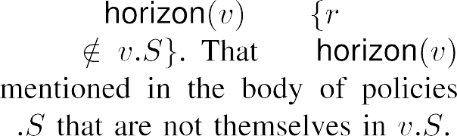


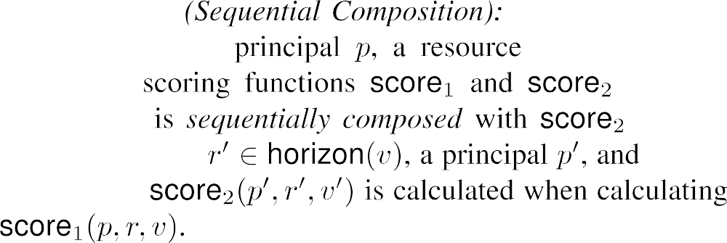









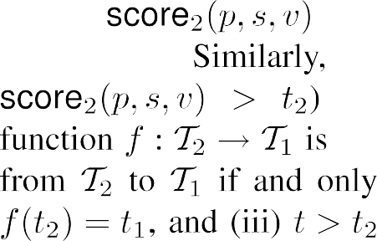



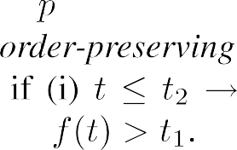

Definitions
Slide credit: Adam Lee

Slide 67








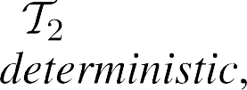


























Composition Theorem
Slide credit: Adam Lee

Slide 68
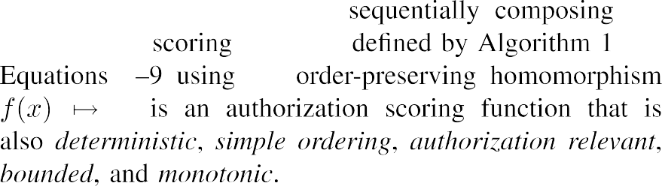



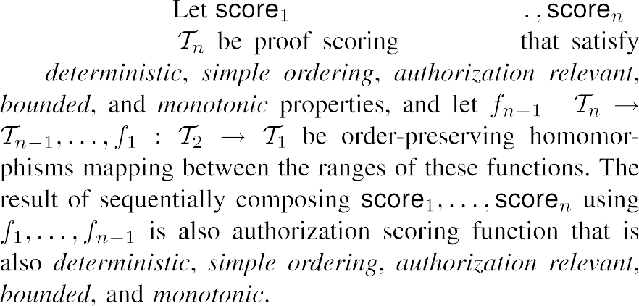
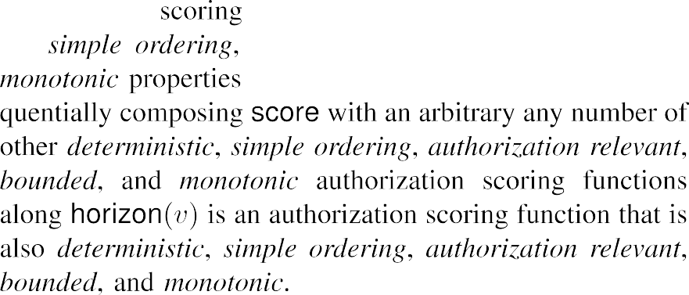
Neat Corollaries
Arbitrary composition along horizon
Arbitrary depth of composition
Slide credit: Adam Lee

Slide 69




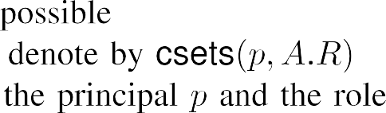



















Scoring Functions: Take 3
Preliminaries
Slide credit: Adam Lee

Slide 70








Scoring Functions: Take 3
Goal: Score role membership, as well as non-membership
Membership: Obvious reasons
Non-membership: Approximate pricing
Slide credit: Adam Lee

Slide 71























Scoring Functions: Take 3
Proof is similar to previous case
Interesting observation: Meets properties needed by composition theorem
Slide credit: Adam Lee

Slide 72
Conclusions
Proofs have a lot more information than the binary yes/no decision that we use them for
We developed a formal framework for scoring these proofs of authorization
Cases explored
  Perfect information a priori
  No information a priori
  Arbitrary combinations
  Incomplete proofs
Slide credit: Adam Lee

Slide 73
What was Wrong with this Talk?
Issues with content:
Why should we care about the problem?
How will the results be useful in practice?
Had no idea where talk was going!
Missing context to understand problem setup
Issues with delivery:
Lack of eye contact
Lecturing to the board/laptop, not the audience
Blurry fonts
Too much text
…
Slide credit: Adam Lee

Slide 74
Example: A Better Talk

Slide 75

Towards Quantitative Analysis of Proofs of Authorization: Applications, Framework, and Techniques
Adam J. Lee adamlee@cs.pitt.edu Department of Computer Science University of Pittsburgh
Ting Yu
yu@csc.ncsu.edu Department of Computer Science North Carolina State University
Slide credit: Adam Lee

Slide 76








Like most access control systems, distributed proof construction
systems are typically used to support binary decisions
Example: Access to a company database
Acme.Access ← Acme.Mgr ✔
✔
Acme.Access ← Acme.PMgr.Asst
Acme.Mgr← Alice
Acme.PMgr← Acme.POrg.Mgr
Bob.Asst← Chuck
Alice
Acme.POrg← MegaCorp
MegaCorp.Mgr← Bob
Mega Corp
Bob
Chuck
Note that…
Both proofs are valid
The first proof is far simpler than the second
Why focus only on the destination (validity)? What about the journey (context)?
Slide credit: Adam Lee

Slide 77




Proofs of authorization reveal a great deal of information about
the conditions under which some access was granted
Authorization robustness
How many proofs can some user generate?
Are these proofs concise, or do they use odd delegations?
How dependent on system state are these proofs?
Applications: Anomaly detection, policy audit
vs.
User-to-user comparison
Policies are requirements
How well do various individuals
satisfy them?
Applications: Top-k analysis, group formation
Examination of incomplete proofs
Policies aren’t always perfect…
How close is an unauthorized user
to accessing a resource?
Applications: Risk assessment, policy revision
Slide credit: Adam Lee

Slide 78
What are we not doing?
Point-based access control & trust management
E.g., Yao et al. 2006
Privacy-preserving compliance checking of point-based policies
Reputation-based trust management
E.g., Kamvar et al. 2003, Xiong and Liu 2003, Josang et al. 2007
Aggregation-based trust, different than credential-based proofs
Risk-based access control
E.g., MITRE 2003, Aziz et al. 2006, Cheng et al. 2007
More on this later…
Reasoning under uncertain information
E.g., Dempster 1976, Shafer 1976, Cox 2004
Focus is on uncertain information and/or inference rules
Slide credit: Adam Lee

Slide 79
Talk Outline
Model for quantitative proof analysis
Proof scoring functions
  Desiderata
  An example scoring construction
  Functional composition
Scoring incomplete proofs of authorization
(Lots of) future directions
Slide credit: Adam Lee

Slide 80

RT₀ is the simplest language in the RT family
Principals are represented by public keys
Policies are constructed using four basic types of assertion
Simple membership: Alice.Friend ← Bob
Bob is a member of Alice’s “Friend” role
Simple containment: Acme.Contractor ← WidgetTech.Employee
WidgetTech employees are “Contractors” at Acme
Intersection containment: Tech.Disct ← StateU.Student ∩ IEEE.member
Students at Univ who are IEEE members are eligible for a discount
Linking containment: Acme.PMgr← Acme.POrg.Mgr
Members of the “Mgr” role defined by any member of “Acme.POrg” are members of Acme’s “PMgr” role
Slide credit: Adam Lee

Slide 81
































Modeling Authorization Scoring Functions
An RT₀ trust management system consists of:
A set P of principals
A set R of roles/resources
A set C of credentials
Very large…
An inference scheme F : P × R × 2^{C} → {True, False}
Each principal has their own view of the system
A set R ⊆ R for which they have complete knowledge
A set C ⊆ C of credentials
ac(r) ≡ { c ∈ C | head(c) = r }
∀ r ∈ R : ac(r) ⊆ C
A store of auxiliary information A
Ignored in this talk, see paper for details
r ∈ v.R
r’ ∉ v.R
Proofs are scored relative to some principal’s view
score : P × R × V → T
Slide credit: Adam Lee

Slide 82
What properties should a proof scoring function have?
Necessary properties ensure that proof scores “make sense”
Deterministic
Simple ordering:
∀ v ∈ V : F(p₁, r, v.C) 𝖠 ¬F(p₂, r, v.C) → score(p₁, r, v) ≥ score(p₂, r, v)
Authorization relevant:
if F(p, r, C) = True, then C is a proof for p to access r
if F(p, r, C’) = False for all C’ ⊂ C, C is a minimal proof
Only credentials belonging to some minimal proof influence score
Desirable properties are beneficial, but not strictly necessary
Bounded: ∃ b₁, b₂ : ∀ p, r, v : b₁ ≤ score(p, r, v) ≤ b₂
Monotonic: v ⊆ v’ → score(p, r, v) ≤ score(p, r, v’)
What might some interesting classes of authorization scoring functions look like?
Slide credit: Adam Lee

Slide 83


Scoring proofs generated with incomplete views
Assumption: Principals start with empty views and discover
minimal proofs of authorization at runtime
Credential chain discovery in RT
Distributed proof construction in, e.g., Grey or Cassandra
Etc.
Let sets(C, r) represent the minimal proofs for r contained in C One simple scoring construction is the following:
This function:
Defines robustness as the number of proofs that a principal can generate
Exponentially decays the contribution of proofs as they are discovered
Slide credit: Adam Lee

Slide 84
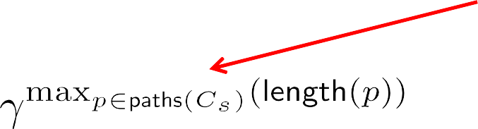
















This simple notion of robustness is not very exciting, but can easily be tuned
Consider a function that weights a minimal
proof (possibly) by comparing it with other minimal proofs
Prefer limited delegation
Examples:
●
Prefer simple structure
●
●
Linear combinations of the above
Prefer multiple, largely
independent proofs
Our scoring construction can then be rewritten as:
Slide credit: Adam Lee

Slide 85
Example, Redux
✔
Acme.Access ← Acme.PMgr.Asst
Acme.Access ← Acme.Mgr ✔
Acme.PMgr← Acme.POrg.Mgr
Bob.Asst← Chuck
Acme.Mgr← Alice
Acme.POrg← MegaCorp
MegaCorp.Mgr← Bob
Alice
Mega
Corp
Bob
Chuck
Using ω_{len}:
score(Alice, Acme.Access, v₁) = 0.365
score(Chuck, Acme.Access, v₂) = 0.328
Using ω_{card}:
score(Alice, Acme.Access, v₁) = 0.365
score(Chuck, Acme.Access, v₂) = 0.215
Note that ω_{ind} is irrelevant in this case…
Slide credit: Adam Lee

Slide 86



This proof scoring function satisfies our desiderata
Theorem: Provided that the function ω used to parameterize
osets is deterministic, the authorization scoring function
satisfies the deterministic, simple ordering, authorization relevant, bounded, and monotonic properties.
The above scoring function
is certainly not the only such authorization scoring function
may not be the best scoring function for all situations
may only be sensible to use on certain parts of a proof
However, it is an interesting building block…
Slide credit: Adam Lee

Slide 87
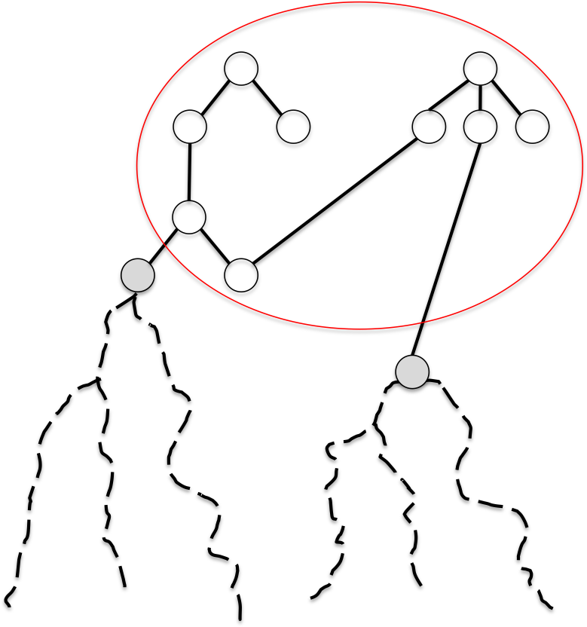
In many situations, defining the proof scoring function to use could be a difficult task
Example: Security administrators within an organization
Perfect information within domain
Exact knowledge of resource/role semantics
Very precise weighting and analysis
Hand-tuned scoring is possible
On-demand information outside of domain
Known semantics for horizon resources
Full semantic knowledge of proof is unlikely
Structure is discovered at runtime
Under what circumstances can good “building block” functions be composed to construct proof scoring functions while still preserving the properties of each building block?
Slide credit: Adam Lee

Slide 88

Fortunately, reasonable proof scoring functions maintain their
properties under sequential composition
Definition: Assume that we have
Principals p and p’
Resources r and r’
Views v and v’
Functions score and score’
horizon(v)
We say that score is sequentially composed with score’ if r’ ∈ horizon(v) and score’(p’, r’, v’) is calculated when calculating score(p, r, v).
Theorem*: Let score₁ : P × S × V → T and score₂ : P × S × V → T be two authorization scoring functions that satisfy the deterministic, simple ordering, authorization relevant, bounded, and monotonic properties. The sequential composition of these functions also satisfies the deterministic, simple ordering, authorization relevant, bounded, and monotonic properties.
Slide credit: Adam Lee

Slide 89
So far, we have focused on scoring complete
proofs of authorization
If a policy is out of date or incomplete, users who should be able
to do something might not be able to
Risk-based access control is one approach to limiting inflexibility
Place a (typically monetary) cap on the amount of risk/damage permissible
Tokenize this risk/damage and distributed it to users
Compute “risk prices” for every resource in the system
If users can pay the access price, they are permitted access
While this would be significantly more flexible than policy-based approaches, pricing access to individual resources is non-trivial
Alternate approach: Rather than pricing resources per user for
every user, price deviations from expected policies
Slide credit: Adam Lee

Slide 90
To price deviations from an expected policy, we first need to be
able to quantify the degree of these deviations
A natural generalization of our framework provides one approach
for doing exactly this
Step 1: Find the canonical proofs of authorization for the resource
All minimal sets of credentials C such that F(p, r, C) = True
Note: These credentials may not all be materialized in the system
Call the result csets(p, r)
Note: The RT credential chain discovery process does this for us
Step 2: Find partial matches between v.C and csets(p, r)
psets(p, r, v) = {(C_{p}, C_{c}) | C_{c} ∈ csets(p, r) 𝖠 C_{p} = v.C ∩ C_{c} 𝖠 C_{p} ≠ C_{c}}
Step 3: Evaluate the quality of each partial match
leaves(C) = { c ∈ C | c of the form r ← p }
ψ(C_{p}, C_{c}) = |leaves(C_{p} ∩ C_{c})| / |leaves(C_{c})|
opsets(p, r, v) = { (w, C_{p}, C_{c}) | (C_{p}, C_{c}) ∈ psets(p, r, v) 𝖠 w = ψ(C_{p}, C_{c}) }
Slide credit: Adam Lee

Slide 91





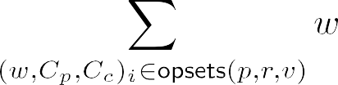
Step 4: Tying it all together
Ensures non-member scores always below 1
Score complete proofs…
…and partial proofs
Note: This function satisfies the deterministic, simple ordering, authorization relevant, bounded, and monotonic properties
Due to our composition theorem, this function can act as a template function that can be sequentially composed with other reasonable authorization scoring functions
Slide credit: Adam Lee

Slide 92



This work is just a first step…
Question 1: These types of scoring functions seem sensible, but do
they make sense in the context of real policies?
Medicine
Academic Departments
Defense
Question 2: RT₀ is a very simple language. What would scoring constructions for more feature-rich languages look like?
Credentials with internal structure (e.g., RT₁)
Flexible rule structure (e.g., SecPAL, Grey)
Reasoning over aggregates like reputation (e.g., CTM, WBSNs)
…
Slide credit: Adam Lee

Slide 93


Efficiency and functional extensions…
Question 3: How can we efficiently construct cost-minimizing
approximate proofs of authorization?
Can we prune the state-space as we search?
Applications to risk-based access control
Question 4: How can we efficiently execute top-k queries over (distributed) authorization datasets?
Group formation
Evaluating Policy Utilization
Slide credit: Adam Lee

Slide 94
Conclusions
Interesting applications of reasoning about proofs of authorization
User-to-user ranking of proofs
User-to-ideal assessment of proof quality/robustness/etc.
Understanding the changing needs of an organization
Risk-aware authorization reasoning
…
Our goals for this initial work
Develop a formal model for proof scoring
Identify necessary and desirable criteria for scoring functions
Demonstrate that these criteria are attainable in practice
Understand the situations in which scoring functions can be composed
There is still much to be done…
Slide credit: Adam Lee

Slide 95



Thank you!
Towards Quantitative Analysis of Proofs of Authorization:
Applications, Framework, and Techniques
Adam J. Lee adamlee@cs.pitt.edu Department of Computer Science University of Pittsburgh
Ting Yu
yu@csc.ncsu.edu Department of Computer Science North Carolina State University
Slide credit: Adam Lee

Slide 96
Why was this better?

Slide 97
How to Review Papers

Slide 98
Why Review Papers?
Reason 1: Testing your own comprehension
Noting contributions, significance, strengths, and weaknesses
Identifying promising areas for future work
Reason 2: Group meetings / reading groups
Similar to above, but to promote discussion within group
Reason 3: Related work in your papers
Can be thought of as very concise paper reviews
Summarize main technical points, compare/contrast with your work
Reason 4: Conference and journal reviews
Peer review is used to judge the merit of scientific papers
Reviews influence accept/reject decision and author revisions
Slide credit: Adam Lee

Slide 99
Purpose of a Conference Review
A conference paper review serves many purposes:
Synthesizes the reviewer’s understanding of the paper
Communicates the reviewer’s thoughts about the paper to other
PC members and the PC chair
Partially documents the PC’s decision to accept/reject the paper
Provides guidance to the authors regarding possible (or mandatory!) improvements to their work
As a result, the review is important at all stages of the process
Bottom line: A paper review should not be a book report!
Slide credit: Adam Lee

Slide 100
Example Review Questions (ICCV’21)
[Summary] In 3-5 sentences, describe the key ideas, experiments, and their significance.
[Strengths] What are the strengths of the paper? Clearly explain why these aspects of the paper are valuable.
[Weaknesses] What are the weaknesses of the paper? Clearly explain why these aspects of the paper are weak. Please make the comments very concrete based on facts (e.g. list relevant citations if you feel the ideas are not novel). If applicable, please indicate key issues and questions which, if well addressed during the 1-page rebuttal, might influence you to change your rating.
[Overall rating] Paper rating (pre-rebuttal)
  Strong Accept / Weak Accept / Borderline / Weak Reject / Strong Reject
[Detailed comments] Additional comments regarding the paper (e.g. typos, any suggestions to make the submission stronger).
[Reproducibility] Is the method described in this paper reproducible?
[Confidence] Reviewer's confidence in his/her recommendation
Please provide an "Overall Rating", following the rebuttal and reviewers discussions.
  Strong Accept / Accept / Leaning to Accept / Learning to Reject / Reject / Strong Reject
Justification of final rating. Describe the rationale for your final rating, including notes based on the rebuttal, discussion, and other reviews.

Slide 101

Structure of a Paper Review
Content:
Very short (1-2 paragraphs)
Overview of the paper
Purpose:
It provides the reviewer with context for the review
It allows the PC chair to get a
quick synopsis of the paper
It convinces the author that the reviewer read and understands the paper
Technical summary Description of contributions Major critiques
Strengths
Weaknesses
Questions
Minor points Concluding remarks
Slide credit: Adam Lee

Slide 102

Structure of a Paper Review
Content:
Very short (1-2 paragraphs)
Quick summary of the novel
aspects of the paper
Purpose:
Novelty is paramount! This provides evidence for the final accept/reject decision
Again, it convinces the author that the reviewer understands the novelty of their contribution
It sets the stage for detailed critiques
Technical summary Description of contributions Major critiques
Strengths
Weaknesses
Questions
Minor points Concluding remarks
Slide credit: Adam Lee

Slide 103
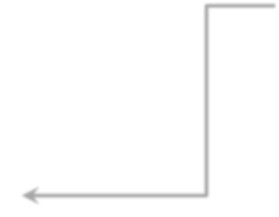

Structure of a Paper Review
Content:
Technical and/or methodological
strengths and weaknesses
Examples:
How interesting is the problem? Novel proof techniques or solutions Missing related work
Assessment of the (in)completeness of the evaluation
…
Purpose:
Primary assessment of the paper
Do the authors bring something of intellectual value to the table?
Is the paper somewhat incremental, but well executed?
Does the paper have fatal flaws?
Typically, this provides fodder for
discussion at the PC meeting
Technical summary Description of contributions Major critiques
Strengths
Weaknesses
Questions
Minor points Concluding remarks
Slide credit: Adam Lee

Slide 104

Structure of a Paper Review
Content:
Remarks on any thing that was unclear in the paper
Purpose:
To stimulate discussion with
other reviewers
To inform the author of questions that remain unanswered after reading the paper
May be addressed by authors in rebuttal
Technical summary Description of contributions Major critiques
Strengths
Weaknesses
Questions
Minor points Concluding remarks
Slide adapted from: Adam Lee

Slide 105

Structure of a Paper Review
Content:
Aspects of the paper that don’t influence the novelty of the contribution, but do impact the quality of the paper overall
Examples:
Typos and grammar errors
Suggestions for better examples
Corrections to minor logical flaws
…
Purpose:
Helpful for planning revisions
Technical summary Description of contributions Major critiques
Strengths
Weaknesses
Questions
Minor points Concluding remarks
Slide credit: Adam Lee

Slide 106
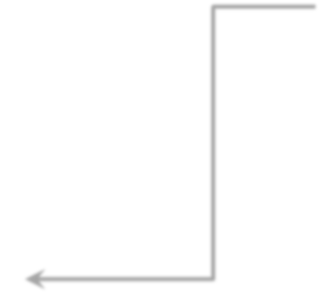
Structure of a Paper Review
Content:
Very short (1-2 paragraphs)
Final assessment of paper, with
justification
Purpose:
Provide final suggestions
Communicate your views on the
paper to others
You might love the paper, yet make many negative critiques
You might hate the paper, yet say some positive things about it
This is where you clarify
Technical summary Description of contributions Major critiques
Strengths
Weaknesses
Questions
Minor points Concluding remarks
Slide credit: Adam Lee

Slide 107
Avoiding Pitfalls
 | Pitfall | Recommendation
1 | Seek to find all flaws in the paper, in part to show your expertise as a reviewer. | Look for reasons to accept a paper. Despite its flaws, does it point in new directions or expose promising insights? The community can benefit from imperfect, insightful papers.
2 | Since the review process is anonymous, it is appropriate to criticize the paper as if the authors did not have feelings. | Your tone should be the same as if you are giving comments to a colleague face-to-face. It is always possible to be constructive, focus on the work, and do not attack the researchers behind it. The purpose of a review is not only for selecting papers, but to improve the quality of all the work in our area.
3 | Reject papers that build on recently-published new directions but accept those that build on the established norm. | While truly new papers are best (and rare), consider accepting papers that follow-up on recently-published promising directions. These papers allow the community to explore ideas that can not be fully-developed in one paper.
4 | Advocate rejecting a paper with little comment, because it is obvious that all with agree with you. Ditto for accept. | Explain why you advocate a rejection or acceptance, because people will often disagree with you. Your explanations will make you a more effective advocate or detractor for the paper.
5 | Advocate rejecting (almost) all papers to show how tough you are. | Your job is to decide what is best which is not usually accomplished by rejecting every submission.
6 | Advocate rejecting a paper because you seem to remember it being the same as (or similar to) unidentified prior work. | In this situation, the professional should reference important prior work after refreshing one's memory regarding what it contains. One missing reference is usually not a reason to reject a paper.
Text from Hill and McKinley
* http://www.cs.utexas.edu/users/mckinley/notes/reviewing.html

Slide 108
Common Reviewing Pitfalls
Saying something has been done before, but not citing papers
Citing your own work—don’t want to reveal your identity, and chances are, other work is relevant and can be mentioned too, if you think the authors made major omissions in citing relevant work
Being unreasonably picky about writing, method and experiments—you should be picky, but pay attention to contributions too, and be willing to forgive small mistakes
Not being critical enough, or being too critical

Slide 109
Common Paper Weaknesses
Not novel (this or very similar techniques have been proposed before)
Missed relevant baselines (competitor methods)
Hard to tell where improvement over baselines comes from—need ablation experiments
Doesn’t improve over baselines by a lot, very small gain over the most similar methods
“Only quantitative results; weak baselines; weak evaluation (automatic/instrinsic vs. human/extrinsic)”
“Weak ablation study; weak experiments (dataset, competitors, baselines)”
Not well written, method not clear, motivation not clear

Slide 110
Discussion of a Paper
AC may call for a discussion (on reviewing platform)
Reviewers bring up especially important points
Other reviewers agree/disagree with whether an issue raised is truly problematic, whether it is a critical problem, etc
Sometimes/often a review will change their mind, based on rebuttal, or based on other reviewer’s comments
It’s ok to change your mind, if you have a good reason– don’t be afraid to
Also don’t be afraid to be the only person being very positive about a paper—and provide arguments

