Slide 1
CS 2001: Research Topics
Scientific method, hypothesis testing, research integrity
Prof. Adriana Kovashka
University of Pittsburgh
September 15, 2026

Slide 2
Plan for this lecture
Scientific method, hypothesis testing, statistical testing
Generalization (ML)
Research integrity
Ethics in research
CVPR workshops…

Slide 3
Scientific Method

Slide 4
The Scientific Method
Define a Question to Investigate
Make Predictions
Gather Data
Analyze the Data
Draw Conclusions
https://www.amnh.org/explore/videos/the-scientific-process

Slide 5
Hypothesis Testing
Relevant course:
https://people.umass.edu/biep540w/
Relevant module: https://people.umass.edu/biep540w/webpages/fall%202016%2008%20literacy.html
Further reading: https://people.umass.edu/biep540w/pdf/8.%20%20Statistical%20Literacy%20Estimation%20and%20Hypothesis%20Testing%202022.pdf

Slide 6
Hypothesis Testing; P-value; Significance level
Hypothesis testing asks how unusual it is to get data that differ from the null hypothesis.
If the data would be quite unlikely under H₀, we reject H₀.
A P-value is the probability of getting the data, or something as unusual or more unusual, if the null hypothesis were true.
The significance level α, often set to 0.05, is a probability used as a criterion for rejecting the null hypothesis.
If the P-value for a test is less than or equal to α, then the null hypothesis is rejected.
Slides: https://people.umass.edu/biep540w/

Slide 7
Hypothesis testing in a nutshell
We want to know something about this population, say, are men and women the same height, on average?
We make an estimate from each of these samples, and from these we can calculate the sampling distribution of the estimate.
Population
Frequency
We can't measure everyone- it would take too long and cost too much. So we take a sample, and meaure those. For these we estimate the difference between men and women's mean height.
Difference in mean height
Sample
Frequency
If the actual sample value is so different from what we would expect samples to look like, then we can say that the men in this population are on average taller than the women.
Difference in mean height
But we have a problem:
The sample doesn't have the same properties as the population, because of chance errors.
So we need to know how good the sample is, and how likely it is that it is much different from the population.
So we imagine making an infinite number of samples, from a distribution where men and women have the same height.
Slides: https://people.umass.edu/biep540w/

Slide 8
Hypothesis testing: Rejecting null hypothesis
Hypotheses are about populations, but are tested with data from samples
Null hypothesis: a specific statement about a population parameter made for the purposes of argument.
Alternate hypothesis: represents all other possible parameter values except that stated in the null hypothesis.
The null hypothesis is usually the simplest statement, whereas the alternative hypothesis is usually the statement of greatest interest.
A good null hypothesis would be interesting if proven wrong.
Slides: https://people.umass.edu/biep540w/

Slide 9
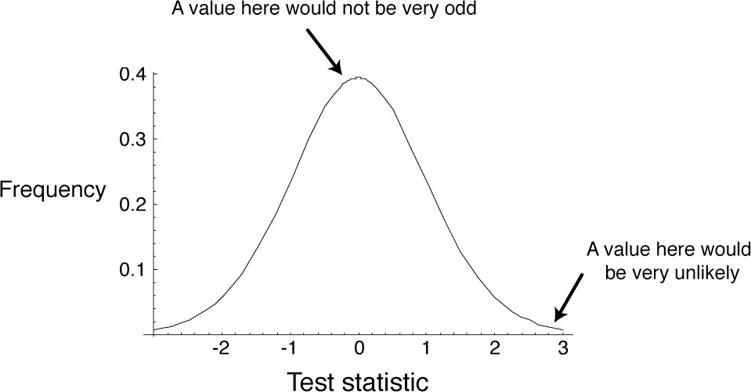
A test statistic summarizes the match between the data and the null hypothesis
Slides: https://people.umass.edu/biep540w/

Slide 10
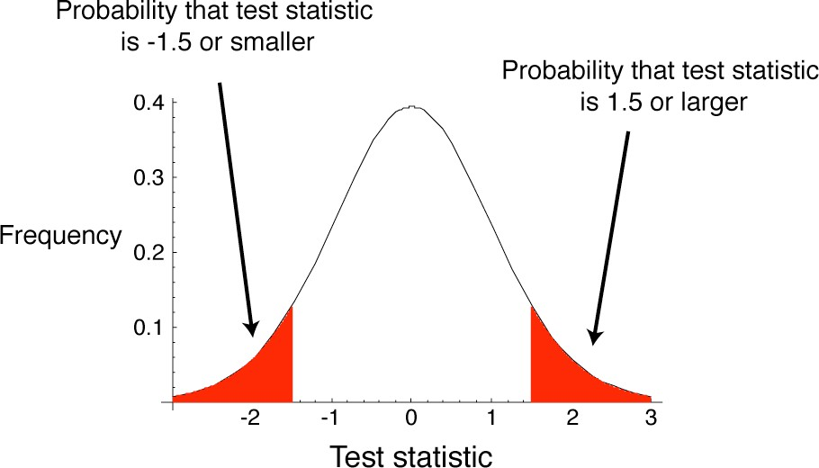
P-value
Slides: https://people.umass.edu/biep540w/

Slide 11
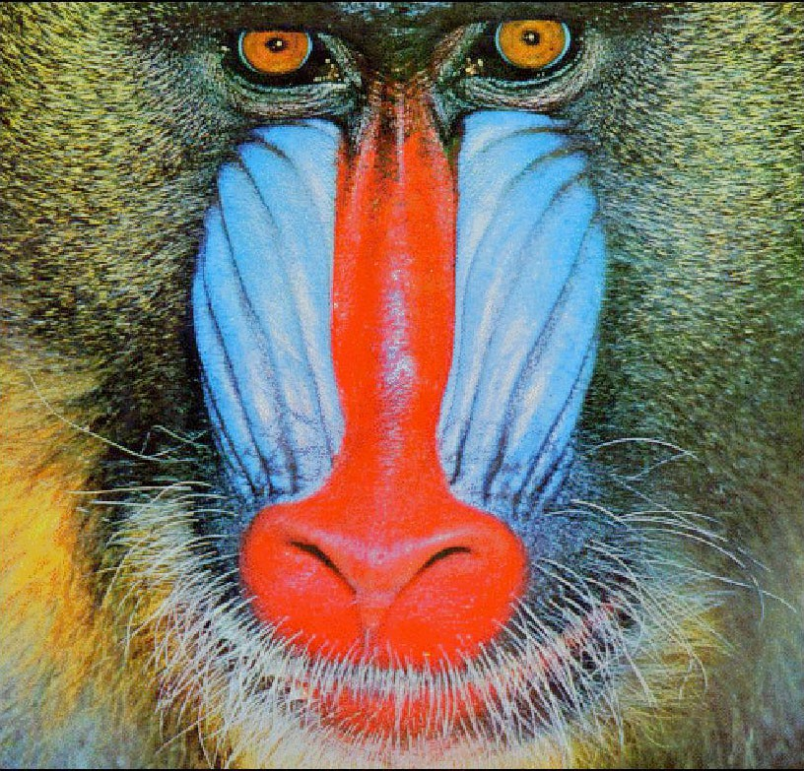
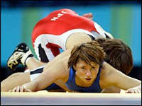
Hypothesis testing: an example
Does a red shirt help win wrestling?
Slides: https://people.umass.edu/biep540w/

Slide 12
The experiment and the results
Animals use red as a sign of aggression
Does red influence the outcome of wrestling, taekwondo, and boxing?
  16 of 20 rounds had more red-shirted than blue- shirted winners in these sports in the 2004 Olympics
  Shirt color was randomly assigned
Slides: https://people.umass.edu/biep540w/
Hill, RA, and RA Burton 2005. Red enhances human performance in contests Nature 435:293.

Slide 13
Stating the hypotheses
H₀: Red- and blue-shirted athletes are equally likely to win (proportion = 0.5).
H_{A}: Red- and blue-shirted athletes are not equally likely to win (proportion != 0.5).
Slides: https://people.umass.edu/biep540w/

Slide 14
Estimating the value
16 of 20 is a proportion of proportion = 0.8
This is a discrepancy of 0.3 from the proportion proposed by the null hypothesis, proportion = 0.5
Is this discrepancy by chance alone?
Need to estimate the probability of such an extreme result
The null distribution for a test statistic is the probability distribution of alternative outcomes when a random sample is taken from a population corresponding to the null expectation.
Slides: https://people.umass.edu/biep540w/

Slide 15
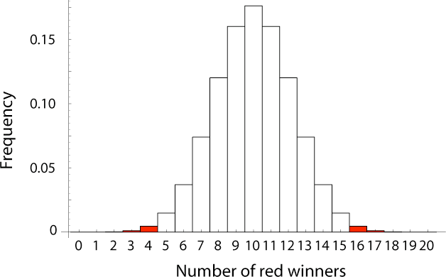
Null distribution of sample proportion
The P-value is calculated as
P = 2 × [Pr(16) + Pr(17) + Pr(18) + Pr(19) + Pr(20)] = 0.012
P < α (α = 0.05), so we reject null hypothesis
Athletes in red shirts were more likely to win
Slides: https://people.umass.edu/biep540w/

Slide 16
More tips and terms
A larger sample will tend to give an estimate with a smaller (tighter) confidence interval; it will give more power to reject a false null hypothesis
Type I error: Rejecting a true null hypothesis
  Probability of Type I error is α (the significance level)
Type II error: not reject a false null hypothesis
Test statistic: A number calculated to represent the match between a set of data and the null hypothesis
  Can be compared to general distribution to infer probability
“Statistically significant”: P < α
Slides: https://people.umass.edu/biep540w/

Slide 17
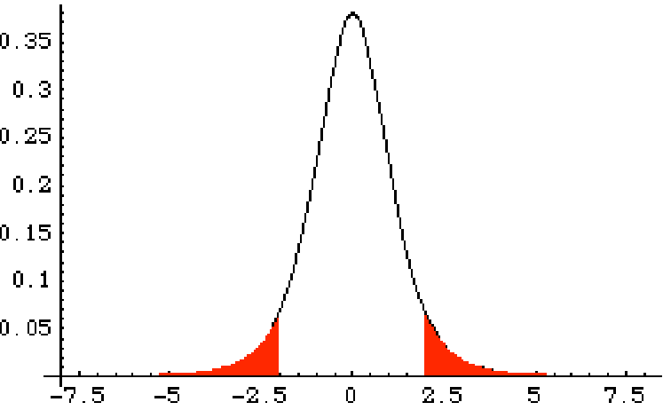
One- and two-tailed tests
Most tests are two-tailed tests.
This means that a deviation in either direction would reject the null hypothesis.
Normally α is divided into α/2 on one side and α/2 on the other.
Test statistic
Slides: https://people.umass.edu/biep540w/

Slide 18
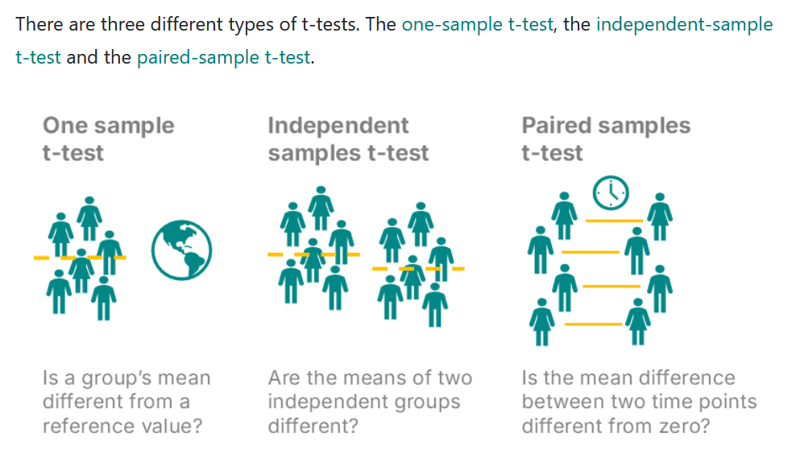
T-tests
https://numiqo.com/tutorial/t-test

Slide 19
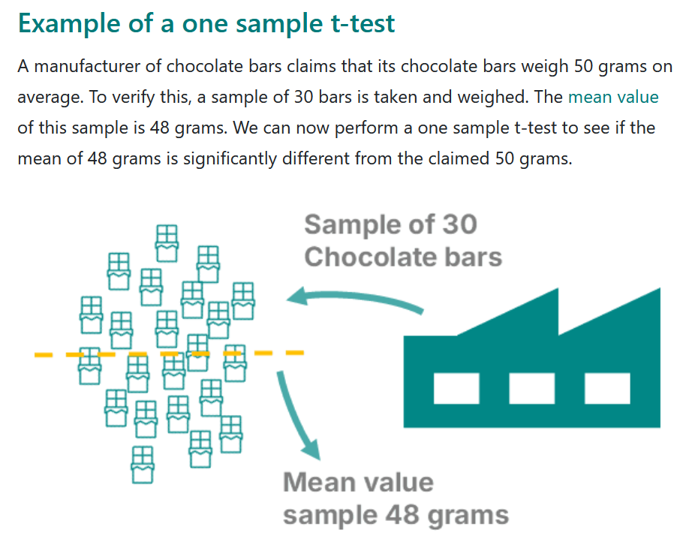
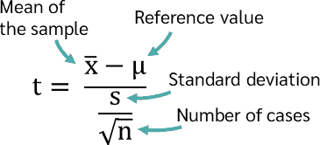
T-tests (cont’d)
https://numiqo.com/tutorial/t-test

Slide 20
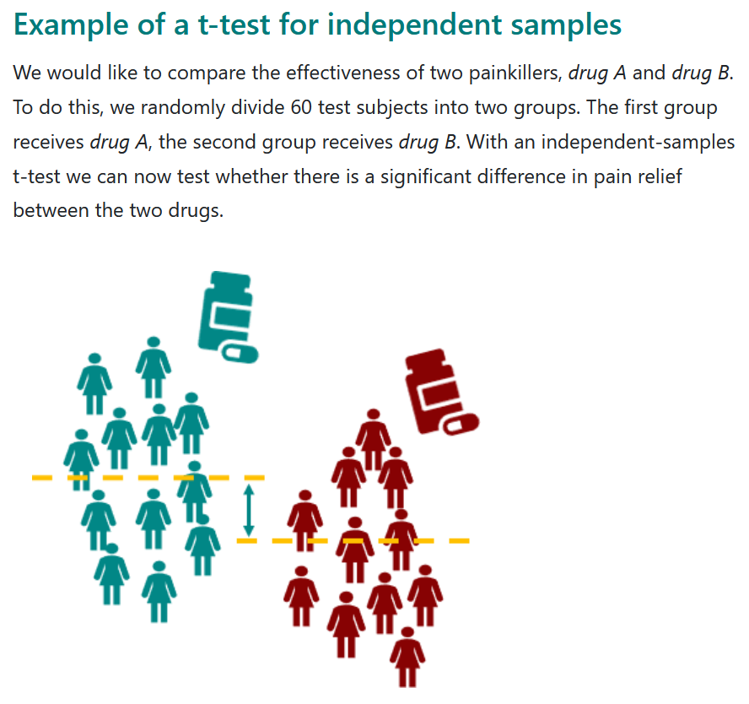
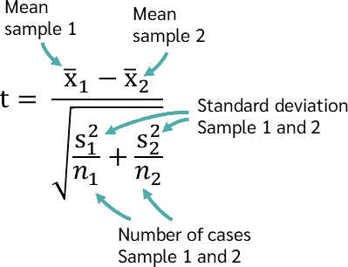
T-tests (cont’d)
https://numiqo.com/tutorial/t-test

Slide 21
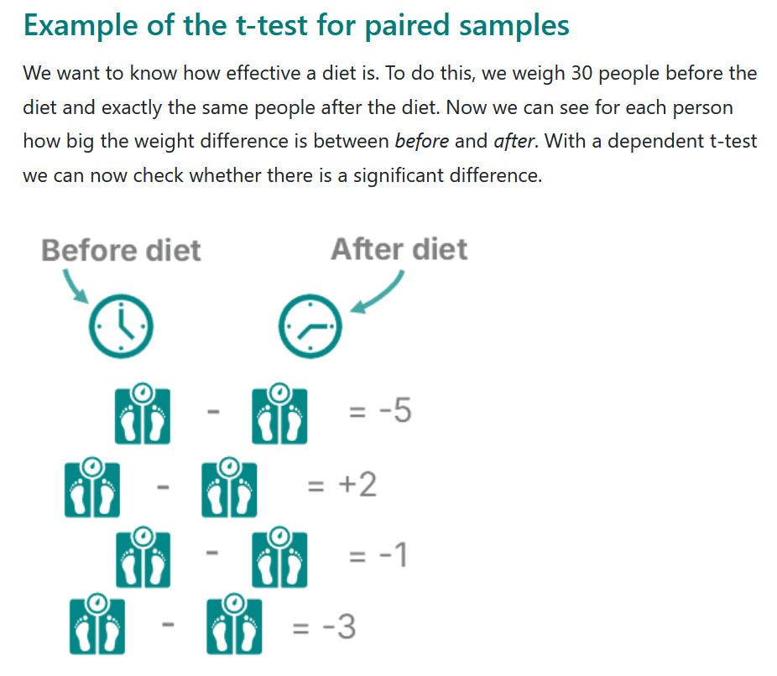
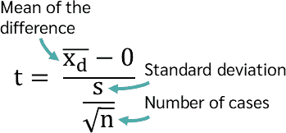
T-tests (cont’d)
https://numiqo.com/tutorial/t-test

Slide 22
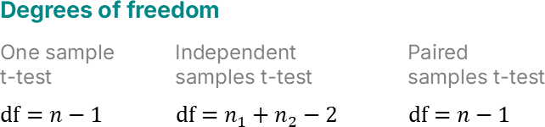
T-tests (cont’d)
Finally, compute p-value from t-value, assuming Student’s t-distribution (like normal but with heavier tails), number of tails (one vs two), degrees of freedom
https://numiqo.com/tutorial/t-test

Slide 23
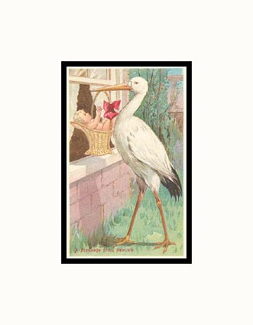
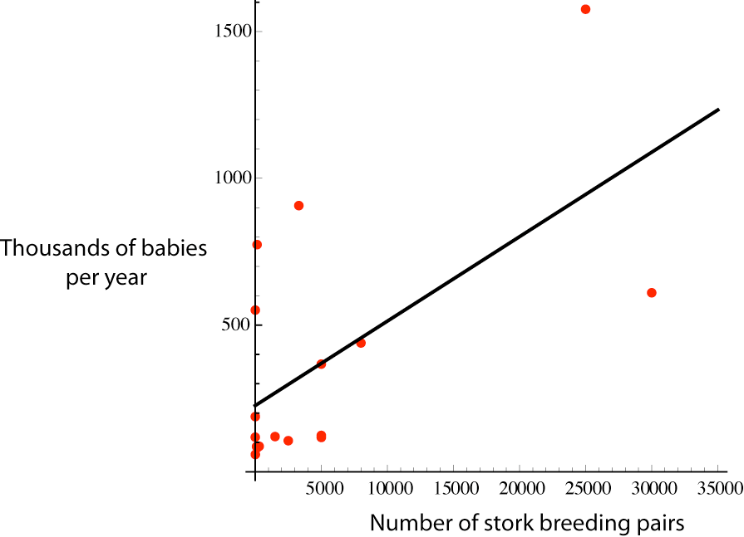
Correlation does not automatically imply causation
Slides: https://people.umass.edu/biep540w/

Slide 24
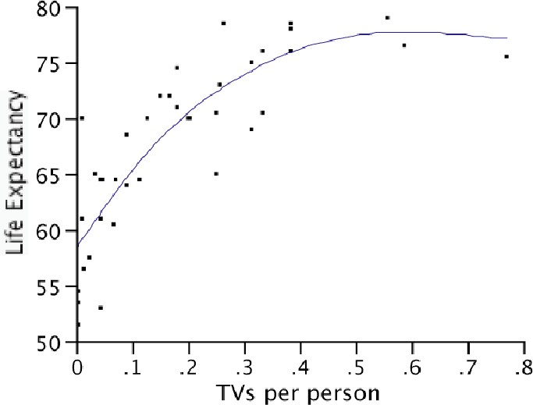
Correlation does not automatically imply causation
Confounding variable:
An unmeasured variable that may be causing both X and Y
Slides: https://people.umass.edu/biep540w/

Slide 25
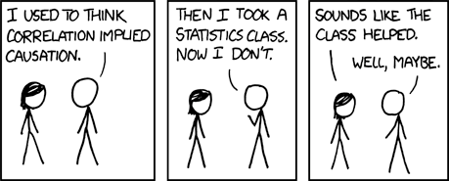
Correlation does not automatically imply causation
Slides: https://people.umass.edu/biep540w/

Slide 26
Why do we care?
What might the hypotheses, populations, means be in your research?

Slide 27
Generalization (ML)
& train-val-test splits

Slide 28
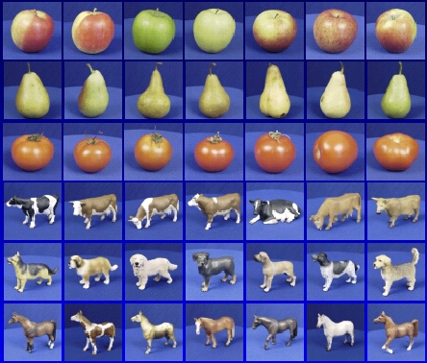

Generalization
Training set (labels known)
Test set (labels unknown)
How well does a learned model generalize from the data it was trained on to a new test set?
Slide credit: L. Lazebnik

Slide 29
Generalization
Components of expected loss
  Noise in our observations: unavoidable
  Bias: how much avg model over all training sets differs from true model
    Error due to inaccurate assumptions/simplifications by the model
  Variance: how much models estimated from different training sets differ from each other
Underfitting: model too “simple” to represent all relevant class characteristics
  High bias and low variance
  High training error and high test error
Overfitting: model too “complex” and fits irrelevant characteristics (noise) in the data
  Low bias and high variance
  Low training error and high test error
Adapted from L. Lazebnik

Slide 30
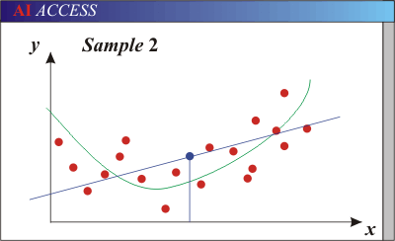
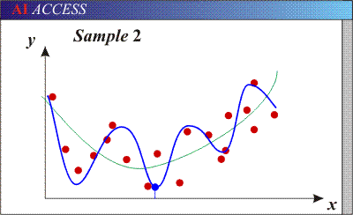
Bias-Variance Trade-off
Models with too few parameters are inaccurate because of a large bias (not enough flexibility).
Models with too many parameters are inaccurate because of a large variance (too much sensitivity to the sample).
Red dots = training data (all that we see before we ship off our model!)
Purple dots = possible test points
Green curve = true underlying model Blue curve = our predicted model/fit
Adapted from D. Hoiem

Slide 31
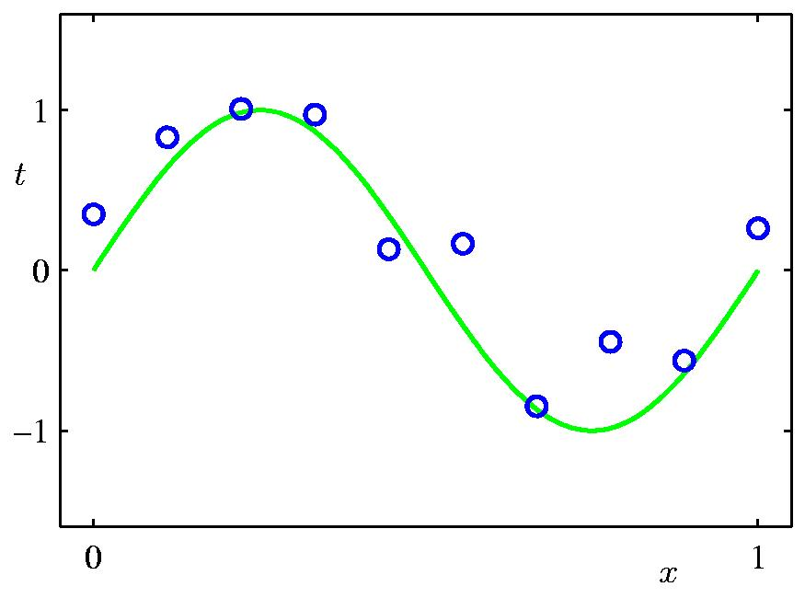
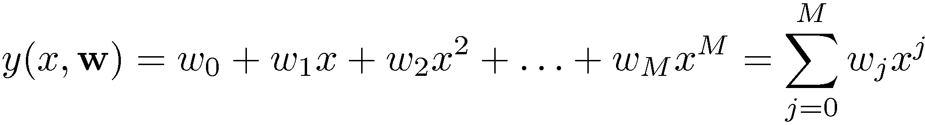
Polynomial Curve Fitting
Slide credit: Chris Bishop

Slide 32
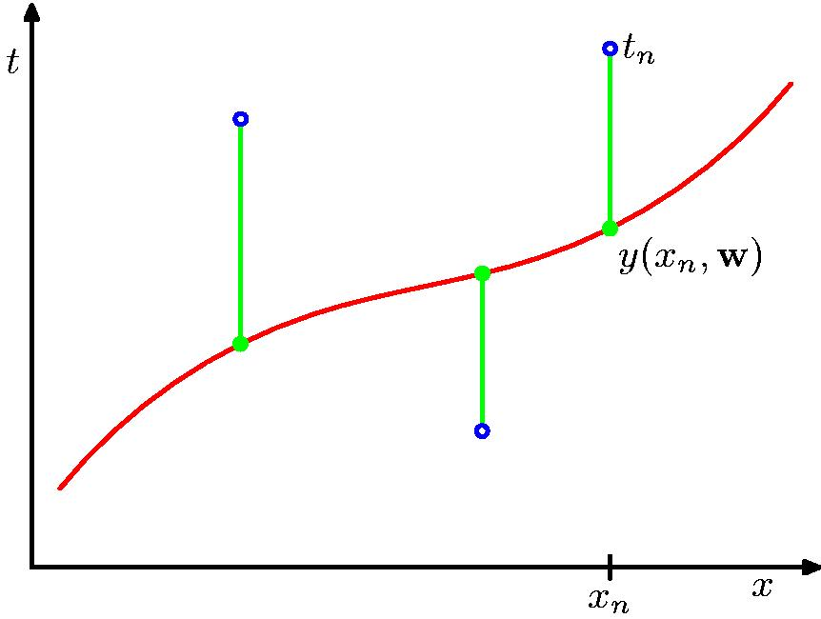
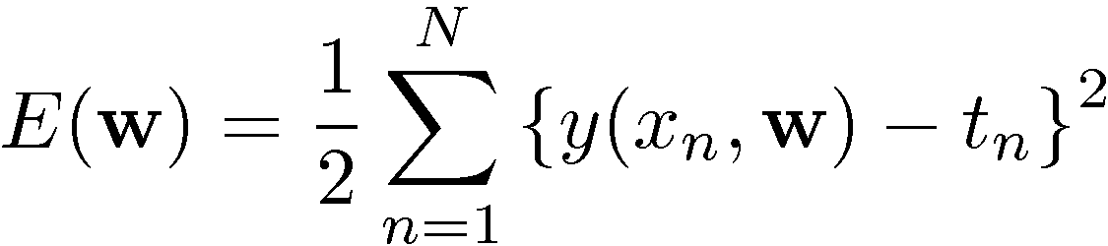
Sum-of-Squares Error Function
Slide credit: Chris Bishop

Slide 33
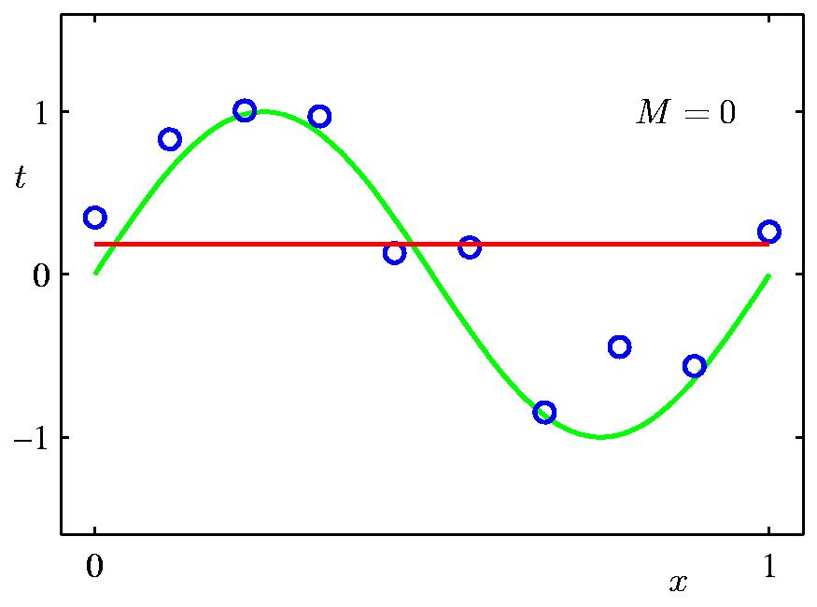
0th Order Polynomial
Slide credit: Chris Bishop

Slide 34
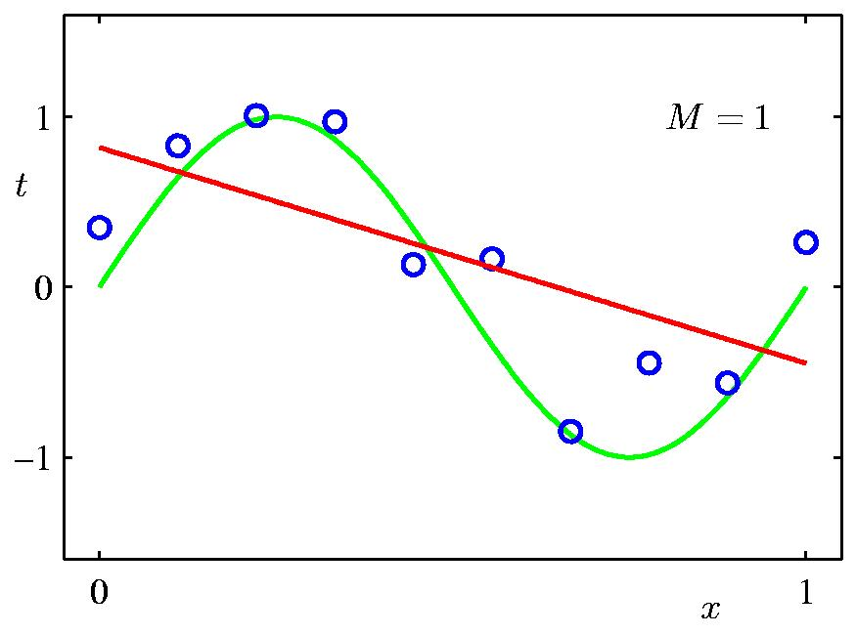
1st Order Polynomial
Slide credit: Chris Bishop

Slide 35
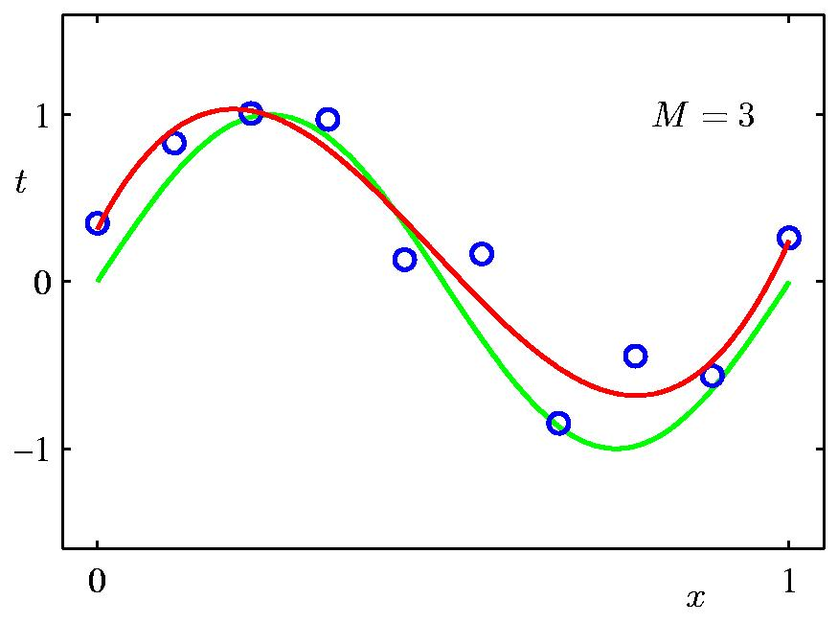
3rd Order Polynomial
Slide credit: Chris Bishop

Slide 36
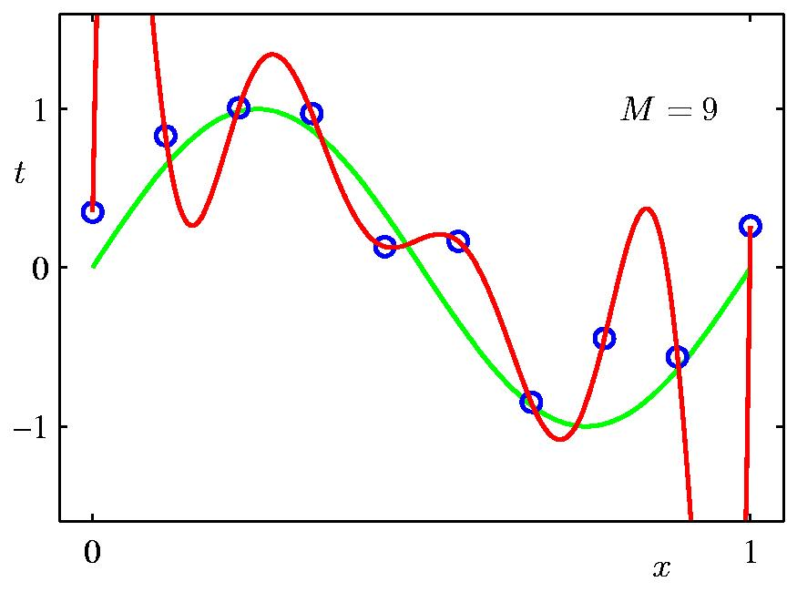
9th Order Polynomial
Slide credit: Chris Bishop

Slide 37
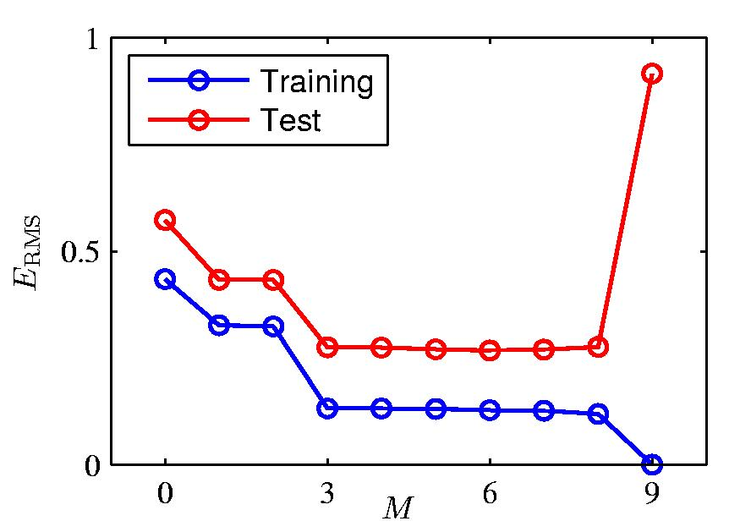
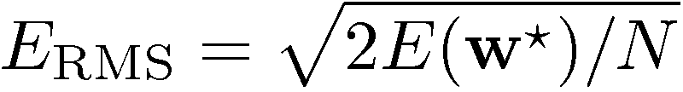
Over-fitting
Root-Mean-Square (RMS) Error:
Slide credit: Chris Bishop

Slide 38
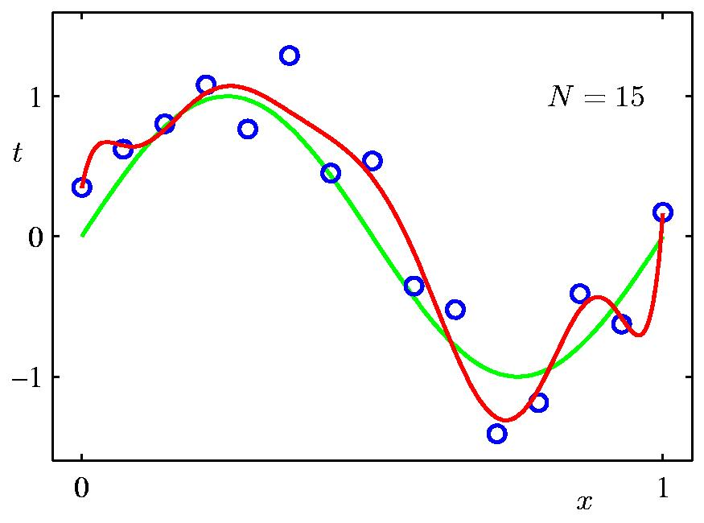
Effect of Data Set Size
9th Order Polynomial
Slide credit: Chris Bishop

Slide 39
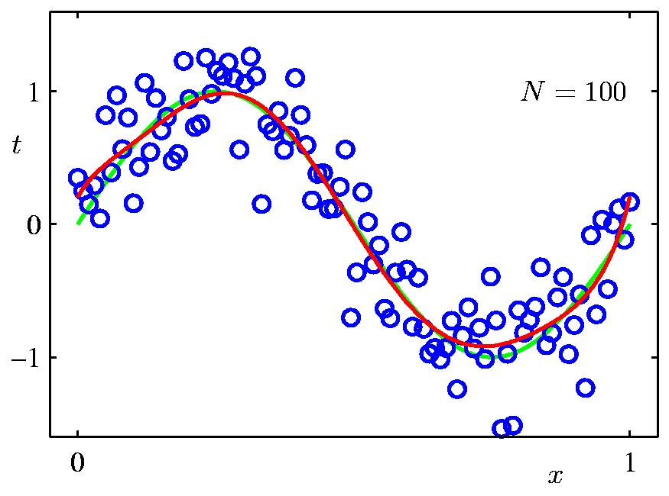
Effect of Data Set Size
9th Order Polynomial
Slide credit: Chris Bishop

Slide 40
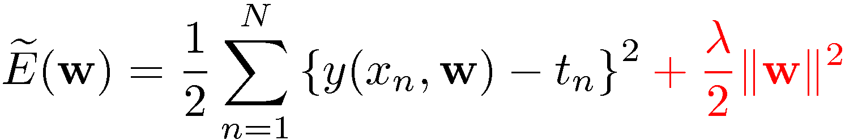
Regularization
Penalize large coefficient values
(Remember: We want to minimize this expression.)
Adapted from Chris Bishop

Slide 41
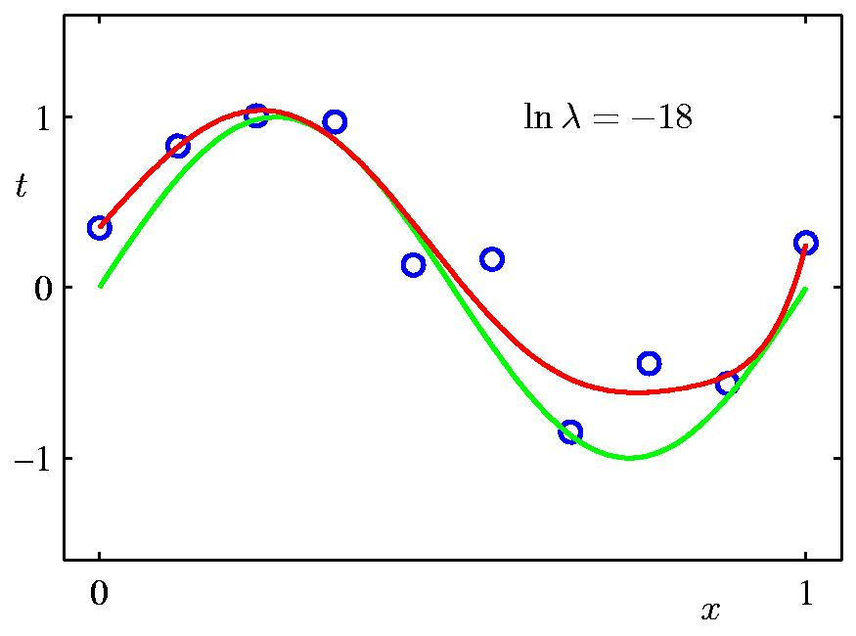
Regularization
Slide credit: Chris Bishop

Slide 42
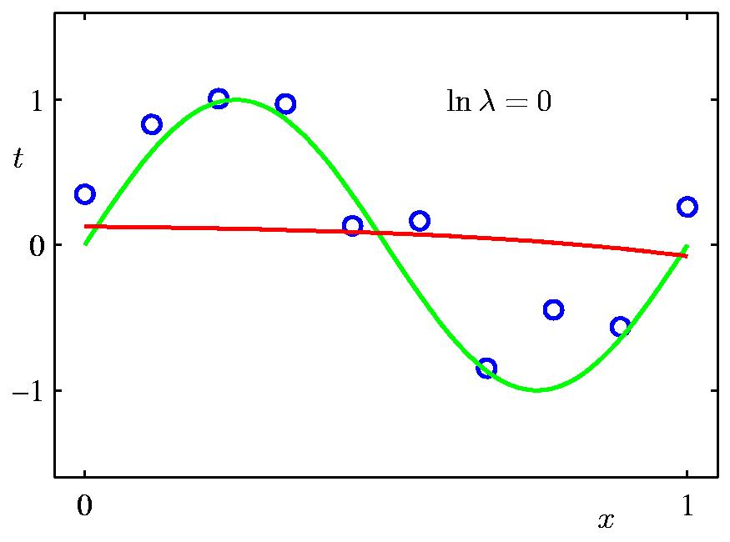
Regularization
Slide credit: Chris Bishop

Slide 43
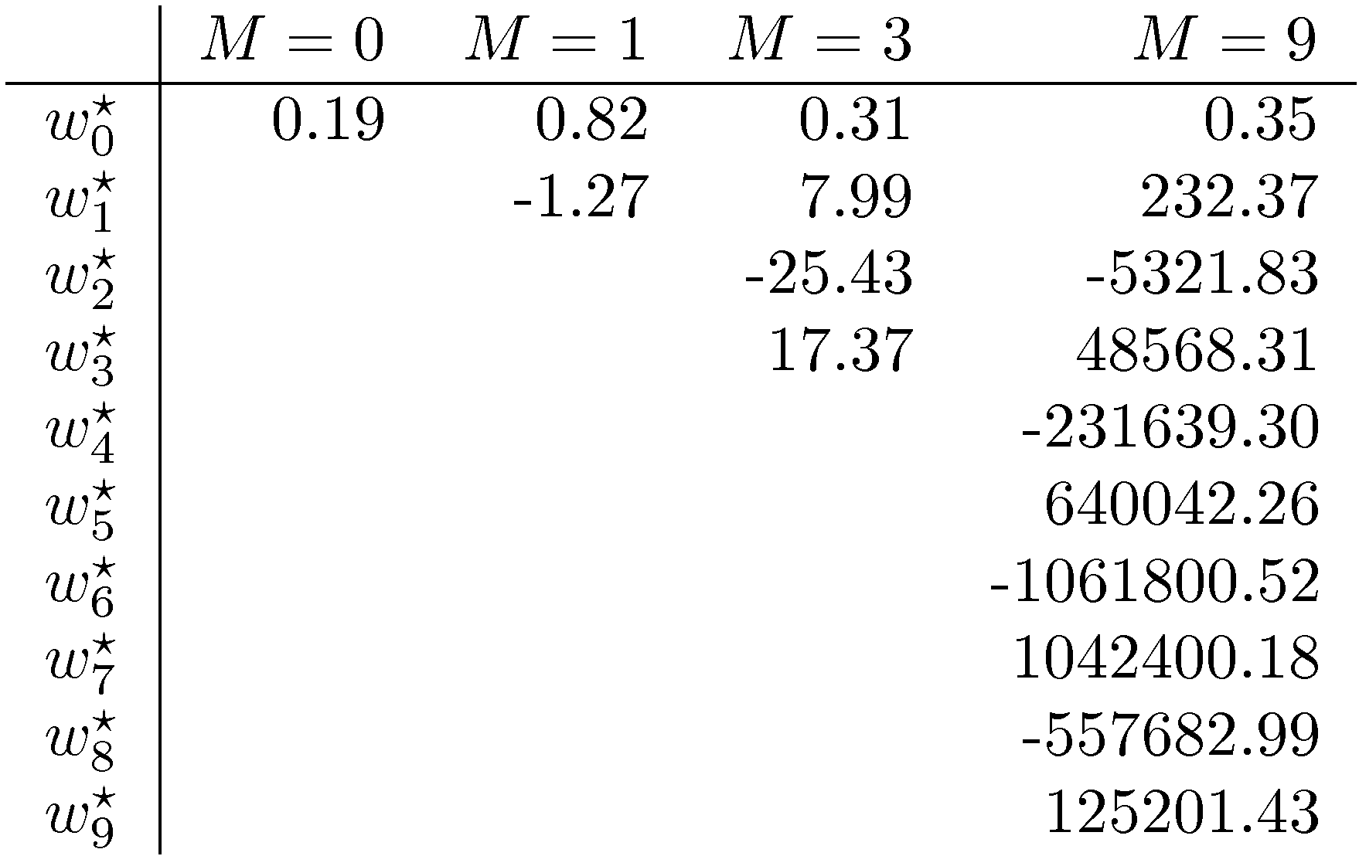
Polynomial Coefficients
Slide credit: Chris Bishop

Slide 44
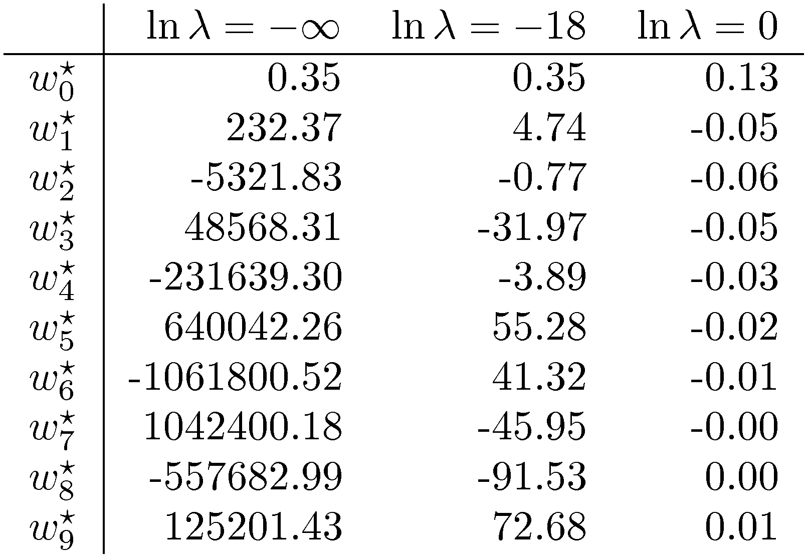
Polynomial Coefficients
No regularization Huge regularization
Adapted from Chris Bishop

Slide 45
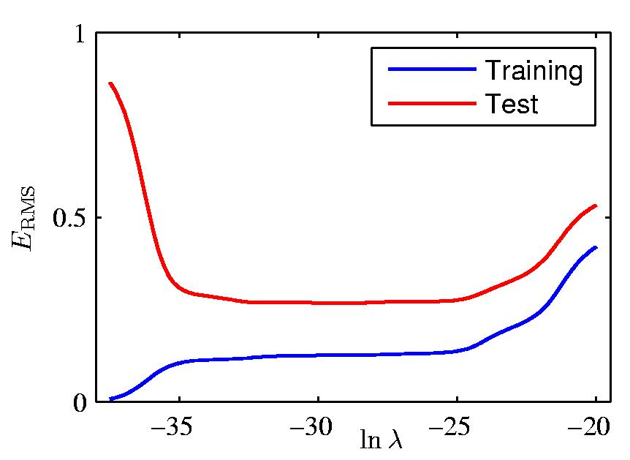
Effect of Regularization
Slide credit: Chris Bishop

Slide 46
Training vs test error
Underfitting
Overfitting
Error
Test error
Training error
High Bias
Low Variance
Complexity
Low Bias
High Variance
Slide credit: D. Hoiem

Slide 47
Effect of Training Set Size
Few training examples
Test Error
Many training examples
High Bias
Low Variance
Complexity
Low Bias
High Variance
Slide credit: D. Hoiem
Notes:
Note: these figures don’t work in pdf

Slide 48
Effect of Training Set Size
Fixed prediction model
Error
Testing
Generalization Error
Training
Number of Training Examples
Adapted from D. Hoiem

Slide 49
Choosing the trade-off between bias and variance
Need validation set (separate from the test set)
Validation error
Error
Training error
High Bias
Low Variance
Complexity
Low Bias
High Variance
Slide credit: D. Hoiem

Slide 50
Research Integrity

Slide 51
Ethical Research
Plagiarism—a big problem!
  Don’t claim others’ work as your own
  Don’t copy text from others’ work—ideally use quotes, but preferably say with your own words
Verify your code and evaluation is sound!
  Proofread code often, ask peers to review
  Don’t fabricate results!
IRB human subjects research
  Talk to your advisor

Slide 52
Ethical Research (cont’d)
Keep in mind social impact
  Who does my research help, hurt?
  Examples: Generative AI—help/hurt?
  Facial recognition software—help/hurt?
  Software that can predict speaker’s face from their voice—help/hurt?
  Predicting political bias from politicians’ portrayals (study how Obama’s face may appear in left/right-leaning media)—help/hurt?

Slide 53
Research Integrity
https://www.orp.pitt.edu/sites/default/files/guidelines_for_responsible_conduct_of_research.pdf

Slide 54
Misconduct in research
“Research misconduct is defined as intentional, knowing, or reckless fabrication, falsification, or plagiarism, in proposing, performing, or reviewing research, or in reporting research results.
Research misconduct does not include honest errors, differences of opinion, or disputes over authorship or credit.”

Slide 55
Falsification and Fabrication of Research Results
“Fabrication is making up data or results and recording or reporting them.
Falsification is manipulating research materials, equipment, or processes, or changing or omitting data or results such that the experimental outcomes are not accurately represented in the research record.
It is falsification to intentionally delete data or fail to report relevant data in any way that conceals the authentic outcome of an experiment.”

Slide 56
Plagiarism
“Authors who present the words, data, or ideas of others with the implication that they are their own, without attribution in a form appropriate for the medium of presentation, are committing theft of intellectual property and may be guilty of plagiarism and, thus of research misconduct. This statement applies to reviews and to methodological and background/historical sections of research papers as well as to original research results or interpretations. If there is word-for-word copying beyond a short phrase of six or seven words of someone else’s text, that section should be enclosed in quotation marks or indented and referenced to the original source, at the location in the manuscript of the copied material. The same rules apply to grant applications and proposals, to clinical research protocols, and to student papers submitted for academic credit. Not only does plagiarism violate the long-standing code of conduct governing all scholars and researchers, but in many cases, it also constitutes an infraction of the law by infringing on a copyright held by the original author or publisher. An author should cite the work of others even if they had been a coauthor or editor of the work to be cited or had been an adviser or student of the author of such work. The definition of plagiarism applies to grant applications or proposals, including background and research plan sections, as well as to publications.”

Slide 57
Misuse of Privileged Information
“Plagiarism includes the unattributed copying of ‘privileged information’. Examples of privileged information include ideas, text, or original figures in grant applications or manuscripts received from a funding agency or journal editor for confidential peer review. In such a case, the plagiarism is a serious matter of theft of intellectual property, because it not only deprives the original author of appropriate credit by citation but could also preempt priority of first publication or use of the original idea to which the source author is entitled. Also, one who breaches confidentiality by showing a privileged unpublished document to an unauthorized person can be held to a shared responsibility for any subsequent plagiarism of the document committed by that unauthorized person.”

Slide 58
Reporting Suspected Misconduct
“Reporting suspected research misconduct is a shared and important responsibility of all members of the academic community. Any person who suspects research misconduct has an obligation to report the allegation to the dean of the unit in which the suspected misconduct occurred or to the Research Integrity Officer (research.integrity@pitt.edu). Allegations are handled under procedures described in the University Policy RI 07 ‘Research Integrity’. All reports are treated confidentially to the extent possible, and no adverse action will be taken, either directly or indirectly, against a person who makes such an allegation in good faith. Protection of whistleblowers against retaliation is guaranteed under policies of both the University and the federal and state governments.”

Slide 59
Recording, Reporting, and Handling Research Data
“Meticulous record-keeping is a sound scientific practice providing an accurate contemporaneous account of observations that become a permanent reference for the researcher, who otherwise might not remember several weeks, months, or years later exactly what had been observed or what methods had been used. An accurate record also serves others who may want to replicate the observation or to apply the method to other situations. In addition, it is an aid in allowing the eventual sharing of information with others and as documentation that might be useful for disproving any subsequent allegations of fabrication or falsification of data.”

Slide 60
Ownership of and Access to Data
“Research data obtained in studies performed at the University of Pittsburgh and/or by employees of the University are not the property of the researcher who generated or observed them or even of the principal investigator of the research group. They belong to the University of Pittsburgh, which can be held accountable for the integrity of the data even if the researchers have left the University. Another reason for the University’s claim to ownership of research data is that the University, not the individual researcher, is the grantee of sponsored research awards. Reasonable access to data, however, should normally not be denied to any member of the research group responsible for collecting the data. If there is any possibility that a copyright or patent application might emerge from the group project, a written agreement within the group should specify the rights, if any, of each member of the group to the intellectual property. A researcher who has made a finding which may be patentable should file an Invention Disclosure with the University’s Innovation Institute.”

Slide 61
Storage and Retention of Data
“Data should typically be stored securely for at least seven (7) years after completion of the project, submission of the final report to a sponsoring agency, or publication of the research, whichever comes last. Some agencies that sponsor research may specify a longer period for which data must be retained, and extended storage of some types of data may be required by laws or regulations. “

Slide 62
Criteria for Authorship
“Publications must give appropriate credit to all authors for their roles in the research. If more than one person contributes, the decision of which names are to be listed as coauthors should reflect the relative contributions of various participants in the research. Many professional associations and research journals have specified criteria for authorship. One common standard appearing in many of these statements is that each author should have participated in formulating the research problem, interpreting the results, and writing the research paper, and should be prepared to defend the publication against criticisms.”
“A person’s name should not be listed as author without his or her knowledge, permission, and review of the final version of the manuscript that includes the names of all coauthors.”

Slide 63
Duplicate Publication
“Researchers should not publish the same article in two different places without legitimate reason and must include appropriate citation in the later publication to the earlier one. In such cases, the editor must be explicitly informed of the prior publication when the manuscript is submitted.”
“If there is unexplained duplication of publications without citation, sometimes referred to as self-plagiarism, a reader may be deceived as to the amount of original research data produced by that investigator.”

Slide 64
Human Subjects Research
“Research protocols involving human subjects must be approved in advance by the University Institutional Review Board (IRB), which determines whether risks posed to subjects are acceptable and whether information describing risks and benefits of subject participation is conveyed to subjects in accurate & intelligible manner.”
“Research means ‘...a systematic investigation, including research development, testing and evaluation, designed to develop or contribute to generalizable knowledge.’ Human subject means ‘...a living individual about whom an investigator (whether professional or student) conducting research obtains (1) data through intervention or interaction with the individual, or (2) identifiable private information’ “
“There may be a number of scholarly activities (e.g., an oral history project) which may not meet the federal definition of research, or other activities (e.g., secondary data analyses using de-identified data) which may be meet the federal definition of research but may not meet the federal criteria for the involvement of ‘human subjects.’
http://www.provost.pitt.edu/documents/GUIDELINES%20FOR%20ETHICAL%20PRACTICES%20IN%20RESEARCH-FINALrevised2-March%202011.pdf

Slide 65
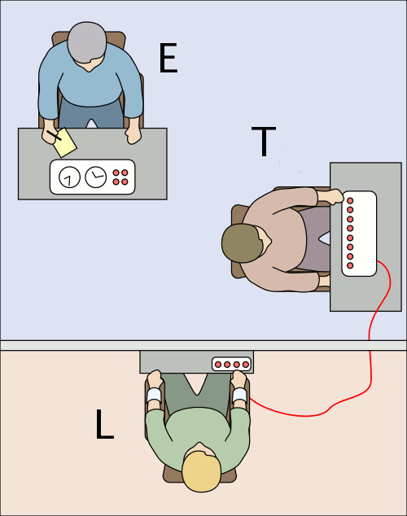
Stanley Milgram’s Experiments
The experimenter (E) orders the teacher (T), the subject of the experiment, to give what the subject believes are painful electric shocks to a learner (L), who is actually an actor and confederate.
The subjects believed that for each wrong answer, the learner was receiving actual shocks, but in reality there were no shocks.
Being separated from the subject, the confederate set up a tape recorder integrated with the electro-shock generator, which played pre-recorded sounds for each shock level.
High percentage of subjects fully obey the instructions
Source: http://en.wikipedia.org/wiki/Milgram_experiments
Slide credit: Peter Brusilovsky, Marek Druzdzel
Notes:
65
The experimenter (E) orders the teacher (T), the subject of the experiment, to give what the teacher (T) believes are painful electric shocks to a learner (L), who is actually an actor and confederate. The subject is led to believe that for each wrong answer, the learner was receiving actual electric shocks, though in reality there were no such punishments. Being separated from the subject, the confederate set up a tape recorder integrated with the electro-shock generator, which played pre-recorded sounds for each shock level.^{[1]}
The Milgram experiment(s) on obedience to authority figures was a series of social psychology experiments conducted by Yale University psychologist Stanley Milgram. They measured the willingness of study participants, men from a diverse range of occupations with varying levels of education, to obey an authority figure who instructed them to perform acts conflicting with their personal conscience. Participants were led to believe that they were assisting an unrelated experiment, in which they had to administer electric shocks to a "learner." These fake electric shocks gradually increased to levels that would have been fatal had they been real.^{[2]}
The experiment found, unexpectedly, that a very high proportion of subjects would fully obey the instructions, albeit reluctantly. Milgram first described his research in a 1963 article in the Journal of Abnormal and Social Psychology^{[1]} and later discussed his findings in greater depth in his 1974 book, Obedience to Authority: An Experimental View.^{[3]}
The experiments began in July 1961, in the basement of Linsly-Chittenden Hall at Yale University,^{[4]} three months after the start of the trial of German Naziwar criminal Adolf Eichmann in Jerusalem. Milgram devised his psychological study to explain the psychology of genocide and answer the popular contemporary question: "Could it be that Eichmann and his million accomplices in the Holocaust were just following orders? Could we call them all accomplices?"^{[5]} The experiment was repeated many times around the globe, with fairly consistent results.^{[6]}

Slide 66
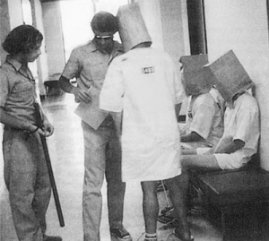
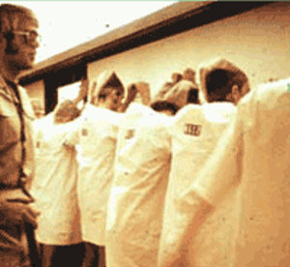
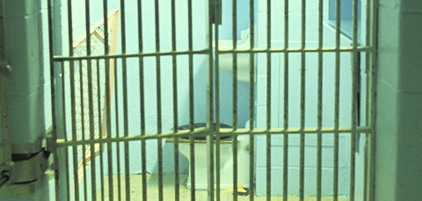
Zimbardo’s Stanford Prison Experiment
Stanford University, 1971
Subjects (coming from the same population) randomly assigned to Prisoners and Prison guards group
Subjects asked to play their roles
The experiment had to be terminated after a few days because it went out of hand (subjects were treating their roles too seriously)
Slide credit: Peter Brusilovsky, Marek Druzdzel
Notes:
66
The Stanford prison experiment (SPE) was a social psychology experiment that attempted to investigate the psychological effects of perceived power, focusing on the struggle between prisoners and prison officers. It was conducted at Stanford University on the days of August 14–20, 1971, by a research group led by psychology professor Philip Zimbardo using college students.^{[1]} In the study, volunteers were assigned to be either "guards" or "prisoners" by the flip of a coin, in a mock prison, with Zimbardo himself serving as the superintendent. Several "prisoners" left mid-experiment, and the whole experiment was abandoned after six days. Early reports on experimental results claimed that students quickly embraced their assigned roles, with some guards enforcing authoritarian measures and ultimately subjecting some prisoners to psychological torture, while many prisoners passively accepted psychological abuse and, by the officers' request, actively harassed other prisoners who tried to stop it. The experiment has been described in many introductory social psychology textbooks,^{[2]} although some have chosen to exclude it because its methodology is sometimes questioned.^{[3]}
The U.S. Office of Naval Research^{[4]} funded the experiment as an investigation into the causes of difficulties between guards and prisoners in the United States Navy and United States Marine Corps. Certain portions of it were filmed, and excerpts of footage are publicly available.
Some of the experiment's findings have been called into question, and the experiment has been criticized for unscientific methodology and possible fraud.^{[5][6]} Although Zimbardo interpreted the experiment as having shown that the "prison guards" instinctively embraced sadistic and authoritarian behaviors, Zimbardo actually instructed the "guards" to exert psychological control over the "prisoners". Critics also noted that some of the participants behaved in a way that would help the study, so that, as one "guard" later put it, "the researchers would have something to work with," which is known as demand characteristics. Variants of the experiment have been performed by other researchers, but none of these attempts have replicated the results of the SPE.^{[7]} The Stanford prison experiment (SPE) was a social psychology experiment that attempted to investigate the psychological effects of perceived power, focusing on the struggle between prisoners and prison officers. It was conducted at Stanford University on the days of August 14–20, 1971, by a research group led by psychology professor Philip Zimbardo using college students.^{[1]} In the study, volunteers were assigned to be either "guards" or "prisoners" by the flip of a coin, in a mock prison, with Zimbardo himself serving as the superintendent. Several "prisoners" left mid-experiment, and the whole experiment was abandoned after six days. Early reports on experimental results claimed that students quickly embraced their assigned roles, with some guards enforcing authoritarian measures and ultimately subjecting some prisoners to psychological torture, while many prisoners passively accepted psychological abuse and, by the officers' request, actively harassed other prisoners who tried to stop it. The experiment has been described in many introductory social psychology textbooks,^{[2]} although some have chosen to exclude it because its methodology is sometimes questioned.^{[3]}
The U.S. Office of Naval Research^{[4]} funded the experiment as an investigation into the causes of difficulties between guards and prisoners in the United States Navy and United States Marine Corps. Certain portions of it were filmed, and excerpts of footage are publicly available.
Some of the experiment's findings have been called into question, and the experiment has been criticized for unscientific methodology and possible fraud.^{[5][6]} Although Zimbardo interpreted the experiment as having shown that the "prison guards" instinctively embraced sadistic and authoritarian behaviors, Zimbardo actually instructed the "guards" to exert psychological control over the "prisoners". Critics also noted that some of the participants behaved in a way that would help the study, so that, as one "guard" later put it, "the researchers would have something to work with," which is known as demand characteristics. Variants of the experiment have been performed by other researchers, but none of these attempts have replicated the results of the SPE.^{[7]}

Slide 67
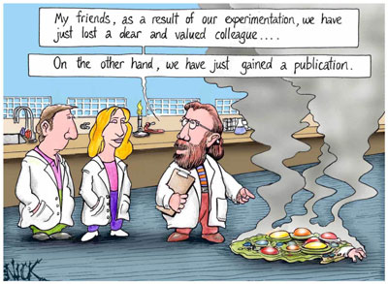
Scientist’s Encounter with Ethics:
Curiosity has Limits
Slide credit: Peter Brusilovsky, Marek Druzdzel

Slide 68
Scientist’s Encounter with Ethics:
Curiosity has Limits
Curiosity drives science.
But curiosity is not a sufficient justification for scientific research: There are many examples of abuse of science in the name of curiosity.
There are committees in every university that need to approve a piece of research with human and/or animal subjects before the research is going to be conducted.
There are even cases of judging afterwards whether the research was ethical or not (e.g., after WW2).
Slide credit: Peter Brusilovsky, Marek Druzdzel

Slide 69
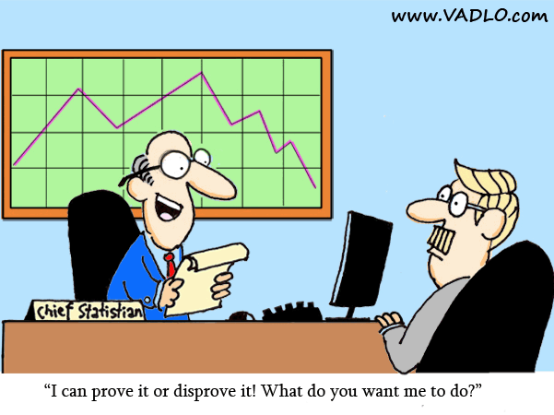
Scientist’s Encounter with Ethics:
Conflict of Interest in Research Funding
You are in the business of serving the humankind in the long run, not pleasing some individuals in the short run!
Slide credit: Peter Brusilovsky, Marek Druzdzel
Notes:
69

Slide 70
Scientist’s Encounter with Ethics:
Intellectual Property
Inventions and ideas should be properly attributed and not “stolen”
Many, many “borderline” situations
What are the rules for paper authorship?
Slide credit: Peter Brusilovsky, Marek Druzdzel
Notes:
70

Slide 71
Scientist’s Encounter with Ethics:
Peer Review
Conflict of interest issues
Protecting the intellectual property of the authors from others
Protecting the intellectual property of the authors from yourself
Slide credit: Peter Brusilovsky, Marek Druzdzel
Notes:
71

Slide 72
Scientist’s Encounter with Ethics:
Plagiarism
IEEE Definition
  "IEEE defines plagiarism as the use of someone else’s prior ideas, processes, results, or words without explicitly acknowledging the original author and source. Plagiarism in any form is unacceptable and is considered a serious breach of professional conduct, with potentially severe ethical and legal consequences.
  https://www.ieee.org/publications/rights/plagiarism/plagiarism-faq.html
ACM Definition
  https://www.acm.org/publications/policies/plagiarism-overview
Slide credit: Peter Brusilovsky, Marek Druzdzel

Slide 73
How to Avoid Plagiarism
Declare!
Make it clear which part of ideas and processes suggested by you is based on past work, give extensive credit in the intro or related work
Make it clear what is your own contribution in the paper
Make citations everywhere you refer to existing process or resuits!
Slide credit: Peter Brusilovsky, Marek Druzdzel

Slide 74
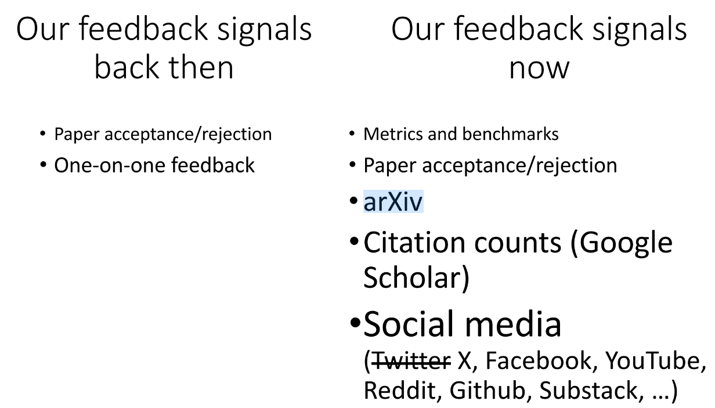
Non serviam
Lana Lazebnik, ICCV 2023 Workshop, https://drive.google.com/file/d/1yjBpvvyxwHJvd99NdLk-d7io7dHtp1ZU/view

Slide 75
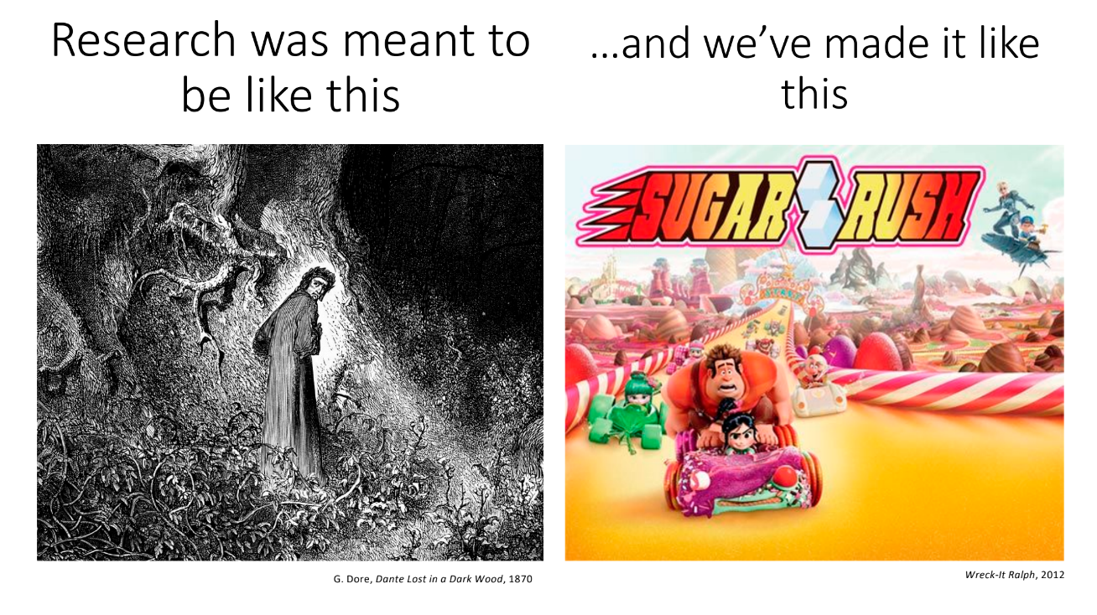
Non serviam
Lana Lazebnik, ICCV 2023 Workshop, https://drive.google.com/file/d/1yjBpvvyxwHJvd99NdLk-d7io7dHtp1ZU/view

Slide 76
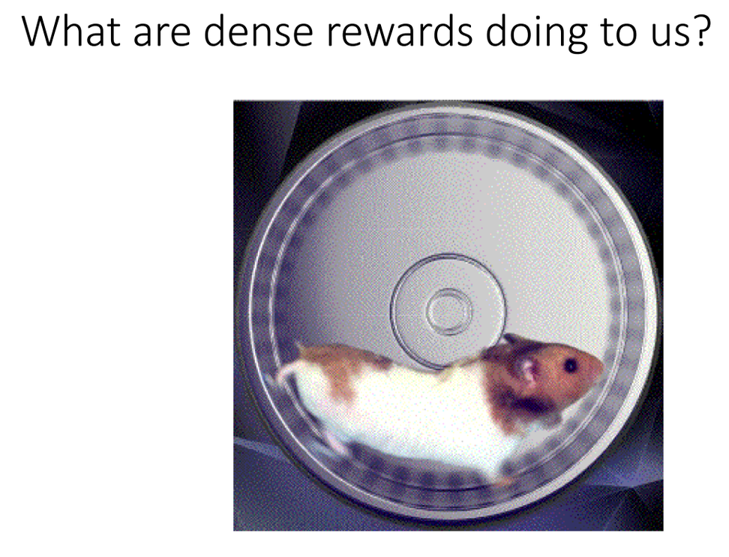
Non serviam
Lana Lazebnik, ICCV 2023 Workshop, https://drive.google.com/file/d/1yjBpvvyxwHJvd99NdLk-d7io7dHtp1ZU/view

Slide 77
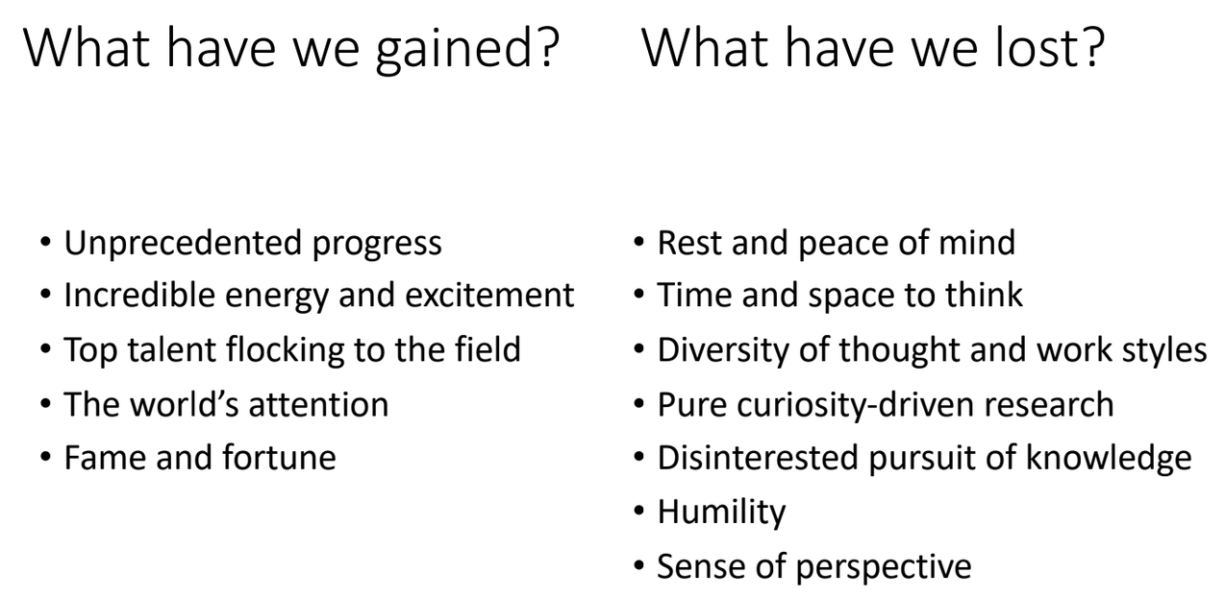
Non serviam
Lana Lazebnik, ICCV 2023 Workshop, https://drive.google.com/file/d/1yjBpvvyxwHJvd99NdLk-d7io7dHtp1ZU/view

