Slide 1
CS 2001: Research Topics
Generating research ideas, creativity, novelty
Prof. Adriana Kovashka
University of Pittsburgh
September 8, 2026

Slide 2
Plan for this lecture
What makes a good idea / research question?
How to come up with ideas?
Getting started on testing ideas

Slide 3
What makes a good idea for a PhD student?
Is it worth doing?
  Will it improve how we do work in the field?
  Will it be useful for the world?
Is it interesting enough?
  Has it been done before?
  Will the community learn something from it?
Can it be done?
  Is it too ambitious?
  Do you and your team have the skills to do it?
  (Are you uniquely qualified to do it?)
Will it fit well in a good PhD thesis?
Is your advisor interested in this?
Does your advisor have funding, or might they be able to acquire it, for this type of idea?

Slide 4
The Heilmeier Catechism
“DARPA operates on the principle that generating big rewards requires taking big risks. But how does the Agency determine what risks are worth taking?
George H. Heilmeier, a former DARPA director (1975-1977), crafted a set of questions known as the "Heilmeier Catechism" to help Agency officials think through and evaluate proposed research programs.
What are you trying to do? Articulate your objectives using absolutely no jargon.
How is it done today, and what are the limits of current practice?
What is new in your approach and why do you think it will be successful?
Who cares? If you are successful, what difference will it make?
What are the risks?
How much will it cost?
How long will it take?
What are the mid-term and final “exams” to check for success?”
https://www.darpa.mil/work-with-us/heilmeier-catechism

Slide 5
National Science Foundation
Merit Review Criteria
“Intellectual Merit: The Intellectual Merit criterion encompasses the potential to advance knowledge; and
Broader Impacts: The Broader Impacts criterion encompasses the potential to benefit society and contribute to the achievement of specific, desired societal outcomes.”
How might these be formulated for some of our iconic papers?
https://www.nsf.gov/pubs/policydocs/pappg18_1/pappg_3.jsp

Slide 6
National Science Foundation
Merit Review Criteria
“The following elements should be considered in the review for both criteria:
What is the potential for the proposed activity to:
  Advance knowledge and understanding within its own field or across different fields (Intellectual Merit); and
  Benefit society or advance desired societal outcomes (Broader Impacts)?
To what extent do the proposed activities suggest and explore creative, original, or potentially transformative concepts?
Is the plan for carrying out the proposed activities well-reasoned, well-organized, and based on a sound rationale? Does the plan incorporate a mechanism to assess success?
How well qualified is the individual, team, or organization to conduct the proposed activities?
Are there adequate resources available to the PI (either at the home organization or through collaborations) to carry out the proposed activities?”
https://www.nsf.gov/pubs/policydocs/pappg18_1/pappg_3.jsp

Slide 7
Are these good or bad ideas?
Develop a dataset for a new problem
Replace the neural architecture in one system with another architecture
Develop a more efficient way to accomplish the same task
Make AI think like a human
Compare how two methods work
Make the outputs of a method more interpretable

Slide 8
How to come up with ideas?
Come up with a new problem – when good/bad?
Twist on an existing problem, with somewhat new approach
Existing problem, propose dramatically new and improved method, or an incremental, but well-performant twist
Solution for an existing problem but under new resource constraints–e.g. limited supervision, computational resources
Blend problems/solutions—apply techniques from one area to another area
Compare methods in a way that hasn’t been compared

Slide 9
Environments for new ideas
Places/settings in which I’ve come up with new ideas that ended up being published:
  While observing my child
  While watching ads during NFL games
  While riding in a cab
  While going for walks
  While reading papers

Slide 10
Quotes about creativity
"You're only given a little spark of madness. You mustn't lose it." - Robin Williams
"Creativity is a wild mind and a disciplined eye." - Dorothy Parker
"Creativity is seeing what everyone else has seen, and thinking what no one else has thought“ – Albert Einstein
"Creativity is just connecting things." - Steve Jobs
"He who has imagination without learning has wings but no feet." - Joseph Joubert
"The imagination is a muscle. If it is not exercised, it atrophies." - Neil Gaiman
"To have a great idea, have a lot of them." - Thomas A. Edison
"Creativity is the art of concealing your source." Coco Chanel
https://teambuilding.com/blog/creativity-quotes (except Einstein)

Slide 11
Catch Me If You Can: Outmanoeuvring the Competition with Your Unique Abilities
Build on your strengths
Observe the trends
Know what others are doing
Collaborate wisely
Go where no one is going / looking
Act fast
Don’t share too early
Convince yourself first
Shout over the rooftops
Grow your human impact
Dima Damen, CVPR 2025 Workshop, https://sites.google.com/view/standoutcv/

Slide 12
Research as an Infinite Game
Anti-fragility: has more upside than downside from random events
Openness: Infinite players continue their play in the expectation of being surprised, not anticipating every future possibility with a goal of controlling the future; if surprise is no longer possible, all play ends
Persistence: This [rejection/failure] is part of the longer game; how to learn and adapt? Many highly cited papers don’t always get the strongest reviews.
Education: ongoing learning, tolerate ambiguity, engage deeply with complexity, contribute knowledge, guide others
Saining Xie, CVPR 2025 Workshop, https://sites.google.com/view/standoutcv/

Slide 13
How to Find a (Good) Research Question?
Peter Brusilovsky, Marek J. Druzdzel
University of Pittsburgh
School of Computing and Information
and Intelligent Systems Program
http://www.pitt.edu/~druzdzel

Slide 14
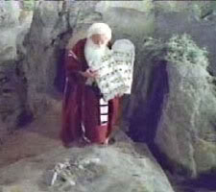
Eighteen fundamental skills of a scientist
How does science work?
What is research?
Identifying good research problems
Writing papers
Presentation in front of an audience
Obtaining funding
Reviewing/refereeing the work of others
Teaching
Guiding students, running a lab, managing projects
Scientific creativity
Information finding
Career planning
Interacting with people and networking
Marketing your skills: job hunt
Balancing your life between work and family
Coping with stress
Ethics in science
Appreciation for quality rather than quantity

Slide 15
Identification of good research questions
•
Finding a research question
“Secret weapon”
Dissertation question
Concluding remarks
Identifying good questions is critical for success.
Very often, especially in the beginning, senior colleagues (such as your mentor) will help you to identify and frame a research question.
Ultimately, however, it is important that you learn the heuristics that are used in this process, so that you can function independently and be successful.

Slide 16
An ideal research question
•
Finding a research question
“Secret weapon”
Dissertation question
Concluding remarks
The characteristics of an ideal research question
Builds on your personal preferences.
  Do you like working individually or in a team?
  What kind of work do you like most (what “drives” you)? Is it theory, implementation, experimentation?
Builds on your technical strengths.
Matches your plans for after obtaining your Ph.D.
… but most important of all
When you wake up in the morning, you feel like getting to work as soon as possible.

Slide 17
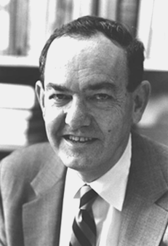
Finding a good research question
•
Finding a research question
“Secret weapon”
Dissertation question
Concluding remarks
Scientific discoveries in the history of humanity involved different creative processes.
It seems that there is no one recipe for doing research, including identification of a research topic.
It is a hard problem, but some heuristics may prove useful
A research problem is a question (as opposed to a topic)
The question does not need to be very specific (“What happens when … ?” is often fine in the beginning)
Subject candidate questions to four basic tests [Herb Simon]

Slide 18

Finding a good research question
•
Finding a research question
“Secret weapon”
Dissertation question
Concluding remarks
Test 1: Is this question solvable within the given amount of time?
What will the answer look like (this determines how we start)?
Is this the right time to start with it?
Can I finish it in less than three to four years that it takes to write a dissertation?
Can I finish it in 8 months that is a usual annual conference cycle?

Slide 19
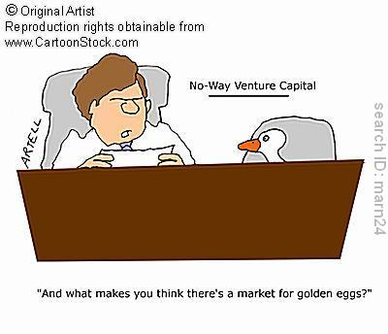
Finding a good research question
•
Finding a research question
“Secret weapon”
Dissertation question
Concluding remarks
Test 2: Will anybody care about the answer?
Is there any utility in answer?
Will at least two people download your paper?
Sometimes we care about the answer even without utility (e.g., DNA structure, structure of the Universe).
Sometimes we care less, e.g., http://www.improbable.com/ig/

Slide 20
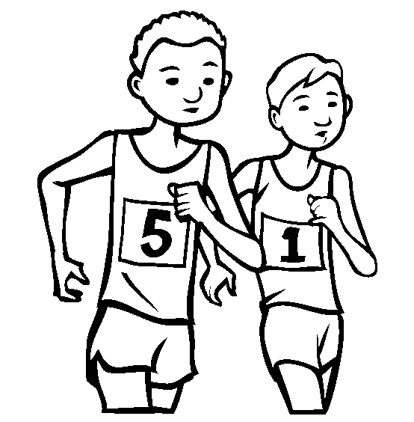
Finding a good research question
•
Finding a research question
“Secret weapon”
Dissertation question
Concluding remarks
Test 3: Will I be the first to answer this question?
This includes the past, but we can insure ourselves by doing a good job on library search.
Auxiliary questions (as long as you are on library search)
Is this the right time to work on this problem (i.e., does the present state of science make the research feasible)?
Are other people working on it now?

Slide 21
Finding a good research question
•
Finding a research question
“Secret weapon”
Dissertation question
Concluding remarks
Test 4: Do I have good tools to address this question?

Slide 22
The concept of a “secret weapon”
•
Finding a research question
“Secret weapon”
Dissertation question
Concluding remarks
What makes me think I will be successful?
“Because I’m smarter than others”
bad answer ... There are scores of smart people around.
You say you are in the 99th IQ percentile?
That’s quite smart!
Only 55,000,000 people are smarter than you!
(Due to late Randy Pausch)

Slide 23
The concept of a “secret weapon”
•
Finding a research question
“Secret weapon”
Dissertation question
Concluding remarks
What makes me think I will be successful?
“Because I work hard”
this is better ...
… but everybody who wants to succeed works hard.

Slide 24
The concept of a “secret weapon”
•
Finding a research question
“Secret weapon”
Dissertation question
Concluding remarks
What makes me think I will be successful?
“Because I have a secret weapon”
Much better!

Slide 25
“Secret weapon”
•
Finding a research question
“Secret weapon”
Dissertation question
Concluding remarks
What is a “secret weapon”?
A comparative, possibly unfair, advantage over your competitors to glory:
A good problem that nobody has thought about before.
Maybe you are the first to think about this problem because of personal experiences?
Advice: Do not look for research ideas in journal articles!

Slide 26
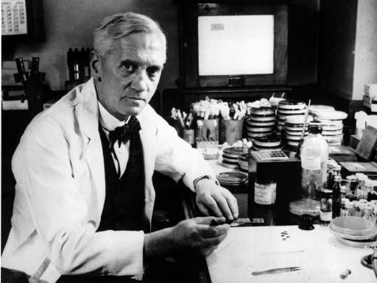
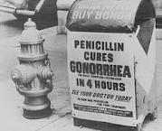
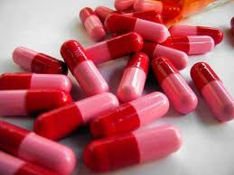
Example of personal experiences: Fleming and the discovery of penicillin
•
Finding a research question
“Secret weapon”
Dissertation question
Concluding remarks
Alexander Fleming (1881-1955)
Built a reputation of a brilliant researcher, although quite untidy.
In 1928, after a month-long vacation, he returned to his lab to find quite a lot of “development” around his cultures.
He examined what has grown around the cultures
Fungus that formed on one of them seemed to kill bacteria around it.
The rest is history (knighthood in 1944, Nobel 1945, his discovery has been called one of the most influential discoveries in the history of science).

Slide 27
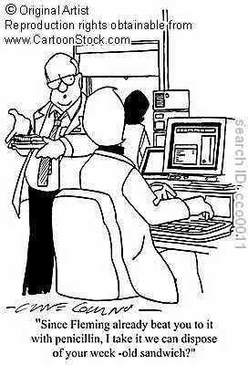
Example of personal experiences: Fleming and the discovery of penicillin
•
Finding a research question
“Secret weapon”
Dissertation question
Concluding remarks
It was a nice idea but may not work for you ☺

Slide 28
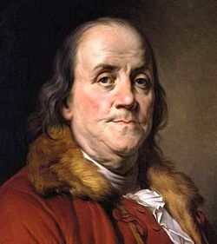
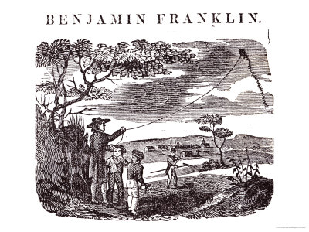
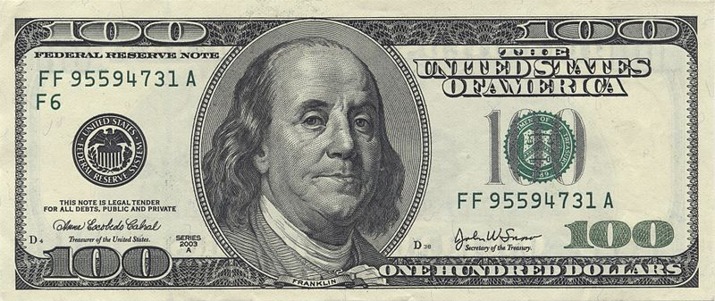
Example of personal experiences: The kite experiment
•
Finding a research question
“Secret weapon”
Dissertation question
Concluding remarks
Benjamin Franklin (1706-1790)
In 1750 he published a proposal for an experiment to prove that lightning is electricity by flying a kite in a storm that appeared capable of becoming a lightning storm.

Slide 29
Example of personal experiences: Are people utility maximizers?
•
Finding a research question
“Secret weapon”
Dissertation question
Concluding remarks
Herbert A. Simon (1916-2001)
During an internship at a local Milwaukee government he observed a serious discrepancy between economic theories (based on the assumption that humans maximize their utility) and reality.
Developed the theory of bounded rationality: Humans do not optimize, they “satisfice.”
Once he saw a computer, he quickly realized its potential and adopted it as a “secret weapon.”
Pursued this idea through theory of organizations, economics (Nobel Prize in Economics, 1978), artificial intelligence (Turing Award, 1975; von Neumann Theory Prize, 1988), and psychology (National Medal of Science, 1986).

Slide 30
Alexander Graham Bell
Alexander Graham Bell's creativity was deeply shaped by an environment saturated with sound, language, and communication challenges from childhood onward. Growing up with a mother who was deaf and a father who was a renowned elocutionist specializing in speech correction, Bell was immersed early in the mechanics of vocal sound and the frustrations of impaired hearing. This home environment, combined with his work teaching deaf students in Boston, gave him firsthand insight into the physical properties of sound waves and human speech that most inventors of his era simply didn't possess. His experiments with tuning forks, his father's "Visible Speech" system for teaching pronunciation, and his own hands-on tinkering with acoustics and electricity converged in a way that primed him to see the telephone not as an abstract engineering puzzle, but as a natural extension of a lifelong preoccupation with helping people hear and be heard—turning what began as personal and familial necessity into one of history's most transformative inventions.
Written by Claude.ai, verified by Adriana based on a “Who was” book

Slide 31
Alexander Graham Bell (cont’d)
Alexander's mother, Eliza Bell, lost most of her hearing during his childhood, and he developed a remarkably intimate solution: he would speak with his lips pressed close against her forehead, letting her feel the vibrations of his voice through the bones of her skull rather than relying on sound reaching her ears. This bone-conduction technique meant that communication with his mother became a tactile, almost sculptural act—he had to think carefully about how to shape and project speech so its physical resonance carried meaning, not just its acoustic signature. It's easy to see how formative this must have been: years before he ever touched a diaphragm or a telegraph wire, Bell was already treating the human voice as something that could be translated into vibration and felt rather than merely heard. That early, deeply personal experiment in converting speech into a different physical medium foreshadows the core insight behind the telephone itself—the idea that the sound of a voice could be carried by something other than air, transmitted through an entirely different channel, and still arrive as recognizable, meaningful speech on the other end.
Written by Claude.ai, verified by Adriana based on a “Who was” book

Slide 32
“Secret weapon”
•
Finding a research question
“Secret weapon”
Dissertation question
Concluding remarks
What is a “secret weapon”?
Special instruments, tools or a piece of knowledge that others don’t have.
Is there anything that I have around me?
Powerful theoretical tools (e.g., Newton).
Biggest, most powerful machine of a certain type (e.g., a powerful accelerator, an excellent networking lab).
Software tools (e.g., GeNIe and SMILE☺).

Slide 33
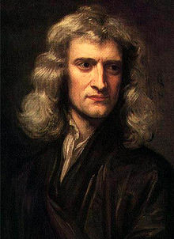
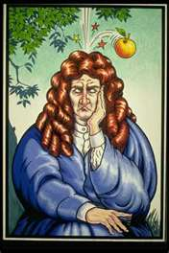
Example of special instruments: Isaac Newton and the calculus
•
Finding a research question
“Secret weapon”
Dissertation question
Concluding remarks
Some historians accuse him of having invented calculus but then withholding from publishing it until forced by Leibnitz
It is a fact that he was able to solve many outstanding problems and has been generally perceived to be a genius
Offered knighthood in 1705 (second scientist knighted after Francis Bacon)
(Apparently the apple thing is a fable ☺)
“If I have seen further it is by standing on the shoulders of giants.”
[Letter from Isaac Newton to Robert Hooke, 5 February 1676]

Slide 34
“Secret weapon”
•
Finding a research question
“Secret weapon”
Dissertation question
Concluding remarks
What is a “secret weapon”?
Training in a discipline that other people likely to work on the same problem are not trained in.
What is my background?
Can I combine my knowledge of music, my interests in biology, art, architecture, my concern about cancer or Alzheimer’s disease, etc., with my discipline?

Slide 35
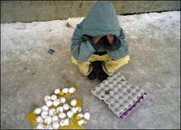
“Don’t put all your eggs in one basket”
•
Finding a research question
“Secret weapon”
Dissertation question
Concluding remarks
It’s a good idea to always have several good questions
… and work on the top three
This may not be a very good idea for doctoral dissertation

Slide 36
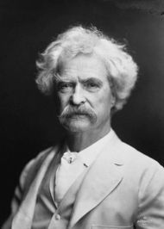

“Chance prefers a prepared mind”
•
Finding a research question
“Secret weapon”
Dissertation question
Concluding remarks
“The man who does not read has no advantage over the man who cannot read.” [Mark Twain]
What made Fleming look at the dishes and notice something unusual?
Learn as much as you can and as diverse knowledge as you can!

Slide 37
Finding a dissertation problem
Finding a research question
“Secret weapon”
Dissertation question
Concluding remarks
•
Similar to the problem of finding a research question, although you are not completely on your own here ...
Listen to your advisor: He/she is (or should be) one of your secret weapons.
What is (or is likely to be) funded? After all, you need to pay the rent and buy bread.
What are the strengths of this group, department, school, university, city? Who are the people I can rely on (my other secret weapons).
Remember that a doctoral dissertation (just like any scientific paper) is merely a progress report.

Slide 38
Finding a dissertation problem
Finding a research question
“Secret weapon”
Dissertation question
Concluding remarks
•
Play actively with the knowledge that you are gaining, lay links between facts, be critical and ask questions.
Take a real problem, preferably with high payoffs, find a good solution, do something practical. Best research ideas come from real problems and recognized real life needs.
Be careful who you are listening to.
Think, think, and once again think. This is what you do best.
Test market your ideas (spouse, friends, advisor, other faculty).

Slide 39
How to judge that it is a “hit” (PB)
Finding a research question
“Secret weapon”
Dissertation question
Concluding remarks
•
Not every selected and explored research question will graduate to the dissertation topic
Try to move on part-way and re-assess the criteria
Motivation
  Are you still excited/motivated to work on this question?
  Does it still looks like a value for your future career?
Feasibility
  To what extent your original idea (and your secret weapon) work
  Is it still looks doable in the remaining time left?
Value
  Is it still highly innovative?
  Is there an evidence that people care?
Do not do all judgement yourself, test the community!
  Brown bag presentations
  Conference talks and posters
  Doctoral Consortia at key conference in your field

Slide 40
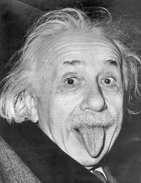

The importance of creativity
Finding a research question
“Secret weapon”
Dissertation question
Concluding remarks
•
Creativity is very important in finding research questions
How do you become creative?
“Imagination is more important than knowledge” Albert Einstein (1879-1955)

Slide 41
Eighteen fundamental skills of a scientist
How does science work?
What is research?
Identifying good research problems
Writing papers
Presentation in front of an audience
Obtaining funding
Reviewing/refereeing the work of others
Teaching
Guiding students, running a lab, managing projects
Scientific creativity
Information finding
Career planning
Interacting with people and networking
Marketing your skills: job hunt
Balancing your life between work and family
Coping with stress
Ethics in science
Appreciation for quality rather than quantity

Slide 42
Concluding remarks
Finding a research question
“Secret weapon”
Dissertation question
Concluding remarks
•
Your motivation and commitment
In order to succeed, you will have to work hard (around 80 hours a week) for ten or so years.
Think whether you really want to get into science. If so, make a commitment and follow it up.
Be enthusiastic about what you are doing. This makes whatever you are doing fun and easy.
If you cannot become enthusiastic, if you suffer from a permanent lack of motivation and nothing seems to work, you should probably consider another career.

Slide 43
Concluding remarks
Finding a research question
“Secret weapon”
Dissertation question
Concluding remarks
•
There is no substitute to interacting with other people
Talk to your advisor
Talk to your colleagues (fellow doctoral students)
Talk with people who are actively working in your area of interest
Talk to professors in related research areas
Talk to your friends and family about your work
Caution!!!
Do not only talk – make sure that you also listen!!!

Slide 44
Concluding remarks
Finding a research question
“Secret weapon”
Dissertation question
Concluding remarks
•
Work hard on your skills
Learn to read quickly.
Write and present your work.
Find a mentor, work with him/her, listen to him/her. He/she is one of your best resources.
Get involved in research as soon as possible. Search for your secret weapons.
Do things for real – you will be doing them for real in a few years from now (if you are not already).

Slide 45
Concluding remarks
Finding a research question
“Secret weapon”
Dissertation question
Concluding remarks
•
Simple and easy tricks that help you succeed
Have friends, balance them out, have anthropologist friend, talk with them, have lunches together. Herb Simon would ask them the question “What’s new in your field?” (if you notice that you have some unique insight on the questions in the field, you have an opportunity!).
Do not treat boundaries between disciplines too seriously: they are artificial anyway.
Structure your time, plan your career, studies, semester, month, week, day. Set aside time for planning.
Have a diary of what you did on a given day, write in your research ideas. (This is a good method to cut out game playing, web browsing, newsgroups, etc.)

Slide 46
Concluding remarks
Finding a research question
“Secret weapon”
Dissertation question
Concluding remarks
•
Simple and easy tricks that help you succeed
Do not automatically suspect that not understanding something is your fault. Ask questions, don’t afraid to look silly. (Remember “The king is naked?” fable?)
Think and do not follow the crowd.
Be honest and not paranoid about your research ideas (or else perhaps they are not your friends?).

Slide 47
Concluding remarks
Finding a research question
“Secret weapon”
Dissertation question
Concluding remarks
•
Simple tricks inspired by cognitive psychology
Active learning: Play with the newly acquired knowledge, create links to knowledge that you already have.
Expose yourself to ideas: This influences creativity.
Set aside large chunks of time for thinking things through (you cannot do without it!).
Develop in yourself a “lifetime learning” mentality.

Slide 48
Testing Your Ideas: Setting Up
Set up code for a baseline method—whether written from scratch, or code other researchers shared—get your “hands dirty”
Set up evaluation—make sure it is correct, fair
  Machine learning: Train/validation/test split (val to pick hyperparameters, use test set once)
  Relevant metrics used—if proposing new metrics, explain why they are needed
  Make sure your method isn’t using unfair advantage—anything that isn’t part of your contribution
  Are the results what you expected? In both cases (yes/no), double-check your work

Slide 49
Developing Your Method
Start with existing method (baseline), use existing code or implement from scratch (sometimes simpler, published code not always easy to use)
Think about which parts of your full framework are your actual contribution that you will highlight in the paper, and which parts are standard

Slide 50
Experiments
You need to show impact of your key contribution
  Scientific method—change one variable at a time, to show its impact
  Bad: 3 new method components (2 of which not very interesting), new metric, new dataset–and only compared against 1 baseline
Gives rise to “ablation” experiments—compare a backbone to the backbone with each of your key ideas added, one at a time, then together
Also need to compare to methods from the very recent literature—the more the merrier (if done properly)

Slide 51
Bookkeeping
When developing your method and conducting validation (e.g. running experiments)– it’s crucial that you document your work!
You should be able to reproduce the exact settings and results that you obtained—apart from factors due to randomness (but can set random seed)
You should know the complete setting of results you include in papers, and all results you show your advisor
You should include as much information as possible to enable others to reproduce your results, even share code if possible—helps with getting your work cited

Slide 52
What if Results Don’t Look Good?
Your baseline and evaluation is set up well, but your proposed method doesn’t outperform the baseline?
This is likely to happen, often—try to understand what isn’t working well and why, then iterate on method
Try simple changes first, e.g. tuning algorithm “knobs”
Come up with simple environments where your new idea should work–e.g. a simpler test set, no-noise environment, attentive users, etc.
It’s ok to iterate on metrics too—perhaps one metric is too coarse to show impact of your method
Keep reading papers to get more ideas on method

Slide 53
Sometimes, You Give Up
Sometimes, you iterate but nothing works
When to give up on this overall idea, topic?
“Give up” = publish in a workshop
Really hard to say, but important to know there may be a time you need to stop—1 year?
Consider whether it is worth investing even more time in this particular project
It doesn’t reflect on your ability as a researcher!
It’s not wasted time—use the skills you acquired to tackle a related problem!

Slide 54
Getting Help
Lots of learning resources on the web
  Check out tutorials from relevant conferences
Peers, senior students
  Formulate your request clearly, make it efficient for them to help
  Don’t hesitate to ask for help—you’re just starting, they’re an expert!
Your advisor
  Often, it makes sense to try to figure things out on your own, unless it’s something that advisor can easily and quickly resolve
  Send email rather than waiting, or show up at their door—if you’ve discussed with your advisor that’s ok; potentially use Slack group
Reading group
  Volunteer to present your work
  Will get help with brainstorming
  Sometimes just talking about your work helps!

Slide 55
Activity 1
Pick a paper by your advisor
Propose extensions
Discuss with peers (in class one), get feedback, defend ideas or move on
Propose 5, select 2, then…
Discuss with advisor why good/bad ideas, what challenges may be
Submit report or discuss (class 2)

Slide 56
Activity 2
Review some papers, see how they presented the scientific gap; think about how this idea may have come about
Read the history of some inventions (e.g. telephone) and the context behind that – where need, idea, and inspiration came from
Read about how writers get ideas
Share with the group

