Slide 1
CS 2001: Research Topics
Scientific enterprise: collaborations, funding, conferences
Prof. Adriana Kovashka
University of Pittsburgh
September 1, 2026

Slide 2
Plan for this lecture
Collaborations
Funding
How conferences work

Slide 3
Collaborations

Slide 4
Types of collaborations
Working with your advisors
Working with other faculty in your department (with/without your advisor)
Working with researchers in your field, but at other institutions
Working with researchers outside your field, at your institution or other institutions

Slide 5
Examples
What collaborations have you heard of? What collaborations does your advisor or department engage in?

Slide 6
Benefits
Shared load
  Oversimplified example: AI researchers don’t have to collect data
More opportunity for impact
  AI work that has a positive impact on public health
Networking
Examples? What else?

Slide 7
Challenges
Publication venues vs goals of project
Discussing topics beyond your typical interest or expertise
Examples? What else?

Slide 8
Criteria for successful collaboration
Shared vision
Understanding and appreciation of each field’s research questions
What else?

Slide 9
The Community Is…
Source of ideas
Place to discuss and test ideas
  Colleagues, presentations, workshops, conferences
Place to report results
  Publishing, conference talks, research colloquia
The mechanism to evaluate quality of ideas, results, contributions
  Peer review
  Replication
The mechanism to propagate ideas
  Citation
  Publicity
  Impact
Slide credit: Peter Brusilovsky, Marek Druzdzel

Slide 10
Networking
You need to know people and you need to be known
Identify leading researchers and other interesting people in your area
Find a chance to get know – meet, write
Use presentations wisely: ask questions, talk with a speaker
Attend professional conferences and use most of it
Make connections from your work to the work of others, make yourself known
Use address book and social linking tools to maintain contacts
Slide credit: Peter Brusilovsky, Marek Druzdzel

Slide 11
Funding

Slide 12
Funding sources (external)
National Science Foundation (NSF)
National Institutes of Health (NIH)
Defense Advanced Research Projects Agency (DARPA)
National Endowment for the Humanities (NEH)
Industry (e.g. Google, Amazon, Adobe)
Foundations (e.g. Sloan, R. K. Mellon, Heinz)

Slide 13
How do funding sources differ?
Basic vs applied research
Fewer/more strings: Do exactly what you promised (or not), on an exact timeline (or not)
Funding expiration (1 year, 3+ years, unlimited)
Working with funders closely or not (before/after grant received)

Slide 14
Funding proposals
Describe the work to be done and its significance
Describe why the team is the right team to do this work
Describe how science will advance as a result of this work being done

Slide 15
Proposal review: NSF
Panel of peers (e.g., 4 researchers) reads and submits reviews
  Often several months after proposal is submitted
Reviews include a score: Excellent, Very Good, Good, Fair, Poor
Proposals with no scores over “Good”, are triaged (not reviewed further)
Remaining proposals are discussed in the panel meeting
Panel gives rating: Highly Competitive (HC), Competitive (C), Low Competitive (LC), Not Competitive (NC)
Panel ranks the HC and C proposals
Panel writes summary for discussed proposals, highlighting the key factors for positive/negative scores
Program manager/director/officer seeks funding from the agency for the top-ranked proposals
Acceptance rates are low, e.g. 15-33% in the Directorate for Computer and Information Science and Engineering (CISE): https://www.nsf.gov/cise/funding-rates

Slide 16
How this matters to you
Thoughts?

Slide 17
Learning to write grant proposals
Not required for your PhD, and not extremely common (but not extremely rare either)
Your proposal has to have a compelling story, with a feasible plan, strong background of the researchers, and promise for impact
Example resources (tips):
  https://learn.hms.harvard.edu/insights/all-insights/essentials-writing-winning-grant-proposal
  https://writingcenter.unc.edu/tips-and-tools/grant-proposals-or-give-me-the-money/

Slide 18
Conference Review Process

Slide 19
Conferences and You
Ratio of conference to journal pubs typically higher in CS than other areas
Conferences at different tiers; top-tier may have acceptance rates of 15-30%
Example goal for your PhD:
  2-3 top-tier conference pubs,
  2-3 second-tier conference pubs,
  1-2 journal pubs

Slide 20
Conference Review Process
Papers are submitted by a fixed deadline
  The more prestigious the conference, the less likely deadline will be extended
Program Chairs assign papers to Area Chairs (semi-automatically) for handling
Area Chairs select reviewers from available pool (and help recruit reviewers)
A paper may be reviewed by 3-5 reviewers

Slide 21
Conference Review Process (cont’d)
In many conferences, reviews are released before final decision, and authors get a chance to respond to comments (rebuttal), to correct misunderstandings and provide further details
Next, reviewers discuss (moderated by AC), update their reviews, and AC makes decision recommendation based on final reviews
How much time does a reviewer spend with a paper? How much time does the area chair spend with it? Which papers does the area chair spend more/less time with? What does this imply for how papers, reviews, and rebuttals should be written?

Slide 22
Conference Review Process (cont’d)
If decision is accept, authors have a few weeks to submit final (“camera-ready”) version
If decision is reject, authors may submit to a workshop associated with the conference, or submit to another conference
Dual submissions usually not ok (can’t have same paper under review for two conferences at the same time)
  Exception: some 4-page extended abstract submissions, considered work in progress
  Those are good to do, can add to CV, but they are non-archival and not considered real publications, so don’t invest too much time

Slide 23
Author/Reviewer Anonymity
Double-blind review: authors don’t know who reviewers are, and vice versa. Why?
Single-blind: authors don’t know reviewer identities
There may be policies about “tech report” submissions (e.g. on arxiv.org) during paper anonymity/review time – allowed/not
You may accidentally find out a paper’s author identities when you review, but you should not actively try to find it out
Reviewer identity is hidden from authors, but not hidden from program and area chairs
Thus, apart from honor and karma, you should do a good job at reviewing because these chairs should have a good opinion of you for later job opportunities

Slide 24
Scores in Reviews
Comments that reviewers write are important; also important are scores
CVPR reviewing scale:
  Strong Accept, Weak Accept, Borderline, Weak Reject, Strong Reject
NeurIPS reviewing scale:
  10: Top 5% of accepted NeurIPS papers. Truly groundbreaking work.
  9: Top 15% of accepted NeurIPS papers. An excellent submission; a strong accept.
  8: Top 50% of accepted NeurIPS papers. A very good submission; a clear accept.
  7: A good submission; accept. I vote for accepting this submission, although I would not be upset if it were rejected.
  6: Marginally above the acceptance threshold. I tend to vote for accepting this submission, but rejecting it would not be that bad.
  5: Marginally below the acceptance threshold. I tend to vote for rejecting this submission, but accepting it would not be that bad.
  4: An okay submission, but not good enough; a reject. I vote for rejecting this submission, although I would not be upset if it were accepted.
  3: A clear reject: I vote and argue for rejecting this submission.
  2: I'm surprised this work was submitted to NeurIPS; a strong reject.
  1: Trivial or wrong or already known.

Slide 25
Reviews Followed by Rebuttals
A rebuttal is a short document (1-page) where authors address concerns by reviewers; typically short deadline for conferences
Typically in question-answer format
The goal is to rebut factual errors on the reviewers’ part, and alleviate concerns for on-the-fence reviewers
Especially important for borderline papers (WA, B, WR) or (WA/WR, B, B) or (B, B, B)

Slide 26
Review Score Scenarios
Which papers (with what scores) get accepted?
  What happens to a paper with (WA, WA, WA)?
  What happens to a paper with (WA, B, WR)?
  What happens to a paper with (WA, WA, SR)?
  What happens to a paper with (B, B, B)?
Scores and decisions for one conference:
  https://papercopilot.com/statistics/iclr-statistics/iclr-2025-statistics/
  https://github.com/evanzd/ICLR2021-OpenReviewData
  https://docs.google.com/spreadsheets/d/1MLlgV82_4K1FJGSjUKm2R8cw5msn4xmrhtnS9FLAS6k/edit#gid=189496698

Slide 27
Role of a Reviewer
A reviewer is a judge—they safeguard the quality of a publication venue
A reviewer also gives feedback and helps steer a particular work (if suggestions that reviewer gives are sensible)
Both of these imply reviewing should be taken very seriously!
Important: Keep papers you review confidential, to protect the authors’ work!
One reviewer responsible for 1/30-th of someone’s PhD career
  Say a student will publish 5 papers (1 per year) to be granted their PhD, 2 attempts to publish one paper, each attempt is reviewed by 3 reviews

Slide 28
A Reviewer Should:
Read the paper carefully (1-2 hours)
Take notes about strengths, weaknesses, points that seem unclear, problematic, even typos (if time)
Use notes to fill out a review template (~15-30 min)
Be responsive to area chair requests for discussion
Read rebuttal, others’ reviews, and complete final scores (if there is a rebuttal/discussion phase)

Slide 29
Reviewer Guideline Examples
NeurIPS: https://neurips.cc/Conferences/2026/ReviewerGuidelines
CVPR: https://cvpr.thecvf.com/Conferences/2026/ReviewerGuidelines
CHI: https://chi2026.acm.org/guide-to-reviewing-papers/
ISCA: https://iscaconf.org/isca2026/submit/reviewers.php

Slide 30
Use of AI in Reviewing
Many conference disallow AI use and may reject your paper if you use it
Some conferences are experimenting with controlled tools for AI-aided reviewing
One conference had a “watermark” to detect unauthorized AI use
Changing landscape: Pay attention to rules of the specific conference

Slide 31
Discussion of a Paper
AC may call for a discussion (on reviewing platform)
Reviewers bring up especially important points
Other reviewers agree/disagree with whether an issue raised is truly problematic, whether it is a critical problem, etc
Sometimes/often a review will change their mind, based on rebuttal, or based on other reviewer’s comments
It’s ok to change your mind, if you have a good reason– don’t be afraid to
Also don’t be afraid to be the only person being very positive about a paper—and provide arguments

Slide 32
Journal reviewing
Reviewers usually suggest minor or major revision on your original submission
You get the same reviewers (a positive)
You can’t just ignore reviewer feedback and submit again (to the same venue)
Longer review timeline

Slide 33
Dual submissions
Each work typically only appears in proceedings for one conference (“archival”)
Most conferences don’t allow the same work to even be under review in two conferences at the same time (violation results in desk reject)
Exceptions to dual submissions in some conferences: non-archival work, extended abstracts (very short papers)

Slide 34
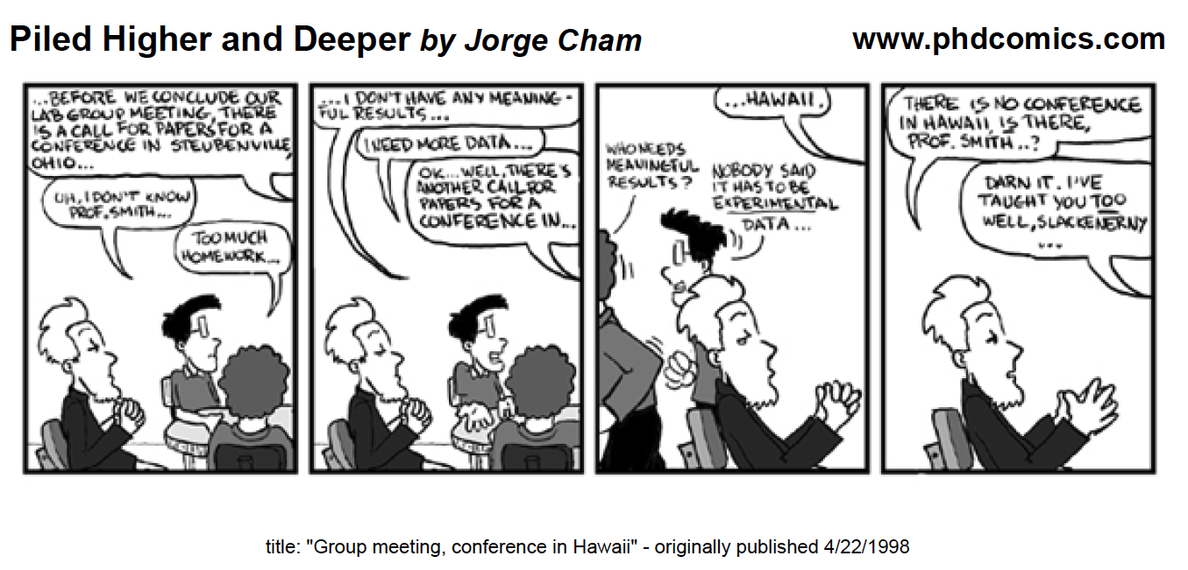
Which conference?
Which factors are important when selecting a conference to attend?
Slide credit: Peter Brusilovsky, Marek Druzdzel

Slide 35
Judging the quality
Conference quality
  First tier, second tier, and weak and junk conferences
  Judging the organizer
  Judging program committee
  Fighting bogus conferences, SciGen
Journal Quality
  Journal Board, Editor
  Publisher
  Indexing
Book Publisher Quality
Slide credit: Peter Brusilovsky, Marek Druzdzel

Slide 36
Your experience with publishing
Please share

Slide 37
Paper acceptance: Case studies activity
Adriana’s examples
  https://openreview.net/forum?id=xpkJiQNC0E
  https://openreview.net/forum?id=opG4m2U0Oo
Find and share your own
  Can look here; Accept/Reject tabs https://openreview.net/group?id=ICLR.cc/2026/Conference

