Slide 1
CS 2001: Research Topics
Introduction
Prof. Adriana Kovashka
University of Pittsburgh
August 25, 2026

Slide 2
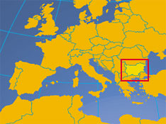

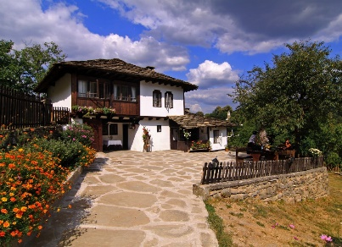

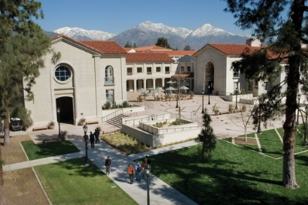
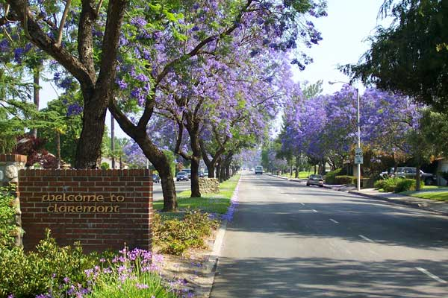
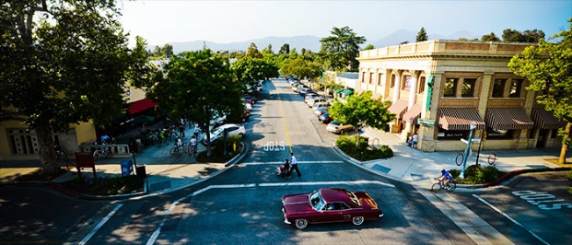
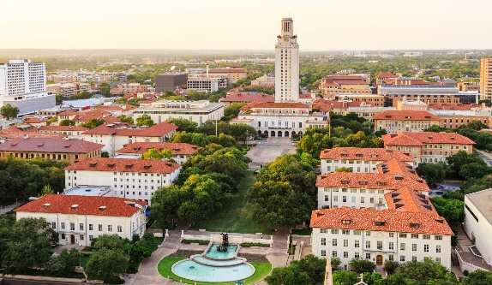
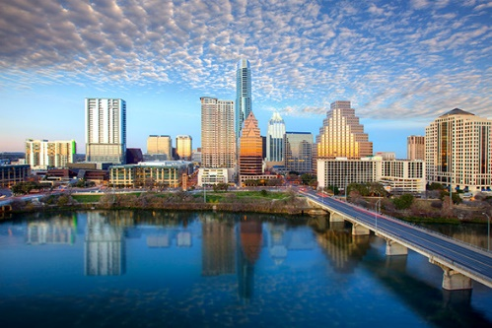
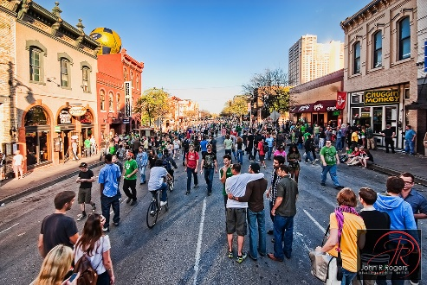
About the Instructor
Born 1985 in
Sofia, Bulgaria
Got BA in 2008 at
Pomona College, CA
(Computer Science &
Media Studies)
Got PhD in 2014
at University of
Texas at Austin
(Computer Vision)

Slide 3
Course Info
Course website: http://people.cs.pitt.edu/~kovashka/cs2001_fa26
Instructor: Adriana Kovashka (kovashka@cs.pitt.edu)
→ Use "CS2001" at the beginning of your Subject
Office: Sennott Square 5325
Class: Tue/Thu, 11am-12:15pm
Office hours: Tue/Thu, 12:15-1pm (preferred) and by appointment
Notes:
Plan + website (4 min)
Introductions of students (10 min)
Intro to visual recognition (12 min)
Topics (12 min)
Structure of course (14 min)
Prereqs test (15 min)
Questions + extra (8 min)

Slide 4
Topics, grading, policies, schedule, readings
See course website

Slide 5
Logistics
If you’re an IS, LIS, ISP student: Submit a request to your respective graduate committee (if in doubt, ask the program administrator) to count this course instead of the standard first-year PhD seminar offered by your program (e.g. INFSCI 3005, LIS 3000)
CS, DINS, ICDS, ISP have agreed to shared offerings of this course, and will alternate offerings across departments

Slide 6
What You Will Get out of This?
Generally, as much as you put into it
The true value of this seminar is in getting you to think seriously about your career.
You will organize your knowledge of the most important, fundamental skills of a scientist.
You may feel bored now and then, but ...
If, during each of our meetings, you get one good idea that you will assimilate and use throughout your career, you will have made a great investment.
Experience with teaching these skills shows consistently that they are priceless.
Slide credit: Peter Brusilovsky, Marek Druzdzel

Slide 7
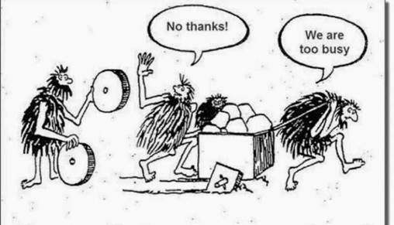
Giving and taking…
Slide credit: Peter Brusilovsky, Marek Druzdzel

Slide 8
Please bring your laptops!
(and only use them for class work)

Slide 9
Introductions
What is your name?
What topics within computing and information are you interested in?
What do you like to do outside of school/work?
Why did you choose to pursue a PhD?
Why did you choose to pursue it at Pitt?

Slide 10
Plan for this lecture
PhD journey
  PhD timeline at Pitt
  Motivation and challenges of doing a PhD
Managing a PhD career
  Communicating with your advisor
  Gaining confidence
  Advice from faculty
  Time management
Resources

Slide 11
PhD Journey

Slide 12




PhD Timeline at Pitt (CS)
2 Classes, A- or better
2 Classes, B or better
CS 2100 – 2899 only
Can count towards core reqs
Demonstrate depth of knowledge
Basic gist of PhD topic area
Committee: 3 CS faculty
Ideally done by end of third year
  At least 8 months after proposal
Comprehensive Exam
CS 2001
Pass (NEW) Prelim CS 2002
Defense
Find an advisor!
Finish CS 2003
1 2
Pass Foundation Course Requirements
3
4
5
6
Dissertation Proposal
By graduation:
six elective courses (grade B- or better)
One course from each of
  AI / Database
  OS / Networks
  Architecture / Compilers
  Theory / Algorithms
At least a B in each
“Contract” for PhD
Committee: 3 CS + 1 external
Slide credit: Adam Lee, Diane Litman

Slide 13
CS PhD Timeline at Pitt
https://www.cs.pitt.edu/current-students/phd-computer-science/degree-requirements
  Let’s spend 5 min to read and ask questions
https://www.cs.pitt.edu/current-students/graduate-policies
  Let’s spend 5 min to read and ask questions

Slide 14
Comprehensive Exam
CS: “Work w/ three faculty members (your advisor and two more) to identify one topic area per faculty member, on which you present essentially a survey of the literature. The topic area should not be too broad (e.g. machine learning) but something a bit more specific. Depending on the area you are working in, faculty may have different expectations.
CS: In AI comprehensive exams, students typically choose 10-15 papers per topic, and share the list with the faculty for feedback (before the exam). The student’s goal is to organize the papers in each area in some meaningful, interesting way. Show families of methods, discuss their similarities and differences, and their strengths and weaknesses. Do NOT show one slide per paper, and do not talk about any one paper in too much detail. Think of comp as writing a survey paper on the topic. You want to present the general directions researchers have explored, educate the audience about when they might choose one family of methods over another, and discuss limitations and open research challenges.
CS: In some systems comps, each topic area has 3-4 papers, but the student should know these papers really well. Sometimes faculty choose seminal papers for the exam, and sometimes faculty request students to pick the important papers in the topic area. Students are responsible for knowing the ancillary/pre-requisite materials for these 3-4 papers, and are also supposed to know how to apply the ideas of the papers to solve other problems. Not too many papers, but a lot of thinking about the papers (techniques and how to apply them).”
IS, ISP: List of questions submitted by faculty member; student has a fixed number of days to draft responses based on the literature
https://docs.google.com/document/d/1mcF3yHJJDdXk7PCMIn54MHufo9tIHweaVDPX5V22Ywk/

Slide 15
Structure of ISP/IS PhD programs
Prerequisite courses (English, HIP, ..)
Coursework
  http://sci.pitt.edu/academics/doctoral/isp/
  http://sci.pitt.edu/academics/doctoral/is/
Preliminary examination
  Course requirements for IS
  Examination
Comprehensive examination
Dissertation proposal
Dissertation defense
Timeline
Expectations
Slide credit: Peter Brusilovsky, Marek Druzdzel

Slide 16
Coursework for PhD in IS
IS situation more complex than ISP
  48 credits for MS graduates, students without MS need to take 12 extra credits (60)
  Part of the coursework treated as a preparation for the comp exam
  IS has five graduate prerequisite courses – need to be completed if missing!
Required coursework (30 credits)
  Four core courses (12 credits)
  One introductory doctoral seminar (3 credits)
  Two topical doctoral seminars (6 credits)
  Two independent research studies (6 credits)
  One advanced statistics (3 credits)
Dissertation work (18 credits)
  A minimum of 18 credits of dissertation study
27 credits: treated as a
preparation for prelim.
examination
Slide credit: Peter Brusilovsky, Marek Druzdzel

Slide 17
Prerequisite Courses for IS PhD
Have to be completed before enrollment or within first 4 terms. Not considered for your 48 credits, but could be a part of 60 for students started without MS
Statistics or Discrete Math (e.g., IS 2060 Statistics or IS 2020 Mathematical Foundations)
Cognitive Psychology (e.g., IS 2300 Human Info Processing or IS 2350 Human Factors)
Systems Analysis and Design (e.g., IS 2510 Information Systems)
Data Structures (e.g., IS 2500 Data Structures)
Database Management (e.g., IS 2710 Database Management)
Slide credit: Peter Brusilovsky, Marek Druzdzel

Slide 18
Preliminary Examination
“Prelim” is focused on research
  You already demonstrated that you can pass exams in your BS (and MS) coursework
  Show that you could produce publishable quality work and research papers
An important and quite likely the most stressful and relatively hardest hurdle in the program
This is where you show that you can make it
3-4 semesters in preparation!
  IS – Second January of your PhD studies
  ISP – End of the second semester
Slide credit: Peter Brusilovsky, Marek Druzdzel

Slide 19
Preliminary Examination for IS: Courses + Defense
Preparation: Course requirements
  Four core curses
    http://www.ischool.pitt.edu/ist/degrees/phd-details.php
  Two independent studies
  Three doctoral seminars (3005 required)
Examination
  Prepare a research paper
  Present and defend your work
You don’t need to have all the courses completed before the examination but you have to fulfill both in order to formally pass the preliminary examination
Slide credit: Peter Brusilovsky, Marek Druzdzel

Slide 20
How to prepare to the Prelim
Learn what good research is
  Working with literature
  Doing research
  Writing
  Presenting
  This course is a good start
Start working on your research early
  Identify faculty who are doing what you are interested in
  Find interesting and promising topic
  Work with advisor and other faculty (2 indep. studies)
Slide credit: Peter Brusilovsky, Marek Druzdzel

Slide 21
Comprehensive Examination
An evaluation of the breadth and depth of your knowledge in your area of focus
Should be relevant to Information Science
Three legs on which your knowledge of the field rests
Lot of flexibility in what these three legs are
Do it when you are ready
  in terms of having selected your research area and dissertation topic
Slide credit: Peter Brusilovsky, Marek Druzdzel

Slide 22
Comprehensive Exam Committee
Your committee (examiners) is very important
Three IS faculty represent three areas of expertise
They will guide your reading to help you gaining critical expertise
First step to dissertation work
  Prelim work will be a ground of your thesis review part
  Your examiners will likely be on your thesis committee
Slide credit: Peter Brusilovsky, Marek Druzdzel

Slide 23
Dissertation Proposal
Identify Dissertation Advisor
Form your dissertation committee
  Four committee members
  Three program faculty, one external member
Prepare and defend your proposal
  A contract between you and your doctoral committee
Once you defended the proposal, you will become a PhD Candidate
  Do it early rather than late
Slide credit: Peter Brusilovsky, Marek Druzdzel

Slide 24
Dissertation Defense
Your final examination in this program
Complete the proposed study
Write your thesis
  Most important publication of your life
  Accessible to all world online
Defend your work
After this examination, you will be a scientist with a license
Slide credit: Peter Brusilovsky, Marek Druzdzel

Slide 25
Stages of the Doctoral Study
Field
Topic
Thesis
Direction
Area / Subarea
Slide credit: Peter Brusilovsky, Marek Druzdzel

Slide 26
Example: Chun Hua Tsai
Information Science
Explanations in RS
Controllability and Explainability
in a Hybrid Social Recommender System
Interfaces for Recommender Systems
Adaptive Systems / Recommender Systems
Slide credit: Peter Brusilovsky, Marek Druzdzel

Slide 27
Mapping to Communities
Field: 1000s of people, superconferences (IJCAI, CHI..)
Topic: 10-20 worlwide
Thesis: 1
Direction: 10s, workshops
Area / Subarea: 100s, smaller conferences (IUI)
Slide credit: Peter Brusilovsky, Marek Druzdzel

Slide 28
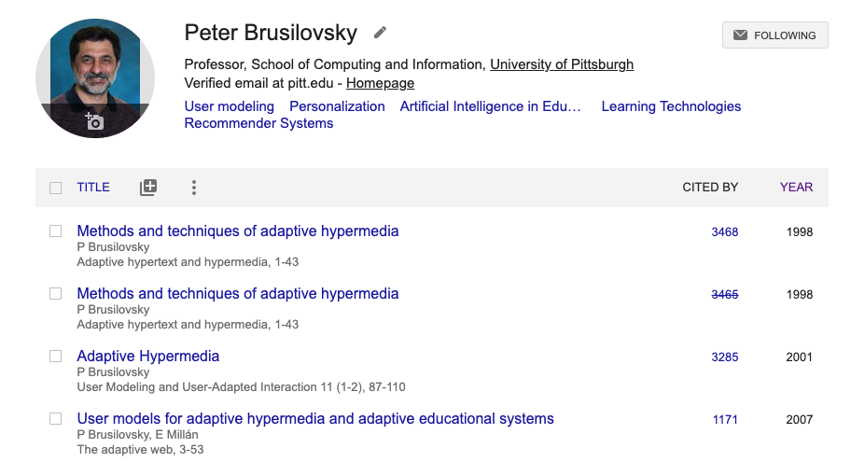
Areas Define Your Subcommunities
https://scholar.google.com/citations?user=s6RpNfAAAAAJ&hl=en
Slide credit: Peter Brusilovsky, Marek Druzdzel

Slide 29
Preliminary Exam: Breadth (Degree!)
Field
Topic
Thesis
Direction
Area
Slide credit: Peter Brusilovsky, Marek Druzdzel

Slide 30
Comprehensive Exam: Depth
Field
Topic
Thesis
Direction
3 Areas!
Slide credit: Peter Brusilovsky, Marek Druzdzel

Slide 31
Choosing Areas: Support Your Thesis!
Information Science
Explanations in RS
Controllability and Explainability
in a Hybrid Social Recommender System
Interfaces for Recommender Systems
Adaptive Systems / Recommender Systems
Recommender Systems: Dr. Peter Brusilovsky
Data Analytics / Visualization: Dr. Yu-Ru Lin
Social Network: Dr. Konstantinos Pelechrinis
Slide credit: Peter Brusilovsky, Marek Druzdzel

Slide 32
A Sample Timeline (IS)
First Year Fall |  | IS 3005 | Core Course | Prerequisite
First Year Spring |  | Independent Study | Doc Seminar | Core Course
First Year Summer |  | Independent Study, Statistics, Last Prerequisite Courses, research and/or teaching
Second Year Fall |  | Doc Seminar | Core Course | Research Study
Second Year Spring | Preliminary Examination | Core Course | Core Course | Advanced Statistics
Second Year Summer |  | Independent Study, research and/or teaching
Third Year Fall |  | Electives | Electives | Electives
Third Year Spring | Comprehensive Exam | Dissertation Work
Fourth Year Fall | Dissertation Proposal Defense | Dissertation Work
Fifth Year Spring | Dissertation Defense | Dissertation Work
Slide credit: Peter Brusilovsky, Marek Druzdzel

Slide 33
Full List of PhD Timelines
CS: https://catalog.upp.pitt.edu/preview_program.php?catoid=236&poid=74646&returnto=25130
IS: https://catalog.upp.pitt.edu/preview_program.php?catoid=236&poid=74649&returnto=25130
LIS: https://catalog.upp.pitt.edu/preview_program.php?catoid=236&poid=74664&returnto=25130
ISP: https://catalog.upp.pitt.edu/preview_program.php?catoid=236&poid=74666&returnto=25130

Slide 34
PhD Timeline at Pitt
More than smarts: Persistence!
Time management should become an art…
Identify larger open problem, not just many
small “neat” problems
writing, Writing, WRITING
Continue reading
Finish course requirements
Identify research areas/professors of interest
Begin reading papers, discussing area, doing pilot experiments / development
1
2
3
4
5
6
Attend group meetings
Read several papers per week
Research! Develop your niche, expertise.
Work on time management skills
reading, Reading, READING
Good thesis or great thesis?
To defend, you must be an expert. Are you?
Resist the temptation to take a job before
you defend. This is a recipe for disaster.
Slide credit: Adam Lee, Diane Litman

Slide 35
What is a PhD?
Imagine a circle that contains all human knowledge
Borrowed from http://matt.might.net

Slide 36
What is a PhD?
By the time you finish elementary school, you know a little
Borrowed from http://matt.might.net

Slide 37
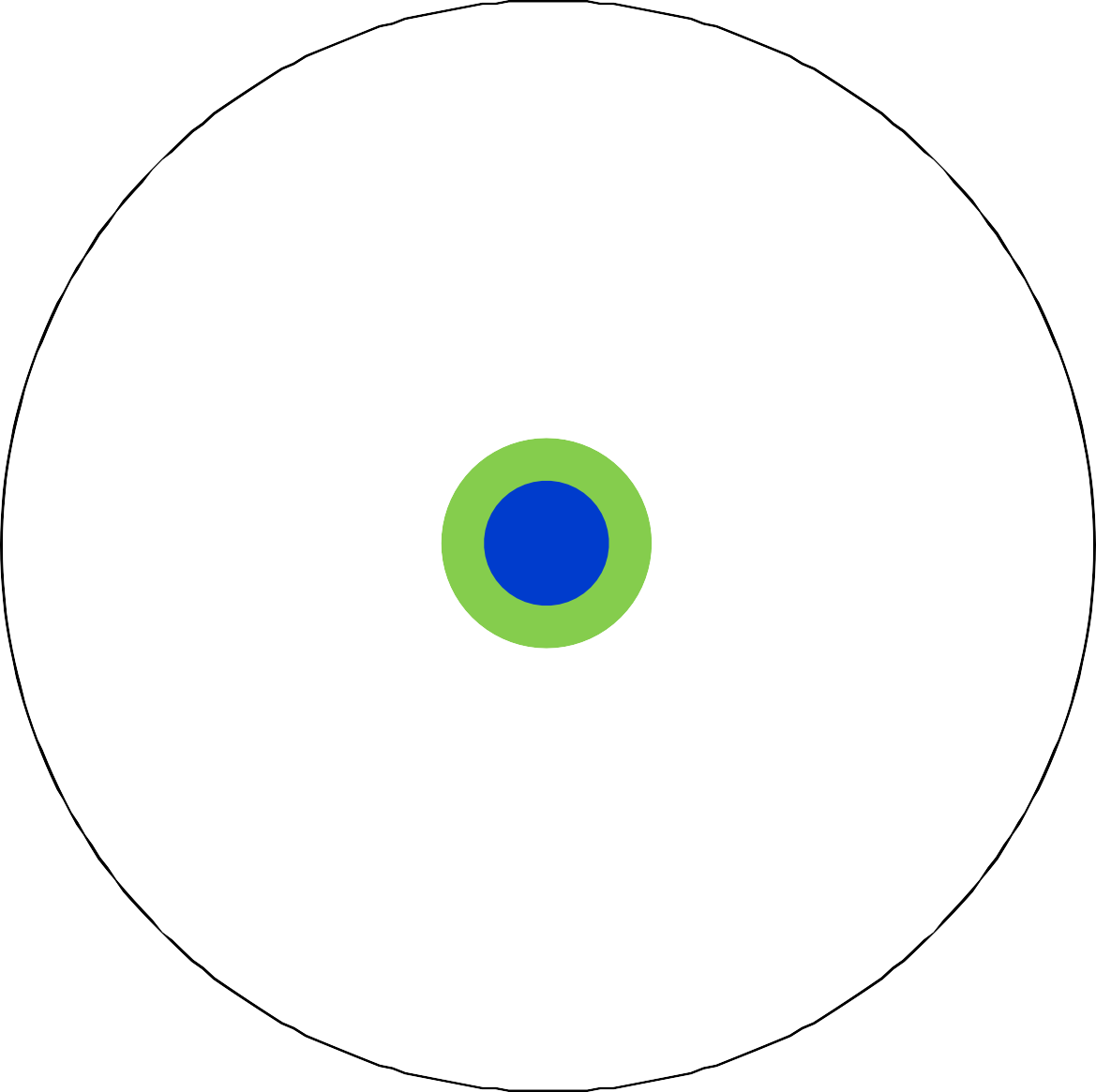
What is a PhD?
By the time you finish high school, you know a bit more
Borrowed from http://matt.might.net

Slide 38
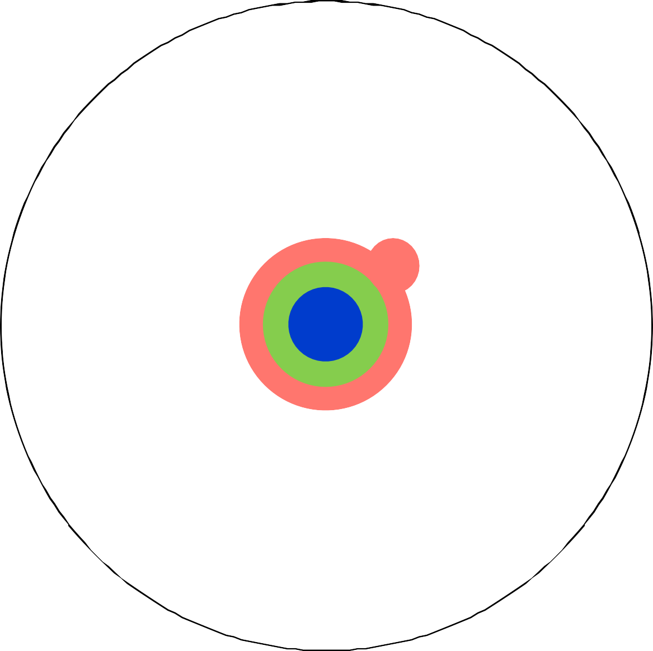
What is a PhD?
With a BS, you begin to develop a specialty
Borrowed from http://matt.might.net

Slide 39
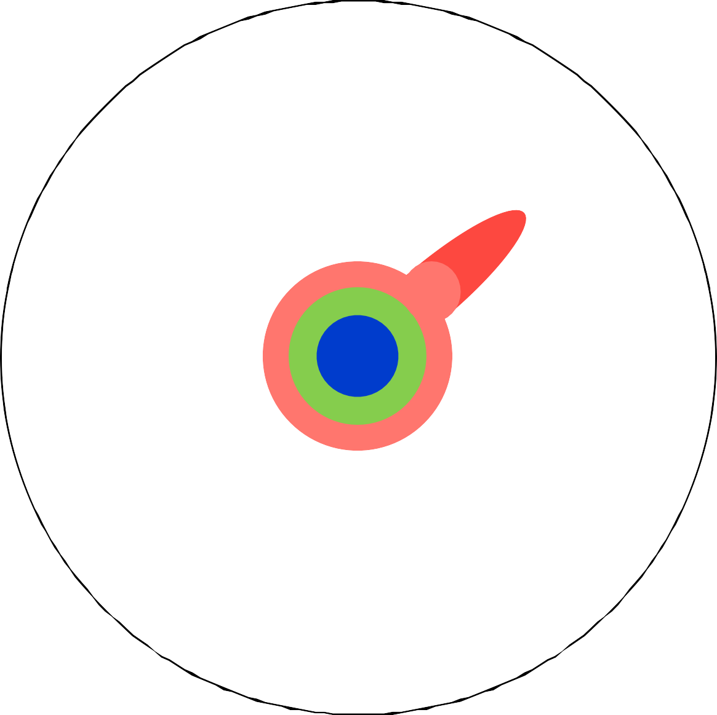
What is a PhD?
An MS deepens that specialty
Borrowed from http://matt.might.net

Slide 40
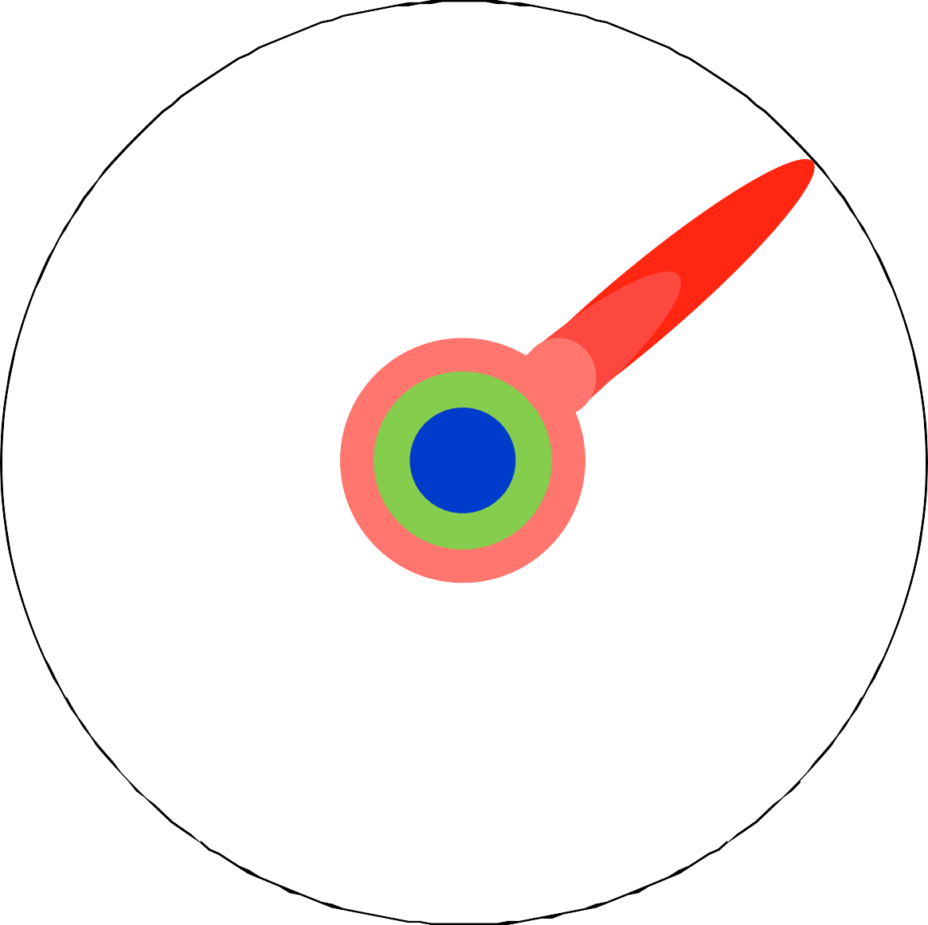
What is a PhD?
Reading research papers takes you to the edge of human knowledge
Borrowed from http://matt.might.net

Slide 41
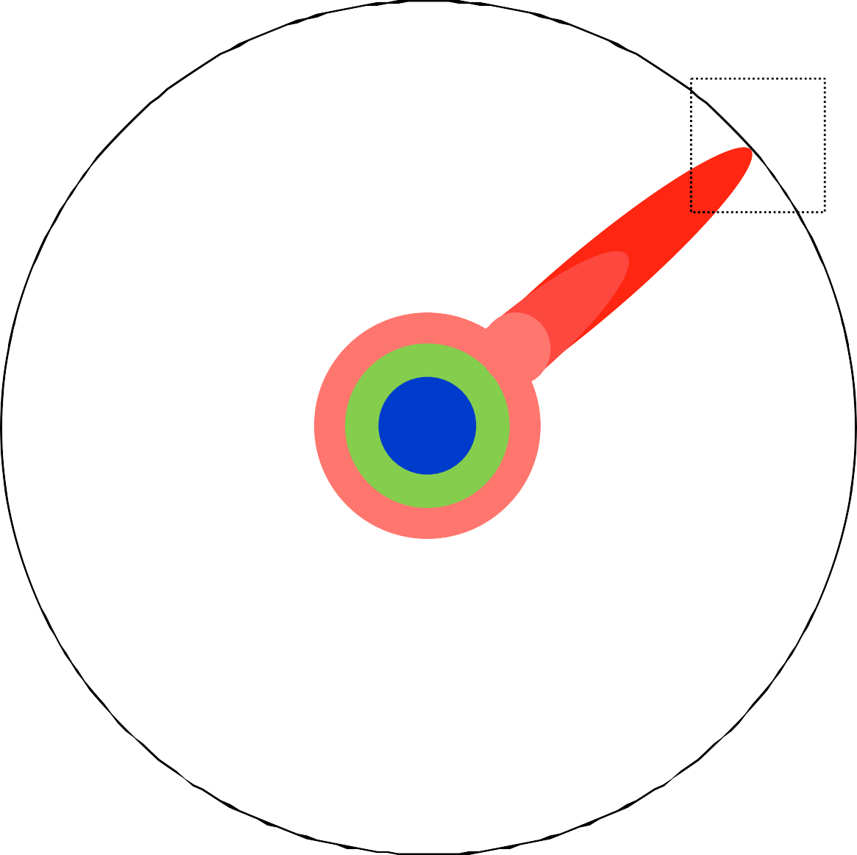
What is a PhD?
Once you’re at the boundary, you focus
Borrowed from http://matt.might.net

Slide 42
What is a PhD?
You push at the boundary for a few years…
Borrowed from http://matt.might.net

Slide 43

What is a PhD?
Until one day, the boundary gives way
Borrowed from http://matt.might.net

Slide 44

What is a PhD?
Ph.D.
And that dent you’ve made is called a PhD
Borrowed from http://matt.might.net

Slide 45
What is a PhD?
Ph.D.
Keep Pushing.
So don’t forget the bigger picture
Borrowed from http://matt.might.net

Slide 46
So… What is a PhD?
A PhD is a process!
Smart is not enough, so a demoralizing process at times…
So much has been done already, how do I keep up?
What new problem should I be solving?
Solving this problem is way harder than I thought it would be…
Why doesn’t my code (or code that I’ve borrowed) work?!
Why do my papers keep getting rejected?
But a process that will educate you greatly
Problem identification and solving
Persistence and hard work
Clear (written and spoken) communication skills
Team work, management, and mentoring
Slide credit: Adam Lee

Slide 47
My Path
Decided to do a PhD because I thought I would enjoy learning more about AI– but no clear plan or goal
My first paper got into CVPR with good reviews, but I quickly got demoralized because the field seemed like chasing 0.5% improvement in accuracy on a benchmark
Then I discovered a topic I was really, really excited about, by reading a paper in reading group; my thesis ended up revolving around it
Even so, my first attempt on this topic didn’t succeed– yet a labmate later got a best paper award out of a similar idea—the line between success and failure is thin
I learned the importance of how you present and argue the importance of your work
I had to at least once read through related work in great detail and implement mathematical details from scratch
I greatly enjoyed having huge time flexibility; one time, this meant I took an acting class; more than one time, it meant spending weeks on 4 hours of sleep—but it was my choice and I felt that it was worth it

Slide 48
A PhD journey is long and not very well defined.
What are you worried or confused about?

Slide 49
Managing a PhD

Slide 50
Choosing an Advisor
Choosing an advisor is a big decision…
Key points: research interest and fit
You are unlikely to finish a PhD that you aren’t interested in…
Take courses and seminars in these areas
Read papers, make sure you’re interested in recent developments
Think about whether you like theory vs. applications
You will be working very closely with your advisor
Do you prefer “hands on” or “hands off” advising?
Can you take direction/criticism from this person?
Use CS2002 and course projects to test fit!
Slide adapted from: Adam Lee

Slide 51
Communicating with your Advisor
Your advisor needs to know that:
  You are independent
  You are reliable
  You are excited about your research
  You will find and read literature without pointers
  You are capable of generating (good) ideas
  You understand the difference between low-level tweaks and mid-level technical innovation
  You can express your ideas and motivate them

Slide 52
Communicating with your Advisor
You need to know that:
  (Same as above, plus)
  Your advisor can fund you (as GSR, TA)
  Your advisor is supportive and kind
  Your advisor can provide the type of help you need
  Your advisor knows about and cares enough about the direction you want to pursue
  What else?

Slide 53
Meetings with your Advisor
Likely every week, maybe more than once a week—set a schedule (more advisable), or meet as-needed
Summarize what your goals were in the past week – what hypotheses you aimed to test, and how you tested them
Describe the methods you read about or developed
Describe results you obtained, and interpret them – are they reliable/significant? What do they imply? What’s next?
Describe challenges you faced, how you resolved them, and how long it took
Your advisor may or may not want to see code, depending on research area
Agree on goals for next week

Slide 54
Communication Issues: Examples
You tried a method; you can’t explain why it makes sense, or it actually doesn’t make sense
You spent a whole week working on something, but have nothing to show for it
You waited a week for a dataset/code/something else to become available, but didn’t ask your advisor for help
You misunderstood what your advisor asked you to try

Slide 55
Trust and Diligence Issues: Examples
Your code obviously has a bug (e.g. you are getting 100% prediction accuracy on a difficult AI task) but you present the results to your advisor without analyzing them
You accidentally deleted your advisor’s dataset/work
You missed a paper deadline
You are not responding to email during business hours, on multiple occasions

Slide 56
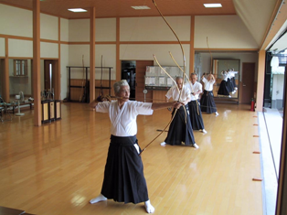
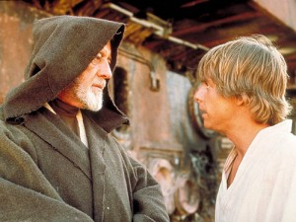
The Master-Apprentice Model
Your success (in science but also elsewhere) depends on your hard work, intelligence, but also on your skills.
A beginning scientist needs to learn how to do research and how to succeed.
Most scientists learn this from their advisors (the master-apprentice model).
This model is used in every domain that is hard to master.
Slide credit: Peter Brusilovsky, Marek Druzdzel

Slide 57
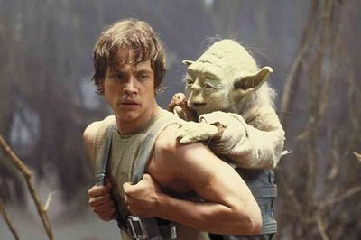
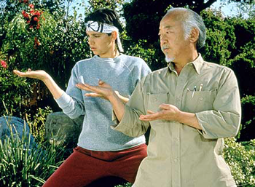
Advisor
Advisor is the most vital to your success
  PhD study is an apprenticeship
Academic advisor vs. research advisor
Find your research advisor
  See and talk to every candidate advisor
  Go to brown bag seminars, colloquia
  Ask around (but use common sense!)
Follow your candidate advisor
  Take his/her classes
  Attend his/her research seminar
  Read his/her thesis and papers
Slide credit: Peter Brusilovsky, Marek Druzdzel

Slide 58
The Advisor: Critical Issues
Is his/her area of research something that I want to get into?
Is he/she a good scientist?
Does he/she have a good track record in terms of publications and funding?
Has he/she been a good advisor for his/her students (ask around)? Have there ever been problems in his/her interactions with students?
Is his/her research style fitting my expectations? Can he/she be my role model?
Will he/she have enough time for me?
Can I get along with him/her personally?
Does he/she have (prospects for) money for me?
Slide credit: Peter Brusilovsky, Marek Druzdzel

Slide 59
Your Dissertation Committee
The Committee is very important
  Shaping your thesis from multiple prospects
  The committee should be strong in the area of your proposed work and should be able to contribute something meaningful to your thesis (they are your secret weapons)
  They will also learn the details of your work and cite/promote it
Think about the committee early
  Take classes with faculty who will likely to be on your committee
  Seek research advise of prospective committee members when appropriate
  Preferably involve the potential committee members in your Comprehensive Exam
  Engage with prospective external committee members (classes, indep. studies, conferences, advise meetings, internship, joint work)
Discuss potential committee members and choose the committee together with your advisor
Slide credit: Peter Brusilovsky, Marek Druzdzel
Notes:
136.142.116.245

Slide 60
The Committee: Critical Issues
There should be no fundamental scientific disagreements between your advisor and the other committee members
There should be no personal animosities between your advisor and the other committee members
They should be reasonable (ask around!)
Every committee member potentially pulls in his/her direction and can mean more trouble for you
Slide credit: Peter Brusilovsky, Marek Druzdzel

Slide 61
Research Journal
Researchers maintain their research journals (logs).
Researchers usually log all important things to remember to their logs
  Summary / ideas from talks they attended
  papers they read
  research ideas
  project plans
  notes on interesting people met
  ideas of new papers, etc.
Slide credit: Peter Brusilovsky, Marek Druzdzel

Slide 62
Gaining Confidence
You have to convince yourself you can do research, starting with a small project where perhaps novelty is present, but small
You have to be strategic about the work you do—it has to be publishable today, given the state of the field
You have to develop a unique research identity—what do you want to be known for?

Slide 63
Advice from the faculty
Your attitude determines how far you go. Ph.D. is not about finishing the jobs I give to you, it’s about solving the problems you care most and make intellectual breakthroughs. Don’t expect to get a todo list from me; Instead, I will guide you to define your own research agenda.
Prioritize research. Research is your key duty and also how the outside world will evaluate you when you leave here. Learning how to de-prioritize other things without annoying other people or hurting yourself is a skill.
Focus on building foundational knowledge for your long-term career. Abraham Lincoln: "Give me six hours to chop down a tree and I will spend the first four sharpening the axe."
Have long-term and short-term plans for your research.
Get your hand dirty.
Document code and record experimental settings and how datasets were filtered.
https://docs.google.com/document/d/1mcF3yHJJDdXk7PCMIn54MHufo9tIHweaVDPX5V22Ywk/

Slide 64
Advice from the faculty (cont’d)
Read lots of papers: keep up-to-date with developments in your field. Focus on understanding their contributions, problem statement (what problem are they addressing), novelty (what new perspective or new method are they introducing), etc. Reading paper guide: http://ccr.sigcomm.org/online/files/p83-keshavA.pdf
Be skeptical when reading papers. Ask yourself: does this research problem make sense to me? Is there a simple way to solve this problem? Why conduct the experiment this way, not that way?
Be curious about other people’s work, even if it is not “your topic/area” (you can learn from listening and even more from asking questions and giving feedback when appropriate)
Journal your ideas and discuss them with peers - discuss your ideas with PhD students to get different perspectives.
https://docs.google.com/document/d/1mcF3yHJJDdXk7PCMIn54MHufo9tIHweaVDPX5V22Ywk/

Slide 65
Advice from the faculty (cont’d)
Focus on progress, not perfection. Have something to show your advisor when you meet even if it’s not perfect, or provide reasons for why you weren’t able to make progress. For papers, try to write a rough draft early even if it’s very poor. […] The process of writing and presenting research often reveals areas where you might need to do some more coding or analysis. It’s ideal to find those early.
Try to “pop up a level” to describe what you’re doing and why relatively frequently. That can help you avoid going down rabbit holes of debugging code forever or building small apps or endlessly tweaking datasets, etc, where there might be quicker and easier alternatives. Writing down weekly goals and accomplishments and discussing those with your advisor can help retain your focus on what matters.
In your research meeting with your advisor, think ahead and be prepared. Prepare to present your results, answer questions that your advisor might ask you, and propose the next steps.
https://docs.google.com/document/d/1mcF3yHJJDdXk7PCMIn54MHufo9tIHweaVDPX5V22Ywk/

Slide 66
Advice from the faculty (cont’d)
Be a nice person. Academia is full of smart people, but being a nice person could help you go a long way.
Build a cohort of fellow doc students early. Lean on them for peer-mentorship, but also friendship. Otherwise, the PhD can be lonely journey.
Follow your heart and focus on things you feel most interesting and important
https://docs.google.com/document/d/1mcF3yHJJDdXk7PCMIn54MHufo9tIHweaVDPX5V22Ywk/

Slide 67
Wise Words from the Faculty
Get involved in research as soon as possible, preferably during your first semester here
Don't jump around in terms of research groups and advisors. Make a commitment and follow it up (unless it really does not work out)
Stop working in the “course and exam” mode. Everybody knows that you are good at it
Don't think that hanging around for five or six years will give you a degree
A degree alone is not enough to get a good job!
  Make sure you are visible, well-published, and competitive when you graduate
Slide credit: Peter Brusilovsky, Marek Druzdzel

Slide 68
More Wise Words from the Faculty
Don't wait for your “lifetime” topic - this is an illusion
  Newell's lecture "Desires and Diversions"
Freedom of choice is also an illusion
Make a commitment to your career, organize your life, make sacrifices (no TV, no newspapers, no newsgroups and web surfing)
Part-time PhD? Consider quitting your job at some point so that you can focus on your studies
Have a role model, be careful whom you are following and who you are listening to. Avoid crowd mentality
Slide credit: Peter Brusilovsky, Marek Druzdzel

Slide 69
And Yet…Do not Burn Yourself out
PhD years are not only about study, it is possibly the best time in your life
  Make them memorable
Combine work, study, with active life
  Take care of your body (eat well, exercise, and use sunscreen ☺)
  Do not neglect social life
  Enjoy cultural life
Pittsburgh is a city of opportunities
  Pitt Arts: http://www.pittarts.pitt.edu/
Slide credit: Peter Brusilovsky, Marek Druzdzel

Slide 70
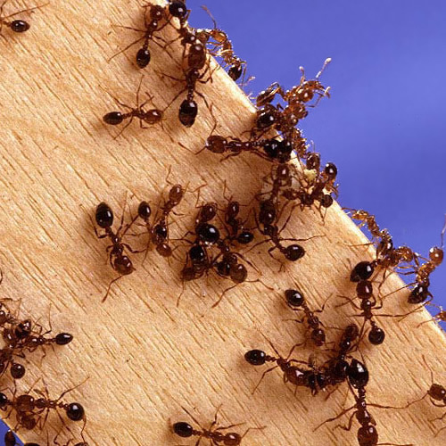
Calendar and good hints are not enough:
Know your priorities
It's not enough to be busy, so are the ants.
The question is, “What are we busy about?”
attributed to Henry David Thoreau
Things which matter the most must never
Be at the mercy of things which matter least.
Johan Wolfgang von Goethe
Slide credit: Peter Brusilovsky, Marek Druzdzel

Slide 71
The four quadrants approach (Covey)
u r g e n c y
Here is where you want to be all the time!
urgent,
important
important, not urgent
i m p o r t a n c e
You don’t want to be here ever
urgent, unimportant
unimportant, not urgent
Slide credit: Peter Brusilovsky, Marek Druzdzel

Slide 72
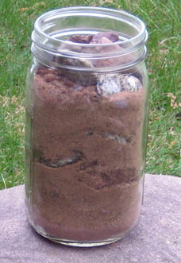
What is really important in life?
Put the largest stones first
Slide credit: Peter Brusilovsky, Marek Druzdzel

Slide 73
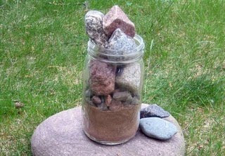
What is really important in life?
What happens when you put in sand and small stones first?
Slide credit: Peter Brusilovsky, Marek Druzdzel

Slide 74
What is your work/life balance strategy?
What advice have you heard?
What advice works/doesn’t?

Slide 75
Resources

Slide 76
Computing etc. Resources
Department labs
Your advisor’s machines
Center for Research Computing (CRC)
Pittsburgh Supercomputing Center (PSC)
Pittsburgh Quantum Institute (PQI)
Google’s Colab
Code sharing and storage: GitHub
Collaborative writing: Overleaf
Reading: Google Scholar, DBLP, etc

Slide 77
Research Fellowships
Pitt: CS50, ISP Provost Fellowship, …
US government: NSF Graduate Research Fellowship
Industry: Google, Facebook, Microsoft, Amazon, IBM, NVIDIA, Qualcomm, etc.
Foundations: Anita Borg
Outdated list: https://docs.google.com/spreadsheets/d/1UpZlMvZ4AMK41MDa8zlnS817BJeeK8ZoCFdhs_AaVbQ/

Slide 78
Writing Resources
The Writing Center: https://www.writingcenter.pitt.edu/

Slide 79
Mental Health Resources
University Counseling Center: https://www.studentaffairs.pitt.edu/cc/

Slide 80
Welcome to the program!
Questions? Comments? Concerns?

