Slide 1
CS 1699: Deep Learning
Modeling Sequences:
Recurrent Neural Networks,
Transformers
Prof. Adriana Kovashka
University of Pittsburgh
March 24, 2020

Slide 2
Plan for this lecture
Recurrent neural networks
  Basics
  Training (backprop through time, vanishing gradient)
  Recurrent networks with gates (GRU, LSTM)
Applications in NLP and vision
  Image/video captioning
  Neural machine translation (beam search, attention)
Transformers
  Self-attention
  BERT
  Cross-modal transformers for VQA and VCR

Slide 3
Recurrent neural networks

Slide 4
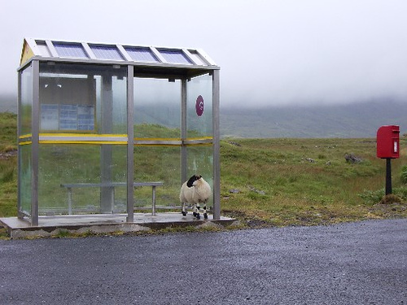
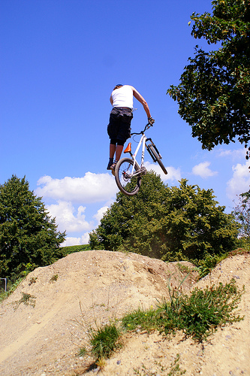
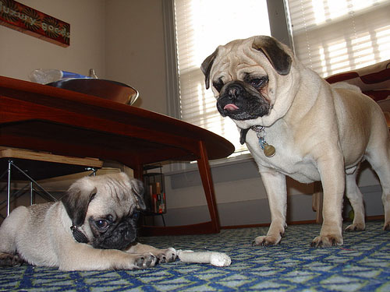
Some pre-RNN captioning results
This is a picture of one sky, one road and one sheep. The gray sky is over the gray road. The gray sheep is by the gray road.
Here we see one road, one sky and one bicycle. The road is near the blue sky, and near the colorful bicycle. The colorful bicycle is within the blue sky.
This is a picture of two dogs. The first dog is near the second furry dog.
Kulkarni et al., CVPR 2011
Notes:
This is a picture of one sky, one road…

Slide 5
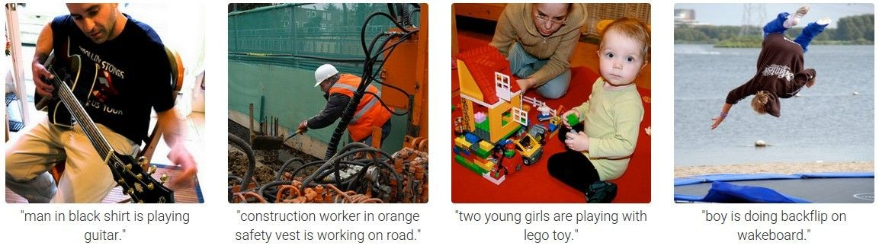
Results with Recurrent Neural Networks
Karpathy and Fei-Fei, CVPR 2015

Slide 6
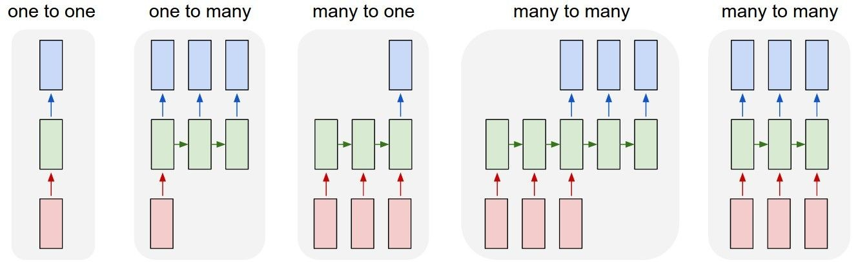
Recurrent Networks offer a lot of flexibility:
vanilla neural networks
Andrej Karpathy

Slide 7
Recurrent Networks offer a lot of flexibility:
e.g. image captioning
image -> sequence of words
Andrej Karpathy

Slide 8
Recurrent Networks offer a lot of flexibility:
e.g. sentiment classification
sequence of words -> sentiment
Andrej Karpathy

Slide 9
Recurrent Networks offer a lot of flexibility:
e.g. machine translation
seq of words -> seq of words
Andrej Karpathy

Slide 10
Recurrent Networks offer a lot of flexibility:
e.g. video classification on frame level
Andrej Karpathy

Slide 11
Recurrent Neural Network
RNN
RNN
x
Andrej Karpathy

Slide 12
Recurrent Neural Network
y
usually want to output a prediction at some time steps
RNN
x
Adapted from Andrej Karpathy

Slide 13

Recurrent Neural Network
We can process a sequence of vectors x by applying a recurrence formula at every time step:
y
RNN
new state
old state input vector at
some time step
some function
with parameters W
x
Andrej Karpathy

Slide 14
Recurrent Neural Network
We can process a sequence of vectors x by applying a recurrence formula at every time step:
y
RNN
Notice: the same function and the same set of parameters are used at every time step.
x
Andrej Karpathy

Slide 15

(Vanilla) Recurrent Neural Network
The state consists of a single “hidden” vector h:
y
RNN
x
Andrej Karpathy

Slide 16
Character-level language model example
Example
RNN
x
y
Vocabulary: [h,e,l,o]
Example training sequence: “hello”
Andrej Karpathy

Slide 17
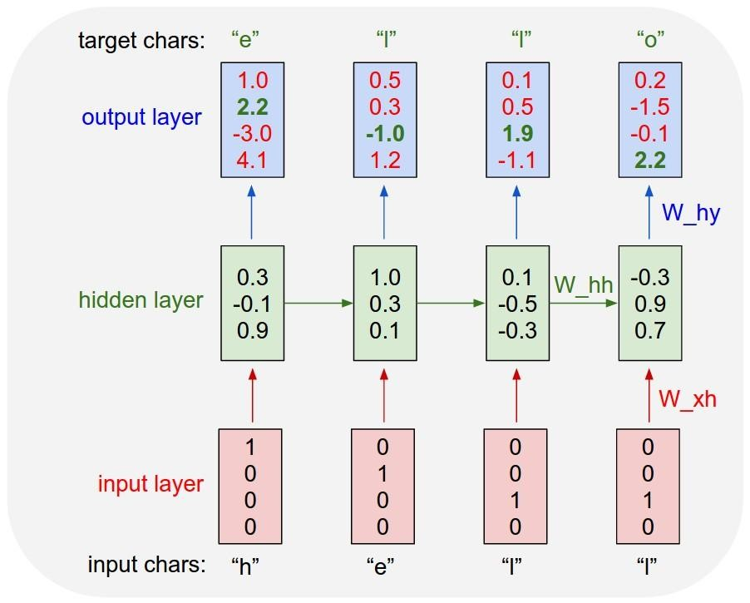
Example
Character-level language model example
Vocabulary: [h,e,l,o]
Example training sequence: “hello”
Andrej Karpathy

Slide 18
Example
Character-level language model example
Vocabulary: [h,e,l,o]
Example training sequence: “hello”
Andrej Karpathy

Slide 19
Example
Character-level language model example
Vocabulary: [h,e,l,o]
Example training sequence: “hello”
What do we still need to specify, for this to work?
What kind of loss can we formulate?
Andrej Karpathy

Slide 20




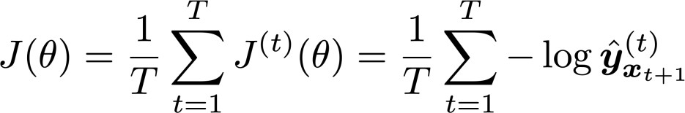
Training a Recurrent Neural Network
Get a big corpus of text which is a sequence of words
Feed into RNN; compute output distribution for every step t.
  i.e. predict probability dist of every word, given words so far
Loss function on step t is cross-entropy between predicted probability
distribution , and true next word (one-hot); V is vocabulary
Average this to get overall loss for entire training set:
Adapted from Abigail See

Slide 21








The vanishing/exploding gradient problem
The error at a time step ideally can tell a previous time step from many steps away to change during backprop
Multiply the same matrix at each time step during backprop
yt−1
y_{t}
yt+1
ht−1
h_{t}
ht+1
W
W
xt−1
x_{t}
xt+1
Richard Socher

Slide 22
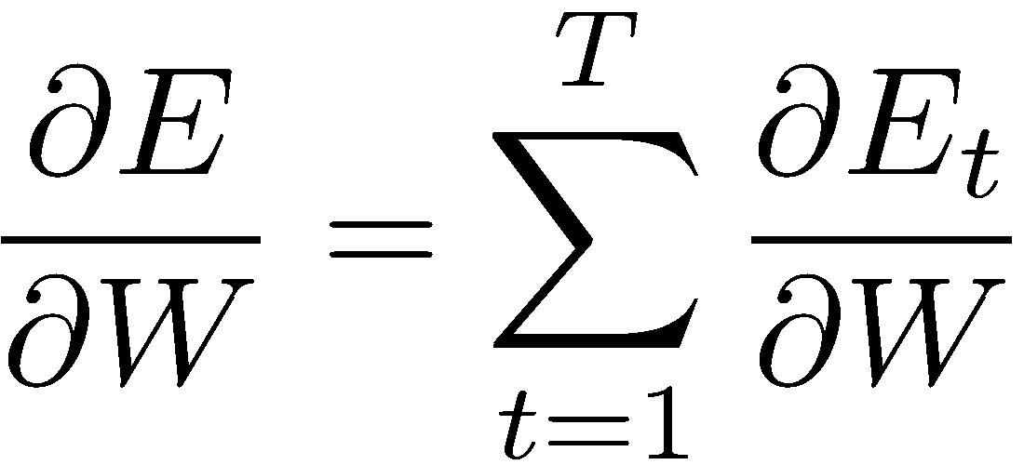
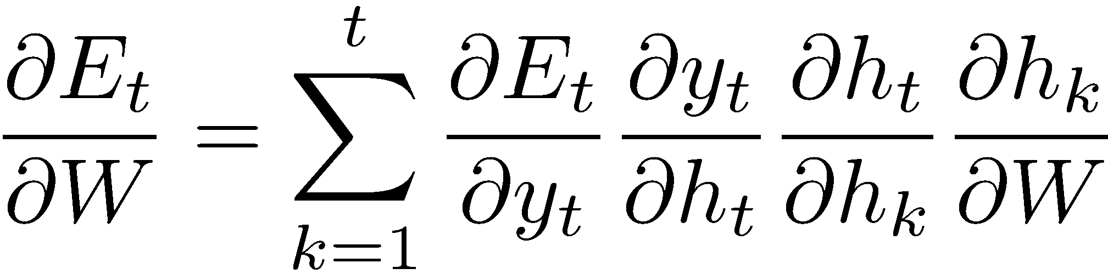
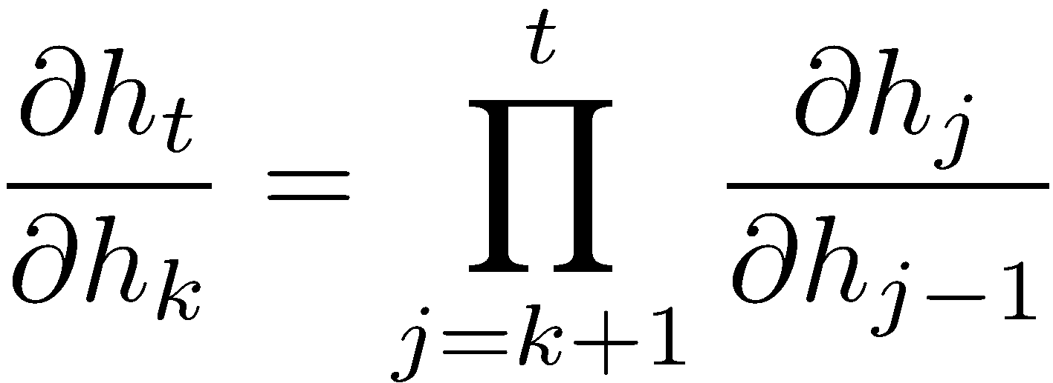
The vanishing gradient problem
Total error is the sum of each error at time steps t
Chain rule:
More chain rule:
Derivative of vector wrt vector is a Jacobian matrix of partial derivatives; norm of this matrix can become very small or very large quickly [Bengio et al 1994, Pascanu et al. 2013], leading to vanishing/exploding gradient
Adapted from Richard Socher

Slide 23
What uses of language models from everyday life can you think of?

Slide 24
Now in more detail…

Slide 25


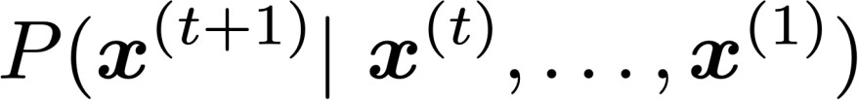


Language Modeling
Language Modeling is the task of predicting what word comes
next.
books
laptops
the students opened their
exams
minds
More formally: given a sequence of words
compute the probability distribution of the next word
,
:
where can be any word in the vocabulary
A system that does this is called a Language Model.
Abigail See

Slide 26
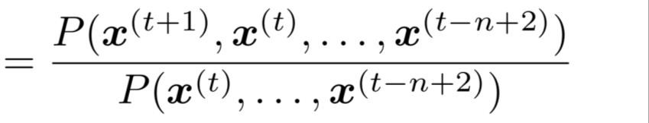
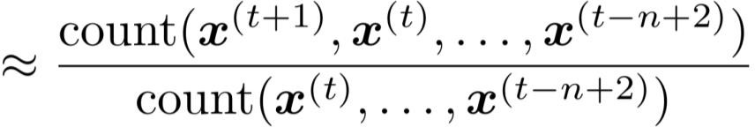
n-gram Language Models
First we make a simplifying assumption:
preceding n-1 words.
n-1 words
depends only on the
(assumption)
prob of a n-gram
(definition of conditional prob)
prob of a (n-1)-gram
Question: How do we get these n-gram and (n-1)-gram probabilities?
Answer: By counting them in some large corpus of text!
(statistical approximation)
Abigail See

Slide 27


Sparsity Problems with n-gram Language Models
Sparsity Problem 1
Problem: What if “students opened their ” never occurred in data? Then
has probability 0!
(Partial) Solution: Add small 𝛿 to the count for every . This is called smoothing.
Sparsity Problem 2
Problem: What if “students opened their” never occurred in data? Then we can’t calculate probability for any !
(Partial) Solution: Just condition
on “opened their” instead.
This is called backoff.
Note: Increasing n makes sparsity problems worse.
Typically we can’t have n bigger than 5.
Abigail See

Slide 28















A fixed-window neural Language Model
books
laptops
output distribution
a
zoo
hidden layer
concatenated word embeddings
words / one-hot vectors
the
students
opened
their
Abigail See

Slide 29


A fixed-window neural Language Model
Improvements over n-gram LM:
books
No sparsity problem
Don’t need to store all observed
n-grams
laptops
Remaining problems:
a
zoo
Fixed window is too small
Enlarging window enlarges
Window can never be large enough!
and are multiplied by completely different weights in
•
.
No symmetry in how the inputs are processed.
We need a neural architecture that can process any length input
the
students
opened
their
Abigail See

Slide 30




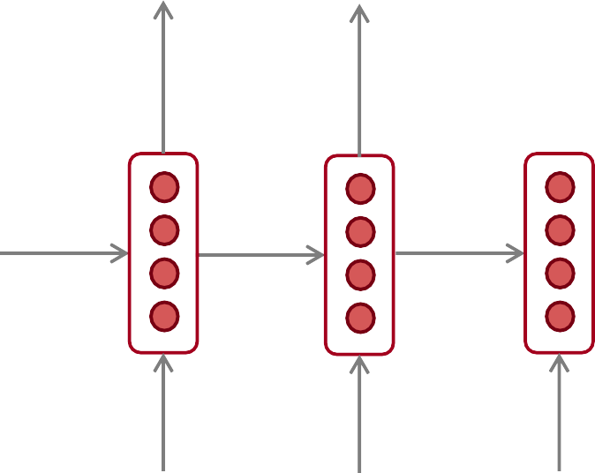










Recurrent Neural Networks (RNN)
A family of neural architectures
Core idea: Apply the same weights repeatedly
outputs (optional)
…
hidden states
…
input sequence (any length)
…
Abigail See

Slide 31


















A RNN Language Model
books
laptops
output distribution
a
zoo
hidden states
is the initial hidden state
word embeddings
words / one-hot vectors the students
opened
their
Note: this input sequence could be much
longer, but this slide doesn’t have space!
Abigail See

Slide 32
A RNN Language Model
books
laptops
RNN Advantages:
Can process any length
input
Computation for step t can (in theory) use information from many steps back
Model size doesn’t
increase for longer input
Same weights applied on every timestep, so there is symmetry in how inputs are processed.
a
zoo
RNN Disadvantages:
Recurrent computation is slow
In practice, difficult to access information from many steps back
the
students
opened
their
Abigail See

Slide 33

Recall: Training a RNN Language Model
Get a big corpus of text which is a sequence of words
Feed into RNN-LM; compute output distribution for every step t.
  i.e. predict probability dist of every word, given words so far
Loss function on step t is cross-entropy between predicted probability
distribution , and the true next word (one-hot for ):
Average this to get overall loss for entire training set:
Abigail See

Slide 34




Training a RNN Language Model
= negative log prob
of “students”
Loss
Predicted prob dists
…
Corpus
the
students
opened
their
exams
…
Abigail See

Slide 35
Training a RNN Language Model
= negative log prob
of “opened”
Loss
Predicted prob dists
…
Corpus
the
students
opened
their
exams
…
Abigail See

Slide 36
Training a RNN Language Model
= negative log prob
of “their”
Loss
Predicted prob dists
…
Corpus
the
students
opened
their
exams
…
Abigail See

Slide 37
Training a RNN Language Model
= negative log prob
of “exams”
Loss
Predicted prob dists
…
Corpus
the
students
opened
their
exams
…
Abigail See

Slide 38
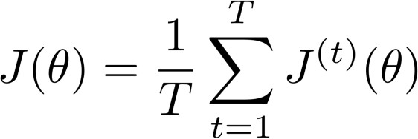
Training a RNN Language Model
Loss
+
+
+
+ … =
Predicted prob dists
…
Corpus
the
students
opened
their
exams
…
Abigail See

Slide 39



Training a RNN Language Model
However: Computing loss and gradients across entire corpus is too expensive!
In practice, consider as a sentence (or a document)
Recall: Stochastic Gradient Descent allows us to compute loss and gradients for small chunk of data, and update.
Compute loss for a sentence (actually a batch of sentences), compute gradients and update weights. Repeat.
Abigail See

Slide 40










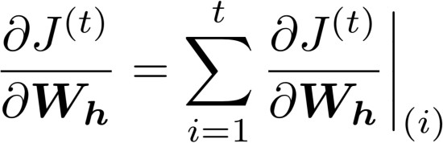
Backpropagation for RNNs
…
…
Question: What’s the derivative of
w.r.t. the repeated weight matrix
?
“The gradient w.r.t. a repeated weight is the sum of the gradient
w.r.t. each time it appears”
Answer:
Why?
Abigail See

Slide 41
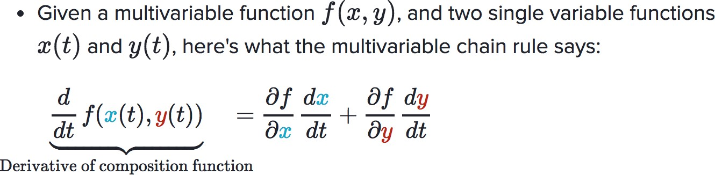
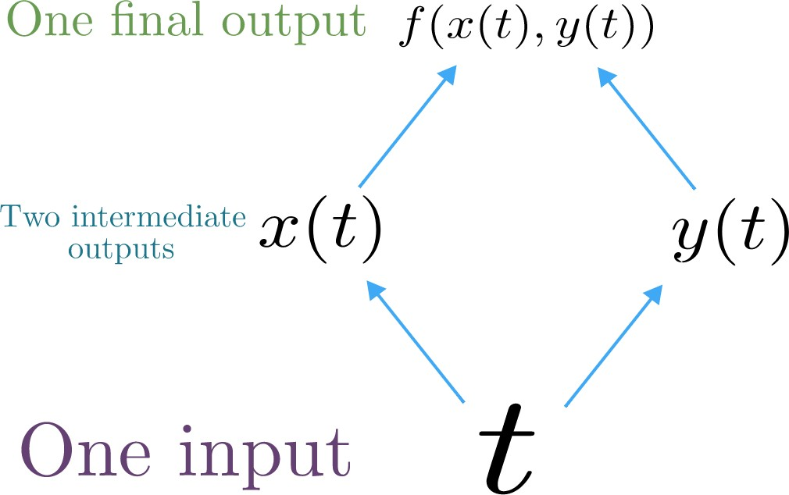
Multivariable Chain Rule
Source:
https://www.khanacademy.org/math/multivariable-calculus/multivariable-derivatives/differentiating-vector-valued-functions/a/multivariable-chain-rule-simple-version
Abigail See

Slide 42
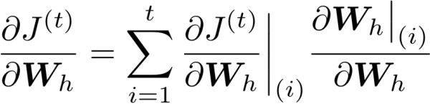




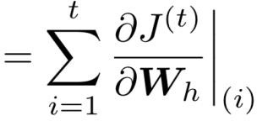



Backpropagation for RNNs: Proof sketch
In our example:
Apply the multivariable chain rule:
= 1
…
Source:
https://www.khanacademy.org/math/multivariable-calculus/multivariable-derivatives/differentiating-vector-valued-functions/a/multivariable-chain-rule-simple-version
Abigail See

Slide 43
Backpropagation for RNNs
…
…
Answer: Backpropagate over timesteps i=t,…,0, summing gradients as you go.
This algorithm is called
“backpropagation through time”
Question: How do we calculate this?
Abigail See

Slide 44
Vanishing gradient intuition
Abigail See

Slide 45
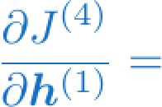
Vanishing gradient intuition
?
Abigail See

Slide 46









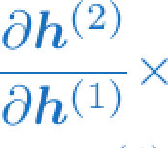
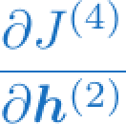
Vanishing gradient intuition
chain rule!
Abigail See

Slide 47
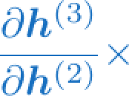
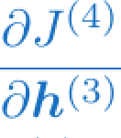
Vanishing gradient intuition
chain rule!
Abigail See

Slide 48
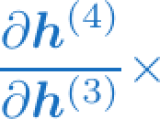
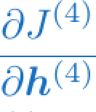
Vanishing gradient intuition
chain rule!
Abigail See

Slide 49
Vanishing gradient intuition
Vanishing gradient problem: When these are small, the gradient signal gets smaller and smaller as it backpropagates further
What happens if these are small?
Abigail See

Slide 50

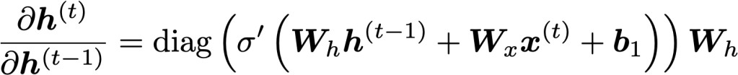


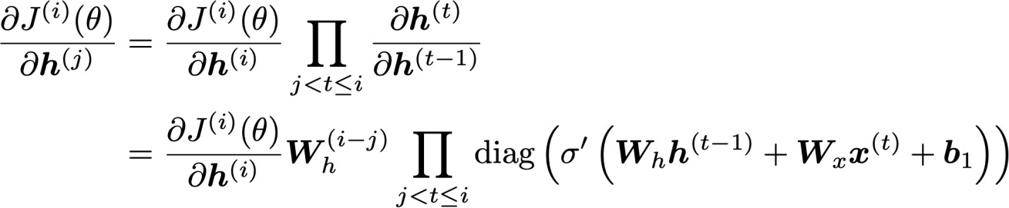

Vanishing gradient proof sketch
Recall:
Therefore:
(chain rule)
Consider the gradient of the loss on step i, with respect
to the hidden state on some previous step j.
(chain rule) (value of )
If W_{h} is small, then this term gets
vanishingly small as i and j get further apart
Abigail See
Source: “On the difficulty of training recurrent neural networks”, Pascanu et al, 2013. http://proceedings.mlr.press/v28/pascanu13.pdf

Slide 51
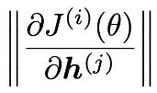
Vanishing gradient proof sketch
Consider matrix L2 norms:
Pascanu et al showed that that if the largest eigenvalue of W_{h} is
less than 1, then the gradient will shrink exponentially
  Here the bound is 1 because we have sigmoid nonlinearity
There’s a similar proof relating a largest eigenvalue >1 to
exploding gradients
Abigail See
Source: “On the difficulty of training recurrent neural networks”, Pascanu et al, 2013. http://proceedings.mlr.press/v28/pascanu13.pdf

Slide 52

Why is vanishing gradient a problem?
Gradient signal from faraway is lost because it’s much
smaller than gradient signal from close-by.
So model weights are only updated only with respect to near effects, not long-term effects.
Abigail See

Slide 53
Effect of vanishing gradient on RNN-LM
LM task: When she tried to print her tickets, she found that the printer was out of toner. She went to the stationery store to buy more toner. It was very overpriced. After installing the toner into the printer, she finally printed her
To learn from this training example, the RNN-LM needs to model the dependency between “tickets” on the 7th step and the target word “tickets” at the end.
But if gradient is small, the model can’t learn this dependency
  So the model is unable to predict similar long-distance dependencies at test time
Abigail See

Slide 54
Effect of vanishing gradient on RNN-LM
is
LM task: The writer of the books
are
Correct answer: The writer of the books is planning a sequel
Syntactic recency: The writer of the books is (correct)
Sequential recency: The writer of the books are (incorrect)
Due to vanishing gradient, RNN-LMs are better at learning from sequential recency than syntactic recency, so they make this
type of error more often than we’d like [Linzen et al 2016]
Abigail See
“Assessing the Ability of LSTMs to Learn Syntax-Sensitive Dependencies”, Linzen et al, 2016. https://arxiv.org/pdf/1611.01368.pdf

Slide 55
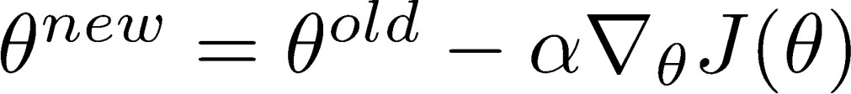
Why is exploding gradient a problem?
If the gradient becomes too big, then the SGD update step becomes too big:
learning rate
gradient
This can cause bad updates: we take too large a step and reach a bad parameter configuration (with large loss)
In the worst case, this will result in Inf or NaN in your network (then you have to restart training from an earlier checkpoint)
Abigail See

Slide 56
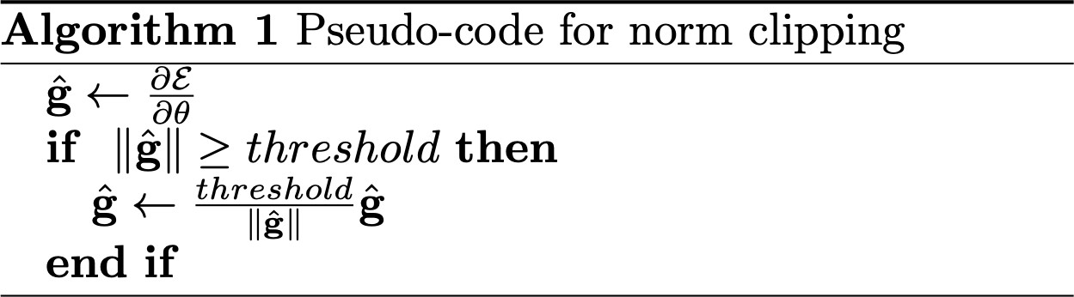
Gradient clipping: solution for exploding gradient
Gradient clipping: if the norm of the gradient is greater than some threshold, scale it down before applying SGD update
Intuition: take a step in the same direction, but a smaller step
Abigail See
Source: “On the difficulty of training recurrent neural networks”, Pascanu et al, 2013. http://proceedings.mlr.press/v28/pascanu13.pdf

Slide 57
RNNs with Gates

Slide 58
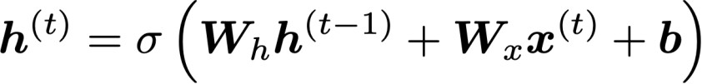
How to fix vanishing gradient problem?
The main problem is that it’s too difficult for the RNN to learn to
preserve information over many timesteps.
In a vanilla RNN, the hidden state is constantly being rewritten
How about a RNN with separate memory?
Richard Socher

Slide 59
Gated Recurrent Units (GRUs)
More complex hidden unit computation in recurrence!
Introduced by Cho et al. 2014
Main ideas:
  keep around memories to capture long distance dependencies
  allow error messages to flow at different strengths depending on the inputs
Richard Socher

Slide 60
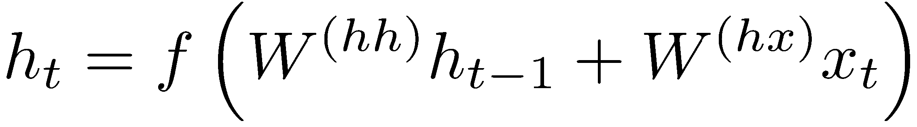
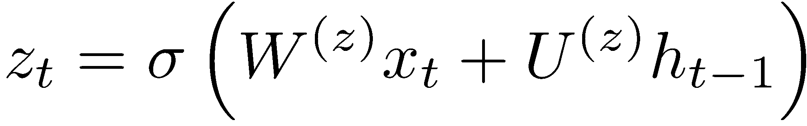
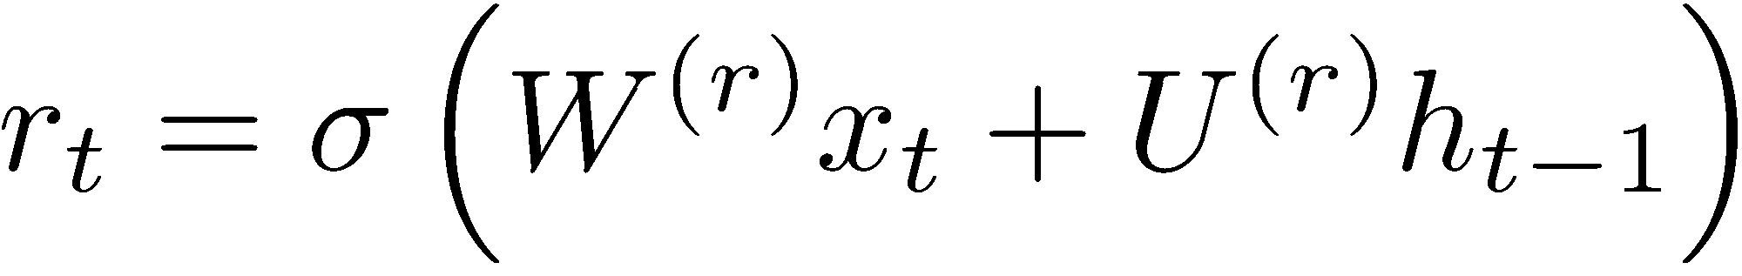
Gated Recurrent Units (GRUs)
Standard RNN computes hidden layer at next time step directly:
GRU first computes an update gate (another layer) based on current input word vector and hidden state
Compute reset gate similarly but with different weights
Richard Socher

Slide 61
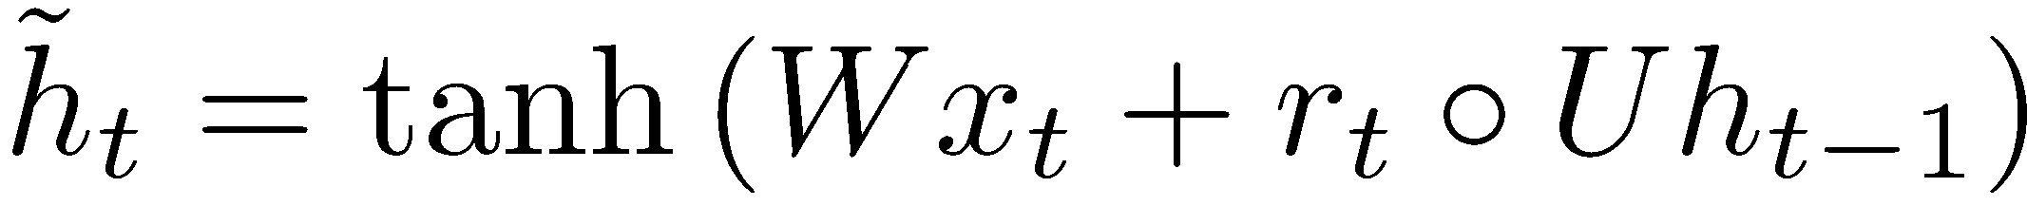
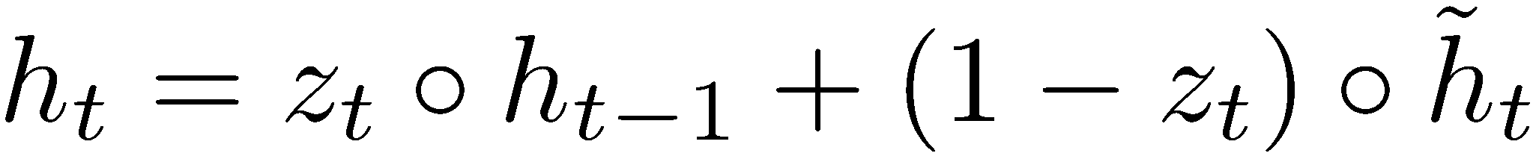
Gated Recurrent Units (GRUs)
Update gate
Reset gate
New memory content:
If reset gate unit is ~0, then this ignores previous memory and only stores the new word information
Final memory at time step combines current and previous time steps:
Richard Socher

Slide 62
Gated Recurrent Units (GRUs)
ht-1
h_{t}
Final memory
~_{ht}
Memory (reset)
~ht-1
Update gate
zt-1
z_{t}
Reset gate
rt-1
r_{t}
Input:
xt-1
x_{t}
Richard Socher

Slide 63
Gated Recurrent Units (GRUs)
If reset r is close to 0, ignore previous hidden state: Allows model to drop information that is irrelevant in the future
If update z is close to 1, can copy information through many time steps, i.e. copy paste state: Less vanishing gradient!
Units with short-term dependencies often have reset gates (r) very active; ones with long-term dependencies have active update gates (z)
Adapted from Richard Socher

Slide 64
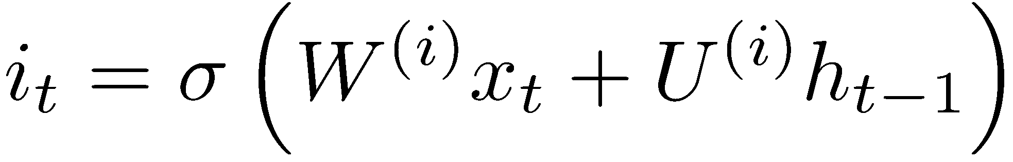
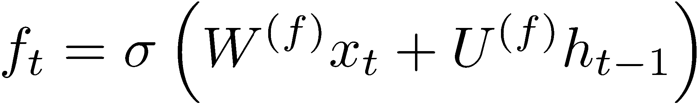
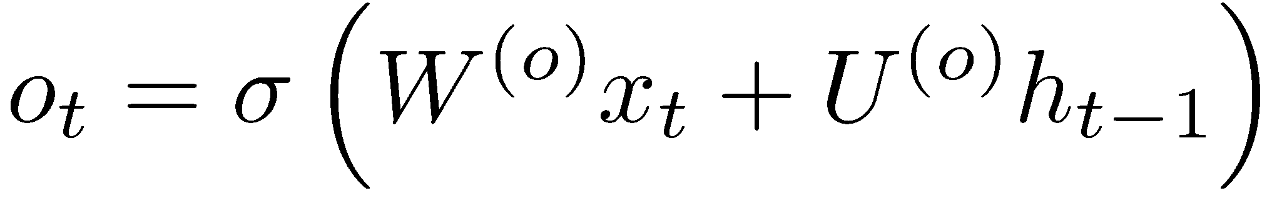
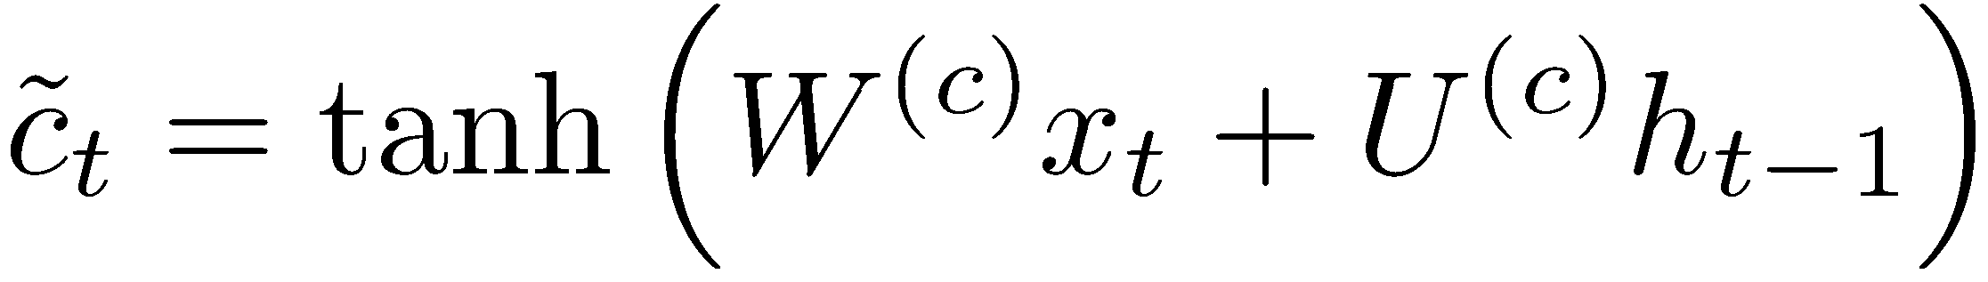
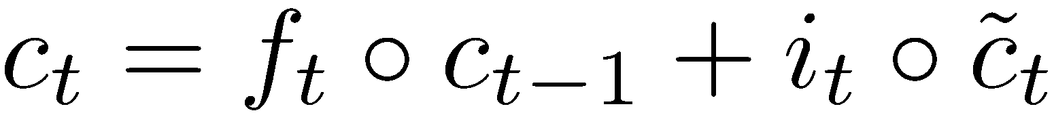
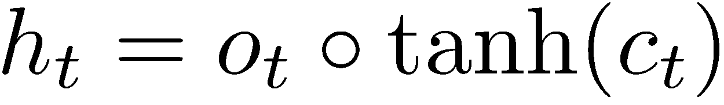
Long-short-term-memories (LSTMs)
Proposed by Hochreiter and Schmidhuber in 1997
We can make the units even more complex
Allow each time step to modify
  Input gate (current cell matters)
  Forget (gate 0, forget past)
  Output (how much cell is exposed)
  New memory cell
Final memory cell:
Final hidden state:
Adapted from Richard Socher

Slide 65
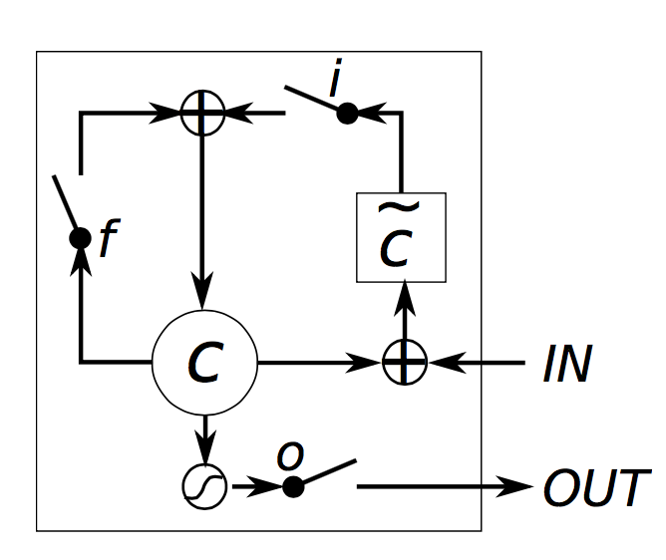
Long-short-term-memories (LSTMs)
Intuition: memory cells can keep information intact, unless inputs makes them forget it or overwrite it with new input
Cell can decide to output this information or just store it
Richard Socher, figure from wildml.com

Slide 66


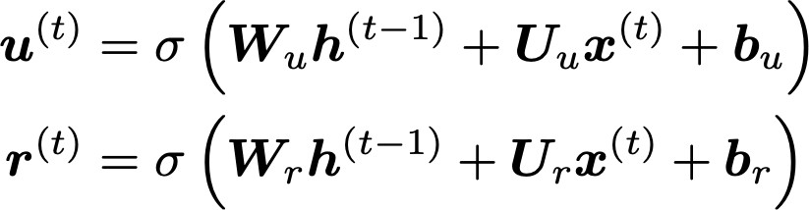
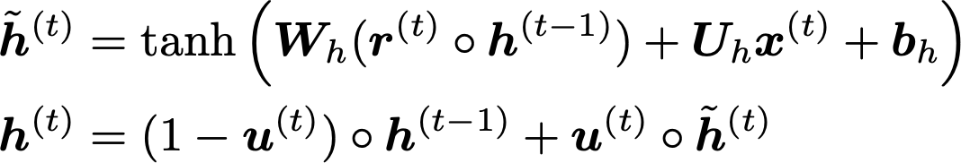
Review on your own: Gated Recurrent Units (GRU)
Proposed by Cho et al. in 2014 as a simpler alternative to the LSTM.
On each timestep t we have input and hidden state (no cell state).
Update gate: controls what parts of hidden state are updated vs preserved
Reset gate: controls what parts of previous hidden state are used to compute new content
New hidden state content: reset gate selects useful parts of prev hidden state. Use this and current input to compute new hidden content.
Hidden state: update gate simultaneously controls what is kept from previous hidden state, and what is updated to new hidden state content
How does this solve vanishing gradient? GRU makes it easier to retain info long-term (e.g. by setting update gate to 0)
Abigail See
"Learning Phrase Representations using RNN Encoder–Decoder for Statistical Machine Translation", Cho et al. 2014, https://arxiv.org/pdf/1406.1078v3.pdf

Slide 67

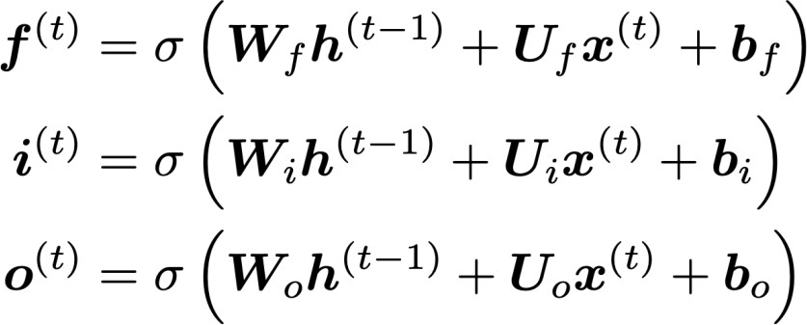
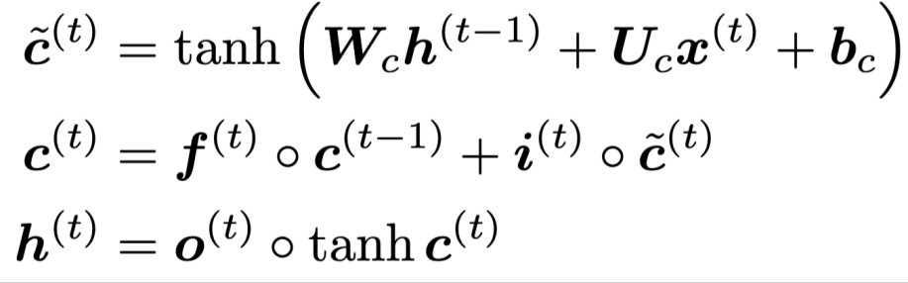
Review on your own: Long Short-Term Memory (LSTM)
We have a sequence of inputs , and we will compute a sequence of hidden states and cell states . On timestep t:
Sigmoid function: all gate values are between 0 and 1
Forget gate: controls what is kept vs forgotten, from previous cell state
Input gate: controls what parts of the new cell content are written to cell
All these are vectors of same length n
Output gate: controls what parts of cell are output to hidden state
New cell content: this is the new content to be written to the cell
Cell state: erase (“forget”) some content from last cell state, and write (“input”) some new cell content
Hidden state: read (“output”) some content from the cell
Gates are applied using element-wise product
Abigail See

Slide 68
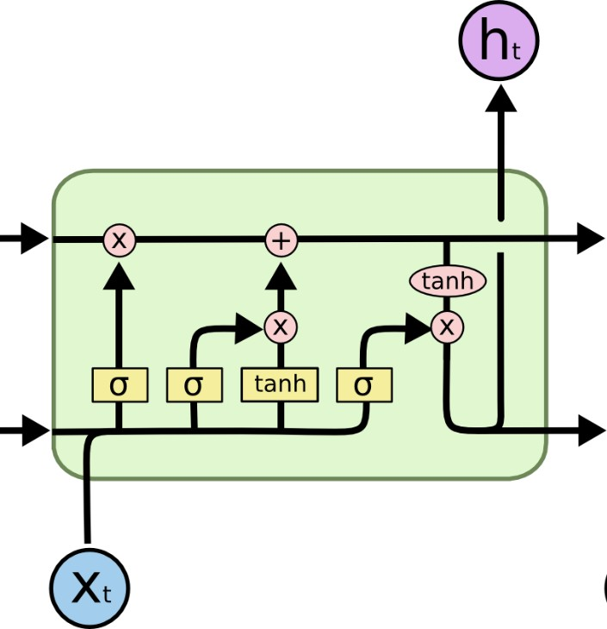

Review on your own: Long Short-Term Memory (LSTM)
You can think of the LSTM equations visually like this:
Write some new cell content
Forget some
cell content
c_{t}
c_{t}
^{c}t-1
f
i_{t}
o_{t}
Output some cell content to the hidden state
Compute the forget gate
t
~_{c}
t
^{h}t-1
h_{t}
Compute the input gate
Compute the new cell content
Compute the output gate
Abigail See
Source: http://colah.github.io/posts/2015-08-Understanding-LSTMs/

Slide 69
LSTM vs GRU
Researchers have proposed many gated RNN variants, but LSTM and GRU are the most widely-used
The biggest difference is that GRU is quicker to compute and has fewer parameters
There is no conclusive evidence that one consistently performs better than the other
LSTM is a good default choice (especially if your data has particularly long dependencies, or you have lots of training data)
Rule of thumb: start with LSTM, but switch to GRU if you want something more efficient
Abigail See

Slide 70
LSTMs: real-world success
In 2013-2015, LSTMs started achieving state-of-the-art results
  Successful tasks include: handwriting recognition, speech recognition, machine translation, parsing, image captioning
  LSTM became the dominant approach
Now (2019), other approaches (e.g. Transformers) have become more dominant for certain tasks.
  For example in WMT (a MT conference + competition):
  In WMT 2016, the summary report contains ”RNN” 44 times
  In WMT 2018, the report contains “RNN” 9 times and
“Transformer” 63 times
Source: "Findings of the 2016 Conference on Machine Translation (WMT16)", Bojar et al. 2016, http://www.statmt.org/wmt16/pdf/W16-2301.pdf
Source: "Findings of the 2018 Conference on Machine Translation (WMT18)", Bojar et al. 2018, http://www.statmt.org/wmt18/pdf/WMT028.pdf
Abigail See

Slide 71

Is vanishing/exploding gradient just a RNN problem?
No! It can be a problem for all neural architectures (including feed-forward and convolutional), especially deep ones.
  Due to chain rule / choice of nonlinearity function, gradient can become vanishingly small as it backpropagates
  Thus lower layers are learnt very slowly (hard to train)
  Solution: lots of new deep feedforward/convolutional architectures that
add more direct connections (thus allowing the gradient to flow)
For example:
Residual connections aka “ResNet”
Also known as skip-connections
The identity connection preserves information by default
This makes deep networks much
easier to train
Abigail See
"Deep Residual Learning for Image Recognition", He et al, 2015. https://arxiv.org/pdf/1512.03385.pdf

Slide 72

Is vanishing/exploding gradient just a RNN problem?
No! It can be a problem for all neural architectures (including feed-forward and convolutional), especially deep ones.
  Due to chain rule / choice of nonlinearity function, gradient can become vanishingly small as it backpropagates
  Thus lower layers are learnt very slowly (hard to train)
  Solution: lots of new deep feedforward/convolutional architectures that
add more direct connections (thus allowing the gradient to flow)
For example:
Dense connections aka “DenseNet”
Directly connect everything to everything!
Abigail See
”Densely Connected Convolutional Networks", Huang et al, 2017. https://arxiv.org/pdf/1608.06993.pdf

Slide 73




Bidirectional RNNs: motivation
Task: Sentiment Classification
We can regard this hidden state as a
representation of the word “terribly” in the context of this sentence. We call this a contextual representation.
positive
Sentence encoding
These contextual representations only contain information about the left context (e.g. “the movie
was”).
What about right
context?
In this example, “exciting” is in the right context and this modifies the meaning of “terribly” (from negative to positive)
the
movie
was
terribly
exciting
!
Abigail See

Slide 74

Bidirectional RNNs
This contextual representation of “terribly”
has both left and right context!
Concatenated hidden states
Backward RNN
Forward RNN
the
movie
was
terribly
exciting
!
Abigail See

Slide 75

Bidirectional RNNs
On timestep t:
This is a general notation to mean “compute one forward step of the RNN” – it could be a vanilla, LSTM or GRU computation.
Forward RNN
Generally, these two RNNs have separate weights
Backward RNN
Concatenated hidden states
We regard this as “the hidden state” of a bidirectional RNN. This is what we pass on to the next parts of the network.
Abigail See

Slide 76

Multi-layer RNNs
The hidden states from RNN layer i
are the inputs to RNN layer i+1
RNN layer 3
RNN layer 2
RNN layer 1
the
movie
was
terribly
exciting
!
Abigail See

Slide 77


Evaluating Language Models
The standard evaluation metric for Language Models is perplexity.
Normalized by number of words
Inverse probability of corpus, according to Language Model
This is equal to the exponential of the cross-entropy loss
:
Lower perplexity is better!
Abigail See

Slide 78
Recap thus far
Language Model: A system that predicts the next word
Recurrent Neural Network: A family of neural networks that:
  Take sequential input of any length
  Apply the same weights on each step
  Can optionally produce output on each step
Vanishing gradient problem: what it is, why it happens, and
why it’s bad for RNNs
LSTMs and GRUs: more complicated RNNs that use gates to control information flow; they are more resilient to vanishing gradients
Abigail See

Slide 79
Plan for this lecture
Recurrent neural networks
  Basics
  Training (backprop through time, vanishing gradient)
  Recurrent networks with gates (GRU, LSTM)
Applications in NLP and vision
  Image/video captioning
  Neural machine translation (beam search, attention)
Transformers
  Self-attention
  BERT
  Cross-modal transformers for VQA and VCR

Slide 80
Applications

Slide 81
Why should we care about Language Modeling?
Language Modeling is a benchmark task that helps us measure our progress on understanding language
Language Modeling is a subcomponent of many NLP tasks, especially those involving generating text or
estimating the probability of text:
  Predictive typing
  Speech recognition
  Handwriting recognition
  Spelling/grammar correction
  Authorship identification
  Machine translation
  Summarization
  Dialogue
  etc.
Abigail See

Slide 82




Generating text with a RNN Language Model
You can use a RNN Language Model to generate text by repeated sampling. Sampled output is next step’s input.
favorite season is
sample sample sample
spring
sample
…
Abigail See
my
favorite
season
is
spring

Slide 83


Generating text with a RNN Language Model
Let’s have some fun!
You can train a RNN-LM on any kind of text, then generate text in that style.
RNN-LM trained on Obama speeches:
Source: https://medium.com/@samim/obama-rnn-machine-generated-political-speeches-c8abd18a2ea0
Abigail See

Slide 84


Generating text with a RNN Language Model
Let’s have some fun!
You can train a RNN-LM on any kind of text, then generate text in that style.
RNN-LM trained on Harry Potter:
Source: https://medium.com/deep-writing/harry-potter-written-by-artificial-intelligence-8a9431803da6
Abigail See

Slide 85


Generating text with a RNN Language Model
Let’s have some fun!
You can train a RNN-LM on any kind of text, then generate text in that style.
RNN-LM trained on paint color names:
This is an example of a character-level RNN-LM (predicts what character comes next)
Source: http://aiweirdness.com/post/160776374467/new-paint-colors-invented-by-neural-network
Abigail See

Slide 86

Generating poetry with RNNs
Fei-Fei Li & Andrej Karpathy & Justin Johnson Lecture 10 - 8 Feb 2016
Lecture 10 -
35
Andrej Karpathy

Slide 87



at first:
Generating poetry with RNNs
train more
train more
train more
Fei-Fei Li & Andrej Karpathy & Justin Johnson Lecture 10 - 8 Feb 2016
Lecture 10 -
36
More info: http://karpathy.github.io/2015/05/21/rnn-effectiveness/
Andrej Karpathy

Slide 88


Generating poetry with RNNs
Fei-Fei Li & Andrej Karpathy & Justin Johnson Lecture 10 - 8 Feb 2016
Lecture 10 -
37
Andrej Karpathy

Slide 89

open source textbook on algebraic geometry
Generating textbooks with RNNs
Latex source
Fei-Fei Li & Andrej Karpathy & Justin Johnson Lecture 10 - 8 Feb 2016
Lecture 10 -
38
Andrej Karpathy

Slide 90

Generating textbooks with RNNs
Fei-Fei Li & Andrej Karpathy & Justin Johnson Lecture 10 - 8 Feb 2016
Lecture 10 -
39
Andrej Karpathy

Slide 91

Generating textbooks with RNNs
Fei-Fei Li & Andrej Karpathy & Justin Johnson Lecture 10 - 8 Feb 2016
Lecture 10 -
40
Andrej Karpathy

Slide 92

Generated C code
Generating code with RNNs
Fei-Fei Li & Andrej Karpathy & Justin Johnson Lecture 10 - 8 Feb 2016
Lecture 10 -
42
Andrej Karpathy

Slide 93

Image Captioning
CVPR 2015:
Deep Visual-Semantic Alignments for Generating Image Descriptions, Karpathy and Fei-Fei Show and Tell: A Neural Image Caption Generator, Vinyals et al.
Long-term Recurrent Convolutional Networks for Visual Recognition and Description, Donahue et al. Learning a Recurrent Visual Representation for Image Caption Generation, Chen and Zitnick
Adapted from Andrej Karpathy

Slide 94
Recurrent Neural Network
Image Captioning
Convolutional Neural Network
Andrej Karpathy

Slide 95

test image
Image Captioning
Andrej Karpathy

Slide 96
test image
Andrej Karpathy

Slide 97
test image
X
Andrej Karpathy

Slide 98

test image
Image Captioning
x0
<START>
<START>
Andrej Karpathy

Slide 99
Image Captioning
test image
y0
before:
h = tanh(W_{xh} * x + W_{hh} * h)
h0
Wih
now:
h = tanh(W_{xh} * x + W_{hh} * h + W_{ih} * im)
x0
<START>
im
<START>
Andrej Karpathy

Slide 100
test image
Image Captioning
y0
sample!
h0
x0
<START>
straw
<START>
Andrej Karpathy

Slide 101
test image
Image Captioning
y0
y1
h0
h1
x0
<START>
straw
<START>
Andrej Karpathy

Slide 102
test image
Image Captioning
y0
y1
sample!
h0
h1
x0
<START>
straw
hat
<START>
Andrej Karpathy

Slide 103
test image
Image Captioning
y0
y1
y2
h0
h1
h2
x0
<START>
straw
hat
<START>
Andrej Karpathy

Slide 104
test image
Image Captioning
Caption generated:
“straw hat”
y0
y1
y2
sample
<END> token
=> finish.
h0
h1
h2
x0
<START>
straw
hat
<START>
Adapted from Andrej Karpathy

Slide 105

Image Captioning
Andrej Karpathy

Slide 106


Video Captioning
English Sentence
RNN
encoder
RNN
decoder
French Sentence
[Sutskever et al. NIPS’14]
RNN
decoder
[Donahue et al. CVPR’15] [Vinyals et al. CVPR’15]
Encode
Sentence
RNN
decoder
Encode
Sentence
[Venugopalan et. al. NAACL’15] (this work)
Key Insight:
Generate feature representation of the video and “decode” it to a sentence
Venugopalan et al., “Translating Videos to Natural Language using Deep Recurrent Neural Networks”, NAACL-HTL 2015

Slide 107





Video Captioning
Input Video
Convolutional Net Recurrent Net
LSTM LSTM
LSTM LSTM
LSTM LSTM
LSTM LSTM
LSTM LSTM
LSTM LSTM
Output
A
boy
. .
.
is
playing
golf
<EOS>
Mean across all frames
Venugopalan et al., “Translating Videos to Natural Language using Deep Recurrent Neural Networks”, NAACL-HTL 2015

Slide 108








Video Captioning
FGM: A person is dancing with the person on the stage. YT: A group of men are riding the forest.
I+V: A group of people are dancing.
GT: Many men and women are dancing in the street.
FGM: A person is cutting a potato in the kitchen. YT: A man is slicing a tomato.
I+V: A man is slicing a carrot.
GT: A man is slicing carrots.
FGM: A person is walking with a person in the forest. YT: A monkey is walking.
I+V: A bear is eating a tree.
GT: Two bear cubs are digging into dirt and plant matter at the base of a tree.
FGM: A person is riding a horse on the stage. YT: A group of playing are playing in the ball. I+V: A basketball player is playing.
GT: Dwayne wade does a fancy layup in an allstar game.
Venugopalan et al., “Translating Videos to Natural Language using Deep Recurrent Neural Networks”, NAACL-HTL 2015

Slide 109


Video Captioning
English Sentence
RNN
encoder
RNN
decoder
French Sentence
[Sutskever et al. NIPS’14]
RNN
decoder
[Donahue et al. CVPR’15] [Vinyals et al. CVPR’15]
Encode
Sentence
RNN
decoder
Encode
Sentence
[Venugopalan et. al. NAACL’15]
Encode
RNN
encoder
RNN
decoder
Sentence
[Venugopalan et. al. ICCV’ 15] (this work)
3
Venugopalan et al., “Sequence to Sequence - Video to Text”, ICCV 2015

Slide 110




S2VT Overview
Video Captioning
CNN
CNN
CNN
CNN
Now decode it to a sentence!
LSTM
LSTM
LSTM
LSTM
LSTM
LSTM
LSTM
LSTM
...
LSTM
LSTM
LSTM
LSTM
LSTM
LSTM
LSTM
LSTM
Encoding stage
A
man
is
talking ...
Decoding stage
Venugopalan et al., “Sequence to Sequence - Video to Text”, ICCV 2015

Slide 111
Neural Machine Translation?
Neural Machine Translation (NMT) is a way to do Machine Translation with a single neural network
The neural network architecture is called sequence-to-sequence (aka seq2seq) and it involves two RNNs.
Abigail See

Slide 112


Neural Machine Translation (NMT)
The sequence-to-sequence model
Encoding of the source sentence.
Target sentence (output)
Provides initial hidden state
for Decoder RNN.
he
hit
me
with
a
pie <END>
argmax
argmax
argmax
argmax
argmax
argmax
argmax
Encoder RNN
Decoder RNN
il
a
m’ entarté
<START> he hit me with a pie
Source sentence (input)
Decoder RNN is a Language Model that generates target sentence, conditioned on encoding.
Encoder RNN produces an encoding of the source sentence.
Note: This diagram shows test time behavior:
decoder output is fed in as next step’s input
Abigail See

Slide 113

Greedy decoding
We saw how to generate (or “decode”) the target sentence by
taking argmax on each step of the decoder
he hit me with a pie <END>
argmax
argmax
argmax
argmax
argmax
argmax
argmax
<START> he hit me with a pie
This is greedy decoding (take most probable word on each step)
Problems with this method?
Abigail See

Slide 114
Problems with greedy decoding
Greedy decoding has no way to undo decisions!
Input: il a m’entarté
→ he
→ he hit
→ he hit a
(he hit me with a pie)
(whoops! no going back now…)
How to fix this?
Abigail See

Slide 115

Exhaustive search decoding
Ideally we want to find a (length T) translation y that maximizes
We could try computing all possible sequences y
  This means that on each step t of the decoder, we’re tracking V^{T} possible partial translations, where V is vocabulary size
  This O(V^{T}) complexity is far too expensive!
Abigail See

Slide 116

Beam search decoding
Core idea: On each step of decoder, keep track of the k most probable partial translations (hypotheses)
  k is the beam size (in practice around 5 to 10)
A hypothesis has a score which is its log probability:
Scores are all negative, and higher score is better
We search for high-scoring hypotheses, tracking top k on each step
Beam search is not guaranteed to find optimal solution
But much more efficient than exhaustive search!
Abigail See

Slide 117

Beam search decoding: example
Beam size = k = 2. Blue numbers =
<START>
Calculate prob
dist of next word
Abigail See

Slide 118
Beam search decoding: example
Beam size = k = 2. Blue numbers =
-0.7 = log P_{LM}(he|<START>)
he
<START>
I
-0.9 = log P_{LM}(I|<START>)
Take top k words and compute scores
Abigail See

Slide 119
Beam search decoding: example
Beam size = k = 2. Blue numbers =
-1.7 = log P_{LM}(hit|<START> he) + -0.7
-0.7
hit
he
struck
-2.9 = log P_{LM}(struck|<START> he) + -0.7
<START>
-1.6 = log P_{LM}(was|<START> I) + -0.9
was
I
got
-0.9
-1.8 = log P_{LM}(got|<START> I) + -0.9
For each of the k hypotheses, find
top k next words and calculate scores
Abigail See

Slide 120
Beam search decoding: example
Beam size = k = 2. Blue numbers =
-1.7
-0.7
hit
he
struck
-2.9
<START>
-1.6
was
I
got
-0.9
-1.8
Of these k² hypotheses,
just keep k with highest scores
Abigail See

Slide 121
Beam search decoding: example
Beam size = k = 2. Blue numbers =
-2.8 = log P_{LM}(a|<START> he hit) + -1.7
-1.7
a
-0.7
hit
he
me
struck
-2.5 = log P_{LM}(me|<START> he hit) + -1.7
-2.9
<START>
-2.9 = log P_{LM}(hit|<START> I was) + -1.6
-1.6
hit
was
I
struck
got
-0.9
-3.8 = log P_{LM}(struck|<START> I was) + -1.6
-1.8
For each of the k hypotheses, find
top k next words and calculate scores
Abigail See

Slide 122
Beam search decoding: example
Beam size = k = 2. Blue numbers =
-2.8
-1.7
a
-0.7
hit
he
me
struck
-2.5
-2.9
<START>
-2.9
-1.6
hit
was
I
struck
got
-0.9
-3.8
-1.8
Of these k² hypotheses,
just keep k with highest scores
Abigail See

Slide 123
Beam search decoding: example
Beam size = k = 2. Blue numbers =
-4.0
tart
-2.8
pie
-1.7
a
-0.7
hit
-3.4
he
me
-3.3
struck
-2.5
with
-2.9
<START>
-2.9
on
-1.6
hit
-3.5
was
I
struck
got
-0.9
-3.8
-1.8
For each of the k hypotheses, find
top k next words and calculate scores
Abigail See

Slide 124
Beam search decoding: example
Beam size = k = 2. Blue numbers =
-4.0
tart
-2.8
pie
-1.7
a
-0.7
hit
-3.4
he
me
-3.3
struck
-2.5
with
-2.9
<START>
-2.9
on
-1.6
hit
-3.5
was
I
struck
got
-0.9
-3.8
-1.8
Of these k² hypotheses,
just keep k with highest scores
Abigail See

Slide 125
Beam search decoding: example
Beam size = k = 2. Blue numbers =
-4.0
-4.8
tart
in
-2.8
pie
with
-1.7
a
-0.7
hit
-3.4
-4.5
he
me
-3.3
-3.7
struck
-2.5
with
a
-2.9
<START>
-2.9
on
one
-1.6
hit
-3.5
-4.3
was
I
struck
got
-0.9
-3.8
-1.8
For each of the k hypotheses, find
top k next words and calculate scores
Abigail See

Slide 126
Beam search decoding: example
Beam size = k = 2. Blue numbers =
-4.0
-4.8
tart
in
-2.8
pie
with
-1.7
a
-0.7
hit
-3.4
-4.5
he
me
-3.3
-3.7
struck
-2.5
with
a
-2.9
<START>
-2.9
on
one
-1.6
hit
-3.5
-4.3
was
I
struck
got
-0.9
-3.8
-1.8
Of these k² hypotheses,
just keep k with highest scores
Abigail See

Slide 127
Beam search decoding: example
Beam size = k = 2. Blue numbers =
-4.0
-4.8
tart
in
-2.8
-4.3
pie
with
-1.7
a
pie
-0.7
hit
-3.4
-4.5
he
me
-3.3
-3.7
tart
struck
-2.5
with
a
-4.6
-2.9
<START>
-2.9
on
one
-5.0
-1.6
hit
pie
-3.5
-4.3
was
I
struck
tart
got
-0.9
-3.8
-5.3
-1.8
For each of the k hypotheses, find
top k next words and calculate scores
Abigail See

Slide 128
Beam search decoding: example
Beam size = k = 2. Blue numbers =
-4.0
-4.8
tart
in
-2.8
-4.3
pie
with
-1.7
a
pie
-0.7
hit
-3.4
-4.5
he
me
-3.3
-3.7
tart
struck
-2.5
with
a
-4.6
-2.9
<START>
-2.9
on
one
-5.0
-1.6
hit
pie
-3.5
-4.3
was
I
struck
tart
got
-0.9
-3.8
-5.3
-1.8
This is the top-scoring hypothesis!
Abigail See

Slide 129
Beam search decoding: example
Beam size = k = 2. Blue numbers =
-4.0
-4.8
tart
in
-2.8
-4.3
pie
with
-1.7
a
pie
-0.7
hit
-3.4
-4.5
he
me
-3.3
-3.7
tart
struck
-2.5
with
a
-4.6
-2.9
<START>
-2.9
on
one
-5.0
-1.6
hit
pie
-3.5
-4.3
was
I
struck
tart
got
-0.9
-3.8
-5.3
-1.8
Backtrack to obtain the full hypothesis
Abigail See

Slide 130
Beam search decoding: stopping criterion
In greedy decoding, usually we decode until the model produces a <END> token
  For example: <START> he hit me with a pie <END>
In beam search decoding, different hypotheses may produce
<END> tokens on different timesteps
  When a hypothesis produces <END>, that hypothesis is complete.
  Place it aside and continue exploring other hypotheses via beam search.
Usually we continue beam search until:
  We reach timestep T (where T is some pre-defined cutoff), or
  We have at least n completed hypotheses (where n is pre-defined cutoff)
Abigail See

Slide 131

Beam search decoding: finishing up
We have our list of completed hypotheses.
How to select top one with highest score?
Each hypothesis on our list has a score
Problem with this: longer hypotheses have lower scores
Fix: Normalize by length. Use this to select top one instead:
Abigail See

Slide 132
How do we evaluate Machine Translation?
BLEU (Bilingual Evaluation Understudy)
BLEU compares the machine-written translation to one or several human-written translation(s), and computes a similarity score based on:
  n-gram precision (usually for 1, 2, 3 and 4-grams)
  Plus a penalty for too-short system translations
BLEU is useful but imperfect
  There are many valid ways to translate a sentence
  So a good translation can get a poor BLEU score because it has low n-gram overlap with the human translation ☹
Abigail See
Source: ” BLEU: a Method for Automatic Evaluation of Machine Translation", Papineni et al, 2002.

Slide 133
MT progress over time
[Edinburgh En-De WMT newstest2013 Cased BLEU; NMT 2015 from U. Montréal]
Phrase-based SMT Syntax-based SMT Neural MT
25
20
15
10
5
0
2013
2014
2015
2016
Source: http://www.meta-net.eu/events/meta-forum-2016/slides/09_sennrich.pdf
Abigail See

Slide 134
NMT: the biggest success story of NLP Deep Learning
Neural Machine Translation went from a fringe research activity in 2014 to the leading standard method in 2016
2014: First seq2seq paper published
2016: Google Translate switches from SMT to NMT
This is amazing!
  SMT systems, built by hundreds of engineers over many years, outperformed by NMT systems trained by a handful of engineers in a few months
Abigail See

Slide 135
So is Machine Translation solved?
Nope!
Many difficulties remain:
  Out-of-vocabulary words
  Domain mismatch between train and test data
  Maintaining context over longer text
  Low-resource language pairs
Further reading: “Has AI surpassed humans at translation? Not even close!”
https://www.skynettoday.com/editorials/state_of_nmt
Abigail See

Slide 136



So is Machine Translation solved?
Nope!
Using common sense is still hard
?
Abigail See

Slide 137

So is Machine Translation solved?
Nope!
NMT picks up biases in training data
Didn’t specify gender
Source: https://hackernoon.com/bias-sexist-or-this-is-the-way-it-should-be-ce1f7c8c683c
Abigail See

Slide 138
NMT research continues
NMT is the flagship task for NLP Deep Learning
NMT research has pioneered many of the recent innovations of NLP Deep Learning
In 2019: NMT research continues to thrive
  Researchers have found many, many improvements to the “vanilla” seq2seq NMT system
  But one improvement is so integral that it is the new vanilla…
ATTENTION
Abigail See

Slide 139

Sequence-to-sequence: the bottleneck problem
Encoding of the
source sentence.
Target sentence (output)
he
hit
me with
a
pie <END>
Encoder RNN
Decoder RNN
il
a
m’ entarté
<START> he
hit
me with
a
pie
Source sentence (input)
Problems with this architecture?
Abigail See

Slide 140
Sequence-to-sequence: the bottleneck problem
Encoding of the
source sentence.
This needs to capture all information about the source sentence.
Information bottleneck!
Target sentence (output)
he
hit
me with
a
pie <END>
Encoder RNN
Decoder RNN
il
a
m’ entarté
<START> he
hit
me with
a
pie
Source sentence (input)
Abigail See

Slide 141

Attention
Attention provides a solution to the bottleneck problem.
Core idea: on each step of the decoder, use direct connection to the encoder to focus on a particular part of the source sequence
First we will show via diagram (no equations), then we will show with equations
Abigail See

Slide 142

Sequence-to-sequence with attention
dot product
Attention
scores
Decoder RNN
Encoder
RNN
il
a
m’ entarté
<START>
Source sentence (input)
Abigail See

Slide 143

Sequence-to-sequence with attention
dot product
Attention
scores
Decoder RNN
Encoder
RNN
il
a
m’ entarté
<START>
Source sentence (input)
Abigail See

Slide 144

Sequence-to-sequence with attention
dot product
Attention
scores
Decoder RNN
Encoder
RNN
il
a
m’ entarté
<START>
Source sentence (input)
Abigail See

Slide 145

Sequence-to-sequence with attention
dot product
Attention
scores
Decoder RNN
Encoder
RNN
il
a
m’ entarté
<START>
Source sentence (input)
Abigail See

Slide 146
Sequence-to-sequence with attention
On this decoder timestep, we’re mostly focusing on the first encoder hidden state (”he”)
Attention
distribution
Take softmax to turn the scores into a probability distribution
Attention
scores
Decoder RNN
Encoder
RNN
il
a
m’ entarté
<START>
Source sentence (input)
Abigail See

Slide 147

Sequence-to-sequence with attention
Attention output
Use the attention distribution to take a weighted sum of the encoder hidden states.
The attention output mostly contains information from the hidden states that received high attention.
Attention
distribution
Attention
scores
Decoder RNN
Encoder
RNN
il
a
m’ entarté
<START>
Source sentence (input)
Abigail See

Slide 148
Sequence-to-sequence with attention
Attention output
he
Concatenate attention output with decoder hidden state, then use to compute 𝑦₁ as before
Attention
distribution
𝑦₁
Attention
scores
Decoder RNN
Encoder
RNN
il
a
m’ entarté
<START>
Source sentence (input)
Abigail See

Slide 149


Sequence-to-sequence with attention
Attention output
hit
Attention
distribution
𝑦₂
Attention
scores
Decoder RNN
Encoder
RNN
Sometimes we take the attention output from the previous step, and also feed it into the decoder (along with the usual decoder input).
il
a
m’ entarté
<START> he
Source sentence (input)
Abigail See

Slide 150











Attention: in equations
We have encoder hidden states
On timestep t, we have decoder hidden state
We get the attention scores for this step:
We take softmax to get the attention distribution
probability distribution and sums to 1)
for this step (this is a
We use to take a weighted sum of the encoder hidden states to get the
attention output
Finally we concatenate the attention output with the decoder hidden state and proceed as in the non-attention seq2seq model
Abigail See

Slide 151
Attention is great
Attention significantly improves NMT performance
  It’s very useful to allow decoder to focus on certain parts of the source
Attention solves the bottleneck problem
  Attention allows decoder to look directly at source; bypass bottleneck
Attention helps with vanishing gradient problem
  Provides shortcut to faraway states
Attention provides some interpretability
  By inspecting attention distribution, we can see what the decoder was focusing on
  We get (soft) alignment for free!
  This is cool because we never explicitly trained an alignment system
  The network just learned alignment by itself
he | hit | me | with | a | pie
il
a
m’
entarté
Abigail See

Slide 152
Attention is a general Deep Learning technique
We’ve seen that attention is a great way to improve the
sequence-to-sequence model for Machine Translation.
However: You can use attention in many architectures (not just seq2seq) and many tasks (not just MT)
More general definition of attention:
  Given a set of vector values, and a vector query, attention is a technique to compute a weighted sum of the values, dependent on the query.
We sometimes say that the query attends to the values.
For example, in the seq2seq + attention model, each decoder hidden state (query) attends to all the encoder hidden states (values).
Abigail See

Slide 153
Plan for this lecture
Recurrent neural networks
  Basics
  Training (backprop through time, vanishing gradient)
  Recurrent networks with gates (GRU, LSTM)
Applications in NLP and vision
  Image/video captioning
  Neural machine translation (beam search, attention)
Transformers
  Self-attention
  BERT
  Cross-modal transformers for VQA and VCR

Slide 154
Transformers
(meaning representation through context, representation learning, unsupervised learning)

Slide 155
How do we represent the meaning of a word?
Definition: meaning (Webster dictionary)
the idea that is represented by a word, phrase, etc.
the idea that a person wants to express by using words, signs, etc.
the idea that is expressed in a work of writing, art, etc. Commonest linguistic way of thinking of meaning:
signifier (symbol) ⟺ signified (idea or thing)
= denotational semantics
Christopher Manning

Slide 156


How do we have usable meaning in a computer?
Common solution: Use e.g. WordNet, a thesaurus containing lists of synonym sets and hypernyms (“is a” relationships).
e.g. synonym sets containing “good”: e.g. hypernyms of “panda”:
from nltk.corpus import wordnet as wn
poses = { 'n':'noun', 'v':'verb', 's':'adj (s)', 'a':'adj', 'r':'adv'}
for synset in wn.synsets("good"):
print("{}: {}".format(poses[synset.pos()],
", ".join([l.name() for l in synset.lemmas()])))
from nltk.corpus import wordnet as wn panda = wn.synset("panda.n.01") hyper = lambda s: s.hypernyms() list(panda.closure(hyper))
noun: good
noun: good, goodness noun: good, goodness
noun: commodity, trade_good, good adj: good
adj (sat): full, good adj: good
adj (sat): estimable, good, honorable, respectable adj (sat): beneficial, good
adj (sat): good
adj (sat): good, just, upright
…
adverb: well, good
adverb: thoroughly, soundly, good
[Synset('procyonid.n.01'), Synset('carnivore.n.01'), Synset('placental.n.01'), Synset('mammal.n.01'), Synset('vertebrate.n.01'), Synset('chordate.n.01'), Synset('animal.n.01'), Synset('organism.n.01'), Synset('living_thing.n.01'), Synset('whole.n.02'),
Synset('object.n.01'), Synset('physical_entity.n.01'), Synset('entity.n.01')]
Christopher Manning

Slide 157
Problems with resources like WordNet
Great as a resource but missing nuance
  e.g. “proficient” is listed as a synonym for “good”. This is only correct in some contexts.
Missing new meanings of words
  e.g., wicked, badass, nifty, wizard, genius, ninja, bombest
  Impossible to keep up-to-date!
Subjective
Requires human labor to create and adapt
Can’t compute accurate word similarity
Christopher Manning

Slide 158
Representing words as discrete symbols
In traditional NLP, we regard words as discrete symbols: hotel, conference, motel – a localist representation
Means one 1, the rest 0s
Words can be represented by one-hot vectors:
motel = [0 0 0 0 0 0 0 0 0 0 1 0 0 0 0]
hotel = [0 0 0 0 0 0 0 1 0 0 0 0 0 0 0]
Vector dimension = number of words in vocab (e.g. 500,000)
Christopher Manning

Slide 159
Problem with words as discrete symbols
Sec. 9.2.2
Example: in web search, if user searches for “Seattle motel”, we would like to match documents containing “Seattle hotel”.
But:
motel = [0 0 0 0 0 0 0 0 0 0 1 0 0 0 0]
hotel = [0 0 0 0 0 0 0 1 0 0 0 0 0 0 0]
These two vectors are orthogonal.
There is no natural notion of similarity for one-hot vectors!
Solution:
Could try to rely on WordNet’s list of synonyms to get similarity?
  But it is well-known to fail badly: incompleteness, etc.
Instead: learn to encode similarity in the vectors themselves
Christopher Manning

Slide 160

Representing words by their context
Distributional semantics: A word’s meaning is given by the words that frequently appear close-by
  “You shall know a word by the company it keeps” (J. R. Firth 1957)
  One of the most successful ideas of modern statistical NLP!
When a word w appears in a text, its context is the set of words that appear nearby (within a fixed-size window).
Use the many contexts of w to build up a representation of w
…government debt problems turning into
…saying that Europe needs unified
…India has just given its
banking
banking banking
crises as happened in 2009…
regulation to replace the hodgepodge… system a shot in the arm…
These context words will represent banking
Christopher Manning

Slide 161
Word vectors
We will build a dense vector for each word, chosen so that it is similar to vectors of words that appear in similar contexts
0.286
0.792
−0.177
−0.107
0.109
−0.542
0.349
0.271
banking =
Note: word vectors are sometimes called word embeddings or word representations. They are a distributed representation.
Christopher Manning

Slide 162




Word meaning as a neural word vector – visualization
0.286
0.792
−0.177
−0.107
0.109
−0.542
0.349
0.271
0.487
expect =
Christopher Manning

Slide 163
3. Word2vec: Overview
Word2vec (Mikolov et al. 2013) is a framework for learning word vectors
Idea:
We have a large corpus of text
Every word in a fixed vocabulary is represented by a vector
Go through each position t in the text, which has a center word
c and context (“outside”) words o
Use the similarity of the word vectors for c and o to calculate the probability of o given c (or vice versa)
Keep adjusting the word vectors to maximize this probability
Christopher Manning

Slide 164

Word2Vec Overview
Example windows and process for computing P(w_{t+j}|w_{t})
P w_{t-2}|w_{t}
P w_{t+2}|w_{t}
P w_{t-1}|w_{t}
P w_{t+1}|w_{t}
…
problems
turning
into
banking
crises
as
…
outside context words in window of size 2
center word at position t
outside context words in window of size 2
Christopher Manning

Slide 165

Word2Vec Overview
Example windows and process for computing P(w_{t+j}|w_{t})
P w_{t-2}|w_{t}
P w_{t+2}|w_{t}
P w_{t-1}|w_{t}
P w_{t+1}|w_{t}
…
problems
turning
into
banking
crises
as
…
outside context words in window of size 2
center word at position t
outside context words in window of size 2
Christopher Manning

Slide 166
Word2vec: objective function
For each position t = 1, … , T, predict context words within a window of fixed size m, given center word w_{j}.
The objective function is the (average) negative log likelihood:
Minimizing objective function ⟺ Maximizing predictive accuracy
Christopher Manning

Slide 167
Word2vec: objective function
We want to minimize the objective function:
Question: How to calculate P(w_{t+j}|w_{t} ; θ)?
Answer: We will use two vectors per word w:
  v_{w} when w is a center word
  u_{w} when w is a context word
Then for a center word c and a context word o:
Christopher Manning

Slide 168
Word2vec: prediction function
This is an example of the softmax function ℝ^{n} → ℝ^{n}
The softmax function maps arbitrary values to a probability distribution p_{i}
  “max” because amplifies probability of largest x_{i}
  “soft” because still assigns some probability to smaller x_{i}
  Frequently used in Deep Learning
Christopher Manning

Slide 169

Peters et al. (2018): ELMo: Embeddings from Language Models
Deep contextualized word representations. NAACL 2018. https://arxiv.org/abs/1802.05365
Breakout version of word token vectors or
contextual word vectors
Learn word token vectors using long contexts not context windows (here, whole sentence, could be longer)
Learn a deep Bi-NLM and use all its layers in prediction
Christopher Manning

Slide 170
Peters et al. (2018): ELMo: Embeddings from Language Models
Train a bidirectional LM
Aim at performant but not overly large LM:
  Use 2 biLSTM layers
  Use character CNN to build initial word representation
  User 4096 dim hidden/cell LSTM states with 512 dim projections to next input
  Use a residual connection
  Tie parameters of token input and output (softmax) and tie these between forward and backward LMs
Adapted from Christopher Manning

Slide 171


ELMo used in a sequence tagger
Christopher Manning, figure from https://tsenghungchen.github.io/posts/elmo/, paper at https://arxiv.org/pdf/1802.05365.pdf

Slide 172

ELMo results: Great for all tasks
Christopher Manning

Slide 173
ELMo: Weighting of layers
The two biLSTM NLM layers have differentiated uses/meanings
  Lower layer is better for lower-level syntax, etc.
    Part-of-speech tagging, syntactic dependencies, NER
  Higher layer is better for higher-level semantics
    Sentiment, Semantic role labeling, question answering, SNLI
Christopher Manning

Slide 174




Let’s scale it up!
ULMfit Jan 2018
Training: 1 GPU day
GPT
June 2018 Training
240 GPU days
BERT Oct 2018
Training
256 TPU days
~320–560
GPU days
GPT-2 Feb 2019
Training
~2048 TPU v3
days according to a reddit thread
Christopher Manning

Slide 175
GPT-2 language model cherry-picked output
SYSTEM PROMPT (HUMAN- WRITTEN)
In a shocking finding, scientist discovered a herd of unicorns living in a remote, previously unexplored valley, in the Andes Mountains. Even more surprising to the researchers was the fact that the unicorns spoke perfect English.
The scientist named the population, after their distinctive horn, Ovid’s Unicorn. These four-horned, silver-white unicorns were previously unknown to science.
Now, after almost two centuries, the mystery of what sparked this odd phenomenon is finally solved.
Dr. Jorge Pérez, an evolutionary biologist from the University of La Paz, and several companions, were exploring the Andes Mountains when they found a small valley, with no other animals or humans. Pérez noticed that the valley had what appeared to be a natural fountain, surrounded by two peaks of rock and silver snow.
Pérez and the others then ventured further into the valley. …
MODEL COMPLETION (MACHINE- WRITTEN,
10 TRIES)
Christopher Manning

Slide 176
Christopher Manning

Slide 177
The Motivation for Transformers
We want parallelization but RNNs are inherently sequential
Despite GRUs and LSTMs, RNNs still need attention mechanism to deal with long range dependencies – path length between states grows with sequence otherwise
But if attention gives us access to any state… maybe we can just use attention and don’t need the RNN?
Adapted from Christopher Manning

Slide 178

Transformer Overview
Attention is all you need. 2017. Aswani, Shazeer, Parmar, Uszkoreit, Jones, Gomez, Kaiser, Polosukhin https://arxiv.org/pdf/1706.03762.pdf
Non-recurrent sequence-to- sequence encoder-decoder model
Task: machine translation with parallel corpus
Predict each translated word
Final cost/error function is standard cross-entropy error on top of a softmax classifier
This and related figures from paper ⇑
Christopher Manning

Slide 179

Dot-Product Attention (Extending our previous def.)
Inputs: a query q and a set of key-value (k-v) pairs to an output
Query, keys, values, and output are all vectors
Output is weighted sum of values, where
Weight of each value is computed by an inner product of query and corresponding key
Queries and keys have same dimensionality d_{k} value have d_{v}
Christopher Manning

Slide 180


Dot-Product Attention – Matrix notation
When we have multiple queries q, we stack them in a matrix Q:
Becomes:
[|Q| x d_{k}] x [d_{k} x |K|] x [|K| x d_{v}]
softmax row-wise
= [|Q| x d_{v}]
Christopher Manning

Slide 181


Scaled Dot-Product Attention
Problem: As d_{k} gets large, the variance of QK^{T} increases → some values inside the softmax get large → the softmax gets very peaked → hence its gradient gets smaller.
Solution: Scale by length of query/key vectors:
The input word vectors are
the queries, keys and values
In other words: the word vectors
select each other
Adapted from Christopher Manning

Slide 182


Multi-head attention
Problem with simple self-attention:
Only one way for words to interact with one-another
Solution: Multi-head attention
First map Q, K, V into h=8 many lower dimensional spaces via W matrices
Then apply attention, then concatenate outputs and pipe through linear layer
Christopher Manning, see page 5: https://arxiv.org/pdf/1706.03762.pdf

Slide 183

Complete Encoder
For encoder, at each block, we use the same Q, K and V
from the previous layer
Blocks are repeated 6 times (in vertical stack)
Christopher Manning

Slide 184

Attention visualization in layer 5
Words start to pay attention to other words in sensible ways
Christopher Manning

Slide 185

Attention visualization: Implicit anaphora resolution
In 5th layer. Isolated attentions from just the word ‘its’ for attention heads 5 and 6. Note that the attentions are very sharp for this word.
Christopher Manning

Slide 186


Parallel attention heads
I
kicked
the
ball
Who
To whom?
Did what?
I
kicked
the
ball
Ashish Vaswani

Slide 187



Transformer Decoder
2 sublayer changes in decoder
Masked decoder self-attention on previously generated outputs:
Encoder-Decoder Attention, where queries come from previous decoder layer and keys and values come from output of encoder
Blocks repeated 6 times also
Christopher Manning

Slide 188

BERT: Devlin, Chang, Lee, Toutanova (2018)
BERT (Bidirectional Encoder Representations from Transformers):
Pre-training of Deep Bidirectional Transformers for Language Understanding
Based on slides from Jacob Devlin
Christopher Manning

Slide 189
BERT: Devlin, Chang, Lee, Toutanova (2018)
Mask out k% of the input words, and then predict the masked words
  They always use k = 15%
store
↑
gallon
↑
the man went to the [MASK] to buy a [MASK] of milk
Too little masking: Too expensive to train
Too much masking: Not enough context
Christopher Manning

Slide 190

Additional task: Next sentence prediction
To learn relationships between sentences, predict whether Sentence B is actual sentence that proceeds Sentence A, or a random sentence
Adapted from Christopher Manning

Slide 191

BERT sentence pair encoding
Token embeddings are word pieces
Learned segmented embedding represents each sentence
Positional embedding
Adapted from Christopher Manning

Slide 192
BERT model architecture and training
Transformer encoder (as before)
Self-attention ⇒ no locality bias
  Long-distance context has “equal opportunity”
Single multiplication per layer ⇒ efficiency on GPU/TPU
Train on Wikipedia + BookCorpus
Train 2 model sizes:
  BERT-Base: 12-layer, 768-hidden, 12-head
  BERT-Large: 24-layer, 1024-hidden, 16-head
Trained on 4x4 or 8x8 TPU slice for 4 days
Christopher Manning

Slide 193

BERT model fine tuning
Simply learn a classifier built on the top layer for each task that you fine tune for
Christopher Manning

Slide 194

SQuAD 2.0 leaderboard, 2019-02-07
Christopher Manning

Slide 195

Cross-modal transformers
Lu et al., “ViLBERT: Pretraining Task-Agnostic Visiolinguistic Representations for Vision-and-Language Tasks”, NeurIPS 2019

Slide 196

Cross-modal transformers
Tan and Bansal, “LXMERT: Learning Cross-Modality Encoder Representationsfrom Transformers”, EMNLP 2019

Slide 197

Cross-modal transformers
Chen et al., “UNITER: Learning UNiversal Image-TExt Representations”, arxiv 2019

Slide 198


Visual Commonsense Reasoning Leaderboard
https://visualcommonsense.com/leaderboard/

Slide 199
Additional resource
Learning about transformers on your own?
  Key recommended resource:
    http://nlp.seas.harvard.edu/2018/04/03/attention.html
    The Annotated Transformer by Sasha Rush
  An Jupyter Notebook using PyTorch that explains everything!
Christopher Manning

Slide 200
Recap
Language modeling is an effective form of unsupervised pretraining for many different supervised tasks
Attention captures relationships effectively, helps with vanishing gradients
Attention is cheap to compute and allows better parallelization during training
Language/sequence models can be extended to settings beyond NLP
You will know the meaning of a concept/word/image by the company it keeps

