Slide 1
CS 1699: Deep Learning
Neural Network Basics
Prof. Adriana Kovashka
University of Pittsburgh
January 16, 2020

Slide 2
Plan for this lecture (next few classes)
Definition
  Architecture
  Basic operations
  Biological inspiration
Goals
  Loss functions
Training
  Gradient descent
  Backpropagation
Tricks of the trade
  Dealing with sparse data and overfitting

Slide 3
Definition

Slide 4
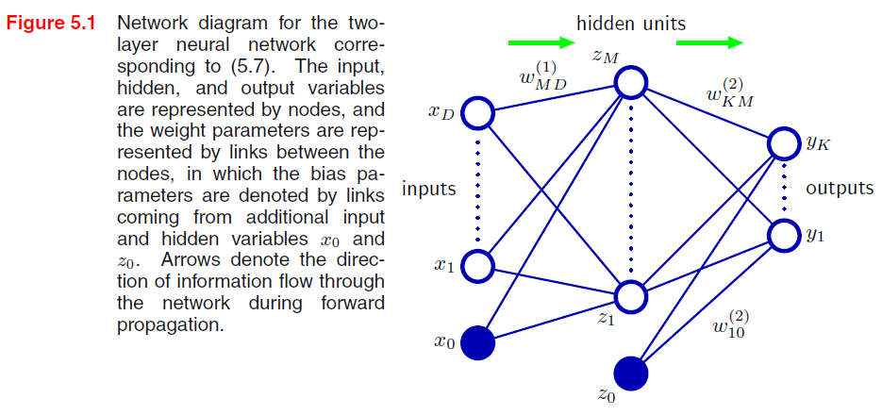


Neural network definition
Activations:
Nonlinear activation function h (e.g. sigmoid, tanh, RELU): e.g. z = RELU(a) = max(0, a)
Figure from Christopher Bishop

Slide 5

Neural network definition
Layer 2
Layer 3 (final)
Outputs
Finally:
(multiclass)
(binary)
(binary)

Slide 6
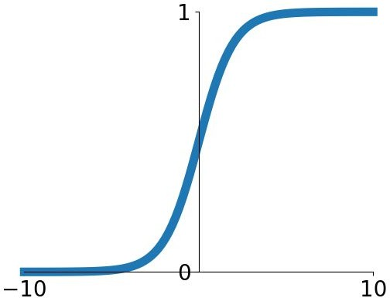
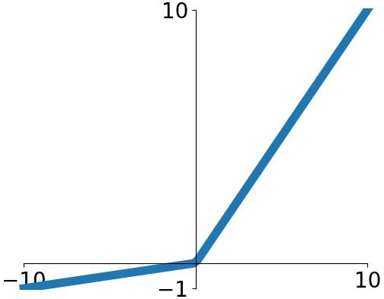


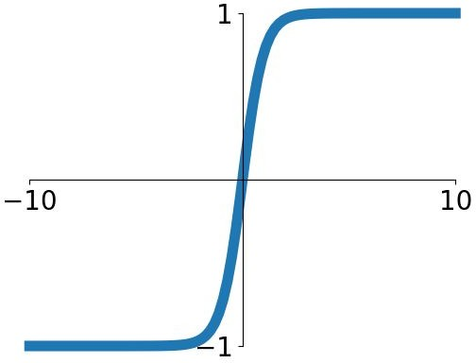


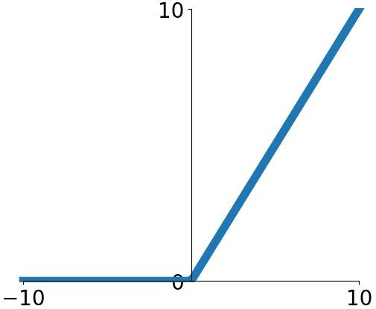
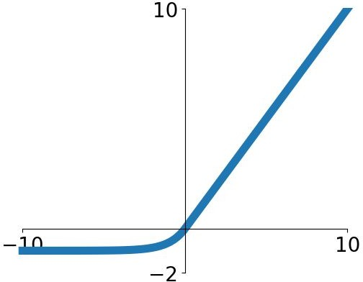

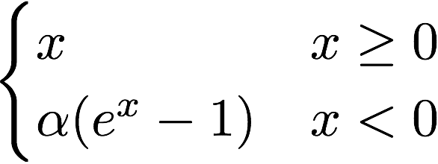
Activation functions
Sigmoid
tanh
Leaky ReLU
Maxout
ReLU
ELU
Fei-Fei Li & Justin Johnson & Serena Yeung Lecture 6 - April 19, 2018
Fei-Fei Li, Andrej Karpathy, Justin Johnson, Serena Yeung

Slide 7
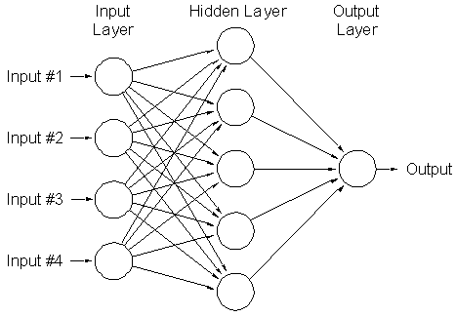
A multi-layer neural network…
Is a non-linear classifier
Can approximate any continuous function to arbitrary accuracy given sufficiently many hidden units
Lana Lazebnik

Slide 8
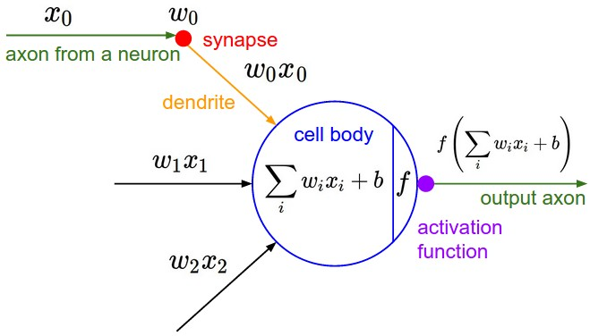
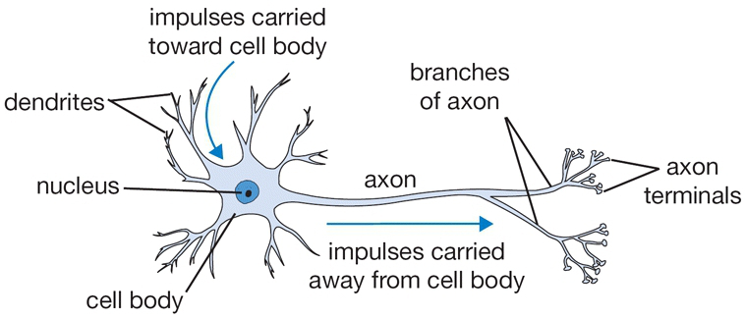
Inspiration: Neuron cells
Neurons
  accept information from multiple inputs
  transmit information to other neurons
Multiply inputs by weights along edges
Apply some function to the set of inputs at each node
If output of function over threshold, neuron “fires”
Text: HKUST, figures: Andrej Karpathy
Notes:
From Wikipedia: At the majority of synapses, signals are sent from the axon of one neuron to a dendrite of another... All neurons are electrically excitable, maintaining voltage gradients across their membranes… If the voltage changes by a large enough amount, an all-or-none electrochemical pulse called an action potential is generated, which travels rapidly along the cell's axon, and activates synaptic connections with other cells when it arrives.

Slide 9
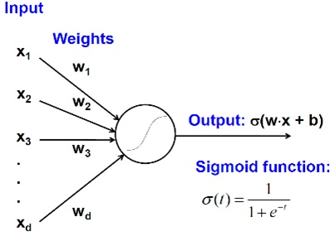
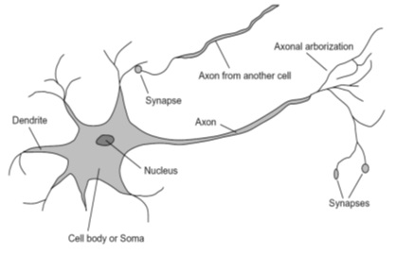
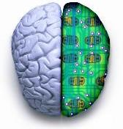
Biological analog
A biological neuron
An artificial neuron
Jia-bin Huang

Slide 10
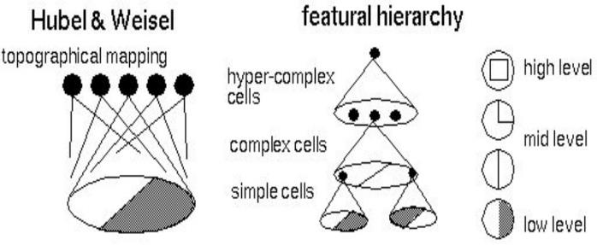
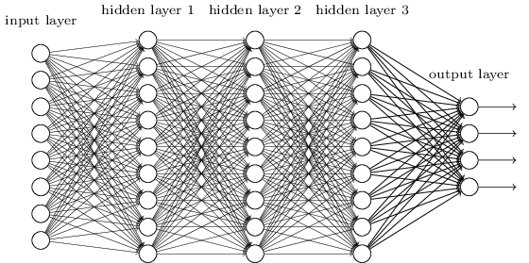
Biological analog
Hubel and Weisel’s architecture
Multi-layer neural network
Adapted from Jia-bin Huang

Slide 11
Feed-forward networks
Cascade neurons together
Output from one layer is the input to the next
Each layer has its own sets of weights
HKUST

Slide 12
Feed-forward networks
Predictions are fed forward through the network to classify
HKUST

Slide 13
Feed-forward networks
Predictions are fed forward through the network to classify
HKUST

Slide 14
Feed-forward networks
Predictions are fed forward through the network to classify
HKUST

Slide 15
Feed-forward networks
Predictions are fed forward through the network to classify
HKUST

Slide 16
Feed-forward networks
Predictions are fed forward through the network to classify
HKUST

Slide 17
Feed-forward networks
Predictions are fed forward through the network to classify
HKUST

Slide 18
Deep neural networks
Lots of hidden layers
Depth = power (usually)
Weights to learn!
Weights to learn!
Weights to learn!
Weights to learn!
Figure from http://neuralnetworksanddeeplearning.com/chap5.html

Slide 19
Goals

Slide 20
How do we train deep networks?
No closed-form solution for the weights (i.e. we cannot set up a system A*w = b)
We will iteratively find such a set of weights that allow the outputs to match the desired outputs
We want to minimize a loss function (a function of the weights in the network)
For now let’s simplify and assume there’s a single layer of weights in the network, and no activation function (i.e. output is a linear combination of the inputs)

Slide 21
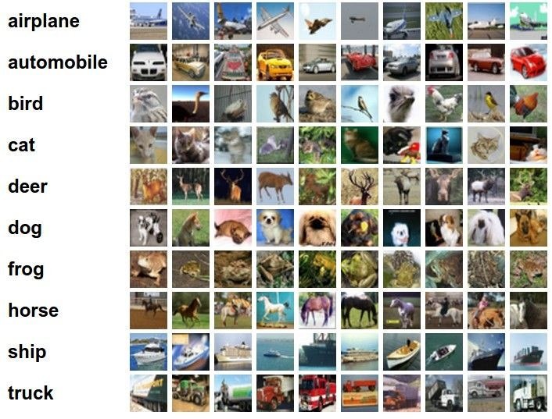
Classification goal
Example dataset: CIFAR-10 10 labels
50,000 training images each image is 32x32x3
10,000 test images.
Andrej Karpathy

Slide 22


Classification scores
image
parameters
f(x,W)
10 numbers, indicating class scores
[32x32x3]
array of numbers 0...1 (3072 numbers total)
Andrej Karpathy

Slide 23
Linear classifier
3072x1
(+b)
10x1
10x1
10x3072
10 numbers, indicating class scores
[32x32x3]
array of numbers 0...1
parameters, or “weights”
Andrej Karpathy

Slide 24
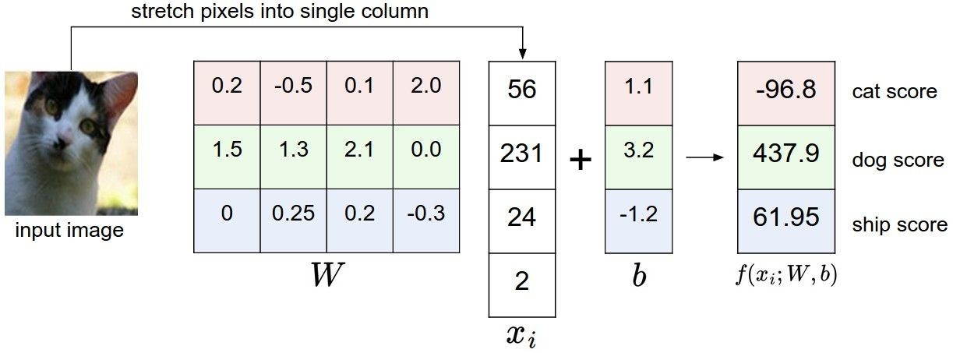
Linear classifier
Example with an image with 4 pixels, and 3 classes (cat/dog/ship)
Andrej Karpathy

Slide 25


Linear classifier
Going forward: Loss function/Optimization
TODO:
1. Define a loss function that quantifies our unhappiness with the scores across the training data.
cat car frog
3.2
5.1
-1.7
1.3
4.9
2.0
2.2
2.5
-3.1
2. Come up with a way of efficiently finding the parameters that minimize the loss function. (optimization)
Adapted from Andrej Karpathy

Slide 26
Linear classifier
Suppose: 3 training examples, 3 classes. With some W the scores
are:
cat car frog
3.2
5.1
-1.7
1.3
4.9
2.0
2.2
2.5
-3.1
Adapted from Andrej Karpathy

Slide 27









Linear classifier: Hinge loss
Suppose: 3 training examples, 3 classes. With some W the scores
Hinge loss:
Given an example
are:
where where
is the image and
is the (integer) label,
and using the shorthand for the scores vector:
cat car frog
the loss has the form:
3.2
5.1
-1.7
1.3
4.9
2.0
2.2
2.5
-3.1
Want: s_{yi} >= s_{j} + 1
i.e. s_{j} – s_{yi} + 1 <= 0
If true, loss is 0
If false, loss is magnitude of violation
Adapted from Andrej Karpathy

Slide 28
Linear classifier: Hinge loss
Suppose: 3 training examples, 3 classes. With some W the scores
Hinge loss:
Given an example
are:
where where
is the image and
is the (integer) label,
and using the shorthand for the scores vector:
the loss has the form:
cat car frog | 3.2 5.1 -1.7 | 1.3 2.2 4.9 2.5 2.0 -3.1
Losses: | 2.9
= max(0, 5.1 - 3.2 + 1)
+max(0, -1.7 - 3.2 + 1)
= max(0, 2.9) + max(0, -3.9)
= 2.9 + 0
= 2.9
Adapted from Andrej Karpathy

Slide 29
Linear classifier: Hinge loss
Suppose: 3 training examples, 3 classes. With some W the scores
Hinge loss:
Given an example
are:
where where
is the image and
is the (integer) label,
and using the shorthand for the scores vector:
the loss has the form:
cat 3.2 car 5.1 frog -1.7 | 1.3 4.9 2.0 | 2.2 2.5 -3.1
Losses: 2.9 | 0
= max(0, 1.3 - 4.9 + 1)
+max(0, 2.0 - 4.9 + 1)
= max(0, -2.6) + max(0, -1.9)
= 0 + 0
= 0
Adapted from Andrej Karpathy

Slide 30
Linear classifier: Hinge loss
Suppose: 3 training examples, 3 classes. With some W the scores
Hinge loss:
Given an example
are:
where where
is the image and
is the (integer) label,
and using the shorthand for the scores vector:
the loss has the form:
cat car frog | 3.2 5.1 -1.7 | 1.3 4.9 2.0 | 2.2 2.5 -3.1
Losses: | 2.9 | 0 | 12.9
= max(0, 2.2 - (-3.1) + 1)
+max(0, 2.5 - (-3.1) + 1)
= max(0, 5.3 + 1)
+ max(0, 5.6 + 1)
= 6.3 + 6.6
= 12.9
Adapted from Andrej Karpathy

Slide 31

Linear classifier: Hinge loss
Suppose: 3 training examples, 3 classes. With some W the scores
Hinge loss:
Given an example
are:
where where
is the image and
is the (integer) label,
and using the shorthand for the scores vector:
cat car frog
the loss has the form:
3.2
5.1
-1.7
1.3
4.9
2.0
2.2
2.5
-3.1
and the full training loss is the mean over all examples in the training data:
L = (2.9 + 0 + 12.9)/3
Losses:
2.9
0
12.9
= 15.8 / 3 = 5.3
Lecture 3 - 12
Adapted from Andrej Karpathy

Slide 32
Linear classifier: Hinge loss
E.g. Suppose that we found a W such that L = 0. Is this W unique?
No! 2W is also has L = 0!
How do we choose between W and 2W?
Slide from Fei-Fei, Johnson, Yeung

Slide 33

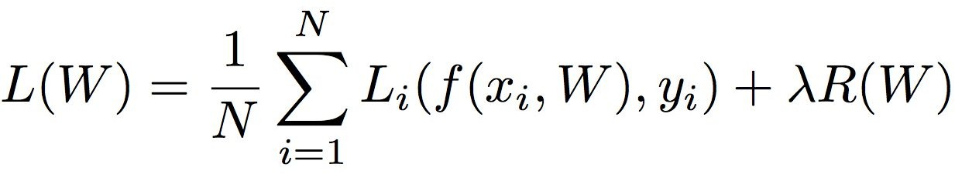
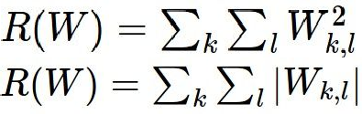

Weight Regularization
= regularization strength (hyperparameter)
Data loss: Model predictions should match training data
Regularization: Prevent the model from doing too well on training data
Simple examples L2 regularization: L1 regularization:
Elastic net (L1 + L2):
More complex:
Dropout
Batch normalization
Stochastic depth, fractional pooling, etc
Why regularize?
Express preferences over weights
Make the model simple so it works on test data
Adapted from Fei-Fei, Johnson, Yeung

Slide 34





Weight Regularization
Expressing preferences
L2 Regularization
L2 regularization likes to “spread out” the weights
Slide from Fei-Fei, Johnson, Yeung

Slide 35
Weight Regularization
Preferring simple models
f₁
f₂
y
x
Regularization pushes against fitting the data
too well so we don’t fit noise in the data

Slide 36



Another loss: Cross-entropy
scores = unnormalized log probabilities of the classes.
where
cat car frog
Want to maximize the log likelihood, or (for a loss function) to minimize the negative log likelihood of the correct class:
3.2
5.1
-1.7
Andrej Karpathy

Slide 37

Another loss: Cross-entropy
Probabilities must be >= 0
Probabilities must sum to 1
cat car frog
3.2 5.1 -1.7 | exp
0.13
0.87
0.00
24.5
164.0
0.18
L_i = -log(0.13)
= 0.89
normalize
unnormalized log probabilities
probabilities
unnormalized probabilities
Aside:
- This is multinomial logistic regression
- Choose weights to maximize the likelihood of the observed x/y data (Maximum Likelihood Estimation; more discussion in CS 1675)
Adapted from Fei-Fei, Johnson, Yeung

Slide 38


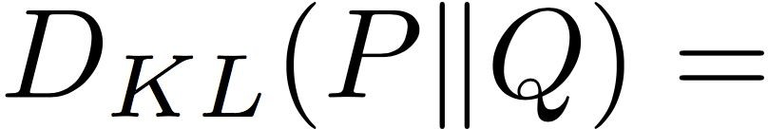
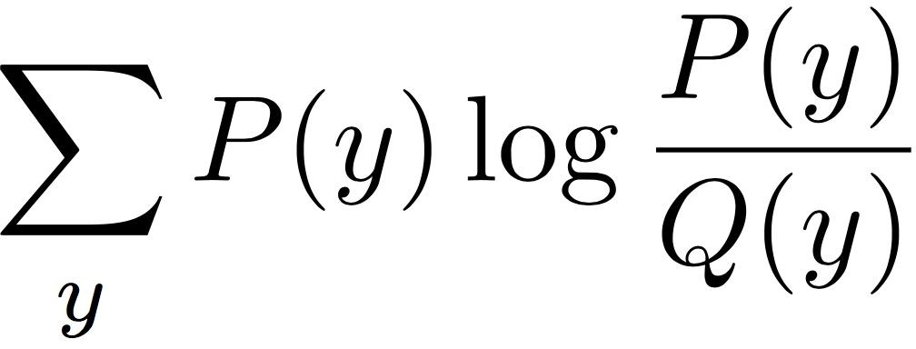
Another loss: Cross-entropy
Probabilities must be >= 0
Probabilities must sum to 1
cat car frog
3.2
5.1
-1.7
24.5
164.0
0.18
0.13
0.87
0.00
compare
 | 1.00
 | 0.00
 | 0.00
exp
normalize
Kullback–Leibler divergence
unnormalized
log-probabilities / logits
unnormalized
probabilities
probabilities
correct
probs
Adapted from Fei-Fei, Johnson, Yeung

Slide 39


Other losses
Triplet loss (Schroff, FaceNet, CVPR 2015)
Anything you want! (almost)
a denotes anchor
p denotes positive
n denotes negative

Slide 40
Training

Slide 41


To minimize loss, use gradient descent
Andrej Karpathy

Slide 42

How to minimize the loss function?
In 1-dimension, the derivative of a function:
In multiple dimensions, the gradient is the vector of (partial derivatives).
Andrej Karpathy

Slide 43

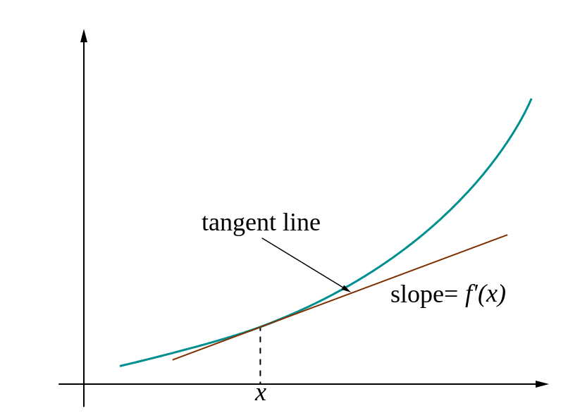
Loss gradients
Denoted as (diff notations):
i.e. how does the loss change as a function of the weights
We want to change the weights in such a way that makes the loss decrease as fast as possible

Slide 44
current W:
gradient dW:
[0.34,
-1.11,
0.78,
0.12,
0.55,
2.81,
-3.1,
-1.5,
0.33,…]
loss 1.25347
[?,
?,
?,
?,
?,
?,
?,
?,
?,…]
Andrej Karpathy

Slide 45
current W:
W + h (first dim):
gradient dW:
[0.34,
-1.11,
0.78,
0.12,
0.55,
2.81,
-3.1,
-1.5,
0.33,…]
loss 1.25347
[0.34 + 0.0001,
-1.11,
0.78,
0.12,
0.55,
2.81,
-3.1,
-1.5,
0.33,…]
loss 1.25322
[?,
?,
?,
?,
?,
?,
?,
?,
?,…]
Andrej Karpathy

Slide 46
current W:
W + h (first dim):
gradient dW:
[0.34,
-1.11,
0.78,
0.12,
0.55,
2.81,
-3.1,
-1.5,
0.33,…]
loss 1.25347
[0.34 + 0.0001,
-1.11,
0.78,
0.12,
0.55,
2.81,
-3.1,
-1.5,
0.33,…]
loss 1.25322
[-2.5,
?,
?,
?,
?,
?,
?,
(1.25322 - 1.25347)/0.0001
= -2.5
?,
?,…]
Andrej Karpathy

Slide 47
current W:
W + h (second dim):
gradient dW:
[0.34,
-1.11,
0.78,
0.12,
0.55,
2.81,
-3.1,
-1.5,
0.33,…]
loss 1.25347
[0.34,
-1.11 + 0.0001,
0.78,
0.12,
0.55,
2.81,
-3.1,
-1.5,
0.33,…]
loss 1.25353
[-2.5,
?,
?,
?,
?,
?,
?,
?,
?,…]
Andrej Karpathy

Slide 48
current W:
W + h (second dim):
gradient dW:
[0.34,
-1.11,
0.78,
0.12,
0.55,
2.81,
-3.1,
-1.5,
0.33,…]
loss 1.25347
[0.34,
-1.11 + 0.0001,
0.78,
0.12,
0.55,
2.81,
-3.1,
-1.5,
0.33,…]
loss 1.25353
[-2.5,
0.6,
?,
?,
?,
?,
?,
?,
(1.25353 - 1.25347)/0.0001
= 0.6
?,…]
Andrej Karpathy

Slide 49
current W:
W + h (third dim):
gradient dW:
[0.34,
-1.11,
0.78,
0.12,
0.55,
2.81,
-3.1,
-1.5,
0.33,…]
loss 1.25347
[0.34,
-1.11,
0.78 + 0.0001,
0.12,
0.55,
2.81,
-3.1,
-1.5,
0.33,…]
loss 1.25347
[-2.5,
0.6,
?,
?,
?,
?,
?,
?,
?,…]
Andrej Karpathy

Slide 50



This is silly. The loss is just a function of W:
want
Calculus
= ...
Andrej Karpathy

Slide 51
current W:
gradient dW:
[0.34,
-1.11,
0.78,
0.12,
0.55,
2.81,
-3.1,
-1.5,
0.33,…]
loss 1.25347
[-2.5,
0.6,
0,
0.2,
0.7,
-0.5,
1.1,
1.3,
-2.1,…]
dW = ...
(some function data and W)
Andrej Karpathy

Slide 52
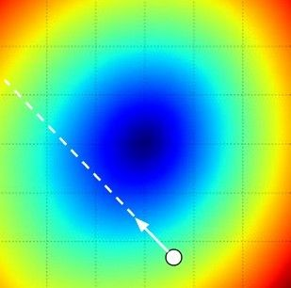
Gradient descent
We’ll update weights
Move in direction opposite to gradient:
L
Time
Learning rate
W_2
original W
W_1
negative gradient direction
Figure from Andrej Karpathy

Slide 53
Gradient descent
Iteratively subtract the gradient with respect to the model parameters (w)
I.e. we’re moving in a direction opposite to the gradient of the loss
I.e. we’re moving towards smaller loss

Slide 54
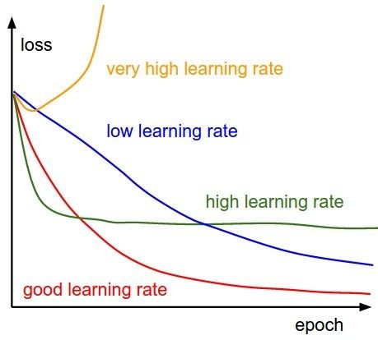
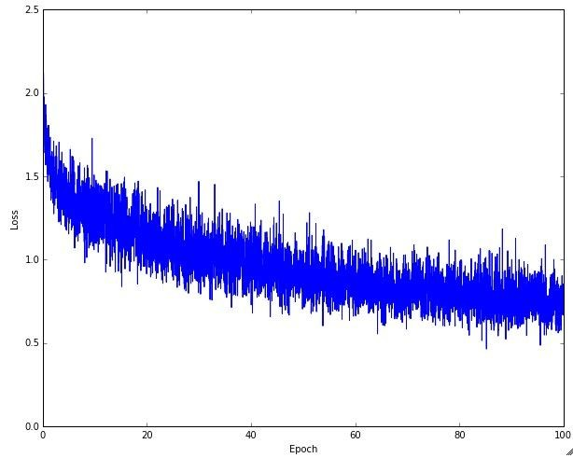
Learning rate selection
The effects of step size (or “learning rate”)
Andrej Karpathy

Slide 55
Gradient descent in multi-layer nets
We’ll update weights
Move in direction opposite to gradient:
How to update the weights at all layers?
Answer: backpropagation of error from higher layers to lower layers

Slide 56
Comments on training algorithm
Not guaranteed to converge to zero training error, may converge to local optima or oscillate indefinitely.
However, in practice, does converge to low error for many large networks on real data.
Local minima – not a huge problem in practice for deep networks.
Thousands of epochs (epoch = network sees all training data once) may be required, hours or days to train.
May be hard to set learning rate and to select number of hidden units and layers.
When in doubt, use validation set to decide on design/hyperparameters.
Neural networks had fallen out of fashion in 90s, early 2000s; now significantly improved performance (deep networks trained with dropout and lots of data).
Adapted from Ray Mooney, Carlos Guestrin, Dhruv Batra

Slide 57
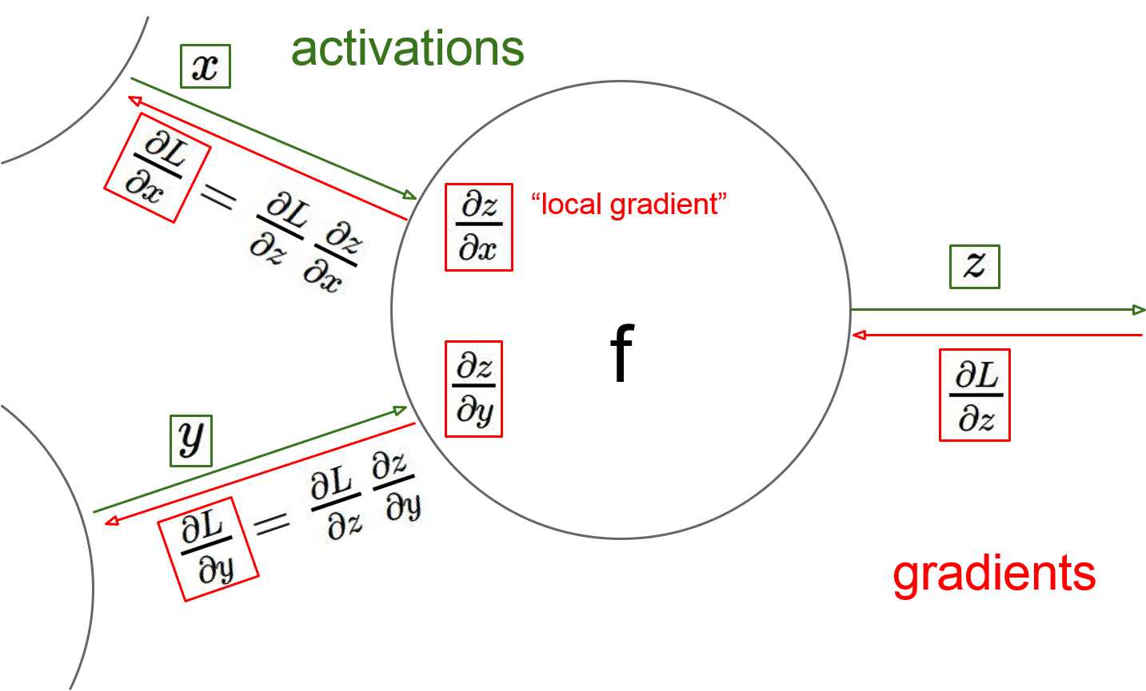
Gradient descent in multi-layer nets
How to update the weights at all layers?
Answer: backpropagation of error from higher layers to lower layers
Figure from Andrej Karpathy

Slide 58
Backpropagation: Graphic example
First calculate error of output units and use this to change the top layer of weights.
output
k
j
i
Update weights into j
w⁽²⁾
hidden
w⁽¹⁾
input
Adapted from Ray Mooney, equations from Chris Bishop

Slide 59
Backpropagation: Graphic example
Next calculate error for hidden units based on errors on the output units it feeds into.
output
k
j
i
hidden
input
Adapted from Ray Mooney, equations from Chris Bishop

Slide 60
Backpropagation: Graphic example
Finally update bottom layer of weights based on errors calculated for hidden units.
output
k
j
i
Update weights into i
hidden
input
Adapted from Ray Mooney, equations from Chris Bishop

Slide 61
Computing gradient for each weight
We need to move weights in direction opposite to gradient of loss wrt that weight:
w_{kj} = w_{kj} – η dE/dw_{kj} (output layer)
w_{ji} = w_{ji} – η dE/dw_{ji} (hidden layer)
Loss depends on weights in an indirect way, so we’ll use the chain rule and compute:
dE/dw_{kj} = dE/dy_{k} dy_{k}/da_{k} da_{k}/dw_{kj}
dE/dw_{ji} = dE/dz_{j} dz_{j}/da_{j} da_{j}/dw_{ji}

Slide 62
Gradient for output layer weights
Loss depends on weights in an indirect way, so we’ll use the chain rule and compute:
dE/dw_{kj} = dE/dy_{k} dy_{k}/da_{k} da_{k}/dw_{kj}
How to compute each of these?
dE/dy_{k} : need to know form of error function
  Example: if E = (y_{k} – y_{k}’)², where y_{k}’ is the ground-truth label, then dE/dy_{k} = 2(y_{k} – y_{k}’)
dy_{k}/da_{k} : need to know output layer activation
  If h(a_{k})=σ(a_{k}), then d h(a_{k})/d a_{k} = σ(a_{k})(1-σ(a_{k}))
da_{k}/dw_{kj} : z_{j} since a_{k} is a linear combination
  a_{k} = w_{k:}^{T} z = Σ_{j} w_{kj} z_{j}

Slide 63
Gradient for hidden layer weights
We’ll use the chain rule again and compute:
dE/dw_{ji} = dE/dz_{j} dz_{j}/da_{j} da_{j}/dw_{ji}
Unlike the previous case (weights for output layer), the error (dE/dz_{j}) is hard to compute (indirect, need chain rule again)
We’ll simplify the computation by doing it step by step via backpropagation of error
You could directly compute this term– you will get the same result as with backprop (do as an exercise!)

Slide 64
Gradients – slightly different notation
The following is a framework, slightly imprecise
Let us denote the inputs at a layer i by in_{i}, the linear combination of inputs computed at that layer as raw_{i}, the activation as act_{i}
We define a new quantity that will roughly correspond to accumulated error, err_{i}
Then we can write the updates as
w = w – η * err_{i} * in_{i}
We can compute error as:
err_{i} =
d E / d act_{i} * d act_{i} / d raw_{i}

Slide 65
Gradients – slightly different approach
We’ll write the weight updates as follows
  w_{kj} = w_{kj} - η δ_{k} z_{j} for output units
  w_{ji} = w_{ji} - η δ_{j} x_{i} for hidden units
What are δ_{k}, δ_{j}?
  They store error, gradient wrt raw activations (i.e. dE/da)
  They’re of the form dE/dz_{j} dz_{j}/da_{j}
  The latter is easy to compute – just use derivative of activation function
  The former is easy for output – e.g. (y_{k} – y_{k}’)
  It is harder to compute for hidden layers
  dE/dz_{j} = ∑_{k} w_{kj} δ_{k} (where did this come from?)
Figure from Chris Bishop

Slide 66
Deriving backprop (Bishop Eq. 5.56)
In a neural network:
Gradient is (using chain rule):
Denote the “errors” as:
Also:
Equations from Bishop

Slide 67
Deriving backprop (Bishop Eq. 5.56)
For output (identity output, L2 loss):
For hidden units (using chain rule again):
Backprop formula:
Equations from Bishop

Slide 68
Putting it all together
Example: use sigmoid at hidden layer and output layer, loss is L2 between true/predicted labels

Slide 69
Example algorithm for sigmoid, L2 error
Initialize all weights to small random values
Until convergence (e.g. all training examples’ error small, or error stops decreasing) repeat:
  For each (x, y’=class(x)) in training set:
    Calculate network outputs: y_{k}
    Compute errors (gradients wrt activations) for each unit:
      δ_{k} = y_{k} (1-y_{k}) (y_{k} – y_{k}’) for output units
      δ_{j} = z_{j} (1-z_{j}) ∑_{k} w_{kj} δ_{k} for hidden units
    Update weights:
      w_{kj} = w_{kj} - η δ_{k} z_{j} for output units
      w_{ji} = w_{ji} - η δ_{j} x_{i} for hidden units
Recall: w_{ji} = w_{ji} – η dE/dz_{j} dz_{j}/da_{j} da_{j}/dw_{ji}
Adapted from R. Hwa, R. Mooney

Slide 70
Another example
Two layer network w/ tanh at hidden layer:
Derivative:
Minimize:
Forward propagation:

Slide 71
Another example
Errors at output (identity function at output):
Errors at hidden units:
Derivatives wrt weights:

Slide 72
Same example with graphic and math
First calculate error of output units and use this to change the top layer of weights.
output
k
j
i
Update weights into j
hidden
input
Adapted from Ray Mooney, equations from Chris Bishop

Slide 73
Same example with graphic and math
Next calculate error for hidden units based on errors on the output units it feeds into.
output
k
j
i
hidden
input
Adapted from Ray Mooney, equations from Chris Bishop

Slide 74
Same example with graphic and math
Finally update bottom layer of weights based on errors calculated for hidden units.
output
k
j
i
Update weights into i
hidden
input
Adapted from Ray Mooney, equations from Chris Bishop

Slide 75
Another way of keeping track of error
Computation graphs
Accumulate upstream/downstream gradients at each node
One set flows from inputs to outputs and can be computed without evaluating loss
The other flows from outputs (loss) to inputs

Slide 76


activations
Generic example
f
Fei-Fei Li & Andrej Karpathy & Justin Johnson Lecture 4 - 13 Jan 2016
Lecture 4 - 22
Andrej Karpathy

Slide 77


activations
Generic example
“local gradient”
f
gradients
Fei-Fei Li & Andrej Karpathy & Justin Johnson Lecture 4 - 13 Jan 2016
Lecture 4 - 23
Andrej Karpathy

Slide 78

activations
Generic example
“local gradient”
f
gradients
Fei-Fei Li & Andrej Karpathy & Justin Johnson Lecture 4 - 13 Jan 2016
Lecture 4 - 24
Andrej Karpathy

Slide 79
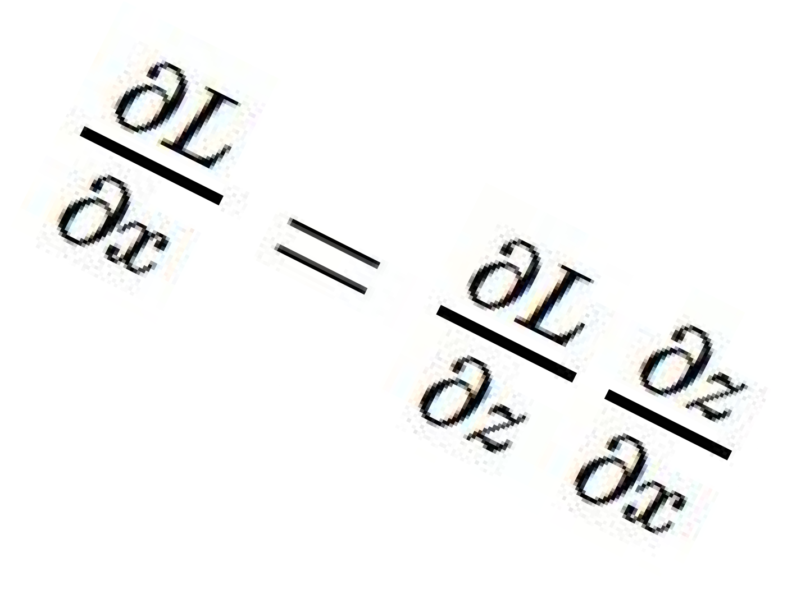
activations
Generic example
“local gradient”
f
gradients
Fei-Fei Li & Andrej Karpathy & Justin Johnson Lecture 4 - 13 Jan 2016
Lecture 4 - 25
Andrej Karpathy

Slide 80
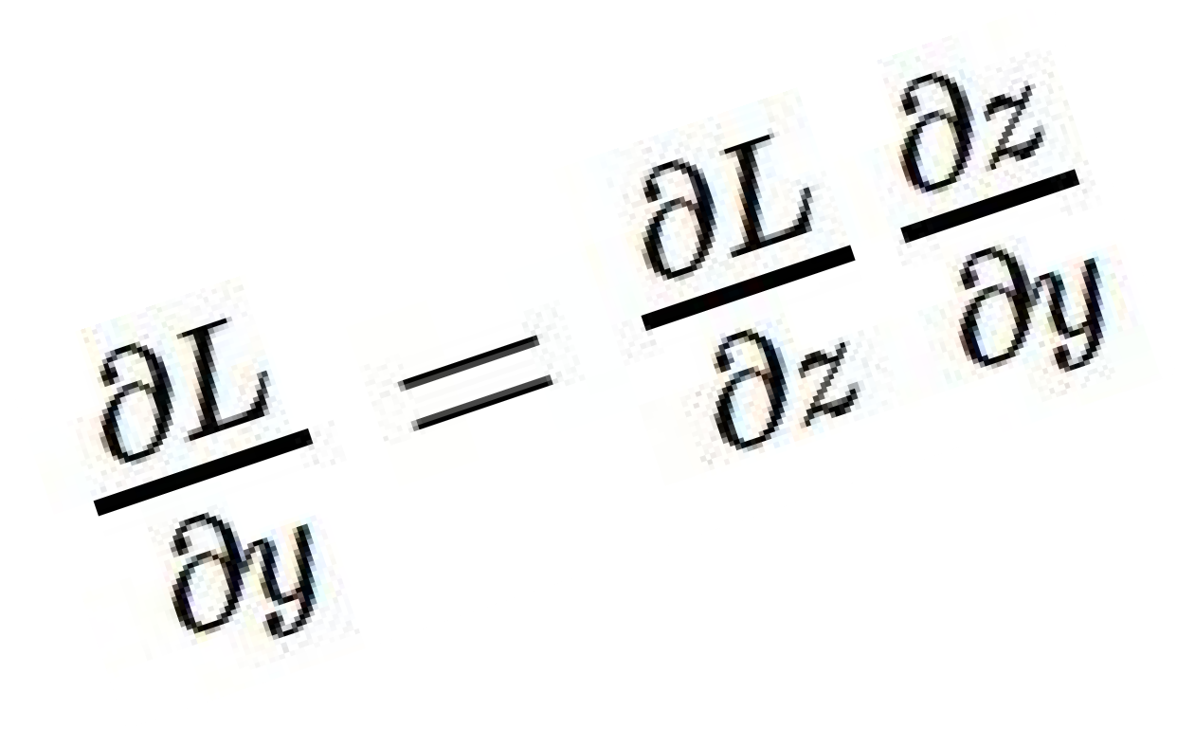
activations
Generic example
“local gradient”
f
gradients
Fei-Fei Li & Andrej Karpathy & Justin Johnson Lecture 4 - 13 Jan 2016
Lecture 4 - 26
Andrej Karpathy

Slide 81
activations
Generic example
“local gradient”
f
gradients
Fei-Fei Li & Andrej Karpathy & Justin Johnson Lecture 4 - 13 Jan 2016
Lecture 4 - 27
Andrej Karpathy

Slide 82
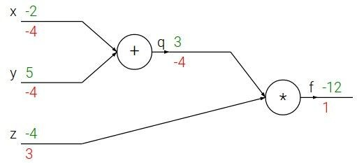

e.g. x = -2, y = 5, z = -4
Another generic example
Fei-Fei Li & Andrej Karpathy & Justin Johnson Lecture 4 - 13 Jan 2016
Lecture 4 - 10
Andrej Karpathy
Notes:
https://www.youtube.com/watch?v=QWfmCyLEQ8U&list=PL16j5WbGpaM0_Tj8CRmurZ8Kk1gEBc7fg&index=4

Slide 83





e.g. x = -2, y = 5, z = -4
Another generic example
Want:
Fei-Fei Li & Andrej Karpathy & Justin Johnson Lecture 4 - 13 Jan 2016
Lecture 4 - 11
Andrej Karpathy

Slide 84

e.g. x = -2, y = 5, z = -4
Another generic example
Want:
Fei-Fei Li & Andrej Karpathy & Justin Johnson Lecture 4 - 13 Jan 2016
Lecture 4 - 12
Andrej Karpathy

Slide 85
e.g. x = -2, y = 5, z = -4
Another generic example
Want:
Fei-Fei Li & Andrej Karpathy & Justin Johnson Lecture 4 - 13 Jan 2016
Lecture 4 - 13
Andrej Karpathy

Slide 86

e.g. x = -2, y = 5, z = -4
Another generic example
Want:
Fei-Fei Li & Andrej Karpathy & Justin Johnson Lecture 4 - 13 Jan 2016
Lecture 4 - 14
Andrej Karpathy

Slide 87
e.g. x = -2, y = 5, z = -4
Another generic example
Want:
Fei-Fei Li & Andrej Karpathy & Justin Johnson Lecture 4 - 13 Jan 2016
Lecture 4 - 15
Andrej Karpathy

Slide 88

e.g. x = -2, y = 5, z = -4
Another generic example
Want:
Fei-Fei Li & Andrej Karpathy & Justin Johnson Lecture 4 - 13 Jan 2016
Lecture 4 - 16
Andrej Karpathy

Slide 89
e.g. x = -2, y = 5, z = -4
Another generic example
Want:
Fei-Fei Li & Andrej Karpathy & Justin Johnson Lecture 4 - 13 Jan 2016
Lecture 4 - 17
Andrej Karpathy

Slide 90

e.g. x = -2, y = 5, z = -4
Another generic example
Want:
Fei-Fei Li & Andrej Karpathy & Justin Johnson Lecture 4 - 13 Jan 2016
Lecture 4 - 18
Andrej Karpathy

Slide 91


e.g. x = -2, y = 5, z = -4
Another generic example
Chain rule:
Want:
Fei-Fei Li & Andrej Karpathy & Justin Johnson Lecture 4 - 13 Jan 2016
Lecture 4 - 19
Andrej Karpathy

Slide 92

e.g. x = -2, y = 5, z = -4
Another generic example
Want:
Fei-Fei Li & Andrej Karpathy & Justin Johnson Lecture 4 - 13 Jan 2016
Lecture 4 - 20
Andrej Karpathy

Slide 93
e.g. x = -2, y = 5, z = -4
Another generic example
Chain rule:
Want:
Fei-Fei Li & Andrej Karpathy & Justin Johnson Lecture 4 - 13 Jan 2016
Lecture 4 - 21
Andrej Karpathy

Slide 94
Tricks of the trade

Slide 95
Practical matters
Getting started: Preprocessing, initialization, choosing activation functions, normalization
Improving performance and dealing with sparse data: regularization, augmentation, transfer
Hardware and software

Slide 96
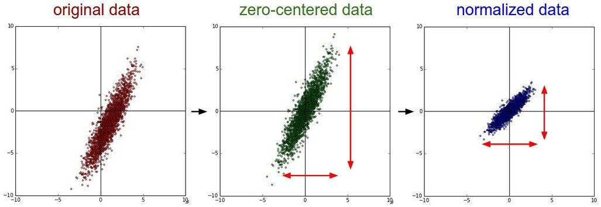


Preprocessing the Data
(Assume X [NxD] is data matrix, each example in a row)
Fei-Fei Li & Justin Johnson & Serena Yeung Lecture 6 - April 19, 2018
Fei-Fei Li, Andrej Karpathy, Justin Johnson, Serena Yeung

Slide 97
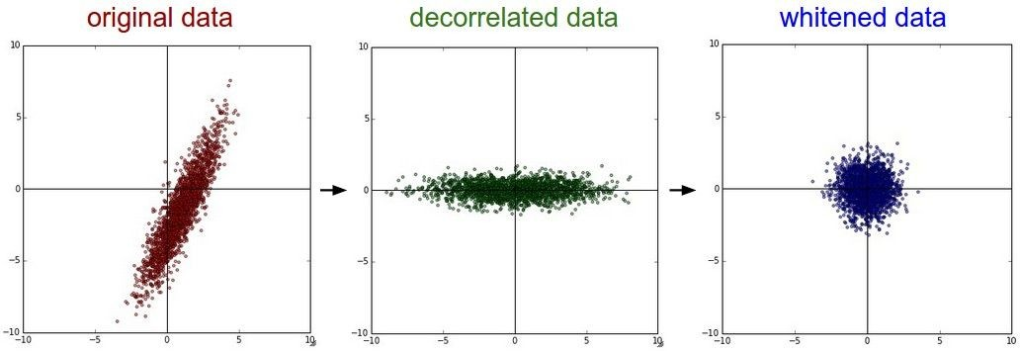
Preprocessing the Data
In practice, you may also see PCA and Whitening of the data
(data has diagonal covariance matrix)
(covariance matrix is the identity matrix)
Lecture 6 - 39
Fei-Fei Li & Justin Johnson & Serena Yeung Lecture 6 - April 19, 2018
Fei-Fei Li, Andrej Karpathy, Justin Johnson, Serena Yeung

Slide 98
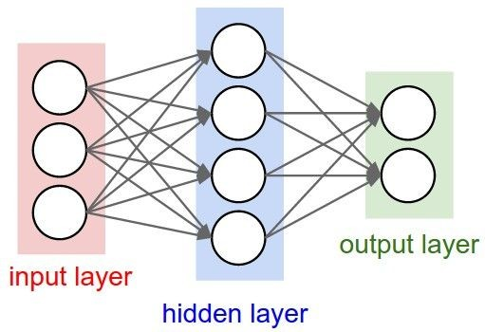
Weight Initialization
Q: what happens when W=constant init is used?
Fei-Fei Li, Andrej Karpathy, Justin Johnson, Serena Yeung

Slide 99
Weight Initialization
- Another idea: Small random numbers
(gaussian with zero mean and 1e-2 standard deviation)
Works ~okay for small networks, but problems with deeper networks.
Fei-Fei Li & Justin Johnson & Serena Yeung Lecture 6 - April 19, 2018
Fei-Fei Li, Andrej Karpathy, Justin Johnson, Serena Yeung

Slide 100
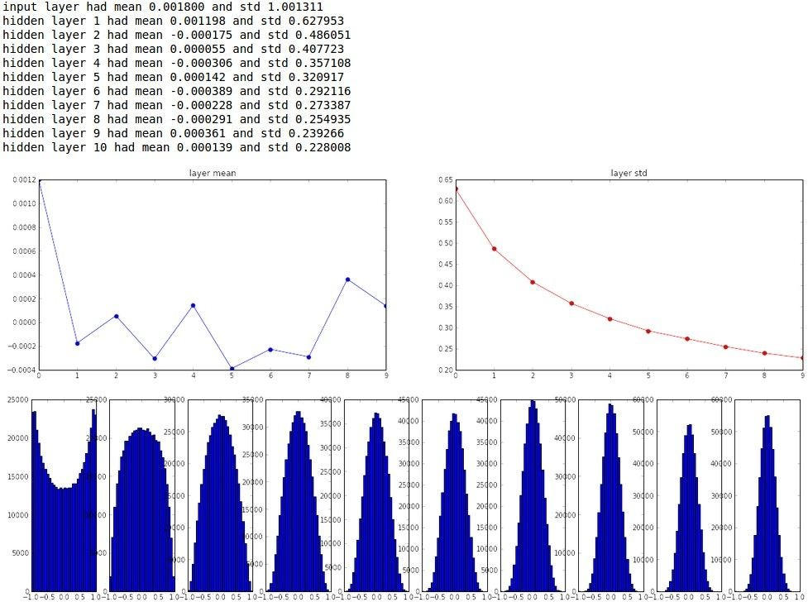
“Xavier initialization” [Glorot et al., 2010]
Reasonable initialization. (Mathematical derivation assumes linear activations)
Fei-Fei Li & Justin Johnson & Serena Yeung Lecture 6 - April 19, 2018
Fei-Fei Li, Andrej Karpathy, Justin Johnson, Serena Yeung

Slide 101
Activation Functions
Sigmoid
tanh
Leaky ReLU
Maxout
ReLU
ELU
Lecture 7 -
Fei-Fei Li & Justin Johnson & Serena Yeung Lecture 7 - April 22, 2019
Fei-Fei Li, Andrej Karpathy, Justin Johnson, Serena Yeung

Slide 102

Activation Functions
Squashes numbers to range [0,1]
Historically popular since they have nice interpretation as a saturating “firing rate” of a neuron
Sigmoid
Fei-Fei Li, Andrej Karpathy, Justin Johnson, Serena Yeung

Slide 103
Activation Functions
Squashes numbers to range [0,1]
Historically popular since they have nice interpretation as a saturating “firing rate” of a neuron
3 problems:
1. Saturated neurons “kill” the gradients
Sigmoid
Lecture 7 -
Fei-Fei Li & Justin Johnson & Serena Yeung Lecture 7 - April 22, 2019
Fei-Fei Li, Andrej Karpathy, Justin Johnson, Serena Yeung

Slide 104
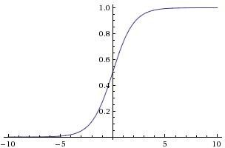



sigmoid gate
x
What happens when x = -10? What happens when x = 0?
What happens when x = 10?
Lecture 7 -
Fei-Fei Li & Justin Johnson & Serena Yeung Lecture 7 - April 22, 2019
Fei-Fei Li, Andrej Karpathy, Justin Johnson, Serena Yeung

Slide 105
Activation Functions
Squashes numbers to range [0,1]
Historically popular since they have nice interpretation as a saturating “firing rate” of a neuron
3 problems:
Saturated neurons “kill” the gradients
Sigmoid outputs are not zero-centered
Sigmoid
Lecture 7 -
Fei-Fei Li & Justin Johnson & Serena Yeung Lecture 7 - April 22, 2019
Fei-Fei Li, Andrej Karpathy, Justin Johnson, Serena Yeung

Slide 106
Activation Functions
Squashes numbers to range [0,1]
Historically popular since they have nice interpretation as a saturating “firing rate” of a neuron
3 problems:
Saturated neurons “kill” the gradients
Sigmoid outputs are not zero-centered
exp() is a bit compute expensive
Sigmoid
Lecture 7 -
Fei-Fei Li & Justin Johnson & Serena Yeung Lecture 7 - April 22, 2019
Fei-Fei Li, Andrej Karpathy, Justin Johnson, Serena Yeung

Slide 107
Activation Functions
Squashes numbers to range [-1,1]
zero centered (nice)
still kills gradients when saturated :(
tanh(x)
[LeCun et al., 1991]
Lecture 7 -
Fei-Fei Li & Justin Johnson & Serena Yeung Lecture 7 - April 22, 2019
Fei-Fei Li, Andrej Karpathy, Justin Johnson, Serena Yeung

Slide 108
- Computes f(x) = max(0,x)
Activation Functions
Does not saturate (in +region)
Very computationally efficient
Converges much faster than sigmoid/tanh in practice (e.g. 6x)
ReLU
(Rectified Linear Unit)
[Krizhevsky et al., 2012]
Lecture 7 -
Fei-Fei Li & Justin Johnson & Serena Yeung Lecture 7 - April 22, 2019
Fei-Fei Li, Andrej Karpathy, Justin Johnson, Serena Yeung

Slide 109
Activation Functions
- Computes f(x) = max(0,x)
Does not saturate (in +region)
Very computationally efficient
Converges much faster than sigmoid/tanh in practice (e.g. 6x)
Not zero-centered output
ReLU
(Rectified Linear Unit)
Lecture 7 -
Fei-Fei Li & Justin Johnson & Serena Yeung Lecture 7 - April 22, 2019
Fei-Fei Li, Andrej Karpathy, Justin Johnson, Serena Yeung

Slide 110
- Computes f(x) = max(0,x)
Activation Functions
Does not saturate (in +region)
Very computationally efficient
Converges much faster than sigmoid/tanh in practice (e.g. 6x)
Not zero-centered output
An annoyance:
hint: what is the gradient when x < 0?
ReLU
(Rectified Linear Unit)
Lecture 7 -
Fei-Fei Li & Justin Johnson & Serena Yeung Lecture 7 - April 22, 2019
Fei-Fei Li, Andrej Karpathy, Justin Johnson, Serena Yeung

Slide 111

x
ReLU
gate
What happens when x = -10? What happens when x = 0?
What happens when x = 10?
Lecture 7 -
Fei-Fei Li & Justin Johnson & Serena Yeung Lecture 7 - April 22, 2019
Fei-Fei Li, Andrej Karpathy, Justin Johnson, Serena Yeung

Slide 112

Activation Functions
[Mass et al., 2013] [He et al., 2015]
Does not saturate
Computationally efficient
Converges much faster than sigmoid/tanh in practice! (e.g. 6x)
- will not “die”.
Leaky ReLU
Lecture 7 -
Fei-Fei Li & Justin Johnson & Serena Yeung Lecture 7 - April 22, 2019
Fei-Fei Li, Andrej Karpathy, Justin Johnson, Serena Yeung

Slide 113

Activation Functions
[Mass et al., 2013] [He et al., 2015]
Does not saturate
Computationally efficient
Converges much faster than sigmoid/tanh in practice! (e.g. 6x)
- will not “die”.
Parametric Rectifier (PReLU)
Leaky ReLU
backprop into \alpha (parameter)
Lecture 7 -
Fei-Fei Li & Justin Johnson & Serena Yeung Lecture 7 - April 22, 2019
Fei-Fei Li, Andrej Karpathy, Justin Johnson, Serena Yeung

Slide 114

Activation Functions
[Clevert et al., 2015]
Exponential Linear Units (ELU)
- All benefits of ReLU
Closer to zero mean outputs
Negative saturation regime compared with Leaky ReLU adds some robustness to noise
Computation requires exp()
Lecture 7 -
Fei-Fei Li & Justin Johnson & Serena Yeung Lecture 7 - April 22, 2019
Fei-Fei Li, Andrej Karpathy, Justin Johnson, Serena Yeung

Slide 115

Maxout “Neuron”
[Goodfellow et al., 2013]
Does not have the basic form of dot product -> nonlinearity
Generalizes ReLU and Leaky ReLU
Linear Regime! Does not saturate! Does not die!
Problem: doubles the number of parameters/neuron :(
Lecture 7 -
Fei-Fei Li & Justin Johnson & Serena Yeung Lecture 7 - April 22, 2019
Fei-Fei Li, Andrej Karpathy, Justin Johnson, Serena Yeung

Slide 116
TLDR: In practice:
Use ReLU. Be careful with your learning rates
Try out Leaky ReLU / Maxout / ELU
Try out tanh but don’t expect much
Don’t use sigmoid
Lecture 7 -
Fei-Fei Li & Justin Johnson & Serena Yeung Lecture 7 - April 22, 2019
Fei-Fei Li, Andrej Karpathy, Justin Johnson, Serena Yeung

Slide 117

Batch Normalization
[Ioffe and Szegedy, 2015]
“you want zero-mean unit-variance activations? just make them so.”
consider a batch of activations at some layer. To make each dimension zero-mean unit-variance, apply:
Fei-Fei Li & Justin Johnson & Serena Yeung Lecture 6 - April 19, 2018
Fei-Fei Li, Andrej Karpathy, Justin Johnson, Serena Yeung

Slide 118


Batch Normalization
[Ioffe and Szegedy, 2015]
“you want zero-mean unit-variance activations? just make them so.”
1. compute the empirical mean and variance independently for each dimension.
N
2. Normalize
D
Fei-Fei Li & Justin Johnson & Serena Yeung Lecture 6 - April 19, 2018
Fei-Fei Li, Andrej Karpathy, Justin Johnson, Serena Yeung

Slide 119



Batch Normalization
[Ioffe and Szegedy, 2015]
Normalize:
Note, the network can learn:
to recover the identity mapping.
And then allow the network to squash the range if it wants to:
Fei-Fei Li & Justin Johnson & Serena Yeung Lecture 6 - April 19, 2018
Fei-Fei Li, Andrej Karpathy, Justin Johnson, Serena Yeung

Slide 120
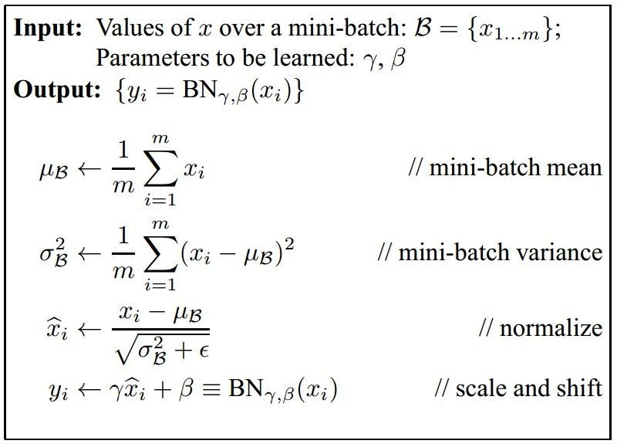
Batch Normalization
[Ioffe and Szegedy, 2015]
Improves gradient flow through the network
Allows higher learning rates
Reduces the strong dependence on initialization
Acts as a form of regularization
Fei-Fei Li & Justin Johnson & Serena Yeung Lecture 6 - April 19, 2018
Fei-Fei Li, Andrej Karpathy, Justin Johnson, Serena Yeung

Slide 121
Batch Normalization
[Ioffe and Szegedy, 2015]
Note: at test time BatchNorm layer functions differently:
The mean/std are not computed based on the batch. Instead, a single fixed empirical mean of activations during training is used.
(e.g. can be estimated during training with running averages)
Fei-Fei Li & Justin Johnson & Serena Yeung Lecture 6 - April 19, 2018
Fei-Fei Li, Andrej Karpathy, Justin Johnson, Serena Yeung

Slide 122
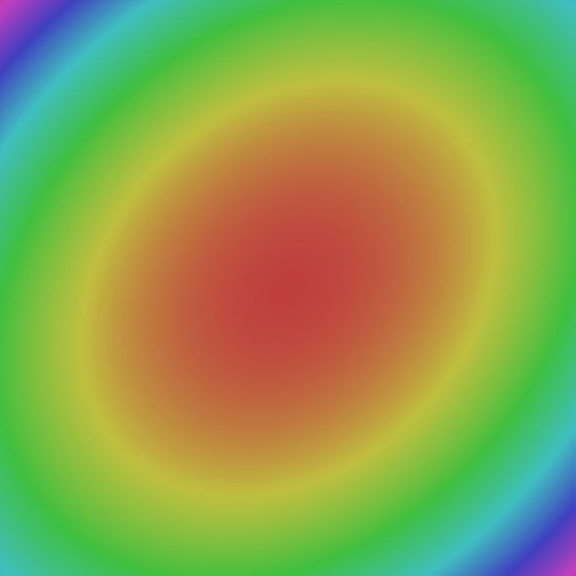
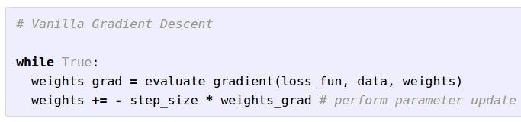

Optimization
W_2
W_1
Next lecture: Problems and better strategies
Fei-Fei Li & Justin Johnson & Serena Yeung Lecture 7 - April 24, 2018
Fei-Fei Li, Andrej Karpathy, Justin Johnson, Serena Yeung

Slide 123
Babysitting the Learning Process
Preprocess data
Choose architecture
Initialize and check initial loss with no regularization
Increase regularization, loss should increase
Then train – try small portion of data, check you can overfit
Add regularization, and find learning rate that can make the loss go down
Check learning rates in range [1e-3 … 1e-5]
Coarse-to-fine search for hyperparameters (e.g. learning rate, regularization)
Fei-Fei Li, Andrej Karpathy, Justin Johnson, Serena Yeung

Slide 124
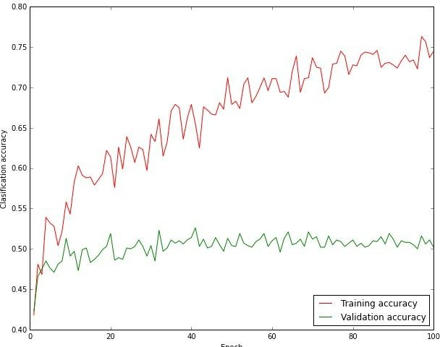
Monitor and visualize accuracy
big gap = overfitting
=> increase regularization strength?
no gap
=> increase model capacity?
Fei-Fei Li & Justin Johnson & Serena Yeung Lecture 6 - April 19, 2018
Fei-Fei Li, Andrej Karpathy, Justin Johnson, Serena Yeung

Slide 125
Dealing with sparse data
Deep neural networks require lots of data, and can overfit easily
The more weights you need to learn, the more data you need
That’s why with a deeper network, you need more data for training than for a shallower network
Ways to prevent overfitting include:
  Using a validation set to stop training or pick parameters
  Regularization
  Data augmentation
  Transfer learning

Slide 126
Over-training prevention
Running too many epochs can result in over-fitting.
Keep a hold-out validation set and test accuracy on it after every epoch. Stop training when additional epochs actually increase validation error.
error
on test data
on training data
0
# training epochs
Adapted from Ray Mooney

Slide 127
Determining best number of hidden units
Too few hidden units prevents the network from adequately fitting the data.
Too many hidden units can result in over-fitting.
Use internal cross-validation to empirically determine an optimal number of hidden units.
error
on test data
on training data
0
# hidden units
Ray Mooney

Slide 128
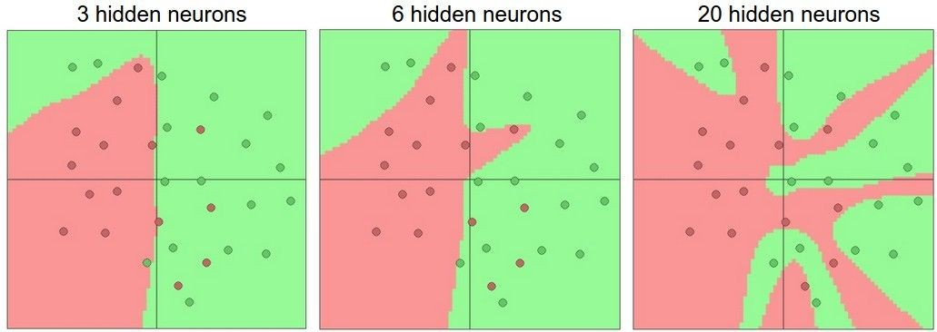
Effect of number of neurons
more neurons = more capacity
Andrej Karpathy

Slide 129
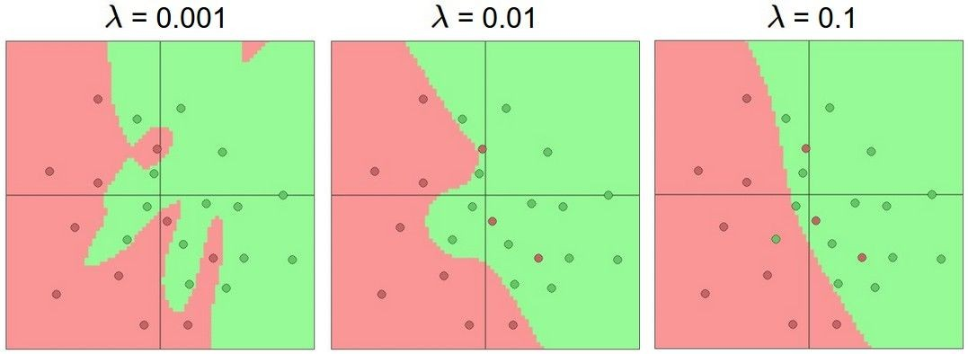
Do not use size of neural network as a regularizer. Use stronger regularization instead:
Effect of regularization
(you can play with this demo over at ConvNetJS: http://cs.stanford. edu/people/karpathy/convnetjs/demo/classify2d.html)
Andrej Karpathy

Slide 130
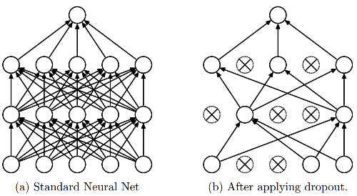
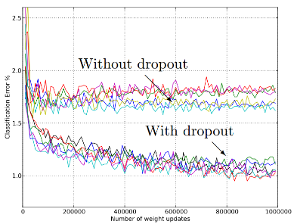
Regularization
L1, L2 regularization (weight decay)
Dropout
  Randomly turn off some neurons
  Allows individual neurons to independently be responsible for performance
Dropout: A simple way to prevent neural networks from overfitting [Srivastava JMLR 2014]
Adapted from Jia-bin Huang

Slide 131

Data Augmentation
“cat”
Load image and label
Compute loss
CNN
Fei-Fei Li & Justin Johnson & Serena Yeung Lecture 7 - April 24, 2018
Fei-Fei Li, Andrej Karpathy, Justin Johnson, Serena Yeung

Slide 132
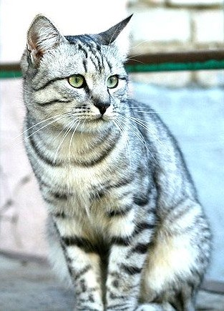
Data Augmentation
“cat”
Load image and label
Compute loss
CNN
Transform image
Fei-Fei Li & Justin Johnson & Serena Yeung Lecture 7 - April 24, 2018
Fei-Fei Li, Andrej Karpathy, Justin Johnson, Serena Yeung

Slide 133

Data Augmentation
Horizontal Flips
Fei-Fei Li & Justin Johnson & Serena Yeung Lecture 7 - April 24, 2018
Fei-Fei Li, Andrej Karpathy, Justin Johnson, Serena Yeung

Slide 134
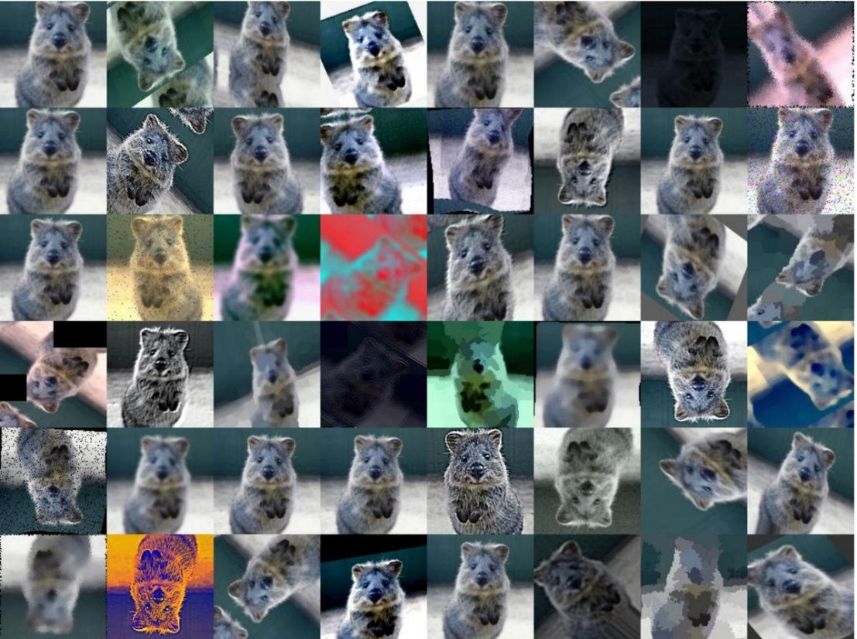
Data Augmentation
Get creative for your problem!
Random mix/combinations of :
translation
rotation
stretching
shearing,
lens distortions
…
Fei-Fei Li & Justin Johnson & Serena Yeung Lecture 7 - April 24, 2018
Fei-Fei Li, Andrej Karpathy, Justin Johnson, Serena Yeung; Image: https://github.com/aleju/imgaug

Slide 135
Data Augmentation
Random crops and scales
Training: sample random crops / scales
ResNet:
Pick random L in range [256, 480]
Resize training image, short side = L
Sample random 224 x 224 patch
Testing: average a fixed set of crops
ResNet:
1. Resize image at 5 scales: {224, 256, 384, 480, 640}
2. For each size, use 10 224 x 224 crops: 4 corners + center, + flips
Fei-Fei Li & Justin Johnson & Serena Yeung Lecture 7 - April 24, 2018
Fei-Fei Li, Andrej Karpathy, Justin Johnson, Serena Yeung

Slide 136
Transfer learning
If you have sparse data in your domain of interest (target), but have rich data in a disjoint yet related domain (source),
You can train the early layers on the source domain, and only the last few layers on the target domain:
Set these to the already learned
weights from another network
Learn these on your own task

Slide 137
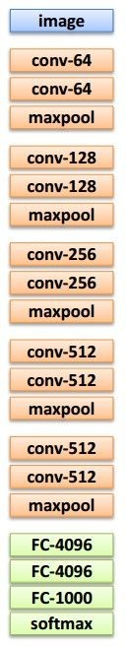
Transfer learning
Source: e.g. classification of animals Target: e.g. classification of cars
1. Train on source (large dataset)
2. Small dataset:
3. Medium dataset:
finetuning
more data = retrain more of the network (or all of it)
Freeze these
Freeze these
Train this
Train this
Lecture 11 - 29
Another option: use network as feature extractor,
train SVM/LR on extracted features for target task
Adapted from Andrej Karpathy

Slide 138
Training: Best practices
Center (subtract mean from) your data
To initialize weights, use “Xavier initialization”
Use RELU or leaky RELU or ELU, don’t use sigmoid
Use mini-batch
Use data augmentation
Use regularization
Use batch normalization
Use cross-validation for your parameters
Learning rate: too high? Too low?

Slide 139
Mini-batch gradient descent
In classic gradient descent, we compute the gradient from the loss for all training examples
Could also only use some of the data for each gradient update
We cycle through all the training examples multiple times
Each time we’ve cycled through all of them once is called an ‘epoch’
Allows faster training (e.g. on GPUs), parallelization

Slide 140
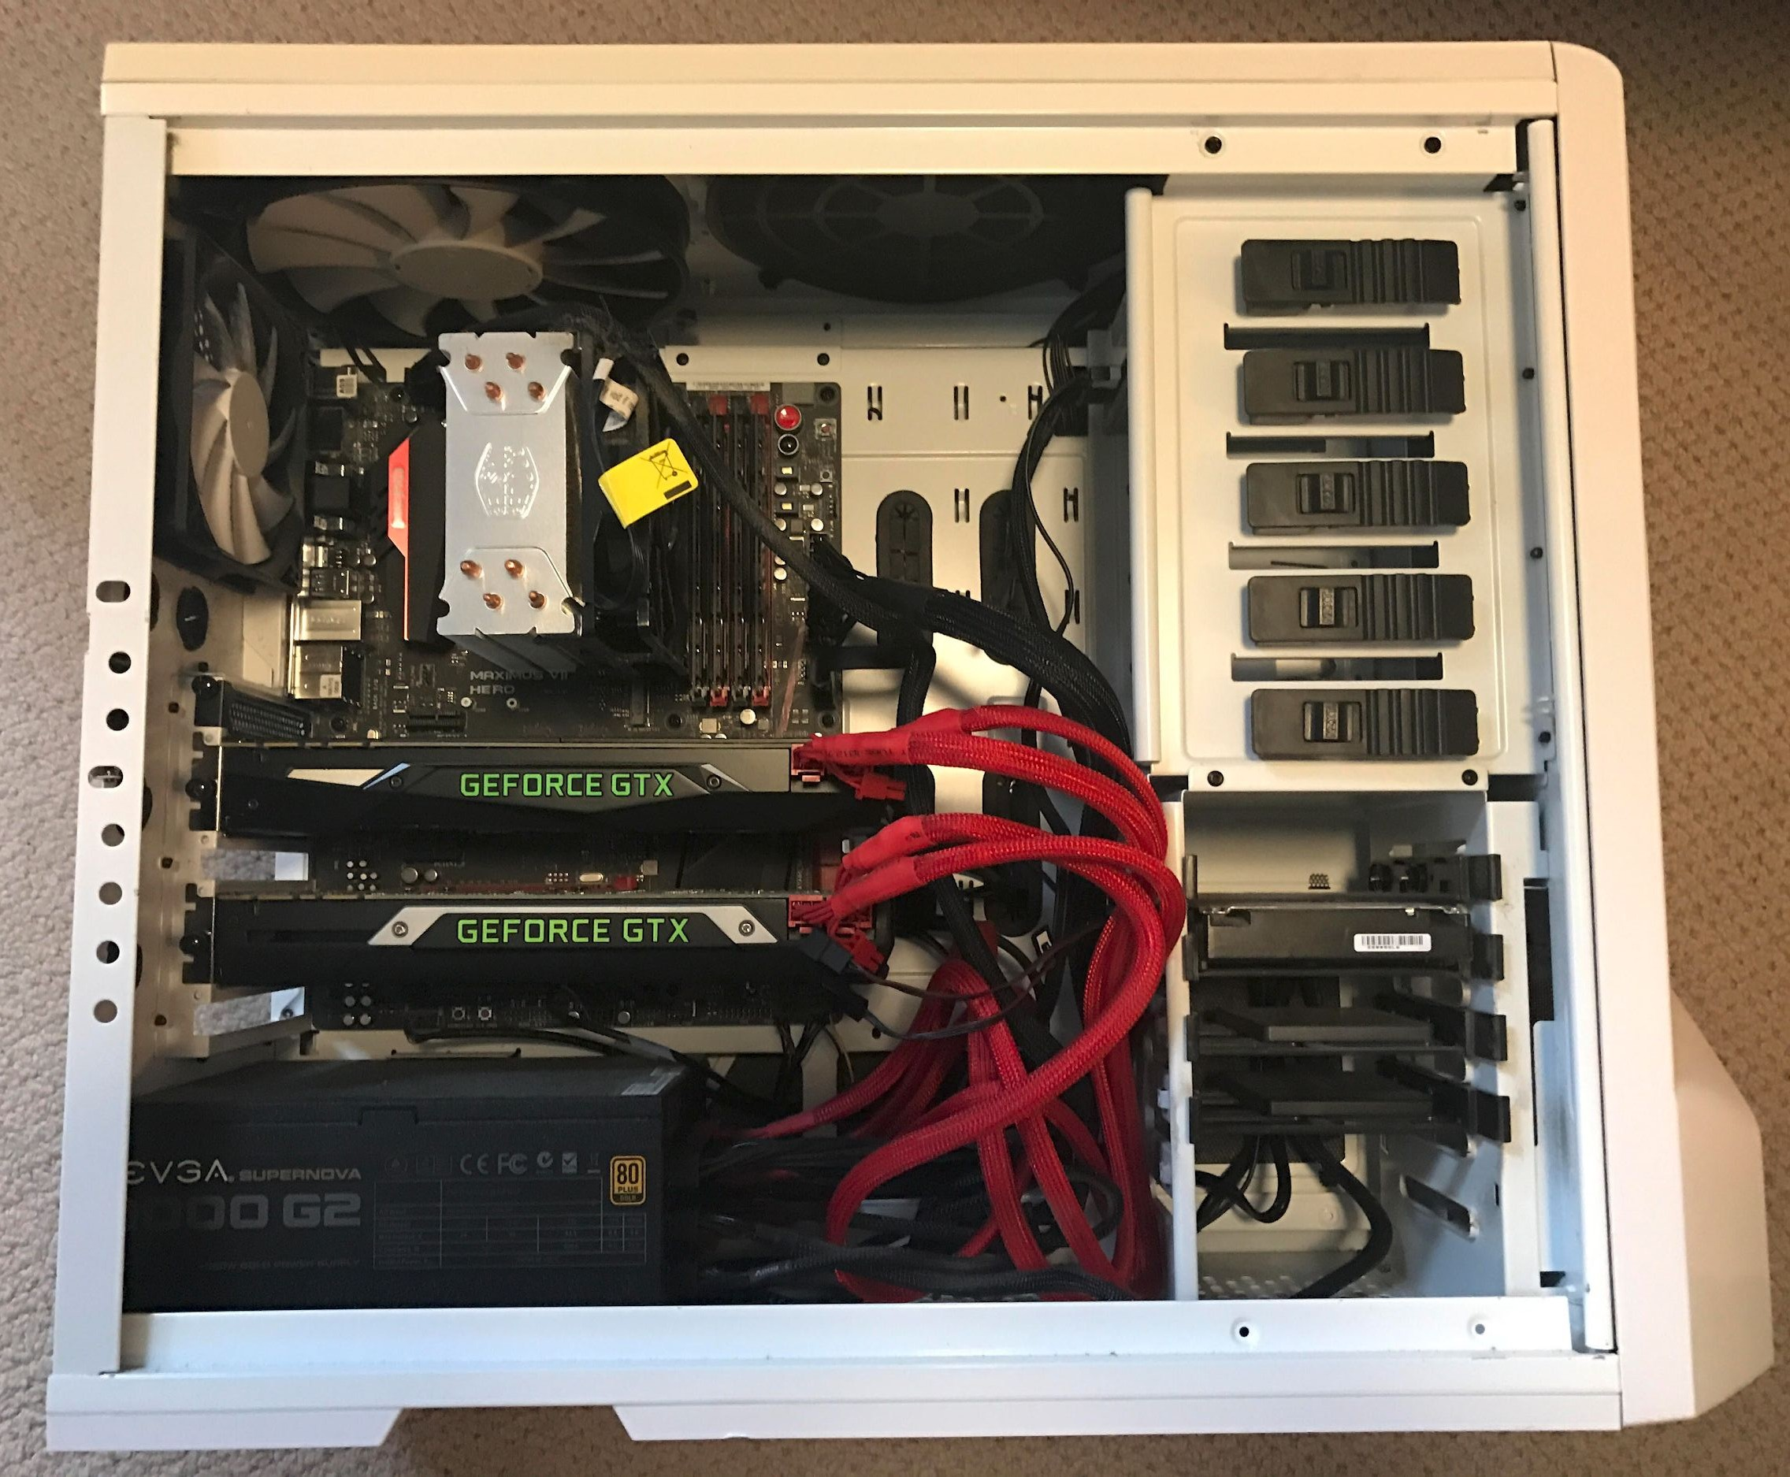
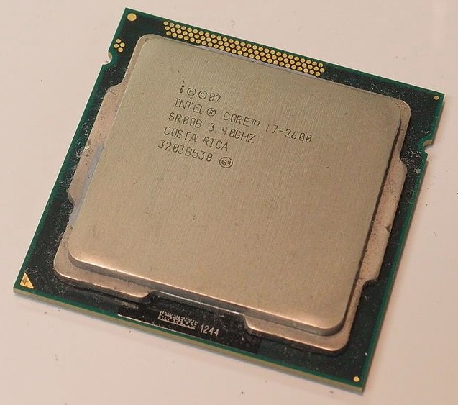
Spot the CPU! (central processing unit)
Fei-Fei Li & Justin Johnson & Serena Yeung
Fei-Fei Li, Andrej Karpathy, Justin Johnson, Serena Yeung

Slide 141

Spot the GPUs! (graphics processing unit)
Fei-Fei Li & Justin Johnson & Serena Yeung
Fei-Fei Li, Andrej Karpathy, Justin Johnson, Serena Yeung

Slide 142
CPU vs GPU
 | Cores | Clock Speed | Memory | Price | Speed
CPU (Intel Core i7-7700k) | 4 (8 threads with hyperthreading) | 4.2 GHz | System RAM | $385 | ~540 GFLOPs FP32
GPU (NVIDIA RTX 2080 Ti) | 3584 | 1.6 GHz | 11 GB GDDR6 | $1199 | ~13.4 TFLOPs FP32
TPU NVIDIA TITAN V | 5120 CUDA, 640 Tensor | 1.5 GHz | 12GB HBM2 | $2999 | ~14 TFLOPs FP32 ~112 TFLOP FP16
TPU Google Cloud TPU | ? | ? | 64 GB HBM | $4.50 per hour | ~180 TFLOP
CPU: Fewer cores, but each core is much faster and much more capable; great at sequential tasks
GPU: More cores, but each core is much slower and “dumber”; great for parallel tasks
TPU: Specialized hardware for deep learning
Fei-Fei Li & Justin Johnson & Serena Yeung
Fei-Fei Li, Andrej Karpathy, Justin Johnson, Serena Yeung

Slide 143
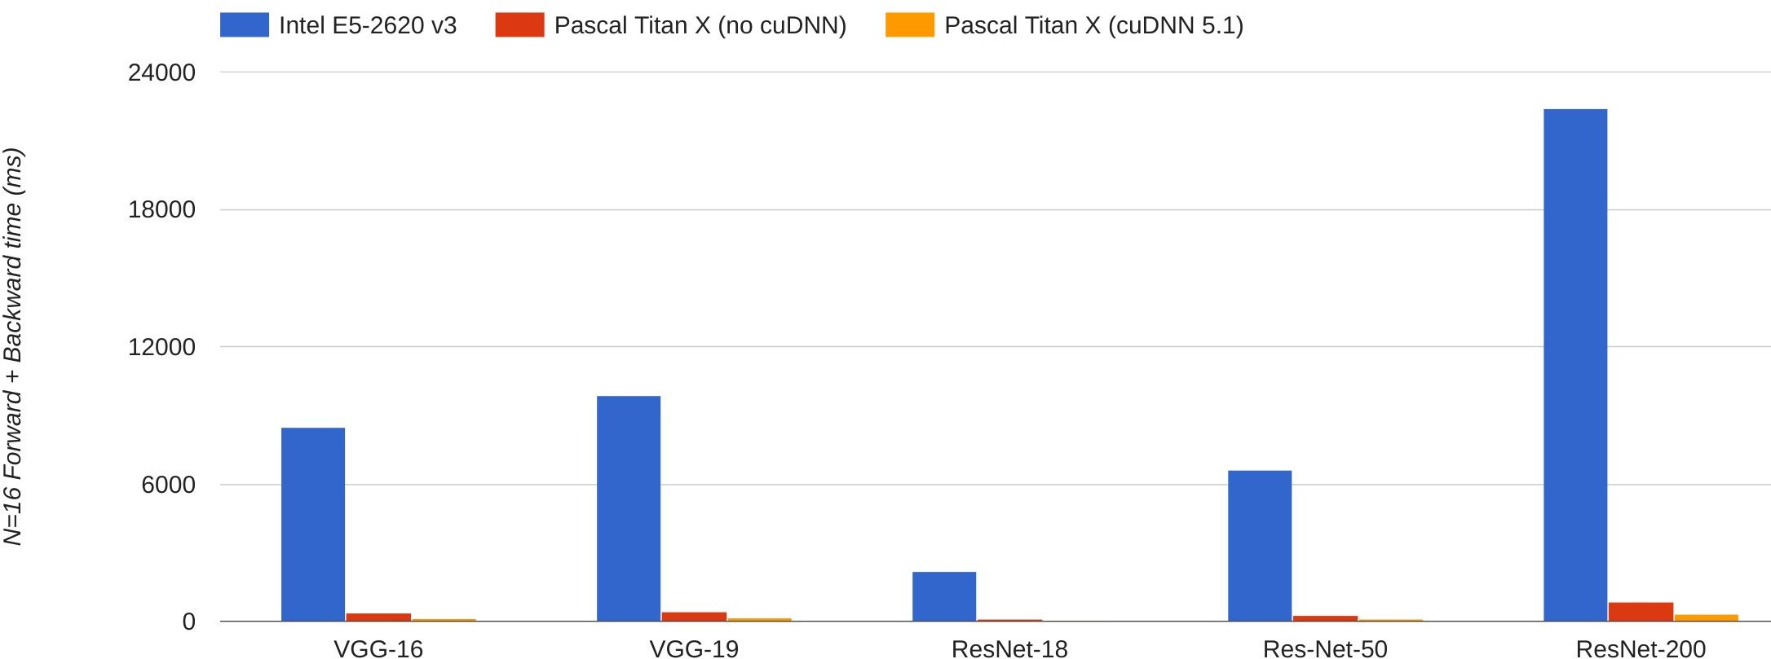



CPU vs GPU in practice
(CPU performance not
well-optimized, a little unfair)
66x
67x 71x 64x
76x
Data from https://github.com/jcjohnson/cnn-benchmarks
Fei-Fei Li & Justin Johnson & Serena Yeung
Fei-Fei Li & Justin Johnson & Serena Yeung Lecture 8 - April 26, 2018
Fei-Fei Li, Andrej Karpathy, Justin Johnson, Serena Yeung

Slide 144


CPU / GPU Communication
Model is here
Data is here
If you aren’t careful, training can bottleneck on reading data and transferring to GPU!
Solutions:
Read all data into RAM
Use SSD instead of HDD
Use multiple CPU threads to prefetch data
Fei-Fei Li & Justin Johnson & Serena Yeung
Fei-Fei Li & Justin Johnson & Serena Yeung Lecture 8 - April 26, 2018
Fei-Fei Li, Andrej Karpathy, Justin Johnson, Serena Yeung

Slide 145
Software: A zoo of frameworks!
PaddlePaddle
(Baidu)
Chainer
Caffe
(UC Berkeley)
Caffe2
(Facebook)
MXNet
(Amazon)
CNTK
(Microsoft)
Torch
(NYU / Facebook)
PyTorch
(Facebook)
JAX
(Google)
Theano
(U Montreal)
TensorFlow
(Google)
And others...
Fei-Fei Li & Justin Johnson & Serena Yeung
Fei-Fei Li & Justin Johnson & Serena Yeung Lecture 8 - April 26, 2018
Fei-Fei Li, Andrej Karpathy, Justin Johnson, Serena Yeung

Slide 146
Summary
Feed-forward network architecture
Training deep neural nets
  We need an objective function that measures and guides us towards good performance
  We need a way to minimize the loss function: (stochastic, mini-batch) gradient descent
  We need backpropagation to propagate error towards all layers and change weights at those layers
Practices for preventing overfitting, training with little data

